Slide 1
FEM Electromagnetic Simulations of Coil 2 Experiment
D. Rinaldoni, B. Bordini
06/12/2024

Slide 2
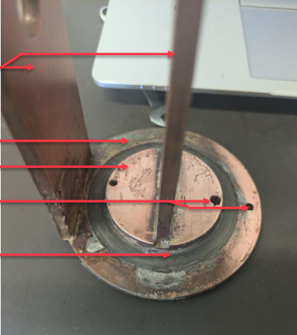
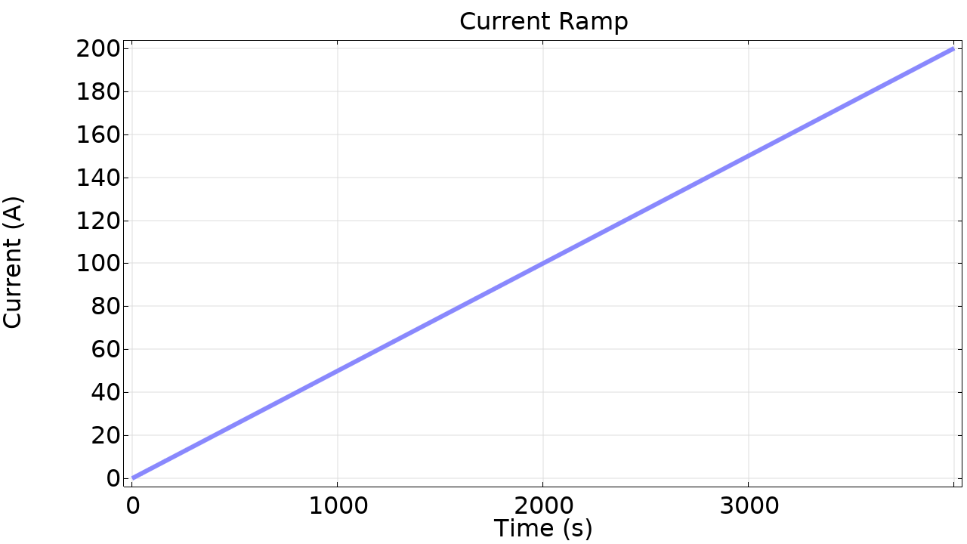
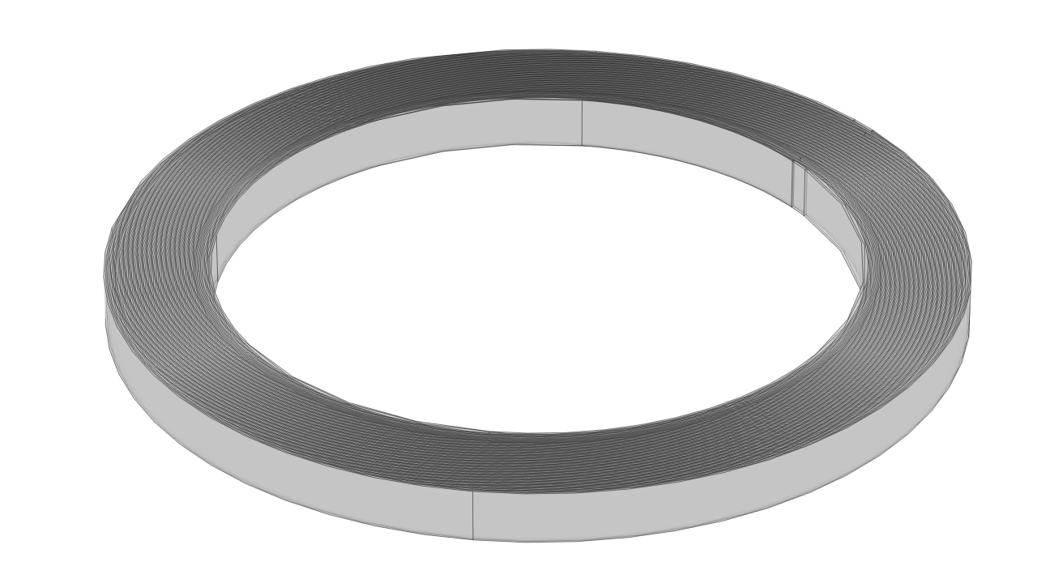
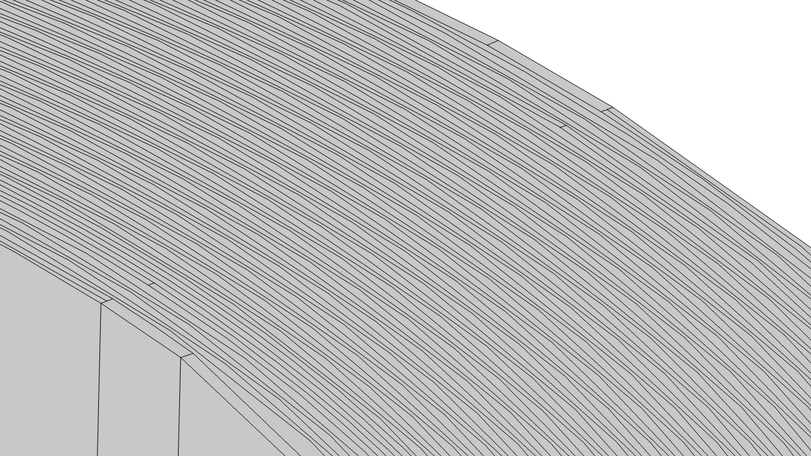
Coil 2 Experiment
1 pancake
84 turns
Inner radius 24 mm
Outer radius 31.6 mm
Thickness 90 µm
Width 4 mm
Current ramp 0.05 A/s ➔ slow ramp
Mahmoud Abdel Hafiz, mmWg presentation, Experimental tests for winding technology of Final Cooling Solenoid
Goal: perform FEM simulations of this pancake and compare them with experimental results

Slide 3
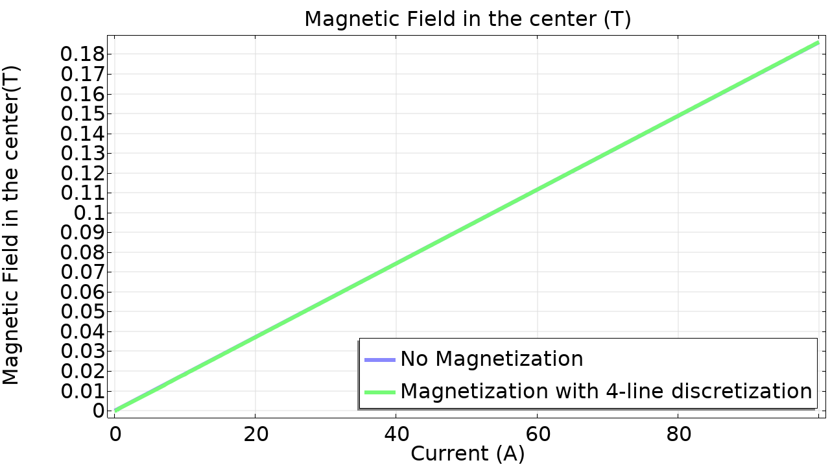
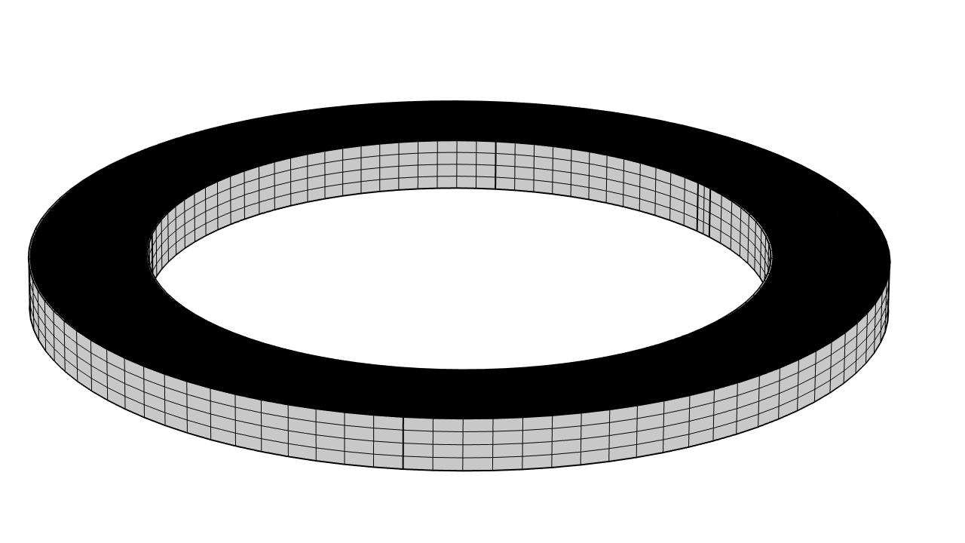
Magnetization Effects
First result: magnetization does not impact the value of the magnetic field in the center
Notes:
Manca 8 linee

Slide 4
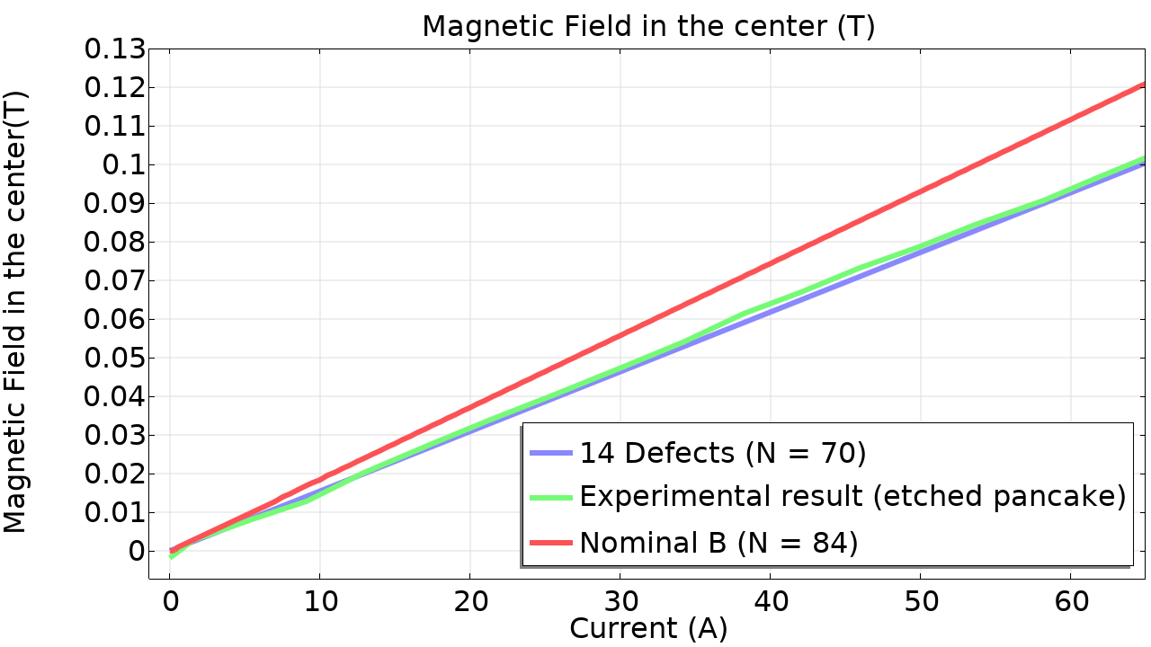
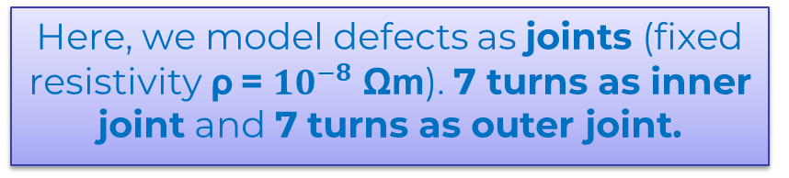
Defects
By looking at the experimental results, the magnetic field generated by the etched pancake is lower than the expected field ➔ Defects in the pancake
It turns out that the same magnetic field trend can be obtained by simulating the same pancake but with 70 turns ➔ 14 turns are defective.
Here, we model defects as joints (fixed resistivity ρ = ${10}^{−8}$ Ωm). 7 turns as inner joint and 7 turns as outer joint.

Slide 5
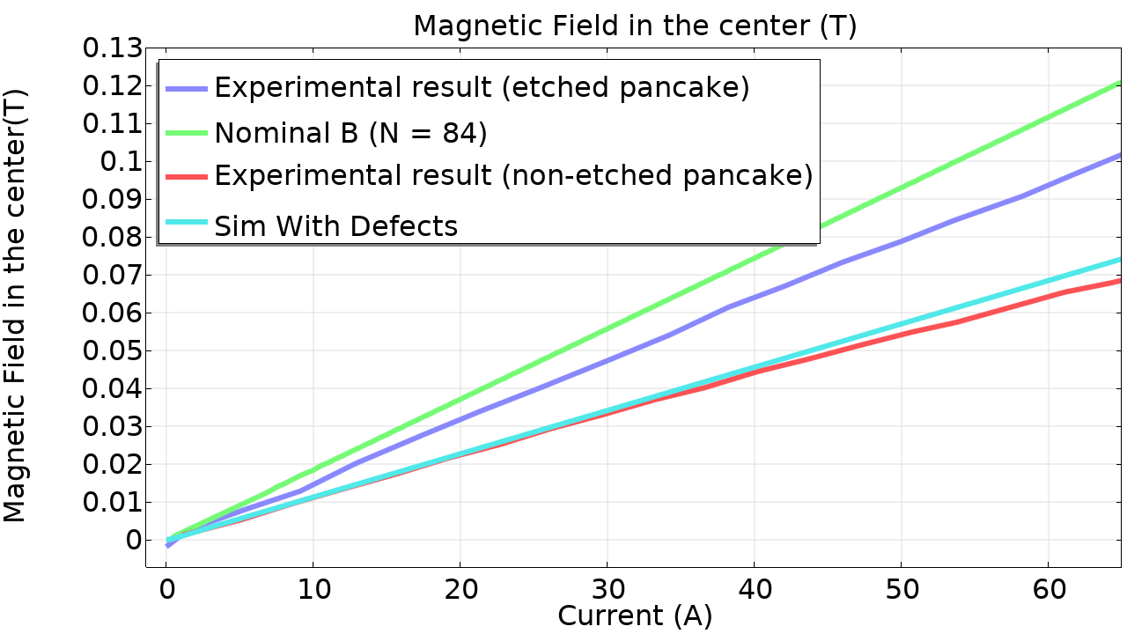
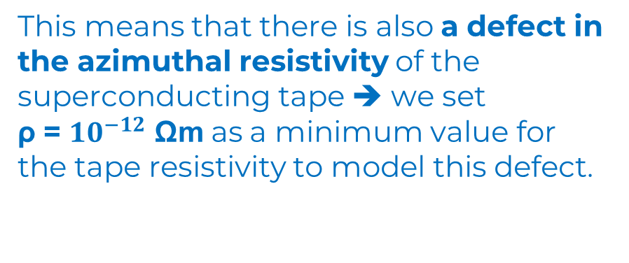
Defects
The experimental results for the non-etched pancake reveal however a discrepancy in the generated magnetic field, even when the coil is far from the critical state.
This means that there is also a defect in the azimuthal resistivity of the superconducting tape ➔ we set
ρ = ${10}^{−12}$ Ωm as a minimum value for the tape resistivity to model this defect.

Slide 6
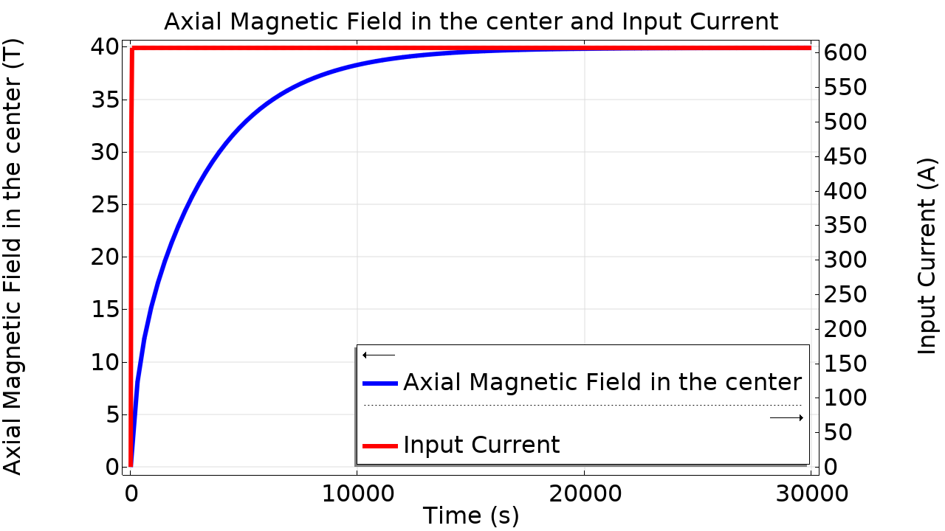
Contact Resistance
Starting from the time constant derived experimentally, which is τ = 4.8 s, one can derive the contact resistance of the tape. It results ρ_{c}= 7 µΩ cm².
This contact resistance value is high enough to energize the 40 T Solenoid in less than 5 hours!
Energization of the 40 T Solenoid using ρ_{c}= 10 µΩ cm².

Slide 7
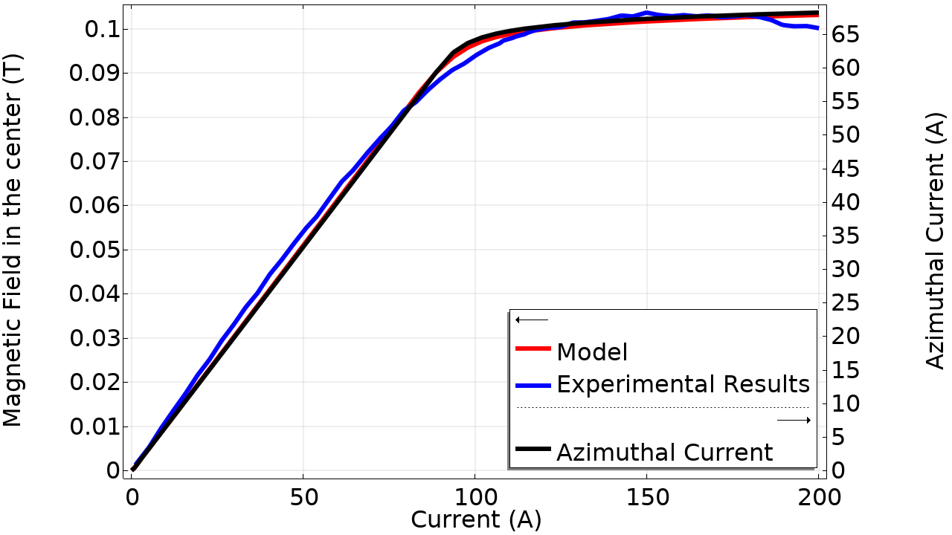
Full non-etched Simulation
Finally a complete simulation of the non-etched pancake is performed.
The critical current is set to 72 A at 0.18 T.
The azimuthal current in the first part of the simulation is lower than the injected current because of the defect.
At the critical state, the azimuthal current reaches a plateau and the rest of the current flows radially.

