Slide 1






Funded by the European Union (EU). Views and opinions expressed are however those of the author only and do not necessarily reflect those of the EU or European Research Executive Agency (REA). Neither the EU nor the REA can be held responsible for them.
Hot winding tool motorisation
Antti Kolehmainen, Frantisek Sanda
CERN

Slide 2
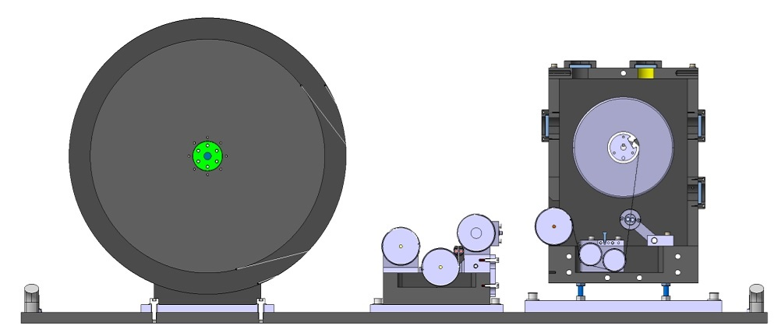
Hot winding tool with instrumentation
Cleaning unit
(not motorised)
Coating unit (T >200°C)
moteur
Motor + clutch
WAT+ load cell
Encoder (speed line)
PLC unit (motor)
Speed : closed loop control
DGT300+ digital controller
Tension : closed loop control

Slide 3
WINDING UNDER TENSION
4 mm tape tension = 30 N
12 mm tape tension = 100 N
Winding speed = 60 RPM
Start Ø = 60 mm
Final Ø = 180 mm

Slide 4
WINDING UNDER TENSION
4 mm tape tension = 30 N
12 mm tape tension = 100 N
Winding speed = 60 RPM
Final Ø = 440 mm
Start Ø = 510 mm
Start Ø = 60 mm
Final Ø = 180 mm

Slide 5
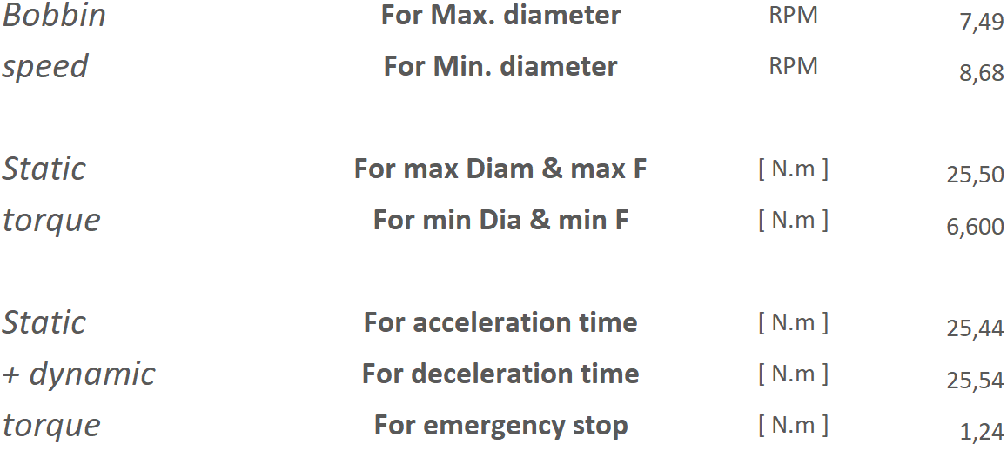
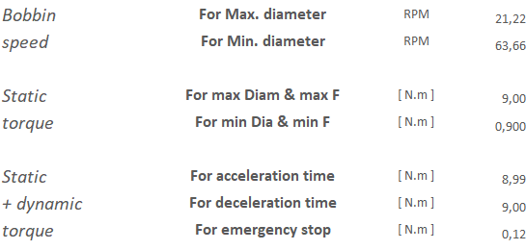
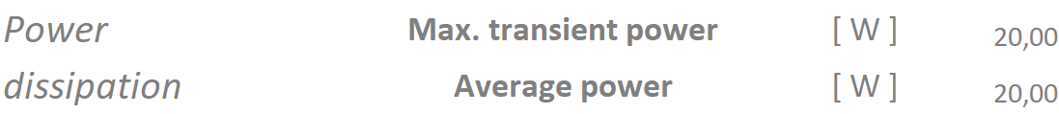

WINDING UNDER TENSION
UNWINDER
Min tension 30N
Max tension : 100N
Rewinding speed ≈ 0,2m/s
Final Ø = 440 mm
Start Ø = 510 mm
Clutch ratings :
REWINDER
Min tension 30N
Max tension : 100N
Rewinding speed = 60 RPM ≈ 0,2m/s
Final Ø = 180 mm
Start Ø = 60 mm
Motor ratings :

Slide 6
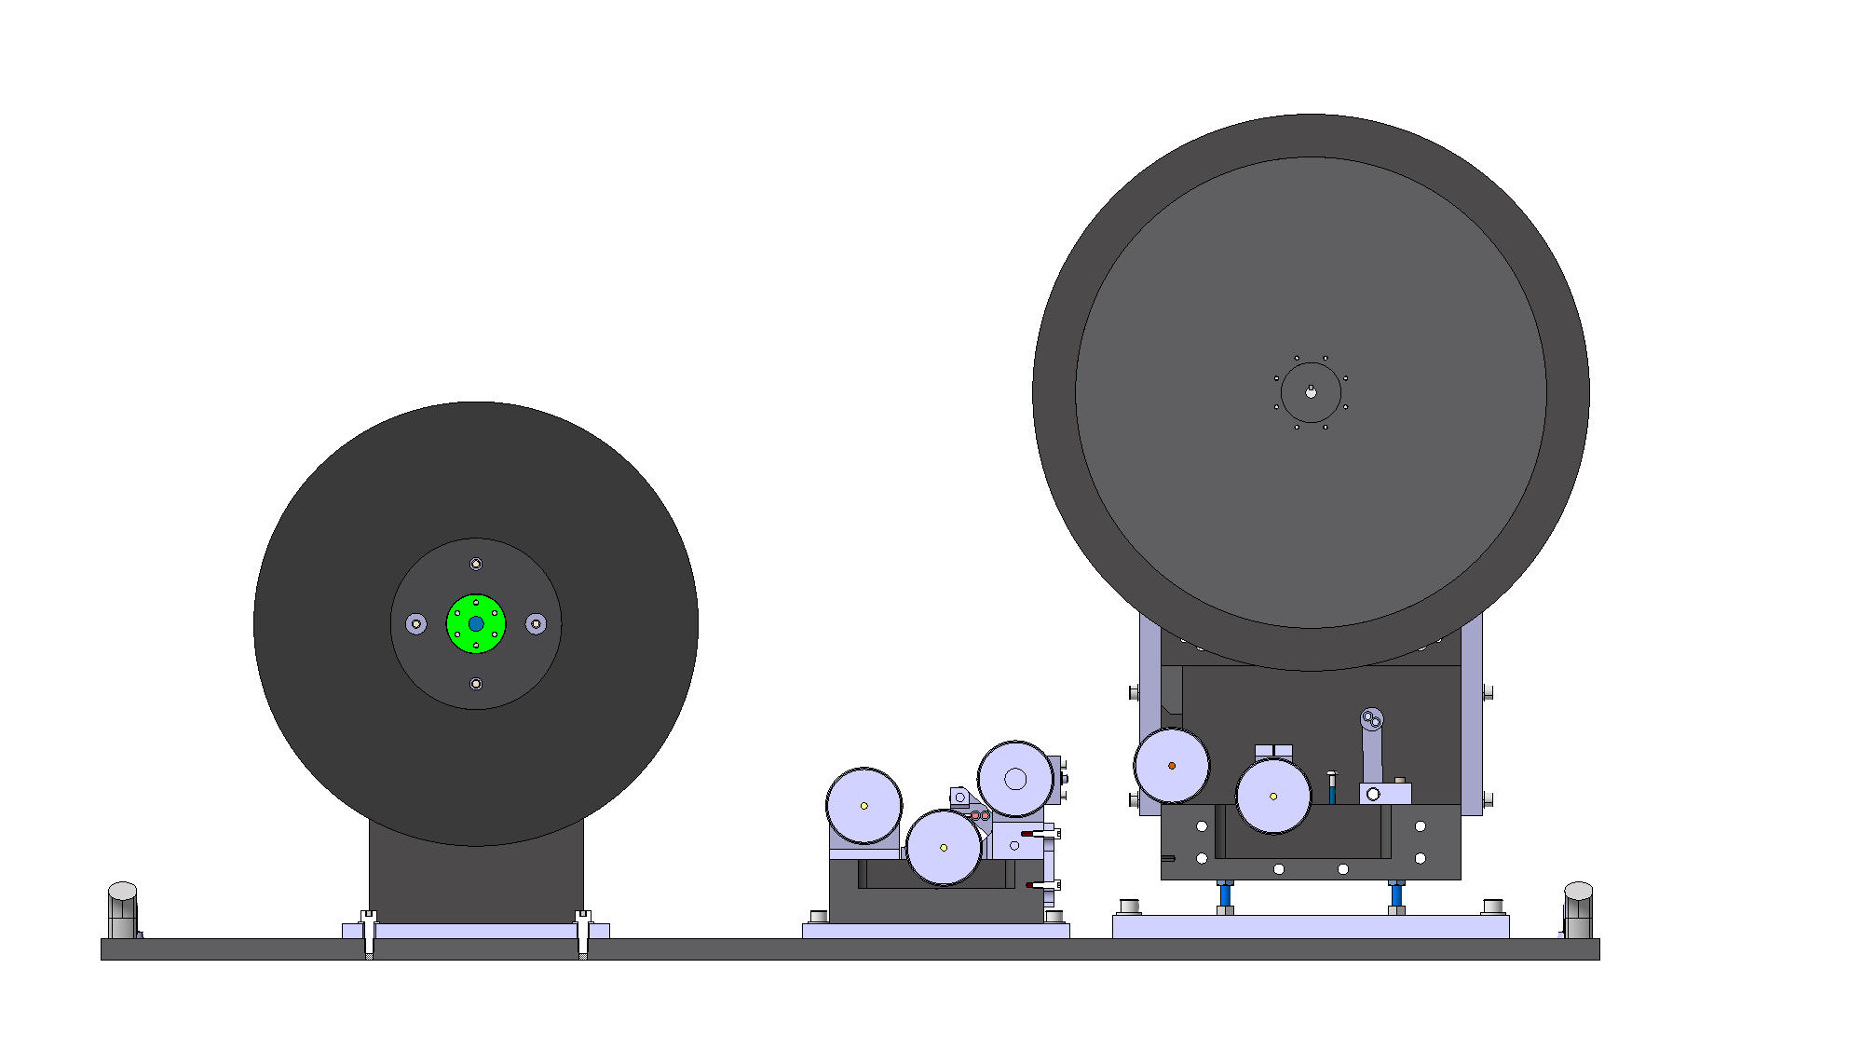
PRE-COATING = WINDING WITH LOW TENSION
Tape tension ≈ 5 N
Speed 60 RPM
Start Ø = 440 mm
Final Ø = 510 mm
Start Ø = ???
Final Ø = ???

Slide 7
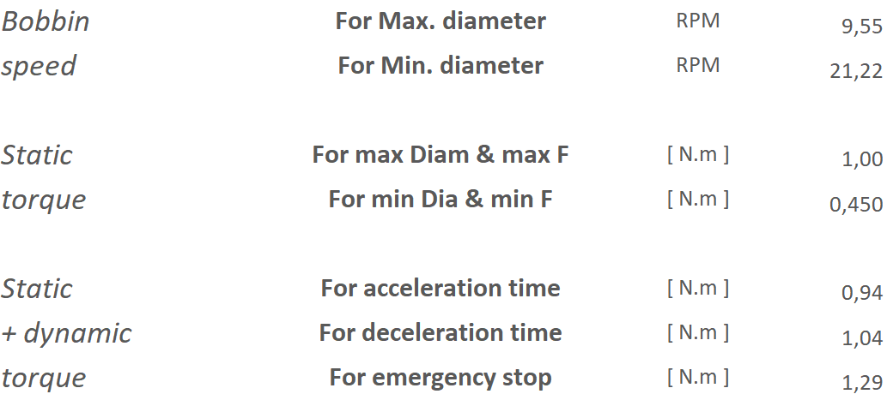
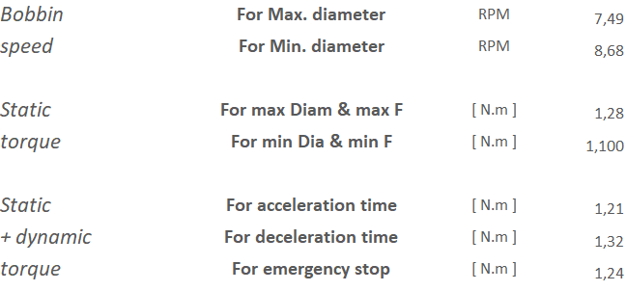
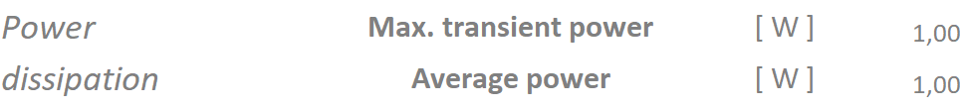
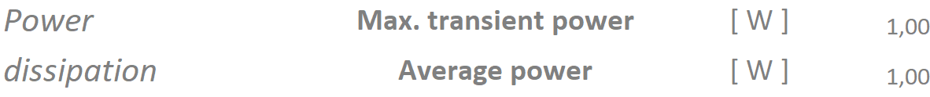
PRE-COATING = WINDING WITH LOW TENSION
UNWINDER
Tension 5N
Rewinding speed ≈ 0,2m/s
Final estimated Ø = 180 mm
Start estimated Ø = 400 mm
Clutch ratings :
REWINDER
Tension : 5N
Rewinding speed = 60 RPM ≈ 0,2m/s
Final Ø = 510 mm
Start Ø = 440 mm
Motor ratings :

Slide 8
Material list
UNWINDER
Clutch EAT350
  REDEX reference : ME321740-00
Min torque : 0,66Nm
Max torque : 350Nm
Speed range : 0-2000rpm
Current supply : 1A
Digital controller : DGT300+
REDEX reference : ME131953-00
Load cell WAT+25
  REDEX reference : ME134802-00
Load range : 2,5N - 250N
Motor (CERN supply)
Min torque <0,66Nm
Max torque >26Nm
REWINDER
Motor (CERN supply)
Min torque <0,9Nm
Max torque >9Nm
Encoder for speed line (CERN supply)

