Slide 1





Study of the spent proton beam extraction channel
MuColl Target meeting 7th March 2024
J. Mańczak, D. Calzolari, A. Lechner

Slide 2
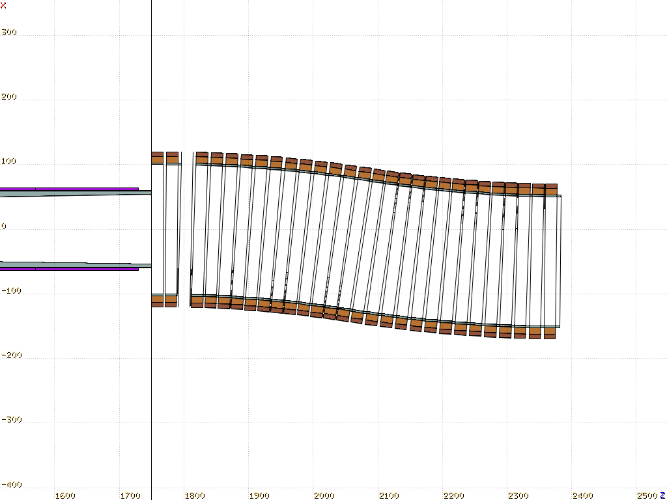
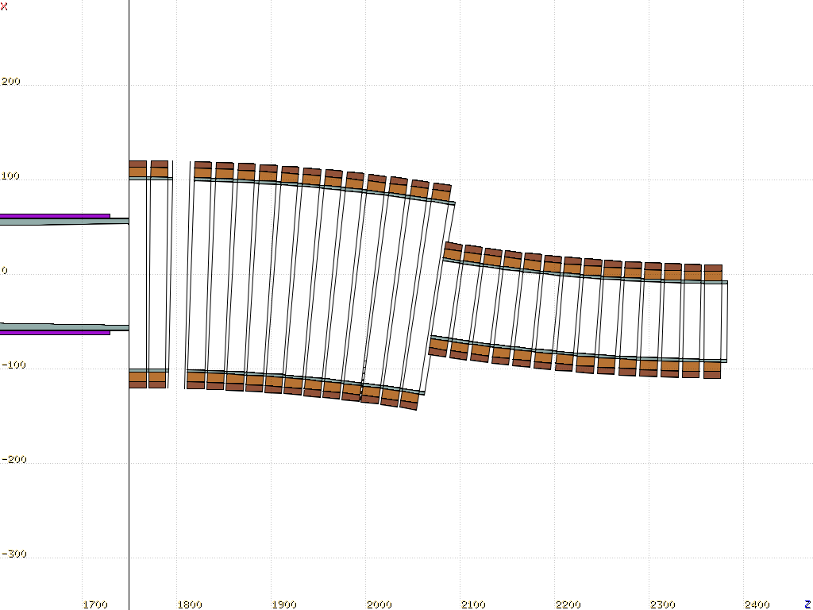
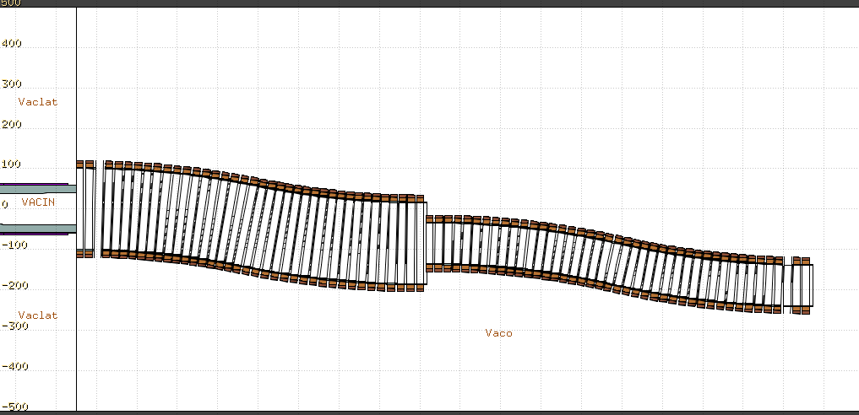
3 main concepts for the proton extraction
The focus of this presentation is Concept2
Concept 1
Concept 2
Concept 1, even though is the simplest, requires wide chicane aperture which might become costly in terms of keeping the desired field strength
Double Chicane
This option gives the best platform for the spatial separation of the spent proton beam after the extraction

Slide 3
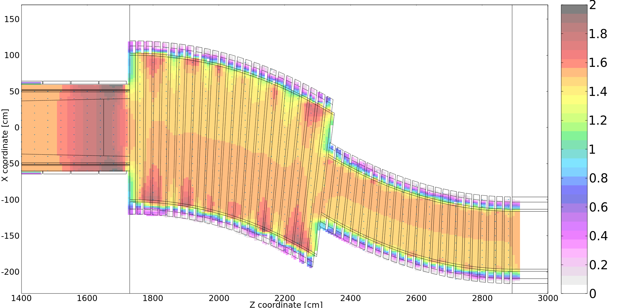
Concept 2 investigated
Parameters in the model:
- Bending radius
- Opening angle
- First half aperture
- Second half aperture
- Relative shift between the
two halfs
- Magnetic field / current density
in each coil
Current densities in the solenoid magnets have been fitted with the MINUIT2 minimizer to achieve 1.5T along the center line of the chicane
This increase in the field strength comes from the fact that the current densities in the tapering magnets were not varied in the fit. The attempt to include just the last magnet did not improve the result.
Long straight element with a fixed current density to stabilize the field at the of the chicane

Slide 4
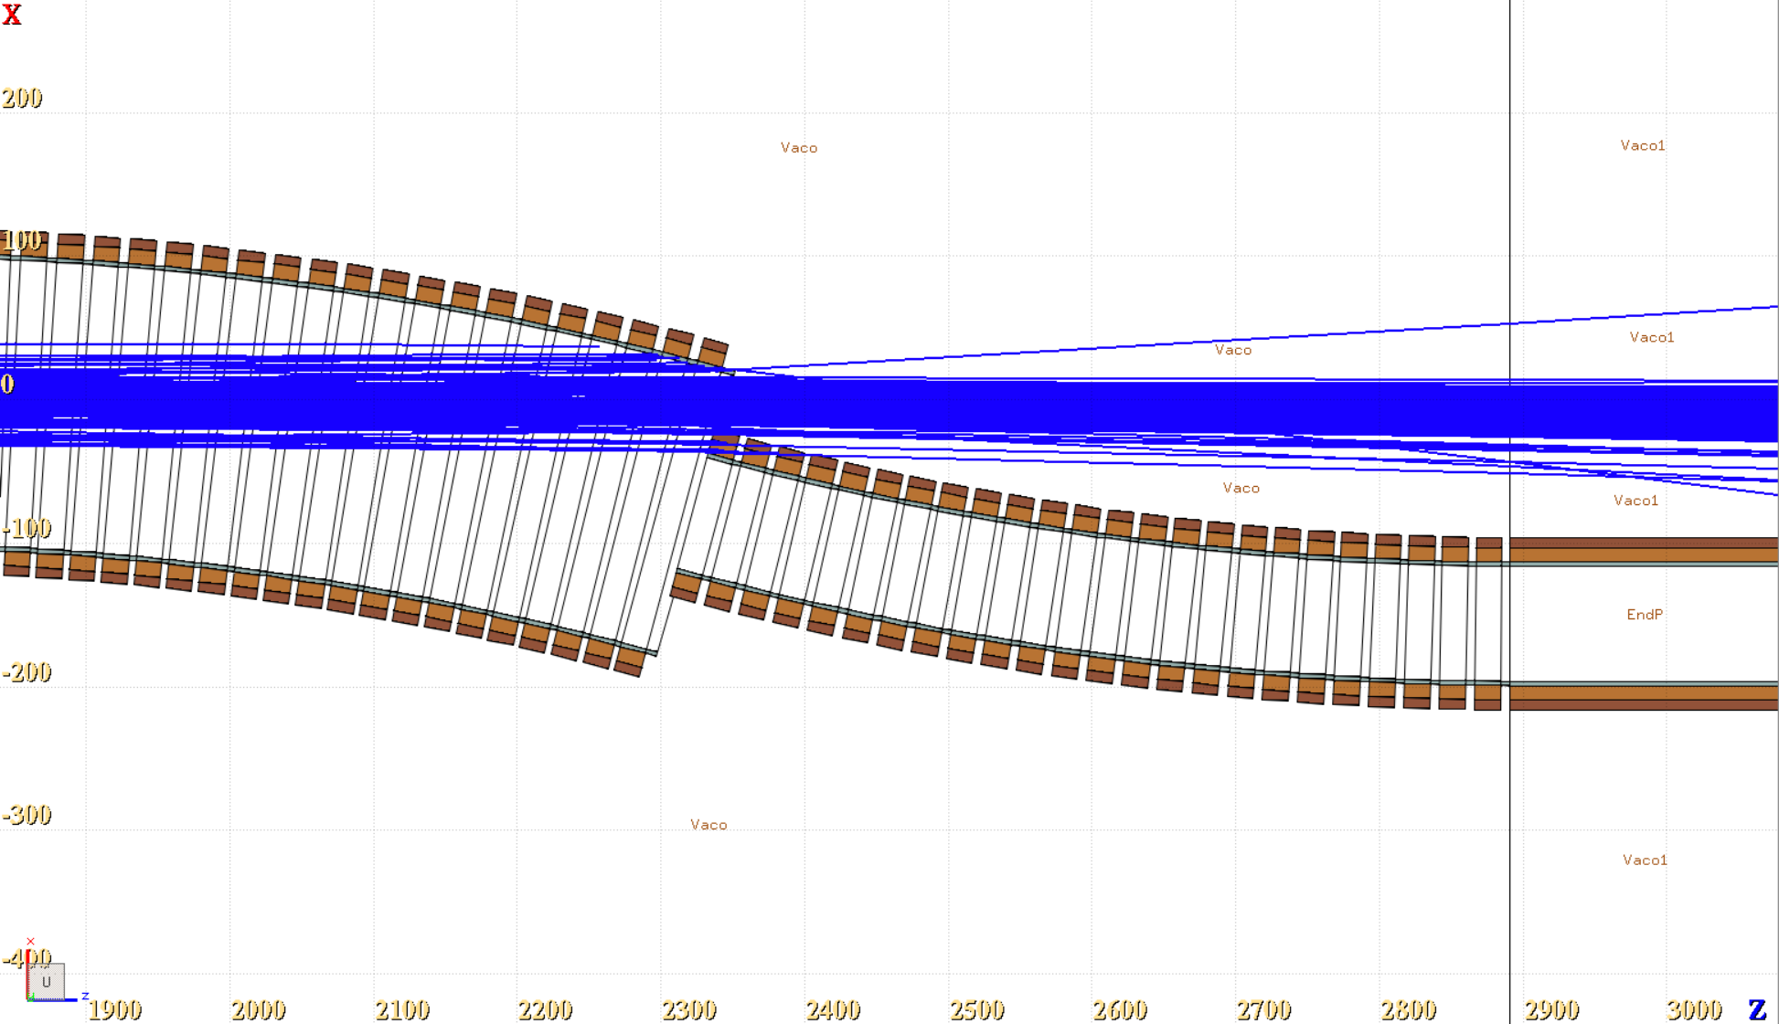
Chicane parameter adjustment
500 primaries
Geometry prepared for a straight target configuration
Angle = 15 deg
Bending Radius = 22 m
Big aperture = 100 cm
Small aperture = 50 cm
Center of the narrow part aligned wit the center of the wide part
Spent primary protons with E > 4 GeV

Slide 5
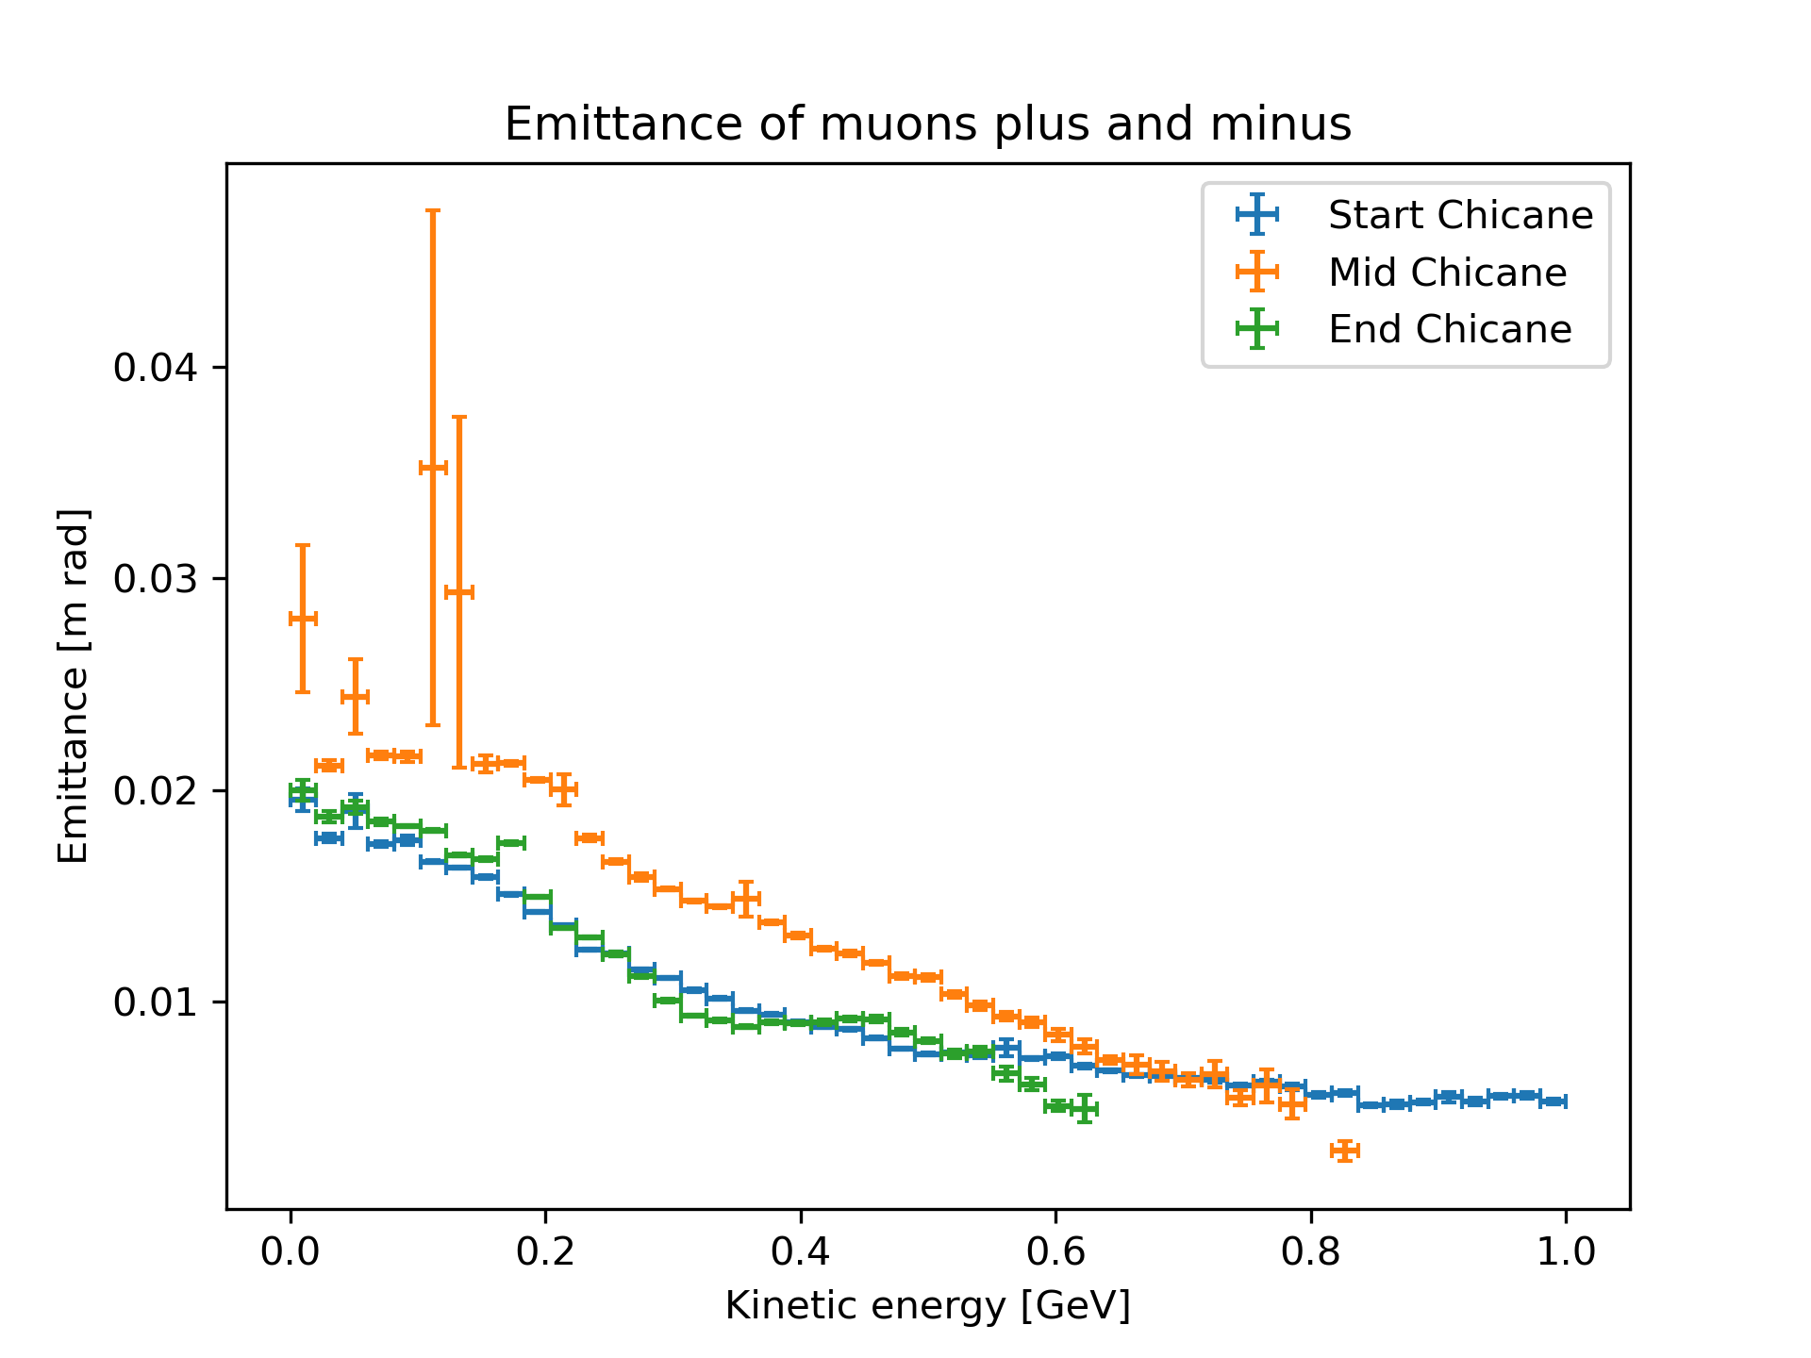
Figure of merit – the muon emittance
In the following slides we will see what’s happening here
More statistic to be run before the annual meeting!
Alternatively, the binning be coarser
Muons with E_{k} > 600 MeV basically do not reach the end of the chicane, they are dumped in the chicane walls.

Slide 6
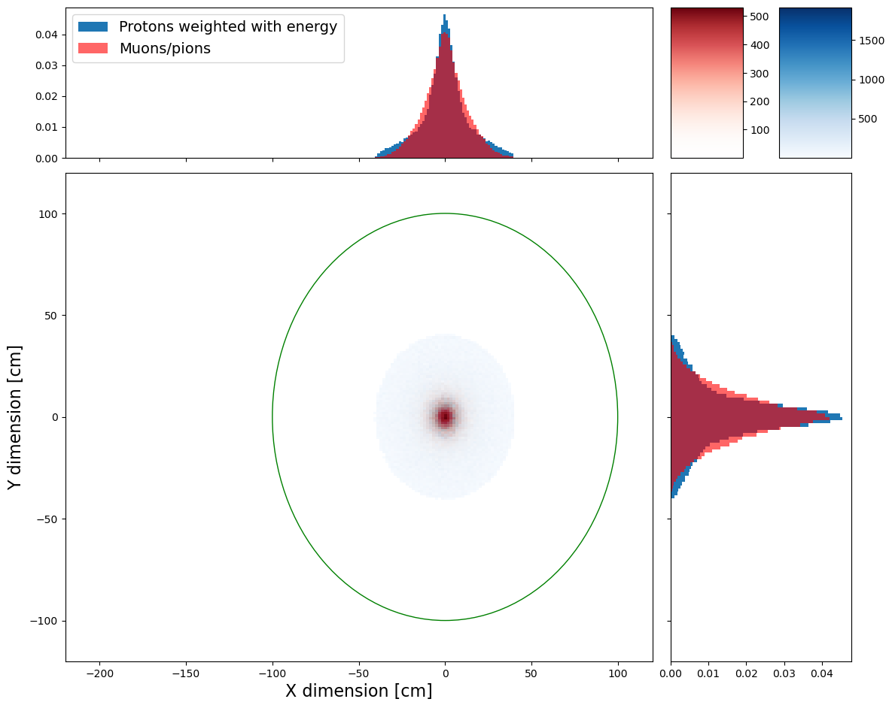
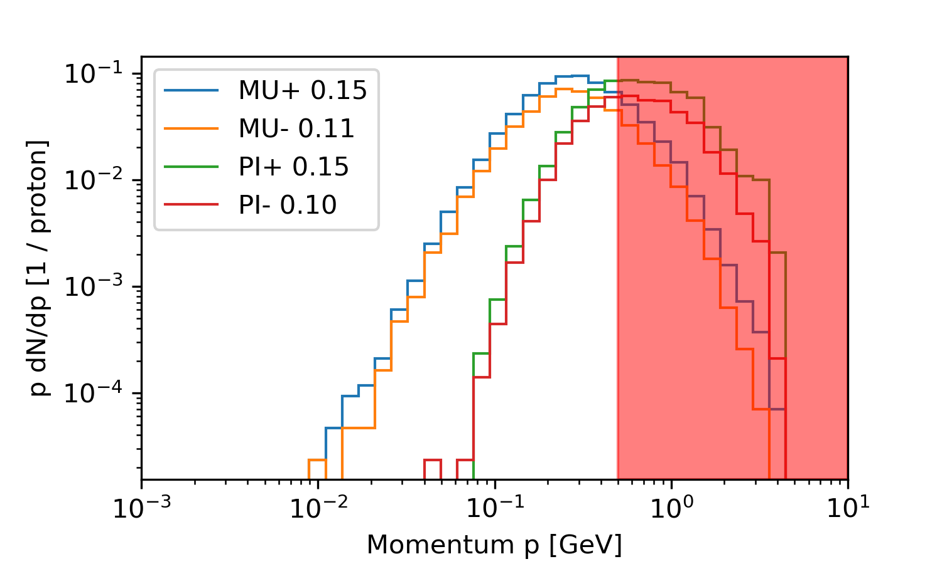
Concept 2, beam shape
Particles entering the chicane are nicely centered.
Out of interest
Momentum spectrum

Slide 7
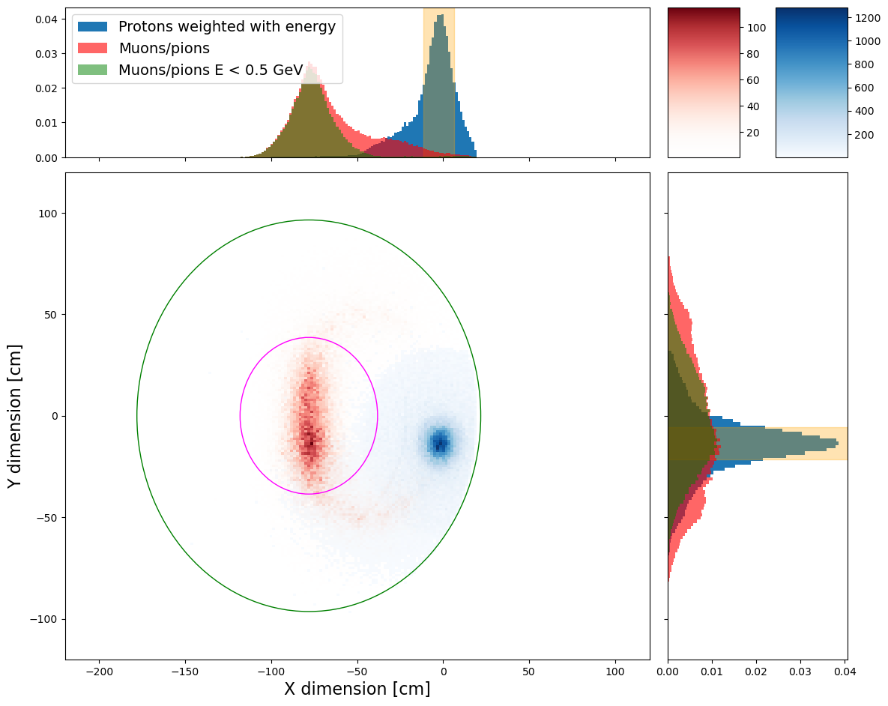
Concept 2, beam shape
FWHM 17.7 cm
FWHM 16 cm
At it was shown before, the transverse emittance of muons in the center of the chicane blows up – here we can see it happens due to the vertical elongation. However, it gets compensated by the end of the chicane.
Here we observe all the particles crossing the dashed line including the ones hitting the magnets

Slide 8
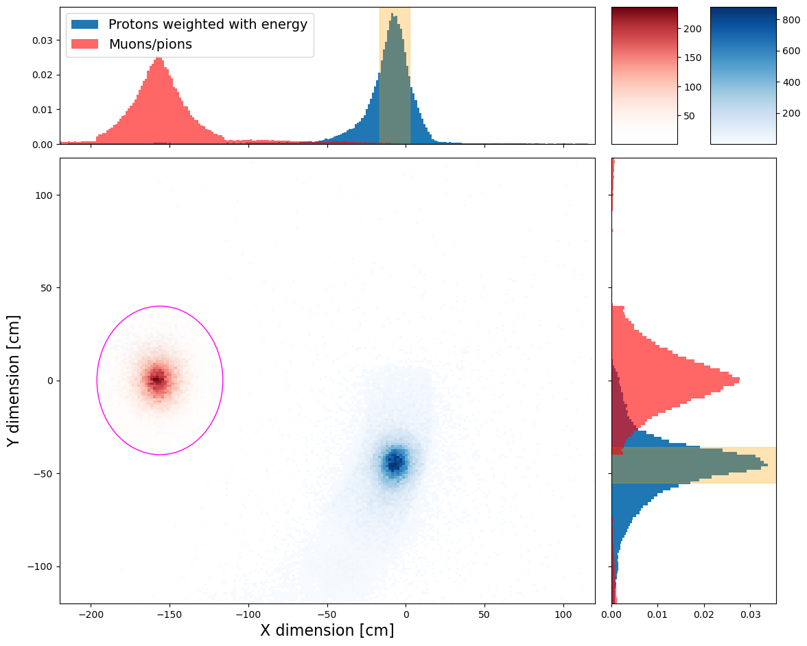

Concept 2, beam shape
FWHM 19 cm
~511 kW extracted!
143 cm
The spent proton beam exiting the chicane is inclined slightly down – its center moves down in Y by 35 cm over a distance of ~5 m in Z.
FWHM 19.2 cm
Out of interest
Momentum spectrum of particles only inside the solenoid!

Slide 9
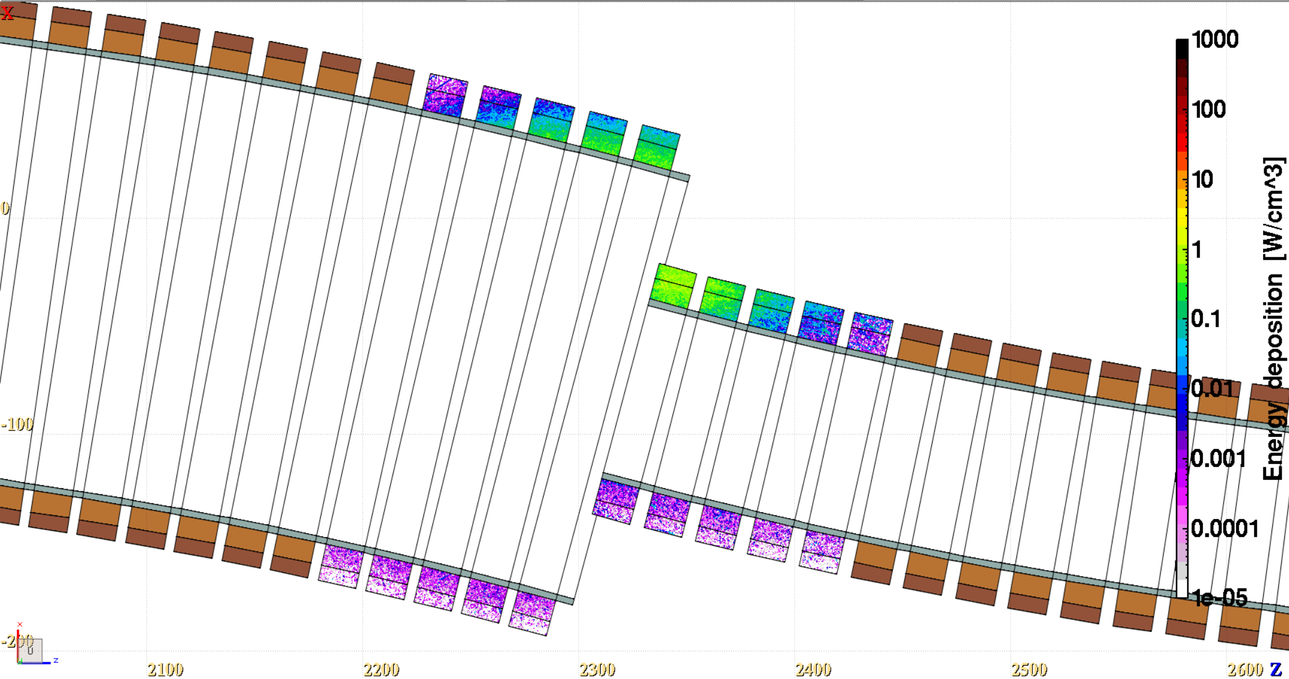
Concept 2, energy deposition to the most exposed magnets
Magnet | Integrated energy deposition [kW]
MagR45 | 2.09
MagR47 | 3.73
MagR49 | 5.32
MagR51 | 24.5
MagR53 | 8.63
MagR55 | 2.51
Total | 46.8
R45
R49
R47
R53
R51
R55
Possibly, the shape can be fine-tuned to reduce the energy deposition or spread it more evenly between the magnets.

Slide 10
Summary
An example chicane confugration was invstigated in the scope of the spent proton beam extraction.
Figure of merit for optimization and future comparisons was developed in the process.
Energy deposition to the chicane magnets should still be reduced, but the power extracted from the system is already high.

Slide 11
Backup

Slide 12
Fitting the field
Reaching 26.5 A/m²
In the narrow part of the chicane, the current densities stay stable around the nominal 16.57 A/m² (value inherited from MAP studies)
The fit limits the parameters (current densties) to
16.57 A/m² +/-60%
Field calculation based on the script developed by
D. Calzolari
In the first part of the chicane, the fitter ramps up the current in one magnet to reduce it greatly in the neighbouring one
Data points corresponding to the center of each solenoid magnet and the field strength of 1.5T
The number of fit parameters is equal to the number of data points – the parameters are the current densities of each magnet

