Slide 1
BGC Automated Process
Liam Luigi Cantu
15/10/2024

Slide 2
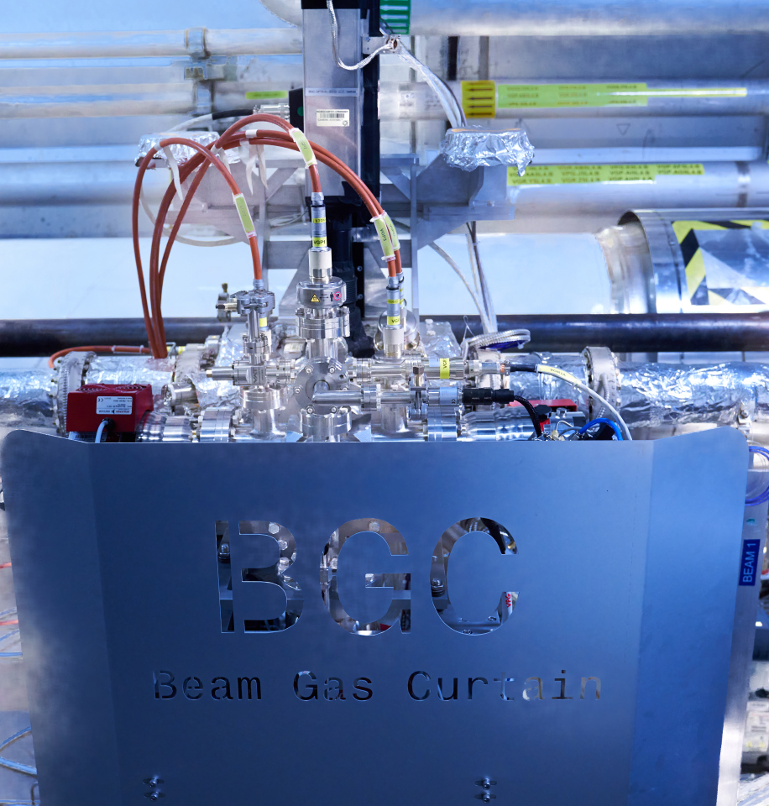
Contents
  Introduction
    BGC vacuum system
    Automation motivation
    Control type development
  The new BGC automated process
    Process flow
    Machine safety measures
  User Interface
    New BGC SCADA panels
    Alarms
  Testing and Installation
    Testing procedure
    Installation plans

Slide 3
Introduction
Motivation, BGC vacuum system and control type development

Slide 4
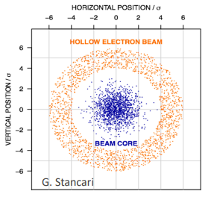
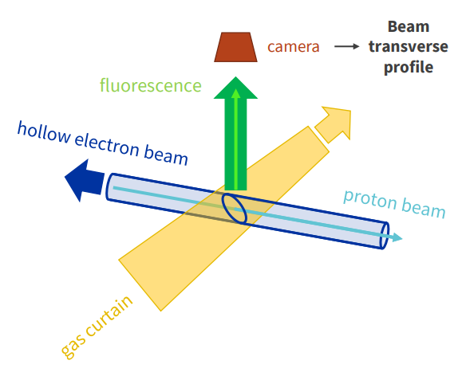
What is the BGC
  Hollow electron lens (HEL) used to actively control beam halo
  Instrument allowing to monitor the beam and HEL through the fluorescence due to interaction between the particle beams and a gas curtain
  SY-BI group cooperation with Cockcroft Institute in the U.K (lead) and GSI Institute in Germany
Notes:
With higher energy beam in HL-LHC, there will be a higher energy halo
Active control of the halo will be necessary using Hollow electron lens
HEL will be a ring-shaped electron beam concentric to the proton beam
BGC will be used to monitor the beam and the HEL and their concentricity

Slide 5
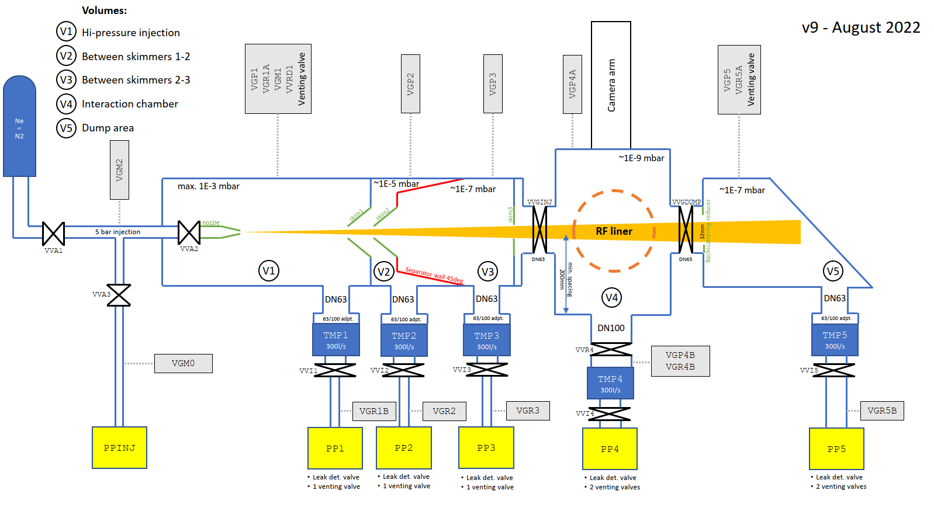
What is the BGC
Notes:
3 chambers: injection, interaction and dump
In the injection chamber nozzle and 2 skimmers shape the gas curtain
Describe the equipment on the BGC and how a normal injection takes place.
Pump nozzle
Open the gate valves (VVR4, VVGINJ and VVGDUMP)
Switch off VGP1
Open first Inj valve VVA1
When all is ready:
Open VVA2, second inj valve

Slide 6
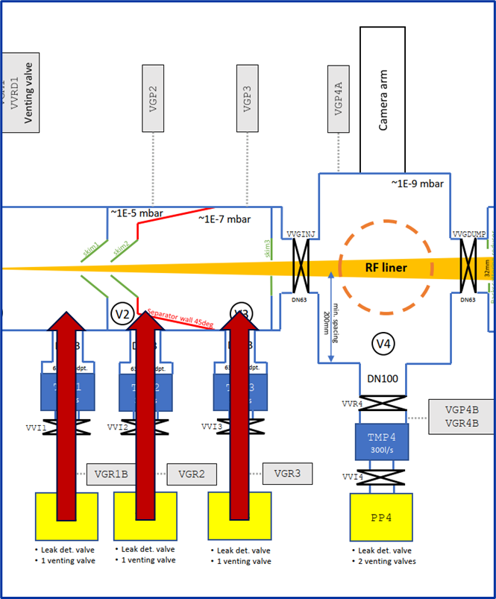
Machine Safety Hazards
  No VVRs on pumping groups:
    Possible backflow from the VPGs
    Could pollute BGC and beam vacuum
  No VVR and a VVT on VPG5:
    VVGDUMP could fail in open state and VPG5 could vent
    Venting of the beam pipe
  Issues with injection causing pressure spike in beam pipe:
    Could cause beam dump
Notes:
Explain why no VVR on pumping groups: space constraints, decision made in the original design

Slide 7
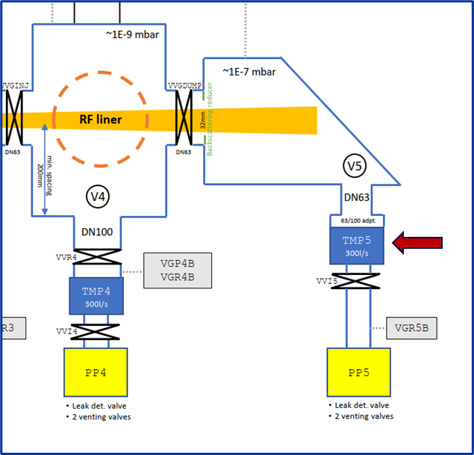
Machine Safety Hazards
  No VVRs on pumping groups:
    Possible backflow from the VPGs
    Could pollute BGC and beam vacuum
  No VVR and a VVT on VPG5:
    VVGDUMP could fail in open state and VPG5 could vent
    Venting of the beam pipe
  Issues with injection causing pressure spike in beam pipe:
    Could cause beam dump

Slide 8
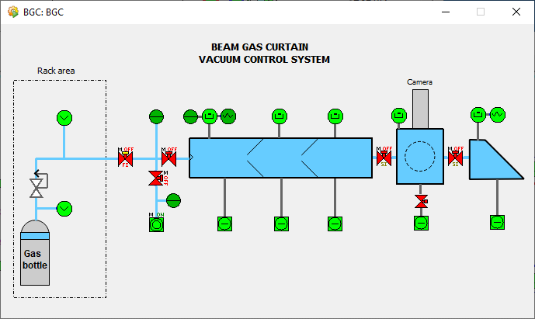
Current operation
  The BGC is currently operated fully manually (using the SCADA) following a detailed procedure
  Must be operated by expert users only
  There is a need to automate the process so that non-experts can safely operate the instrument
  Reliability and safety also increase with an automated process
Notes:
Mention current risk of human error, doing something wrong while following the procedure

Slide 9
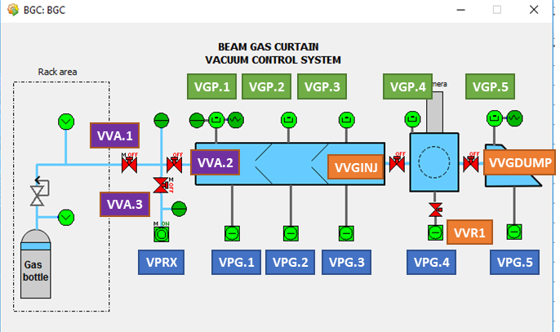
Scope of the process
  Automate preparation and injection sequence of the instrument based on experience operating it in the last year
  Returning to initial state after an injection
  Recovery from failures in the process
  Excluded:
    Pump down/preparation of the instrument after venting
    Other specific tasks not related to injection
Notes:
Need to simplify user interaction with the machine, but also give information
AUTOMATION FOR OPERATORS NEEDS TO BE THE SCOPE, not for experts

Slide 10
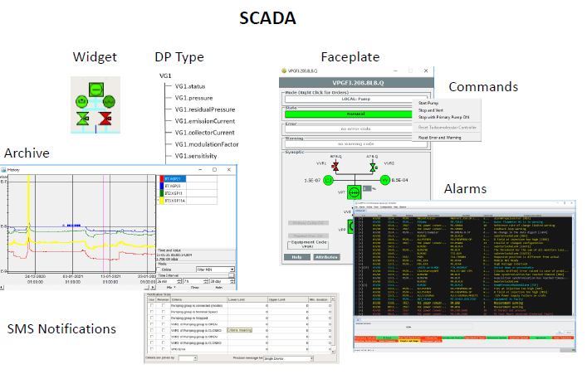
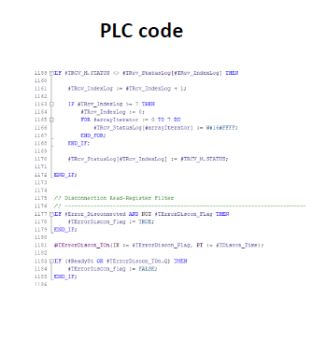
Control type definition
  “Classes” from which vacuum equipment is instantiated
  Definition of attributes, alarms, Scada datapoint
  Definition of communication with PLC
  PLC code
  SCADA panel and code development
  All devices on the BGC are defined as control types
  Automation of the process is a new control type that controls all the individual devices
Notes:
Mention that the automation of the process is implemented as a new control type that controls each individual device (each one has control type). Give examples: gauge, valve…

Slide 11

Process Control
Process Flow and Machine Safety Measures

Slide 12
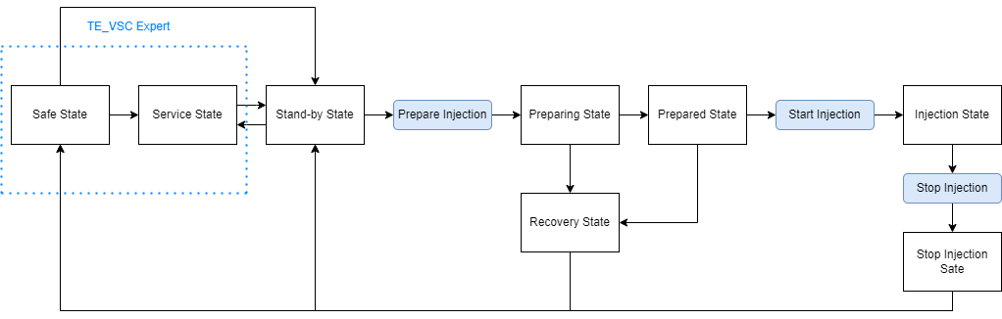
General process flow
Technical Specification and User Manual: https://edms.cern.ch/document/2757469/5
Notes:
Stand-by state is normal state instrument is in when ready to start preparation
For injection we go through preparing, prepared, injection and stop injection, with commands to trigger the transitions (mention timeouts)
If anything goes wrong in prep, we go to recovery
If anything goes wrong in injection we go to stop injection
Safe and Service state are only accessible to experts
Safe state entered when there is an issue during prep, injection, stop injection or recovery, when plc restarted, after a power loss
Standby entered after a successful injection, a timeout of prepared or injection, or force recovery command
All valves forced closed and gauges forced on in standby and safe

Slide 13
Process conditions and device Interlocks
  Two safety measures:
    Device Interlocks:
      Can be START or FULL Interlocks
      Maintaining same interlocks as when process was manually operated
      Baseline safety that protects the machine
    Process Conditions, when breached:
      In Stand-by state will not allow process to start
      In Preparing, Prepared and Injection states, will move to the safe state in a controlled manner
      Different values depending on the state
Notes:
MAKE CLEAR THAT CONCERN IS MACHINE SAFETY
Device interlocks are what protect the machine from issues we saw earlier, baseline safety
START, when breached:
When a device is not allowed to switch on, f.e. valve not allowed to open
FULL, when breached:
When a device is not allowed to switch on and is switched off it is already on, f.e. valve not allowed to open and if open it is immediately closed
Process Conds, affect the automatic process , checks between and during the states

Slide 14
Process Conditions
Start Conditions
Pressure values from all gauges
Prepare Conditions
Slightly less stringent pressure requirements
Injection Conditions
Higher value pressure limits (injecting)
Pumps in nominal state
Pumps in nominal state
Valves closed and valid
Pumps in nominal state
Valves valid
Valves valid
Pressure requirement for gas at injection
Notes:
Explain why we have different conditions
Explain different pressures better

Slide 15
Device Interlocks
  Will always be acting and override the process, baseline safety
  Consist in:
    Open and full ITLs on Gate valves
    Start Interlocks on the VPG processes and Open Interlocks on their VVIs (avoid back-streaming)
    VPG4 VVT Full ITL
    Injection valve open and full ITLs
    PPINJ full ITL
  If disabling of ITLs needed for operations on the BGC, will be done manually by controls expert

Slide 16
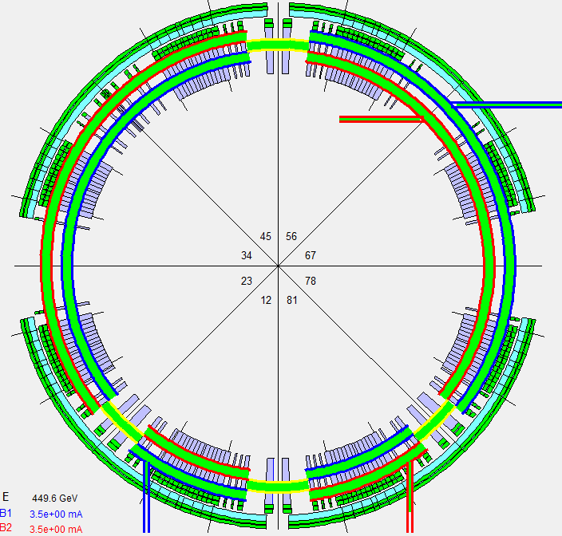
User Interface
New SCADA panels and Alarms

Slide 17
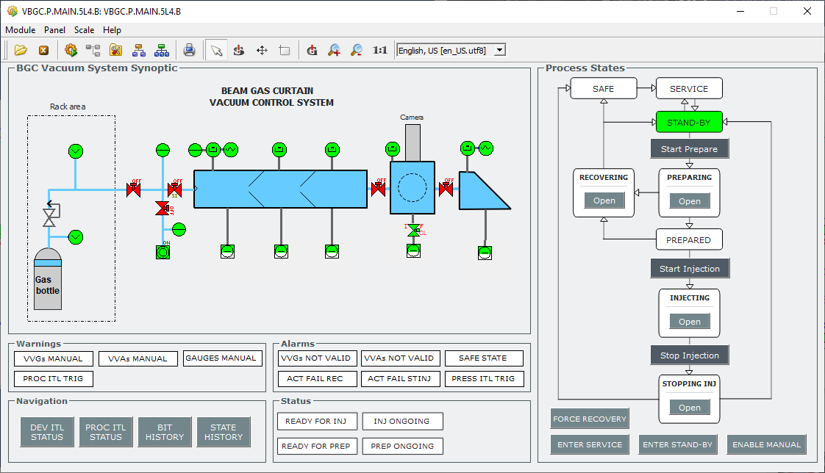
SCADA Layout – Main Panel
Notes:
Can easily monitor the current step and the process in general on the right, where commands can also be sent
Operator commands in the state diagram , expert commands below
Warnings and Status’ can be seen
Alarms for dangerous conditions
Navigation buttons to see other panels, such as the interlock monitoring

Slide 18
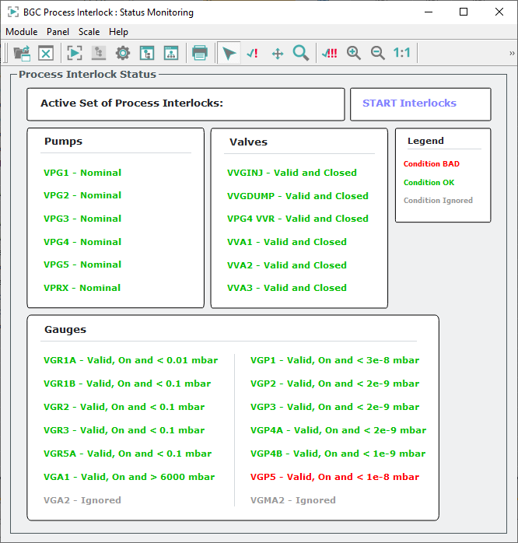
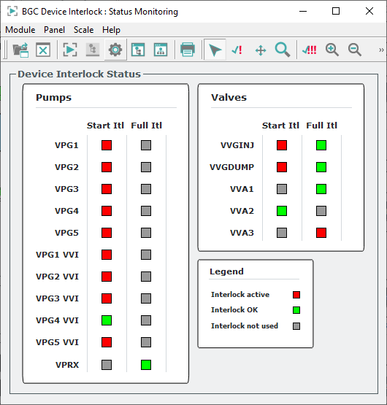
SCADA Layout – ITL panels
Notes:
Can monitor process conditions:
Which conditions are active
If one of the conditions is breached
Can monitor device interlocks:
Can see start and full itls for each device, and see if they are breached

Slide 19
SCADA Layout – Main Panel
Notes:
Open buttons on the state diagram open detailed panels about the main steps

Slide 20
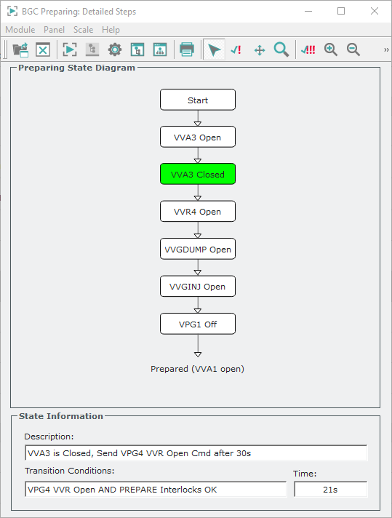
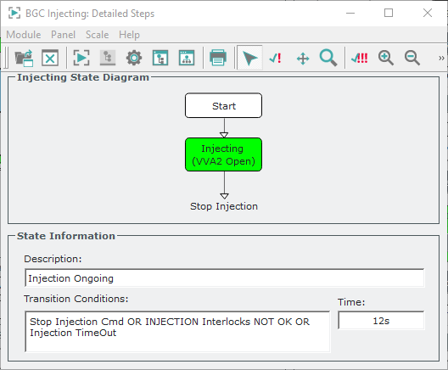
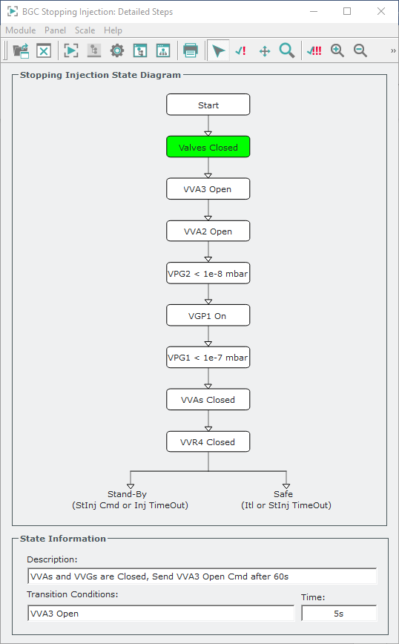
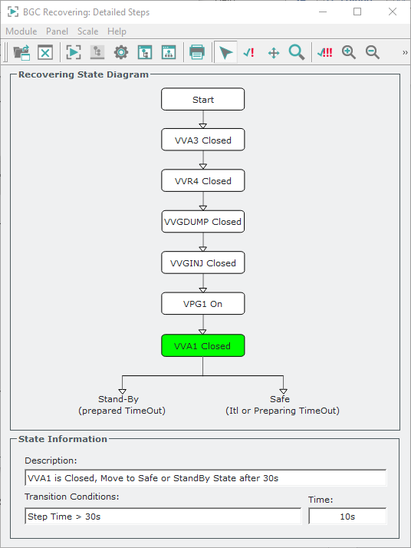
SCADA Layout – State detailed steps panels
Notes:
The detailed panels for the preparing, injecting, stopping injection and recovery states can be seen
Here the detailed steps can be seen
Description of each step, transition conditions to the next step and current step time are displayed

Slide 21

Alarms
Notes:
Another important element of the user interaction are the alarms
These will be configured to send an SMS alert to selected BGC experts if something goes wrong
The configured alarms are….

Slide 22

Testing and Installation
Testing procedure and Installation plans

Slide 23
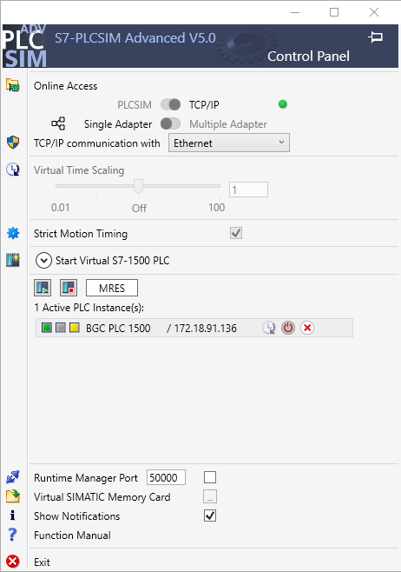
Testing procedure
  As much effort in testing as in development
  Testing was carried out through simulations with a SCADA instance and a simulated PLC running on a desktop computer
  Only the BGC main controller was run, with signals and interlocks from pumping groups simulated in the software
  The code controlling each equipment (control types) was modified to simulate real-world behaviour and errors in equipment
  A checklist of tests was produced and followed so that every functionality and possible failure scenarios of the process were tested
  Testing checklist available: https://edms.cern.ch/document/3174228/1

Slide 24
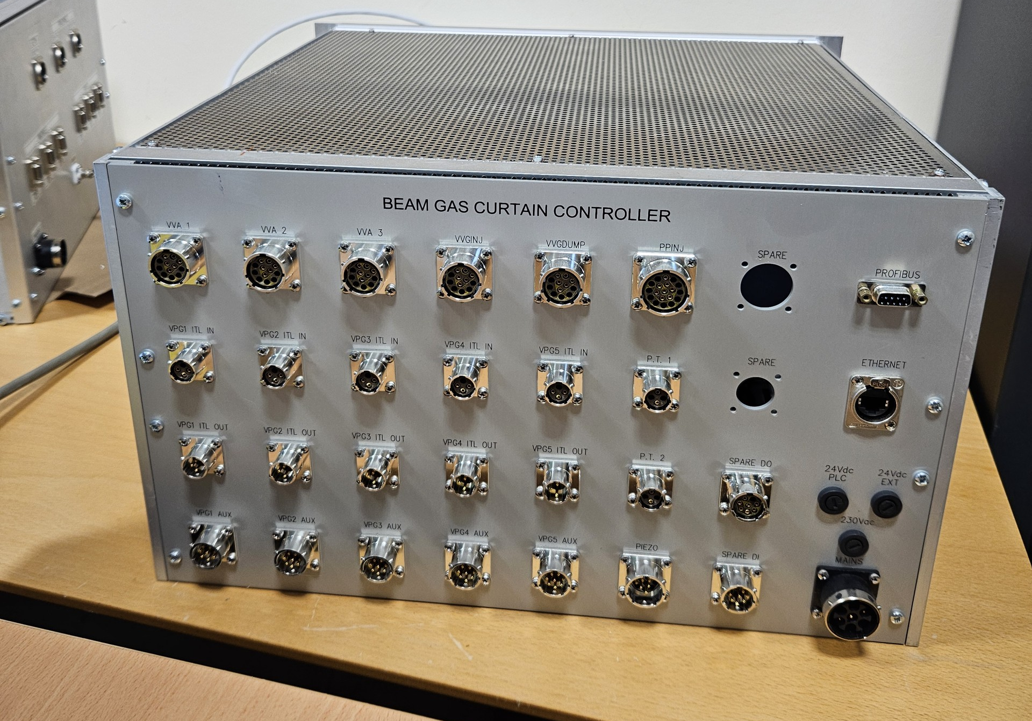
Installation plans
  W2 to W5 2025, coordinated with SY-BI skimmer exchange
  No major changes to cabling in the tunnel needed, only need to replace the old crate with the new one (W2)
  Coils on the VVGs to be changed to 24Vdc coils (W2)
  Three stages of commissioning (W4-5):
    Simulators connected to all the valves and test all functionality (by triggering process conditions as well with gauge simulators)
    Simulators connected only to the gate valves, test injection and functionality without injecting in the beam pipe
    Try a real injection with the sector valves closed

Slide 25
Thank You
For Your Attention
Notes:
ANY QUESTIONS?

Slide 26
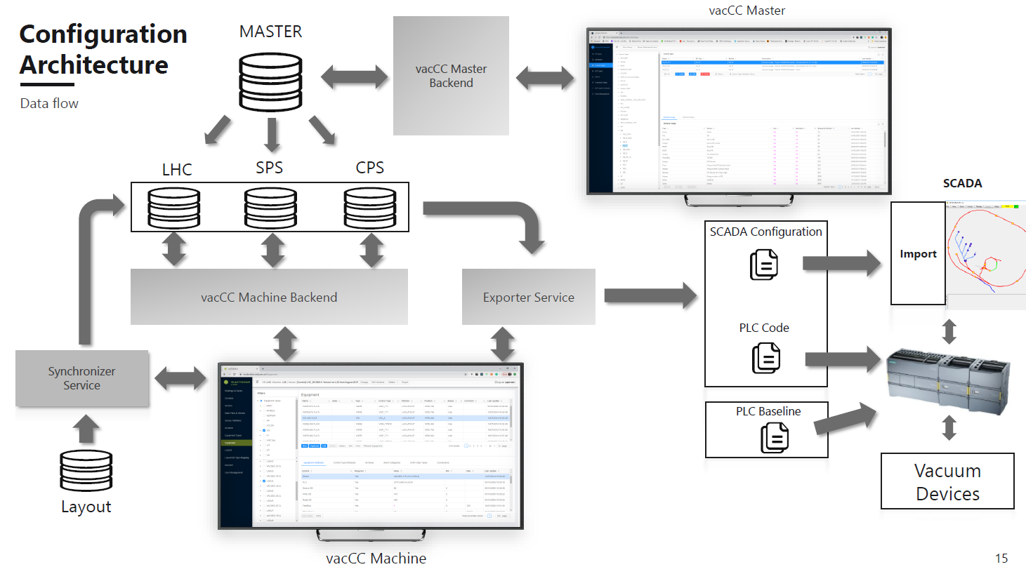
Vacuum framework
Notes:
Vacuum framework:
Master db that has all the definitions of the control types
Instantiated in each machine db, which are set up using the vacCC machine
The exporter automatically generates scada config files and PLC sources
PLC baseline code (part of CT definition) and generated sources are used for the PLC projects
Scada config files are imported to set up the SCADA

Slide 27
Process Conditions
START CNDS (Stand-by State)
Device | Process Interlock Conditions
VGR1A | < 1e-2 mbar, on and not in error
VGR1B, VGR2, VGR3, VGR5A | < 1e-1 mbar, on and not in error
VGP1 | < 3e-8 mbar, on and not in error
VGP2 | < 2e-9 mbar, on and not in error
VGP3 | < 2e-9 mbar, on and not in error
VGP4A | < 2e-9 mbar, on and not in error
VGP4B | < 1e-9 mbar, on and not in error
VGP5 | < 1e-8 mbar, on and not in error
PT101 (VGA1) | > 6000 mbar, on and not in error
VVGINJ, VVGDUMP, VVR4, VVA1, VVA2, VVA3 | Closed, not in error and not in warning
PPINJ (VPRX), VPG1, VPG2, VPG3, VPG4, VPG5 | In nominal state
PREPARE CNDS (Preparing and Prepared States)
INJECTION CNDS (Injection State)
Device | Process Interlock Conditions
VGR1A | < 2e-2 mbar, on and not in error
VGR1B, VGR2, VGR3, VGR5A | < 5e-1 mbar, on and not in error
VGP2 | < 3e-5 mbar, on and not in error
VGP3 | < 3e-5 mbar, on and not in error
VGP4A | < 1e-7 mbar, on and not in error
VGP5 | < 1e-6 mbar, on and not in error
PT101 (VGA1) | > 6000 mbar, on and not in error
PT301 (VGA2) | > 2000 mbar, on and not in error
VGM2 (VGMA2) | > 2000 mbar, on and not in error
VVGINJ, VVGDUMP, VVR4, VVA1, VVA2, VVA3 | Not in error and not in warning
PPINJ (VPRX), VPG1, VPG2, VPG3, VPG4, VPG5 | In nominal state
Device | Process Interlock Conditions
VGR1A | < 2e-2 mbar, on and not in error
VGR1B, VGR2, VGR3, VGR5A | < 5e-1 mbar, on and not in error
VGP2 | < 2e-9 mbar, on and not in error
VGP3 | < 2e-9 mbar, on and not in error
VGP4A | < 5e-8 mbar, on and not in error
VGP5 | < 1e-7 mbar, on and not in error
PT301 (VGA2) | > 2000 mbar, on and not in error
VVGINJ, VVGDUMP, VVR4, VVA1, VVA2, VVA3 | Not in error and not in warning
PPINJ (VPRX), VPG1, VPG2, VPG3, VPG4, VPG5 | In nominal state
Notes:
Explain why we have different conditions, don’t show values

Slide 28
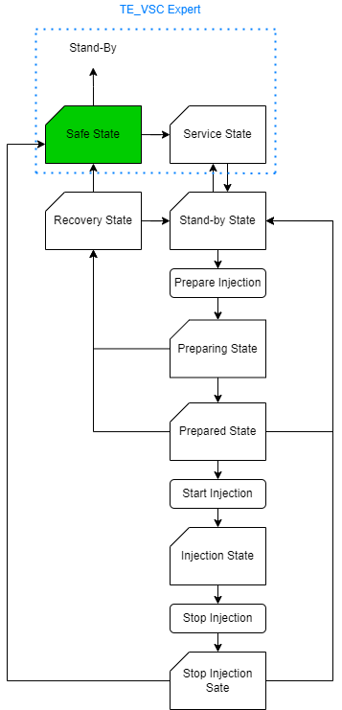
Safe State
  Entered when:
    recovered from a process condition breach during the preparation phase or during the injection itself
    failure of one of the steps/actuators during the recovery or injection stopping procedures
    failure of one of the steps/actuators during the preparing or injecting states
    after a power loss
    after a restart of the PLC
  Can only be exited with command from a TE-VSC expert
  All valves forced closed (except VVR4 when the injection could not be stopped) and gauges forced on
Notes:
Highlight state

Slide 29
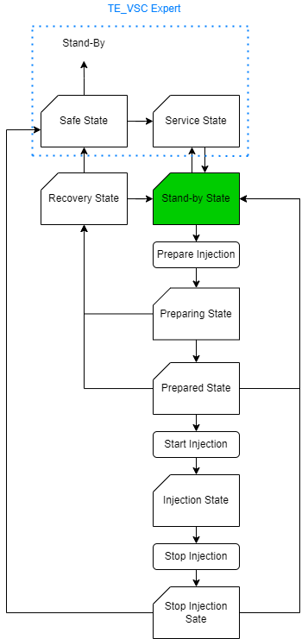
Stand-By State
  State in which the instrument remains when not currently in operation
  The instrument must be in this state and the START Process conditions must all be satisfied before the instrument can move to the Preparing state
  All valves are forced closed and gauges forced on
  Entered when:
    The process completes with no issues
    Timeout in prepared or injecting state
    Force Recovery command sent

Slide 30
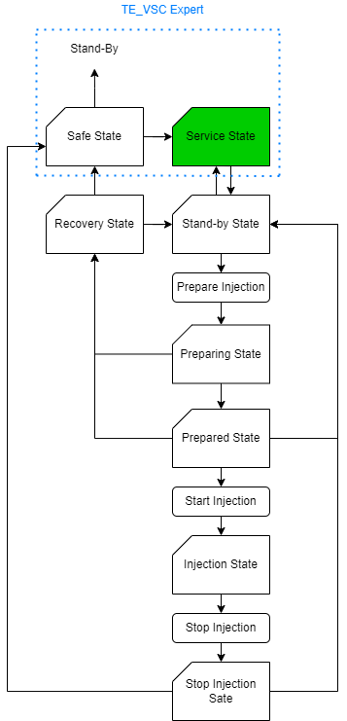
Service State
  Can only be entered/exited by TE-VSC experts
  The equipment is still forced to auto mode, but no auto commands are sent by the process
  To be used for manual operations undertaken by experts which are not part of the automatic process

Slide 31
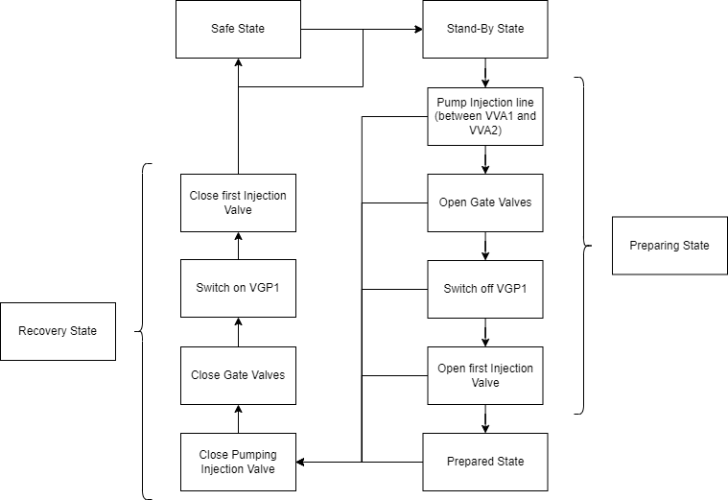
Preparing and Recovery States

Slide 32
Prepared State
  There is a 10-minute timeout on the prepared state
  Injection can be started with Start Injection command
  Ready for Injection Status must be achieved to move to the Injecting State

Slide 33
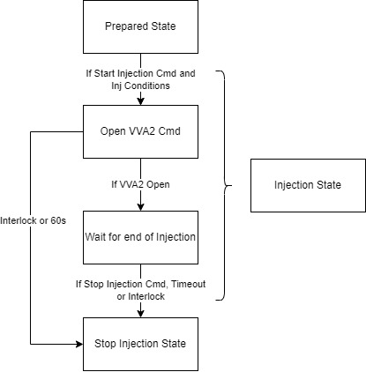
Injecting State
  There is an 8-hour timeout on injection
  The injection is stopped with the “Stop Injection” command
  INJECTION process conditions are active

Slide 34
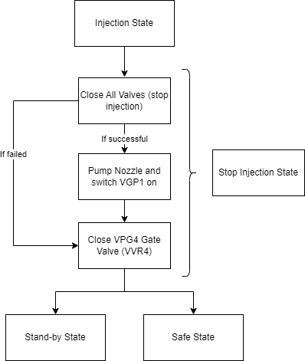
Stopping Injection State

Slide 35
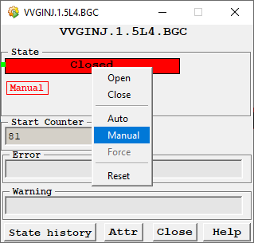
Manual commands
  Components always kept in auto mode by default
  Manual Enable command only accessible to expert users:
    Will allow components to be set to manual mode and not be controlled by the process
    Must be used with care and only available to experts
    Once disabled will set all equipment back to auto mode

