Slide 1

Study of thin Si₃N₄ windows for the Muon Collider
Valentina Giovinco
M. Morrone, J.A. Ferreira, C. Garion
29/10/2024

Slide 2
Summary
Introduction
Bulge test setup
Si₃N₄ membranes characterization
Potential other applications of the bulge test setup
Potential other applications of the Si₃N₄ membranes
Conclusions and future steps

Slide 3
Summary
Introduction
Bulge test setup
Si₃N₄ membranes characterization
Potential other applications of the bulge test setup
Potential other applications of the Si₃N₄ membranes
Conclusions

Slide 4
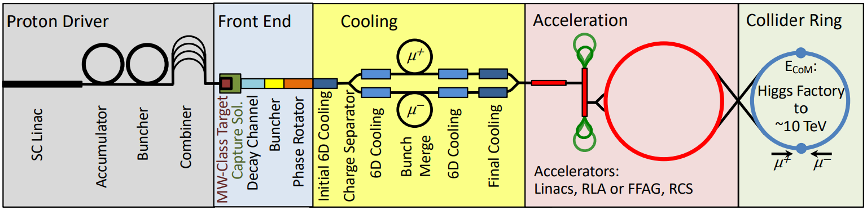
Introduction
Muon Collider
Less energy to run the muon collider (10-14 TeV lepton collider would be comparable to a 100TeV proton-proton collider).
Negligible synchrotron radiation due to the high mass of the muon (105.66 MeV/c² ≈200 times heavier than electrons).
Short muon lifetime (2.2 µs at rest).
A short, high-intensity proton pulse is produced.
Longitudinal and transverse emittance of the muon beam are reduced by a series of cooling stages.
Collision
Protons produce pions which decay into muons.
The muon beam is formed.
The focused beam is accelerated to collision energy.
[1, 2]

Slide 5
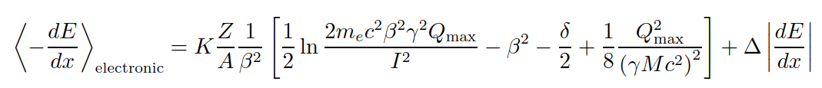
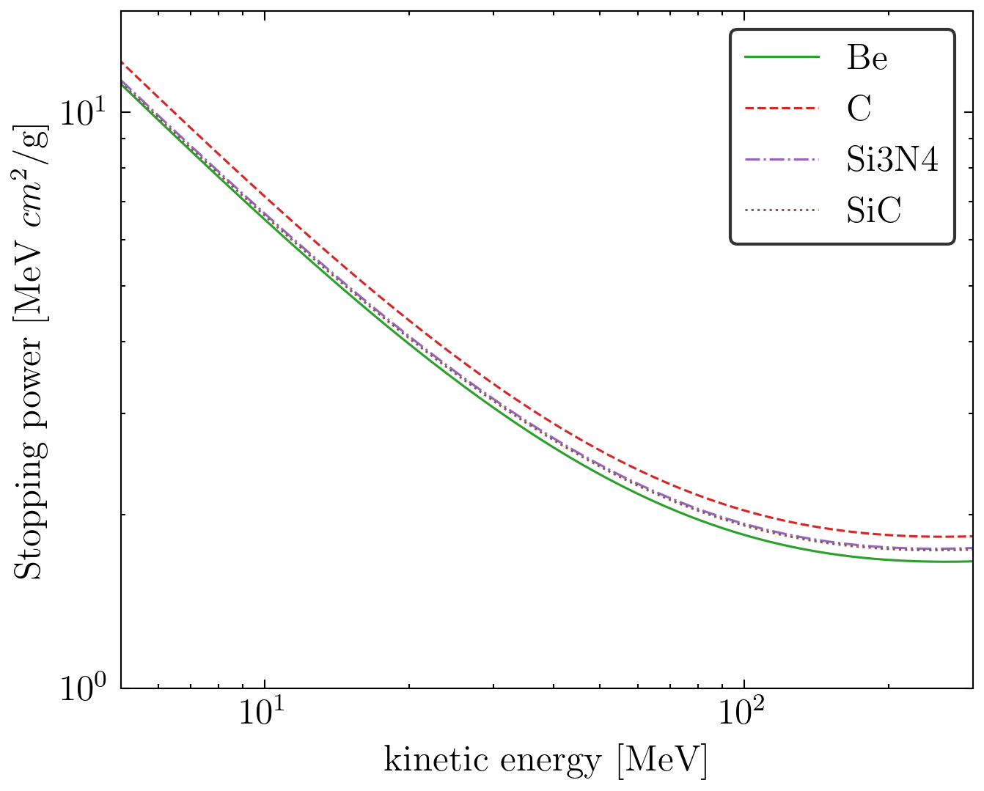
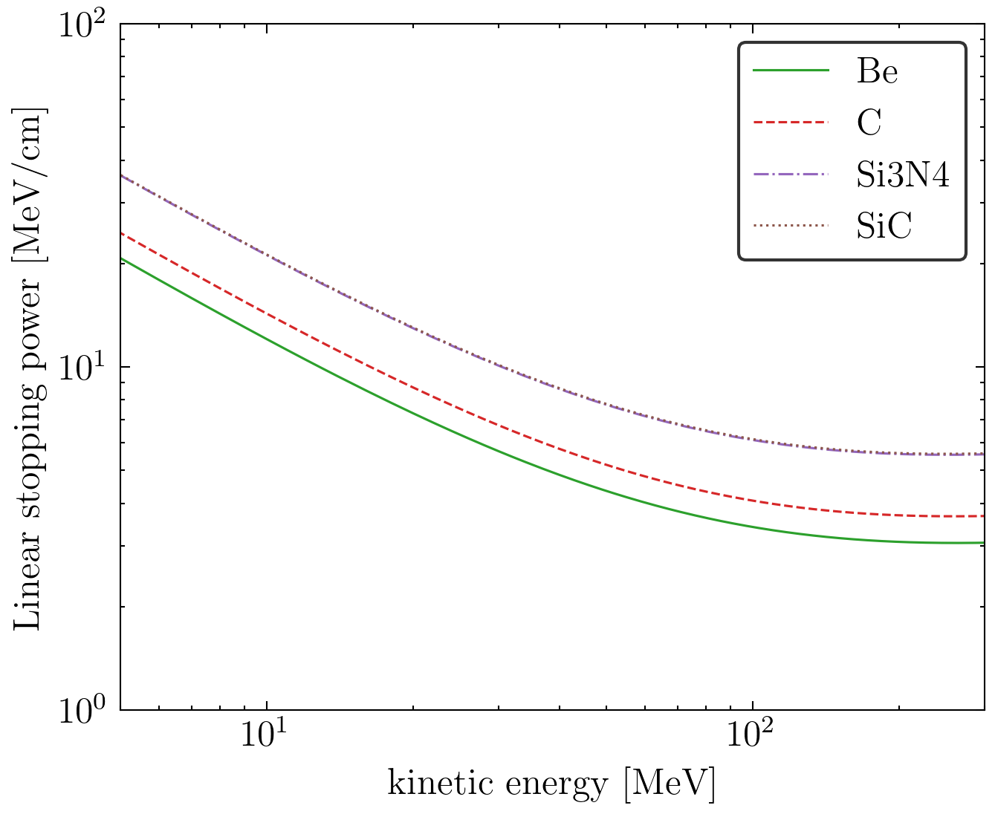
Introduction
Beam windows for final cooling
Absorbers (i.e., LH₂, LiH) and vacuum are alternated in the final cooling → Windows
Low energy beam: 20 to 5 MeV
→Thin windows (<15 µm to lose <1% of the energy)
→Small windows (10×σ, σ=0.6 mm at 5Hz)
Bethe-Bloch equation to calculate the stopping power at low energy (100keV to 100 MeV) [3]:
Possible material candidates → Be, C, Si₃N_{4,} SiC, …
 |  | 5 MeV | 20 MeV
Be | Stopping power [MeV×cm²/g] | 11.2 | 4.0
 | Linear stopping power [MeV/cm] | 21 | 7.3
C | Stopping power [MeV×cm²/g] | 12.2 | 4.3
 | Linear stopping power [MeV/cm] | 25 | 8.7
Si₃N₄ | Stopping power [MeV×cm²/g] | 11.8 | 4
 | Linear stopping power [MeV/cm] | 37 | 13
SiC | Stopping power [MeV×cm²/g] | 11.2 | 4.0
 | Linear stopping power [MeV/cm] | 36 | 13

Slide 6
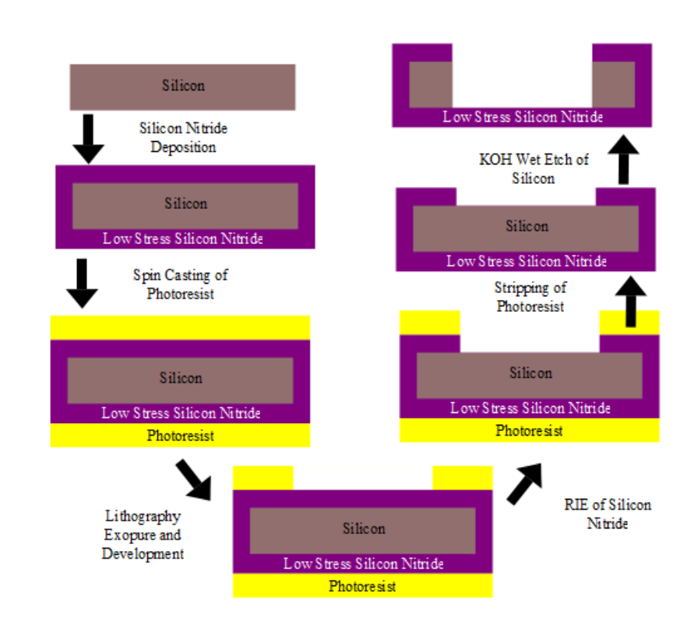
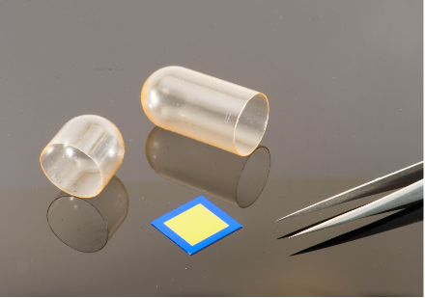

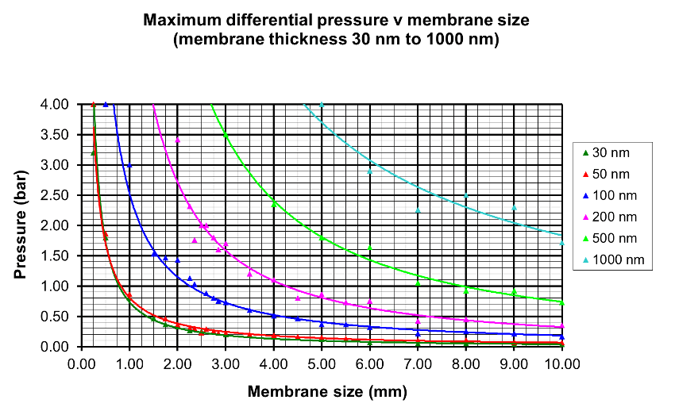
Introduction
Si₃N₄ windows
Commercially available
Thickness <1 µm
They can work at cryogenic temperature [4]
Bulk material has excellent mechanical properties [5]
Design of a beam window requires to study:
  Radiation resistance under proton irradiation with high brightness beams.
    1 µm 6mm x 6mm windows tested at HiRadMat
  Mechanical properties from cryogenic temperature (77K) to high temperature 425K (around 150°C)
    Bulge tests on membranes of different shapes and dimensions

Slide 7
Summary
Introduction
Bulge test setup
Si₃N₄ membranes characterization
Potential other applications of the bulge test setup
Potential other applications of the Si₃N₄ membranes
Conclusions

Slide 8
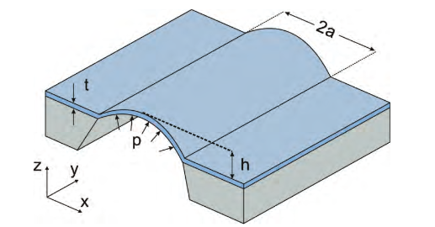
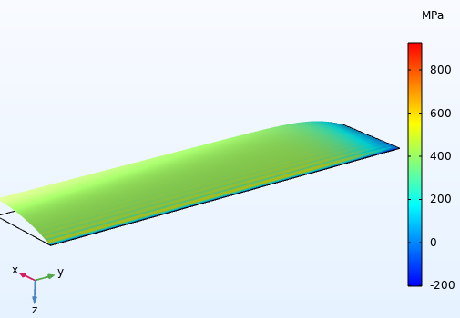




Bulge test setup
Experimental technique
Membrane
Setup: sample fixed along the edges and uniformly pressurized from one side.
Measurement: maximum deflection of the membrane as a function of the applied pressure.
Objective: determine the mechanical properties of freestanding membranes.
d
Frame
Method: analytical models are available to post-process experimental data. The Vlassak method has been applied to study rectangular membranes (aspect ratio > 4:1).
Stress /Strain state central section
Stress and strain
Bulge equation
$σ_{xx}=\frac{E_{Y}}{1−ν^{2}} (ε_{xx}$- $ε_{0}$)+ $σ_{0}$
$$σ_{xx}=\frac{pa^{2}}{2dt}$$
Initial residual stress
Young’s modulus
Plane-strain modulus
$$p=2 σ_{0} t \frac{d}{a^{2}}+\frac{4}{3 (1+ν)}\frac{E}{1−ν}t \frac{d^{3}}{a^{4}}$$
$$ε_{xx}=\frac{2d^{2}}{3a^{2}}+ε_{0}$$
Poisson’s coefficient
[6, 7, 8]

Slide 9
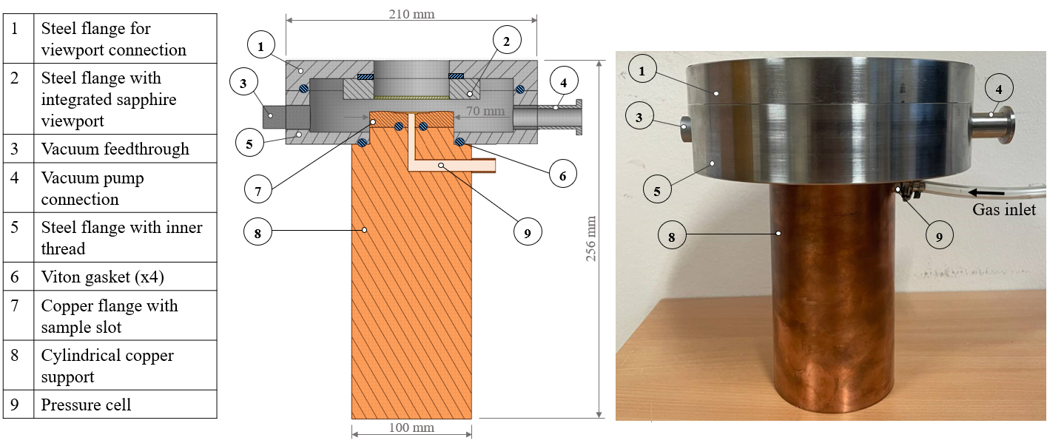
Bulge test setup
Mechanical assembly
1 | Steel flange for viewport connection
2 | Steel flange with integrated sapphire viewport
3 | Vacuum feedthrough
4 | Vacuum pump connection
5 | Steel flange with inner thread
6 | Viton gasket (x4)
7 | Copper flange with sample slot
8 | Cylindrical copper support
9 | Pressure cell
Temperature control: the copper cylinder can be cooled or heated to change the temperature of the sample by conduction.
Helium injection: maintains pressure stability at T=77K by avoiding phase transition.
Leak tightness: ensured by Viton O-ring or flat gaskets.

Slide 10
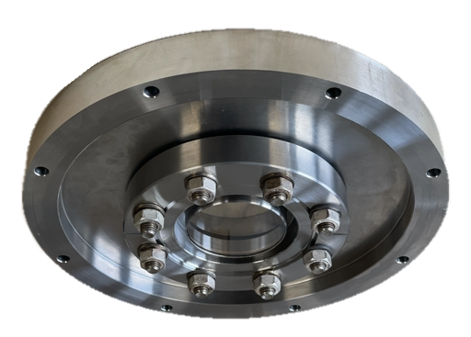
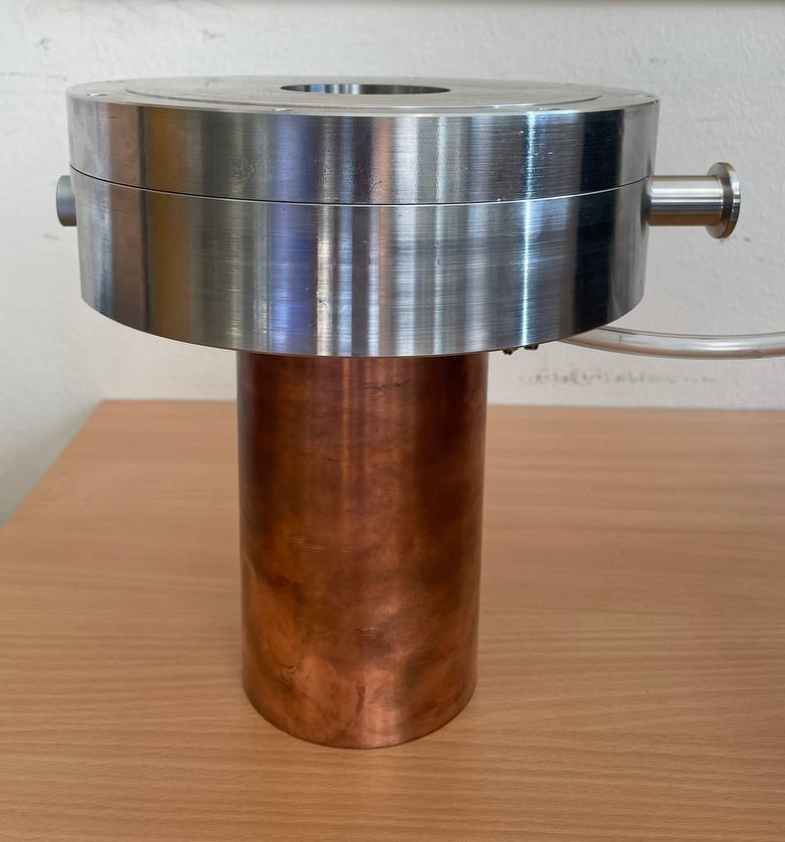
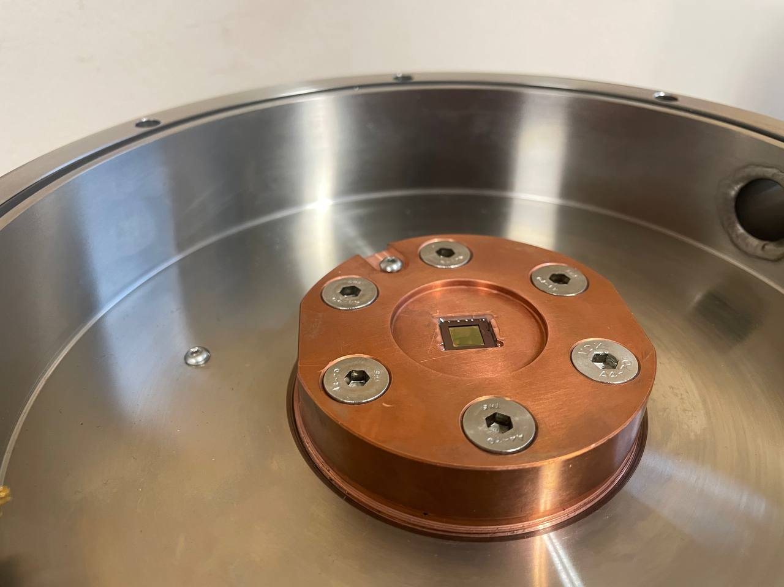
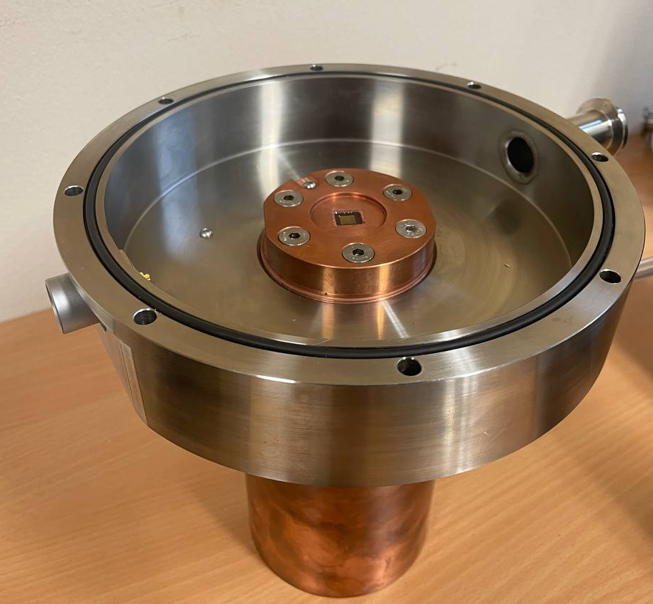
Thanks Hendrik!
Bulge test setup
Mechanical assembly
Viewport
STEEL FLANGE
PT100 slots
Sample
COPPER FLANGE
STEEL FLANGE

Slide 11
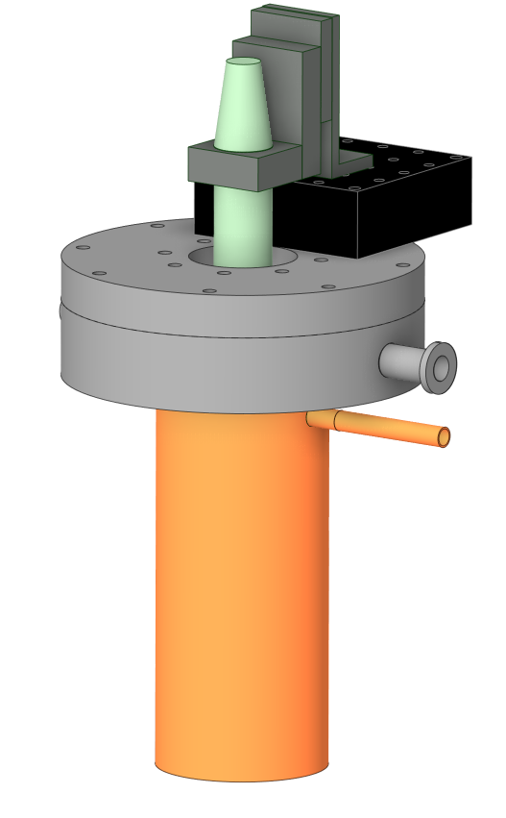
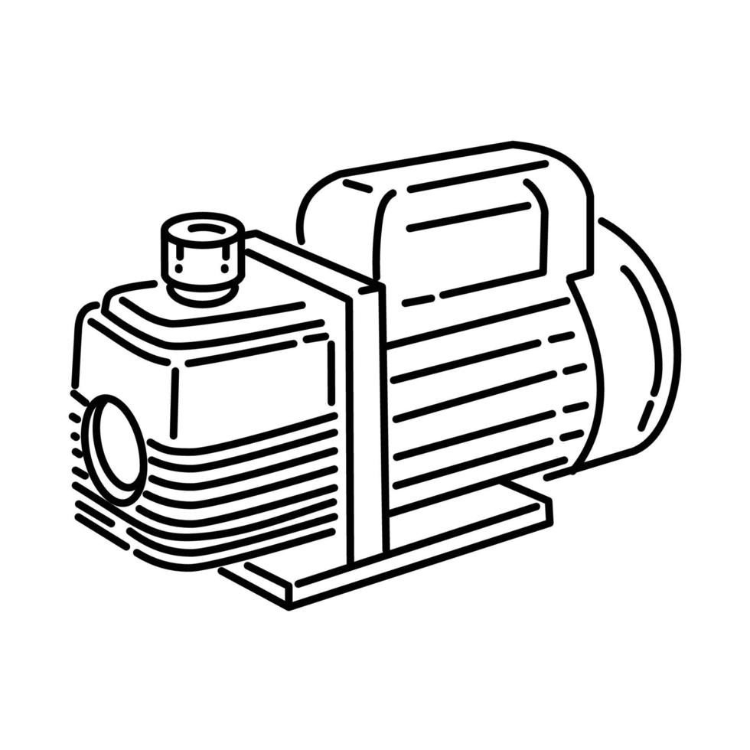
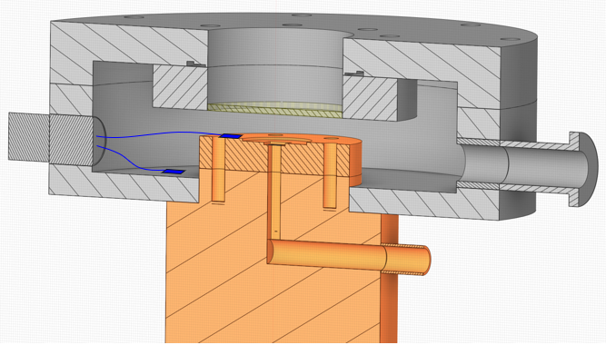
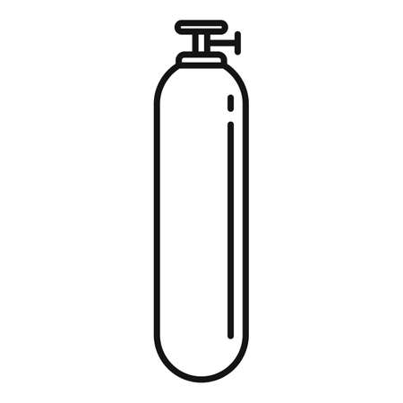
Bulge test setup
Instrumentation
DAQ developed and installed by Rodrigo Ferreira (TE-VSC)
1. Optical sensor
2. Servomotor stage
Vacuum pump
5. PT100s
4. Piezo gauge
Optical sensor (confocal chromatic): measures membrane deflection.
He
Servomotor stage: enable horizontal movement of the optical sensor to probe the membrane surface.
INLET
VALVE
Pressure control system: regulates pressure during testing.
Piezo gauge sensor: measures applied pressure to the membrane.
OUTLET
VALVE
PT100s: measure membrane and system components temperature.
3. Pressure control system

Slide 12
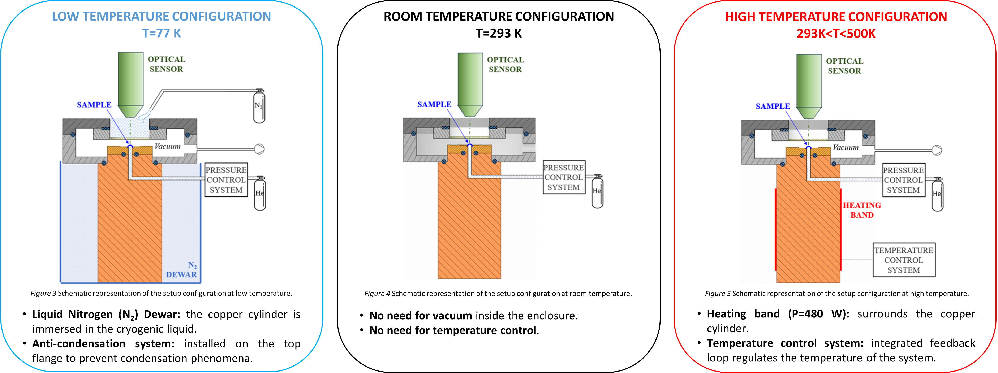
Bulge test setup
Three temperature configurations

Slide 13
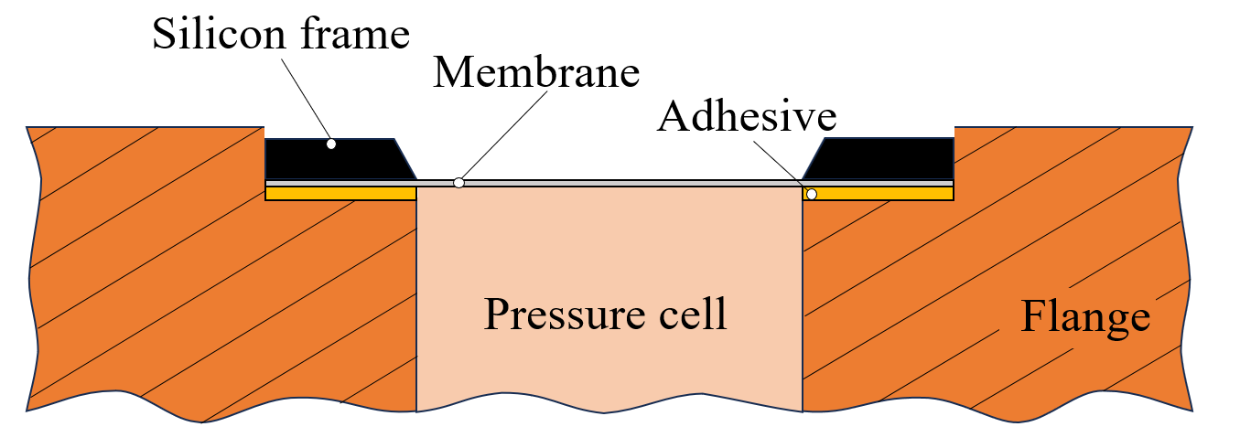
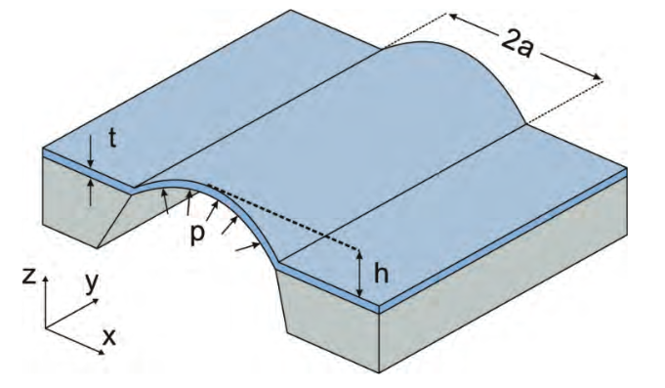
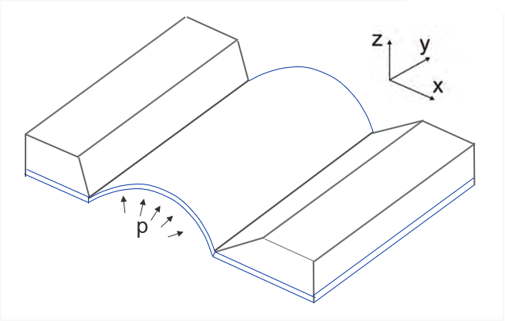
Bulge test setup
Sample mounting
Sample structure: a freestanding membrane supported by a silicon frame.
Sample mounting: bonding to a special slot created on the dedicated flange; it allows good repeatability of sample placement.
Sample orientation: two different ways to mount the membrane were investigated:
NEGATIVE ORIENTATION
POSITIVE ORIENTATION
Orientation | Adhesive | Temperature | Pressure @ failure
NEGATIVE | Acrylic glue (instantaneous) | RT | < 1 bar
POSITIVE | Acrylic glue (instantaneous) | RT | ~2 bars
Positive orientation prevents delamination phenomena.

Slide 14
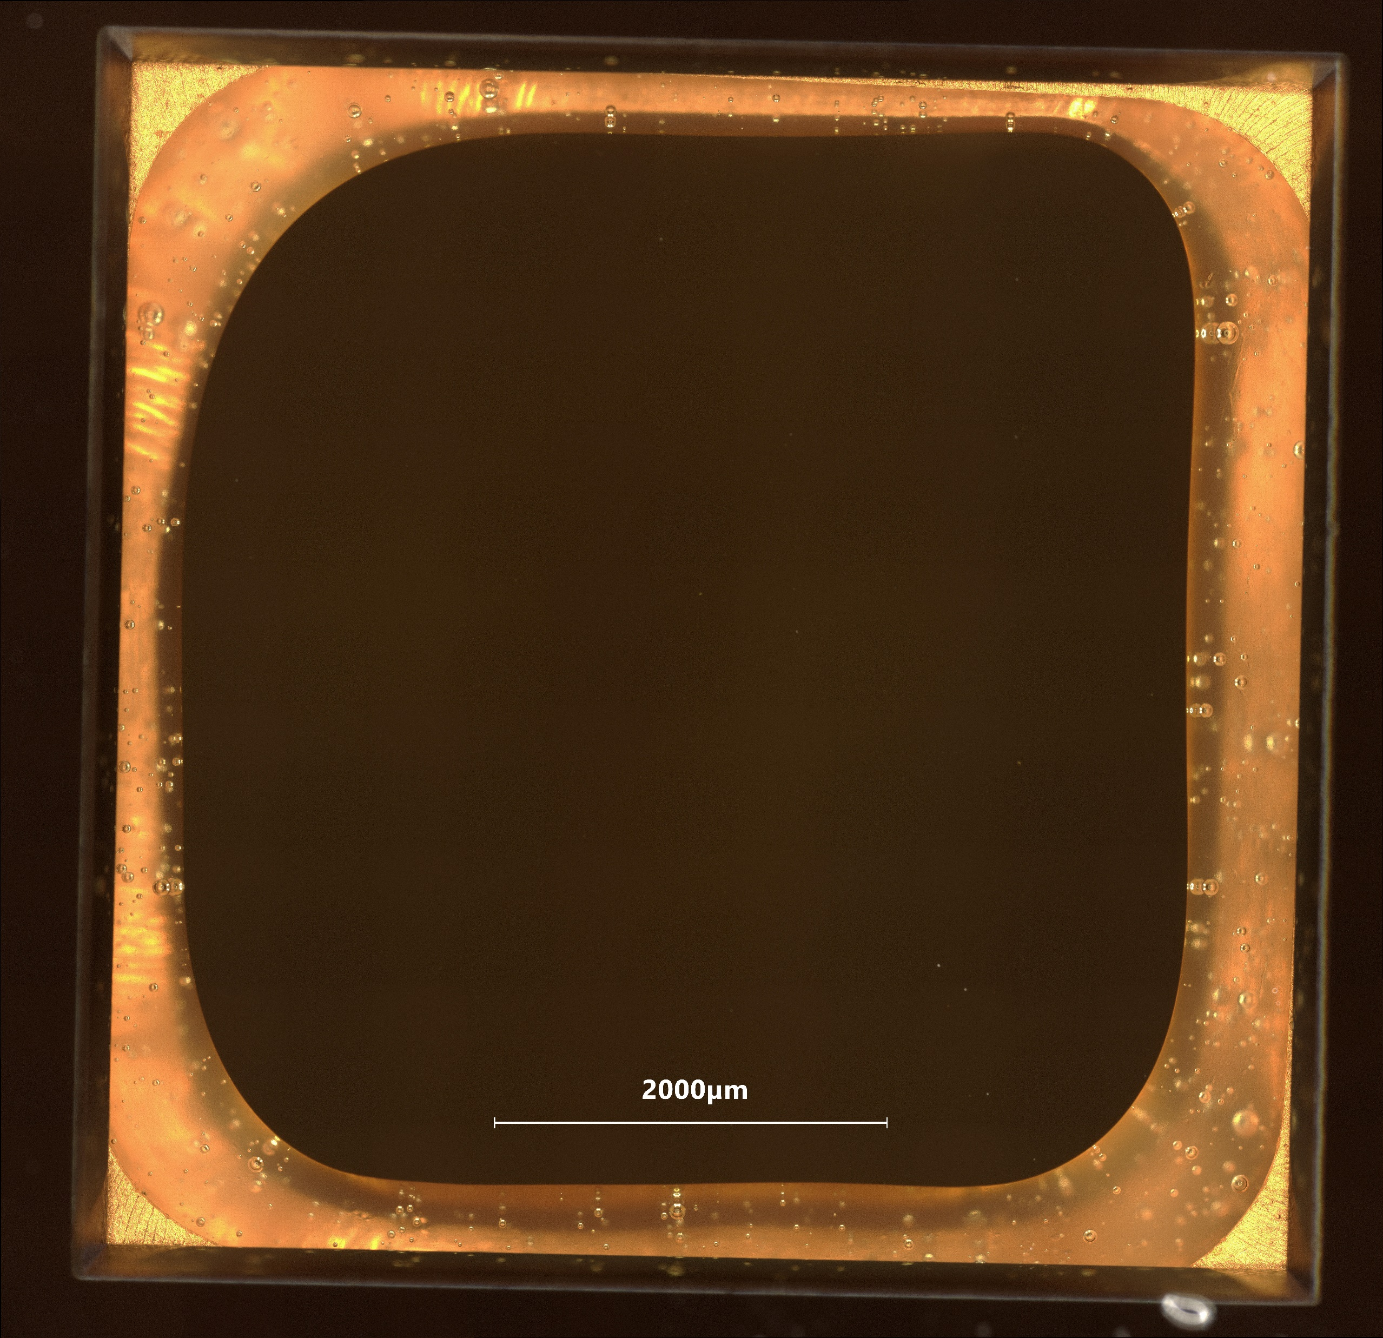
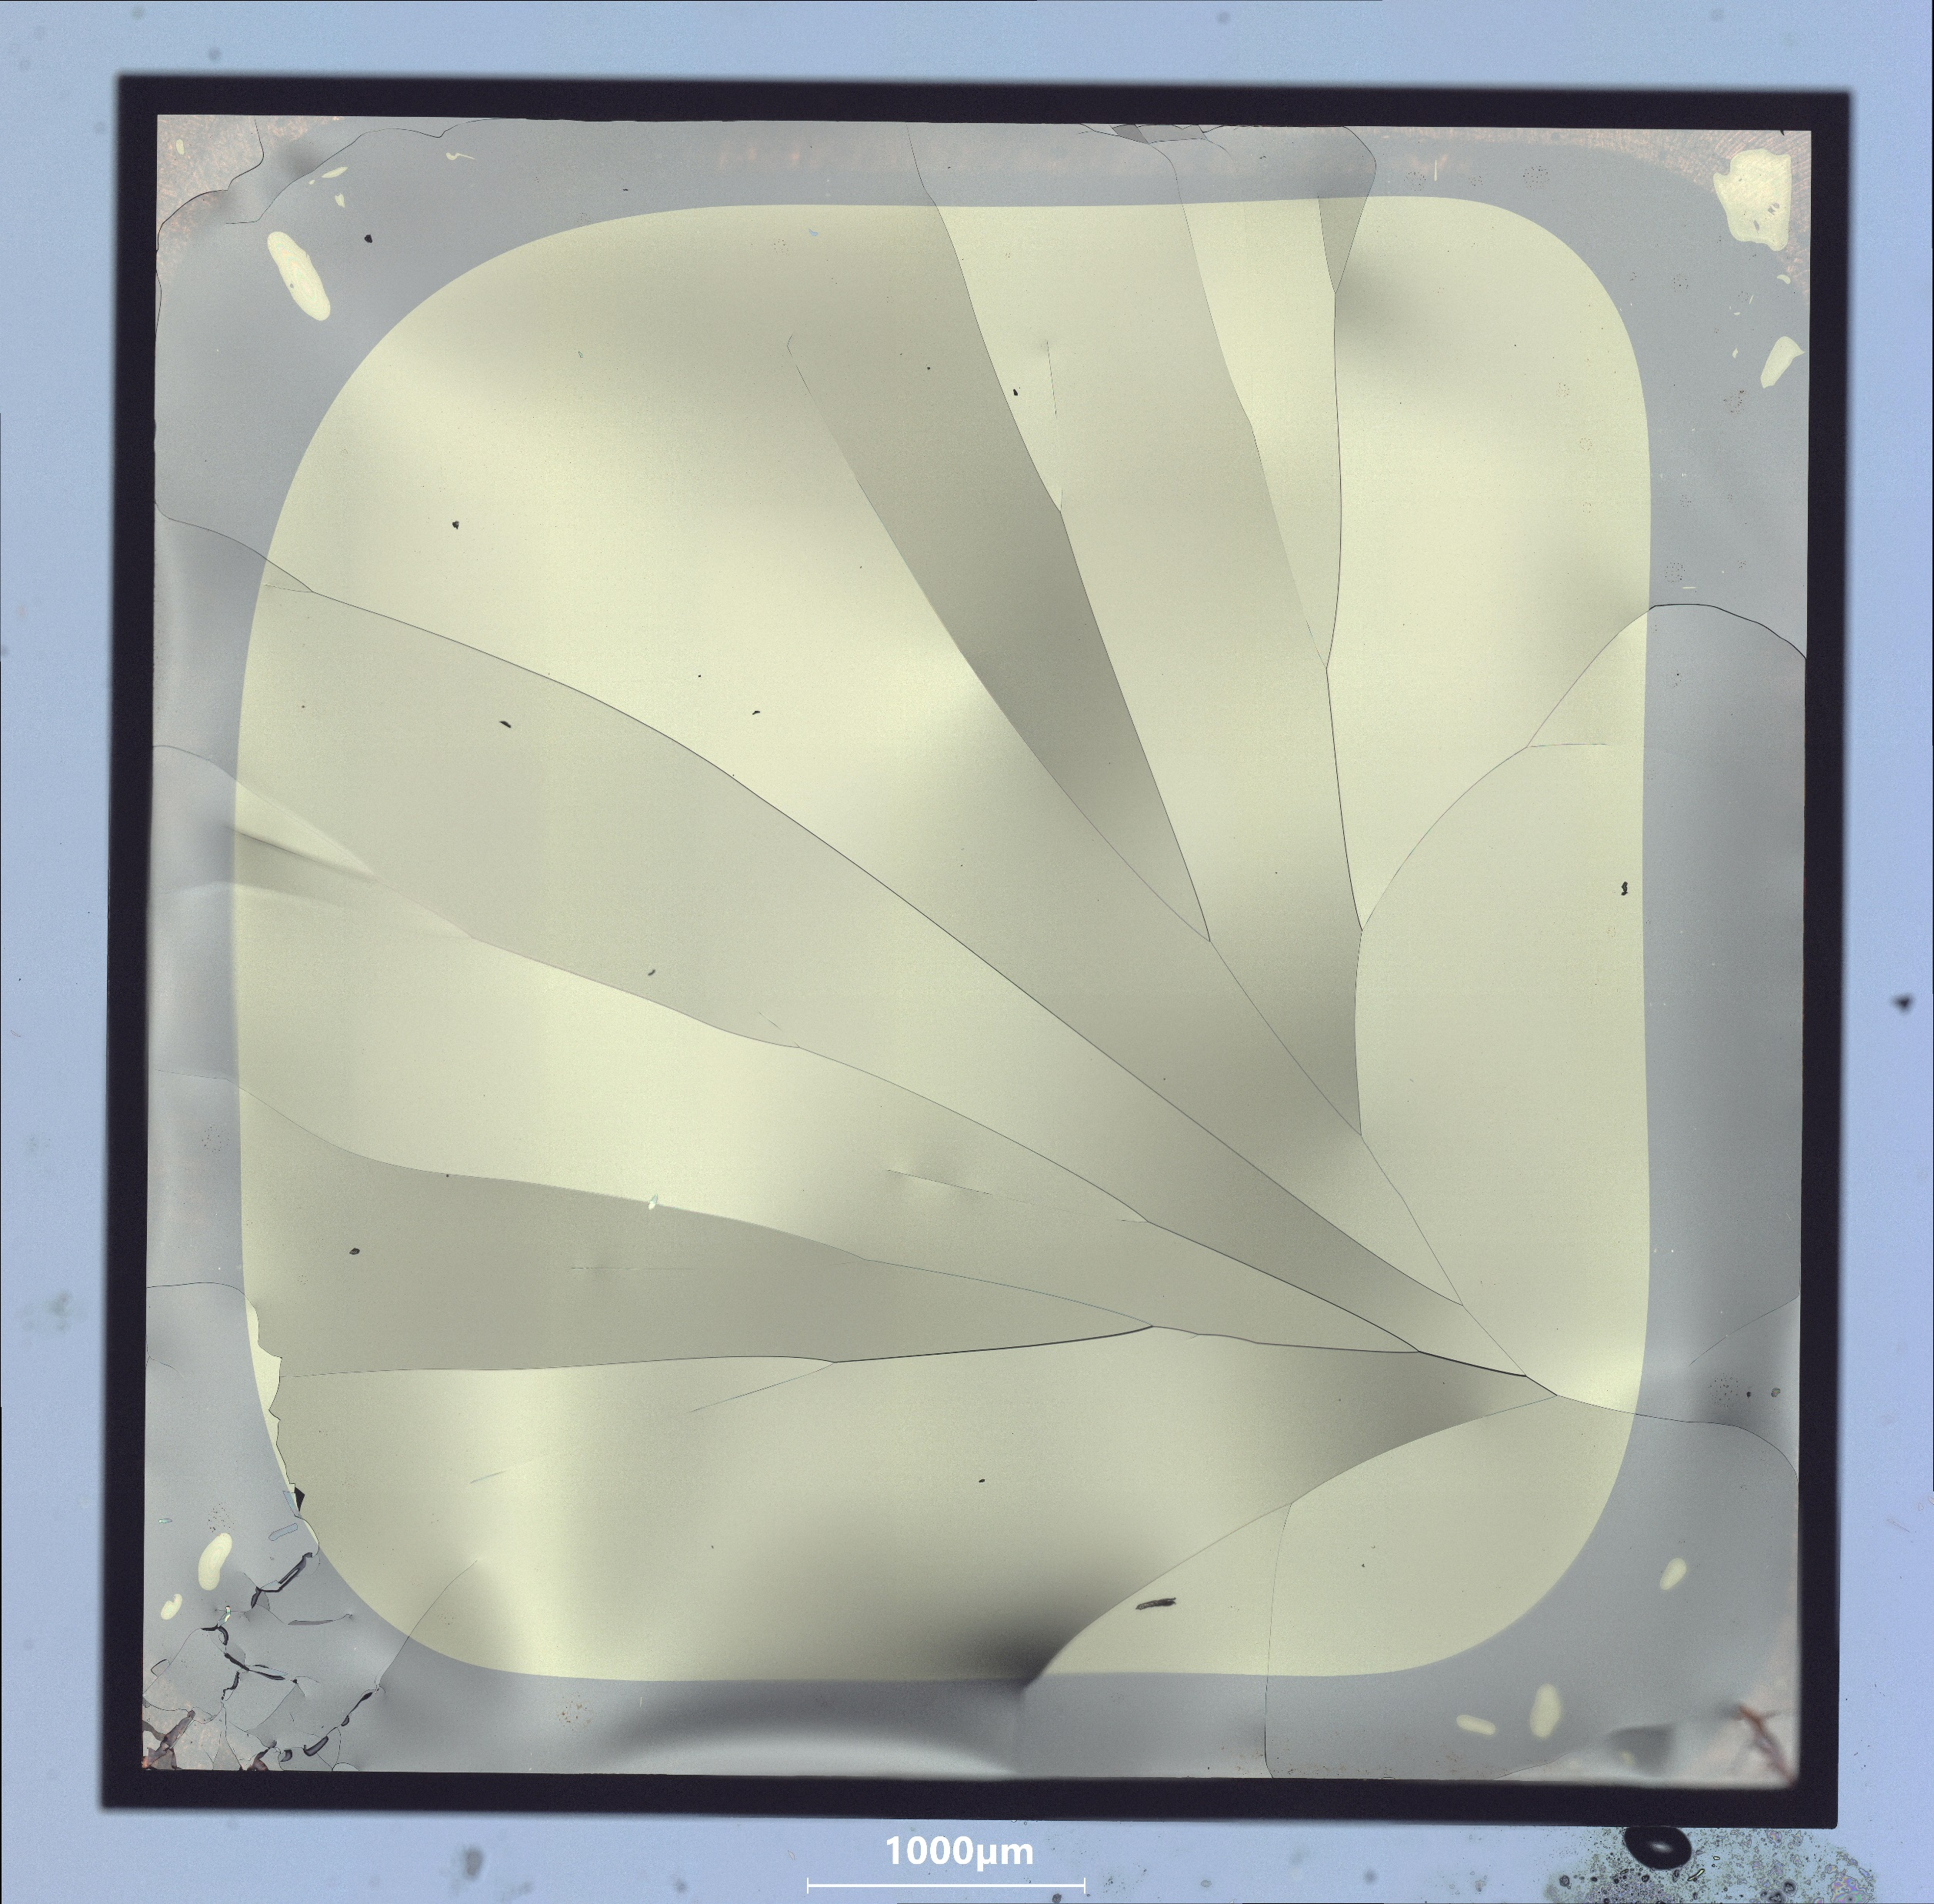
Bulge test setup
Sample mounting
OPTICAL MICROSCOPE IMAGES
Membrane failure during cooldown.
Possible causes and solutions:
  Substrate/sample thermal deformation mismatch:
    Increase the slot size of the copper flange
    Change the substrate material
  Glue degradation at cold:
    Test different glues
Before cooling
After cooling
Adhesive=Araldite Rapid
Inspection performed by Ignacio Santillana (EN-MME)

Slide 15
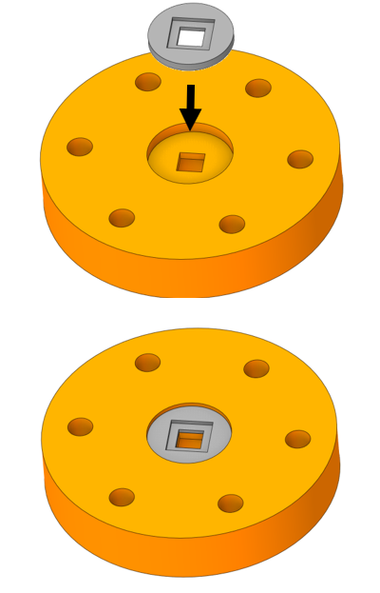
Bulge test setup
Sample mounting
OPTICAL MICROSCOPE IMAGES
Membrane failure during cooldown.
Possible causes and solutions:
  Substrate/sample thermal deformation mismatch:
    Increase the slot size of the copper flange
    Change the substrate material
  Glue degradation at cold:
    Test different glues
Before cooling
After cooling
INVAR disc (t=2 mm)
COPPER flange
Adhesive=Araldite Rapid
Brazing performed by Alexandre Gerardin (EN-MME)

Slide 16
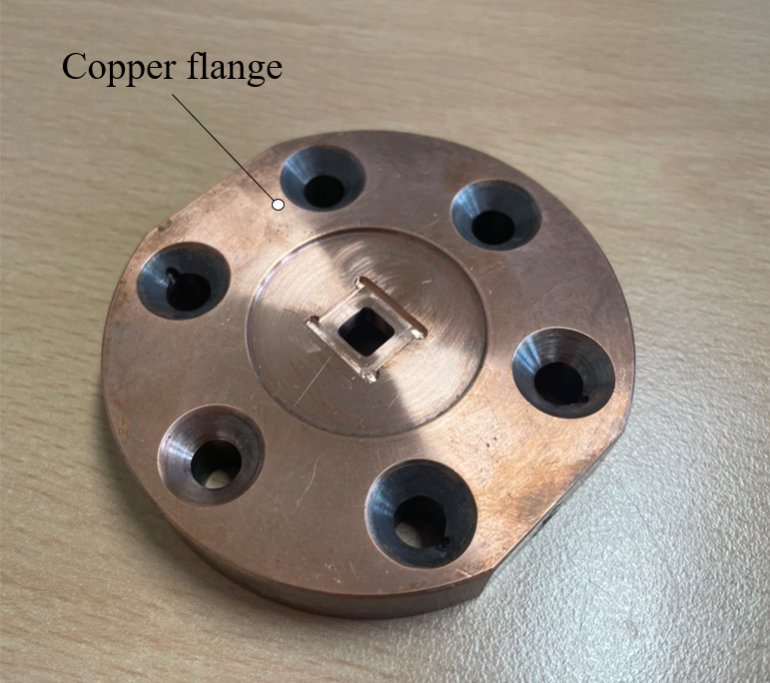
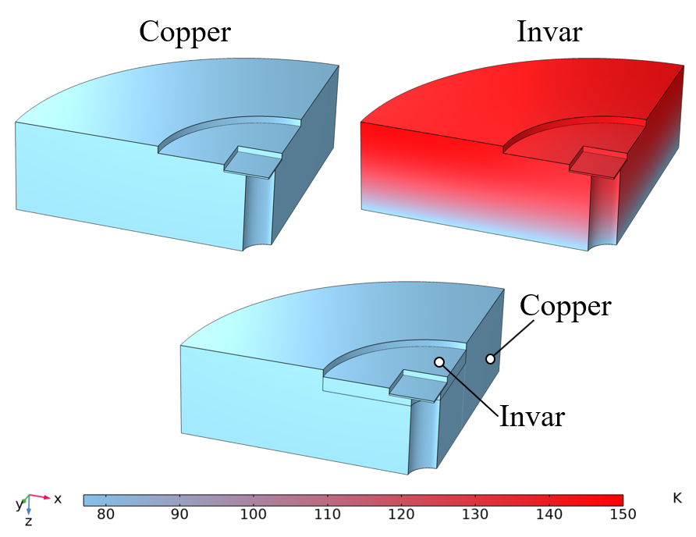
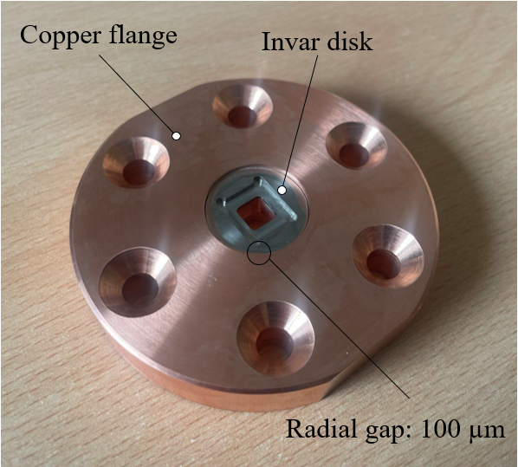
Bulge test setup
Sample mounting
Invar-copper flange designed to house the sample for low and high temperature measurements:
  CTE_{INVAR} ≈ CTE_{Si} → Low thermal stress on the sample during heating/cooling
  High k_{Cu}→ Effective heating/cooling of the sample
FE simulation results: stationary flange temperature reached after the copper cylinder is fully in contact with liquid N₂ (=77K)
Copper flange
Invar flange
Invar-copper flange
Thermal efficiency X
Sample-flange contraction ✓
Thermal efficiency ✓
Sample-flange contraction X
Thermal efficiency ✓
Sample-flange contraction ✓
E_{Cu} =130 GPa
k_{Cu} =400 W m⁻¹ K⁻¹
CTE_{Cu}=16 ppm °C⁻¹
E_{INVAR}=140 GPa
k_{INVAR}=15 W m⁻¹ K⁻¹
CTE_{INVAR}=2.5 ppm °C⁻¹

Slide 17
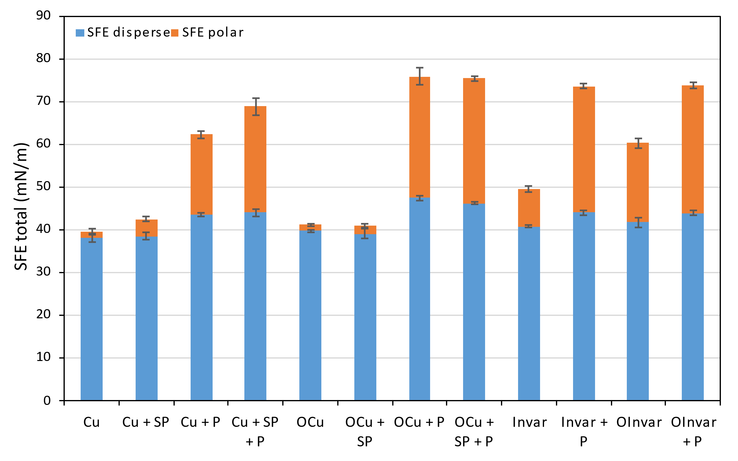
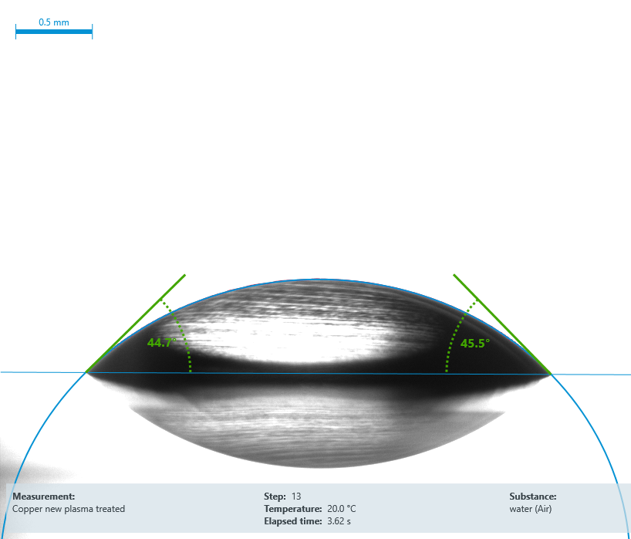
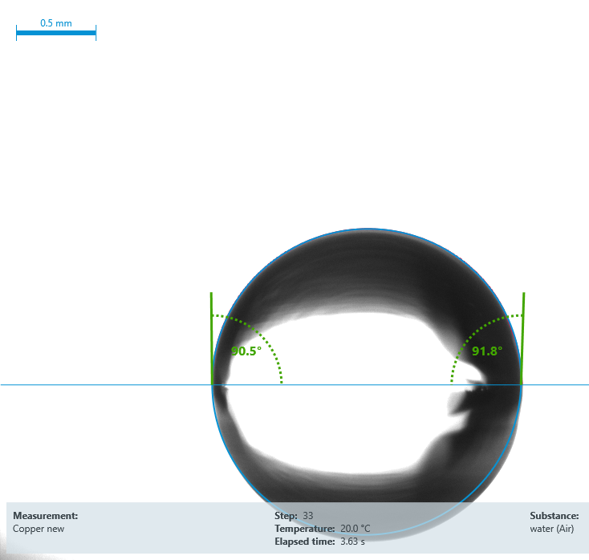
Bulge test
Adhesives for different temperature tests
Tests performed by Vincent Schenk and Sebastien Clement (TE-MSC)
Sample/substrate adhesion depends on:
  1. Substrate properties → SURFACE ENERGY TEST
    The higher the surface energy, the better the adhesion properties of the substrate
    Different materials/preparation surfaces have been tested
    Disperse and polar components have been determined for each surface →similar components means better adhesion
SP: sand paper P: plasma cleaning O: oxidized
1
2
2
1

Slide 18
Bulge test
Adhesives for different temperature tests
Sample/substrate adhesion depends on:
  2. Adhesive properties → BULGE TESTS
    Adhesives affect the mechanical response of the membrane
    The adhesion quality has been defined by determining the maximum pressure at membrane failure
    Adhesives have been tested at different temperatures to evaluate high and low temperature resistance
ADHESIVE PERFORMANCE
Epoxy bi-component adhesives | Cure | Pressure @ failure
 |  | CT=77K | RT=293K | HT=420K
Araldite RAPID | 2h @RT | < 1bar | 5±1 bar | 1.5 bar *
Araldite STANDARD | 24h @RT | 1.5 bar | 5±1 bar | 1.5 bar *
STYCAST 2850FT CAT27 | 4h @120°C | Not tested | Not tested | 3.5 bar *
LOCTITE ABLESTIK 286 | 24h @RT | Not tested | Not tested | broken
3M DP190 | 24h @RT | 5±1 bar | 5±1 bar | broken
LOCTITE EA 9492 | 3dd @RT | 3±1 bar | 4±1 bar | broken
MG 832HT | 24h @RT | broken | 3±1 bar | 2 bar
15 mm
3 mm
1 bar≈0.5 kg/membrane
5 bar≈2.5 kg/membrane
*not repeatable because of the high deformation of the membrane during heating

Slide 19
Summary
Introduction
Bulge test setup
Si₃N₄ membranes characterization
Potential other applications of the bulge test setup
Potential other applications of the Si₃N₄ membranes
Conclusions

Slide 20
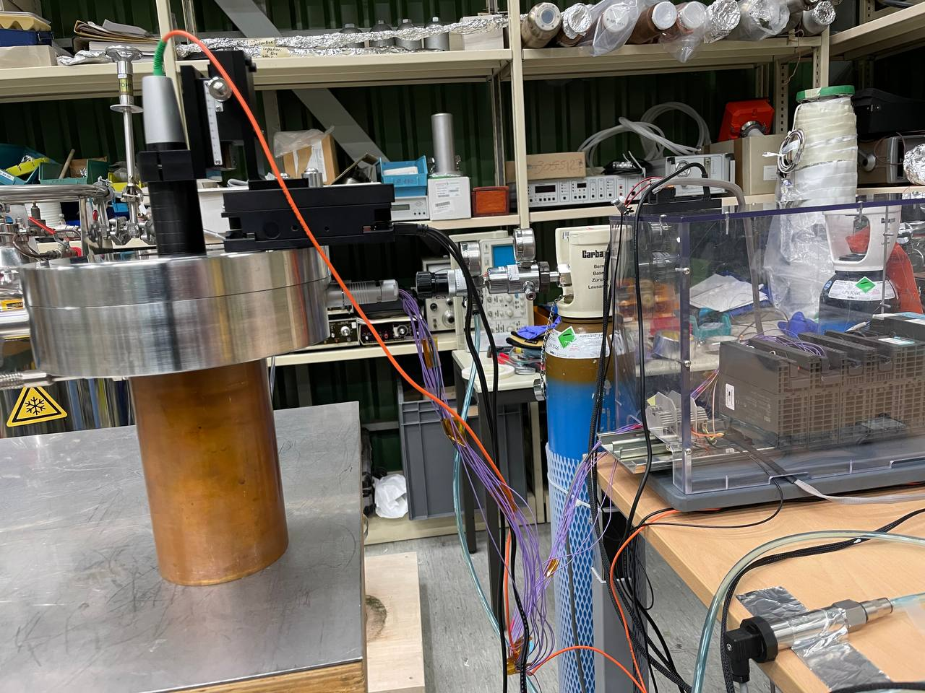
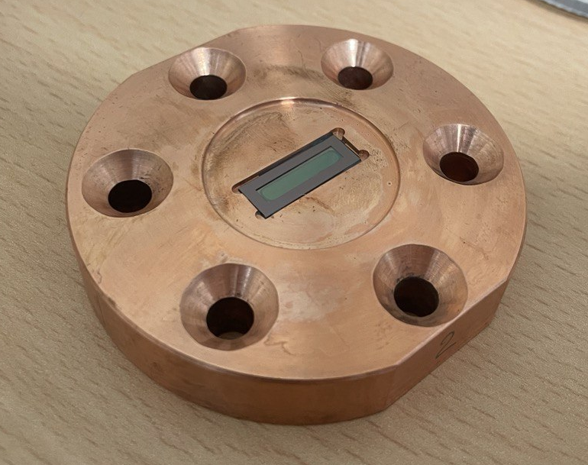
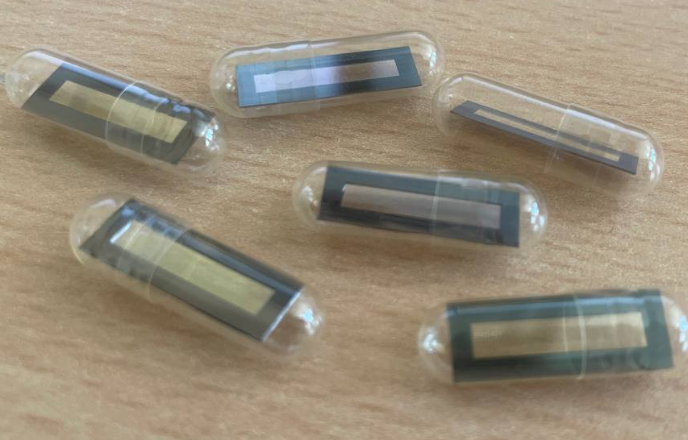
Si₃N₄ membranes: bulge tests @RT
Freestanding silicon nitride (Si₃N₄) membranes
Frame dimension: 19 mm x 7 mm
Frame thickness: 200 µm
Membrane dimension: 15 mm x 3 mm
Membrane thickness: 1000 nm
Membrane shape: rectangular
Testing temperature: Room Temperature (≈22°C)
Number of sample tested: 5
Pressure load rate: 100 mbar/min
Adhesives: LOCTITE EA9492, 3M DP190, MG 832HT
Data post-processing: analytical procedure+FEM
DAQ system
Helium bottle
Room temperature measurements setup

Slide 21
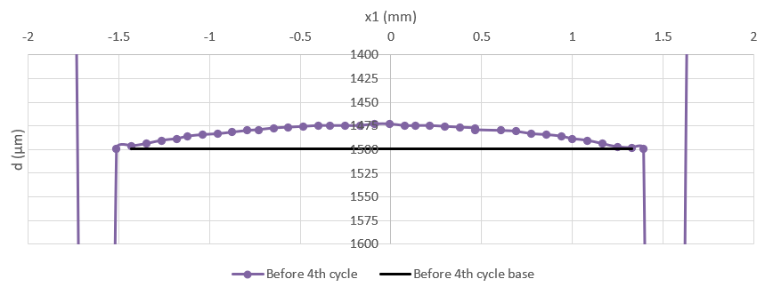
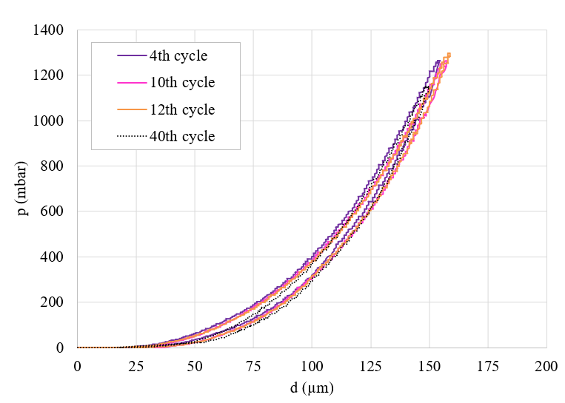
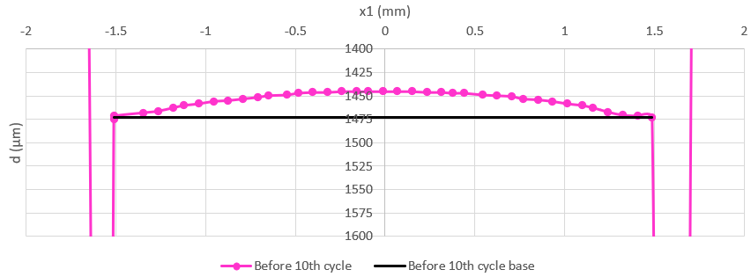
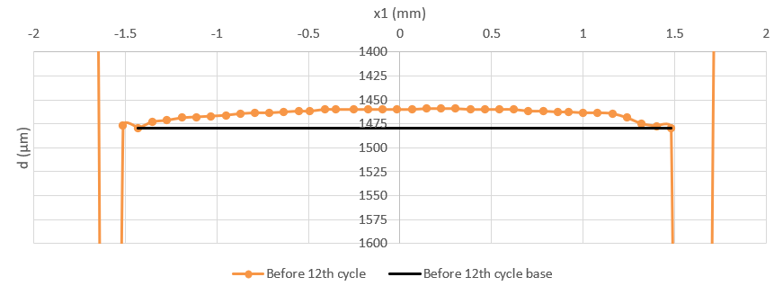
Si₃N₄ membranes: bulge tests @RT
Initial condition
The initial deformation of the membrane must be evaluated (and compensated) before each cycle
A repeatable behavior of the membrane is measured after many cycles (N_{max}=40)
The mechanical hysteresis measured by bulge tests is attributed to the glue, as demonstrated by FEM.
x1
x
Adhesive=3M DP190

Slide 22
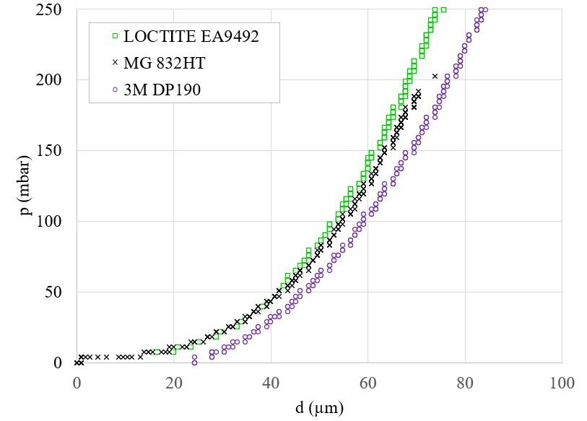
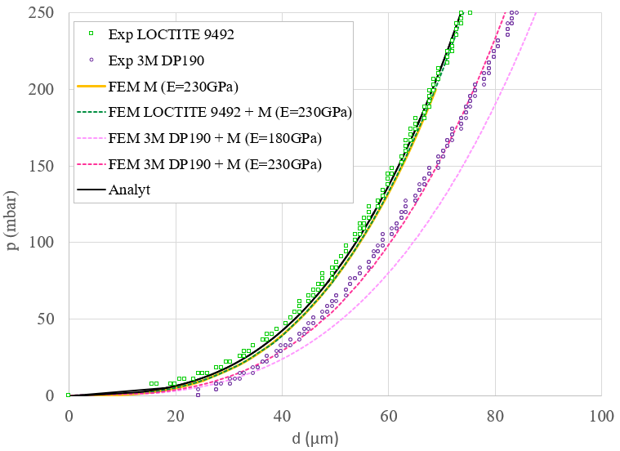
Si₃N₄ membranes: bulge tests @RT
FEM vs ESPERIMENTS
Adhesive type: bi-component epoxy resin → LOCTITE EA9492, MG 832HT, 3M DP190
Adhesive effect: compensated by FEM → the adhesive+sample system response during bulge test is simulated to demonstrate and evaluate the influence of the adhesive on the measurement
→ no influence of LOCTITE EA9492.
LOCTITE+M E=230GPa
3M DP190, M E=230GPa
3M DP190, M E=180GPa
E_{LOCTITE EA9492}=6.7 GPa, t_{3M DP190} =0.2mm
E_{3M DP190u} =0.5 GPa, t_{3M DP190} =0.2mm
Young’s modulus | LOCTITE 9492 | 230 | GPa
Young’s modulus | 3M DP190 | 180 | GPa

Slide 23
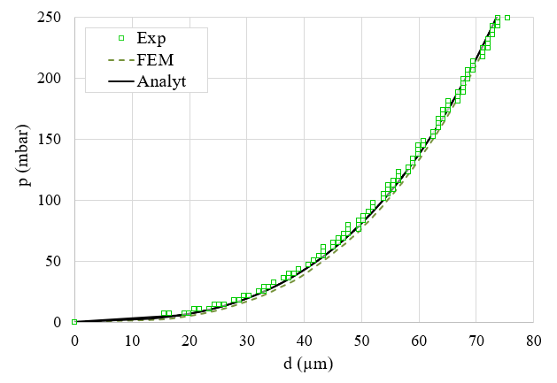
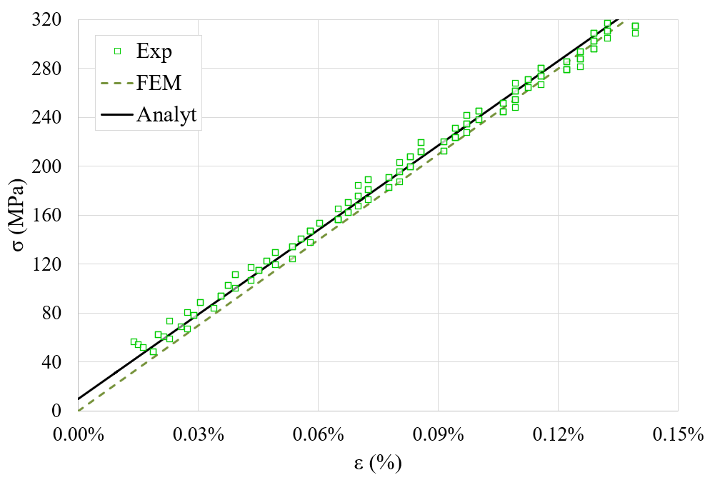
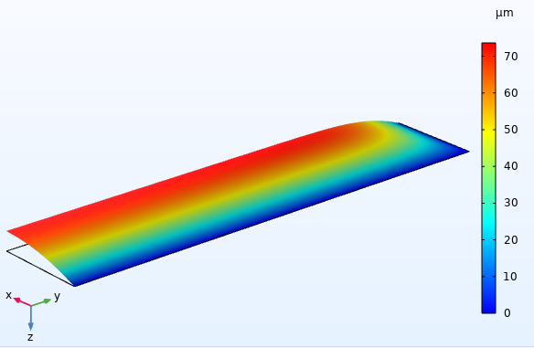

Si₃N₄ membranes: bulge tests @RT
Material properties
Membrane properties: calculated from the pressure-deflection curve obtained using the LOCTITE EA9492 adhesive.
displacement @ p=250mbar
Adhesive=LOCTITE 9492
$σ_{xx}$ @ p=250mbar
Young’s modulus | E | 230±10 | GPa
Initial Residual Stress | σ₀ | 10±5 | MPa
Poisson’s coefficient | ν | 0.1 | /
Ultimate pressure | p_{u} | 3±1* | bar
Ultimate tensile stress | σ_{xx,u} | 2 ±0.4** | GPa
*Remember this is for rectangular membranes!
**Indirect measure from p_{u}, under the hp of complete elastic material behaviour!

Slide 24
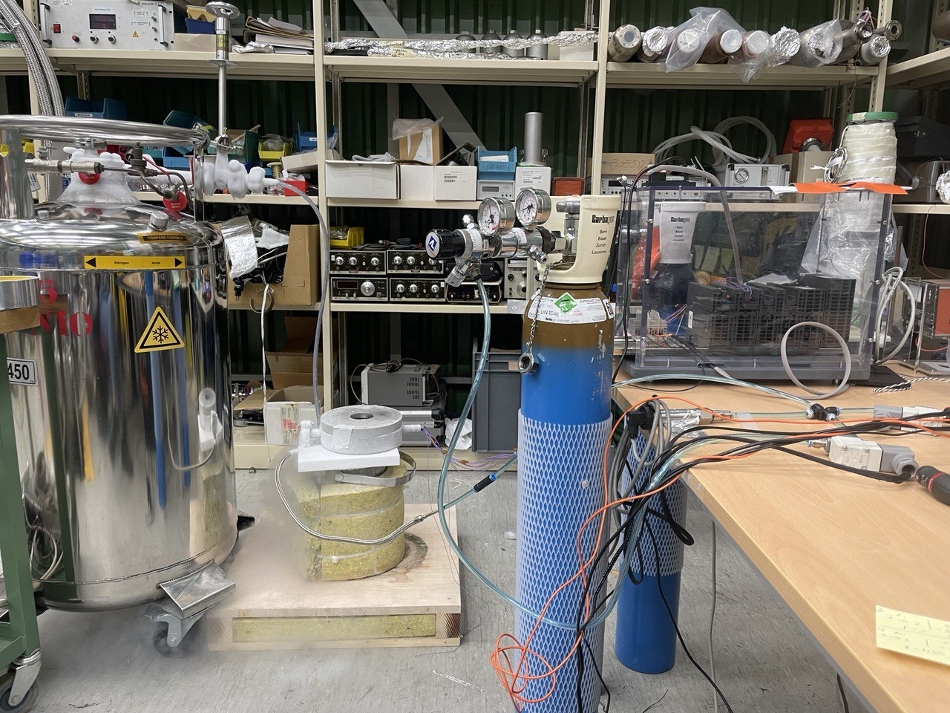
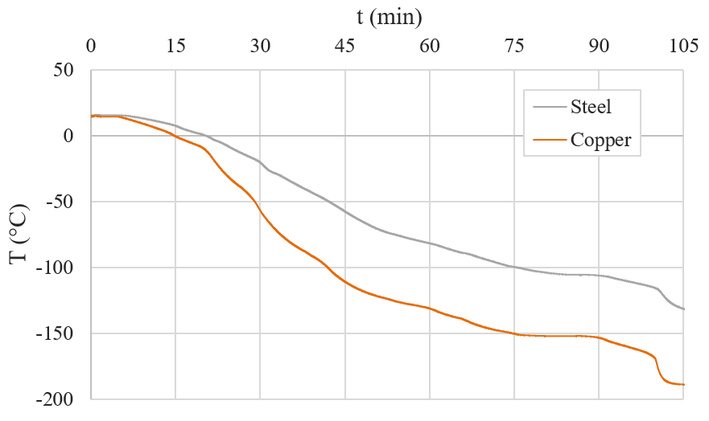
Si₃N₄ membranes: bulge tests @CT
Freestanding silicon nitride (Si₃N₄) membranes
Frame dimension: 19 mm x 7 mm
Frame thickness: 200 µm
Membrane dimension: 15 mm x 3 mm
Membrane thickness: 1000 nm
Membrane shape: rectangular
Testing temperature: Cold Temperature (≈-196°C)
Number of sample tested: 4
Pressure load rate: 100 mbar/min
Adhesives: LOCTITE EA9492, 3M DP190
Data post-processing: analytical procedure+FEM
DAQ system
Helium bottle
N₂ Dewar
Cold temperature measurements setup

Slide 25
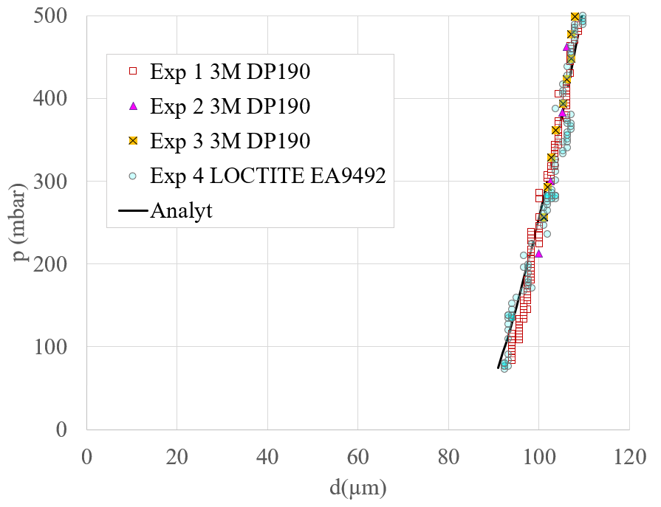
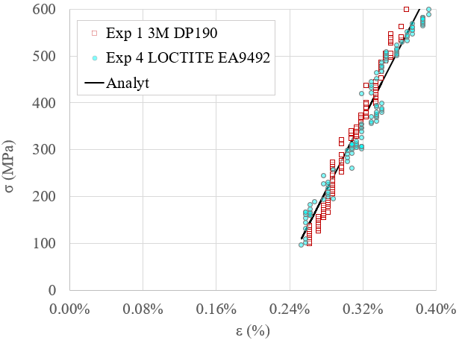
Si₃N₄ membranes: bulge tests @CT
Young’s modulus | E | 380±15 | GPa
Initial Residual Stress | σ₀ | -850±30 | MPa
Poisson’s coefficient | ν | 0.1 | /
Ultimate pressure | p_{u} | 5±1 | bar
Ultimate tensile stress | σ_{xx,u} | 3 ±0.4 | GPa

Slide 26
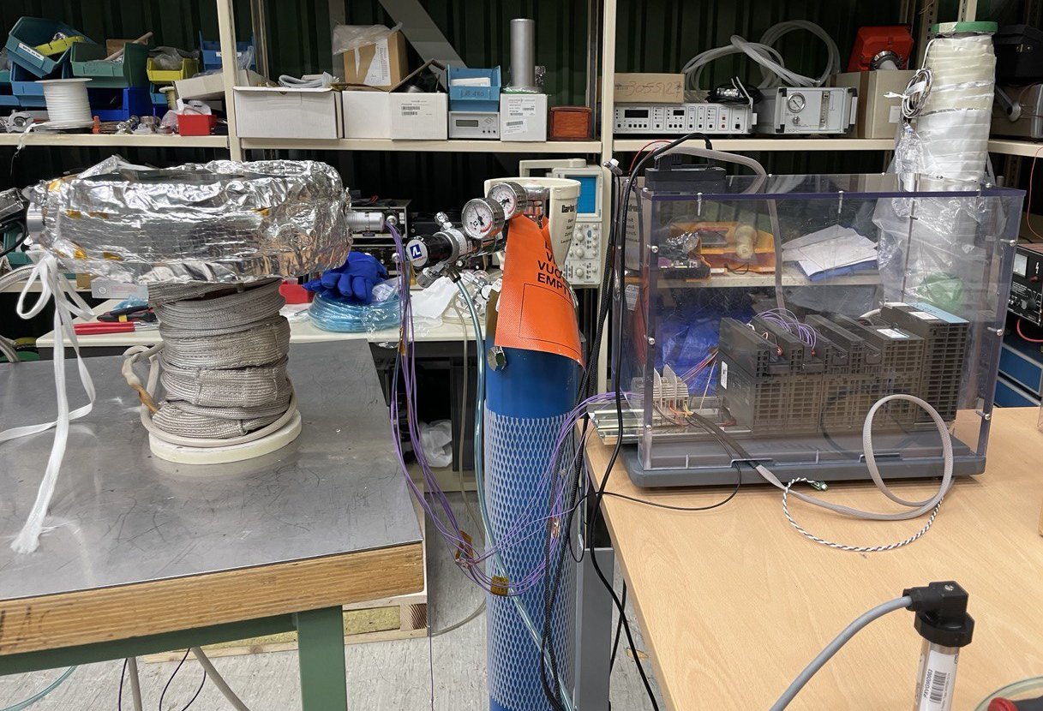
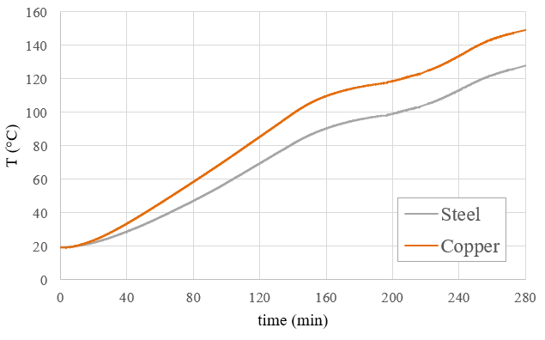
Si₃N₄ membranes: bulge tests @HT
Freestanding silicon nitride (Si₃N₄) membranes
Frame dimension: 19 mm x 7 mm
Frame thickness: 200 µm
Membrane dimension: 15 mm x 3 mm
Membrane thickness: 1000 nm
Membrane shape: rectangular
Testing temperature: Hot Temperature (=150°C)
Number of sample tested: 3
Pressure load rate: 100 mbar/min
Adhesives: MG 832HT
Data post-processing: analytical procedure+FEM
DAQ system
Helium bottle
High temperature measurements setup

Slide 27
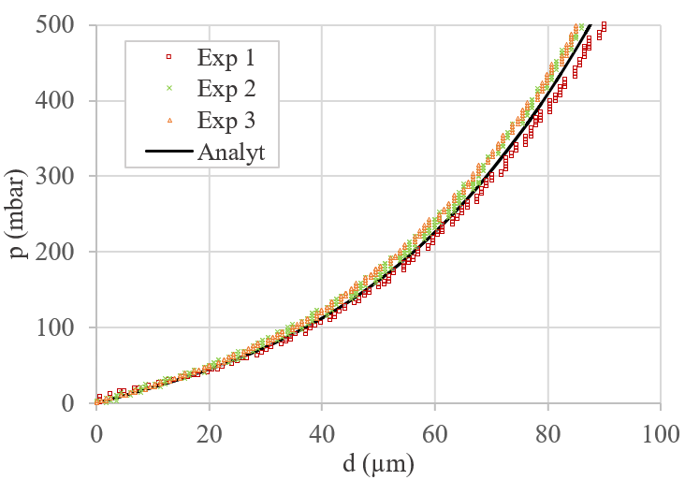


Si₃N₄ membranes: results @HT
Material properties
FEM simulation: the flange+adhesive+sample system response during heating + bulge test is simulated to:
  1. Estimate the residual stress in the membrane after heating: simulation results match the experimental measurements.
y
x
σ_{xx} @T=150°C
Young’s modulus | E | 230±10 | GPa
Initial Residual Stress | σ₀ | 230±20 | MPa
Poisson’s coefficient | ν | 0.1 | /
Ultimate pressure | p_{u} | 2±0.5 | bar
Ultimate tensile stress | σ_{xx,u} | 1.5 ±0.2 | GPa

Slide 28



Si₃N₄ membranes: results @HT
Material properties
FEM simulation: the flange+adhesive+sample system response during heating + bulge test is simulated to:
  2. Estimate the Young’s modulus of the membrane determined by bulge test: simulation reveals that the experimentally measured lower membrane stiffness (E=180GPa) is an artifact due to the compliance of the rest of the system.
y
x
displacement @p=250mbar
Young’s modulus | E | 230±10 | GPa
Initial Residual Stress | σ₀ | 230±20 | MPa
Poisson’s coefficient | ν | 0.1 | /
Ultimate pressure | p_{u} | 2±0.5 | bar
Ultimate tensile stress | σ_{xx,u} | 1.5 ±0.2 | GPa

Slide 29

Si₃N₄ membranes
Material properties at three different temperatures
PARAMETER |  | THIN MEMBRANE |  |  | BULK | UNIT
 |  | -196 °C | 22 °C | 150 °C | 22 °C
Young’s modulus | E | 380±15 | 230±10 | 230±10 | 120÷241 | GPa
Initial Residual Stress | σ₀ | -850±30 | 10±5 | 230±20 | / | MPa
Poisson’s coefficient | ν | 0.1 | 0.1 | 0.1 | 0.23÷0.28 | /
Ultimate pressure | p_{u} | 5±1 | 3±1 | 2±0.5 | / | bar
Ultimate tensile stress | σ_{xx,u} | 3±0.4 | 2 ±0.4 | 1.5 ±0.2 | 0.06÷0.525 | GPa

Slide 30
Summary
Introduction
Bulge test setup
Si₃N₄ membranes characterization
Potential other applications of the bulge test setup
Potential other applications of the Si₃N₄ membranes
Conclusions

Slide 31




Potential other applications of the bulge test setup
Design of a new holder flange
Socket head screw Ø6mm
DISK1
DISK 2
FLANGE
CIRCULAR MEMBRANE
Different material and size of membranes can be tested: Glassy Carbon, Mylar ®, …
A circular shape of membrane can be easily obtained.
The use of three pieces (flange + disks) allows to test different membrane apertures by only changing the disks (cheap and easy manufacture).

Slide 32

Potential other applications of the bulge test setup
FTA beam line window
Contact person: Alexandre Sinturel (TE-VSC)
Initial deformation
Material=Ti-6Al-4V
t=50µm
OD=70mm
Aperture=44mm
Membrane aperture
PROBLEM
Pressure test on the membrane (1 bar applied): experimental measurements (taken with a contact displacement sensor) and FEA solutions didn’t match.
SOLUTION
The confocal chromatic sensor was used to trace the profile of the membrane before measurements along the diameter: the measurements reveal a plastic deformation of the membrane (wavy profile).
The confocal chromatic sensor was used to measure the maximum deflection of the membrane at 1 bar applied pressure: the measurement corresponds to the FEA solution.

Slide 33






Potential other applications of the bulge test setup
Gasket profile
Contact persons: Gregory Cattenoz and Marios Kyprianidis (TE-VSC)
r (mm)
A
A
Δd_{max}≈310 µm
NOMINAL CASE
y
r
D
B
Δd_{max}≈334 µm
x
B
d (µm)
C
Δd_{max}≈296 µm
C
Flange
DN600mm
PROBLEM
Leakage in a vacuum system.
SOLUTION
The confocal chromatic sensor was used to trace the profile of a copper gasket and assess that the knife depth is within the tolerance range
D
Δd_{max}≈300 µm
Notes:
.

Slide 34
Summary
Introduction
Bulge test setup
Si₃N₄ membranes characterization
Potential other applications of the bulge test setup
Potential other applications of the Si₃N₄ membranes
Conclusions

Slide 35
Potential other applications of Si₃N₄ membranes
Transfer of Si₃N₄ membranes from a silicon frame to a metal support (copper): under investigation in collaboration with the TE-VSC-SCC section.
Low-energy beam windows
AWAKE plasma cells
Electro-beam welding

Slide 36
Summary
Introduction
Bulge test setup
Si₃N₄ membranes characterization
Potential other applications of the bulge test setup
Potential other applications of the Si₃N₄ membranes
Conclusions and future steps

Slide 37





Conclusions
Design, development and validation of a bulge test setup to test thin membranes at 77 K, 293 K and up to around 500 K.
Definition of the bulge test procedure for thin membranes at different temperatures.
Characterization of Si3N4 membranes from 77 K to 425 K, in terms of elastic properties and resistance to burst.
Design and development of a new flange to investigate mechanical properties of larger membranes.

Slide 38
Future steps
Characterization of Si₃N₄ membranes in terms of fracture toughness, creep and fatigue properties.
Assessment of the possibility to transfer the Si₃N₄ membranes from the silicon frame to a metal support.
Characterization of different types/size of membrane.
Definition of a protocol of the bulge test procedure for thin membranes at different temperatures.
Journal paper on the characterization of Si₃N₄ membranes at different temperatures.

Slide 39
Thanks to:
Berthold Jenninger (TE-VSC) for the very useful suggestions during the design phase of the bulge test setup.
Rodrigo Ferreira (TE-VSC) for the development and installation of DAQ for data acquisition and storage.
Alexandre Gerardin (EN-MME) for the invar-copper brazing.
Ignacio Santillana (EN-MME) for the various microscopic inspections of the Si₃N₄ windows.
Vincent Schenk and Sebastien Clement (TE-MSC) for investigating adhesion performance and different adhesives for bulge testing.

Slide 40
Thank you for your attention!

Slide 41
References
[1] Muon Collider European Strategy, 2020 [2] Schulte, D. (2022). The muon collider. JACoW IPAC, 2022, 821-826.
[3] Groom, D. E., Mokhov, N. V., & Striganov, S. I. (2001). Muon stopping power and range tables 10 MeV–100 TeV. Atomic Data and Nuclear Data Tables, 78(2), 183-356.
[4] P.T. Törmä, J. Kostamo, H. Sipilä, M. Mattila, P. Kostamo, E. Kostamo, H. Lipsanen, C. Laubis, F. Scholze, N. Nelms, B. Shortt, and M. Bavdaz, IEEE Transactions on Nuclear Science 61, 695 (2014).
[5] R.L. Edwards, G. Coles, and W.N. Sharpe, Experimental Mechanics 44, 49 (2004).
[6] Merle, B. (2013). Mechanical properties of thin films studied by bulge testing. Friedrich-Alexander-Universitaet Erlangen-Nuernberg (Germany).
[7] J. J. Vlassak and W. D. Nix. New bulge test technique for the determination of young’s modulus and poisson’s ratio of thin films. J Mater Res, 7(12):3242–3249, 1992.
[8] J. J. Vlassak. New Experimental Techniques and Analysis Methods for the Study of the Mechanical Properties of Materials in Small Volumes. PhD thesis, Stanford, 1994

Slide 42
Backup slides

Slide 43


Confocal chromatic sensor
A polychromatic light source illuminates the surface of the object.
The light is focused at different distances depending on the wavelength and only the light of a very narrow wavelength range is focused on the surface to be measured, with the remaining light concentrically distributed around this focus point onto a larger area.
By determining the wavelength of the focused light, which is reflected back into the optical system, very precise distance measurements are possible (nm resolution).

Slide 44




FEM simulations @HT
Load and boundary conditions
Symmetry (along x)
Frictionless support
p
Symmetry (along y)
HEATING
BULGE TEST

Slide 45





FEM simulations
Material properties
COPPER
SILICON NITRIDE
SILICON
E=169 GPa
(constant with temperature)

Slide 46



FEM simulations
Material properties
GLUE: MG 832HT
GLUE: 3M DP190
E=4 GPa
(constant with temperature)

