Slide 1
Review of the cryogenic by-pass for the LHC DS collimators
Electrical circuit modification, including operational considerations
Presented by A. siemko
With inputs and contributions from:
r. principe, r. denz and s. russenschuck

Slide 2
General electrical considerations
From the electrical point of view:
  The cryogenic by-pass represents an additional segment of the busbars added to the magnet circuits
  The cryogenic by-pass creates an electrical singularity in magnet circuits
  Electrical integrity of the main magnet circuits and the spool magnet circuits on both sides of point 3 is affected
  Electrical modifications can impact on operations

Slide 3
risk analysis during the Design phase
  Analysis of the 13 kA busbar circuit vs.:
    Electrical continuity resistive (Cu and SnAg)
    Electrical continuity (s.c. cable and wire splices)
    Insulation
    Robust and simple solutions, stable in time
    Criticity and sensibility
    Mechanical issues (Lorentz forces)
  See also: The Risk Analysis of the LHC 13 kA circuits, available at EDMS 1139345
  Continuous exchange of information between the TE-MSC and EN-MME on electrical issues since the very beginning of the cryogenic by-pass project

Slide 4
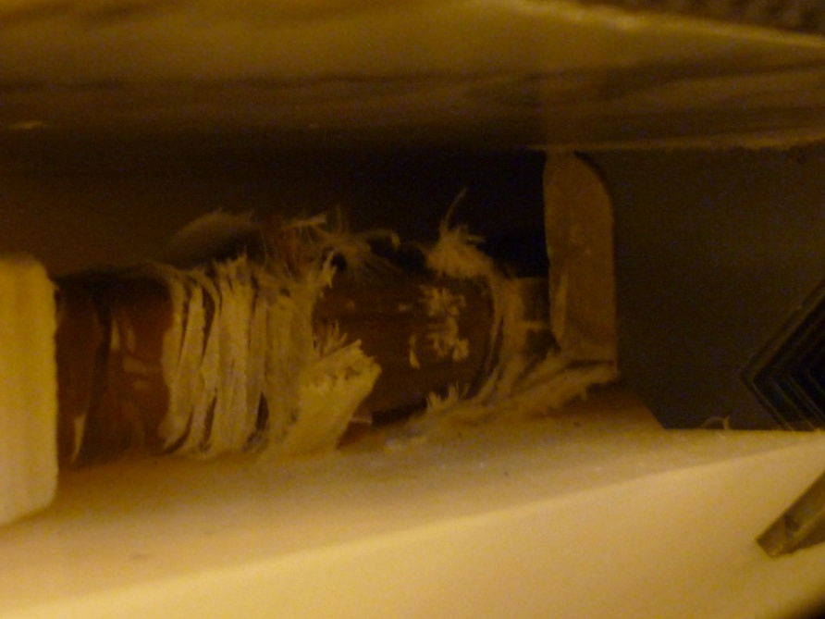
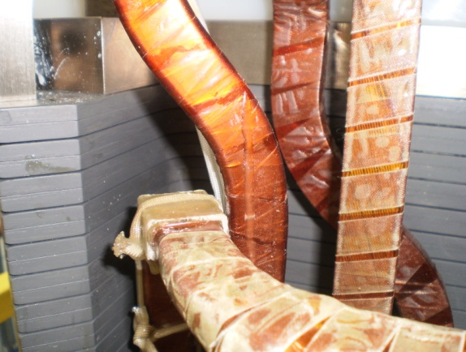
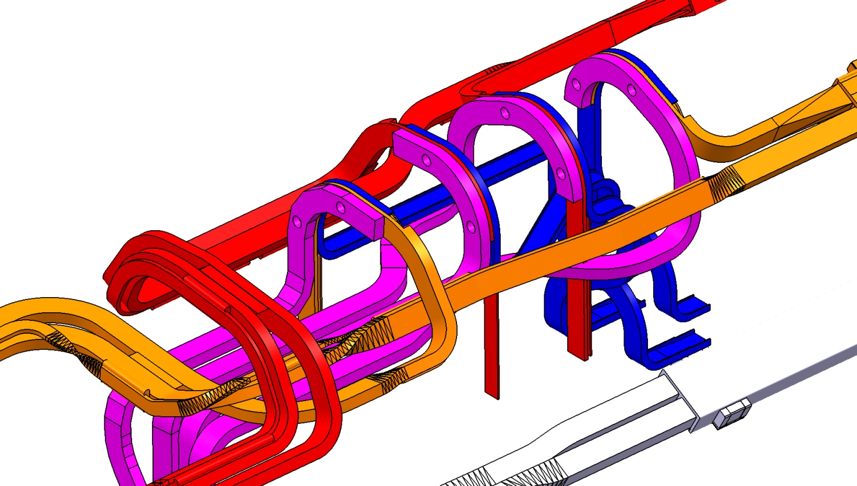
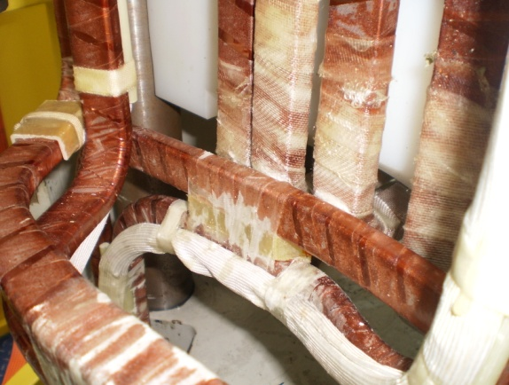
Lessons learnt were taken into account
Few examples (many others available)
Dipole line MQ double lyra
Kapton damaged
Bus bar routing in the SSS

Slide 5
risk analysis
Design phase: the check list
  Check the DESIGN CONSISTENCY
    construction process compromising the quality of the circuit (continuity resistive or supra, quality of insulation in the long term)
    i.e. quality of the electric joint in the classical interconnection
    i.e. quality of the contact in the splice of the SSS quadrupoles (examples and pics available by tomorrow)
  Avoid COMPLEX ROUTING
    busbar partially filled in SnAg, continuity of the resistive circuit
    i.e. see coil connections in the SSS quadrupole magnets, some parts manually filled badly compromising the soldering process (pics available by tomorrow).
  Polyimide exposed to friction (insulation concerns)
  Busbars locally positioned with INADEQUATE COMPONENTS
    Shape and material (sharp angles, G11, examples)
    Assembly (examples)
  Standard components to be improved (spider, supports in the pipe M1+3 and M2).
  Adequate dimensioning and positioning of the components to compensate the Lorentz forces (mainly M1+3).
  Electromagnetic field interactions: busbars in the vicinity of the vacuum pipe (calculation required to estimate the influence on the beam).
  Busbar movements (single bar) vs. the cryobypass structure
    assembly phase (compression, extension, possible conflicts)
    thermal and magnetic cycles
  Relative movements between busbars

Slide 6
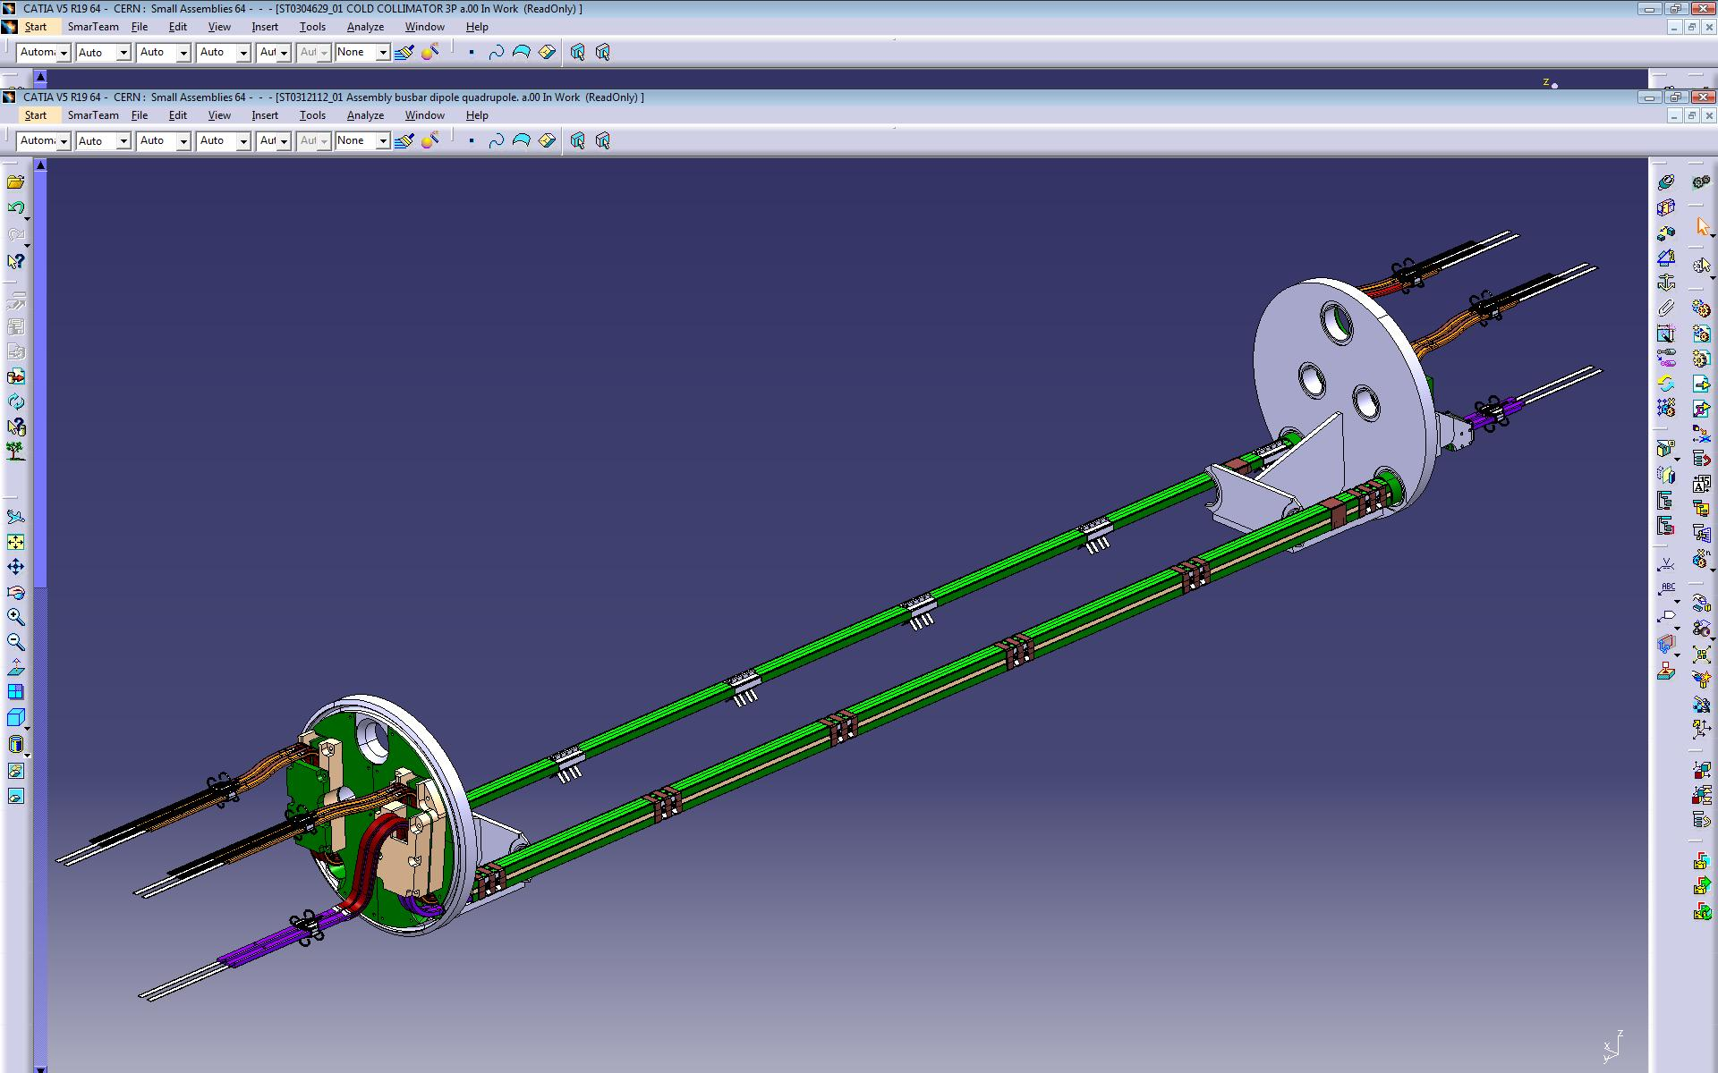
New design of the fixtures to manage the Lorenz forces reduce the relative movement and to position the bars
Reuse of validated designs like central part of the busbars

Slide 7
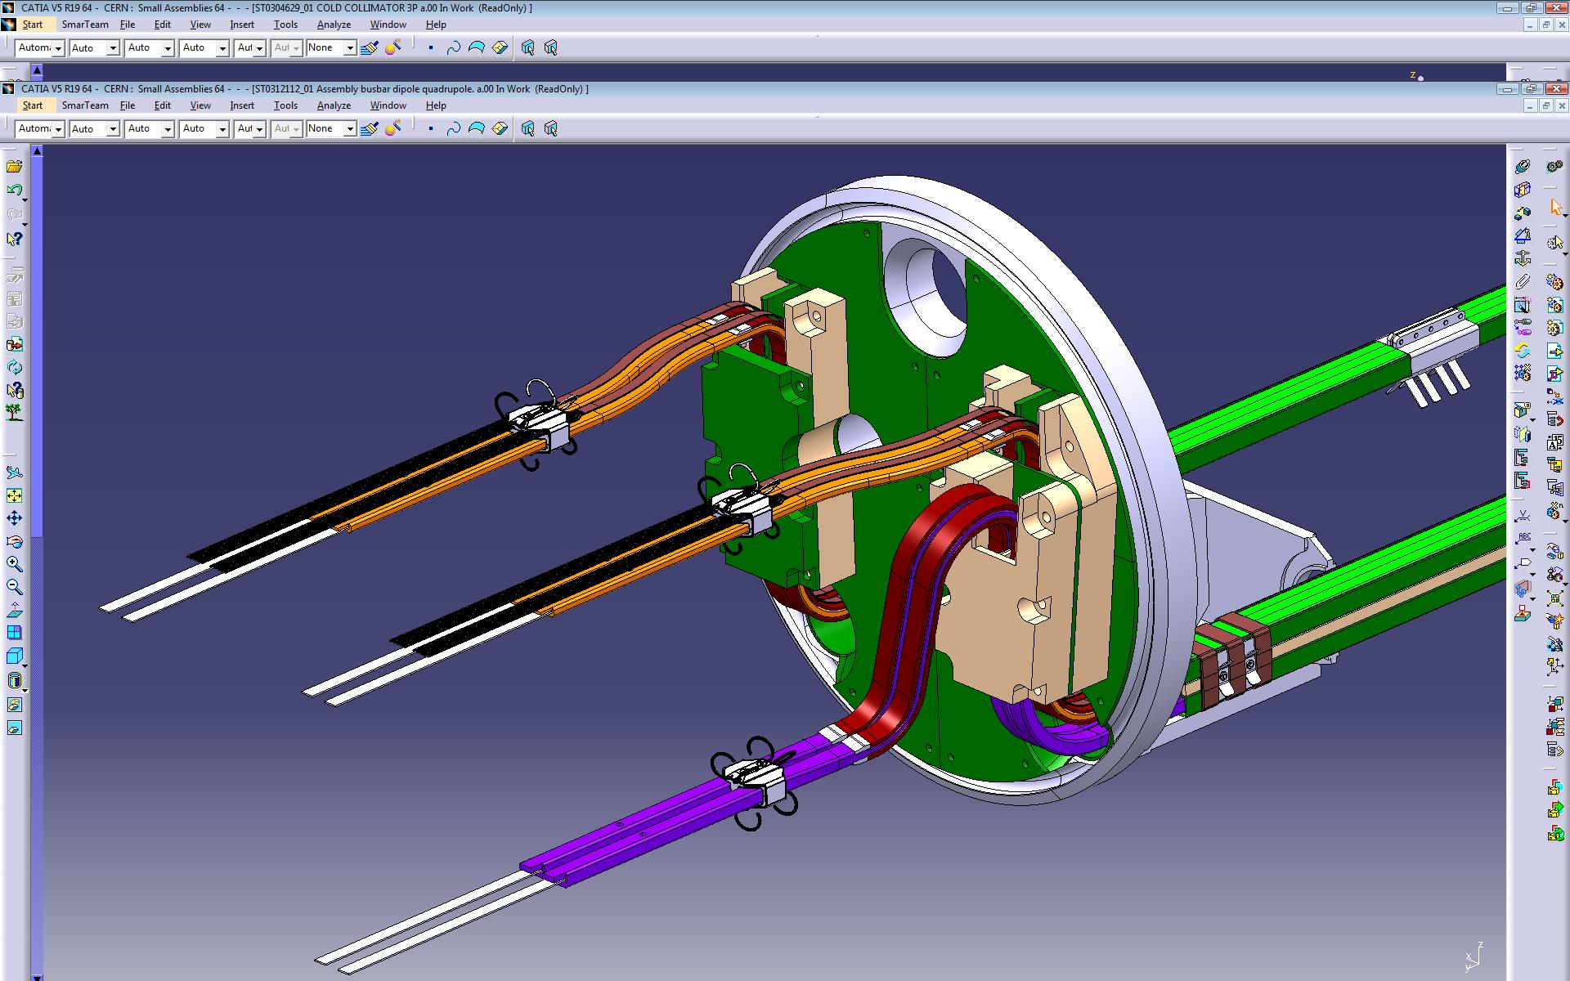
Insulating layer (PEHD, rayton)
behind the Quad lyras
Spider design
to be modified
Insulating protection
(with smooth profiles)
at M1+3 and M2
Insulating layer (PEHD ?) inserted
between Dip and Quad lyras

Slide 8
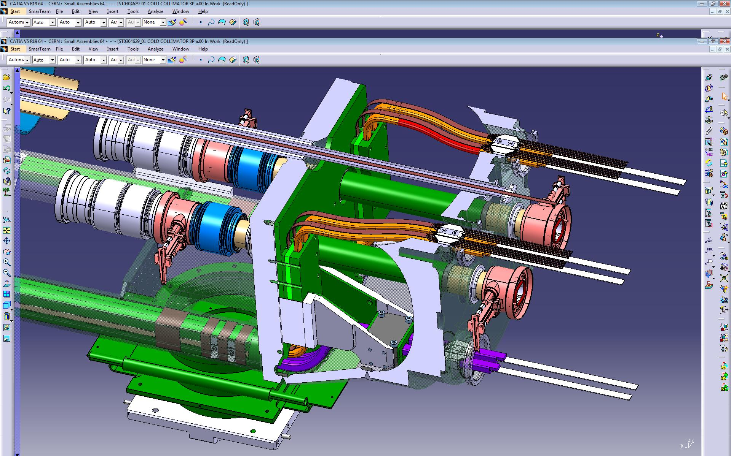
Magnetic shielding
around the beam pipe

Slide 9
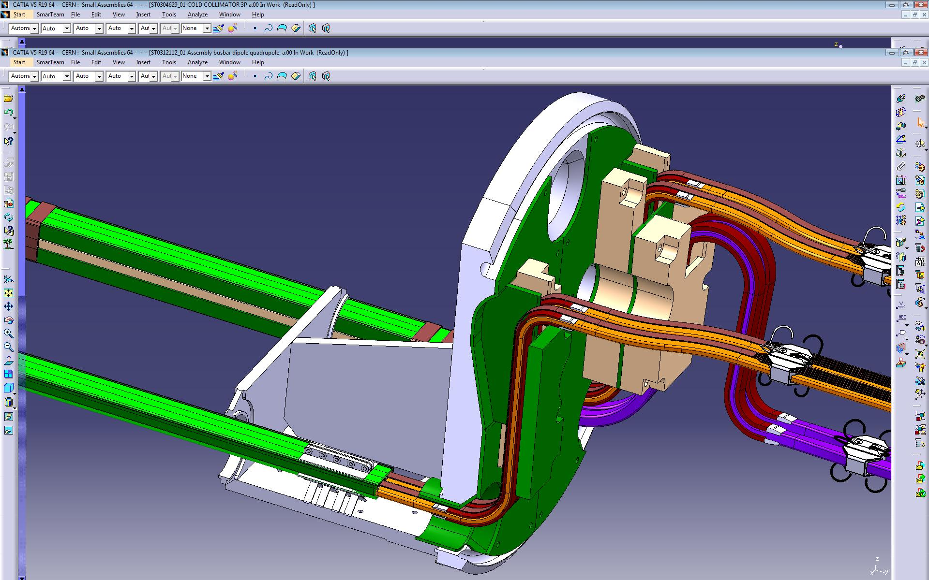
Electrical insulation box separating M1 and M3 busbars
Analysis of the busbar maximum movement (assembly phase and thermal)

Slide 10
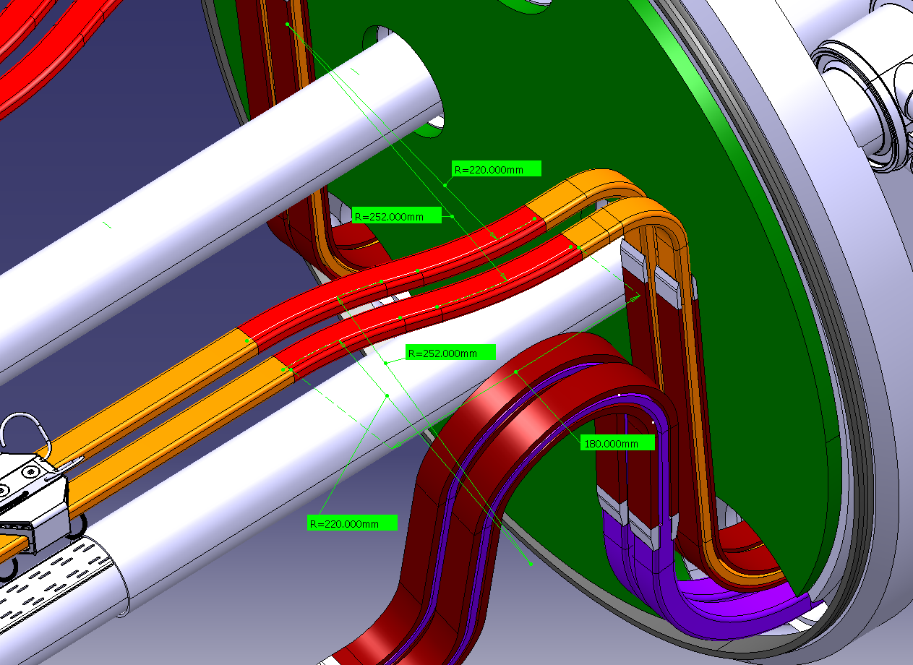
Evaluation of the minimum distances between the metallic parts (bb or steel structures) in order to avoid the possible contacts and frictions.
Insertion of stable insulating layers where necessary in order to avoid fatigue (due to friction) on the kapton/isopreg insulation

Slide 11
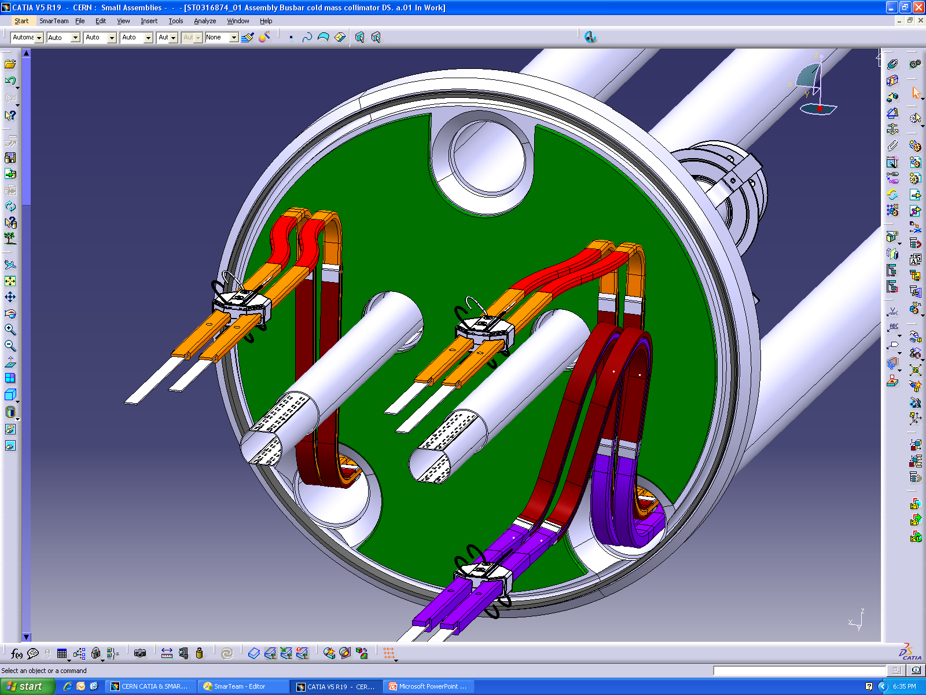
Insulating layer (PEHD, rayton)
behind the Quad lyras
Spider design
to be modified
Magnetic shielding
around the beam pipe
Insulating protection
(smooth profiles)
at M1+3 and M2
Insulating layer (PEHD ?) inserted
between Dip and Quad lyras

Slide 12
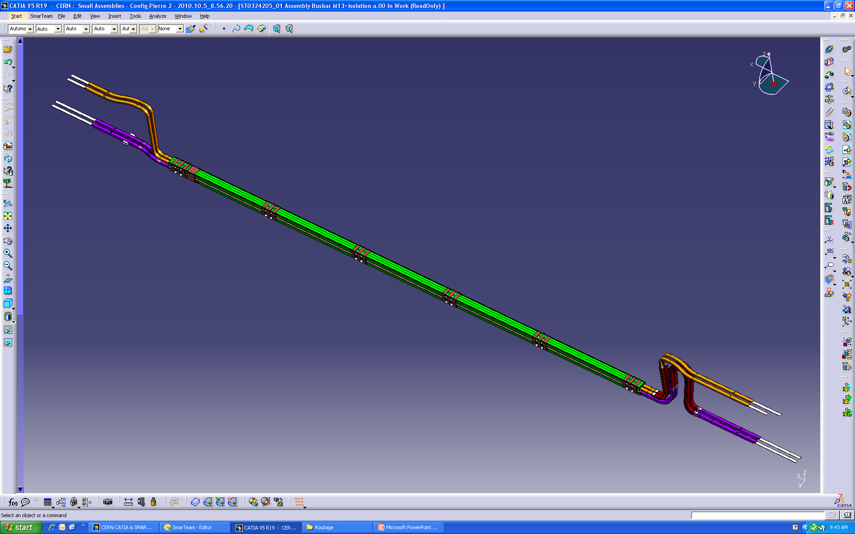
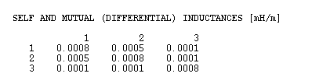
Protection issue: Electro-magnetic coupling between bus-bars
New, additional coupling among M1-M3-auxiliary busbars

Slide 13
Protection issue: Electro-magnetic coupling between bus-bars
Cross-talk between superconducting circuits due to inductive and capacitive coupling
  Only an issue during fast current discharges with some 100 As-1
  Estimates indicate that over the concerned bus-bar length ca 180 V apparent voltage may be induced
    nQPS nominal threshold for splice protection will be U_{TH} = 300 V with 10 seconds reaction time permitted
Two cases to be considered:
  M1 versus M3
  and spools versus M1/M3

Slide 14
Protection issue: Electro-magnetic coupling between bus-bars
Case1: M1 and M3
  Potential trigger of nQPS (splice protection only) systems during fast discharges
    Concerned systems do no activate quench heaters
    Global circuit protection will initiate fast circuit discharge if any of the main circuits is triggering -> no issue for LHC exploitation
Case 2: M1/M3 and spools
  Between M1/M3 and spools
    A trip of a spool piece circuit must not cause a fast discharge of one of the main circuits
    Spool piece bus-bars are currently routed close to M1 and M2
    So far no major problems observed but no guarantee for the new case (needs to be verified experimentally)
Eventual coupling effects could be mitigated /ruled out by additional instrumentation

Slide 15
Protection issue: Revised protection scheme
In principle the protection of the new bus-bar segments and splices could be assured by the existing protection units but …
  Neighboring QPS locations have to be modified introducing a singularity in the QPS protection scheme
    By this the protection of the original segment will be weakened
  No possibility other than raising thresholds to overcome problems related to cross-talk or other EMC related perturbations (e.g. collimator operation …)
    Change of thresholds not recommended for LHC running with nominal powering parameters
  No separate protection or diagnostics for the newly installed components
    New type of cryostat etc. -> enhanced diagnostic capabilities desired

Slide 16
Protection issue: Revised protection scheme
Implement dedicated protection module allowing decoupling and supervision of the busbars and interconnections routed through the new cryostats
Add two redundant twisted pairs per interconnection in lines M1, M2 and M3
  12 x 2 twisted pairs per QTC → design is critical for the overall electrical integrity and protection efficiency
    One or two IFS boxes required depending on integration
Additional taps can be used as well for the quality assurance and electrical tests @ warm
No additional taps required for spool piece bus-bars protection
  Nevertheless very useful for diagnostics -> implementation to be considered

Slide 17
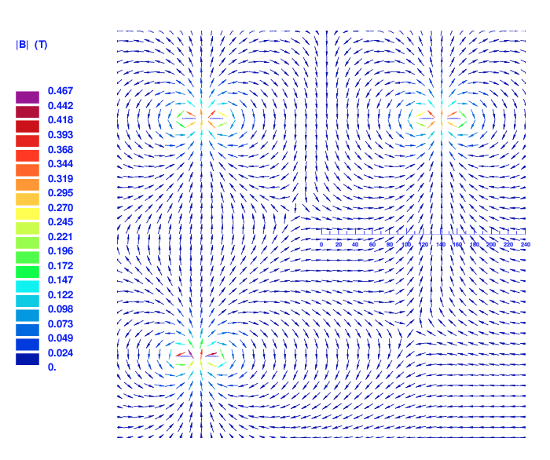
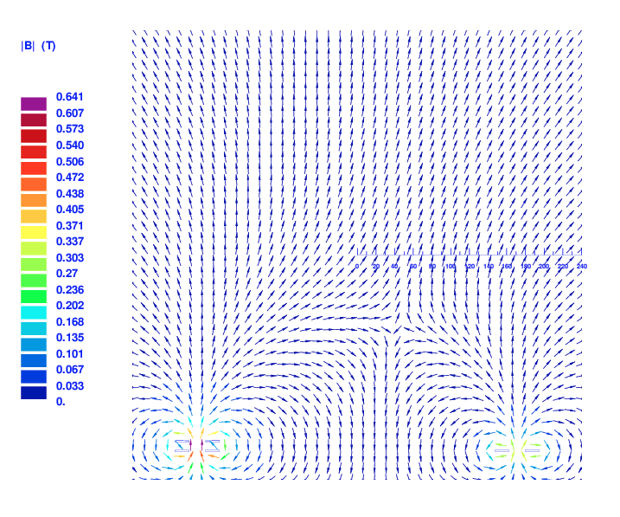
Field errors: possible impact on operaions
Detailed calculations were performed by S. Russenschuck

Slide 18
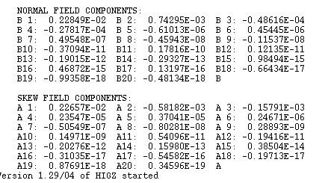
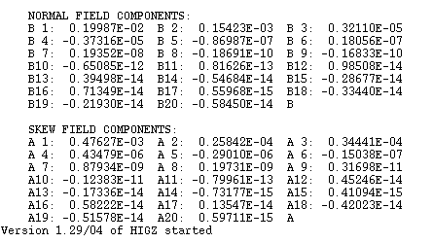
Field errors: possible impact on operaions
Field components in standard interconnection region and in the new cryogenic by-pass
No issue for the field quality, if we consider the length of this cryostat with respect to the length of all standard interconnection.

Slide 19
Other operational considerations
Risks for operation start-up
  The new cryogenic by-pass introduces significant modification to the main and spool LHC magnet circuits around point 3
  Additional QPS hardware to be installed, integrated and tested
  New cabling
Risks for operation
  More hardware in the tunnel impacts always on reliability & maintenance
  Increased coupling between busbars in conjunction with existing and new noise sources can cause additional, spurious trips impacting on the machine integrated luminosity

Slide 20
conclusions
The new cryogenic by-pass introduces an electrical singularity to several magnet circuits in point 3
  Protection issue can be mitigated by implementing dedicated protection module allowing decoupling and supervision of the busbars and interconnections routed through the new cryogenic by-pass
Lessons learnt during the LHC project were taken into account in the electrical design principles of the new cryogenic by-pass
  reuse of validated designs like central part of the busbars
  Improved design of all known weak points like: lyres, interfaces and transitions, fixtures, etc.
Electrical modifications of circuits introduced by the new cryogenic by-pass seem to be of no major operation concern

