Slide 2
Overview on High Field Magnet program at CIEMAT
J. García-Matos, C. Martins, F. Toral, CIEMAT
J. C. Pérez, CERN

Slide 3
Table of contents
Background
High field magnet program at CIEMAT
Ongoing activities

Slide 4
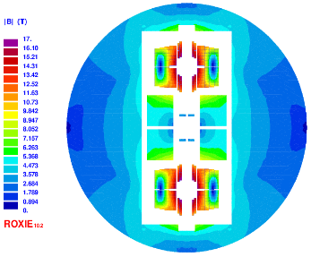
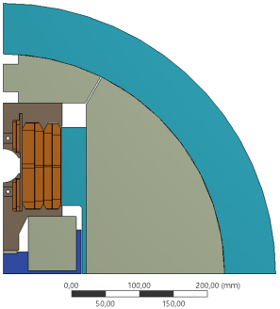
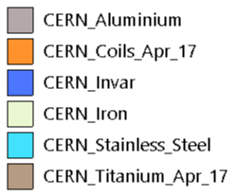
Background
EuroCirCol layout for 16 T common coil magnet
4

Slide 5
High field magnet program at CIEMAT
Initial constraints for the research on high field magnets at CIEMAT:
  Some delay to start the activity due to the workload driven by MCBXF magnets.
  The new laboratory will not be fully operational till Spring 2024.
  Previous work was focused on common coil layout.
Our proposal is based on the following steps:
  Model magnet using RMC coils in common coil configuration.
  Revisit the existing design of 16T common coil dipole magnet.
  Research on fabrication techniques: react-and-wind coils.
  Prototype of a high field magnet in common coil configuration.

Slide 6
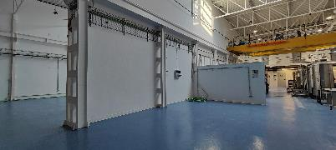
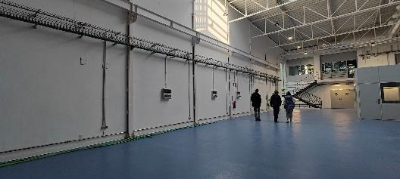
Magnet laboratory at CIEMAT (I)
The building has been finished.
A new crane is necessary for the hall devoted to magnet assembly.

Slide 7
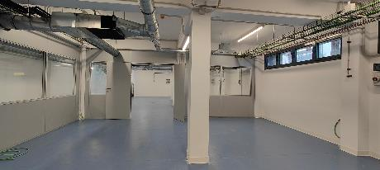
Magnet laboratory at CIEMAT (II)
Procurement of large equipment is starting: reaction furnace, press.
Procurement of the rest of the equipment is more advanced: machines for mechanical workshop, benches, shelves, tooling.

Slide 8
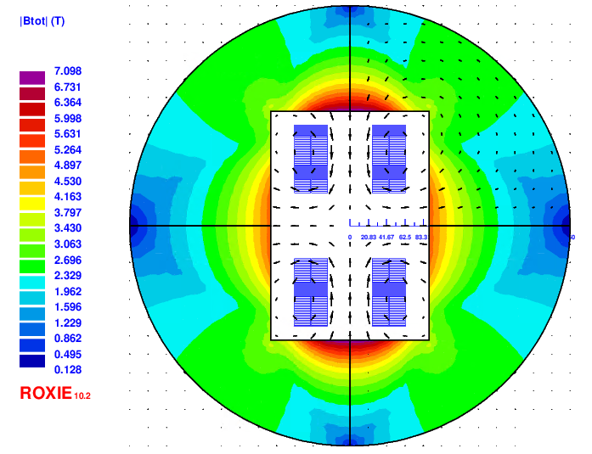
Design of a common coil magnet using existing RMC coils (I)
First design yields about 10 T in a 50 mm aperture.

Slide 9
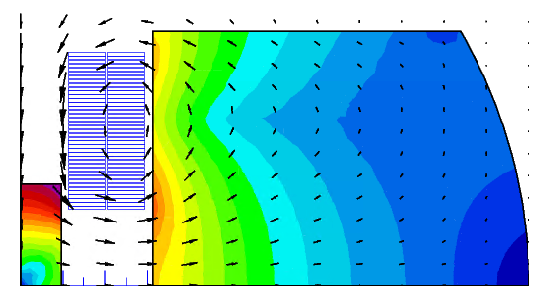
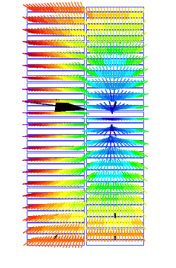
Design of a common coil magnet using existing RMC coils (II)
Sensitivity analysis is ongoing:
  position of coils vs field aperture
  iron geometry vs Lorentz forces
First calculations on magnet protection.

Slide 10
Design of a common coil magnet using existing RMC coils (III)
Study of previous experiences: visit to BNL and LBNL.
First mechanical calculations:
  Conceptual analysis: preload, type of support structure

Slide 11
Design of a CIEMAT FCC-hh short dipole model magnet
Two strands are available for the model magnet fabrication: MQXF and ERMC-1.
Electromagnetic calculations of a common coil magnet providing 14 T in the aperture are ongoing (restrained optimization because of available strands).
The first objective is to evaluate the Lorentz forces.

Slide 12
Conclusions
The new laboratory building is finished. Procurement of equipment is ongoing.
Design of a common coil model magnet using existing RMC coils is progressing.
Electromagnetic calculations of a 14 T common coil magnet have just started.

