Slide 2
Update on Common Coil activities at CIEMAT
J. García-Matos, C. Martins, F. Toral, CIEMAT
J. C. Pérez, CERN

Slide 3
Table of contents
High field magnet program at CIEMAT
Common Coil ongoing activities:
    Magnetic design
    Mechanical design

Slide 4
High field magnet program at CIEMAT
Initial constraints for the research on high field magnets at CIEMAT:
  Some delay in starting the activity due to the workload driven by MCBXF magnets.
  The new laboratory will not be fully operational till Spring 2024.
Our proposal is based on the following steps:
  Model magnet using RMC coils in common coil configuration (ISAAC Investigating Superconducting Assembly to Address Common coil mechanics).
  Research on fabrication techniques: react-and-wind coils.
  Prototype of a high field magnet in common coil configuration.

Slide 5
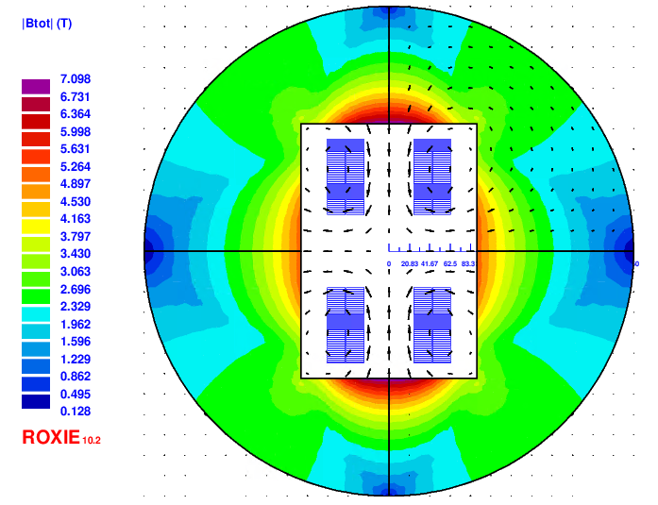
Magnetic design: Goals & constrains
Main goal: learn for the 14T model, mostly mechanics
  Provide 14T in the aperture (100% load required)
  Decrease F_{y}: Low vertical preload goal (free horizontal movement, without friction)
  Mechanics & assembly as easy as possible
Initial base case

Slide 6
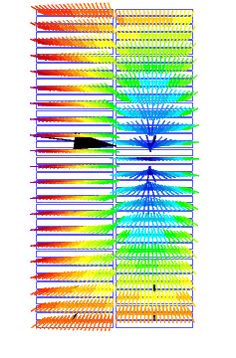
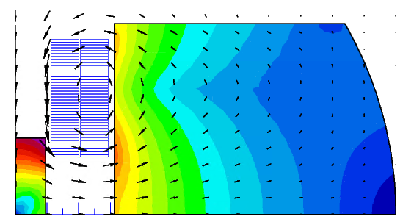
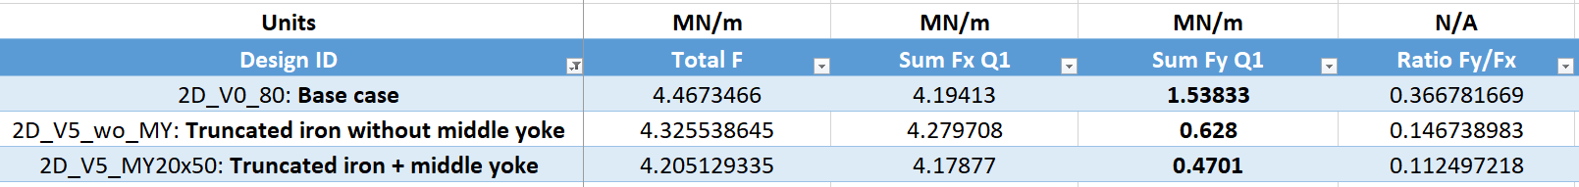
Magnetic design: Decreasing F_{y}
Vertical EM forces inside the coil need to be as balanced as possible
Yoke is used to pull the field lines in the desired direction
Yoke is truncated above the coil to provide good horizontal support
Middle yoke helps to decrease F_{y} significantly
Mechanics of this truncated option need to be analyzed
Truncated yoke

Slide 7
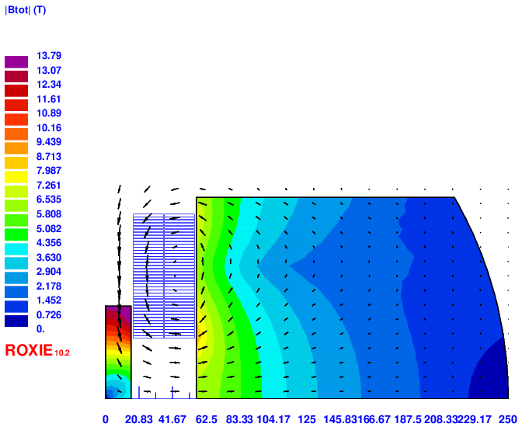
Magnetic design to provide 14T
Aperture decreased from 50 mm to 34 mm
Yoke very close to the coil (only 1.2 mm away)
Intra-beam distance tuned to decreased a2
Middle yoke has a strong influence despite its assembly could be not straightforward
Protection is possible using a dump resistor according to first simulations: R_{dump} = 45 mΩ yields a hotspot temperature of 286K and 900V voltage
Design ID | Block | Final RMC_CC | CC | CC* | Units
Aperture | 74 | 34 | 74 | 74 | mm
Intra-beam dist. | - | 150 | 152 | 252 | mm
I_nom | 14486 | 19083 | 21353 | 20460 | A
Yoke outer radius | 246 | 250 | 246 | 246 | mm
B | 14 | 14 | 11.3 | 11.96 | T
Peak field | 16.16 | 14.8 | 14.27 | 14.51 | T
Peak Field/B | 1.154 | 1.0571 | 1.263 | 1.213 | -
Load | 99.99 | 99.99 | 100.27 | 100.36 | %
Stored energy | 1752 | 1038 | 1701 | 1733 | kJ/m
Static Self Induct. | 16.7 | 5.7 | 7.46 | 8.28 | mH/m
L*I | 242 | 109 | 159 | 169 | HA/m
Stray field (20 mm) | 1.188 | 0.44 | 0.65 | 1.56 | T
Sum Fx Q1 | 5.1 | 6.636 | 5.79 | 6.53 | MN/m
Sum Fy Q1 | -4.3 | 0.474 | 3.02 | 0.73 | MN/m
Final RMC_CC

Slide 8
Magnetic design: field quality vs coil position
14T Magnet aperture: 34 mm
Horizontal displacement 0.5mm => decrease field 1% aprox and multipoles variation below 0.5 units
mm | T | units | units | units | units | units | units | units | units | %
Displ. X | Aperture field | b3 | b5 | b7 | b9 | a2 | a4 | a6 | a8 | % B
0 | 13.999139 | 297.12975 | 0.74637 | 2.18884 | -0.52826 | 3.02079 | -25.65207 | -1.53509 | 1.44829 | 0
0.5 | 13.863671 | 297.03506 | 1.08324 | 2.19718 | -0.53572 | 1.49924 | -25.94459 | -1.55069 | 1.46195 | -0.96768808
1 | 13.729701 | 296.82646 | 1.42133 | 2.20147 | -0.5382 | -0.00928 | -26.23901 | -1.56249 | 1.47012 | -1.92467551
1.5 | 13.597258 | 296.50431 | 1.75736 | 2.20814 | -0.54216 | -1.50665 | -26.53531 | -1.57543 | 1.4797 | -2.87075512

Slide 9
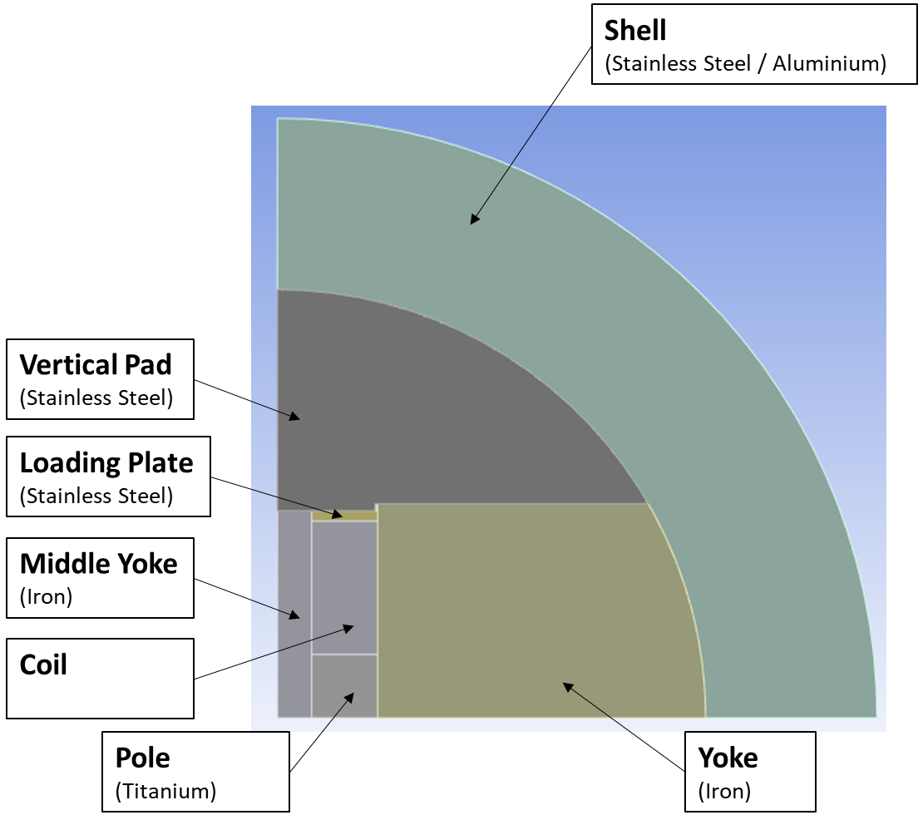
Mechanical design (I)
First mechanical simulations:
Parts in contact (without prestress) at room temperature
Stainless Steel vertical pad
Cooling (from 295.15K to 1.9K)
Electromagnetic Forces

Slide 10
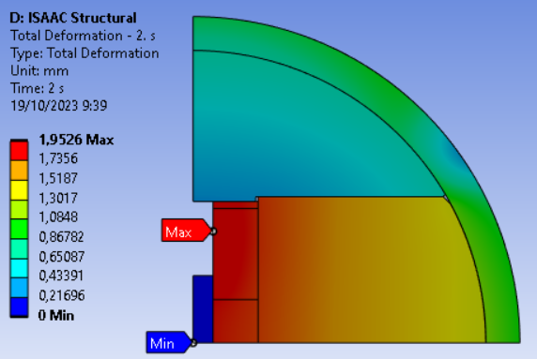
Mechanical design (I)
Aluminium Shell similar to SMC CERN block configuration
  Outer yoke radius: 250 mm
  Shell thickness: 29 mm
Goal: Coil displacement below 1mm (after cooling)
in order to:
Reduce the possibility of sudden coil movements
Aperture field over 13.7T

Slide 11
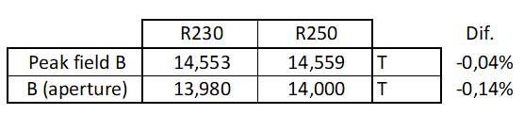
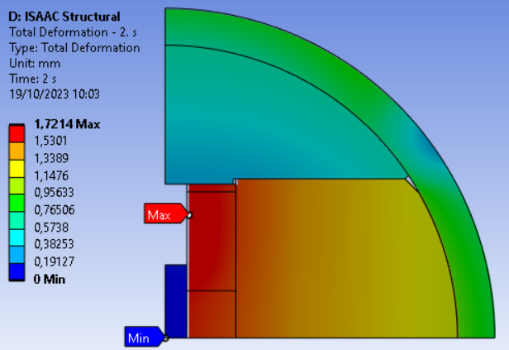
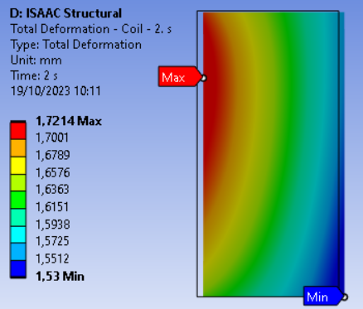
Mechanical design (III)
Final RMC_CC
Aluminium Shell inner radius from 250mm to 230mm:
  Very similar magnetic field (14T => 13.98T)
  Coil displacement reduced (1,95mm => 1,72mm)

Slide 12
Conclusions
The new laboratory building is finished. Procurement of equipment is ongoing.
Magnetic & Mechanical design of a 14T CC magnet using existing RMC-QXF coils (ISAAC):
  F_{y} decreased: analysis of free horizontal movement of the coils without friction
  Analysis of magnetic field sensitivity vs. coil position
  Mechanical structure design ongoing (shell materials, dimensions...). Minimize coil horizontal displacement (less than 1mm)

