Slide 2
Update on Common Coil activities at CIEMAT
J. García-Matos, C. Martins, F. Toral, CIEMAT
J. C. Pérez, CERN

Slide 3
Table of contents
Prototype magnet laboratory commissioning
ISAAC design
14 T magnetic design

Slide 4
Prototype magnet laboratory commissioning (I)
Some problems with the building: air conditioning, roof leaks, space for winding machine.
Procurement of small equipment in good progress.
Call for tenders for reaction furnace and collaring press is ongoing.
Production of coils for HL-LHC correctors is resumed in-house: important dedication of resources for two years.

Slide 5
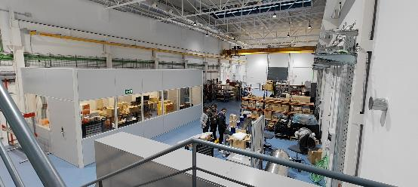
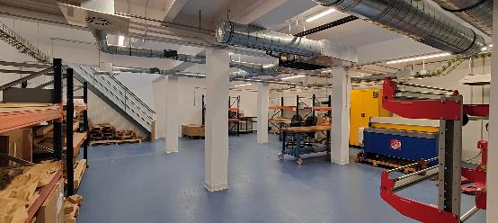
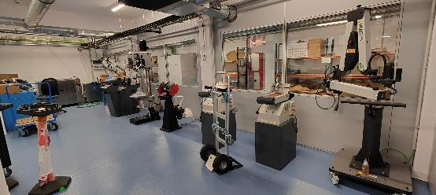
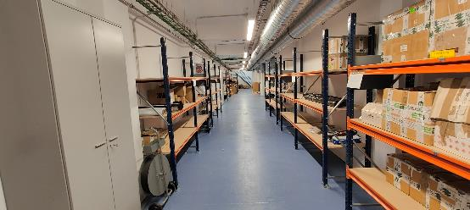
Prototype magnet laboratory commissioning (II)

Slide 6
Table of contents
Prototype magnet laboratory commissioning
ISAAC design
14 T magnetic design

Slide 7
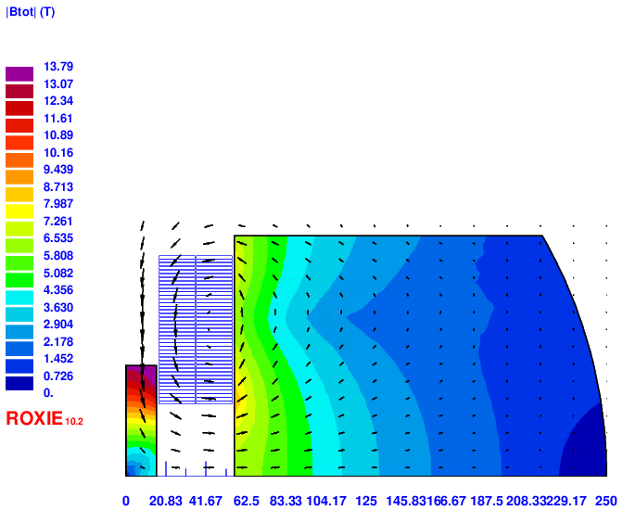
ISAAC magnetic design to provide 14T
ISAAC: Investigating Superconducting Assembly to Address Common coil mechanics
Aperture decreased from 50 to 34 mm
Yoke very close to the coil (only 1.2 mm distance)
Intra-beam distance tuned to decrease a2
Middle yoke has a strong influence despite its assembly could be not straightforward
Protection is possible using a dump resistor according to first simulations: R_{dump} = 45 mΩ yields a hotspot temperature of 286K and 900V voltage (adiabatic simulation)
Design ID | Block | Final RMC_CC | CC | CC* | Units
Aperture | 74 | 34 | 74 | 74 | mm
Intra-beam dist. | - | 150 | 152 | 252 | mm
I_nom | 14486 | 19083 | 21353 | 20460 | A
Yoke outer radius | 246 | 250 | 246 | 246 | mm
B | 14 | 14 | 11.3 | 11.96 | T
Peak field | 16.16 | 14.8 | 14.27 | 14.51 | T
Peak Field/B | 1.154 | 1.0571 | 1.263 | 1.213 | -
Load | 99.99 | 99.99 | 100.2 | 100.36 | %
Stored energy | 1752 | 1038 | 1701 | 1733 | kJ/m
Static Self Induct. | 16.7 | 5.7 | 7.46 | 8.28 | mH/m
L*I | 242 | 109 | 159 | 169 | HA/m
Stray field (20 mm) | 1.188 | 0.44 | 0.65 | 1.56 | T
Sum Fx Q1 | 5.1 | 6.636 | 5.79 | 6.53 | MN/m
Sum Fy Q1 | -4.3 | 0.474 | 3.02 | 0.73 | MN/m
Final RMC_CC

Slide 8
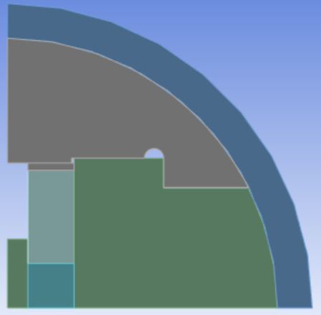
ISAAC mechanical design: stiff support structure
Let’s explore the use of yoke as support structure
Upper part is made in stainless steel: it may help to contain the large Lorentz horizontal force
Aluminium shell also contributes to hold the forces
The coil would lose contact with this part during cooling down: it could move horizontally without friction
Assembly with bladder and keys is not modeled yet
Slight preload just to keep contact between parts

Slide 9
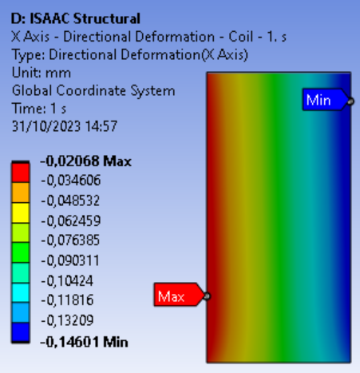
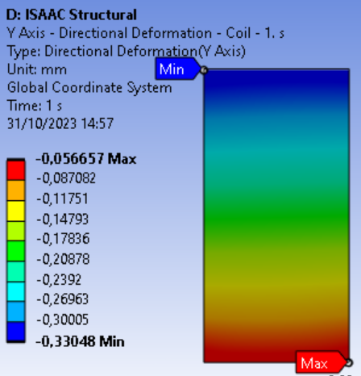
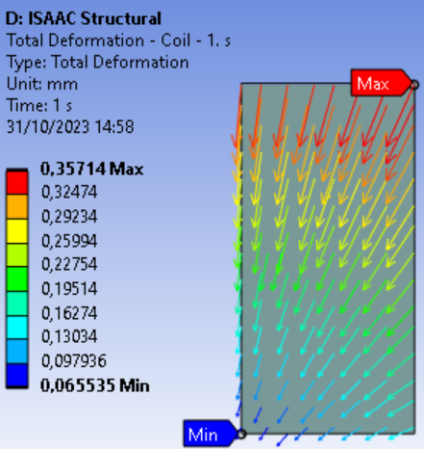
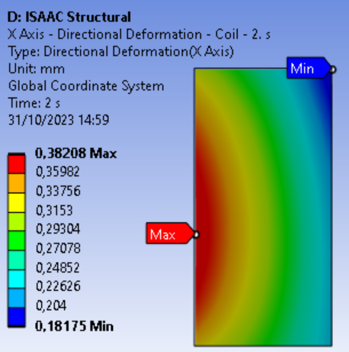
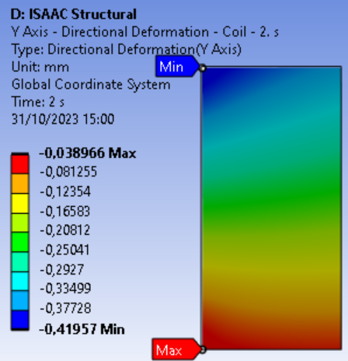
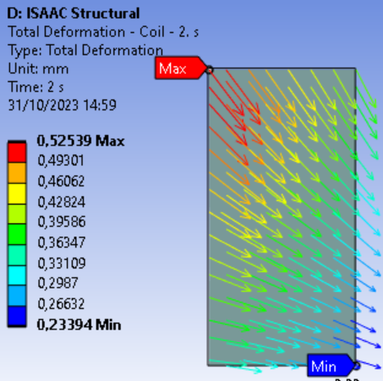
Mechanical design: coil displacement
Horizontal coil displacement below 0.5 mm
COOLING
X displacement
Y displacement
Total displacement
COOLING + EM

Slide 10
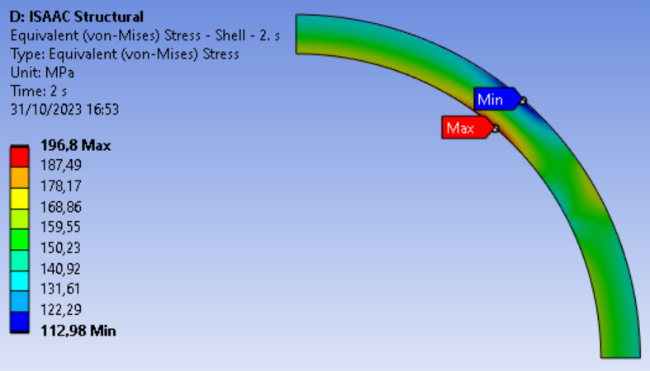
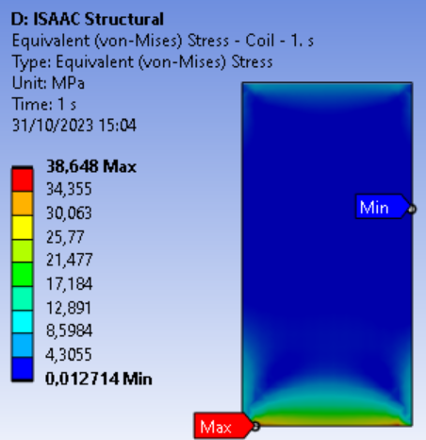
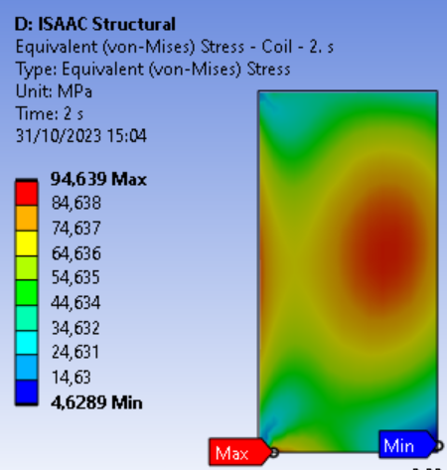
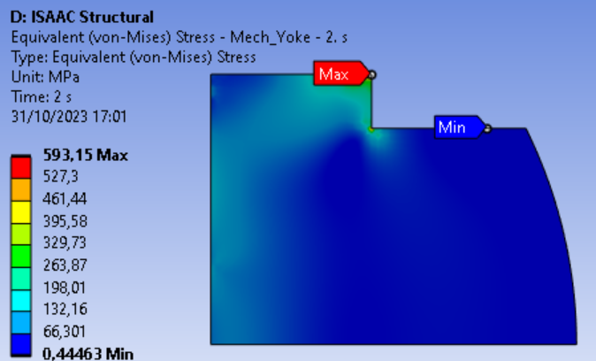
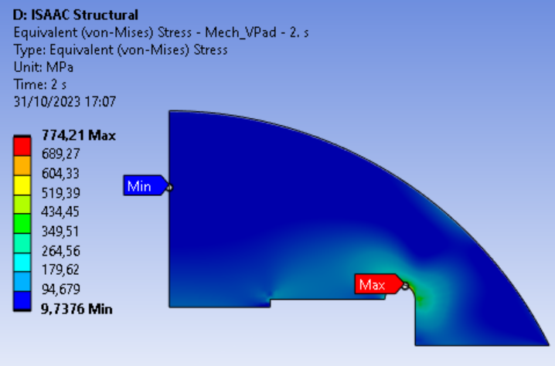
Mechanical design: stress distribution
Coil stress below 95 MPa!!
No significant problems for the structural parts.
Detailed design is ongoing.
COOLING
COOLING + EM

Slide 11
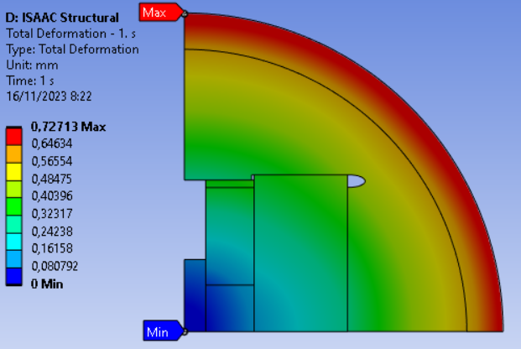
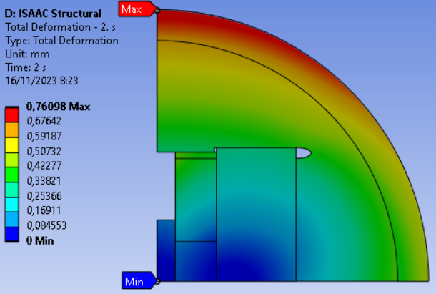
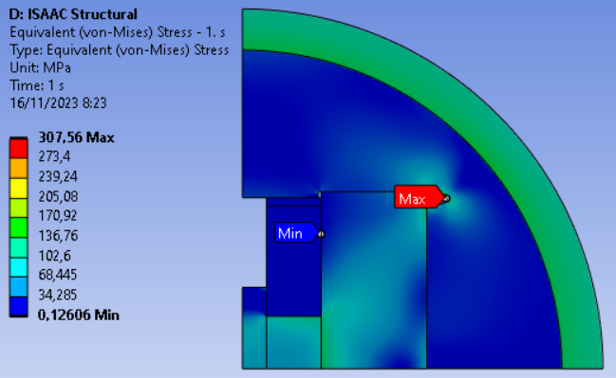
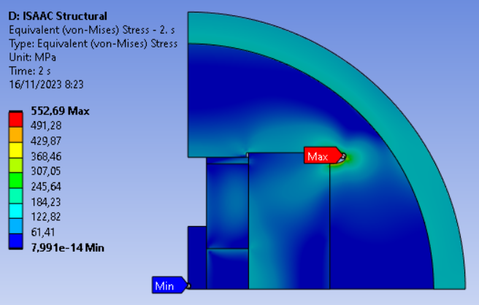
ISAAC mechanical design optimization
COOLING
COOLING + EM
We are exploring different design options to minimize stresses and coil displacements.
No final results yet.

Slide 12
Table of contents
Prototype magnet laboratory commissioning
ISAAC design
14 T magnetic design

Slide 13
14 T CC demonstrator: magnetic design
Based on existing strands at CERN.
Aiming at 14 T at 50 mm aperture, 2 m long.
First choice is 1.1 mm strand for high field coil and 1 mm strand for low field coil.
1.1 mm strand is requested by CEA, PSI and CIEMAT.
No final design yet.

Slide 14
Conclusions
Progress on magnet laboratory commissioning, but long way still to finish. Full operation for the end of 2024.
Detailed mechanical design of ISAAC model magnet is ongoing.
Magnetic design of 14 T common coil demonstrator is ongoing to define the needs for 1.1 mm strand.

