Slide 1


The recent progress of LPF3 testing
中国科学院高能物理研究所
Institute of High Energy Physics, CAS
中科院高能所超导磁体组
Superconducting Magnet Group, IHEP
Superconducting Magnet Group, Accelerator Division
Institute of High Energy Physics, Chinese Academy of Sciences (IHEP, CAS)
2023.12.14

Slide 2
Outline
A brief review of the design and fabrication of LPF3 magnet
Recent test progress of LPF3 magnet
Summary
2
Notes:
2

Slide 3
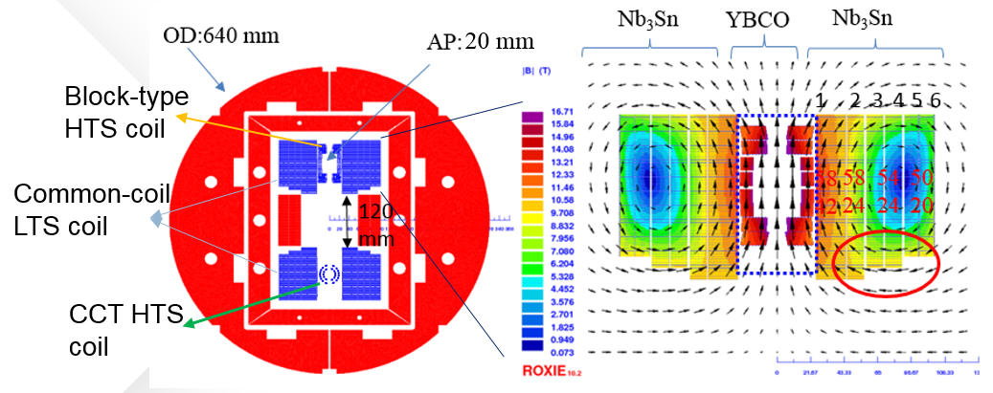
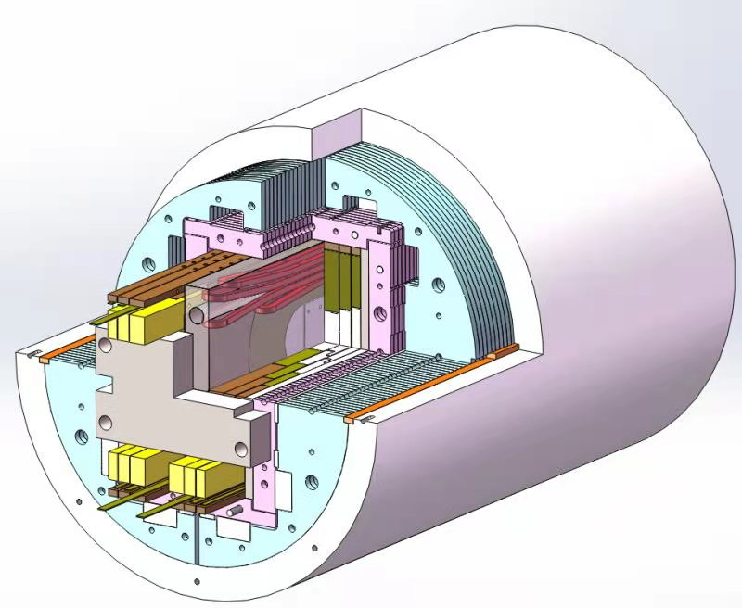
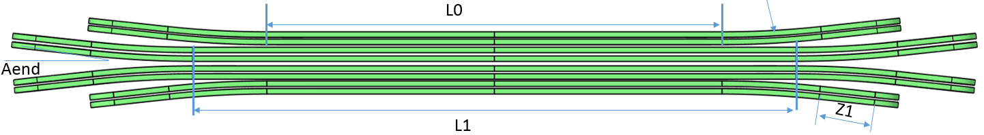
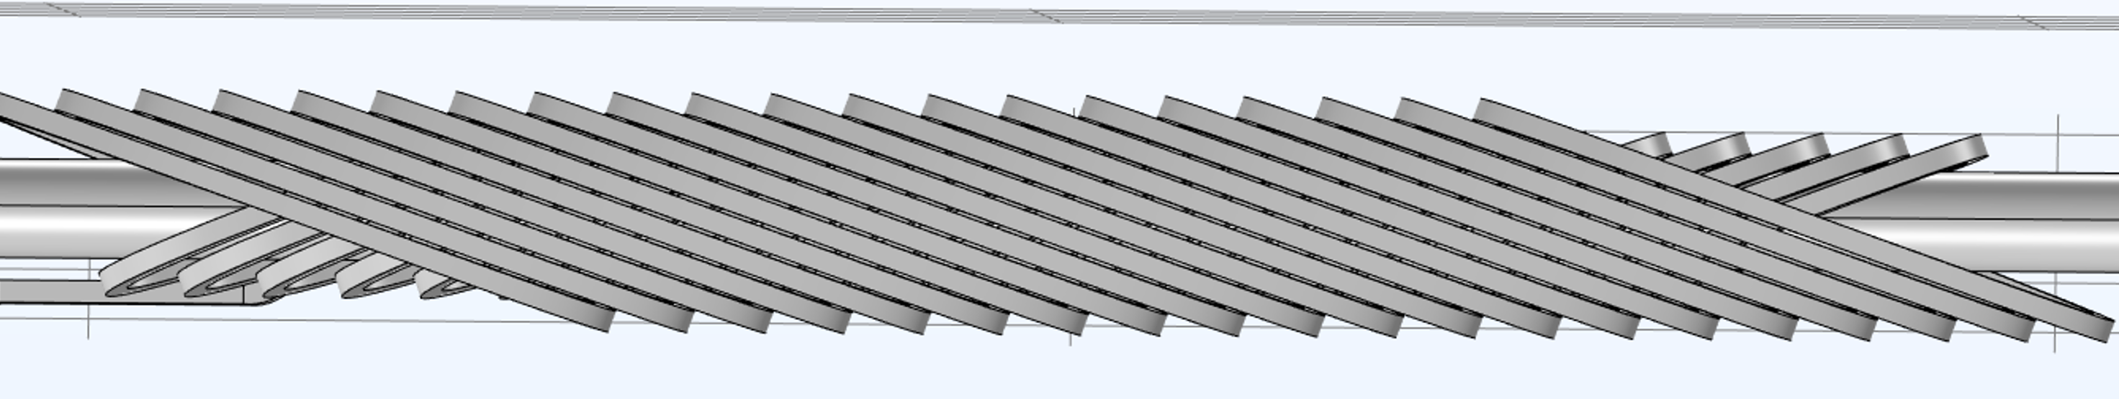
Development of LPF3- electromagnetic design
Aiming at 16 T：13 T (LTS) + 3 T (HTS)
To be 16 T
Cross-section of LPF3
Field and flux distribution (1st and 2nd quadrant)
Schematic of LPF3
ReBCO Block-type insert coil
ReBCO CCT insert coil

Slide 4
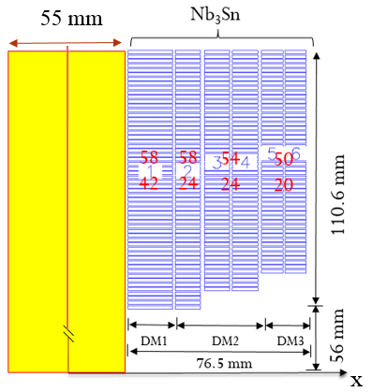
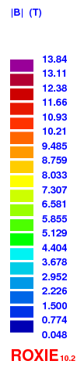
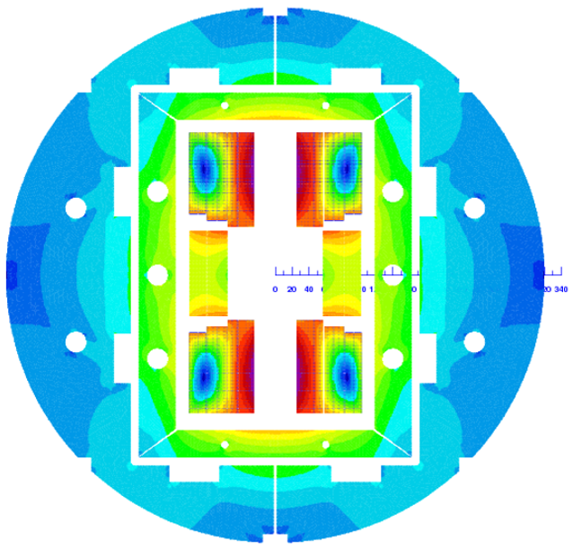
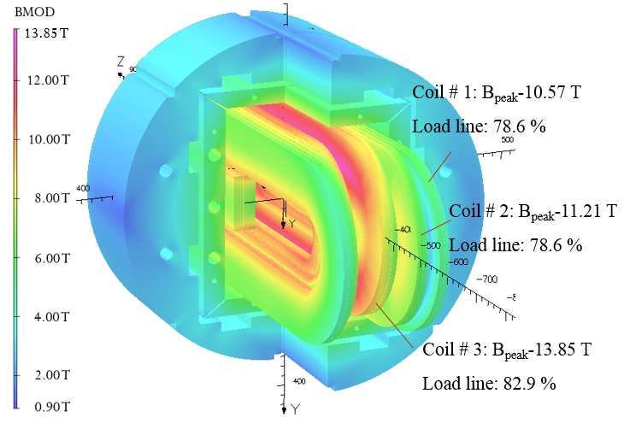
Electromagnetic design of LPF3-LTS
Nb₃Sn: 13 T
Coil
# 3
Coil
# 2
Coil
# 1
First quadrant coil layout
Field distribution in the cross-section (2D)
Field distribution in the magnet (3D)
Main parameters of the magnet LPF3-LTS
Current | 7580 A |  | Blocks | Block 1 | Block 2 | Block 3 | Block 4 | Block 5 | Block 6
Main field | 13.02 T |  | Peak field (T) | 13.85 | 11.13 | 10.95 | 11.21 | 10.57 | 10.47
 |  |  | LL ratio (%) | 82.91 | 78.16 | 77.18 | 78.6 | 78.63 | 78.09
Integral harmonics (-150-150mm); R-10 | b3: 102.76 |  | b5: -0.08 | b7: -0.01 | b9: 0 | a2: -48.11 | a4: -0.14 | a6:-0.02 | a8: 0
Integral harmonics (-150-150mm); R-15 | b3: 231.17 |  | b5: -0.42 | b7: -0.06 | b9:0.01 | a2: -72.09 | a4: -0.46 | a6:-0.14 | a8: 0.01
Parameters | Aperture Ns | Aperture diameter | Peak field | Temperature | Load line ratio | Energy | Induct-ance | LSS (coil #1,2,3) | LSS (coil #1,2,3) | Cable Ns (DM1,2,3)
Unit | - | mm | T | k | - | MJ | mH | mm | mm | -
Value | 2 | 55 | 13.85 | 4.2 | 82.9 | 2.155 | 13.01 | 400,550,620 | 400,550,620 | 42,24,20

Slide 5
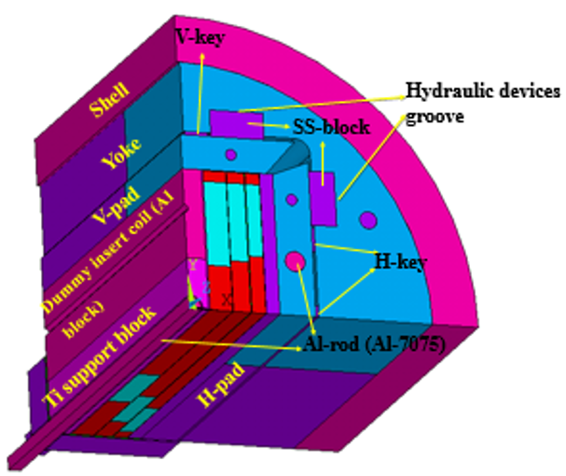
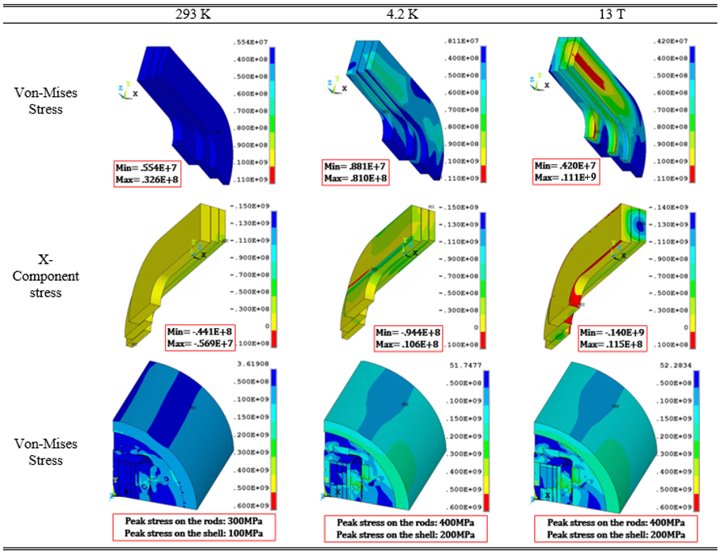
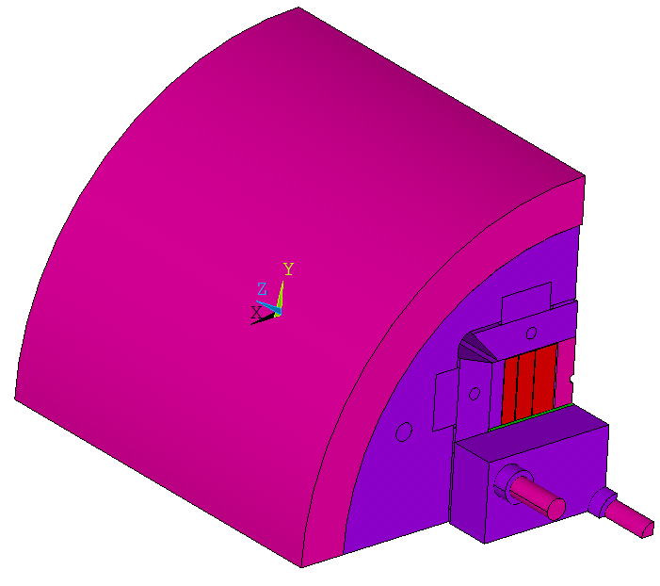
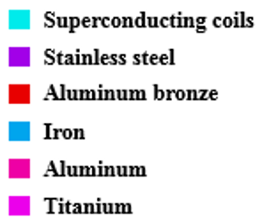
Mechanical analysis of LPF3-LTS
f=0.2; interference=-0.8 mm
1/8 mechanical FEA model
Stress variation during the three loading steps
Required maximum pre-stress for bladders: 80 Mpa. Peak stress in coils during the three loading steps: 140 Mpa.

Slide 6
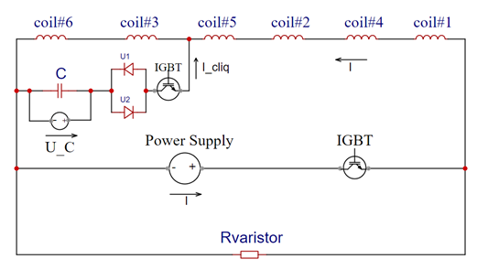
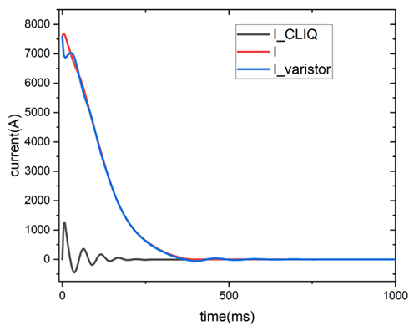
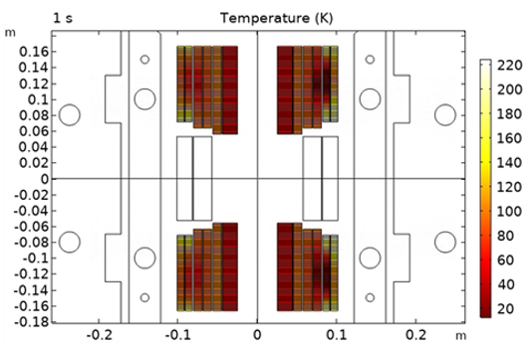
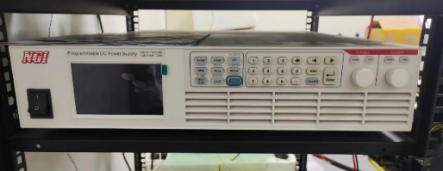
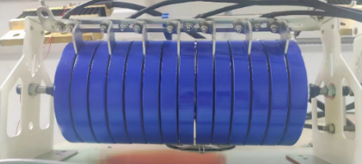
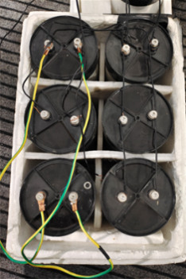
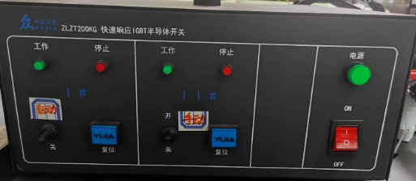
Quench protection analysis of LPF3-LTS
CLIQ + Varistor
The design circuit of quench protection
The current in the CLIQ circuit and current decay
Power supply in the CLIQ system
The varistor
The temperature distribution of the magnet
The IGBT in the CLIQ system
The capacitance
CLIQ + varistor is adopted to accelerate the propagation of quench in the magnet.
The capacitance: 30 mF; the charging voltage: 500 V; the hotspot temperature is about 224 K at 7850 A.

Slide 7
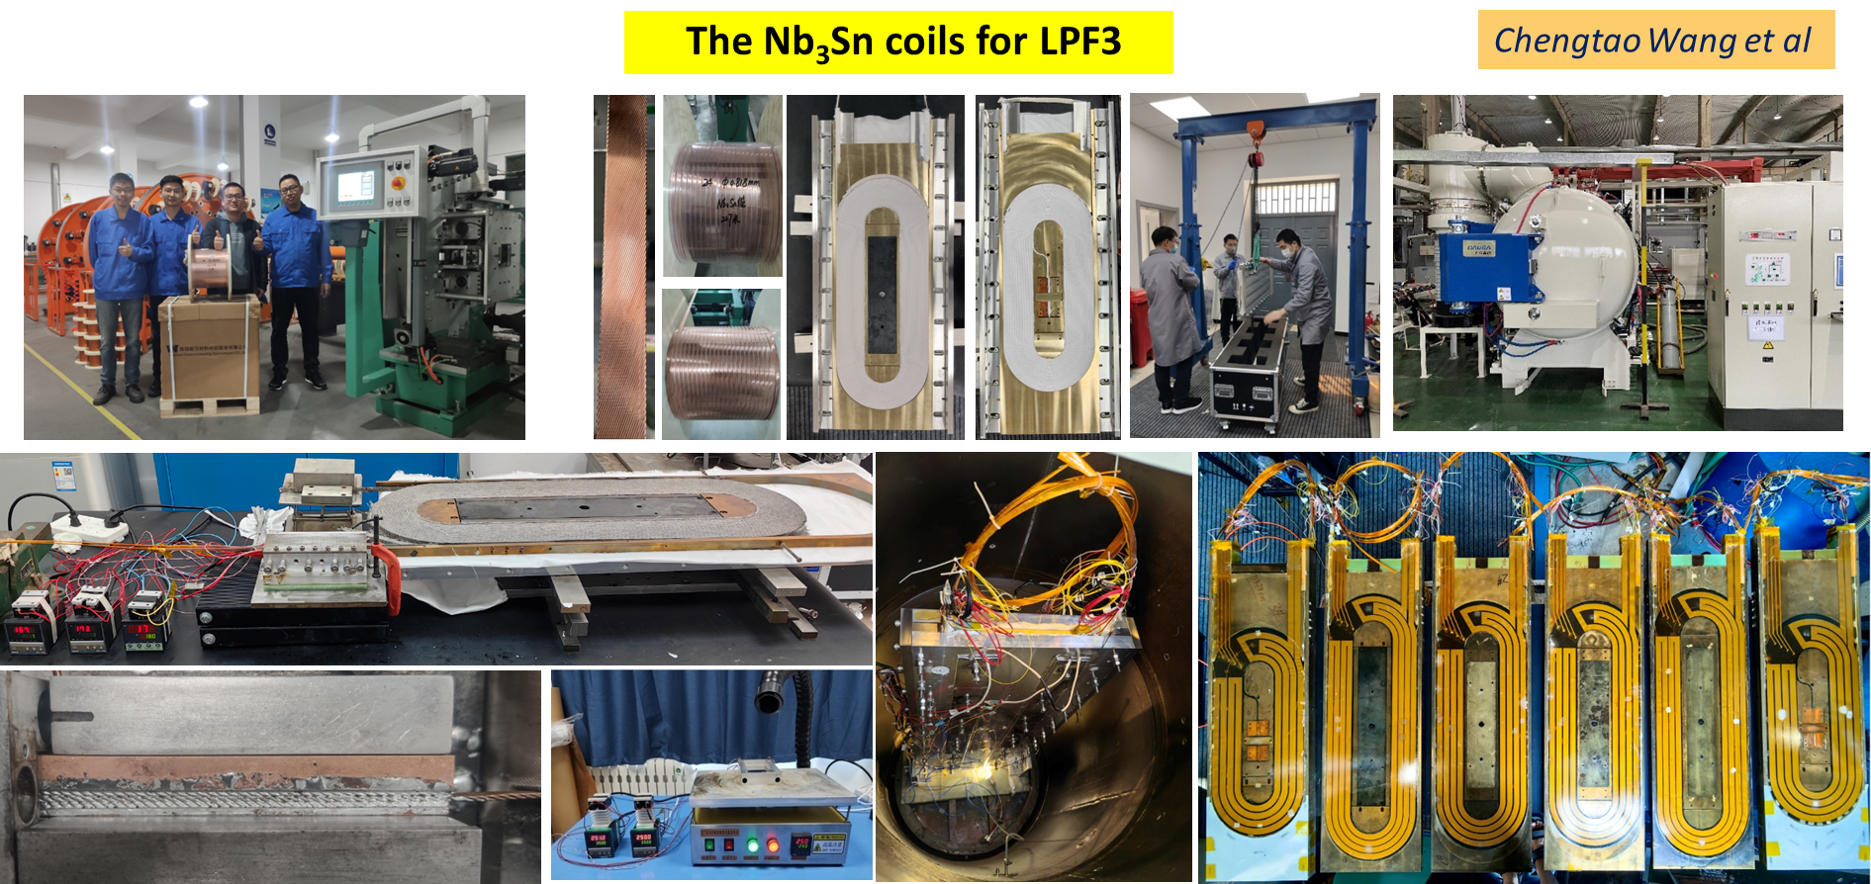
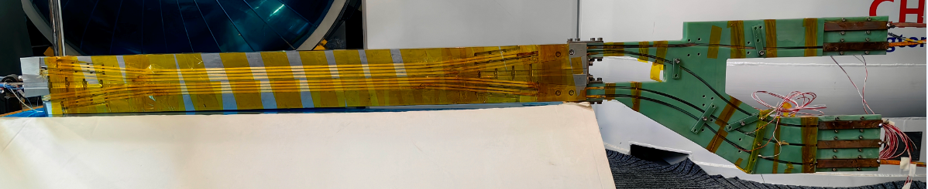
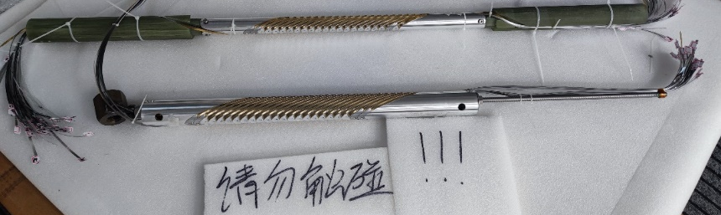
Fabrication of LPF3
The HTS insert coils for LPF3
Block-type
CCT

Slide 8
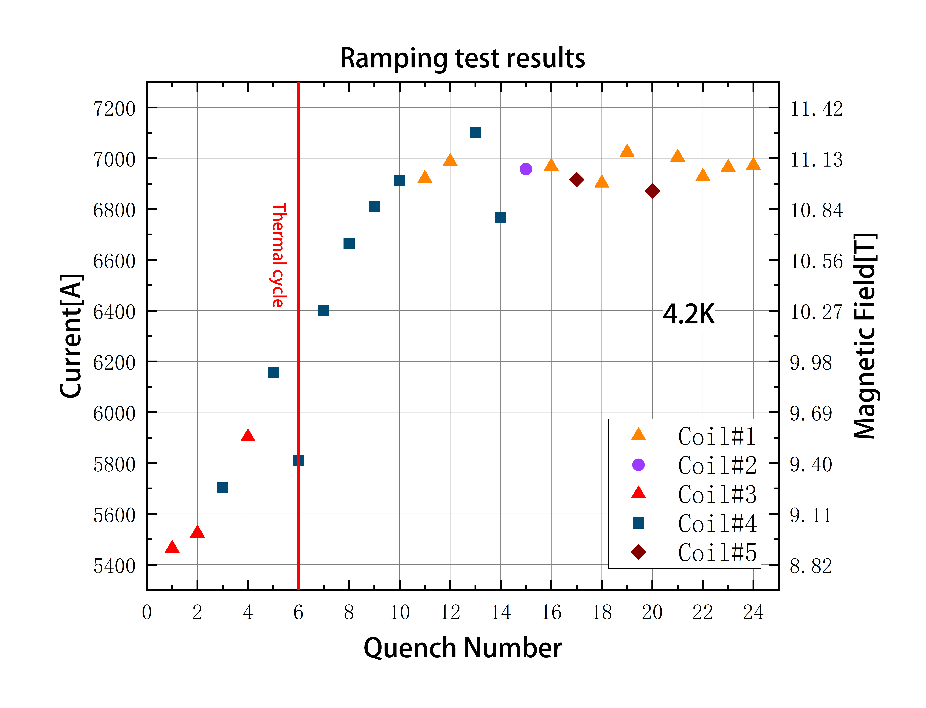
Recent test results of LPF3-LTS
The 1st preliminary test carried out in the week Sep 3-8 2003. The six Nb₃Sn coils were firstly ramped
5 quenches occurred from 9 to 10 T, mainly caused by flux jump, but with an encouraging upward trend
The performance test of LPF3 was continued in the last three weeks after the thermal cycle. A maximum field of 11.28 T has been reached within two apertures. More testing is ongoing.
11.28 T
Test paused
Test paused
Test paused
Test paused
Waiting for the helium to be produced

Slide 9
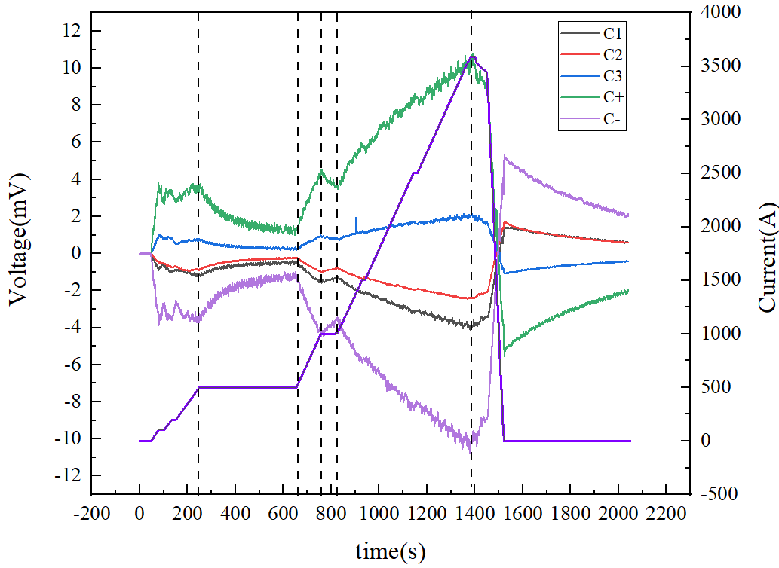
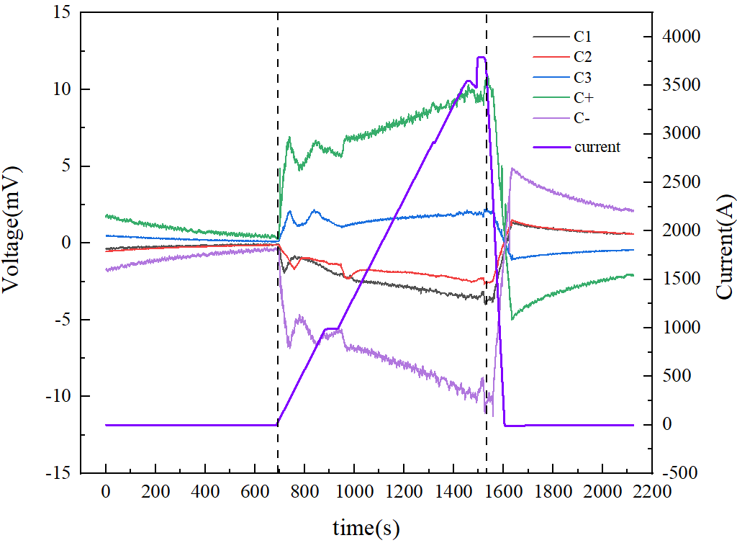
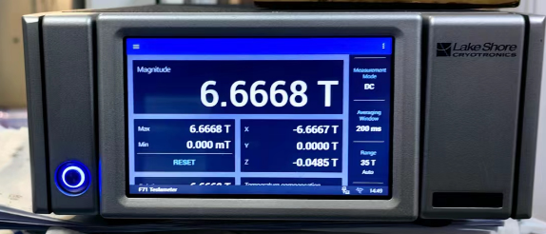
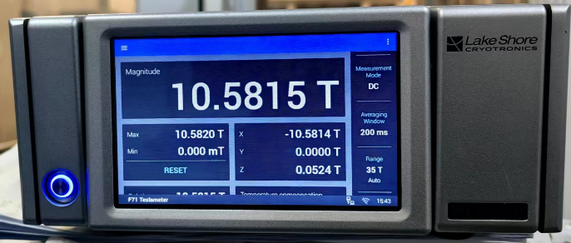
Recent test results of LPF3-HTS
The preliminary test of Block-type insert coil was carried out under self-field, 5 T and 9 T. The coil has been subjected to a maximum current of over 3790 A (the designed current), with no quenches observed.
As commonly observed in NI coils, a charging delay between the power supply current and generated magnetic field has also been found in this insert coil.
Due to the significant heat generated by the current leads, the test had to be stopped as soon as the current reached ~3800 A. The field provided by the HTS insert coil is 1.91 T @ self-field, 1.67 T @ 5 T and 1.58 T @ 9 T, respectively.
No quench
3500 A
No quench
3800 A
current
current
current
Test result of Block-type insert coil under 5 T
Test result of Block-type insert coil under 9 T

Slide 10
Summary
Based on the experiences mastered in the LPF1 series magnets, a 16-T high field dipole magnet named LPF3 has been designed, fabricated and is in the performance test process.
The preliminary test of Nb₃Sn coils showed promising results, with a maximum field of 11.28 T @ 7101 A & 4.2 K reached within two apertures. Futher training tests will be carried out soon.
The preliminary test of Block-type insert coil was carried out under self-field, 5 T and 9 T, respectively. The coil has been subjected to a maximum current of 3800 A, with no quenches observed. A charging delay between the power supply current and generated magnetic field was found during the ramping test. More tests would also be performed to investigate the electrical-magnetic behavior of this coil soon.

Slide 11
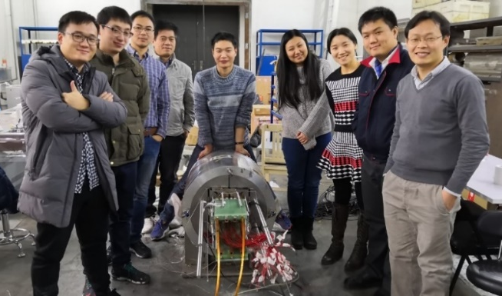
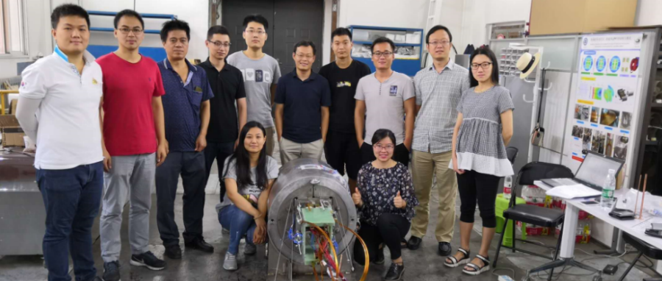
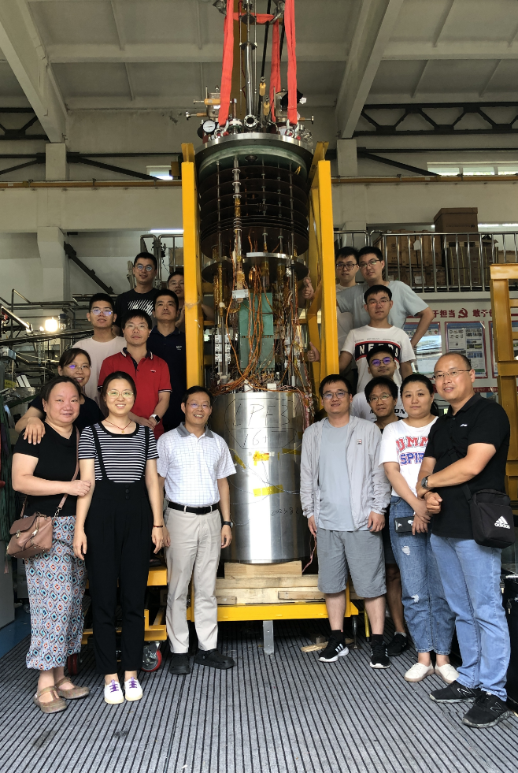
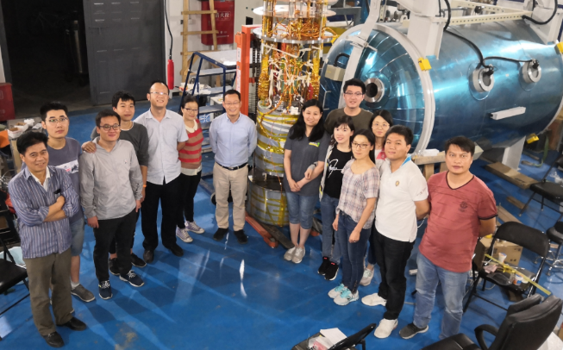
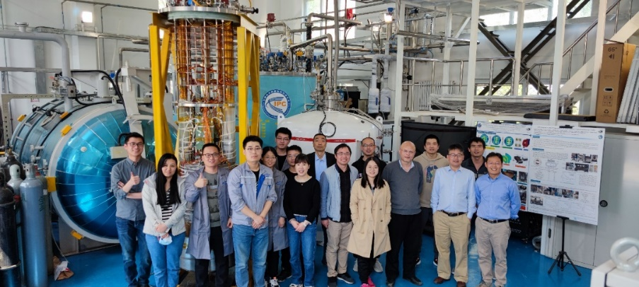

2018
2019
2020
2021
2023
10.23 T
10.71 T
12.47 T
To be beyond 16 T
Year:2018
2019
2020-2021
2022-2023
Welcome to visit Qingjin’s lab!
Thanks！

