Slide 1
HI-ECN3 target complex handling equipment
Brainstorming - Consolidation - Upgrade
J-L GRENARD SY-STI 05-03-2024
HI-ECN3 WP4

Slide 2
List of current equipment – TCC8
30t Overhead travelling crane CRPR-00560 (refurbishment 2014)
Need to upgraded
Full remote control
Off board control cubicles
Full redundancy
Positioning system
Full set of PTZ cameras
Capability to attach tools and motorized spreaders
Auxiliary hoist 5t/10t
~like the TCC2 crane after refurbishment
To be refurbished at beginning of LS3

Slide 3
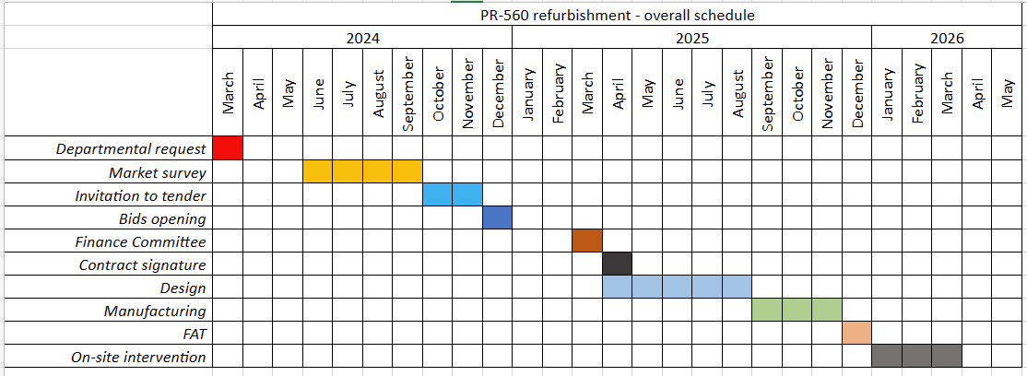
List of current equipment – TCC8
30t upgrade draft schedule

Slide 4
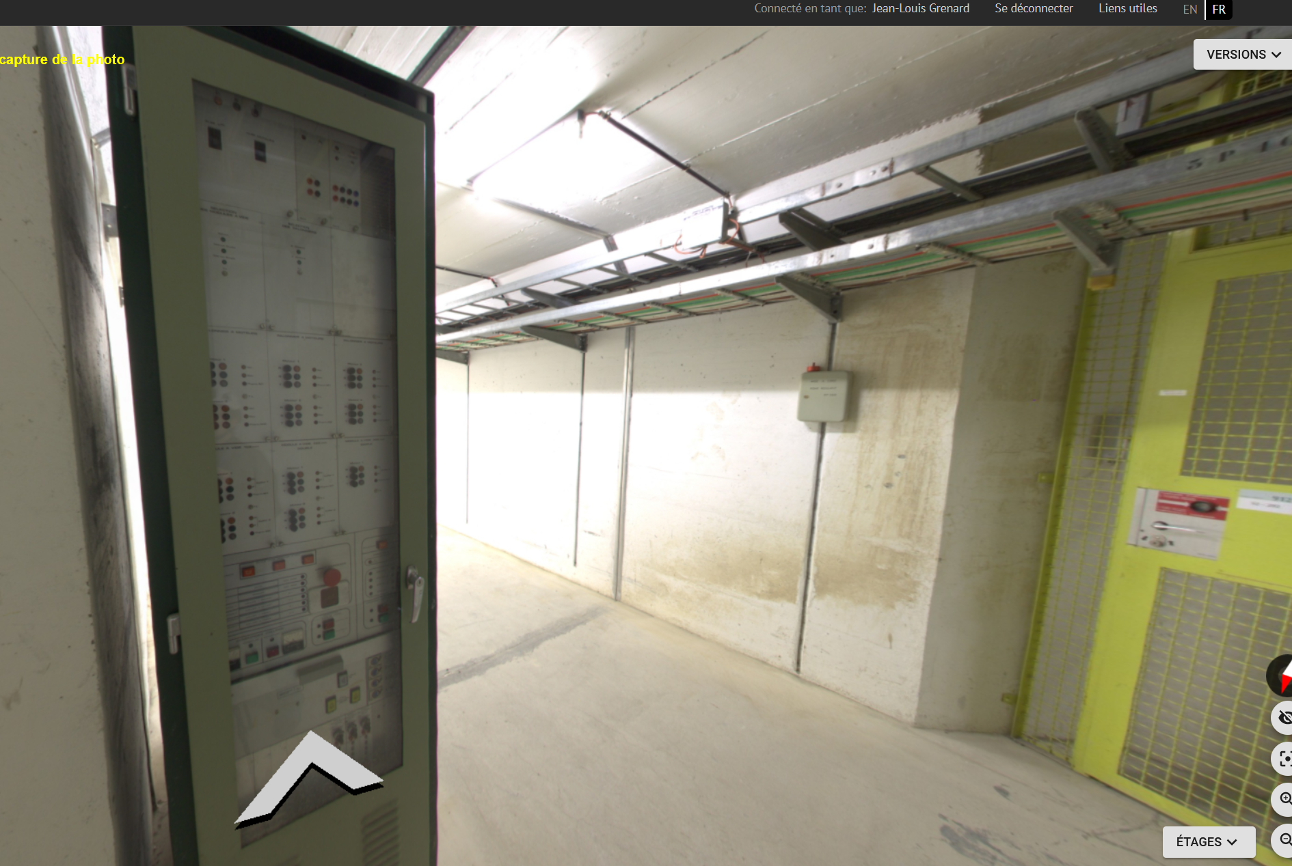
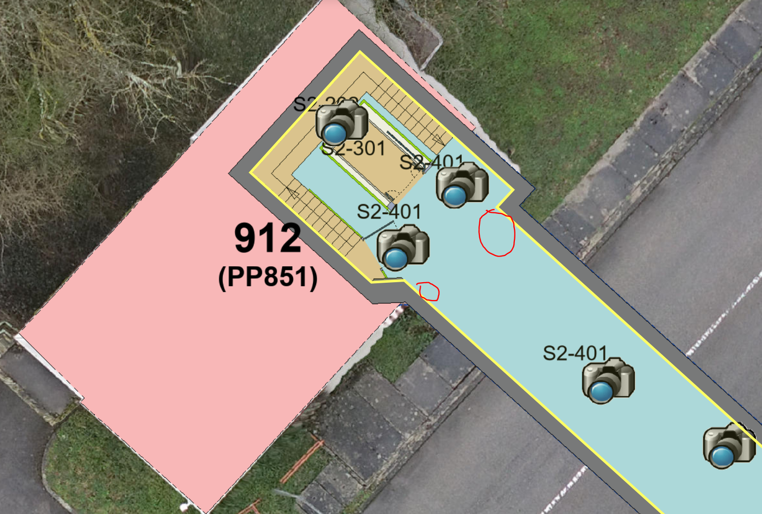
Old TCC8 crane equipment 912/S2-401
To be removed (YETS 24-25)
Cables to be identified for future removal cable campaign

Slide 5
List of current equipment – 911
45t overhead travelling crane CRPR-00610 (replaced 2016)
  Assessment to understand if compatible with objects we need to handle
  Need to relocate Crane main switch (currently located on foreseen new door)
  Need to rework crane access (currently located on foreseen new door)
1t Lift CRAS-00520 (Foreseen in NA-CONS) date?

Slide 6
List of current equipment – 912
0.9t Lift CRAS-00529 (replaced 2020)
  No new actions?

Slide 7
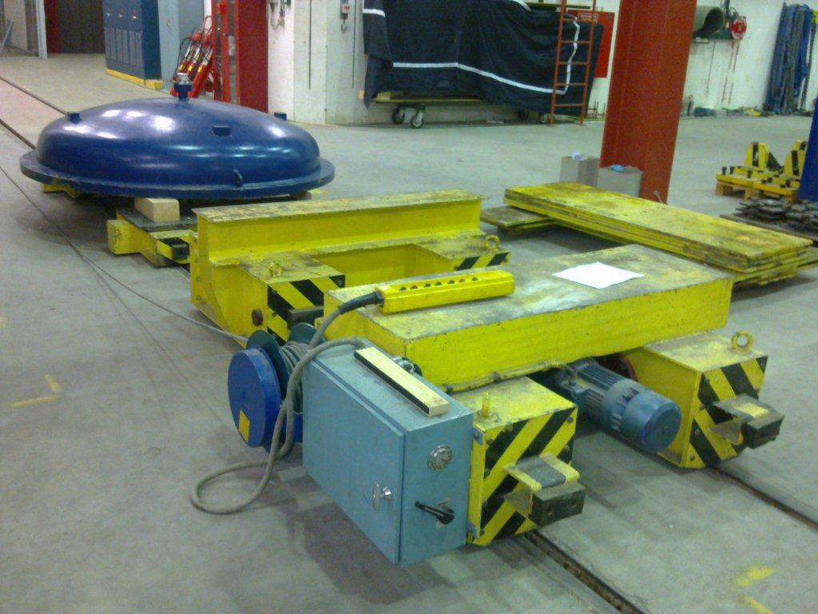
List of current equipment – ECN3
40t overhead travelling crane CRPR-00561 (refurbishment 2012-2013)
  Not needed in the handling process for target station objects
40t Transfer table CRCH-00415
  (Foreseen in NA-CONS) date YETS 24-25?
  Need to be refurbished
  Off board control cubicles (like for the PSB CRCH-00066/67)

Slide 8
New target complex service building 1/2
30t Overhead travelling crane
  New
  Installation ~2029
Transfer trolley (between 911 and new building)
  On rail?
  Installation ~2029/2030
Hoist(s) for maintenance of cooling and ventilation systems
  Installation ~2029/2030

Slide 9
New target complex service building 2/2
(~10t) crane (inside service cell)
New
Full remote control
Off board control cubicles
Full redundancy
Positioning system
Full set of PTZ cameras
Capability to attach tools and motorized spreaders
Installation ~2030

