Slide 2
BDF Project: Cooling and Ventilation Infrastructure and Target CV Systems
CV Technical Review
Pietro Avigni, Michele Battistin

Slide 3
Outline
BDF Project
  Overview of the Project
  Cooling Design
  Ventilation Design
BDF Target Prototype (TCC2)
  Target and Target Prototype Design
  Cooling Skid Design
  Installation and Testing
BDF Helium Passivation System
  Overview and Process Description
  Selection of Components
  Budget & Schedule

Slide 4
Outline
BDF Project
  Overview of the Project
  Cooling Design
  Ventilation Design
BDF Target Prototype (TCC2)
  Target and Target Prototype Design
  Cooling Skid Design
  Installation and Testing
BDF Helium Passivation System
  Overview and Process Description
  Selection of Components
  Budget & Schedule

Slide 5
BDF Introduction
BDF is a planned high intensity fixed target facility in the North Area of the SPS for beam dump experiments
High intensity proton beam:
  Pulsed power deposition: 2.5 MW over 1 second, repeated every 7.2 seconds (Cyclic);
  355 kW average beam power over time;
Dense target/dump to maximize particle interaction/production;
Facility designed so that can be reused for multiple experiments;
First experiment to be hosted: SHiP (Search for Hidden Particles);
Minimal impact on running the North Area program.

Slide 6
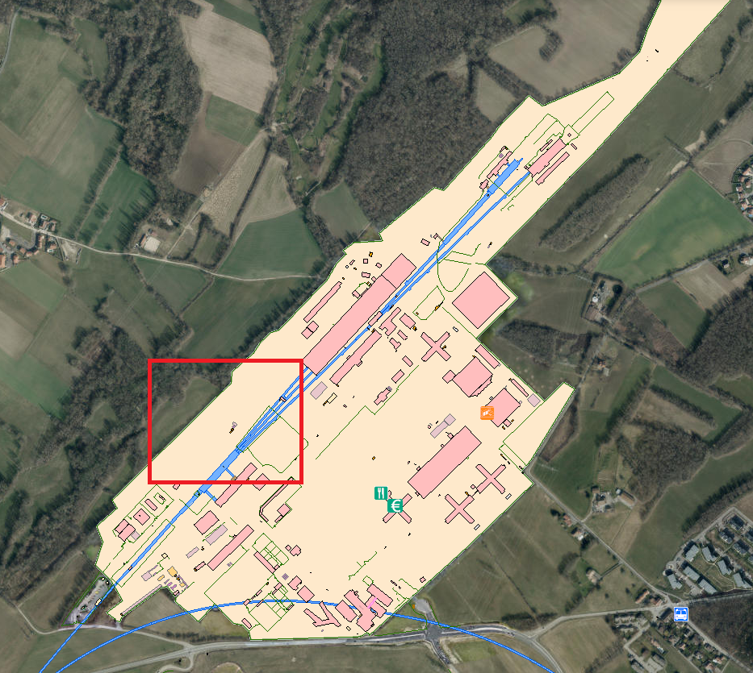
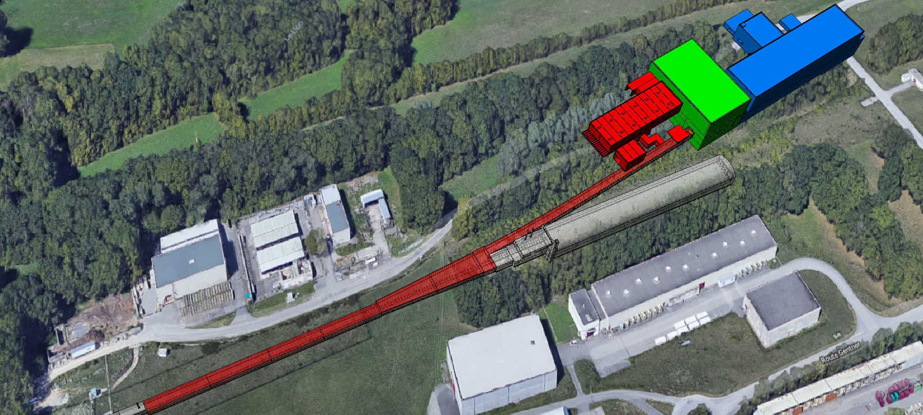
BDF Layout
Target Complex
Jura
Auxiliary Building
Experimental Area
Extraction Tunnel
Junction Cavern
TCC2
Access Building
TDC2
BA80
Beam direction
Salève
Google Maps
Full integration from transfer line to experimental area completed
Locations of structures and services defined and optimized in terms of radiation protection, safety and accessibility.

Slide 7
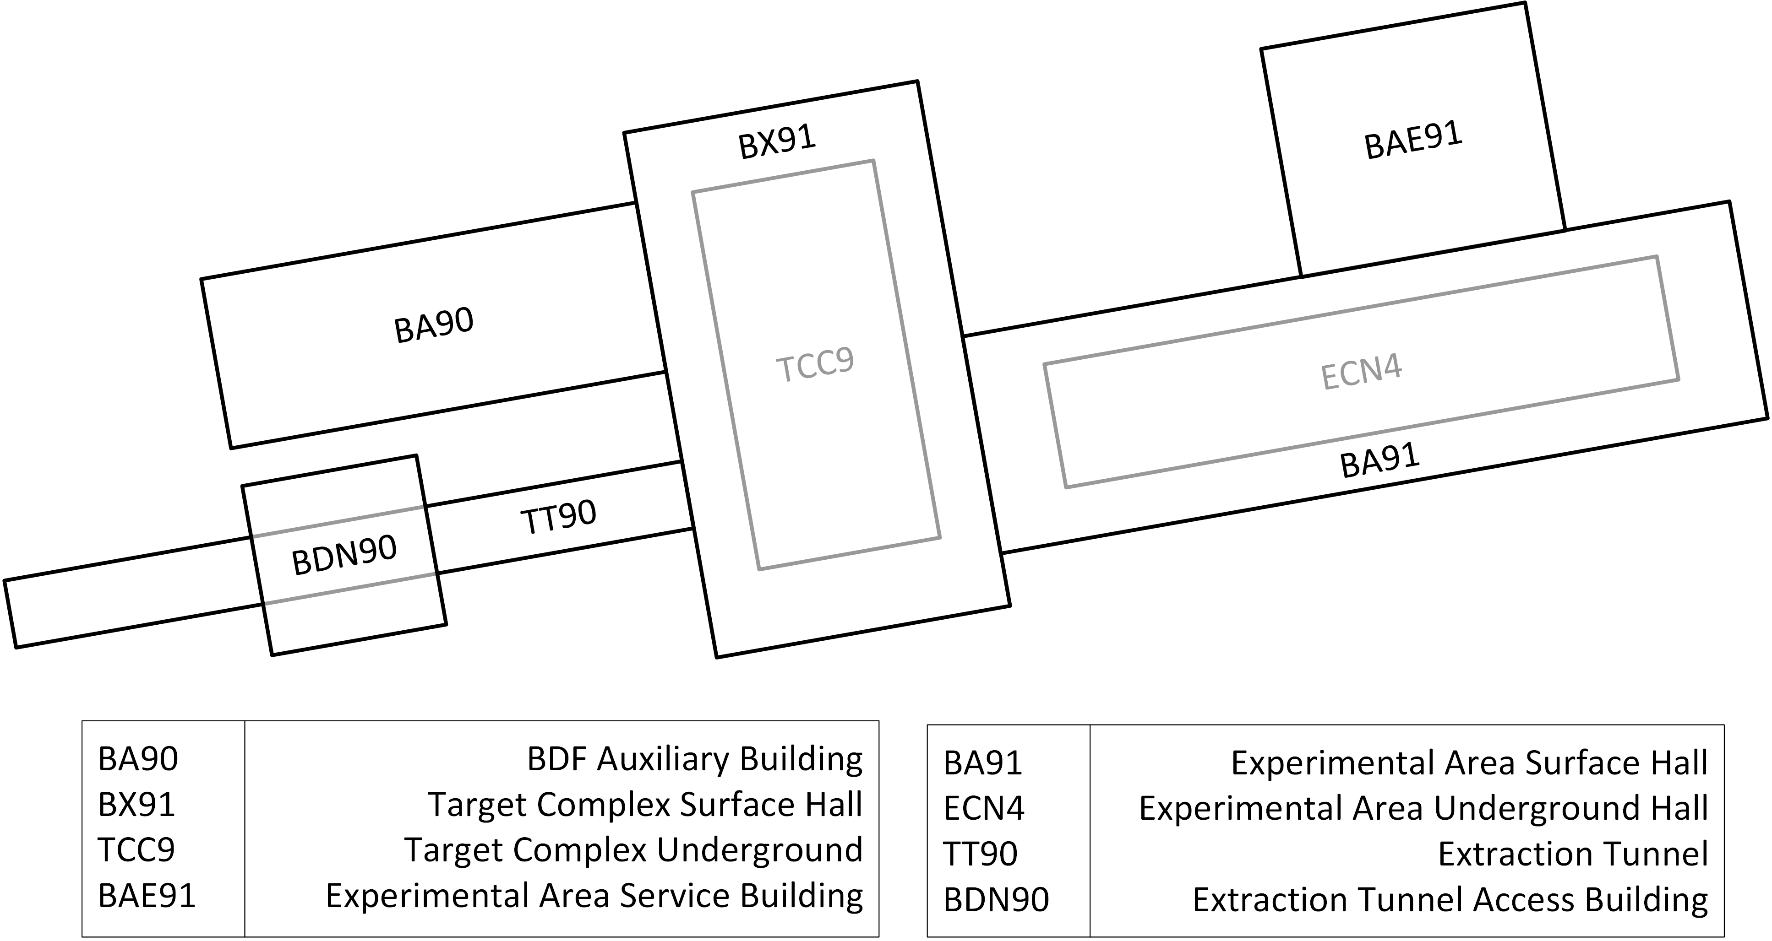
BDF Naming

Slide 8
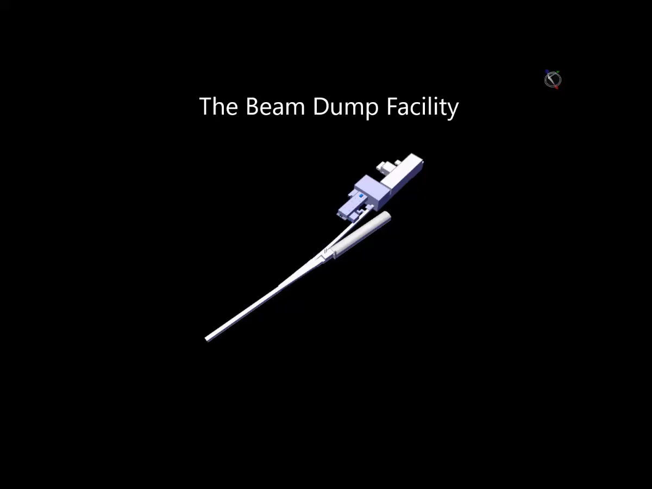
BDF Video: Facility Overview

Slide 9
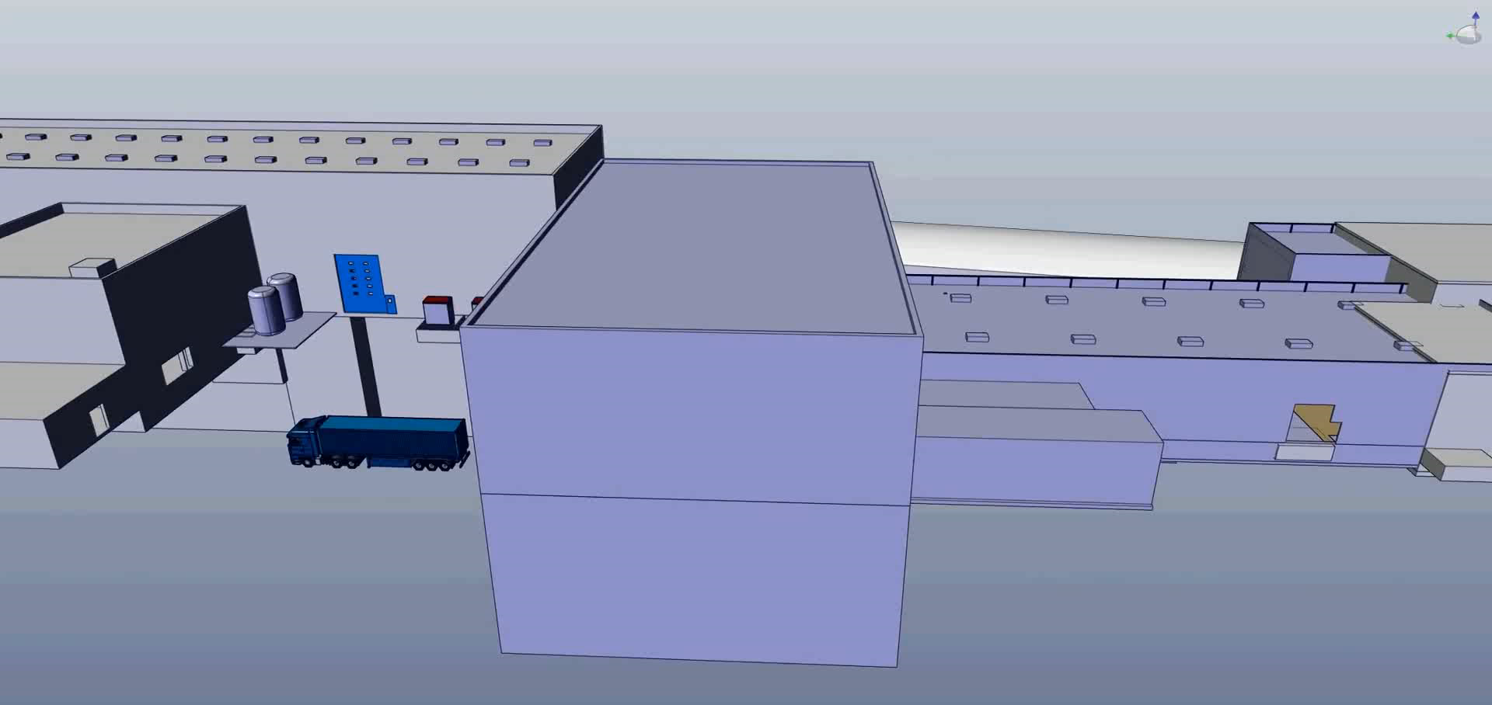
BDF Video: Target Complex

Slide 10
BDF Extraction Area
Extraction Area
Beam direction
Google Maps

Slide 11
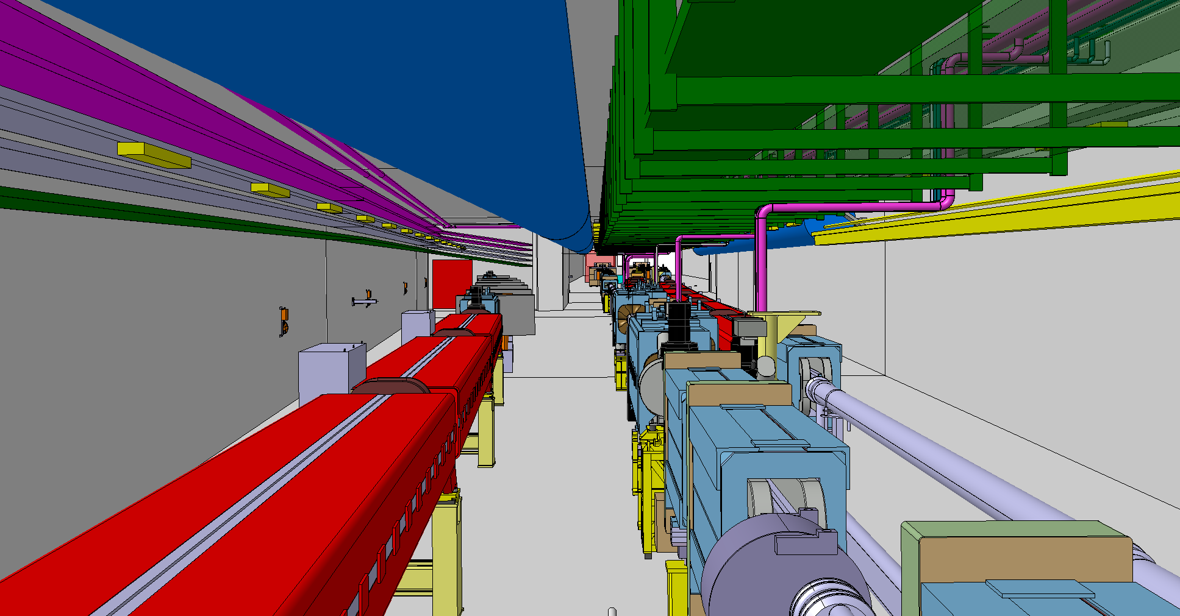
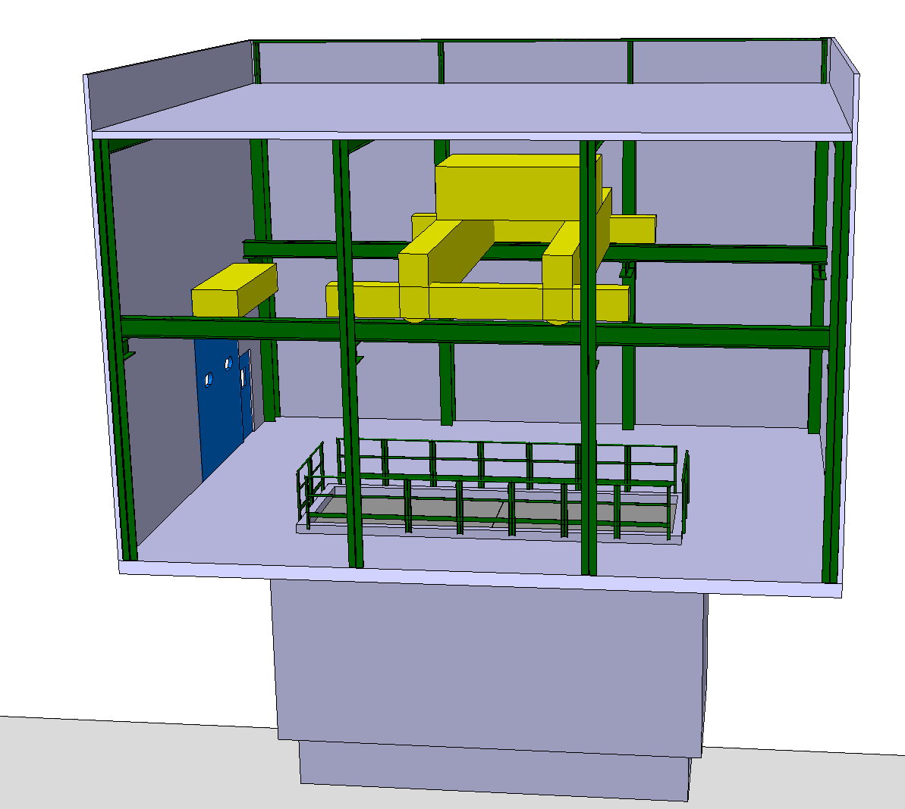
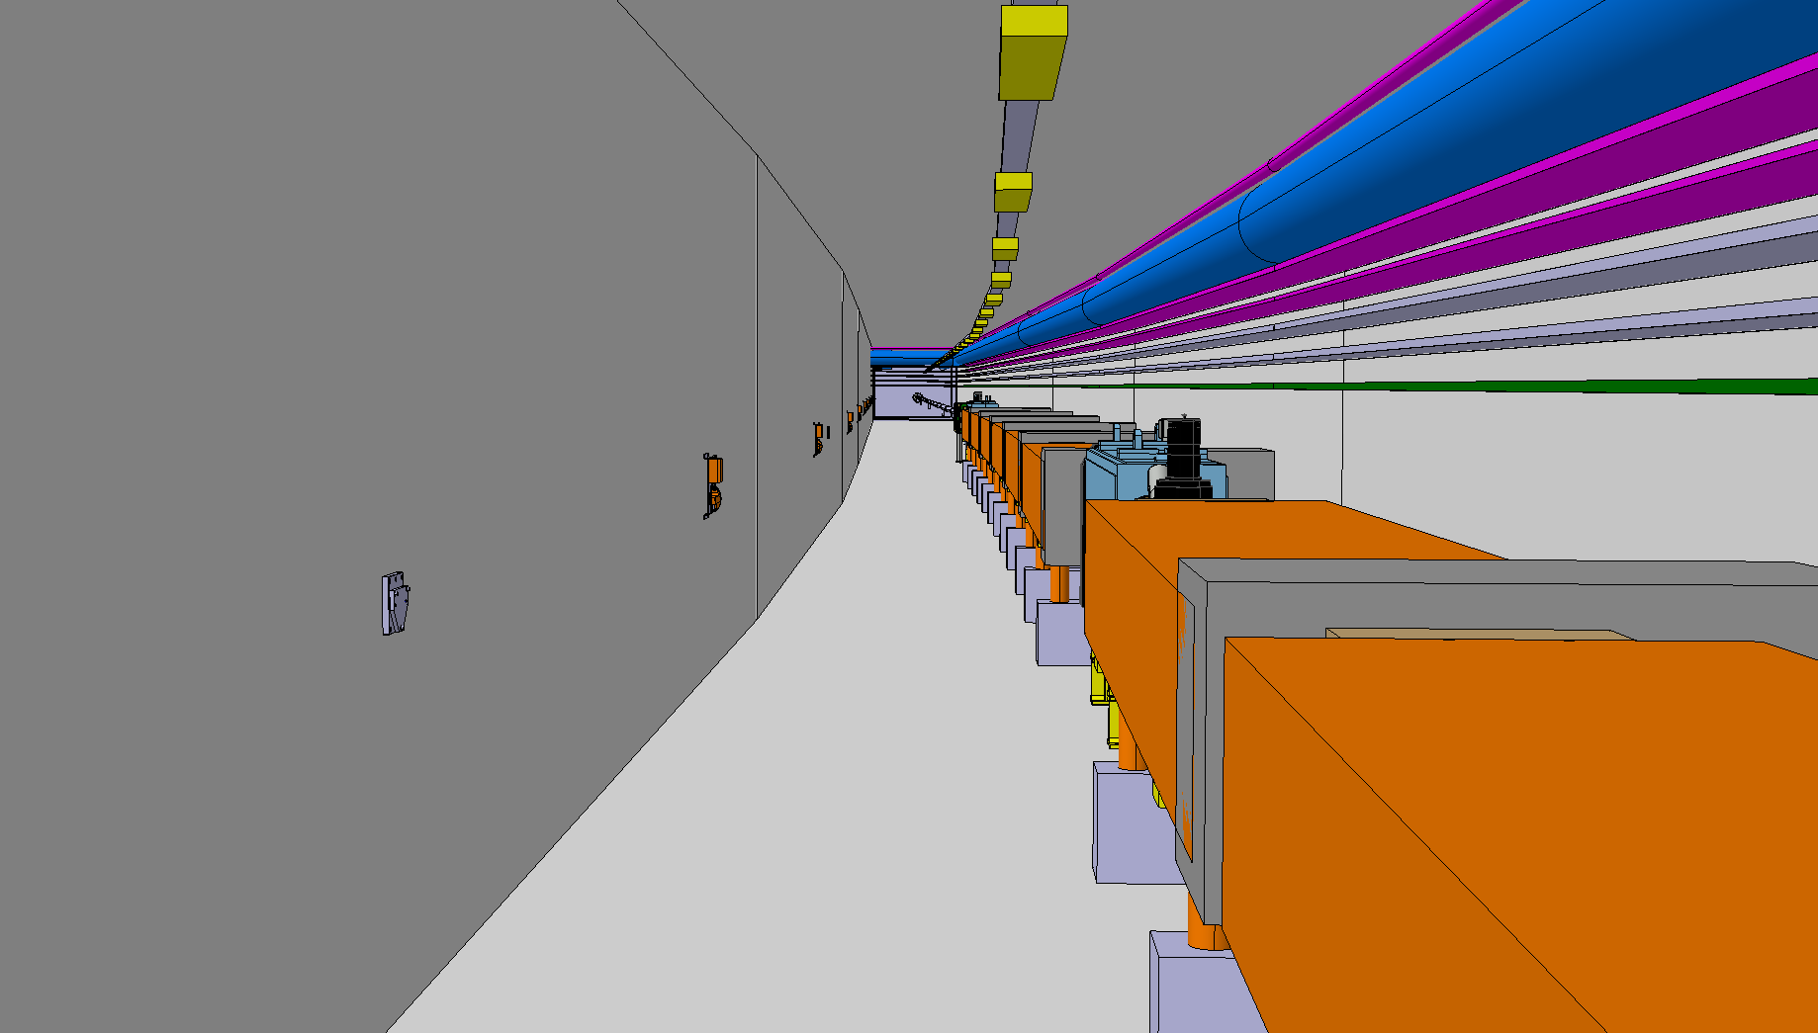
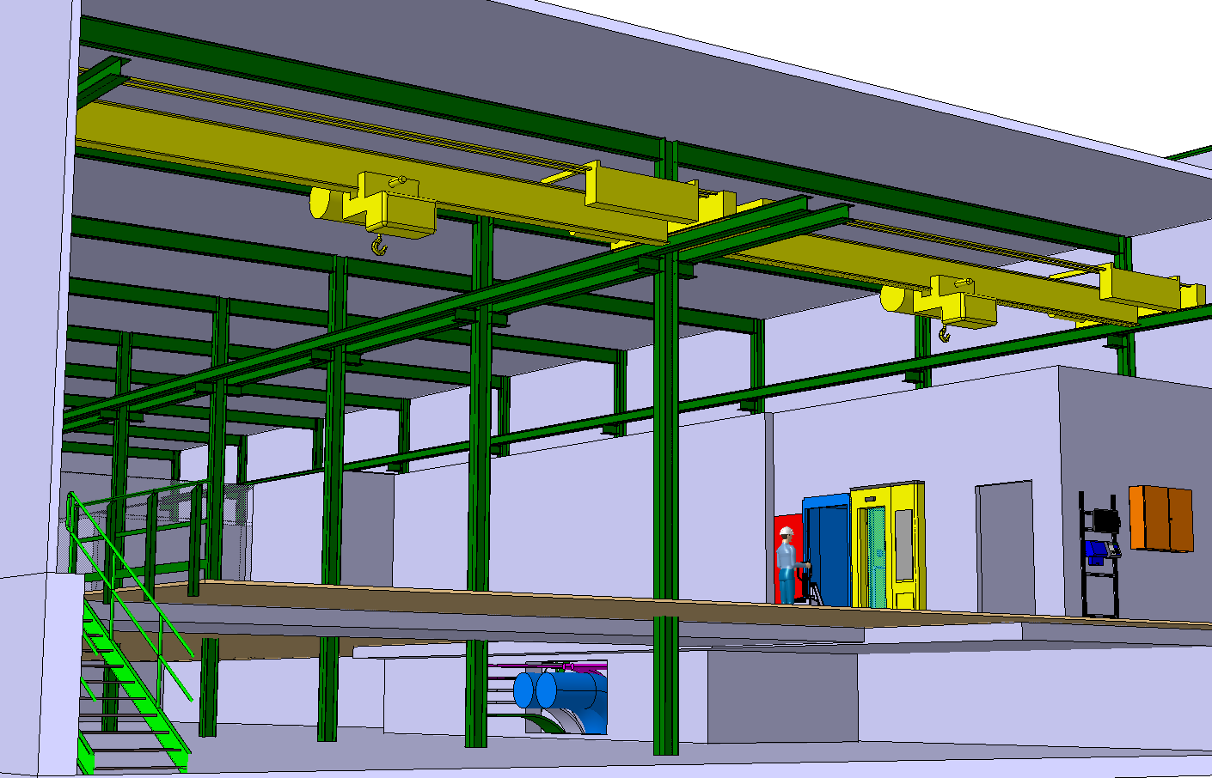
BDF Extraction Area
Junction Cavern
Access Building
30t crane
TT90
TDC2
Lorry
access
BDF beamline
Shaft
Extraction Tunnel
Auxiliary Building
Ventilation
Crane
BDF beamline
Access control
Transport accessway
False floor

Slide 12
BDF Target Complex
Target Complex
Beam direction
Google Maps

Slide 13
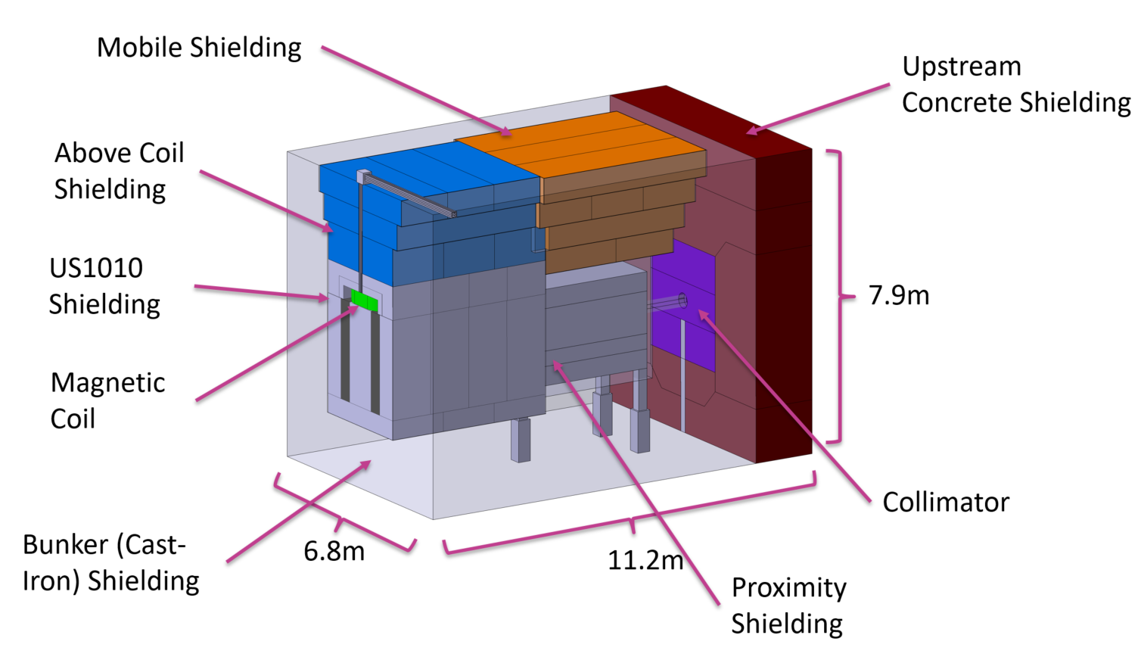
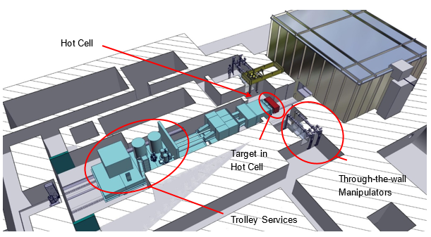
Two technical solutions
Target is located 15 m underground, relatively close to the CERN fence (~70 m)
Cast-iron and steel shielding enclose target (3700 tonnes)
Target bunker inside an active circulation He-vessel
Fully remote handling/manipulation during the lifetime of the facility
Target complex design developed in detail → demonstrated feasibility of construction, operation, maintenance and decommissioning
Crane handling solution
Shielding, supports, target, moved by crane
Trolley handling solution
Target and services on trolleys on rails
SPS beam

Slide 14
BDF Experimental Area [SHiP]
Experimental Area
Beam direction
Google Maps

Slide 15
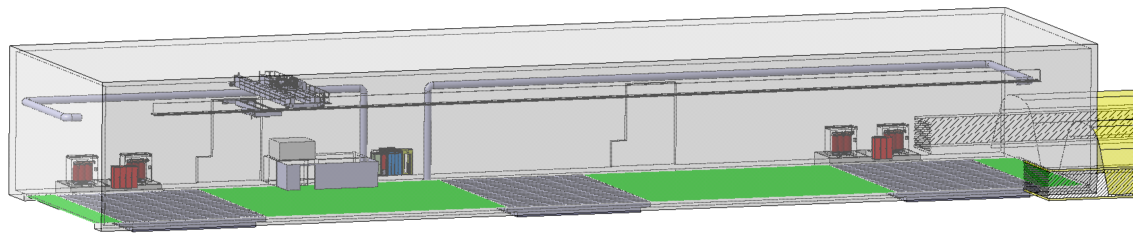
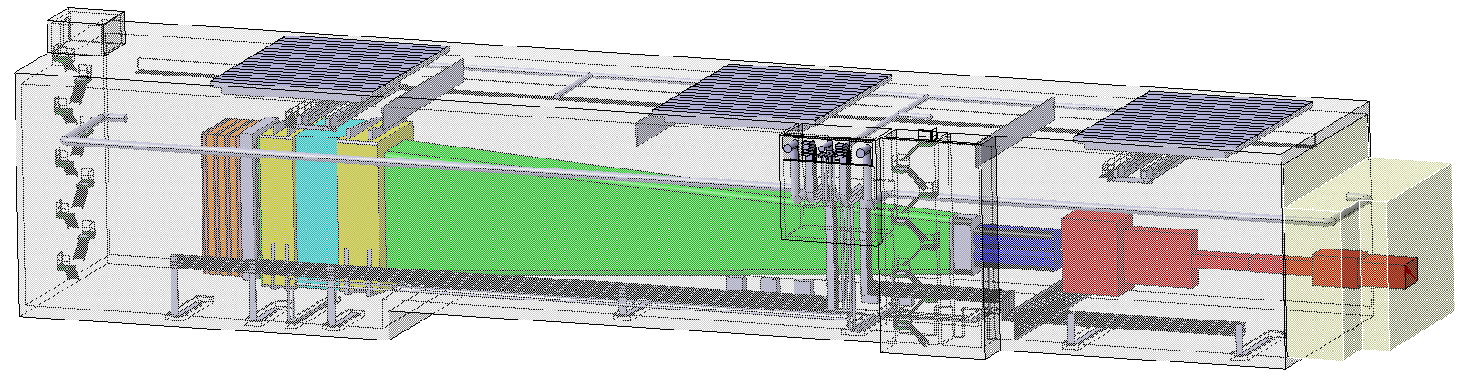
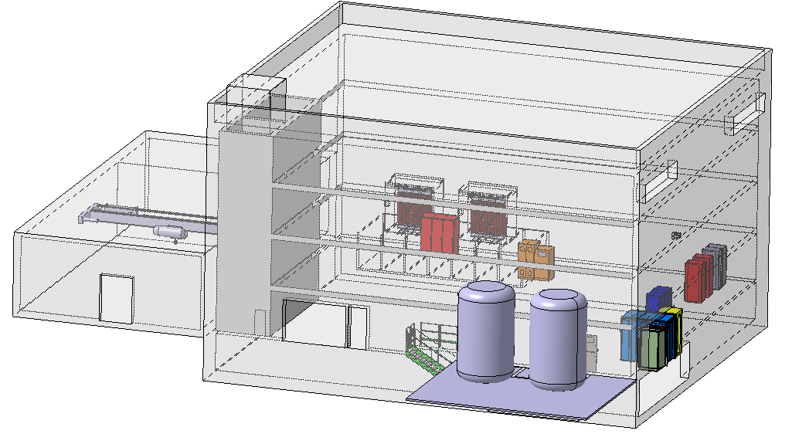
BDF Experimental Area [SHiP]
Surface Hall
3 access points
80 m
Experimental Hall
20 m
SHiP magnet
Decay volume
Muon shield
Service Building

Slide 16
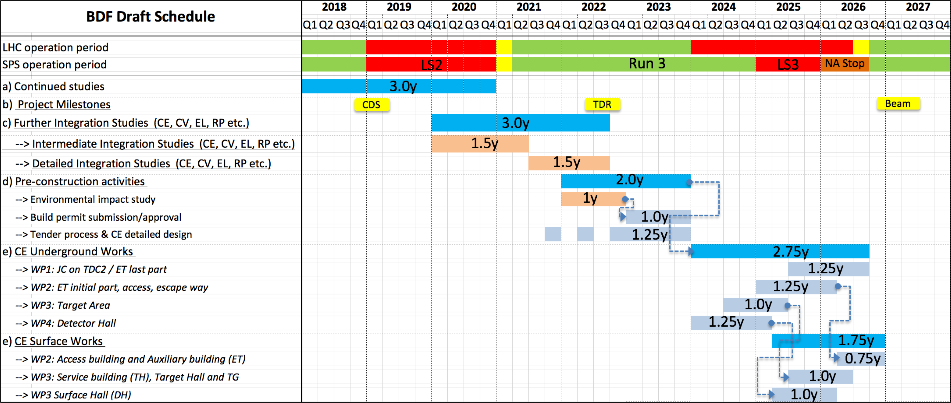
BDF Provisional Schedule
We are here
(Q1 2019)
Project approval
(Possible date)

Slide 17
BDF CV Design
 | Cooling Systems | Ventilation Systems | Other Systems
Extraction Area | Magnets Power converters Primary system Cooling towers (Chilled water) | Tunnel Auxiliary building Access building Evaporators room (TBC) | Compressed air Rising system
Target Complex | Target Proximity shielding Magnetic coil Helium circulation Helium Passivation | Surface hall Access Area Hot Area | Compressed air for draining Rising system Evaporation system Smoke extraction
Experimental Area | Magnets Power converters | Surface Hall Experimental Hall Service Building | Compressed air Rising system Smoke extraction
Let’s see the cooling and the ventilation design now…

Slide 18
BDF Cooling Requirements
Extraction Area (WP: EDMS 2050765)
Equipment | Number of equipment | T_{in} | Delta T | T_{out} | Flow / unit |  | Dissipated power / unit | Total dissipated Power | Pin | Pressure drop | Pout | Total flow | Type of water | Activated water?
 |  | (°C) | (°C) | (°C) | (l/min) | (m3/h) | (kW) | (kW) | (bar) | (bar) | (bar) | (m3/h)
QTG.01 | 1 | 27 | 7.3 | 34.3 | 6.9 | 0.4 | 3.5 | 3.5 | 7.5 | 6 | 1.5 | 0.4 | Demineralized | Yes
QTL.02 | 1 | 27 | 7.5 | 34.5 | 26.0 | 1.6 | 13.6 | 14 | 7.5 | 6 | 1.5 | 1.6 | Demineralized | Yes
QTL.03 | 1 | 27 | 5.8 | 32.8 | 26.0 | 1.6 | 10.6 | 11 | 7.5 | 6 | 1.5 | 1.6 | Demineralized | Yes
QTL.04 | 1 | 27 | 2.3 | 29.3 | 26.0 | 1.6 | 4.2 | 4.2 | 7.5 | 6 | 1.5 | 1.6 | Demineralized | Yes
QTL.05 | 1 | 27 | 7.9 | 34.9 | 26.0 | 1.6 | 14.4 | 14 | 7.5 | 6 | 1.5 | 1.6 | Demineralized | Yes
QTL.06 | 1 | 27 | 12.5 | 39.5 | 26.0 | 1.6 | 22.6 | 23 | 7.5 | 6 | 1.5 | 1.6 | Demineralized | Yes
MBB | 5 | 27 | 15.2 | 42.2 | 57.1 | 3.4 | 60.7 | 303 | 13.5 | 12 | 1.5 | 17.1 | Demineralized | Yes
MBN | 18 | 27 | 15.4 | 42.4 | 27.7 | 1.7 | 29.8 | 536 | 2.5 | 1 | 1.5 | 29.9 | Demineralized | Yes
MDXl | 6 | 27 | 3.7 | 30.7 | 7.3 | 0.4 | 1.9 | 12 | 7.5 | 6 | 1.5 | 2.6 | Demineralized | Yes
MDXl dill | 6 | 27 | 3.3 | 30.3 | 7.3 | 0.4 | 1.7 | 10 | 7.5 | 6 | 1.5 | 2.6 | Demineralized | Yes
Water-cooled cables | 1 | 27 | 17.2 | 44.2 | 167 | 10.0 | 200 | 200 | 6.5 | 5 | 1.5 | 10.0 | Demineralized | Yes
Power converters | 1 | 27 | 3.3 | 30.3 | 660 | 39.6 | 150 | 150 | 4.5 | 3 | 1.5 | 39.6 | Demineralized | No
Target Complex (WP: EDMS 2050757)
Equipment | Number of equipment | T_{in} | Delta T | T_{out} | Flow / unit |  | Dissipated power / unit | Total dissipated Power | Pin | Pressure drop | Pout | Total flow | Type of water | Activated water?
 |  | (°C) | (°C) | (°C) | (l/min) | (m3/h) | (kW) | (kW) | (bar) | (bar) | (bar) | (m3/h)
Target | 1 | 27 | 6.7 | 33.7 | 750 | 45 | 350 | 350 | 22 | 3.5 | 18.5 | 45 | Demineralized | Yes
Proximity shielding | 1 | 27 | 3.0 | 30.0 | 96 | 5.76 | 20 | 20 | 2 | 1 | 1 | 5.76 | Demineralized | Yes
Magnetic coil | 1 | 27 | 8.6 | 35.6 | 250 | 15 | 150 | 150 | 20 | 19 | 1 | 15 | Demineralized | Yes (Not much)
Experimental Area (WP: EDMS 2050772)
Equipment | Number of equipment | T_{in} | Delta T | T_{out} | Flow / unit |  | Dissipated power / unit | Total dissipated Power | Pin | Pressure drop | Pout | Total flow | Type of water | Activated water?
 |  | (°C) | (°C) | (°C) | (l/min) | (m3/h) | (kW) | (kW) | (bar) | (bar) | (bar) | (m3/h)
Emulsion spectrometer magnet | 1 | 27 | 15.1 | 42.1 | 1800 | 108 | 1900 | 1900 | 13 | 12 | 1 | 108 | Demi | No
Decay volume / vacuum | 1 | 27 | 40.9 | 67.9 | 6.67 | 0.40 | 19 | 19 | 13 | 12 | 1 | 0.40 | Demi | No
Main spectrometer magnet | 1 | 27 | 14.3 | 41.3 | 1084 | 65.0 | 1083 | 1083 | 13 | 12 | 1 | 65.04 | Demi | No
Power converters | 1 | 27 | 3.8 | 30.8 | 480 | 28.8 | 126 | 126 | 4.5 | 3 | 1.5 | 28.8 | Demi | No

Slide 19
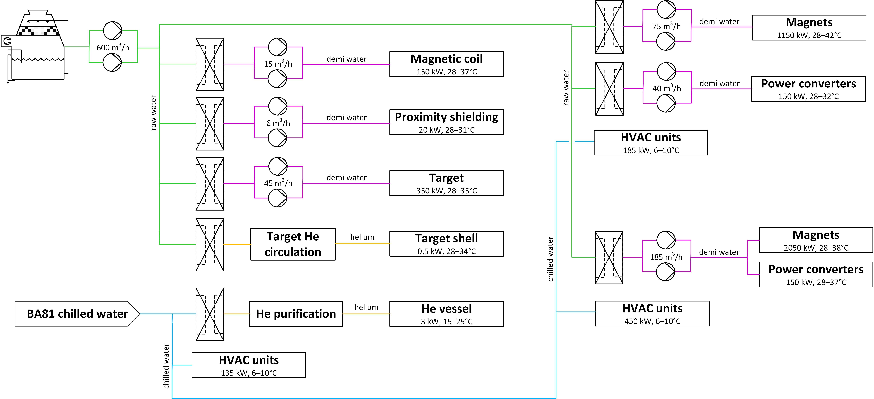
BDF Cooling Design
Extraction Area
Target Complex
Experimental Area
Type of cooling | Extraction Area [kW] | TC [kW] | Exp. Area [kW] | BDF complex TOTAL [kW]
Demineralized water | 1300 | 600 | 2200 | 4500
Chilled water | 185 | 135 | 450 | 770

Slide 20
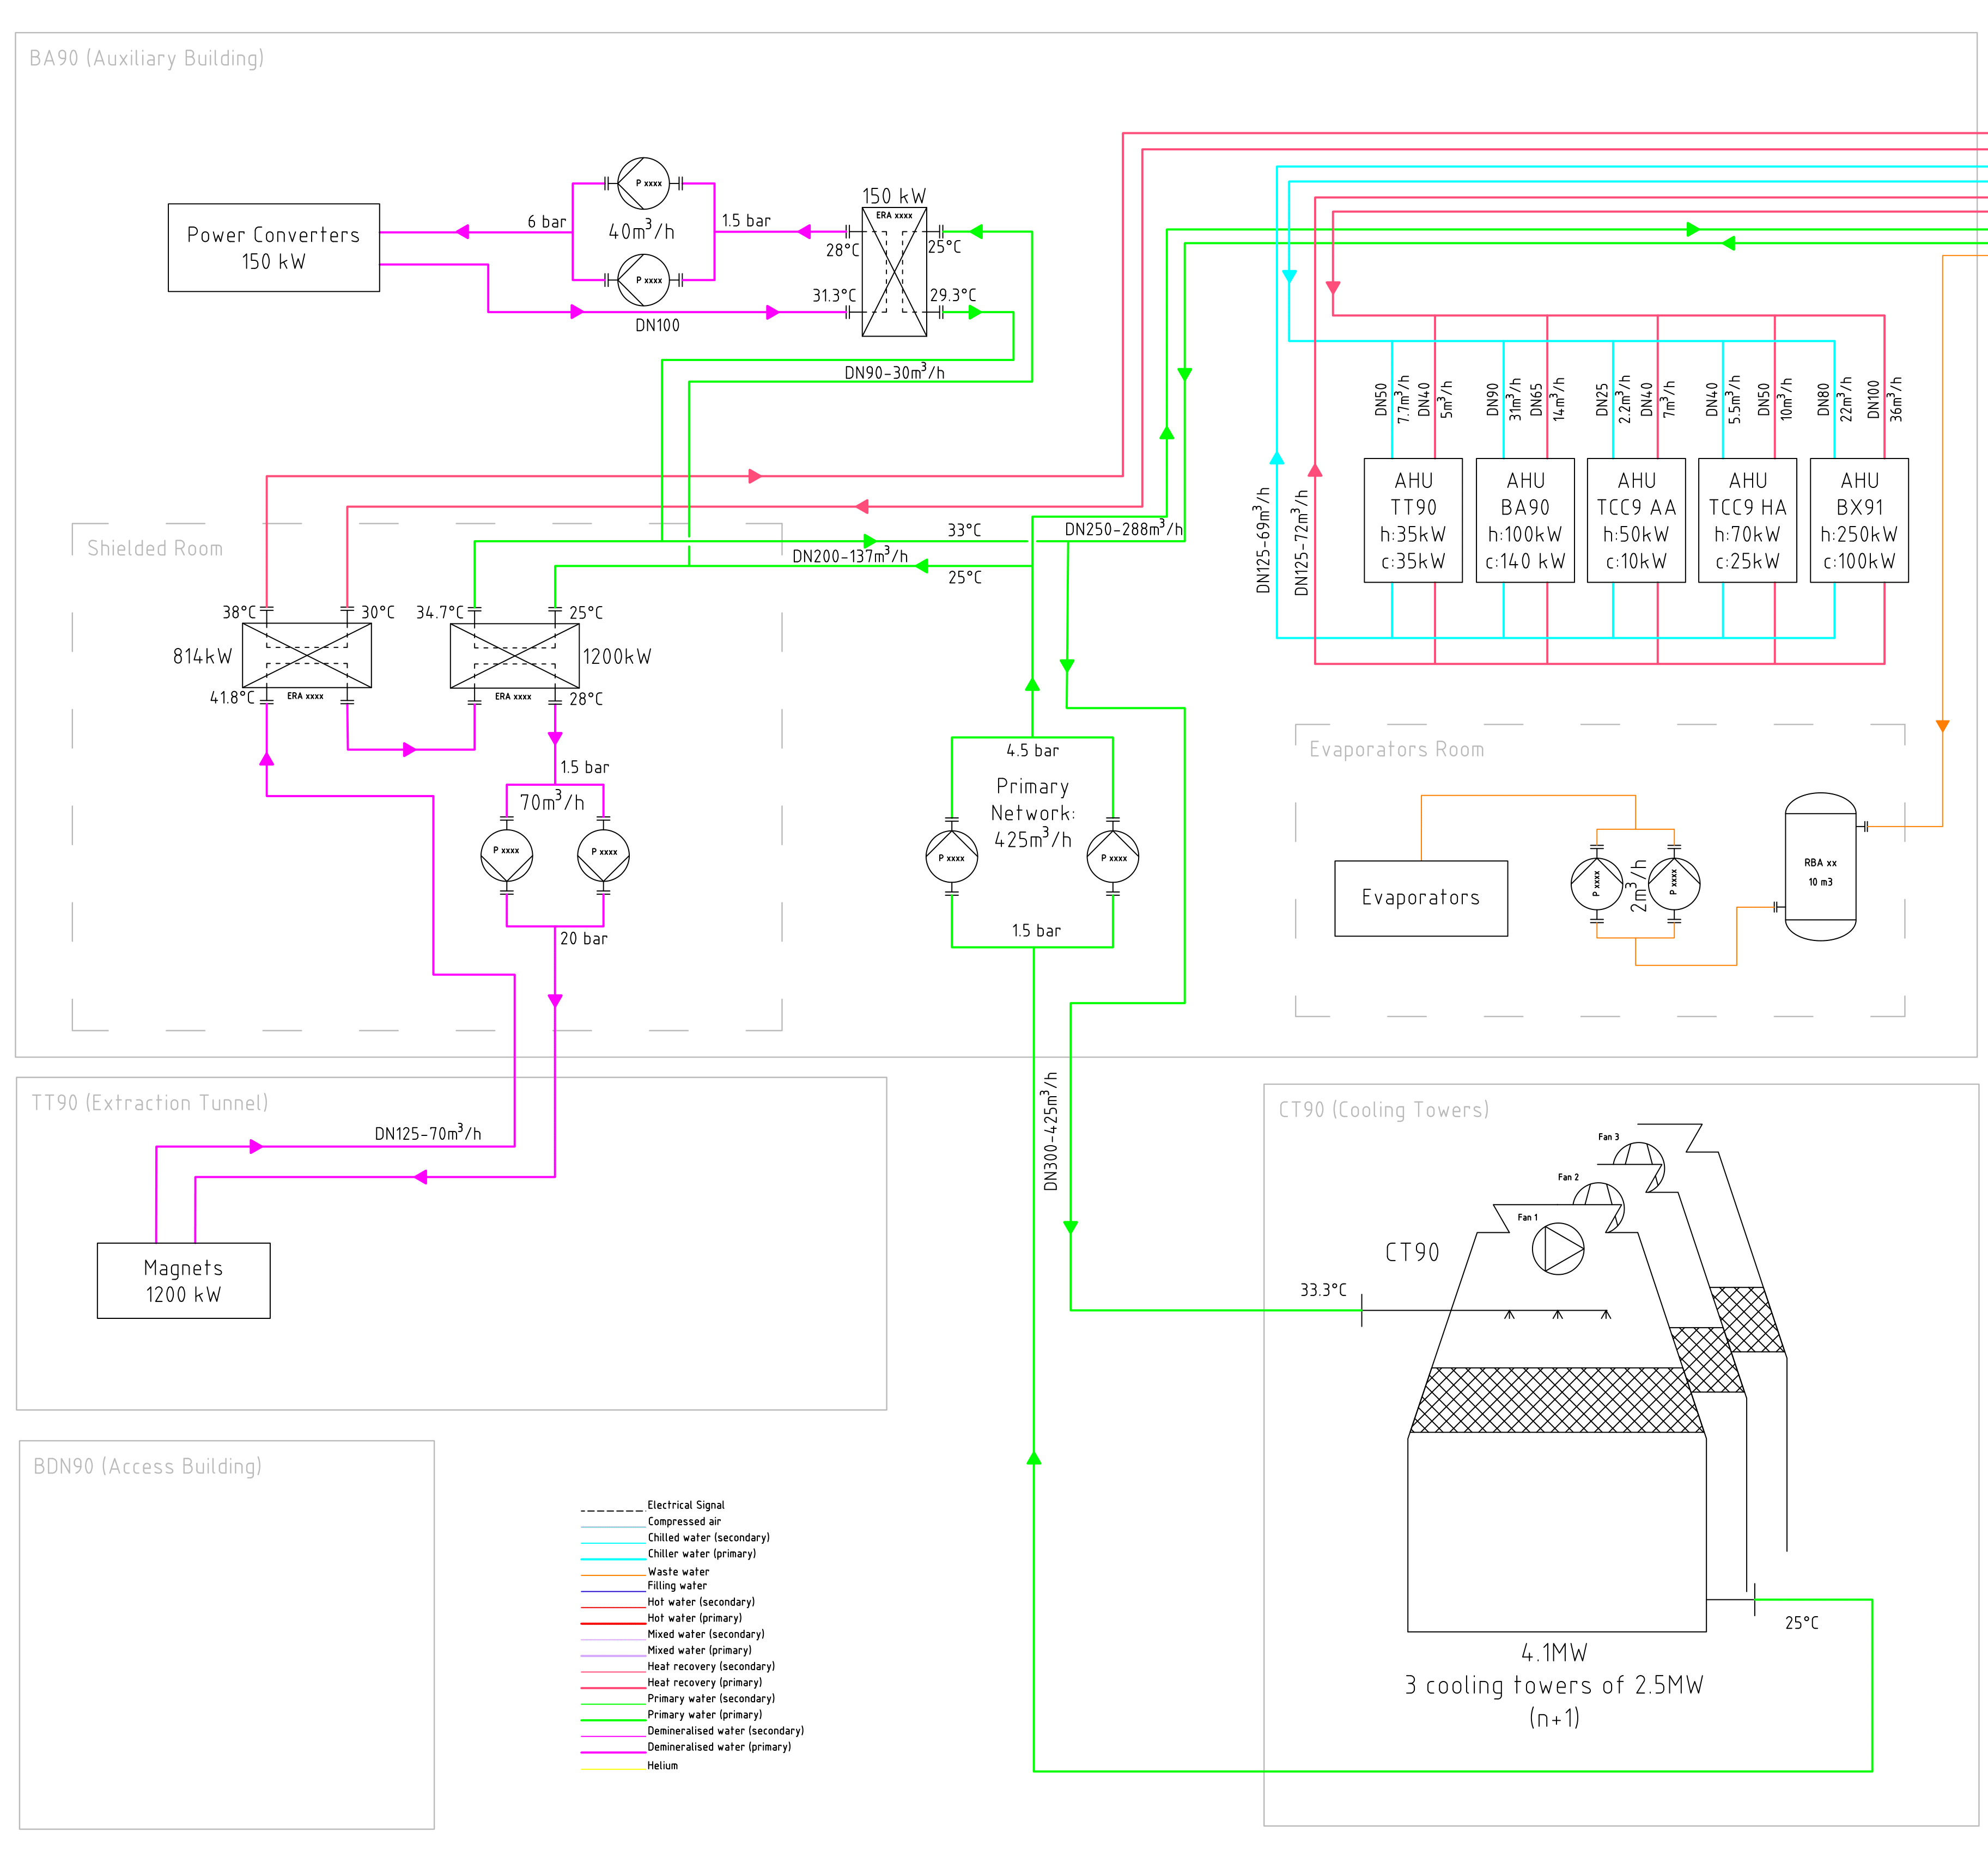
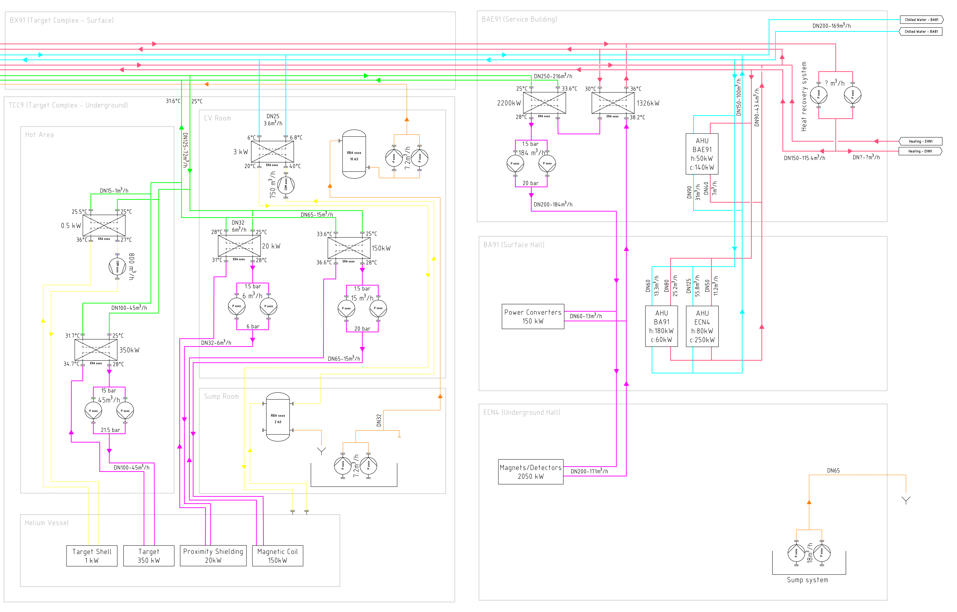
BDF Cooling Synoptic (CS)
Extraction Area
Target
Complex
Experimental
Area

Slide 21
Extraction Area CS

Slide 22
Target Complex CS

Slide 23
Experimental Area CS

Slide 24
BDF Primary Cooling
Extraction Area
Target Complex
Experimental Area

Slide 25
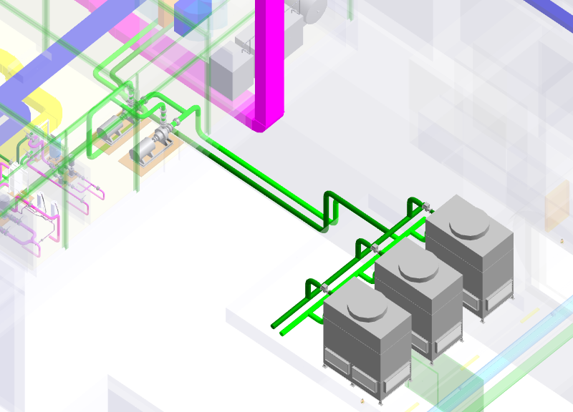
BDF Primary Cooling
Option 1 Local cooling towers | Option 2 CT2 cooling towers
Operation independent from other cooling systems in the Prevessin area | Operation dependent on CT2 towers availability
Operation and maintenance more complex (water treatment, etc.) | No added complexity from operation and maintenance standpoint
Potential activation confined to new experimental area | Potential activation spreading over CT2 cooling system
Requires installation of cooling towers and pumping station on the new site | Requires the upgrade of the CT2 pumps and a new pipeline (technical gallery)
4500 kW nominal, 600 m3/h
3 CT (N+1 redundancy) 2500 kW each
DT: 7 K (9 K for high power SHiP magnet)
2 pumps (N+1) in auxiliary building

Slide 26
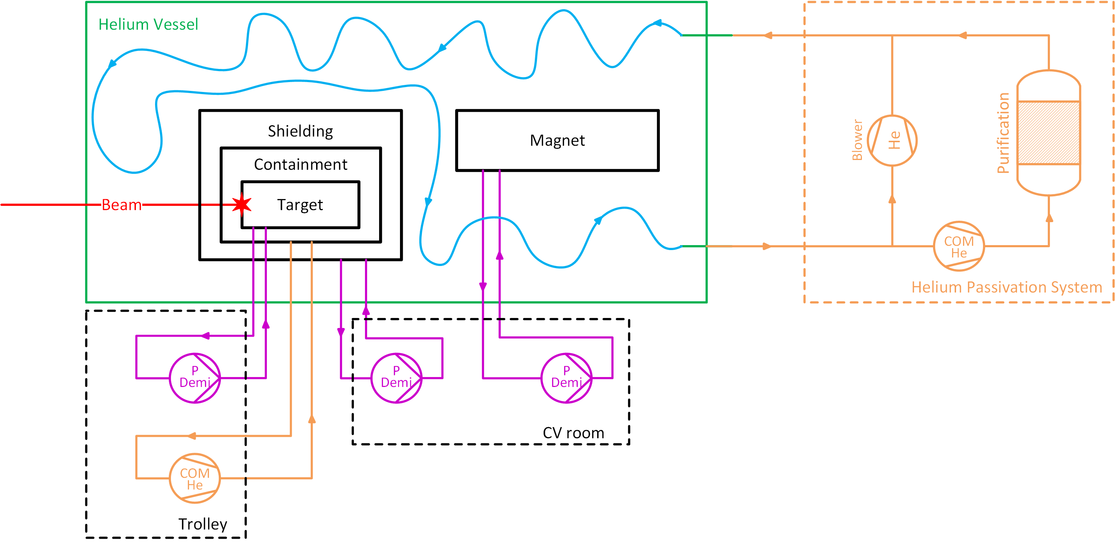
Helium Vessel CV Systems

Slide 27
Target Water Cooling System
Extraction Area
Target Complex
Experimental Area

Slide 28
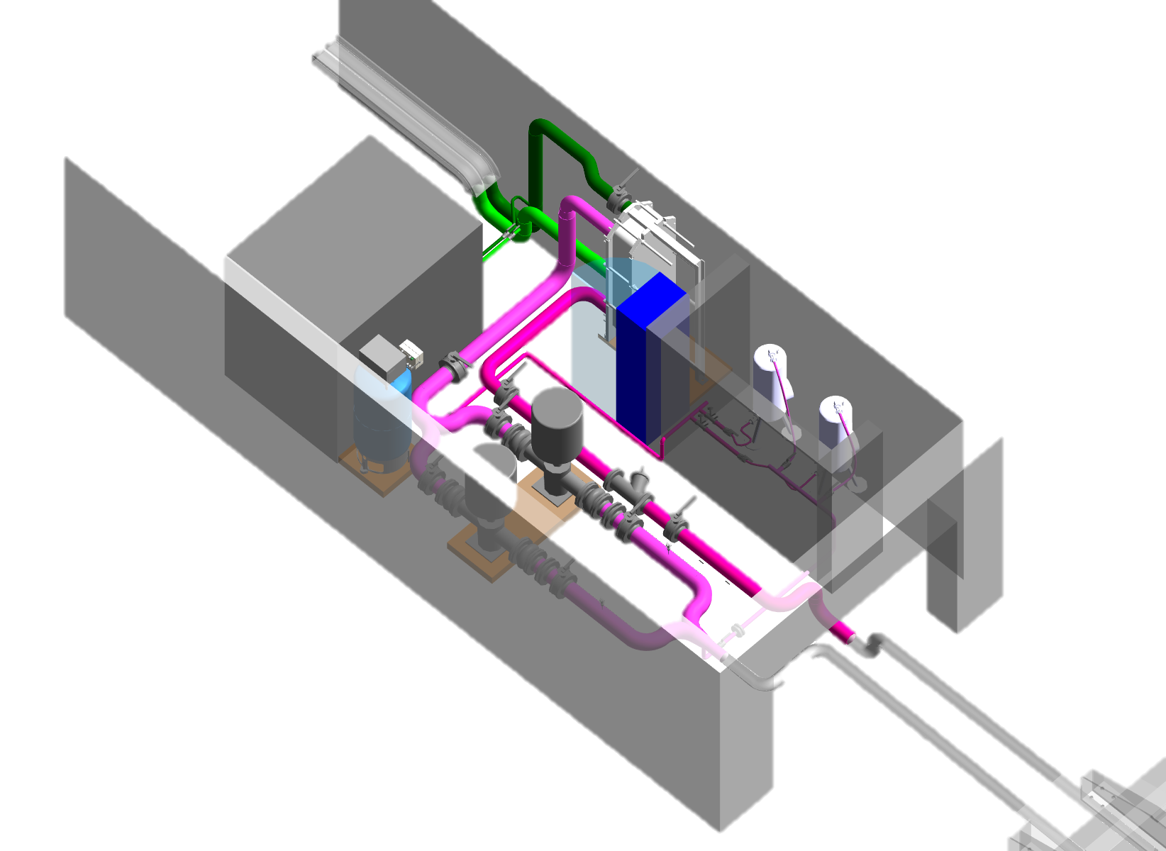
Target Water Cooling System
On trolley
Secondary demi water,
350 kW on average
Double-wall heat exchanger: prevent cross-contamination
EPDM OK for gaskets
Automated filling, pressurization and draining
Radioactive area: pneumatic actuators

Slide 29
BDF Shielding & Magnet Cooling
Extraction Area
Target Complex
Experimental Area

Slide 30
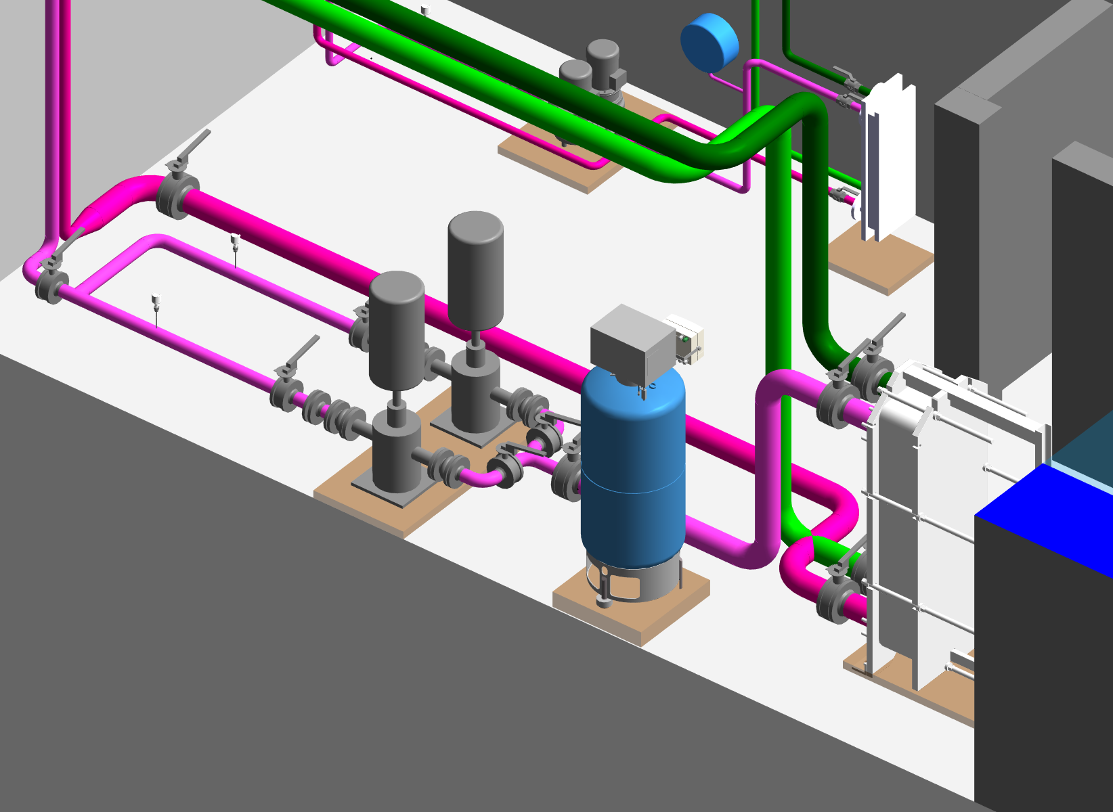
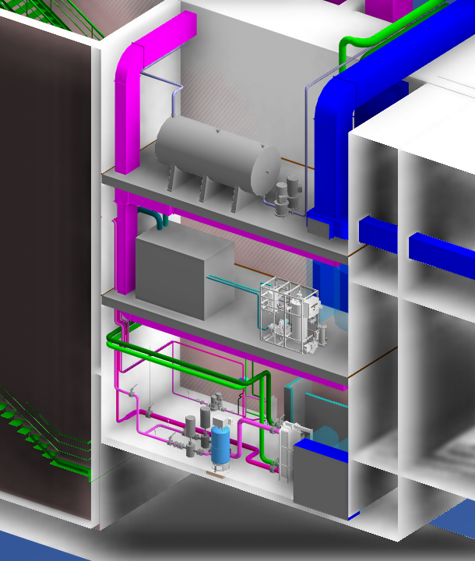
BDF Shielding & Magnet Cooling
CV room
CV room: lowest level
2 circuits:
  Shielding: 20 kW
  Magnet: 150 kW
Demineralized water
Redundant shielded cartridges
Investigating He cooling for magnet

Slide 31
BDF Target Helium Circulation
Extraction Area
Target Complex
Experimental Area

Slide 32
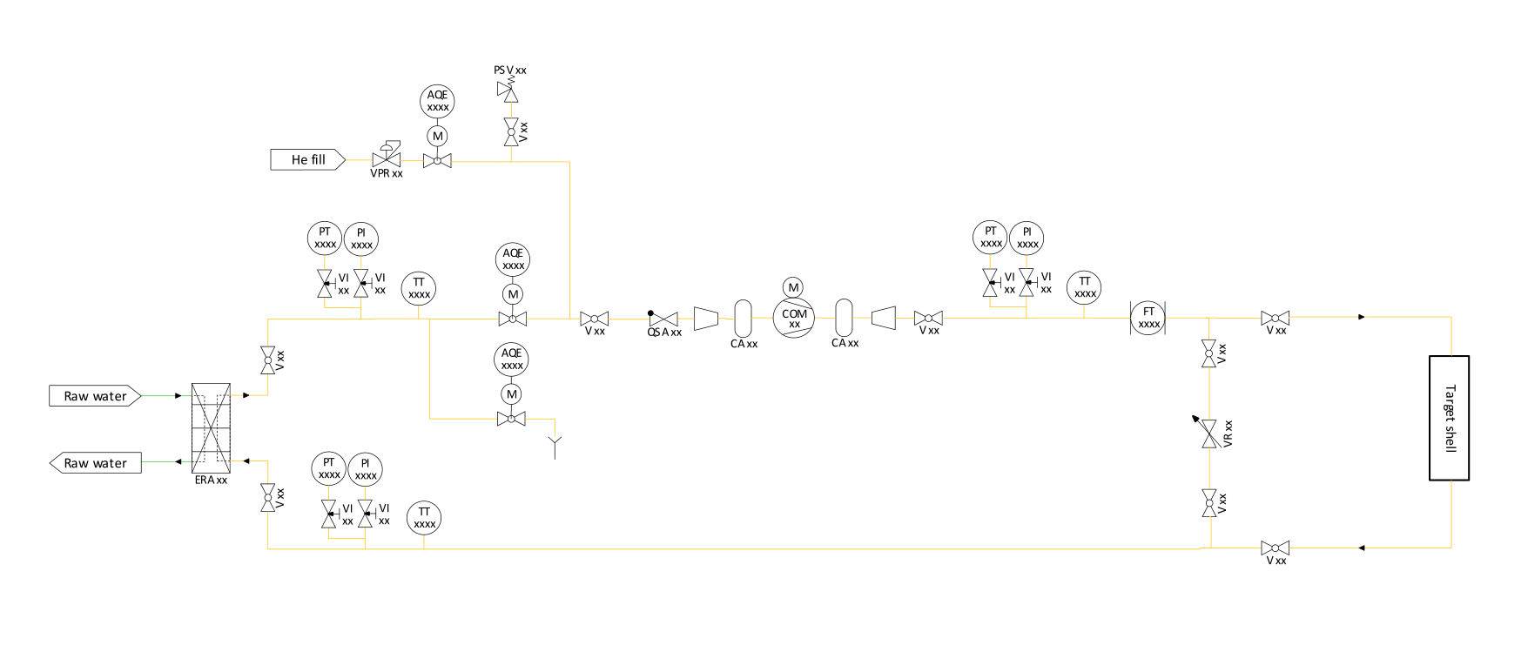
BDF Target Helium Circulation
Purpose:
Blow helium around target containment;
Detect leaks from target containment;
Parameter | Unit | Value
Location | - | Trolley
Flow rate | g/s | 4.1
Changes per hour | 1/h | 1000
T in | °C | 28
T out max | °C | 50
DT max | °C | 22
Thermal load | kW | 0.5
Piping size | - | DN25
Pressure supply | bara | 1.1
Pressure drop | Pa | 6000

Slide 33
BDF Helium Passivation
Extraction Area
Target Complex
Experimental Area

Slide 34
BDF Magnets Cooling
Extraction Area
Target Complex
Experimental Area

Slide 35
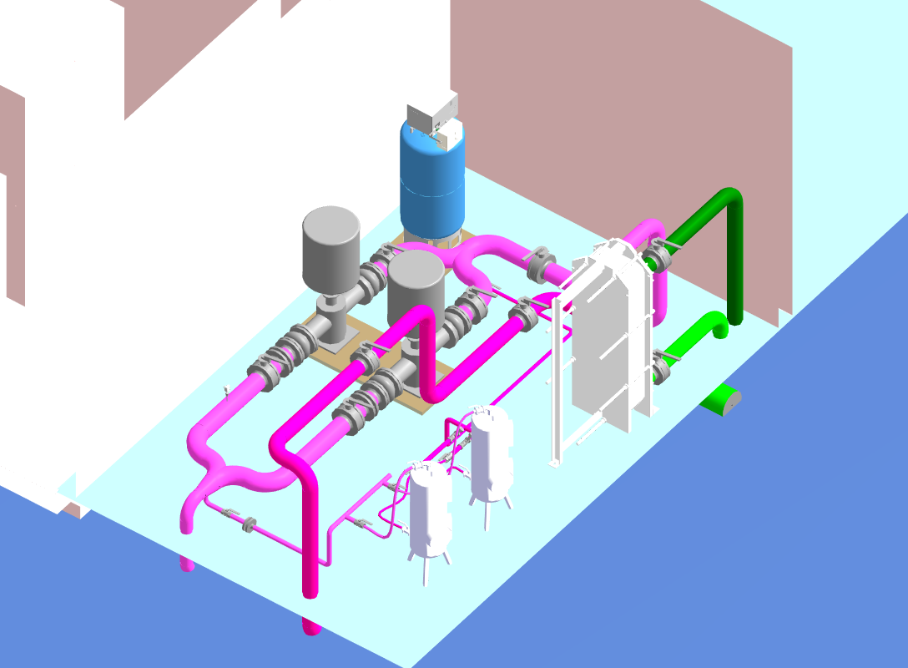
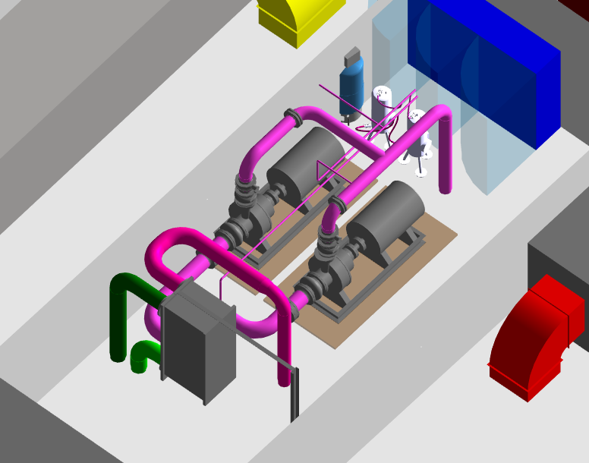
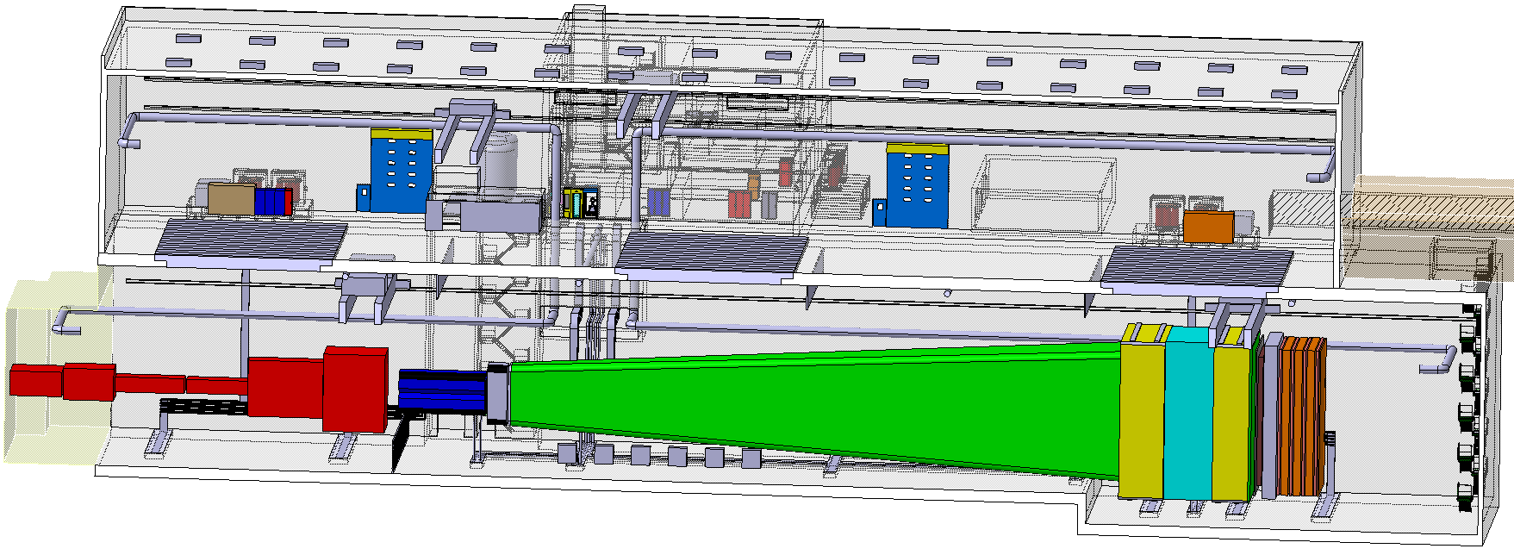
BDF Magnets Cooling
Extraction Tunnel
Experimental Area
1200 kW, 75 m3/h, 41°C
20 bar, demi water
Cooling station in auxiliary building
2200 kW, 185 m3/h, 37°C
Demi water
Cooling station in service building

Slide 36
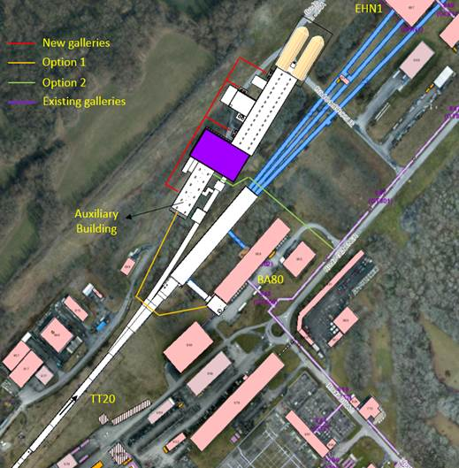
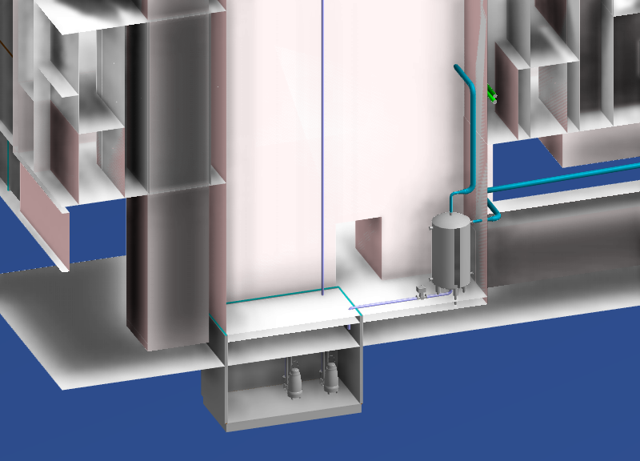
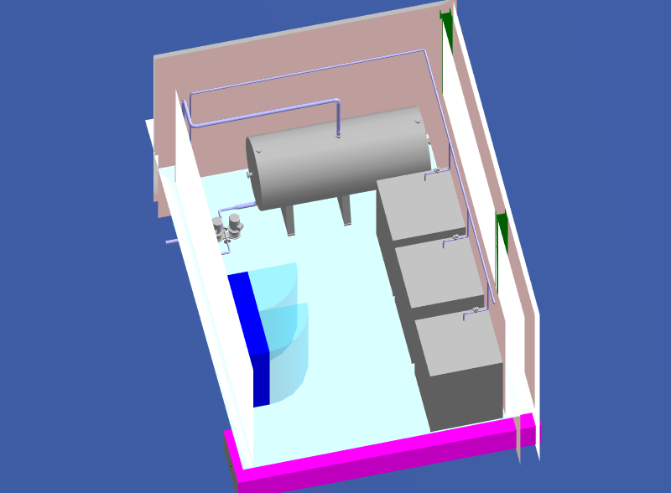
Chilled Water and Rising System
Technical Gallery, options:
Evaporation System

Slide 37
BDF Ventilation Requirements
Extraction Area (WP: EDMS 2050765)
Ventilation Area | T Range [°C] | RH range [%] | Min Heat Load [kW] | Max Heat Load [kW] | RP Class
Extraction tunnel | 18-26 | <70% | -33 | 28 | NC
Access building | 18-26 | - | -22 | 8 | NC
Auxiliary building | 18-26 | <70% | -102 | 138 | NC
Target Complex (WP: EDMS 2050757)
Ventilation Area | T Range [°C] | RH range [%] | Min Heat Load [kW] | Max Heat Load [kW] | RP Class
Surface hall | 18-26 | - | -129 | 48 | C1
Access area | 18-26 | <70% | -3 | 6 | C1
Hot area | 18-24 | <70% | -2 | 16 | C2
Experimental Area (WP: EDMS 2050772)
Ventilation Area | T Range [°C] | RH range [%] | Min Heat Load [kW] | Max Heat Load [kW] | RP Class
Experimental hall | 18-26 | 40-70 | -75 | 253 | NC
Surface hall | 18-26 | - | -173 | 57 | NC
Service building | 18-26 | <70 | -49 | 125 | NC

Slide 38
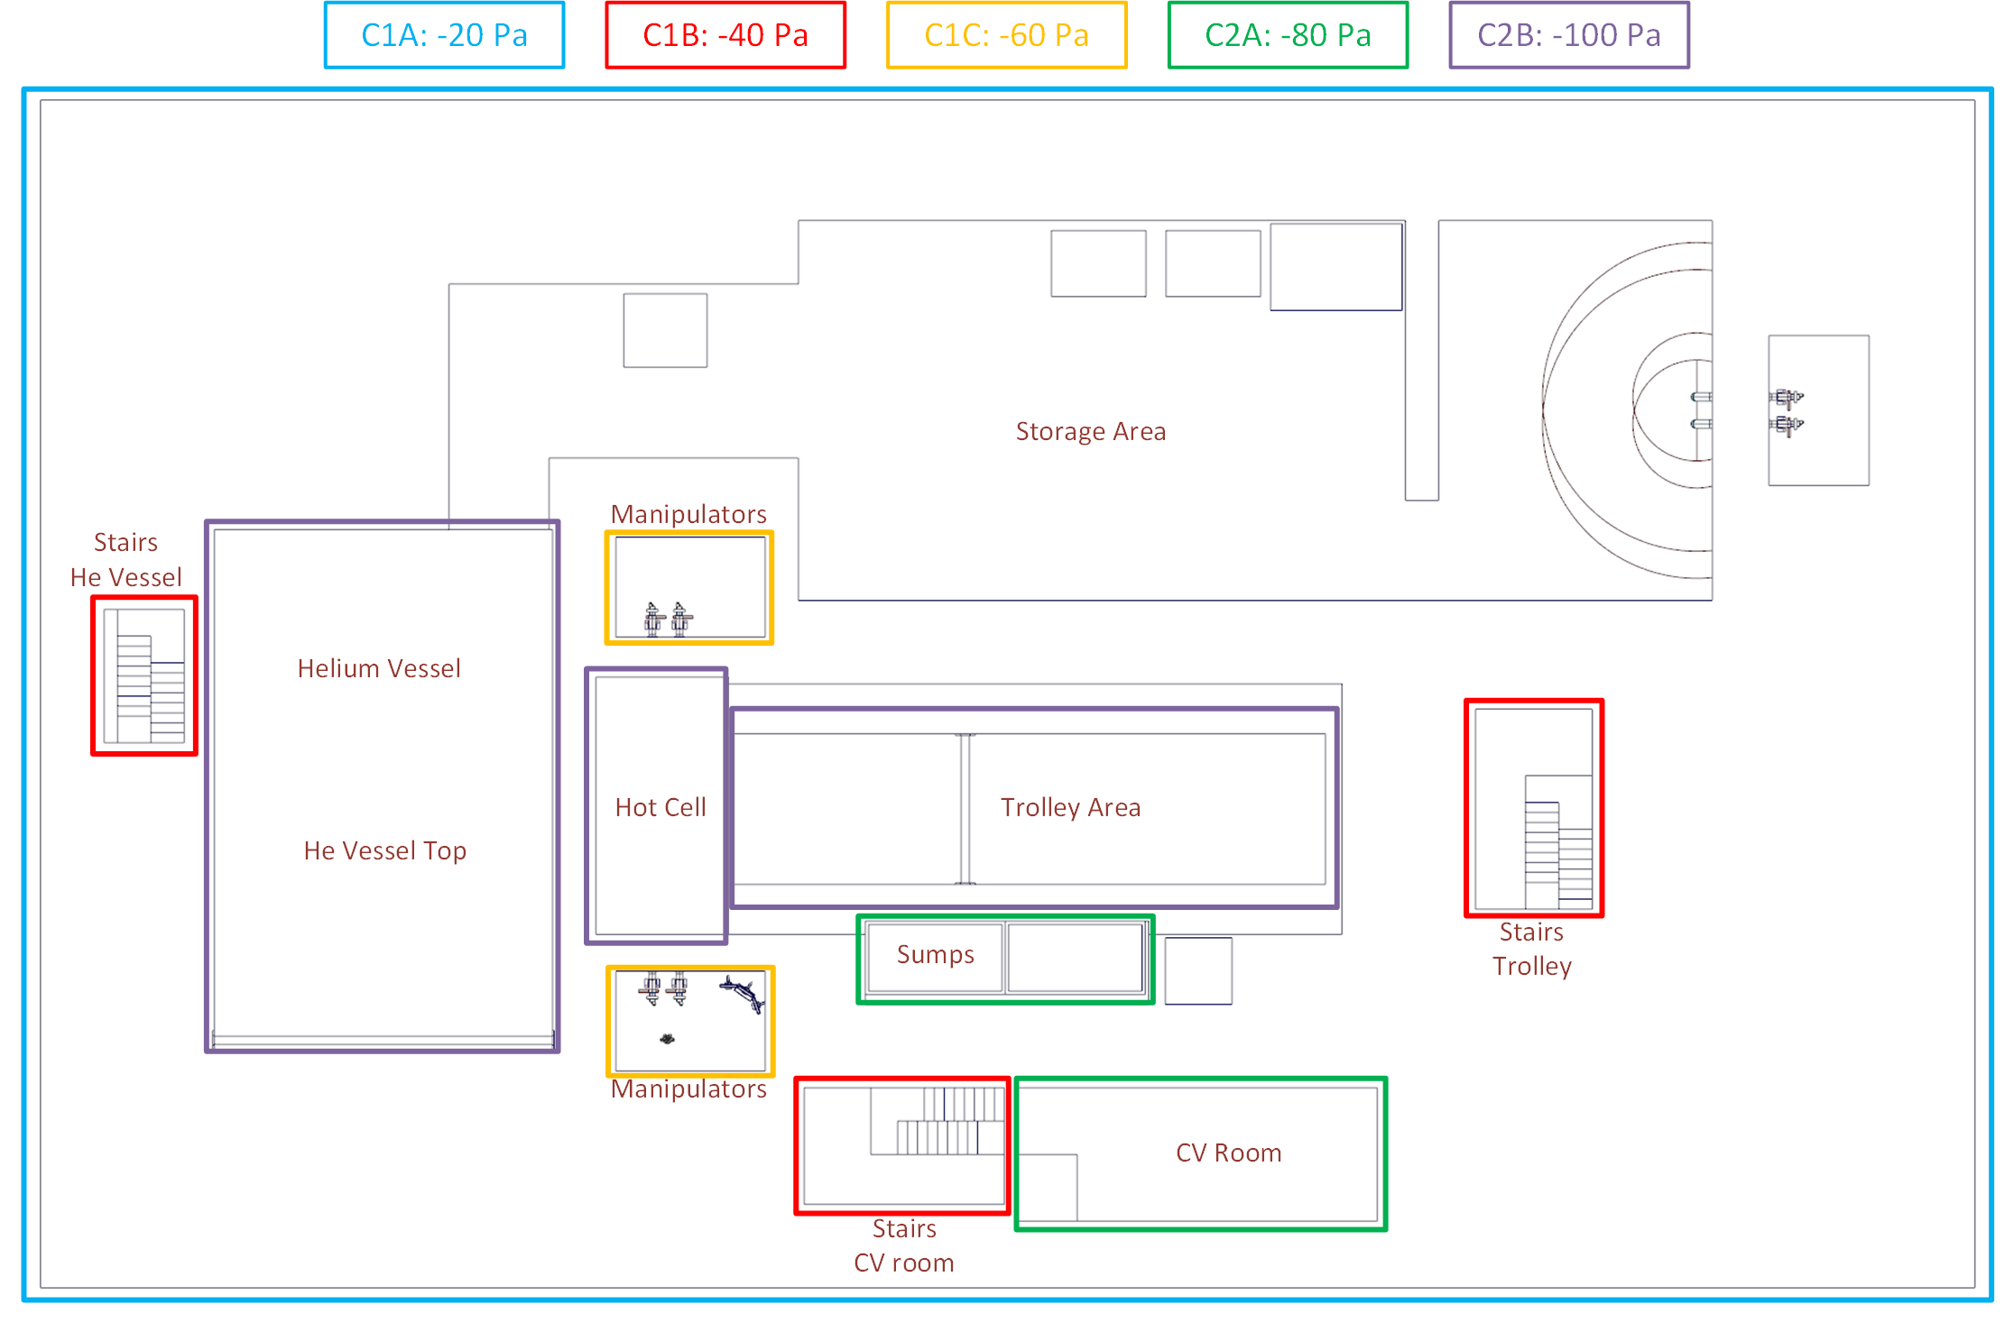
BDF Dynamic Confinement Requirements
Row Labels | Tot Volume [m³] | Min RP flow [m³/h]
C1A | 28 786 | 28 800
C1B | 618 | 1 250
C1C | 291 | 1 200
C2A | 901 | 1 800
C2B | 746 | 3 750
RP requirements: ISO 17873:2004(E)

Slide 39
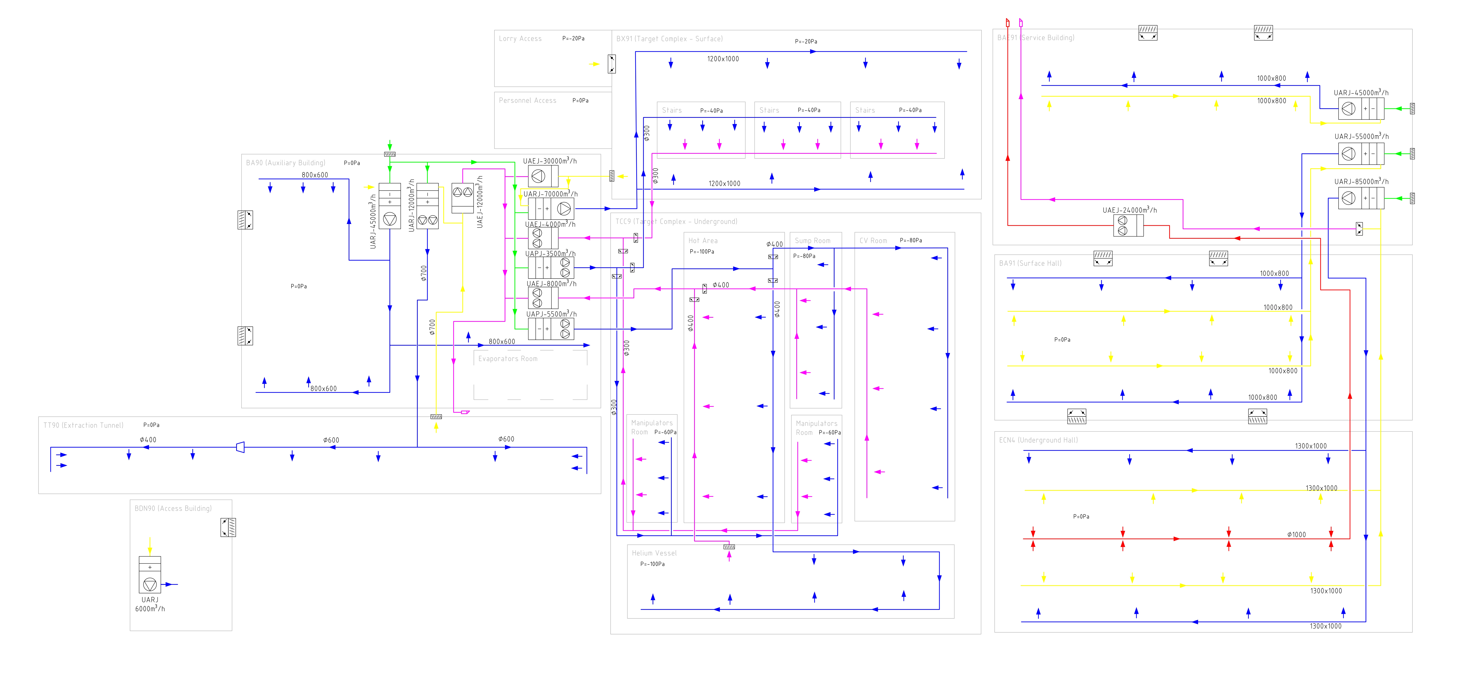
BDF Ventilation Synoptic (VS)
Extraction
Area
Target
Complex
Experimental
Area

Slide 40
BDF VS Extraction Area

Slide 41
BDF VS Target Complex

Slide 42
BDF VS Experimental Area

Slide 43
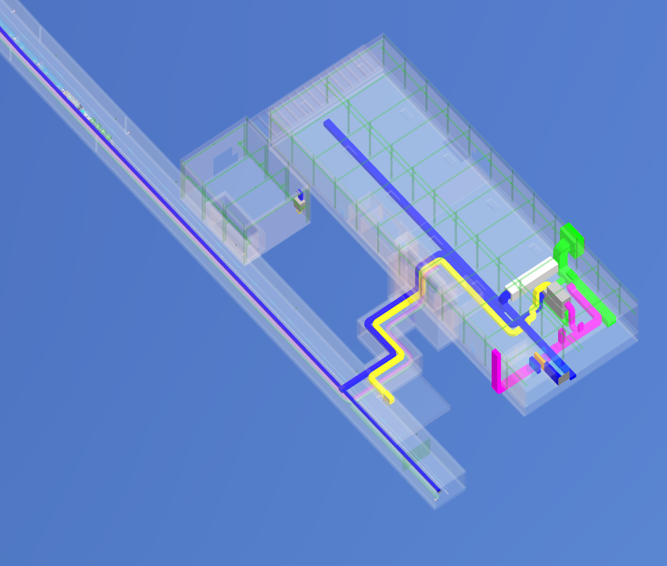
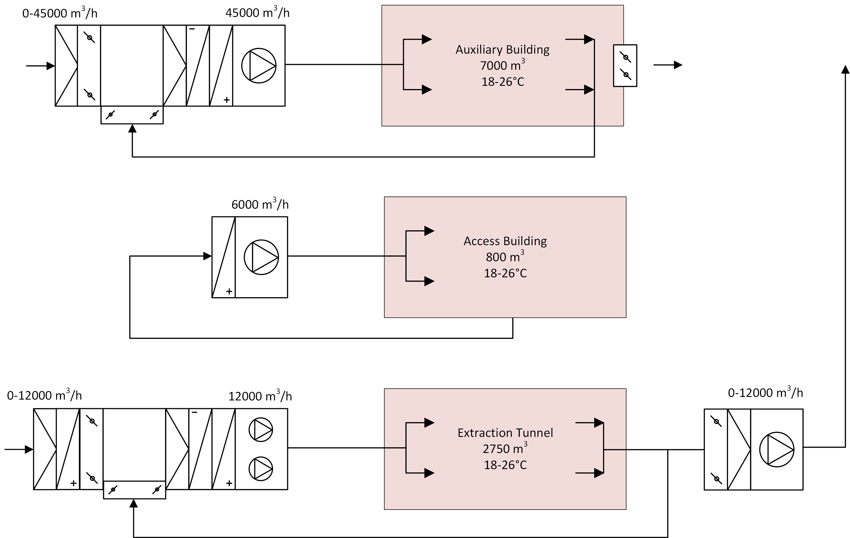
Extraction Area Ventilation
AHUs in auxiliary building
Activation only for Tunnel
No dynamic confinement
Extraction only during shutdown

Slide 44
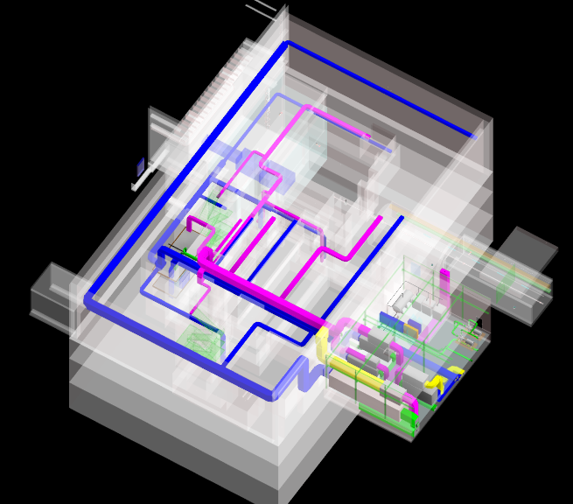
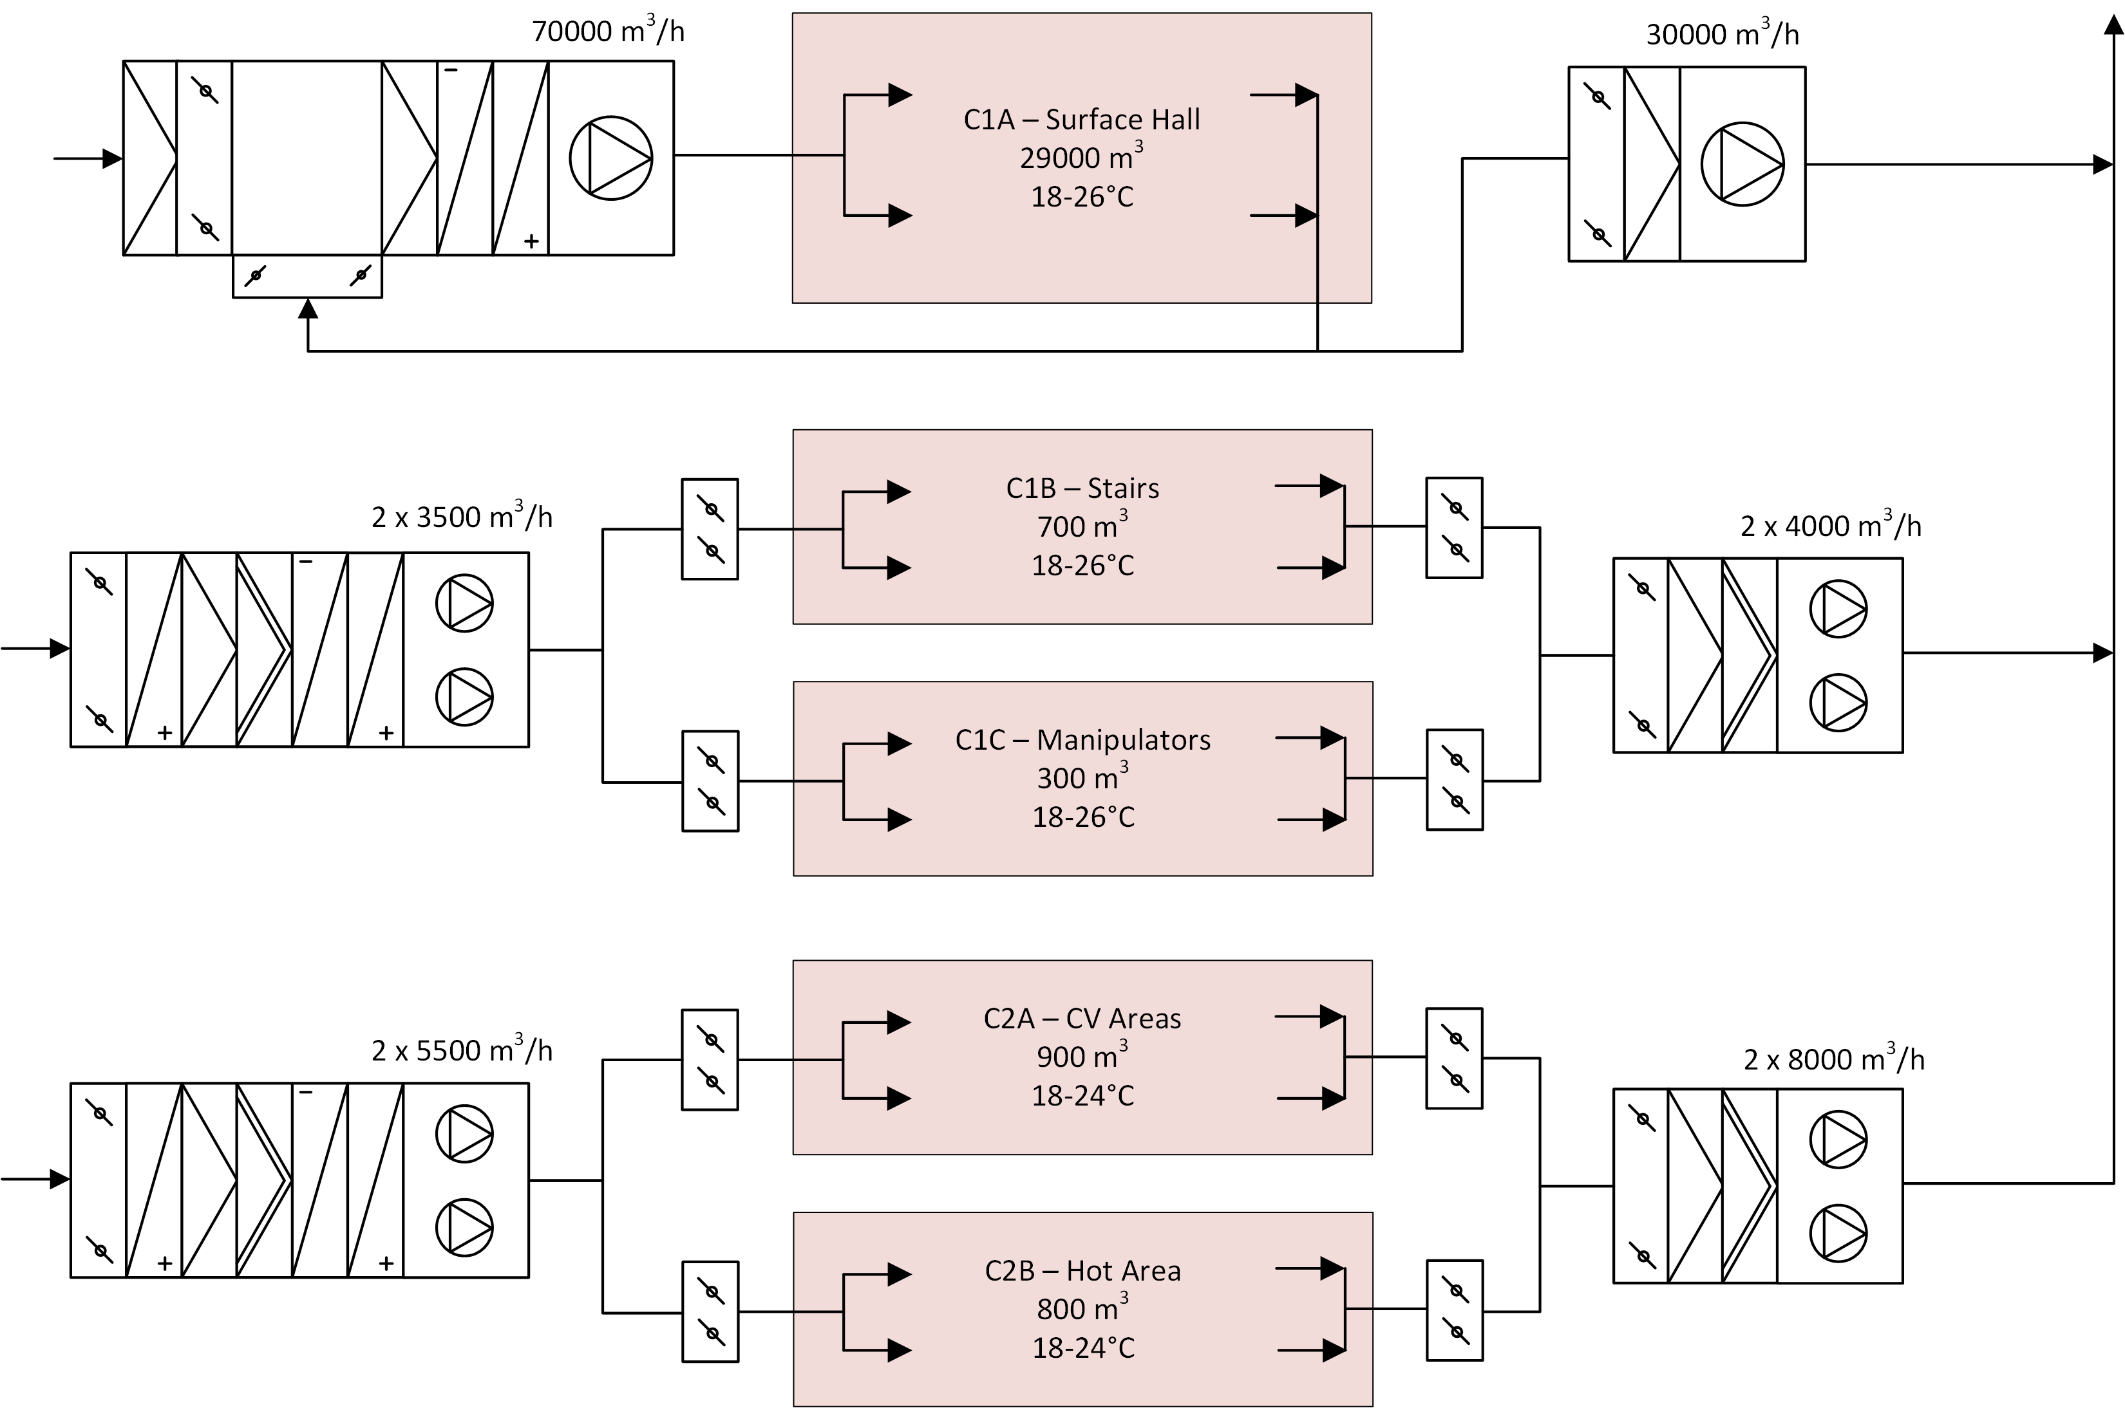
TC Ventilation
AHUs in auxiliary building
Pressure cascade from -20 Pa to -100 Pa
3 classes: C1A, C1B, C2
Extractors for depressurization

Slide 45
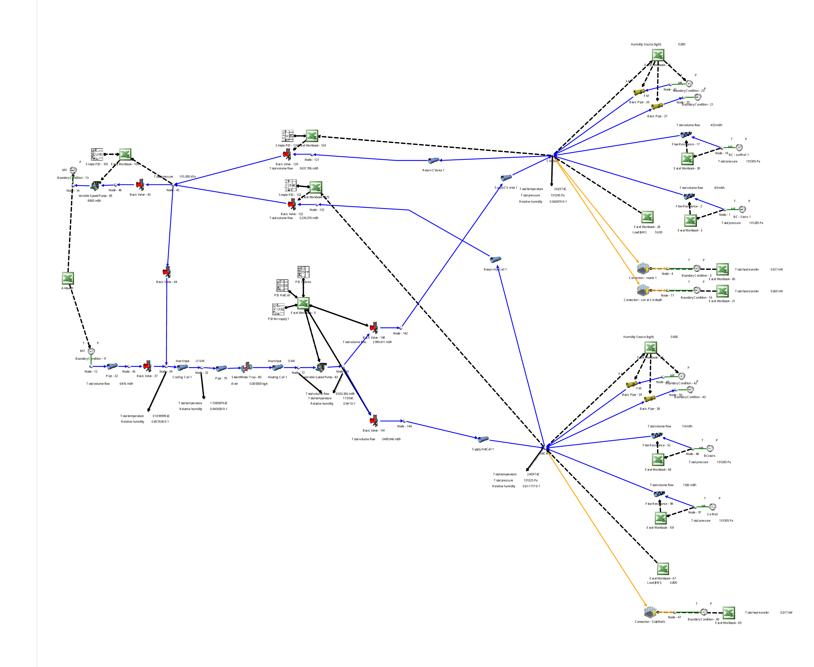
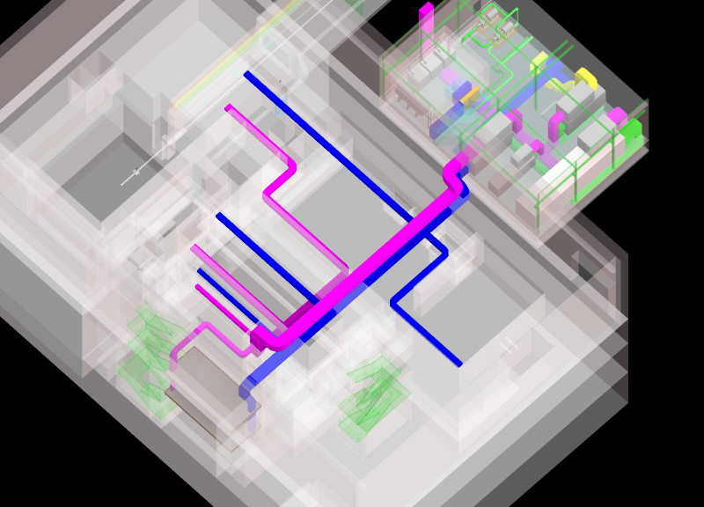
TC Hot Area HVAC Flownex
Humidity source
Regulation approach (PID controller, control components)
Air leakage
Heat loads
Sizing (piping, dampers, control valves)

Slide 46
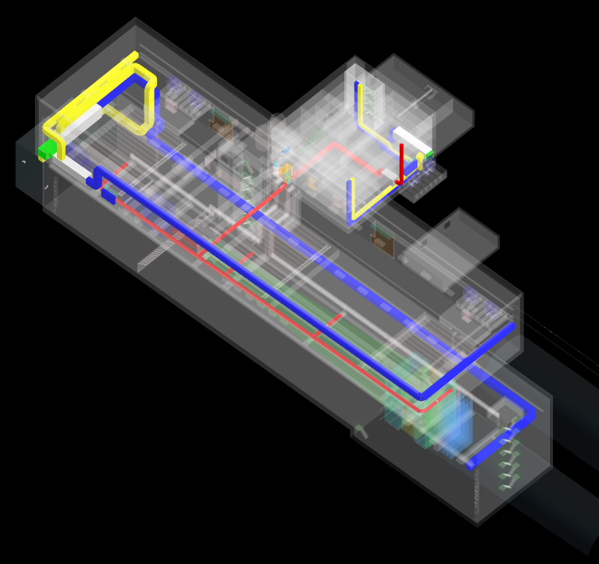
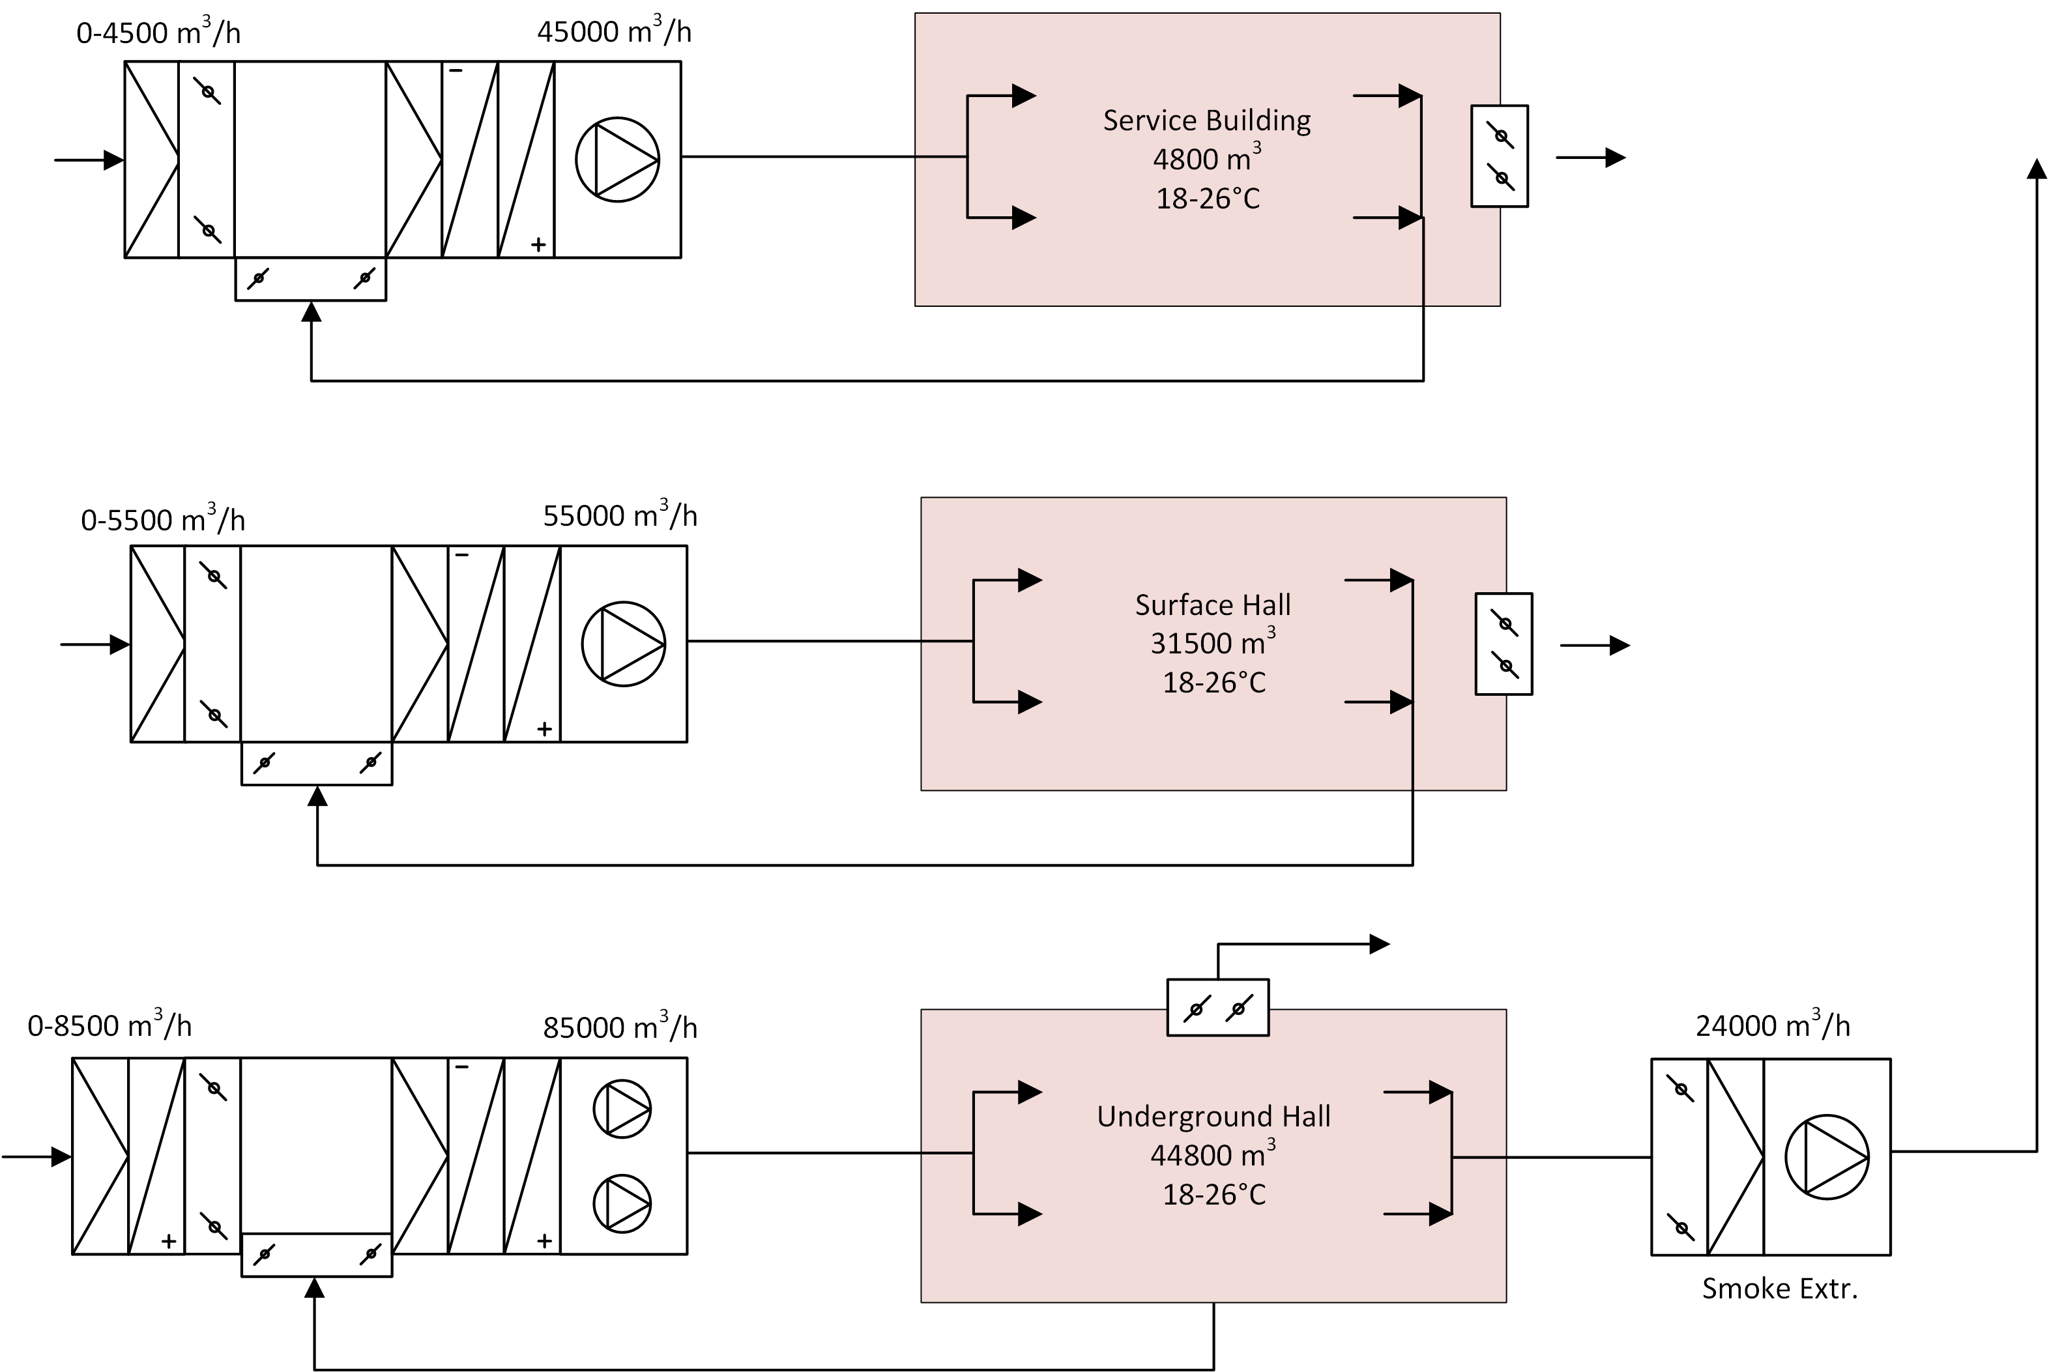
Experimental Area Ventilation
AHUs in service building
No activation expected
No dynamic confinement
CFD for underground flow

Slide 47
Outline
BDF Project
  Overview of the Project
  Cooling Design
  Ventilation Design
BDF Target Prototype (TCC2)
  Target and Target Prototype Design
  Cooling Skid Design
  Installation and Testing
BDF Helium Passivation System
  Overview and Process Description
  Selection of Components
  Budget & Schedule

Slide 48
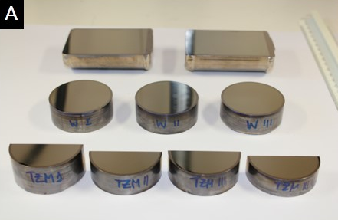
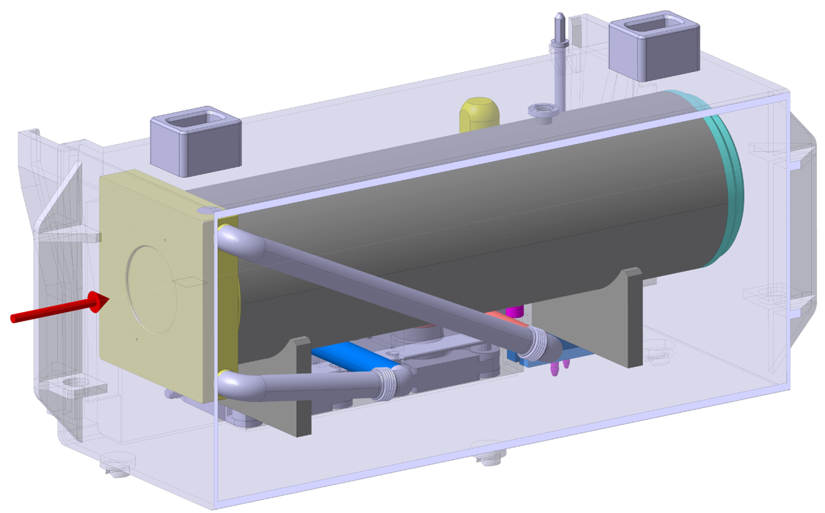
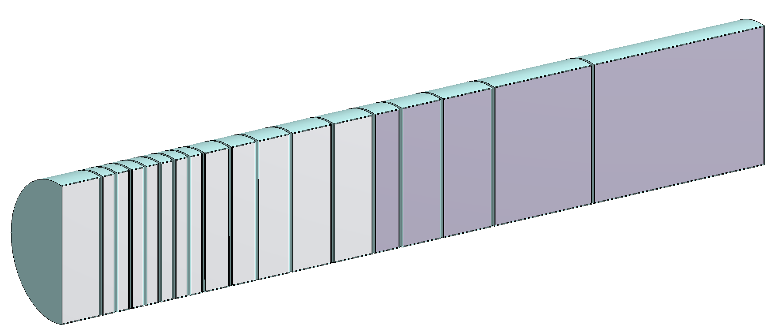
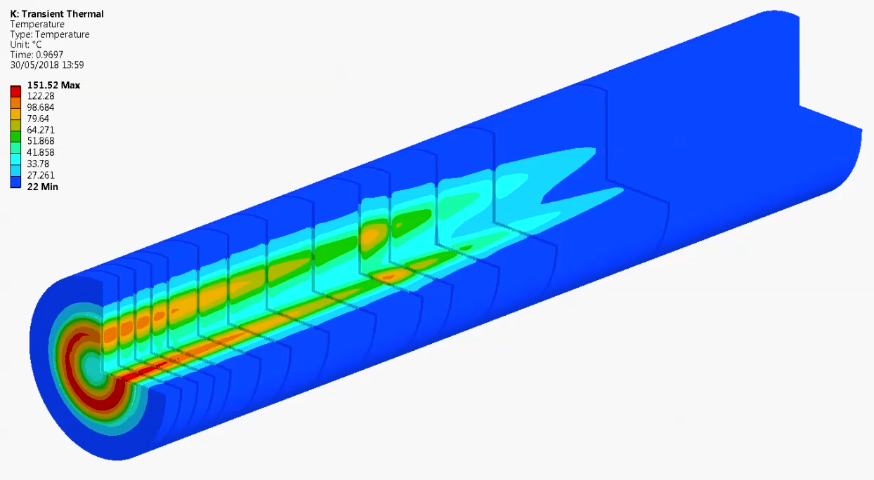
BDF Target Design
Need to dissipate around 320 kW of heating power (~5 MW/m³)
Optimized segmentation, forced water cooling
CFD simulation mainly by CV
Thermo-mechanical design
  2nd part: Tungsten core
  High-Z and good performance under irradiation
  1st part: TZM core
  Molybdenum alloy, higher strength and recrystallization temperature than pure Mo
  Ta/Ta2.5W cladding
Ø250 mm
~1.5 m

Slide 49
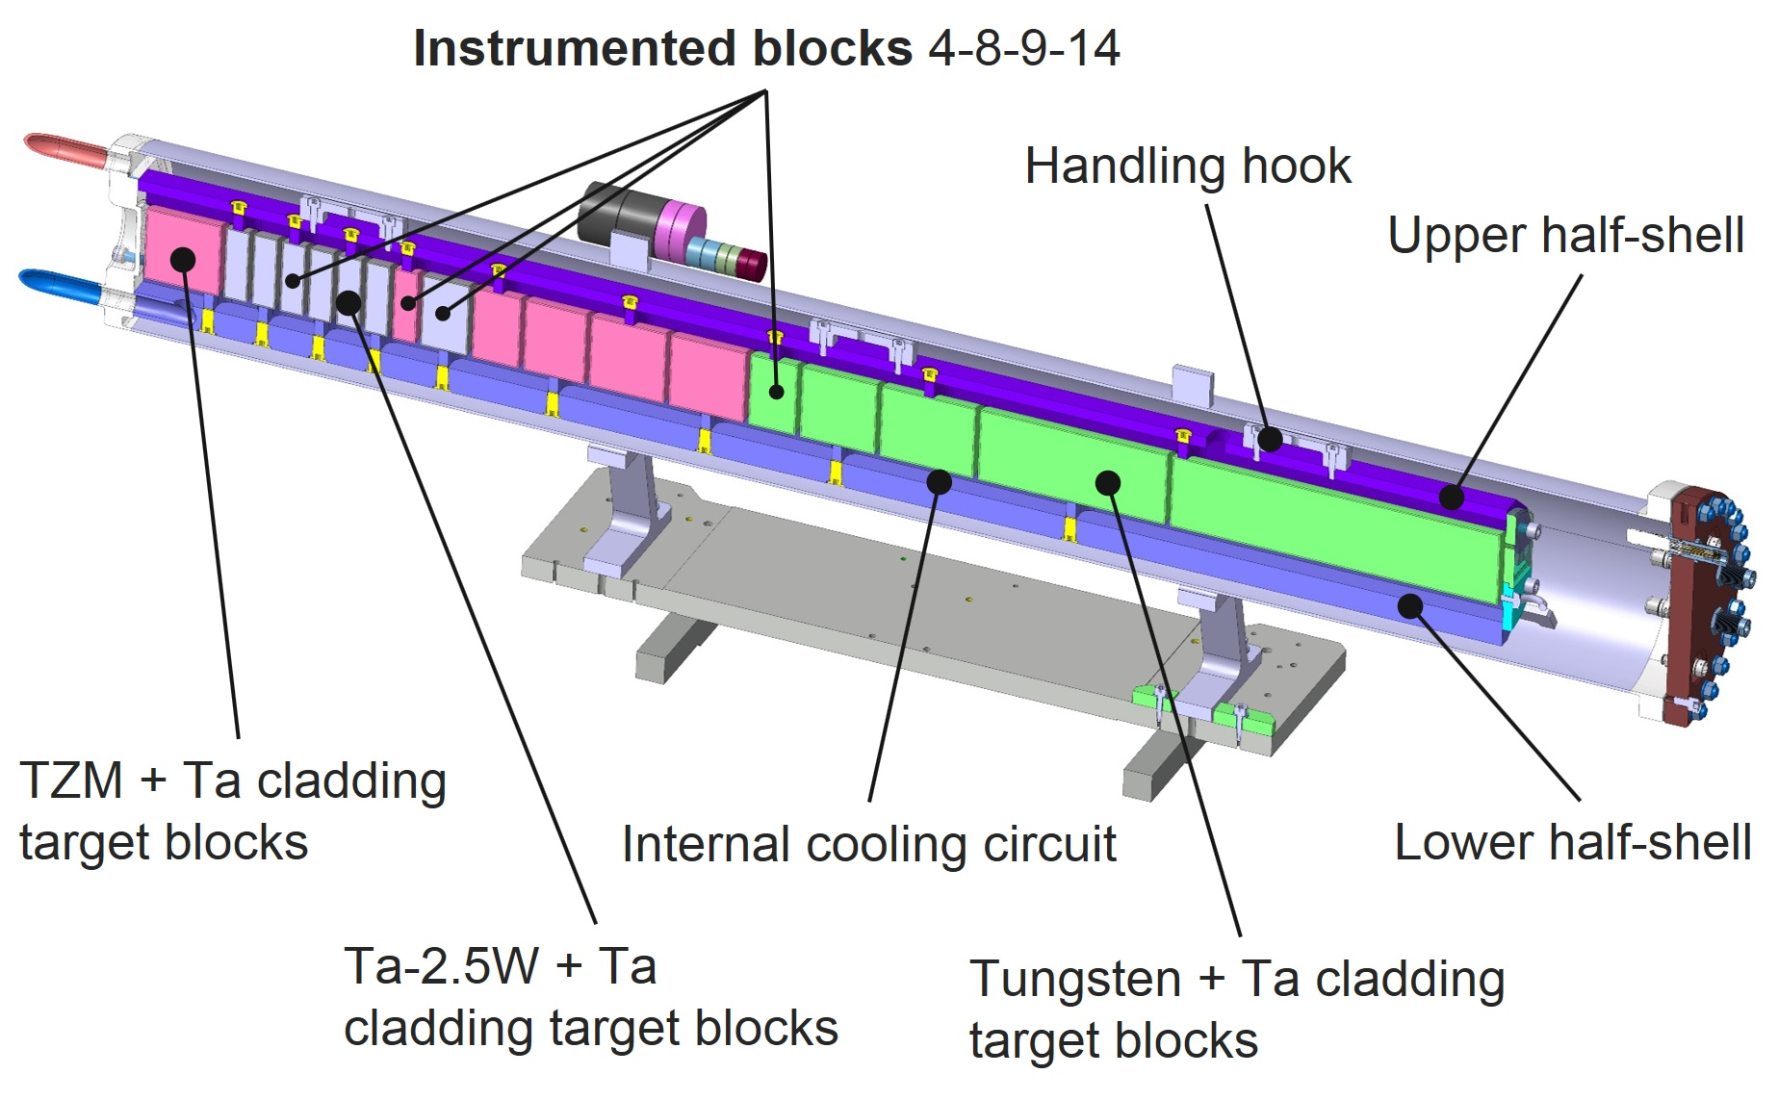
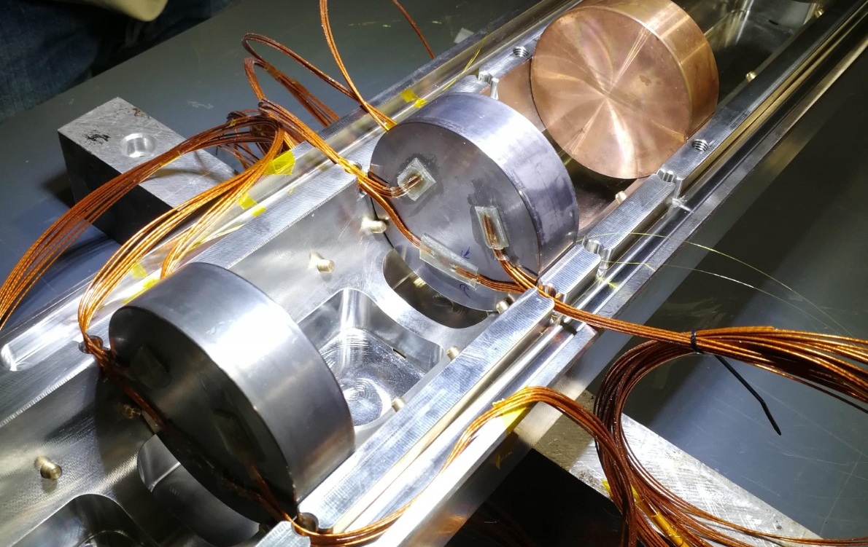
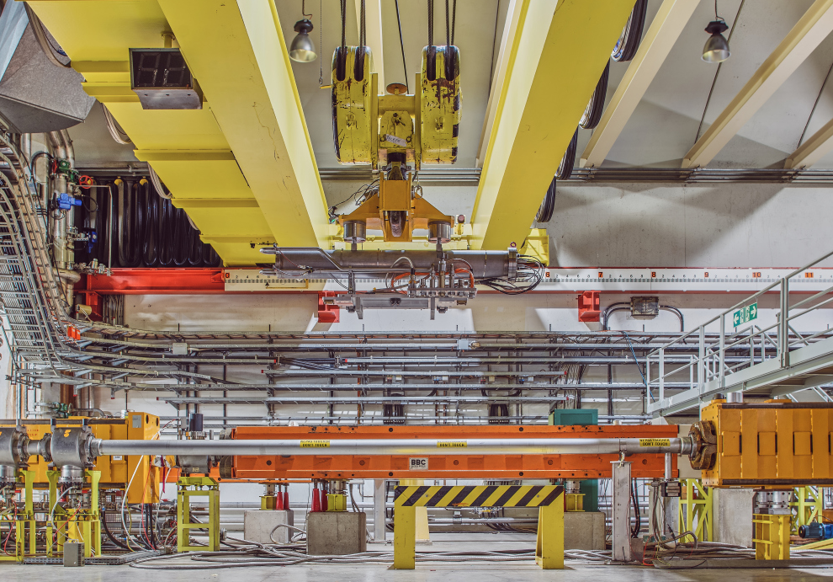
BDF Target Proto
Reliability of the target is a critical aspect for the design of BDF
  Representative beam test executed before LS2
Reduced scale prototype
  Reduced diameter (80 mm)
Experimental setup installed in TCC2, upstream T6 primary target
High intensity beam on target during >14 h (45 kW deposited ~6 MW/m3)
  Online measurements performed
  Good correlation with simulations
Validation of final target operational conditions

Slide 50
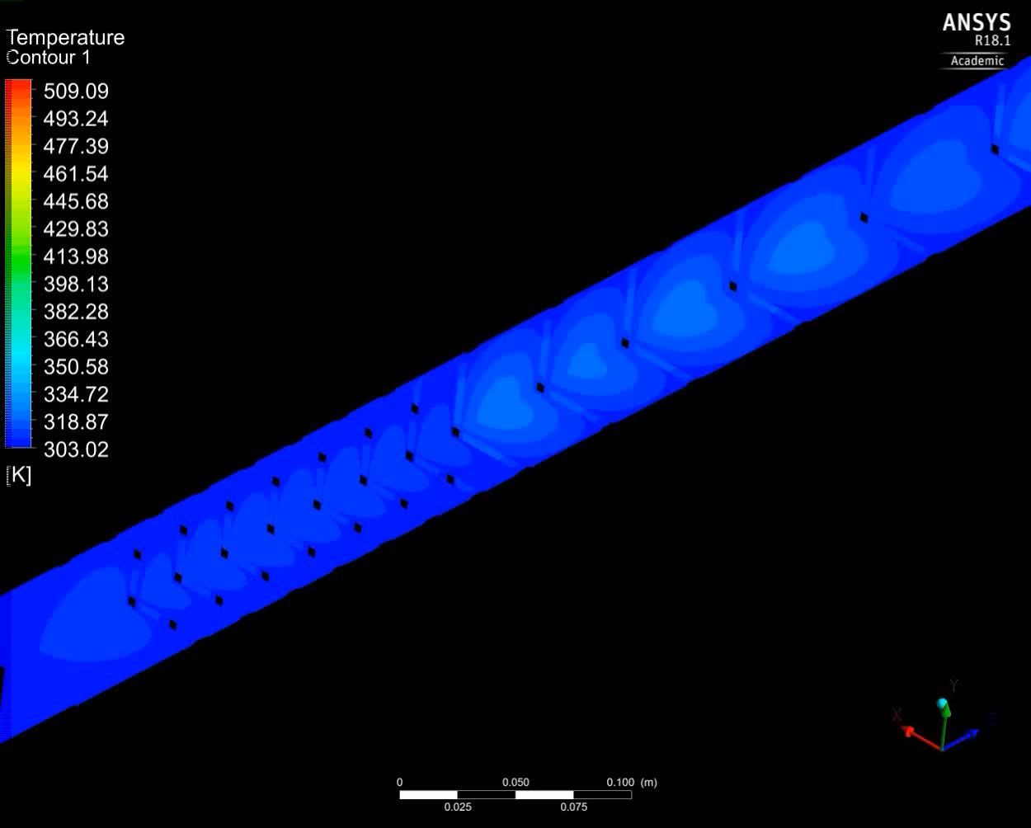
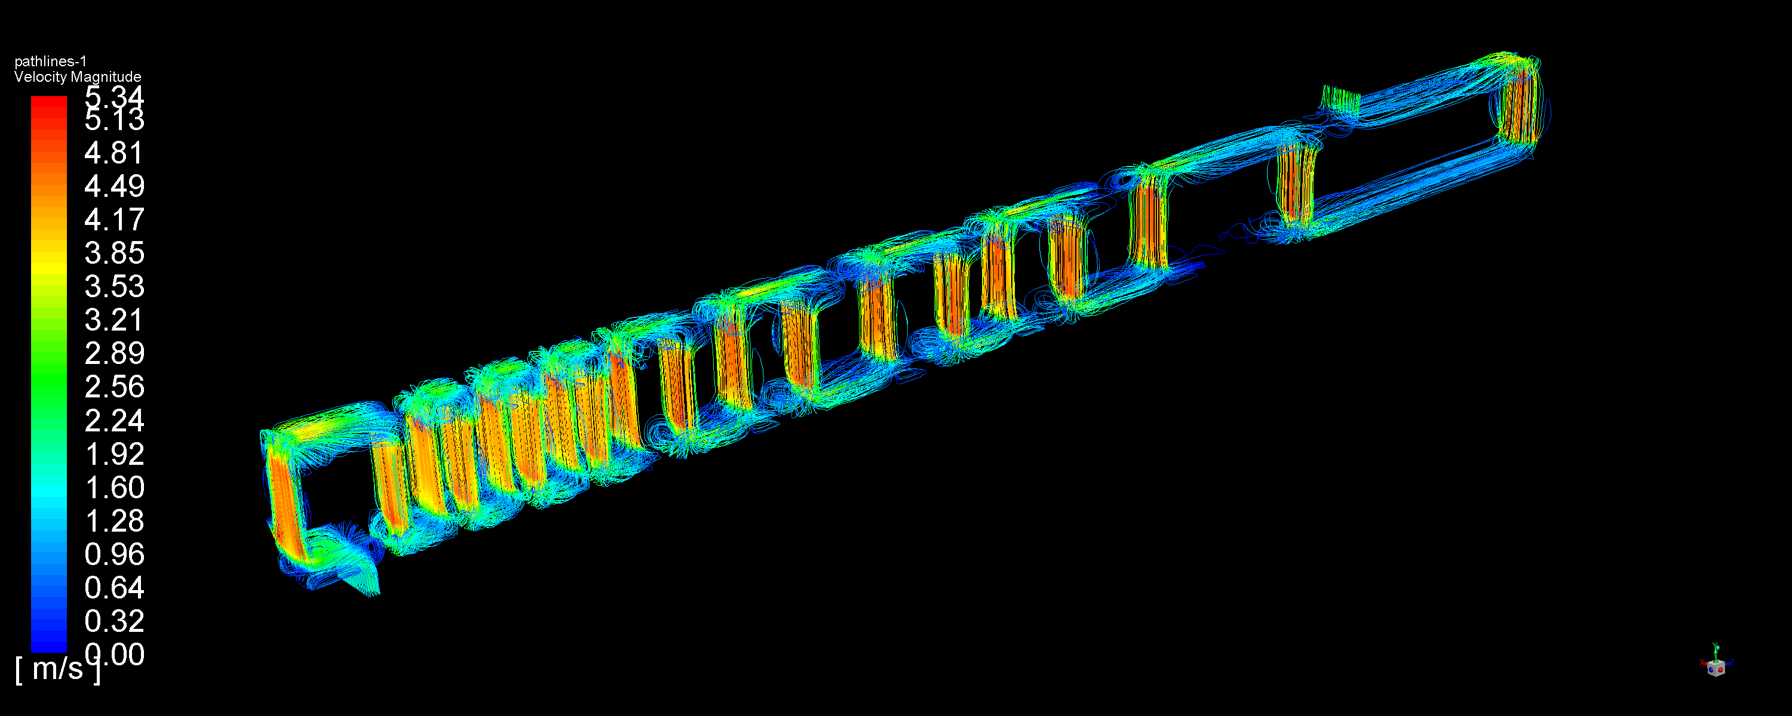
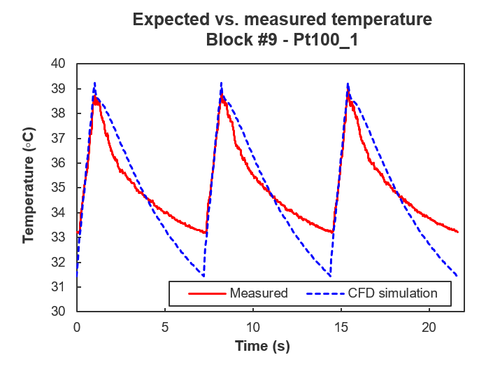
BDF Target Prototype

Slide 51

P&ID prototype target cooling skid
Installed in TA801 to supply cooling in TCC2

Slide 52




Installation – BA80
TCC2
TA801
TCC2
TA801
TA801

Slide 53



Skid in TA801
Start date | End date | Monitoring System | R-factor | Φ_{HEH} [pp/cm²] | Φ_{ThN} [pp/cm²]
19/09/2018 | 17/10/2018 | BatMon pair | 7.8* | 5.11 x 10⁸ | 4.00 x 10⁹
 |  | RadMon 1 | 45.4 | 6.26 x 10⁶ | 2.84 x 10⁸
 |  | RadMon 2 | 29.0 | 2.31 x 10⁷ | 6.69 x 10⁸

Slide 54


R2E - LOFC

Slide 55
Outline
BDF Project
  Overview of the Project
  Cooling Design
  Ventilation Design
BDF Target Prototype (TCC2)
  Target and Target Prototype Design
  Cooling Skid Design
  Installation and Testing
BDF Helium Passivation System
  Overview and Process Description
  Selection of Components
  Budget & Schedule

