Slide 1


Prospects for Jet Measurements
Yen-Jie Lee (MIT)
ALICE USA meeting at Yale
Yale, New Haven, Connecticut
31 May, 2024
MIT HIG group's work was supported by US DOE-NP

Slide 2
Open Questions
What are the properties of QGP?
How does the hydrodynamization happen and how QGP is created?
How does hadronization happen in low and high parton density environment?

Slide 3
Answers with Hard Probes
What are the properties of QGP?
Extract its properties from slow (diffusion) and fast moving hard probes
(energy loss / elastic scatterings)
How does the hydrodynamization happen and how QGP is created?
Start from probes that are far from hydrodynamization
Excite QGP response and see how it evolves
How does hadronization happen in low and high parton density environment?
Study how heavy quarks and jets hadronize

Slide 4
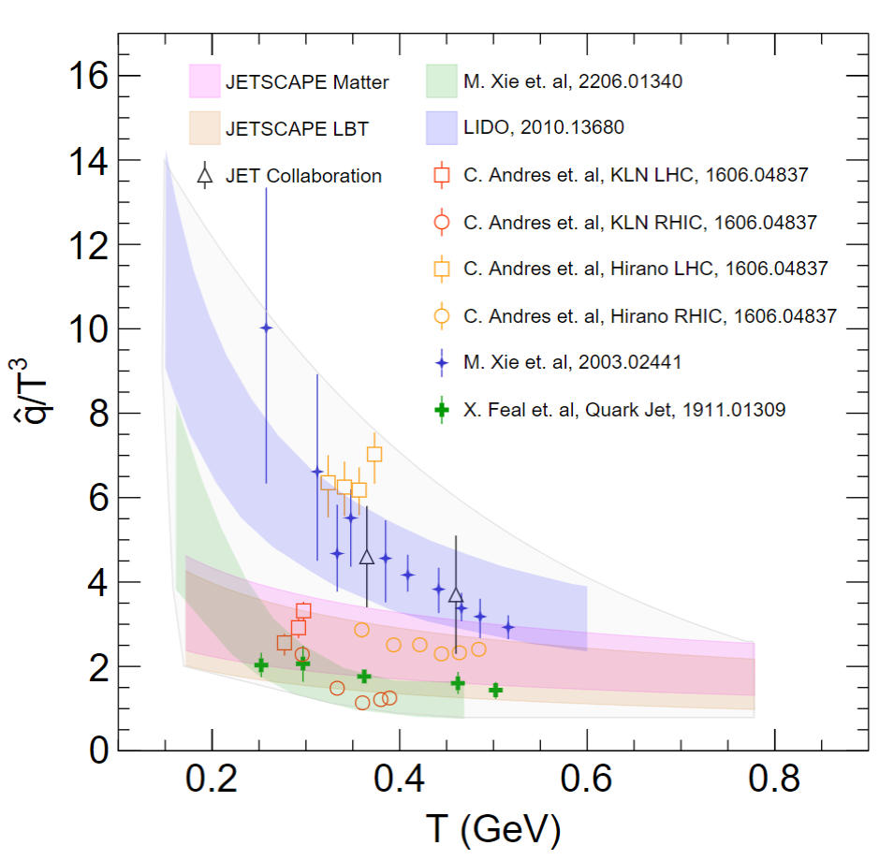
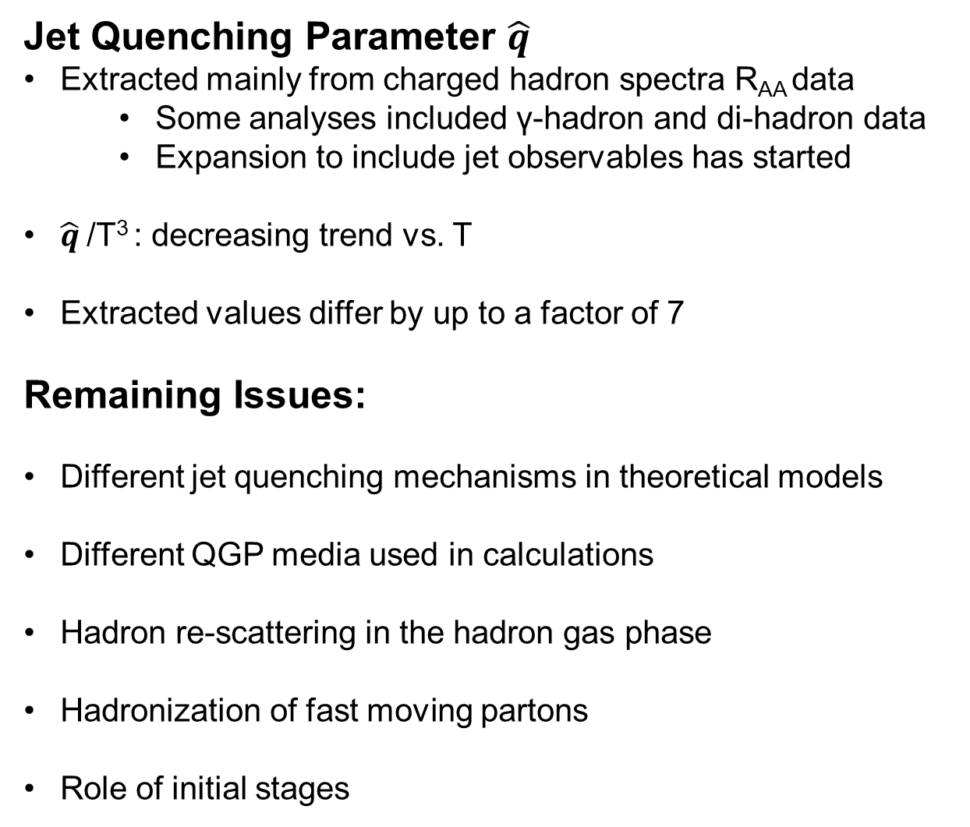
QGP Transport Properties with RHIC and LHC Run 2 Data
Jet Quenching Parameter $\hat{q}$
Extracted mainly from charged hadron spectra R_{AA} data
  Some analyses included γ-hadron and di-hadron data
  Expansion to include jet observables has started
$\hat{q}$/T³ : decreasing trend vs. T
Extracted values differ by up to a factor of 7
Remaining Issues:
Different jet quenching mechanisms in theoretical models
Different QGP media used in calculations
Hadron re-scattering in the hadron gas phase
Hadronization of fast moving partons
Role of initial stages
Compilation by YJL, Michael Winn, Liliana Apolinario arXiv:2203.16352
Progress in Particle and Nuclear Physics, 103990 (2022)

Slide 5
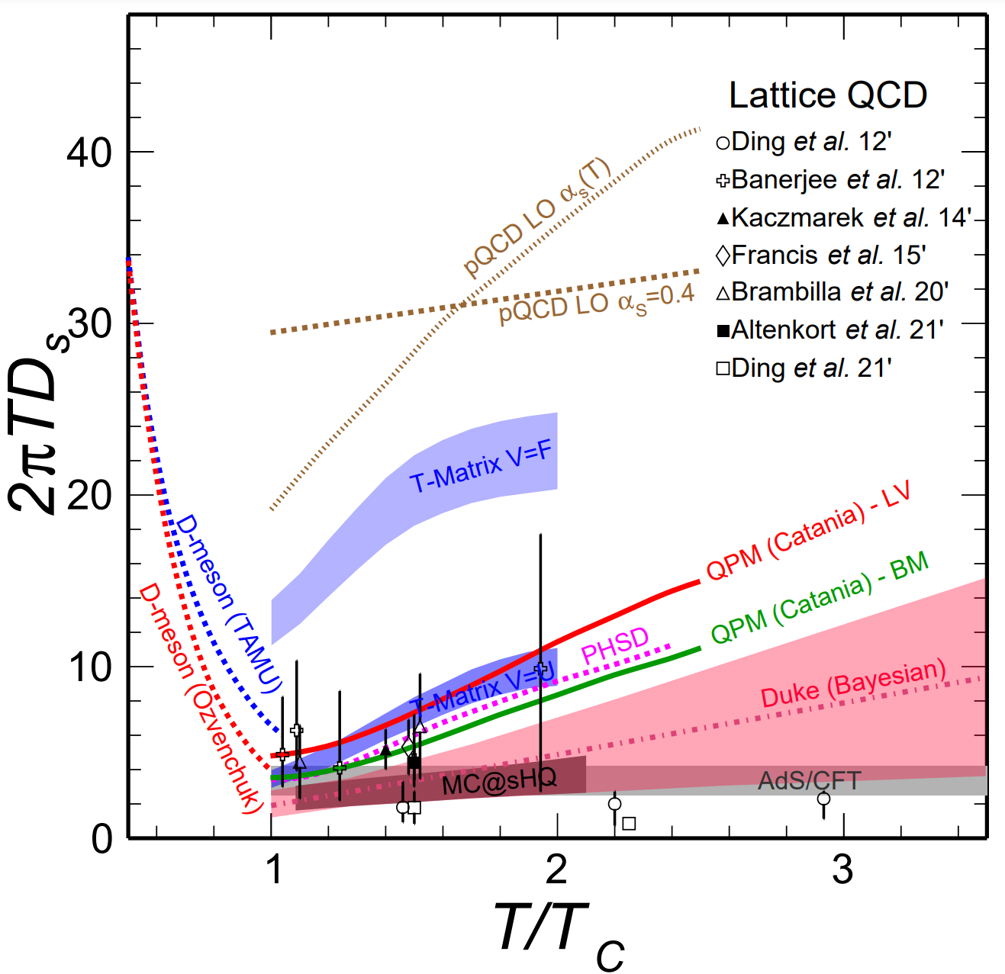
QGP Transport Properties with RHIC and LHC Run 2 Data
Charm diffusion coefficient D_{s}
Bayesian analysis from D meson R_{AA} and v₂
pQCD calculations at LO are ruled out by the data
Non-perturbative calculations with a potential close to the HQ free energy from LQCD are not viable
Increasing trend of 2πTD_{s} vs. T in various models
Remaining Issues:
Hadronization of charm quarks
Charm diffusion mechanism
Different QGP media used in various calculations
Precision of the experimental data
See Francesco Prino’s talk
Xin Dong, YJL, Ralf Rapp, Ann.Rev.Nucl.Part.Sci. 69 (2019) 417-445

Slide 6
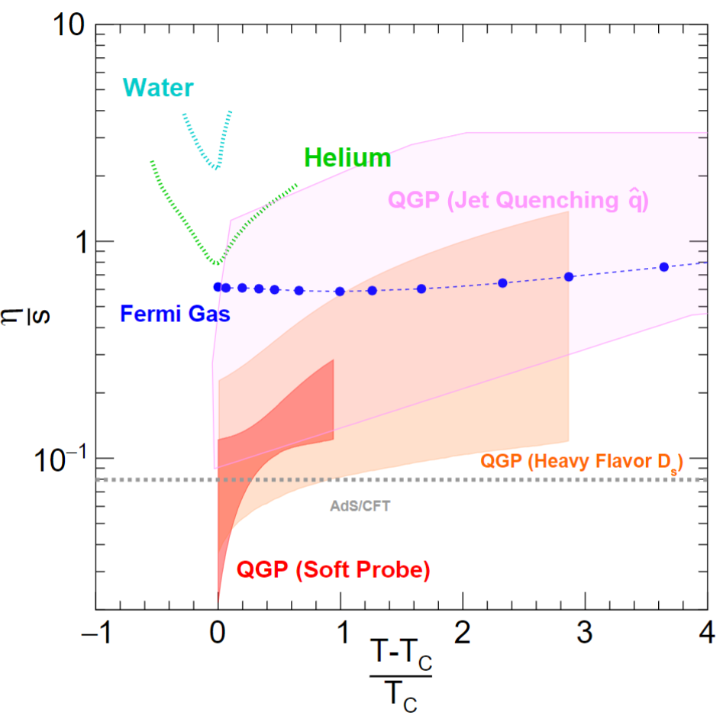
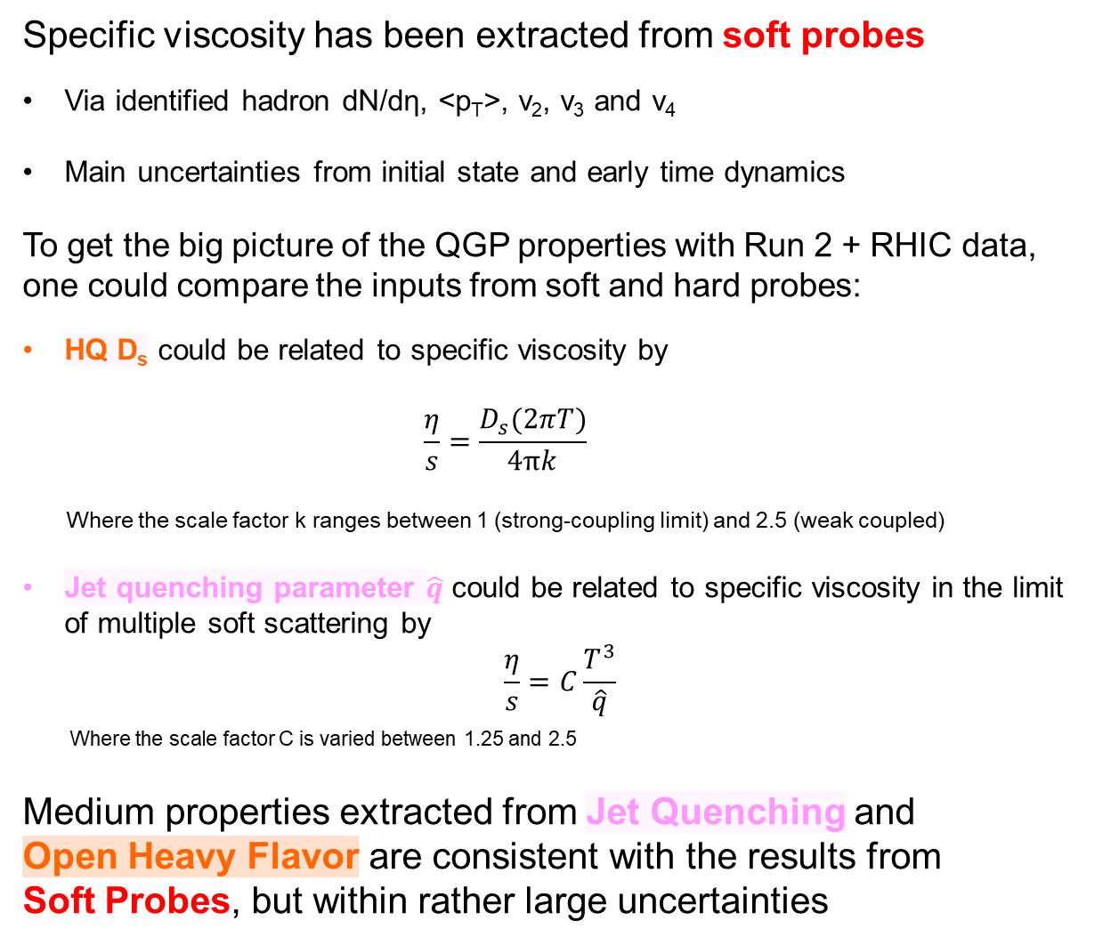
Medium Properties from Soft and Hard Probes
Specific viscosity has been extracted from soft probes
Via identified hadron dN/dη, <p_{T}>, v₂, v₃ and v₄
Main uncertainties from initial state and early time dynamics
To get the big picture of the QGP properties with Run 2 + RHIC data, one could compare the inputs from soft and hard probes:
HQ D_{s} could be related to specific viscosity by
  $$\frac{η}{s}=\frac{D_{s}(2πT)}{4πk}$$
Where the scale factor k ranges between 1 (strong-coupling limit) and 2.5 (weak coupled)
Jet quenching parameter $\hat{q}$ could be related to specific viscosity in the limit of multiple soft scattering by
$$\frac{η}{s}=C\frac{T^{3}}{\hat{q}}$$
Where the scale factor C is varied between 1.25 and 2.5
Medium properties extracted from Jet Quenching and
Open Heavy Flavor are consistent with the results from
Soft Probes, but within rather large uncertainties
R. Rapp, H. van Hees, 0903.1096
X. Dong, YJL, R. Rapp, 1903.07709
A. Majumder, B. Muller, Xin-Nian Wang PRL 99 (207) 192301
B. Muller PRD 104 (2021) 7, L071501
Compilation by YJL, Michael Winn, Liliana Apolinario arXiv:2203.16352
Progress in Particle and Nuclear Physics, 103990 (2022)

Slide 7

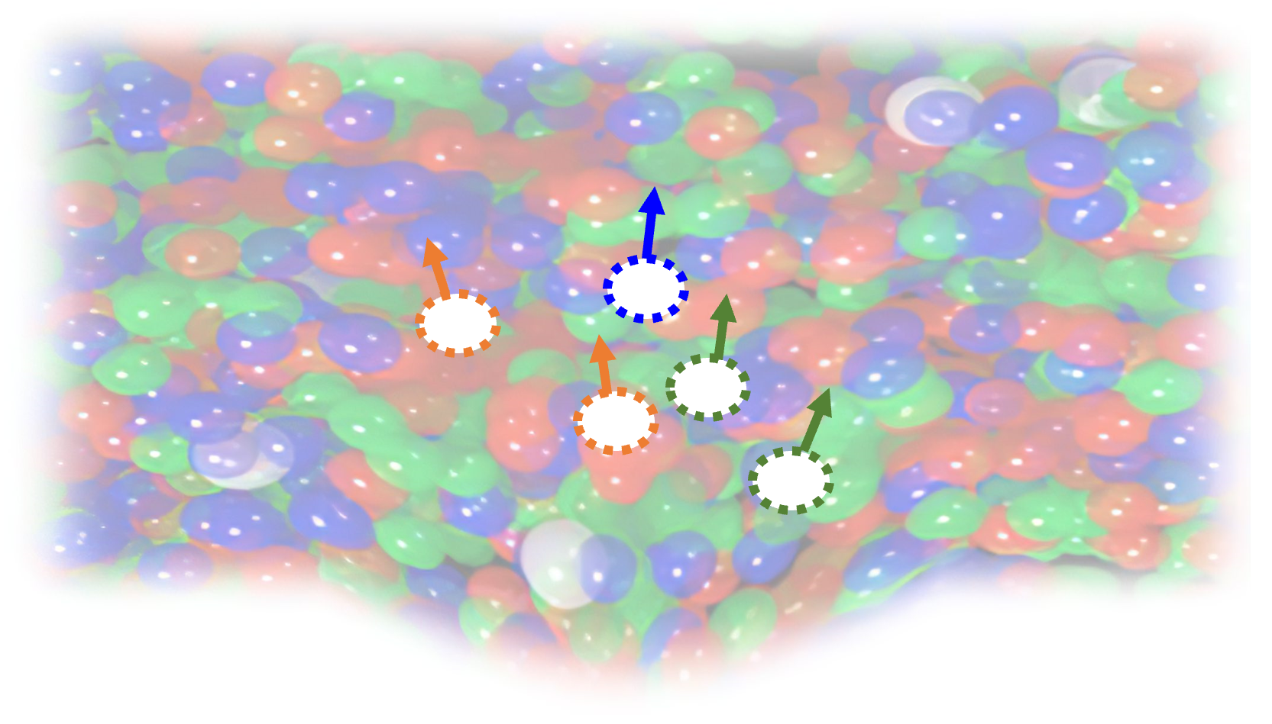
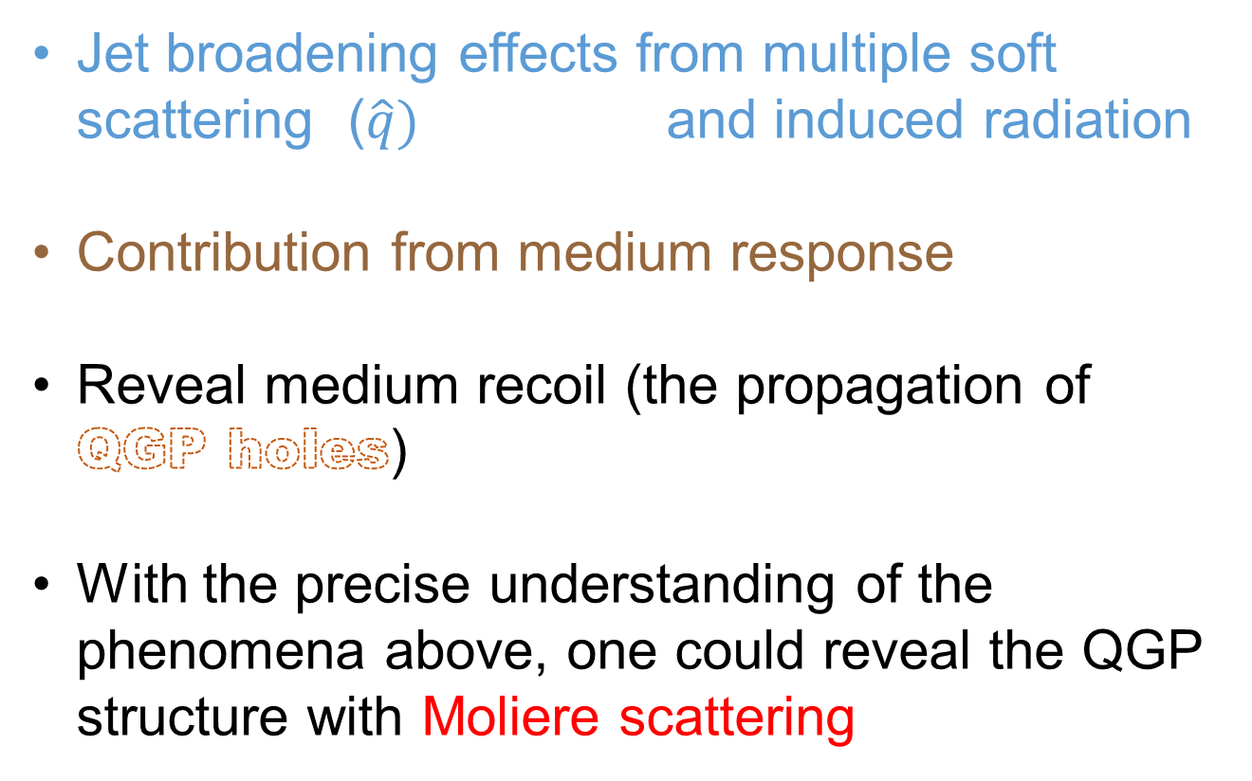
QGP Transport Properties and Structure with Jets
Jet broadening effects from multiple soft scattering ($\hat{q})$ and induced radiation
Contribution from medium response
Reveal medium recoil (the propagation of QGP holes)
With the precise understanding of the phenomena above, one could reveal the QGP structure with Moliere scattering
Jet
“Hole”

Slide 8
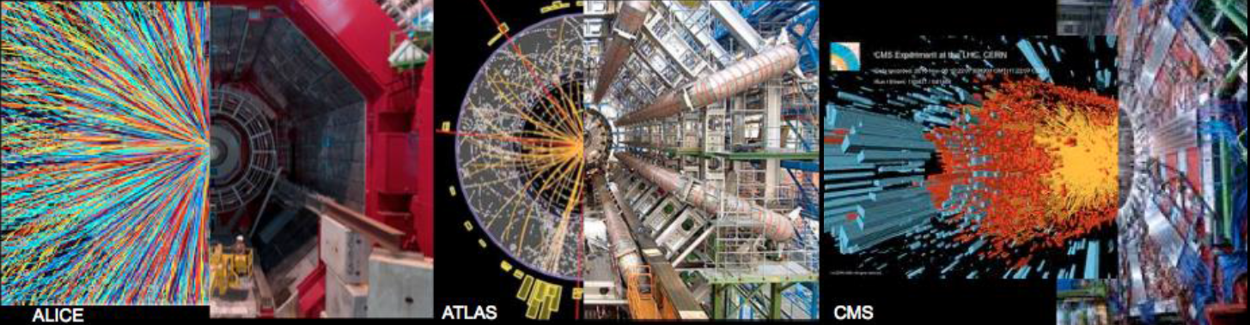
Lessons learned from Jet Data
Jet quench in large collision system, quenched energy recovered only when we include low p_{T} particles up to very large angle (ΔR ~ 2)
Jet quenching depends on the color charge and parton shower shape: broad showers are more quenched and results in apparent narrowing of inclusive jet
No sign of jet quenching in smallest collision systems through jet spectrum and substructure

Slide 9
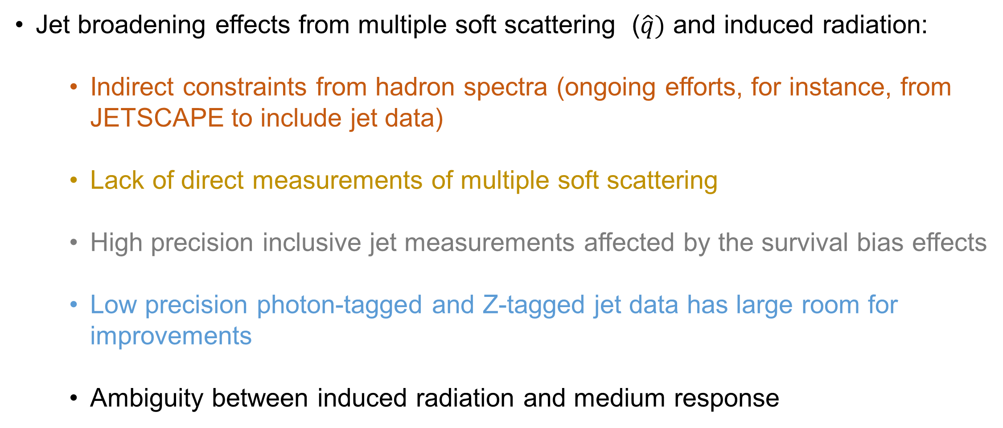
MSS and Induced Radiation
Jet broadening effects from multiple soft scattering ($\hat{q})$ and induced radiation:
  Indirect constraints from hadron spectra (ongoing efforts, for instance, from JETSCAPE to include jet data)
  Lack of direct measurements of multiple soft scattering
  High precision inclusive jet measurements affected by the survival bias effects
  Low precision photon-tagged and Z-tagged jet data has large room for improvements
  Ambiguity between induced radiation and medium response

Slide 10
Prospects for Jet Measurements
Observables that are only / maximally sensitive to medium response
(2) Initial parton virtuality tagging and EEC
(3) Comprehensive survey of the jet splitting with Lund plane. Correlate the observables designed from different phase space on Lund plane.
(4) Search for elastic scattering with optimized observables and direct measurement of HQ diffusion
(5) Time dependence: Delay the starting time of the quenching effect with W/Z jet
Jet
“Hole”

Slide 11

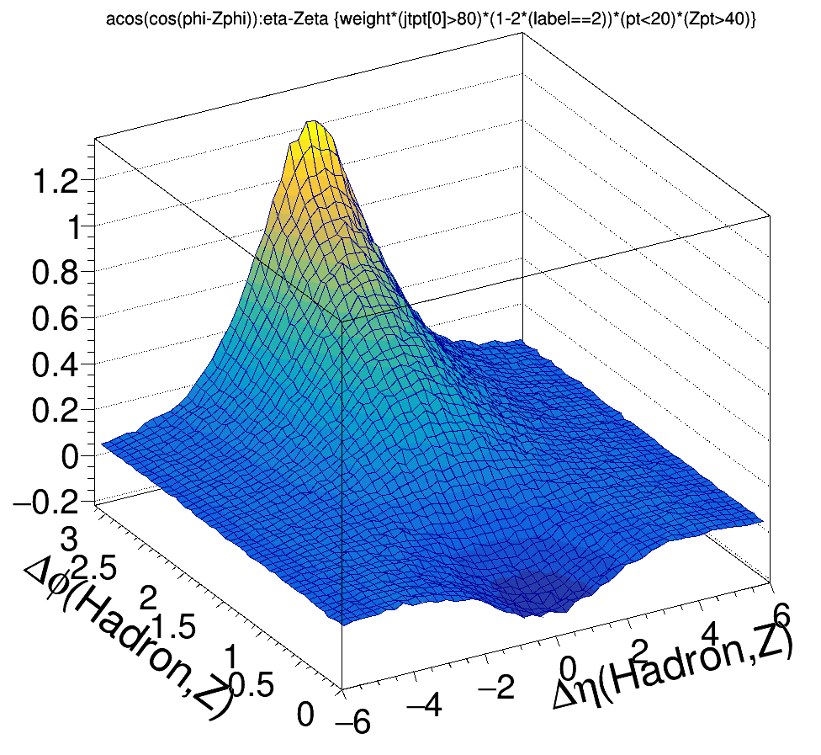
(1) Reveal the Negative Wake Contribution
Enhancement of particle
“Positive wake”
Depletion of particle
“Recoil”
“QGP hole”
“Negative wake”
Position space
Z⁰ and wake hadron correlation in Hybrid model
Daniel Pablo, Krishna Rajagopal, YJL
Momentum space

Slide 12
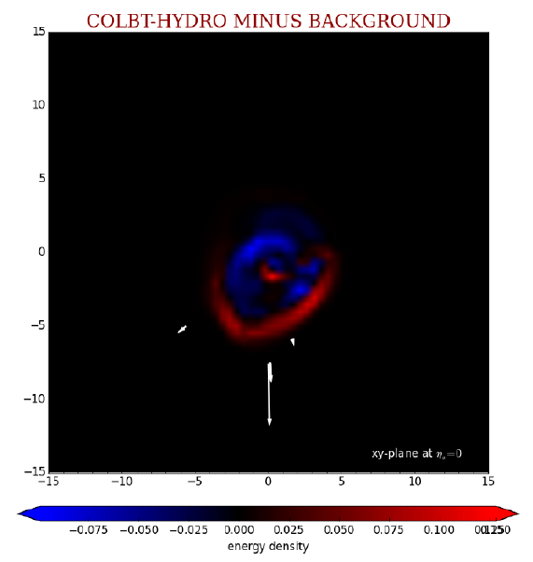
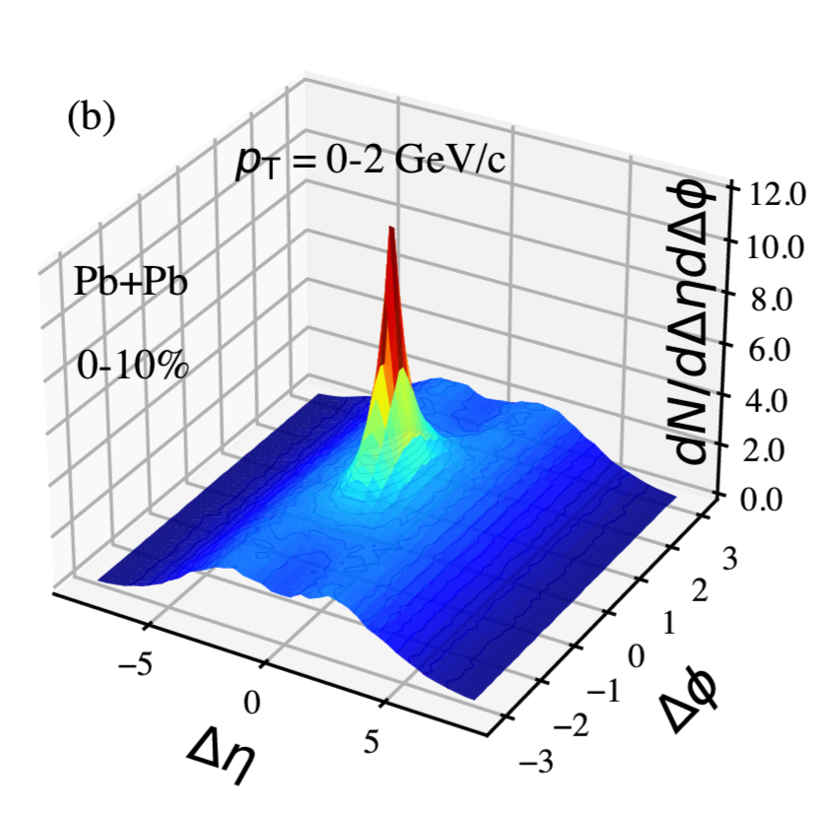
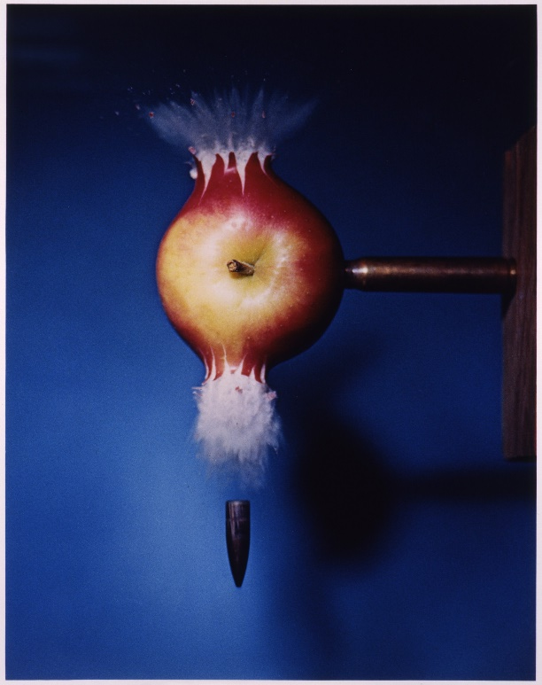
Measure the “Depletion” due to Medium Recoil
CoLBT
Photon tagged Jet-hadron correlation
Diffusion wake in CoLBT
PRL 130, 052301 (2023)
Zhong Yang, Tan Luo, Wei Chen,
Longgang Pang, and Xin-Nian Wang
Tan Luo, Xin-Nian Wang
Z⁰ - wake hadron correlation in Hybrid model
Daniel Pablo, Krishna Rajagopal, YJL
Hole
“Hole”
Jet
Hole
Jet
Bullet
Hole
Measure the boson-side associated yield with Photon-jet and Z-jet

Slide 13
Reveal the Negative Wake Contribution
Receive back reaction effect
from the away side jet
Receive partial back reaction
from the away side jet
No back reaction from the
electroweak boson
Leading
Subleading
Z,γ

Slide 14
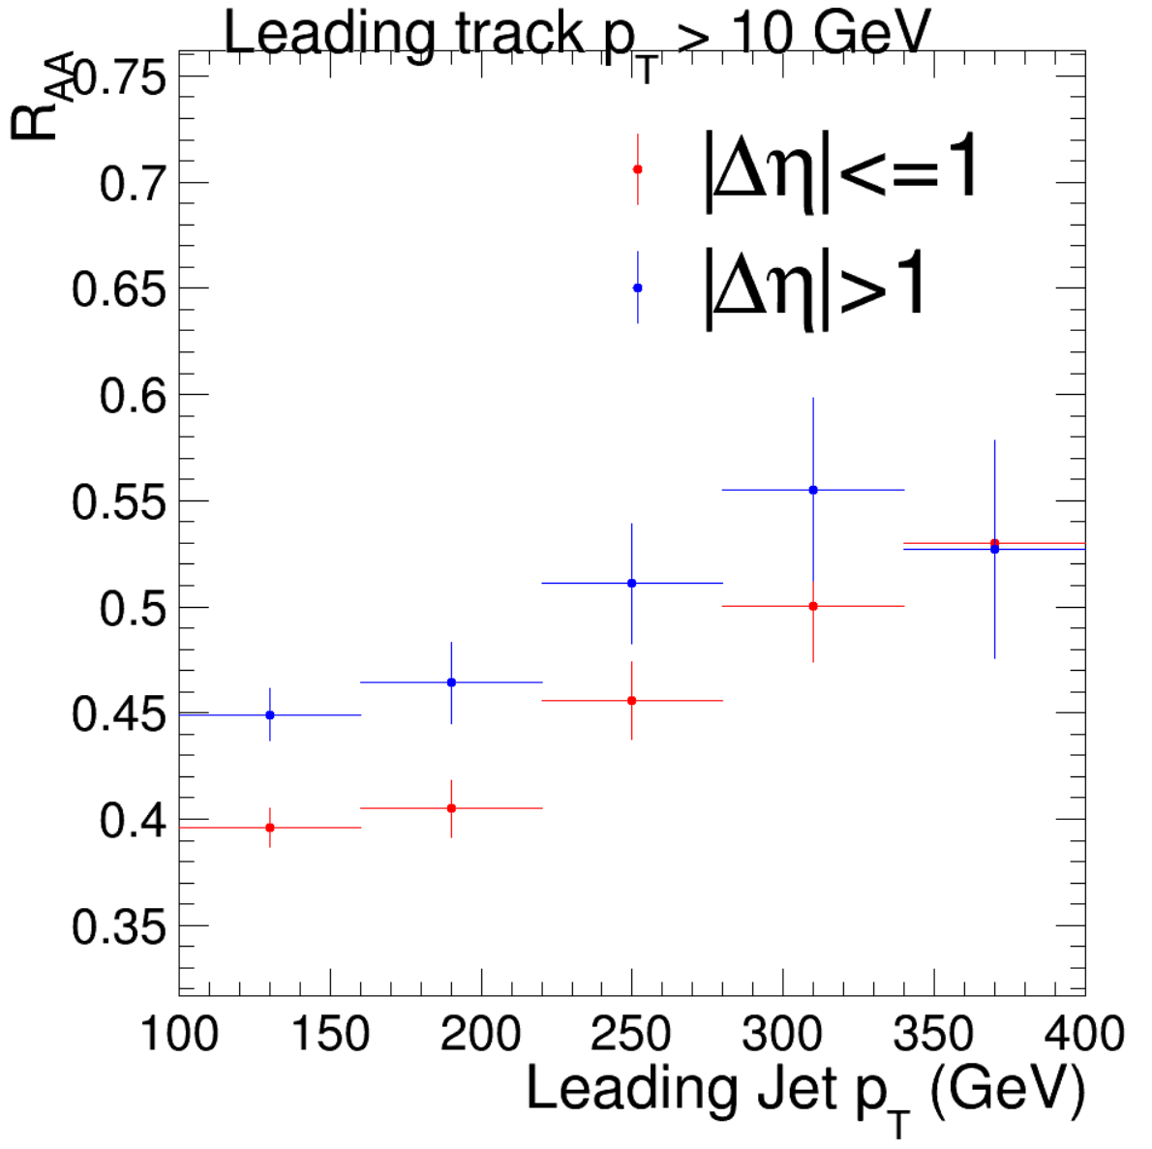
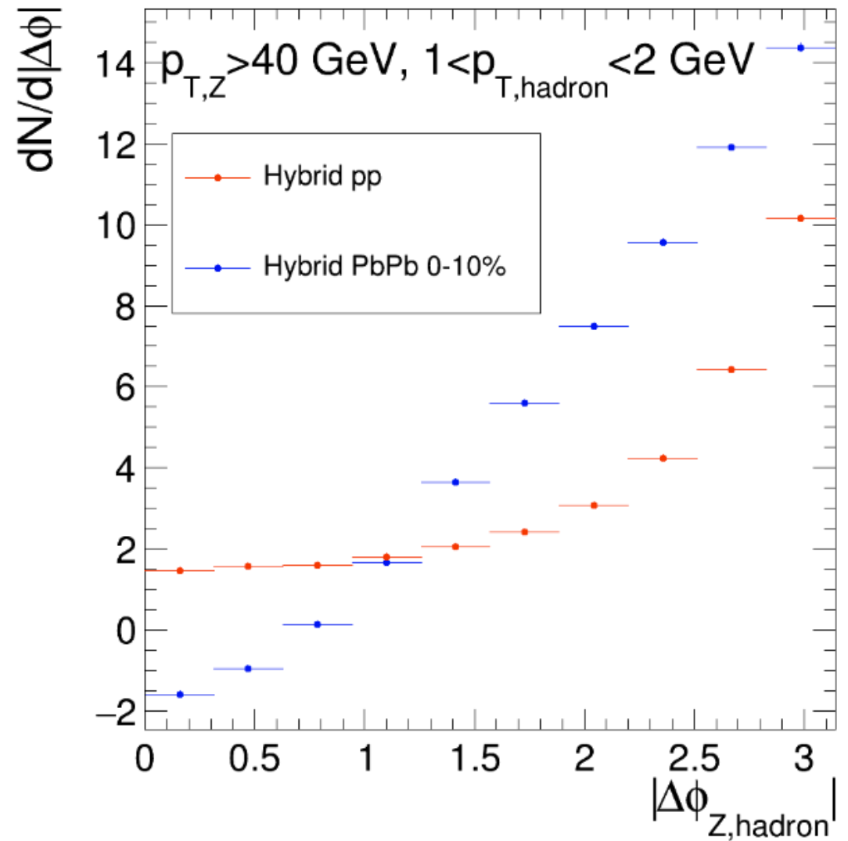
Reveal the Negative Wake Contribution
Receive back reaction effect
from the away side jet
Receive partial back reaction
from the away side jet
No back reaction from the
electroweak boson
Daniel Pablo, Krishna Rajagopal, YJL

Slide 15
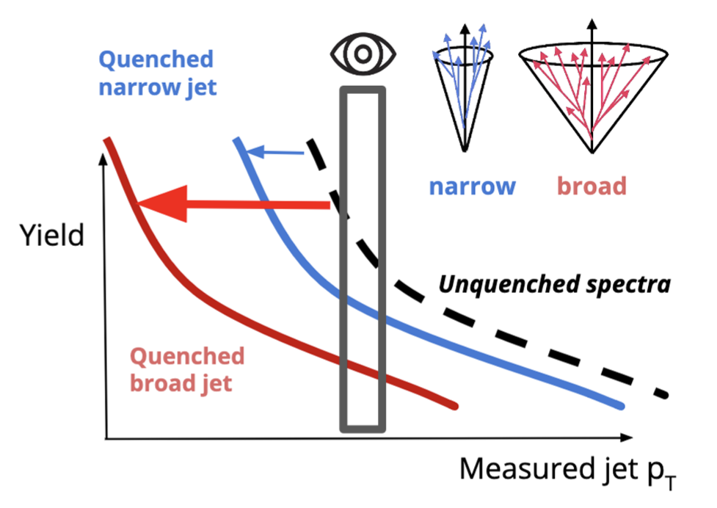
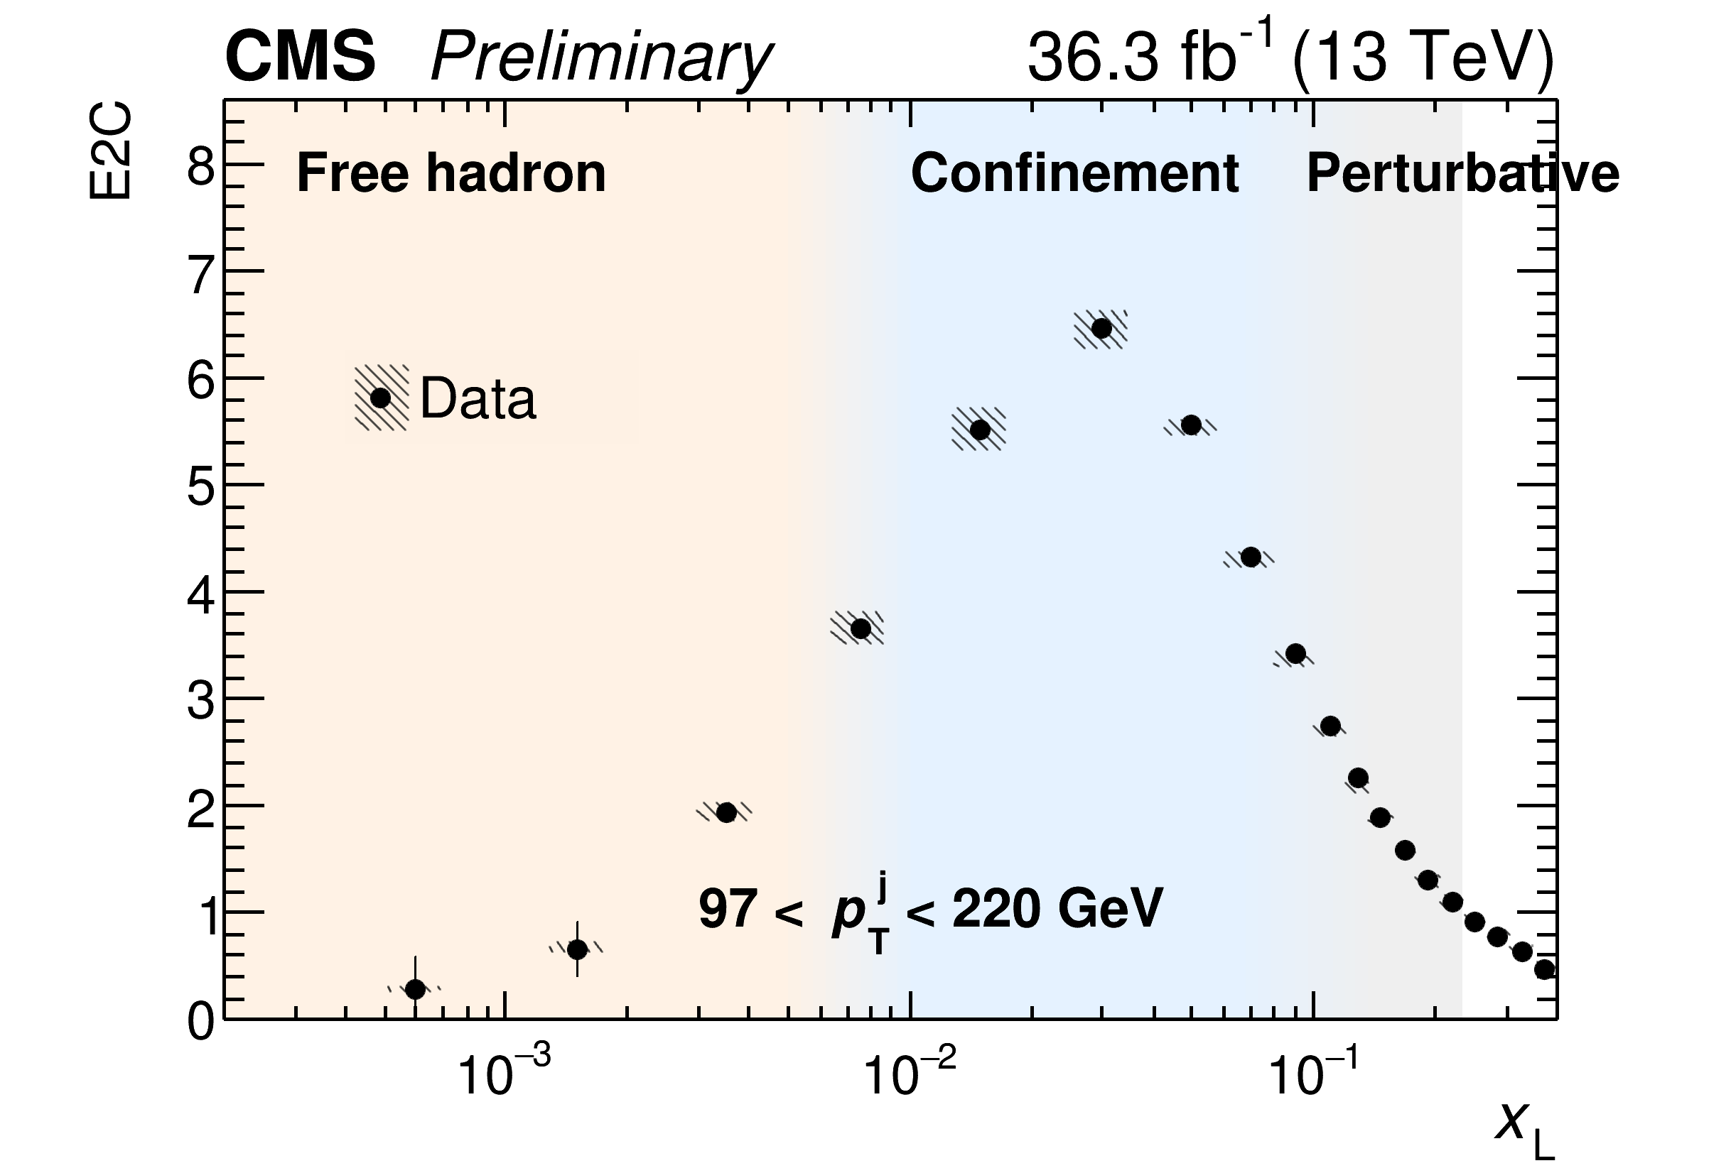
(2) Tag the (Initial) Parton Virtuality of a Jet
Inclusive jet substructure studies show jets are narrowing, offering detailed insights per jet, advance from jet shape and FF. However, the measurements are significantly affected by selection bias.
Highest priority on substructure observables that reduce survival-bias.
Linking the (initial) virtuality of parton showers to jet measurements with (photon/Z)-jet or parton-shower based tagging for inclusive jet.

Slide 16
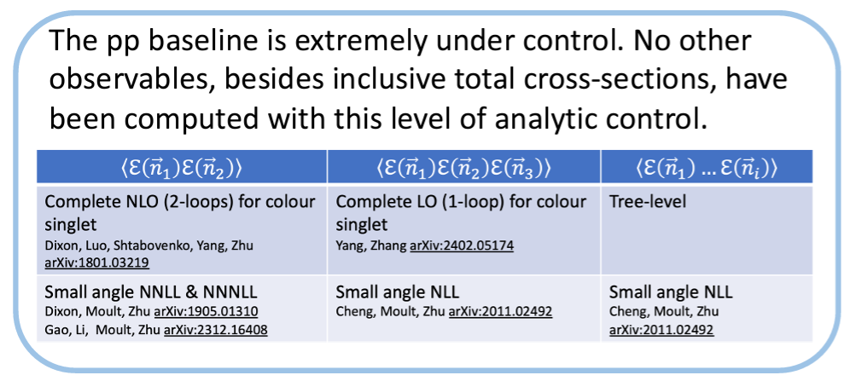
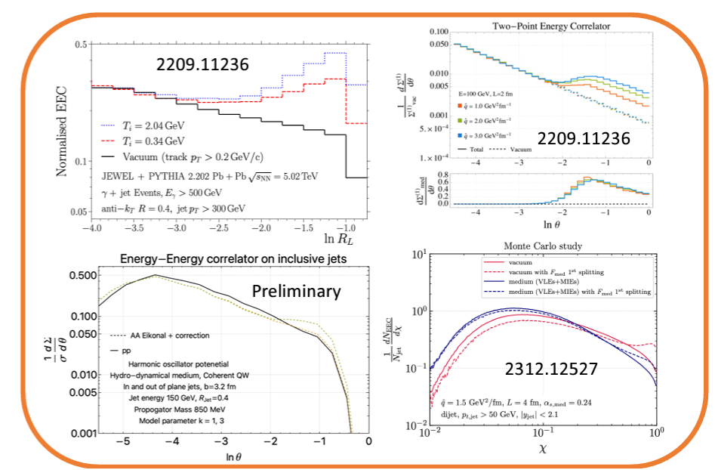
Energy-Energy Correlators
Moreover, EEC could be performed
with (inclusive jet based)
or
without jet reconstruction
(with photon or Z-tagged jets)
Compiled by Jack Holguin

Slide 17
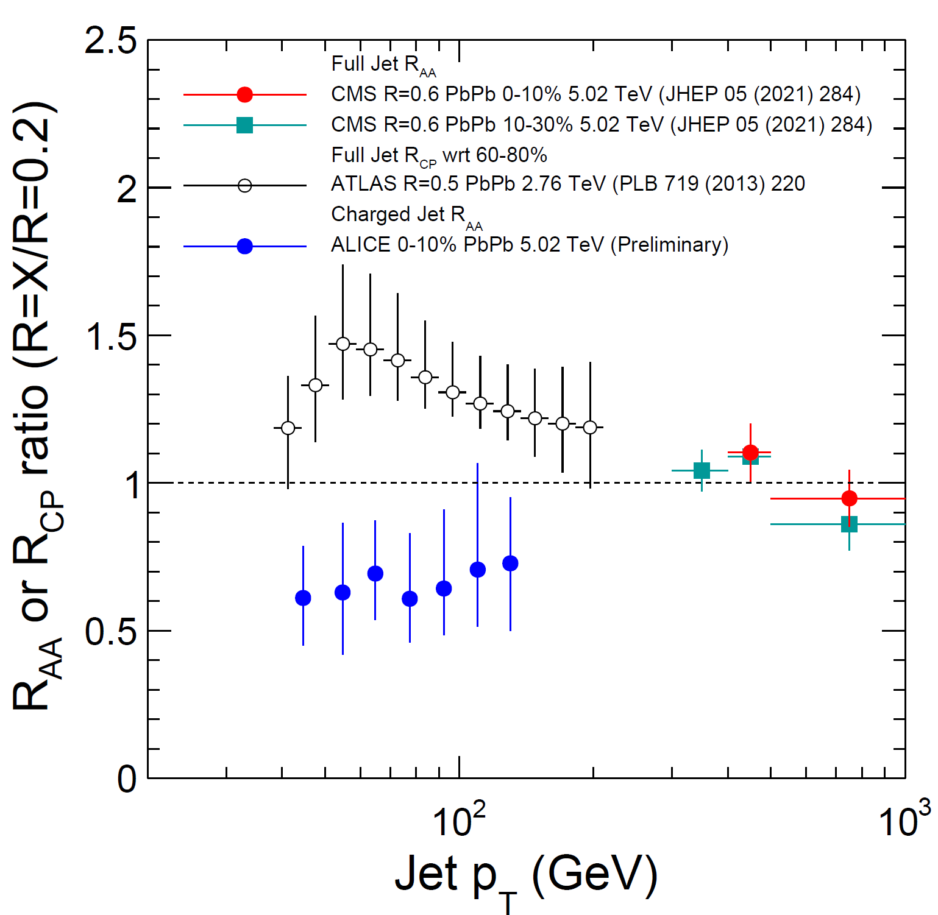
Follow Up with the Large Area Jets
JHEP 05 (2021) 284
Need high precision measurement and resolution of the ATLAS / ALICE discrepancy

Slide 18
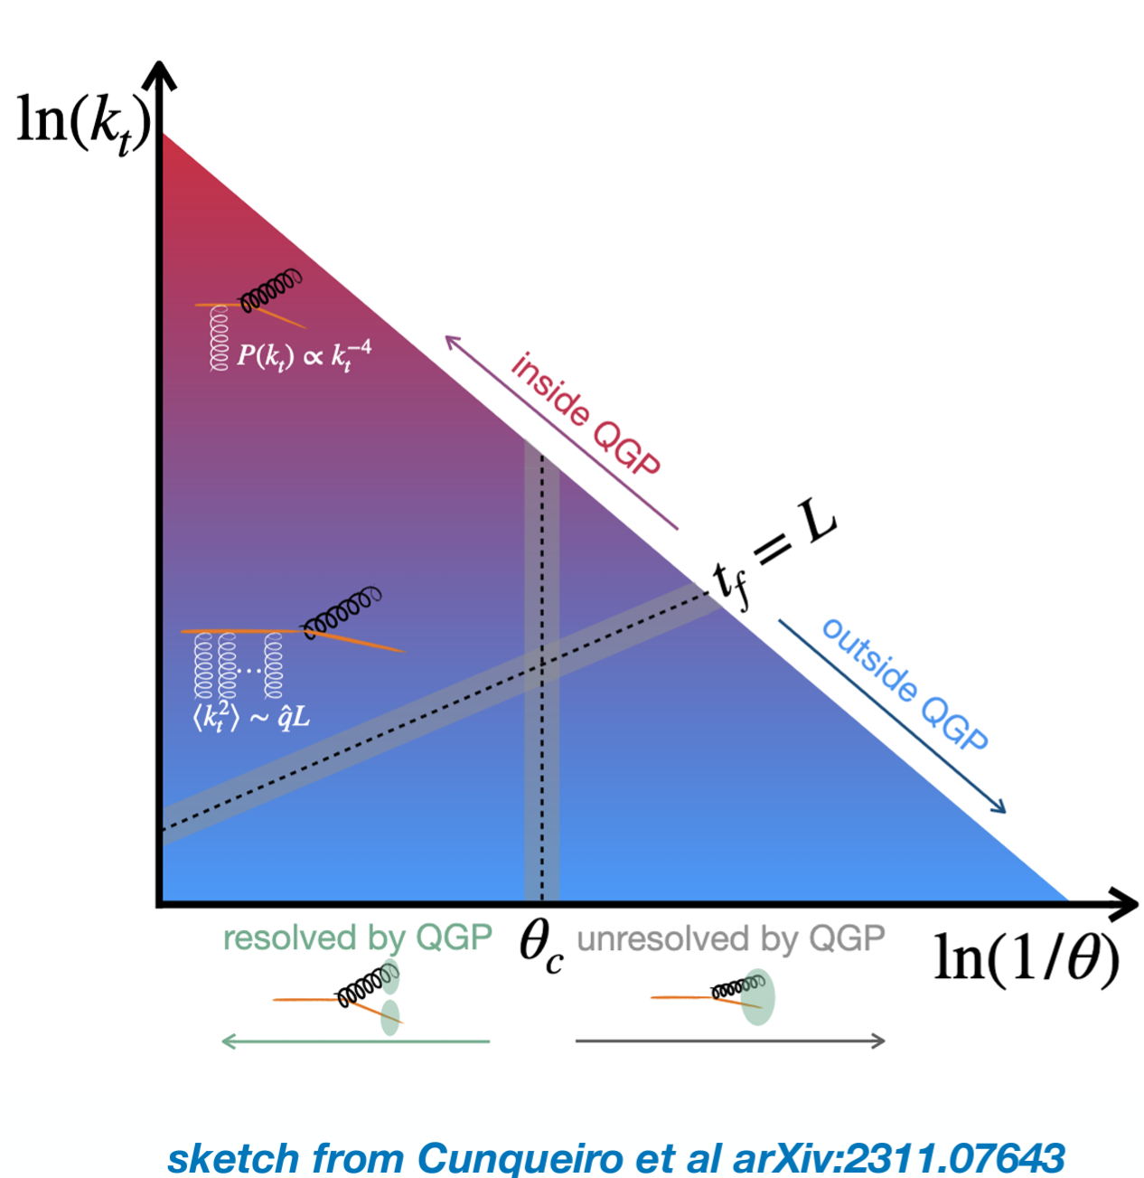
(3) Survey of the Jet Splitting with Lund Plane
L ~ 4 fm ~ 20 GeV⁻¹
t_{f} = 2/(k_{t}θ) = L
Inside QGP:
k_{t} > 0.1/θ (GeV)
Large angle
Small angle, collinear

Slide 19
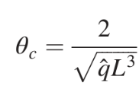
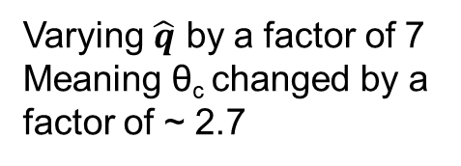
(3) Survey of the Jet Splitting with Lund Plane
L ~ 4 fm ~ 20 GeV⁻¹
t_{f} = 2/(k_{t}θ) = L
Inside QGP:
k_{t} > 0.1/θ (GeV)
PLB 725, 357 (2013)
Varying $\hat{q}$ by a factor of 7
Meaning θ_{c} changed by a factor of ~ 2.7
Large angle
Small angle, collinear
θ_{c}~ 0.04
$\hat{q}=1.5 GeV2/fm$→

Slide 20
(3) Survey of the Jet Splitting with Lund Plane
Ideally we want to measure the full Lund plane with
high p_{T} photon-tagged jets
High statistics high p_{T} inclusive jet data are still to be measured.
Validate our theoretical understanding of the splitting in different part of the phase space in Lund Plane
Correlate the substructure derived from different regions in the Lund Plane (Controlled vs. Medium modified).

Slide 21
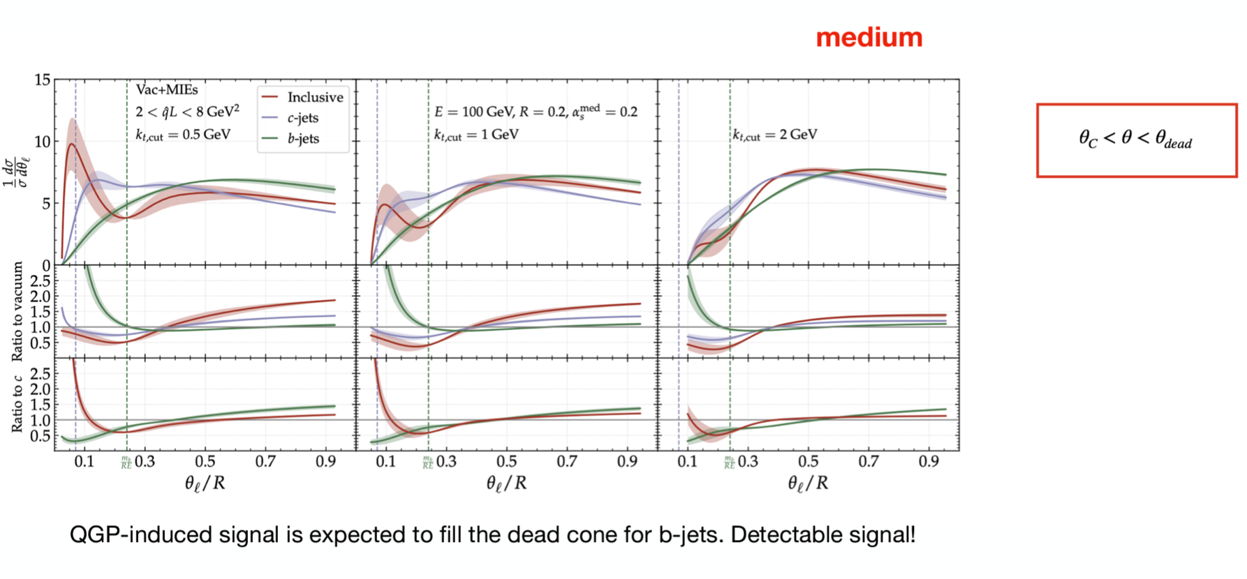
Dead cone in HIC using Jet Tree
Leticia Cunqueiro

Slide 22



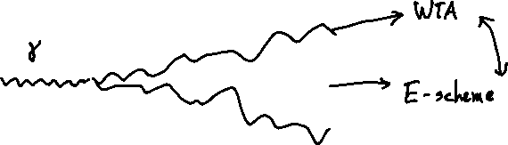




(4) MSS and Search for Elastic Scattering
The angular separation of jet axes (Δ_{j}) calculated with energy weight (“E-scheme”) and a winner-take-all (WTA) scheme
WTA follows the leading energy flow, has larger sensitivity to $\hat{q}$ (multiple scattering) than E-scheme, where the effects are averaged out
_{PbPb/pp}
QGP decorrelate the jet axes via
multiple scattering and elastic scattering
1
Jet
Larger suppression of wide parton shower
in QGP (“Survival Bias”)
Δ_{j}
WTA=E-scheme

Slide 23
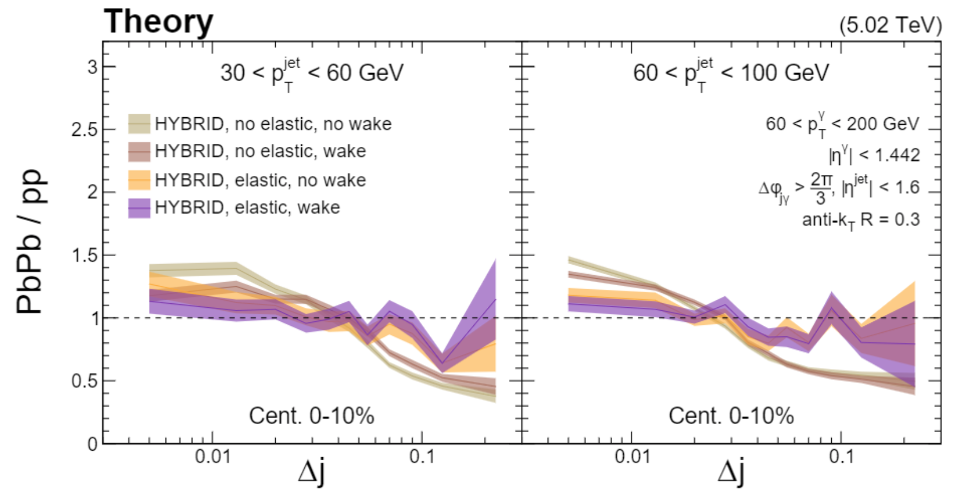
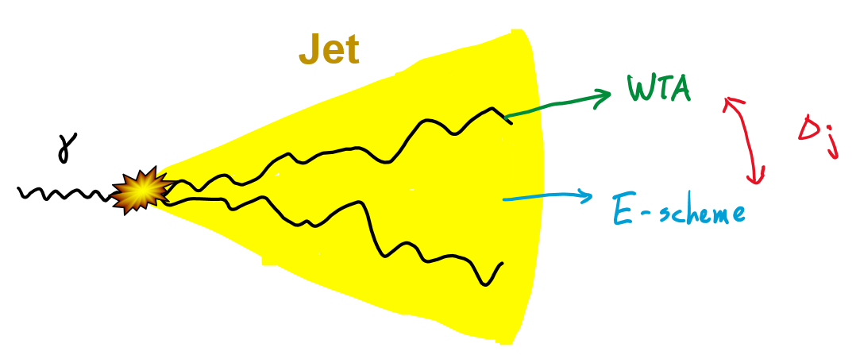
Photon-tagged Jet Δ_{j} (WTA, E-Scheme)
At fixed photon p_{T}, different jet p_{T} intervals could be used as a proxy of the degree of quenching of the associated jets
HYBRID model: Δj sensitive to elastic scattering and insensitive to wake effect
Subjet multiplicity: sensitive variable based on HYBIRD
More quenched jets
Less quenched jets
Daniel Pablo, Krishna Rajagopal

Slide 24
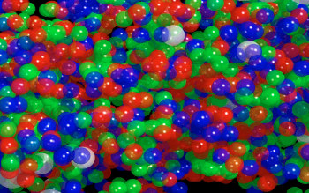
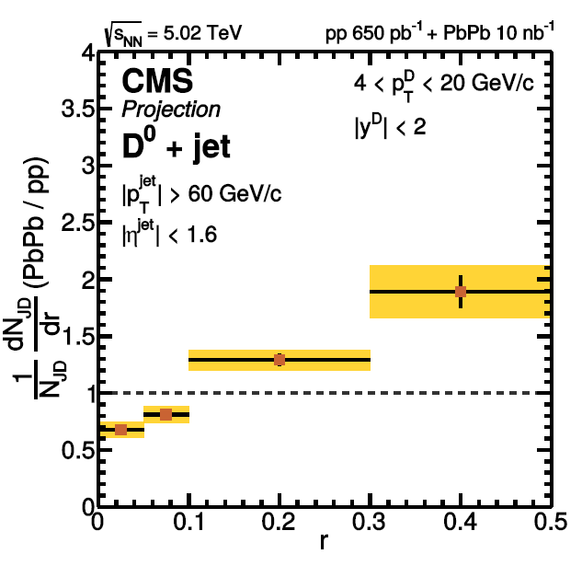
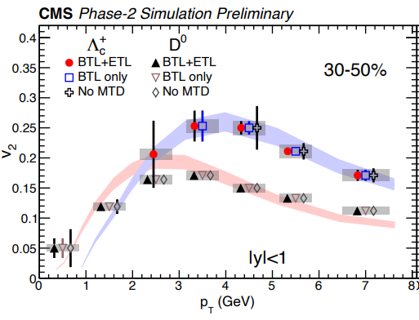
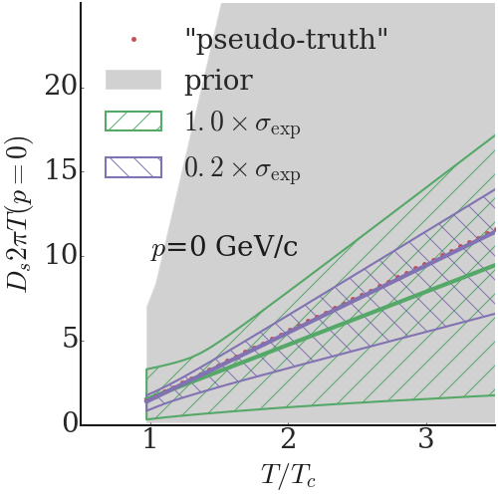
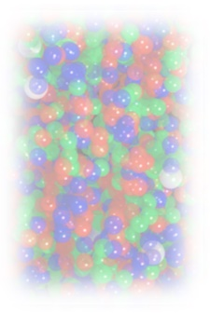
High Precision Measurement of HQ Diffusion
Jet-D⁰ Correlation
D⁰ and Λ_{c} v₂
D_{s} vs. T
Charm Quark
c
HL-LHC
HL-LHC
u
D⁰
c
u
Jet
CMS PAS-FTR-18-025
CMS DP_2021_037
Charm quark
Δr
Study how charm jet hadronized in different collision systems
Direct observation of charm diffusion with D⁰-Jet correlation
Together with v₂ and R_{AA} :Strong constraint on the HQ diffusion coefficient D_{s}
D⁰

Slide 25
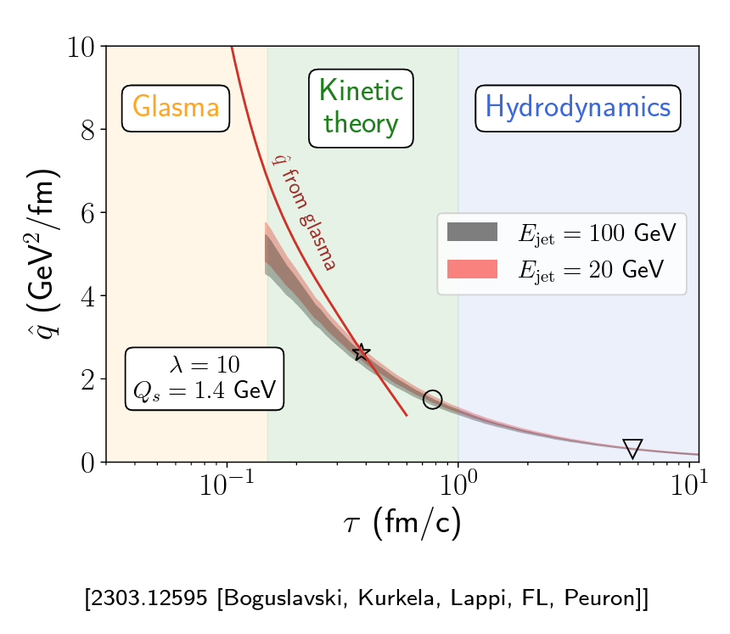
(5) Time Dependence of Jet Quenching
Jet quenching parameter extracted from experiment mostly only in hydrodynamics phase
To describe high p_{T} hadron v₂ and R_{AA}, later quenching start time is preferred in models:
  Carlota Andres et al.
  (R_{AA} and v₂, PLB 803 (2020) 135318) : τ₀ ~ 0.6 fm/c
  JETSCAPE (R_{AA}): τ₀ ~ 0-1 fm/c
What is the role of the Glasma phase?

Slide 26
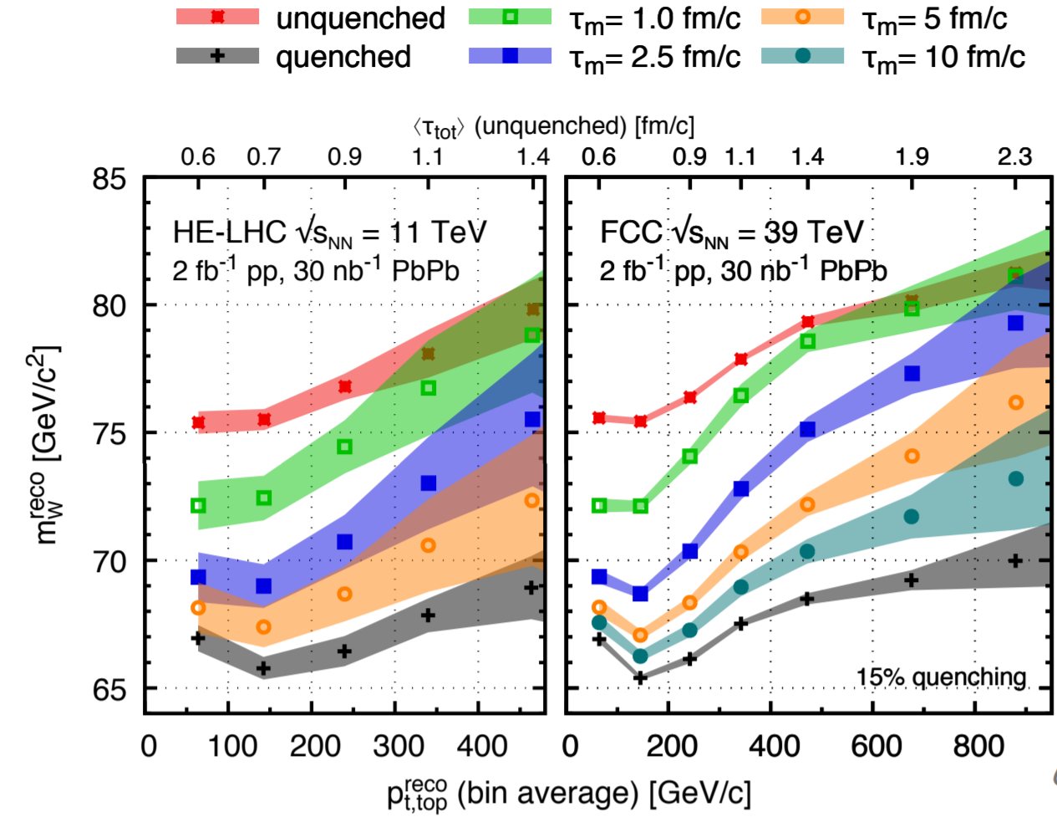
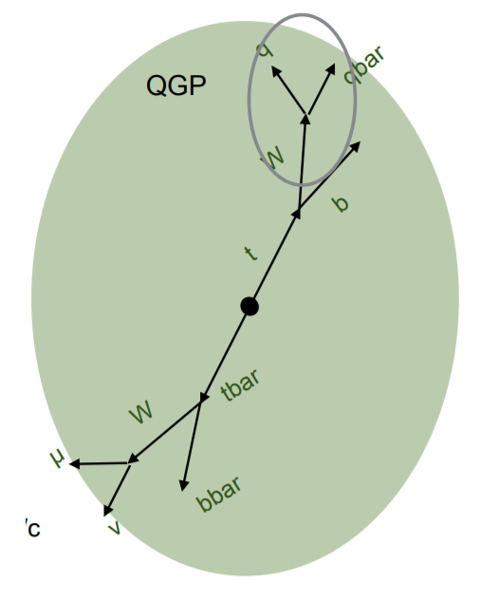
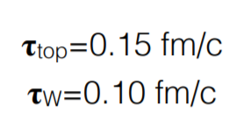
(5) Time dependence: Quenching effect with W/Z jet
Negligible interaction between Top / W and the QGP
τ_{m} : quenching end time
Longer total delay time of the W (τ_{tot}) leads to smaller modification of W mass in heavy ion collisions
Probe the “start” and “end” time of the QGP!!
“A Yoctosecond Chronometer.” (Gavin Salam)
Notes:
1000 W jet 2018 sample

Slide 27
Summary
Within the next decade, we expect significant progress on jet measurements
  Detection of medium recoil effects
  Detailed understanding of medium response and jet hadronization
  Direct detection of MSS and color coherence effect in QGP
  Improved understanding of shower shape dependence of jet quenching
  Direct detection of charm and charge diffusion
  Revealing elastic scattering in QGP
  Limit or detection of jet quenching signal in small systems (e.g., OO)
  Jet quenching start time with boosted W/Z jet
Aim to greatly enhance the precision of QGP properties
and study the consistency between extractions using
soft and hard probes.

Slide 28
Backup slides

Slide 29
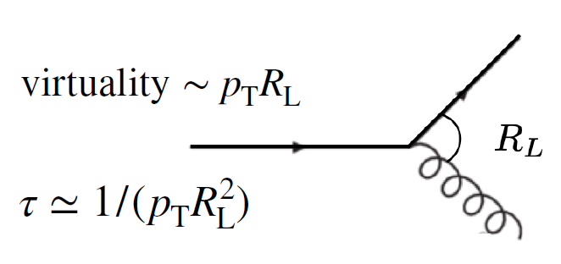
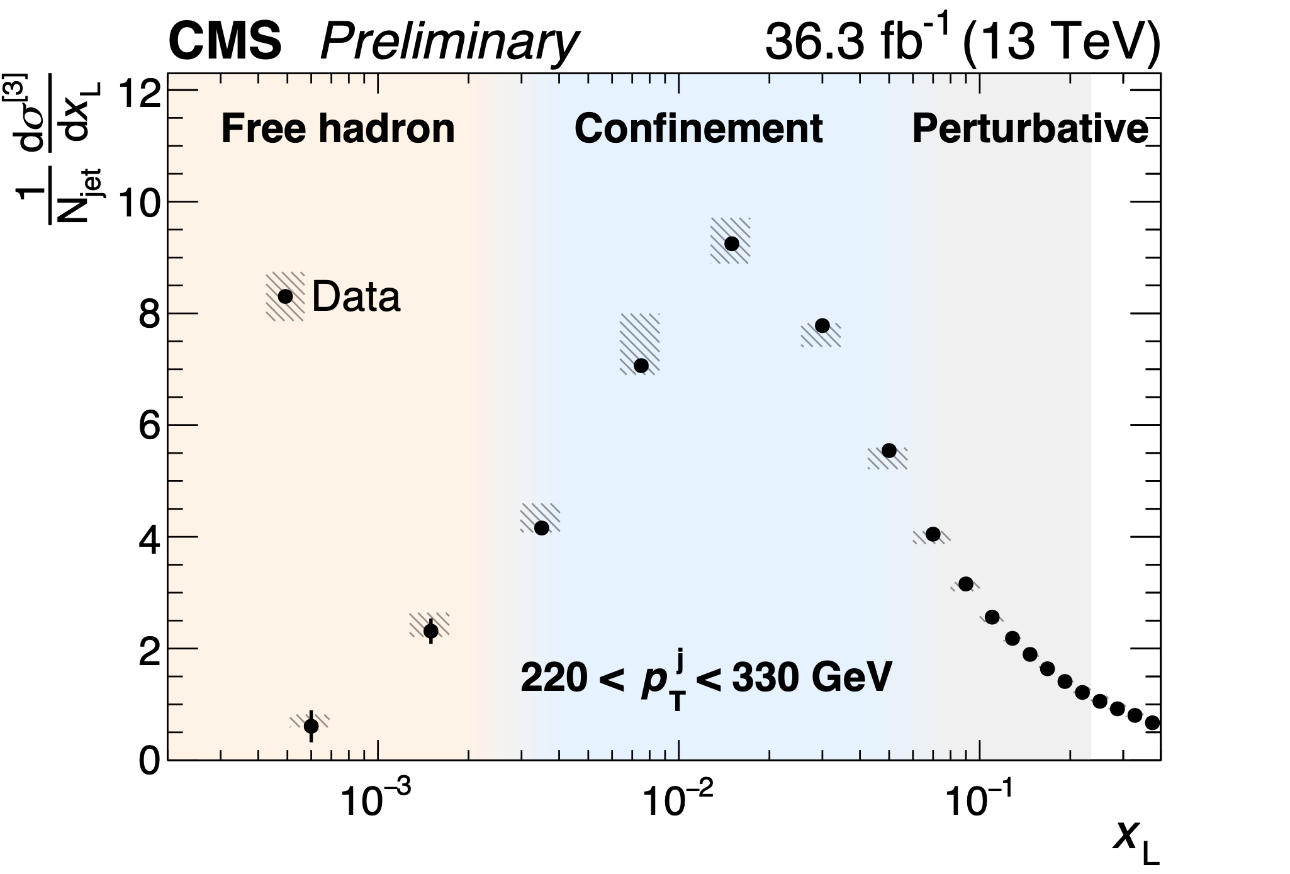

Unfolded EEC in pp at 13 TeV
Confinement
Phase transition
from parton to hadron
29
Non-interacting hadron random distribution integer power-law scaling
Interacting partons non-integer scaling
Time

