Slide 1
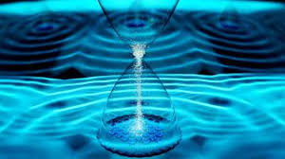
TIMECRYSTALLINE VORTICES, STAGNATION POINTS
AND THE POINCARÉ INDEX FORMULA
Antti Niemi -- Nordita

Slide 2
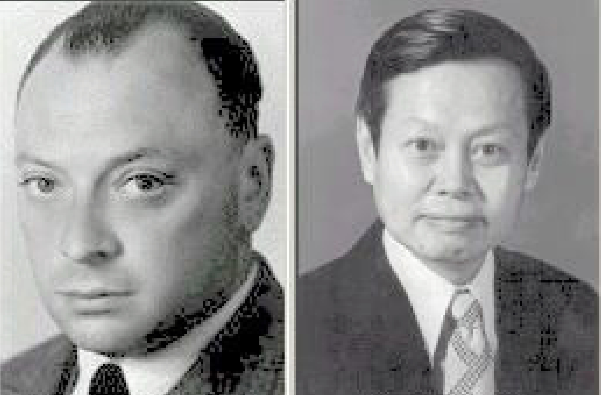
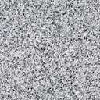
70th Anniversary of the mass-gap problem
C.N. Yang (1954):

Slide 3
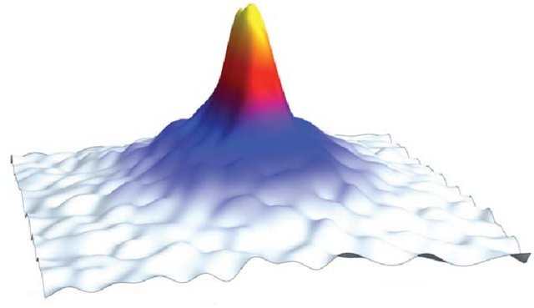




SU(2) YM motivation:
“on-shell” decomposition
Gross-Pitaevskii equation
with harmonic trap (NLSE):
Gross-Pitaevskii free energy:
Rigorous results (Lieb et.al.)
For g ∈ [5,500] 2D Gross-Pitaevskii equation
describes N ∼10⁴ - 10⁶ ultracold Bose-Einstein
condensed alkali atoms in a typical experiment
with axially symmetric oblate harmonic trap
- Relevant point:

Slide 4
Plan:
Vortices and Gross-Pitaevskii – textbook results
Vortices and time crystals
Vortices are anyons
Topological (phase) transition
Order parameter and the Poincaré index formula

Slide 5
Properties of Gross-Pitaevskii:
Poisson brackets
-
= 1 (normalization)
number of atoms
Conserved quantities:
z-component of macroscopic angular momentum
Topological quantity:
vorticity

Slide 6
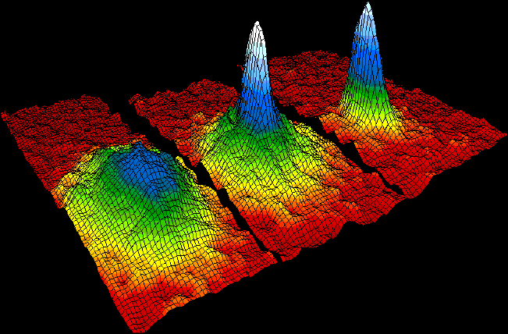
Known results:
Fundamental excitations are vortices
There is no stable vortex solution of the static GP equation
There are stable vortex solutions that are stationary in a uniformly rotating frame
chemical potential for N
These vortices solve the time independent GP (nonlinear Schrödinger) equation

Slide 7
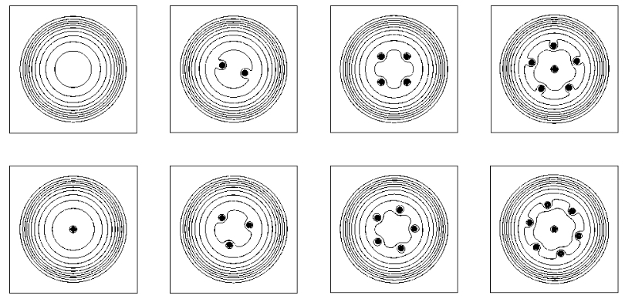
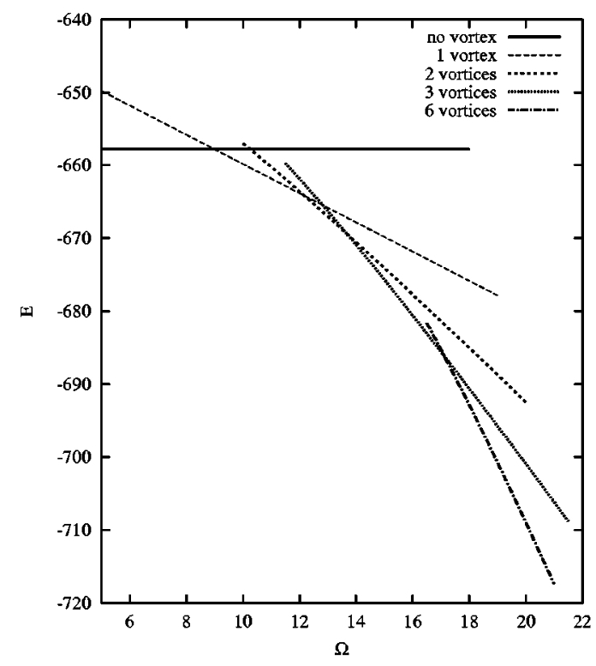
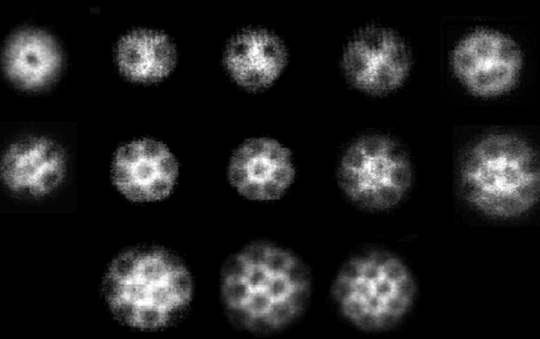
Vortices in rotating condensates:
Numerical simulations:
Vortex (Abrikosov) lattices are modeled as minimum energy critical points of F_{𝛺}
Vortices in a rotating condensate form highly symmetric lattices.
Ω increases
NOTE: Unlike Euler
vortices the vortex
energy is finite! No
delta-functions!
Experimental observations:
“Highly symmetric”

Slide 8

Vortices and time crystals

Slide 9

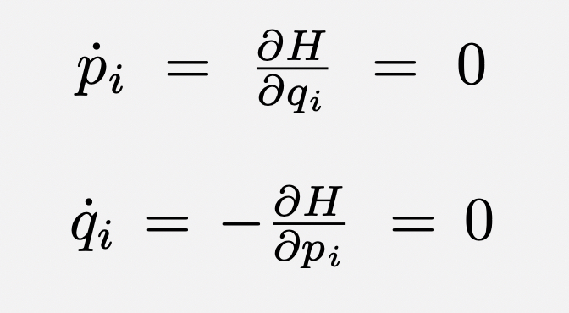
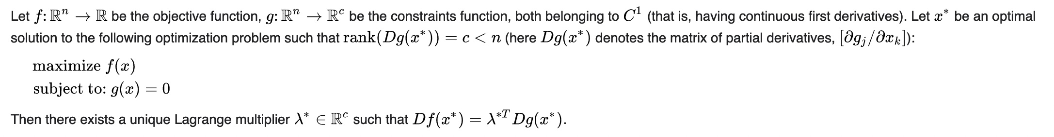
PARADIGM:
“A time crystal never reaches thermal equilibrium, as it is a type of nonequilibrium matter, a form of matter proposed in 2012, and first observed in 2017. This state of matter cannot be isolated from its environment—it is an open system in nonequilibrium.”
Energy minimum is critical point
There are no hamiltonian time crystals
Counterexample:
Hamiltonian with condition
Hamilton’s equation has no time independent solution
Lagrange multiplier theorem:

Slide 10
Critical point:
Constrained optimization:
Energy H
Energy H and set of conditions Gª = 0
Minimize energy
critical point of H
Minimize energy H subject to conditions
Hamilton’s equation:
time crystal
No “time crystal”

Slide 11
Question: Are there non-symmetric minimal energy vortex solutions of the Gross-Pitaevskii equation
that are NOT critical points of the free energy?
Minimize
NOTE:
Macroscopic
angular momentum
Does not need to be integer
≡ 1 (normalization)
Subject to conditions
The minimum of F subject to conditions can be found as a critical point of
“Lagrange multiplier theorem”
“Time independent GP in rotating frame”
Solve for

Slide 12
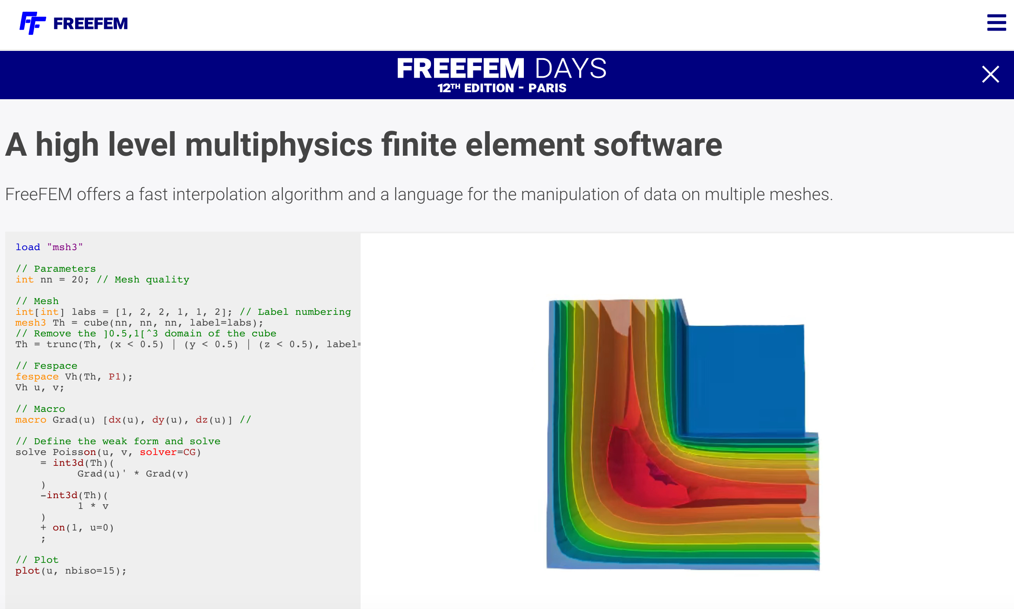
Note:
with
Spontaneous symmetry breakdown: U(1)XU(1) -> U(1)
Timecrystalline evolution is a symmetry transformation
Search for a solution numerically:

Slide 13
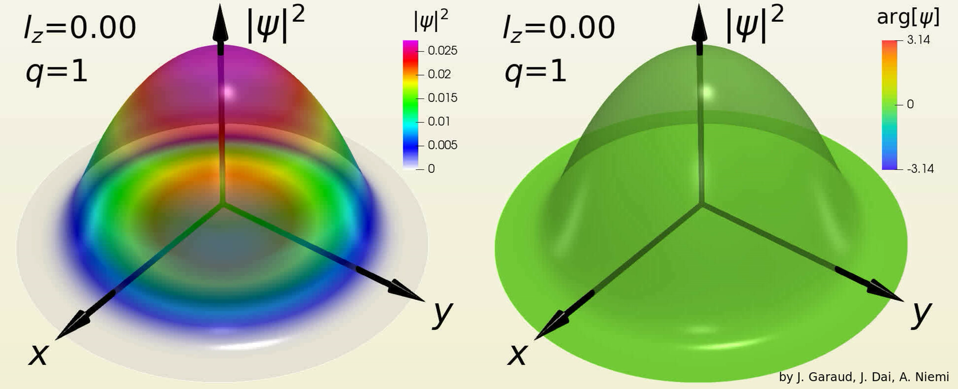

Slide 14
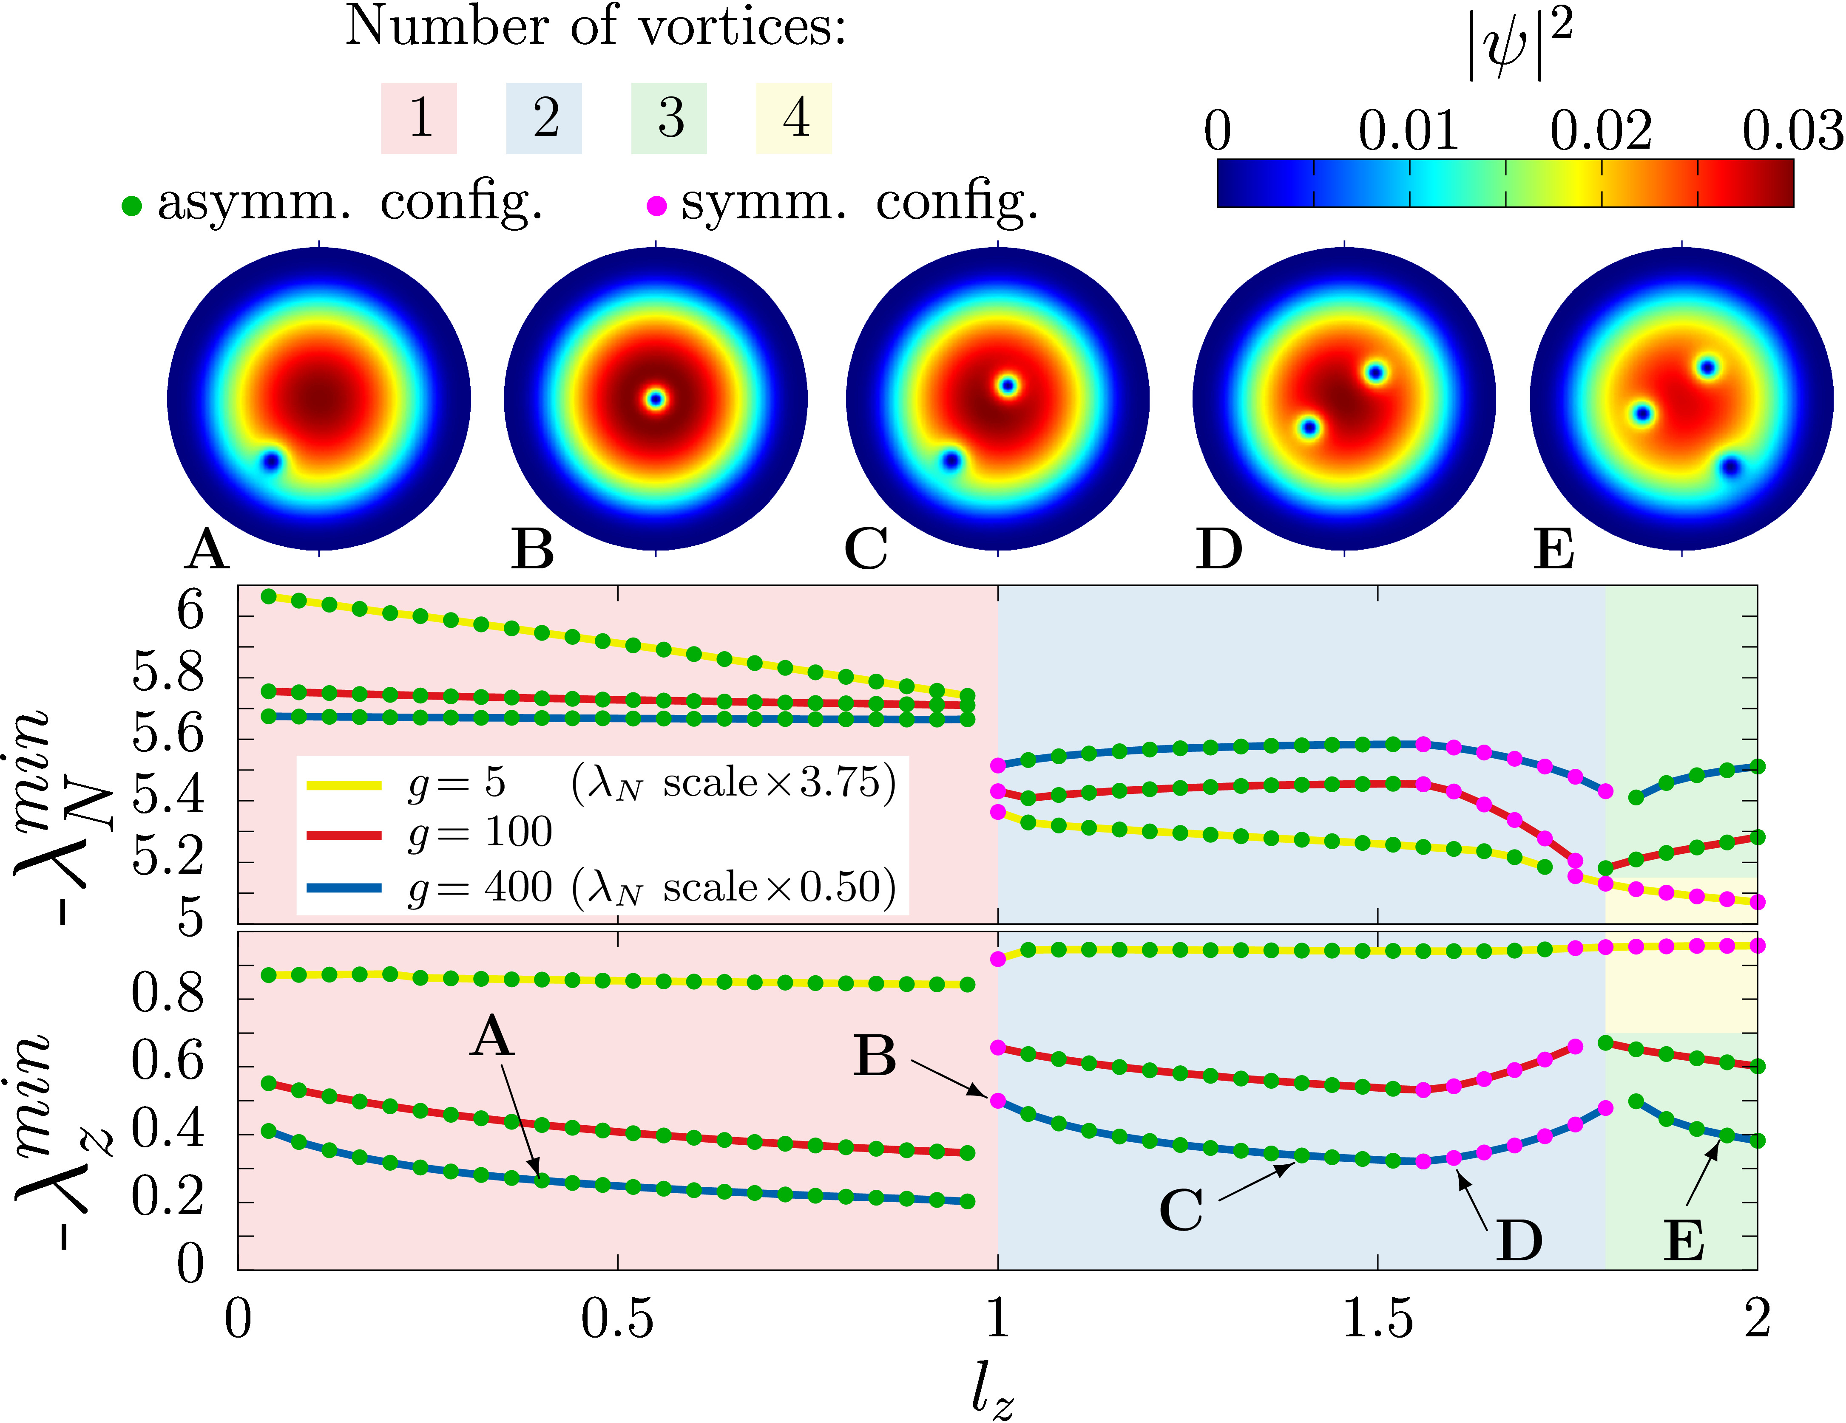
Vortices are timecrystalline – a vortex always moves

Slide 15
Vortices are anyons
“In two dimensions, exchanging identical particles twice is not equivalent to leaving them alone. The particles’ wavefunction after swapping places twice may differ from the original one; particles with such unusual exchange statistics are known as anyons. By contrast, in three dimensions, exchanging particles twice cannot change their wavefunction, leaving us with only two possibilities: bosons, whose wavefunction remains the same even after a single exchange, and fermions, whose exchange only changes the sign of their wavefunction.”

Slide 16
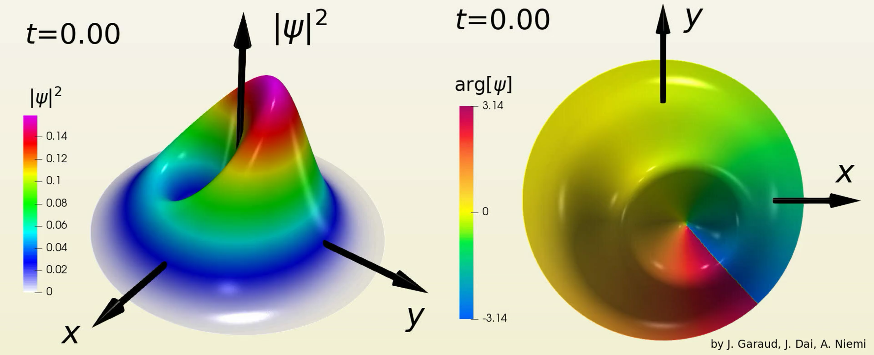
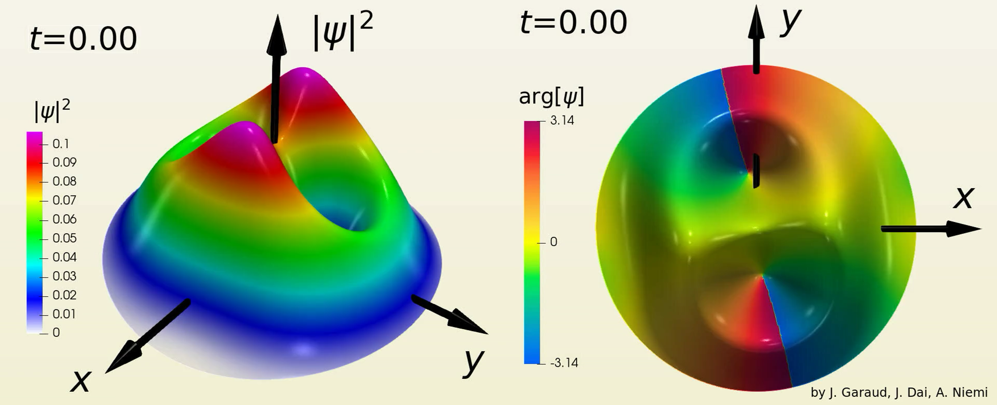
Time evolution:

Slide 17
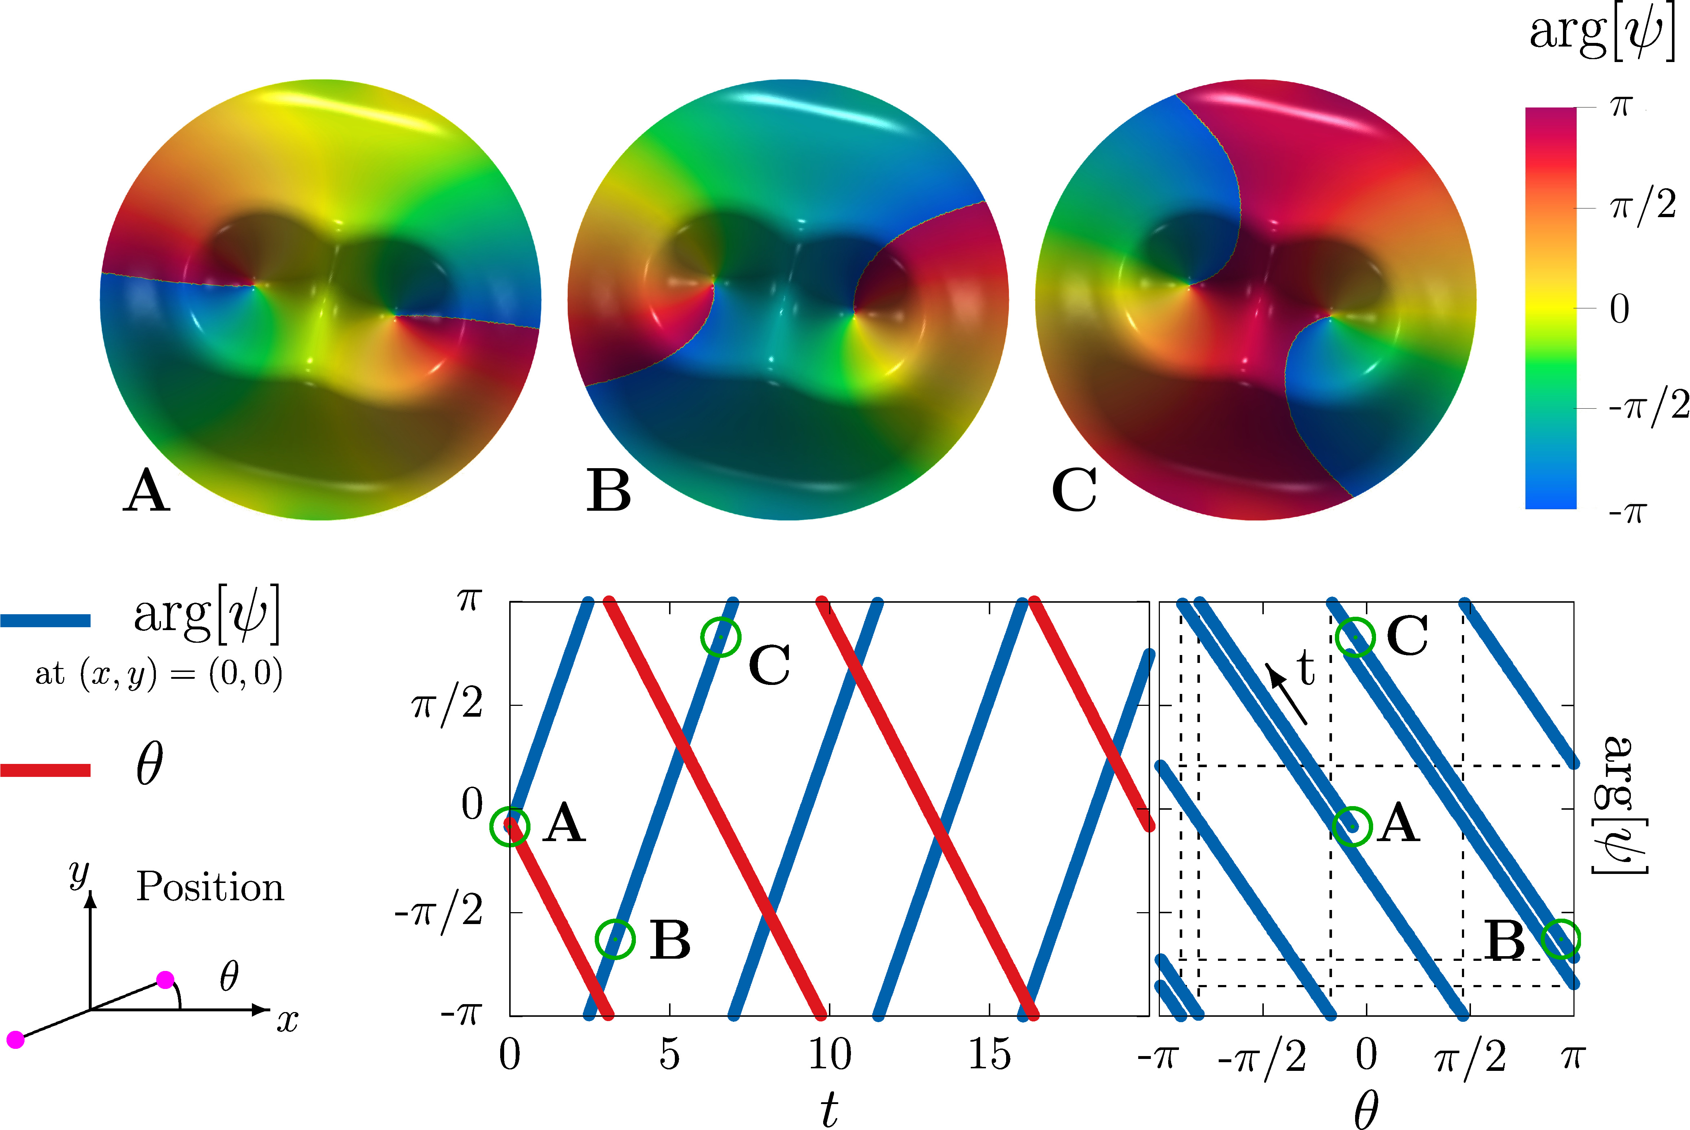
Vortices are timecrystalline anyons:
”Kinetic angular momentum”
"Statistical gauge field”
Accrued phase of wavefunction depends on
as statistical parameter

Slide 18
Saddle points, topological (phase) transitions
And the Poincaré index formula

Slide 19
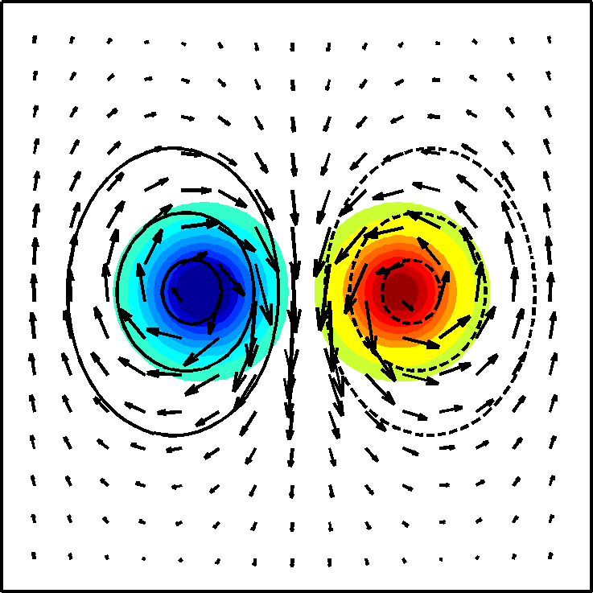
conventional (super)fluid vortices:
vortex
Opposite circulations
antivortex
Circulation:
Circulation = +1 for a single vortex, and -1 for a single antivortex
Normally, no other topological invariant -- but is this the full story??

Slide 20
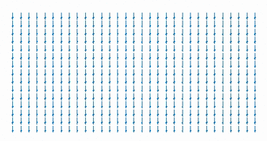
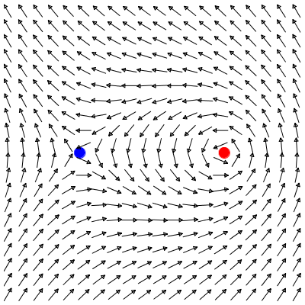
Vortices and saddles (stagnation points) as topological structures:
(anti)vortex=center
stagnation point = saddle
Two different integral invariants:
center
Circulation:
saddle
center
Winding number:
saddle

Slide 21


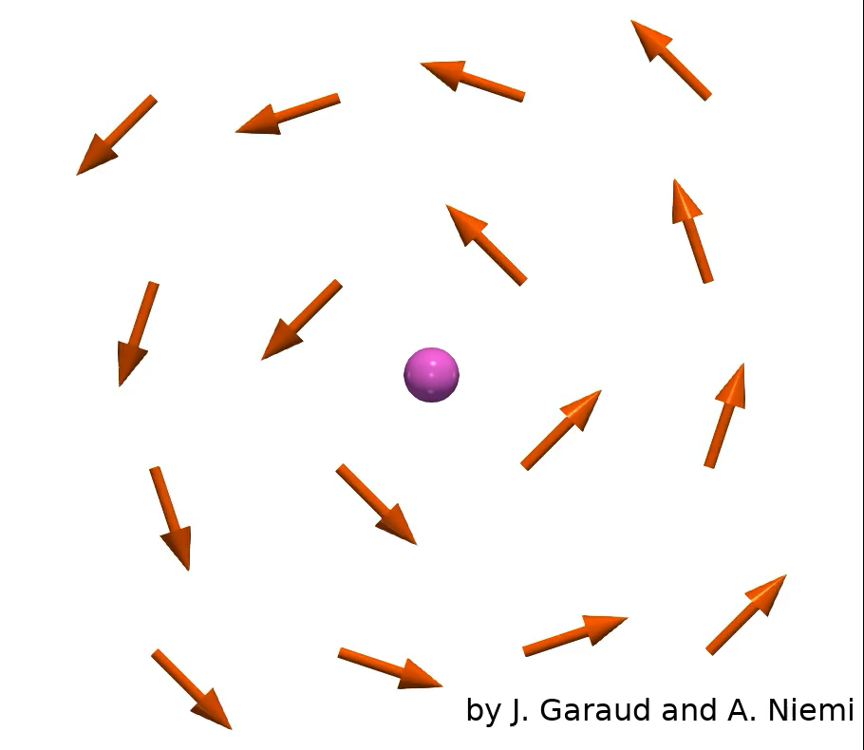
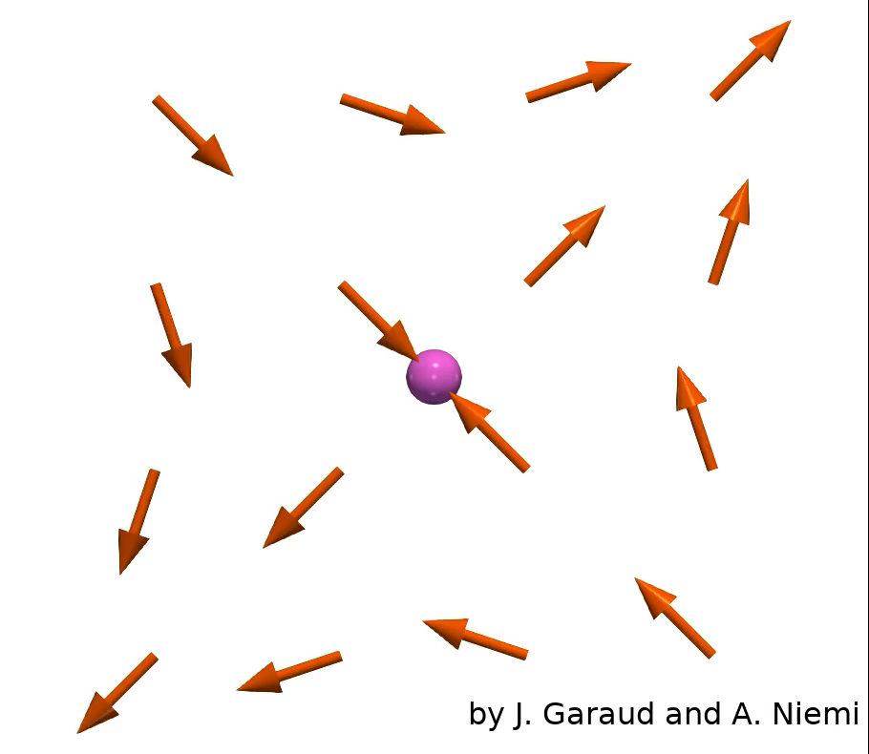
Vector fields, critical points and the winding number:
counterclockwise center, source, sink, clockwise center
Only saddle has winding number -1
All have winding number +1

Slide 22
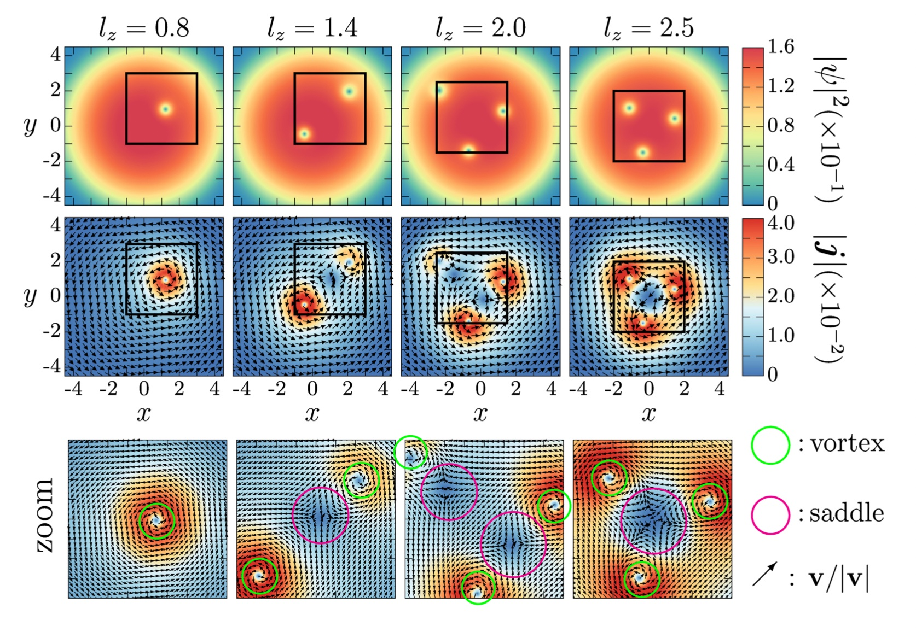
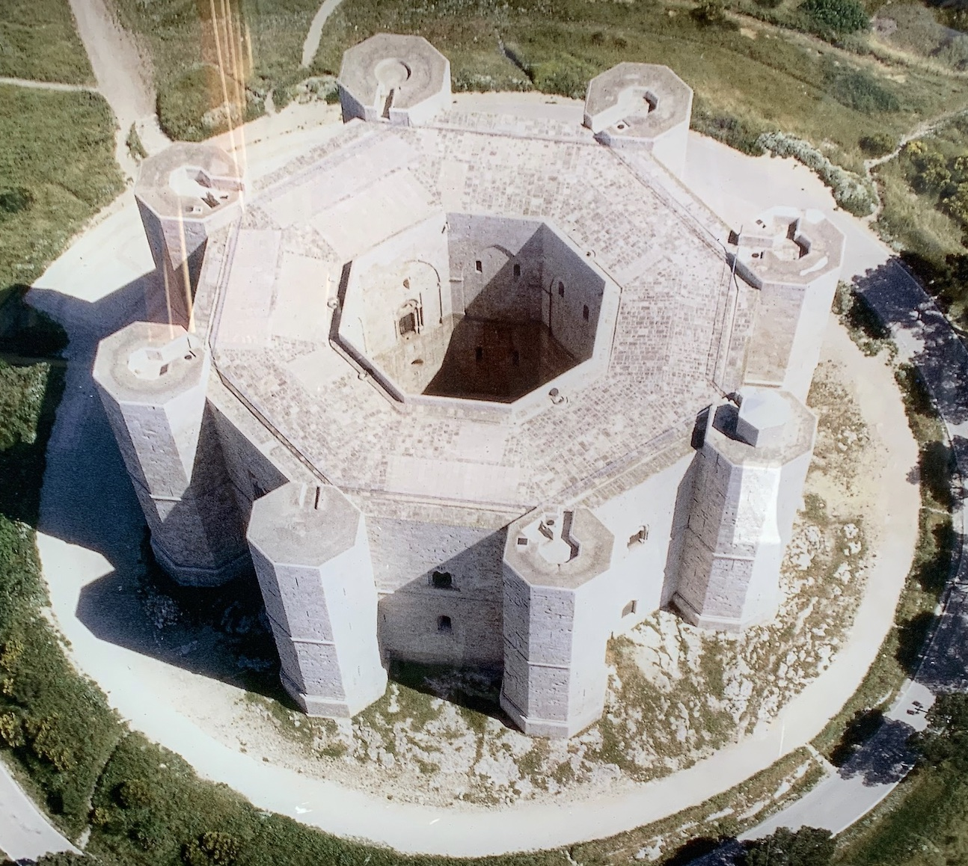

Vortices and stagnation points (saddles) for small angular momentum:
Stagnation point = saddle
Vortex = center
Vortices form lattices but Saddles aggregate

Slide 23
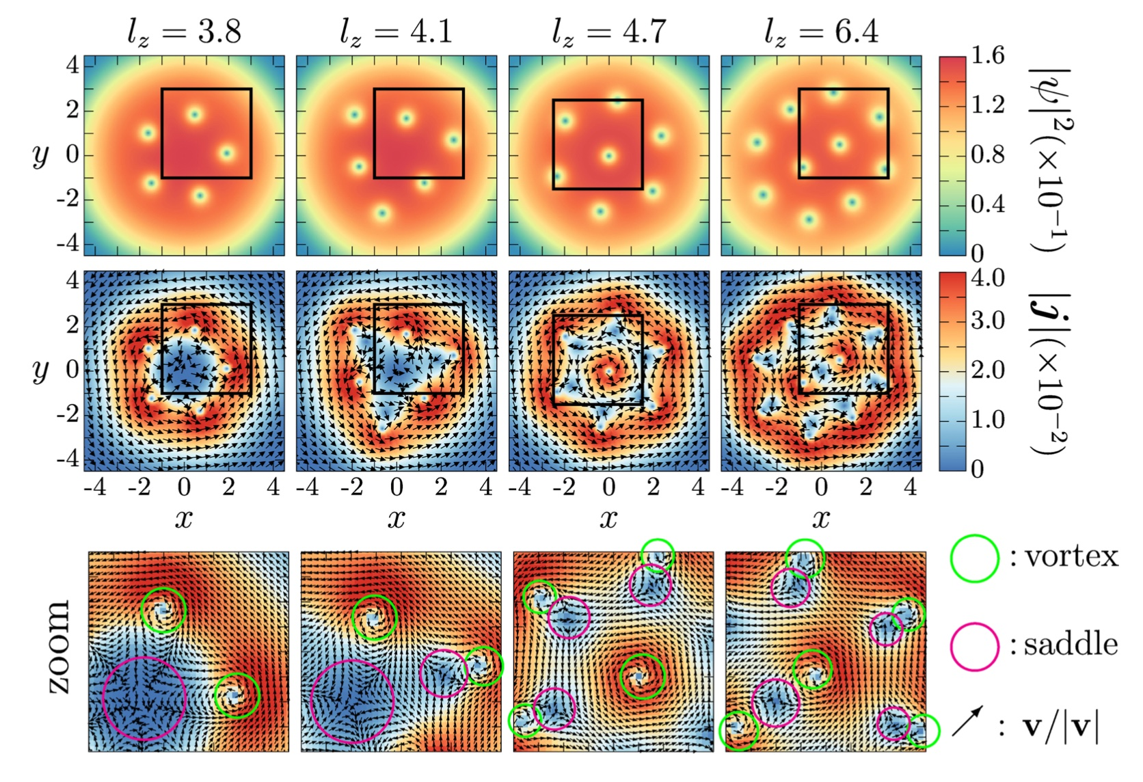
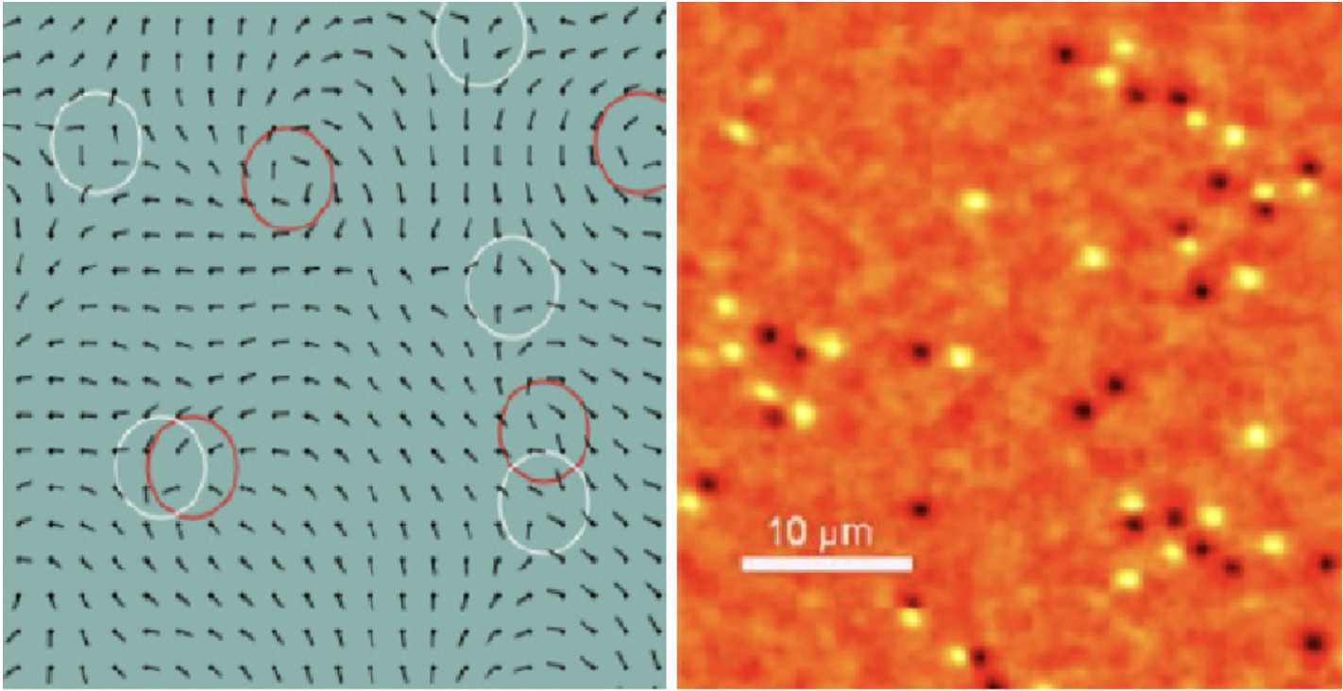
Vortices and saddles at large angular momentum:
Change in local topology:
Kosterlitz-Thouless XY Model
Energy of vortices and saddles
(logarithmically) divergent
Topological phase transition
Saddle aggregation
l_{z} increases
Vortex-saddle pairing
IMPORTANT DIFFERENCE: Energy of vortices diverges but energy of saddles finite in London limit of GP!

Slide 24
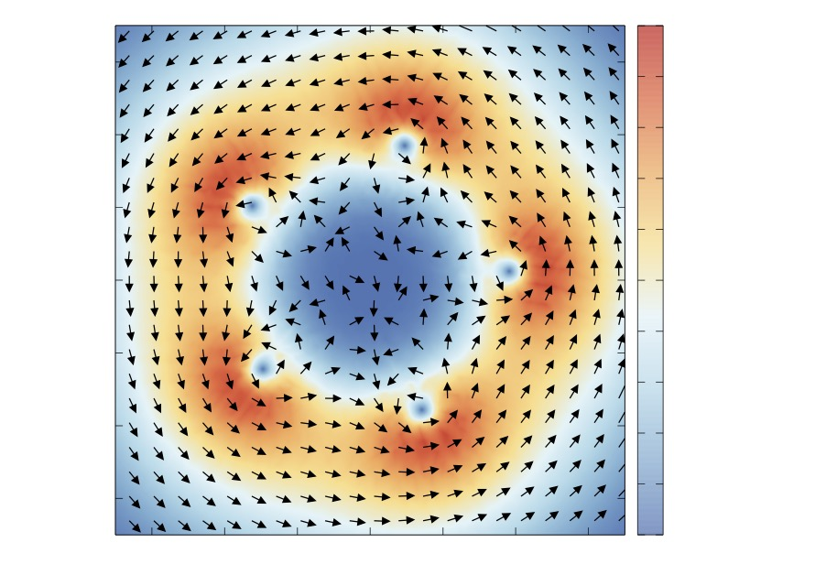
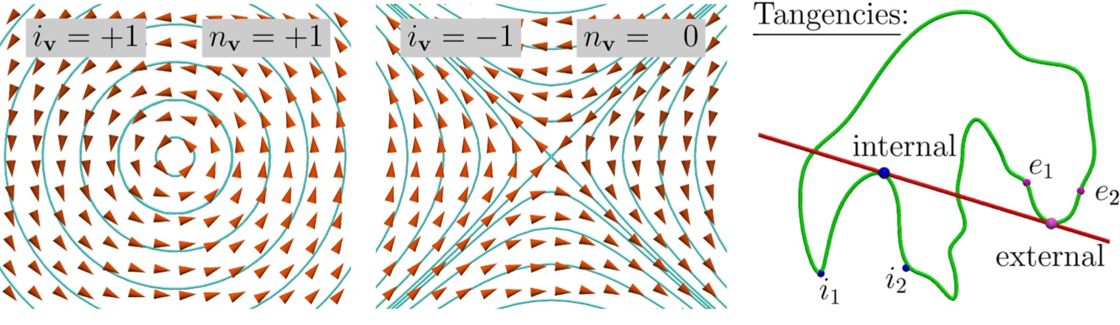
How to resolve centers and
saddles in a given region:
(Winding number)
(Circulation)
Order parameter: Poincare index formula (for winding number)

Slide 25
Lessons:
(Free) energy minima do not need to be critical points
This can take place when there are symmetries with conditions
Energy minima that are not critical points are often time dependent
Timecrystalline dynamics, in Hamiltonian or Schrödinger context
Time dependent minimum energy trajectories are symmetries
Spontaneous symmetry breaking seems to be prerequisite for time crystals
New physical phenomena
Anyonic and timecrystalline vortices, topological phase transition in cold atoms, …
Examples of Poincaré Index formula and other index theorems
Centers, saddles and topology of 2D vector fields
What about D=3 (and higher) dimensions?

