Slide 1


LS3 preparations
06 March 2024

Slide 2
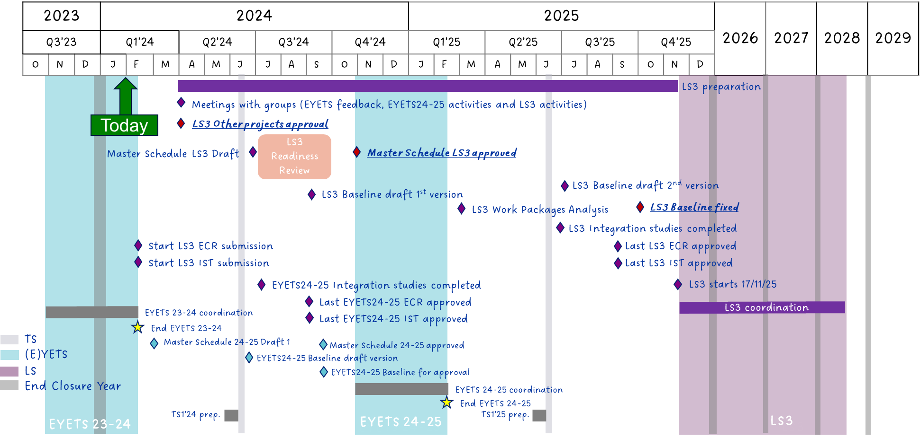
LS3 roadmap

Slide 3

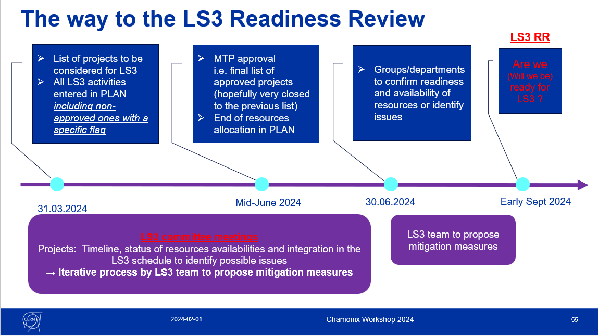
Global CERN timelines
  The injectors must remain aligned with the global CERN timelines

Slide 4
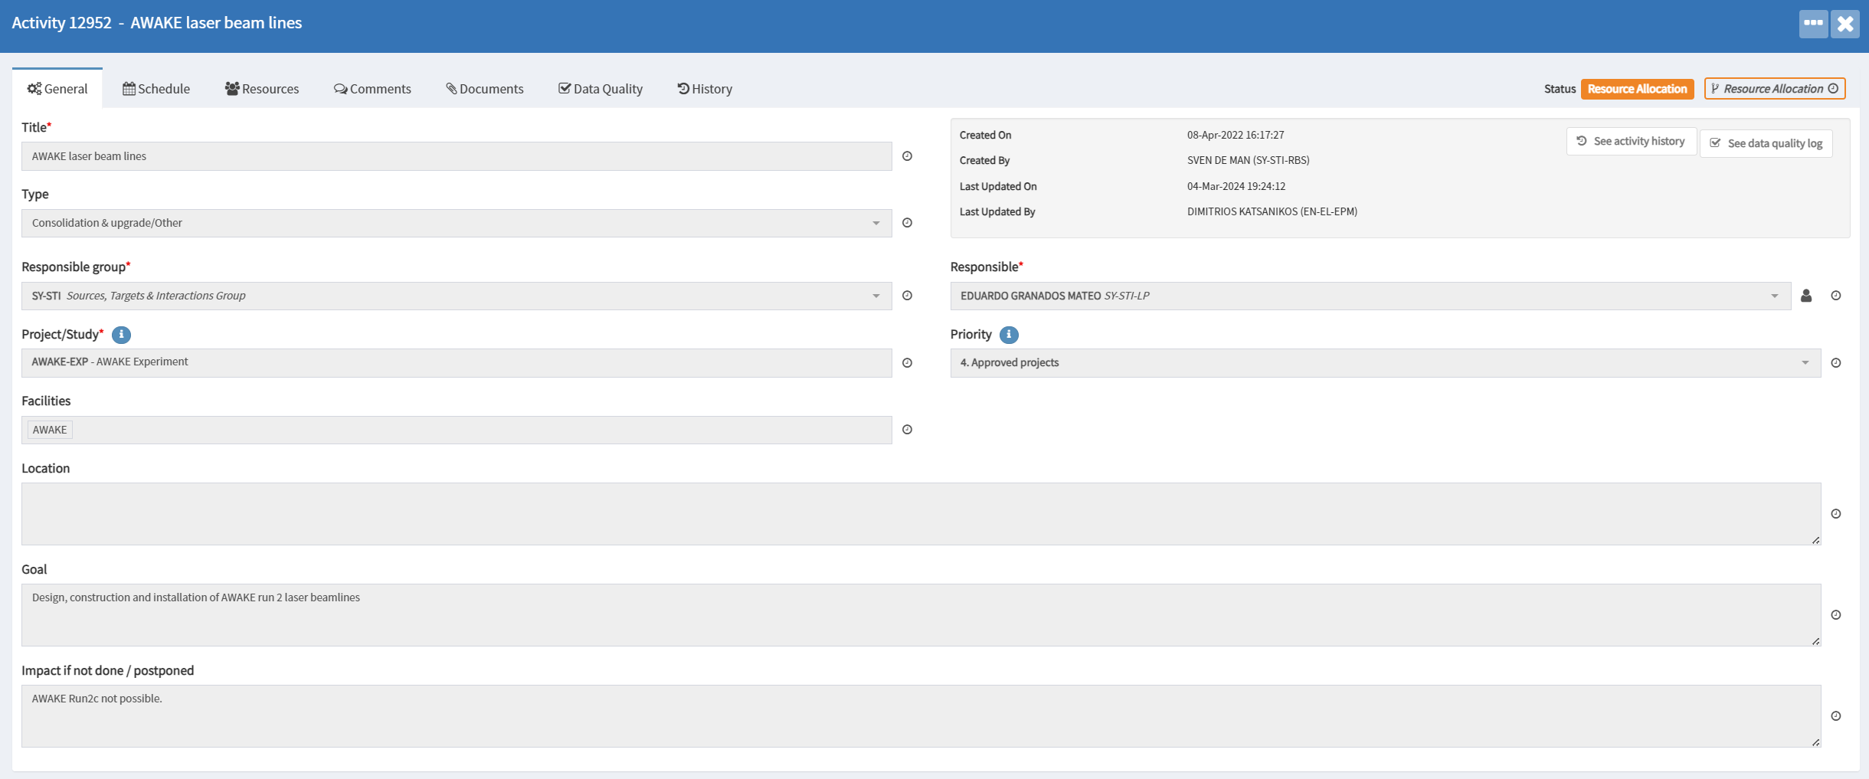
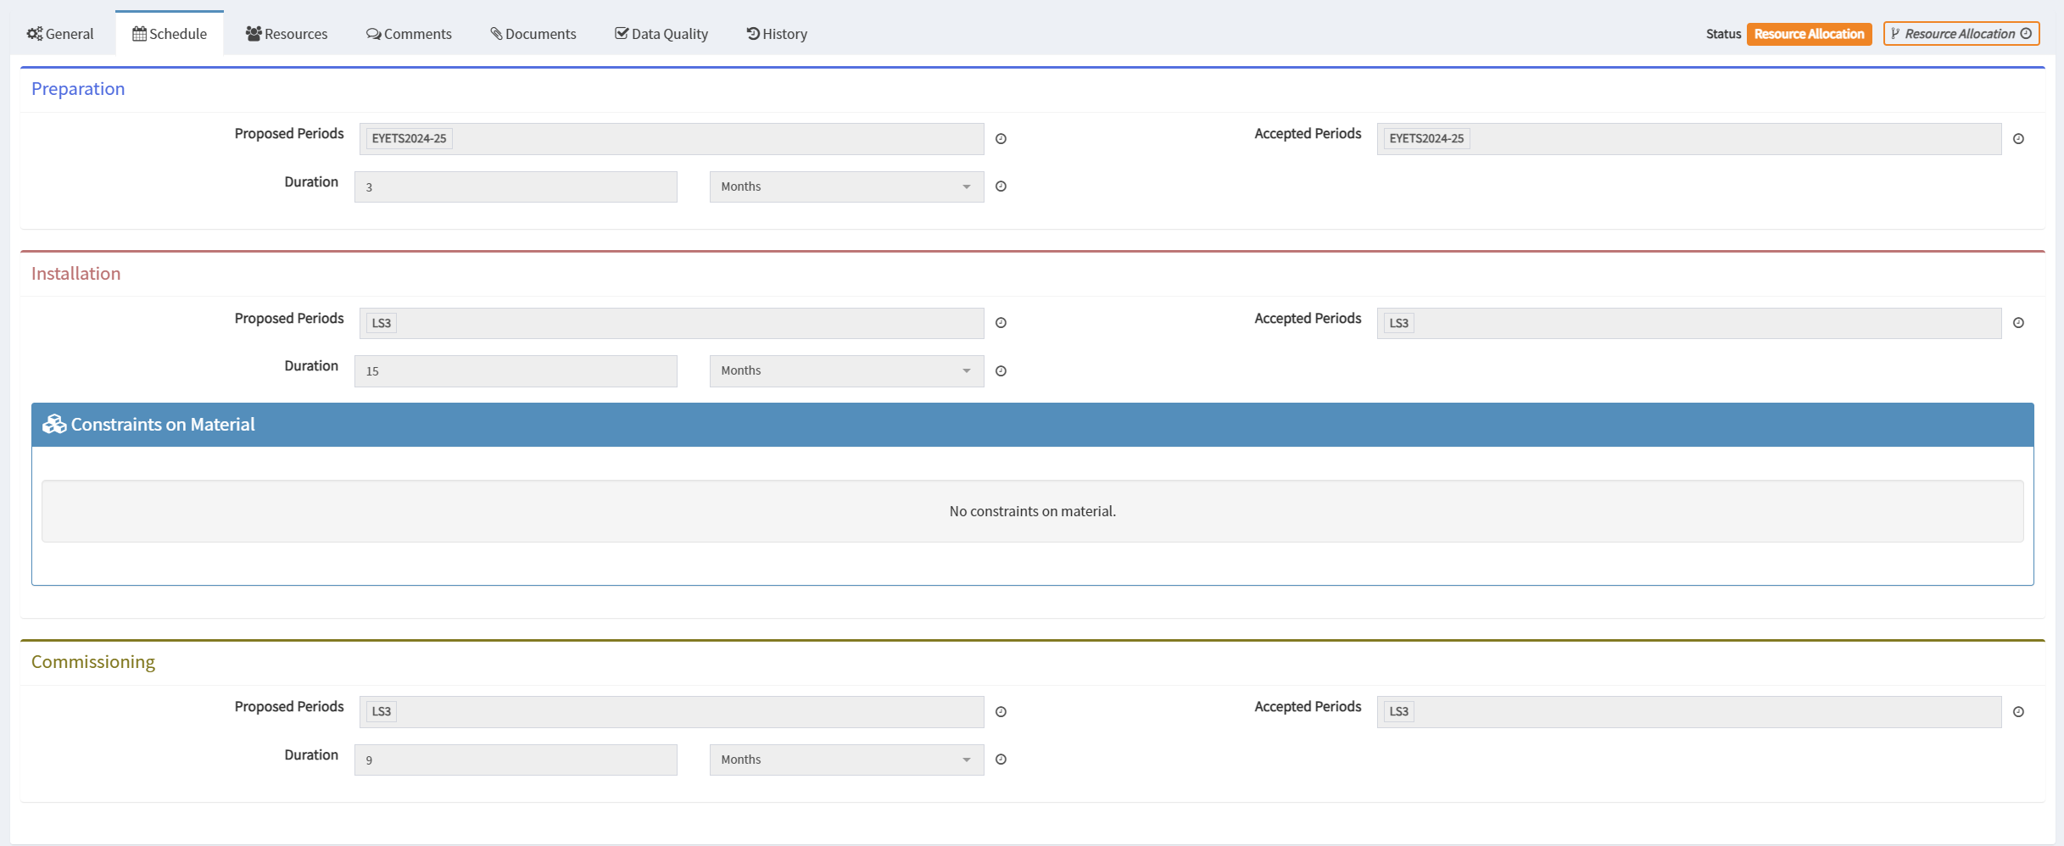
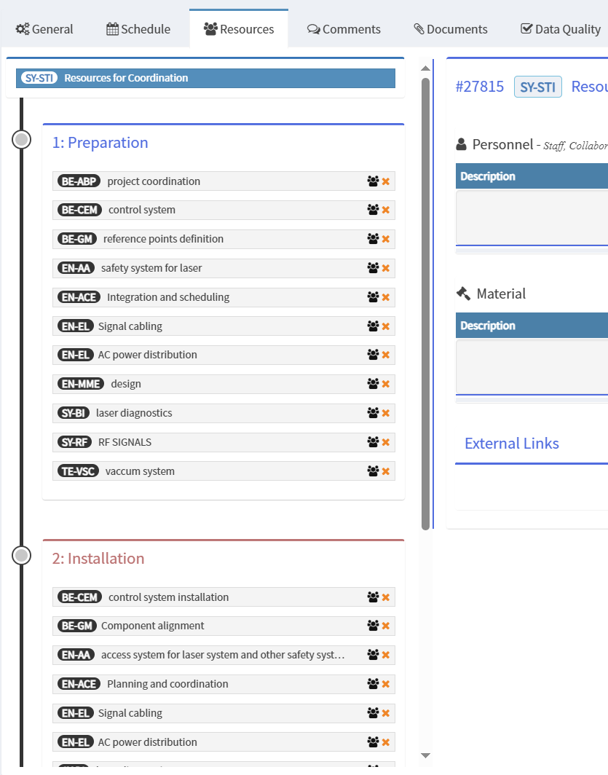
PLAN tool : plan.cern.ch
Everyone should have EN-EL in the resources

Slide 5
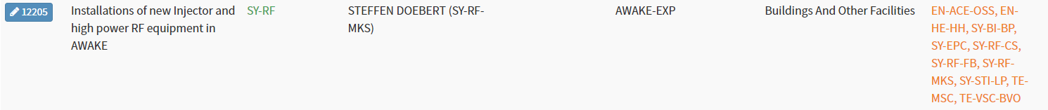
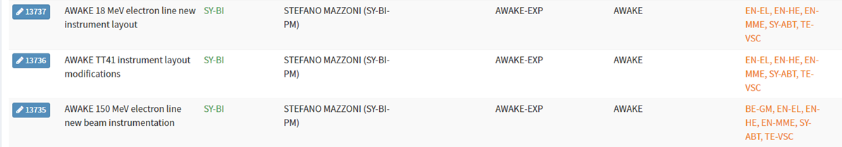
PLAN activities
To be filled before 31.03.2024
CP | Description | PLAN
CP1 | SPS beam, RF timing | one PLAN activity «Upgrade of SPS beam and RF timing in AWAKE»
CP2 | Proton & Electron beam lines | One PLAN activity «installation of proton and electron lines in AWAKE» Or two PLAN: “installation of proton line in AWAKE” + “installation of electron lines in AWAKE” + PLAN activity for EPC ? “new converters for AWAKE” ? + PLAN activity for magnets ?
CP3 | Electron source
CP4 | Infrastructure
CP5 | Laser beam line
CP6 | Beam instrumentation
CP7 | Plasma cell technology

Slide 6
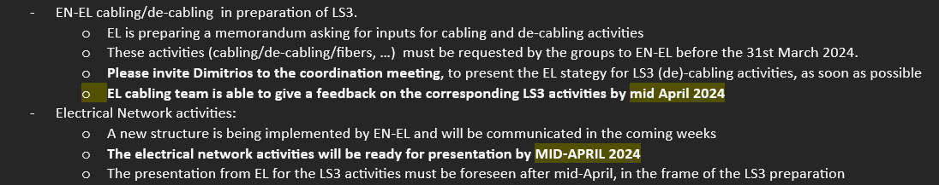
Cabling requests
To be sent before 31.03.2024
Important dates for AWAKE:
Cabling request deadline = 31.03.2024
Electrical network facility deadline = April 2024 ?

Slide 7
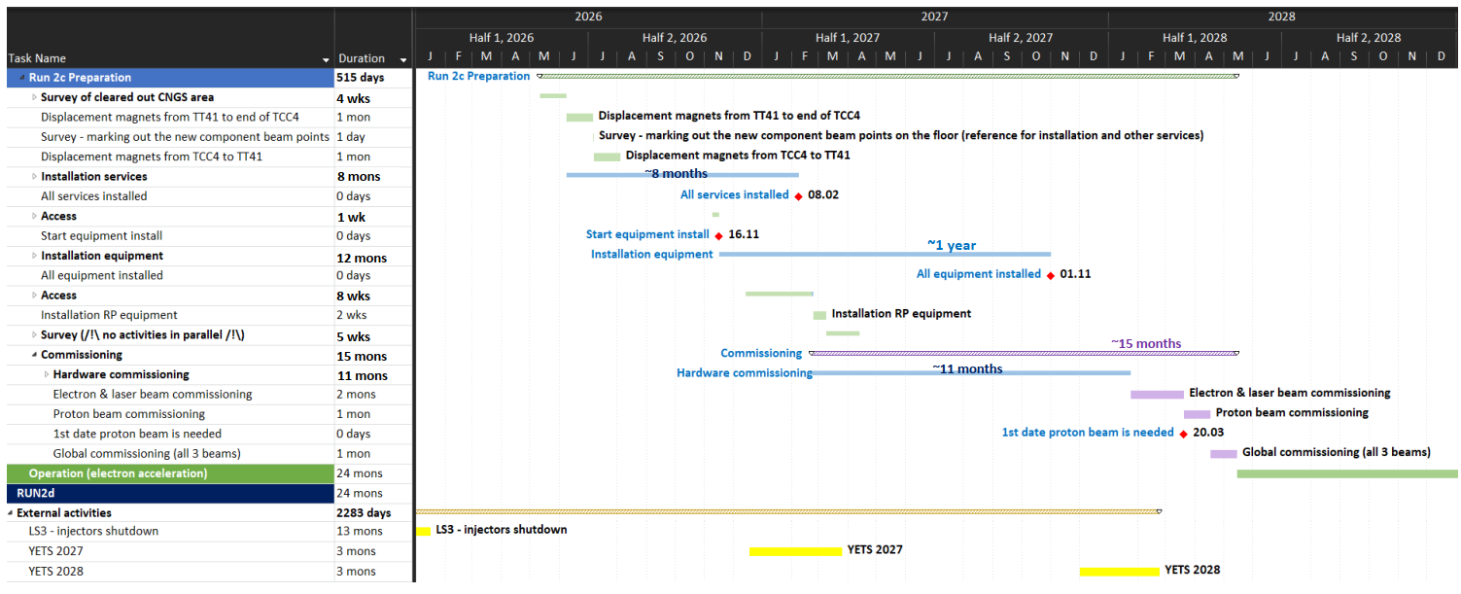
AWAKE run 2c installation schedule
Draft planning expected for June 2024
The LS3 roadmap foresees:
  Master schedule by June 2024
  LS3 readiness review September 2024
For AWAKE, this means:
  Review of run2c schedule
  Identify which groups intervenes when
  Probable bottlenecks = EN-EL & EN-CV activities for 2026

Slide 8
Summary
Before 31.03.2024:
  Send cabling requests to EN-EL
  Enter your activity in PLAN
In the coming months, to be finalised by June:
  Review run2c installation schedule

