Slide 1
AWAKE Run2c vs Run2a&2b Infrastructure Integration
Integration Team: A. Pardons, E. Guran, V. Clerc (3D Drawings)
Update from 2020 document (P. Wiwattananon)

Slide 2

Run 2ab vs Run2c
Run2c has 2 times large/complex equipment than Run2ab
Run2c requires at least x2 spaces/volume than Run2ab
In Run2c integration design →take into account: the accessibility of equipment – obey rule for minimum passage (800mm width free) for emergency evacuation
In Run2c integration design →take into account: the transportation of equipment to the AWAKE experimental area: transportation width = 1.3m
Update January 2024
AWAKE Run2ab vs Run2c Infrastructure Integration
2

Slide 3











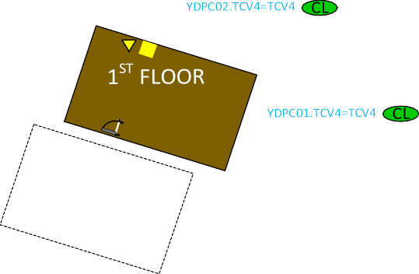

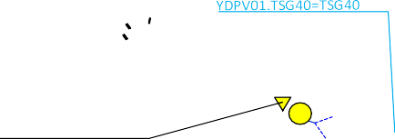


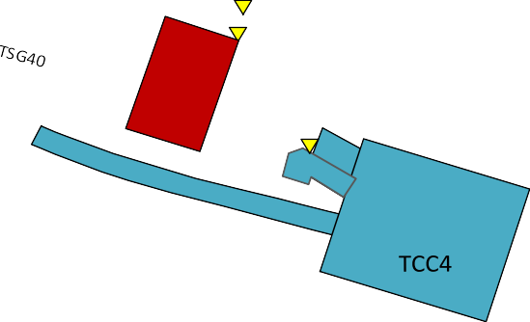
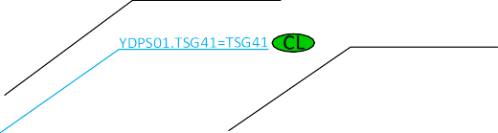

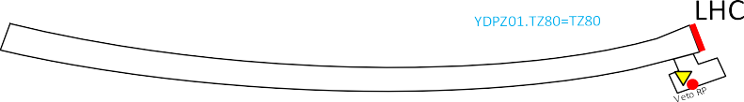
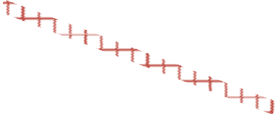

TAG41
 |  |  |  | Material Access device - MAD
 |  |  |  | Personal access Device - PAD
 |  |  |  | EIS-Beam ou Machine / EIS Laser ou Electron
 |  |  |  | End-of-Zone door
 |  |  |  | Sector Ventilation door
 |  |  |  | Sector Ventilation Door with line of sight door
S# |  |  |  | Sector n°
 |  |  |  | Patrol checkpoint
 |  |  |  | Laser Patrol checkpoint
CL |  |  |  | Door connected to cabled loop
 |  |  |  | Local RP veto release
ACCESS POINT
YDA01=TAG41
ECA4
YWBVR01=TAG41
YDAP01=TAG41
YDPZ01=TAG41
YDAM01=TAG41
YWBPC01=TAG41 YWBPA01.TAG41=TAG41
ACCESS POINT
YDA01=TT40
S0
CL
YWBPA02.TAG41=TAG41
S0
ACCESS POINT
YDA01=TAG42
YDPZ01=TAG42 YWBPB01.TAG42=TAG41
YDPS01.TAG42=TAG42
S1
YDAM01=TAG42
YDAP01=TAG42
S0
CL
S1
YWBPA03.TAG41=TAG41
Bending Magnet
MBSG 410010
Beam Stopper
TBSE 410113
Bending Magnet
MBG 410147
TT40
S1
YWBPA04.TAG41=TAG41
Electrons RF
Electrons HV
YWBPA08.TCV4=TCV4
YWBPB02.TCV4=TCV4
YWBPB01.TCV4=TCV4
YWBPA07.TCV4=TCV4
YWBPA06.TCV4=TCV4
YWBPA02.TSG40=TSG40
Laser shutter LSSe2
Laser shutter LSSe1
S5
TJ8
YWBPA05.TCV4=TCV4 YWBVR01.TSG41=TSG41
S2
S7
S2
YWBPA01.TSG4=TSG4
YWBPB01.TSG40=TSG40
TCV4
YWBPA01.TSG41=TSG41
S6
S2
YWBPA02.TSG4=TSG4
YWBPB03.4115=TT41
YWBPB02.4115=TT41
YWBPA02.TSG42=TSG42
Laser shutter LSSP1
Laser shutter LSSP2
YWBPA01.TSG40=TSG40
YWBPA03.TCV4=TCV4
YDPS02.TCV4=TCV4
S3
YWBPA01.TSG42=TSG42
S3
YWBPB01.TSG47=TSG47
S4
YWBPB01.TSG4=TSG4
YWBVR01.TZ80=TZ80
YWBPB01.TZ80=TZ80
YWBPB03.TCV4=TCV4
YWBPA04.TCV4=TCV4 YWBPA01.TT43=TT43 YWBPA03.TT43=TT41
S8
YWBPB02.TSG47=TSG47
YWBPB04.TT41=TT41
YDPS01.TCV4=TCV4
YWBPA02.TCV4=TCV4
YWBPA01.TCV4=TCV4
YWBPA09.TSG41=TCV4 YWBPB01.TSG41=TSG41
YWBPA02.TCC4=TCC4
YWBPB01.TSG42=TSG42
YWBVR01.TCC4=TCC4
S9
YWBPA01.TCC4=TCC4
Update January 2024
AWAKE Run2ab vs Run2c Infrastructure Integration
3

Slide 4
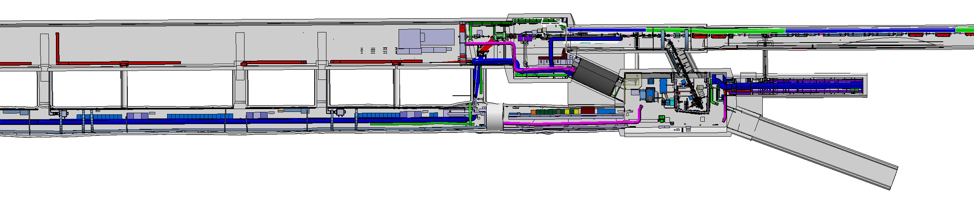
Run2c vs Run2ab
Slide 5: Run2ab Experimental Area
CNGS area – to be dismantled
Run1
TSG45
TSG44
TSG43
TSG42
AWAKE CNGS Area Dismantling is before & during LS3 (2025-2026)
Run2c Integration/installation is during LS3 (2026-2027)
Laser beam compressor 2
Spectrometer
2 Plasma Cells
Laser beam compressor 1
Run2
2 WDL Chiller Units
2 Electron Sources
UV laser room
Klystrons
Update January 2024
AWAKE Run2ab vs Run2c Infrastructure Integration

Slide 5
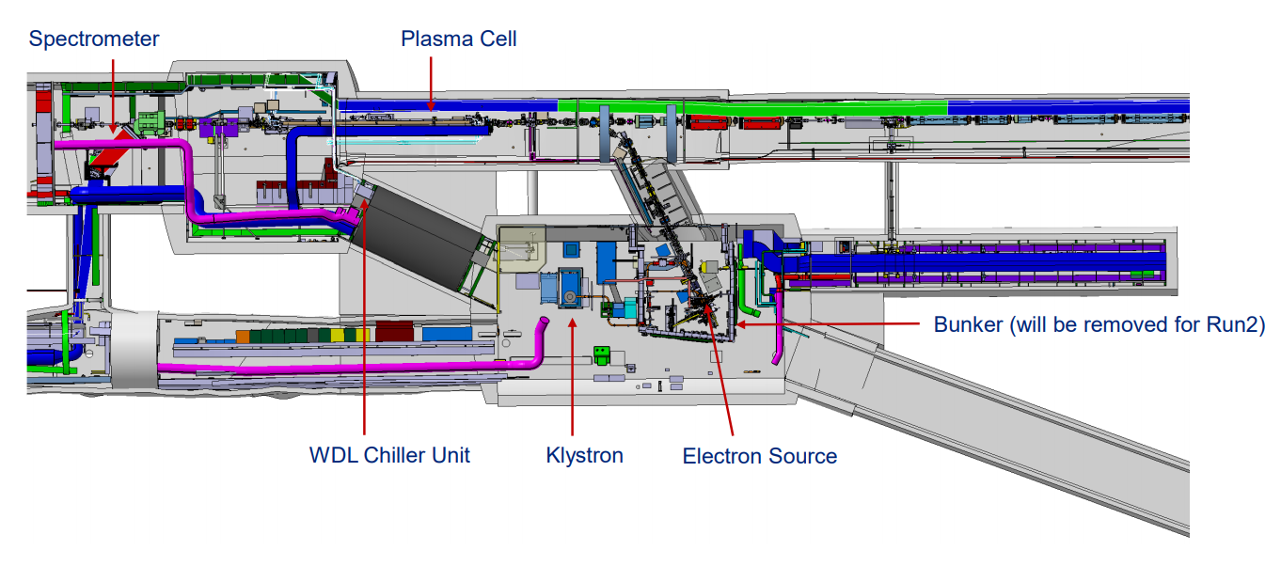
Run 2ab
Update January 2024
AWAKE Run2ab vs Run2c Infrastructure Integration

Slide 6
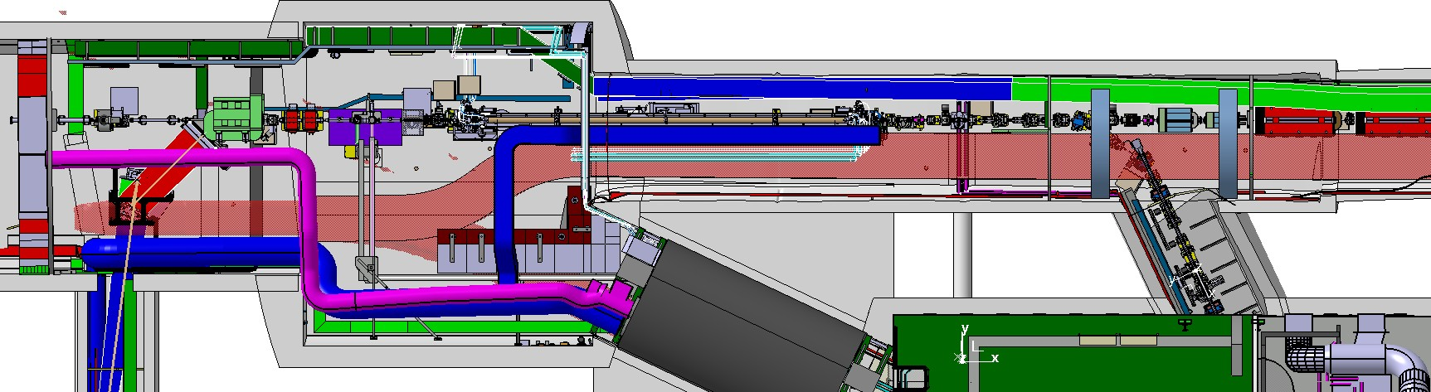
AWAKE Run2ab – Transportation Path
1.25m H=2m
1m H=1.8m
1.25m H=2m
Update January 2024
AWAKE Run2ab vs Run2c Infrastructure Integration

Slide 7
Extra Slides AWAKE Run2c
Run2c Plasma Cell1 Moves 40m Downstream Relative to Run1 Plasma Cell
Update January 2024
AWAKE Run2ab vs Run2c Infrastructure Integration

Slide 8
AWAKE Run2c Infrastructure
AWAKE Run2ab
Slide 9: Upstream
Slide13: Electron Sources
Slide 10: Experimental Area
Slide 15: Spectrometer
Slide 12: Merging Mirror
Slide 14: Plasma Cells
Slide 11: Klystron
Update January 2024
AWAKE Run2ab vs Run2c Infrastructure Integration

Slide 9
Upstream – TT41
AWAKE Run2ab
AWAKE Run2c
Laser Merging Mirror Equipment → move 35m downstream relative to Run2ab position.
Proton beam magnets → relocate to support the Run2c plasma cell1 location and avoid conflicts with infrastructure, e.g. doors, in the tunnel.
Update January 2024
AWAKE Run2ab vs Run2c Infrastructure Integration

Slide 10
BEAM HEIGHT – TT41
About 1°
BEAM 1.418m
0.270m
0.544m

Slide 11
Experimental Area – TCC4
AWAKE Run2ab Plasma Cell
AWAKE Run2c Plasma Cell1
AWAKE Run2ab Plasma Cell moves 40m downstream → AWAKE Run2c Plasma Cell1
Working spaces around the laser merging mirror, compressor1, and electron sources obey the safety passage rule!
Update January 2024
AWAKE Run2ab vs Run2c Infrastructure Integration

Slide 12
Klystrons - TCV4
Transportation Path
TSG41
Double spaces required for Run2c (additional) klystrons → TCV4 allows a perfect location with optimum waveguide length.
Update January 2024
AWAKE Run2ab vs Run2c Infrastructure Integration

Slide 13
Laser Merging Mirror Area – TCC4
Laser Beam Diagnostic
Compressor 1
Working table
Laser merging mirror
moves 35m from Run2ab
BPMI
MDSV
QTSD
QTLD
Equipment
transfer area
TSG41
Sufficient transfer (area) of equipment to the trailer.
Update January 2024
AWAKE Run2ab vs Run2c Infrastructure Integration

Slide 14
Electron Sources – TCC4
Electron Source1
Electron Source2
Plasma Cell1
Working spaces around the electron sources obey the safety rule! Electron beams geometries obey technical requirements.
Update January 2024
AWAKE Run2ab vs Run2c Infrastructure Integration

Slide 15
BEAM HEIGHT – TCC4 – BEFORE PLASMA CELL
BEAM 1.585m
Plasma Cell1
0.455m
0.450m

Slide 16
Plasma Cells – TCC4
Working table
Plasma Cell1
Working table
Plasma Cell2
Update January 2024
AWAKE Run2ab vs Run2c Infrastructure Integration

Slide 17
Spectrometer – TCC4
Dipole preferred
location for TSG45
TSG45
Update January 2024
AWAKE Run2ab vs Run2c Infrastructure Integration

Slide 18
BEAM HEIGHT – TCC4 – AFTER PLASMA CELL
Plasma Cell2
BEAM
1.6m

Slide 19
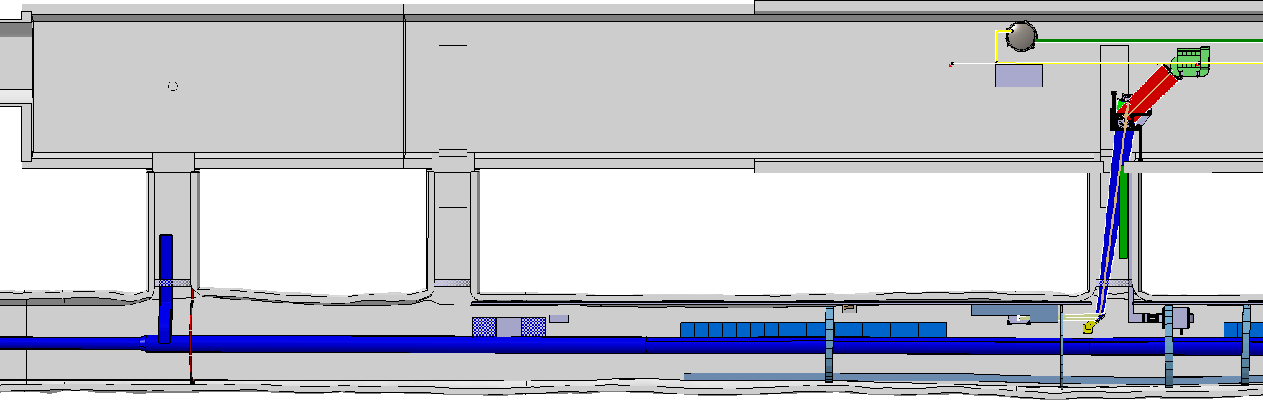
Available Space Downstream
35.39m
23.39m
TSG 47
TSG 46
TSG 45
Ventilation
Update January 2024
AWAKE Run2ab vs Run2c Infrastructure Integration

Slide 20
Transportation

Slide 21



Working space – obey the safety passage rule!
Transportation Path
TCC4 – TSG41 – TCV4 – TAG41
TSG45 TSG44 TSG43
Transportation of Large/Complex Equipment:
TSG42
Plasma Cells: via TAG41, TAG42 and TT41 - follow Run2ab procedures.
Electron Sources: via TSG41, TCV4, TCC4 – follow Run2ab transportation procedures.
MBXFD (dipole) at the spectrometer: follow Run2ab transportation procedures.
Klystrons: subcomponents must be assembled at the TCV4. No foreseen transportation issues.
Discussed, no blocking points.
Update January 2024
AWAKE Run2ab vs Run2c Infrastructure Integration

Slide 22
Laser merging mirror
moves 35m from Run2ab
Access to
equipment
Working table
Compressor 1
Laser Beam
Diagnostic
1.3m
Meet required transportation width of 1.3m.
No equipment conflicts.
Update January 2024
AWAKE Run2ab vs Run2c Infrastructure Integration

Slide 23
TCV4
2.1m
TSG41
1.3m
Klystron subcomponents can be transported via TAG41 and assembled onsite at the TCV4.
Update January 2024
AWAKE Run2ab vs Run2c Infrastructure Integration

Slide 24
home.cern

