Slide 1




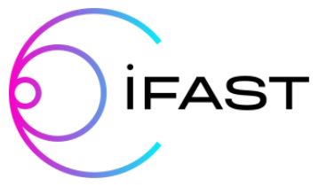


Thin Film Superconducting Cavities For Sustainable Accelerators
Daniel Seal
daniel.seal@stfc.ac.uk

Slide 2

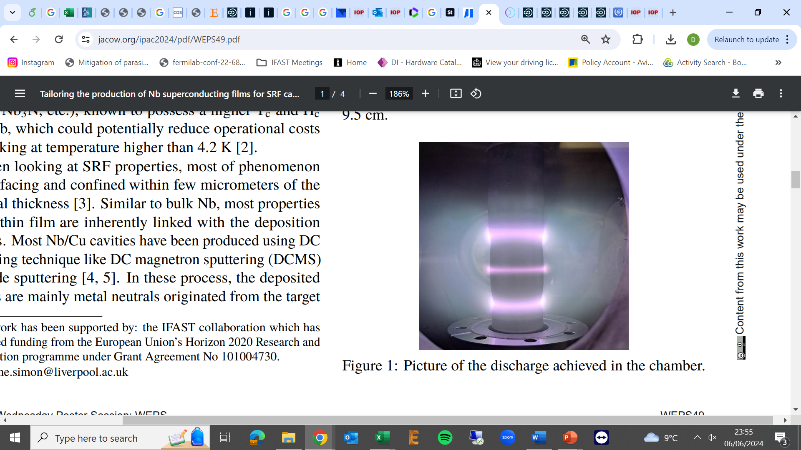
Agenda
1. Our Goal
2. Thin Film Development
3. Thin Film Testing
4. Future

Slide 3


1. Our Goal

Slide 4
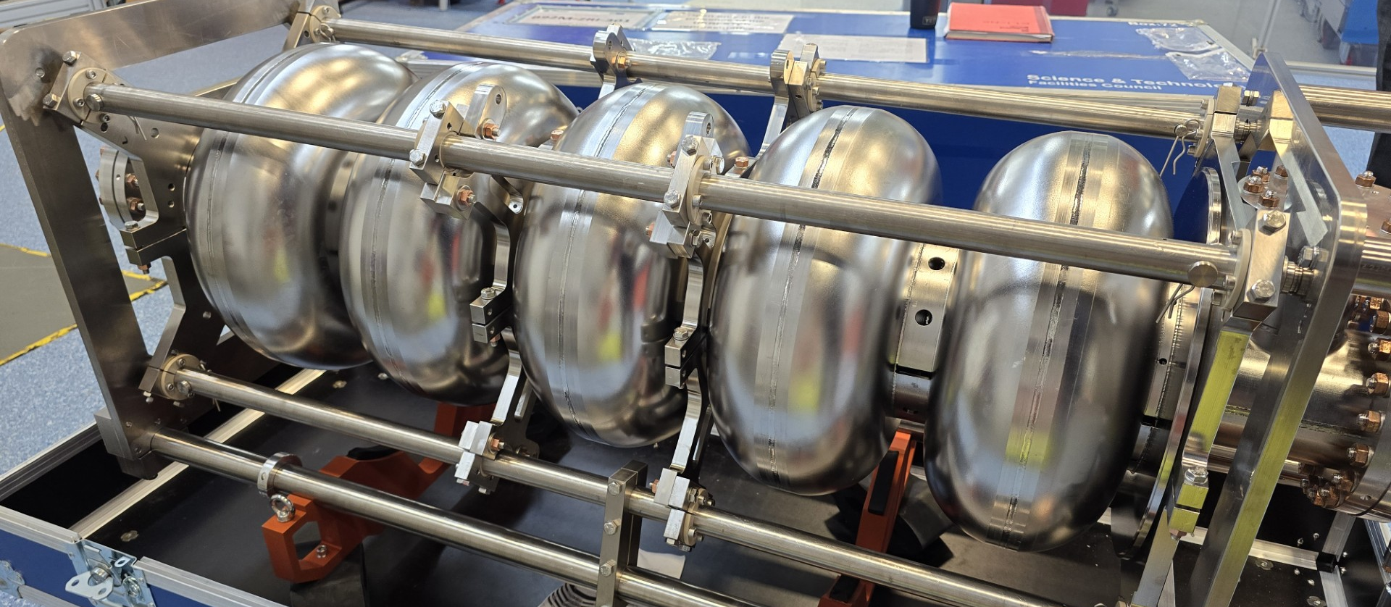

Bulk Nb Dominates SRF
Image © STFC John Dawson
Bulk Nb
  Highest T_{c}, B_{c1}, B_{sh} of any element
  Large Q₀ (10¹⁰- 10¹¹)
  CW operation
$$Q_{0}∝\frac{1}{R_{s}}$$
Nb : Limits @ 2 K, 1.3 GHz :
Accelerating gradient, E_{acc} ~ 55 MV/m (± 5 MV/m)
(Geometry : B/E_{acc} ~ 4.2 mT/(MV/m))
Surface resistance, R_{s} = R_{BCS} + R_{rés}.
Q₀
Investment +
Power consumption
Q₀ ↑ Costs ↓
Aimed performance
Present state
High field dissipations
P = const, ↑
Quench
E_{acc}
Bulk Nb has reached limits:
Q₀ > 10¹⁰
E_{acc} > 50 MV/m
(1.3 GHz, 2 K)
Investment
E_{acc} ↑ Costs ↓
E_{acc} ∝ B_{RF} ≤ B_{sh}
Courtesy of C. Antoine (CEA)
Notes:
SC cavity are intensively used for accelerating charged particles, but bulk Nb cavities are ay their performance limit E_{acc} ∝ B_{RF} ≤ B_{SH} and Q₀ ∝ 1/R_{S} .
We aim to increase both E_{acc} and Q₀. for this we have to look for new solutions.

Slide 5
From Bulk Nb To Thin Films
Today
Future ?
Protection, low secondary emission yield
RF side
Native oxide
Unstable upon annealing
High T_{c} SC
S-I-S multilayers
Image © STFC John Dawson
High purity Niobium Optimized only for thermal conduction
Niobium or…
Structure, high thermal conductivity (Copper ?)
Native oxide
Not optimized for thermal transfer
External layer, optimized for thermal transfer
Helium side
Courtesy of C. Antoine (CEA)
Image courtesy: C. Antoine
Notes:
Shallow penetration depth of RF fields
Can decouple RF surface from cavity support structure
Drastic cost reduction

Slide 6
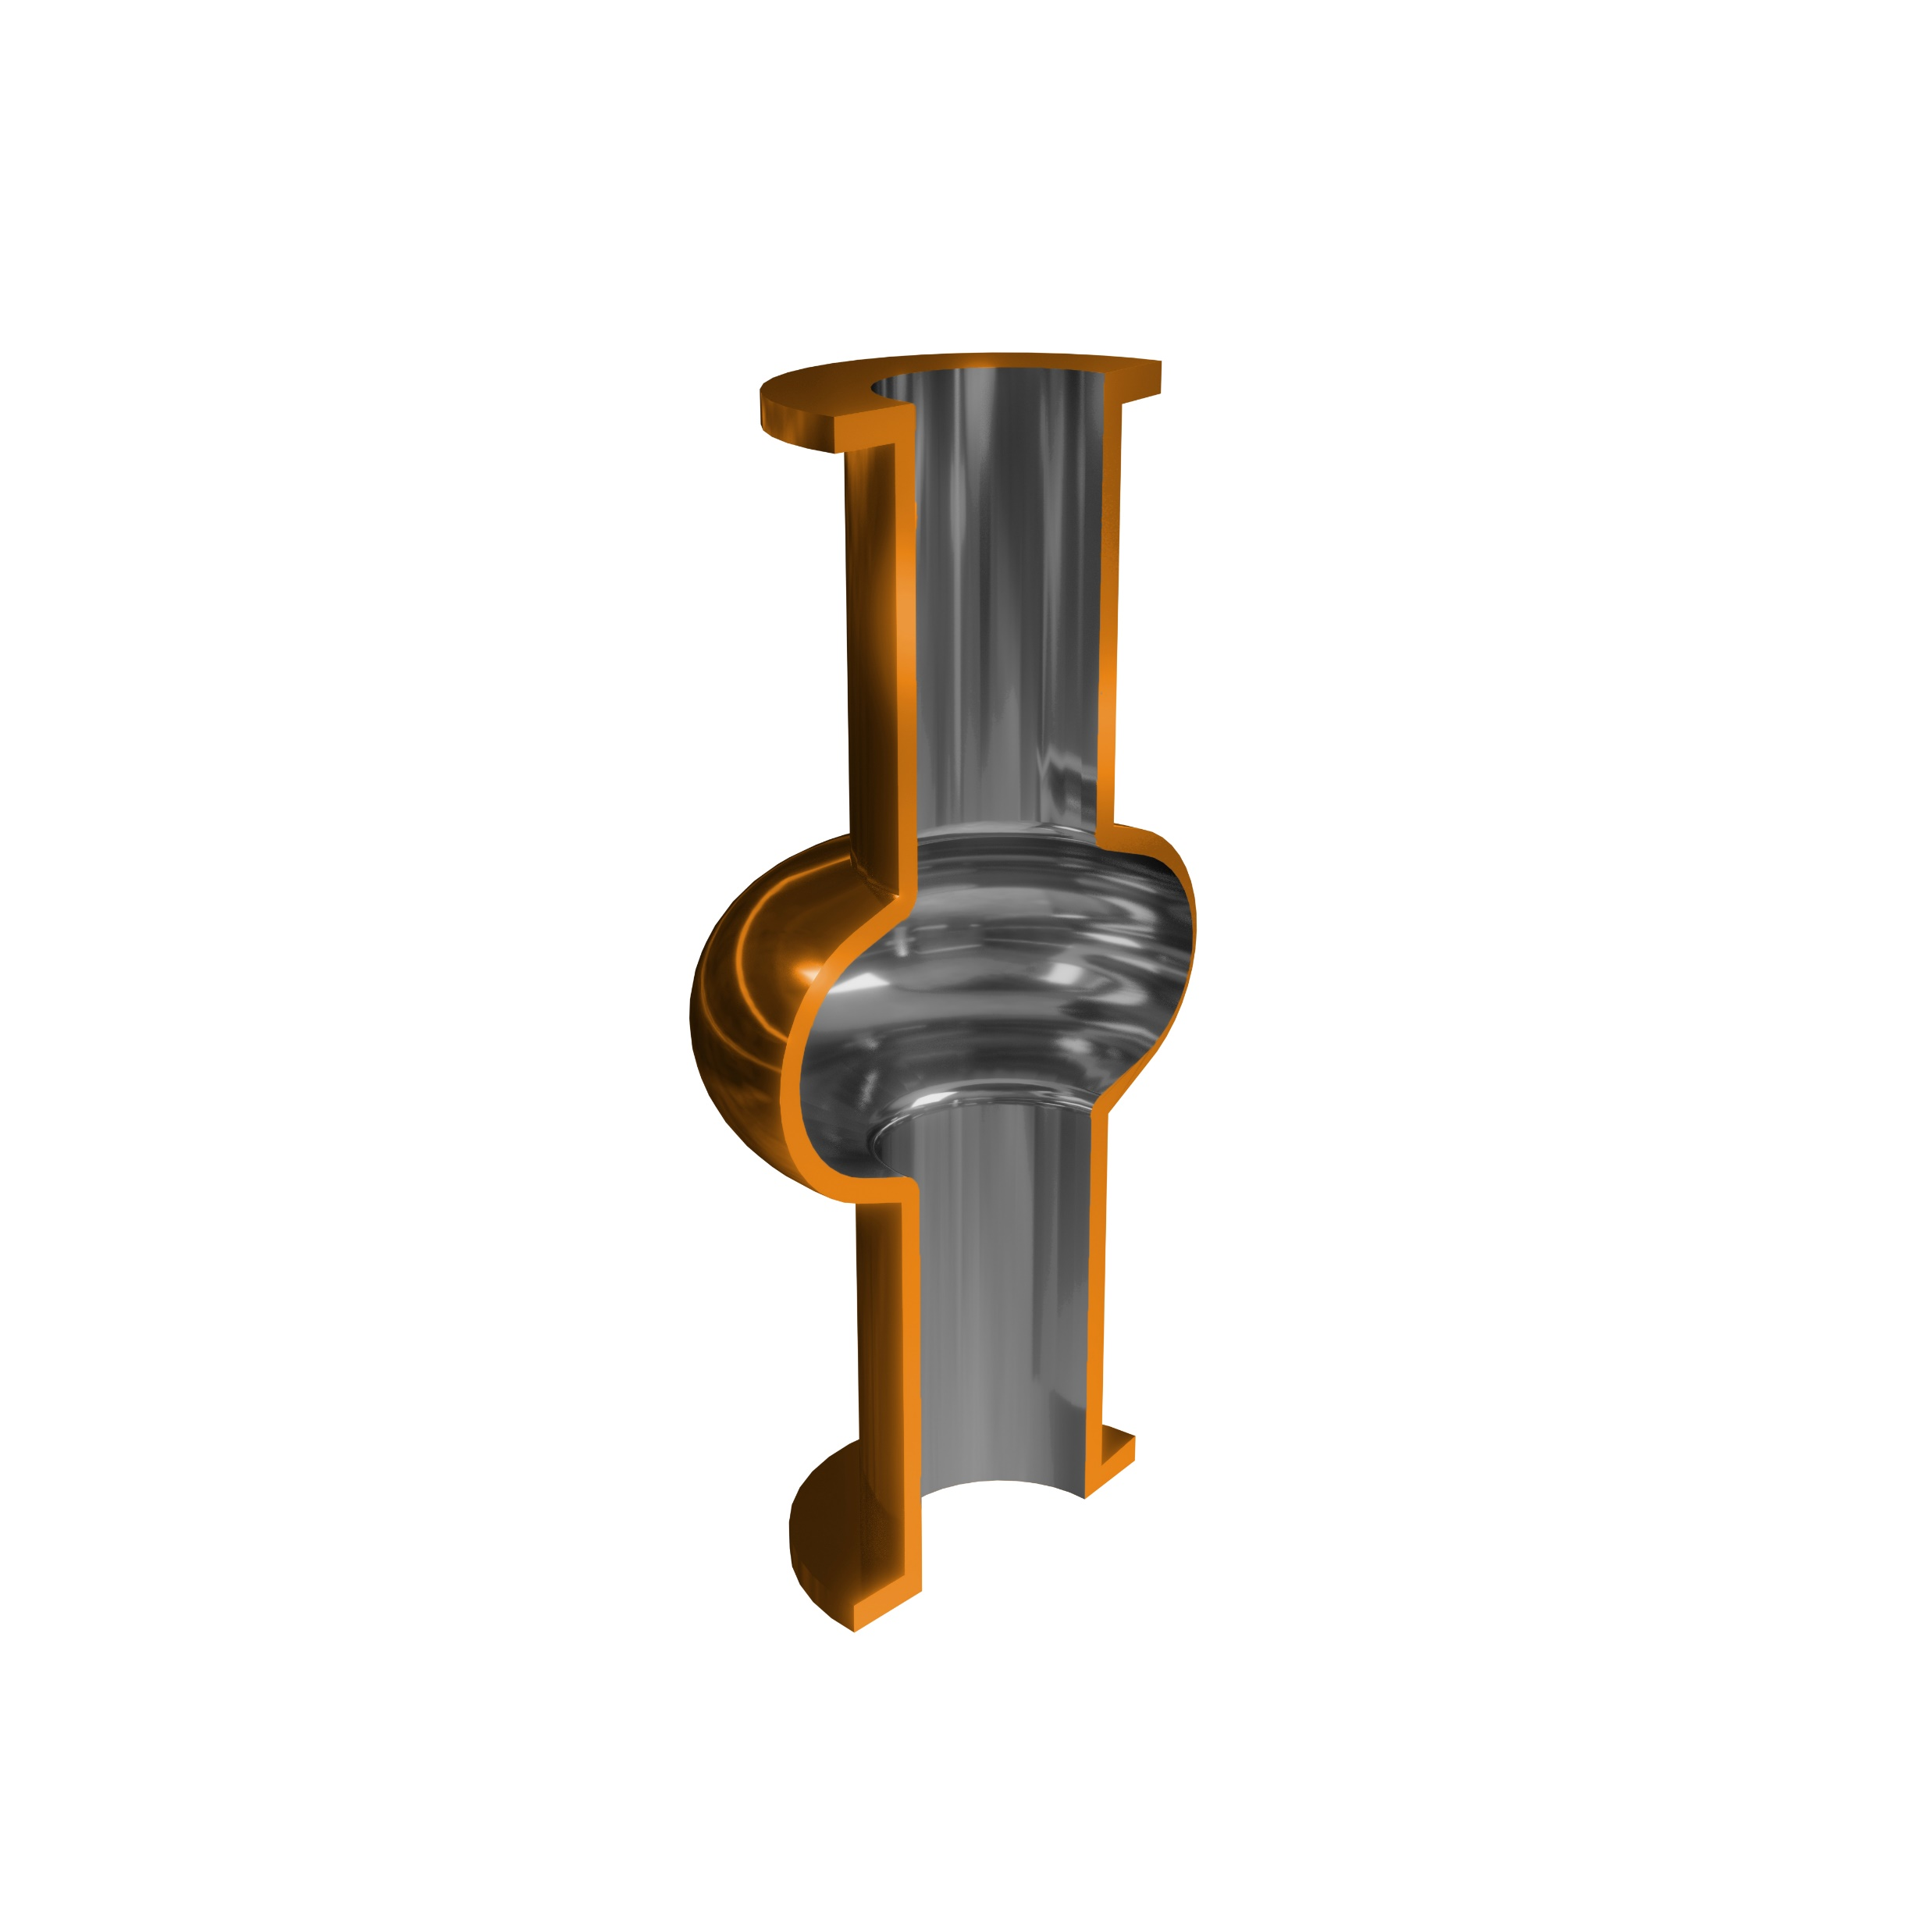
Superconductors Being Considered
High B_{sh} → High E_{acc} → fewer cavities
Material | T_{c} (K) | B_{sh} (mT)@ 0 K
Pb | 7.1 | 100
Nb | 9.2 | 219
NbTiN | 17.3 | 439
V₃Si | 17.0 | 490
NbN | 17.3 | 214
Nb₃Sn | 18.3 | 425
Nb₃Al | 18.5-19.1
MgB₂ | 39.0 | 170
Why thin film on copper?
Cheaper than Nb
Higher thermal conductivity
Easily machinable
High T_{c} → High Q₀ → less cooling
Courtesy of C. Antoine (CEA)
Notes:
Add different materials beyond Nb

Slide 7
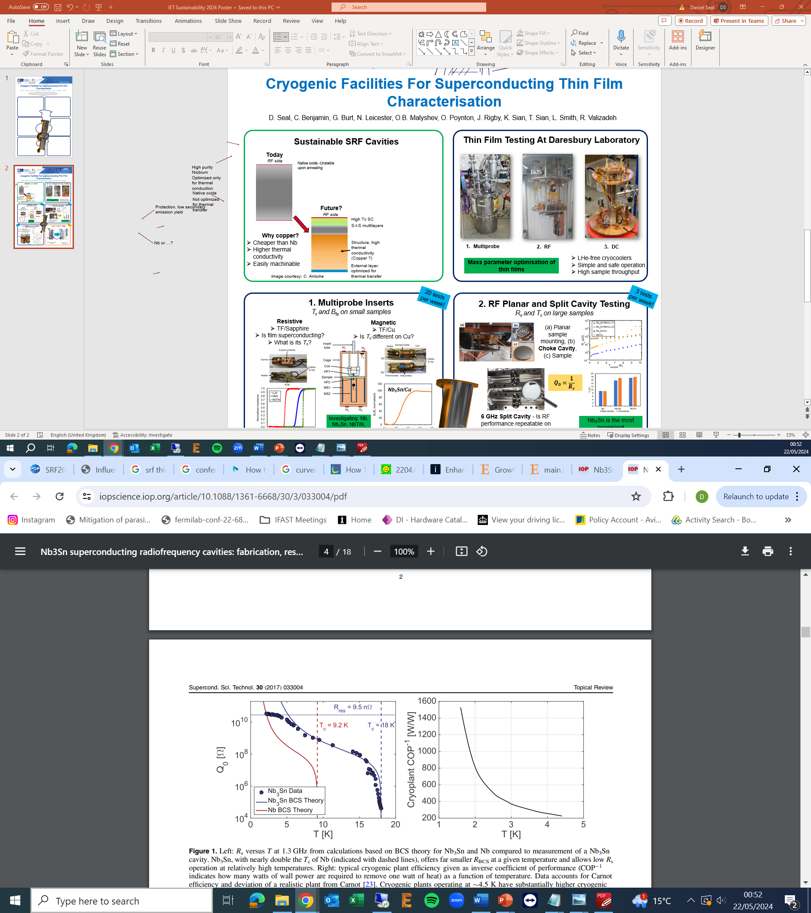
Saving Energy For Future Accelerators
Moving from 2 K to 4.5 K reduces cryogenic power by factor 3!
Image © STFC John Dawson
S. Posen, Supercond. Sci. Technol. 30 (2017) 033004
Infrastructure
Operation
Estimated cryogenic costs of ESS (M€):
2 K (Bulk Nb)
40
11
4.5 K (Thin Film)
25
4
C. Z Antoine: IPAC2023
Notes:
Nb3Sn low surface resistance operation at higher temperatures than Nb
Inverse coefficient of performance – watts of wall power to remove 1 watt of heatn- accounts for Carnot efficiency (4.5 K more efficient than 2 K)
Liquid helium system rather than superfluid helium makes cryogenic system simpler, easier maintenance, fewer pumps, no 2K return line etc – infrastructure cost
Decrease plug power by factor 3 - operation cost
Reduce cost of cryogenic plant – 2 K He not needed

Slide 8
2. Thin Film Development

Slide 9
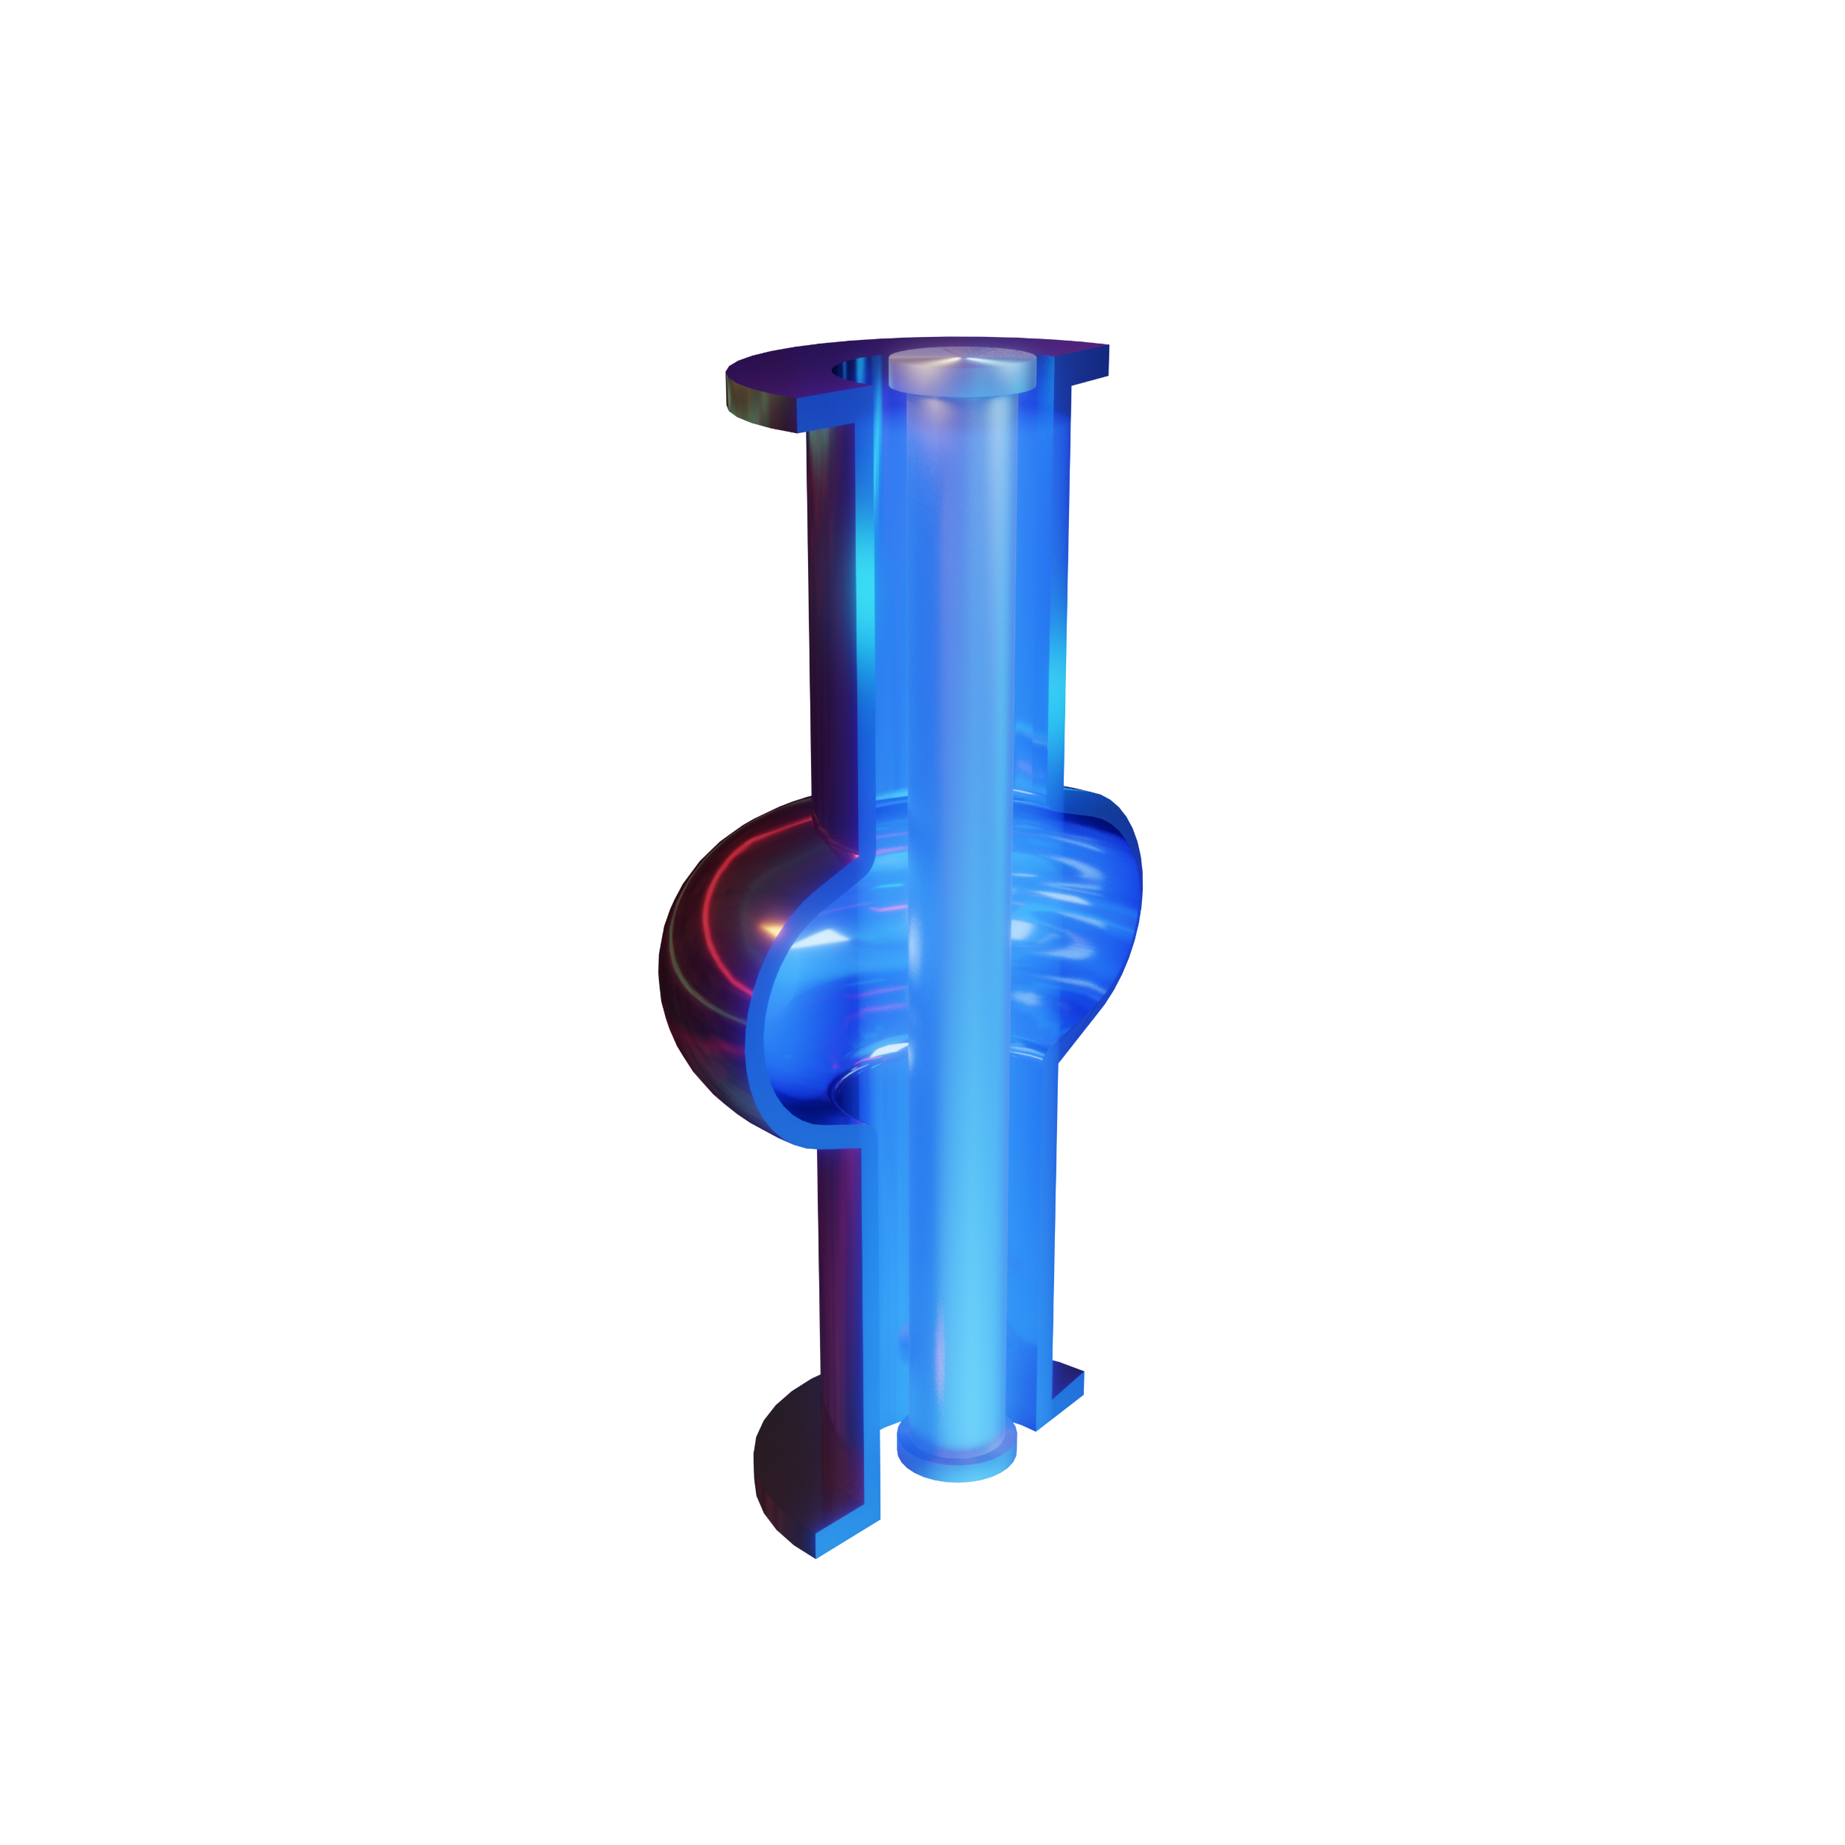
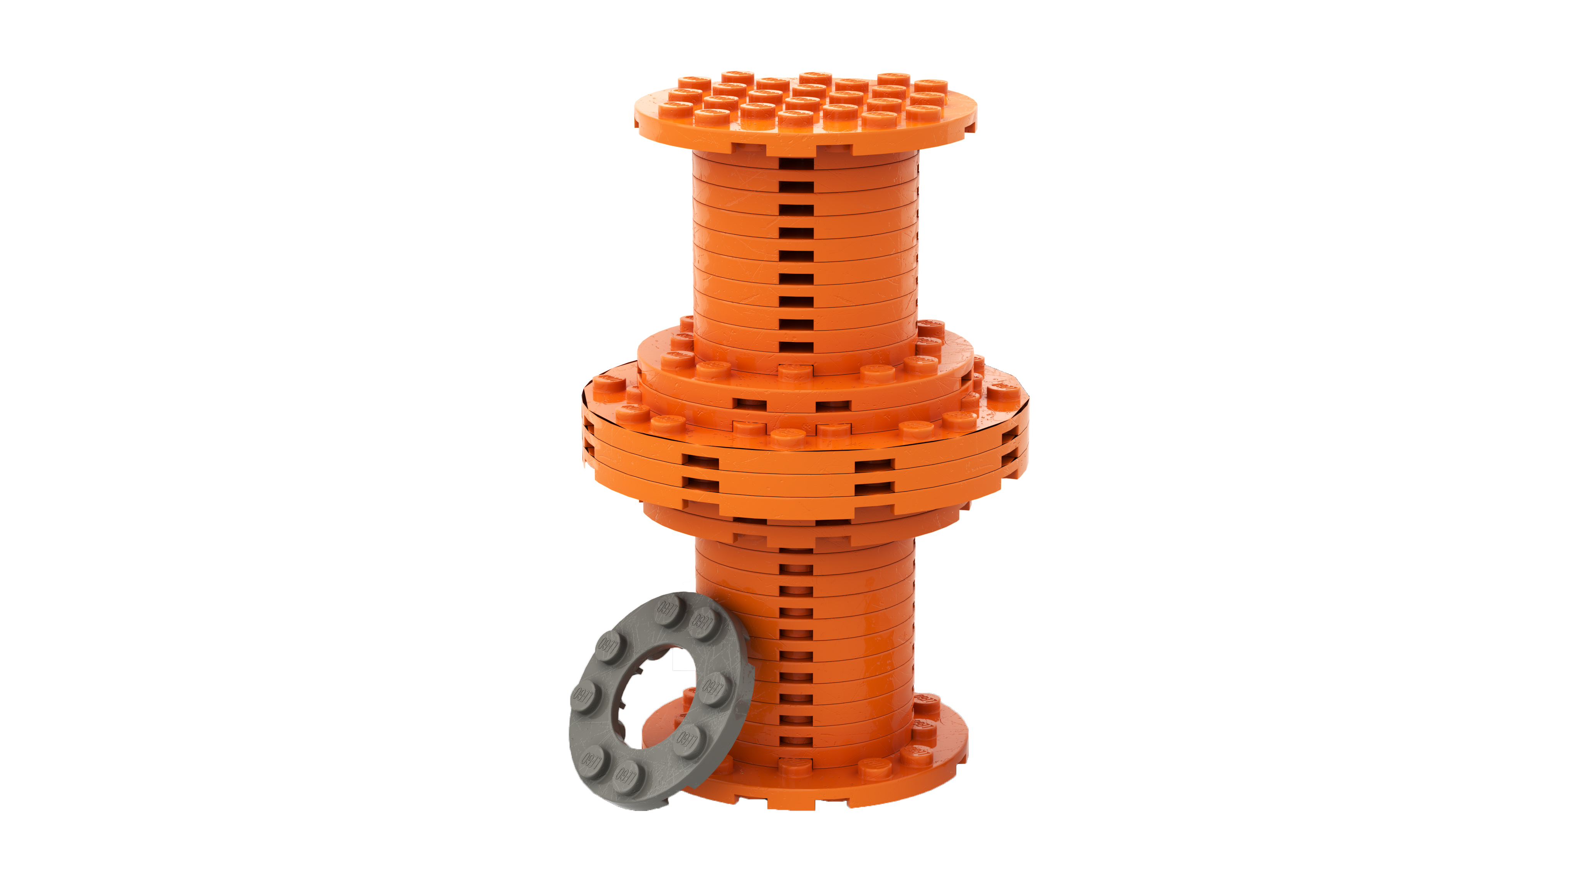
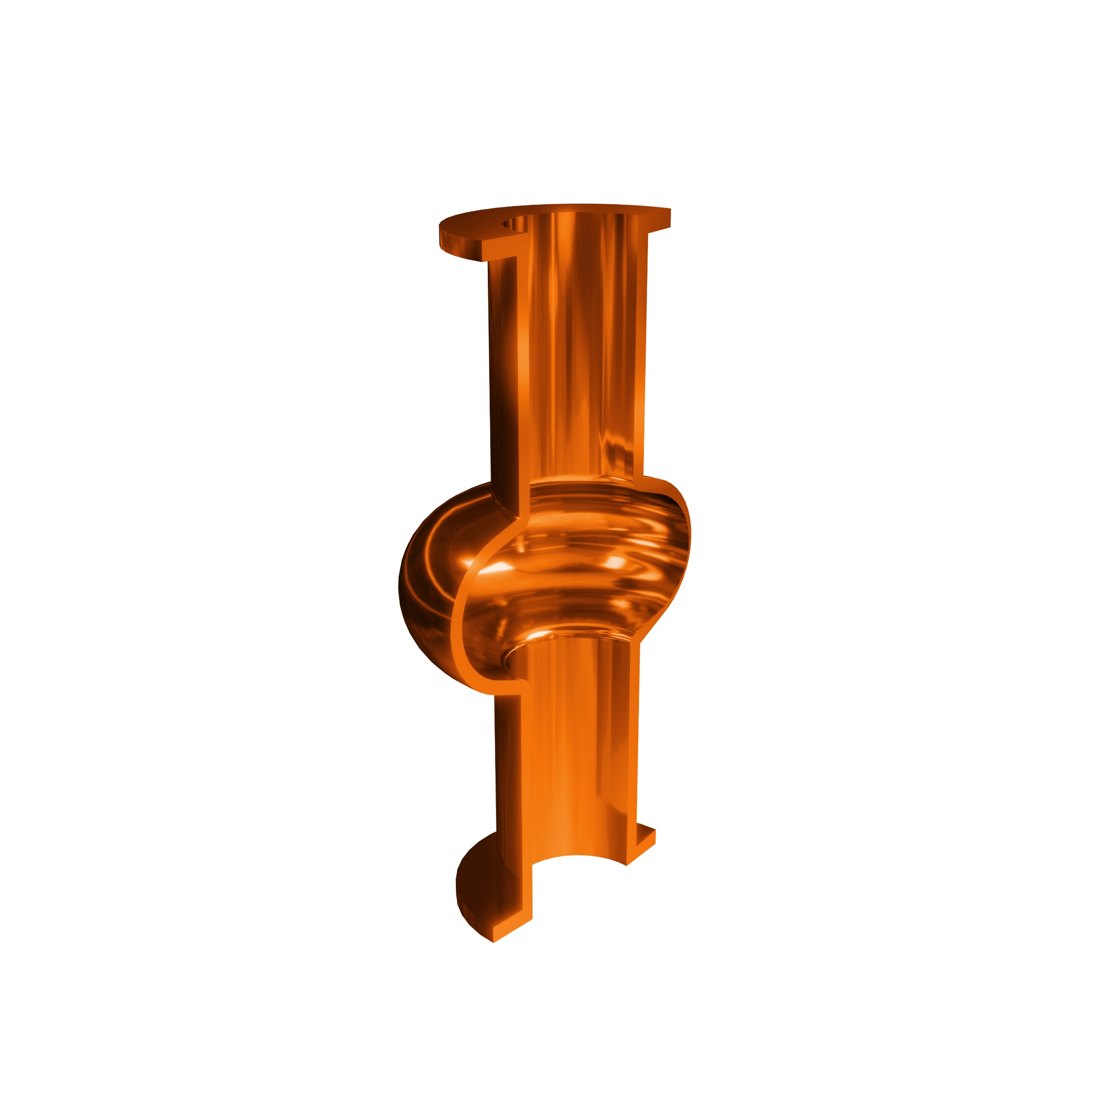


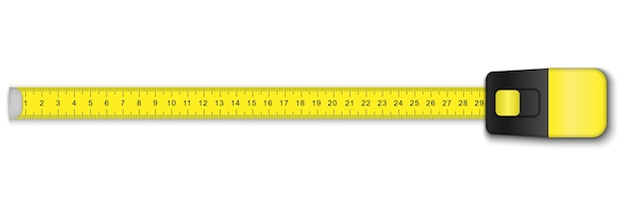
Thin Film Pathway
Initial testing on planar samples
SC Film Coating &
Surface Analysis
SC property evaluation
RF test
Cavity Forming
Surface Polishing
Post Treatments
Aim: Produce a prototype, high performance
1.3 GHz thin film SRF elliptical cavity
Q₀ > 10¹⁰ @ 4.5 K

Slide 10
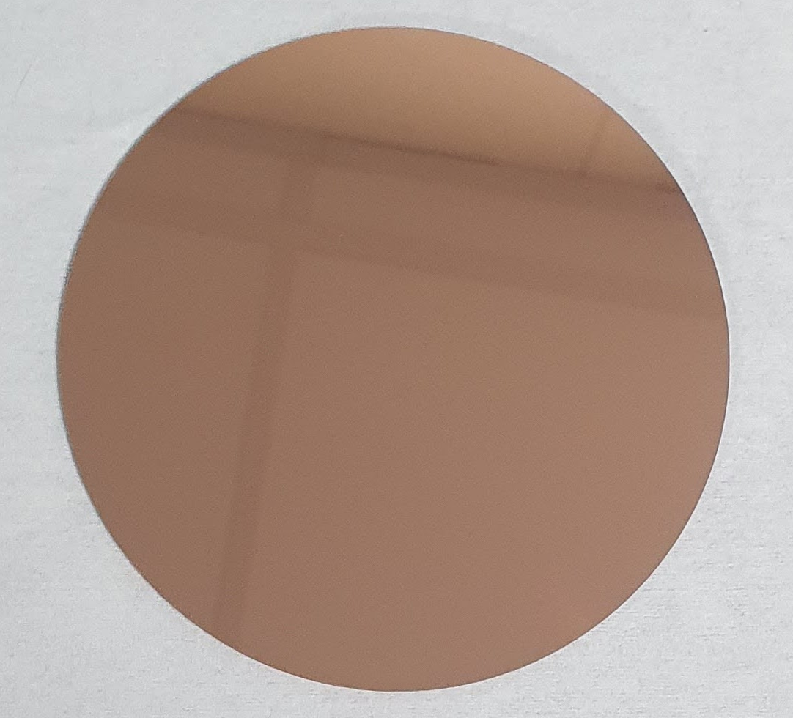
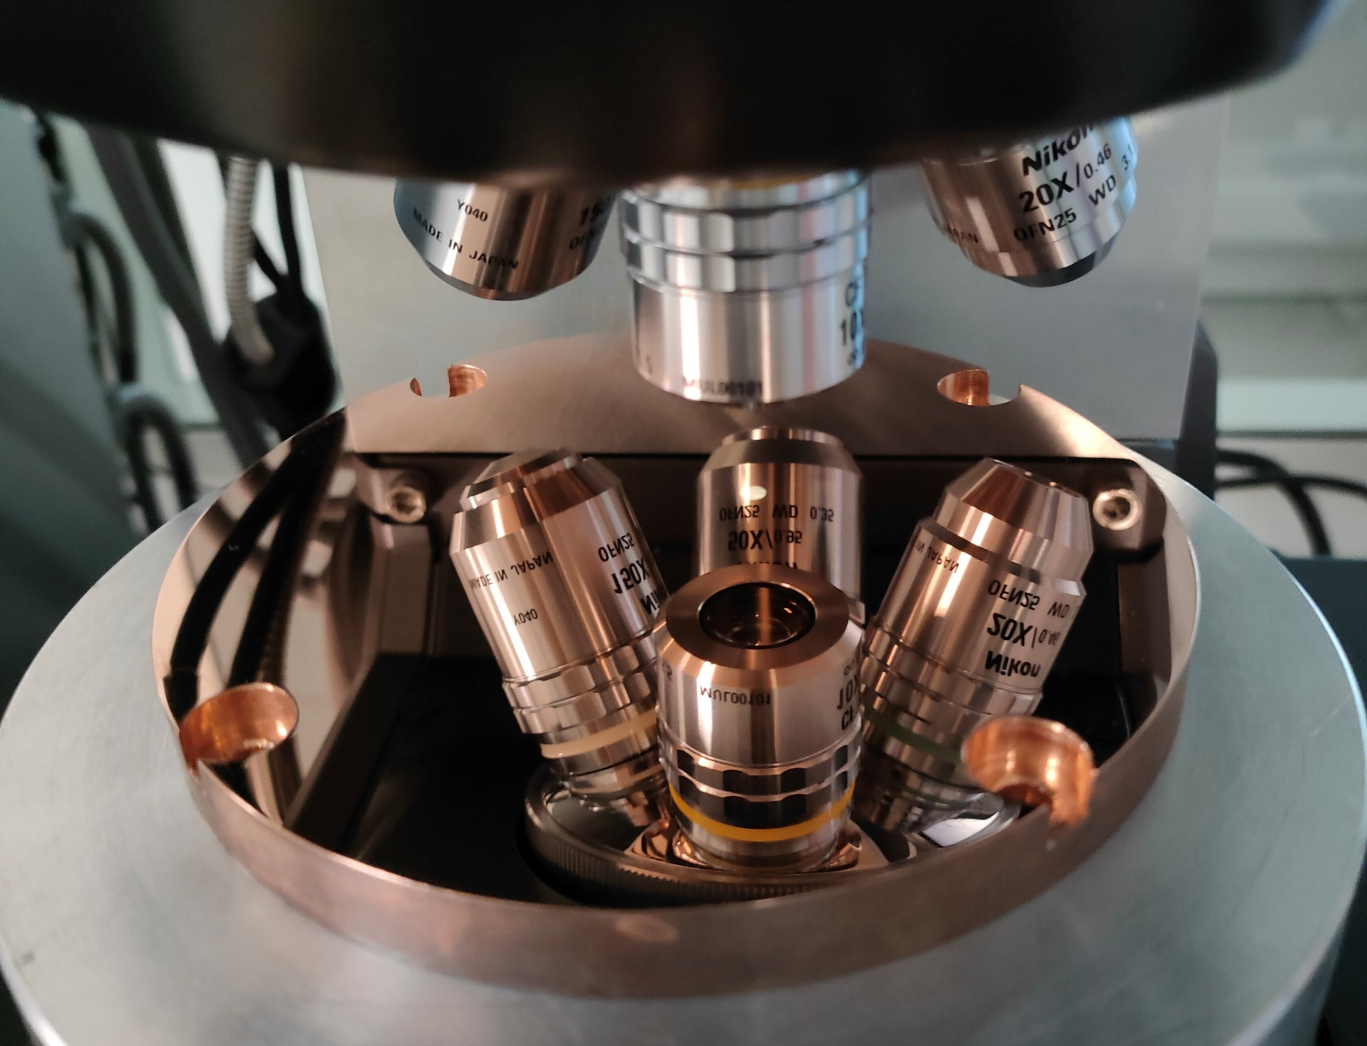

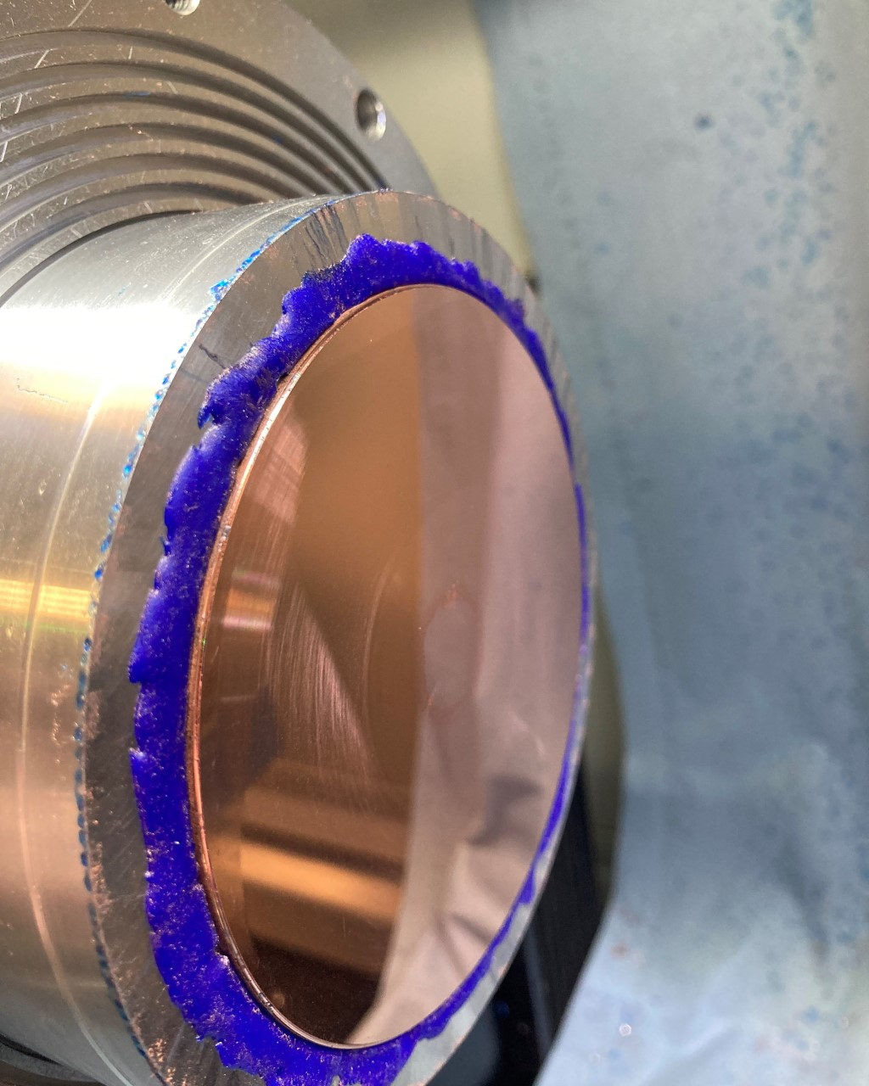
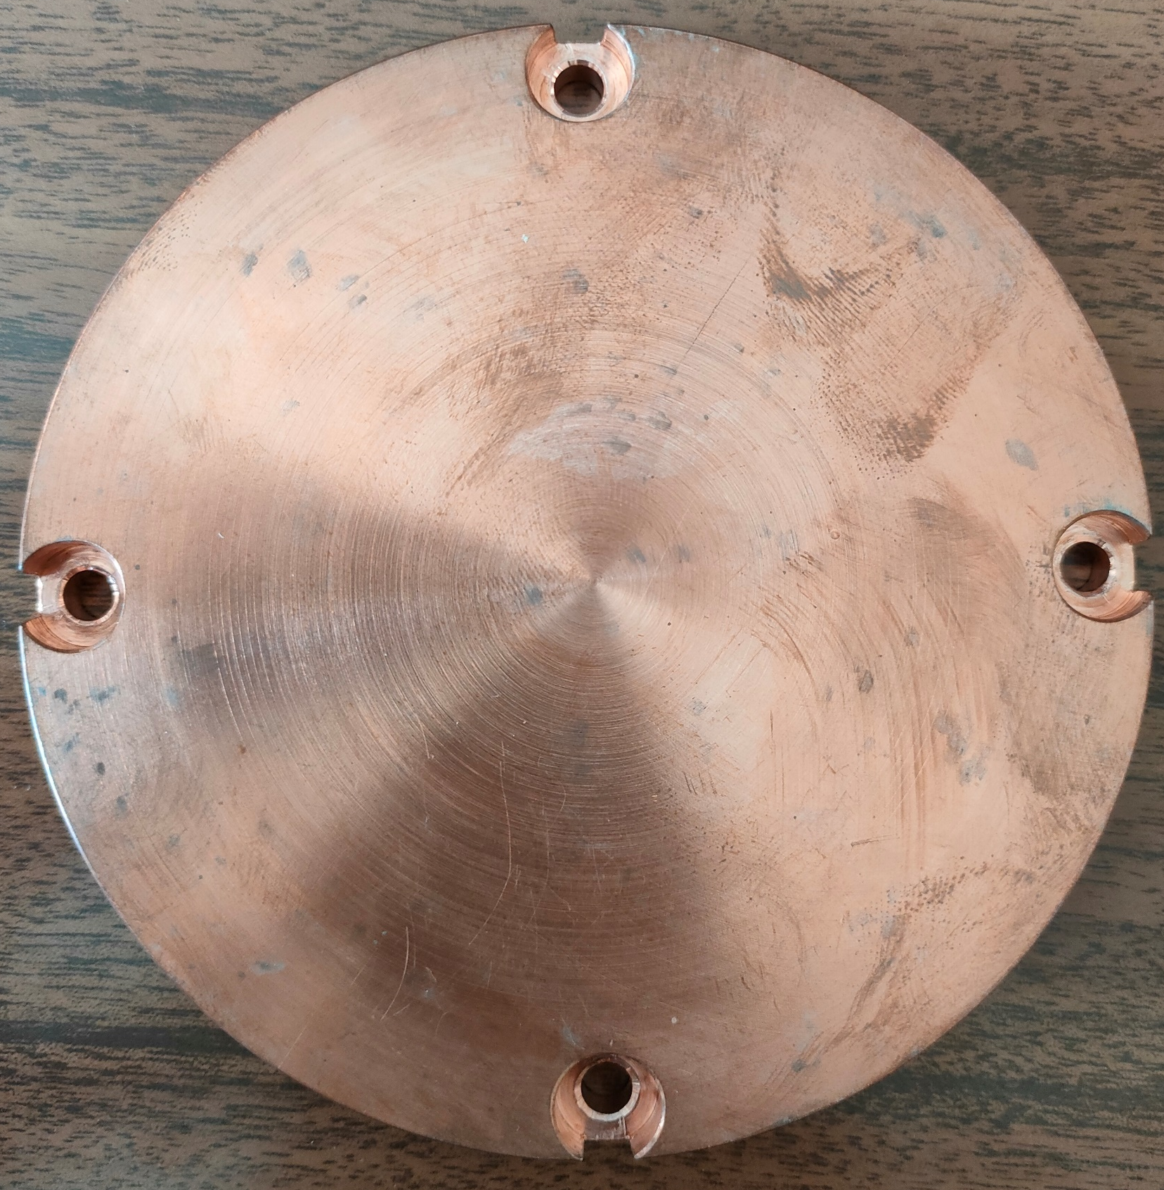
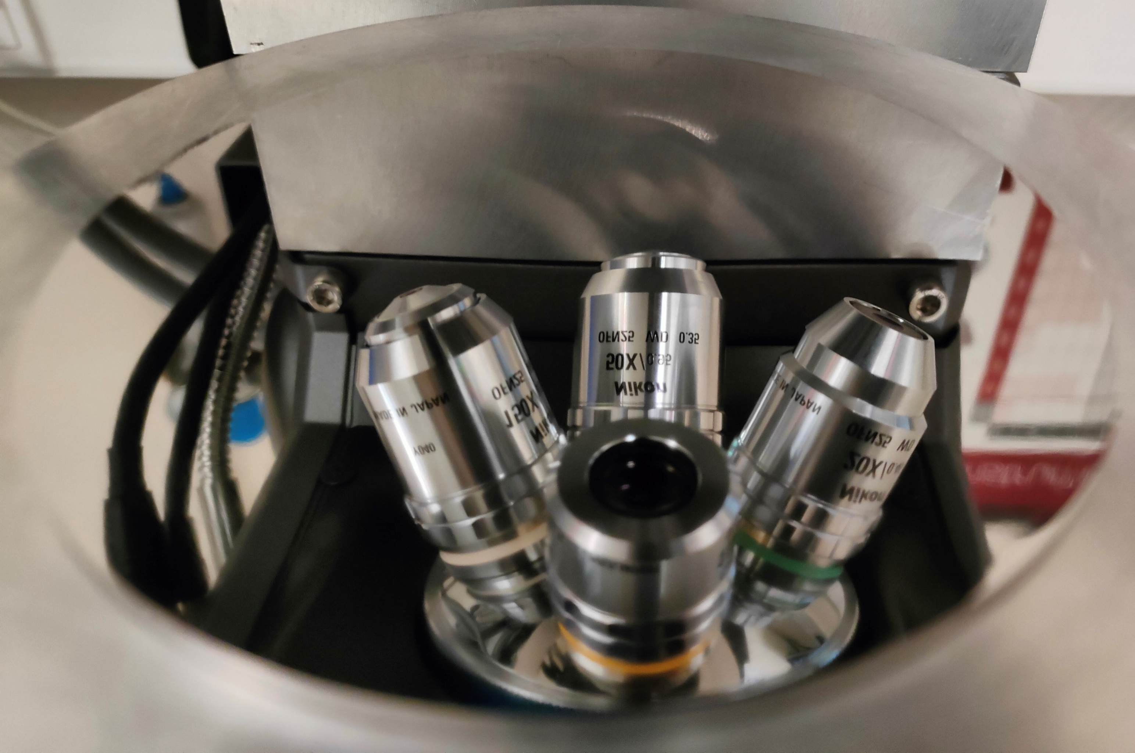
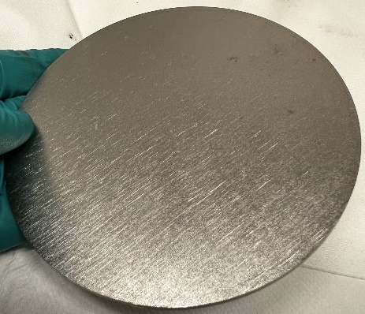
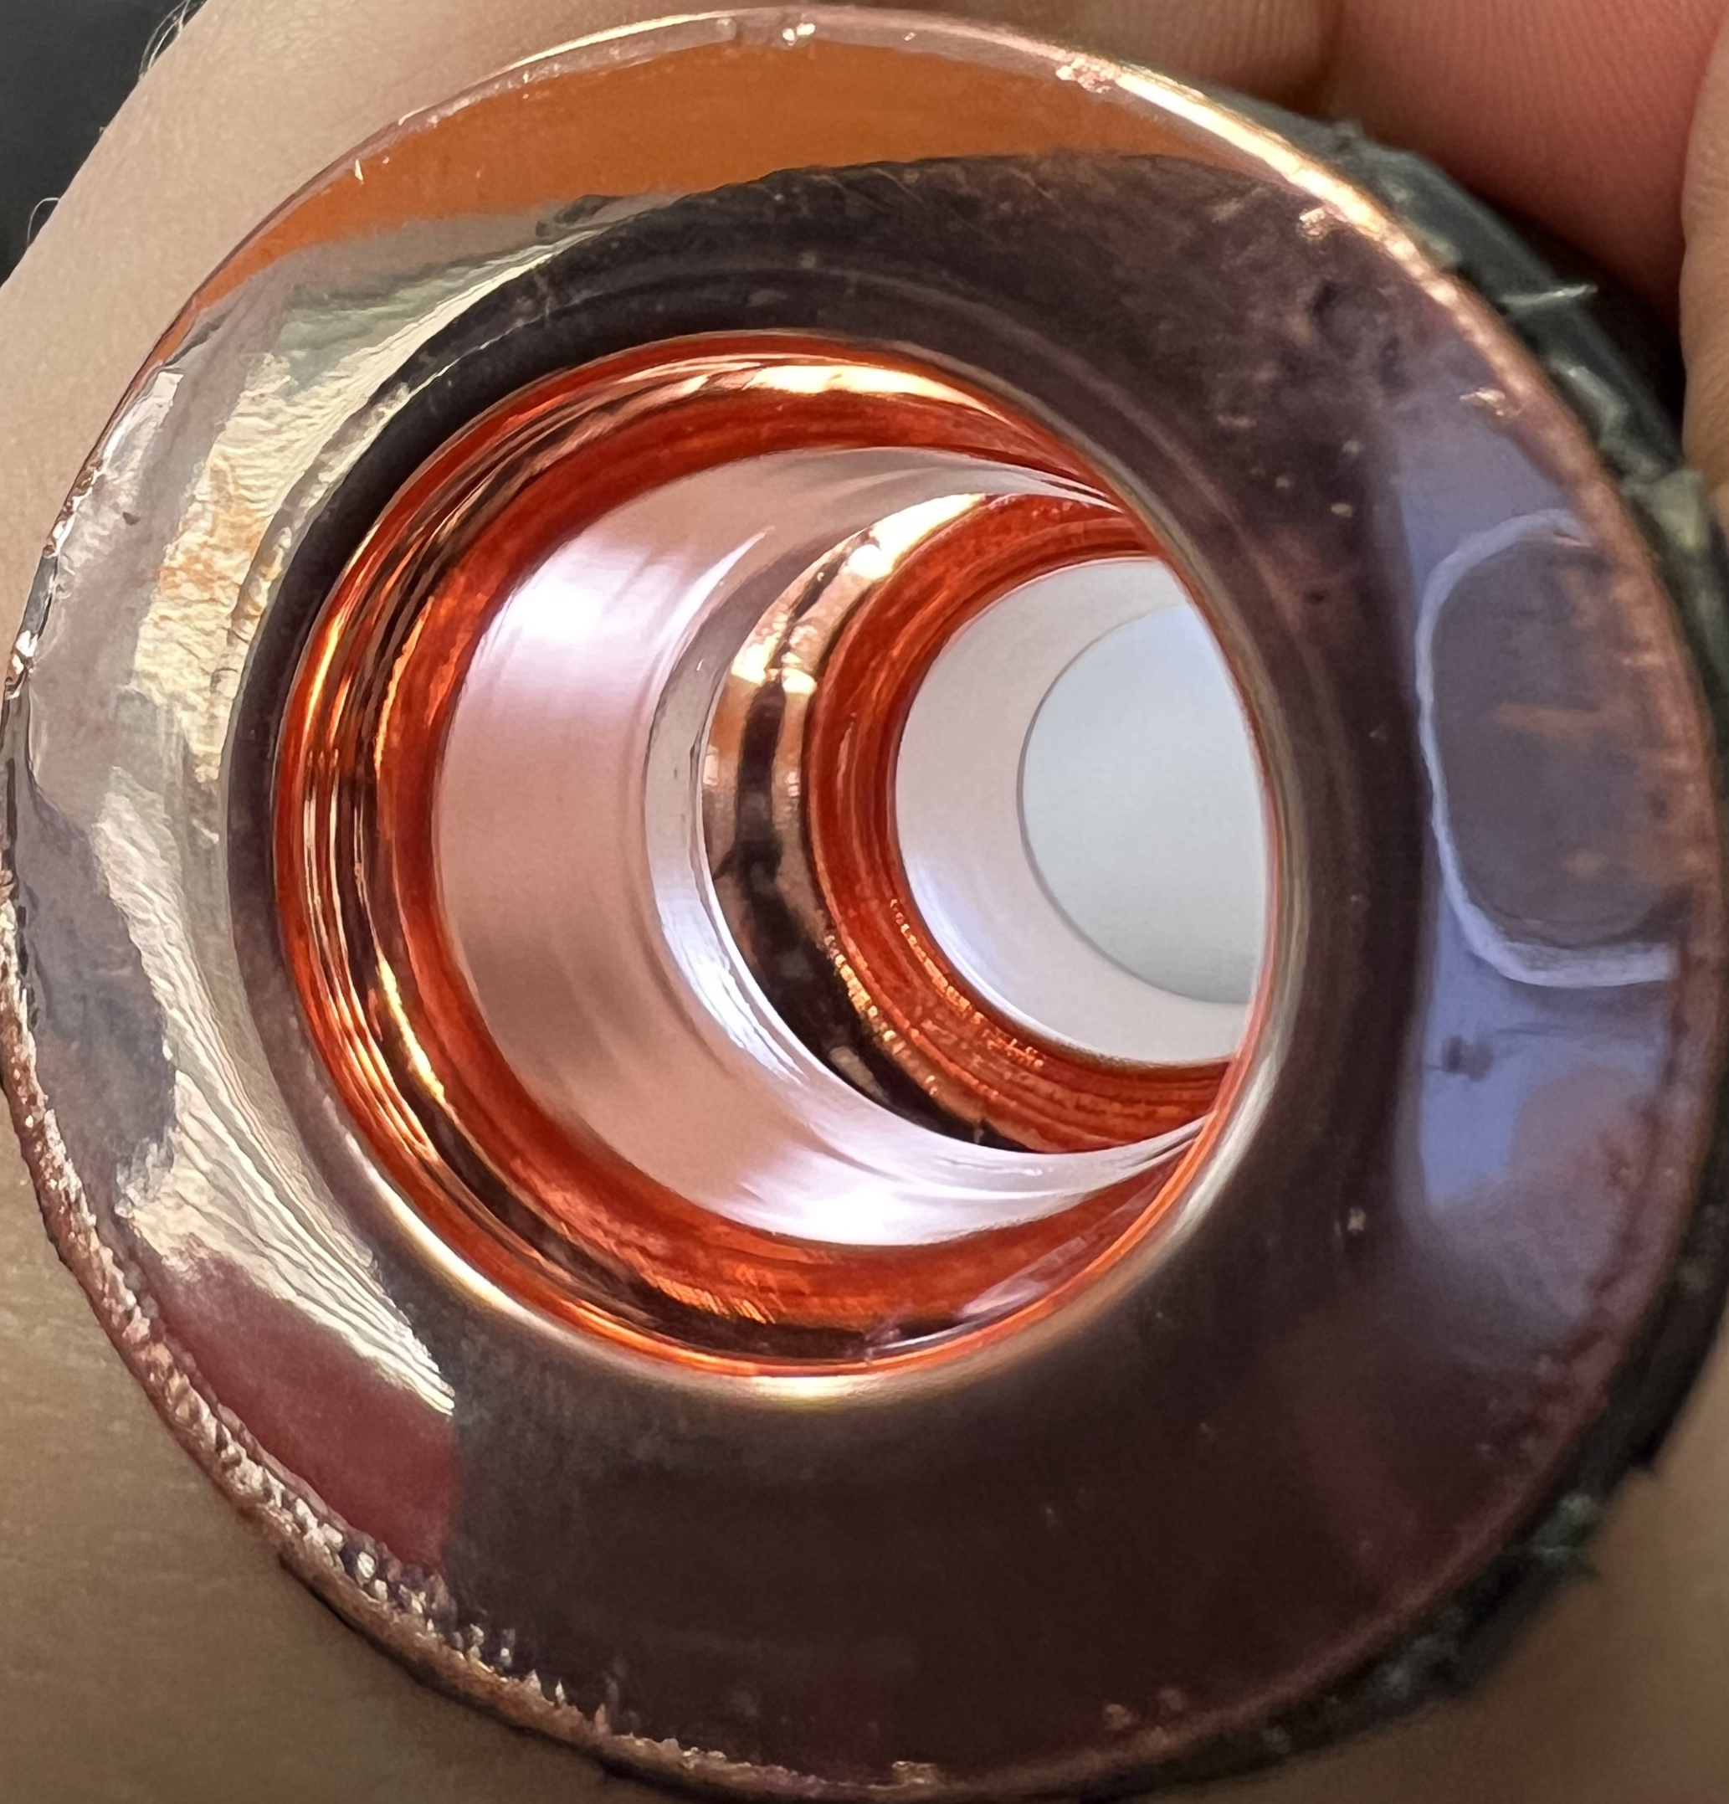
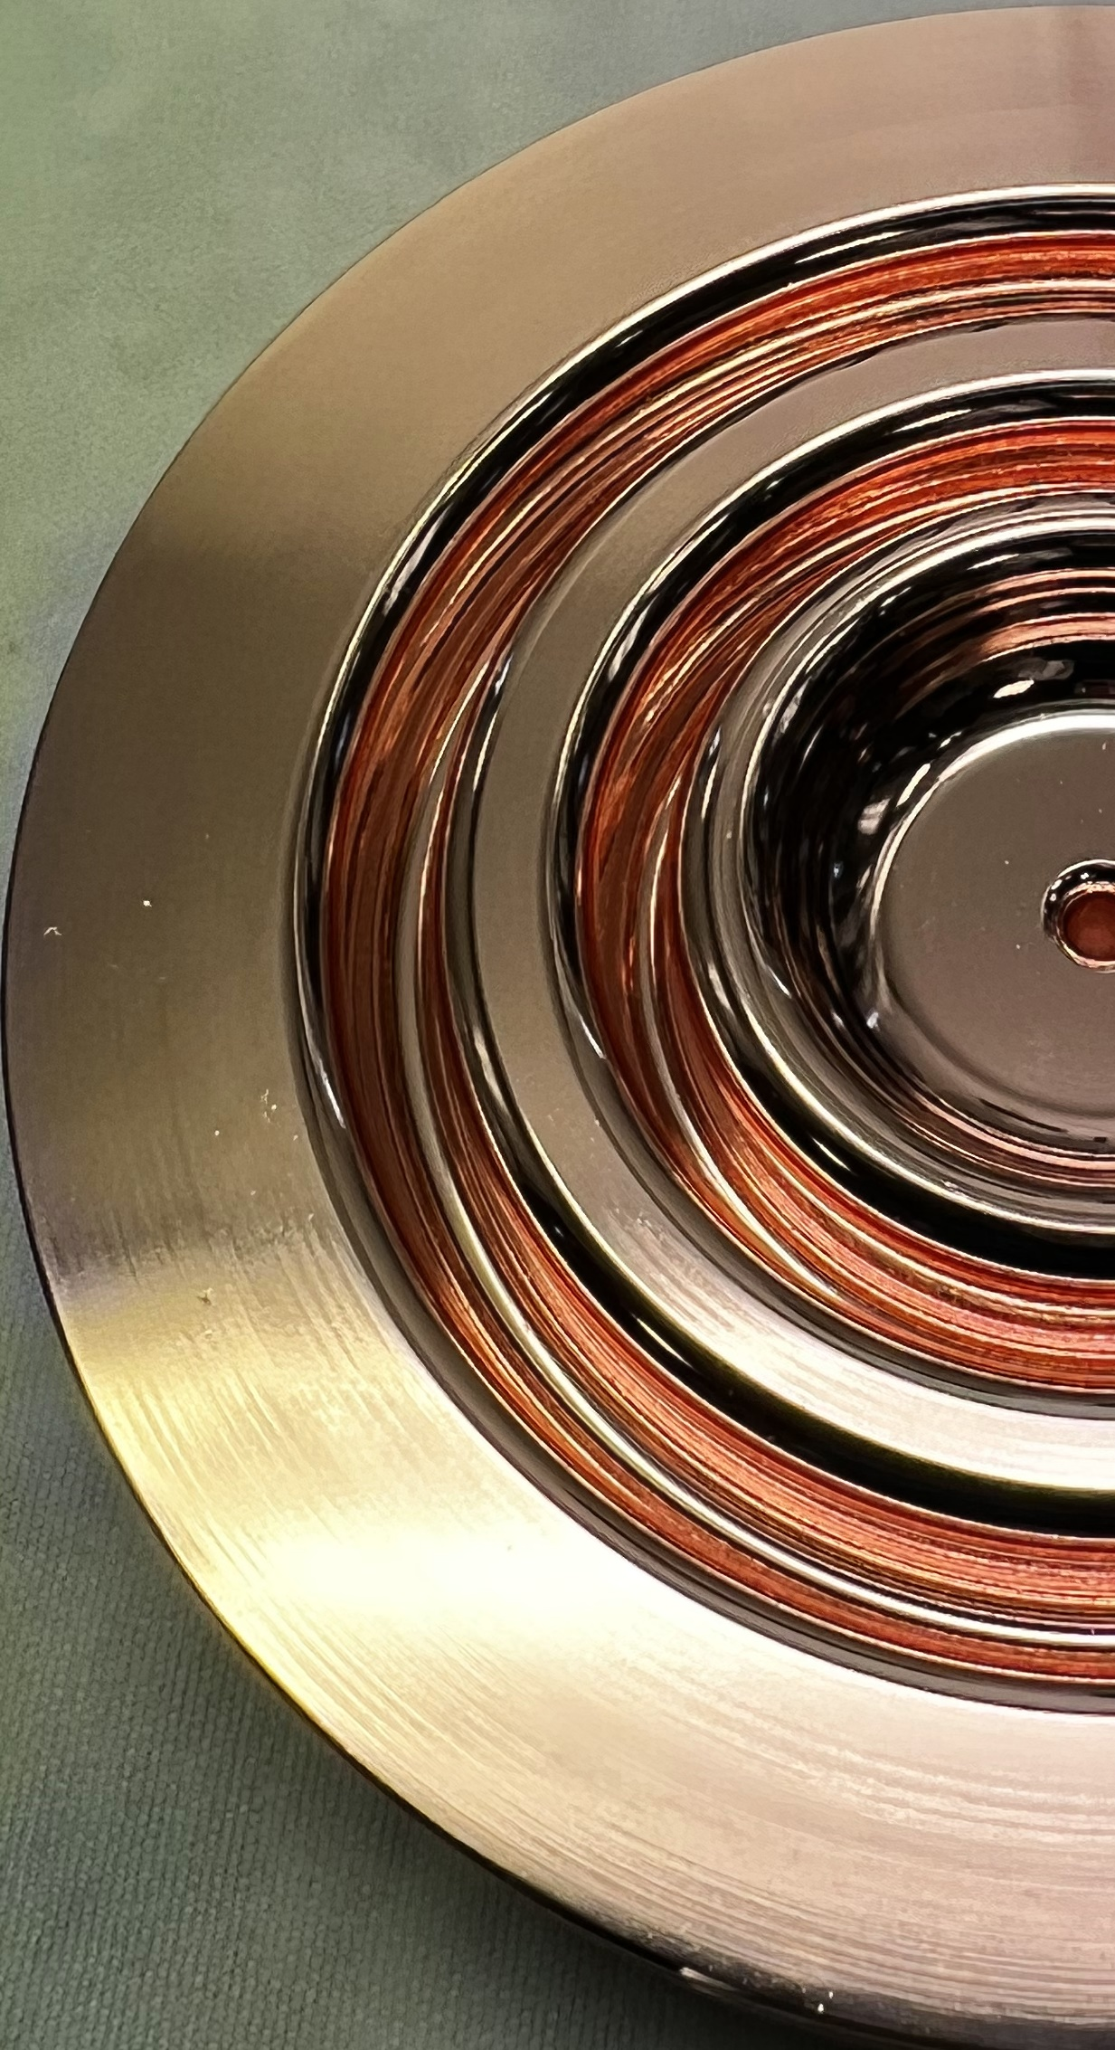
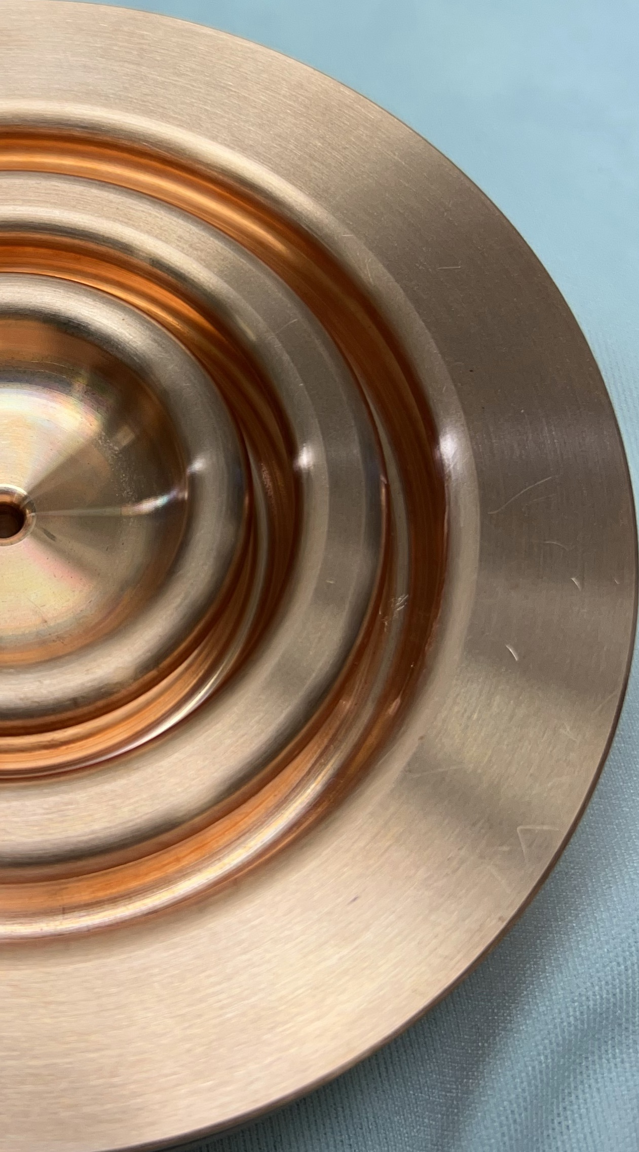
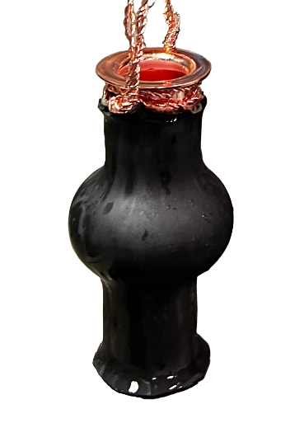
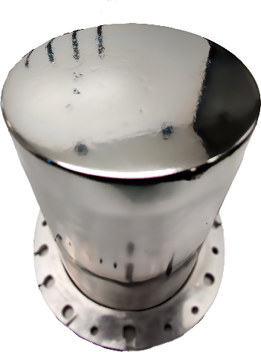
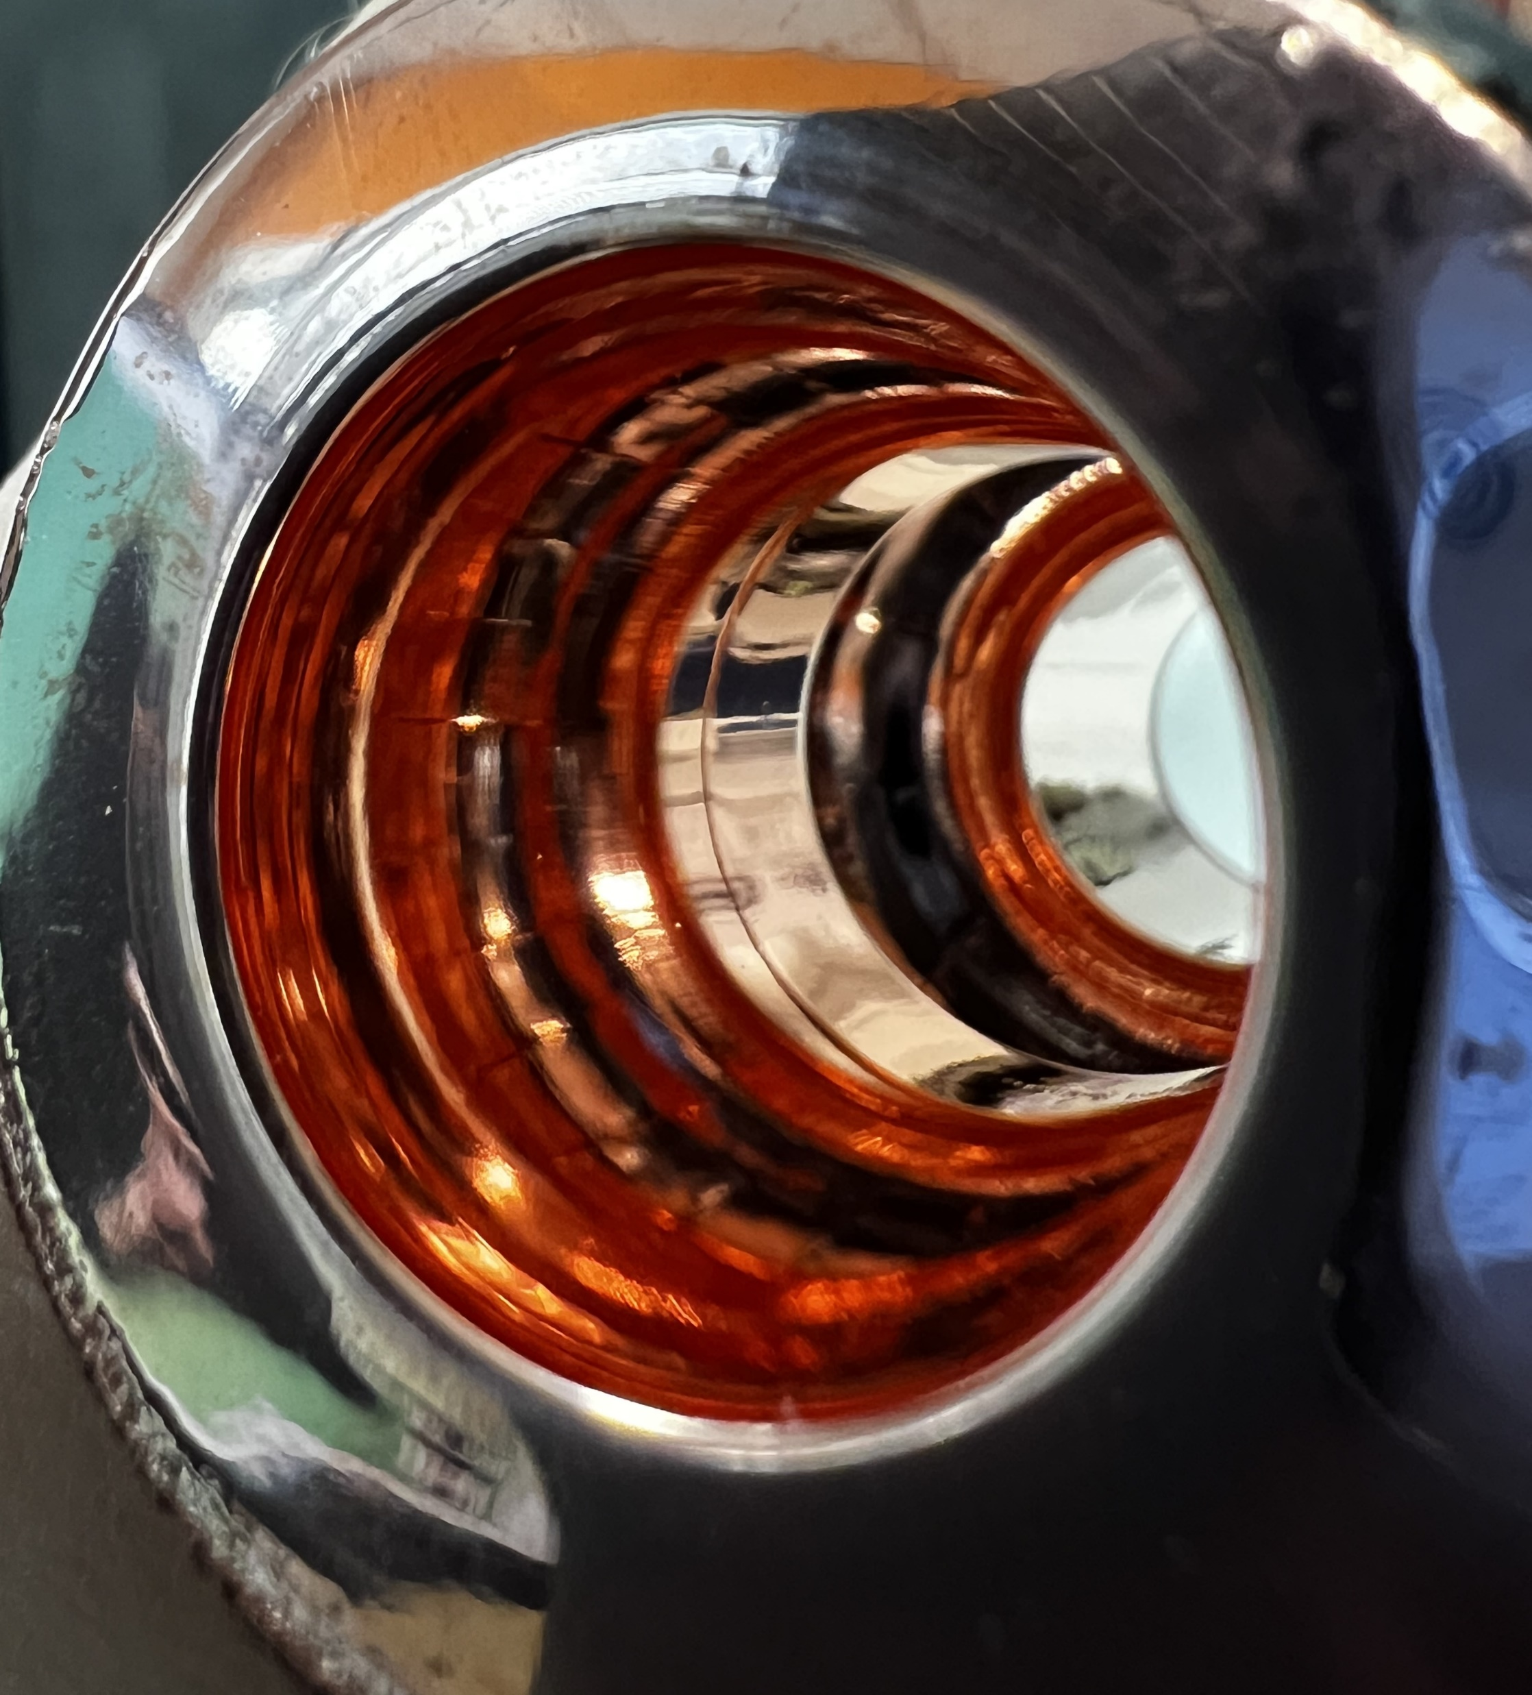
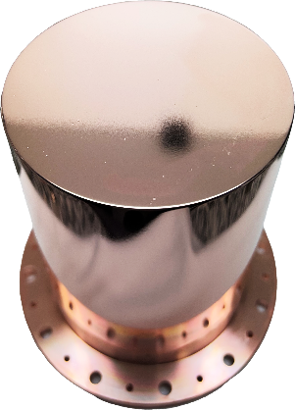
Surface Polishing
MP Cu Disk
DT Cu Disk
At STFC:
  Some mechanical polishing
  Diamond turning (DT)
IFAST Partners:
  Mechanical polishing;
    Tumbling
    Metallographic (MP)
  Chemical polishing
    SUBU
    Electropolishing (EP)
    Plasma Electrolytic Polishing (PEP)
MP Nb Disk
In development at STFC
PEP Quadrupole Resonator (QPR)
Green alternative
PEP 6 GHz Cavity
SUBU Cu Choke Cavity
Courtesy of E. Chyhyrynets & C. Pira (INFN)

Slide 11
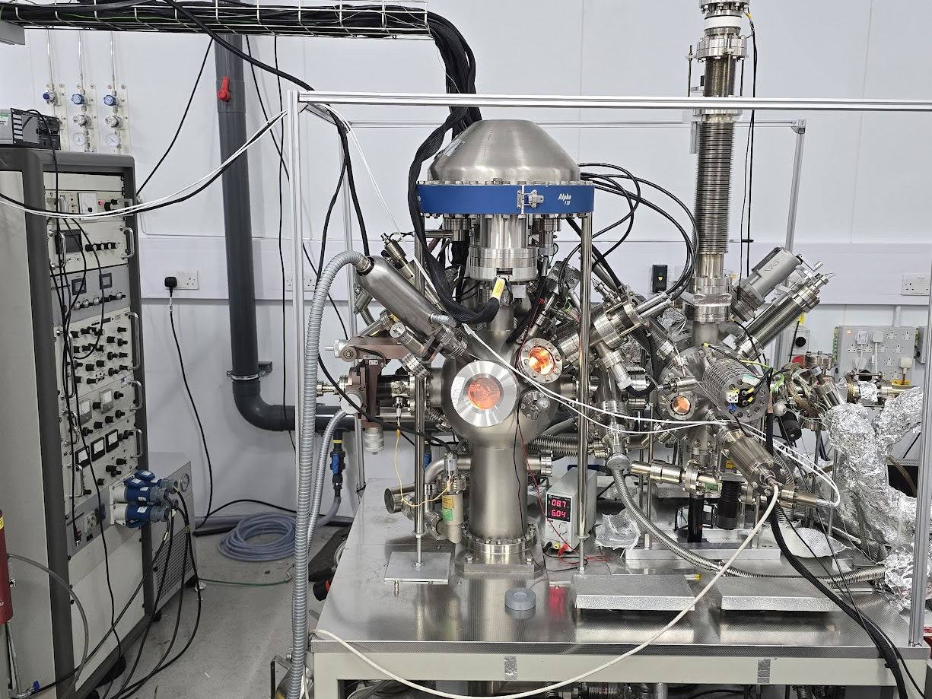
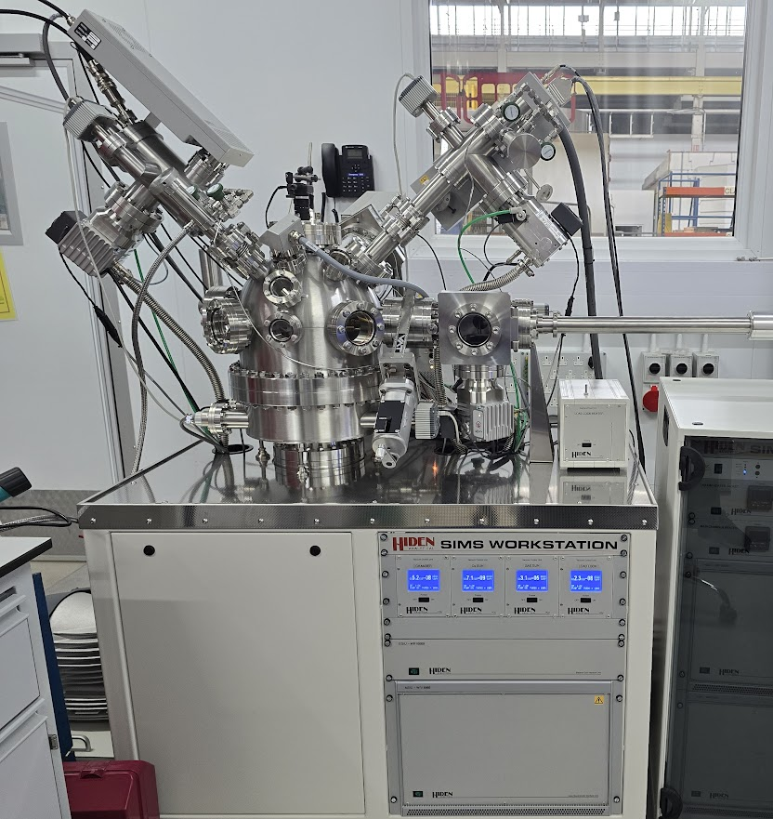
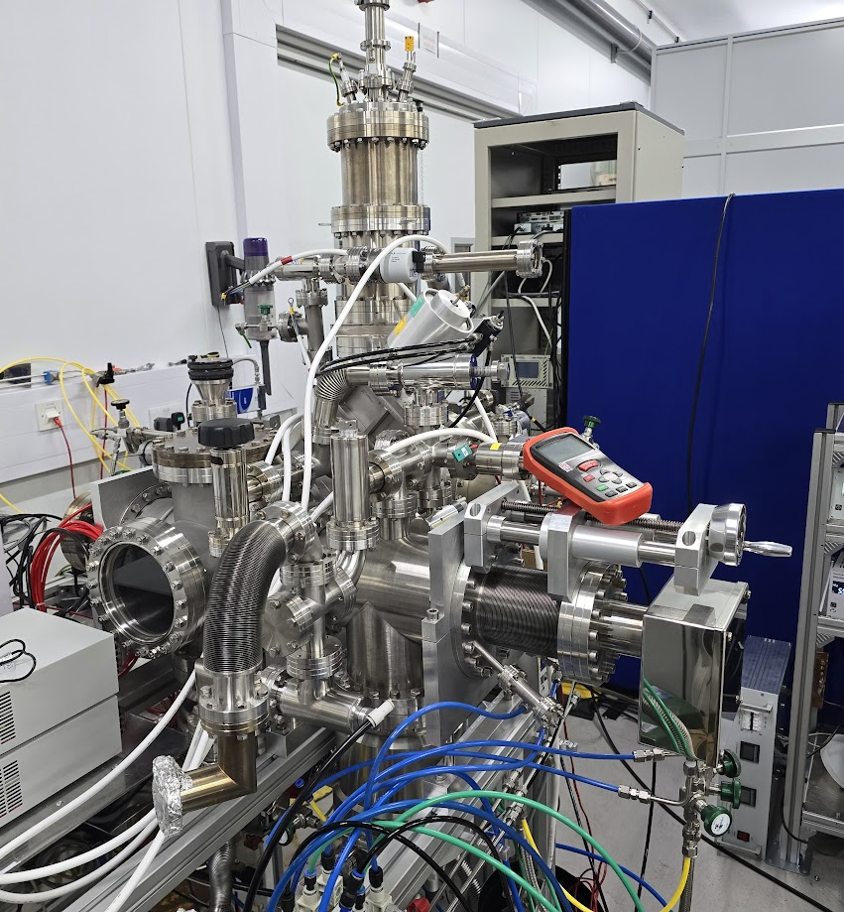
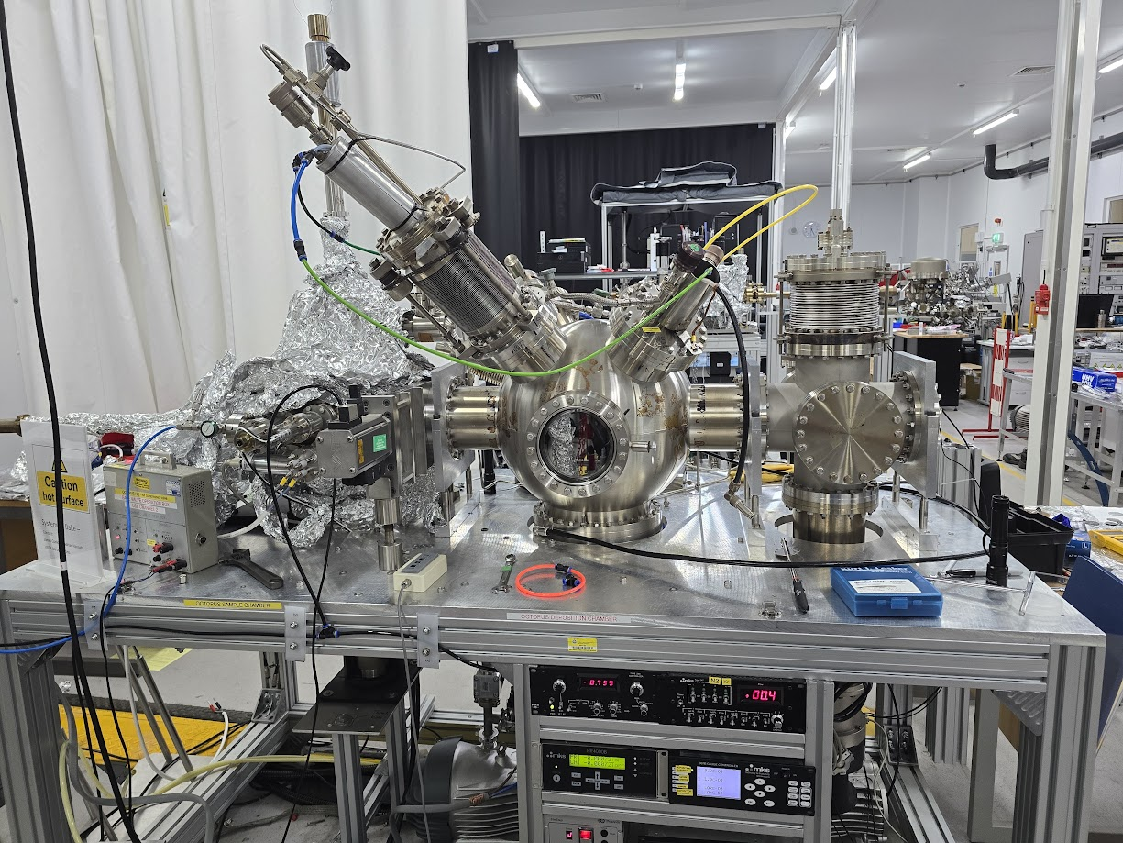
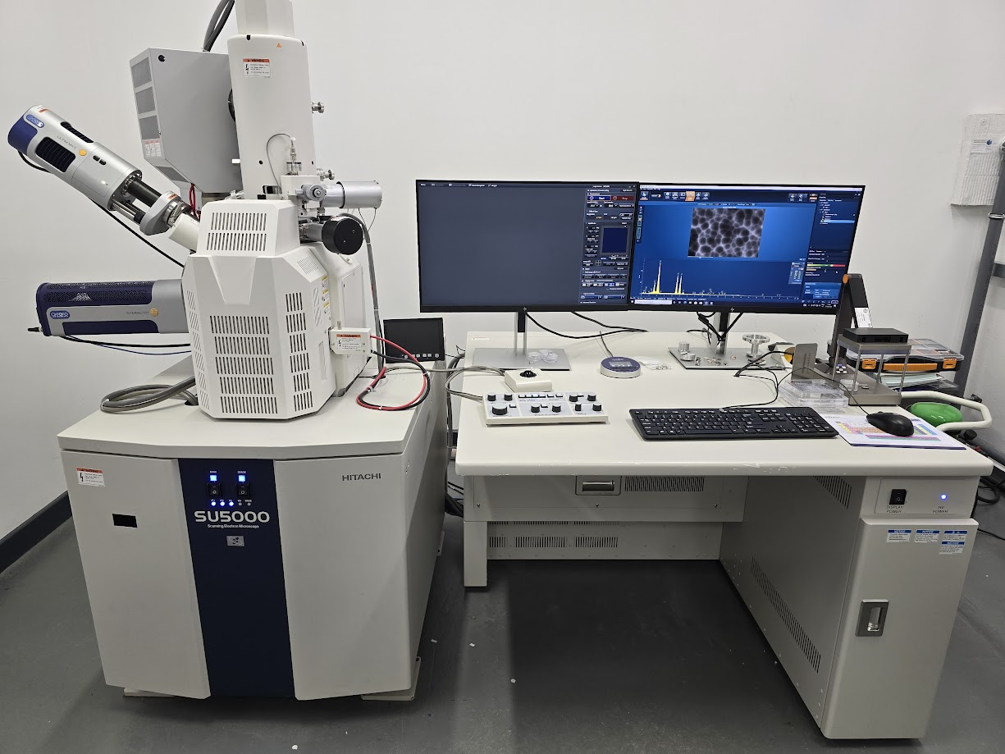
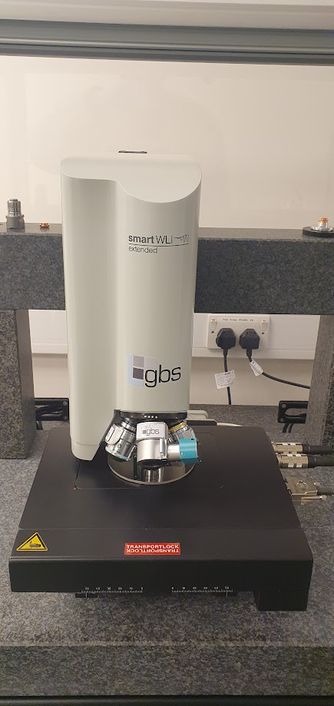
Thin Film Depositions - Planar Samples
Planar samples provide a cost-effective pathway for thin film R&D
X-ray Photoelectron Spectroscopy
Secondary Ion Mass Spectrometry
Sample disks for mass parameter optimisation
QPR samples for high RF field analysis
Scanning Electron Microscopy
White Light Interferometry
Notes:
Characterisation facilities

Slide 12
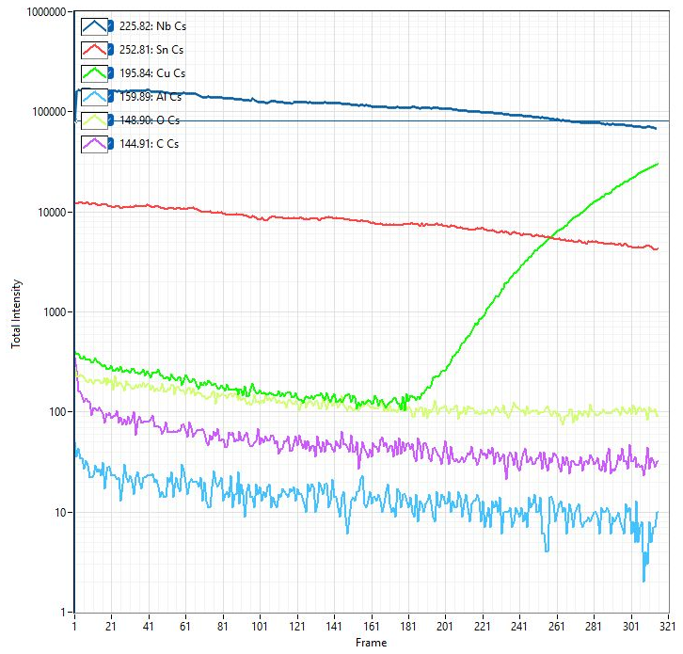
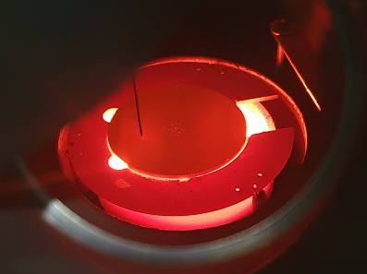
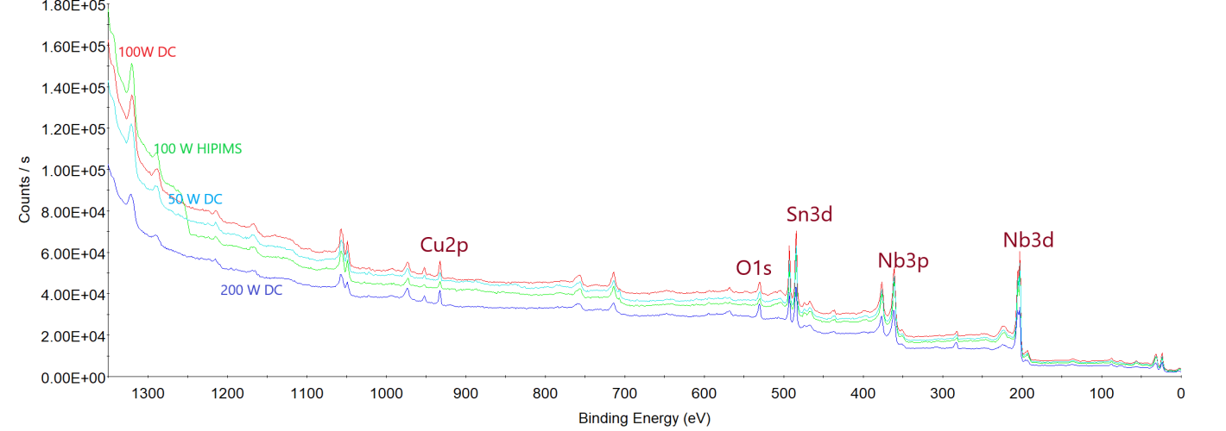
Thin Film Depositions - Planar Samples
  Can Nb₃Sn sputtering match or exceed performance of Sn vapour diffusion into bulk Nb?
SIMS on 100 W HiPIMS
Four point probe
Nb₃Sn on 50-100 mm substrates
  Theoretical T_{c} = 18 K
  DC, HiPIMS
  Effect of magnetron power, deposition temperature
SEM – high grain density
Nb
Sn
Cu
~ 2 μm
Effect of DC magnetron power
XPS comparison of Nb₃Sn/Cu (~ few nm depth)
Notes:
To reduce fabrication cost

Slide 13
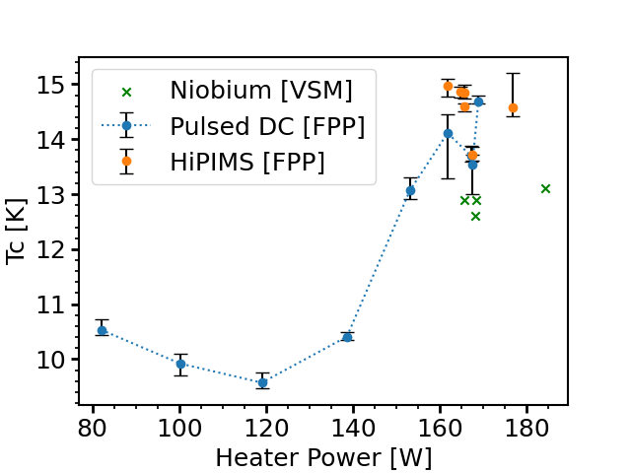
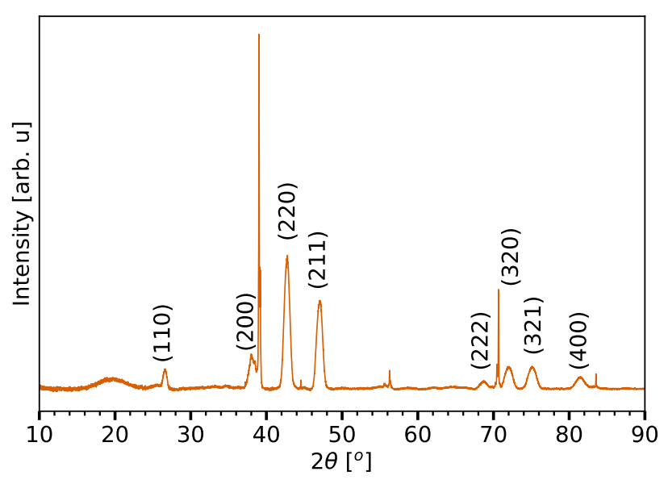
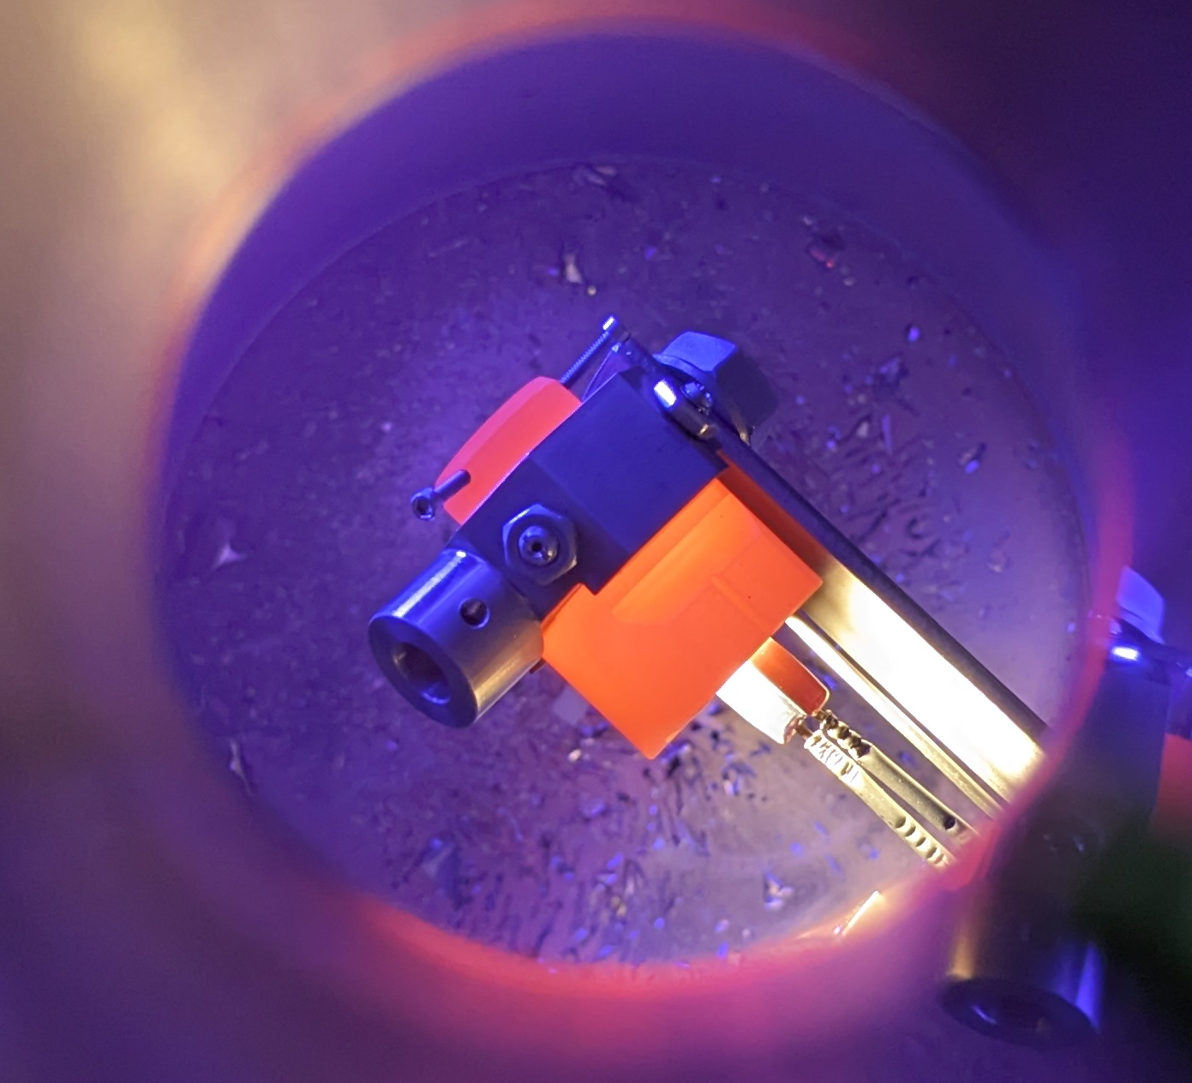
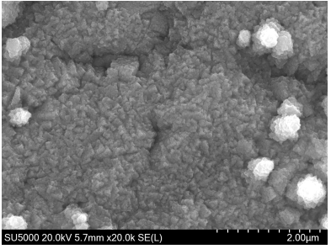
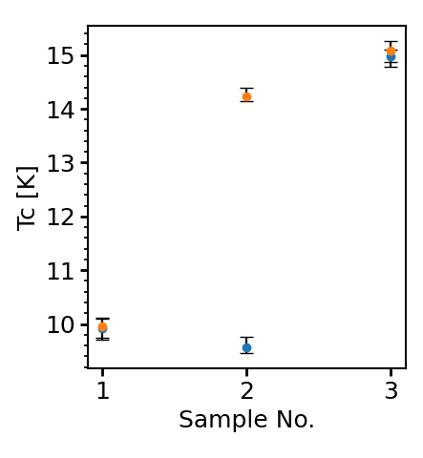
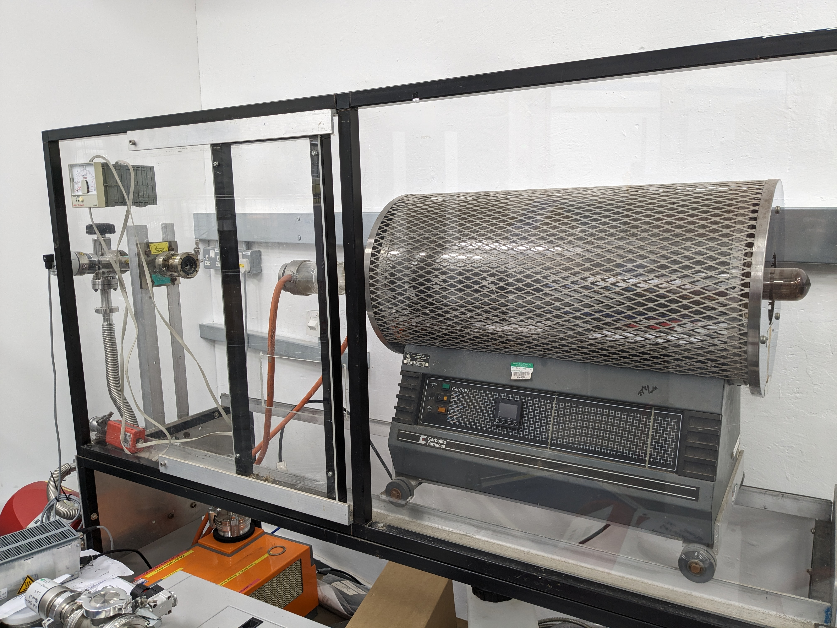
Thin Film Depositions - Planar Samples
  Is V₃Si a viable alternative material?
Effect of heater power on T_{c}
V₃Si on 10 mm substrates
  Theoretical T_{c} = 17 K
  Initial steps to improve T_{c} and consistency of growth
  Post-annealing required – furness, laser, flash lamp
XRD V₃Si/Nb
SEM – small crystallites
Effect of post-deposition annealing
800 c
800 c
600 c
C. Benjamin et al. V3Si: An alternative thin film material for superconducting RF cavities, IPAC 24

Slide 14
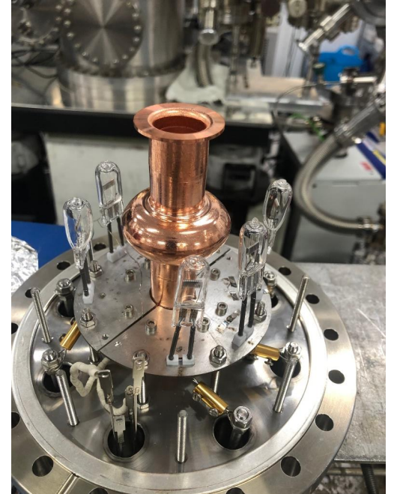
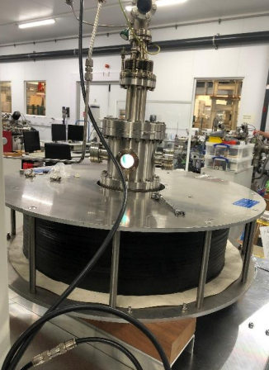
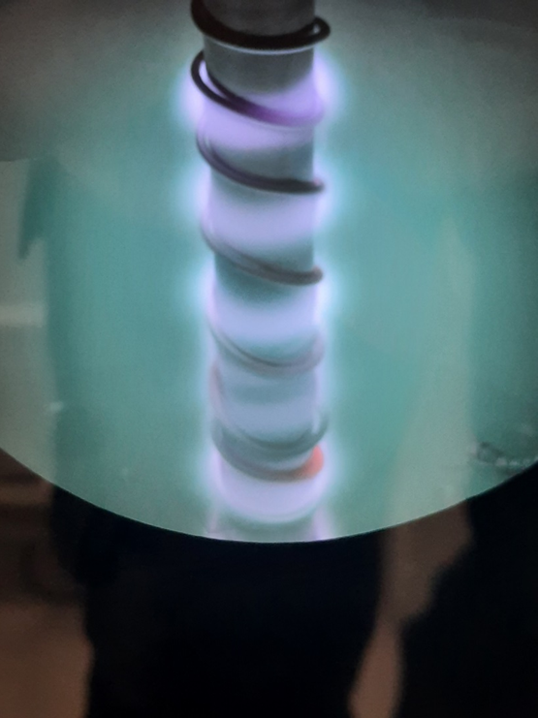
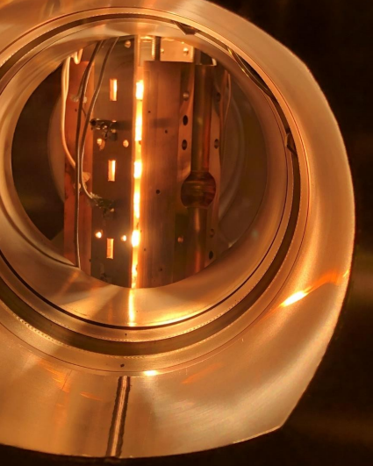
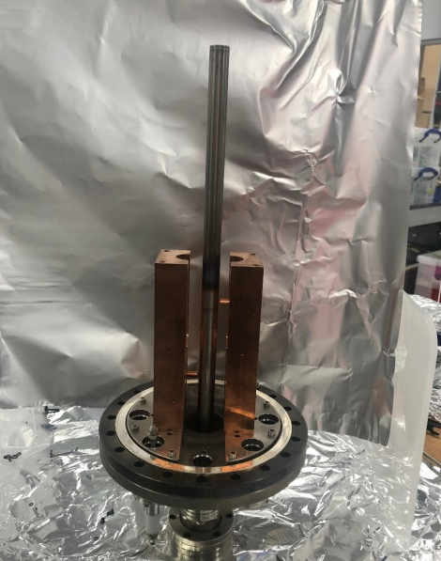
Thin Film Depositions – 6 GHz Cavities
  Are performances on flat geometries repeatable on curved geometries?
  Closed Seamless Cavities
  Open Split Cavities
Nb target with Ti wire
Deposition facility
Planar magnetron
Cylindrical magnetron
ms-Flash Lamp Annealing at HZDR
Nb, NbTiN, Nb₃Sn, V₃Si
Courtesy of S. Prucnal & S. Zhou (HZDR)
Notes:
Copper drawn from a single sheet rather than welded

Slide 15
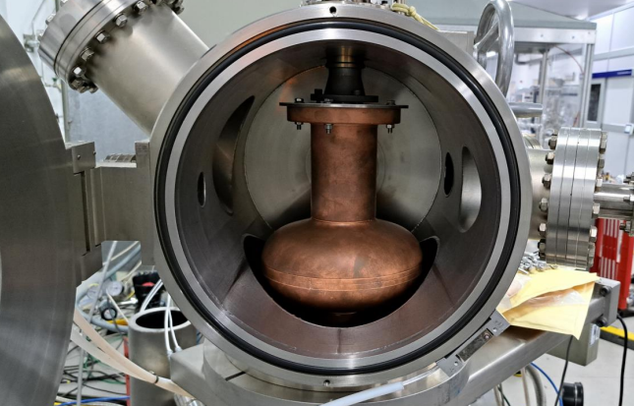
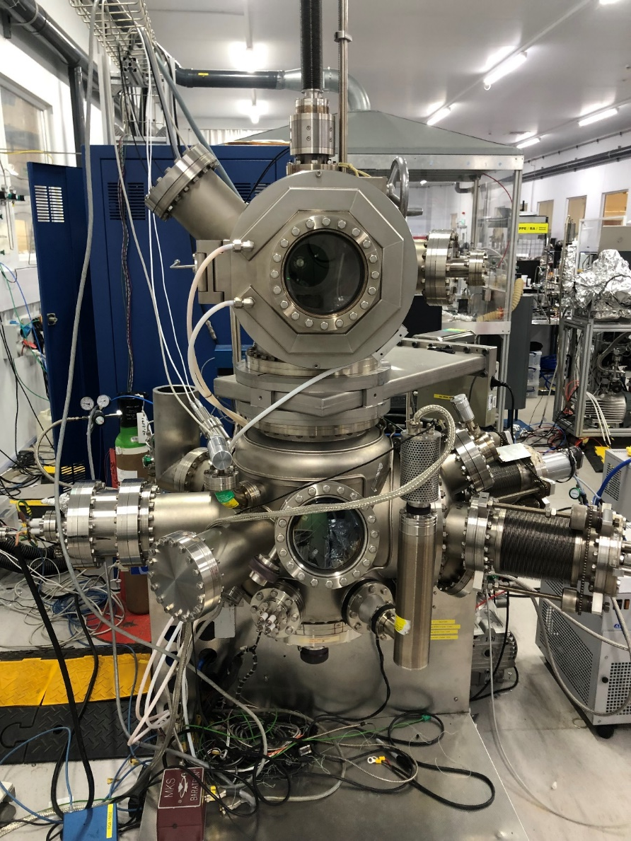
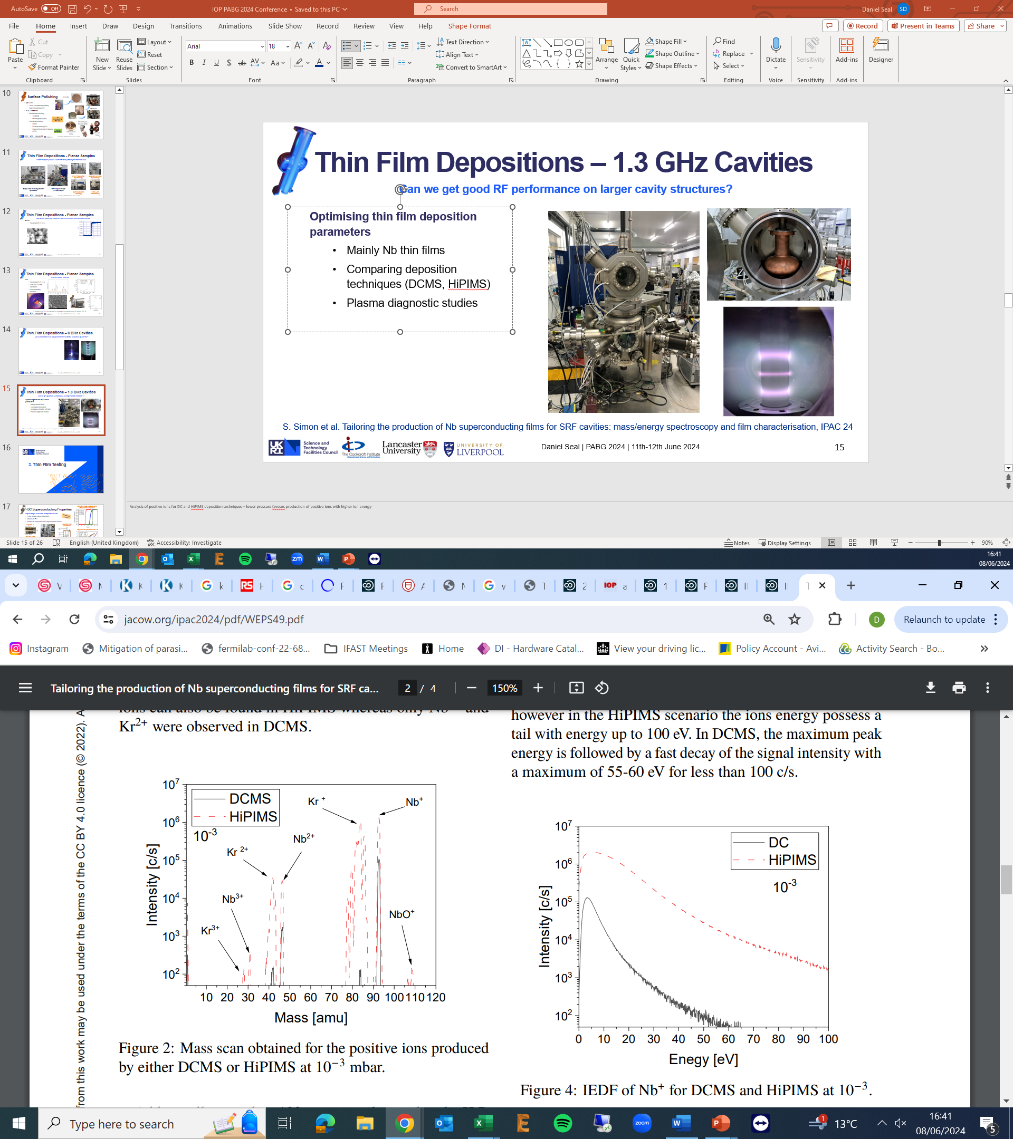
Thin Film Depositions – 1.3 GHz Cavities
  Can we achieve uniform coatings on larger cavity structures?
Optimising thin film deposition parameters
  Mainly Nb thin films so far
  Comparing deposition techniques (DCMS, HiPIMS)
  Plasma diagnostic studies
Mass scan at 10⁻³ mbar
Ion energy distribution function of Nb⁺ at 10⁻³ mbar
S. Simon et al. Tailoring the production of Nb superconducting films for SRF cavities: mass/energy spectroscopy and film characterisation, IPAC 24
Notes:
Analysis of positive ions for DC and HiPIMS deposition techniques – lower pressure favours production of positive ions with higher ion energy

Slide 16
3. Thin Film Testing

Slide 17
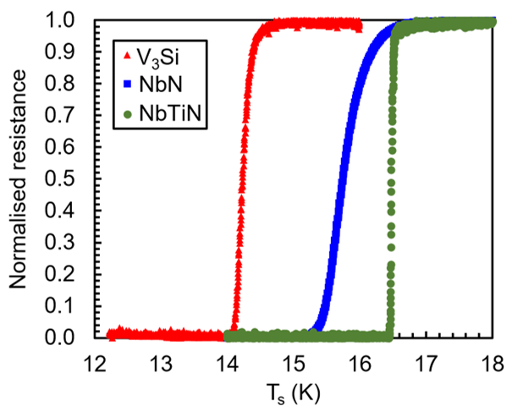
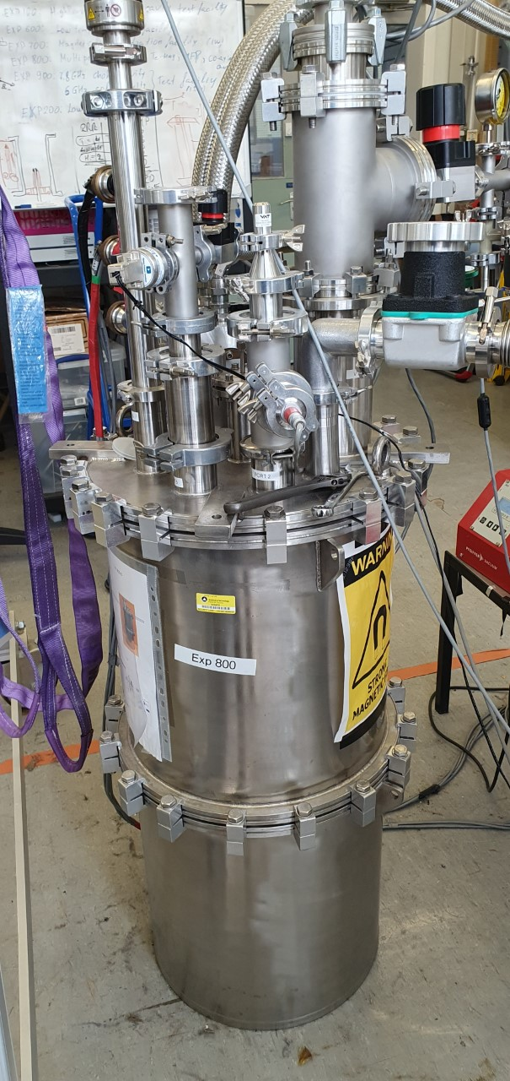
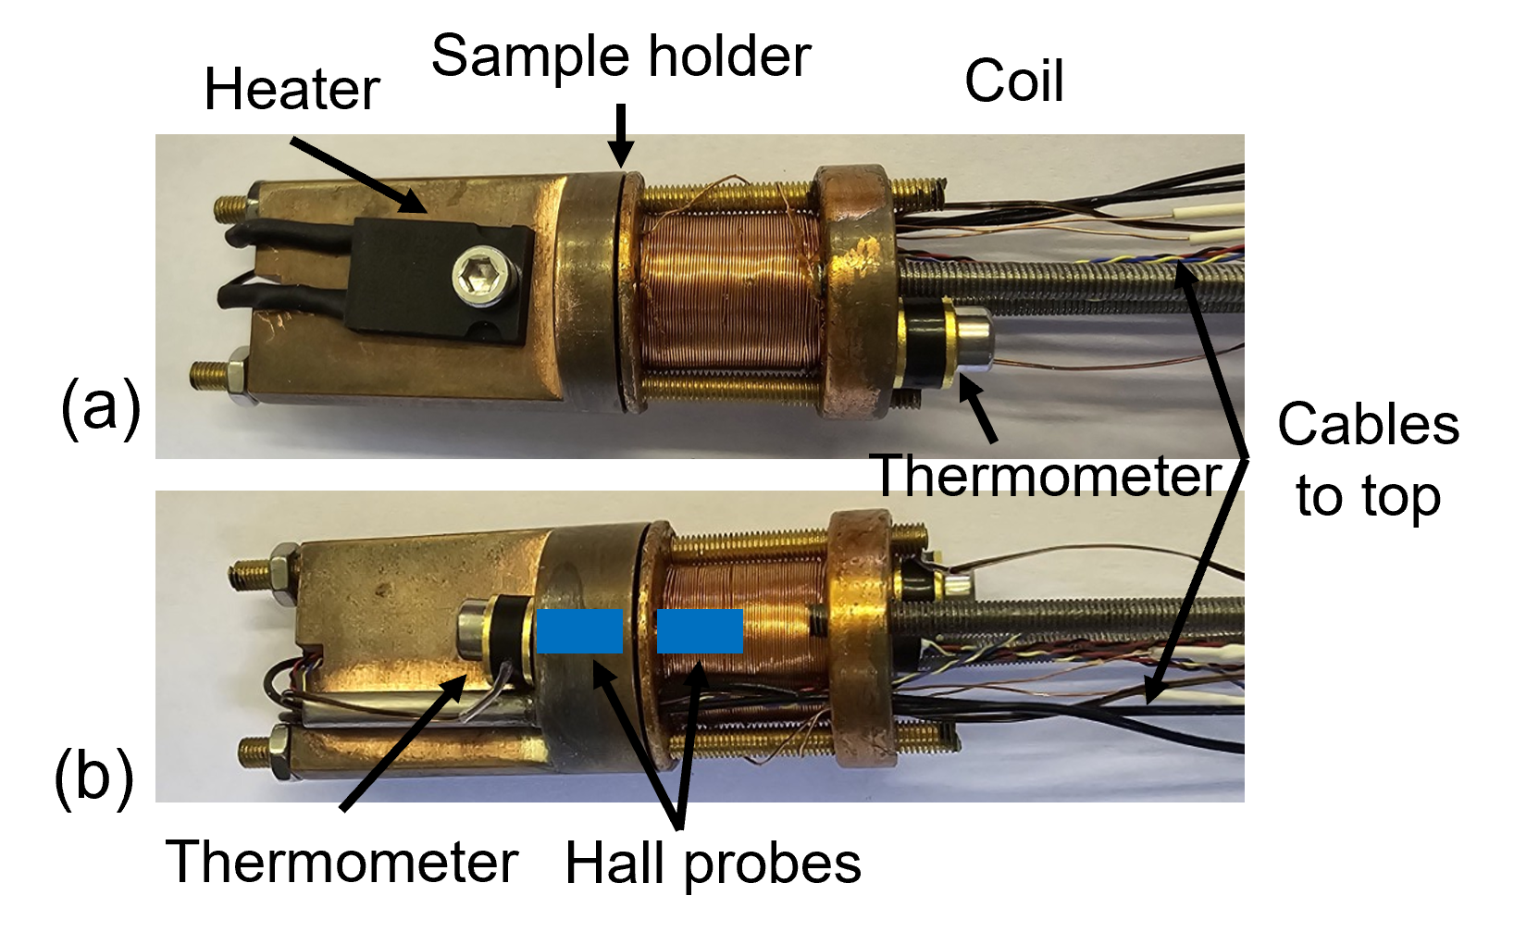
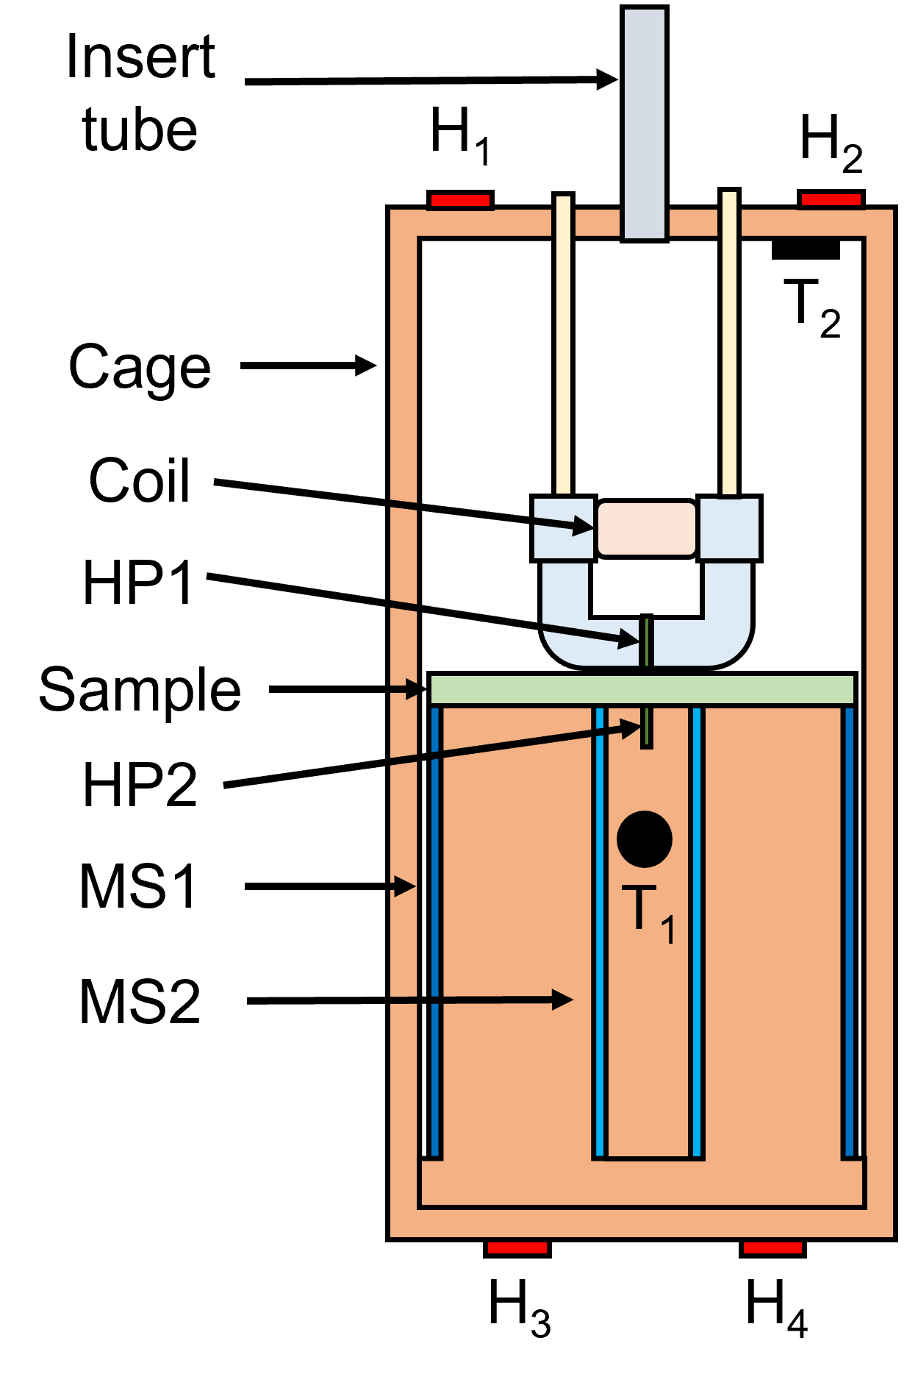


Four-point probe measurements with alternative materials
DC Superconducting Properties
Rapid sample tests with multiprobe inserts
Is the sample superconducting?
What is its T_{c}?
What is its behaviour under high magnetic fields?
20 tests per week!
Magnetic T_{c}
Magnetic Field Penetration
Magnetic field penetration with Nb
Four-point probe
D. Seal et al. Upgraded multiprobe sample inserts for thin film SRF cavity developments, IPAC 24
Notes:
All systems are closed cycle cryocoolers

Slide 18




DC Magnetic Field Penetration
3 tests per week!
Is there a correlation between DC & RF performance?
Cavity-like DC fields applied:
  Parallel
  From one side (unlike SQUID VSM)
  B < 600 mT
Recently upgraded facility:
  Test 10 cm samples size and 6 GHz split cavities
  Magnetic shields
  Minimal damage to films
V₃Si/Nb/Cu Sample
$$R=1 − \frac{B_{2}}{B_{1}}$$
Meissner state when R = 1

Slide 19



Effect of deposition temperature on Nb/Cu
RF Test With Choke Cavity
Most importantly, how does the thin film perform under RF conditions?
7.8 GHz Choke Cavity
Low field measurements:
  R_{s} vs B_{sample, pk}
  R_{s} vs T_{sample}
  Penetration depth vs T_{sample}
Mass parameter optimisation prior to:
  High field/low frequency tests with QPR
  Cavity tests
Effect of magnetron power on Nb₃Sn/Cu
3 tests per week!

Slide 20



First tests autumn 2024!
Low Power Cavity Testing
Cryocooler based facility
P < 2.5 W, T > 4 K (est.)
Quick first cavity test
Good cavities will have high power test in LHe
4 types of cavity
1.3 GHz closed
1.3 GHz split (in development)
6 GHz closed
6 GHz split
Cold head
Feedthroughs for RF, wiring etc
1.3 GHz cavity
Adapter for heat links
6 GHz split cavity
Courtesy of O. Poynton & J. Rigby

Slide 21





High Power Cavity Testing
First tests summer 2024!
Full Q₀ vs E_{acc} test with LHe
Testing with existing STFC/DL LHe infrastructure mainly used for ESS & PIP-II cavity tests
Upgrades now allow for:
A RF single system for 650 MHz, 700 MHz and 1.3 GHz
P ≤ 200 W, T = 2 K & 4.2 K
Capability for 9-cell tests
Existing SRF Test Facilities at Daresbury Laboratory
Courtesy of T. Sian & C. Hill

Slide 22
4. Future

Slide 23





The Future of Thin Film SRF in the UK
Reduce capital and running costs of accelerators!
Continuing R&D
Thin film coatings
Post-processing
Quick sample testing
Split cavities
Multi cells
Cavity testing
UK XFEL
ISIS II
Loaded test in CLARA
ILC
FCC

Slide 24
Acknowledgements
STFC/CI: O. B. Malyshev, R. Valizadeh, C. Benjamin, O. Poynton, J. Rigby, A. Akintola, T. Sian, L. Smith, J. Conlon, C. Benjamin, S. Pattalwar, G. Miller, A. Blackett-May, A. Vick, C. Hill, M. Pendleton, M. Jones, P. Smith, A. Wheelhouse, D. Mason
Lancaster University/CI: G. Burt, N. Leicester, H. Marks, A. Mogheyseh
University of Liverpool/CI: S. Simon, J. Bradley
INFN: C. Pira, E. Chyhyrynets​, D. Ford, A. Salmaso
IJCLAB: D. Longuevergne, O. Hryhorenko​
CEA: C. Antoine
IEE: E. Seiler, R. Ries
HZDR: S. Prucnal, S. Zhou

Slide 25






Science and Technology Facilities Council
@STFC_matters
Science and Technology Facilities Council

