Slide 1
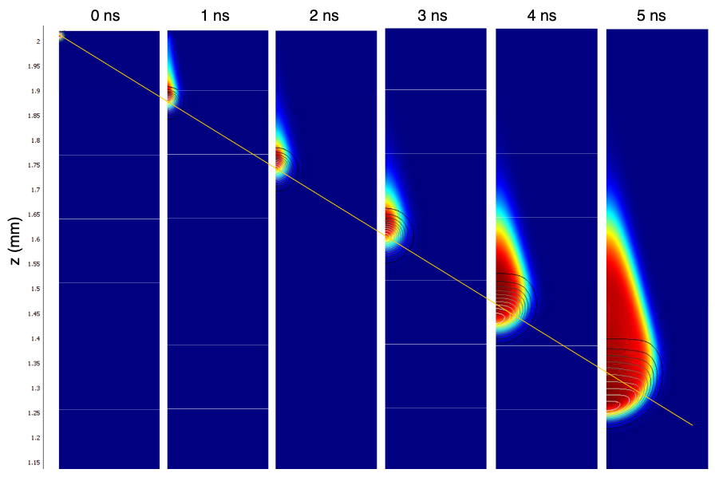
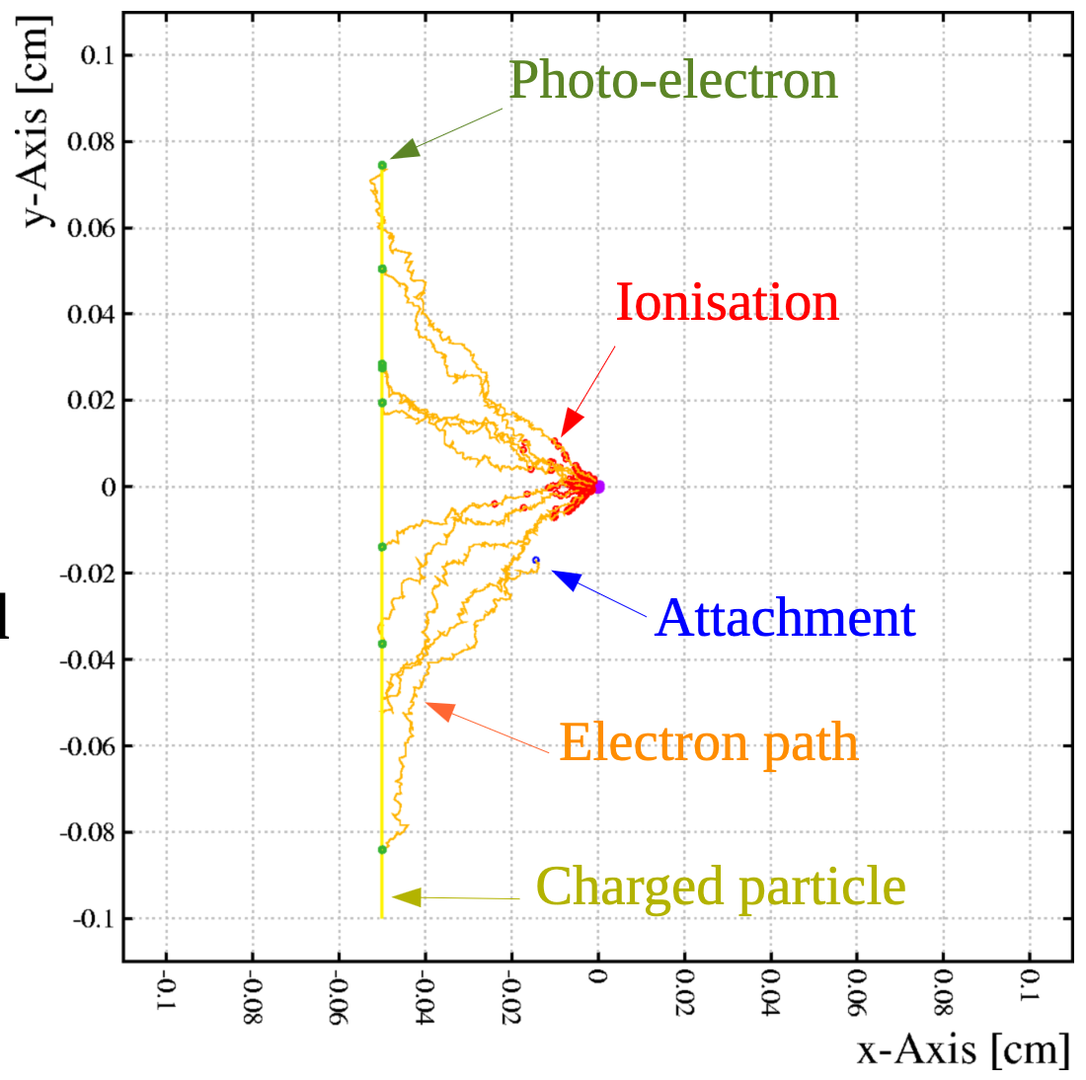
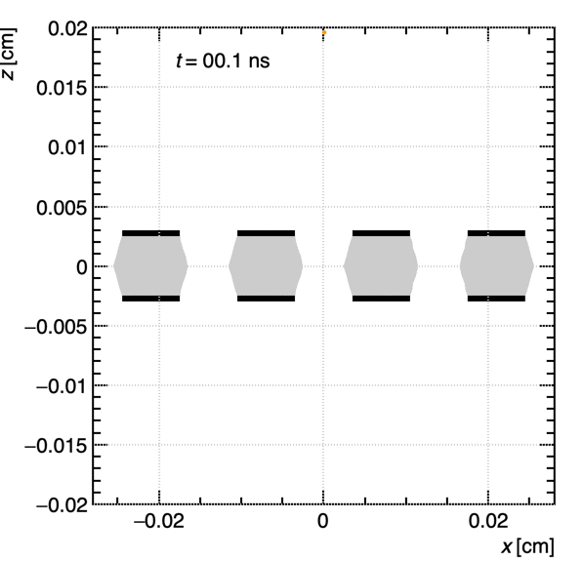
Proposal for Organization of WG4
Detector Physics Modelling and Simulation
Piet Verwilligen for the
WG4 Conveners

Slide 2
Premises
Gasesous Detectors are a large community
  Even when looking only at people / groups dedicating (part) of their time to physics modelling & simulation
  E.g. Survey response: 89 responses, some for their group
  (and not including WG conveners)
Reasons one comes to WG4 can be to …
  work on his/her own interest, but let the community profit / benefit from the work they do by sharing code / sharing experience / good practice / …
  search for collaborators to take on larger tasks
  Learn from other groups how to start simulations or to learn limitations of the current state-of-the-art
  … [add your motivation here]

Slide 3
In WG4 …
We will not do the work for you …
instead we would like develop a fertile ground for simulation work
We will host and help groups / individuals coming from the various work-packages to:
  Help/guide to develop the code they need for their WP
    Validate data
    Understand data => model = > simulate to confirm model
Help / host groups / individuals willing to push boundaries of simulation further
Help groups working effectively together

Slide 4
Through …
We believe this is best done in smaller groups that share the same interest and where there is time to know each other and look for synergies to work together
Therefore we propose the creation of “Task Force” or “Topical Groups” dedicated to the different areas
  Have several suggestions, we will try to ignite all, but we will see how many will become active and “self-sustaining”
  Work will be done if people are interested to free their time to work on it … we will help by providing aid and constructive atmosphere
Organization of WG4 working meetings:
  Can have a common part (general interest) and a topical part
  Invite WP leaders to present simulation work to be done in their WP
  Rotation of topical parts
  Agenda to be defined and communicated ahead
    Each topical group will meet 2-3-4 / year
    Can become more if activity ramps up …. (bottom-up approach)

Slide 5
Suggestions for “Topical Groups”
Communication & Documentation
  Develop website, develop documentation, Prepare examples (and publis), simulation school
  Translate C++ to python, SWAN / Collab notebooks
Space Charge & Large Avalanches
  New – hybrid – algorithms: cpu & memory efficient
  Electric field update for large space-charge, Investigate use of GPU
Resistive Detectors
  Signal induction in detectors with resistive layers
  Simulate / model large-size effects (distance to GND)
  Transmission line / signal transmission over large distances
Ecological / New gases (incl x-sections, Py- / Beta- / Magboltz / Methes …)
Measurements and modelling of non-equilibrium and low-pressure effects
  Measurement and extraction of Penning effect, feedback, ion mobilities , ion-clusters
Software Integration & Development
  Core software development, Software maintenance, Software optimization (reduce mem)
  Parallelization, use of heterogeneous computing (gpu), pioneer machine-learning?
  Integration of different sw to work smoother together, …
Rare-event TPC simulations
  Development of electro luminescense, Negative ions, ….
Wire Detectors (discussing Data/MC comparisons, outstanding issues, …)

Slide 6
How?
Working toghether on the same topic / towards a shared goal can help start a collaboration
this is a ”required” condition, this is not a “sufficient” condition …
  Personal / group collaboration depend on many human factors
  We will not force people to work together if they cannot get along with each other
  As WG conveners we will strive to:
    Converge on topics / goals if we see manpower & will available
    Avoid as much as possible work duplication / parallel groups
    Find a place for everyone to conduct his/her research
    Create a stimulating environment for everybody
  Ideally we can create a situation where we can find funding toghether
    Small projects between 2-3 institutes with funding for 1-2 doctoral students
Note: we are a working group …
  This means … working toghether and sharing information / experience
  This is not a conference where you come, you present your work, respond to questions and return home to continue your work alone

Slide 7
Topical meetings … how?
We would like to understand from everyone to which (1+) topical groups they feel they belong to
Topical meetings can have their own organization
  E.g. topical meeting on communication / documentation will be different from the topical meeting on the development of new code for avalanches …
  But note that we will have likely an audience (participants!) with a mixed experience / background
    Therefore an overview talk to start with that illustrates the state of the art given by one expert of the field would be desirable to have everyone on the same page
    This can be followed by a discussion where we can agree on a work plan and on sharing of the tasks, common funding requests, shared PhD stud …
WG4 conveners will investigate with the different groups their availability and come up with a planning for the next 3+ months

Slide 8
Questions / Discussion?
Your input here

