Slide 1
Latvia - CERN: state-of-play
Prof. Toms TORIMS
CERN National Contact point of Latvia

Slide 2
Latvia is reliable and honest partner of CERN

Slide 3
Latvia - CERN strategy
Publicly available, including its English translation
Approved by Government in Dec 2022
Has very clear and detailed implementation plan
Is being successfully coordinated by CERN National Contact Point of Latvia and implemented by all involved parties
Is benefiting from comprehensive public funding mechanism and stakeholder engagement
The main goals are being steadily assured
  Meaningful and coordinated participation of Latvia at CERN in the Associate Member state status
  To become Full Member state within 2-3 years

Slide 4
I.
Meaningful and coordinated participation of Latvia at CERN in the Associate Member state status

Slide 5
Where Latvia is today?
Meaningful and coordinated participation of Latvia at CERN
Benefiting from the opportunities at CERN – in the best possible way and at all levels
Providing sustainable contribution in attaining the State priorities in education, science, economic development and R&D
To foster environment of the scientific excellence and industrial leadership
To concentrate available and to attract new human resources / to use strategically available financial instruments
Within the next years to achieve “well balanced country” status and to ensure 60/40 proportion for scientific HR / industrial return

Slide 6
Where Latvia is today?
Benefiting from the opportunities at CERN – in the best possible way and at all levels - participation and contribution
Consortium (RTU+LU) in the CMS experiment – since 2017
Consortium (RTU+LU) in the MEDICIS experiment – since 2020
  The European medical isotope programme: Production of high purity isotopes by mass separation (PRISMAP) project – since 2021
LU in AEgIS experiment – since 2021
LU in ISOLDE experiment – revitalised in 2023
Participation of the RTU in CERN accelerator technology projects
  Future Circular Collider (FCC) – since 2015
  International Muon Collider Collaboration (IMCC) – since 2023
  Next Ion Medical Machine Study (NIMMS) project – since 2019
  Innovation Fostering in Accelerator Science and Technology (I.FAST) project
  Heavy Ion Therapy Research Integration plus (HITRIplus) Project – since 2021

Slide 7
Where Latvia is today?
Benefiting from the opportunities at CERN – in the best possible way and at all levels - Where you can physically find Latvia @CERN?
Latvia Accelerator Technology team is fully integrated within CERN - ATS-DO and @Kamchatka
Close collaboration with Groups at CERN: Beams; Cryogenics and Vacuum
Leading role in CMS MTD and BTL in particular - CMS Tracker Integration Facility (TIF)
CMS and CMS Technical Coordination – @B40, @Prévessin site and Point5
AEgIS experiment – @Antimatter Factory
MEDICIS experiment - @ISOLDE/MEDICIS
+ groups in Latvia @Riga Technical University and University of Latvia + Tier2 federative partners

Slide 8
Where Latvia is today?
Benefiting from the opportunities at CERN – in the best possible way and at all levels – reminder – Latvia joined CERN in Aug 2022!
CERN Doctoral Student Programme (DOCT) – 7
CERN – Latvia Doctoral Programme – 100% paid by Latvia - 4 so far
CERN Technical Student Programme (TECH) - 1
CERN Summer Student Programme (2+2 every year) – 20 since 2013
Internship at CERN (STAG programme) – 1
Participation in CERN Graduate Programmes
  Early-Career Professionals
  Project Graduates (GRAD) - 1
  Research Fellows (FELL) – 4
CERN (STAF) - 5 staff

Slide 9
Where Latvia is today?
- To concentrate available and to attract new human resources / to use strategically available financial instruments – 2M+/annum + ILO costs
- To foster environment of the scientific excellence and industrial leadership
National Research Programme “High-Energy Physics and Accelerator Technologies” – 300 000 EUR in 2024 – will be doubled at least
CERN membership payments – 1.066 250 CHF in 2024
Comprehensive public funding package - 950 788 in 2024, of which
  participation in CERN experiments – 511 282 EUR
  CERN National Contact Point, incl. Outreach and education activities – 339 506 EUR
  Tier2 Computing Center – 100 000 EUR

Slide 10
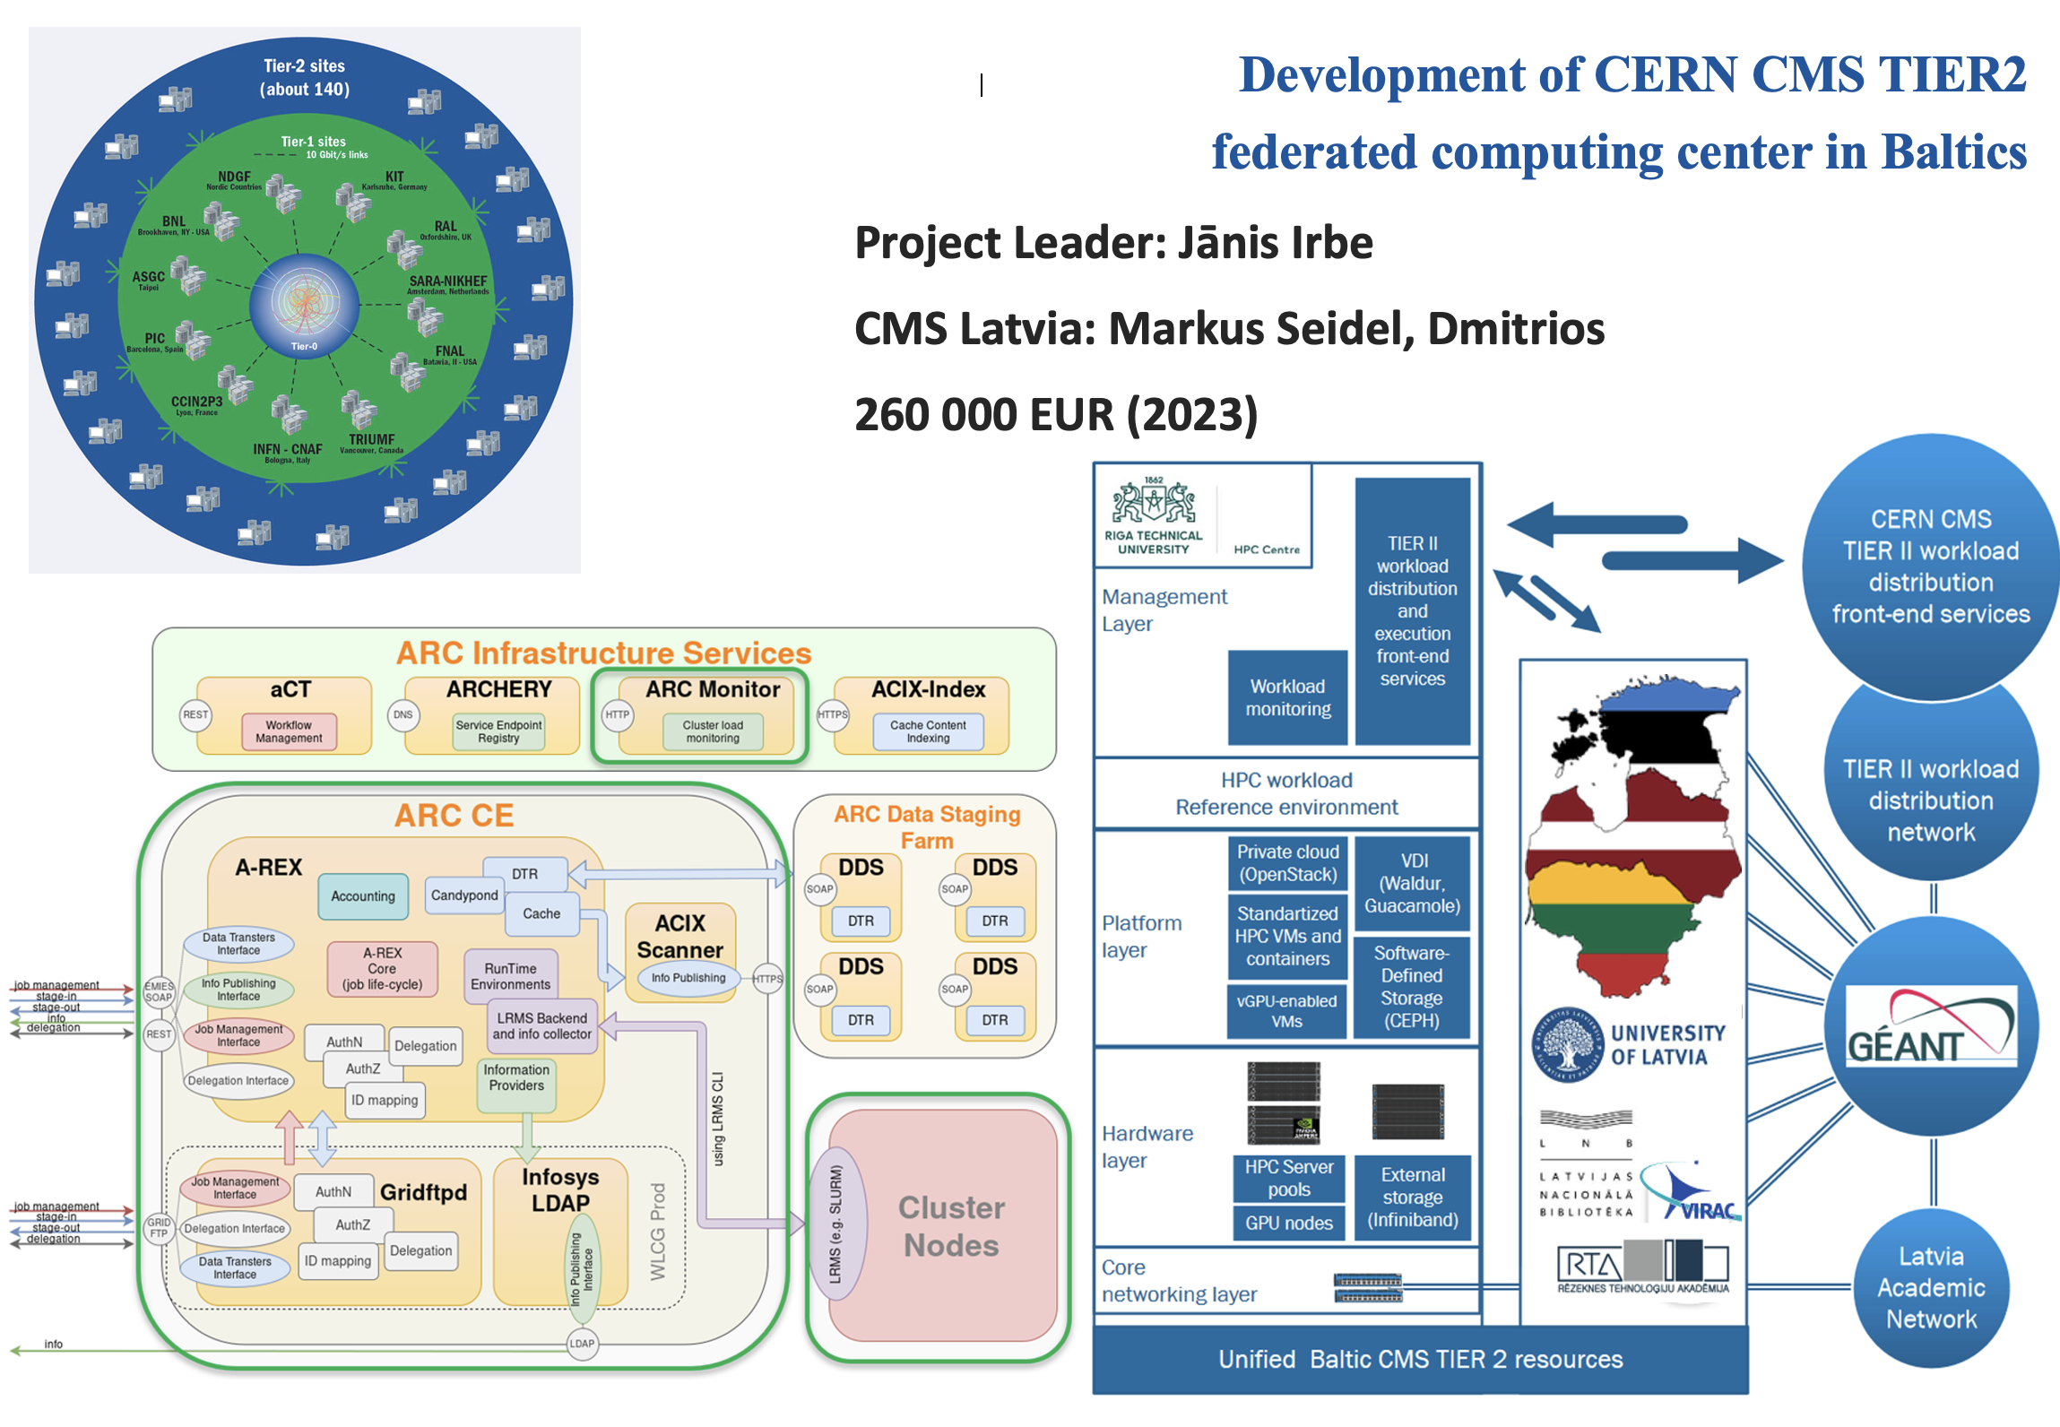
Where Latvia is today?
none

Slide 11
Where Latvia is today?
Providing sustainable contribution in attaining the State priorities in education, science, economic development and R&D
Outreach / annual activities – fully paid by Latvia
There were 1000+ LV nationals visiting CERN
“shadowing” of the LV scientific and technical personnel at CERN - 31
High School pupil visits to CERN - 49
Pupil visits to CERN – the School of Young Physicists - 3
The TechGirls visits to CERN - 4
Master and doctoral students (groups) educational visits to CERN - 65
Participation in the CERN Teacher Programme – 100+ teachers

Slide 12
Where Latvia is today?
Providing sustainable contribution in attaining the State priorities in education, science, economic development and R&D
- To promote collaboration between Latvia and CERN, scientific groups and entrepreneurs
CERN Latvia (stakeholder) Group and close link with Latvian staff at CERN – 14th meeting will be held in Apr @CERN
Joint doctoral study programme “Particle Physics and Accelerator Technologies” by the RTU and LU – up and running – thanks to CBG!
Federated Tier-2 CERN/CMS computing centre – inauguration
Institute of Particle Physics and Accelerator Technologies – up and running

Slide 13
II.
To become Full Member state within 2-3 years

Slide 14
Where Latvia is today?
Engagement of decision-makers and partners
To ensure support from CERN management and Member States
To actively participate in the work of the CERN Council and committees by forming a positive opinion about Latvia’s eligibility for the status of a full-fledged Member State
To coordinate the participation of Latvia in the work of the CERN Council and its committees
To promote coordination at the level of the Baltic States, which involves speaking with one single voice in the context of CERN at the level of the CERN Baltic Group and Baltic Assembly

Slide 15
Where Latvia is today?
Scientific and technical measures
To ensure stable State funding for CERN activities in Latvia – multi-annual budget planning with the steady growth
To increase the capacity and competence in the field of high-energy physics and accelerator technologies (done!):
  Establishment of a scientific institute associated with CERN in LV
  A stable team of LV scientists operates independently at CERN
To promote the awarding of industrial contracts from CERN (ILO)
To build a positive image of collaboration with CERN in Latvia #LatvijaCERN

Slide 16
Take away messages
Latvia is reliable and honest partner of CERN
CERN – Latvia membership was and is a very good deed
Latvia has delivering tangible contribution to the CERN scientific programme
Latvia is ready to take the next step – to become full member of CERN

Slide 17
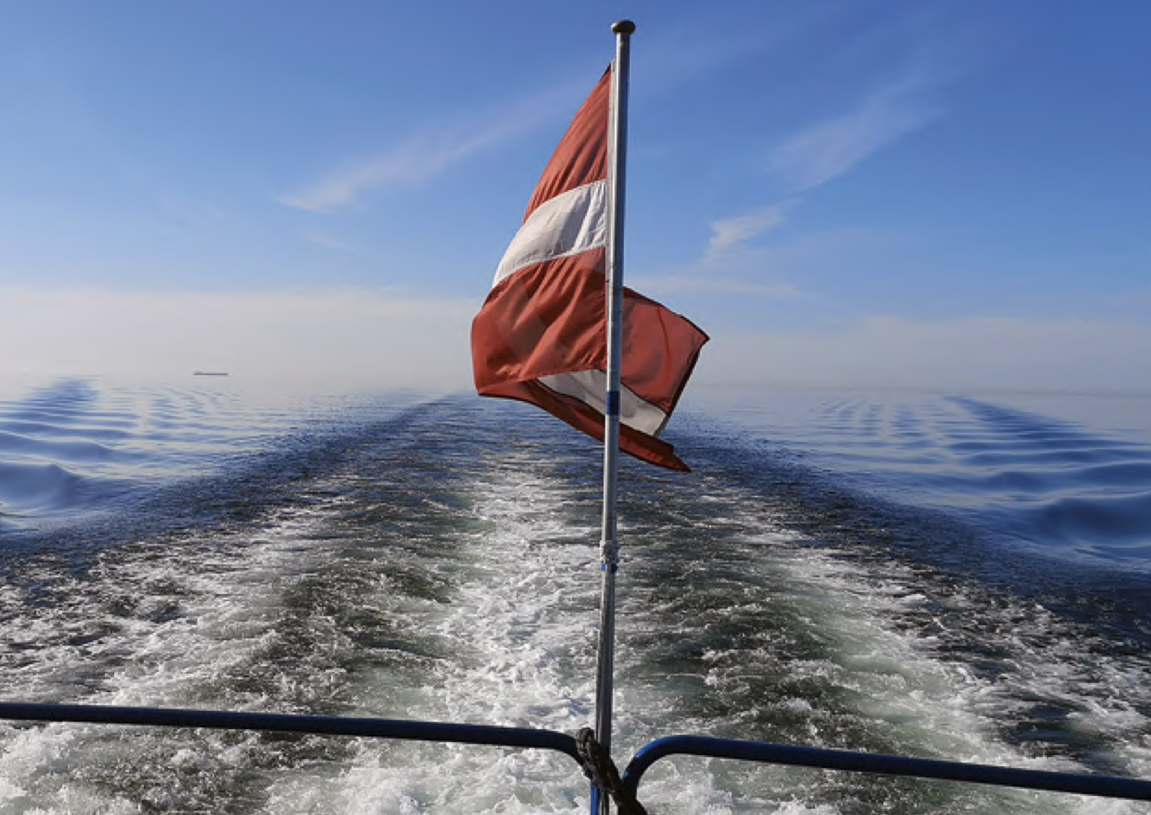
Latvia is navigating steadily at cruise speed and with straight-forward course

