Slide 1




Status of the Cherenkov and High Frequency BPMs
Bethany Spear
P. Burrows, M. Krupa, T. Lefevre, S. Mazzoni, C. Pakuza, E. Senes, M. Wendt, W. Zhang
AWAKE Collaboration Meeting
March 2024

Slide 2
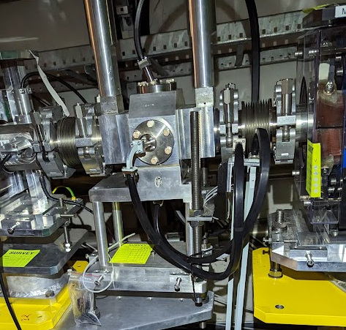
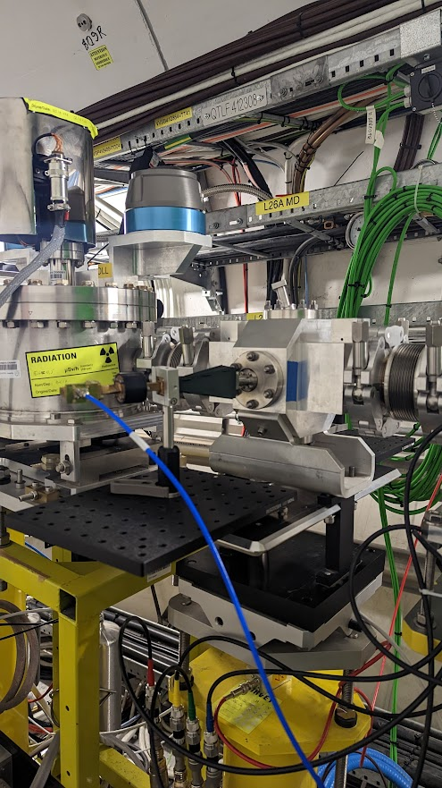
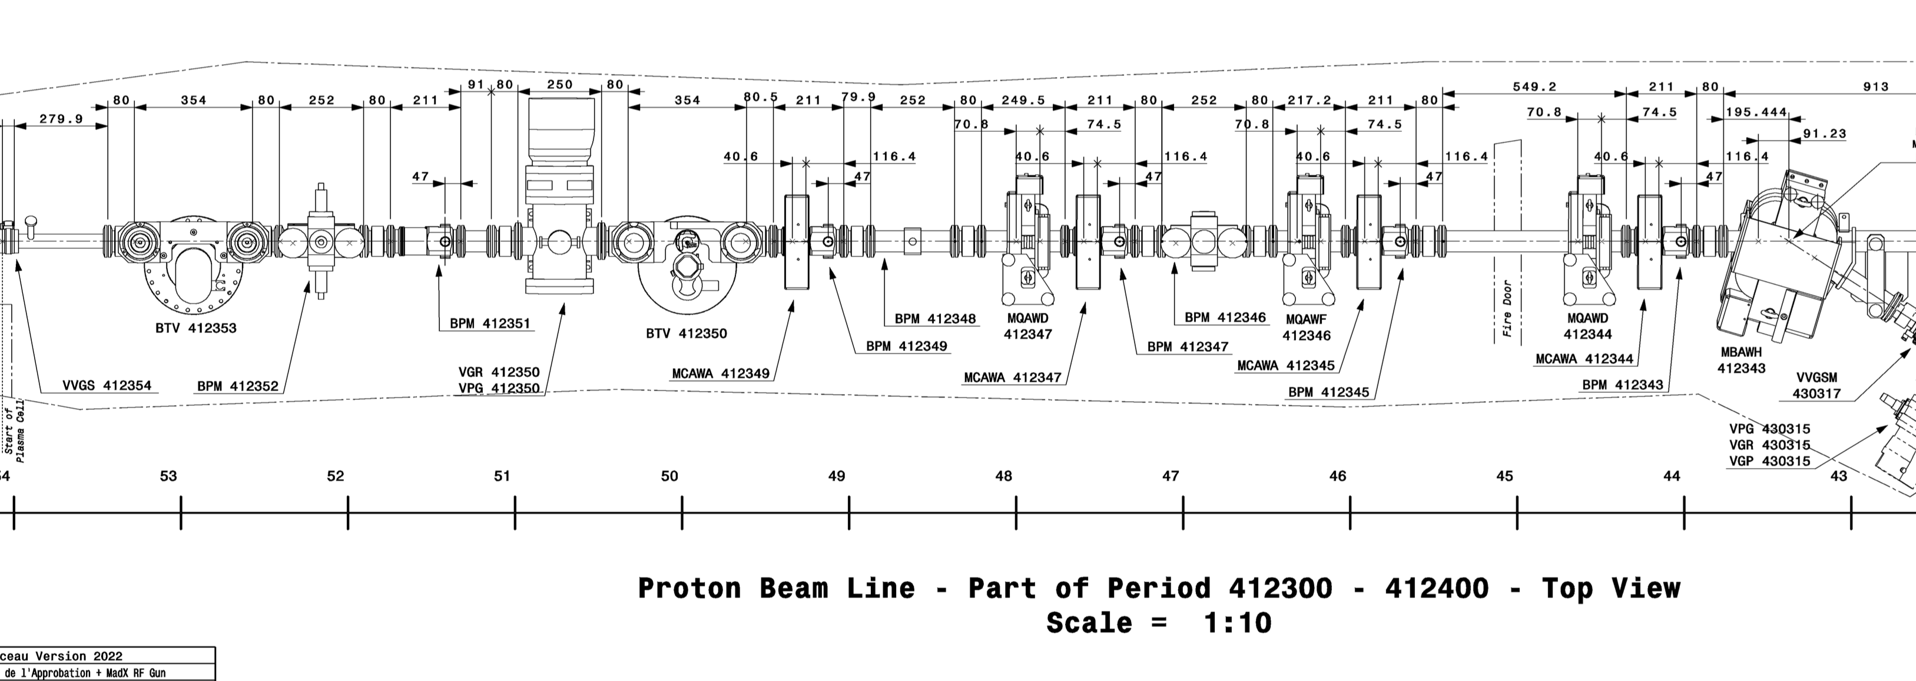
ChDR BPMs in the AWAKE beamline
One BPM installed with 2 mounted optical boards on either side for higher frequency broadband testing
One BPM connected to TRIUMF electronics
Logged on NXCALS as of Oct 23
ChDR BPM
ChDR BPM
Plasma
cell
Beam

Slide 3
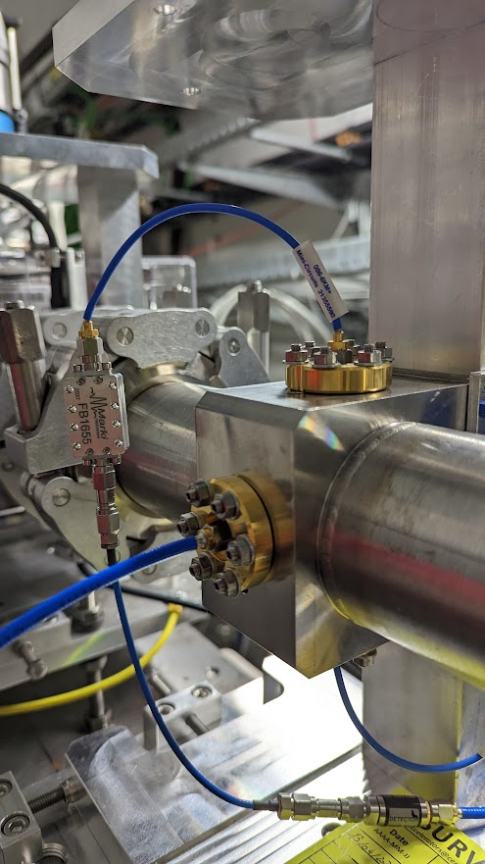
High Frequency button based BPM
One HF BPM installed between the ChDR BPMs
2 symmetrical planes
HF BPM
Plasma
cell
Beam

Slide 4
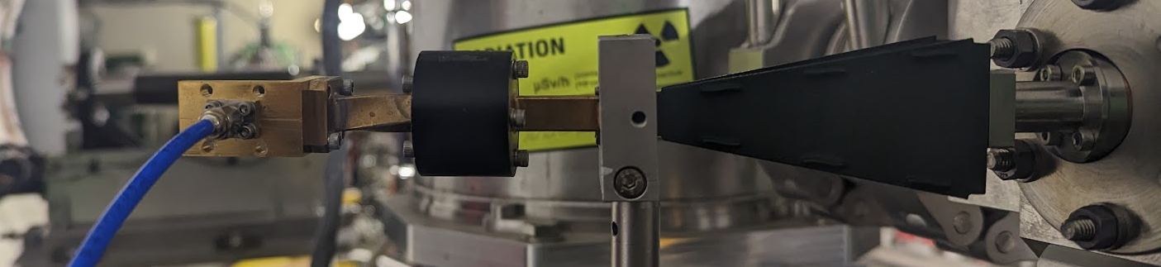
Proton only Studies
Proton Studies
Determining the signal contribution from the Protons for both the ChDR BPM and HF BPM in different frequency regimes
ChDR ranges tested: WR28(26.6-40GHz), WR15(50-75GHz), WR10(75-110GHz), Filtered WR28(30GHz-40GHz)
HF ranges: 26GHz Filter, through 40GHz Diode detector (Coaxial)
Diode
Coaxial to 8GHz Scope
Isolator
WR28 Gain Horn
Example setup for the ChDR BPM

Slide 5
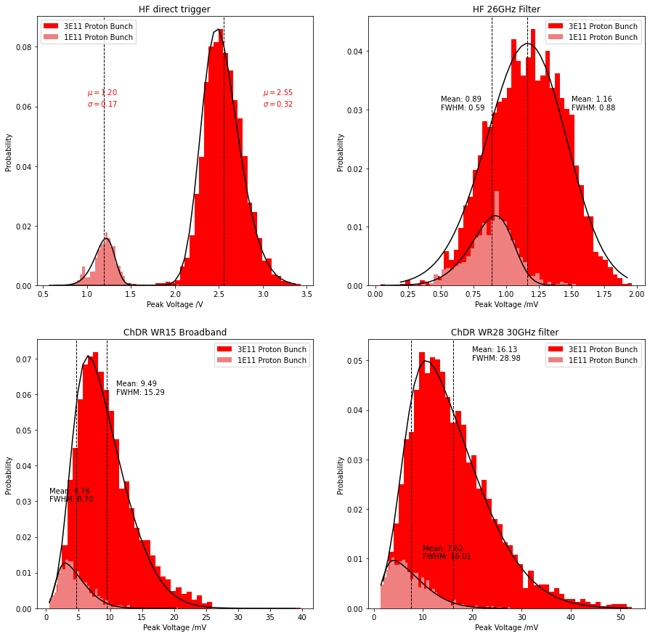
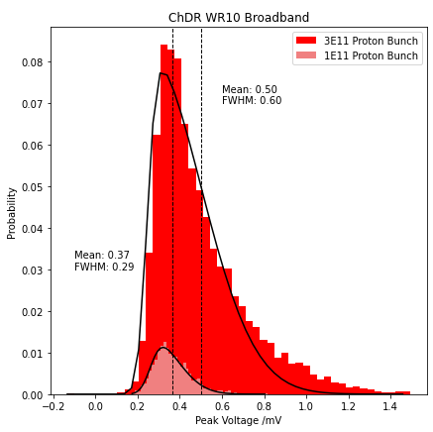
Procedure for electron Beam tests
Proton Studies
For each Proton shot over 5000 shots, the Proton signal was recorded on a 8GHz Oscilloscope
For both 1E11 and 3E11 protons

Slide 6
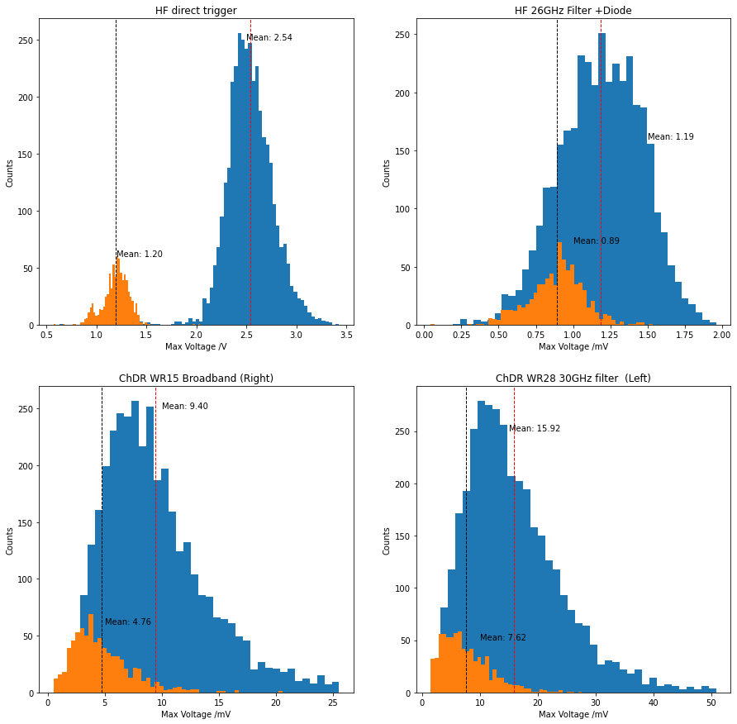
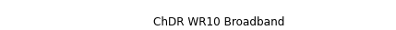
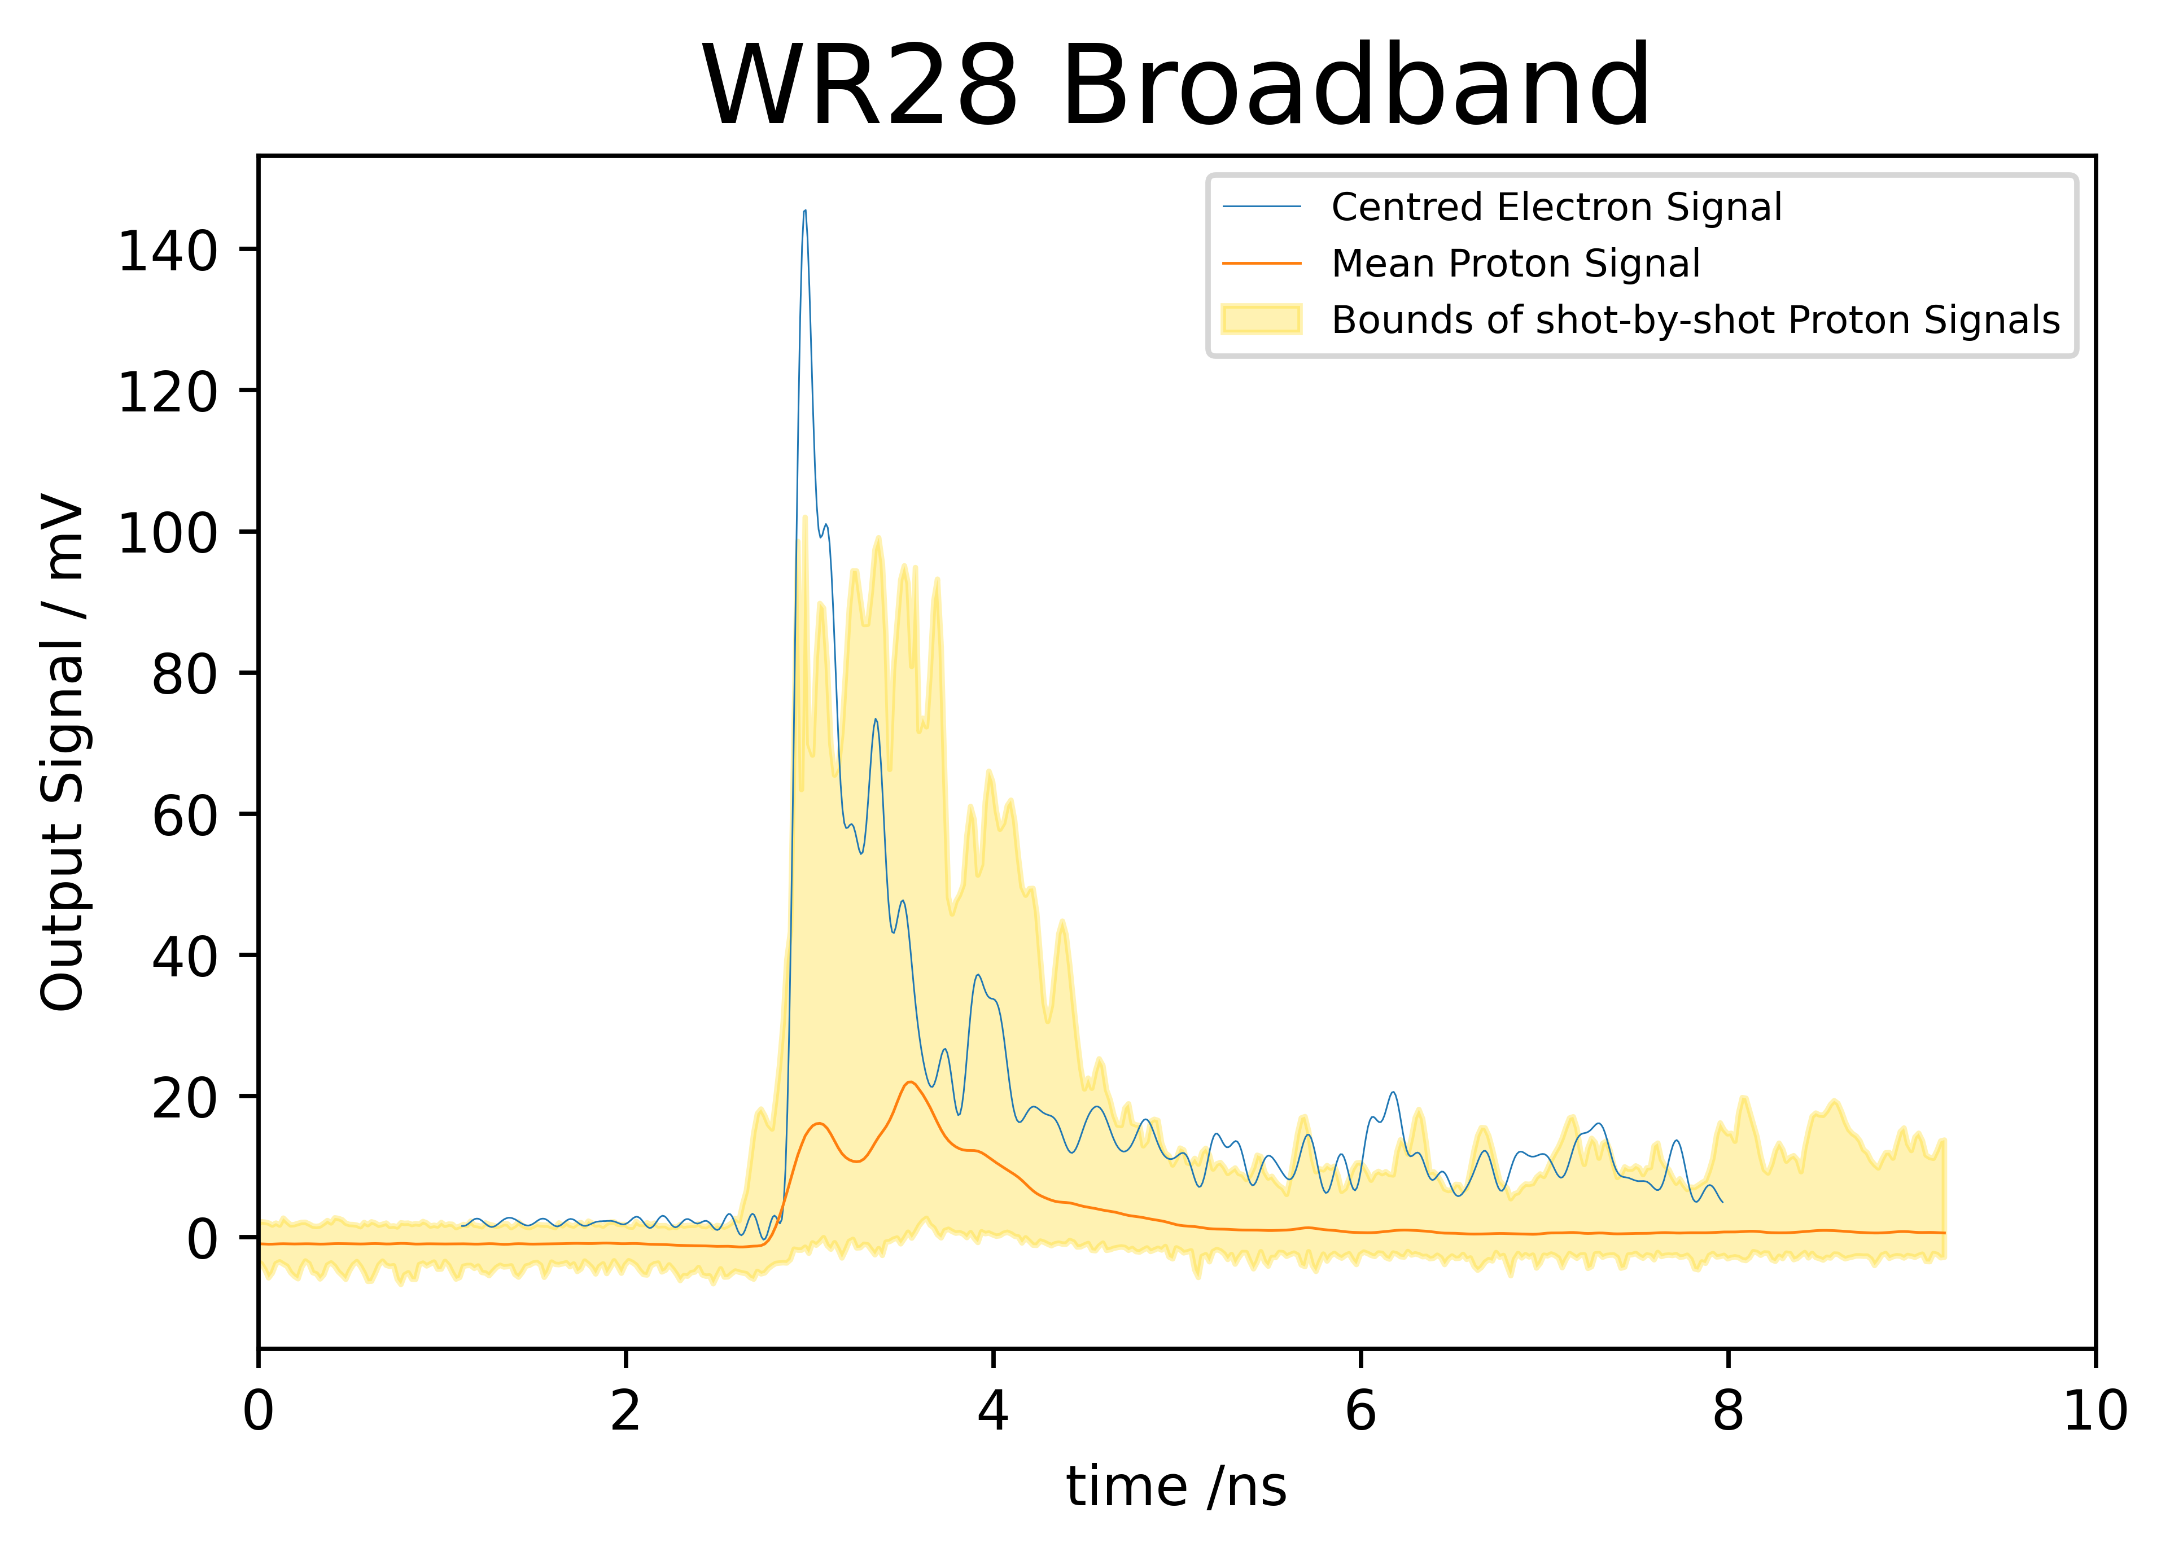
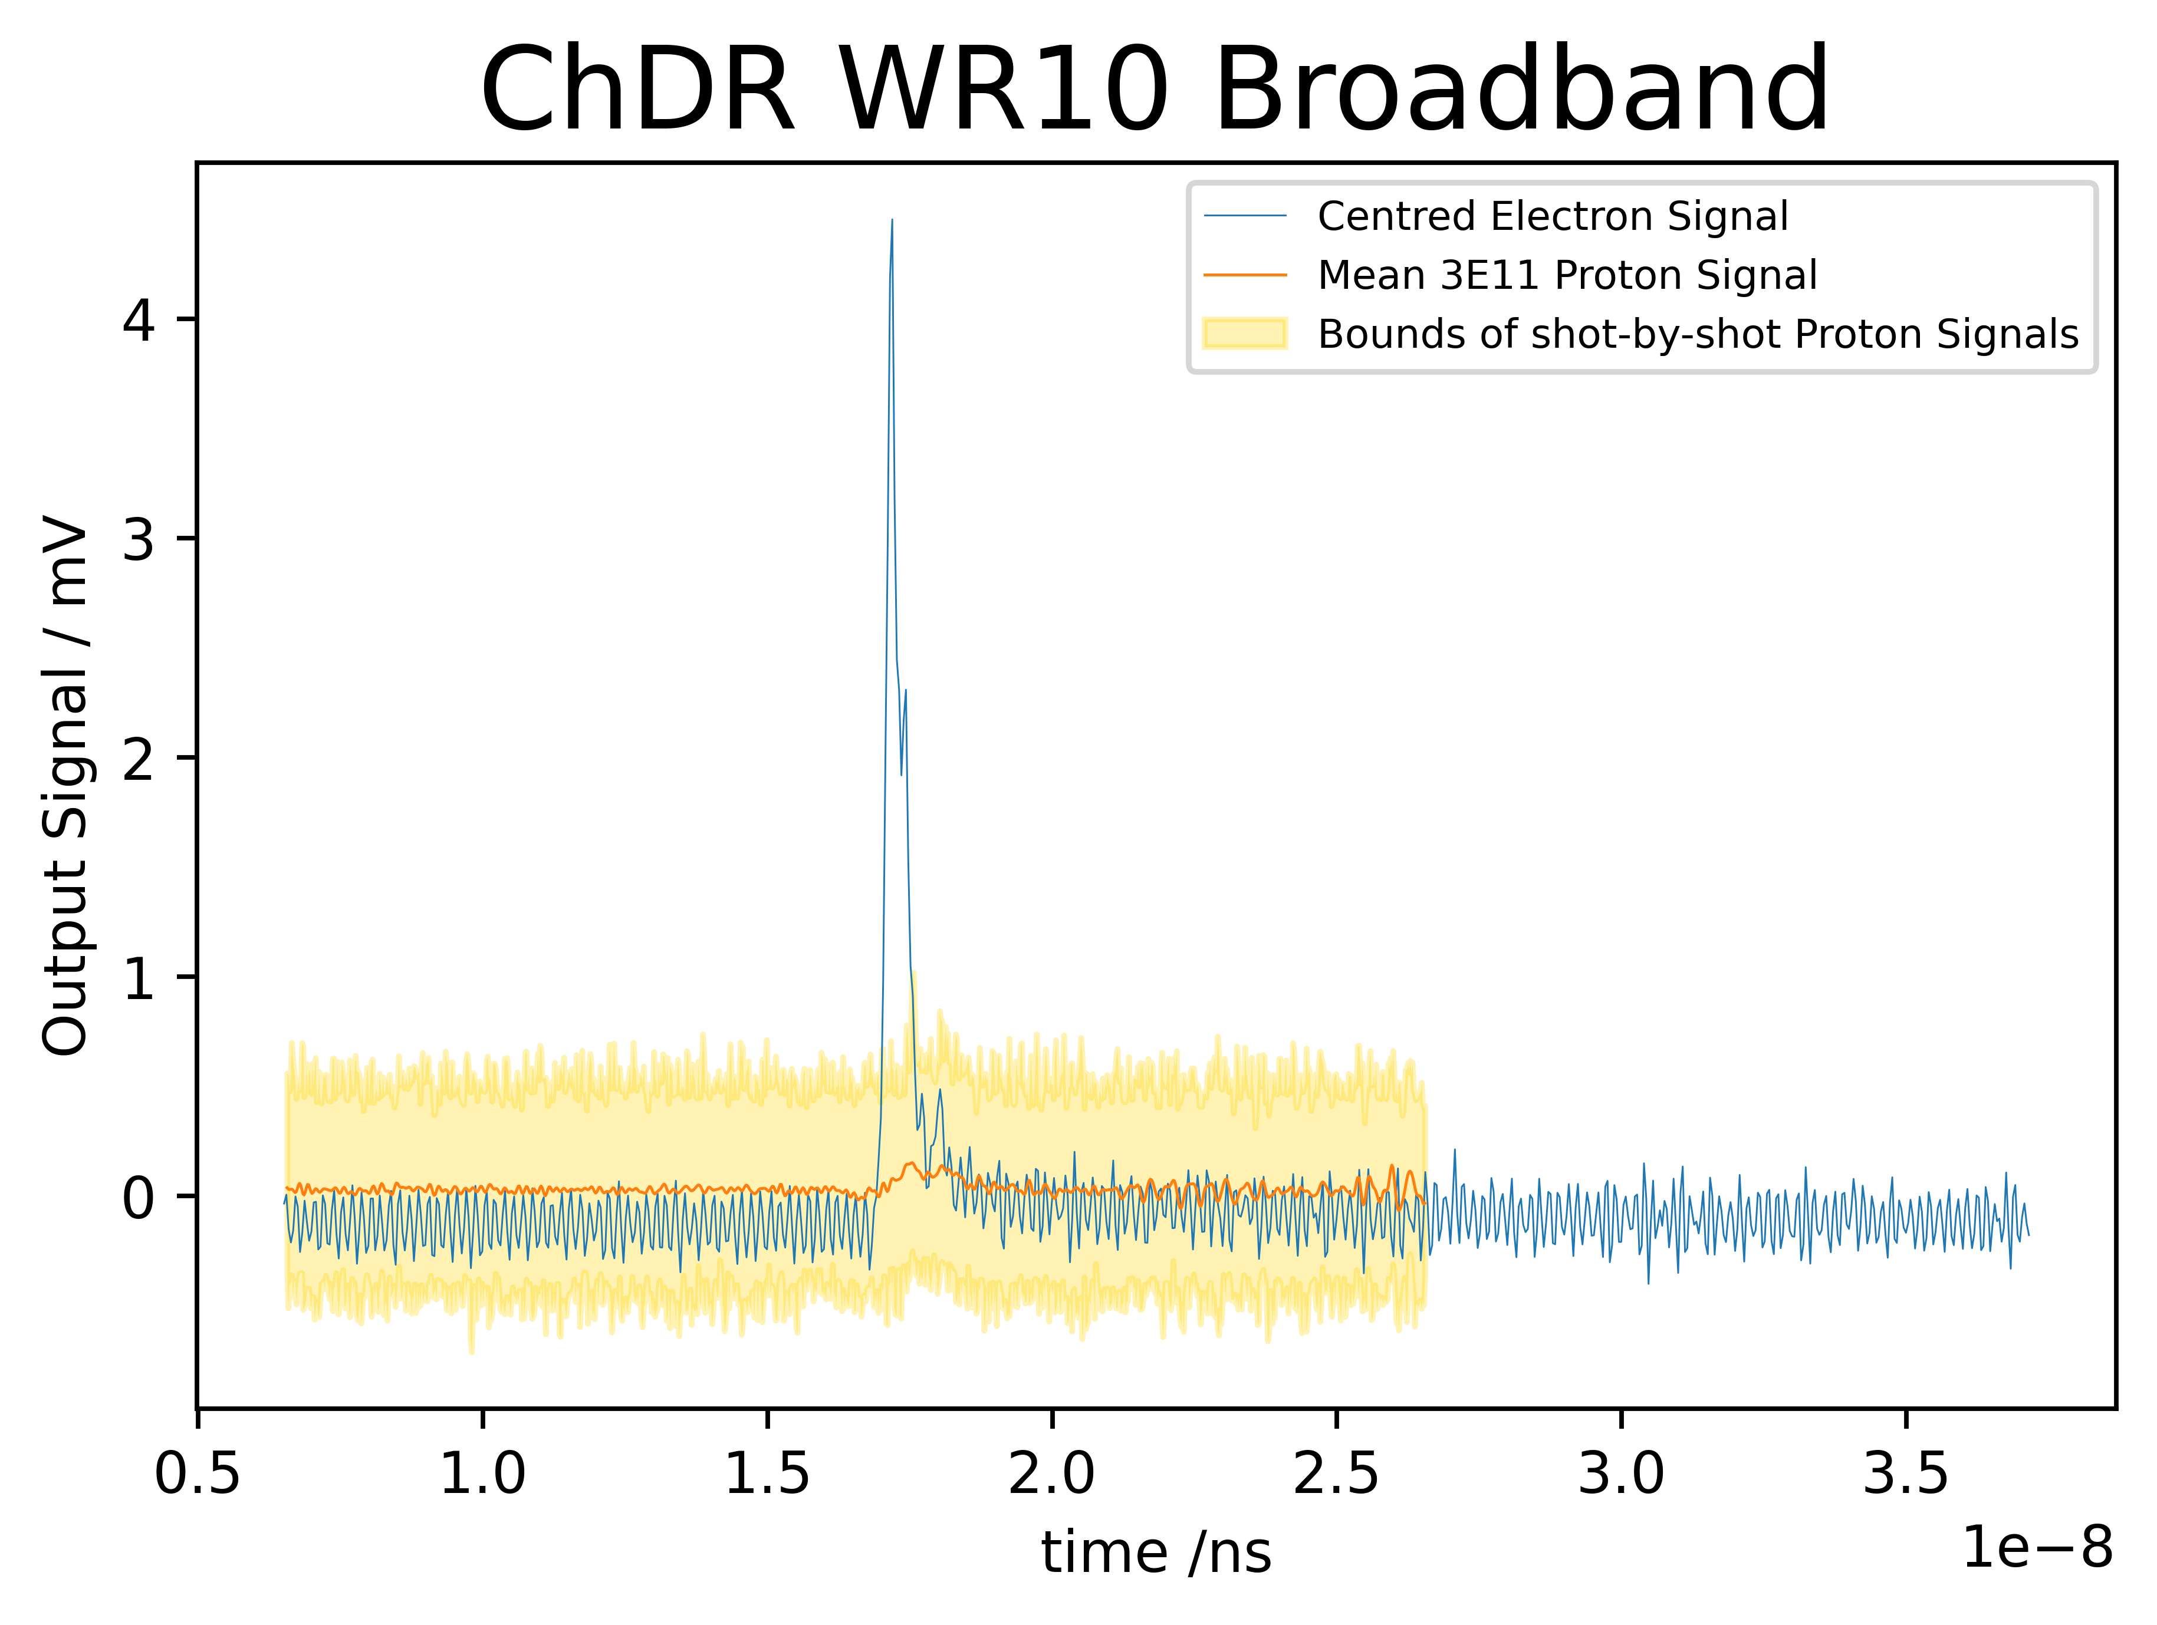
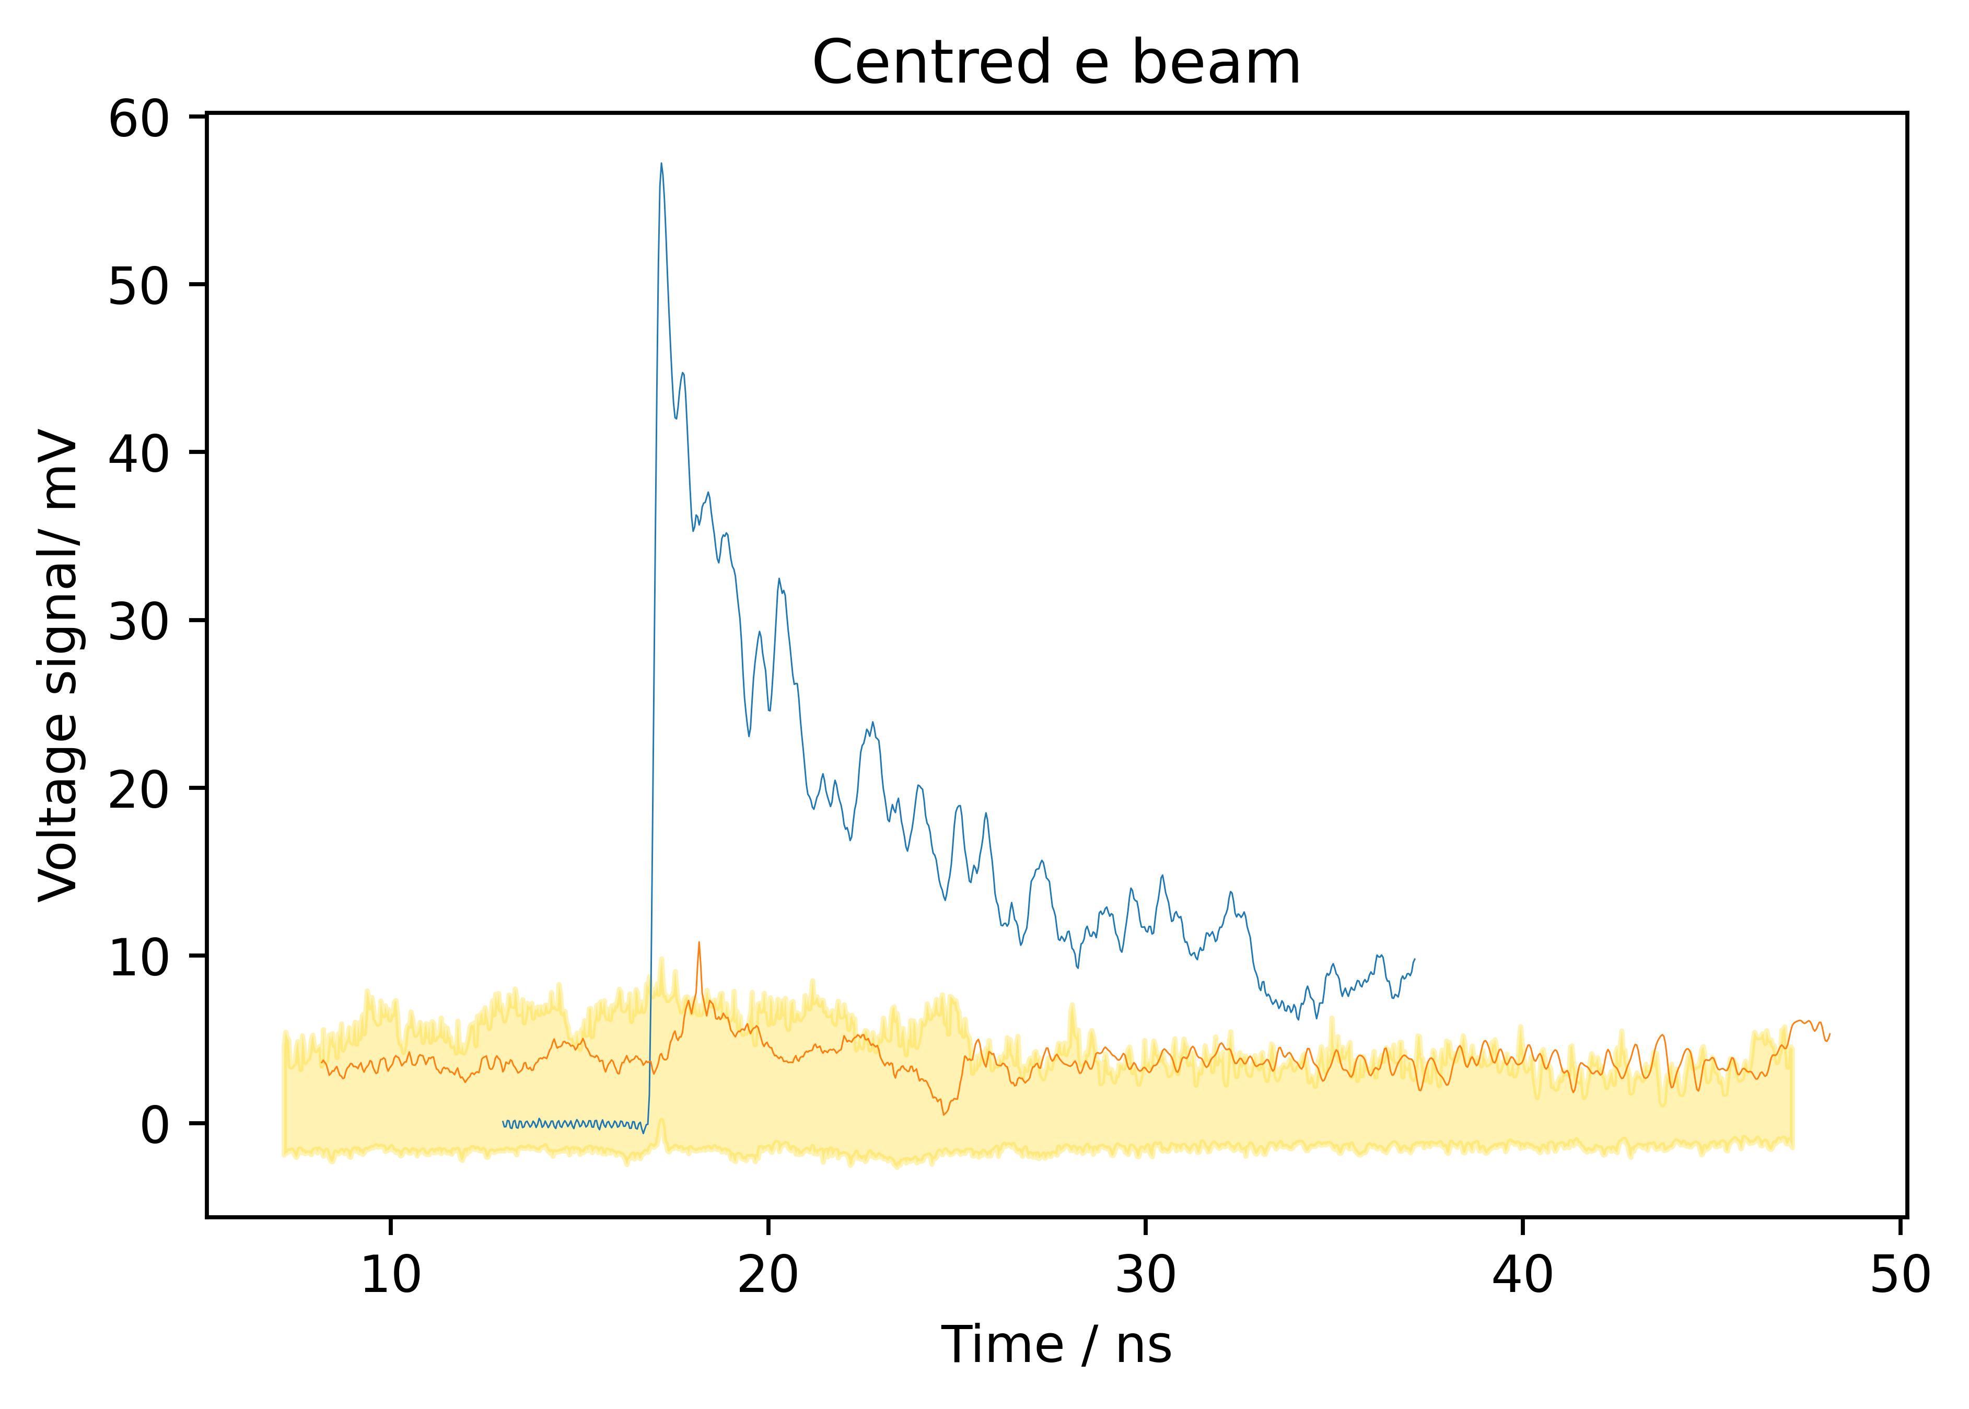
Procedure for electron Beam tests
Proton Studies
Up to 70% of 300pC electron signal
Up to 3% of 300pC electron signal
Up to 15% of 300pC electron signal

Slide 7
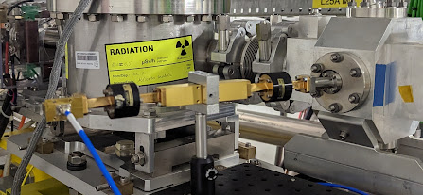
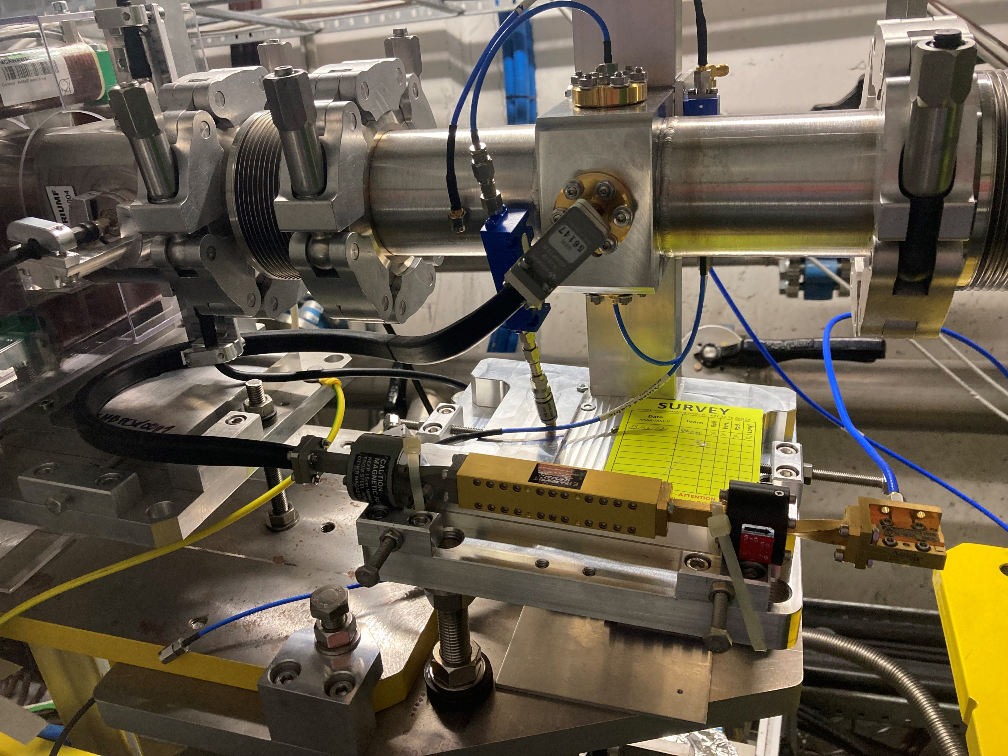
Proton and Electron Studies
The Ka-Band read-out arms are identical and pass a frequency range ~20...32 GHz, given by the low-pass filter and the WR28 dimensions. At the end there is a Ka-Band diode detector.
The ChDR radiator is connected through a quarter wavelength -transformer to the WR28 read-out arm, the HF-button utilizes a R281B coaxial-to-WG adapter
and a flexible WR28 waveguide.
Single arm read-out only

Slide 8
Proton and Electron Studies
Only the horizontal planes of the 2 BPMs under investigation
Quadrupoles 45,47 turned off
Correctors 47,49 turned off
Steering the beam on MCAWA412345 in the horizontal plane
ChDR
BPM
Plasma
cell
HF BPM

Slide 9
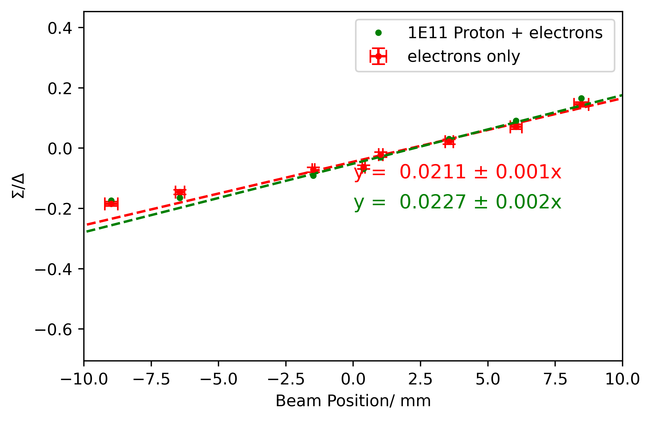
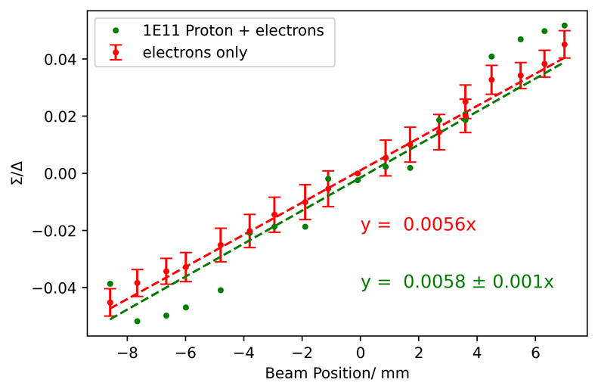
Electron Position scan with Low Intensity Protons
ChDR BPM
HF BPM
Sensitivity is consistent between electrons, and Protons + electrons over ~ 10mm at 1e11 bunch intensities

Slide 10
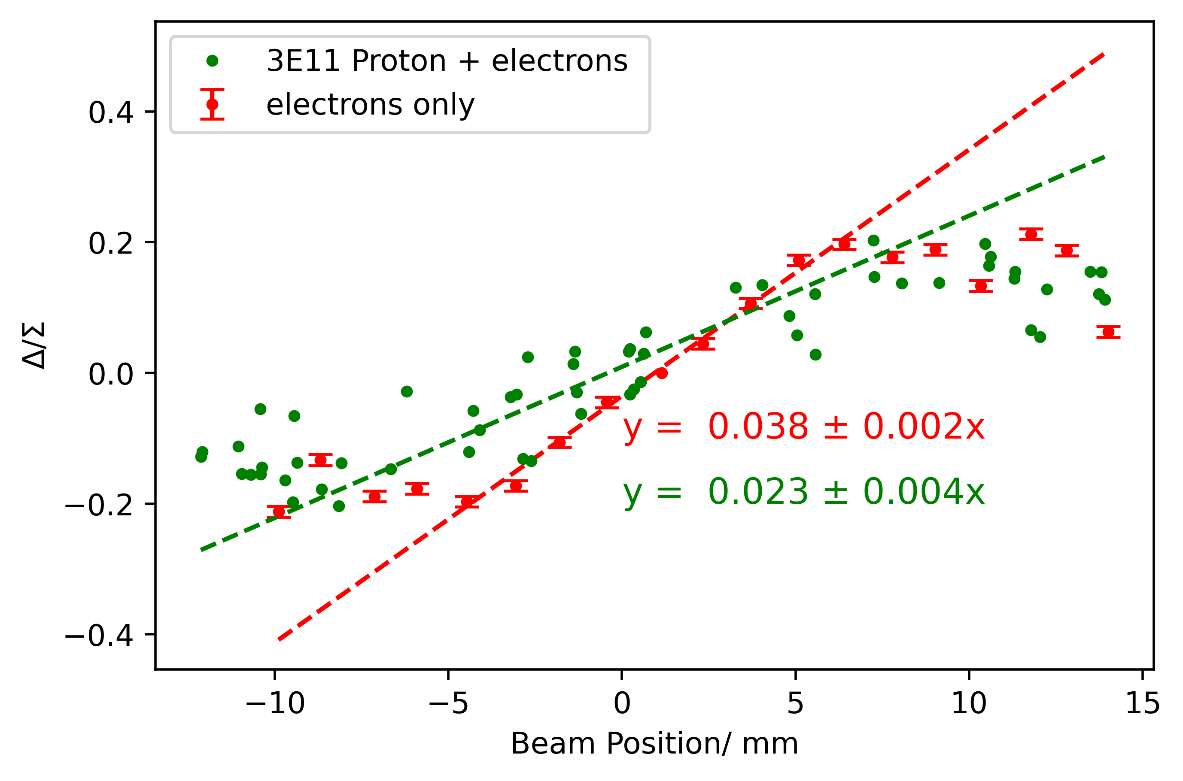
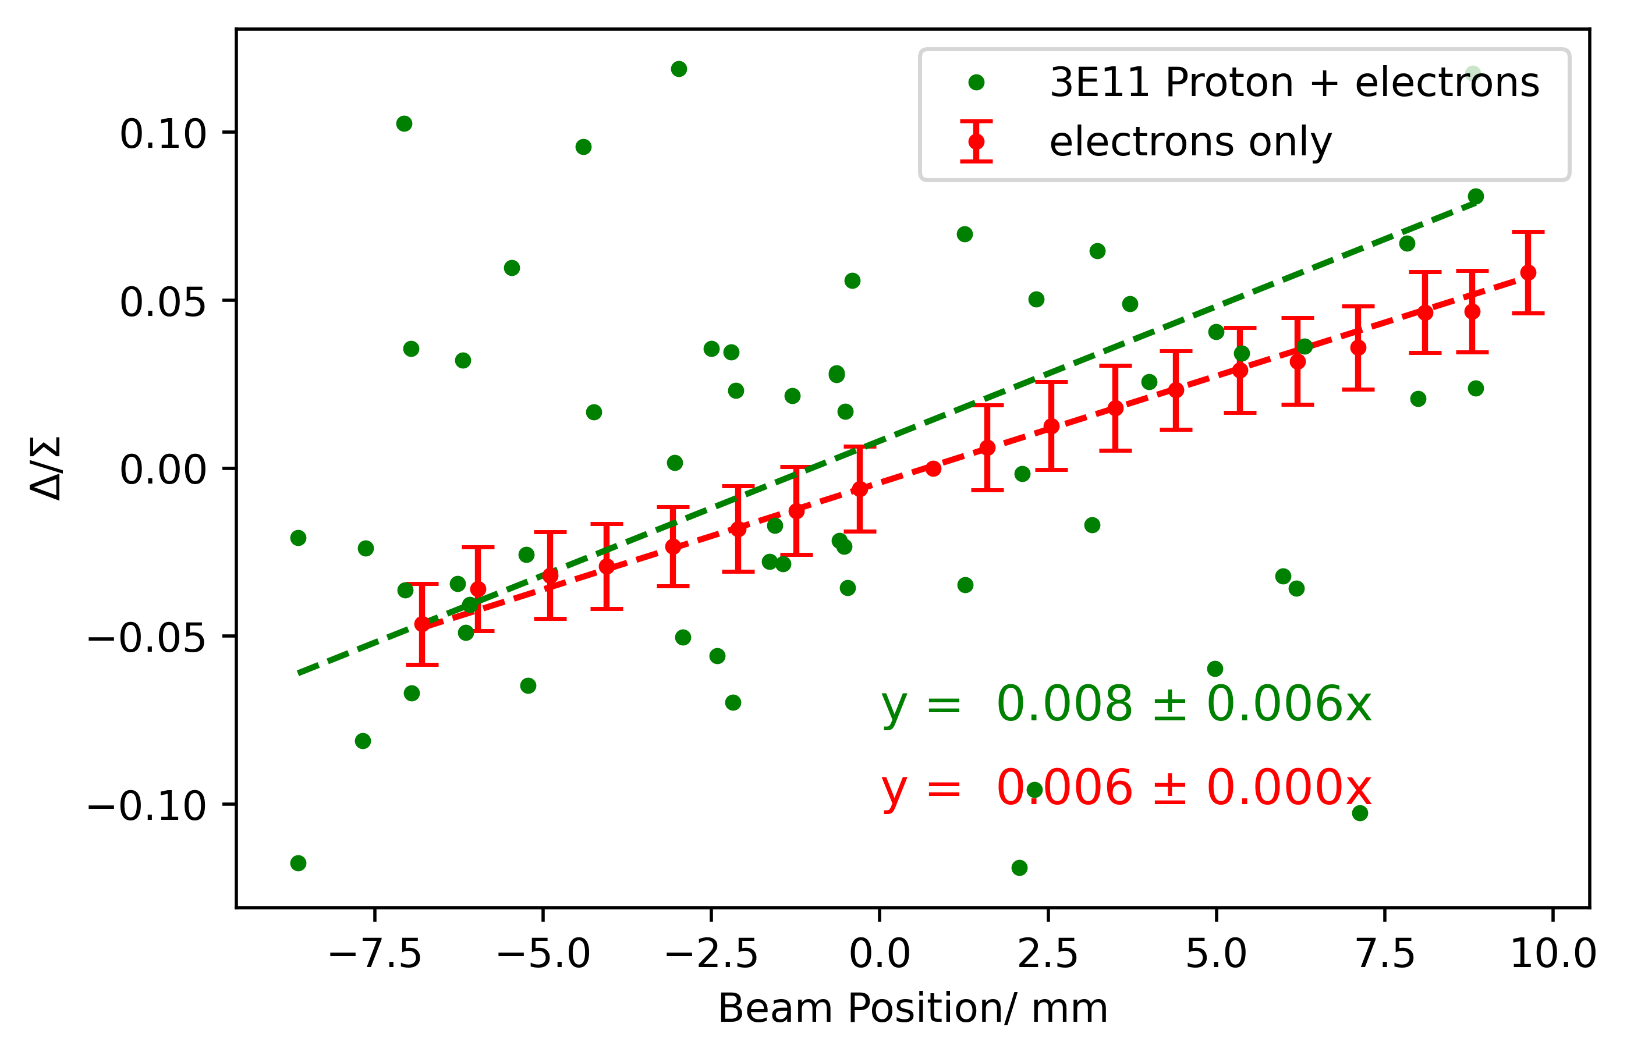
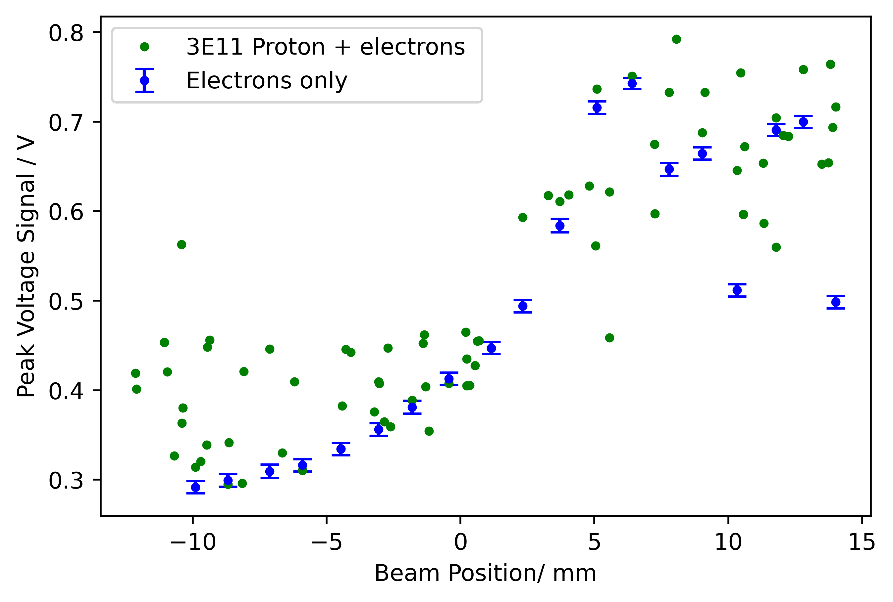
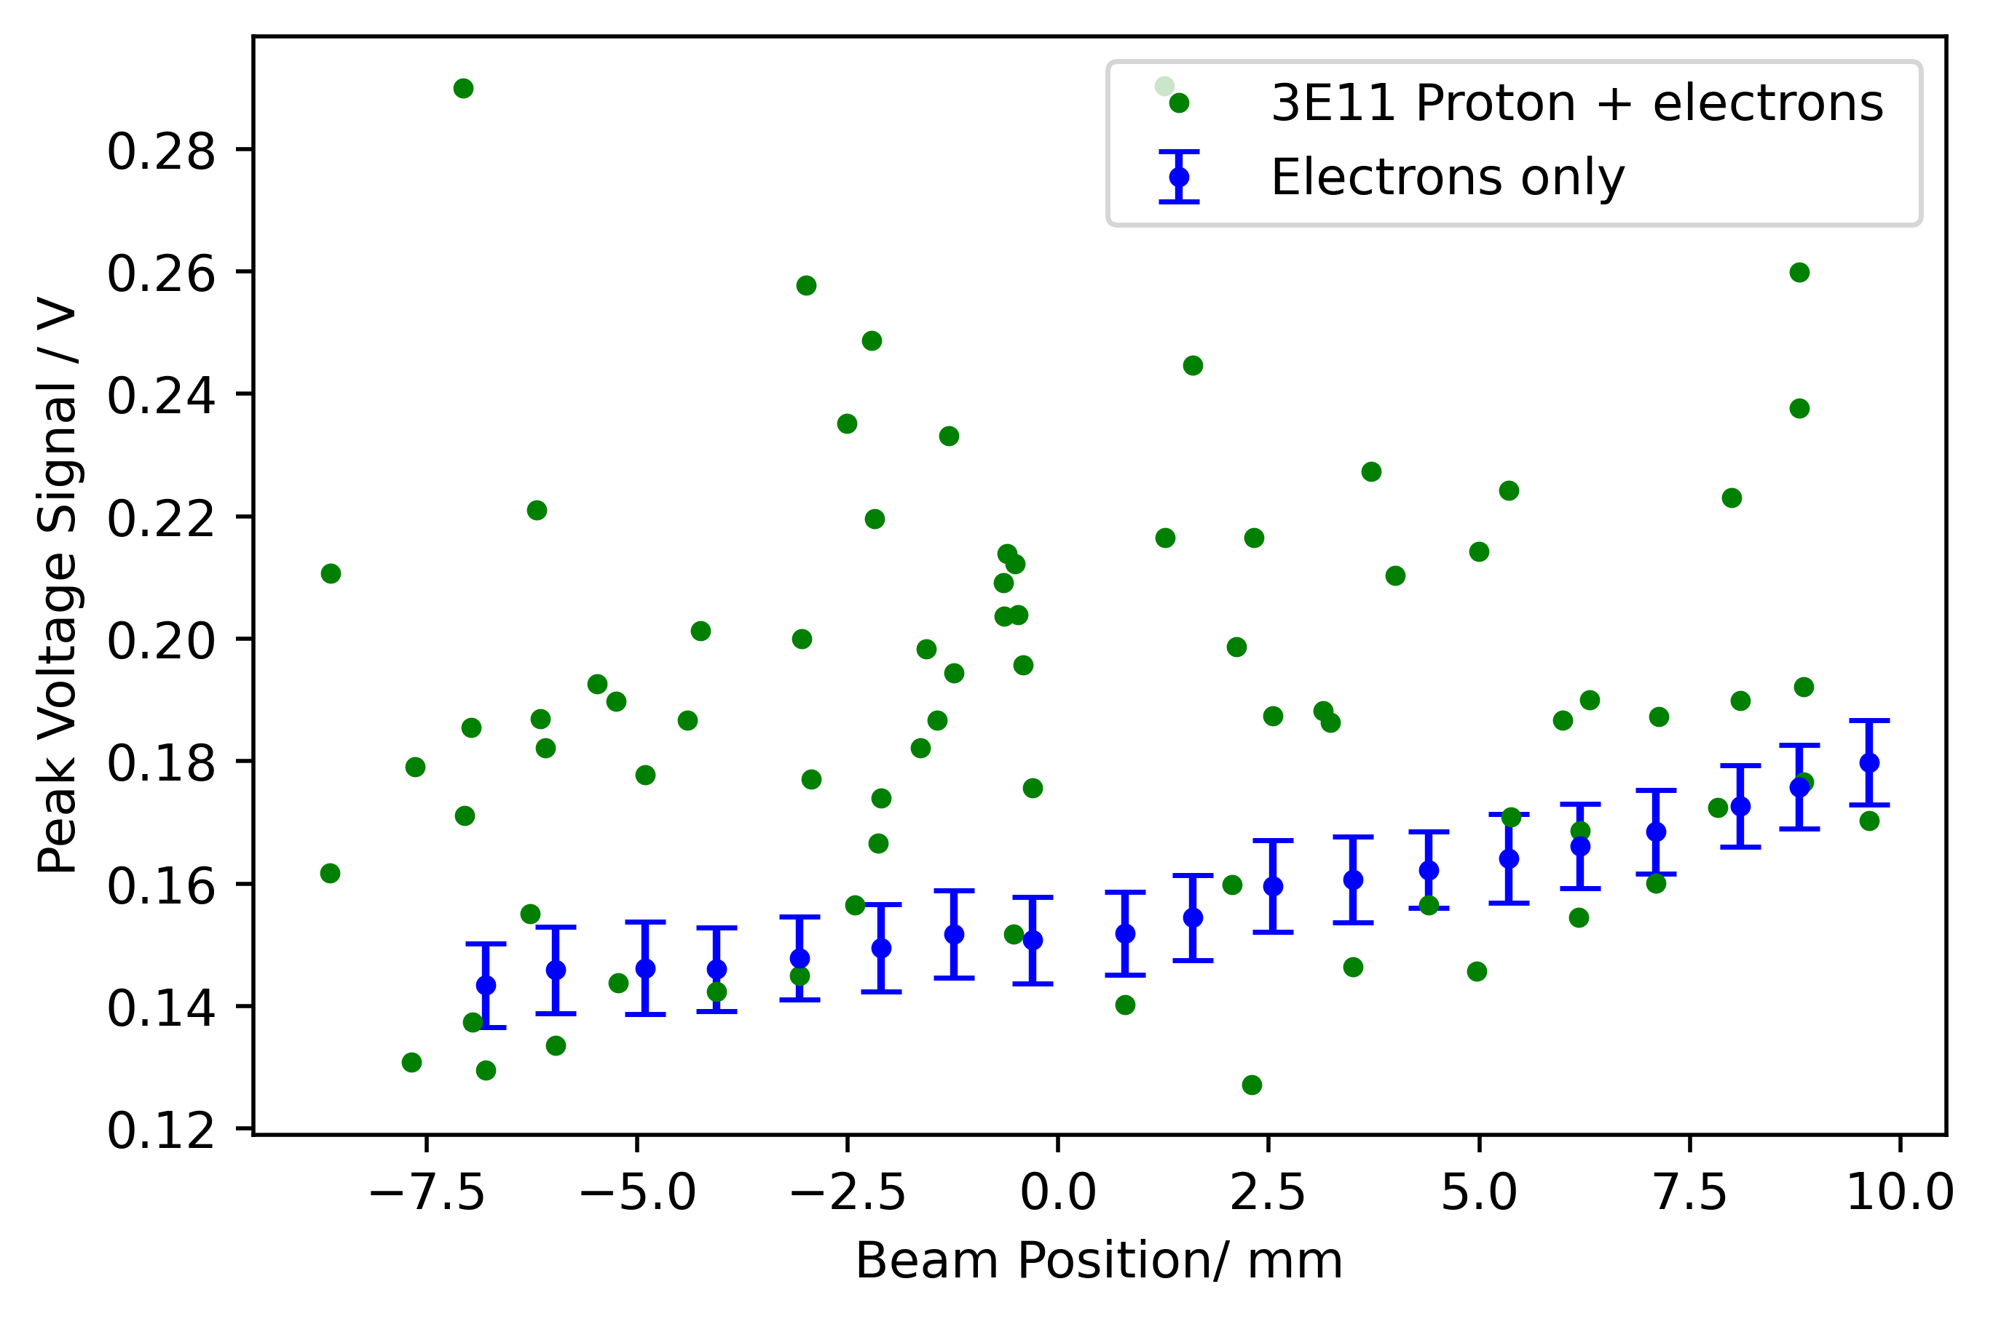
Electron Position scan with High Intensity Protons
ChDR BPM
HF BPM
Large shot-by-shot variation in proton signal
Position sensitivity has deteriorated at high proton bunch intensities

Slide 11
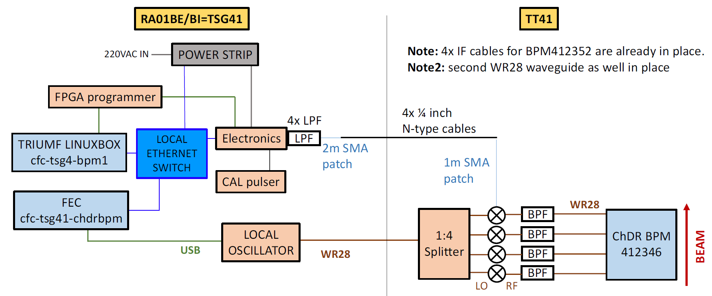
TRIUMF commissioning + installation
Current Status
First TRIUMF installation in 2022
Minimal beam tests completed, no further investigation until October 2023
Digitiser characterised and commissioned with help from TRIUMF personnel
BPF @ 30.5GHz w/ BW = 1GHz
Installation and connection of additional digitizer and LO from TRIUMF on 28 September
Calibration of WGs, mixers, in-line filters and cables with CW source on 5 October
Calibration/commissioning of new digitizer less trivial – black box, requires some time to understand the system and get it operational/publishing data on FESA
LO running at 28GHz

Slide 12
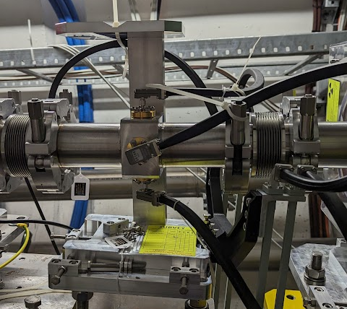
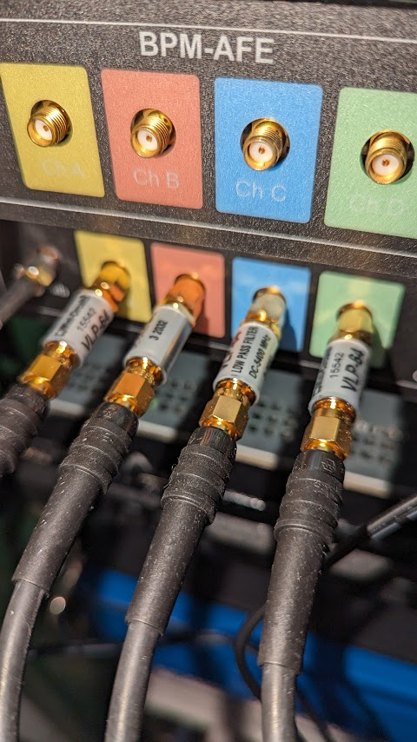
TRIUMF configuration
The upstream ChDR BPM and HF BPM
Only the horizontal planes of the 2 BPMs under investigation were connected to the original TRIUMF digitiser
HF BPM
ChDR BPM
Plasma
cell
Beam
ChDR H+
ChDR H-
HF H+
HF H-

Slide 13
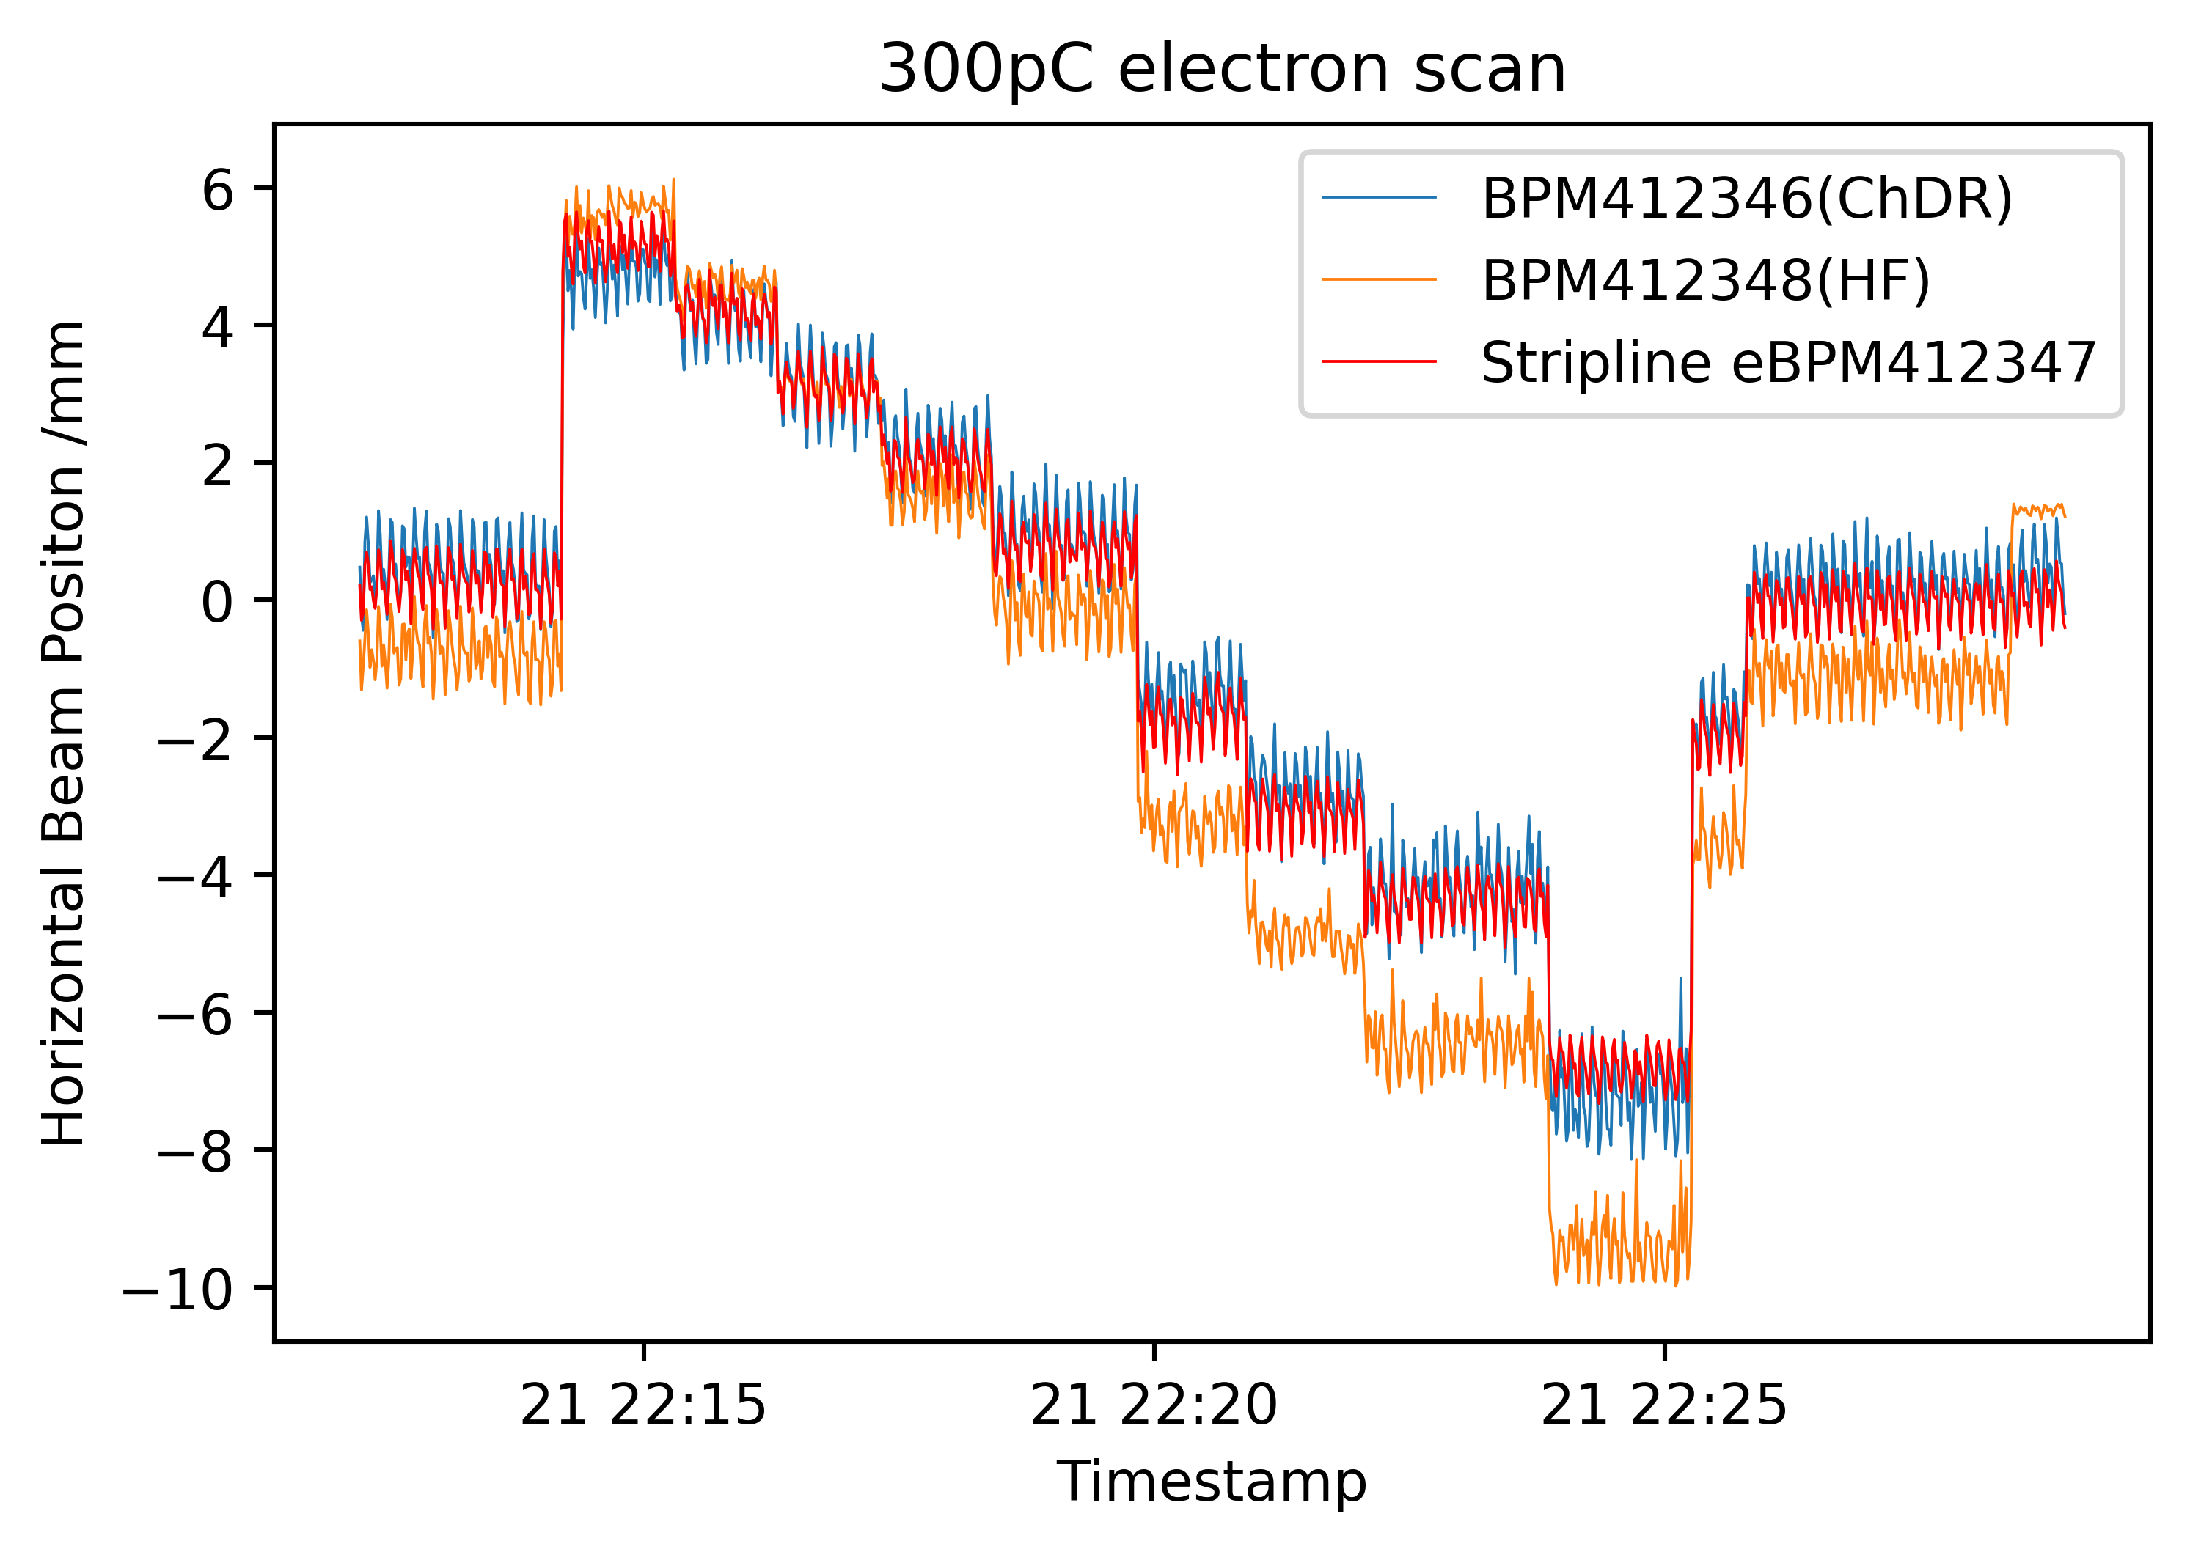
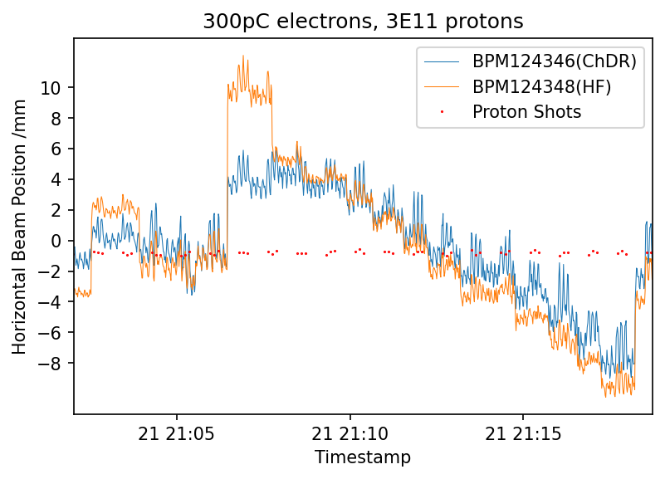
TRIUMF Scans
Nice agreement with current stripline eBPMs, but proton signal still appearing
Linear relationship of BPM positions and gradient represents their respective distances to the corrector

Slide 14
Conclusions and Future Outlook
Extensive testing of both BPM types over the course of this beam year
Electron scans show we have very good sensitivity to the beam
Proton studies indicate the spectrum of the proton bunch frequency content extends much higher than theorised
Initial Proton and Electron tests show we have very good Proton discrimination at low proton bunch intensities
Calibration of the second TRIUMF digiziter and connection of all channels of the ChDR and HF BPMs for complete horizontal and vertical position measurements
With electrons: position scans with degaussed magnets, and comparison of performance e.g. resolution between stripline, ChDR and HF BPMs
Electrons and protons: how well the ChDR BPM suppresses the proton bunch, again measurements of the resolution

