Slide 1
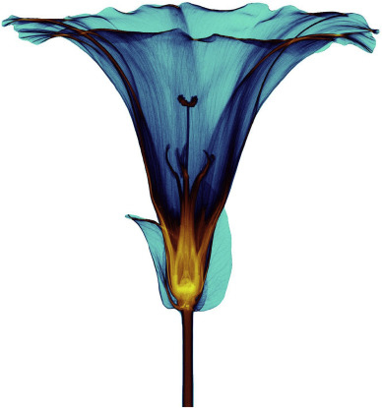
MEDIPIX
DETECTORS

Slide 2
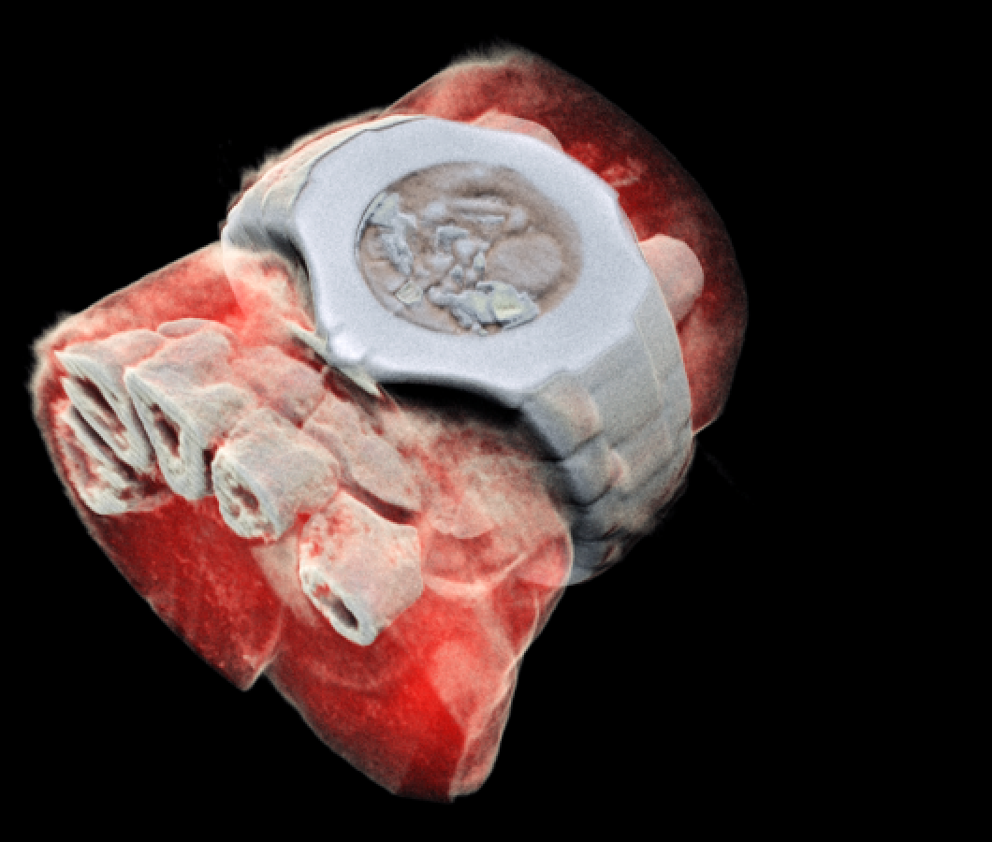
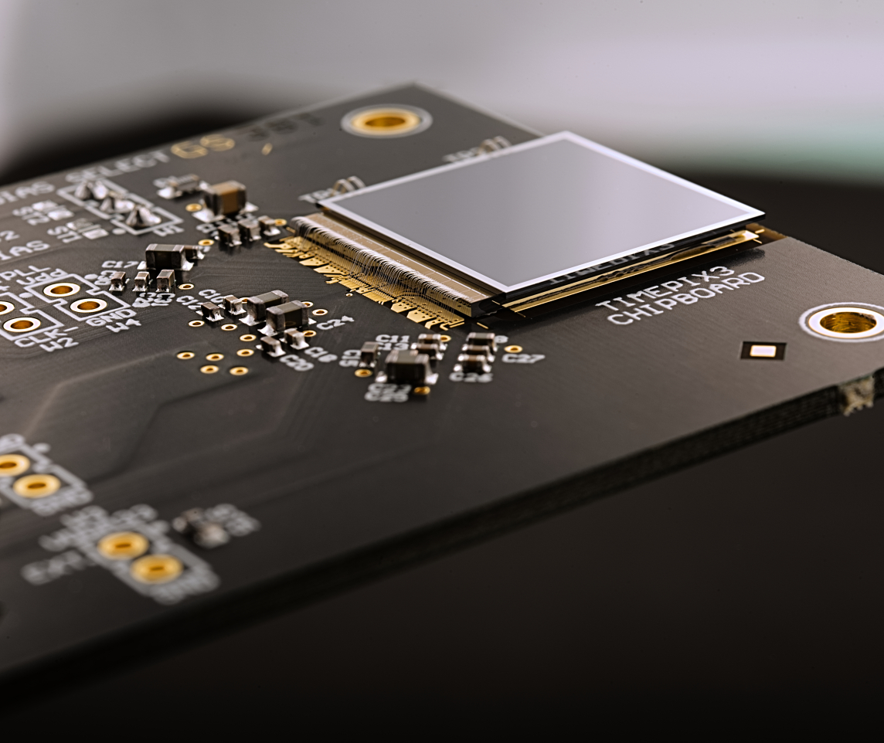
Outline
Interaction of radiation with matter
Photon counting detectors
Medical applications

Slide 3
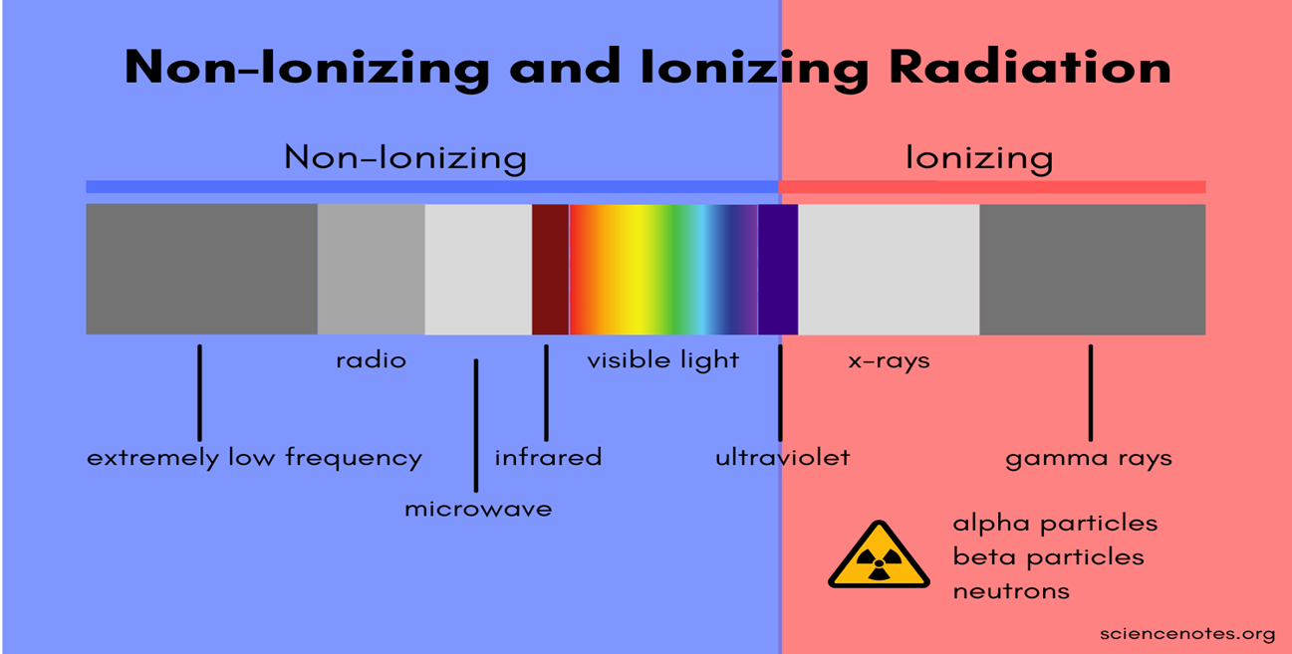
Introduction about Radiation
What is radiation?
Radiation is the emission or transmission of energy in the form of waves or particles through space or through a material medium.
Radiation is often categorized as either ionizing or non-ionizing

Slide 4
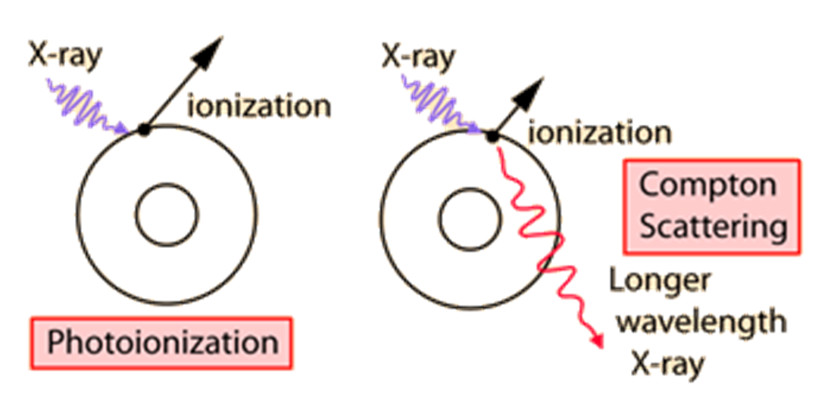
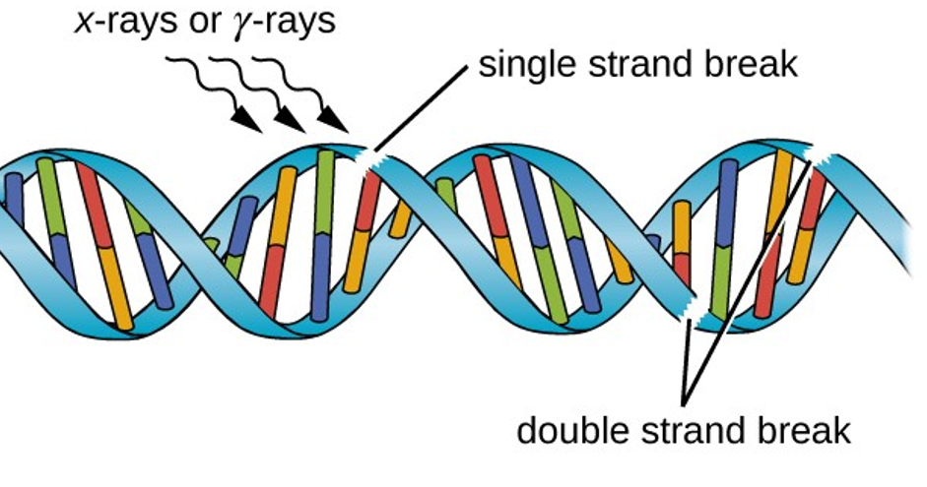
Ionization
Ionization is the ejection of one or more electrons from an atom or molecule to produce a fragment with a net positive charge (positive ion)

Slide 5
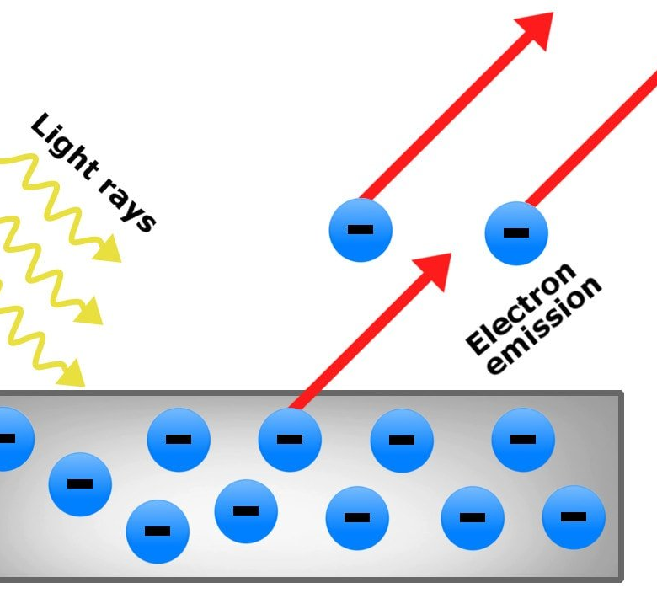
X-rays
The mechanisms of interaction for ionizing radiation in the form of x-rays and gamma-rays include the
Photoelectric effect,
Compton scattering and at high enough energies,
Electron positron pair production.

Slide 6

Photon counting detectors

Slide 7
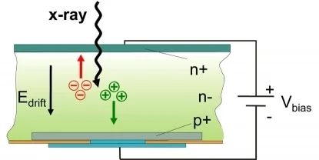
Sensor in hybrid detectors
When ionising radiation strikes the
detector its energy is deposited in the silicon layer.
This is then converted into an electrical signal and amplified.

Slide 8
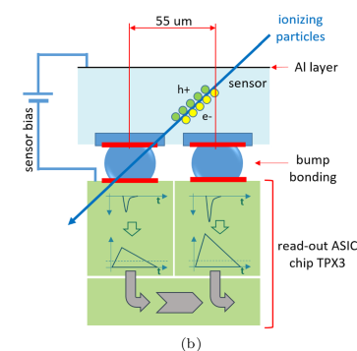
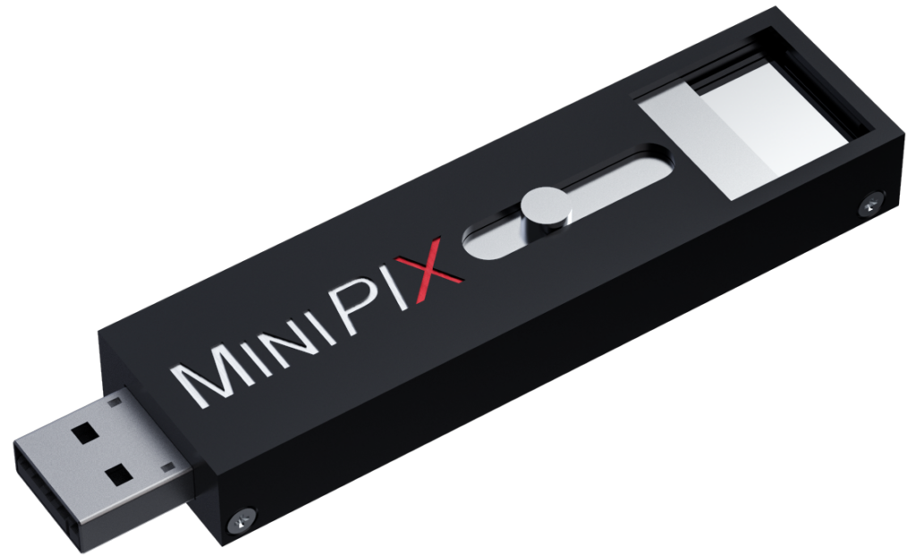
Timepix3 detector

Slide 9
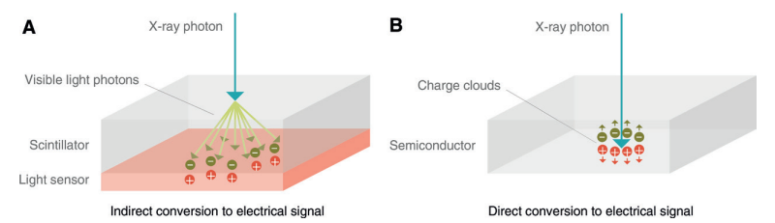
Photon counting detectors
1. Direct conversion
Conventional energy-integrating detector
Photon-counting detector
https://doi.org/10.1148/radiol.2018172656

Slide 10
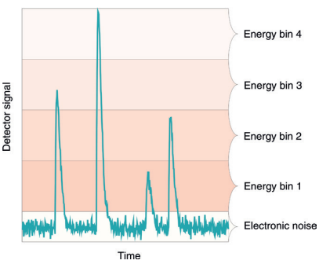
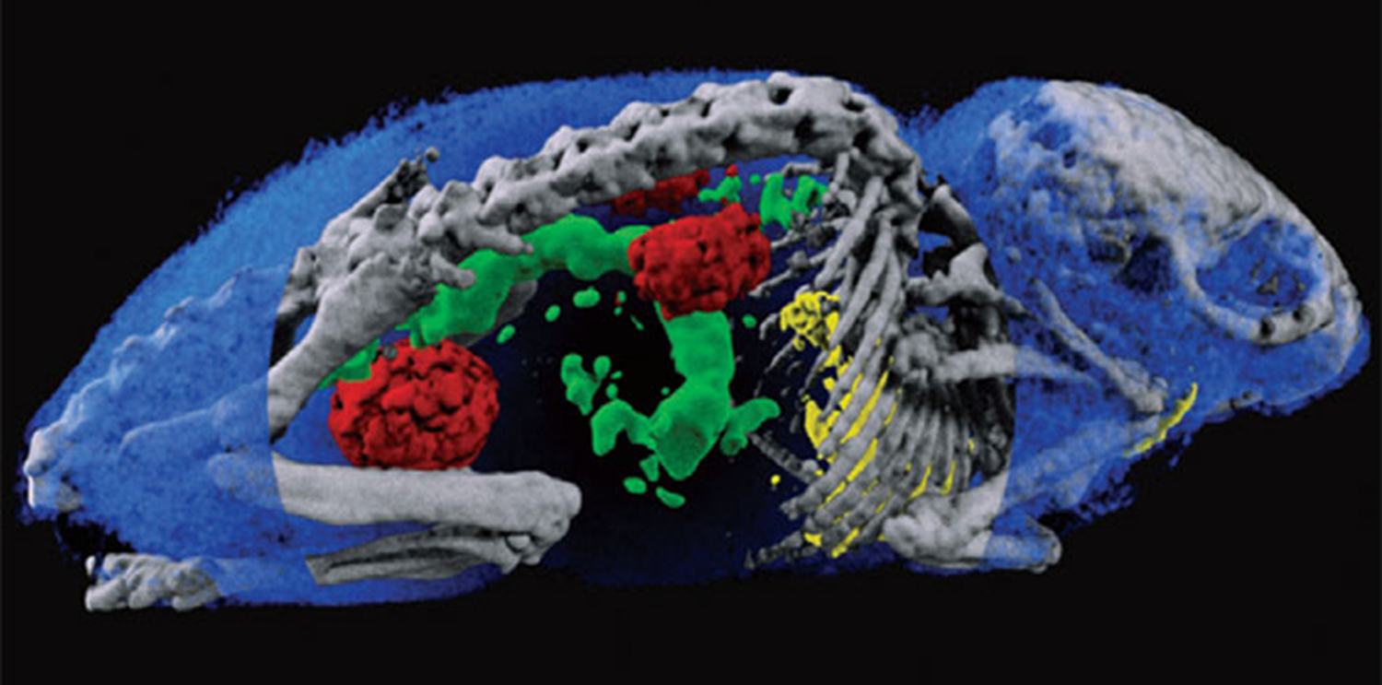
2. Elimination of electronic noise
The PCD is able to discriminate the energy of each incident x-ray photon.

Slide 11
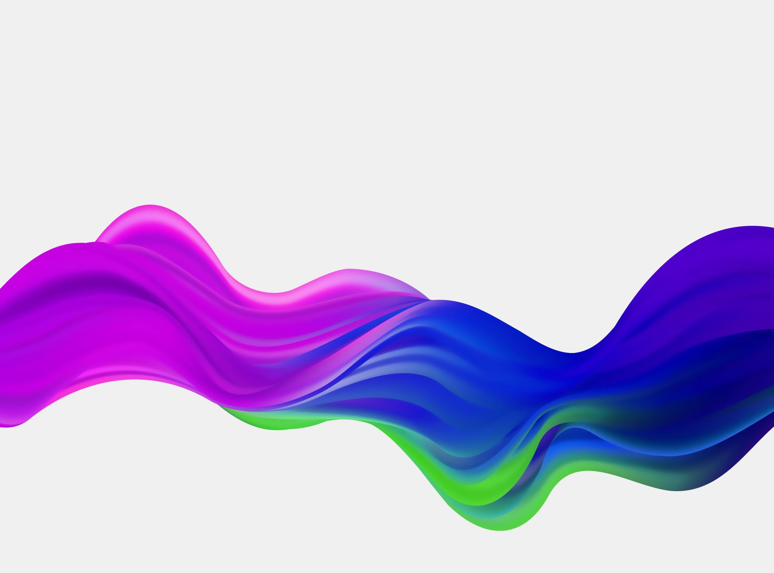
Medical applications

Slide 12
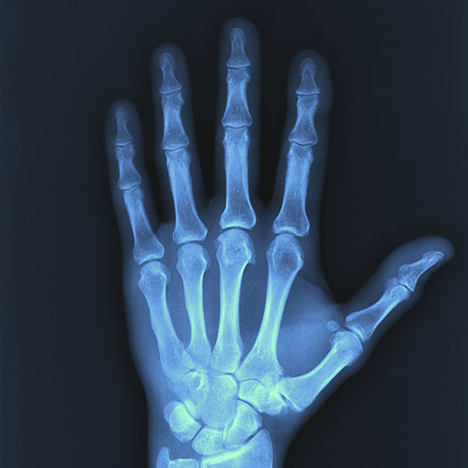
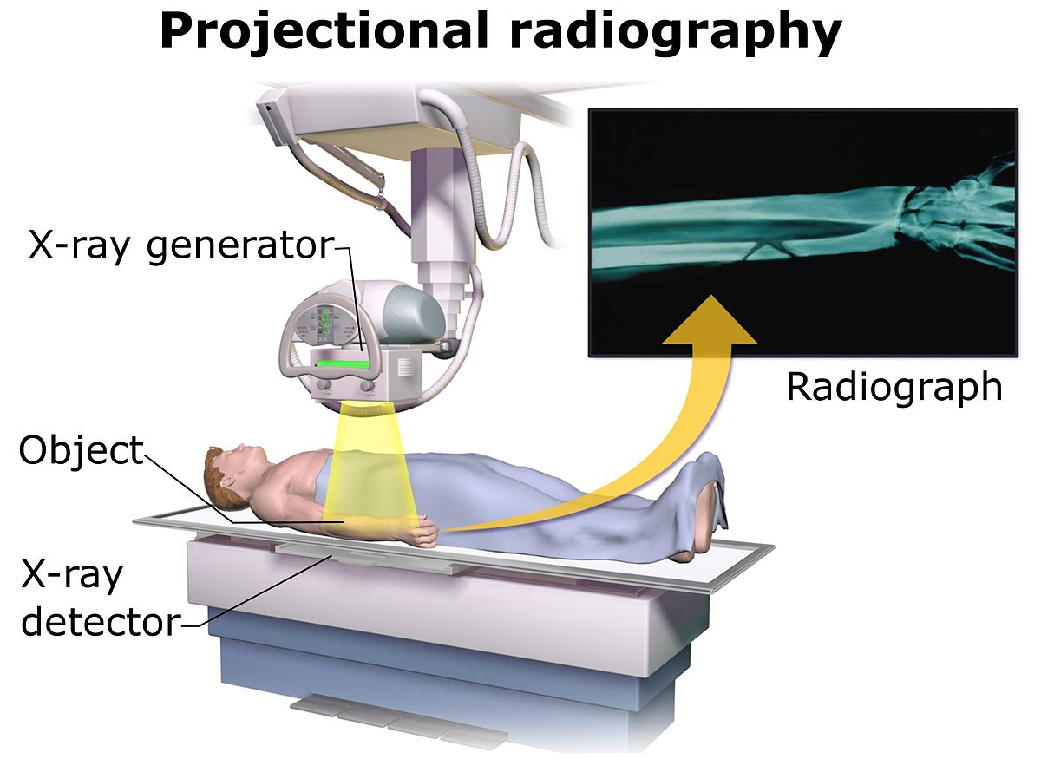
Conventional X-ray imaging

Slide 13
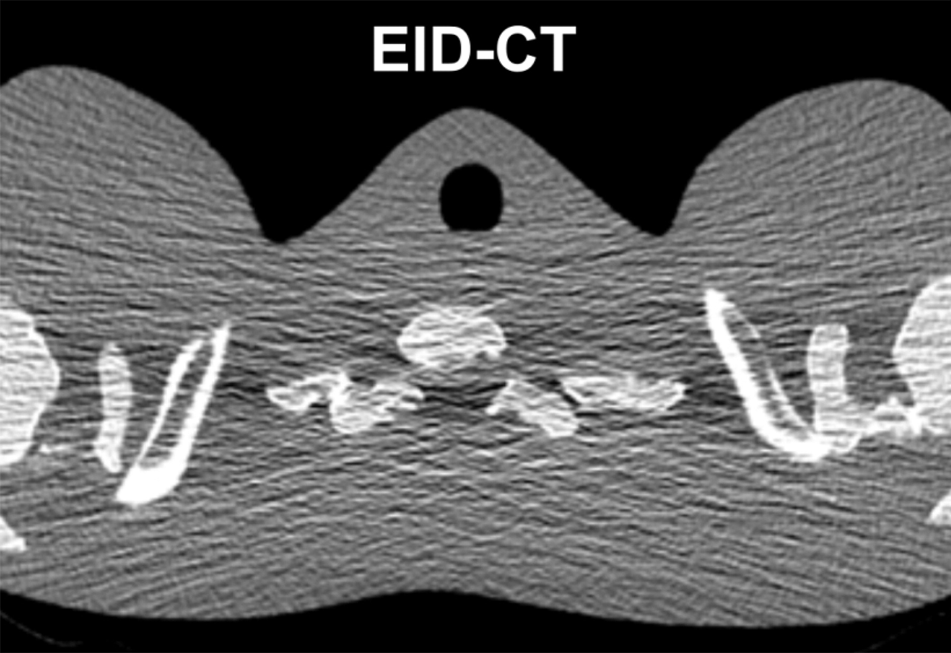
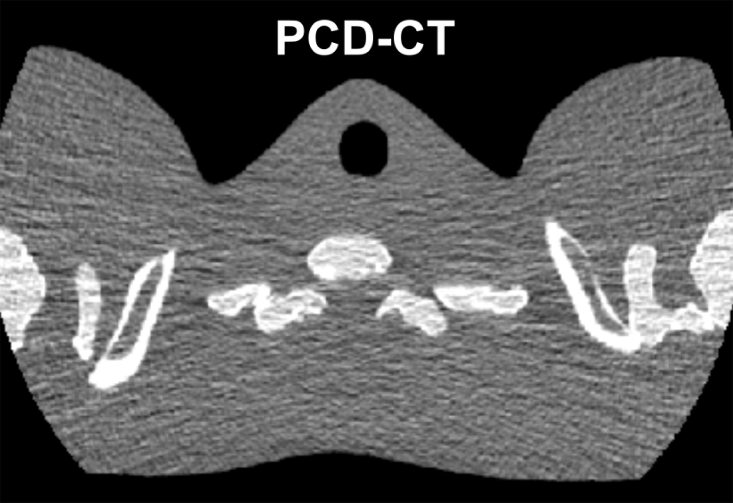
Medical applications: CT
The shoulder section of a thorax phantom reconstructed from data acquired with EID CT (a) and with PCD CT (b) using the same x-ray tube potential and radiation dose

Slide 14
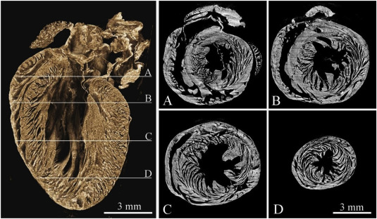
Tomographic reconstruction of a mouse heart

Slide 15
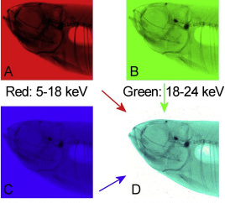
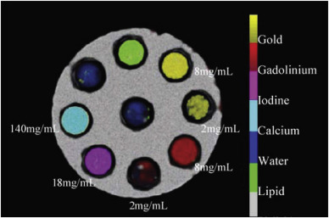
Coloured X-ray imaging using the head of a small fish
Notes:
The swim bladder is white as the air around the fish because the photons of all energy ranges are almost not absorbed here. The low energy photons are not able to penetrate the tissue and the remaining photons of the medium and high energy range appear cyan colored. The bones are blue-black colored because only the high energy photons are able to penetrate them

Slide 16
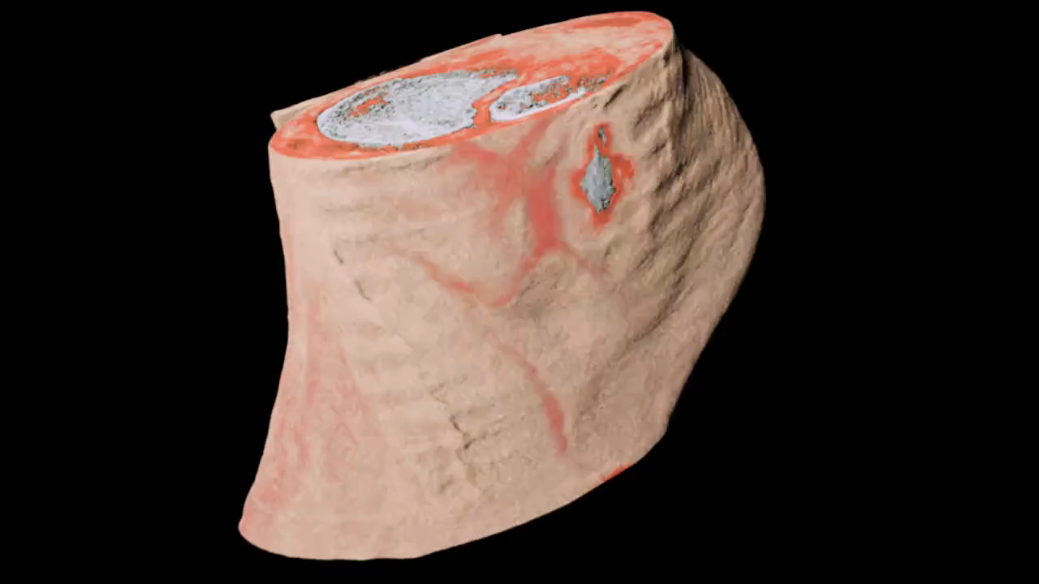
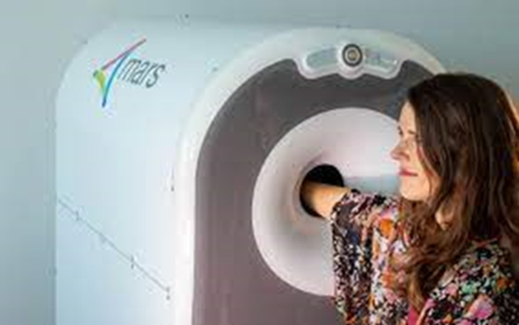
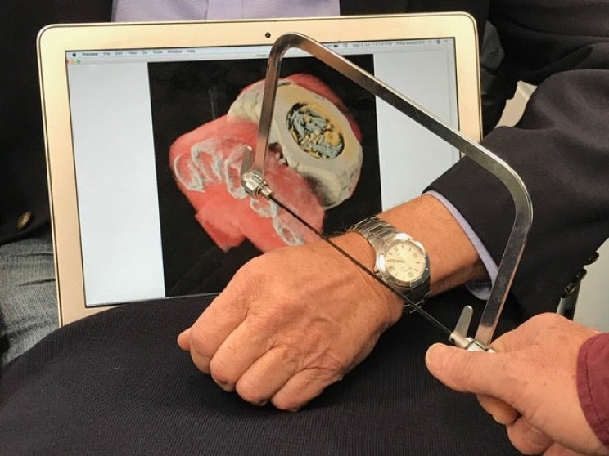
Spectroscopic X-ray imaging
Notes:
MARS Bioimaging’s 3D colour X-ray wrist scanner is awaiting approval to start clinical trials at Lausanne University Hospital (CHUV, Switzerland) and is the subject of ongoing clinical trials within the Pacific Radiology Group, New Zealand's largest radiology service provider. CERN and the New Zealand company MARS Bioimaging teamed up in 2008 to develop this 3D colour X-ray scanner based on the Medipix3 technology.
The X-ray beams used in medical equipment contain a wide spectrum of X-ray energies, which can be thought of as different X-ray colours. In conventional detectors, the image taken is based on the total X-ray energy absorbed by each pixel, forming a kind of black and white image. When spectroscopic detectors are used, the images also contain the “colours” of the incoming X-rays, providing better, clearer images at optimised doses with significant benefits when diagnosing disease. In some circumstances, MRI (magnetic resonance imaging) may even become superfluous. In other cases, where metal contrast agents attached to bio-markers are injected into the body, expensive PET–CT (positron emission tomography – computed tomography) scans, may be avoided.

Slide 17
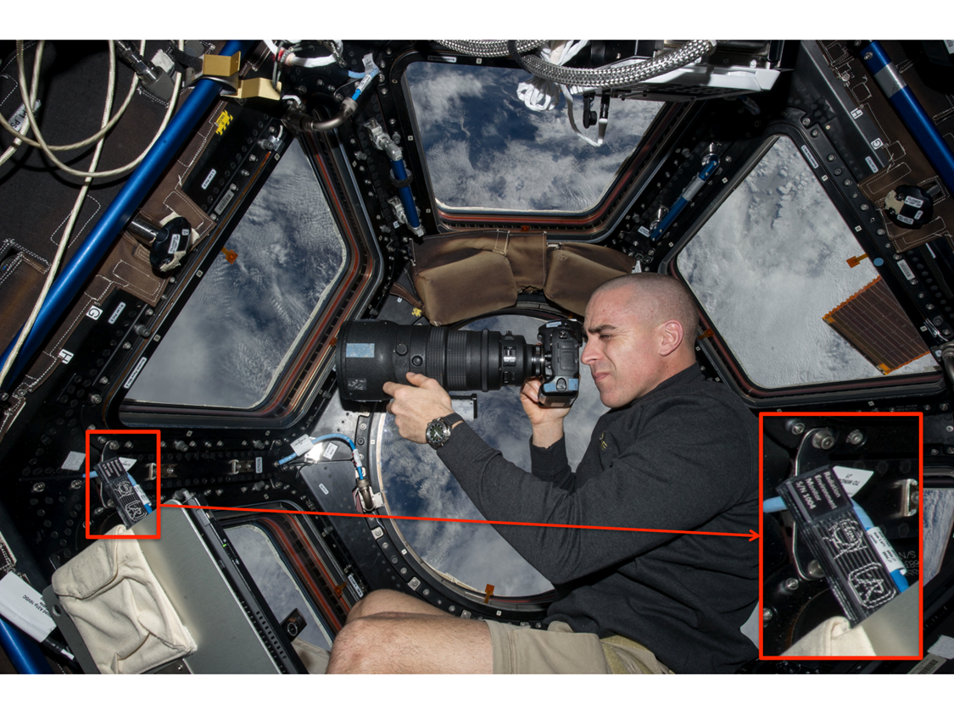
Application in Space Dosimetry
Timepix is being exploited for radiation monitoring in NASA’s Orion rocket and at the International Space Station
Image of the astronaut Chris Cassidy working near the Timepix USB on the International Space Station (Courtesy of NASA, photo ref. no. iss036e006175)

Slide 18
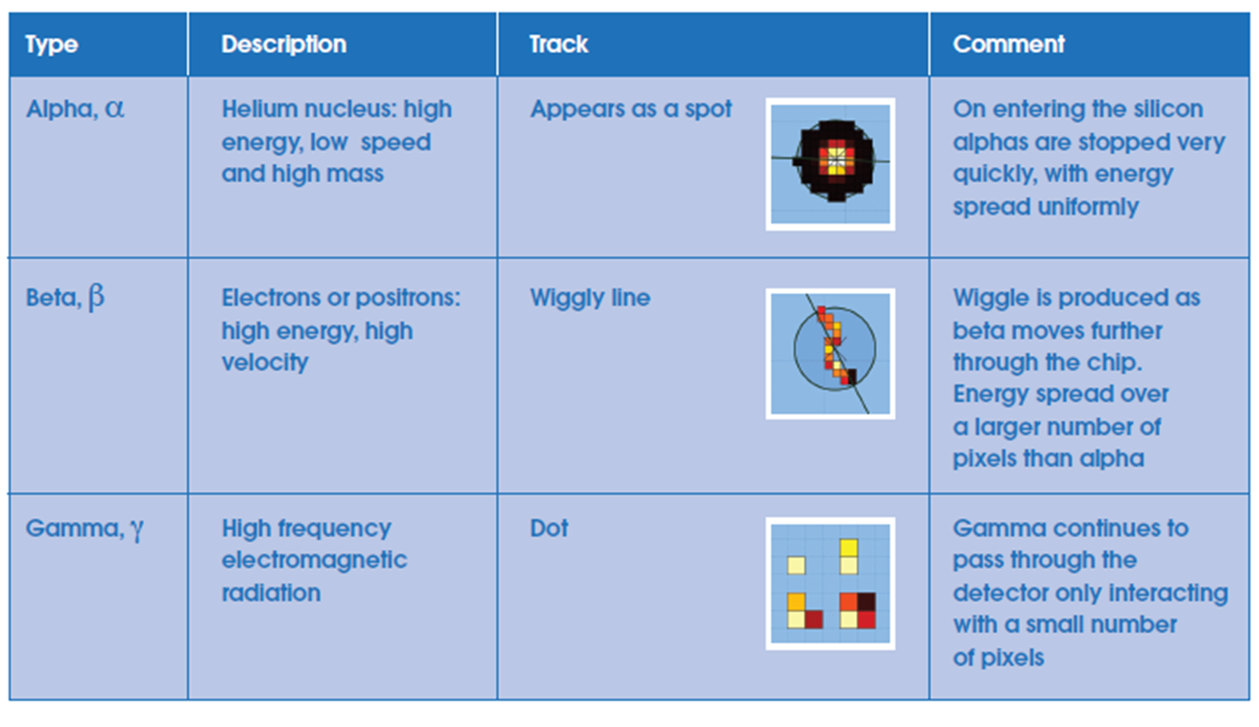
Application: school projects Particle identification

Slide 19
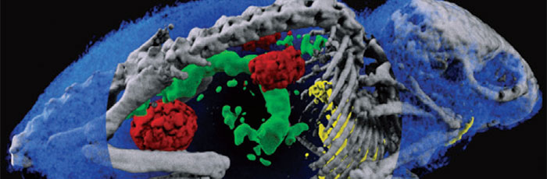
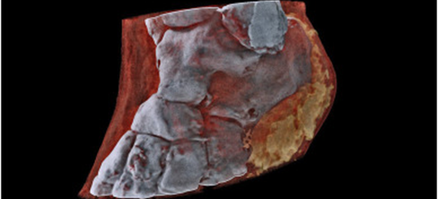
Thank you

Slide 20
Extra slides

Slide 21
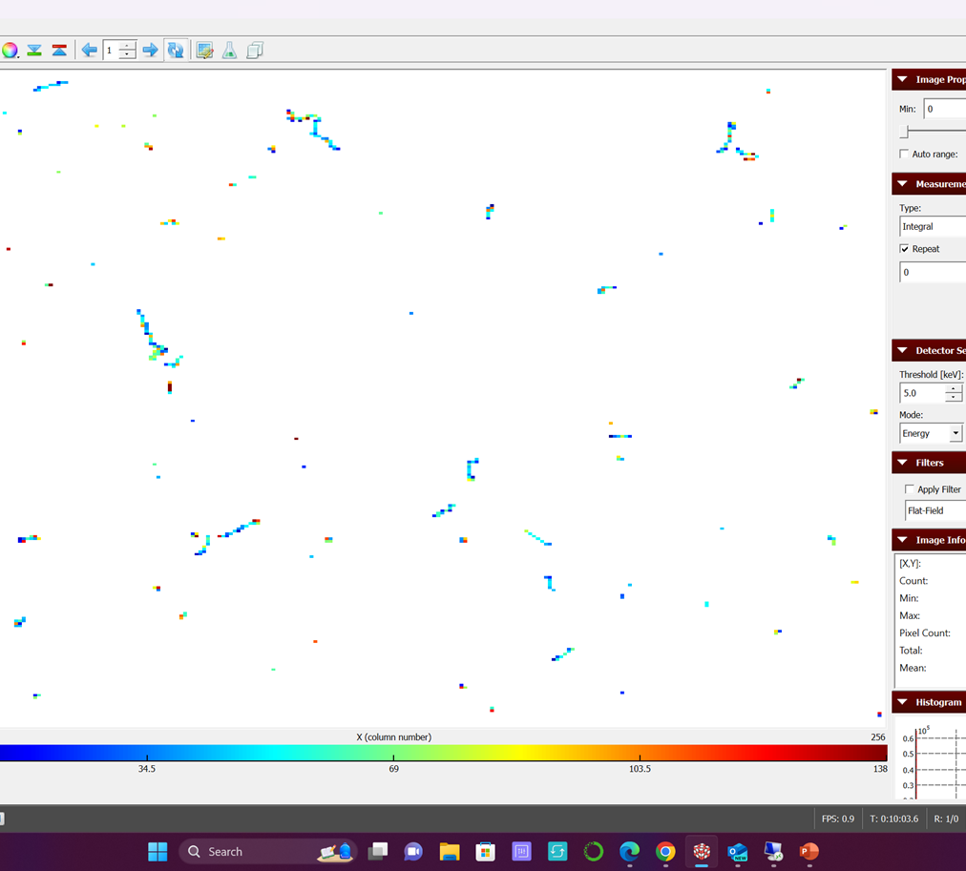
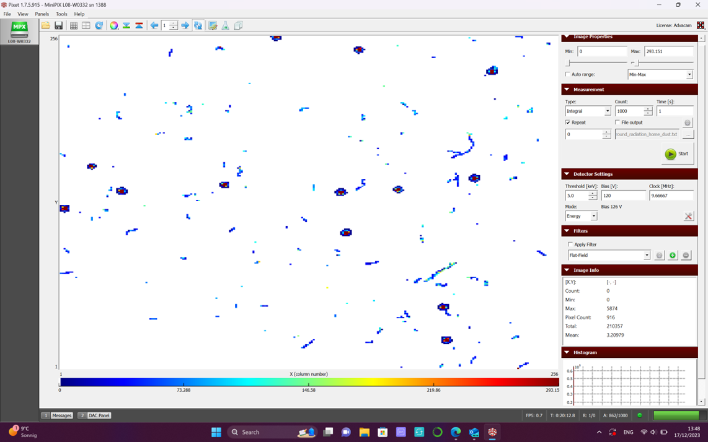
Comparison of background radiation

