Slide 1


Particle therapy masterclass
Therapy planing of *Here* (here type the organ eg. Head and neck, liver, prostate)
*here* (here type which institution)
*here* (here type your name)

Slide 2
Table of content
TG-119 (test case)
Liver
COMPARAISON PHOTON vs PROTON THERAPY TG-119
COMPARISON PROTON vs CARBON ION THERAPY Tg-119
COMPARAISON PHOTON vs PROTON THERAPY Liver
COMPARAISON PHOTON vs CARBON ION THERAPY Liver

Slide 3
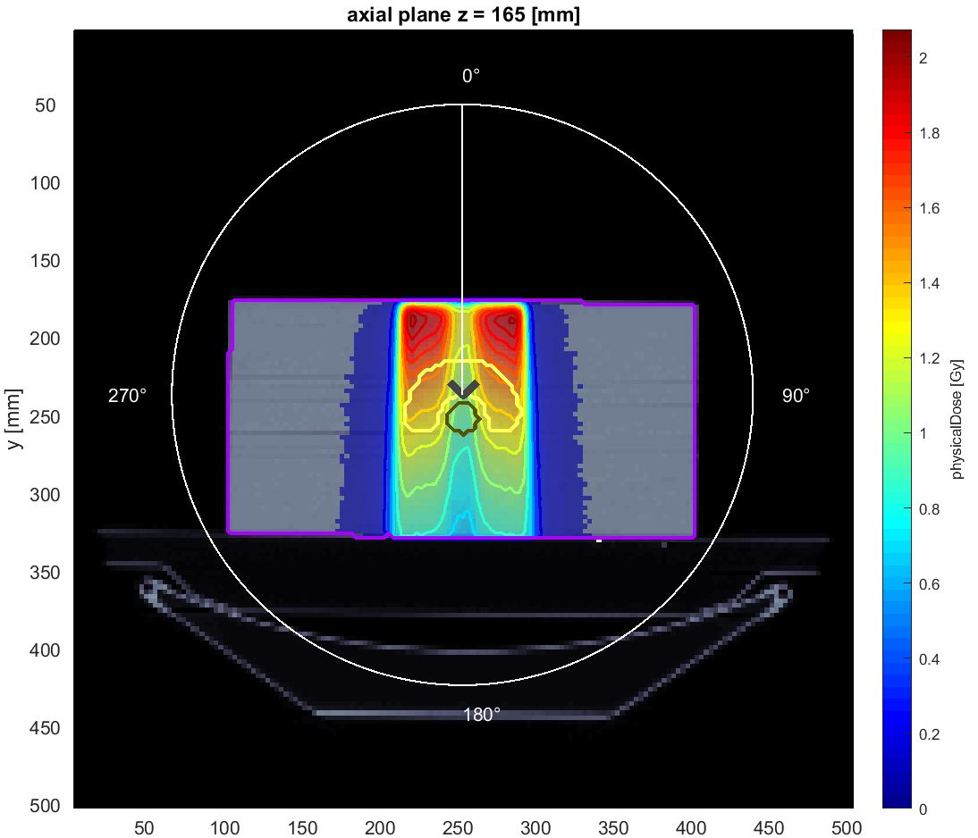
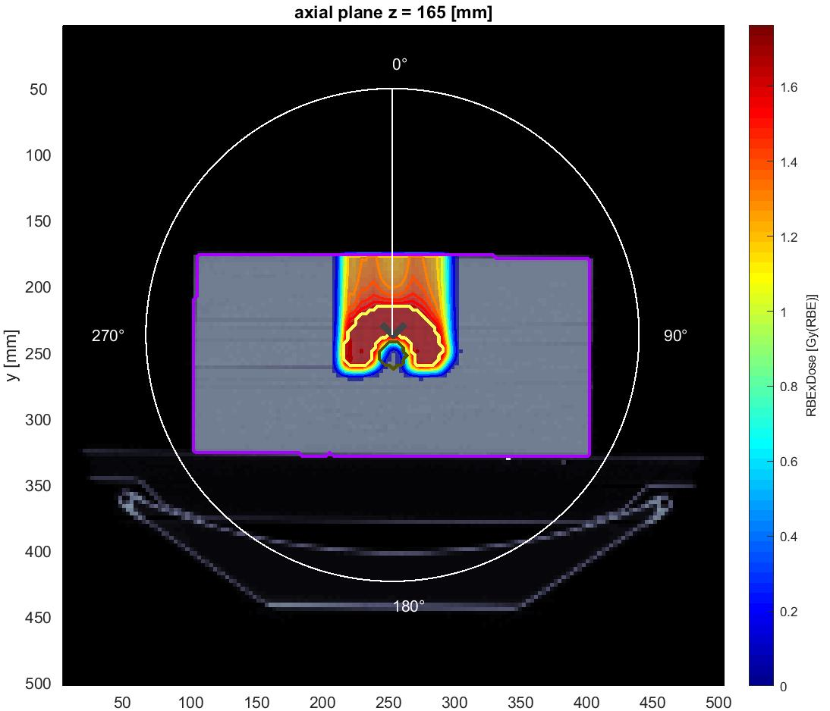
Comparaison Photon vs proton
Cas TG-119
Photon therapy
Proton therapy
Here write a short summary of the picture bellow
Here write a short summary of the picture bellow
Insert the CT picture for photon therapy of the given organ
Insert the CT picture for proton therapy of the given organ

Slide 4
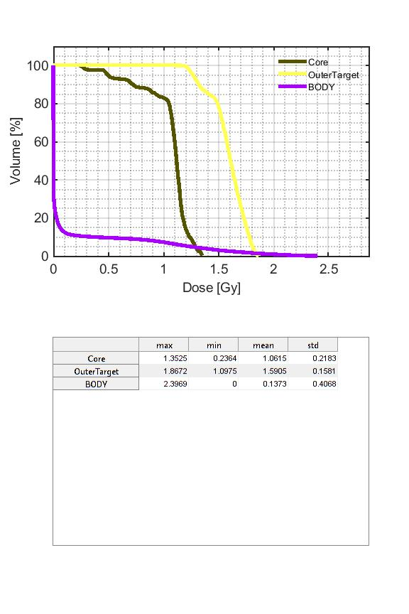
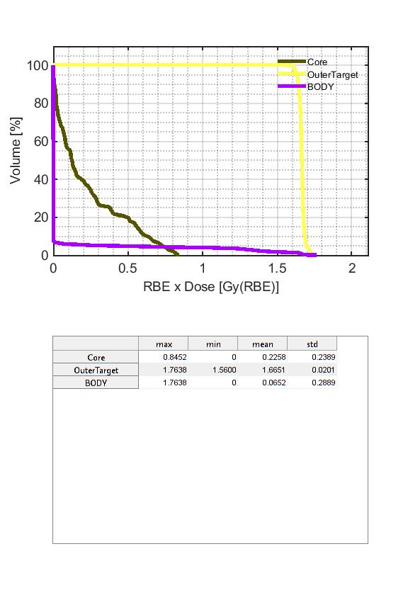
Comparaison Photon vs proton
Cas TG-119

Slide 5
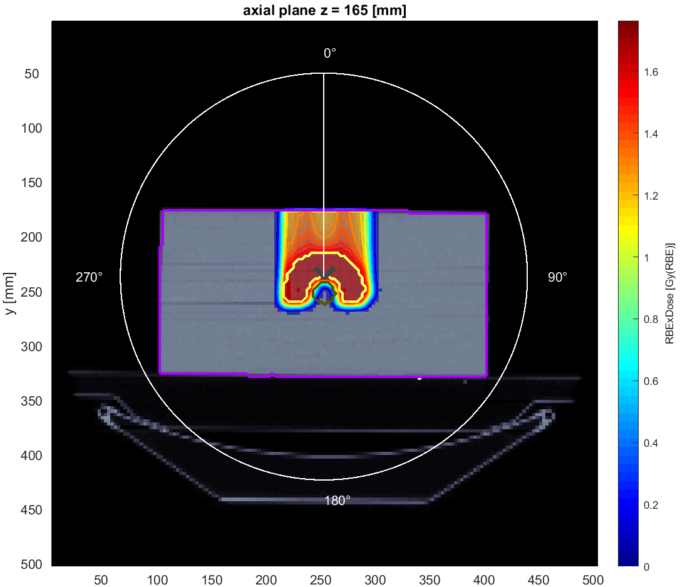
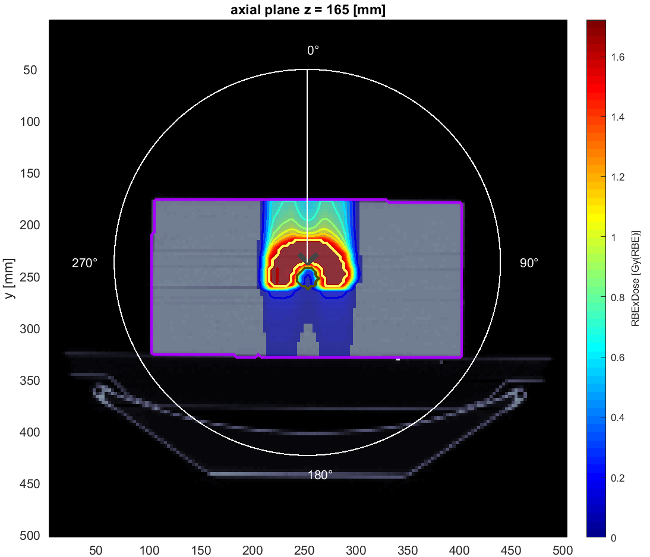
Comparaison Proton vs ion Carbone
Cas TG-119

Slide 6
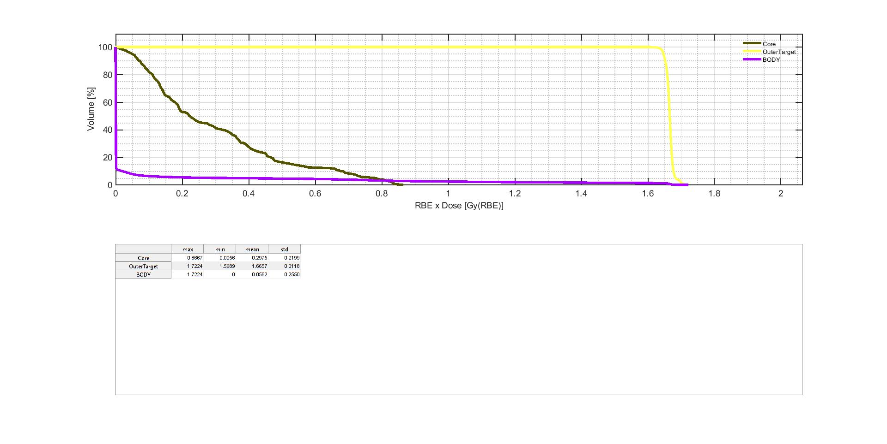
Comparaison Proton vs ion Carbone
Cas TG-119

Slide 7
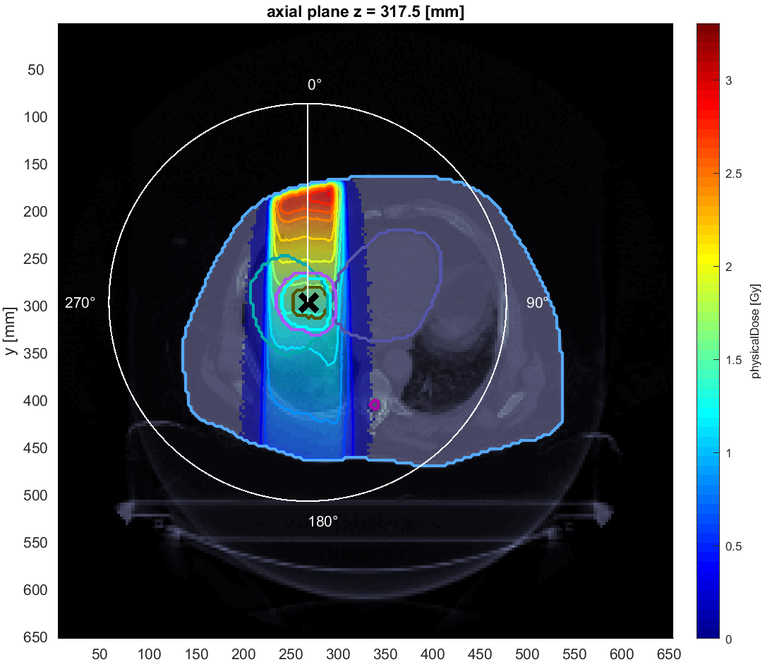
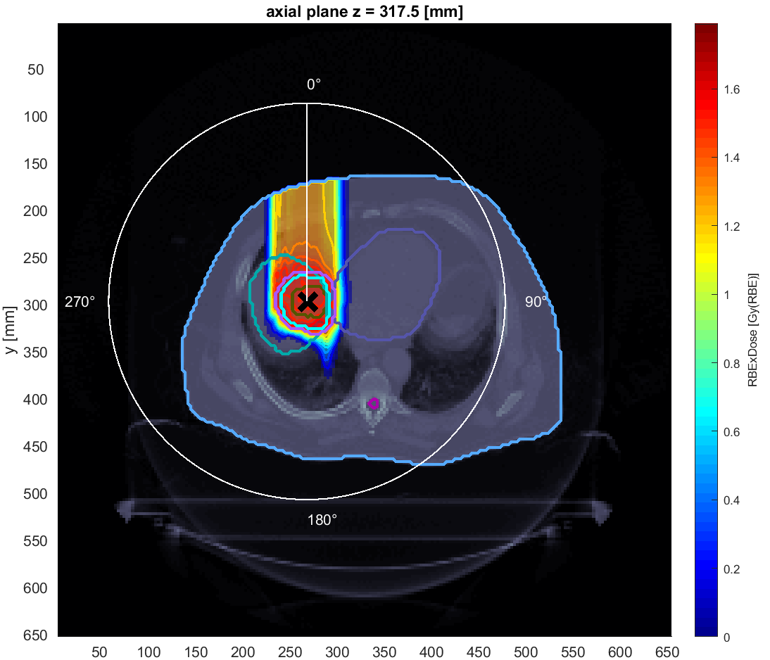
Comparaison Photon vs proton
Cas Liver
Photon therapy
Proton therapy
Here write a short summary of the picture bellow
Here write a short summary of the picture bellow
Insert the CT picture for photon therapy of the given organ
Insert the CT picture for proton therapy of the given organ

Slide 8
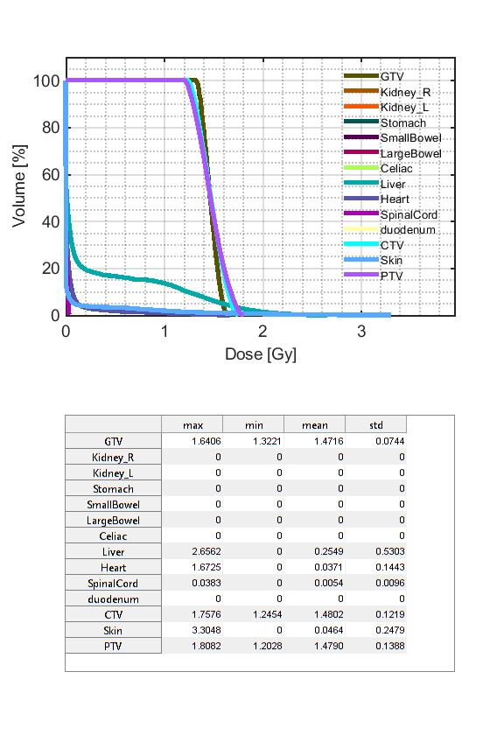
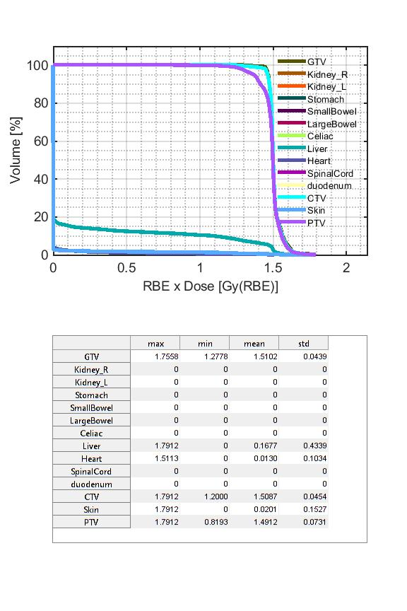
Comparaison Photon vs proton
Cas Liver

Slide 9
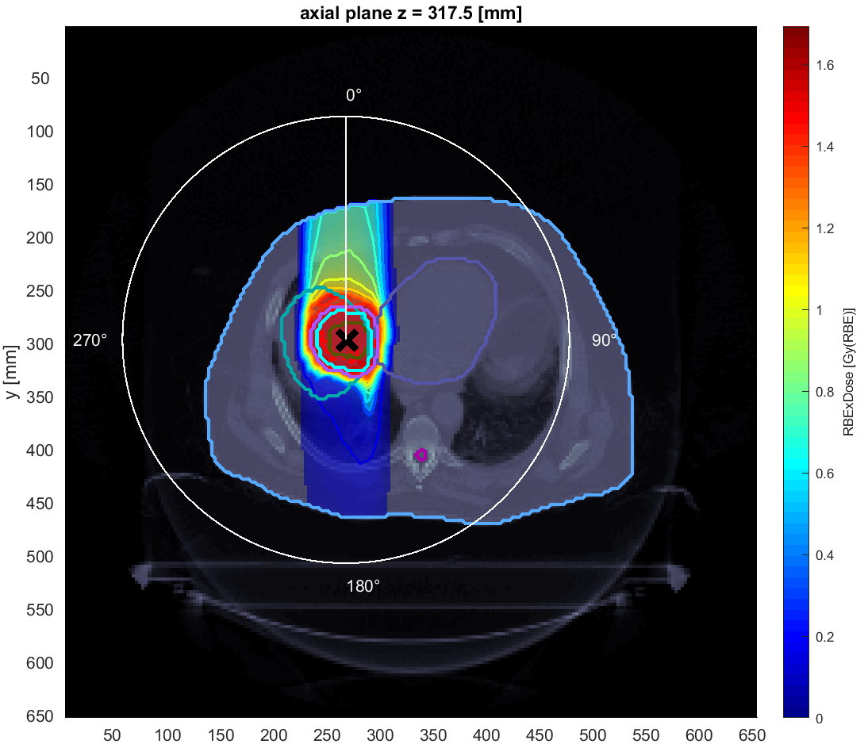
Comparaison Proton vs ion Carbone
Cas Liver

Slide 10
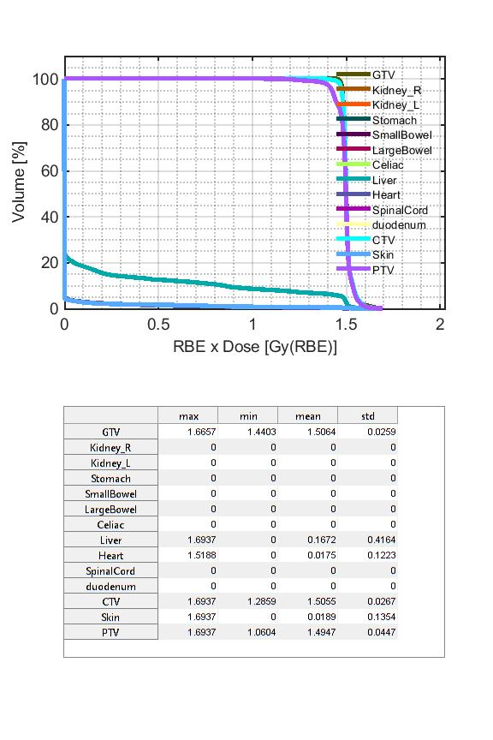
Cas Liver
Comparaison Proton vs ion Carbone

Slide 11
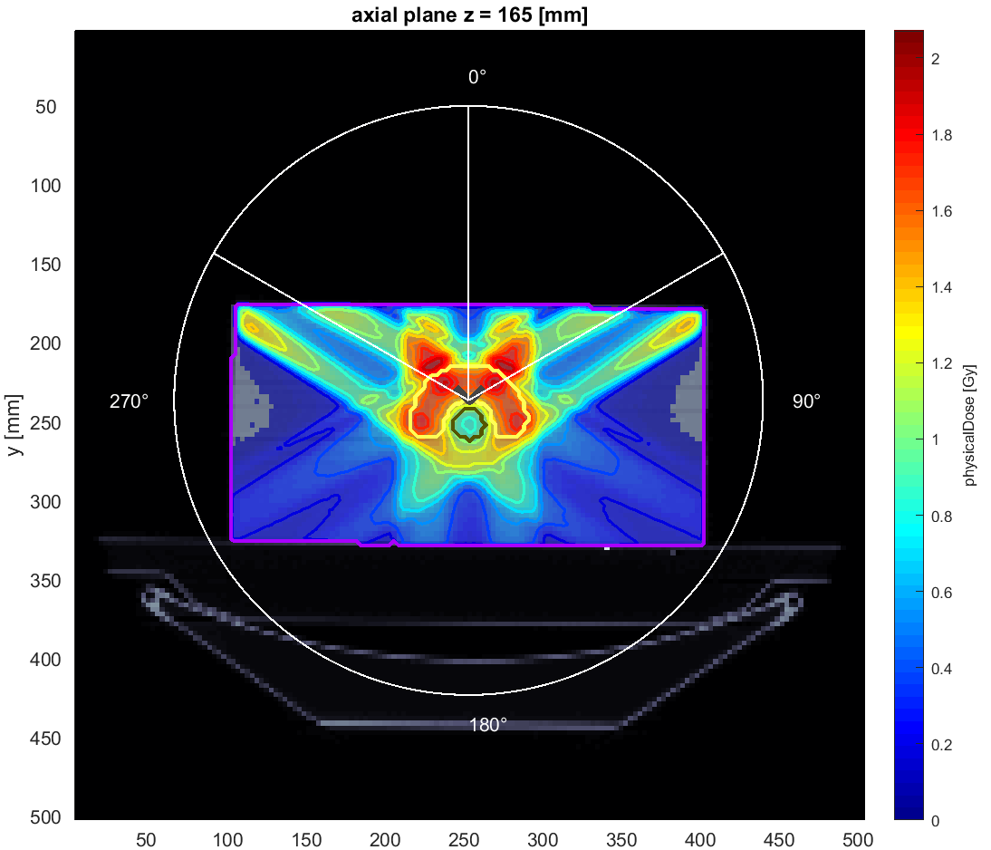
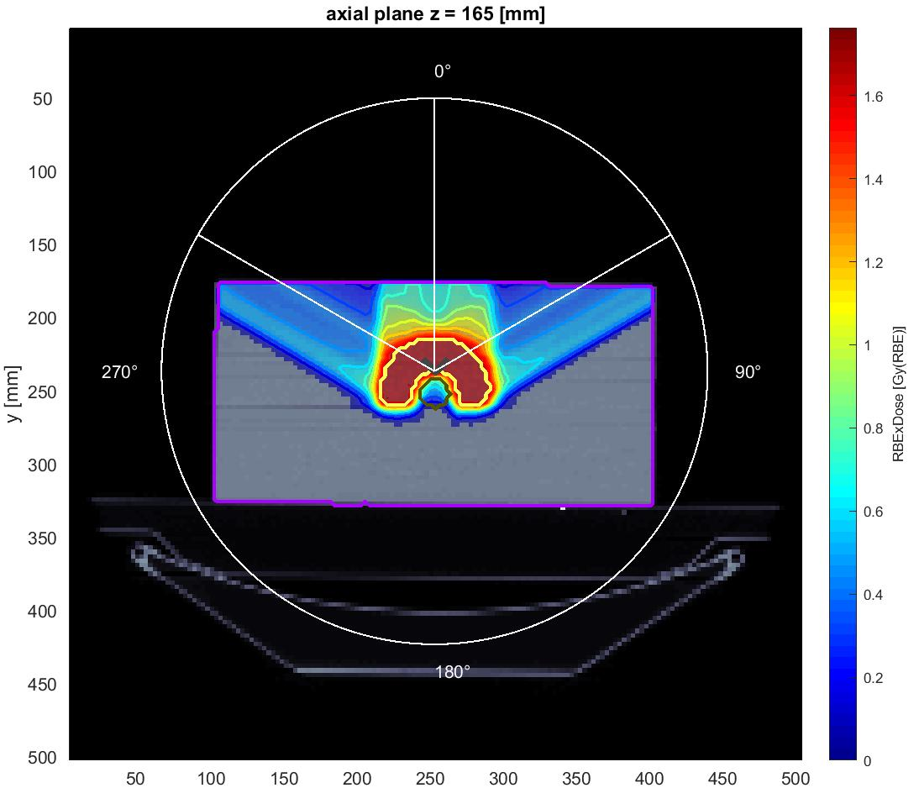
Cas TG_119
Photon 3 angles
Proton 3 angles

Slide 12
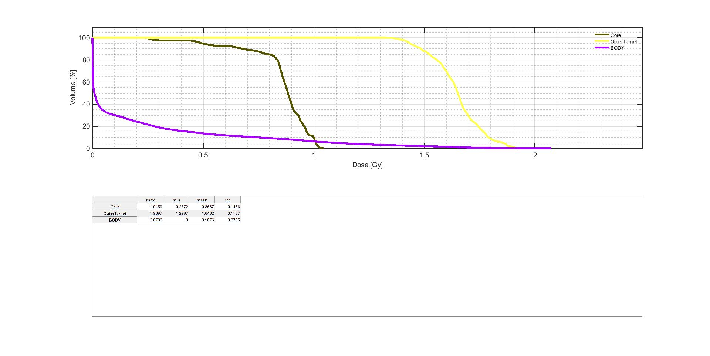
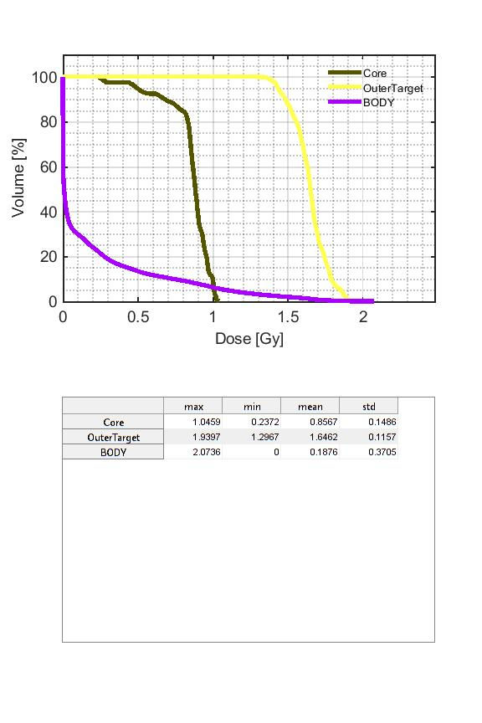
Cas TG_119
Photon 3 angles
Proton 3 angles

Slide 13
Thank you for your attentin

