Slide 1

Updates on FCC-ee IP Tuning Knobs
Satya Sai Jagabathuni
with inputs from Frank Zimmermann, Felix Simon Carlier and Leon Van Riesen-Haupt
FCC Optics Tuning Meeting, 15 March 2024

Slide 2

Introduction
So far, Knobs have been developed for $β_{x}^{∗}$ , $β_{y}^{∗}$ , $waist_{\left\{x,y\right\}}^{∗}$, orbit in x & y planes, Vertical Dispersion ($ƞ_{y}^{∗}$) and x-y coupling ($f_{1001}^{∗} and f_{1010}^{∗}$)
Demonstrated better performance in the presence of errors in the lattice
Necessity for other knobs such as Horizontal dispersion Knob ($ƞ_{x}^{∗}$) and the derivative of the horizontal dispersion ($ƞ_{px}^{∗}$)
Special Knobs for Chromatic-coupling ($\frac{Δf_{1001}^{∗}}{Δδ_{p}}$, $\frac{Δf_{1010}^{∗}}{Δδ_{p}}$) correction at the IP
15 Mar2024
S.S.Jagabathuni | Updates on FCC-ee IP Tuning Knobs
2

Slide 3

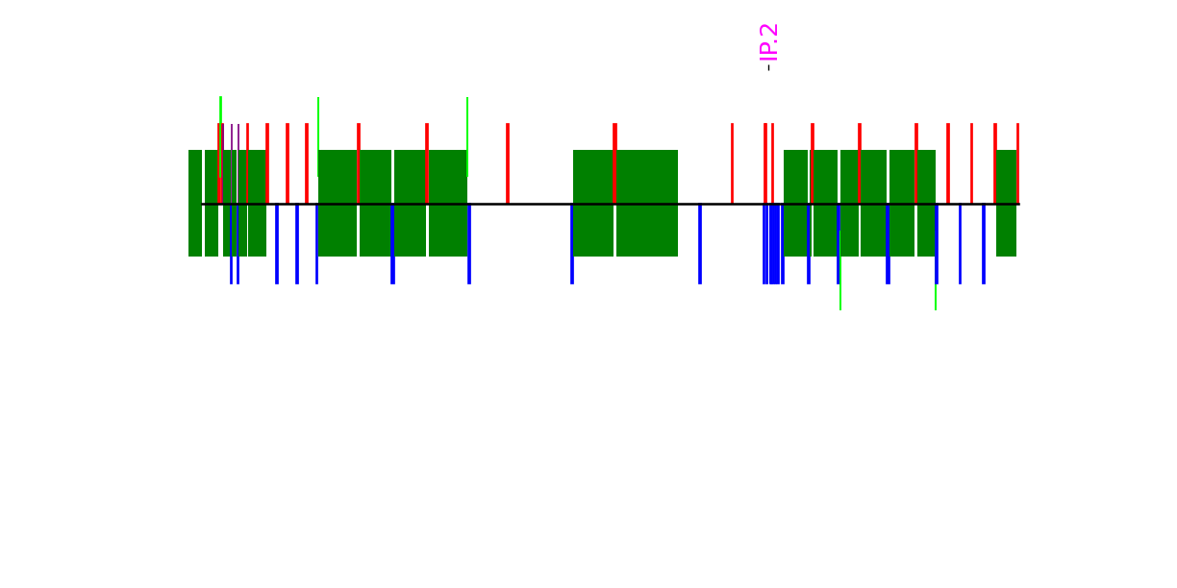
Horizontal Dispersion Knob
Make use of the quadrupoles on both sides of IP located at
Dispersion suppressor region QL[1-4] and QS[1-3]
Matching section QB[1-6] and QA[1-6] and
Dispersive regions QC[3-7]L and QC[3-7]
Knob range appears to be -2mm to 2mm
Dispersion
Suppressor
section
Matching
Section
15 Mar 2024
S.S.Jagabathuni | Updates on FCC-ee IP Tuning Knobs
3

Slide 4
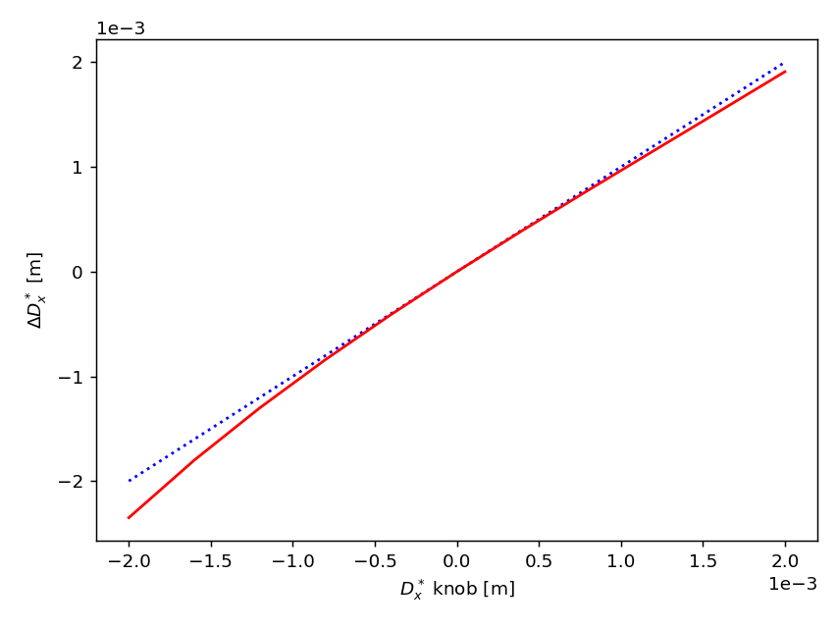
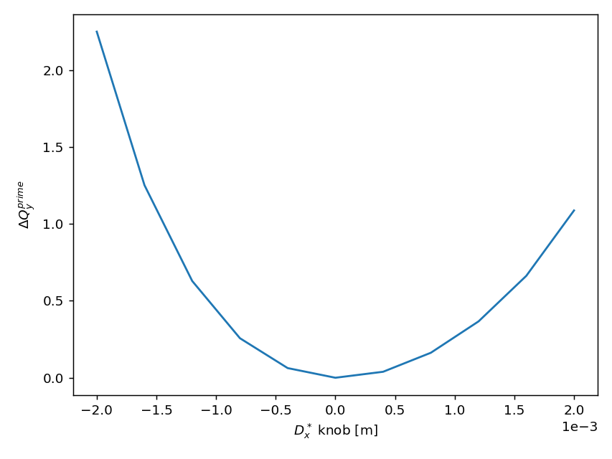
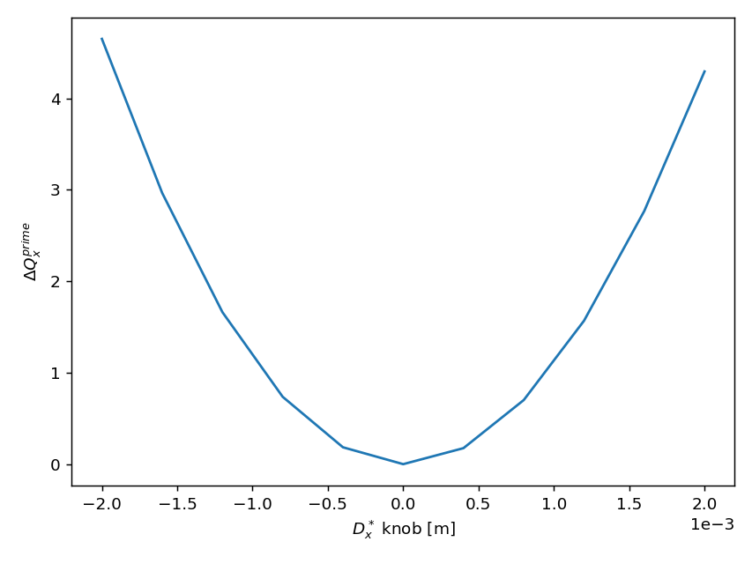
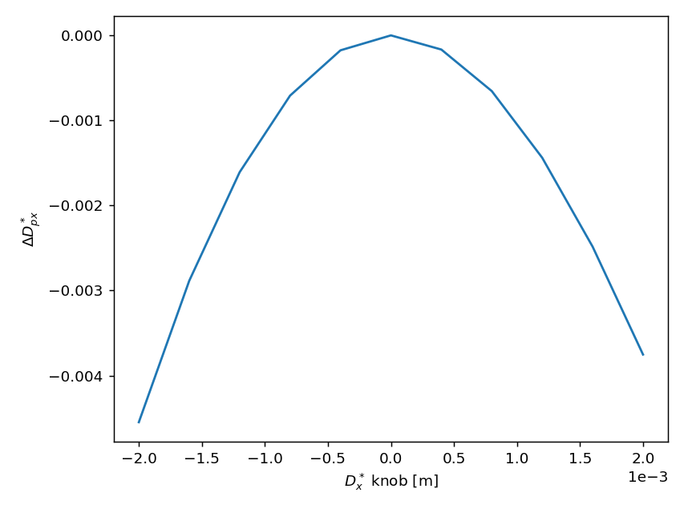
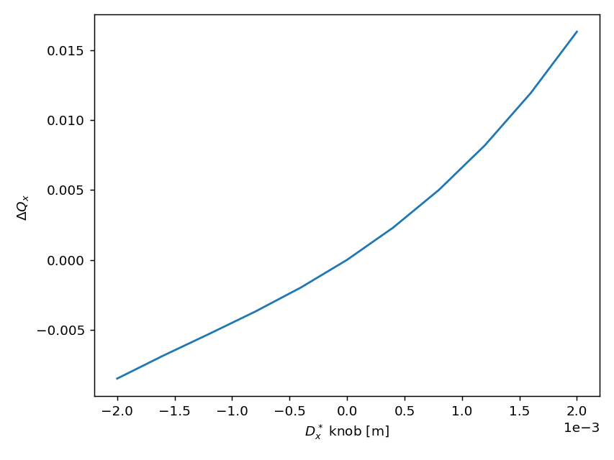
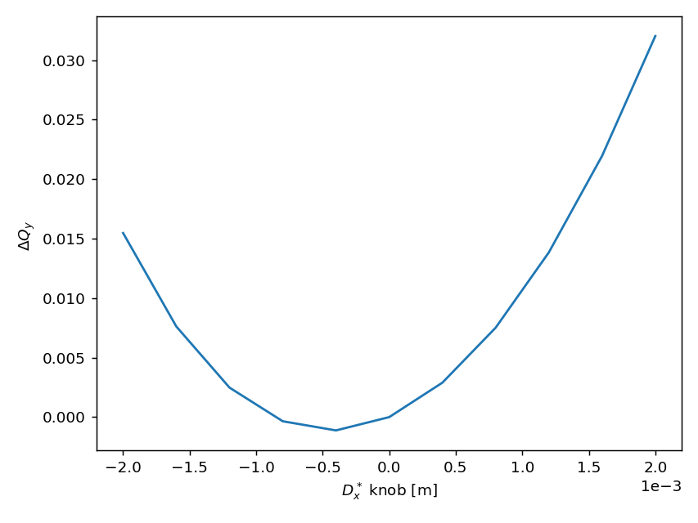
Horizontal Dispersion Knob
15 Mar 2024
S.S.Jagabathuni | Updates on FCC-ee IP Tuning Knobs
4

Slide 5
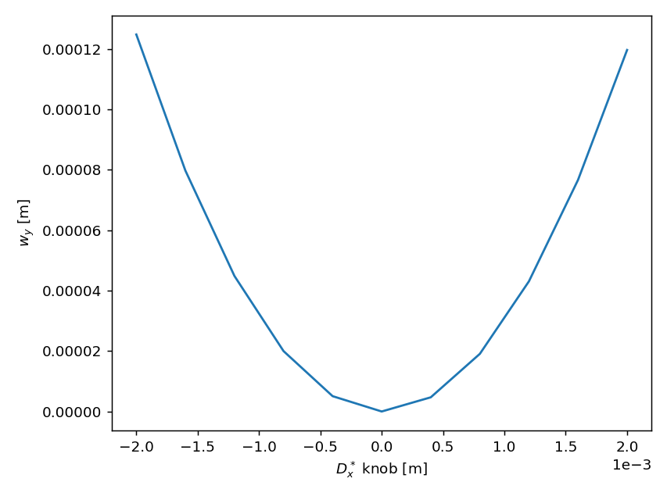
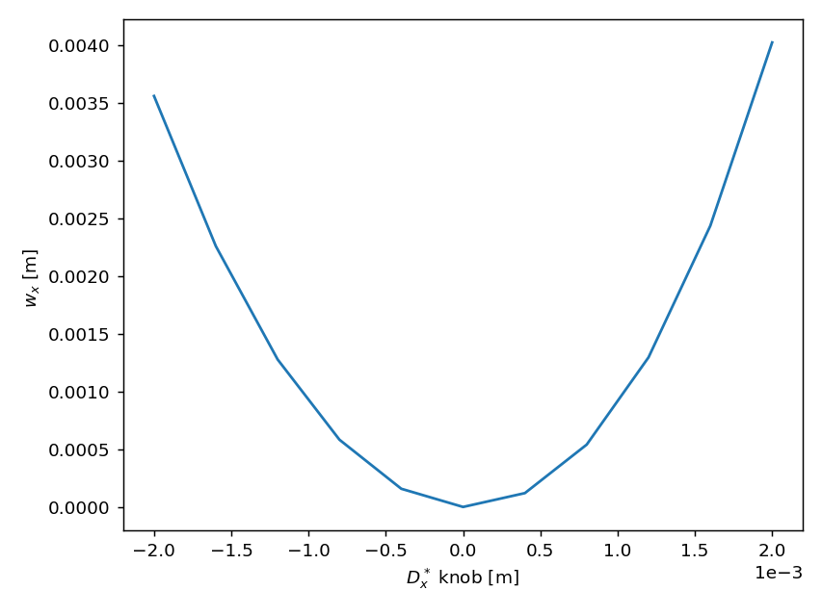
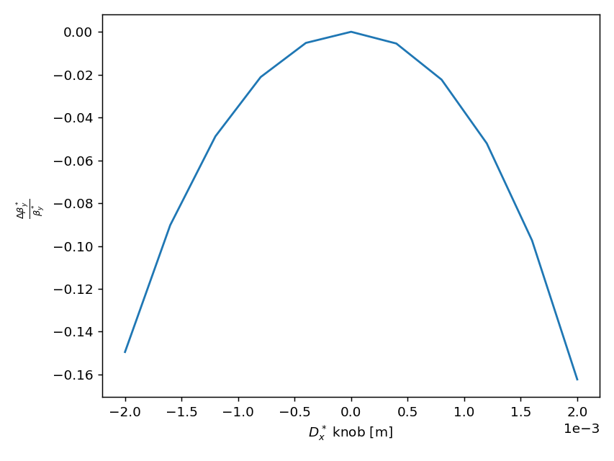
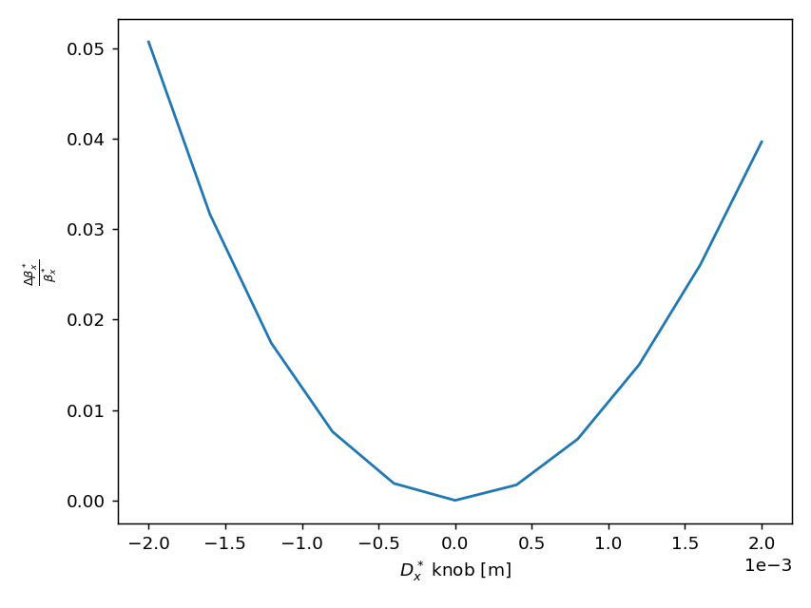
Horizontal Dispersion Knob
15 Mar 2024
S.S.Jagabathuni | Updates on FCC-ee IP Tuning Knobs
5

Slide 6
Derivative of Horizontal Dispersion Knob
Make use of the quadrupoles on both sides of IP located at
Dispersion suppressor region QL[1-4] and QS[1-3]
Matching section QB[1-6] and QA[1-6] and
Dispersive regions QC[3-7]L and QC[3-7]
Knob range appears to be -0.02 to 0.02
15 Mar 2024
S.S.Jagabathuni | Updates on FCC-ee IP Tuning Knobs
6

Slide 7
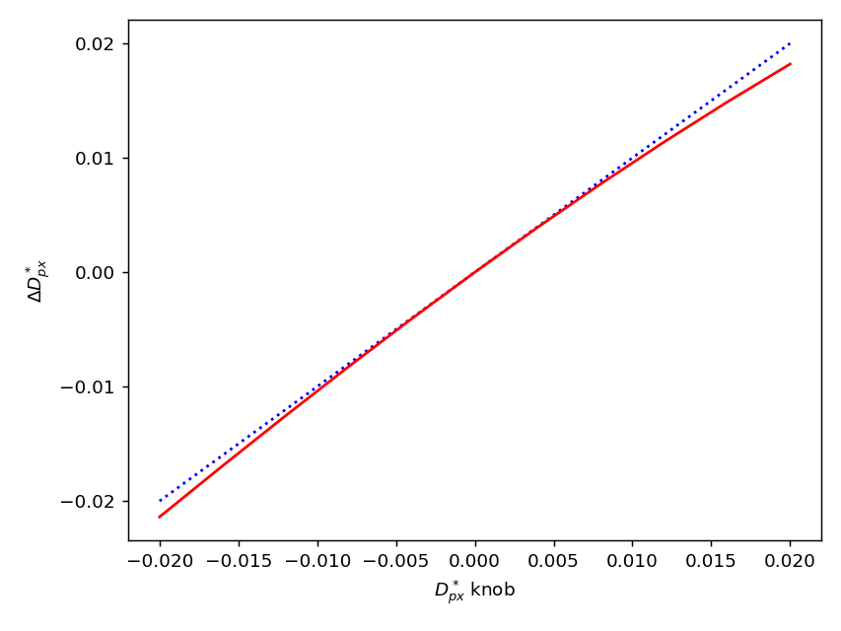
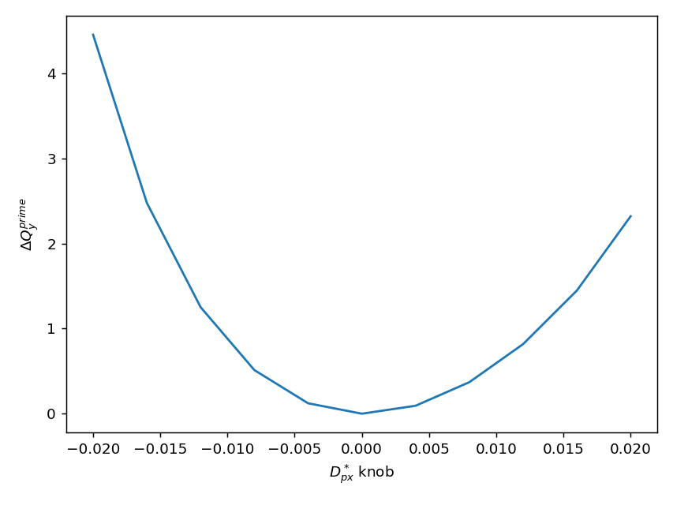
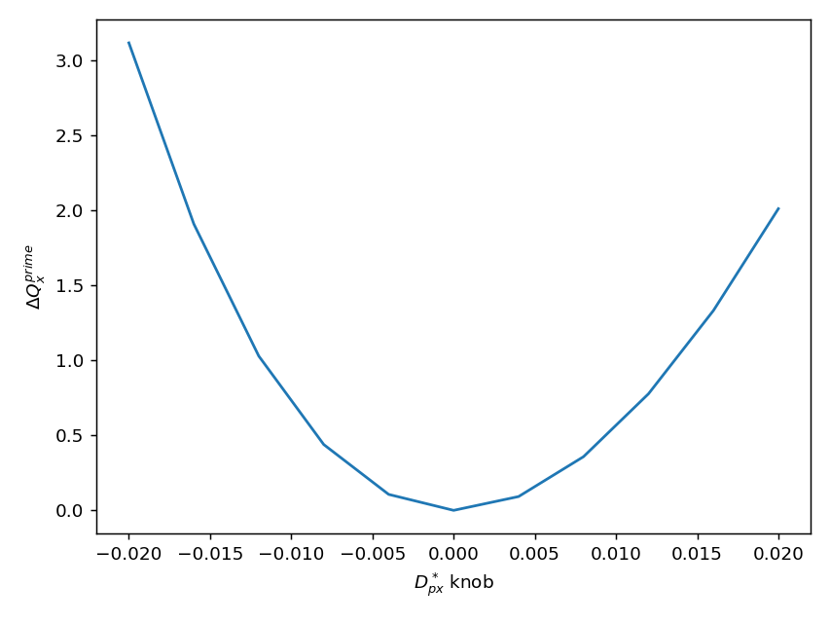
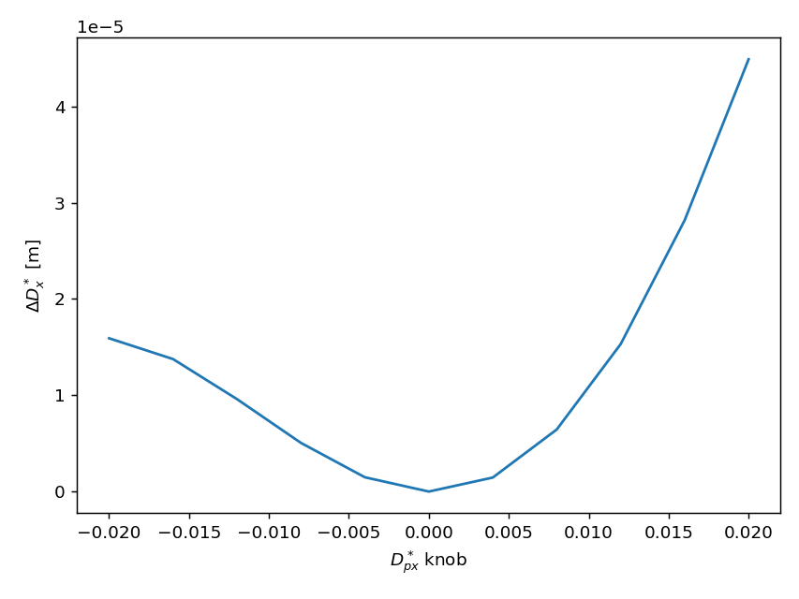
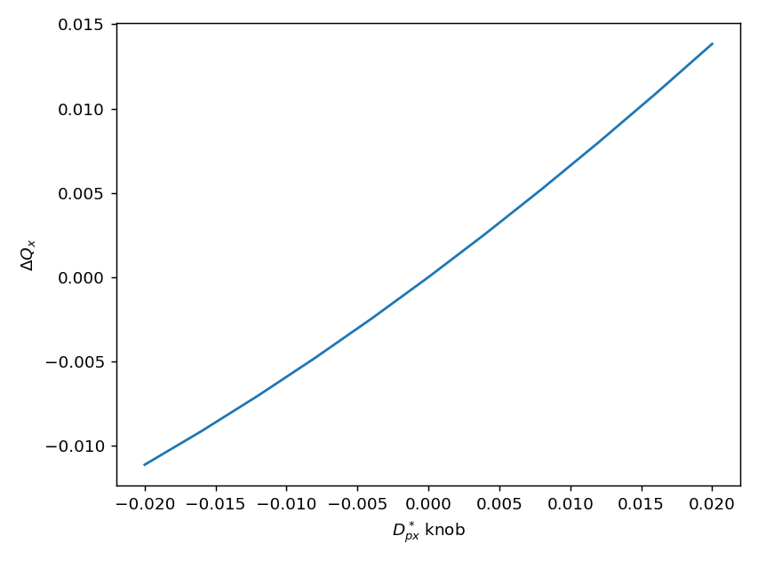
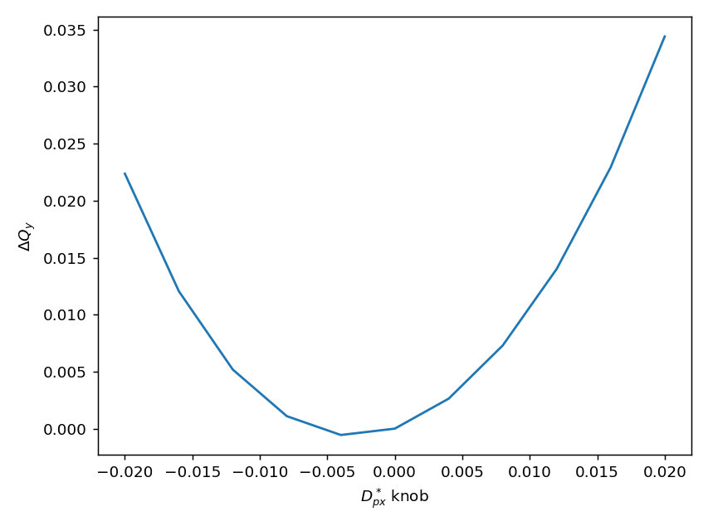
Derivative of Horizontal Dispersion Knob
15 Mar 2024
S.S.Jagabathuni | Updates on FCC-ee IP Tuning Knobs
7

Slide 8
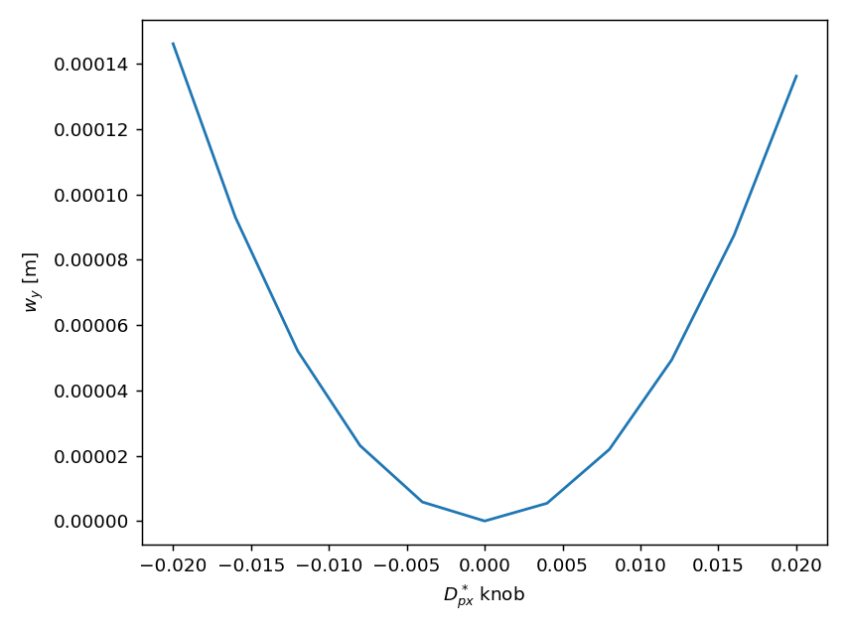
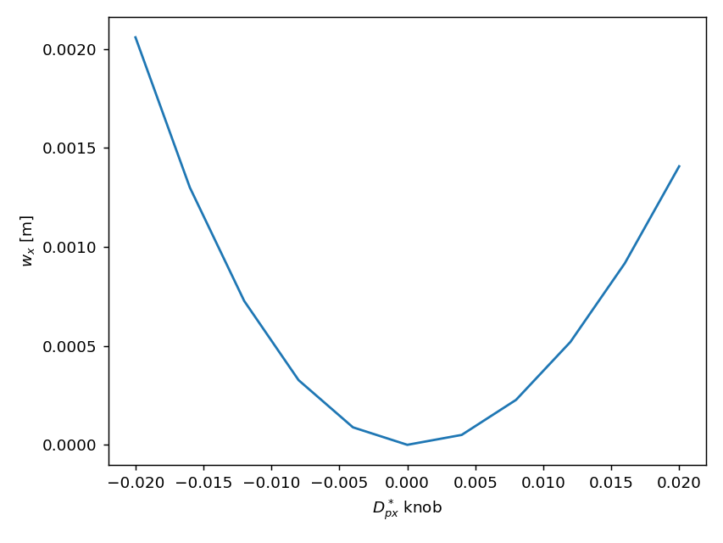
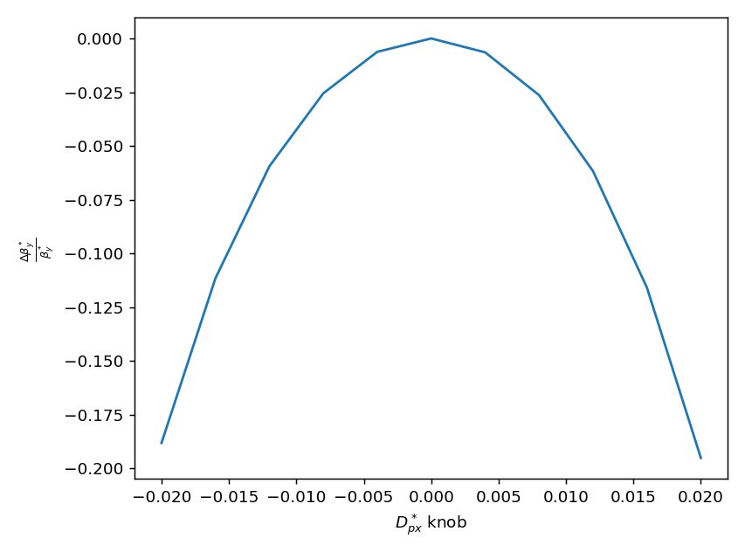
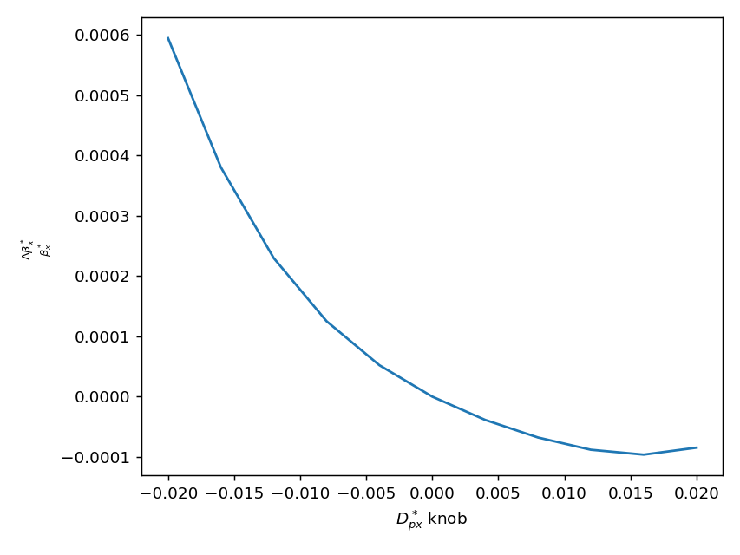
Derivative of Horizontal Dispersion Knob
15 Mar 2024
S.S.Jagabathuni | Updates on FCC-ee IP Tuning Knobs
8

Slide 9
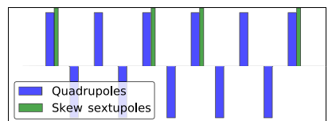

Chromatic-Coupling Knob
Courtesy: T. H. B. Persson
Transverse Coupling can be described by RDT’s ($f_{1001}^{∗} and f_{1010}^{∗}$)
No source of coupling at the IP
Coupling is completely compensated by an anti-solenoid scheme
Any sextupole tilt or roll errors potentially generate Chromatic dependence on Coupling
Can be corrected with the help of Skew sextupolar fields
Four pairs of skew sextupoles needed on each side of the IP, with a phase advance of 180 degrees in between a pair of skew sextupole
15 Mar 2024
S.S.Jagabathuni | Updates on FCC-ee IP Tuning Knobs
9

Slide 10
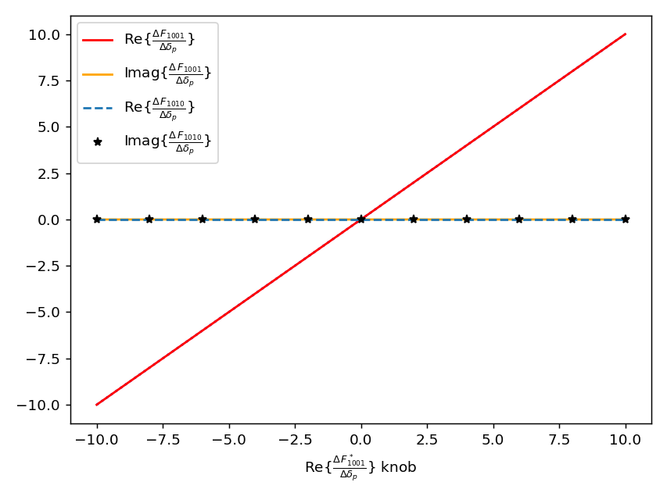
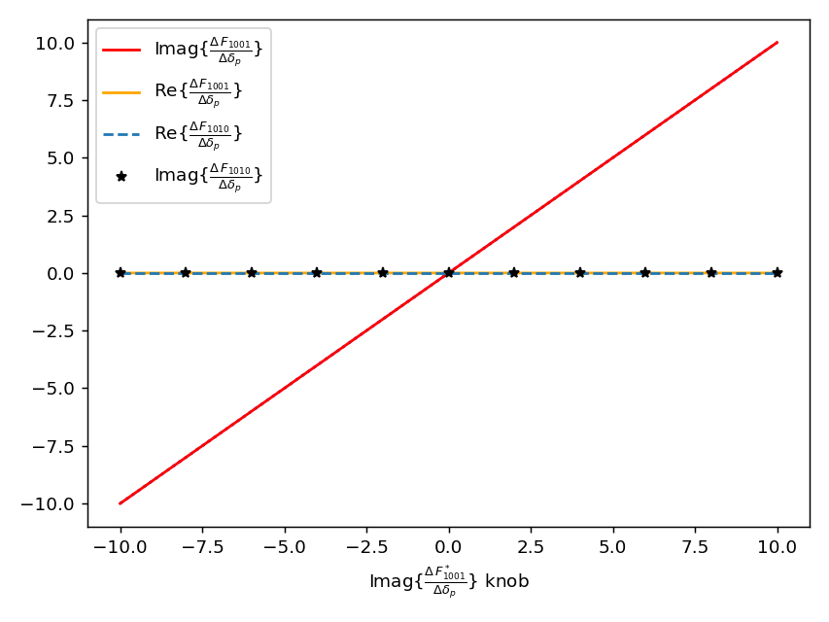


Chromatic-Coupling Knob $\frac{Δf_{1001}^{∗}}{Δδ_{p}}$
Knob range appears to be -10 to 10
Knob to tune real part of $\frac{Δf_{1001}^{∗}}{Δδ_{p}}$
Knob to tune Imag part of $\frac{Δf_{1001}^{∗}}{Δδ_{p}}$
15 Mar 2024
S.S.Jagabathuni | Updates on FCC-ee IP Tuning Knobs
10

Slide 11
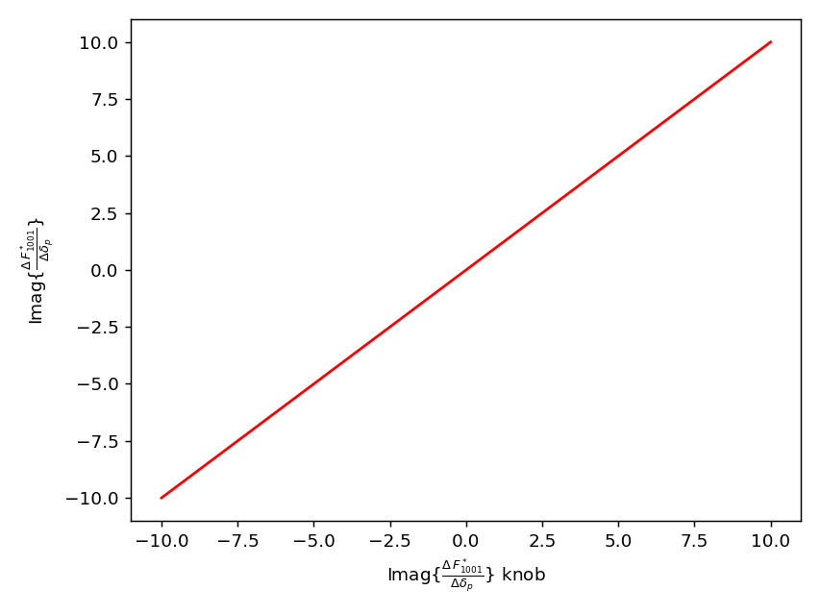
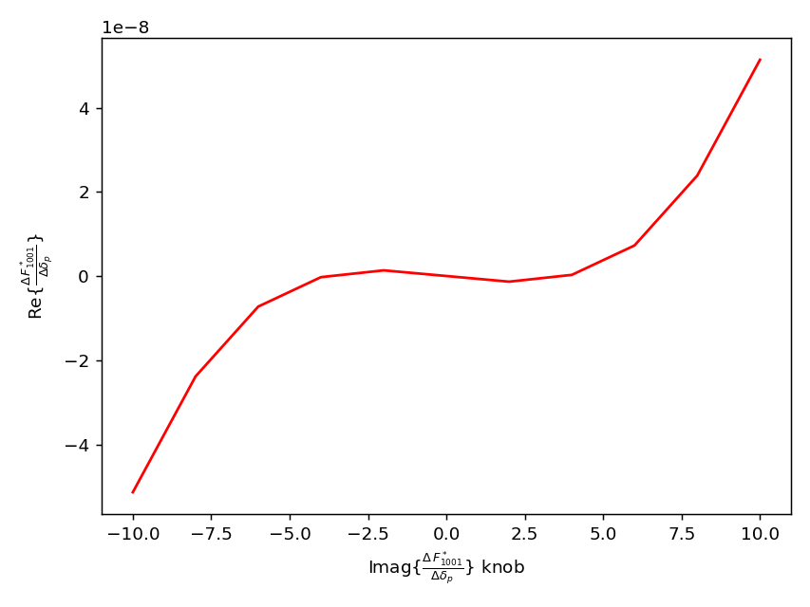
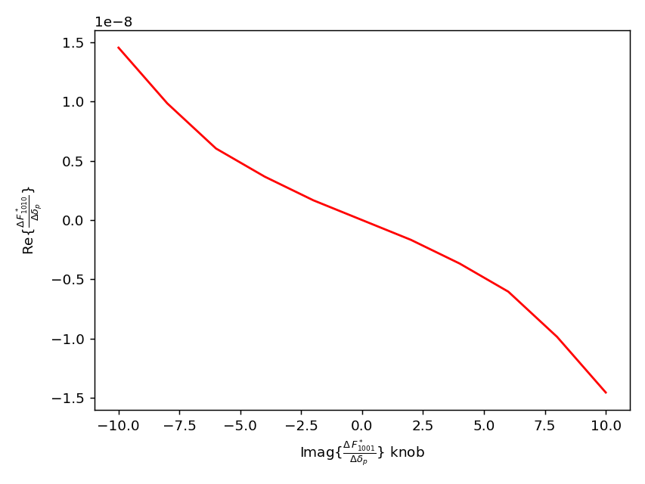
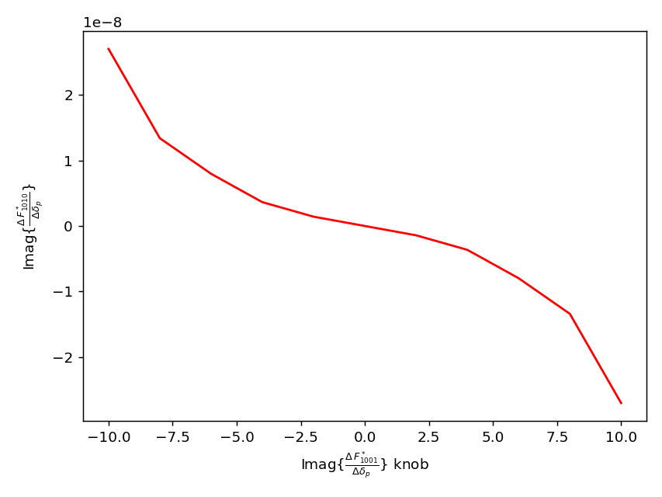
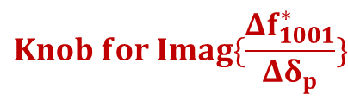
$$Knob for Imag\{\frac{Δf_{1001}^{∗}}{Δδ_{p}}\}$$
15 Mar 2024
S.S.Jagabathuni | Updates on FCC-ee IP Tuning Knobs
11

Slide 12

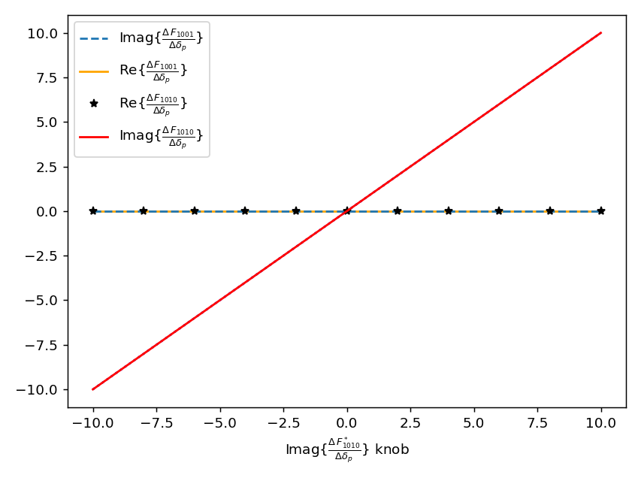


Chromatic-Coupling Knob $\frac{Δf_{1010}^{∗}}{Δδ_{p}}$
Knob to tune real part of $\frac{Δf_{1010}^{∗}}{Δδ_{p}}$
Knob to tune Imag part of $\frac{Δf_{1010}^{∗}}{Δδ_{p}}$
15 Mar 2024
S.S.Jagabathuni | Updates on FCC-ee IP Tuning Knobs
12

Slide 13
Further tasks
Next steps:
Implement chromatic-coupling knob using MAD-NG
Test the effectiveness of knobs on Tessa’s lattice with all global corrections performed
Optics correction in the Final-Focus system to determine the alignment tolerances for the magnets
15 Mar 2024
S.S.Jagabathuni | Updates on FCC-ee IP Tuning Knobs
13

Slide 14
Thank you for your attention
15 Mar 2024
S.S.Jagabathuni | Updates on FCC-ee IP Tuning Knobs
14

Slide 15
Backup Slides
15 Mar 2024
S.S.Jagabathuni | Updates on FCC-ee IP Tuning Knobs
15

Slide 16
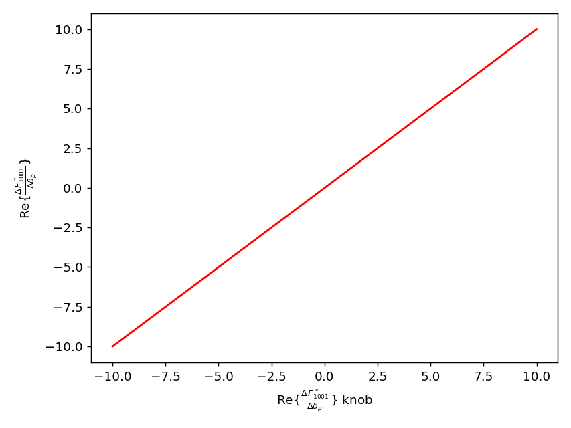
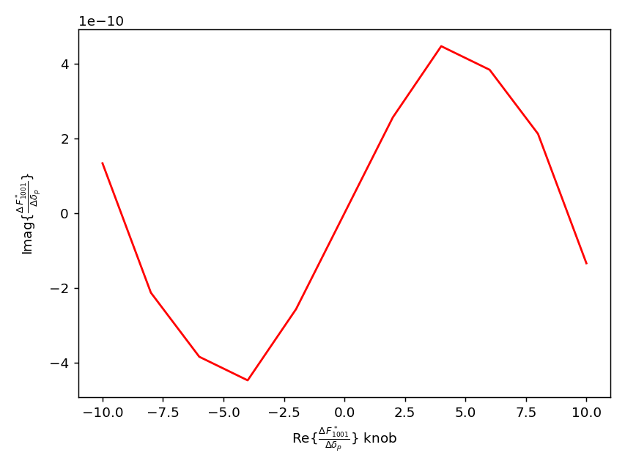
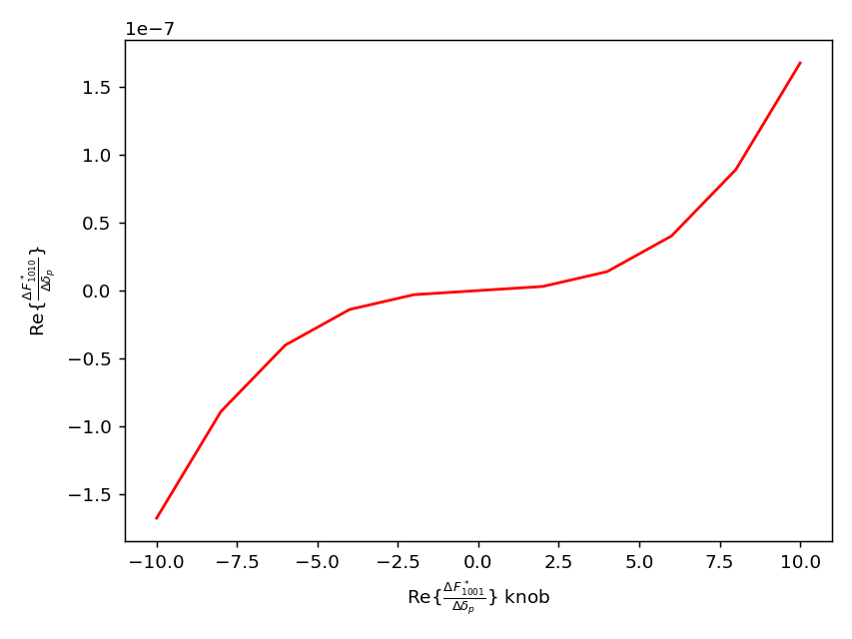
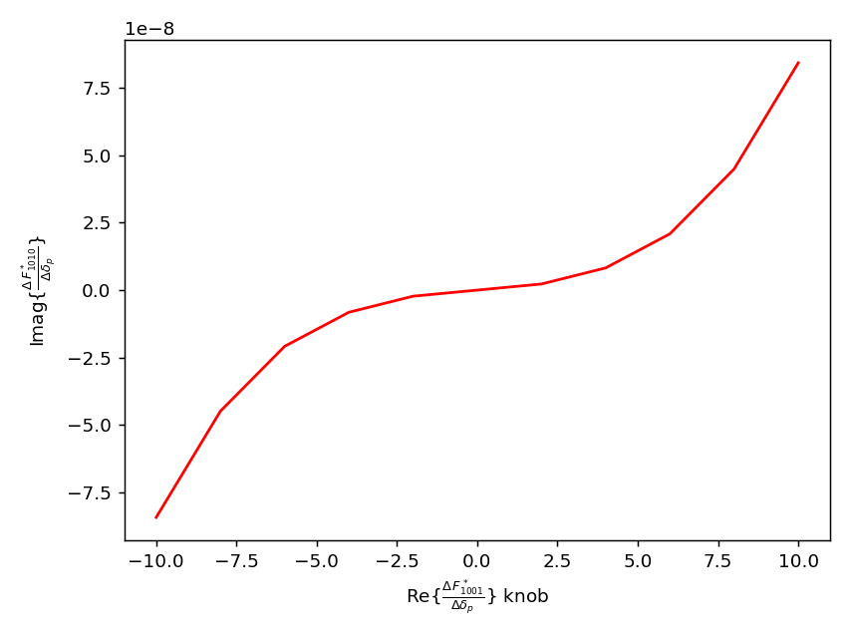
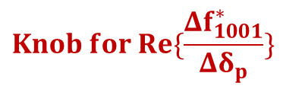
$$Knob for Re\{\frac{Δf_{1001}^{∗}}{Δδ_{p}}\}$$
15 Mar 2024
S.S.Jagabathuni | Updates on FCC-ee IP Tuning Knobs
16

Slide 17

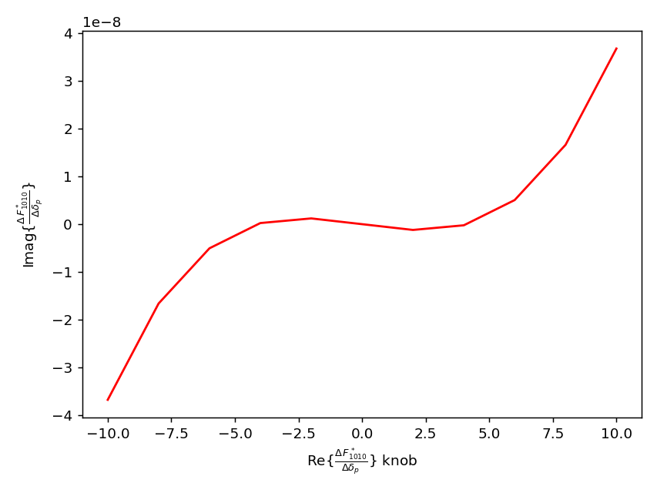
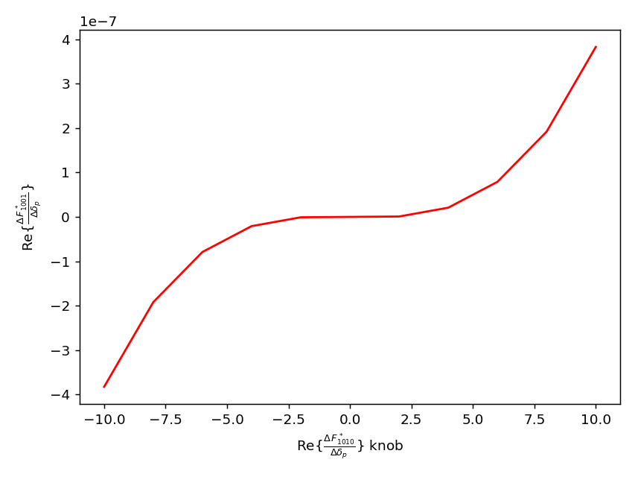
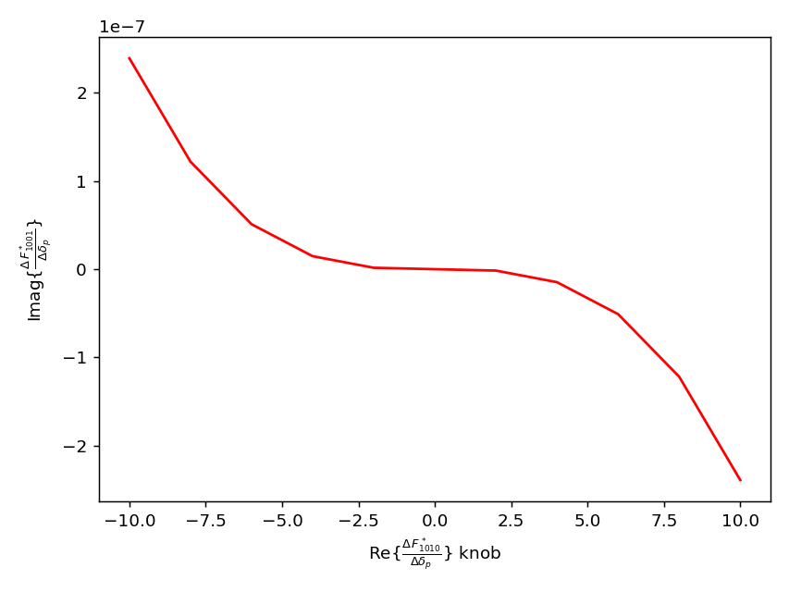

$$Knob for Re\{\frac{Δf_{1010}^{∗}}{Δδ_{p}}\}$$
15 Mar 2024
S.S.Jagabathuni | Updates on FCC-ee IP Tuning Knobs
17

Slide 18

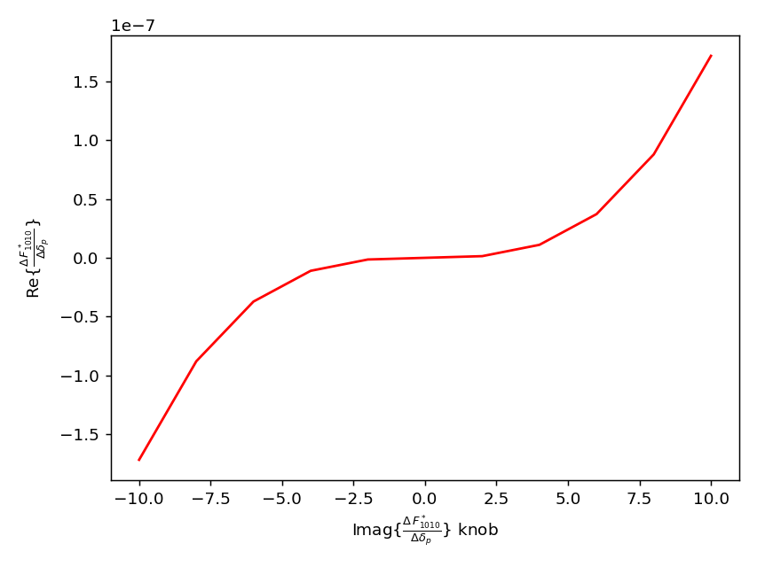
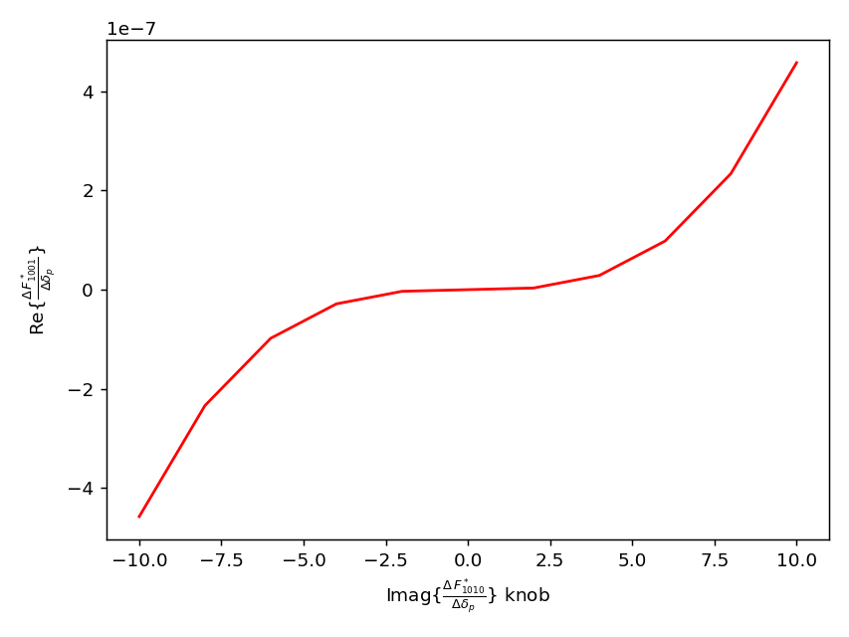

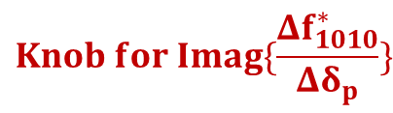
$$Knob for Imag\{\frac{Δf_{1010}^{∗}}{Δδ_{p}}\}$$
15 Mar 2024
S.S.Jagabathuni | Updates on FCC-ee IP Tuning Knobs
18

