Slide 1
Sustainability in the operation of the machines
For the Sustainable Accelerators Panel
Rende Steerenberg BE-OP
With valuable input from many - thanks
22 March 2024

Slide 2
Content
The Context
Sustainability in Operations: some examples
Operations Contributing to Sustainability
Concluding Remarks

Slide 3
Content
The Context
Sustainability in Operations: some examples
Operations Contributing to Sustainability
Concluding Remarks

Slide 4
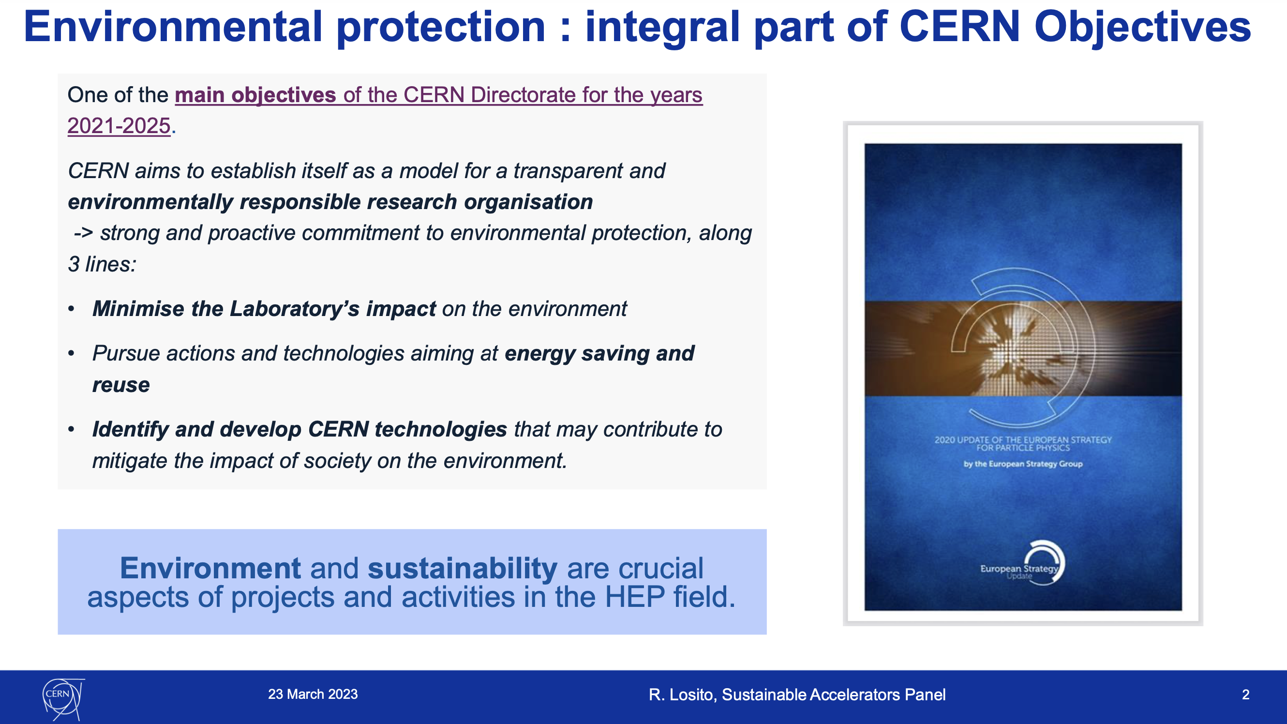
From Roberto’s 1st SAP meeting
Bringing sustainability into the desing and construction of a new accelerator is already a challenge.
Enhancing sustainability in existing accelerators and facilites is even a bigger challenges because one has to deal with legacy systems, which were not conceived with sustainability in mind.

Slide 5
Existing Accelerators & Facilities
Is the strength of CERN also a weakness?
We tend to build on the past and re-use previously flagship machines as injectors for new flagship machines
The ‘recycling’ of older facilities is in itself sustainable and often driven by a need and project cost containment
Legacy equipment do often not align with the more recent sustainability goals
Need for consolidation, following many years of operation, is an opportunity to enhance sustainability
Answer:
No, but we do not always
appreciated this aspect

Slide 6
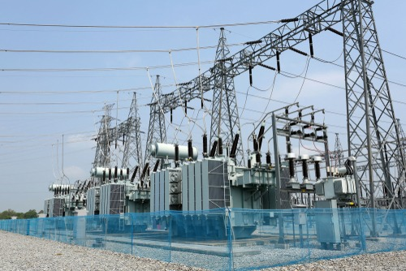
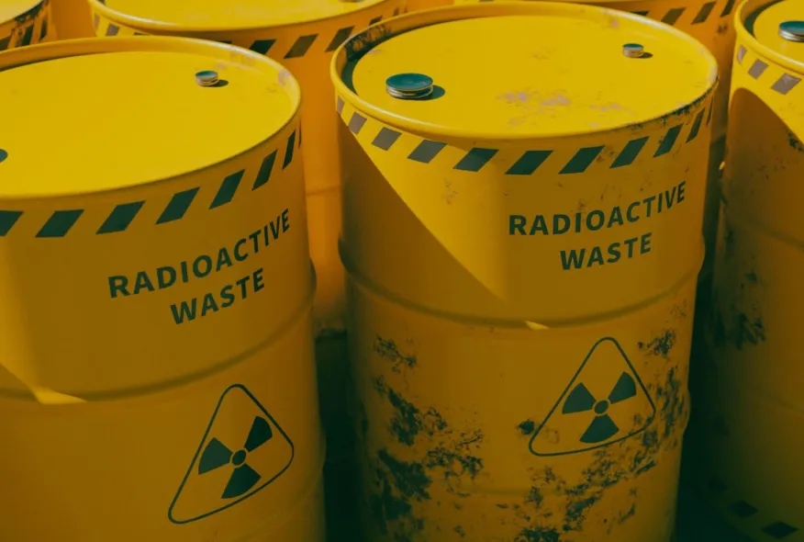

Sustainable Accelerator Operation
The primary challenges lies in the substantial energy requirement
Optimising the efficiency and making efficient use of accelerators is crucial for minimising energy consumption
Waste management, including radioactive waste, is another significant aspect
Minimising activation by reducing beam losses or managing beam losses
Fostering a sustainability culture within “Operations” is essential for driving continuous improvement in accelerator operations
Raise awareness on environmental impact and collaborate among stakeholders

Slide 7
Accelerator schedules
Accelerator schedulling – can reduce electricity consumption, but also physics output
With the energy crisis in 2022 the YETS 22-23 was anticipated and extended by 2 weeks.
YETS 23-24 was anticipated by 6 weeks and extended by 4 weeks (15 weeks to 19 weeks) to cover the period with the high electricity costs.
YETS 24-25 was always planned to be 19 weeks beam to beam on the request of ATLAS and CMS for the CO₂ cooling installation and commissioning but was anticipated 6 weeks too.
These measures were mainly cost driven and not necessarily with sustainability in mind
It affects our core business directly and is in the end not sustainable
In any case the experiments need a certain number of collisions or protons on target
If we we have shorter runs every year the experiment wil take more years to complete – less sustainable
Effective schedulling primarily assists managing electricity cost, yet it alone does not inherently enhance the sustainability of accelerator operations

Slide 8

“Operation” of the Accelerator Complex
The equipments groups are responsible for the operation of their systems
This includes design, construction or procurement, operation, consolidation and maintenance
These groups (should) have their own sustainabiity initiatives and targets
The operations group forms the glue between the pieces and runs the individual systems as a whole to produce the required particle beams
This includes, machine configuration, settings management, development and deployment of methods and tools to produce and deliver beams
The Operations group (should) have its own sustainability initiatives and target and collaborate with the other groups on theirs.
SY-EPC
TE-MSC
EN-EL
TE-VSC
EN-CV
BE-OP
SY-STI
TE-CRG
SY-RF

Slide 9
Content
The Context
Sustainability in Operations: some examples
Operations Contributing to Sustainability
Concluding Remarks

Slide 10
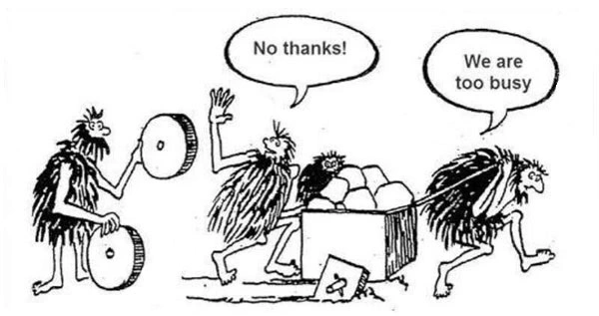
The Typical Context…
We are all very busy with many things and enhancing sustainability in accelerator operations is not always given sufficient priority

Slide 11
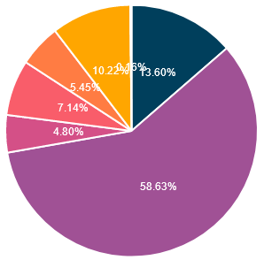
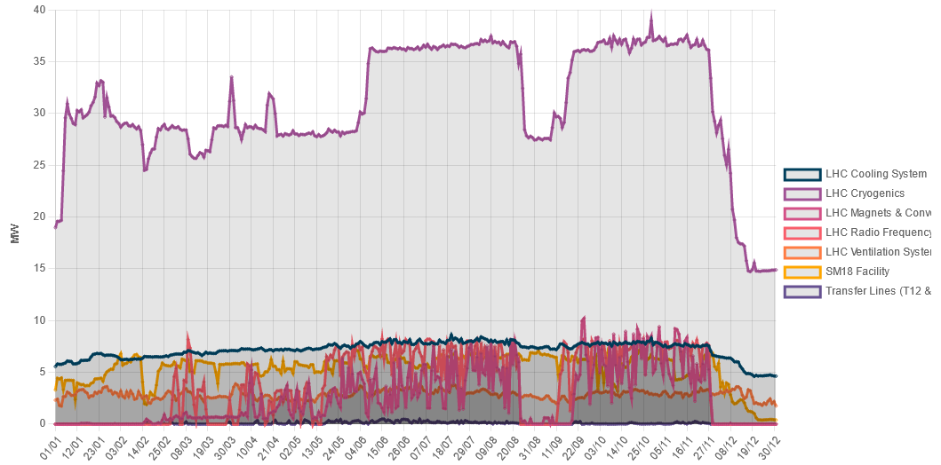
LHC Machine electrical Consumption 2022
35 MW
LHC Cryo
Main consumer: Cryogenics with ~50%
SM18
LHC Cooling
LHC Magnets + Converters
LHC machine total power ~75 MW
Dominated by cryogenics
Cryogenic power is heavily modulated by e-could induced heatload
Chamonix 2023

Slide 12
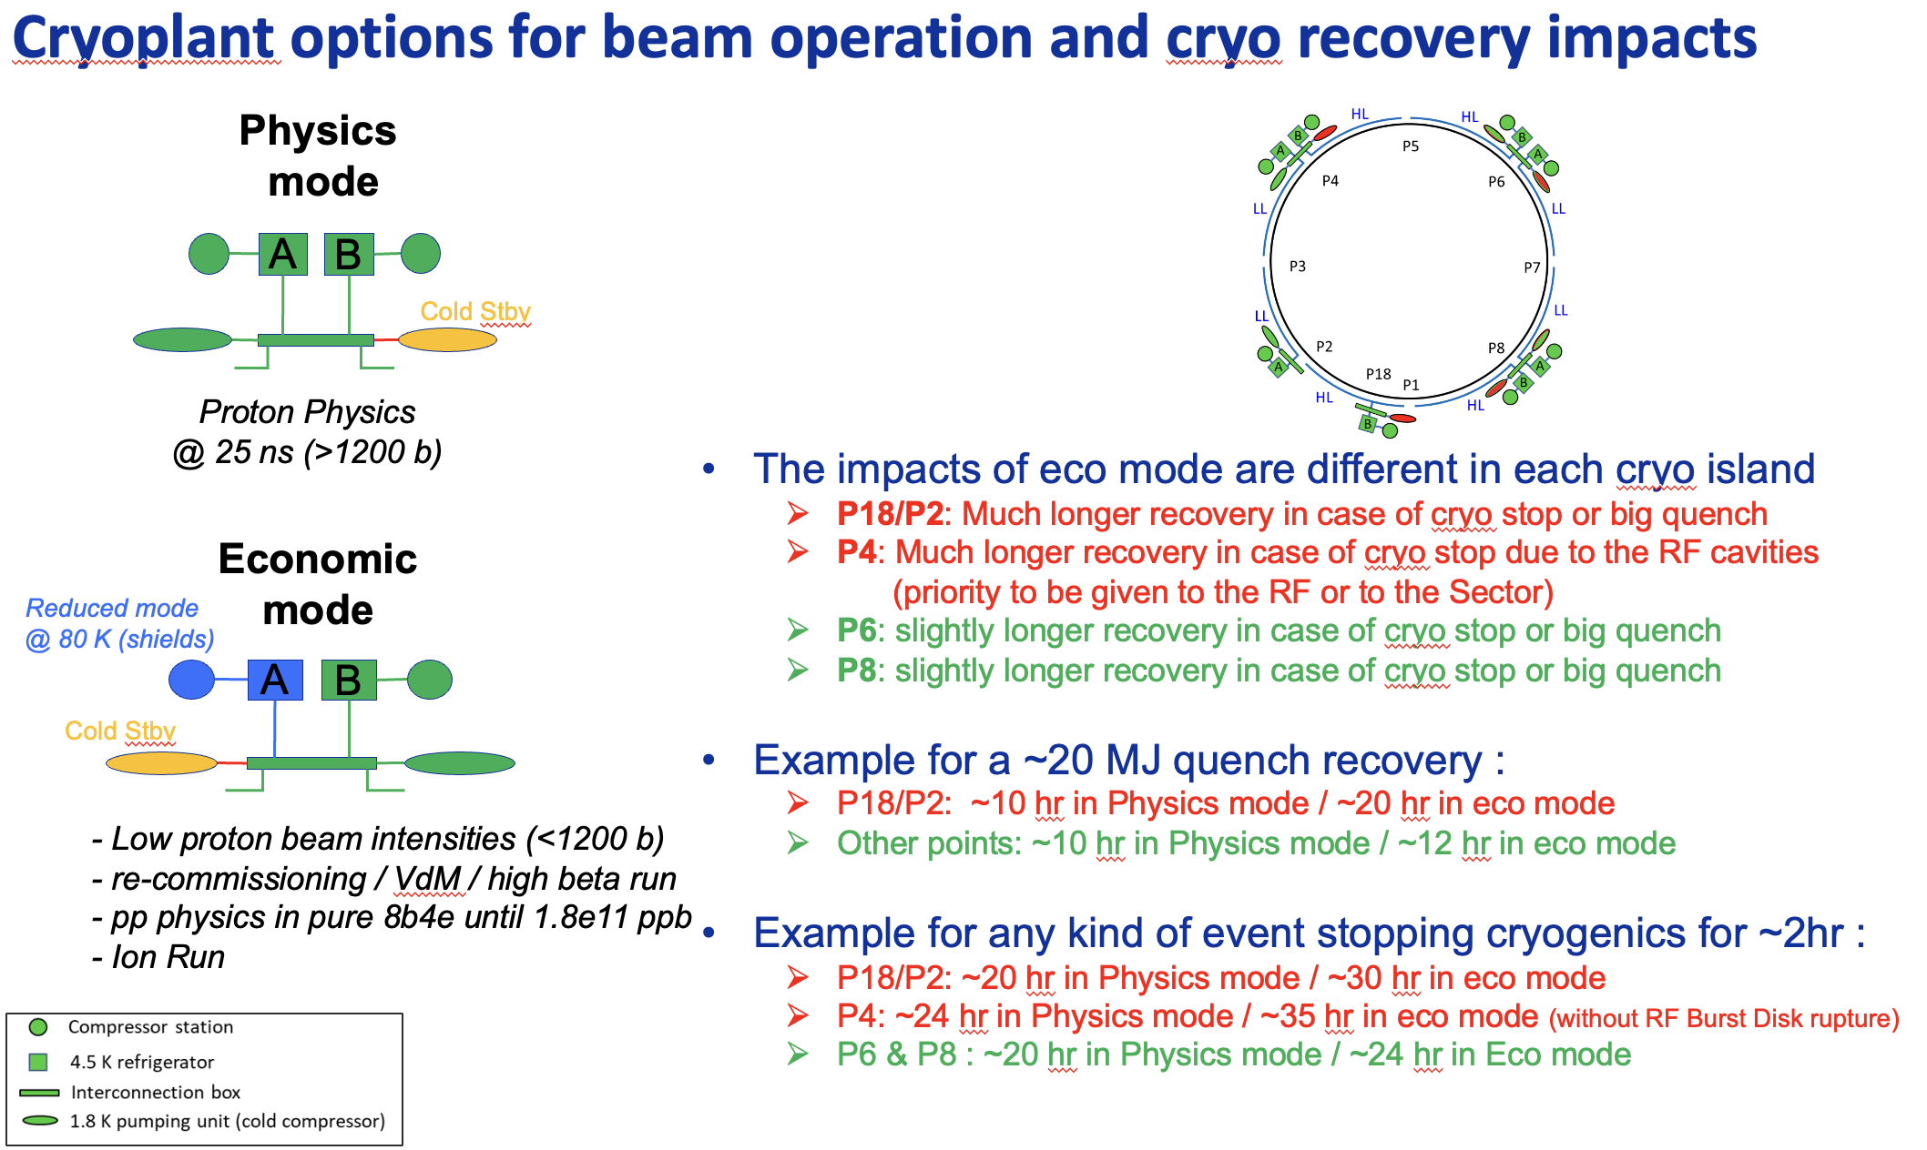
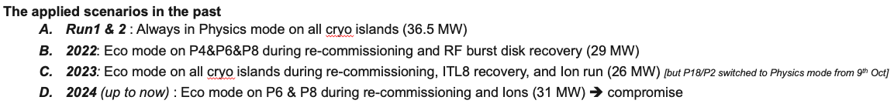
Beam Dependend Actions by Cryogenics
When being a too ambitious with the eco mode, we can easily lose all savings made by the eco mode due to a much longer quench recovery time
Benjamin Bradu
LMC#481

Slide 13
Physics output versus Cryo power
Physics requirement: maximise number of collisions
Maximise intensity per bunch: 1.1 x 10¹¹ppb (design) → 1.6 x 10¹¹ (2023) → up to 1.8 x 10¹¹ (2025)
Maximise the number of bunches: ~ 2800 b/beam (design) → ~ 2400 b/beam (average in practice)
Electron cloud induced heat load is the limiting factor for cryogenics
Heat induced on the beam screen needs to be evacuated → Electrical power consumption through cryo
Possible operational mitigations:
  Scrubbing, but has limits.
  Adapt filling scheme to reduce electron cloud production – leave regular gaps in the bunch trains
  Each filling scheme with reduced number of bunches affects physics output – optimum continuously being explored

Slide 14
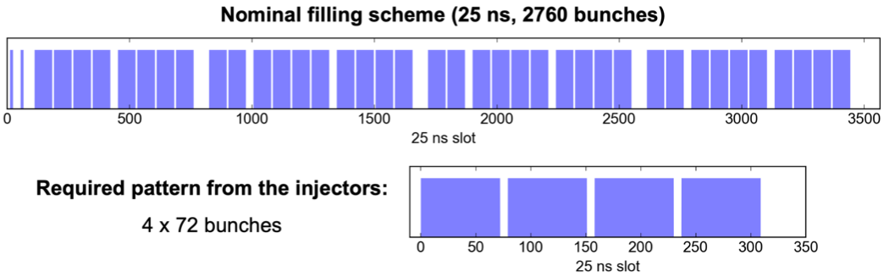
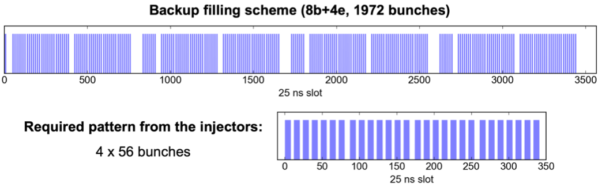
Electron Cloud Mitigation Through the Filling Scheme
G. Skripka and G. Iadarola

Slide 15
Physics output versus Cryo power
Physics requirement: maximise number of collisions
Maximise intensity per bunch: 1.1 x 10¹¹ppb (design) → 1.6 x 10¹¹ (2023) → up to 1.8 x 10¹¹ (2025)
Maximise the number of bunches: ~ 2800 b/beam (design) → ~ 2400 b/beam (average in practice)
Electron cloud induced heat load is the limiting factor for cryogenics
Heat induced on the beam screen needs to be evacuated → Electrical power consumption through cryo
Possible operational mitigations:
  Scrubbing, but has limits.
  Adapt filling scheme to reduce electron cloud production – leave regular gaps in the bunch trains
  Each filling scheme with reduced number of bunches affects physics output – optimum continuously being explored
Ultimate mitigation (non-operations):
Reduce secondary emission yield by coating → Partially planned for LS3
Strategy was presented at Chamonix 2024

Slide 16
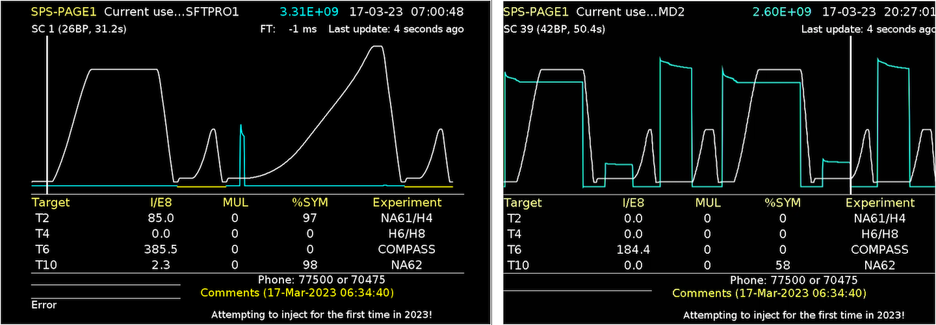
SPS Eco Mode and Hysteresis Compensation
The versatility of the SPS super cycle comes with advantages & challenges
In case beam is not detected the SPS will go into dynamic economy mode
  Reducing the power consumption, but ensuring the magnetic hysteresis is managed correctly
  If magentic hysteresis could be managed differently one could perhaps avoid pulsing at all if no beam is detected

Slide 17
Hysteresis Compensation Using Machine Learning
Hysteresis cycle are needed to guarantee as much as possible similar magentic conditions for different instances of the same cycle in the super cycle
Needed to:
Limit max rms current
Manage hysteresis
May consume ~ 25 MWh/day
Predicting hysteresis and feeding this forward into the next cycle could potentially avoid the the need for “empty” pulses between cycles
  This is being addressed through the EPA project in BE-CSS in collaboraiton with BE-OP

Slide 18
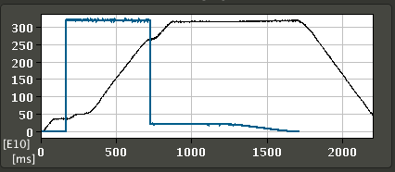
Combined Beam Production on a Single Cycle
PS East Area operation would use the full cycle in the PS Booster and PS to accelerate only one bunch in one of the 4 rings
Combining PS East Area and nTOF operation in a single cycle provide more physics output for the same energy consumed
This still leaves two PSB rings unused
This could be even further enhance if the PS Booster could send two rings to ISOLDE and two rings to the PS
Extr. to East Area
Extr. to nTOF

Slide 19
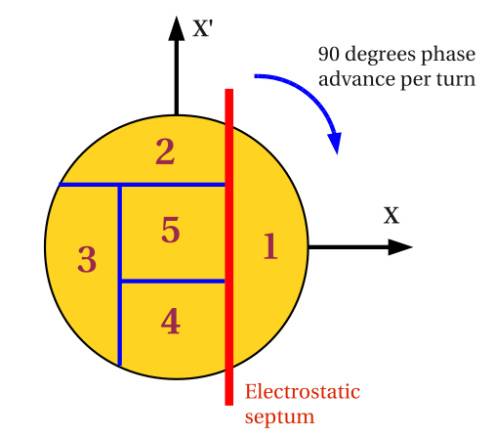
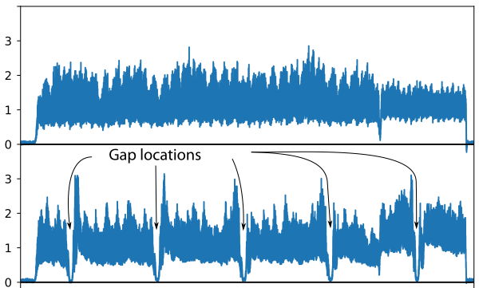


Beam loss management
Continuous loss reduction during routine beam operation is a priority
  Is done through manual or automated optimisation of beam trajectory, extraction process, etc.
  Reduce induced radiation, shorten downtime in case of interventions and minimise radioactive waste
MTE – Multi-turn Extraction
  A completed project that reduces drastically loses at PS extraction for the SPS fixed target beam
  Project lead by BE-ABP, involved many groups among which BE-OP
Recenltly the introduction of a barrier bucket further reduced the remaining extraction losses

Slide 20
Content
The Context
Sustainability in Operations: some examples
Operations Contributing to Sustainability
Concluding Remarks

Slide 21
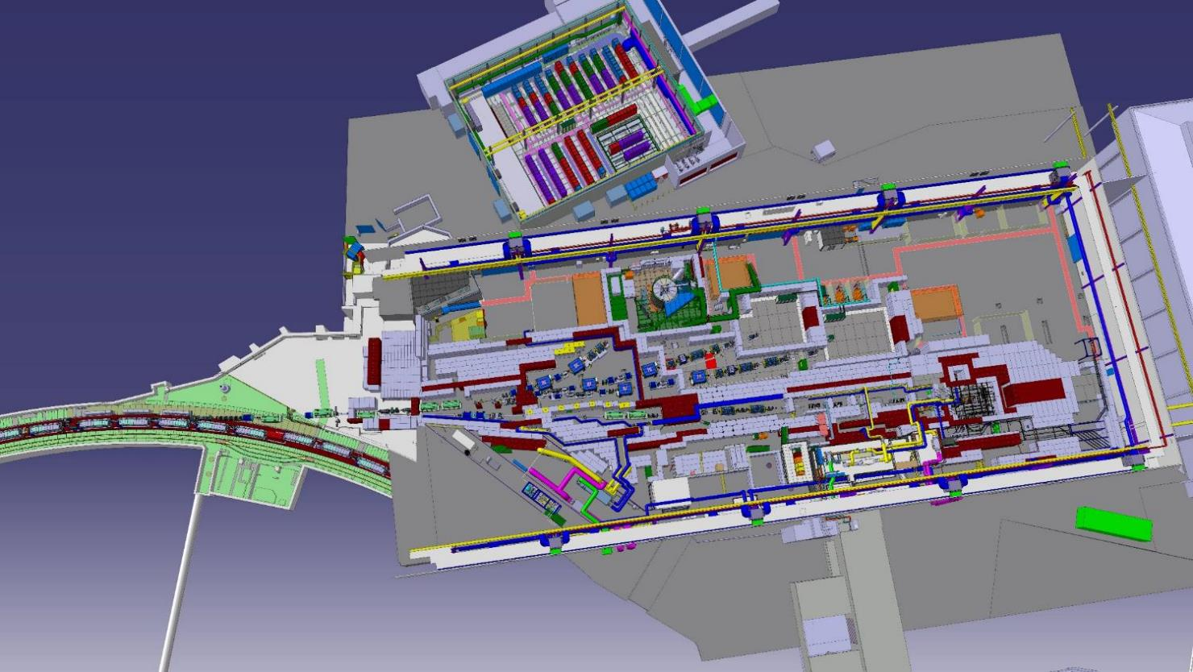
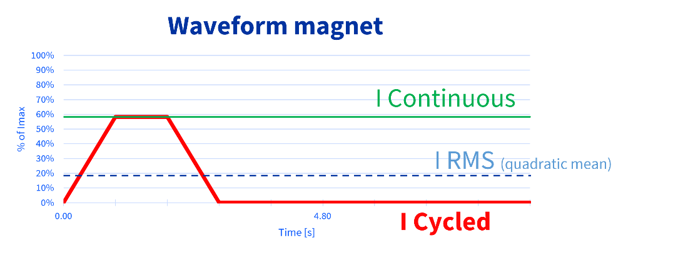
Sustainable PS East Area Consolidation
Good example of changing fundamental operational modes through good collaboration between many groups including BE-OP:
  Optimising operational requirements while reducing power consumption
  Pulsing the magnets during beam passage instead of DC mode saves ~ 6 GWh/yr
Together with other measures taken on the building, CV and EL this results in energy savings amounting to ~ 600 kCHF/yr
OP can contribute to projects and provide a coherent optimised operational point of view
Next: North Area Consolidation
Energy Management Panel #33

Slide 22
Content
The Context
Sustainability in Operations: some examples
Operations Contributing to Sustainability
Concluding Remarks

Slide 23
Concluding Remarks
OP areas of biggest impact are electricity consumption and radioactive waste
Most of the accelerators contain legacy equipment and consolidation offers opportunities to enhance sustainability
  BE-OP can provide input to projects and contribute to a coherent approach through collaboration
  A good examples are the the MTE project and PS East Area consolidation project – we can do the same for the other consolidation subjects like NA-Cons.
Operations can positively influence sustainability, but we may need to create more awareness
  We can investigate further optimising operational processes – mainly small contributions
  We should profit from the period leading up to LS3 to gather more ideas, even with a small impact, and benefit from LS3 to develop and deploy them
  Possibly we can address awareness through a dedicated presentation and discussions during an OP group meeting or as part of the BE-OP shut-down lectures
Suggestions, support and collaboration always welcome !!!

