Slide 1


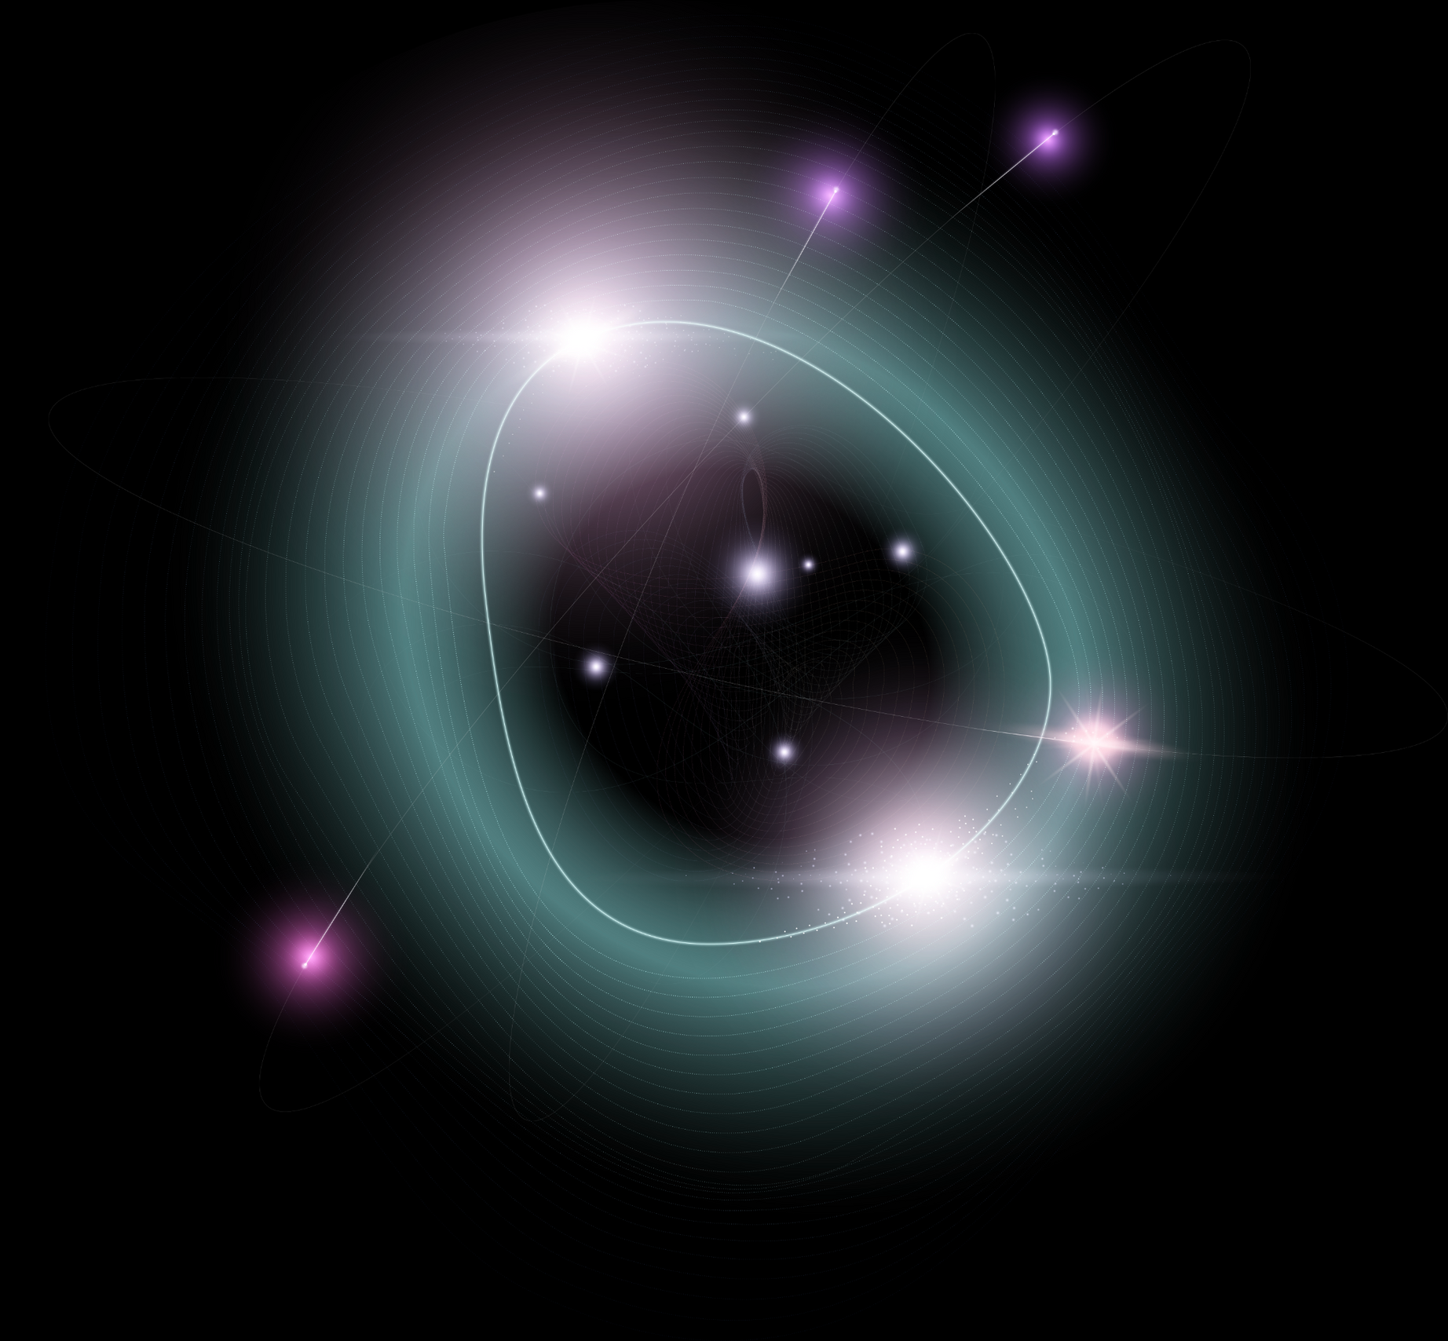


Vector Like Quarks search set-up
+Lego ParticleFlow
Camila Pazmino, 2024 USCMS PURSUE intern

Slide 2


Table of contents
01
02
03
Why VLQs?
The Method
Our Toolbox
04
05
06
Event Selection
Progress
ParticleFlow Simulation

Slide 3
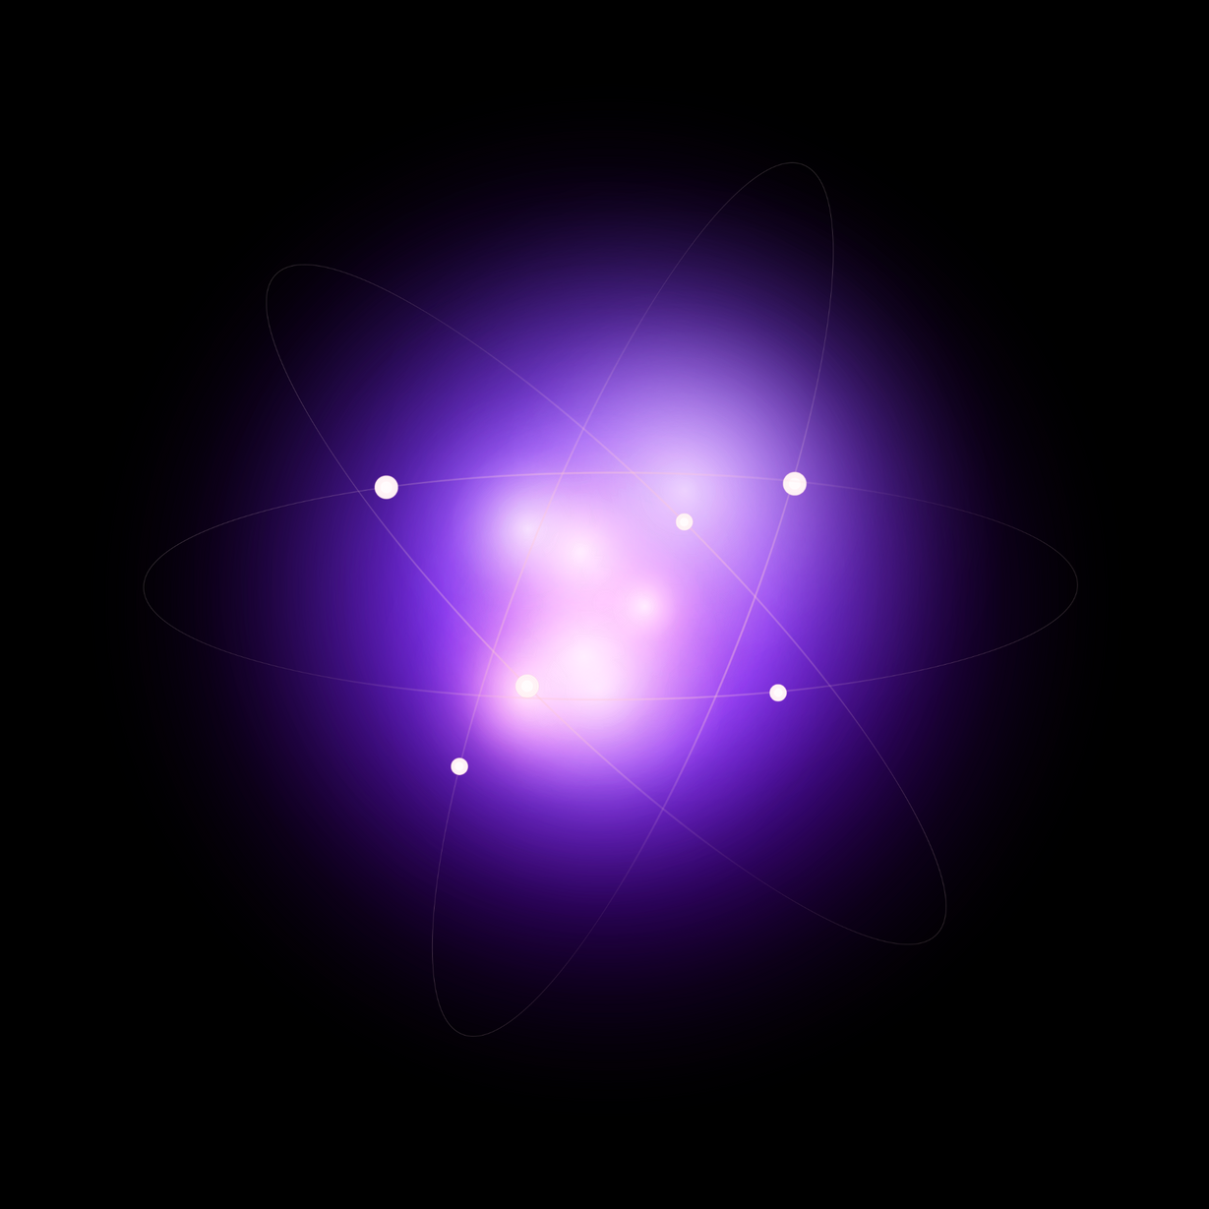
01
Why VLQs?

Slide 4




Why does anyone care?
  Vector like quarks (VLQ) are hypothesized heavy fermions.
  Potential to help solve the limitations posed by the Standard model (SM).
  Vector-like in nature & not constrained by Higgs boson.
  Setting up a search is the first step to discovering new physics.
  I collaborated in building a robust VLQ analysis tool.
Proton (visually enlarged to 10 times its mass), 0.938 GeV
SM top quark, 175 GeV
VLQ Top quark, TeV scale

Slide 5
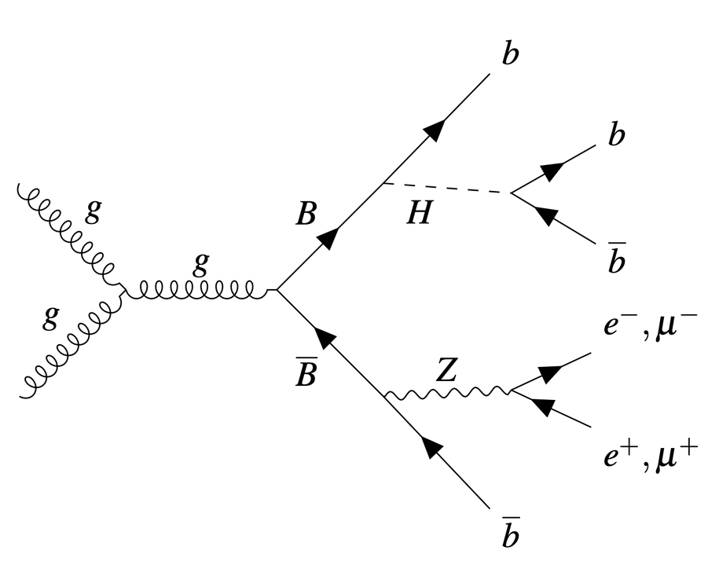
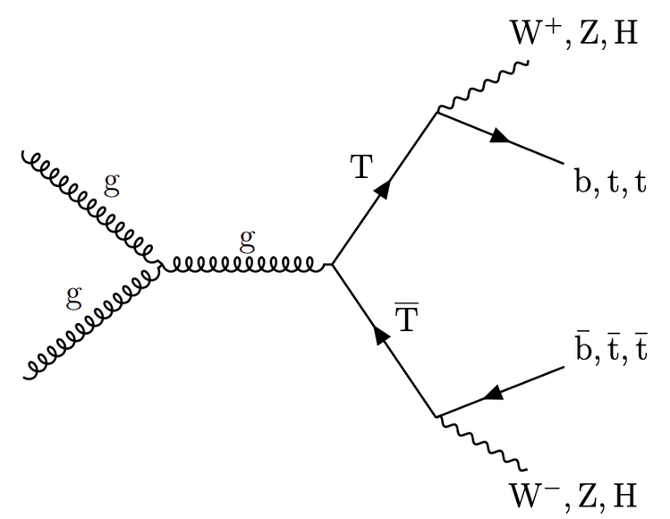

Image 1. Sample Feynman diagram for VLQ TTbar pair production with decays to third generation quarks and SM bosons (The CMS Collaboration, 2023).
Image 2. Sample Feynman diagram for VLQ BBbar pair production with fully hadronic final states, including leptonic Z decays (Grancagnolo, 2024).
(Grancagnolo, 2024): arXiv:2405.08782v1
(The CMS Collaboration, 2023): arXiv:2209.07327v2

Slide 6

02
The Method

Slide 7


Objective
  Create a VLQ software search tool that uses CMS Run 3 data.
  Functional with both MonteCarlo simulations and real CMS collision datasets

Slide 8
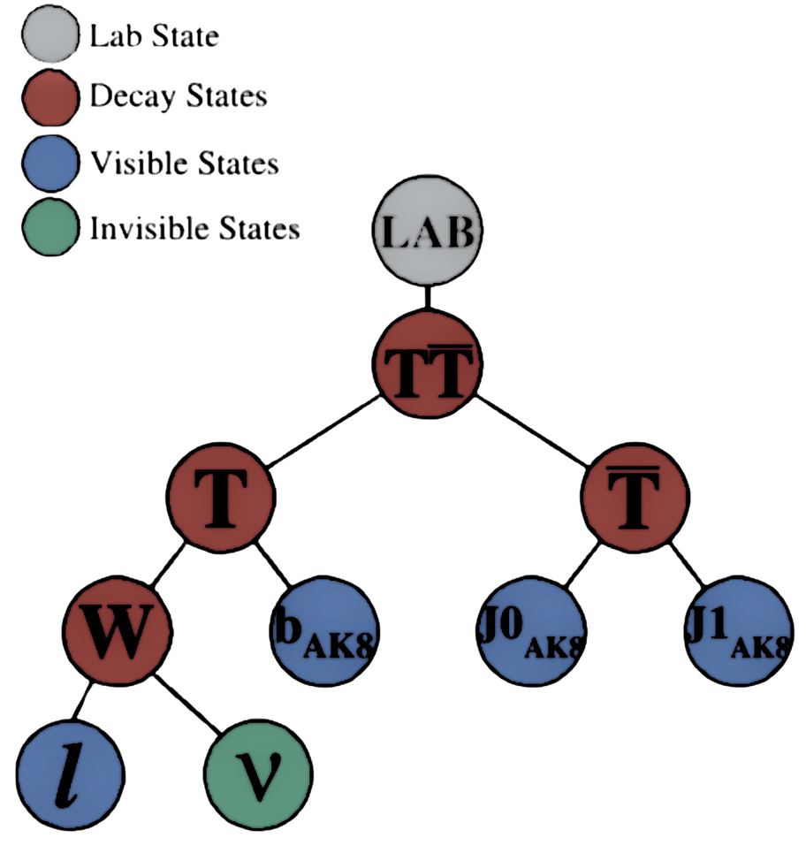

Methodology
By implementing Recursive Jigsaw Reconstruction (RJR) and the TIMBER analysis framework, we create a program that is to be deployed to the FermiLab server grid so it can analyze all Run 3 data.
Image 2. Sample RestFrames decay tree for VLQ TTbar pair production.

Slide 9





Project Scheme
Define events and build recursive jigsaw reconstruction trees.
Utilize corrected architecture to run ~all MC for 2022 and 2023.
Step 1
Step 3
Step 2
Step 4
Set up 2022 & 2023 data corrections.
Test limit & compare current analysis to LHC Run-2 analysis.

Slide 10

03
Our Toolbox

Slide 11

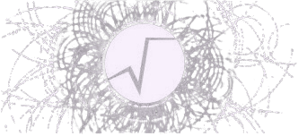



Relevant tools for the search software
Python/C++
ROOT
TIMBER
RJR
Scripting. Main program runs on python 3.
ROOT data analysis framework
Tree Interface for Making Binned Events with RDataFrame
Recursive Jigsaw Reconstruction
RestFrames software library

Slide 12
TIMBER
What?
How?
1) Open ROOT file(s)
2) Keeps track of processes
3) Keeps native RDataFrame tools
Loops over the data frame and grouping actions
Nodes store information about their parents or children.
RDataFrame for each node is kept accessible

Slide 13
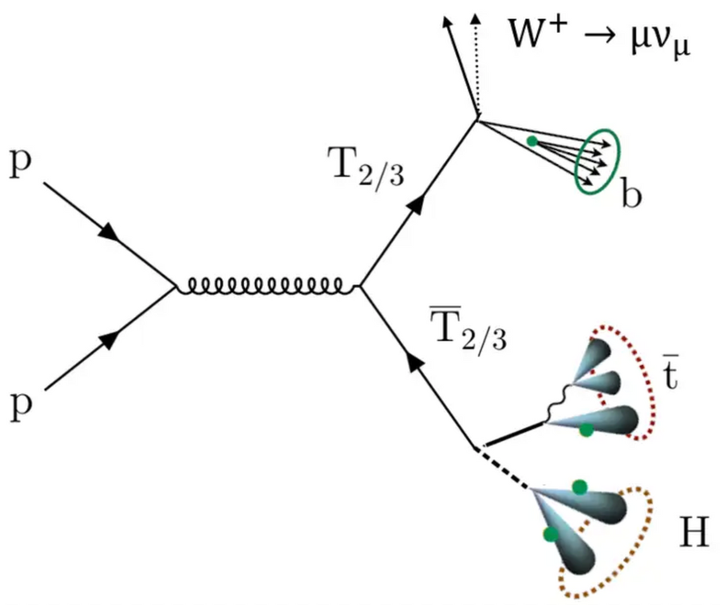
Recursive Jigsaw Reconstruction
RJR comes from RestFrame, a software library for HEP event analysis.
Possible defining groups for VLQ decay trees:
  One option is a combinatoric group of 2 jets (allows us to categorize events by how they are tagged).
  Another option is a jet + W, implementing standard rules for rebuilding the boson.
  There’s more possibilities

Slide 14

04
Event Selection

Slide 15
Criteria
We need a single lepton, missing transverse energy, and at least 3 boosted (large-radius) jets:
  The single-lepton channel provides broad sensitivity to all TT decays, as well as sensitivity to B quark decays to tW.
    Either t or W decay leptonically into a charged lepton and a neutrino, while the other initial products decay hadronically and produce large-radius jets.
  Boosted jets are separated from the leptonic particle candidate by ∆R > 0.8, to ensure unique decay products.
  Dominant SM background processes are W+jets production and tt production.
  Events matching the expected decay modes are observed in simulation to have well-reconstructed VLQ mass peaks.

Slide 16
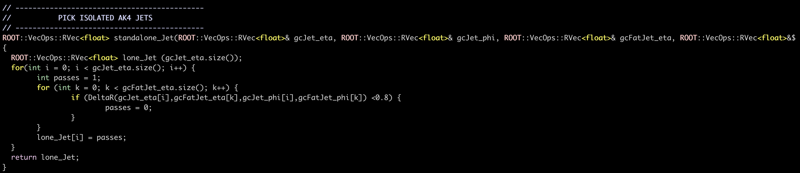


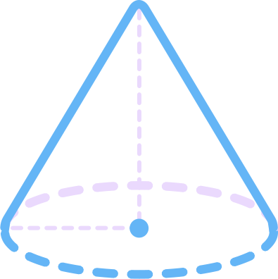
Example

Slide 17
05
Progress

Slide 18
My action plan
Manually update all physics objects corrections
Updating all simulation and data samplenames
for LHC Run 3
1st half June:
2nd half June:
1st half July:
2nd half July:
Updating
(Re)defining
Comparing
Testing
Define event selection criteria as functions / update existing functions
Test MonteCarlo and dataset samples in all different run periods

Slide 19




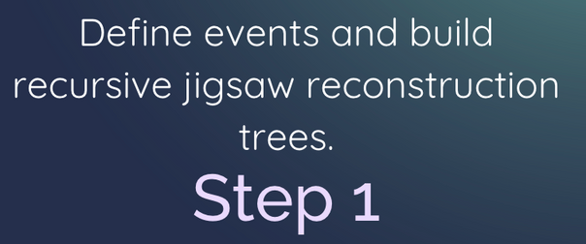
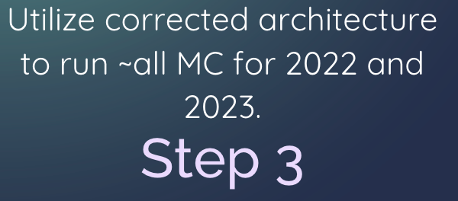
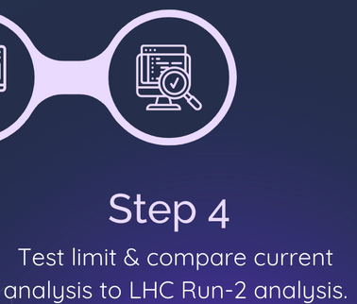
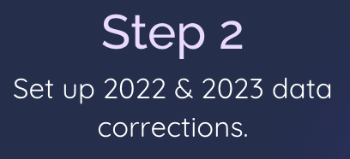

My action plan versus THE action plan
Define events and build recursive jigsaw reconstruction trees.
Utilize existing run schemas to run ~all MC for 2022 and 2023.
Step 1
Step 3
Step 2
Step 4
Set up 2022 & 2023 data corrections.
Test limit & compare current analysis to LHC Run-2 analysis.
(Re)
things

Slide 20
What’s next
  Run all data for CMS Run 3 through our program.
  Get results (set of events that passed selection).
  Plot observables.
  Statistical tests will tell if there’s VLQ evidence in our results.

Slide 21
06
Lego ParticleFlow

Slide 22
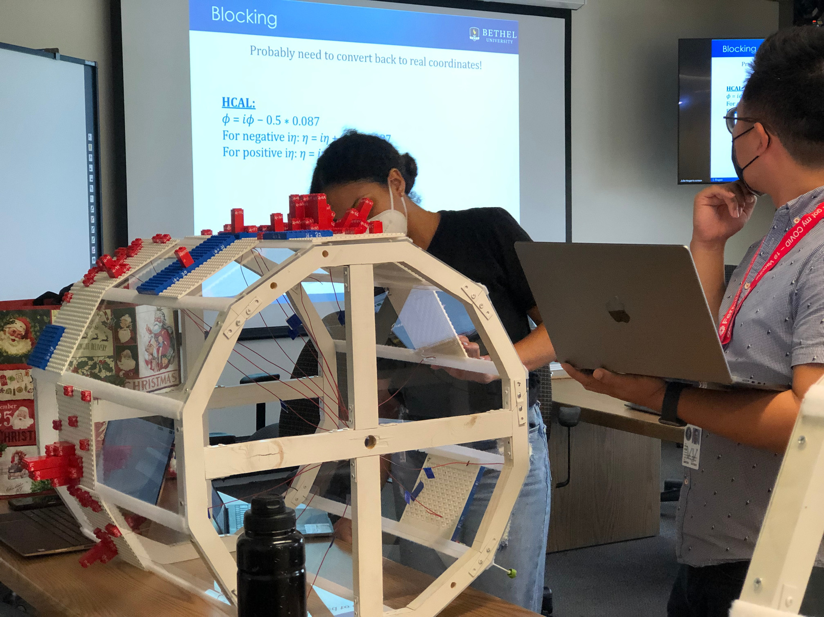
LEGO Particle Flow is an interactive, hands-on activity for graduate students at the CMS summer HATS

Slide 23
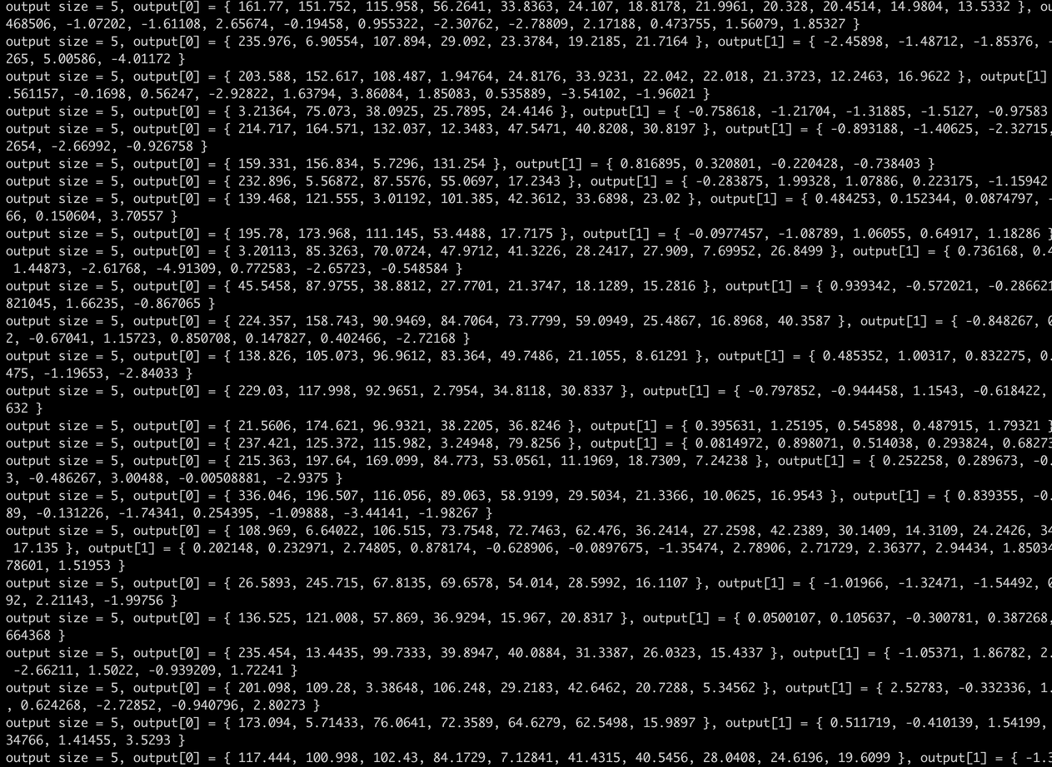
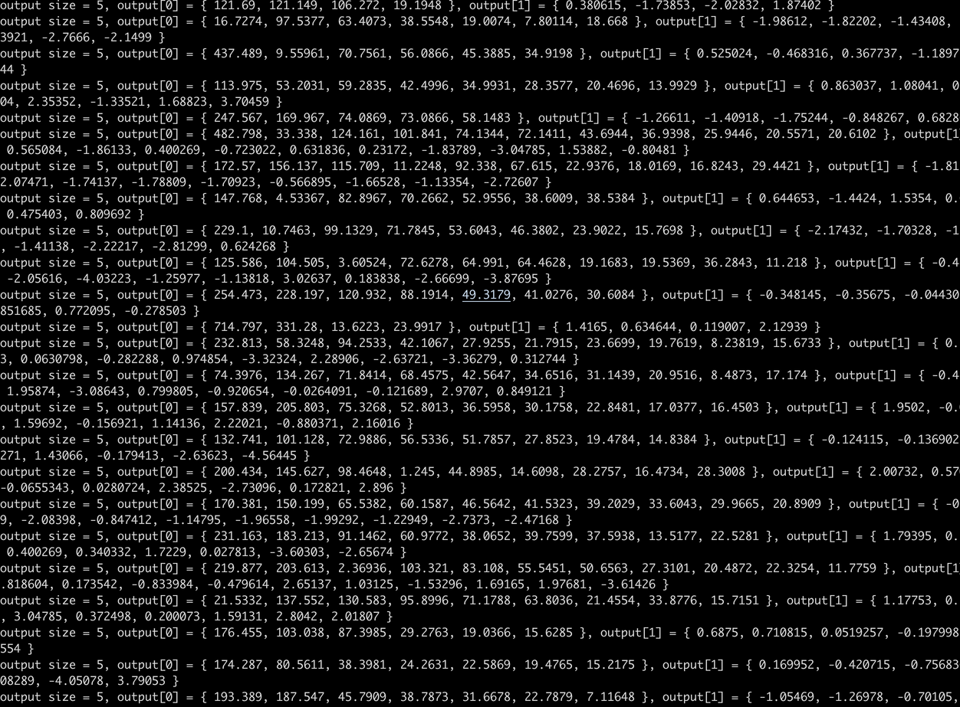

Slide 24
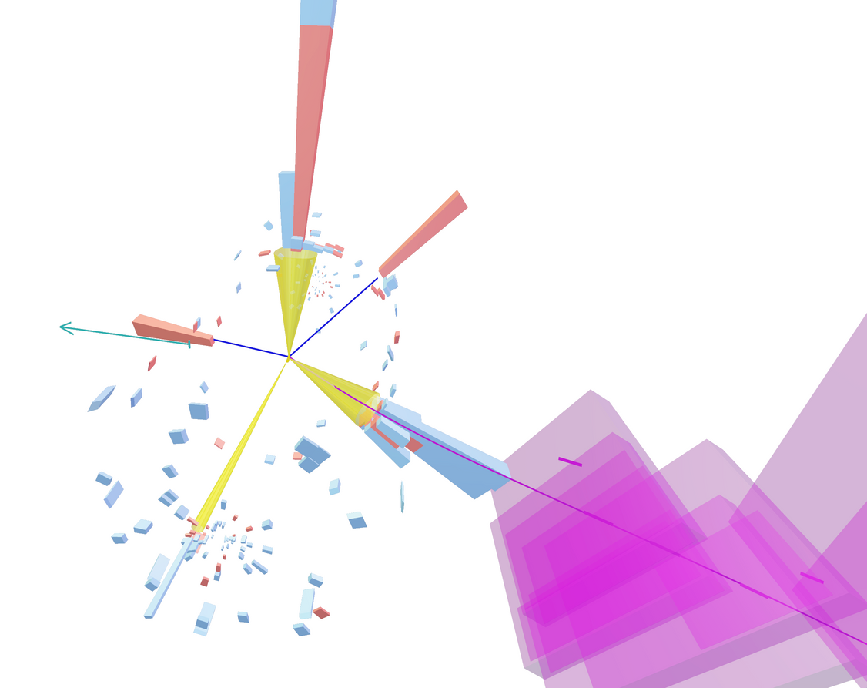
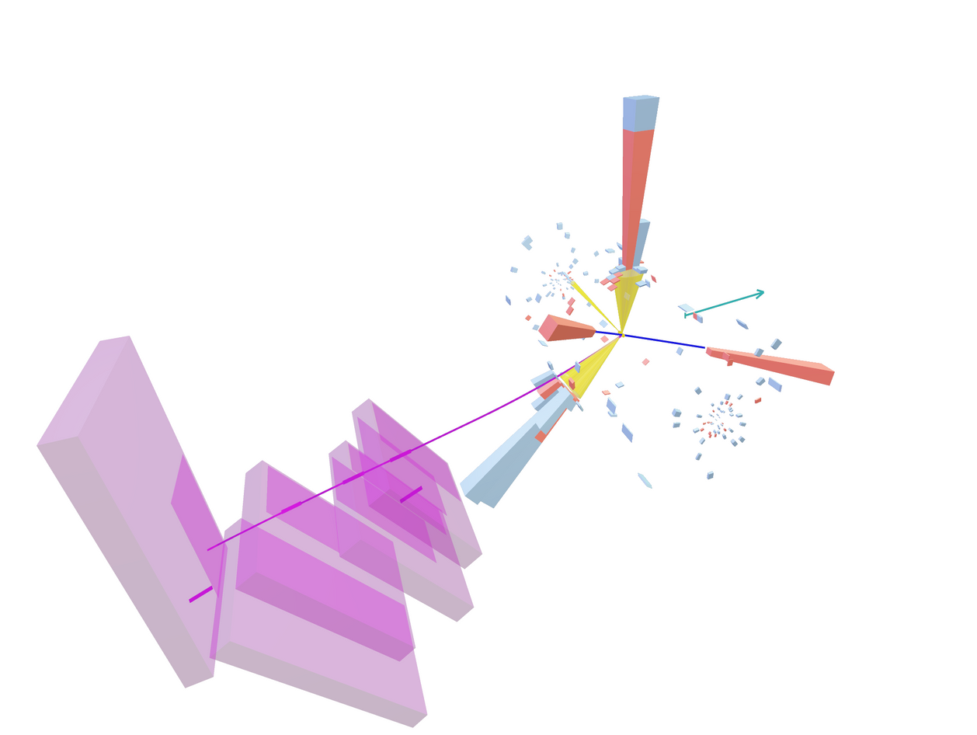

Slide 25
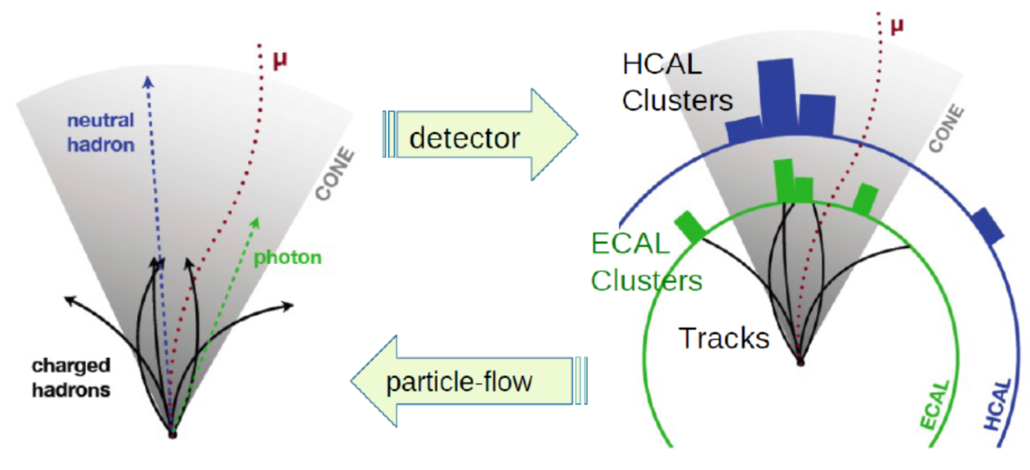


Slide 26
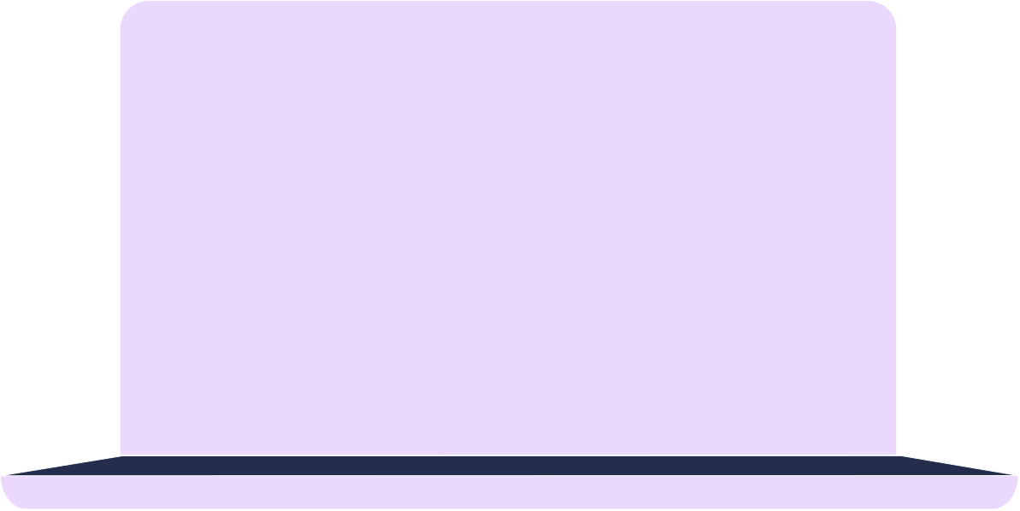
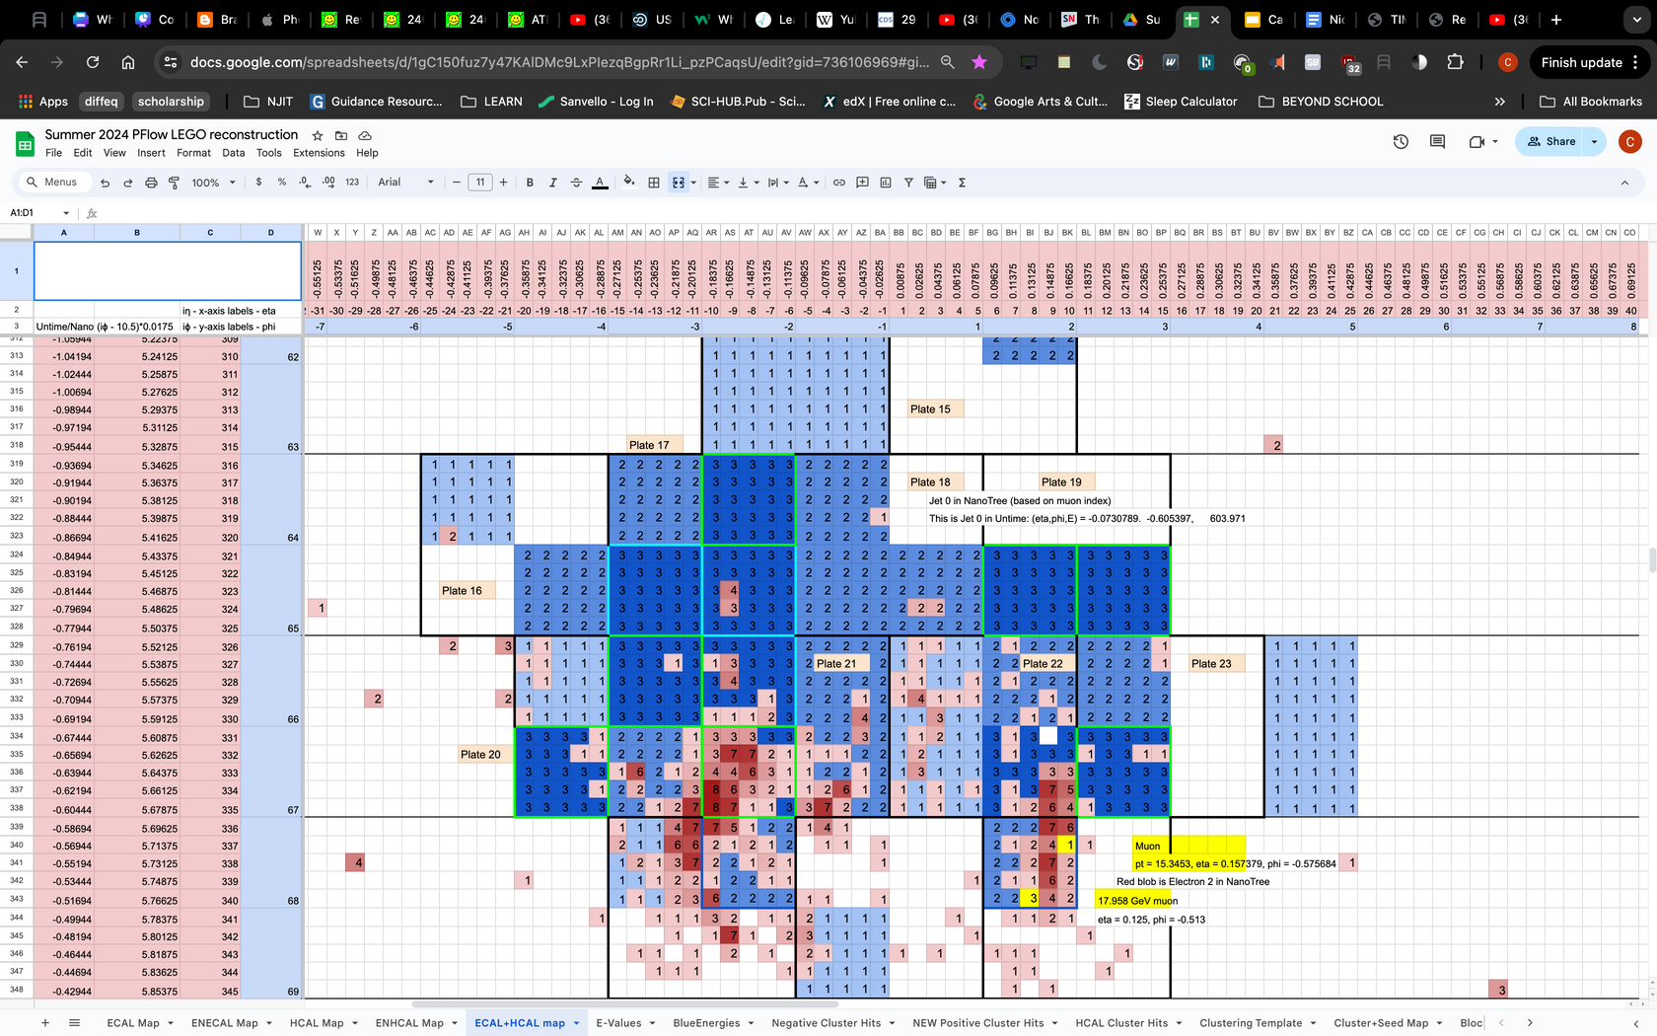

Slide 27
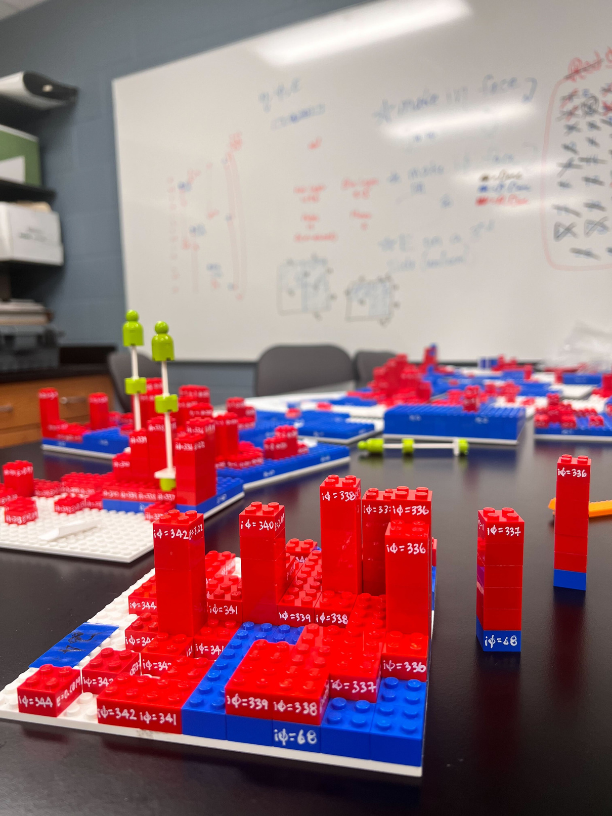
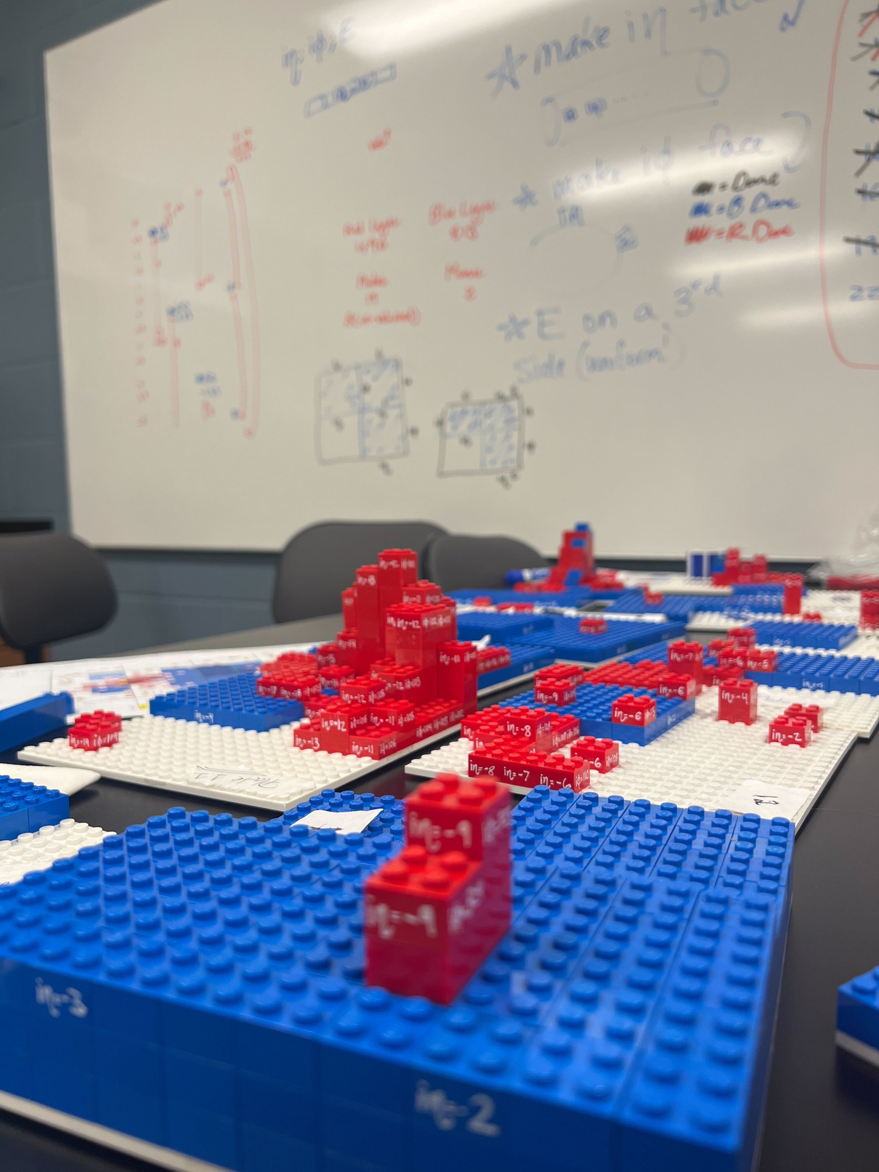

Slide 28
Thanks!

Slide 29
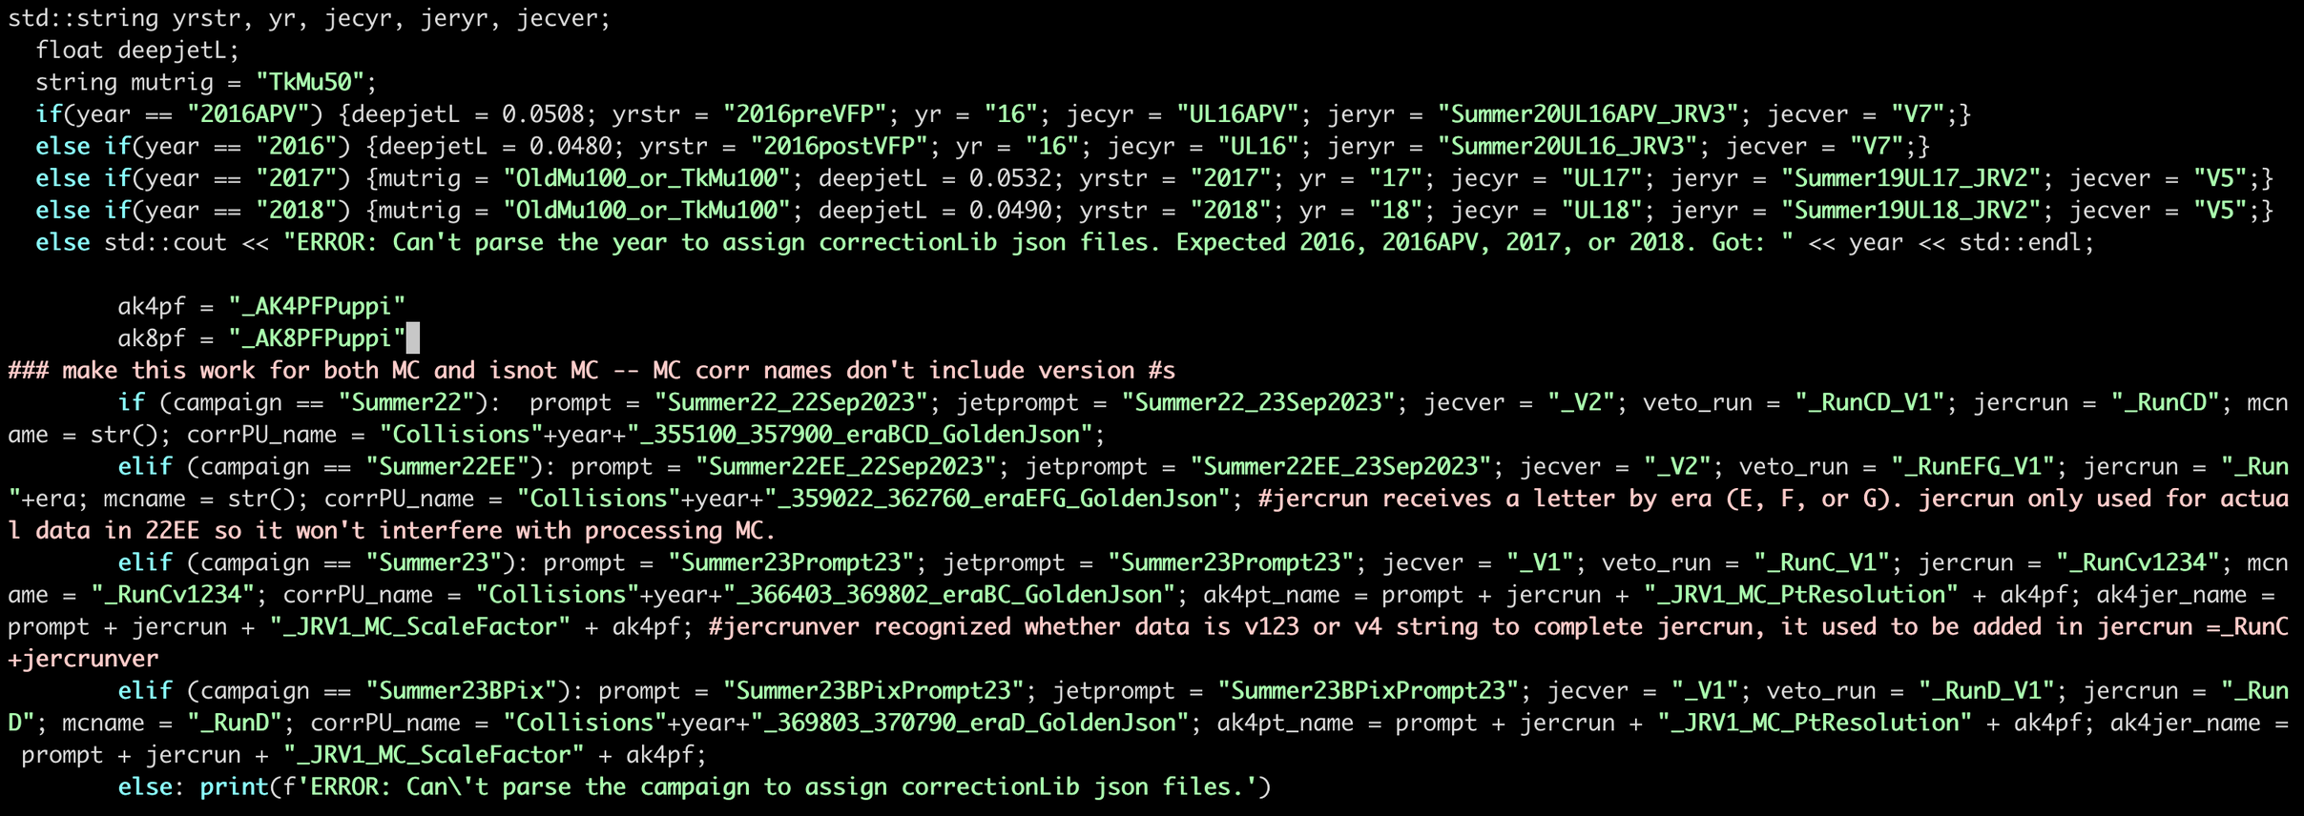

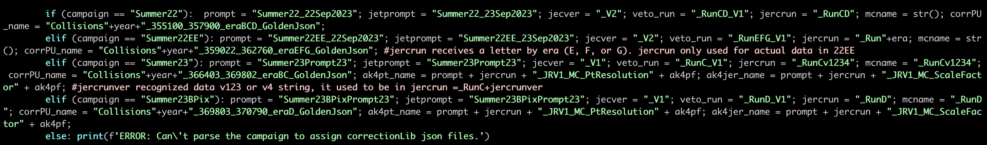
Manually update physics objects

Slide 30
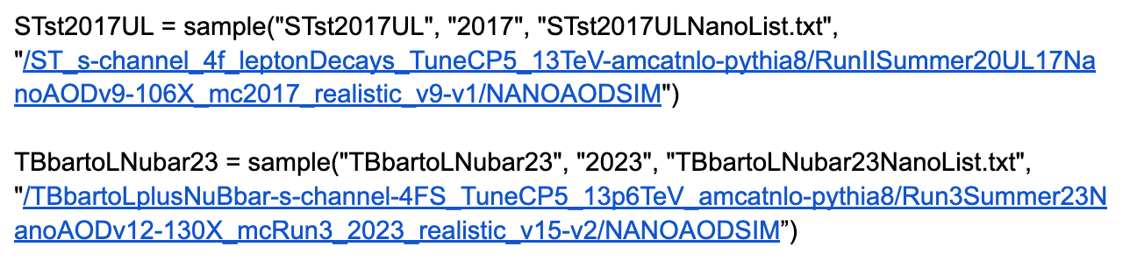
Updating all simulation and data samplenames for LHC Run 3

Slide 31
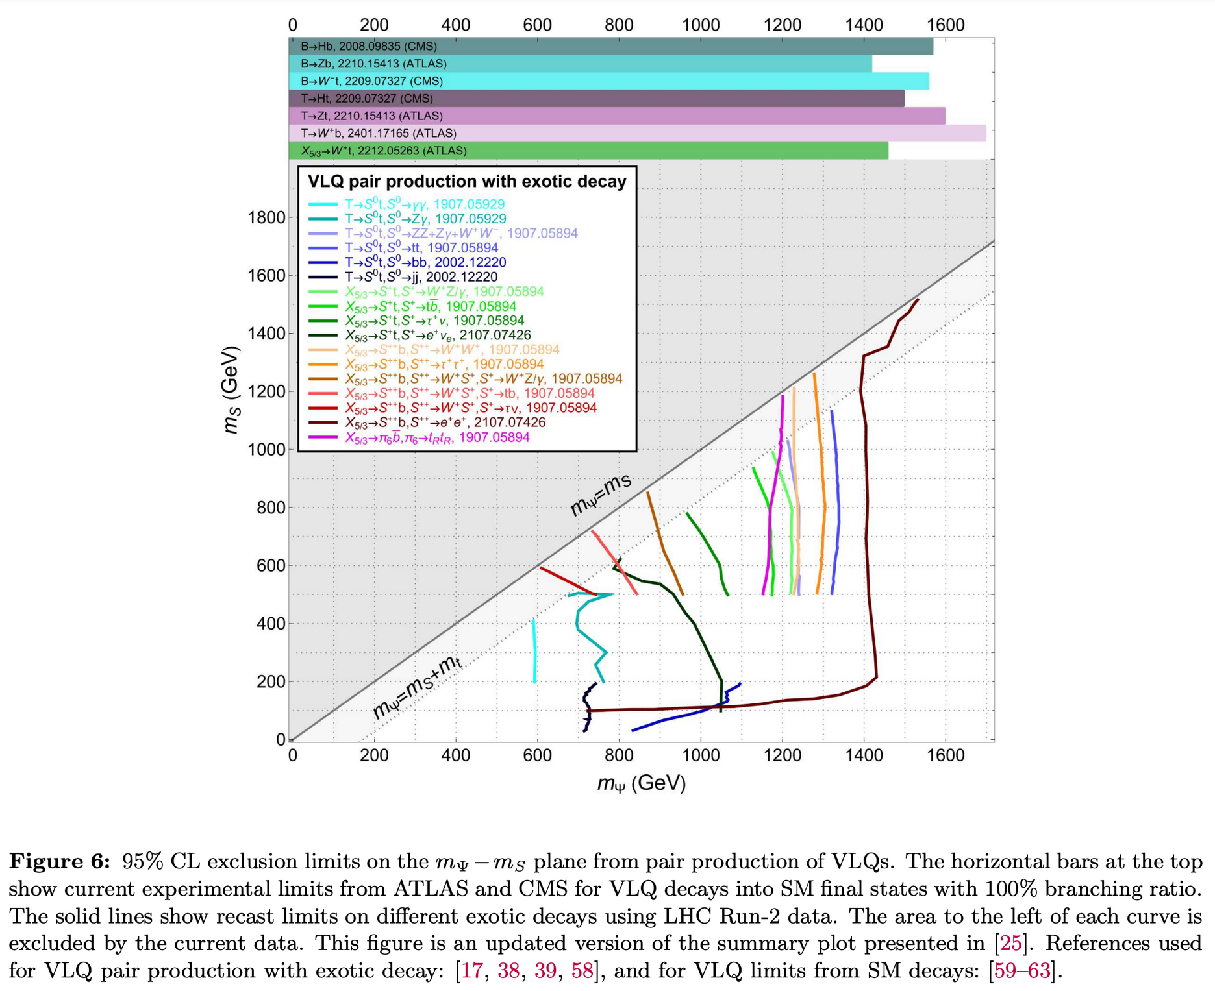
Experimental mass limits
arXiv:2406.09193v1

Slide 32
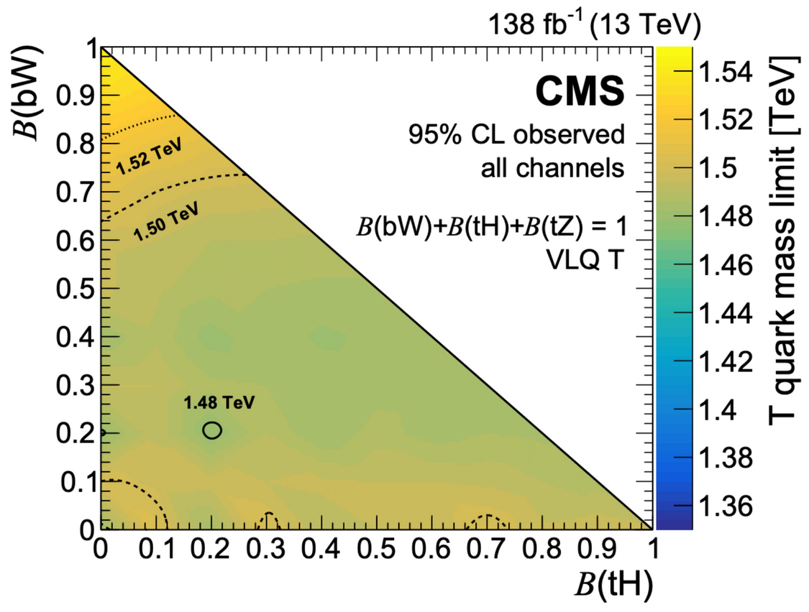
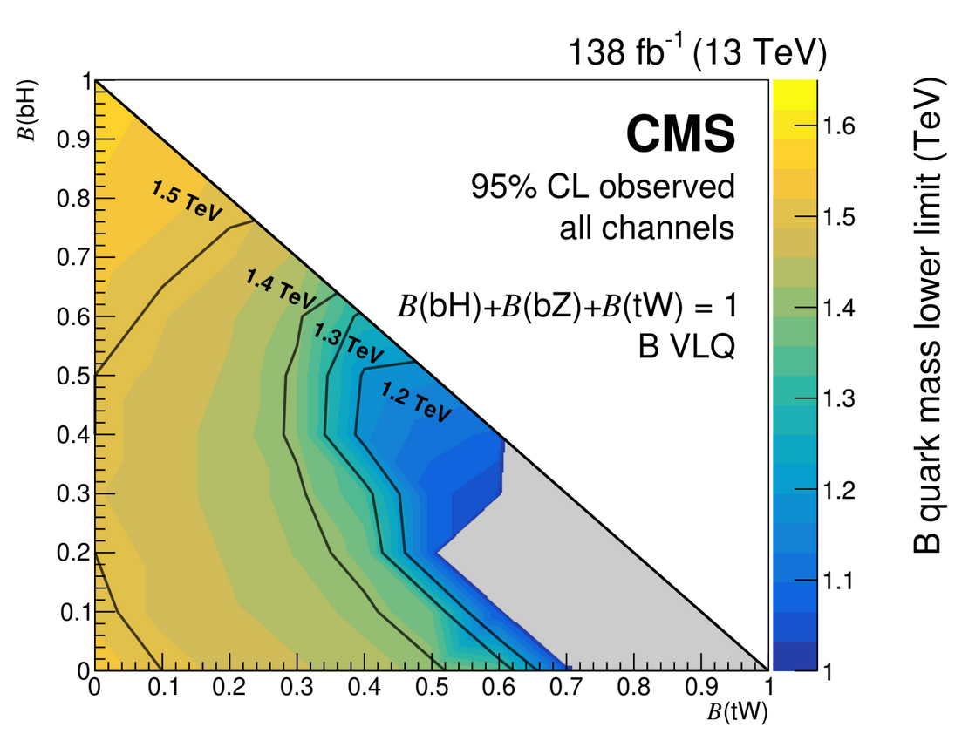


Experimental mass limits

Slide 33




What’s the hierarchy problem?
47:37-48:52

Slide 34
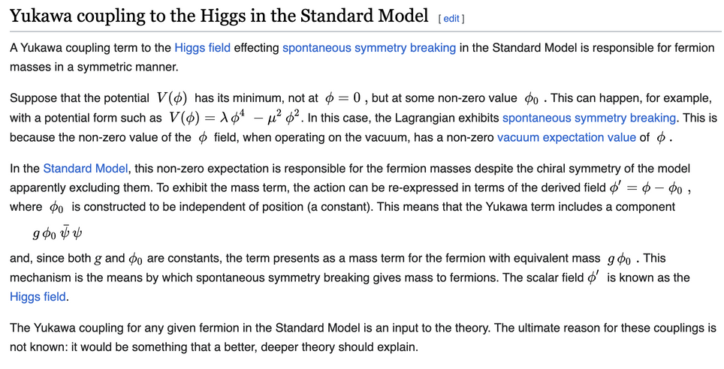
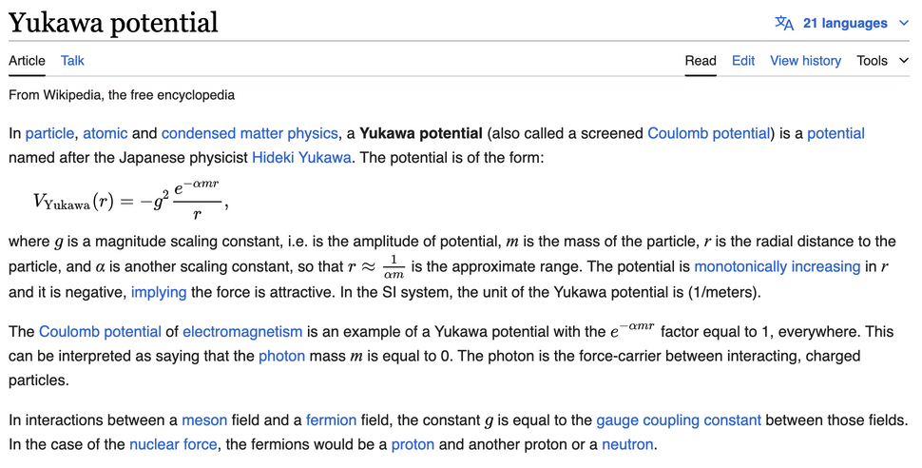
Yukawa coupling?

