Slide 1
Maintenance part storage on Meyrin Site.
Common storage for CO2 cooling and Gas systems.

Slide 2
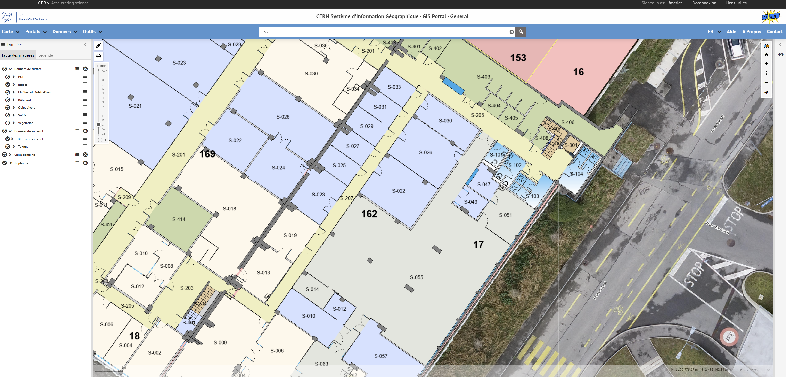
Actual storage for mechanical parts 169/S-022

Slide 3
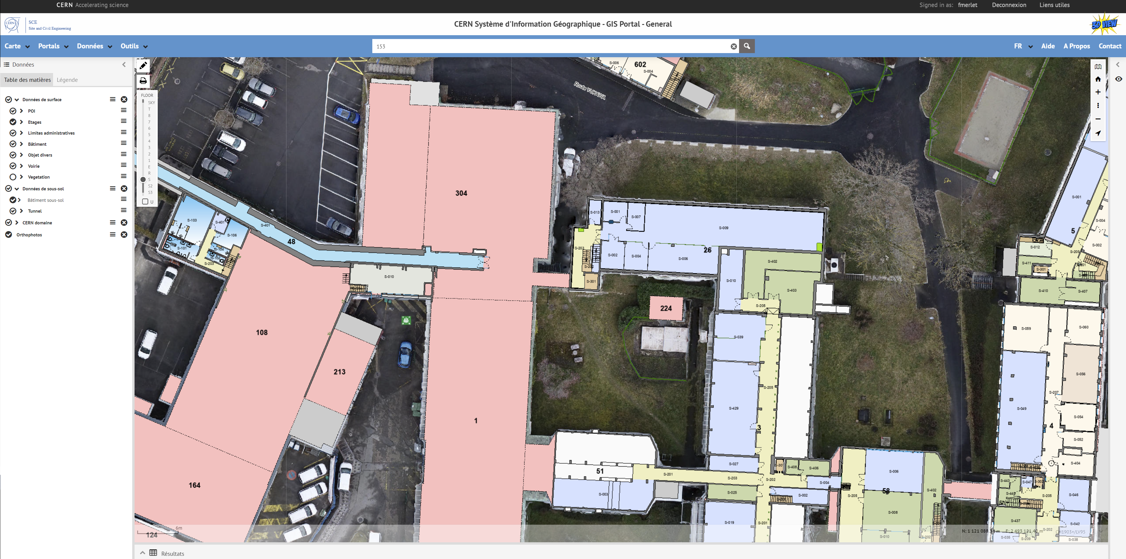
New local for storage 26/S-004 and 006

