Slide 1



Heat transfer studies with supercritical carbon dioxide for detector applications
Camila Rocio PEDANO MEDINA
30/10/2024
This project has received funding from the European Union’s Horizon 2020 Research and Innovation programme under Grant Agreement No 101004761.
Notes:
Good morning,
My name is Camila Pedano and I am a PhD student in the department of Experimental Physics, Detector Technologies group. I work in the section Fluidic Systems, where I study RandD in detector cooling. I started my PhD in Karlsruhe Institute and under Gentner Scholarship in July 2022. I hop on today to give you an overview of my PhD status and progress in the last two years.

Slide 2
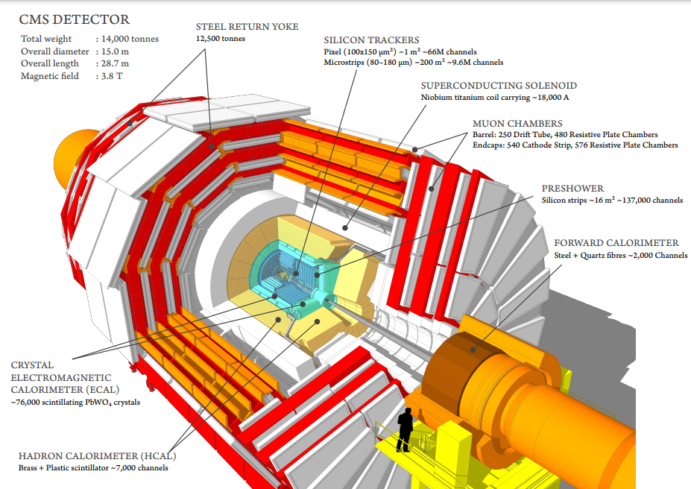
What do we cool when we cool detectors?
Thermal management of modern silicon detectors for HEP experiments is a challenging area due to geometrical, environmental and performance constraints.
The Tracker has typically two tasks:
identification of the particle by associating it with a charge and a momentum
determination of the vertex
Notes:
Before diving into the topic, let’s find ourselves first in the scope of CERN. As you well know, Particle physics experiments in colliding beams are generally composed of detectors concentrically organized around the interaction point. Together with the detector, a powerful magnet which provides a strong field, thus bending the particles. The first set of detectors around the interaction point is generally denominated as The Tracker. The tracker has two main jobs: identification of the particle by associating it with a charge and momentum, and determination of the vertex. There are more detectors in further layers, but we will just stay here.

Slide 3

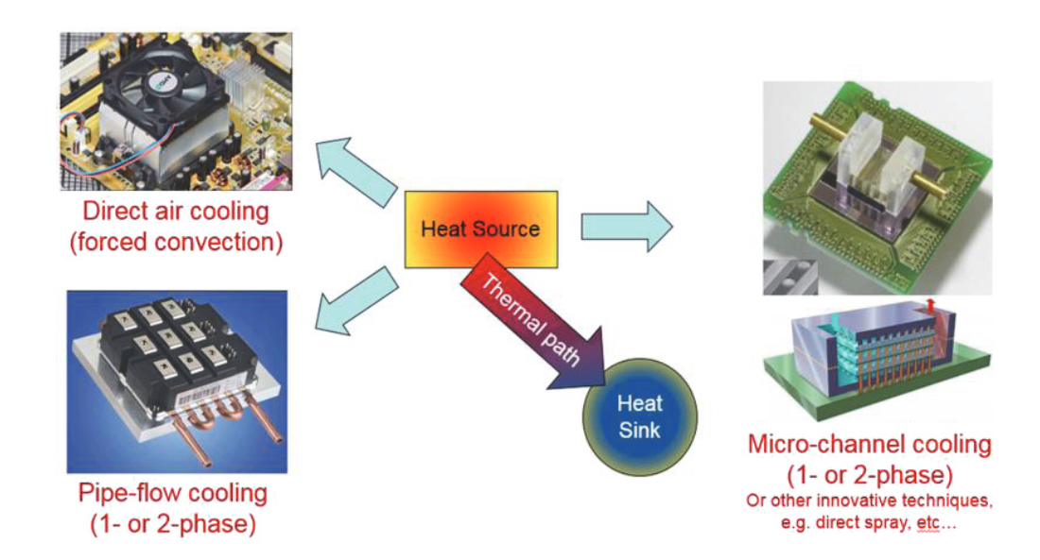
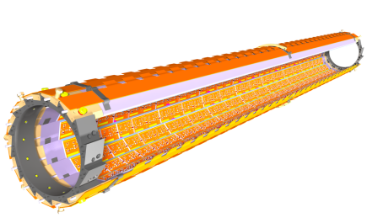
Challenges
Problem of detector cooling is rather generic when dealing with heat dissipation of electronic components, the stringent constraints pose additional difficulties for the thermal engineer
Generic problem
+ big constraints
= need for cool solutions
Minimizing material budget X/X0
Sensor temperatures << 0
Very stable and controlled temperature
Heat source distributed along the convoluted surfaces
Very little space
High magnetic field, high radiation
Long distance between cooling plant and heat sink
Notes:
Silicon detectors are full of electronics. Electronics produce heat, which we must dissipate. The problem of detector cooling seems to be rather generic, like any other electronics thermal management. When I say generic problem for the thermal engineer, I mean that whenever we think of dissipating heat means that we have a heat source, we need a heat sink and we need to optimize the thermal path to get from the heat source to the heat sink. In addition to this, the stringent environmental, stability and space constraints (among others) pose challenges in detector cooling.
Unlike typical electronics cooling, our systems must operate with precise stability ranges to avoid interference with the trackers. Additionally, space is scarce, and materials must withstand high levels of radiation and maintain performance over extended periods.

Slide 4
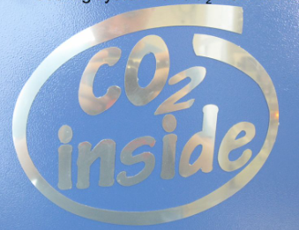
Future of HEP detectors
1990s
2000s
2014 on
Water in single-phase in a leakless sub-atmospheric pressure system
Evaporative cooling systems with perfluorocarbons started being used due to their better performance
A new technology using evaporative flows of CO2 was developed and started cooling ATLAS ITk
CO2 boiling flows will be the standard refrigeration approach for cold-operated detectors at HL/LHC.
We still need room temperature cooling for HL-LHC detectors not requiring cold operation and service trays
Options available right now for this are:
Water
Synthetic refrigerants
Ammonia, sCO2, HCs
Notes:
In the past, HEP detectors were cooled with water in single-phase in a leakless sub-atmospheric pressure system. In the 2000s, evaporative cooling systems with perfluorocarbons started being used thanks to their better performance. Since 2014, a new technology using evaporative flows of CO2 was developed and started cooling ATLAS ITk. Currently, boiling co2 flows are the standard refrigeration approach for cold-operated silicon detectors at HL-LHC. However, room temperature liquid cooling will still be used in many HL-LHC detectors not requiring cold operation, as well is another non-detector parts like service trays leading to the innermost part of the detector.
The options available for this right now are:
Water
Synthetic refrigerants
Ammonia, CO2, HCs

Slide 5
Future of HEP detectors
1990s
2000s
2014 on
Water in single-phase in a leakless sub-atmospheric pressure system
Evaporative cooling systems with perfluorocarbons started being used due to their better performance
A new technology using evaporative flows of CO2 was developed and started cooling ATLAS ITk
Although boiling flows of CO2 could be used at ambient temperature conditions (below 74 bar, Pc), multibranched boiling flows require a lot of expertise not only in design but also in M&O.
Whereas for cold operation it is essentially mandatory to go two-phase, in room temperature, single phase systems deliver satisfactory performances that make it unnecessary to get things complicated with two-phase
Notes:
In the past, HEP detectors were cooled with water in single-phase in a leakless sub-atmospheric pressure system. In the 2000s, evaporative cooling systems with perfluorocarbons started being used thanks to their better performance. Since 2014, a new technology using evaporative flows of CO2 was developed and started cooling ATLAS ITk. Currently, boiling co2 flows are the standard refrigeration approach for cold-operated silicon detectors at HL-LHC. However, room temperature liquid cooling will still be used in many HL-LHC detectors not requiring cold operation, as well is another non-detector parts like service trays leading to the innermost part of the detector.
The options available for this right now are:
Water
Synthetic refrigerants
Ammonia, CO2, HCs
A final point before I continue is that although boiling flows of CO2 could be used at ambient temperature conditions, they also require a lot of expertise, not only in the design, but in maintenance and operation.
Whereas for cold operation it is essentially mandatory to go to evaporative flows, in room temperature, single phase systems deliver satisfactory performance that make it unnecessary to go complex with two phase.

Slide 6

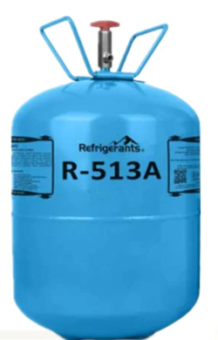

Fluid comparison
Water
Synthetic refrigerants (single phase)
Very good thermal-fluid properties
    High specific heat capacity
    High heat conductivity
Electrically conductive !!!
Dangerous in case of leaks
For sub-atmospheric circuits, strong limitations on pressure drops (<1 bar total) and risk of circuit clogging if air is sucked in
Risk of galvanic corrosion in the piping
Dielectric, non-toxic, non-flammable
Worse refrigerant properties than water
PFCs: very high GWP, use banned by EC (also looks bad for CERN)
HFO/HFEs: low GWP, but form PFAs, will soon be banned in use by the EC. Also looks bad for CERN reputation
Notes:
Water is a great coolant, since it has great thermal-fluid properties. Specifically, it has a very high specific heat capacity, meaning that it needs quite some energy to increase its temperature by one degree. It also has a high heat conductivity, meaning that it is also quite fast at transferring heat from a hot surface to a cold one. Additionally, it is cheap and non-toxic. The problem with water is its electrical conductivity, which is a showstopper when cooling down cable trays, since a leak would be very dangerous. Additionally, even purified water can pick up ions from metal sources and become conductive over time.
Our second option was synthetic refrigerants, which present advantages like non-toxicity, dielectric and non-flammable. Sadly, all of them have worse refrigerant properties than water. Additionally, here we have to make a strong point on the environmental impact of such substances.
I will briefly talk about Perfluorocarbons (PFCs) and Hydrofluoroolefins (HFOs). PFCs are very advantageous in radiation-heavy environments, however they have an extremely high global warming potential (GWP), meaning their environmental impact is significant if released into the atmosphere.
Regarding HFOs, they have a lower environmental impact, however they break down in the atmosphere to give PFAs, which are highly persistent chemicals, known as forever chemicals, since they do not degrade in the environment.

Slide 7
Options available for future applications
HCs
Ammonia
Cannot be used underground!
Toxic
Highly flammable
sCO2
High heat transfer coefficient
Low viscosity: reduced pumping power requirements, allows for smaller and lighter piping systems
High volumetric cooling capacity: high density, can carry a significant amount of heat per unit volume
High thermal conductivity: quick transfer of heat from hot to cold surface areas
High operating pressure: size reduction and high pressure drop allowance
Isothermal cooling could be achieved if designed properly
Notes:
So, now we got to the last three. Among these, boiling flows of ammonia or hydrocarbons would be an option, however ammonia is highly toxic and HCs are very flammable, therefore none can be used underground. Boiling flows of CO2 present the highest performance of all our options, however one needs to build complex systems requiring a lot of effort in the design phase and specialized expertise in maintenance and operation phases.
Our option here is to go to single phase CO2 (single phase as supercritical), which shows a very simple single-phase flow circuitry, with thermal fluid properties potentially better than water. CO2 can provide good heat transfer coefficients, and another winning point is that the low viscosity allows us to use very small pipes, thus reducing space and mass.
CO2 also shows a high volumetric cooling capacity due to its high density (meaning there is more fluid in our fluid), thus carrying a significant amount of heat per unit volume.
High thermal conductivity also characterizes co2.
One of the drawbacks is that to achieve the high cooling performance we need high pressure, however since some decades we are rather proficient at dealing with this, and it may even be used as an advantage, since we can tolerate very high pressure drops if needed.
Additionally, if the circuits are well designed, one could be potentially capable of providing a unique single-phase refrigeration with no temperature increase along the pipe.
A last issue here is that the characteristics are not fully known, which highlights the need of dedicated R&D, which is where we are!

Slide 8
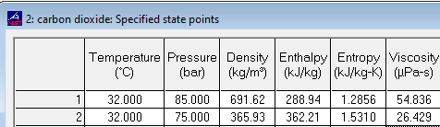
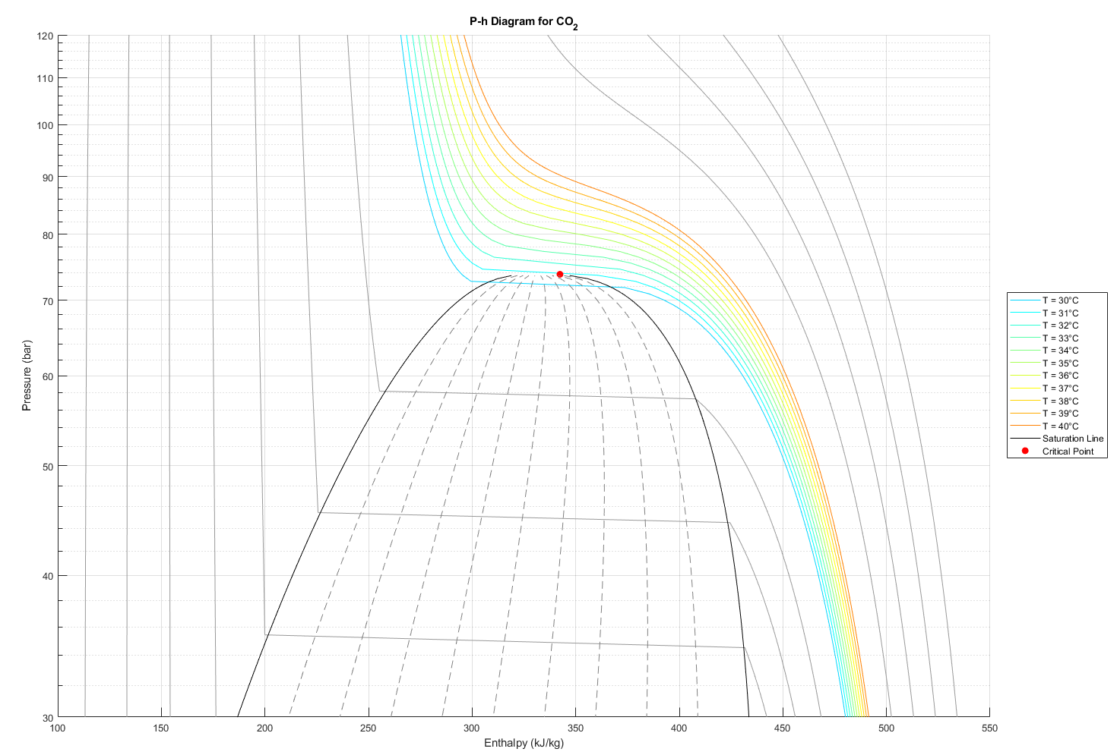
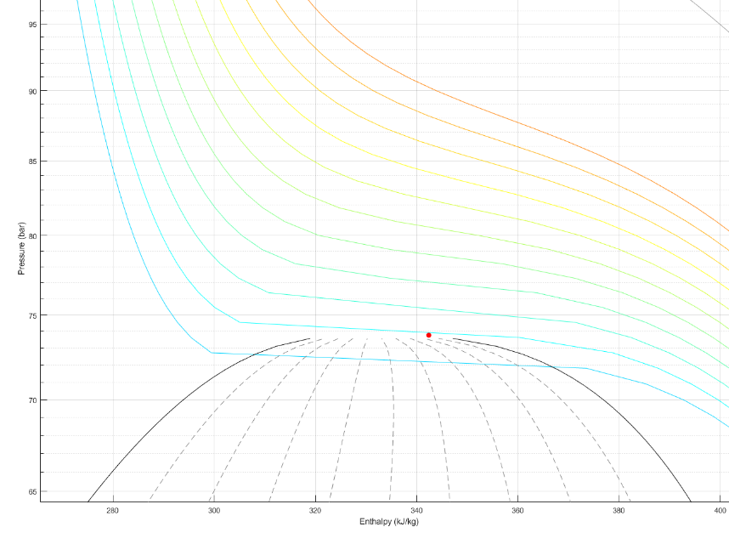

Isothermal cooling?
$$∆h≅73 kJ/kg$$
Notes:
Here we see a pressure/enthalpy diagram of co2. The dome represents the points at which vapor-liquid equilibrium exists. Here, the change in properties from liquid to vapour is discontinuous. Above the critical point stands what we call supercritical fluid, which combines properties of both gases and liquids.
Above this point, properties like density and heat conductivity vary sharply although this variation decreases when increasing operating pressure.
What I mean when I say one could design a system for isothermal cooling is that one could use pressure drop in order to follow the change of fluid properties, as well as pressure-temperature dependence in order to achieve isothermal flow in a pipe, accompanied with a good enthalpy change, needed for sinking heat.

Slide 9
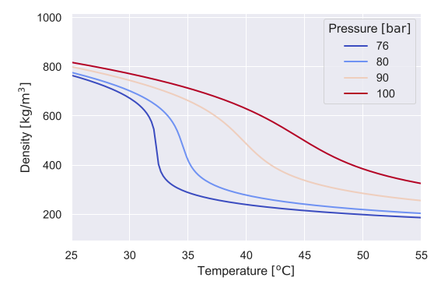
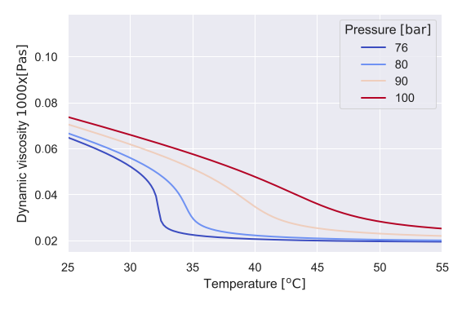
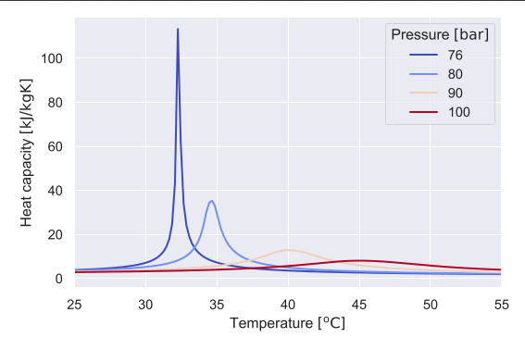

Challenges of sc-fluids
$$∆T<5$$
At pressures above critical pressure, change of fluid properties is continuous but rather sharp
Large variations in density lead to buoyancy forces and flow instabilities
Change in turbulence production can lead to a significant variation of the HTC with small changes of temperature and pressure
Heat Transfer Deterioration can occur: HTC reaches a minimum value leading to very high wall temperature values
Difficulties in prediction of heat transfer behavior
Notes:
As I said before, the main challenge with supercritical co2 is the lack of information. The exact influence of certain process parameters remains unknown, and open source knowledge is scarce.
On the right, three figures showcase the variation of three important properties for heat transfer. Density, dynamic viscosity and heat capacity vary enormously at pressures above critical, and in a very narrow range of temperatures.
The variation of these and other properties leads to changes in buoyancy forces and leads to flow instabilities. This change in buoyancy can alter turbulence production, thus leading to a significant variation of the heat transfer coefficient in small changes of temperature and pressure. Additionally, a phenomenon known as HTD can occur, where HTC reaches a minimum value leading to very high wall temperature values.
All these issues remain unknown and call for dedicated R&D in the field.

Slide 10
What is needed?
Main factors to study:
  Mass flux
  Diameter
  Inlet temperature
  Pressure
  Heat flux
  Flow orientation
Goals
  Characterization of heat transfer coefficient
  Pressure drop
Notes:
After a literature search, the main factors affecting heat transfer with sco2 were found to be the mass flux, diameter, inlet temperature, pressure, heat flux and flow orientation.
The goal of my study is to provide an analysis of the parametric trends in order to characterize the heat transfer coefficient, as well as the pressure drop associated with specific operating parameters. Additionally, one could then find a comfortable and safe operating condition to be applied to detector cooling.

Slide 11
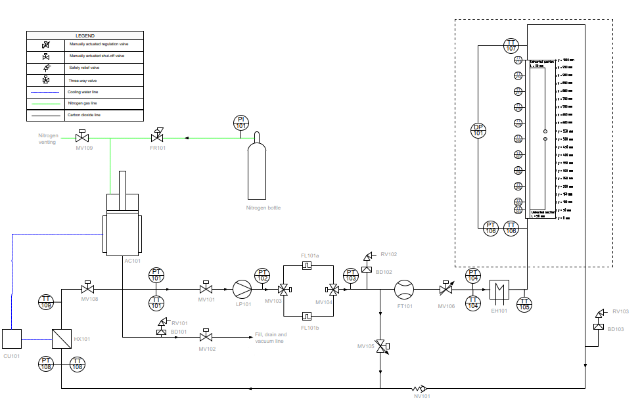
New test setup at CERN
1
2
3
4
Notes:
For this study, I have built a test setup. The setup is shown in the P&ID in the image. The process is centered around the accumulator, shown with the number 1. This unit is a cooled bellow-piston accumulator that provides static pressure to the co2 it contains by means of gas nitrogen. After this, the liquid pump (2) flows the co2 through the rest of the setup to compensate for pressure drops. After this stage, flow is regulated by means of manual valves, flow is measured and the fluid temperature is adjusted before entering the test section. The test section is contained between 3 and 4, and is where all the wall temperatures and pressure drops are measured. After the test section, the fluid is again cooled to its initial temperature and brought back to the start of the process.

Slide 12
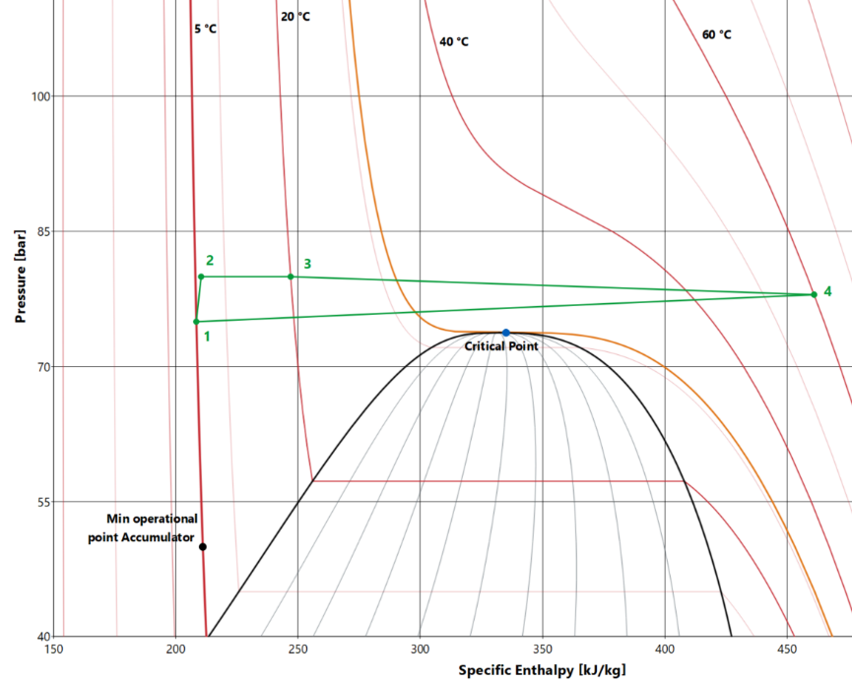
New test setup at CERN
1
2
3
4
Notes:
The process is again depicted in a ph diagram, where we see the fluid pressure and temperature changes throughout the process.

Slide 13
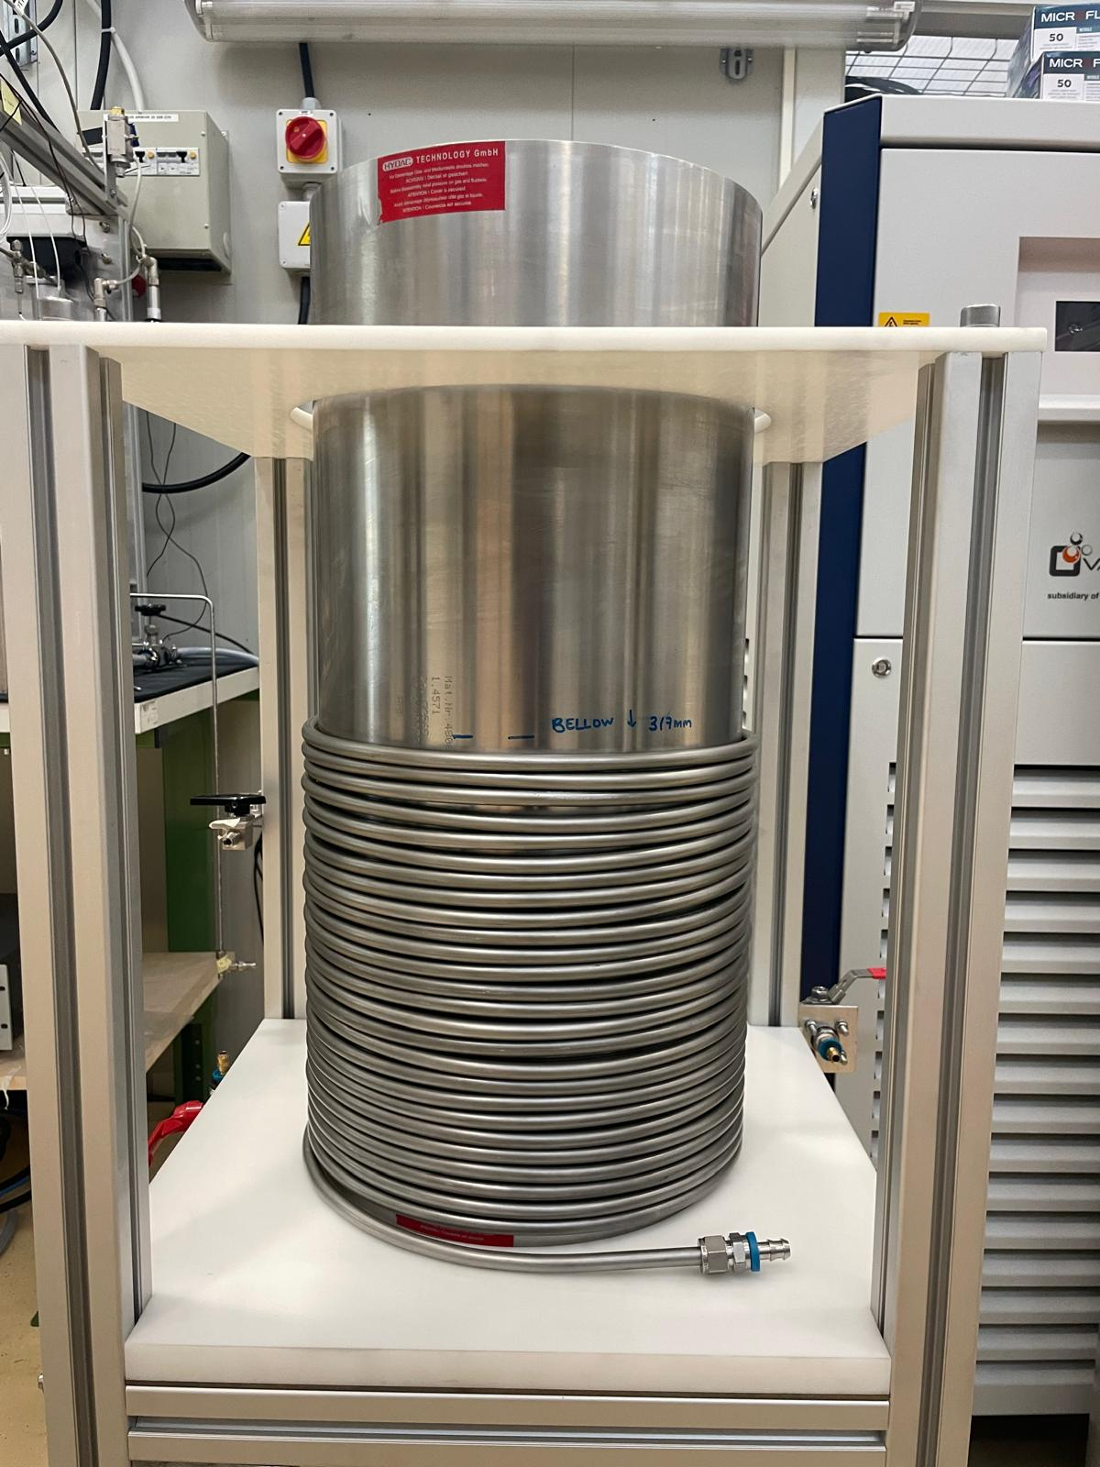
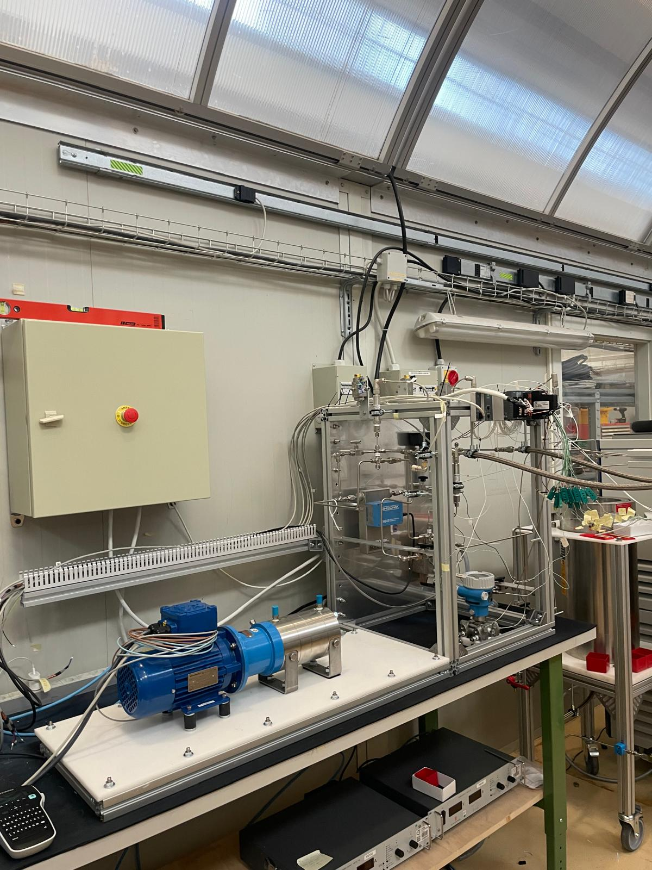
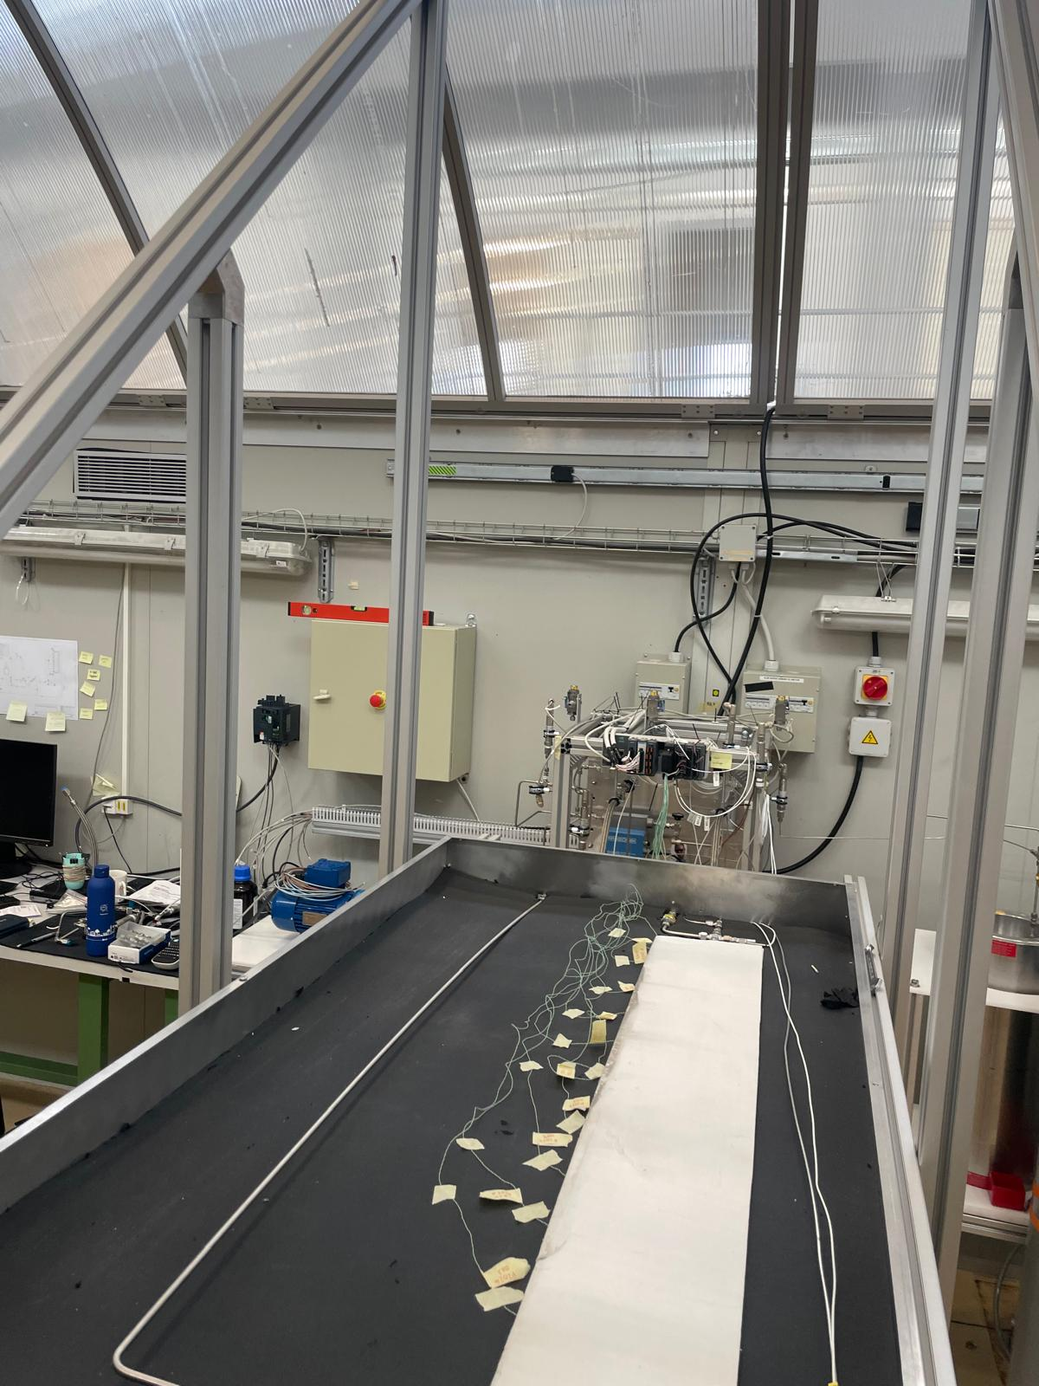
Status
Notes:
The setup is now almost fully built, with only missing final touches in the electrical cabinet, data acquisition software, etc.

Slide 14
Timeline
Currently
Beginning of 2025
End of 2025
Finish software for DAQ
Commissioning
Setup validation and first results
Data acquisition
Writing thesis

Slide 15
Thanks!

Slide 16
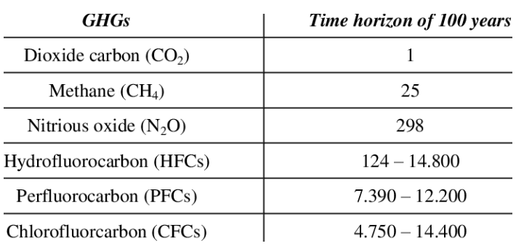
Some definitions
GWP: index to measure how much infrared thermal radiation a GHG would absorb over a given time frame after being emitted into atmosphere
Always referred to CO2, so it is basically the mass of CO2 that would warm the earth as much as the mass of that gas

Slide 17
(small parenthesis)
1990s
2000s
2014 on
Water in single-phase in a leakless sub-atmospheric pressure system
Evaporative cooling systems with perfluorocarbons started being used due to their better performance
A new technology using evaporative flows of CO2 was developed and started cooling ATLAS ITk
Although boiling flows of CO2 could be used at ambient temperature conditions (below 74 bar, Pc), boiling flows require a lot of expertise not only in design but also in M&O.
Whereas for cold operation it is essentially mandatory to go two-phase, in room temperature, single phase systems deliver satisfactory performances that make it unnecessary to get things complicated with two-phase

