Slide 1












Improved Maxwell Demon cooling of antiprotons and direct constrains on antiproton lifetime limits
Julia Jäger
for the BASE collaboration
30/10/2024

Slide 2
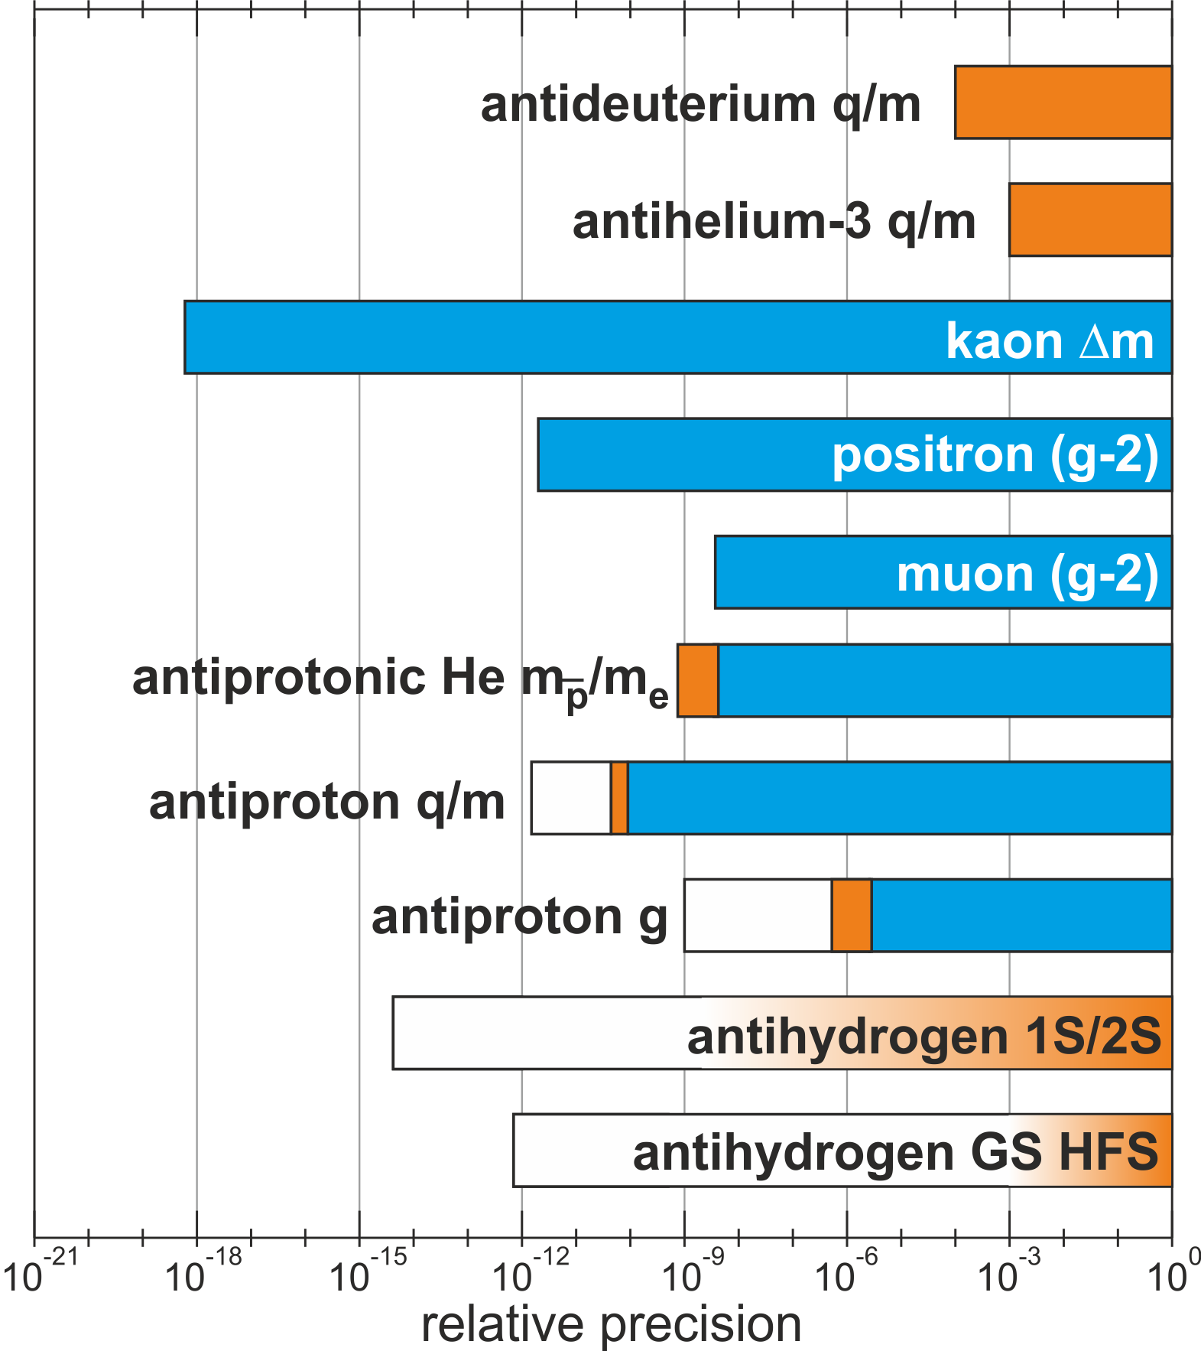
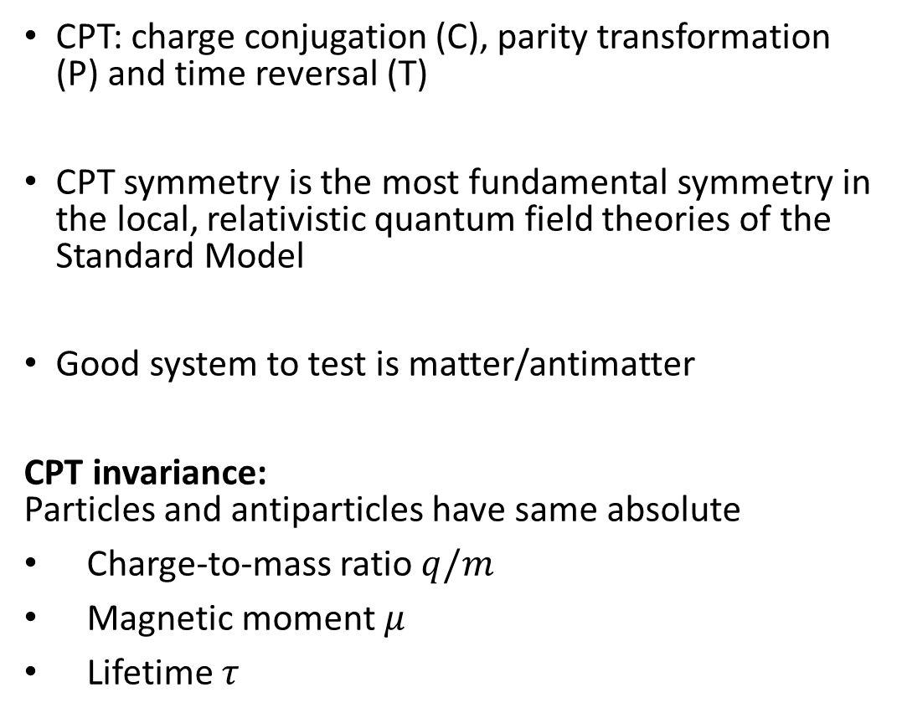
Test of CPT Symmetry
CPT: charge conjugation (C), parity transformation (P) and time reversal (T)
CPT symmetry is the most fundamental symmetry in the local, relativistic quantum field theories of the Standard Model
Good system to test is matter/antimatter
CPT invariance:
Particles and antiparticles have same absolute
Charge-to-mass ratio $q/m$
Magnetic moment $μ$
Lifetime $τ$
Recent
Past
Planned
CERN
ALICE
electron g
muon g
CERN
AD
antihydrogen 1S/2S
antihydrogen GSHFS
We can measure this!

Slide 3



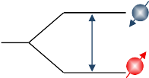
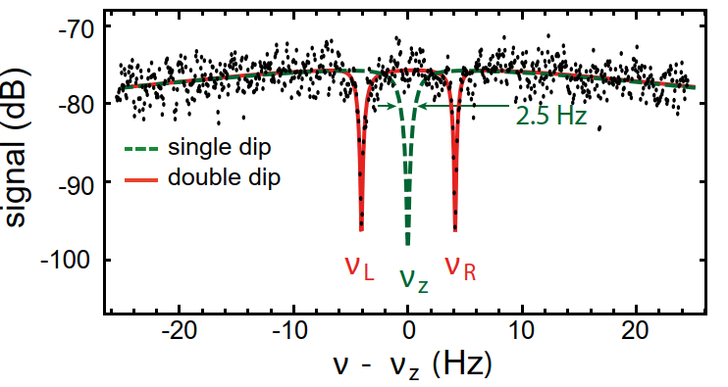
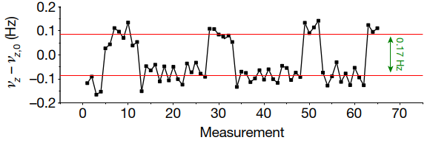
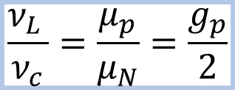
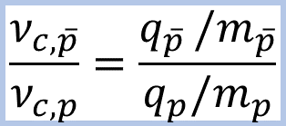
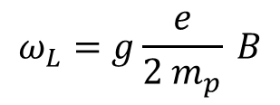
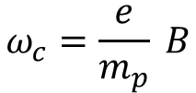
Single Particle Measurements in Penning Traps
High precision mass spectroscopy
High precision magnetic moment measurements
$$\frac{ν_{c,\overline{p}}}{ν_{c,p}}=\frac{q_{\overline{p} }/m_{\overline{p}}}{q_{p}/m_{p}}$$
$$\frac{ν_{L }}{ν_{c}}=\frac{μ_{p}}{μ_{N}}=\frac{g_{p}}{2}$$
$$ω_{c}=\frac{e}{m_{p}} B$$
$$ω_{L}=g\frac{e}{{2 m}_{p}} B$$
spin down
spin down
16 p.p.t. comparison of the antiproton-to-proton charge-to-mass ratio
[1] BASE Collaboration, Nature 601, 53–57 (2022)
1.5 p.p.b. Measurement of antiproton magnetic moment
[2] BASE Collaboration, Nature 550, 371-374 (2017)

Slide 4
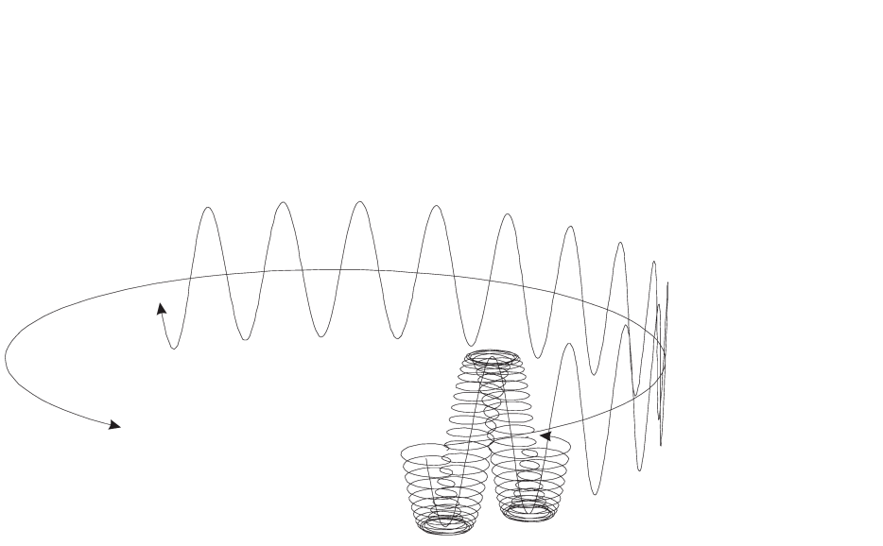
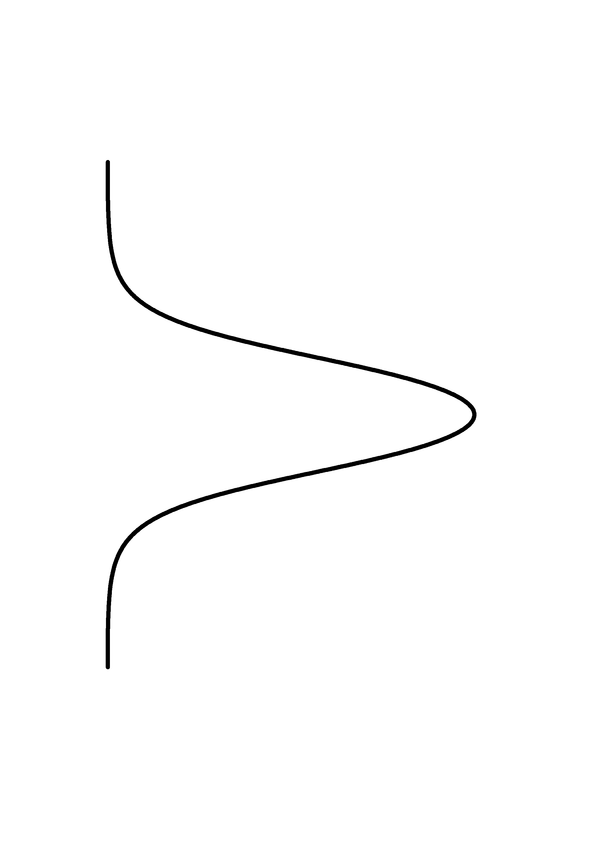
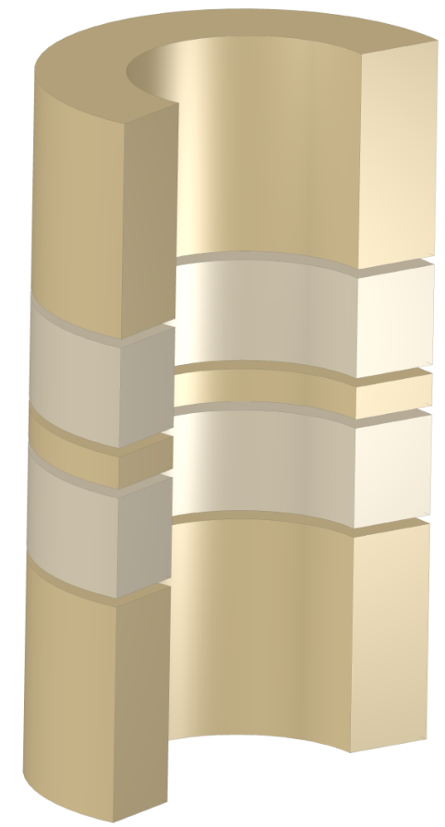
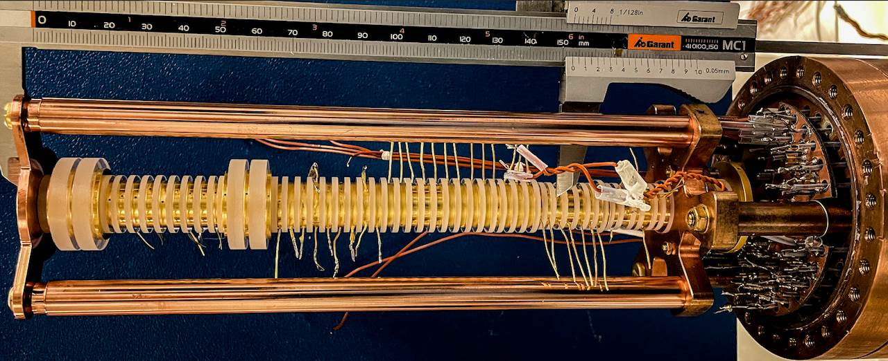

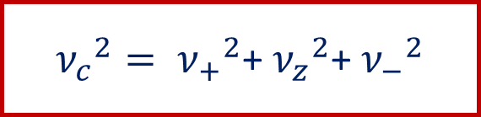

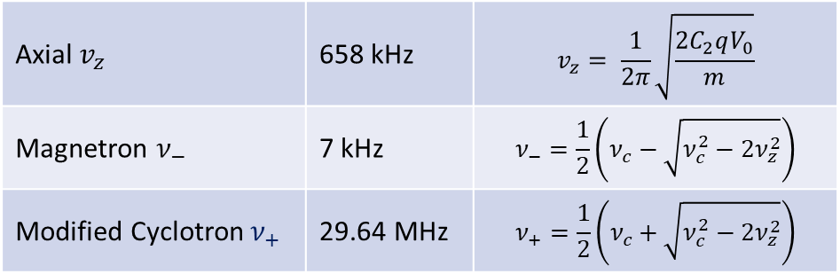
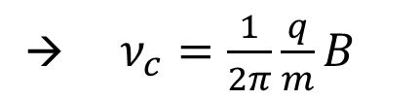
Penning Trap
Radial confinement: $\vec{B}=B_{0}\hat{z}$
Axial confinement: $Φ\left(ρ,z\right)=V_{0}C_{2}\left(z^{2}− \frac{ρ^{2}}{2}\right)$
Eigenfrequencies:
Brown-Gabrielse invariance theorem:
Axial Motion
Modified Cyclotron Motion
Reservoir trap
Magnetron Motion
Axial $v_{z}$ | 658 kHz | $$v_{z}= \frac{1}{2π}\sqrt{\frac{2C_{2}qV_{0}}{m}}$$
Magnetron $ν_{−}$ | 7 kHz | $$ν_{−}=\frac{1}{2}\left(ν_{c}−\sqrt{ν_{c}^{2}−2ν_{z}^{2}}\right)$$
Modified Cyclotron${ ν}_{+}$ | 29.64 MHz | $$ν_{+}=\frac{1}{2}\left(ν_{c}+\sqrt{ν_{c}^{2}−2ν_{z}^{2}}\right)$$
Precision trap
Analysis trap
Cooling trap
${ν_{c}}^{2}= {ν_{+}}^{2}$+ ${ν_{z}}^{2}$+ ${ν_{−}}^{2}$
→ $ν_{c}=\frac{1}{2π}\frac{q}{m}B$
[3] L.S. Brown and G. Gabrielse, Rev. Mod. Phys. 58, 233, 1986

Slide 5
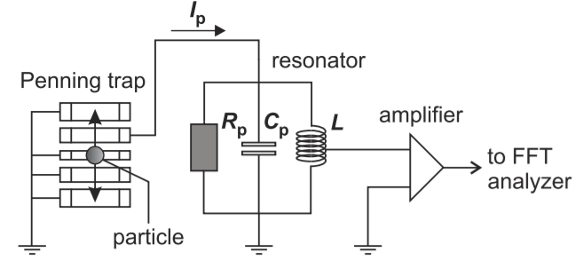
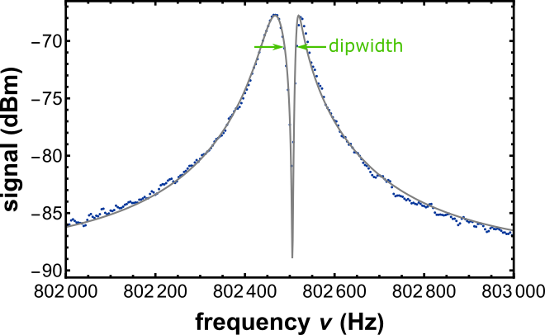

Frequency Measurements
Measurement of tiny image currents (~fA) induced in trap electrodes
In thermal equilibrium:
  Particles short noise in parallel
  Appears as dip in detector spectrum
Interaction constant:
$$γ=\frac{R_{p}}{m} \frac{q^{2}}{D_{eff}^{2}}=\frac{Δν}{2π}=\frac{1}{τ}$$
[4] D. Wineland and H. Dehmelt, J. Appl. Phys. 46, 919 (1975) [5] H. Nagahama et al., Rev. Sci. Instrum. 87, 113305 (2016).

Slide 6
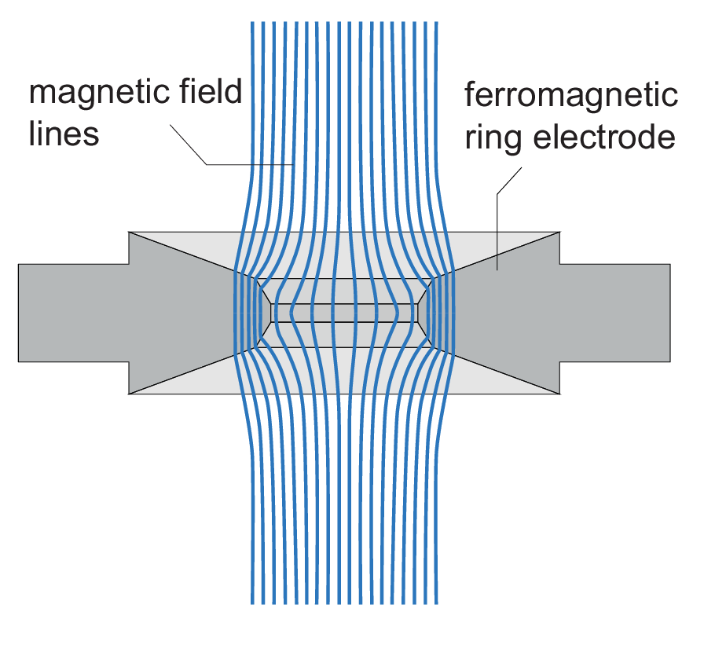
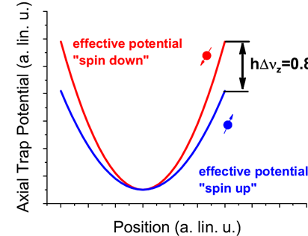
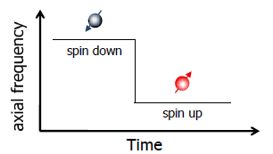

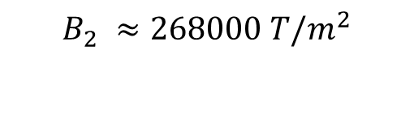

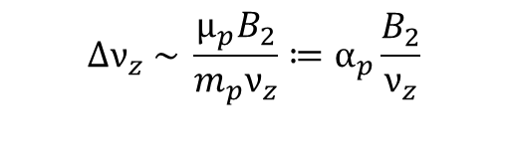
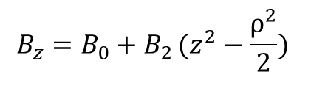

Larmor Frequency Determination
Measurement based on continuous Stern Gerlach effect
Energy of magnetic dipole in magnetic field
Leading order magnetic field correction
→ Adds a spin dependent quadratic axial potential
→ Axial frequency becomes dependent of the spin state
In order to resolve the change of the spin state
we need extremly high $B_{2}$ (axial frequency ~ 650kHz):
$$Φ_{M}=−\left.(\vec{μ_{p}}⋅\vec{B})\right.$$
$$B_{z}=B_{0}+B_{2}\left.(z^{2}−\frac{ρ^{2}}{2}) \right.$$
$$Δν_{z} \sim \frac{μ_{p}B_{2}}{m_{p}ν_{z}}≔α_{p}\frac{B_{2}}{ν_{z}}$$
$$B_{2} ≈268000 T/m^{2}$$
$Δν_{z}≈173 mHz$
[6] H. Dehmelt, Proc. Natl. Acad. Sci. U.S.A. 83, 2291 (1986) [7] Ulmer et al., PRL 106, 253001 (2011)

Slide 7
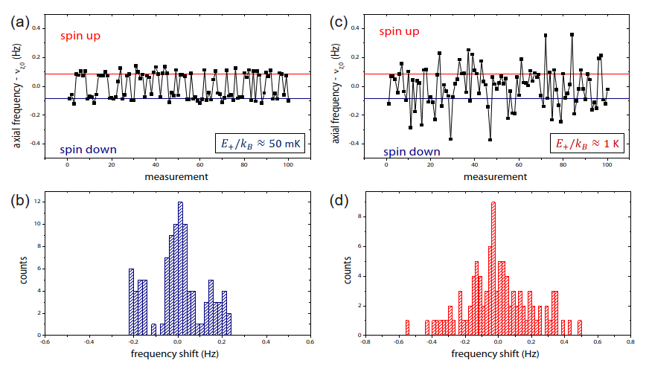
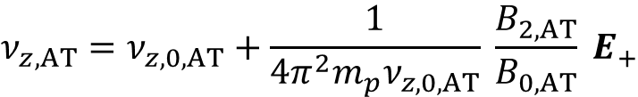
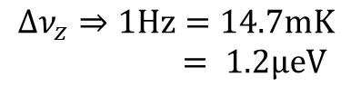
Single Spin Flip
Radial quantum jumps shift the axial frequency:
Cyclotron quantum jump induces about ~61 mHz shift, while spin flip ~173 mHz
Tiny heating of the radial mode results in significant fluctuations of the axial frequency.
Energy sensitivity in BASE:
→ Reduce cyclotron energy!
cold particle (50mK)
hot particle (1K)
$$ν_{z,AT}=ν_{z,0,AT}+\frac{1}{4π^{2}{m_{p}ν}_{z,0,AT}} \frac{B_{2,AT}}{B_{0,AT}} E_{+}$$
$$Δν_{z}⇒1Hz=14.7mK$$
$= 1.2μeV$
high-fidelity spin state resolution
fidelity at 65%, not useful for measurements
[8] C. Smorra et al., Phys. Lett. B 769, 1 (2017)

Slide 8
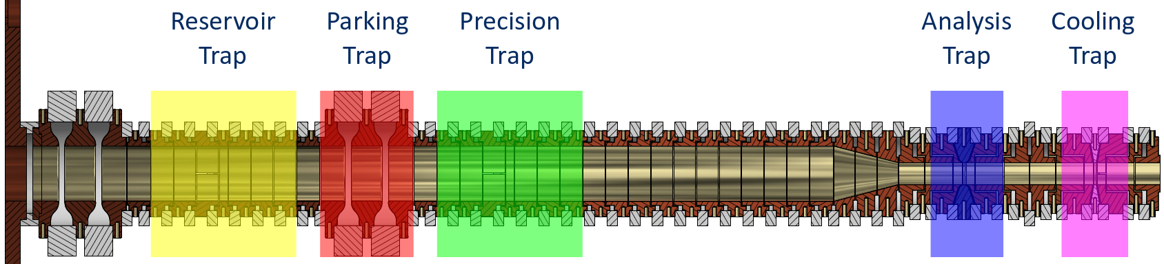
Improved Cyclotron-Mode Cooling

Slide 9
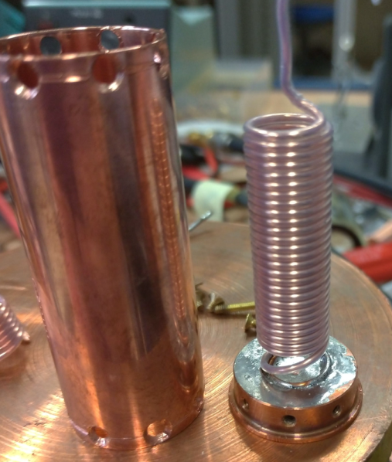
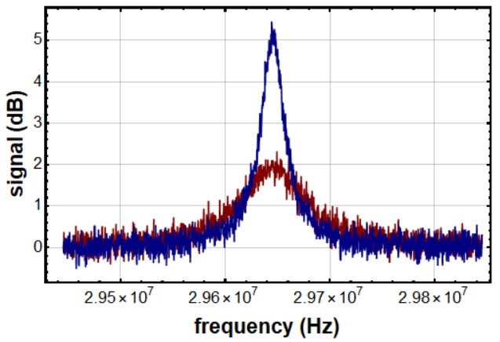
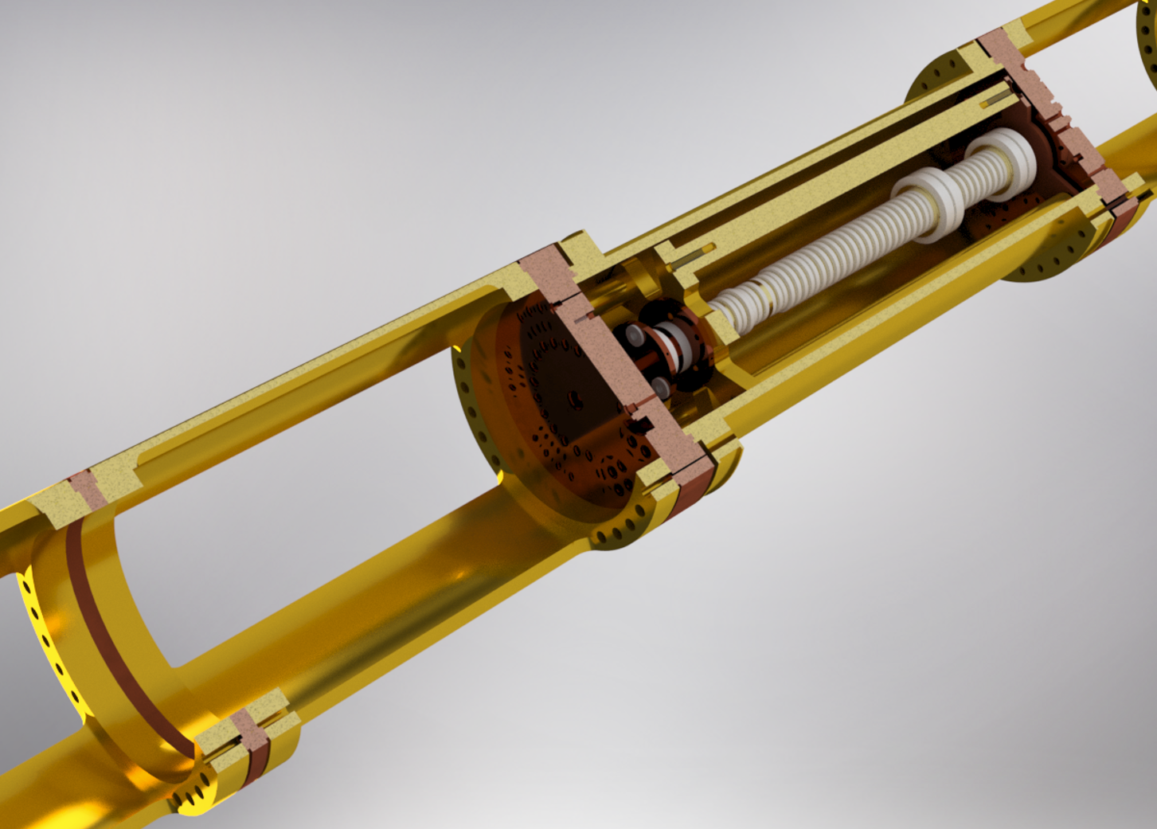
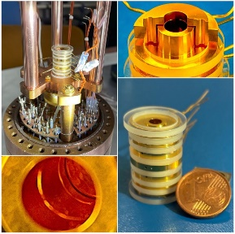

The Technical Setup
We want efficient cooling:
  Fast
  Intrinsic low temperature
Dedicated Cooling trap (CT)
High performance detection resistor
Reduced detector temperature
2016
2024
Property of the trap
Cooling time constant
of particle:
$$τ=\frac{m}{R_{p}}{\left(\frac{D_{eff}}{q}\right)}^{2}$$
Property of the resonator
2024 detector position
2016 detector position
[9] M.Fleck, PhD Thesis (2022) [10] B. Latacz et al., PRL 133, 053201 (2024)

Slide 10
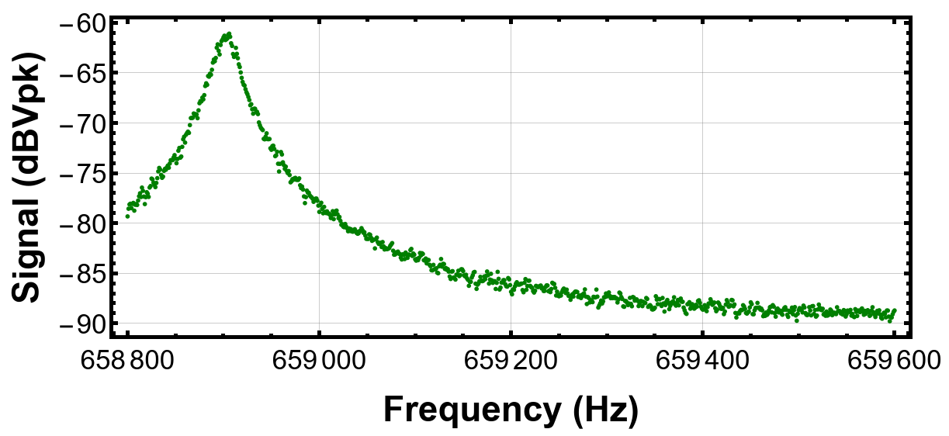
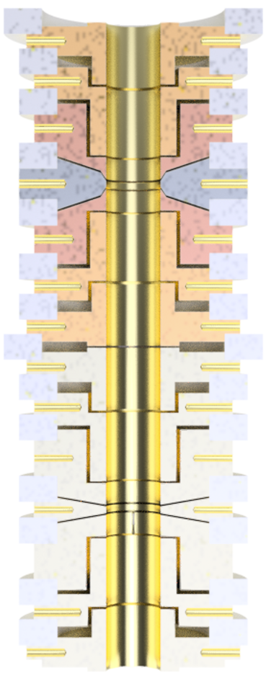
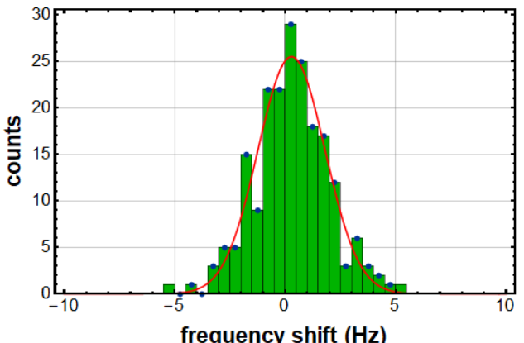
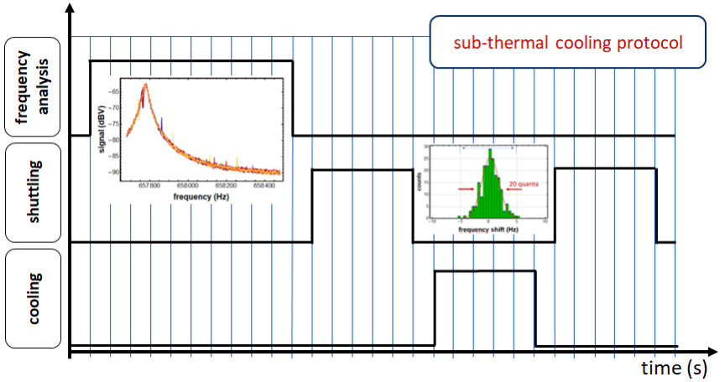
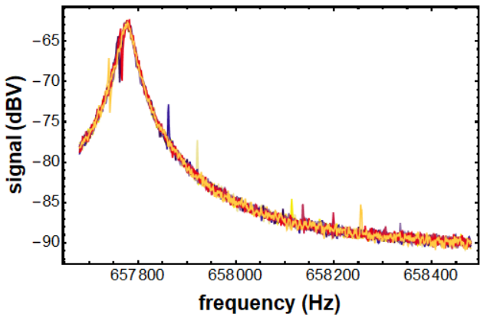
Sub-Thermal Cooling
Sequence:
Measure axial frequency in AT (16s)
Transport AT – CT (5s)
Thermalize in CT (5s)
Transport CT – AT (5s)
Take reference spectrum of resonator
Cooling Trap
Thermalize particle
Transport scatter: 18 mK
Analysis Trap
Measure frequency
20 quanta
Particle below threshold → STOP
Particle above threshold

Slide 11
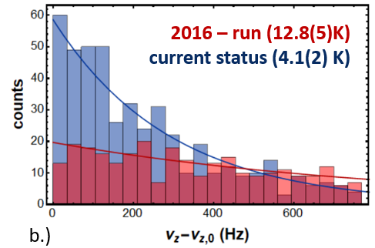
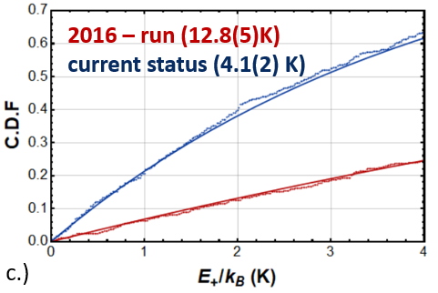

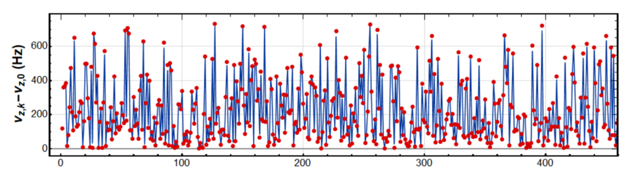
Temperature Measurement
Sequence:
  Measure axial frequency in AT
  Shuttle AT – CT
  Thermalize in CT
  (here 20s)
  Shuttle CT – AT
(4.2(2)K)
Fast Cooling
Temperature Analysis
Decreased the detector temperature by a factor of 3!

Slide 12
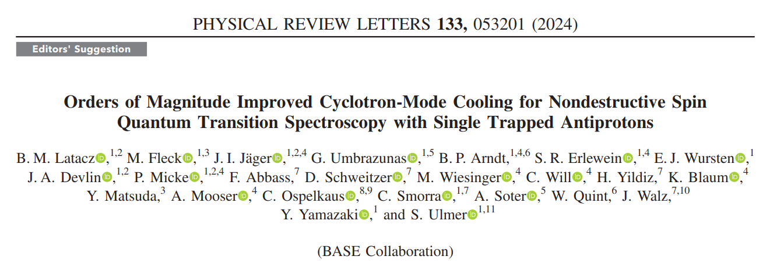
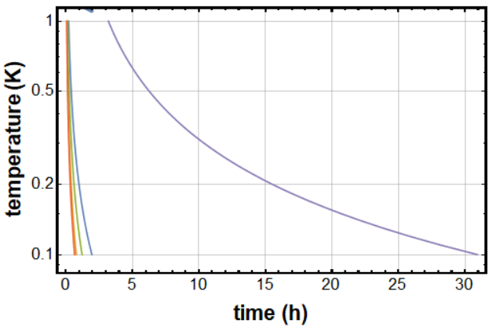
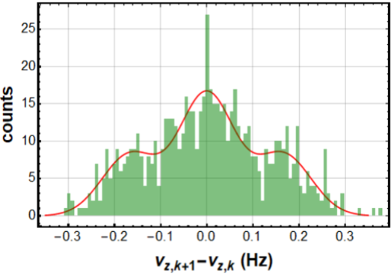
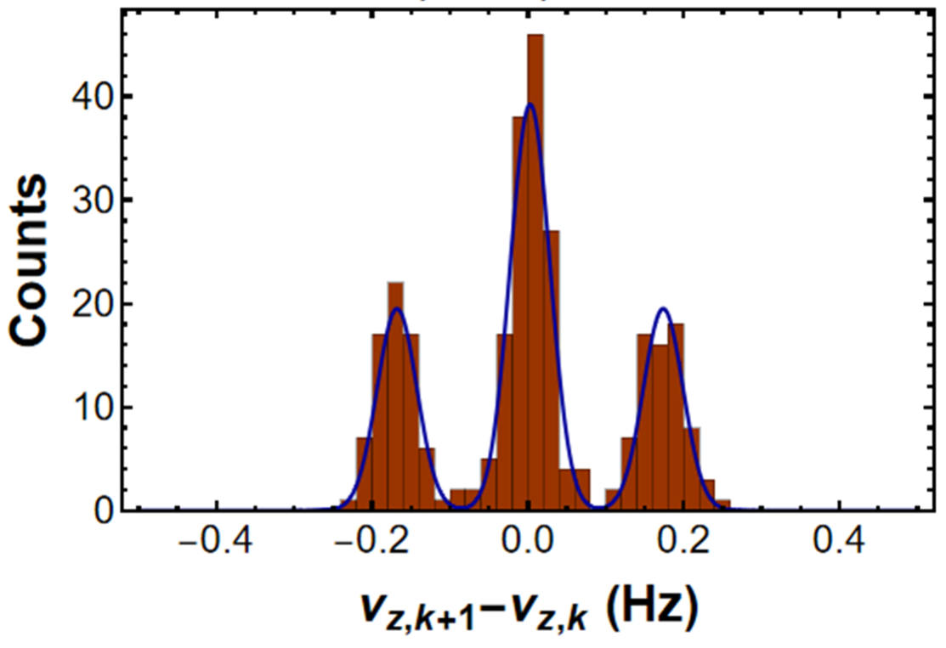
Result: 80 Times Faster Cooling
Status 2016 run with 600s cooling in the PT
at a cyclotron temperature of 12.7(5)K
2016
Status 2024 with cooling for 5s in the CT
and a cyclotron temperature of 4.2(2) K
2024
Explicitly demonstrated:
robust 200mK particle preparation in 8 minutes compared to previously 15h.
Further improvements possible

Slide 13
Antiproton Lifetime Estimation

Slide 14
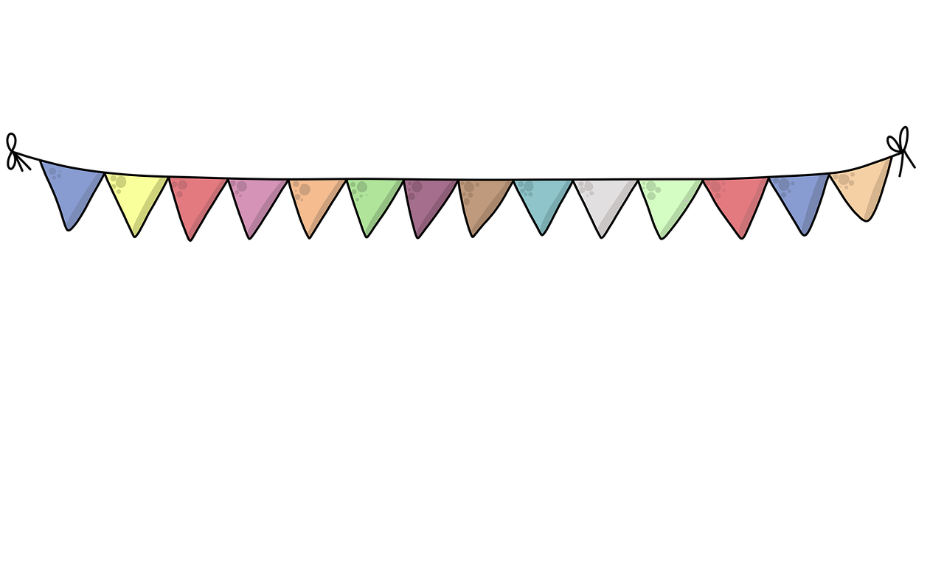



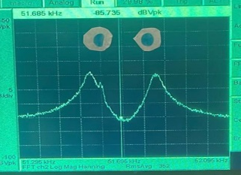
Happy Birthday Antiprotons!
(Trapped since 27/10/2023)

Slide 15
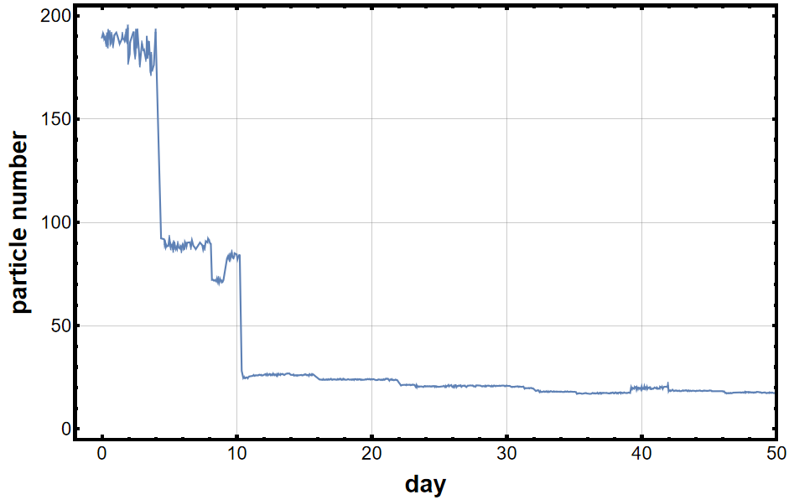



Reservoir Trap
Continuously monitor Reservoir trap
Dipwidth $∝$ particle number
pbars after $H^{−}$ cleaning
human error
cloud of pbars extracted to PT, merged again with losses
human error
detector detuned
extraction
[4] D. Wineland and H. Dehmelt, J. Appl. Phys. 46, 919 (1975)

Slide 16


Antiproton Lifetime Estimation
Extracted integrated observation time in 2024 data: 16.98 a
With previous acquired data: 46.78 a
→ $τ_{lower}$ > 43.89 a (CL: 0.68)
PRELIMINARY
Increased antiproton lifetime by a factor of 4
(previous published value: 10.2 a [13])
[11] S. Sellner et al., New J. Phys. 19, 083023 (2017)

Slide 17
Summary
Status 2016
Improved the cooling of the cyclotron mode in a Penning trap significantly
Trapped antiprotons for over a year
Improve limits on antiproton lifetime
Status 2024

Slide 18










Thanks for your attention!

Slide 19
Back-Up

Slide 20


Experiment Apparatus
4-Trap Penning trap system
Superconducting Magnet
Cryostats for LN2 and LHe
Antiproton beam

Slide 21

BASE Trap Stack
Reservoir Trap: Stores cloud of antiprotons, suspends single antiprotons for measurements.
Precision Trap: Homogeneous field for frequency measurements, B₂ < 4 μT / m².
Analysis Trap: Inhomogeneous field for the detection of antiproton spin flips, B₂ = 300 kT / m².
Cooling Trap: Fast cooling of the cyclotron motion.

Slide 22

Sideband Cooling
“Simple” measurement
  $$ν_{c}=\sqrt{ν_{+}^{2}+ν_{z}^{2}+ν_{−}^{2}}$$
Sideband method:
  Axial dip spectrum: $ν_{z}$
  Sideband radio-frequency drive at
  $ν_{rf}≈ ν_{+}−ν_{z}$
  Double dip spectrum:
  $ν_{+}=$ $ν_{rf}+ν_{l}+ν_{r}−ν_{z}$
  Magnetron mode: $ν_{−}≈ν_{z}^{2}/(2ν_{+})$
[1] BASE Collaboration, Nature 601, 53–57 (2022) [12] E. A. Cornell et al., Physical Review A, 41(1):312–315, 1 (1990)

Slide 23



Where Has All the Antimatter Gone?
Standard Model
Baryon/Photon Ratio | 10⁻¹⁸
Baryon/Antibaryon Ratio | 1
Sakharov conditions [1]:
Baryon number violation
C and CP violation
Interactions out of thermal equilibrium
Observation
Baryon/Photon Ratio | 0.6 * 10⁻⁹
Baryon/Antibaryon Ratio | 10 000
or alternatively CPT violation
CPT invariance:
Particles and antiparticles have same absolute
Charge-to-mass ratio $q/m$
Magnetic moment $μ$
Lifetime $τ$
We can measure this!
[13] A.D. Sakharov, JETP Lett 5, 24 (1967)

Slide 24


Antiproton Production
Proton/Antiproton energies:
PS: 26 GeV
target: 3.6 GeV
AD: 5.3 MeV
Elena: 100 keV
fa
https://cds.cern.ch/record/2800984
https://indico.cern.ch/event/1058016/attachments/2278827/3895791/IntroductionAntimatterFactoryVirtualTour.pdf

Slide 25


Further Improvements for Faster Cooling
Reduce detector temperature
  Feedback cooling
  Experiment temperature:
  Future experiment planned at 200 mK
Simultaneous readout of axial frequency
and cyclotron cooling in the same trap

Slide 26


The Cooling Trap – Comparaison
Technical parameters:
Parameter | 2016 measurement (PT) | 2022 measurement (CT)
detection Q | 450 | 1250
$$R_{p}$$ | 75.000 $Ω$ | 360.000 $Ω$
pickup length ${(D}_{eff})$ | 21.5 mm | 4.8 mm
thermalization time $τ$ | 370 s | 4.2 s
2016
2022
Sequence optimization:
Item | 2016 | 2022
Spec AVG | 64s | 16s
TP from AT | 78s | 5s
Thermalize | 600s | 5s
TP To AT | 78s | 5s
Single Cycle | 820s | 31s
Improvement Factor: 26 (* 3 times T reduction)
2022 detector position
2016 detector position

Slide 27






Averaging Time Studies
$$1σ$$
$$2σ$$
$$3σ$$
$$4σ$$
Optimized single shot particle readout time for high identification efficiency:
  16s at 0.5K detection bandwidth and 95.8% detection efficiency.
  16s at 0.25K detection bandwidth and 99.8% detection efficiency.
Reduction of averaging time by 75%:
Significance of peak feature changes depending on position on resonator
  Different particle-to-detector coupling
  Dispersion of particle feature on the slope of resonator
  Altered optimum trap parameters caused by B4
2016 | 2022
64s | 16s

Slide 28
Transport Optimization
Transport scatter
(detuned cyclotron detector):
2016 – to protect particle after sub-thermal cooling, we went slow – 80s per AT/PT cycle.
2024 – much faster cooling, different types of time scales, different experiments. Shorter path between traps, less electrodes – 5s per AT/CT cycle
Current heating rate: 20 quanta per transport
  → Thermal background fluctuation: 18 mK
Improvement of transport time: factor of 16
20 quanta
2016 | 2024
160s | 10s

Slide 29



Thermalization Time Optimization
Use correlation estimates to determine optimum particle / detector coupling time.
  Measure frequency scatter as a function of particle / detector interaction time
→ Cooling time constant: ${ τ}_{CT}=4.7\left(4\right) s$
Fastest ever observed resistive cooling of the cyclotron mode $E_{+}$

