Slide 1
PARTICLE RELEASE TEST - MOTIVATION
It is known that carbon foams release powder when manipulated with hands.
The air flow can create the same effect when passing through the foams.
Tests performed up to now do not show any major consequence.
  Characteristic times of minutes, while the ITS3 will run 24/7 during many months.
  It is important to study the long term effects.
A setup dedicated with this topic is currently being installed to answer questions:
  Size and shape of the particles (protection of wire bonding).
  Risk of structural failure caused by possible degradation
  If the behavior is different in the RVC and K9 foams or not.

Slide 2
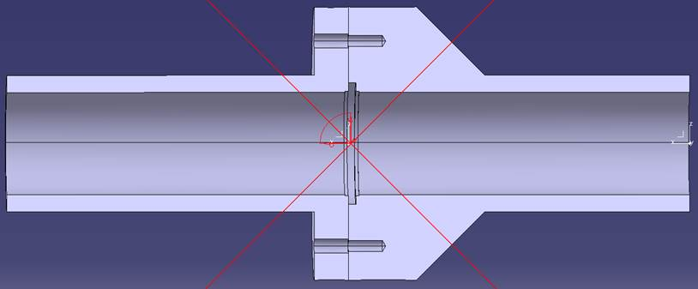
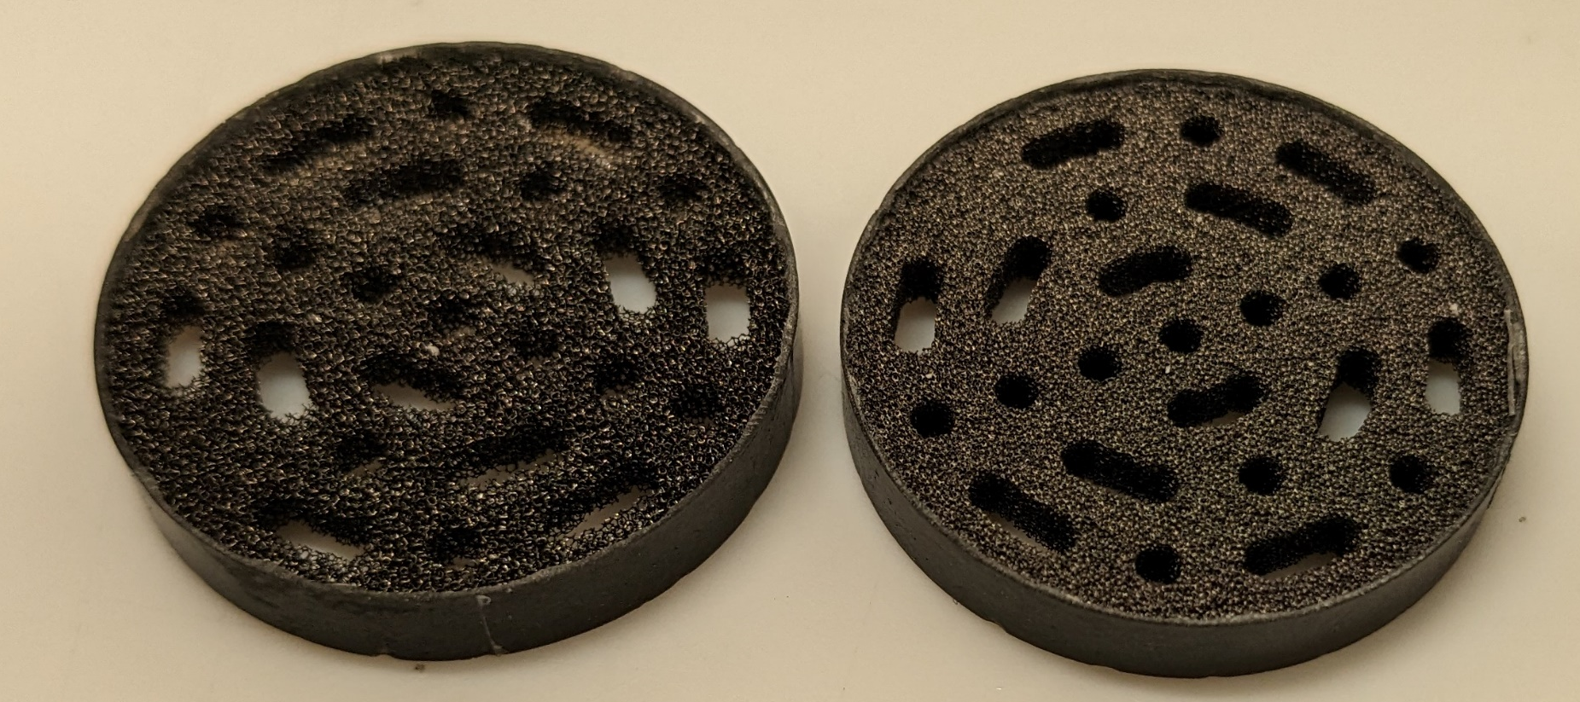
PARTICLE RELEASE TEST – SCHEMATIC
DP1
DP2
Carbon foam sample
Carbon foam sample
FESTO block
P0
T1
P1
P2
T2
Compressed
air network
filters
M0
Filters
Test rig
Test rig
Air flow generated by the compressed air network of CERN.
Initial festo block with filters, mass flow meter (M0), and pressure sensor (P0).
Two foam simples representing the pressure loss of ITS3 layers.
Differential pressure sensors to measure the foam pressure loss over time.
  Significant erosion → Lower pressure loss.
Temperature sensors at inlet (T1) and outlet (T2) (ideally ALICE cavern temperature conditions).
Additional absolute pressure sensors at inlet (P1) and outlet (P2) to verify data given by other sensors.
Filters (pre-filter and fine) to collect the released powder
  Initially powder collected every day, next steps based on the results
All sensor output values to be read in LabView, exported to a .dat file to check daily or weekly the status.
Installation at Point 2 (piscine) due to continuous demand of air for a long time, noise, and space reasons.
  Continuous operation during months
Foam samples

Slide 3
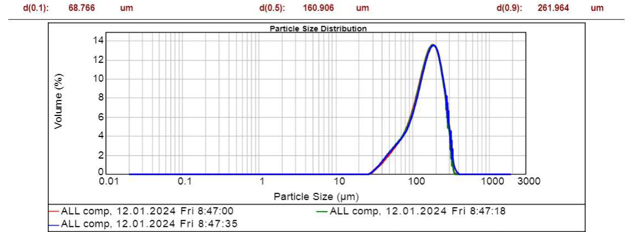
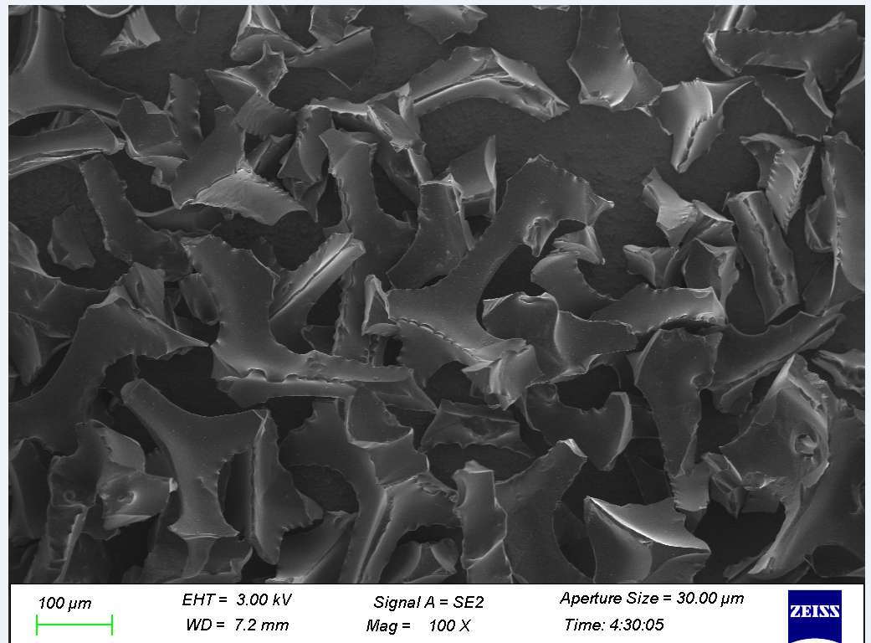
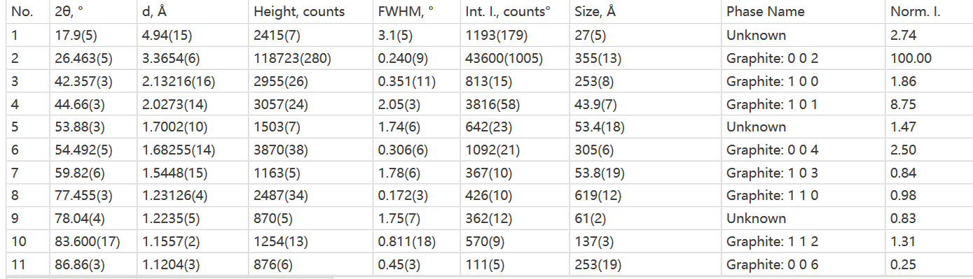
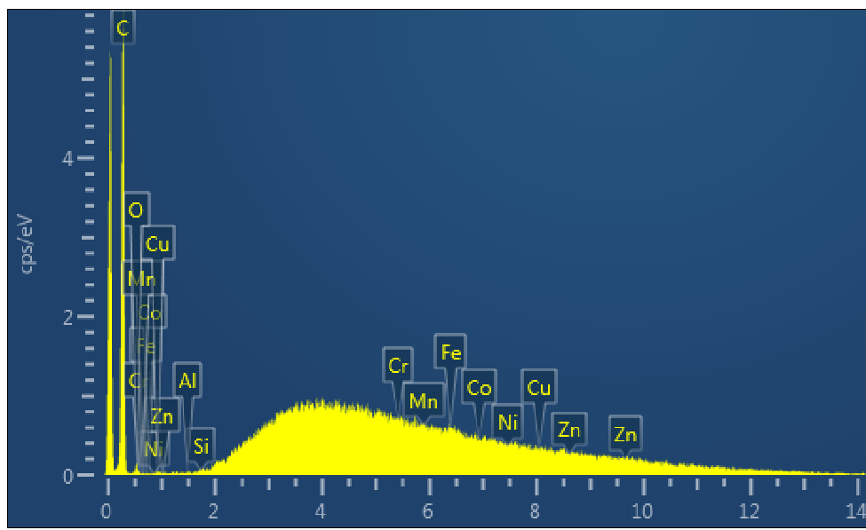
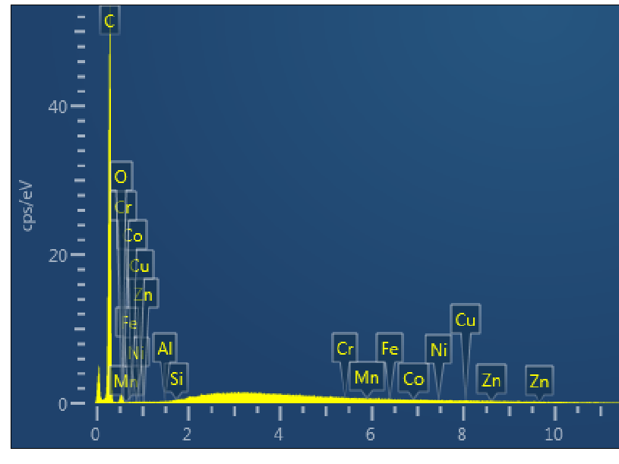
PARTICLE RELEASE TEST - OUTPUTS
Particle shape and size.
  Powder samples (obtained by disintegrating the foam by hand) produced for first test.
  Samples sent to UniversalLab (CH) → Particle size distribution (Laser diffraction for high quantities, microscope images for low quantities)
Particle sixe distribution of Allcomp powder
SEM image of RVC powder
2. Particle composition (UniversalLab, possible to do at CERN)
  XRD analysis (RVC not identified, non-crystalline).
  SEM analysis
XRD analysis of K9 foam
RVC
K9

Slide 4
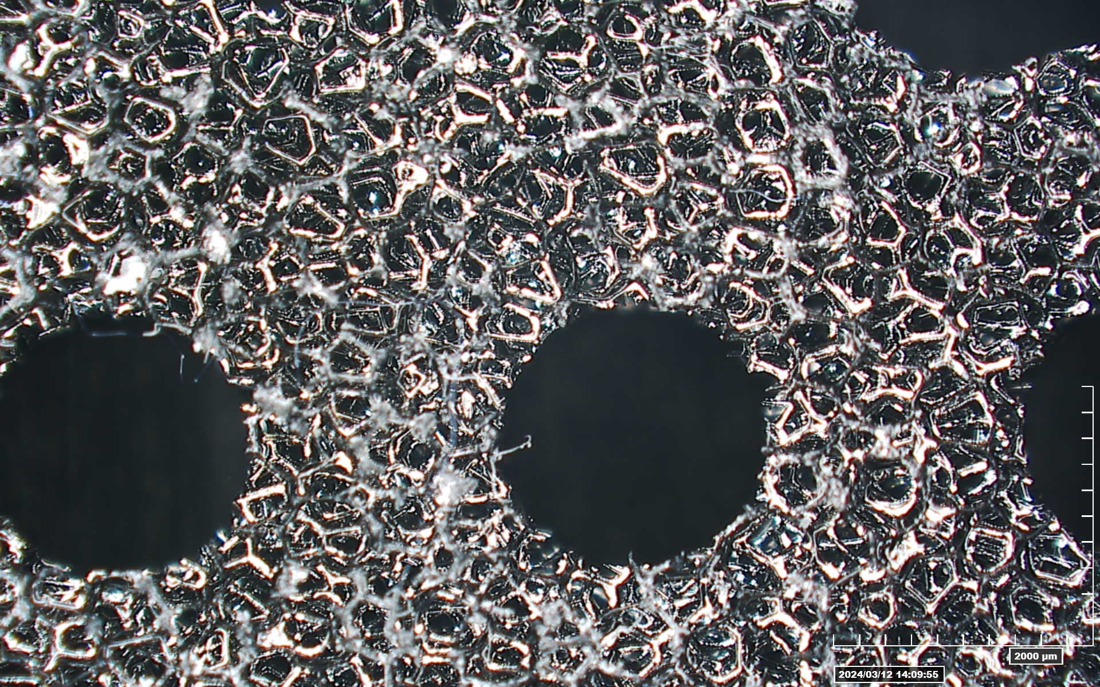
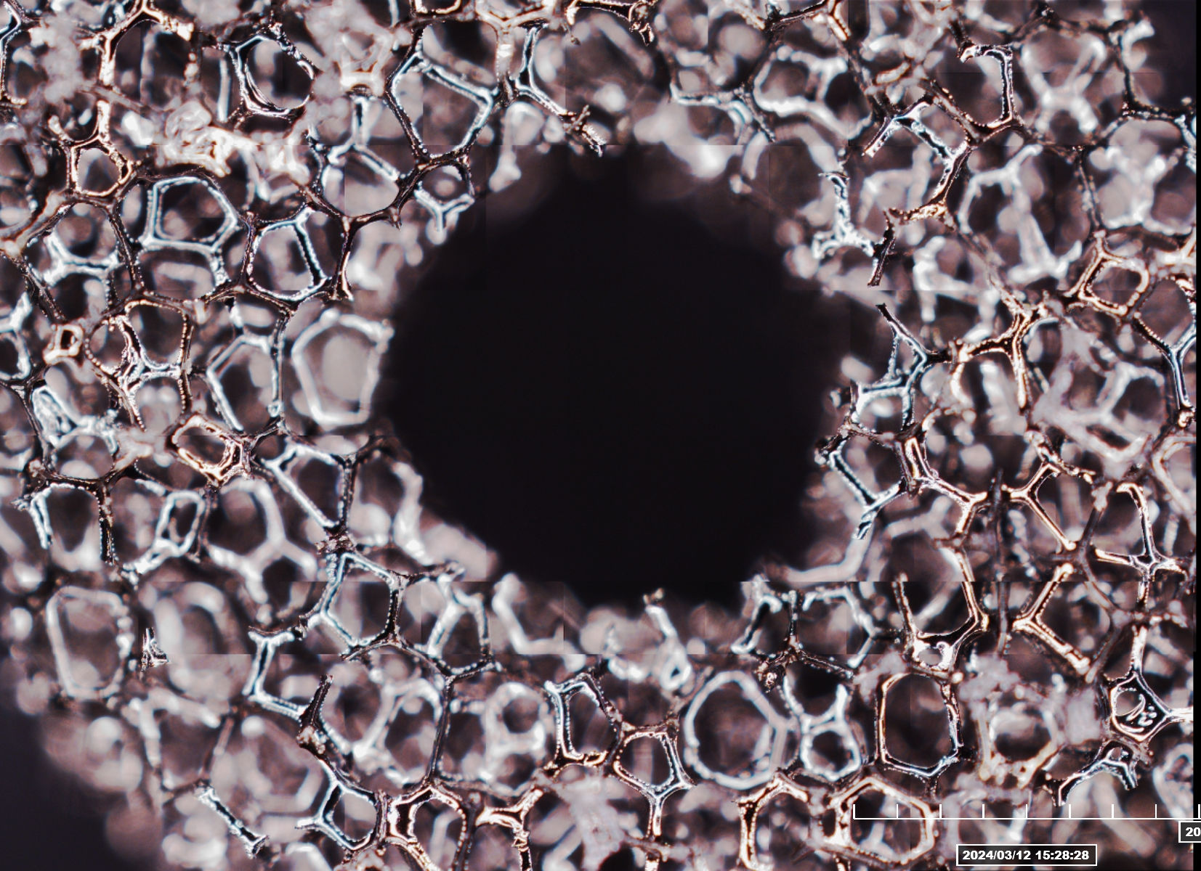
PARTICLE RELEASE TEST - OUTPUTS
Optical microscope images before and after of the carbon foam samples (CERN)
  Images before tests already obtained

Slide 5
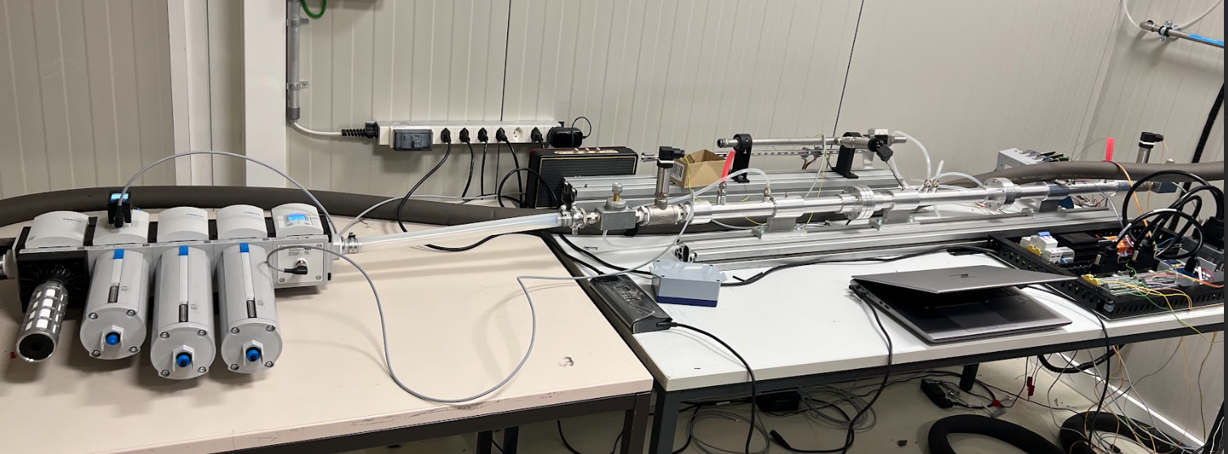
PARTICLE RELEASE TEST – CURRENT STATUS
Construction is progress
Pressure sensors
Festo block
Temperature sensors
Box with all electronics

