Slide 1
ILD at CLIC: a status overview
Lucie Linssen
on behalf of many contributors to the CLIC detector study
http://lcd.web.cern.ch/LCD/

Slide 2
Other CLIC-related talks at this meeting
Software meeting:
Technical validation of iLCSoft => Andre Sailer
PID in Pandora and Tracking efficiencies with background => Jacopo Nardulli
New PandoraPFA developments => John Marshall
MDI meeting:
Recent Progress at CERN on LC Detector Engineering&Integration and Detector Movement => Andrea Gaddi, Maciej Herdzina
ILD meeting:
Recent Coil developments at CLIC => Andrea Gaddi
Muon system layout optimisation and yoke geometry at CLIC => Erik van der Kraaij
CLIC experience of using Whizard and Pythia => Stephane Poss
Backgrounds in CLIC: what can we learn for ILD => Andre Sailer
Status of IR Design for CLIC => Andrea Gaddi
Many more details in the above talks
My apologies for not mentioning all individual contributors

Slide 3
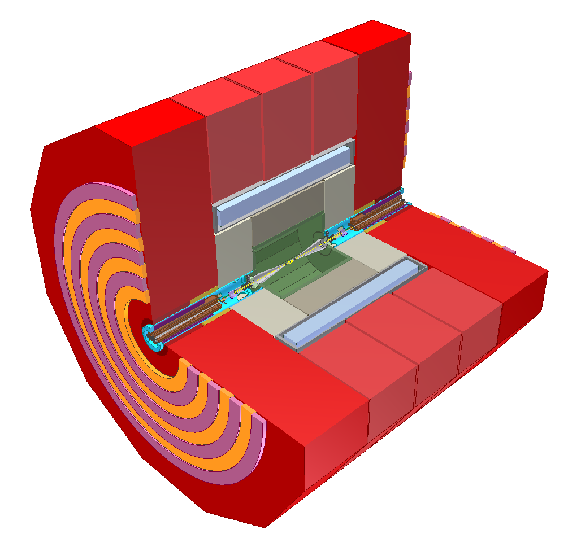
Changes to ILD for CLIC
… in a few words ….
Yoke dimensions and Yoke instrumentation
layout changed
Many changes in forward region
Solenoid at 4T, dimensions ~unchanged
Calorimetry, 7.5 Λ_{i}, tungsten barrel, steel end-cap
6 m
Vertex detector: increased radius + FTD optimised; beam pipe changed
Main tracker, unchanged

Slide 4
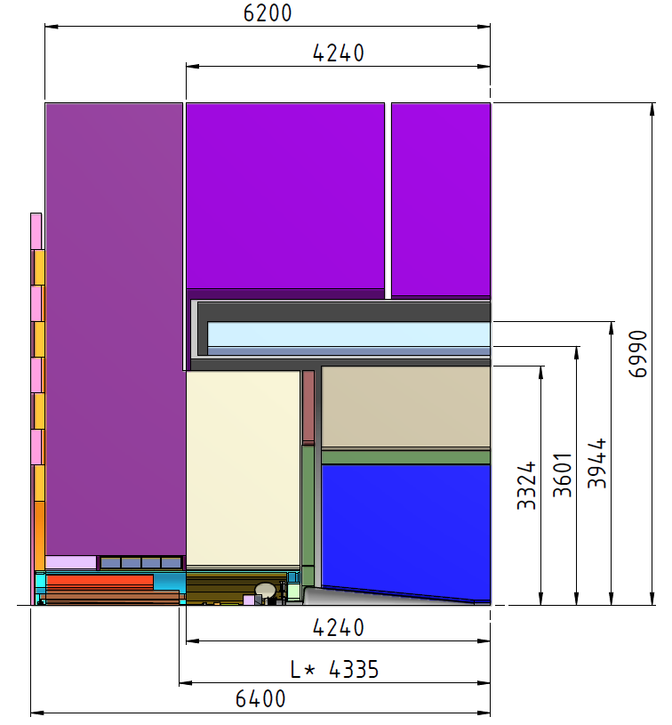
CLIC_ILD detecor
Engineering, integration and magnet studies by:
B. Cure, A. Gaddi, H. Gerwig, M. Herdzina, A. Herve, F. Ramos, N. Siegrist
Detector simulation model:
A. Sailer
Simulation model described here:
https://edms.cern.ch/document/1134612

Slide 5
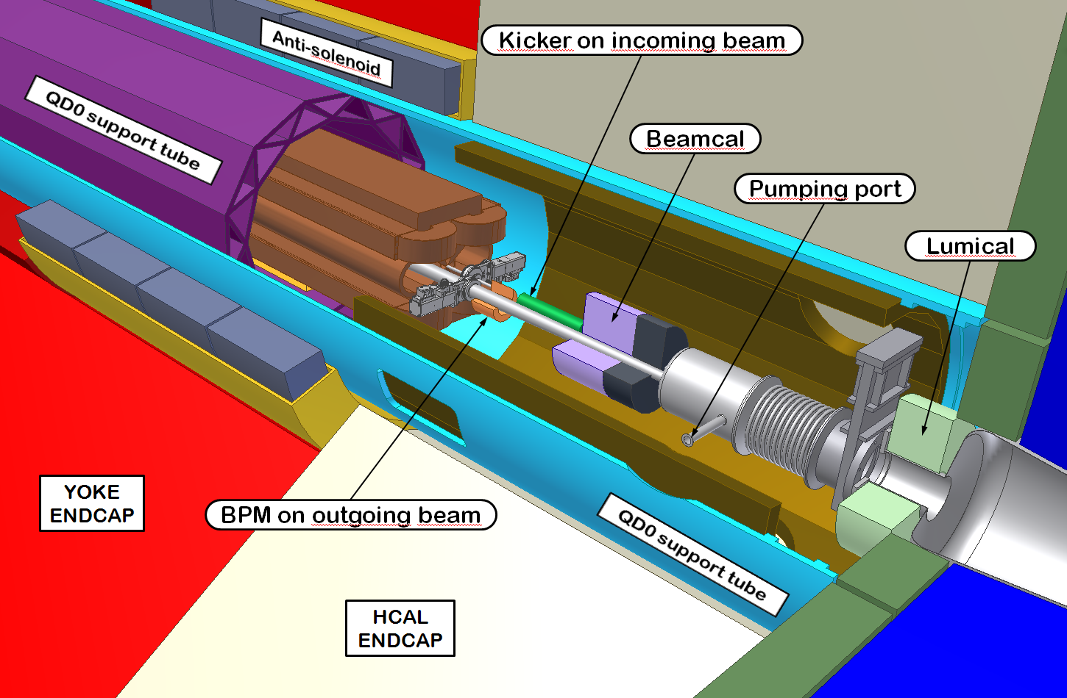
Details of forward detector region

Slide 6
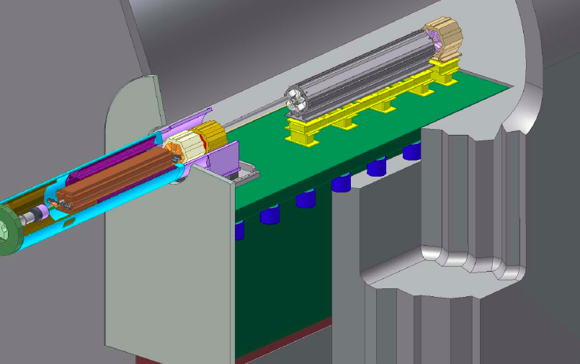
Final focus stabilisation
Experiment side
Accelerator tunnel side
Final focus stabilisation to 0.3 nm required
Achieved with combination of active and passive elements

Slide 7
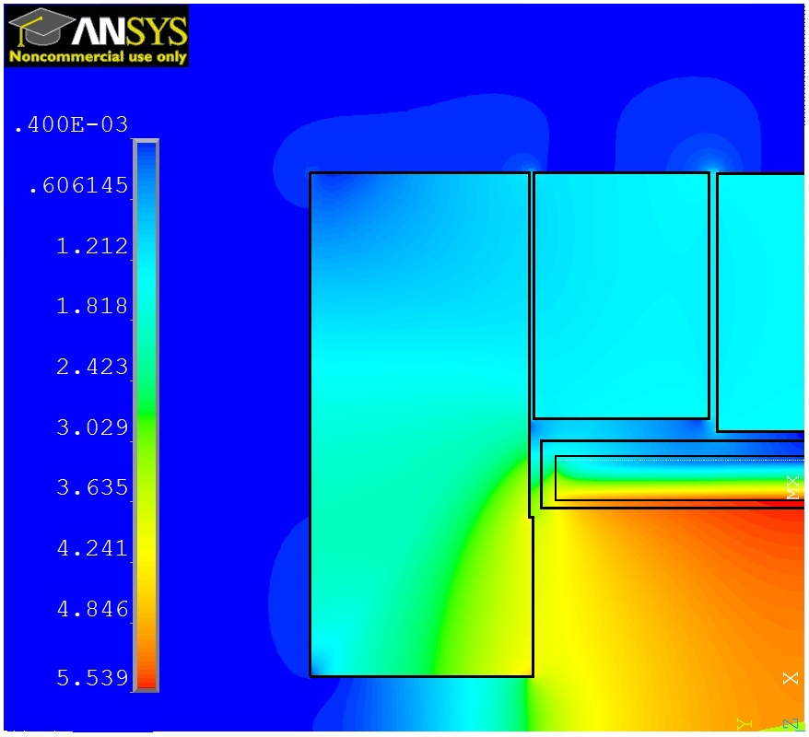
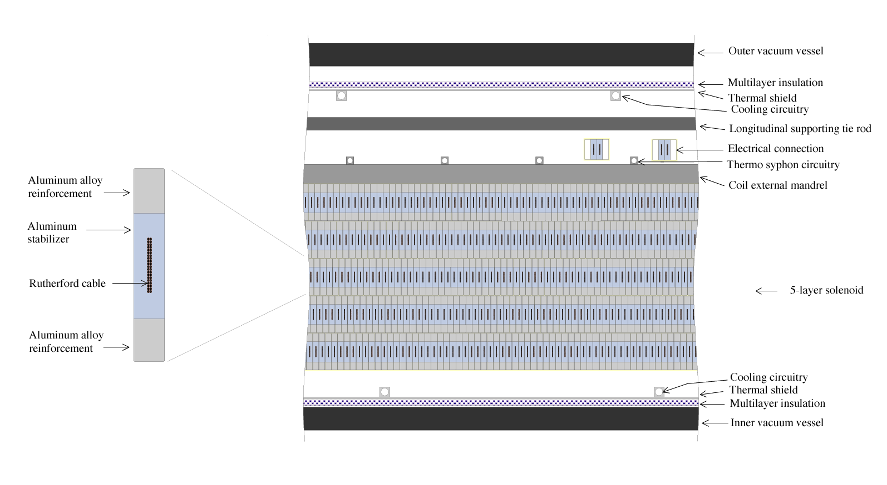
Solenoid studies
Engineering studies of 4-5 T solenoid with 3.4-2.8 m inner bore
Based on experience of CMS and ATLAS solenoids
  Engineering calculations
  Coil design
  Reinforced conduction (materials R&D and extrusion test)
  Services, quench protection, etc.
CERN, KEK, SLAC, Genova INFN, CEA, etc
Field map of 5T magnet model
Coil composition for 5T magnet model

Slide 8
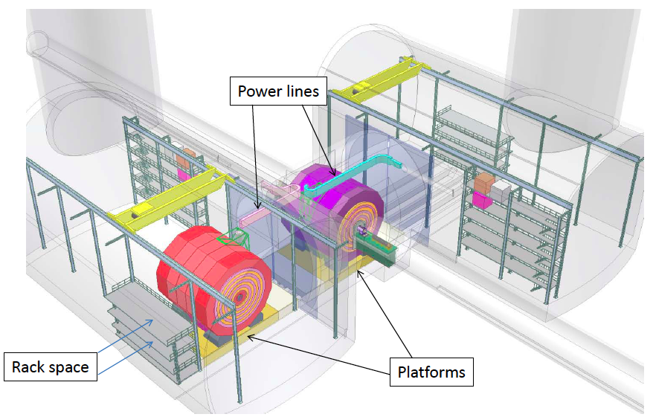
Two experiments in push-pull
e⁻
e⁺

Slide 9
CLIC time structure
Train repetition rate 50 Hz
156 ns
20 ms
CLIC
CLIC: 1 train = 312 bunches 0.5 ns apart 50 Hz
ILC: 1 train = ~1300 bunches ~700 ns apart 5 Hz

Slide 10
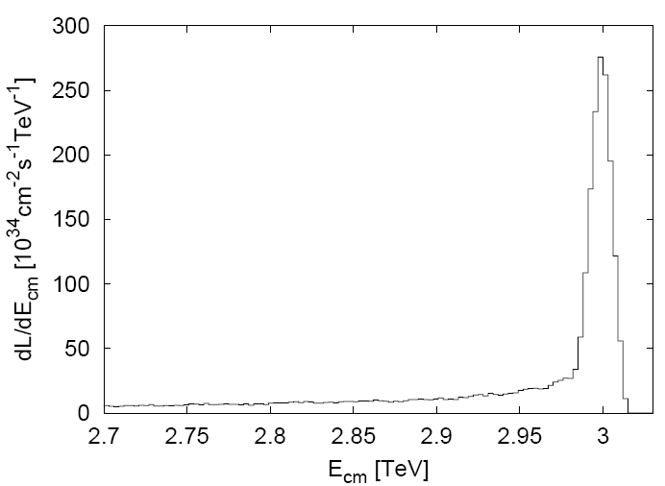
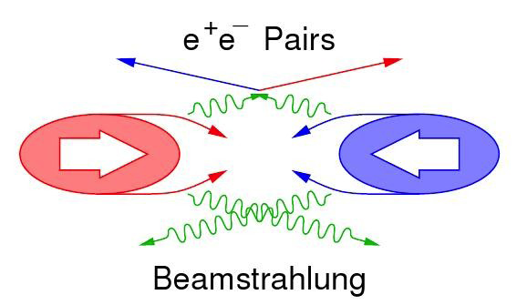
Beam-induced background (1)
Main backgrounds:
CLIC 3TeV beamstrahlung ΔE/E = 29% (10×ILC_{value})
  Coherent pairs (3.8×10⁸ per bunch crossing) <= disappear in beam pipe
  Incoherent pairs (3.0×10⁵ per bunch crossing) <= suppressed by strong solenoid-field
  γγ interactions => hadrons (3.2 hadron events per bunch crossing)
In addition: Muon background from beam delivery system(~5 muons per bunch crossing) <= spread over detector surface
CLIC luminosity spectrum
30% in “1% highest energy”

Slide 11
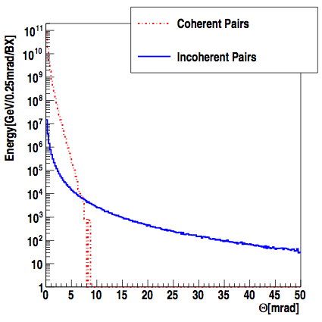
Beam-induced background (2)
Coherent pairs:
Very numerous at very low angles
Very high total energy
Incoherent pairs:
Extend to larger angles
More difficult for the detector
A. Sailer
Determines beam crossing angle (20 mrad)
Determines opening angle of beam pipe for outgoing beam (±10 mrad)

Slide 12
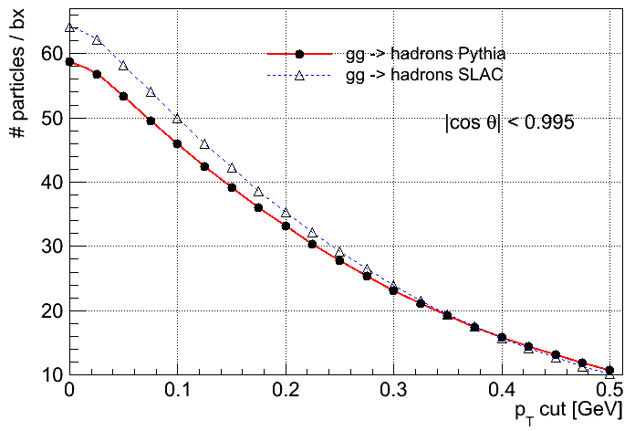
Beam-induced background (3)
CLIC beamstrahlung: γγ ➔ hadrons
Per bunch crossing:
3.2 such events
~28 particles into the detector
50 GeV
Forward-peaked
15 TeV dumped in the detector per 156 ns bunch train !
we need
TIME STAMPING !
…and play with clever event selections
D. Dannheim

Slide 13
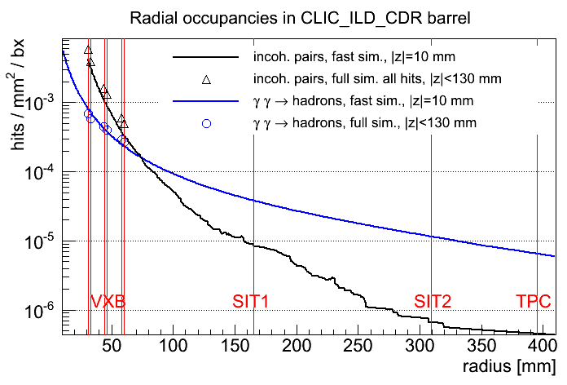
Barrel occupancies in CLIC_ILD_CDR vs. radius
Incoherent pairs dominate at small radius
γγ→hadrons dominate at larger radii
Good agreement between full and fast simulation
Up to ~1.5 hits / mm² / bunch train in innermost vertex layer
D. Dannheim

Slide 14
Tracking detectors in CLIC_ILD_CDR
SET: 2 stereo-strip cylinder layers, σ_{Rφ}=7 μm; σ_{z}=50 μm
ETD:
triple-layer
strip disks
σ_{Rφ}~σ_{R}~7 μm
Time projection chamber (TPC):
224 layers, σ_{Rφ}~100 μm per layer
SIT 1/2: 2 stereo-strip cylinder layers, σ_{Rφ}=7 μm; σ_{z}=50 μm
B=4 T
FTD 7-11: 5 stero-strip disk layers, σ_{Rφ}=7 μm; σ_{z}=50 μm

Slide 15
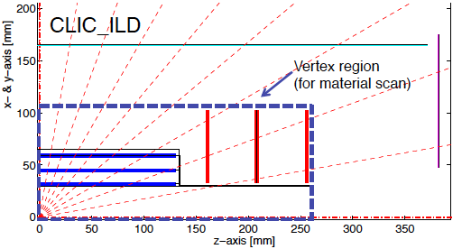
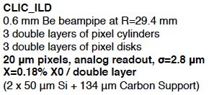
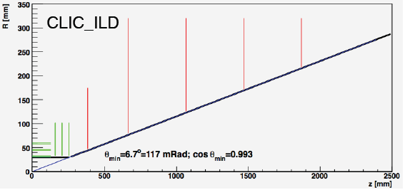
CLIC_ILD vertex detector
D. Dannheim

Slide 16
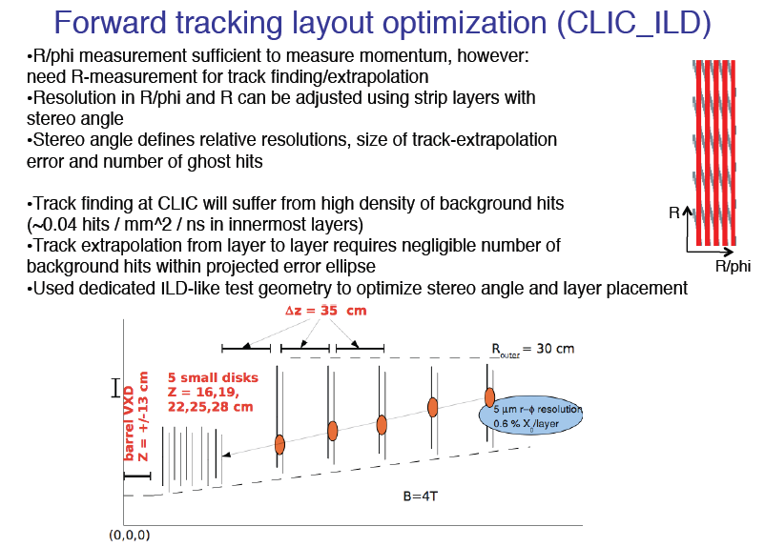
Forward tracking layout optimisation
Became
0.015…
M. Vos

Slide 17
Beam pipe and silicon tracking: VTX / SIT / FTD
FTD 11
FTD 10
SIT 2
FTD 9
FTD 8
SIT 1
FTD 7
FTD 1-6
VXD 1-6
D. Dannheim

Slide 18
Beam pipe and silicon tracking: VTX / SIT / FTD
R=240 mm
Conical + forward
beam pipe: Iron,
d = 4 to 4.8 mm
z=0
260
2645
3170
SIT 1
FTD 1-6
FTD 7
VXD 1-6
Straight section of beam pipe:
Beryllium, d=600 μm
R=29.4 mm
D. Dannheim

Slide 19
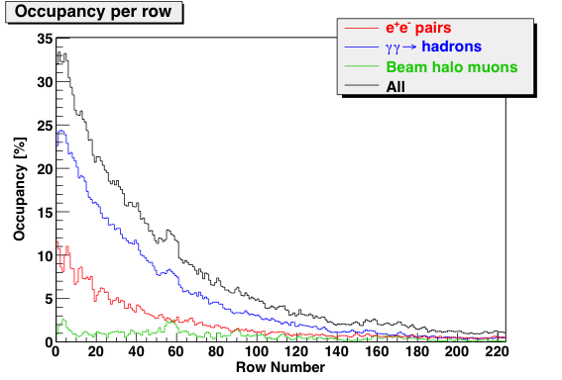
TPC occupancies
M. Killenberg
Pad occupancy (percent of time voxels occupied) for full bunch train and 6*1 mm² pads at 40 MHz readout

Slide 20
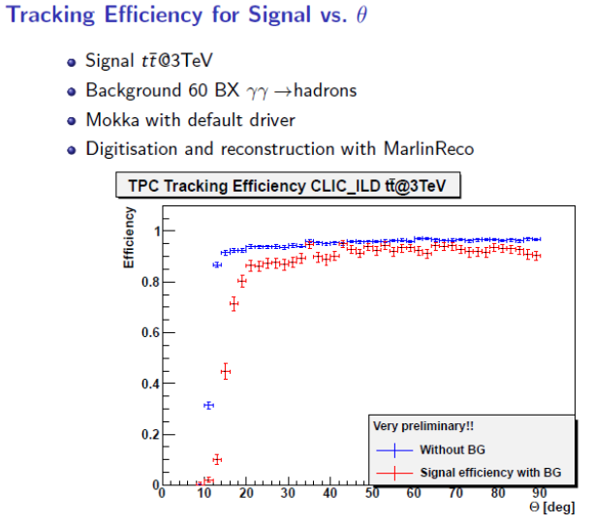
CLIC_ILD tracking with background
M. Killenberg, J. Nardulli

Slide 21
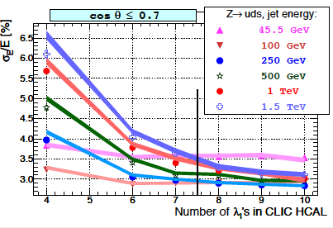
HCAL depth, tail catching and jets
PFA study
Full ILD-type detector
barrel with tungsten HCAL absorbers
A. Lucaci Timoce
Solid lines: not tails catcher Markers: with tail catcher
CLIC_ILD has:
  Barrel: 7.5 Λ_{i}, with tungsten absorber
  End cap: 7.5 Λ_{i}, with steel absorber

Slide 22
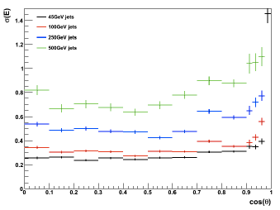
PandoraFPA, jet energy resolution
CLIC_ILD
M. Thomson, J. Marshall

Slide 23
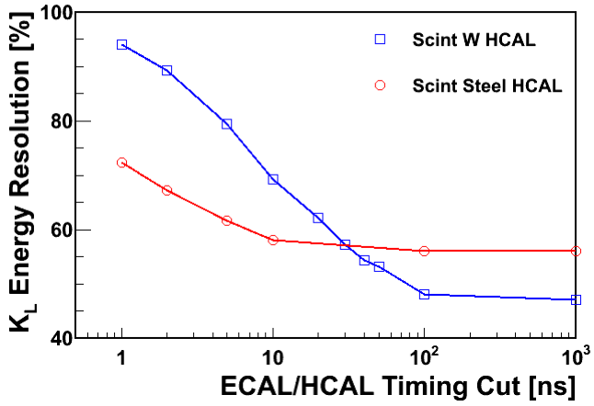
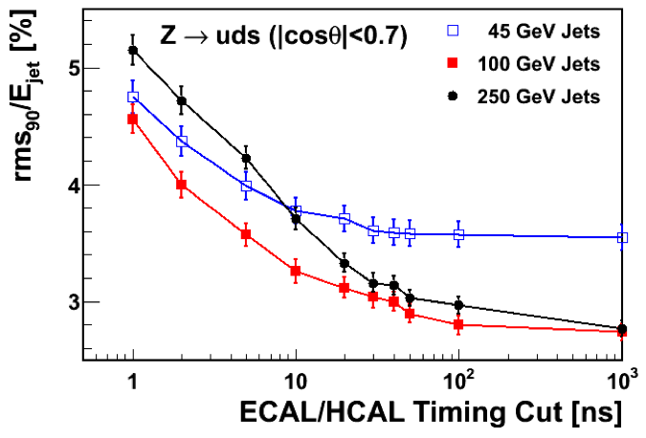
Hadron shower timing in tungsten and steel
Hadron shower development in tungsten is slower than in steel
Signal in tungsten HCAL need to be integrated over at least ~50 ns

Slide 24
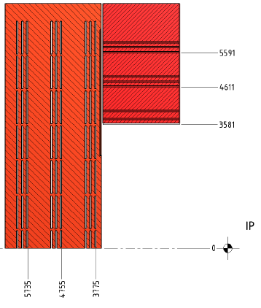
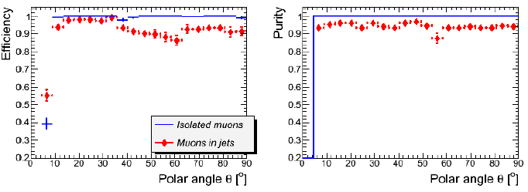
Yoke + Muon instrumentation
3 times 3 instrumented layers
Barrel starts with an active layer
Functions:
  Tail catcher (small improvement, 3 layers)
  Muon identification (all 3×3 layers)
E. Van der Kraaij, B. Schmidt, H. Gerwig, N. Siegrist, F . Ramos

Slide 25
Background suppression at CLIC
Strategy followed for the suppression of background:
Full reconstruction + PFA analysis with background overlay
  Taking into account detector integration times and hit timing resolution
  Provides TOF-corrected timing of clusters
  Precision on cluster-time is typically better than time-resolution of individual hits
Then apply cluster-based timing cuts
  These cuts depend on particle-type, p_{t} and detector region
  This allows to protect high-p_{t} physics objects and to act more severely on low-p_{t} forward-going objects (where background is more severe)
Core Marlin software processors involved:
  TimingOverlay
  LooseSelectedPandoraNewPFAs
  SelectedPandoraNewPFAs
  TightSelectedPandoraNewPFAs
M. Thomson, J. Marshall

Slide 26
Detector Assumptions
Calorimeters
  Assume all hits have a timestamp
    currently no smearing of hit times, assumed ~ 2 ns
  Assume two hit separation limited to 20 ns
    Hits within 20 ns are merged (use time for highest ph hit)
  For ECAL/HCAL endcap reconstruction integrate over 10 ns
  For HCAL barrel integrate over 100 ns
Silicon in trackers
  Integrate over time window of 10 ns
  No accounting for multiple hit capability
    occupancies fairly low
TPC
  Integrate over full bunch-train
  Require a matched Si hit in the above 10 ns window
  For looping tracks, also require arrival at ECAL within 50 ns
Defines input to event reconstruction

Slide 27
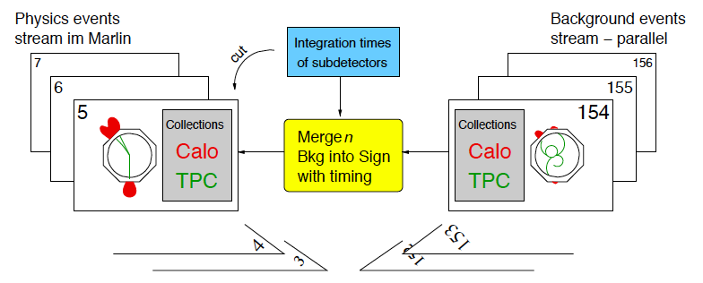
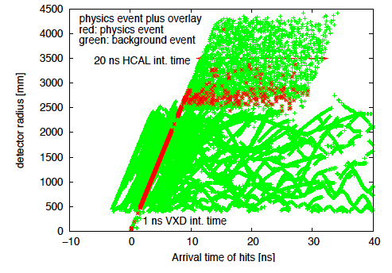
Marlin Processor “OverlayTiming”
Combining physics and background data streams
At digitisation stage
For selected number of bunch crossings
Taking into account detector integration times
Radius
LCD-Note-2011-006 (nearly final)
https://edms.cern.ch/document/1144892
Calorimeter
TPC tracker
Si tracking/vertex
Time
P. Schade, A. Sailer, A. Lucaci

Slide 28
PFO-based timing cuts
  Example: SelectedPandoraNewPFAs
Cut | Photon | Neutral h | Charged
Max pT to apply loose cut | 4.0 GeV | 8.0 GeV | 4.0 GeV
Loose timing cut | 2.0 ns | 2.5 GeV | 3.0 ns
pT to apply tight cut | 0.75 GeV | 0.75 GeV | 0.75 GeV
Tight cut | 1.0 ns | 1.5 ns | 1.5 ns
Far forward cosθ | 0.975 | 0.975 | n/a
Far forward loose cut | 2.0 ns | 2.0 ns
Far forward tight cut | 1.0 ns | 1.0 ns
Track-only min pT |  |  | 0.5 GeV
Track-only max time at ECAL |  |  | 10 ns
M. Thomson, J. Marshall

Slide 29
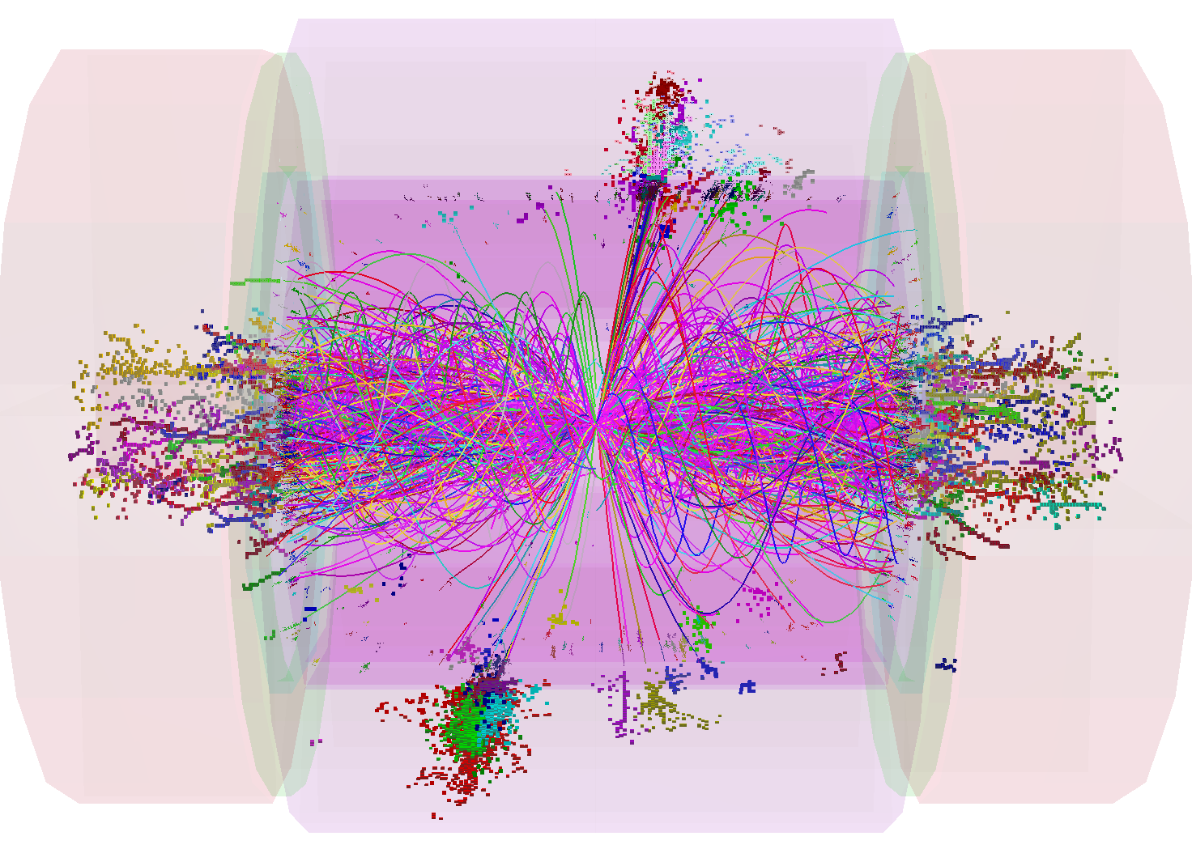
PandoraNewPFAs
1 TeV Z=>qqbar
1.4 TeV of background !
with 60 BX background

Slide 30
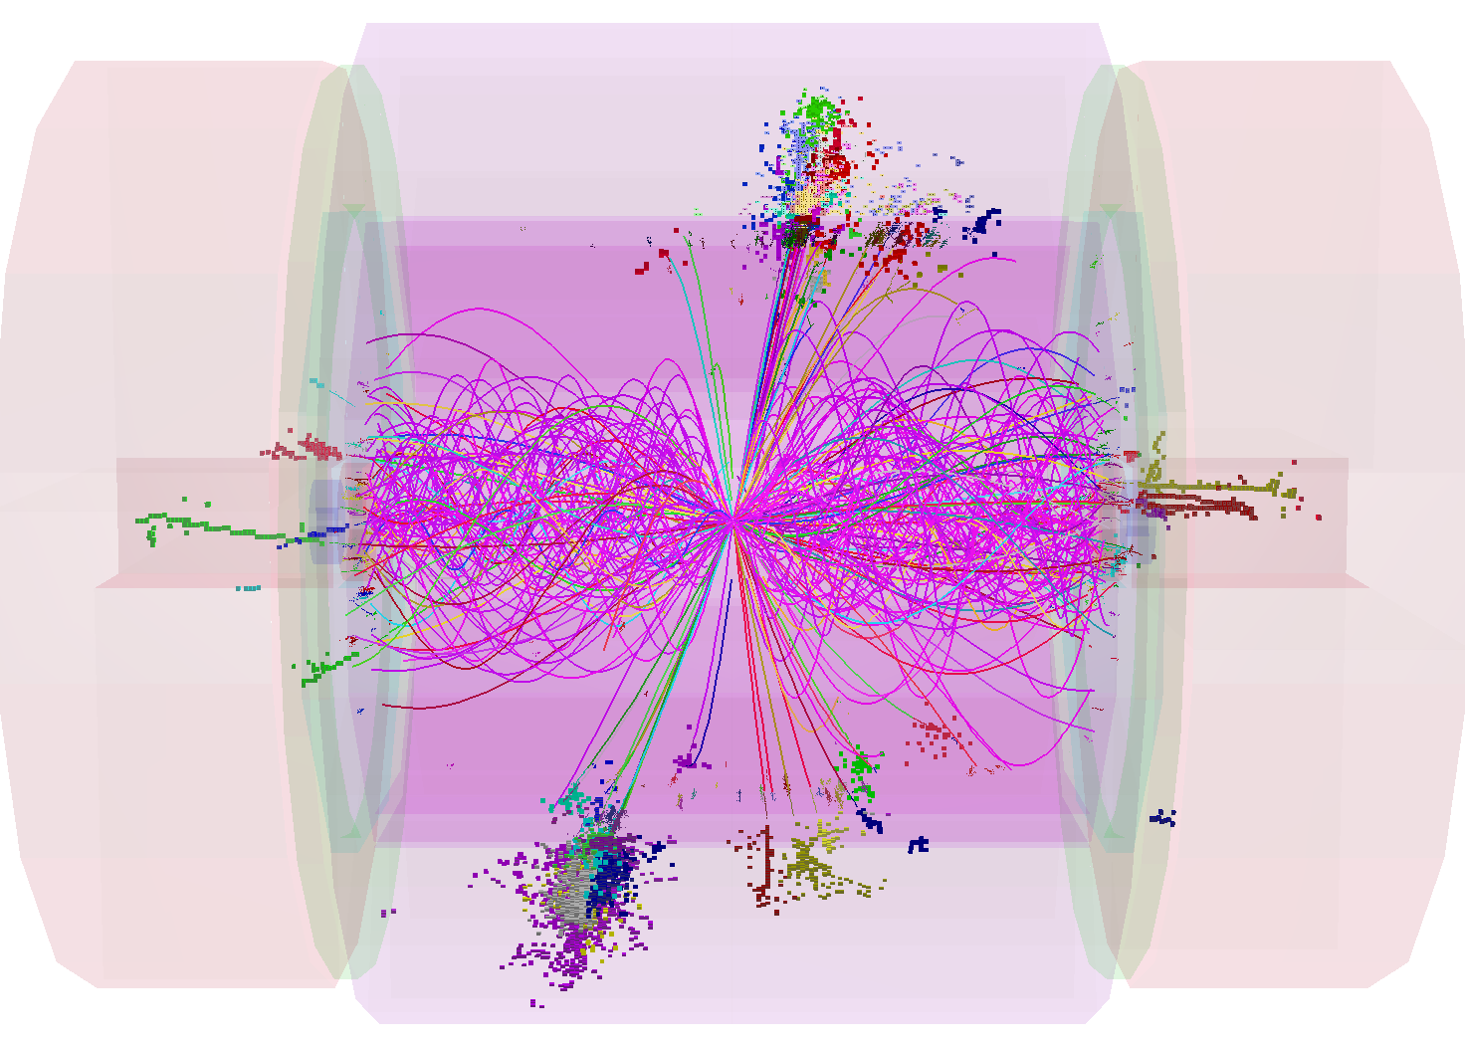
LooseSelectedPandoraNewPFAs
0.3 TeV of background

Slide 31
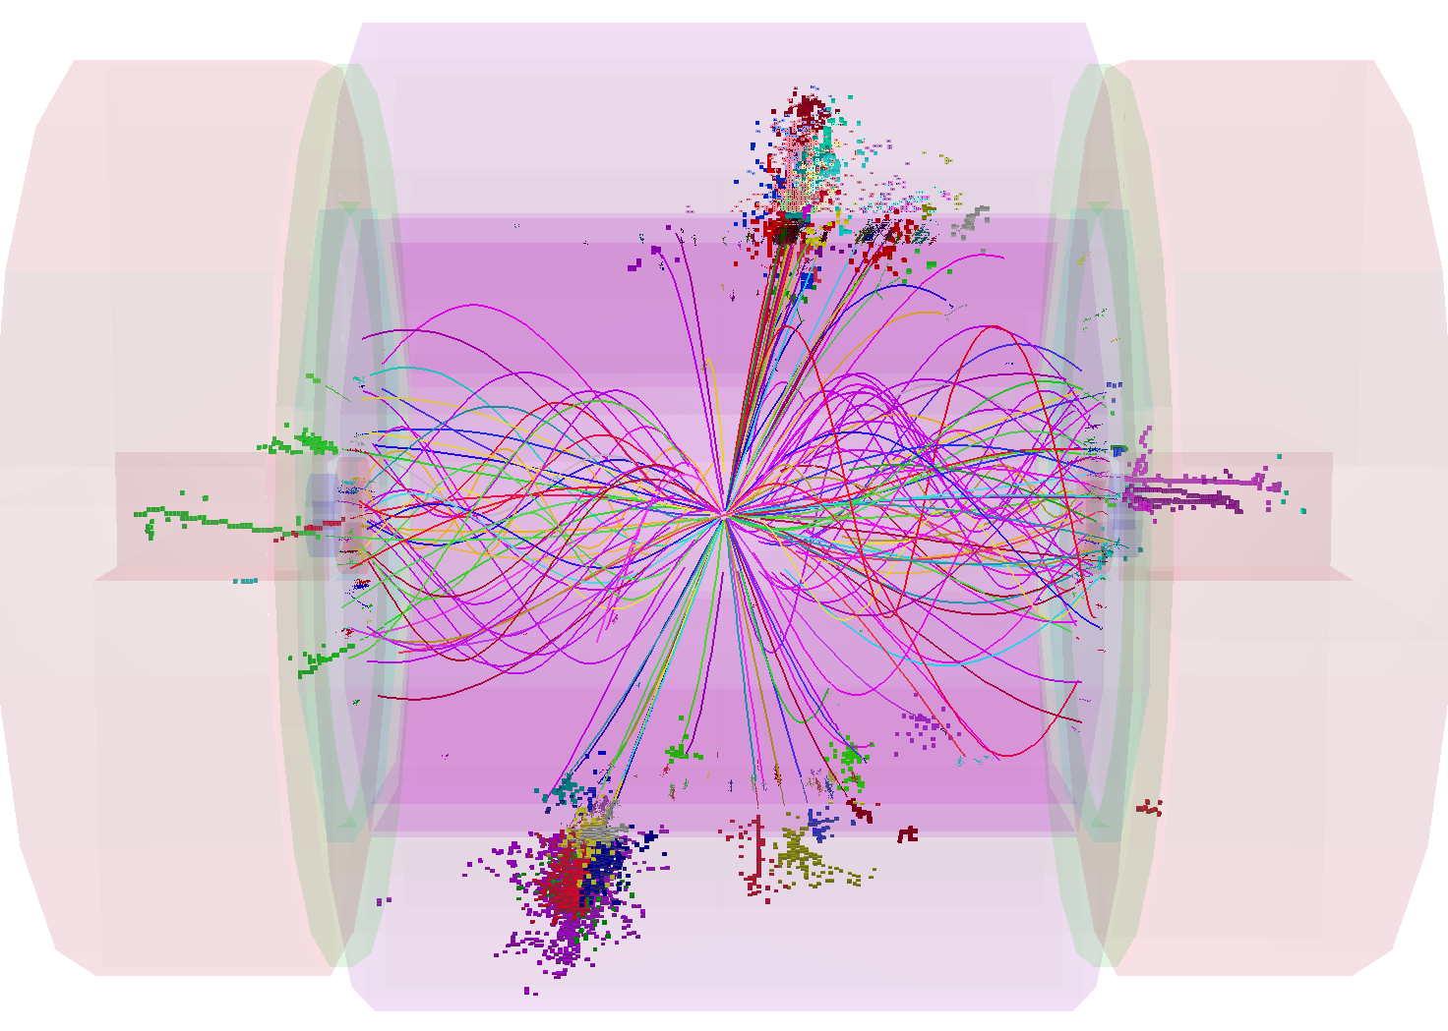
SelectedPandoraNewPFAs
0.2 TeV of background

Slide 32
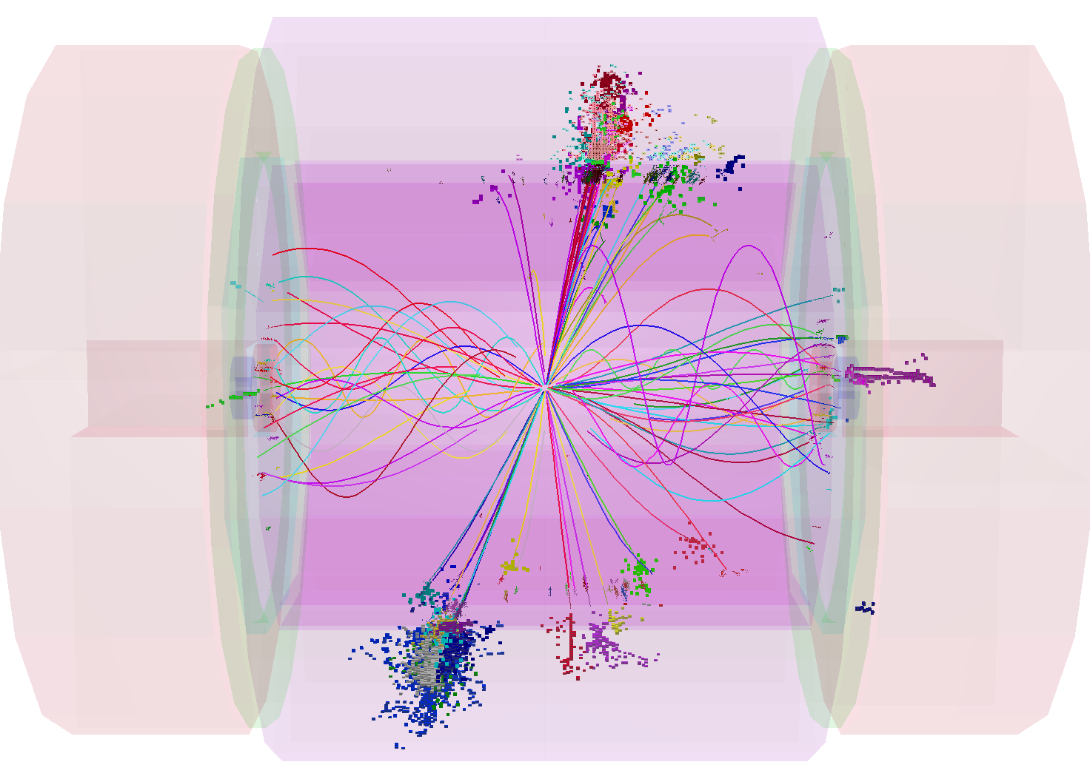
TightSelectedPandoraNewPFAs
0.1 TeV of background
M. Thomson. J. Marshall

Slide 33

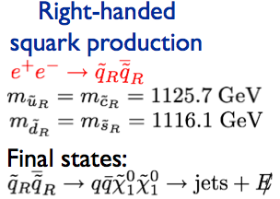







Benchmark studies with CLIC_ILD (1)
Heavy Higgs production:
Final states:

Slide 34
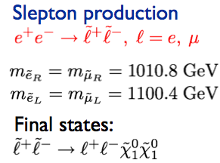
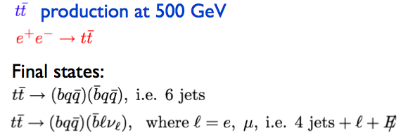
Benchmark studies with CLIC_ILD (2)

Slide 35
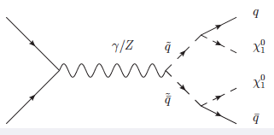
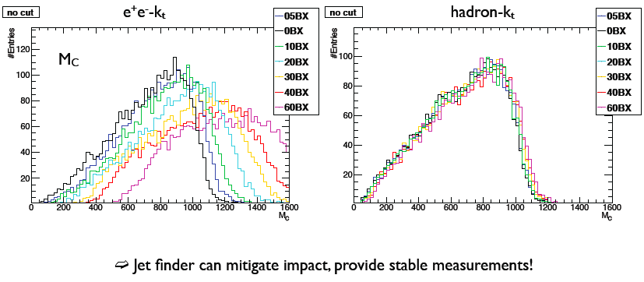
Squark study / Jet finding at CLIC (1)
Several jet-finding algorithms are explored
Example: Squark benchmark study,
MC level (no PFO timing cuts)
L. Weuste, F. Simon

Slide 36
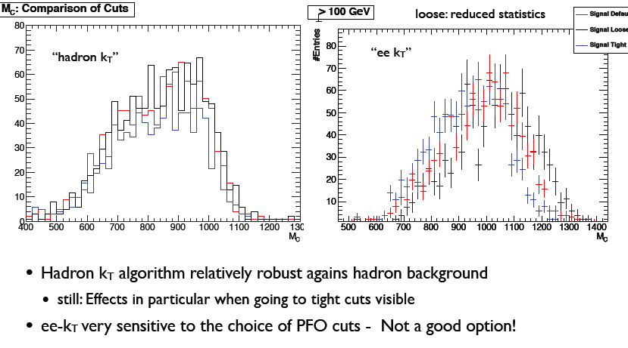
Squark study / Jet finding at CLIC (2)
Example: Squark benchmark study,
Full simulation level (including PFO timing cuts)
L. Weuste, F. Simon

Slide 37
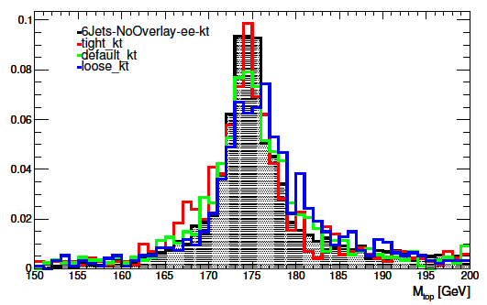
Top mass / jet finding / background
Top reconstruction (ttbar, 6 jets) at 3 TeV
Coloured lines: with background overlay (60 BX)
A. Espargliere, K. Seidel

Slide 38
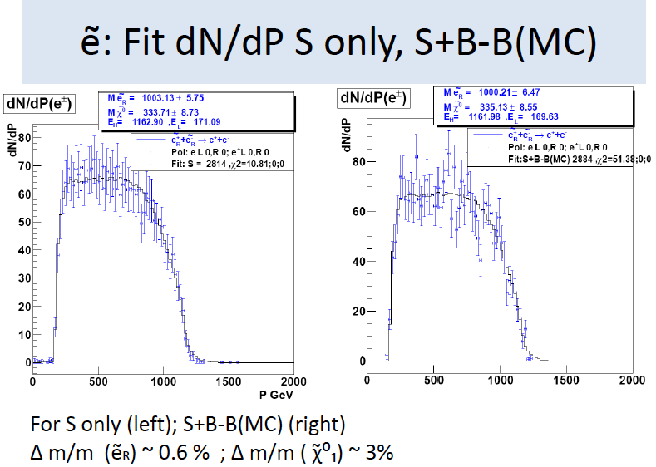
Slepton benchmark study
JJ. Blaising

Slide 39
Participation “CLIC study” to DBD ?
Participation in engineering and integration studies
  E.g. design, vibration and alignment aspects of the detector platforms, moveable service lines, general infrastructure aspects
  Vibration measurements
Engineering/design parameters of the ILD solenoid and its return yoke.
Studies of muon identification and + yoke instrumentation layout
PFA jet energy resolution and HCAL leakage as a function of HCAL depth
Studies of particle ID for photons electrons and muons using PFO’s at 1 TeV
Studies of occupancies and radiation levels in the vertex and tracking detectors due to beam-induced background at 1 TeV
Participation in GRID production for the DBD using ILCDIRAC (within ILC common data sample subgroup)
Participation in 1 or 2 detector benchmark studies at 1 TeV

Slide 40
Timeline of CDR + Review
The current official due-date for CDR (accelerator + detector) is "end of the year" for a presentation to CERN SPC.
For our physics/detector Volume 2, we have a due-date of end-August 2011. This comprises studies of 3 TeV CLIC, and some comparison with ILC at 500 GeV.
★★★★
The period September => November 2011 will be used for:
  Additions to the CDR, in particular the CLIC staged energy approach (not too much work for us, we think) and possibly also a few “spare subjects”
  An internal review of the detector CDR, October 18+19+20

Slide 41
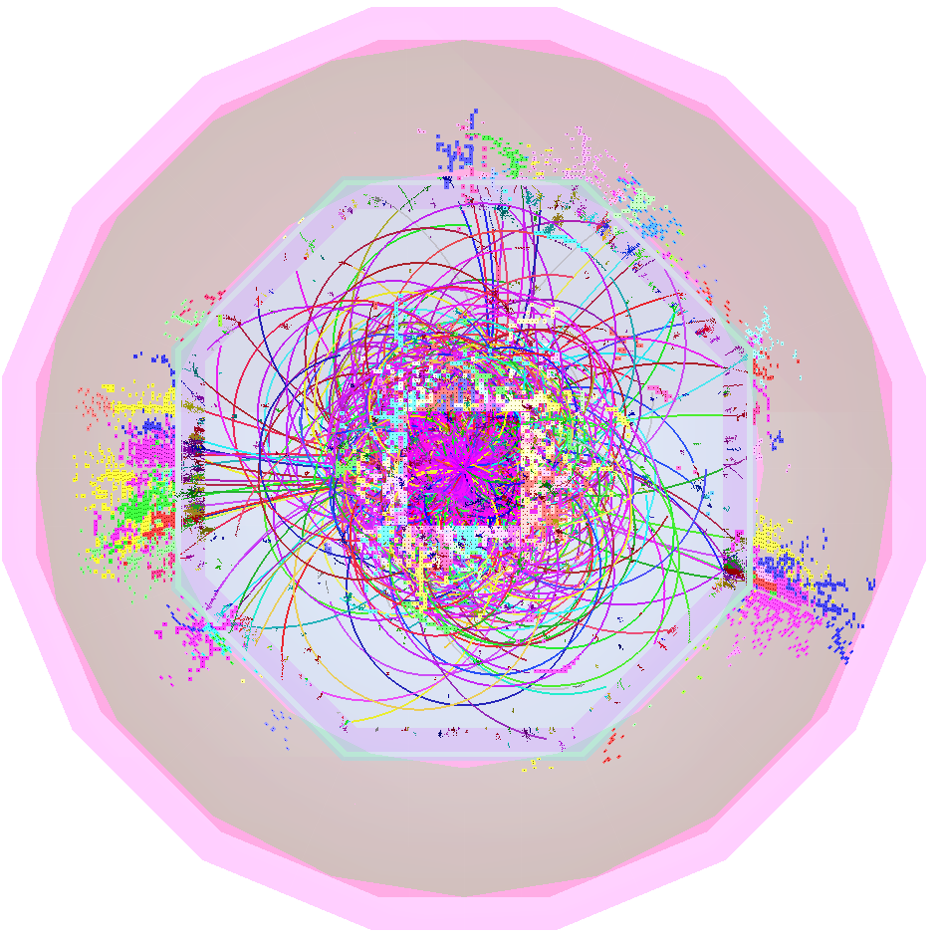
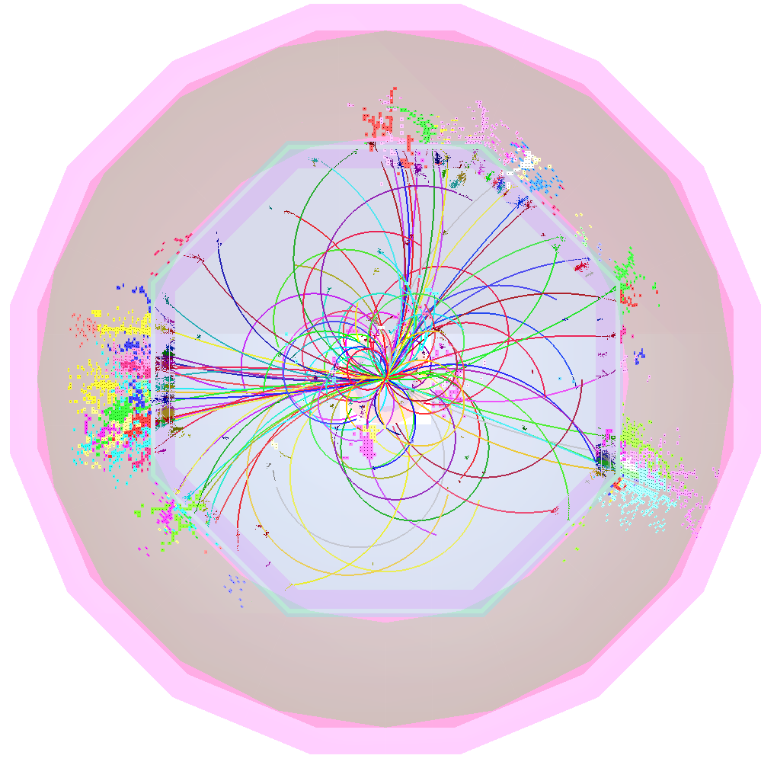
The CLIC detector CDR is well on track
This would not have been possible without all prior work done for the ILC
THANK YOU !

Slide 42
CLIC machine parameters
Parameter | Value
Center-of-mass energy √s | 3 TeV
Instantaneous peak luminosity | 5.9x10³⁴ cm⁻² s⁻¹
Integrated luminosity per year | 500 fb⁻¹
Beam crossing angle | 20 mrad
Train length | 156 ns
N_{bunches} / train | 312 (every 0.5 ns)
Train repetition rate | 50 Hz
IP size x/y/z | 45 nm / 1 nm / 40 μm
# γγ→hadrons / bx | 3.2
# incoherent electron pairs / bx | 3 x 10⁵
# halo muons | 5 (including safety factor of 5)

Slide 43
Differences CLIC_ILD_CDR vs. ILC_ILD_LOI
Changes for CLIC conditions motivated by larger beam-induced backgrounds:
  Beryllium beam pipe and inner vertex barrel layers further away from IP
  Thick conical iron beam pipe pointing to IP, designed as shield against backscatters
  Additional pixel and strip layers in the forward region
  (also motivated by enhanced physics cross sections at 3 TeV in forward region)
TPC: adapted new engineering model with thinner center cathode, thicker endplates
No changes (yet) in SIT, SET, ETD
Same respective single-point resolutions for pixel and strip detectors as for ILD versions
See LCD-note-2011-2 for detailed description of CLIC_ILD_CDR geometry
 | ILC_ILD_LOI 2009 | CLIC_ILD_CDR 2011
Central beam pipe | |z|<80 mm, d=250 μm Beryllium (+ optional coating), R_{min} = 14 mm | |z|<260 mm, d=600 μm Beryllium, R_{min} = 29.4 mm
Outer conical beam pipe | 80 mm < |z| < 2250 mm, d = 0.75-2 mm Beryllium | 260 mm < |z| < 2645 mm, d = 4 – 4.8 mm Iron
VTX barrel double layers | R = 16,18,37,39,58,60 mm; L = 125 mm / 250 mm | R = 31,33,44,46,58,60 mm; L = 250 mm
FTD pixel disks | 3 single layers: z = 220, 371, 645 mm | 3 double layers: z = 160,162,207,209,255,257 mm
FTD strip disks | 4 layers: z = 1046,1447,1849, 2250 mm | 5 layers: z = 382,665,1066,1467,1869 mm
TPC endplates | 15% X/X0 | 28% X/X0

Slide 44
Vertex-region layout
FTD 1-6
r=120
VXD 1-6
z=130
0.6 mm Be beam pipe at R_{i}=29.4 mm (|z|<260 mm)
VXD 1-6: 3 double layers of pixel cylinders (|z|<130 mm) FTD 1-6: 3 double layers of pixel disks
20 μm pixels, analog readout, σ=2.8 μm
X=0.18% X0 / double layer
(2 x 50 μm Si + 134 μm Carbon Support)

Slide 45
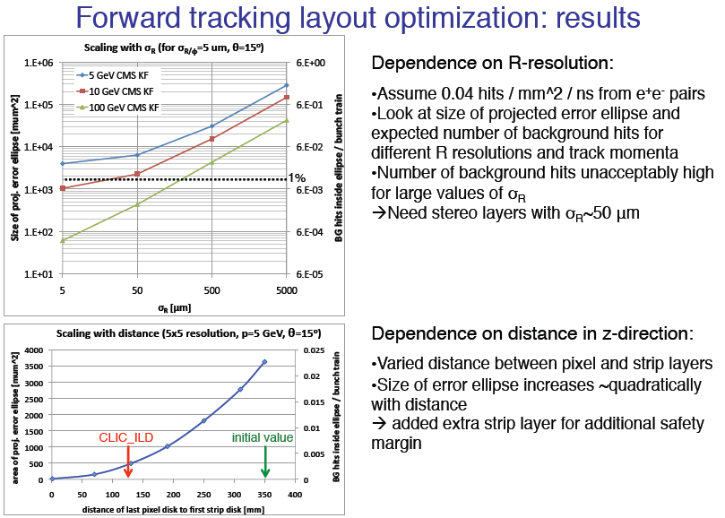
Forward tracking layout: results
M. Vos, D. Dannheim

Slide 46
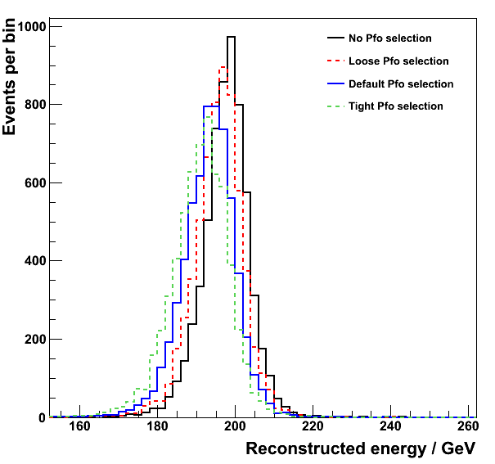
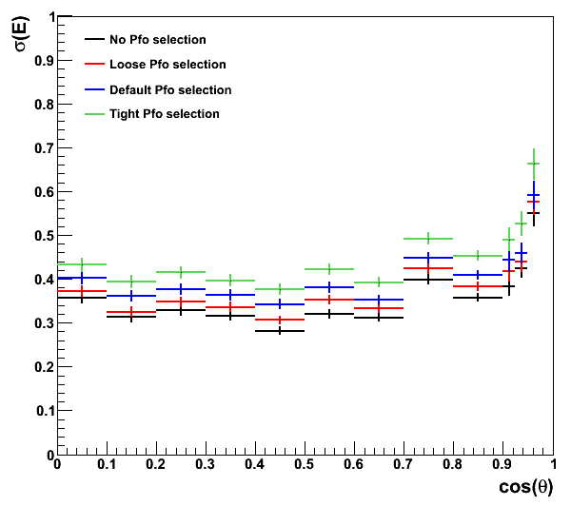
CLICPfoSelection
J. Marshall, M. Thomson
100GeV jets
100GeV jets
Sum of selected pfo energies for 200GeV
Z→uds events in barrel region, |cos θ| < 0.7
σ(Ε) (truncated width) for reconstructed energy distributions as a function of |cos θ|

Slide 47
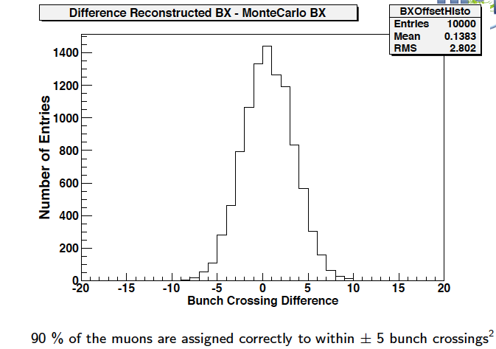
Time-stamping with TPC at CLIC
Approximately 40 micron drift per BX, ~7mm drift for full train
Study mismatch between outer Si tracker (SET) and TPC tracks.
Different muon energies, different angles.
For: Energy 50 GeV, dip angle 5, SET resolution 50 μm
M. Killenberg

