Slide 1
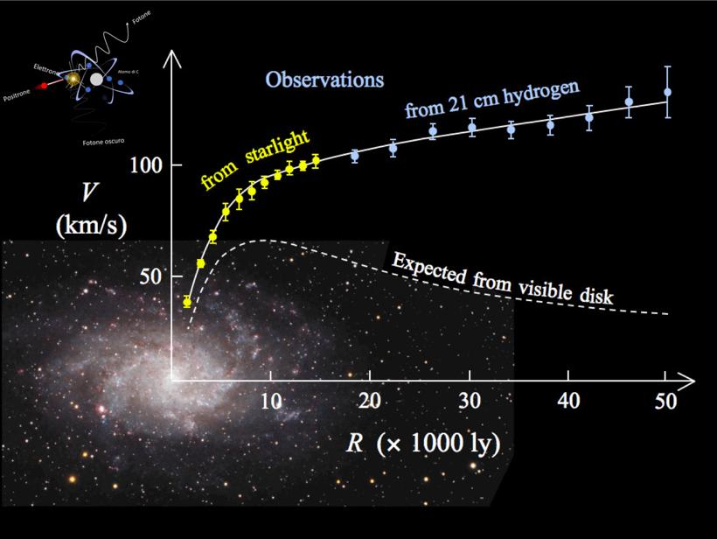


New evidence of hidden sectors in Atomki anomalies?
Prof. Mauro Raggi
CERN and Sapienza Università di Roma
EPFL Lausanne Seminar
May 6th 2024

Slide 2
Outline
The Dark Matter problem
The ATOMKI anomaly and the X₁₇
Experimental directions
What is the nature of X₁₇? Is X₁₇ a dark Matter Candidate?

Slide 3
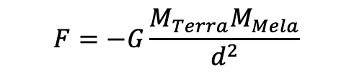

Everything started with an apple!
Sir Isaac Newton
(1642 – 1726)
Principia 1687
"It happened while he was sitting in contemplation, because of the fall of an apple." 1665
$$F=−G\frac{M_{1}M_{2}}{d^{2}}$$
$$F=−G\frac{M_{Terra}M_{Mela}}{d^{2}}$$
He realized almost immediately that his law could explain Kepler's laws and therefore also applied to the planets motion!

Slide 4
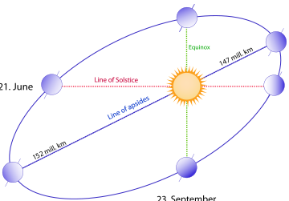
The orbits of the planets: a subtle balance
The planet maintain its orbit due to the
equilibrium of two forces:
F_{c}
F_{c}
F_{g}
F_{g}
Solving for the velocity
D
The speed at which a planet orbits a massive body decreases as the distance from the body increases, following a 1/√D relationship.
Notes:
equilibrio delle forze

Slide 5
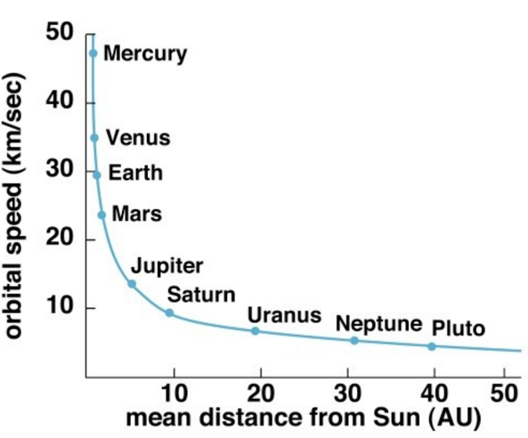


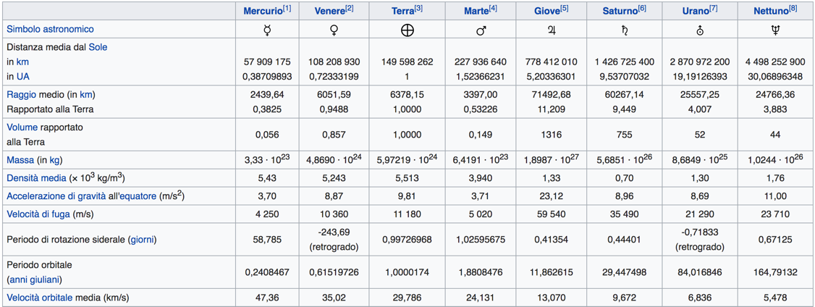
Predicting planet’s velocities
Given Earth travels at ~29.8 km/s, what conclusions can we draw about the velocities of the other planets?
Saturn is ~10 times farther from the sun than the earth therefore:
Uranus is ~19 times farther from the sun than the earth therefore:
1AU = distance
Earth-Sun

Slide 6
That's not the whole story: Zwicky's doubts
Fritz Zwicky (1898–1974)
Studying the speed of 8 galaxies in the Coma Cluster in 1933, he found that they were moving too fast to still be in the cluster!
From these measurements he calculated that the mass of the cluster was 400 times that derived from the mass of visible matter. He concluded that there must be some non-visible matter which he called "dark matter"
Notes:
ricordati i gas

Slide 7
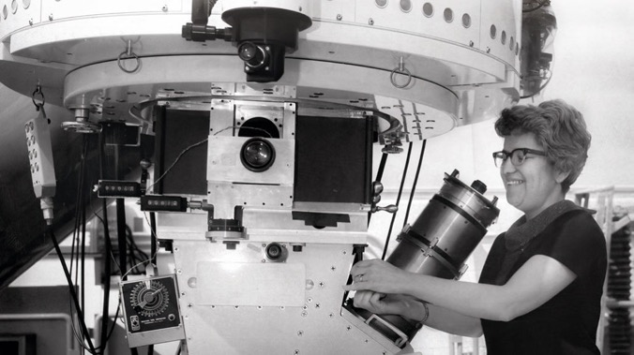
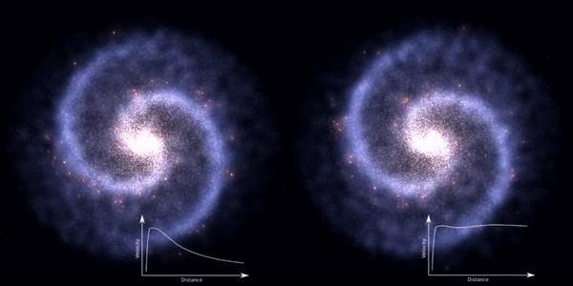
Vera Rubin rotation curves
Vera Rubin - Kent Ford
In 1974 they measured the stars rotation speed in spiral galaxies, particularly the andromeda one.
The observed star velocities were very different from Newton's predictions!
The rotation speed was constant!
Rubin's calculation suggested that the observed matter was less than one-fifth of what was needed, leading to Zwicky's proposition of the existence of invisible matter as the only plausible explanation!
predizione di Newton

Slide 8
Understanding a rotation curve
Newton’s prediction
How to make the rotation curve flat outside the core?
According to Newton and Visible Matter
1) Inside the galaxy core using inner mass M(r)
2) Outside the galaxy core using full visible core mass
this additional mass is what we call
“the Dark Matter”!

Slide 9
What is the universe made up of?
Ordinary matter accounts for less than 20% of the matter in the universe.
All planets, asteroids, etc., constitute less than 0.03% of the universe mass!
Are we sure that dark matter is not composed of ordinary matter?

Slide 10

Identikit of the DM: particle hypothesis
Identikit of the Dark Matter
It should be stable (or at least have an average lifespan of over 13 billion years!).
It should be electrically neutral or have strongly suppressed interaction with ordinary matter.
It should be massive to have gravitational interaction

Slide 11
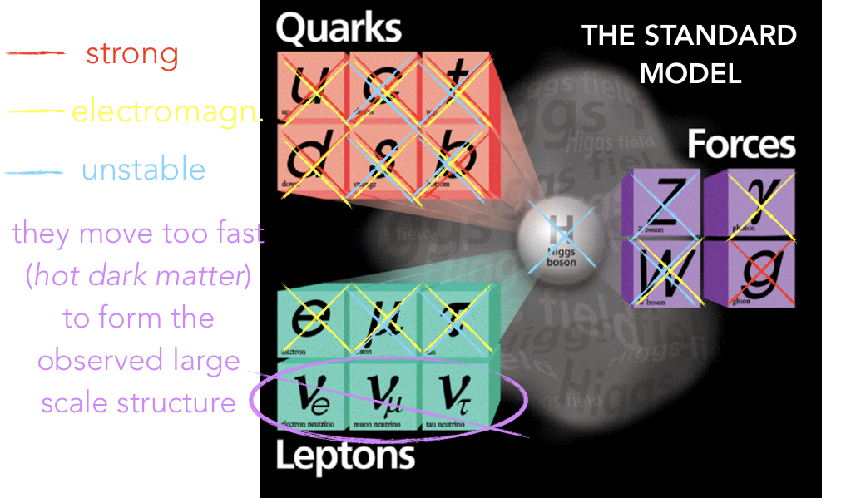
No candidate among the known particles
Neutrinos are almost what we are looking for, but they are too light and move too quickly!

Slide 12
Solving Dark Matter: the WIMPs
Hot universe
T>M_{DM}
Freezed universe
T<M_{DM}
DM produced in SM particle collisions.
End of DM production density start decreasing
DM density reaches relic density equilibrium
From freeze out theory
Using CMB we can measure Ω_{DM}h²~0.1
LHC
need a GeV to TeV mass particle with weak interaction!

Slide 13
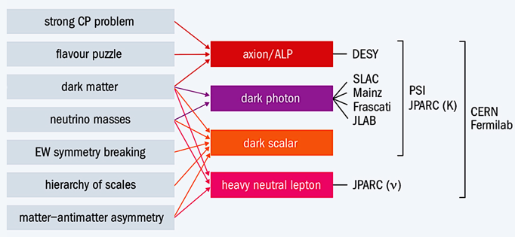
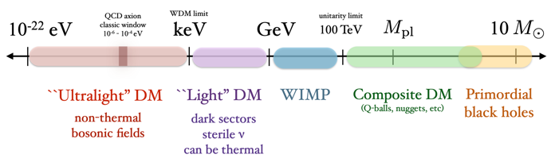
Solving dark Matter: the dark sectors
Portal
Standard
Model
Dark
Sector
Mediator
Feeble,
non-gravitational interaction with ordinary matter
Dark matter
Dark forces
Other dark particles
Dark sector candidates can explain SM anomalies: (g-2)μ, ⁸Be, proton radius
The mediator can have a small mass (MeV - 1 GeV)
Dark sectors particles can have their own new forces (dark forces)
Due to its small mass the mediator can be produced at low energy accelerators
It can decay back to ordinary matter, “visible” decays, or not, “invisible” decays.
HEP open issues
Portals
Laboratories
Thermal

Slide 14
The Atomki anomaly and X17

Slide 15
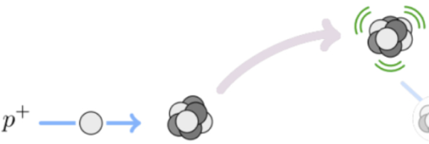
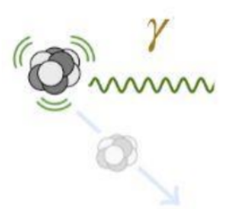
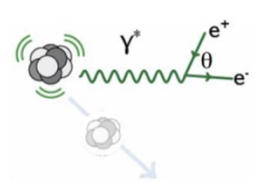

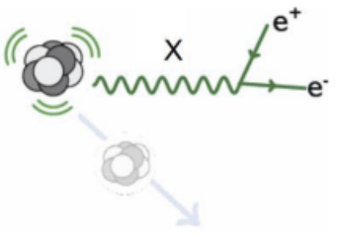
New Physics in nuclear IPC transitions
Excite the nucleus by proton capture:
choose the level by using appropriate p energy (few MeV)
γ emission
IPC
Standard Model deexcitation mechanisms:
a) γ emission
b) Internal Pair Creation (IPC):
- emit an off-shell photon γ*
- γ* decays to ee pair
New Physics (NP) deexcitation mechanisms:
- Produce an intermediate on shell new particle X (mass M_{X})
- X decays to e⁺e⁻ pair
NP produce enhanced IPC rate and different θ_{ee} distribution!
Need transitions with ΔE> M_{X}

Slide 16
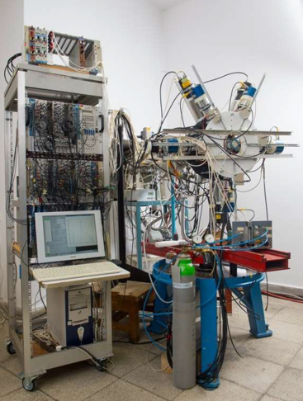

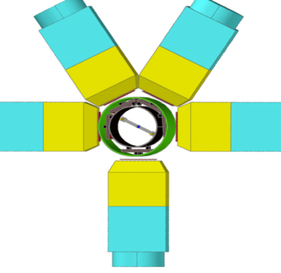
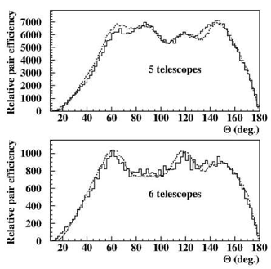
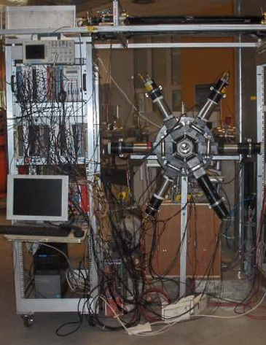
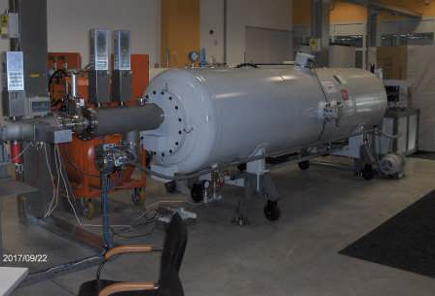
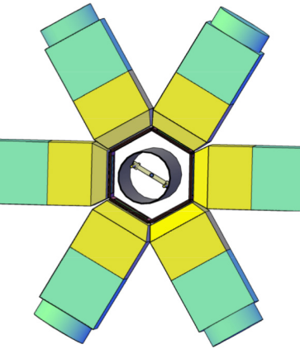
IPC experimental setup at Atomki
2 different setup used by Atomki for IPC measurements:
- 5 arms spectrometer (MWPC and 5 DE/E)
- 6 arms spectrometer (Si strip and 6 DE/E)
Different acceptance and detector types in ⁸Be and ⁴He
5 arm spectrometer ⁸Be 2016
6 arm spectrometer ⁴He 2020
Tandetron Accelerator
Beam current capability
at 2 MV: 200 μA protons

Slide 17
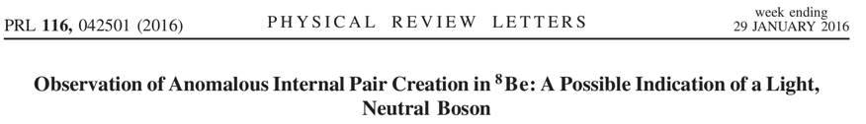
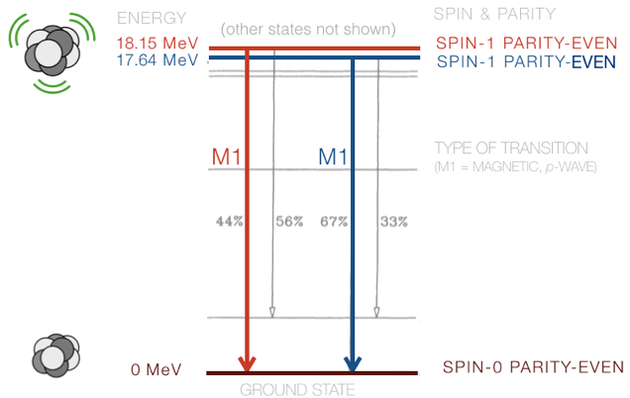
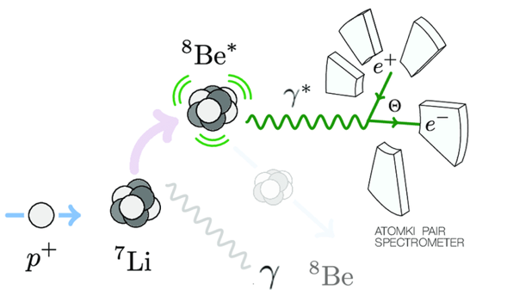
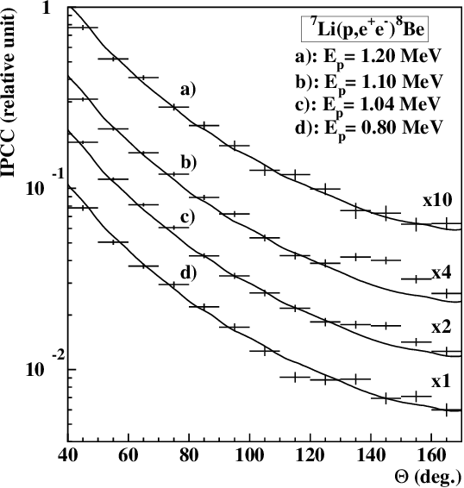
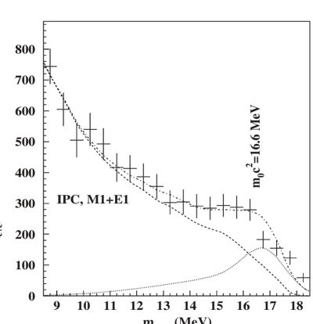
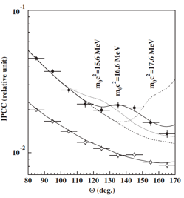

⁸Be anomaly: first evidence
PRL 116, 042501 (2016)
p + ⁷Li —> ⁸Be*(18.15 MeV) —> ⁸Be + e⁺e⁻
Anomaly observed only in 2 over 4 proton energies
Anomaly observed only for symmetric track events
Anomaly observed only for ⁸Be 18.15 MeV transition
6.8σ effect! not a fluctuation
$$m_{X}c^{2}=16.70.35stat0.5syst MeV$$

Slide 18
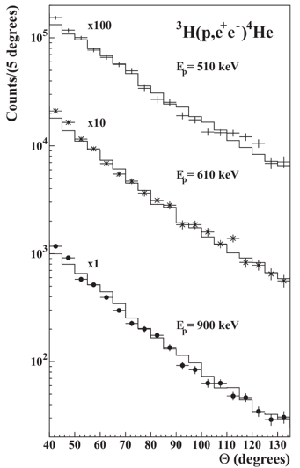
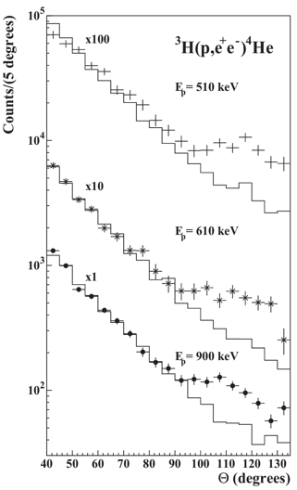
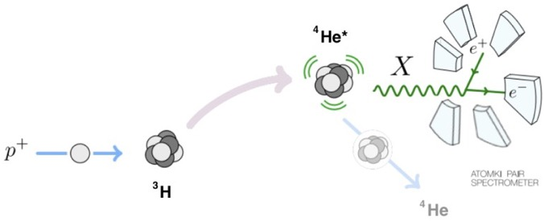
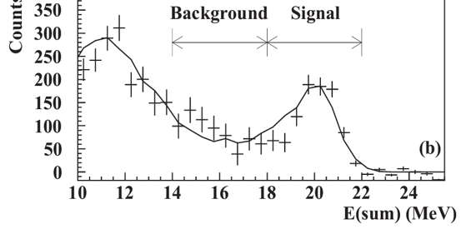
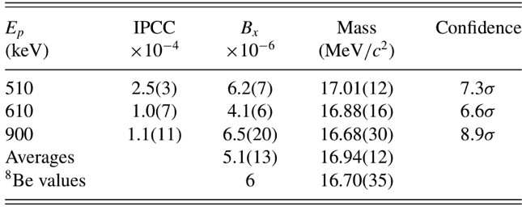
The ⁴He Atomki anomaly: 2020
Phys. Rev. C 104, 044003 (2021)
p + ³H —> ⁴He* —> ⁴He + e⁺e⁻
$$m_{X}c^{2}=16.94 ±0.12stat±0.21syst MeV$$
Phys. Rev. C 104, 044003 (2021)
Atomki has confirmed the anomalous peak in the angular distribution of ⁸Be IPC in ⁴He transitions at different angle.
The difference was expected due to the higher ΔE in ⁴He
The ⁴He angle indicated same X mass value.

Slide 19
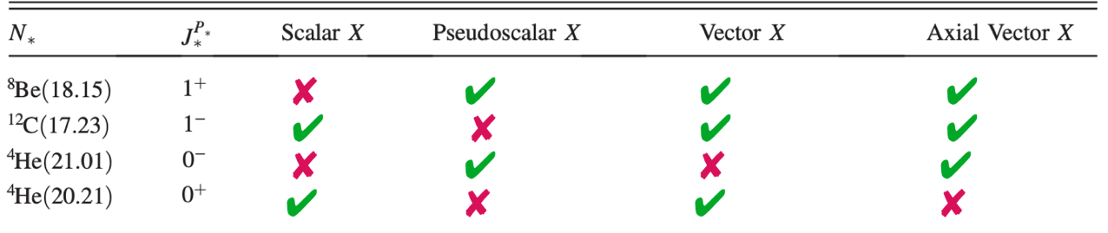
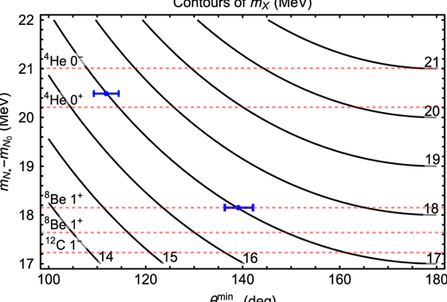
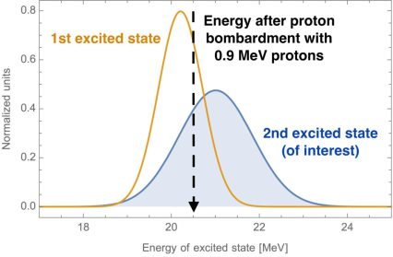

⁸Be and ⁴He consistency and ¹²C
Feng et., Phys. Rev. D 102, 036016
Feng et al., suggested that the X17 should be observed in ¹²C transitions
X17 observations in ¹²C will point to a vector or axial vector nature for X17
$$θ_{ee}^{min}≈2arcsin⁡\left(\frac{m_{X17}}{m_{N∗}−mN}\right)$$
¹²C angle expected to be
at ∼160°

Slide 20
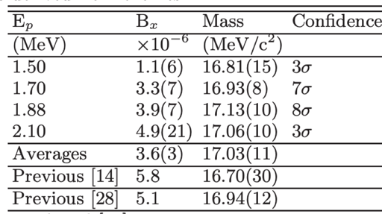
The ¹²C : September 2022
Phys. Rev.C 106 (2022) 6
¹²C*
¹¹B
¹²C
p+¹¹B—>¹²C*(17.23 MeV)—>¹²C + e⁺e⁻
As predicted by J. Feng et al.
excess at 160°
Same X17 particle suggested by the ⁸Be and ⁴He anomalies
M_{X}=17.03±0.11±0.20 MeV

Slide 21

Global ΔE vs angle consistency
PHYS.REV. D 108, 015009 (2023)
Using angular data only: 11 measurements
$$θ_{ee}^{min}≈2arcsin⁡\left(\frac{m_{X17}}{m_{N∗}−mN}\right)$$
Using width for each element: 3 measurements
Data form ⁸Be, ⁴He, ¹²C are consistent and point to: M_{X17}=16.85±0.04 MeV

Slide 22
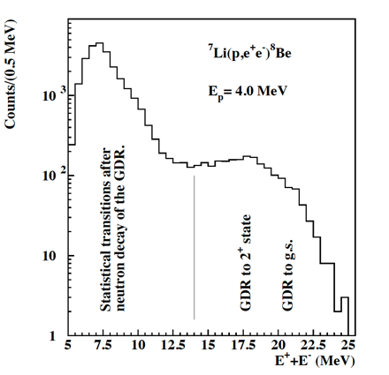
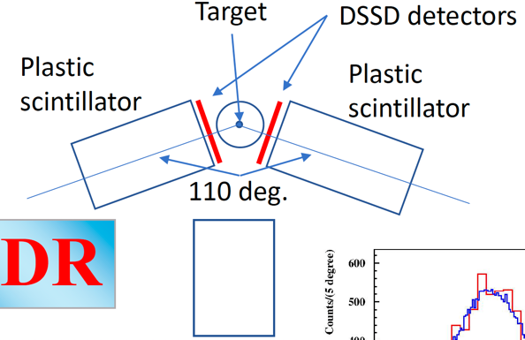
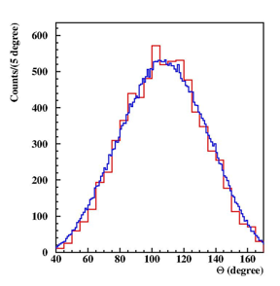
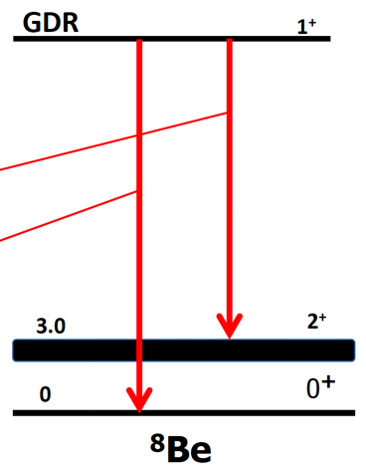
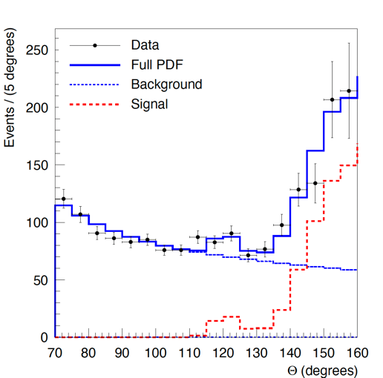
⁸Be giant resonance anomaly: 2023
arXiv:2308.06473
Atomki group: ⁸Be experiment in GDR region
New 2 arm spectrometer closer to the target
E_{P} up to 4 MeV
1⁺ to 2⁺ ~17.5 MeV
1⁺ to 0⁺ ~20.5 MeV
2 peak structure observed!
impressive angular agreement with particle hypothesis.
More information can be found here: ISMD 2023
  https://indico.cern.ch/event/1258038/timetable/#20230822.detailed

Slide 23
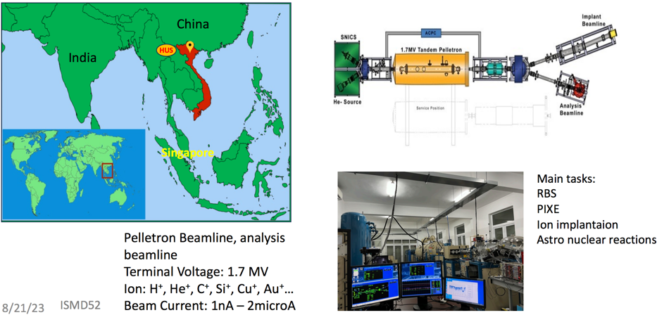
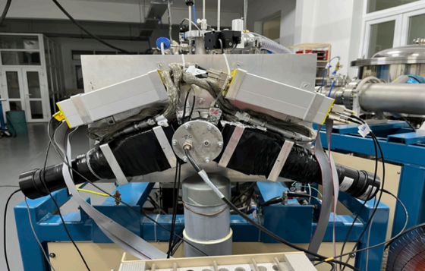
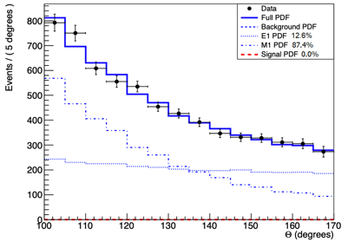
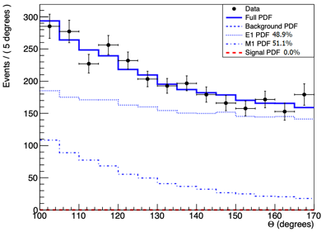
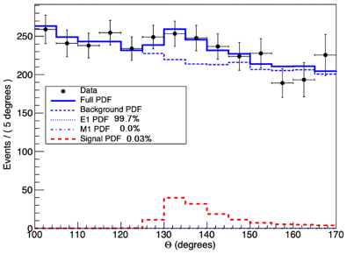
Confirmed in Vietnam 2023?
ISMD2023
2 arm spectrometer (ATOMKI like)
ATOMKI group participants
⁷Li and ¹¹B target used.
E_{P}=441 keV
E_{P}=800 keV
E_{P}=1225 keV
Universe 2024, 10(4), 168;
Anomaly confirmed at 1225 KeV E_{p}. Not observed for lower bombarding energies.

Slide 24
Can we trust the Atomki anomaly?
Evidence in favor:
  All the three anomalies ≳6 σ, not a statistical fluctuation
  Bumps, not general excesses. Not a single bin or a last bin effect
        Bumps disappear ΔE<17MeV and for asymmetric tracks
      Bumps are produced by different detector configurations (2-5-6 arms)
  By introducing a single new particle, remarkable improvement of all the fits
  SM explanation theoretically strongly disfavored:
    8Be [Zhang+, (2017), Gysbers+, (2023)]; 4He [Viviani+, (2021)]
    No explanation so far including all three anomalies at the same time
  ⁸Be-⁴He-¹²C anomalies kinematically & dynamically consistent for V (and A): Barducci & Toni, Eur.Phys.J.C 83 (2023) 3, 230 [arXiv:2212.06453])
  For ¹²C the effect was predicted, and confirmed by experimental data
  Additional recent evidence in GDR experiment
  Partially independent confirmation from Hanoi University
Odds against:
No independent confirmation so far
Strong constraints on the parameter space from particle physics experiments

Slide 25
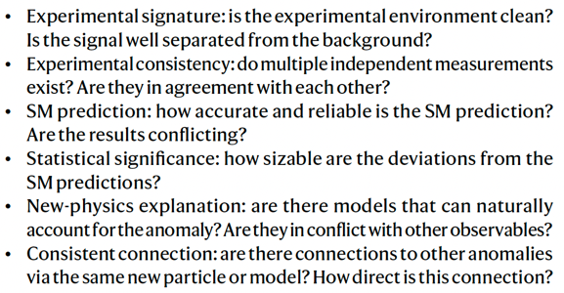
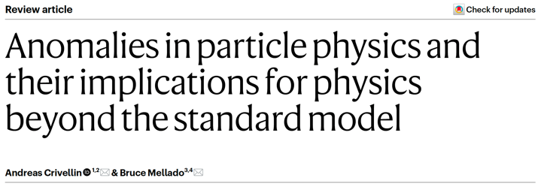
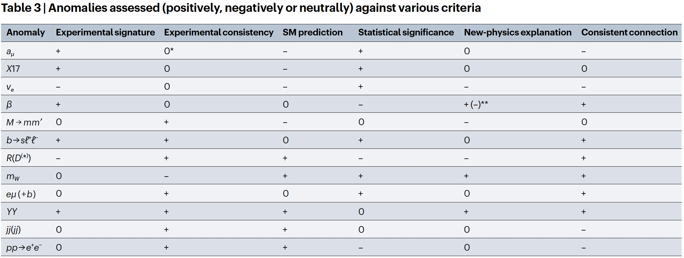
Judging the anomaly: nature reviews
https://doi.org/10.1038/s42254-024-00703-6

Slide 26
Status of theoretical understanding
Can we explain the effect?
Not in within the SM
Zhang & Miller PLB 773, 2017 [nucl-th]
Aleksejevs+, arXiv:2102.01127 [nucl-th]
Viviani+ Phys. Rev. C 105, 014001
Is the effect due to X17?
Kinematic
Dynamic
consistent
Feng+, PRL 1604.07411 [hep-ph]
Feng+, PRD 1608.03591 [hep-ph]
Toni+ JHEP02(2023)154 [hep-ph]
Is X17 a vector or a scalar?
Vector or Axial vector
Feng+, PRD 1608.03591 [hep-ph]
Toni+ JHEP02(2023)154 [hep-ph]
What is the best X17 mass value?
Mass fit:
16.85±0.04Mev
B. Denton+ Phys. Rev. D 108, 015009
Is there a BSM solution?
Several different one
Feng+, PRL 1604.07411 [hep-ph]
Phys. Rev. D 103, 055018

Slide 27
Experimental directions
Shedding light on X17
6–8 Sept 2021
Centro Ricerche Enrico Fermi
Conference Website
Conference Proceedings

Slide 28
Experimental directions
Atomki Nuclear
⁸Be,⁴He,¹²C,GDR
It’s the result
genuine
It’s due to
a new particle
Nuclear physics
experiments
Particle physics
experiments
MEGII @ PSI
p⁷Li->⁸Be*->⁸Be e⁺e⁻
ISMD:
NA48/2 CERN
π⁰-> γ X17
PLB 746 (2015) 178-185
AN2000 @ LNL
p⁷Li->⁸Be e⁺e⁻
NA64 CERN
eN->eN X17
PRD 101, 071101 (2020)
n_ToF @ CERN:
n³He->⁴He e+e-
PRC 105, 014001
NA62 CERN
π⁰-> X17 X17
PRD 105, 015017 (2022)
U Montreal:
p⁷Li->⁸Be*->⁸Be e⁺e⁻
arXiv:2211.11900
PADME LNF
e⁺e⁻->X17->e⁺e⁻
PRD 106,115036

Slide 29
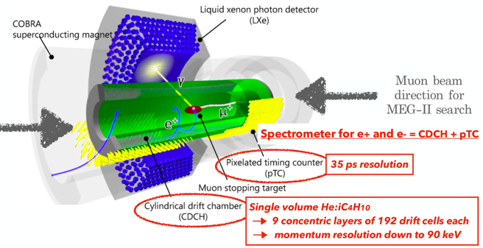
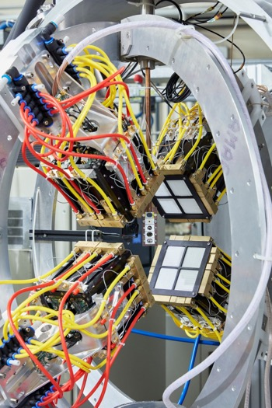



⁸Be nuclear experiments
MEG-II experiment @PSI special Run for X17
4 arm spectrometer at INFN
Laboratori Nazionali di Legnaro
EPJC 83, 230 (2023)
p + ⁷Li —> ⁸Be + e⁺e⁻
p + ⁷Li —> ⁸Be + e⁺e⁻
For the first time in vacuum spectrometer
Scintillating fibre tracking
Using AN2000 accelerator
p energy up to 2 MeV
Engineering run 12/2023
Using AN2000 accelerator
p energy ~1MeV
Engineering run 12/2023
BG studies with 400KeV proton beam ongoing during this week!
EPJC 83, 230 (2023)

Slide 30



NToF: new approach to ⁴He
Innovative neutron beam based excitation mechanism
see Carlo Gustavino
The only experiment proposed so far for to replicate ⁴He anomaly
Thorough theoretical discussion to be found in:
Phys. Rev. C 105, 014001
Chance to have data in late 2024 early 2025

Slide 31
X17: particle physics case
Theory insights based Atomki data :
Scalar excluded by parity conservation in ⁸Be
Pseudo scalar disfavoured by the ¹²C observation
What next in particle physics experiments:
Explore the all possible solution to search for signal outside nuclear physics
Concentrate attention on Vector and Axial Vector cases theoretically favoured solutions
Don’t forget Scalars and Pseudo scalars nature can always be different from what we expect!
Try to be as much model independent as possible

Slide 32







Pure dark photon: excluded NA48/2
CERN
NA48/2
2003-4
For genuine A’ ε_{f}= εq_{f} Feng et. al from the X17 rate:
[PRL 117, 071803 (2016)]
NA48/2 experiment limits for A’ in K±_{2pD}:
K±→π±π⁰_{D} with π⁰_{D}= γe⁺e⁻ [PLB 746 (2015) 178-185]
In case X17 is a dark photon we should have in addition:
π⁰ → γX17 → γe⁺e⁻
X17 should appear as a peak at 17 MeV in the m_{ee} spectrum.
π-phobic/P-phobic vector particle:
[PRL 117, 071803 (2016)]
π⁰ -> X γ : |2ε_{u} + ε_{d}| < 8 x 10⁻⁴ (NA48/2)
B_{X17}/B_{γ}: |ε_{u} + ε_{d}|≈ 4 x 10⁻³ (Atomki)
ε_{d} ≈ -2 ε_{u} (±10%) ==> ε_{p} = 2ε_{u} + ε_{d} ≈ 0;
2ε_{u}+ε_{d} ≈0 ==> π⁰->Xγ = 0 forbidden
Universal coupled vector hypothesis A’ firmly excluded
p-phobic vector still alive!

Slide 33



Generical vector constraints NA64
NA64 CERN NA, uses 150 GeV e⁻ beam on thick target.
only e⁻ -> no problem with extra couplings!
[PRD 101, 071101 (2020)]
How it works:
1) Beam e⁻ losses part of its energy in W_{cal} before radiating.
2) After radiating A’ is absrobed by W_{cal} depsiting all of its energy.
3) A’ is radiated and decays after the W_{cal}
4) Energy of the ee pair from the A’ decay is measured by ECal
Dump experiment:
- limited in the high ε values by X17 lifetime
- No possibility to measure mass of eventually observed events
- just counts general event excess

Slide 34




Axion like X17: excluded by NA62
M. Pospelov noted: [PRD 105, 015017 (2022)]
If a=X17 X17−>e⁺e⁻ and we have π⁺4e final state
a) main SM background K⁺→π⁺π⁰_{DD} has lower rate
b) m_{ee}= m_{a} is a strong kinematical constraint
χPT G8
dominance assumption
NA62 Search for K⁺ →π⁺aa →π⁺e⁺e⁻e⁺e⁻ [PLB 846 (2023) 138193]
- Full NA62cdata set collected in 2017–2018
- Expected BG = 0.18±0.14 events
- No events are observed in the signal region m_{π4e}~ m_{K+}
- NA62 obtained:
which rules out the QCD axion hypothesis for the X17.
[PLB 846 (2023) 138193]

Slide 35


Constraints on X17: pure lepton
Phys. Rev. D 101, 071101 (R) (2020)
Phys. Rev. D 104, L111102 (2021)
X17 as a vector (V) or axial vector (A) particle:
Theoretically favoured by ATOMKI oboservations.
NA48/2 bound not valid for “protophobic” V and A
(g-2)_{e} bound weaker for vectors
Still a lot of free parameter space for vector X17
X17 as pseudo scalar particle:
Theoretically disfavoured by ¹²C
(g-2)_{e} bound stronger for pseudo scalars
Ruled out in pion decays (π⁰->aa)
Weak contraints in pure lepton-phillic models

Slide 36



As simple as possible: the resonance search
X₁₇
e⁺
[M.R., E. Nardi et al. PRD 97, 095004 (2018)]
Just flip the diagram
Atomki X₁₇
e⁻
X₁₇
e⁺
and connect!
e⁻
e⁺
X17
X₁₇
e⁺
No model dependence just electron coupling!
Extremely high production rate Breit-Wigner enhancement
e⁻
e⁻
Lowest possible α suppression
Extremely small Γ_{X17}
<10⁻² eV
We need a lot of positrons in very limited COM energy range
[M.R. L. Darmé E. Nardi et al. PRD 106,115036]
We can have >1E10 e⁺ in 20KeV CoM energy at LNF!
Ok let’s do that at PADME!

Slide 37











The mass scan PAMDE search strategy
PADME, can use resonant X17 production process
Extremely effective in producing X17 but in a very small mass range
Scan E_{beam}=260–300 MeV in <1 MeV steps
t-channel
s-channel
$e^{+}e^{−}→γγ$
$$\#\frac{events}{σ}$$
Completely data driven no theory or MC inputs
Signal should emerge on top of Bhabha BG in one or more points of the scan.
Background estimated from surrounding bins
$\left|p\right|$ [GeV]
Cartoon view of the technique
$$Bhabha scattering$$
Bhabha scattering
$t$channel
$s$channel
e⁺e⁻−>γγ

Slide 38


PADME expected limits
L. Darmé, M. Mancini, E. Nardi, M. Raggi
Darmé et al. Phys. Rev. D 106,115036
Vector X17
Pseudo scalar X17
BG from SM Bhabha scattering under control down to ε = few 10⁻⁴
Need precise luminosity measurement and systematic errors control (<1%)
Need ~1E10 POT per each energy point
PADME maximum sensitivity in the vector case

Slide 39

PADME Run III data set: winter 2022
Run III PADME data set contains 3 subset
On resonance: 47 points (263-299) MeV
Below resonance: 5 points (205-211) MeV
Over resonance: 1 energy 402. MeV
On resonance points spaced by ~0.75 MeV
Point spacing equal to the energy resolution
Mass region 16.4 MeV<M_{X17}<17.5 MeV
statistics >1x10¹⁰ PoT per point
Below resonance spaced by ~1.5 MeV
Statistics >1x10¹⁰ PoT per point
Used to validate analysis method
arXiv:2304.09877v1
¹²C mass constraint
1 over resonance energy 5 different runs
Statistics ~0.4x10¹⁰ PoT per run ~2E10 total
Used to validate NPoT measurement stability
GREEN mass range fit results in arXiv:2304.09877v1
Dots mass points explored by PADME
Mass limit imposed by ¹²C observation

Slide 40


PADME Run III data analysis status
Scatter e+ on e- in the diamond target to select e⁺e⁻−> e⁺e⁻
Measure, direction and energy of each track with Ecal
Transform back to the Centre of Mass: e⁺e⁻ are back-to-back.
Select events with θ₁+θ₂=π and φ₁-φ₂=π
After selecting pure e⁺e⁻−> e⁺e⁻ search for unexpected excess from e⁺e⁻−>X17−> e⁺e⁻ by scanning the X17 mass region.
BG down to few % level
can be measured in data

Slide 41




PADME out of resonance data sets
Over resonance 402 MeV
Below resonance 205-212
RMS ~0.7% over the 5 runs
Constant fit has a good χ²
  No significant systematic errors
Vertical scale arbitrary
RMS <1% over the 5 energies
Good χ² of the linear fit
  Trend due to acceptance
Vertical scale arbitrary:

Slide 42
Conclusions
8Be, 4He, 12 C GDR anomalies observed IPC at Atomki appear to
be consistent with a particle physics interpretation (X17)
- Statistical evidence is very strong (~ 7σ for each nucleus)
SM explanations via higher order nuclear effects, interferences, higher multipoles contributions, are theoretically (strongly) disfavoured…
Present data from a single experiment.
- See, however, Hanoi experiment 22/08
- Additional independent validations are needed.
Intense effort for new Nucl. Phys. experiments is ongoing.
- First results expected not earlier than late 2024 early 2025.
Being based on resonant production, a particle physics experiment like PADME will be decisive to validate/disprove the X17 hypothesis.

Slide 43
Is X17 a dark matter candidate?
Is X17 is a good DM candidate? NO
- Violates the rule 1) ”It should be stable” X17 decays to SM e⁺e⁻ pairs.
Is X17 is a good WIMP candidate? NO
- X17 mass in too low for a WIMP
Is X17 a good Dark Sector candidate? maybe (too early)
- X17 mass is in the correct mass range (few MeV to < 1 GeV)
- X17 is weekly coupled to SM fermions
- X17 is similar a light mediator particle for dark sectors
Could X17 be related to the DM problem?
- If X17 it’s a vector particle could act as mediator for a new U(1)_{D} symmetry?
- In this case the DM fermions need to be at higher mass scales (Mχ >> 17MeV)
Could X17 help with other anomalies?
- If X17 it’s a vector particle could help with (g-2)_{e} and (g-2)μ anomalies

Slide 44

Thank you for your attention and
Join the dark side!

Slide 45
Backup slides

Slide 46


Kinematics and the y cut.

Slide 47


Looking on the mass sidebands
PADME collected two off resonance data sets:
  Over Resonance: 402 MeV 5 Runs for a total of 1.2E10 POT (collected 1w of October 2022)
  Below Resonance: 205-211 MeV 5 energies for a total of 5E10 POT (last w of November 2022)
First selection aimed at N(2cl)/N_{PoT} studies:
  2 in time clusters in the Δt < 5ns in Ecal
  Energy and radius cuts, reasonable Centre of Gravity
  Cluster energy vs angle correlation compatible with a 2 body final state.
Over Resonance: 402 MeV
Below Resonance: 205 MeV

Slide 48

1. How Dark Matter was born
Universo caldo
T>M_{DM} x<1
Cooled Universe
T<M_{DM} x>1
DM density too low, DM production stops
Freeze out produced a relic DM density

Slide 49
2. Non vogliamo nuove forze!
Dal freeze-out possiamo stabilire
Dalle misure di CMB sappiamo che:
Senza introdurre una nuova forza ma utilizzando l’interazione debole che già abbiamo!
DM
Wimp
Ci serve soltanto una particella pesante con interazione debole ma non nuove forze!
Chiameremo questa particella WIMP.
Materia
ordinaria

Slide 50
Ricerca diretta di DM - Wimps
Nucleo
Nucleo
anni 80
WIMP
WIMP

Slide 51
XENON1T ai laboratori del Gran Sasso
1m
1m
3.300 Kg di Xenon liquido alla temperatura di 95 gradi sotto zero

Slide 52
Measuring dark matter:
Gravitational lensing
Light in the presence of large densities of matter does not travel in a straight line but along the lines of space-time warped by gravity locally.

Slide 53

What does a galaxy look like?
Dark matter
visible matter

Slide 54
Stato della ricerca diretta di DM
per ora nessuna buona notizia purtroppo!

Slide 55







DS search: experimental approaches
Electron beam experiments production
    Just $A’$-strahlung
Positron based experiments
  $A’$-strahlung
  Associated production $e^{+}e^{−}→A^{′}(γ)$
  Resonant production $e^{+}e^{−}→e^{+}e^{−}$
Brems.
Visible decays: $A’→e^{+}e^{−} A’→μ^{+}μ^{−}$
    Thick target electron/protons beam is absorbed (NA64, old dump experiments)
    Thin target searching for bumps in ee invariant mass
Invisible searches: $A’→χχ$
  Missing energy/momentum: $A’$produced in the interaction of an electron beam with thick/thin target (NA64/LDMX)
  Missing mass: $e^{+}e^{−}→A^{′}(γ)$ search for invisible particle using kinematics (Belle II, PADME)
Associated production
Resonant
Visible decay
Invisible decay

Slide 56


How can we make our life easier?
Positron beams
We need higher production cross section!
Can move from associated to resonant production
  b) Radiative annihilation O(α²)
  c) Resonant annihilation O(α)
Profit for a higher production in a tiny mass region

Slide 57

Electron motion in C effect

Slide 58


X17 observables at PADME
Several different observables can be used with different systematics
γγ
N(2cl)/NPoT ⟹ existence of X17
High statistical significance (small sensitivity loss due to small γγ BG)
No ETag related systematic errors
N(ee)/N(γγ) ⟹ existence of X17
Lower statistical significance due to smaller γγ cross section
Do not depend on N_{PoT} (no N_{PoT} systematic) error dominated by tagging efficiency
N_{e+e−}/N_{PoT} ⟹ vector nature of X₁₇
Systematic errors due to ETag tagging efficiency stability and N_{PoT}
N_{γγ}/N_{PoT} ⟹ pseudo-scalar nature of X₁₇
Systematic errors due to ETag tagging efficiency stability and N_{PoT}

Slide 59


Obtaining energy steps and resolution
Courtesy of
P. Valente
Use the first dipole magnet and collimators to select energy
dp ∝ collimator aperture.
Change the first dipole magnet current to change the energy
Correct the trajectory using second dipole to put the beam back on axis at PADME
Measure the displacement at the target and timePix to measure the energy step performed
second
dipole
Collimators
First dipole

Slide 60




Muon g-2 anomaly
g-2 in the standard model
About 3σ discrepancy between theory and experiment (3.6σ, if taking into account only e+e−>hadrons)
Additional diagram with dark photon exchange can fix the discrepancy (with sub GeV A’ masses)
Contribution to g-2 from dark photon
g-2 and A’
A’

Slide 61



g-2e anomaly
Significant discrepancy in the last two results on the α determination
Produce a modified (g-2)_{e} exclusion which allows a region of existence of X17
https://www.nature.com/articles/s41586-020-2964-7

Slide 62


Montreal experiment
Wire chamber surrounding the target

