Slide 1


WEEK 11: 14/03/2024
PRESENTER:
AMIN BOUZAIENE
CERN| EP-DT-FS Group

Slide 2
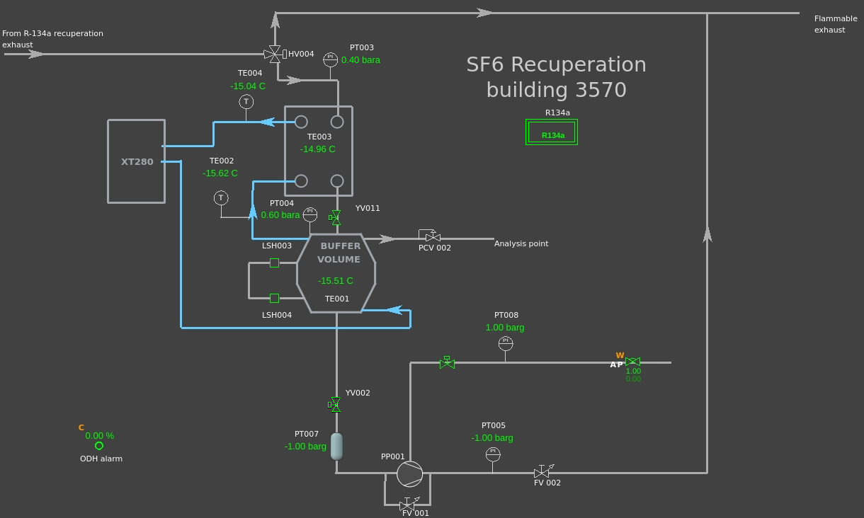
SF6 OLD RACK
What was done ?
Lauda connected to SF6 rack
What else needs to be done ?
Leak tests need to be done for the rack after restart of R134a recovery
CERN| EP-DT-FS Group

Slide 3
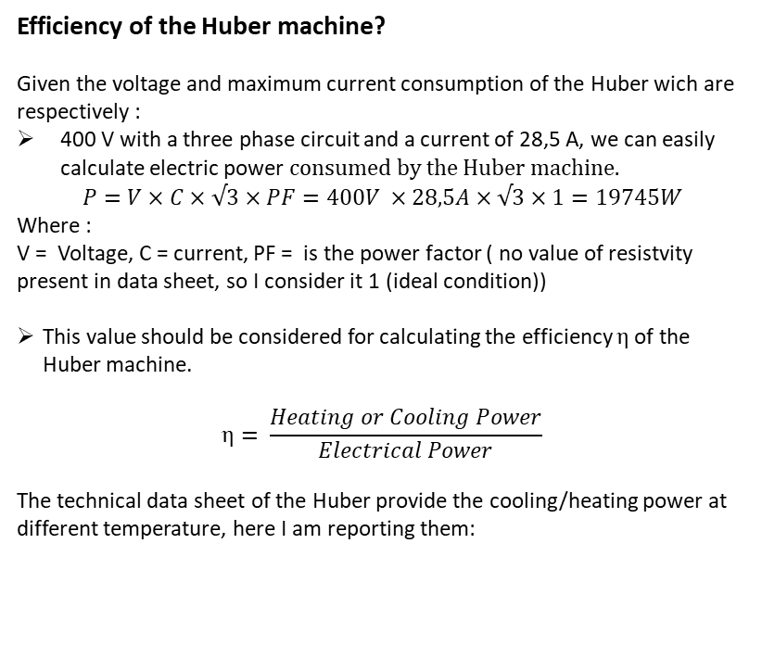
  HUBER-UNISTAT 915w
Efficiency of the Huber machine?
Given the voltage and maximum current consumption of the Huber wich are respectively :
400 V with a three phase circuit and a current of 28,5 A, we can easily calculate electric power $consumed by the Huber machine.$
$$P=V×C×√3×PF=400V ×28,5A×√3×1=19745W$$
Where :
V = Voltage, C = current, PF = is the power factor ( no value of resistvity present in data sheet, so I consider it 1 (ideal condition))
This value should be considered for calculating the efficiency $η$of the Huber machine.
$$η= \frac{Heating or Cooling Power}{Electrical Power}$$
The technical data sheet of the Huber provide the cooling/heating power at different temperature, here I am reporting them:
Temperature [°C] | Heating Power[kW]
100 | 11
150 | 9
200 | 7,5
250 | 6,5
Temperatutre [°C] | Cooling Power [kW]
0 | 11
-20 | 11
-40 | 8,2
-60 | 4,2
-80 | 1,3
-90 | 0,6
CERN| EP-DT-FS Group

Slide 4
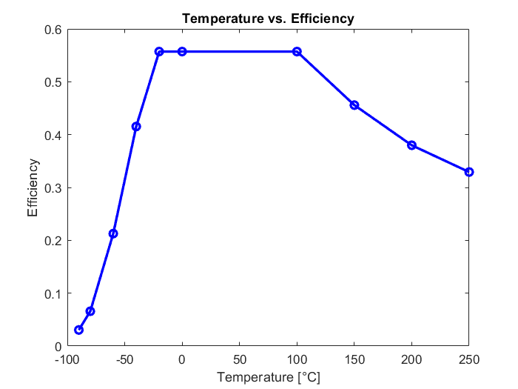
  Temperature vs Huber efficiency
Here at the right, we can see that :
The lower the temperature the lowest the efficiency of the Huber Machine
Maximum efficiency of Huber (0,57) is reached at a temperature range between -40°C to 100°C
At temperaure grater than 100 °C efficiency is decreasing till a minum value of 0,32 at 250 °C
CERN| EP-DT-FS Group

Slide 5
  Huber efficiency in R134a recovery system
In R134a recovery system the Huber is setted at a temperature range between -36°C to -34°C, so for getting the exact value of Available Power at that temperature we should do a linear interpolation between -20°C /-40°C:
  After linear interpolation between this two values:
    At a Temperature of -34°C we have an Huber Efficiency of 0,46 -> available power 9 [kW]
    At a Temperature of -36°C we have an Huber Efficiency of 0,44 -> available power 8,7 [kW]
So we can assume that we have an average available power of :
8,8 [kW] with an average efficiency of 0,45
CERN| EP-DT-FS Group

Slide 6
  Electric Consumption and CO2 eq of R134a recovery system
For calculating the electric consumption of R134A recovery system we should take into account :
Electricity spended by the electrick rack wich is assumbed to be negligible
Consumption of compressor-> air driven gas booster ( no electricity needed ) so it is negligible
Huber electric consumption : 20 [kW]
So considering that CMS is located in France and we are connected to the France electric grid:
average yearly CO2 emission from electric grid/kWh is 53 gCO2eq/KWh ( value taken by :https://app.electricitymaps.com/map)
So, considering only electricity : 9 toneqCO2/working year
CERN| EP-DT-FS Group

Slide 7
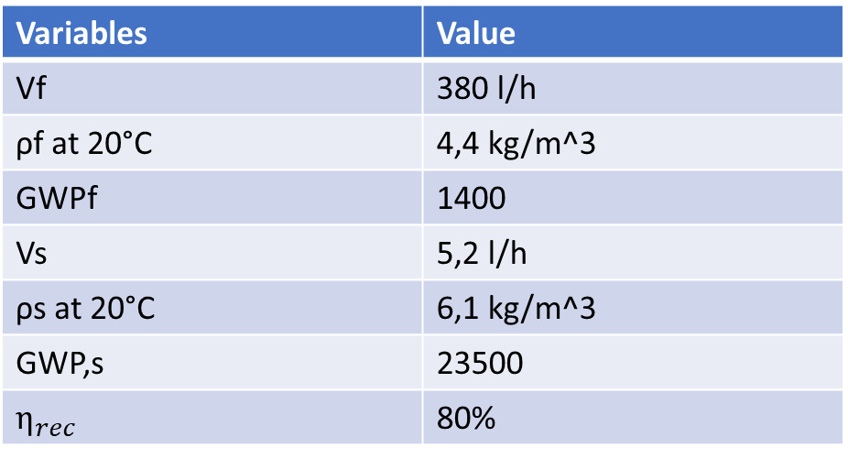
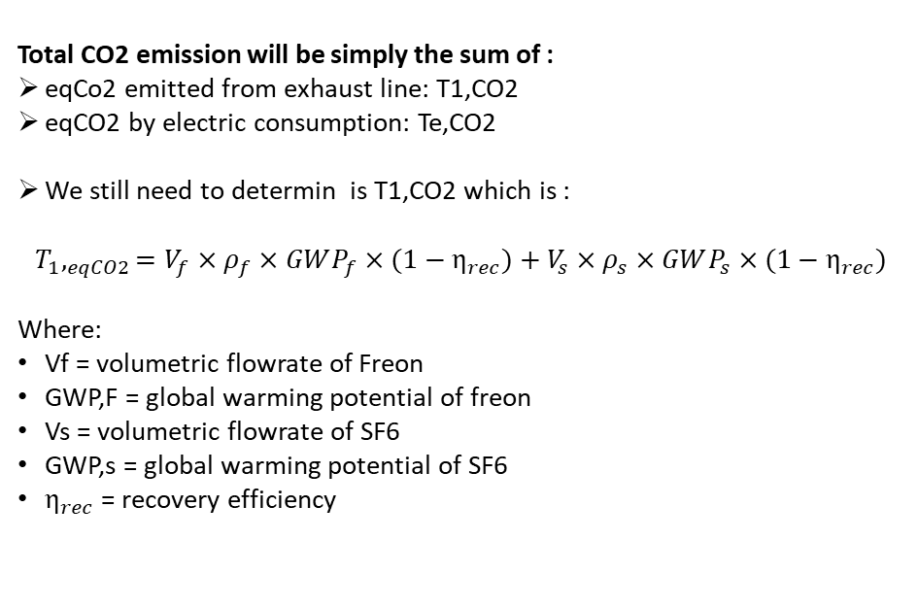
  Total eqCo2 emission for Freon recovery system
Variables | Value
Vf | 380 l/h
ρf at 20°C | 4,4 kg/m^3
GWPf | 1400
Vs | 5,2 l/h
ρs at 20°C | 6,1 kg/m^3
GWP,s | 23500
$η_{rec}$ | 80%
Total CO2 emission will be simply the sum of :
eqCo2 emitted from exhaust line: T1,CO2
eqCO2 by electric consumption: Te,CO2
We still need to determin is T1,CO2 which is :
$$T_{1},_{eqCO2}=V_{f}×ρ_{f}×GWP_{f}×(1−η_{rec})+V_{s}×ρ_{s}×GWP_{s}×(1−η_{rec})$$
Where:
Vf = volumetric flowrate of Freon
GWP,F = global warming potential of freon
Vs = volumetric flowrate of SF6
GWP,s = global warming potential of SF6
$η_{rec}$ = recovery efficiency
Total eqCo2 emitted from exhaust line = 4372 tCo2eq/year
Total eq Co2 = T1,eqCO2 + Te,CO2 = 4380 tCo2eq/year
CERN| EP-DT-FS Group

Slide 8
\ What’s NEXT ?
Tests of R134a recovery system for optimal parameters ->On going
Tests of SF6 prototype 0 -> after leak tests of R134a recovery system
Test in LAB 256 -> on going
CERN| EP-DT-FS Group

