Slide 1



WEEK 11: 14/03/2024
M.C. Arena, A. Bouzaiene, D. Galassi
CERN| EP-DT-FS Group

Slide 2

R134a what happened
What was problem?
- Columns 3 and 4 weren’t filling up
- Vaisala’s peaks of humidity
How are we tackling the issue?
- Investigate the reason behind the Vaisala peaks and its influence to the columns malfunctioning
- Tests the capability of the single columns to fill up at a fixed flow and time
CERN| EP-DT-FS Group

Slide 3
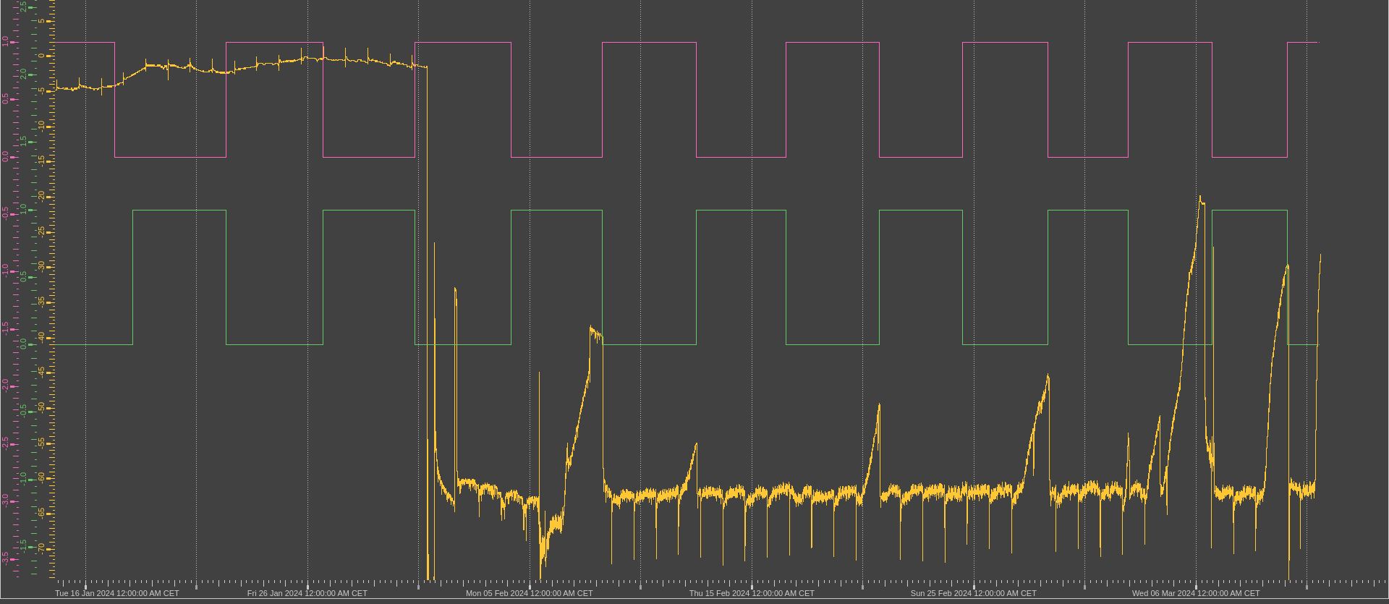
R134a... humidity
There are humidity cycles resulting in peaks and possible solidification of water…
Purifier 2 module:
Humidity
Adsorber 1:
Adsorber 2: the adsorber is not able to complete an entire cycle as it saturates. This effect looks regular and at each repetition:
- The peak’s start is anticipated
- The integral of the peak increases
(see )
CERN| EP-DT-FS Group

Slide 4
R134a... humidity
Purifier 2 module:
Humidity
Adsorber 1: differently from the other column here the effect is not cyclical. So it is probable that the problem here can be the regeneration process…?
(see )
Adsorber 2:
CERN| EP-DT-FS Group

Slide 5
R134a Test’s Summary
Tchiller = - 36 Celsius
Possible error of measurement/ conversion factor
CERN| EP-DT-FS Group

Slide 6
R134a Test’s results with manual valve closed
Date | Time start | Time end | Tot time [min] | Col | Input flow | DPT start | DPT end | deltaP | pressure Top [barg] | flow exh flammable [air] | flow exh flammable [l/h] | fill rate norm [mbar/100ln] | T chiller | T 2nd chiller
12-Mar | 10:31 | 11:33 | 62 | 1 | 100 | 20 | 25.7 | 5.7 | 0.009 | 3.1 | 1.24 | 5.7 | -36 | 20
11-Mar | 14:30 | 15:31 | 61 | 2 | 100 | 24.7 | 30 | 5.3 | 0.042 | 2.73 | 1.09 | 5.3 | -36 | 20
12-Mar | 09:25 | 10:25 | 60 | 3 | 100 | 23.6 | 28.5 | 4.9 | 0.033 | 20.1 | 8.04 | 4.9 | -36 | 20
11-Mar | 15:40 | 16:40 | 60 | 4 | 100 | 19.9 | 24.8 | 4.9 | 0.02 | 63.57 | 25.43 | 4.9 | -36 | 20
CERN| EP-DT-FS Group

Slide 7
R134a Test’s results with system in normal mode
Date | Time start | Time end | Tot time [min] | Col | Input flow | DPT start | DPT end | deltaP | pressure Top [barg] | flow exh flammable [air] | flow exh flammable [l/h] | fill rate norm [mbar/100ln] | T chiller
13-Mar | 09:43 | 10:43 | 60 | 1 | 100 | 28.6 | 32.8 | 4.2 | 0.01 | 83.40 | 33.72 | 4.2 | -36
13-Mar | 14:28 | 15:01 | 33 | 3 | 100 | 22.4 | 22.7 | 0.3 | 0.02 | 120.2 | 48.08 | 0.3 | -36
13-Mar | 15:12 | 16:08 | 56 | 4 | 100 | 19.7 | 21 | 1.3 | 0.021 | 781 | 211.08** | 1.3 | -36
13-Mar | 16:03 | 17:03 | 60 | 2 | 100 | 14.9 | 23.4 | 8.5 | 0.037 | 370 | 100.00 | * | -36
CERN| EP-DT-FS Group

Slide 8
R134a Test’s results (summer 2023) - comparison
Col 1 → 4.54 mbar/100 l/h
Col 2 → 4.12 mbar/100 l/h
Col 3 → 2.70 mbar/100 l/h
Col 4 → fillinrate too low
CERN| EP-DT-FS Group

