Slide 1
From AWAKE 2b to AWAKE 2c
De-cabling AWAKE 2b and installation (EN-EL) of AWAKE 2c
Discussion with EN-EL, 14/3/2024

Slide 2
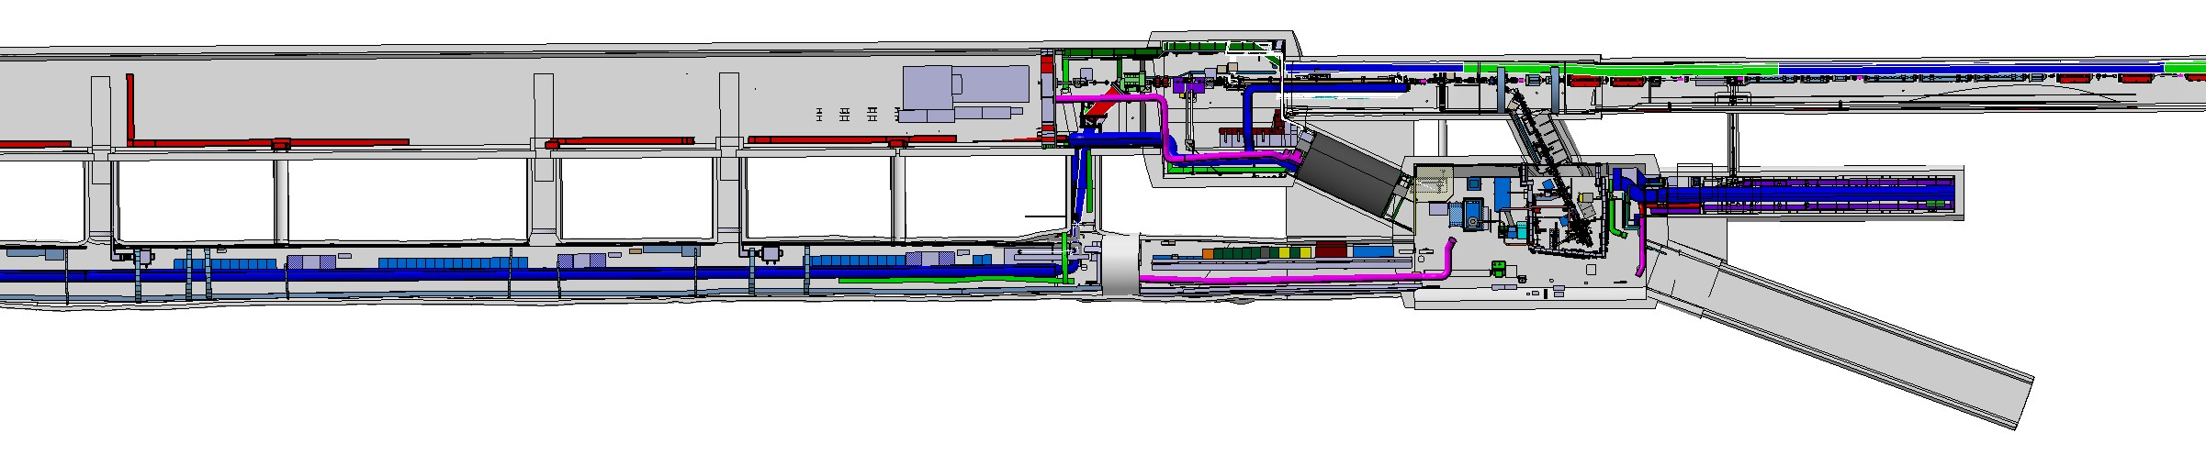
Step 2: CNGS dismantling
Step 1: dismantling of run 2b
Run1
TSG45
TSG44
TSG43
TSG42
AWAKE CNGS Area Dismantling is before & during LS3 (2025-2026)
Run2c Integration/installation/commissioning is during LS3 (2026-2028)
Laser beam compressor 2
Spectrometer
2 Plasma Cells
Laser beam compressor 1
Run2
Step 3: Run2c installation
2 WDL Chiller Units
2 Electron Sources
UV laser room
Klystrons

Slide 3
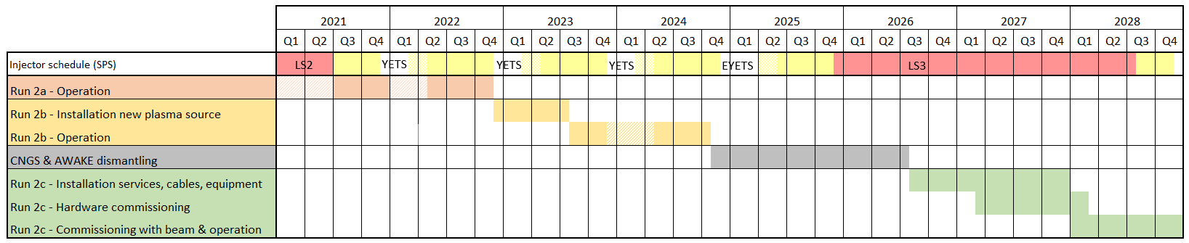
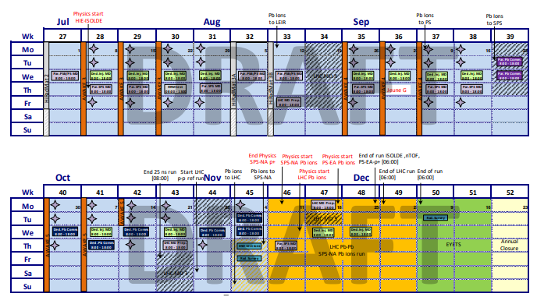
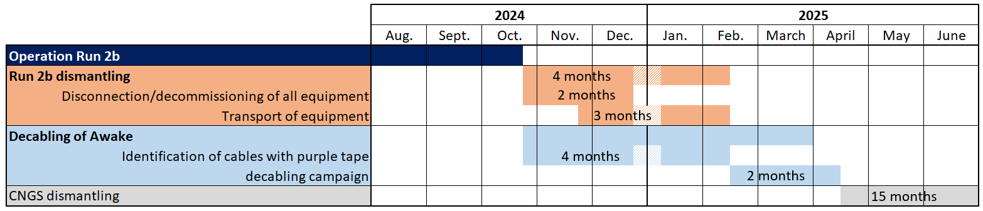
Timeline
Step 1
DRAFT
End of Awake operations: October 2024
Run 2b dismantling: 2months of decommissioning + 3 months of transport
Decabling: ~2 months of works
If the 2 additional weeks of beam approved → ~1month shift

Slide 4
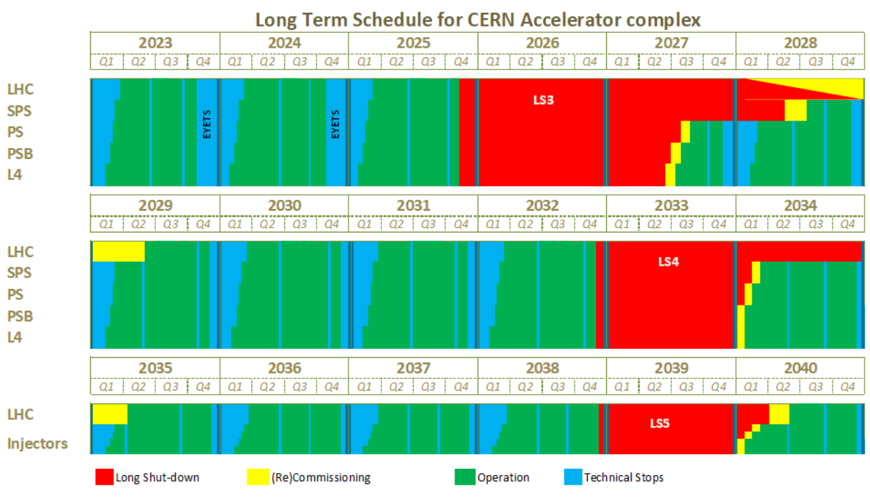
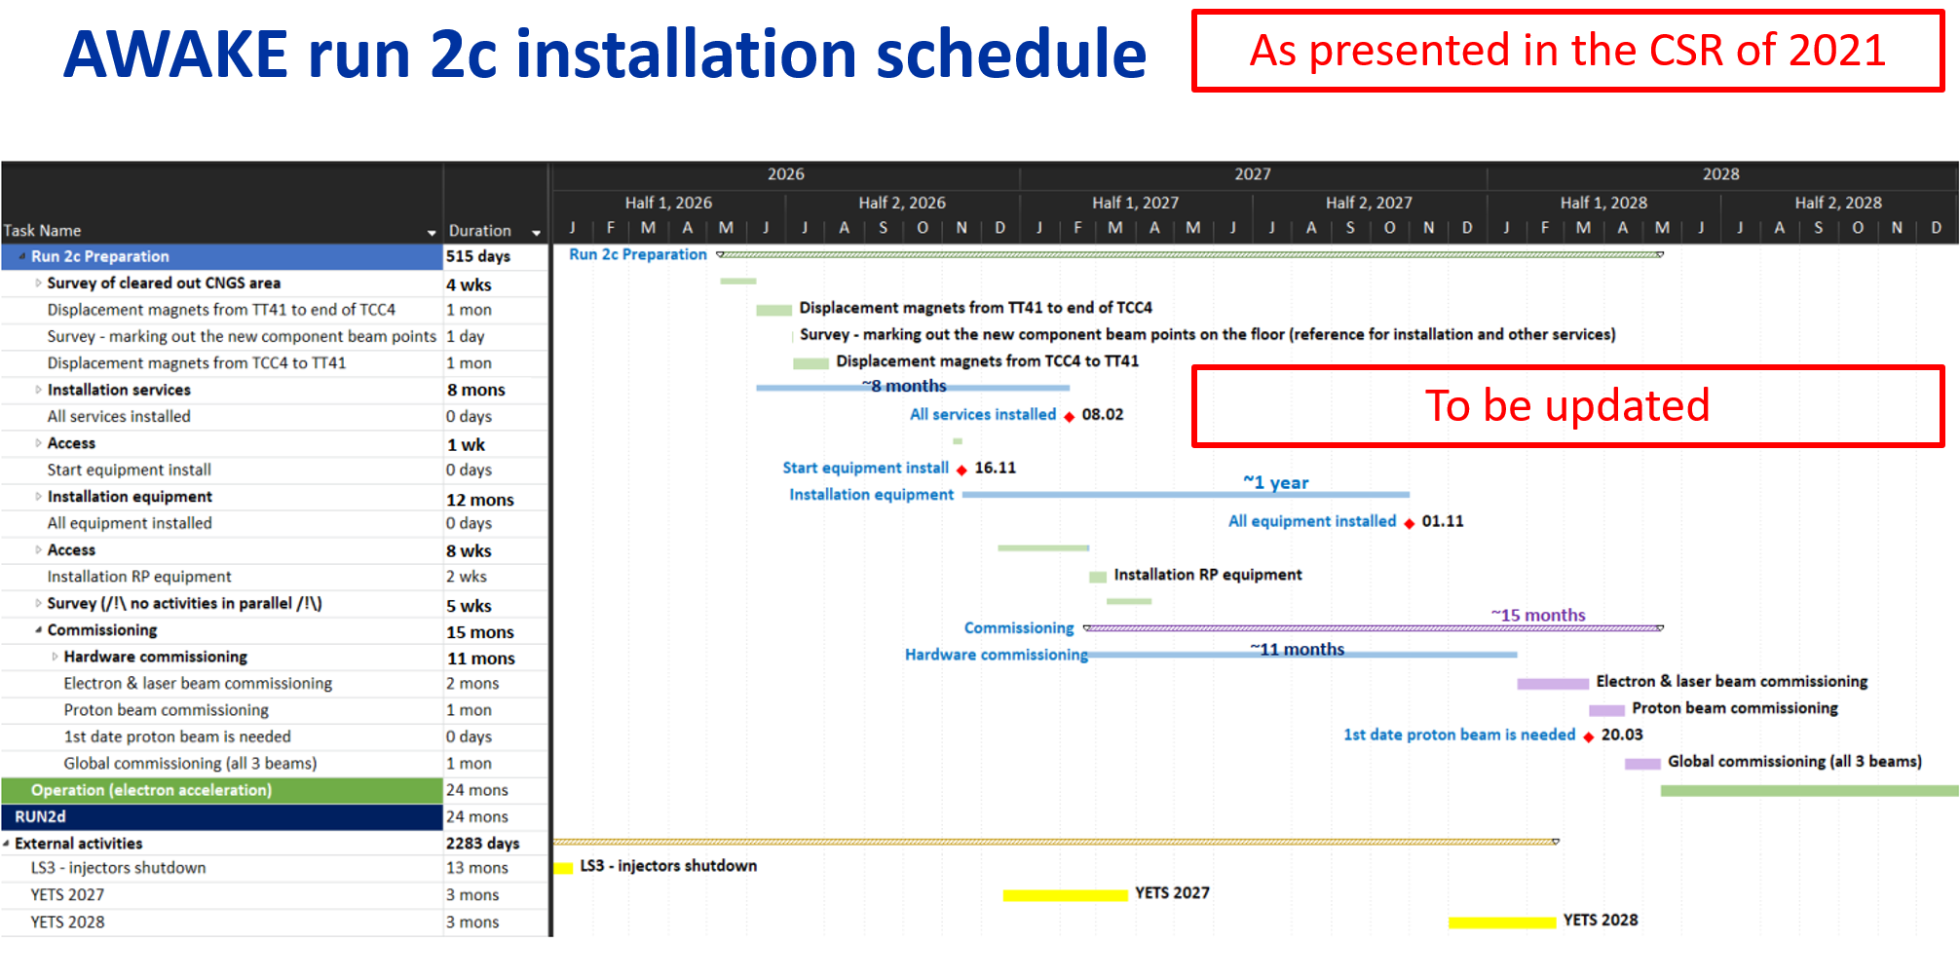

Run 2c installation
Step 3
Installing run 2c during LS3 brings some constraints:
  Availability of resources
  Respect deadlines linked to LS3 even though the project is not yet approved
For AWAKE, next milestones:
  PLAN activities by 31.03.2024
  Cabling request by 15.04.2024
  Electrical network request by 15.04.2024
  Review of run2c schedule for June 2024
Run2b operation
Run2b dismantling
CNGS dismantling
Run 2c installation

Slide 5
General Awake roadmap
2023 | 2024 |  |  |  |  |  |  |  |  |  |  |  | 2025
Dec. | Jan. | Feb. | March | April | May | June | July | Aug. | Sept. | Oct. | Nov. | Dec. | Jan. | Feb. | March
Inventory of equipment
Establish sequence for dismantling
Decommissioning
Transport out
Run 2b dismantling
Listing cables for decabling
Pre-identification of cables
Preparation of lockout document
Identification of cables (purple tape)
Decabling
Decabling
Input Awake activities in PLAN
Cabling requests
Draft schedule
LS3 readiness review
EL network request
Review installation planning
Run2c preparation
Review integration layout of run2c
5

Slide 6
What we know: cabling
Cable routing study to be done.
  The area will be de-cabled
  New cables can use all 6 TSG4x galleries between TSG4 and TCC4
  TT43 will be empty (formerly e-beam) and can also be used for cable trays
Beamlines (vac, BI, …)
Plasma cells
Instrumentation
E-magnets
E-sources
Racks
RF Klystrons

Slide 7
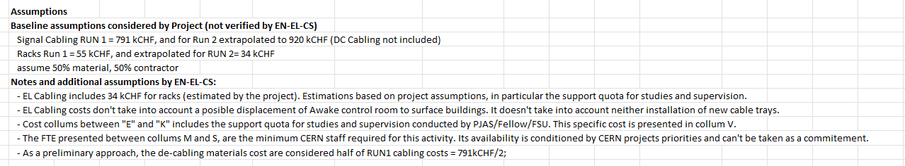

What we know: cabling & de-cabling
Estimate of cable amount exists – extrapolated from Run1/Run2ab
Cost and resource estimate from 2021 C&S Review on EDMS 3056166
Reasoning behind cabling & rack estimates (extrapolation) on EDMS 3062059.
WP | Name | GROUP | cost 2022 [kCHF] | cost 2023 [kCHF] | cost 2024 [kCHF] | cost 2025 [kCHF] | cost 2026 [kCHF] | cost 2027 [kCHF] | cost 2028 [kCHF] | cost 2029 [kCHF] | cost 2030 [kCHF] | cost 2031 [kCHF] | cost 2032 [kCHF] | cost TOTAL [kCHF] (incl. grad) |  | workforce 2022 [FTE.yr] | workforce 2023 [FTE.yr] | workforce 2024 [FTE.yr] | workforce 2025 [FTE.yr] | workforce 2026 [FTE.yr] | workforce 2027 [FTE.yr] | workforce 2028 [FTE.yr] | workforce 2029 [FTE.yr] | workforce 2030 [FTE.yr] | workforce 2031 [FTE.yr] | workforce 2032 [FTE.yr] | workforce TOTAL [FTE.yr] |  | cost grads TOTAL [kCHF] 2024-2032
WP24.1 | EL - Electrical System | EN-EL | 0 | 0 | 70 | 199 | 378 | 194 | 0 | 0 | 0 | 0 | 0 | 841 |  | 0.00 | 0.00 | 0.25 | 0.50 | 0.50 | 2.00 | 0.00 | 0.00 | 0.00 | 0.00 | 0.00 | 3.25 |  | 100
WP24.2 | EL - Cabling AC & DC | EN-EL | 0 | 0 | 0 | 322 | 904 | 211 | 0 | 0 | 0 | 0 | 0 | 1437 |  | 0.00 | 0.00 | 0.00 | 0.09 | 0.21 | 0.06 | 0.00 | 0.00 | 0.00 | 0.00 | 0.00 | 0.36 |  | 265
WP24.3 | EL - Decabling | EN-EL | 0 | 0 | 40 | 448 | 10 | 0 | 0 | 0 | 0 | 0 | 0 | 498 |  | 0.00 | 0.00 | 0.04 | 0.10 | 0.00 | 0.00 | 0.00 | 0.00 | 0.00 | 0.00 | 0.00 | 0.14 |  | 102

Slide 8
What we know: electrical infrastructure
Document M. Lonjon March 2021
WP | Name | GROUP | cost 2022 [kCHF] | cost 2023 [kCHF] | cost 2024 [kCHF] | cost 2025 [kCHF] | cost 2026 [kCHF] | cost 2027 [kCHF] | cost 2028 [kCHF] | cost 2029 [kCHF] | cost 2030 [kCHF] | cost 2031 [kCHF] | cost 2032 [kCHF] | cost TOTAL [kCHF] (incl. grad) |  | workforce 2022 [FTE.yr] | workforce 2023 [FTE.yr] | workforce 2024 [FTE.yr] | workforce 2025 [FTE.yr] | workforce 2026 [FTE.yr] | workforce 2027 [FTE.yr] | workforce 2028 [FTE.yr] | workforce 2029 [FTE.yr] | workforce 2030 [FTE.yr] | workforce 2031 [FTE.yr] | workforce 2032 [FTE.yr] | workforce TOTAL [FTE.yr] |  | cost grads TOTAL [kCHF] 2024-2032
WP24.1 | EL - Electrical System | EN-EL | 0 | 0 | 70 | 199 | 378 | 194 | 0 | 0 | 0 | 0 | 0 | 841 |  | 0.00 | 0.00 | 0.25 | 0.50 | 0.50 | 2.00 | 0.00 | 0.00 | 0.00 | 0.00 | 0.00 | 3.25 |  | 100
WP24.2 | EL - Cabling AC & DC | EN-EL | 0 | 0 | 0 | 322 | 904 | 211 | 0 | 0 | 0 | 0 | 0 | 1437 |  | 0.00 | 0.00 | 0.00 | 0.09 | 0.21 | 0.06 | 0.00 | 0.00 | 0.00 | 0.00 | 0.00 | 0.36 |  | 265
WP24.3 | EL - Decabling | EN-EL | 0 | 0 | 40 | 448 | 10 | 0 | 0 | 0 | 0 | 0 | 0 | 498 |  | 0.00 | 0.00 | 0.04 | 0.10 | 0.00 | 0.00 | 0.00 | 0.00 | 0.00 | 0.00 | 0.00 | 0.14 |  | 102

Slide 9
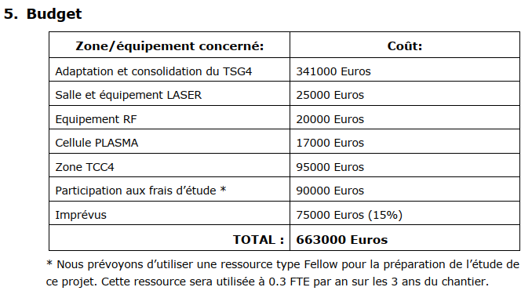
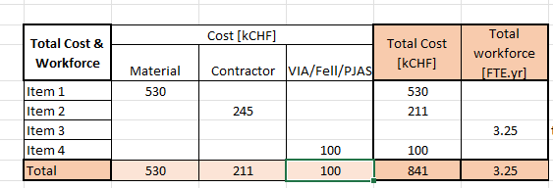
What we know: electrical infrastructure
Document M. Lonjon March 2021 EDMS 2471171
WP | Name | GROUP | cost 2022 [kCHF] | cost 2023 [kCHF] | cost 2024 [kCHF] | cost 2025 [kCHF] | cost 2026 [kCHF] | cost 2027 [kCHF] | cost 2028 [kCHF] | cost 2029 [kCHF] | cost 2030 [kCHF] | cost 2031 [kCHF] | cost 2032 [kCHF] | cost TOTAL [kCHF] (incl. grad) |  | workforce 2022 [FTE.yr] | workforce 2023 [FTE.yr] | workforce 2024 [FTE.yr] | workforce 2025 [FTE.yr] | workforce 2026 [FTE.yr] | workforce 2027 [FTE.yr] | workforce 2028 [FTE.yr] | workforce 2029 [FTE.yr] | workforce 2030 [FTE.yr] | workforce 2031 [FTE.yr] | workforce 2032 [FTE.yr] | workforce TOTAL [FTE.yr] |  | cost grads TOTAL [kCHF] 2024-2032
WP24.1 | EL - Electrical System | EN-EL | 0 | 0 | 70 | 199 | 378 | 194 | 0 | 0 | 0 | 0 | 0 | 841 |  | 0.00 | 0.00 | 0.25 | 0.50 | 0.50 | 2.00 | 0.00 | 0.00 | 0.00 | 0.00 | 0.00 | 3.25 |  | 100
WP24.2 | EL - Cabling AC & DC | EN-EL | 0 | 0 | 0 | 322 | 904 | 211 | 0 | 0 | 0 | 0 | 0 | 1437 |  | 0.00 | 0.00 | 0.00 | 0.09 | 0.21 | 0.06 | 0.00 | 0.00 | 0.00 | 0.00 | 0.00 | 0.36 |  | 265
WP24.3 | EL - Decabling | EN-EL | 0 | 0 | 40 | 448 | 10 | 0 | 0 | 0 | 0 | 0 | 0 | 498 |  | 0.00 | 0.00 | 0.04 | 0.10 | 0.00 | 0.00 | 0.00 | 0.00 | 0.00 | 0.00 | 0.00 | 0.14 |  | 102

Slide 10
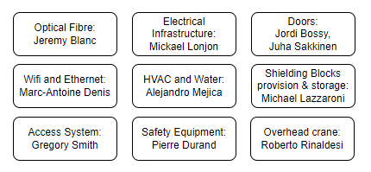
Extra: Surface building CNGS dismantling
SCE contact: David Gomez
Services contacts:
Installation services ~March-May 2025, will need cables.
Proposal: dedicated meeting with service contacts and EN-EL cabling
(needed before 15/4 or not?)

