Slide 1
LHCb Upgrade 2 Fibres
B. Leverington

Slide 2
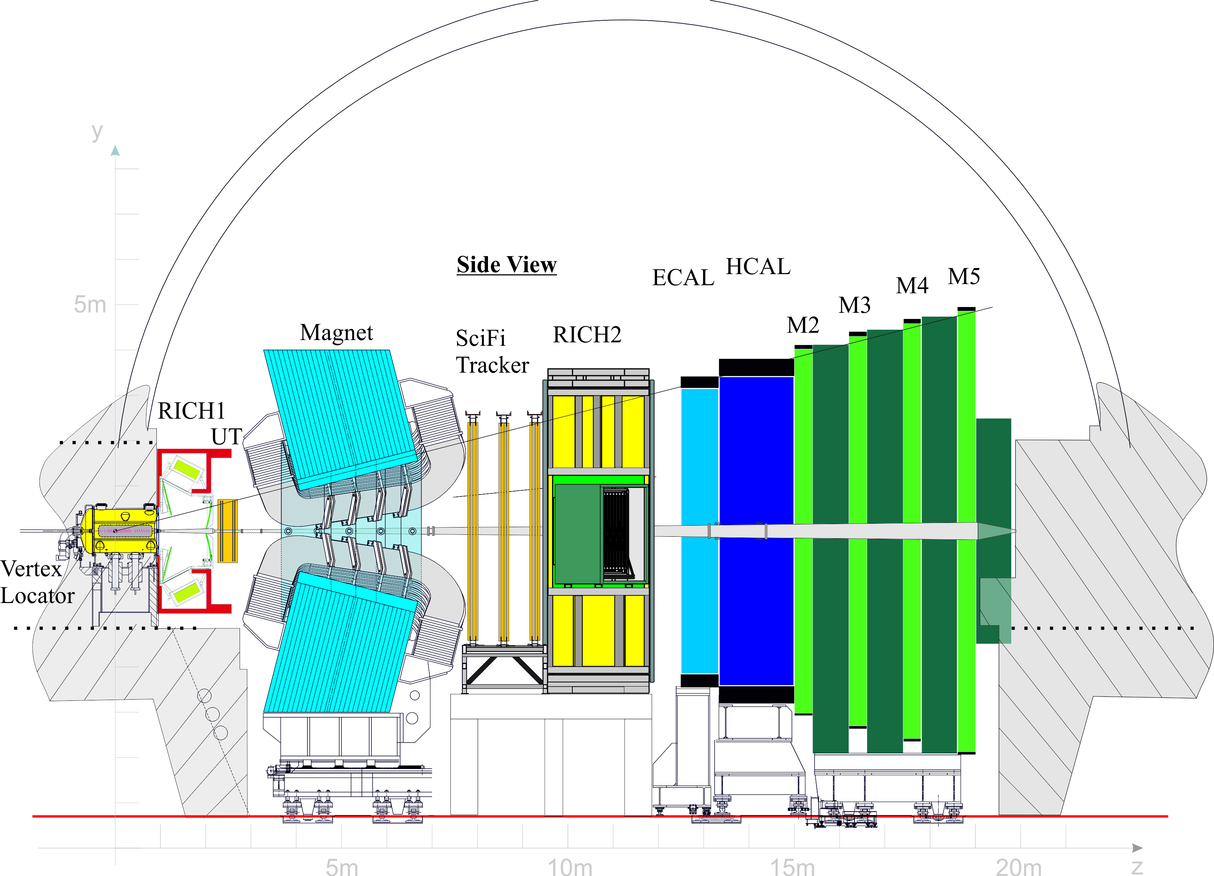
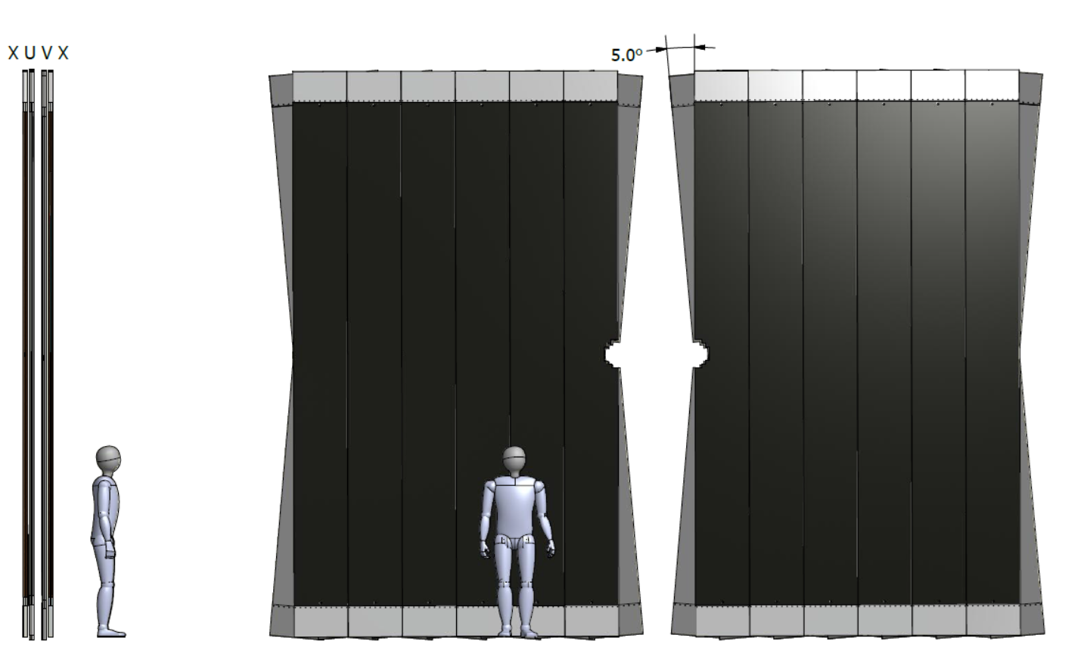
LHCb Scintillating Fibre Tracker
Read-out Box
x 3
SiPM
fibres
+
mirror
5 m
fibres
Beam Pipe
144 modules in 12 layers (360 m² total area)
1 Module consists of 8 fibre mats (1152 mats)
Fibre mats (6 layers per mat) run in vertical direction (L≈ 2 x 2.5m)
Fibres: Ø 250µm, L=2.5m, total length >10,000 km)
Fibres interrupted in mid-plane (y=0) and mirrored
Read out at top and bottom with SiPM arrays (128 channels, 250 µm pitch, 590k SiPM channels)
SiPMs + FE electronics + services in a “Readout Box”
SiPM
6 m

Slide 3
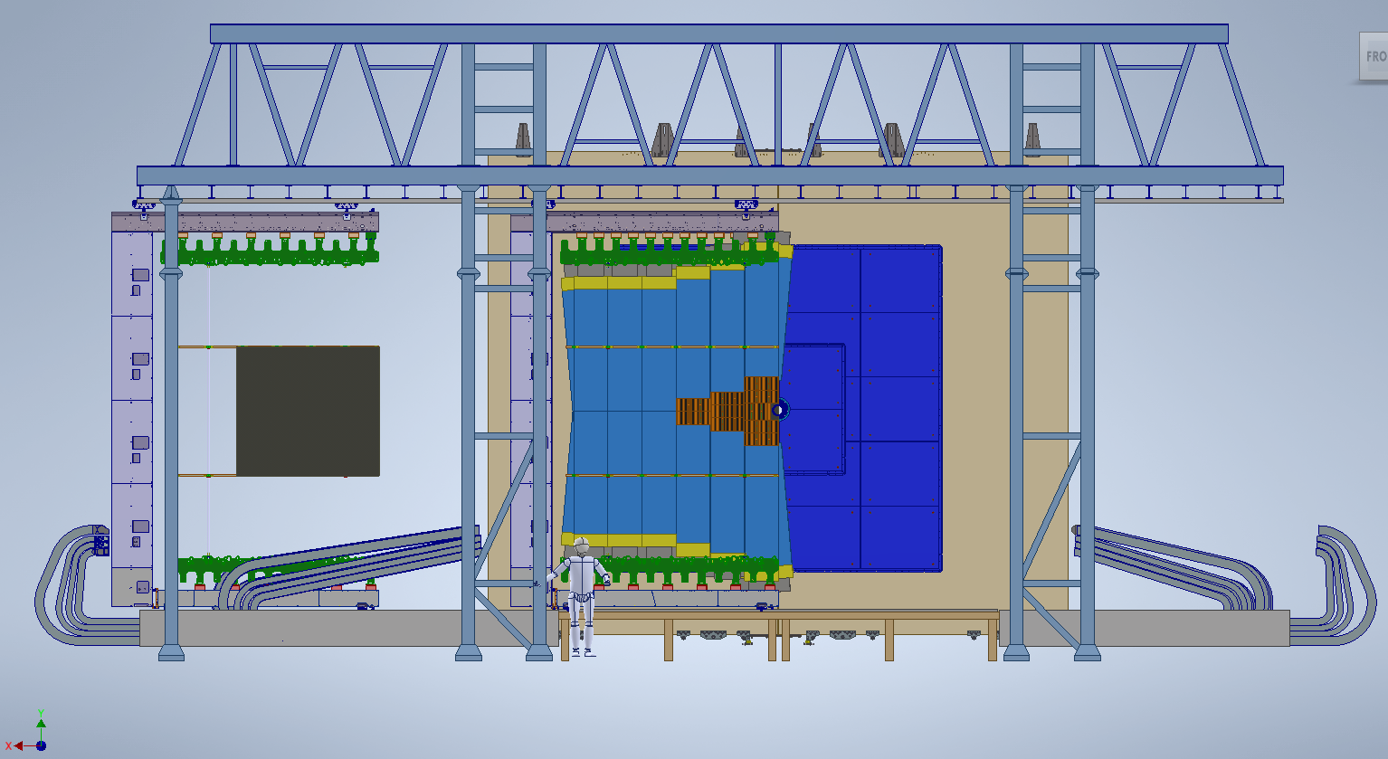
SciFi in Upgrade 2
Up to 7x more radiation: put silicon pixel tracker in the high radiation (occupancy) region
Build a new SciFi Tracker with cryogenic cooled Silicon Photomultipliers

Slide 4
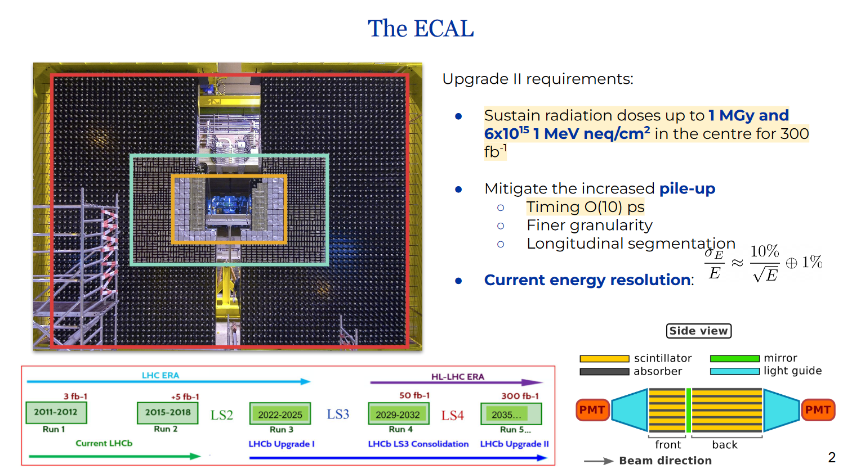

Slide 5
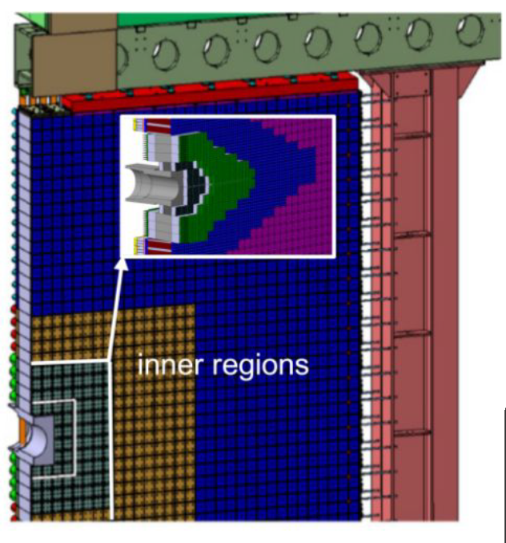
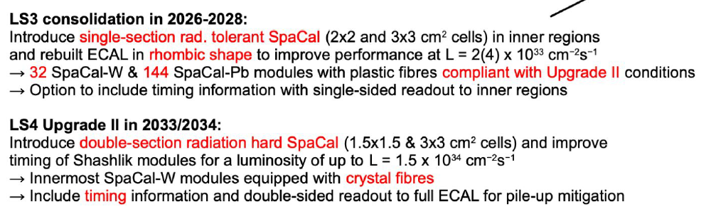
ECAL Upgrade in LS3 and LS4

Slide 6
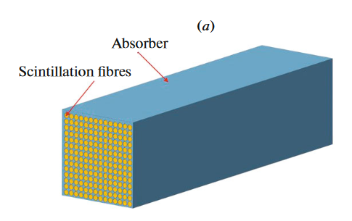
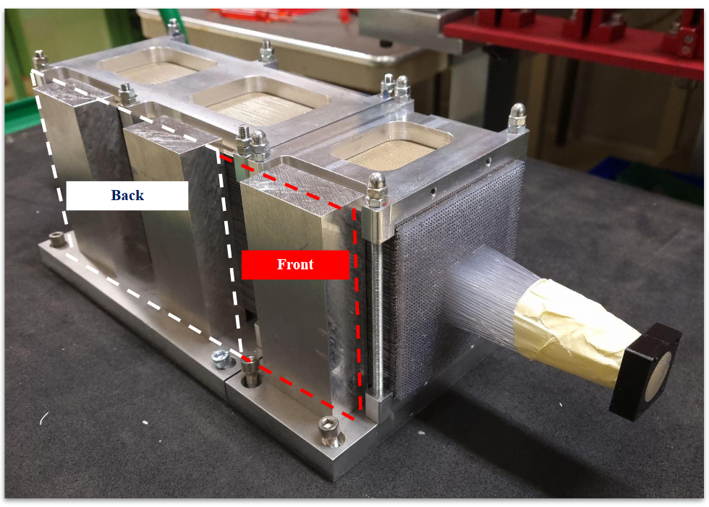
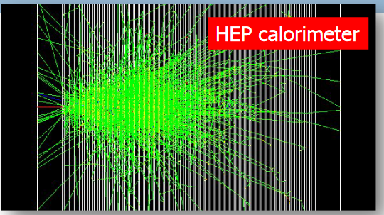
SPACAL (Spaghetti Calorimeter)

Slide 7
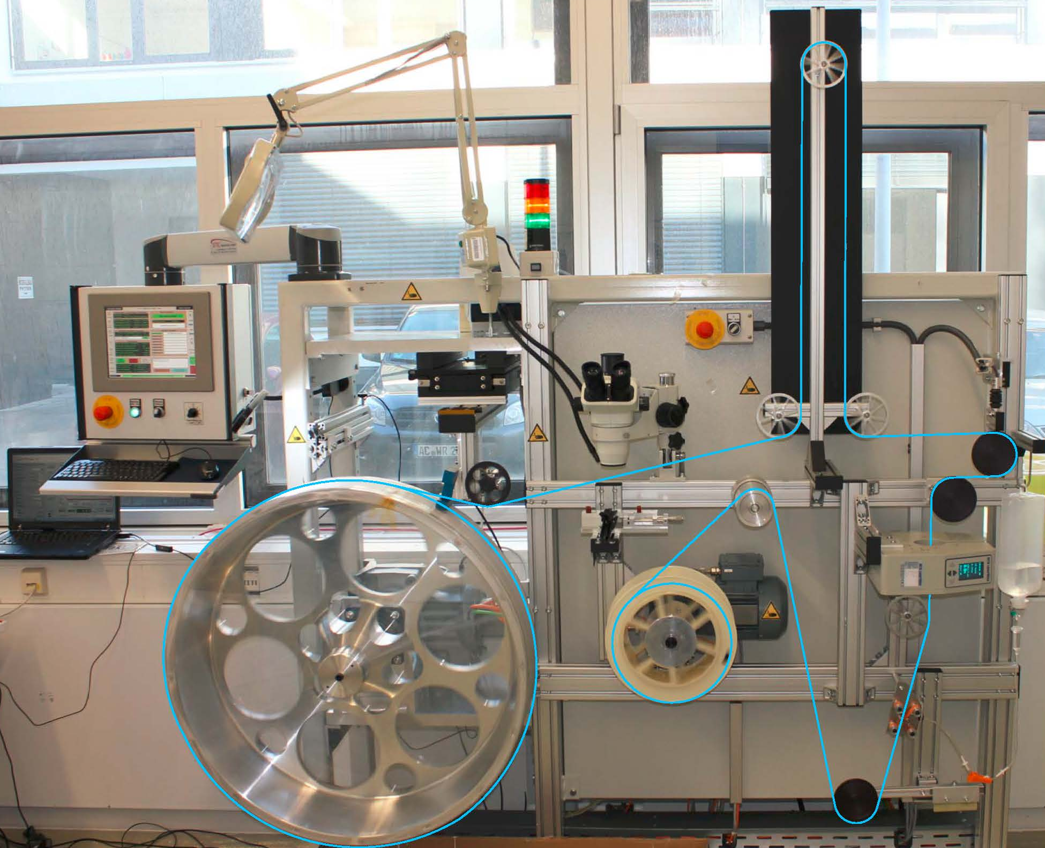
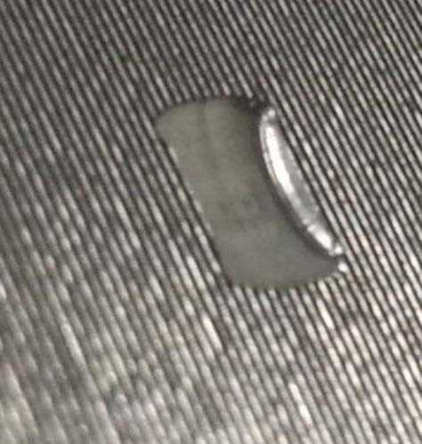
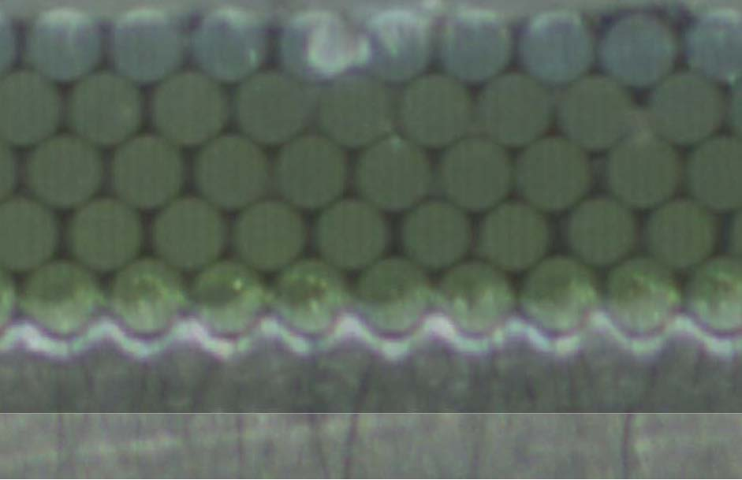
Principle of Fibre Mat Winding
Thread and hole for alignment pin
Threaded winding wheel
First layer is directly wound onto hub,
following layers are wound into groove-like depressions of preceding layers
Need about 8km of fibre for one mat of 6 layers 2.5 meters long
→ 10,000 km of fibre in total

Slide 8
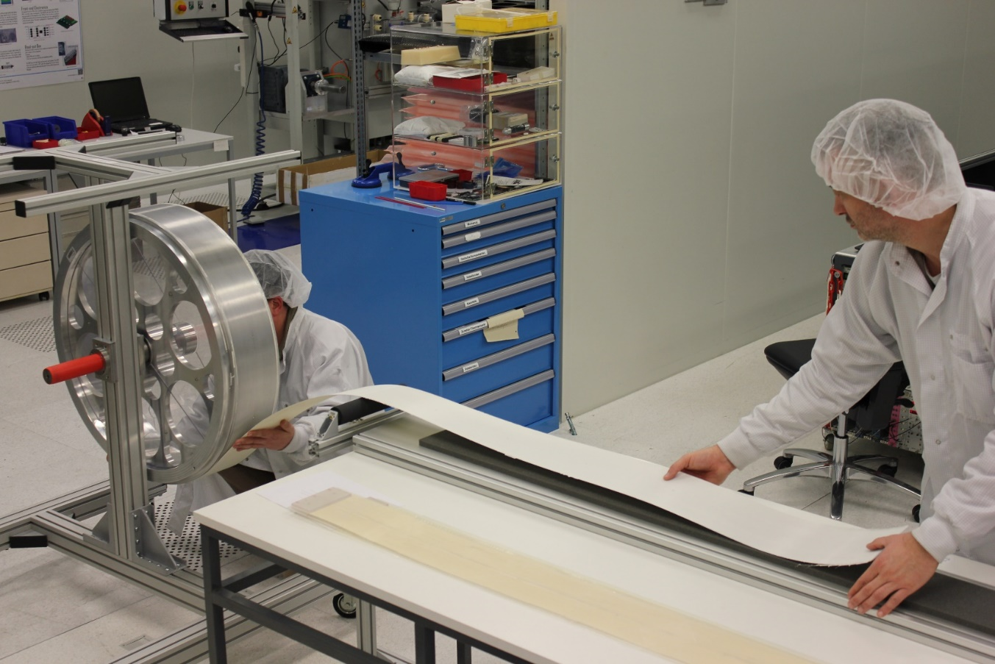

Slide 9
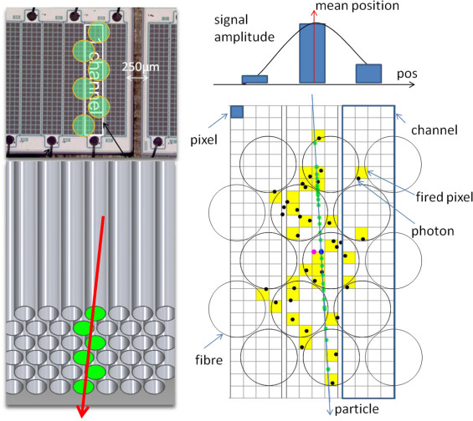
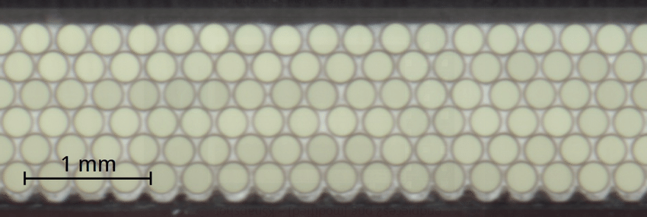
Fibres and SiPMs
Double clad fibres
Regularly packed fibres
-> 1 mat ~ 8km of fibre with few bumps that disturb the matrix
1.3mm
B. Leverington - Fibre Developments
9

Slide 10
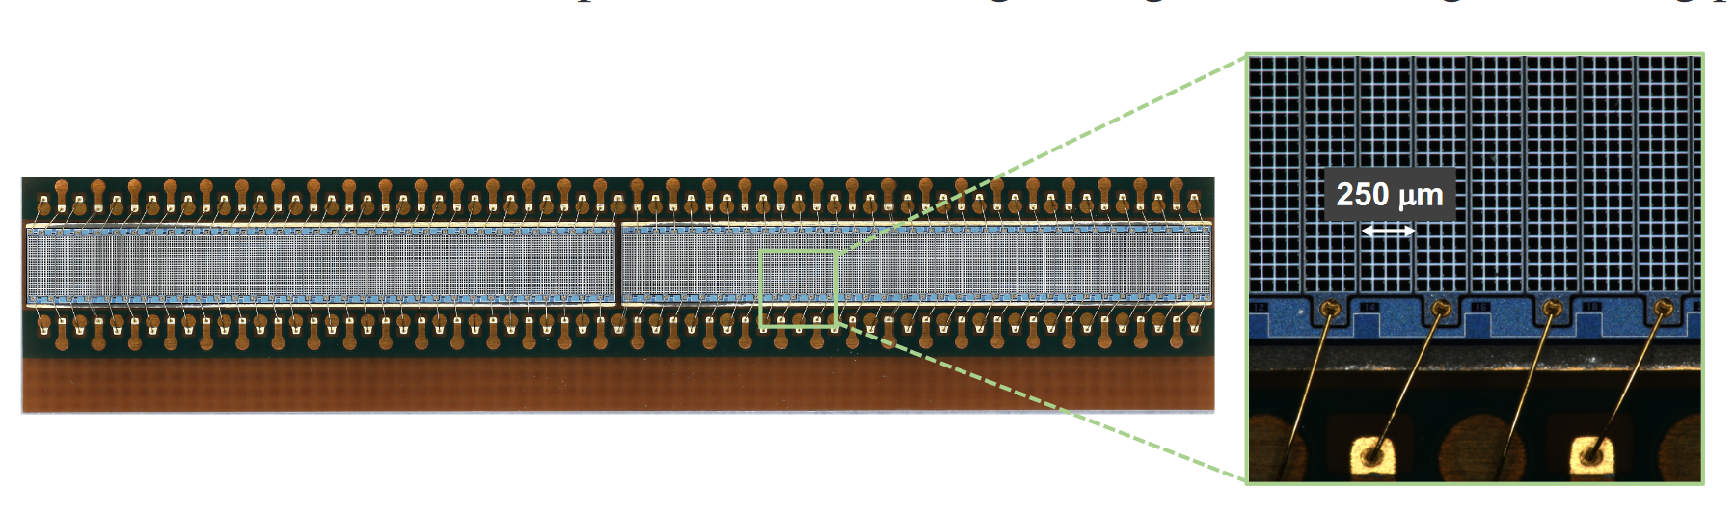
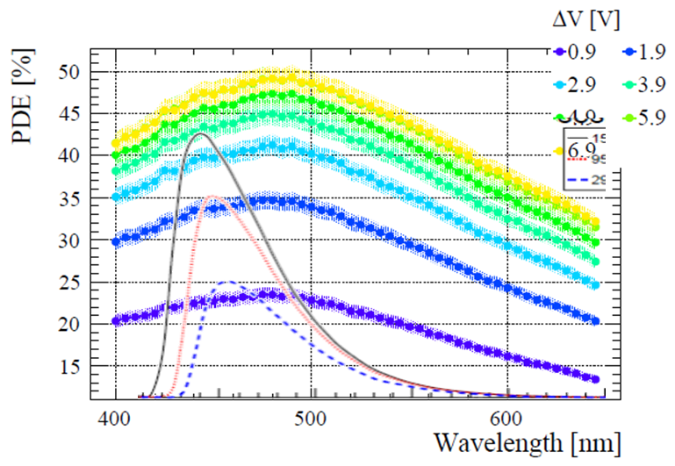
H2017 SiPM arrays in Upgrade 1 SciFi
32mm
Wavelength spectra of the fibre should match the photon detection efficiency of the SiPM
Kuraray SCSF-78MJ spectra shown.

Slide 11
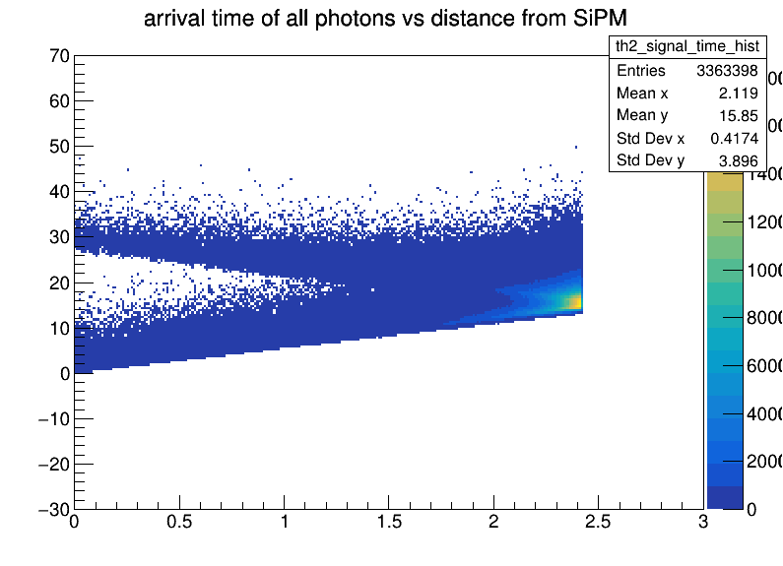
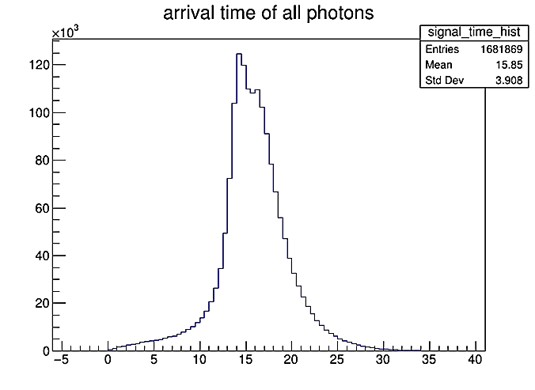
Time Distribution
SCSF-78MJ fibre have a 2.8ns decay time
Keep the light in one 25ns bunch crossing (BX)
Fibre length
Scintillator decay time
NEXT BX +1
time / ns
MAIN BX 0
Arrival time / ns
PREV BX -1
No time-of-flight of particles here. Just scintillation and propagation time.
yHit from SiPM / m

Slide 12
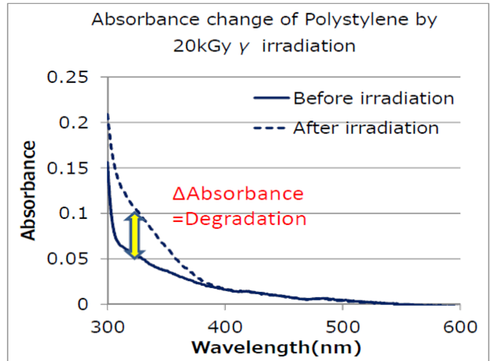
Radiation Damage of Scintillating Fibres

Slide 13
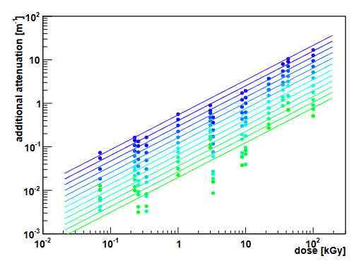
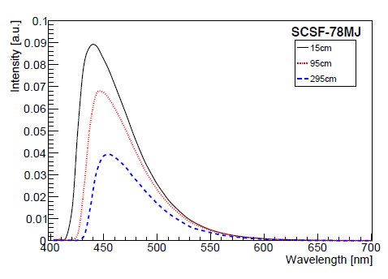
Radiation Damage of Scintillating Fibres
Additional attenuation from ionizing attenuation damage
Intrinsic attenuation
Before irradiation
Greener wavelengths are attenuated less by radiation damage:
The fibre “yellows”
operational

Slide 14
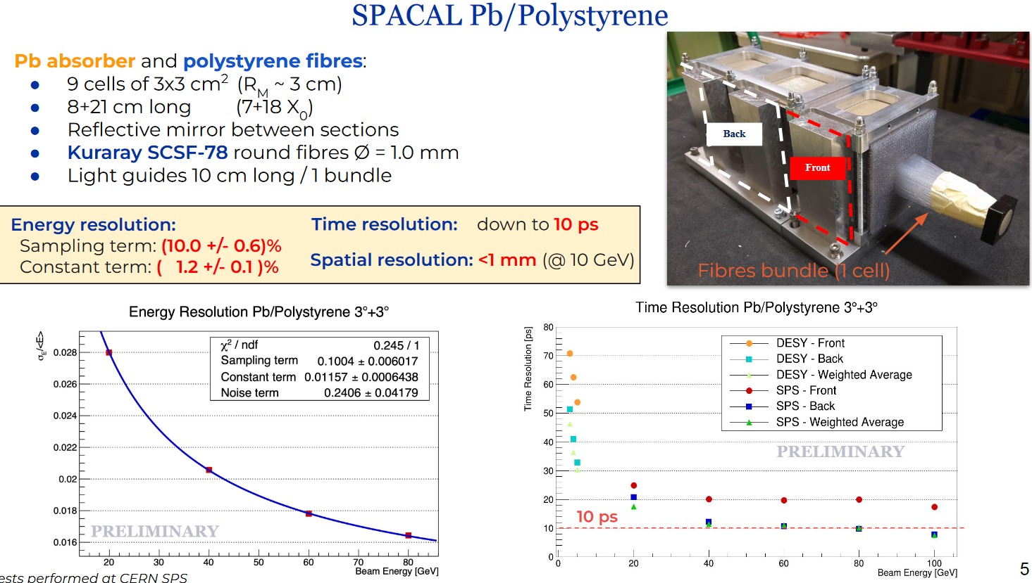
ECAL Performance

Slide 15
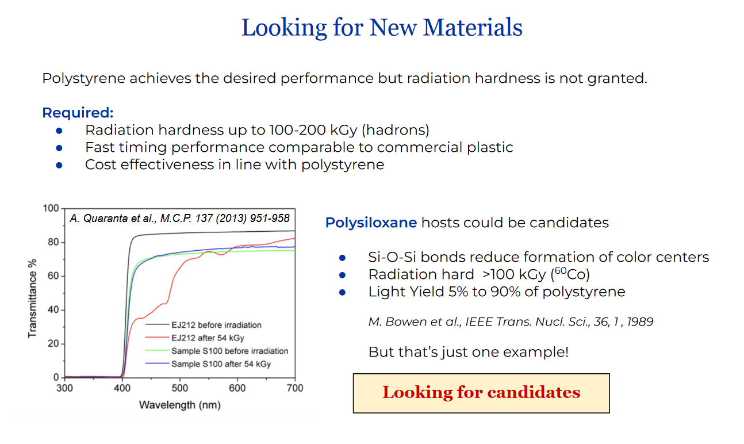
ECAL

Slide 16
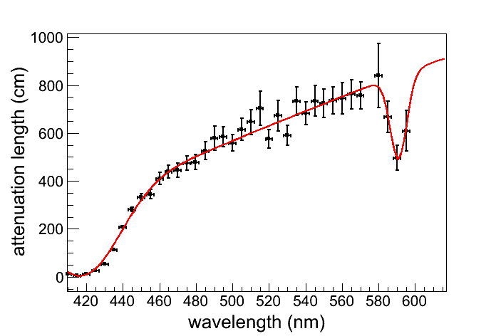
Avenues for Investigation: Fibres
Wanted: Fast green to red scintillator
  Radiation damage creates strong absorption in the UV-blue region in the polystyrene
  Standard 3HF has 8 ns decay time. Tau<4ns is needed to produce most of the light in the 25ns bx. (Propagation time over 2.5m + scintillation decay time)
  New (since 2014) developments in scintillators on the following 3 slides
Modifications to claddings? Coatings?
Collaborations with polymer chemists and industry needed here.
Unirradiated SCSF-78MJ (blue fibre)
Green wavelengths less attenuated in polystyrene

Slide 17

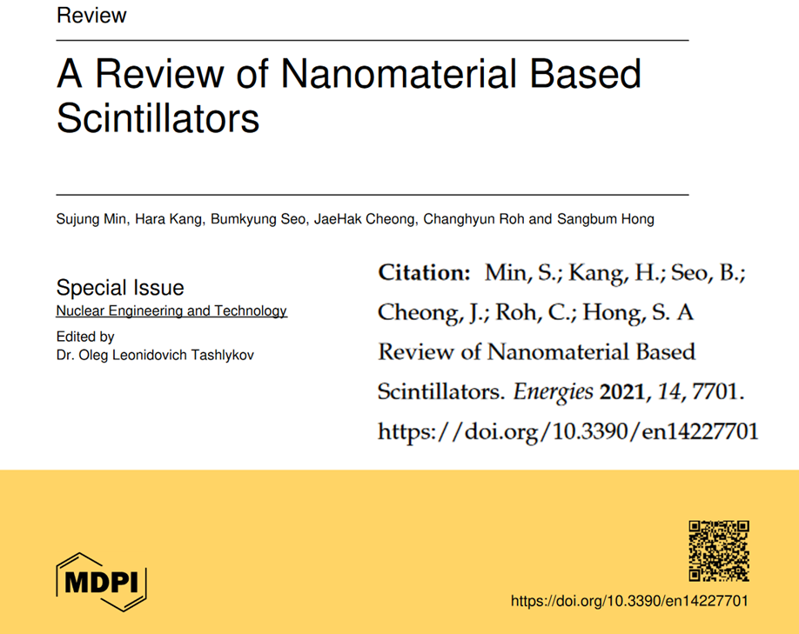



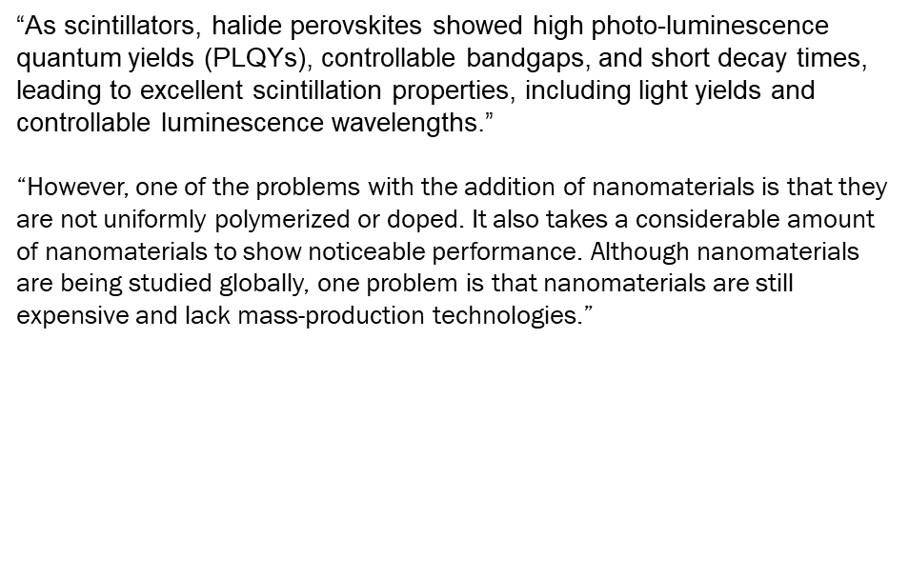
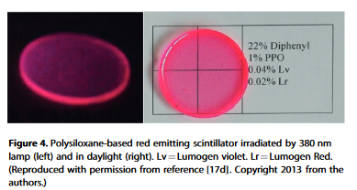
“for the replacement of 3He (neutron detectors) seem a good goal for international laboratories. Gamma spectrometry is also one of the highest challenge chemists have to achieve in the near future. “
Lots of “promising, but…”

Slide 18
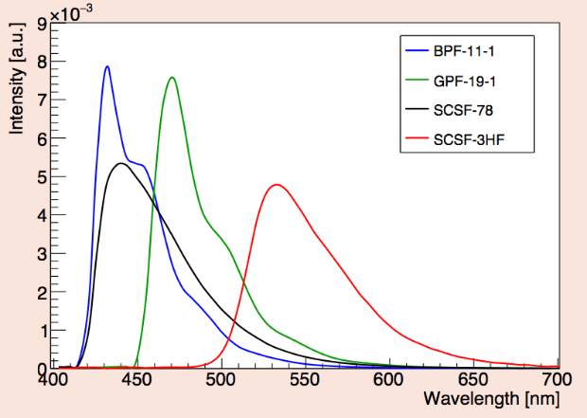
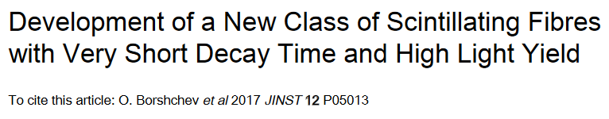
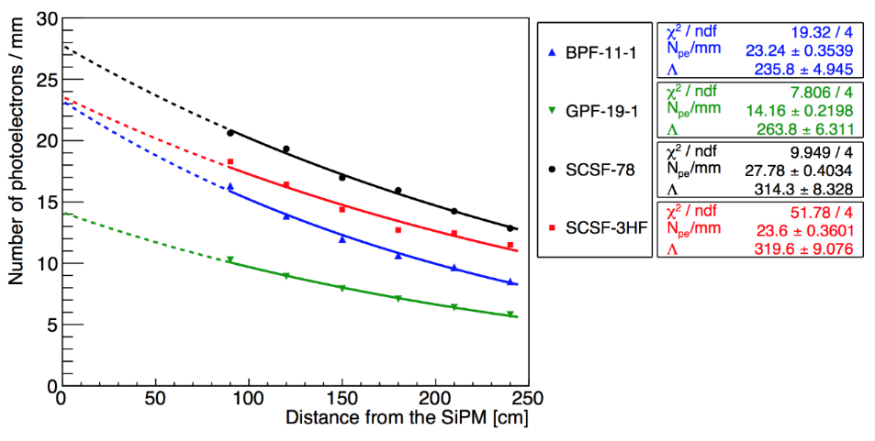
NOL fibre
Emission spectra (@ 15 cm from excitation point)
https://www.nature.com/articles/srep06549
Blue NOL fibre
Green NOL fibre
Blue standard fibre
Green standard fibre
8 iterations of NOL fibres in 2017
  Best were 50% faster than standard fibres, τ∼1ns.
  Best light yield about 15% lower than standard fibres.
Might be a material impurity problem.
  No control over the production of the materials.
  Large volumes probably impossible.
Green fibres (emission peak ∼500 nm) might be still interesting to test.
No hadron irradiation done yet!!! X-ray results are ok.
  Optimise for an irradiated detector

Slide 19

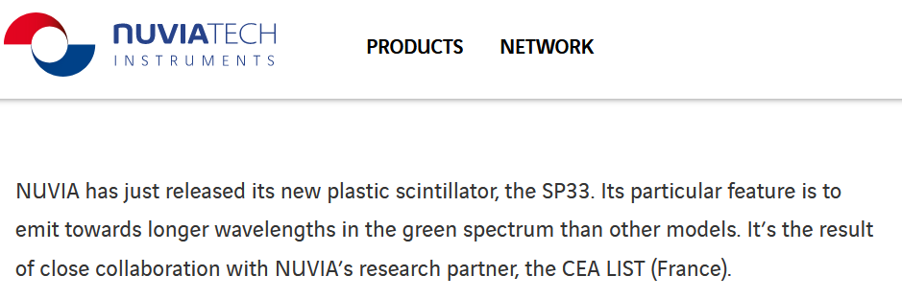
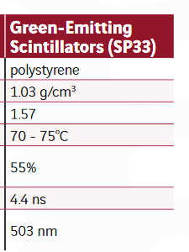
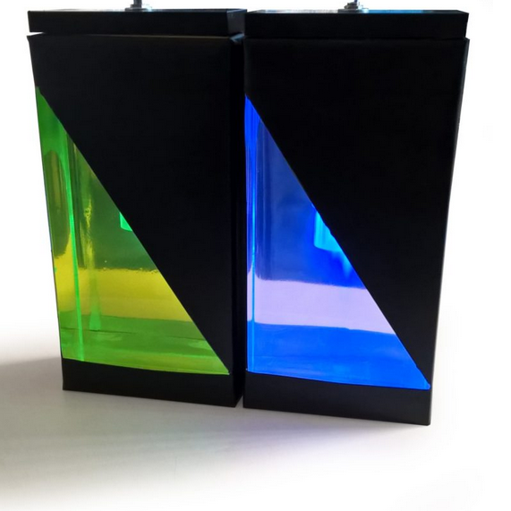
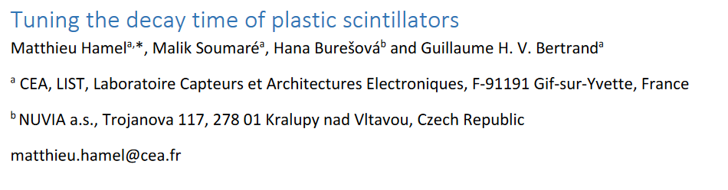
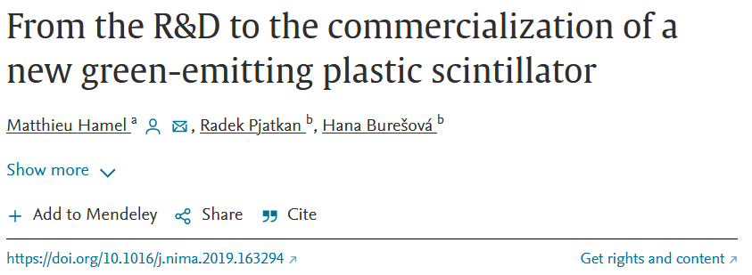
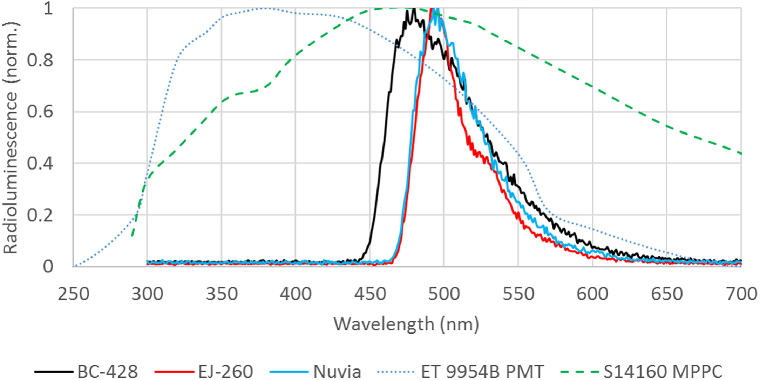
Matthieu Hamel. Progress in fast and red plastic scintillators. Chemosensors, 2022, 10 (2), pp.86. 10.3390/chemosensors10020086 cea-03582648
Anthracene
We are pursuing this as a fibre to test. Fast enough, bright like the Kuraray 78MJ.
Need real samples. Could be a game changer.

Slide 20
Summary
The future use scintillating fibres at LHCb significantly benefits from an improved bright, greener, and faster fibre
Program has started to search for new scintillators for fibres for the future
  Requires industry partners for the production of fibres

Slide 21

ECFA Detector R&D
The Roadmap (248 p) https://cds.cern.ch/record/2784893?ln=en
“In the area of detector development, it is vital to build on Europe’s world-leading capabilities in sensor technologies for particle detection, using gas and liquid-based or solid-state detectors, as well as energy measurement and particle identification. Also required are cutting-edge developments in bespoke microelectronics solutions, real-time data processing and advanced engineering. Adequate resourcing
for such technology developments represents a vital component for future progress in experimental particle physics.”

Slide 22
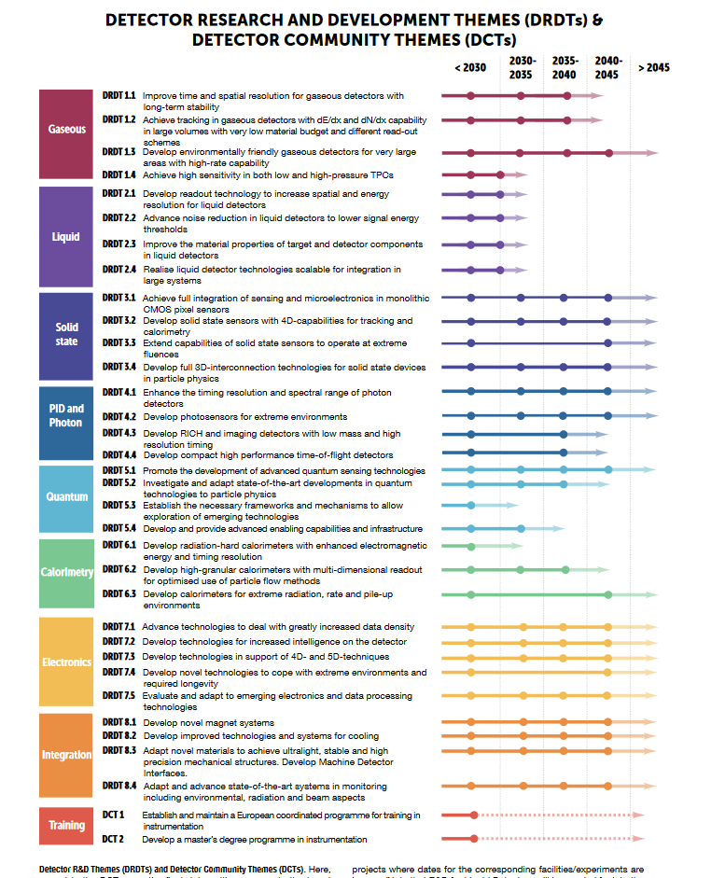
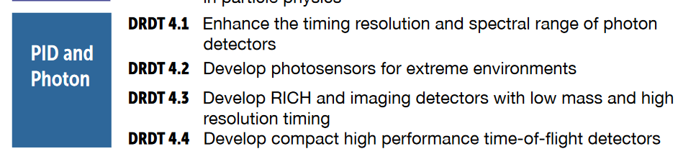
DRD4.5
“…nine task forces set up by ECFA to develop a strategy for future detector R&D priorities. All the themes are critical to achieving the science programme outlined in the ESPP and are derived from the technological challenges that need to be overcome for the scientific potential of the future facilities and projects listed in the ESPP to be realised. It is important to ensure that, for each of the future facilities mentioned in the ESPP, detector readiness should not be the limiting factor in terms of when the facility in question can be realised. “
2023
4.5 added
4.5A. “Improvement of the performance SciFi trackers in high rate and high radiation environments

Slide 23
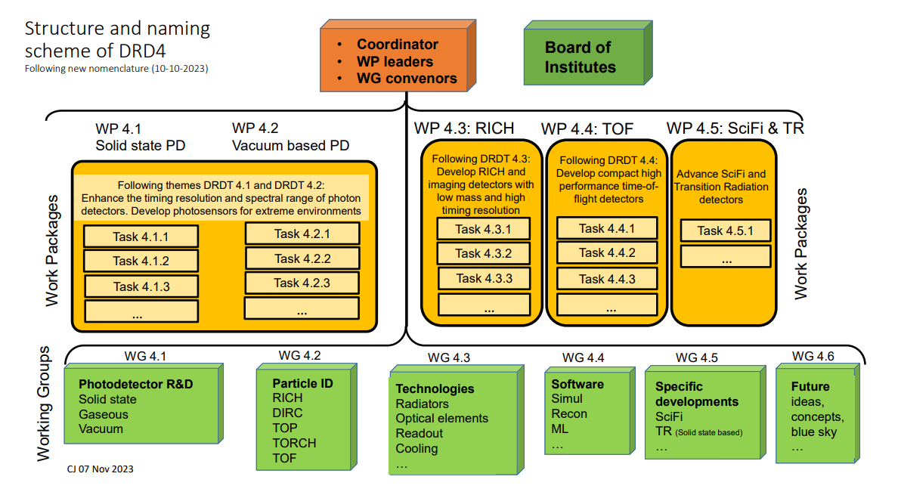

Slide 24
ECFA DRD4
Work-Package(s) 4.5
Blake Leverington, as coordinator, on behalf of the participating groups
Physikalisches Institut, Heidelberg Universitaet

Slide 25
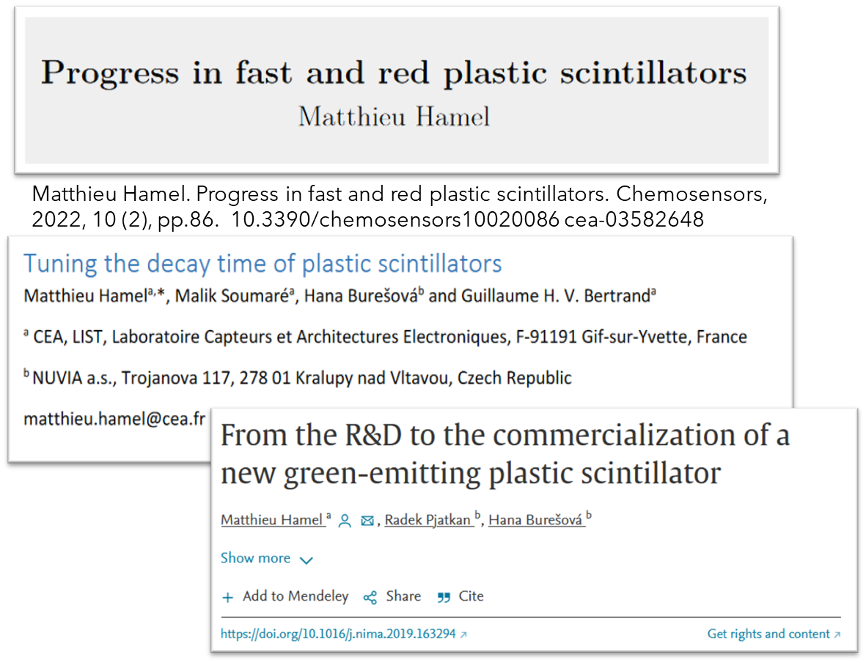
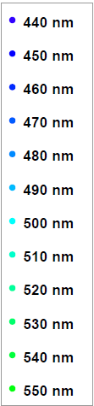
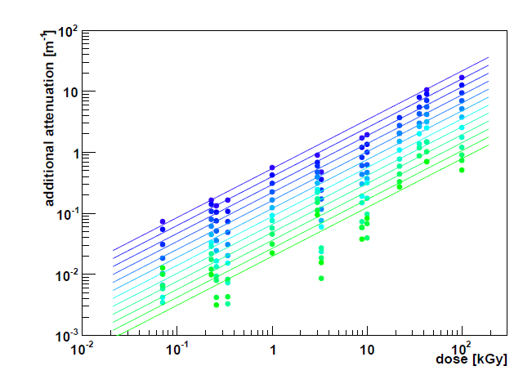
WP 4.5
Task 4.5.1:
“Develop an improved radiation hard scintillating fibre with a fluorescence decay time less than 4 ns.”
The standard fast fibre is over 25 years old (SCSF-78M and -78MJ from Kuraray)
  Peaks at 450nm, 3.5m attenuation length, 2.8ns decay time
  3HF has a decay time of 8ns, but peaks at 550nm.
Goal: A new fibre with larger Stoke’s Shift (to >500nm ) would improve the transmission after irradiation of the fibre
  Should have same or better light yield, attenuation, decay time, and stable in time.
Approx. Operational range of 78MJ
Intrinsic attenuation length 3.5m
Lots of “promising, but…”
From the thesis of R. Ekelhof, 2016. TU Dortmund

Slide 26
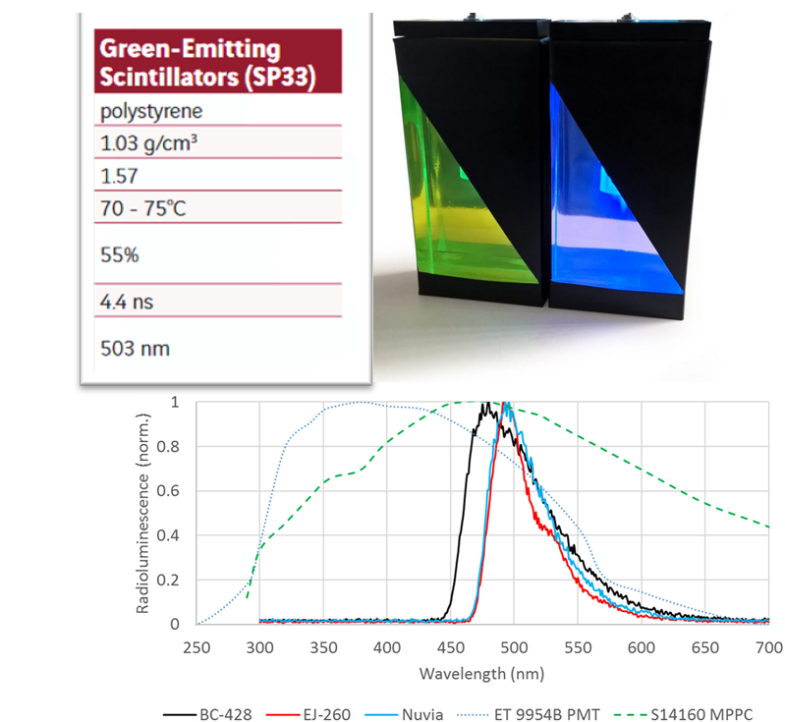
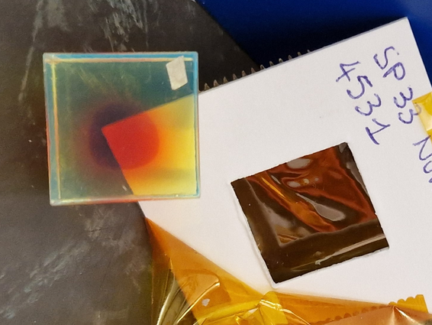
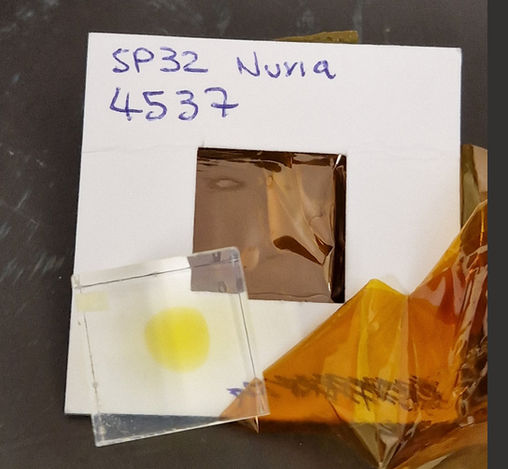
WP 4.5
Task 4.5.1 Milestones:
First, identify new scintillators, fluorescent dyes, or fibre modifications
  Market, literature (organic chemistry journals), simulation. Make contacts.
Obtain samples and characterize the bulk scintillator material → Possibly the hardest part. We can’t produce our own.
  Radiation hardness, timing, wavelength
Production of fibre samples (a few km) with Kuraray
  In contact with positive response. Production facility closed until mid-2024.
Testing and qualification of prototype fibre samples
  Light yield, attenuation length, timing, radiation hardness
Task 4.5.1 Deliverables:
  Report on candidates (between 2 and 3)
  Report on any produced prototype. Not guaranteed to find any.
SP32 and SP33 Sample 2 months after irradiation at CERN (~50kGy).

Slide 27
Participating Groups
WP 4.5 | 4.5.1
CERN SY-BI | x
CERN-EP | x
CERN-LHCb | x
Clermont-Ferrand | x
Heidelberg | x
Lausanne - EPFL | x
No. of groups | 6
EPFL
  Has produced a few fibre based trackers and telescopes for various experiments and projects
  SiPM development with Hamamatsu and FBK; microlenses; irradiation studies
  Fibre winding for LHCB SciFi Tracker
  Cryo-cooling of SiPMs for LHCb Upgrade 2
  Investigating new scintillators with polymer chemists at EPFL
  Good connection with Kuraray (fibres)
Heidelberg
  Module production for LHCb SciFi Tracker
  Irradiation studies of Fibres
  Development of LHCb Upgrade 2 Fibre and Pixel Tracker
  Ion-beam profile monitor for HIT clinic
  Investigating new scintillators for fibres
CERN-LHCb + -EP + SY-BI
  SPACAL for LHCb ECAL LS3 and Run5/6 Upgrades
  Irradiation of Scintillators
  LHCb SciFi QA
  Scintillator irradiation and characterization
  Beam Instrumentation
Clermont-Ferrand (Pascal Perret et al.)
  LHCb SciFi Tracker Electronics
Other groups expressed interest in the WG, but not willing to commit to the WP

Slide 28
Resources
Group |  | FTE available |  |  |  | add. FTE needed |  |  |  | funds available [kEUR]
Short name | Country | 2024 | 2025 | 2026 | >2026 | 2024 | 2025 | 2026 | >2026 | 2024 | 2025 | 2026 | >2026
CERN SY-BI | CE | 0.10 | 0.10 | 0.10 | 0.10 | 0.00 | 0.00 | 0.00 | 0.00 | 0.00 | 0.00 | 0.00
CERN-EP | CE | 0.10 | 0.10 | 0.10 | 0.10 | 0.00 | 0.00 | 0.00 | 0.00 | 1.00 | 1.00 | 1.00
CERN-LHCb | CE | 0.10 | 0.10 | 0.10 | 0.10 | 0.00 | 0.00 | 0.00 | 0.00 | 0.00 | 0.00 | 0.00
Clermont-Ferrand | FR | 0.10 | 0.10 | 0.10 | 0.10 | 0.00 | 0.00 | 0.00 | 0.00 | 1.00 | 1.00 | 1.00
Heidelberg | DE | 0.2 | 0.4 | 0.4 | 0.4 | 0.00 | 0.00 | 0.00 | 0.00 | 7.00 | 7.00 | 7.00
Lausanne - EPFL | CH | 0.4 | 0.4 | 0.4 | 0.4 | 2 | 2 | 2 | 2 | 50 | 50 | 50 | 10

