Slide 1
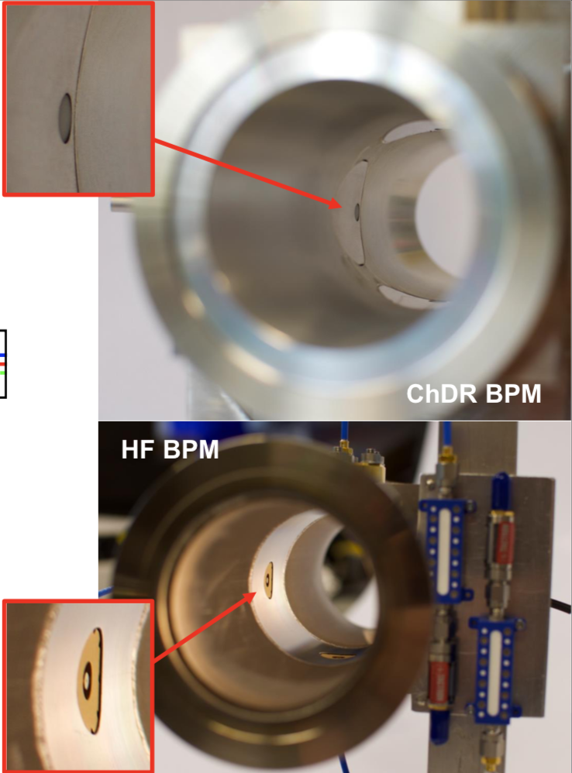
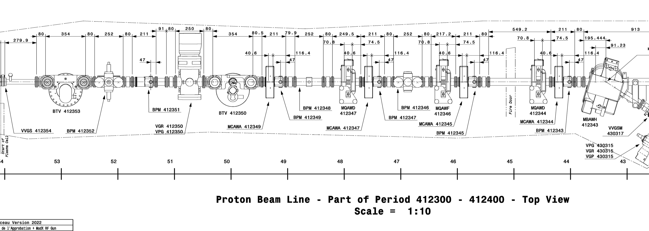
Location of BPMs in the beam line
Drawing number: SPSLAWK_0032
ChDR BPM
HF BPM
ChDR BPM
Plasma
cell
Beam

Slide 2
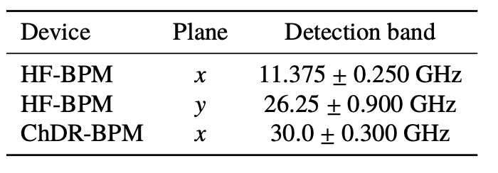
Set-up as of last December
The horizontal plane of the closest ChDR BPM to the plasma cell was connected to a scope (Tektronix MSO6) controlled by python script outside of the tunnel – not continuously logged
Have 2 ADCs from TRIUMF for the 2 ChDR BPMs, one calibrated and the other newly installed last December
Horizontal plane of HF BPM and ChDR BPM connected to the channels of the calibrated TRIUMF ADC
ChDR BPM
HF BPM
ChDR BPM
Plasma
cell
Beam

Slide 3
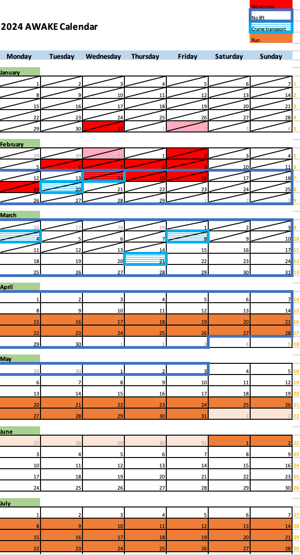
Status of TRIUMF ADCs and scheduling
Both ADCs are in building 867
Received the programmable variable attenuator last week
Will try next week to calibrate
Crane handling on 21st March (next Thursday) confirmed by Eloïse this morning – can also just be carried down if needed
Spoke to Weida yesterday, possibility to come for one week end of March or beginning of April, he will check and get back to me

Slide 4
Plans for data-taking this year
Beth - continuous logging of all 4 channels of HF BPM and ChDR BPM during the runs (connected to TRIUMF electronics)
Logging of one plane of ChDR BPM closest to the plasma cell on scope – 2 free channels on scope
Horns need to be reinstalled – which band?
Emily – connect one plane of HF BPM to scope, with filters? Which type?
Measure attenuation with VNA
Logging with electrons outside of the run?
Proposed schedule:
  have everything ready for logging for Beth by 15th April, data taking electrons and protons during the run
  Measure cable attenuation for HF BPM set-up for Emily week 29th April (meantime, prepare equipment and tests to be done) and then have this connected to the scope that week for data taking with electrons (to be checked when with AWAKE), one plane or two? Which one?

