Slide 1
CERN Highlights and Future Plans
CERN - Ukraine 2024: "Past - Present – Future" Conference
Joachim Mnich
May 28th, 2024

Slide 2

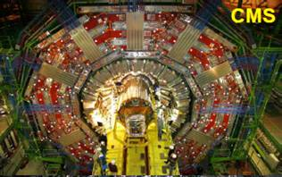


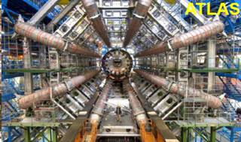


Large Hadron Collider (LHC)
Protons
(ions)
In addition:
TOTEM
LHCf
MoEDAL
FASER
SND@LHC
Atlas
Protons
(ions)

Slide 3

LHC Experiments: Physics Output
ALICE:
477 papers submitted
Number of publications to date on collision data:
ATLAS: 1277 papers CMS: 1279 papers
on many different topics
LHCb:
713 papers submitted

Slide 4
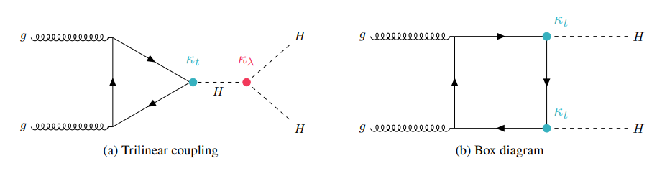
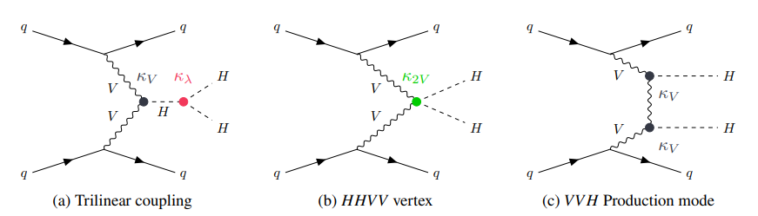
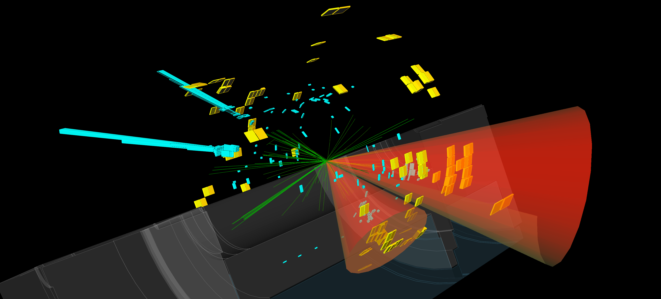

LHC Experiments: Higgs Physics
Example: Measurement of Higgs couplings by CMS
Starting to explore Higgs self-coupling (Di-Higgs production)
Candidate HH → bƃγγ event
Tracks
B jets
Photons

Slide 5
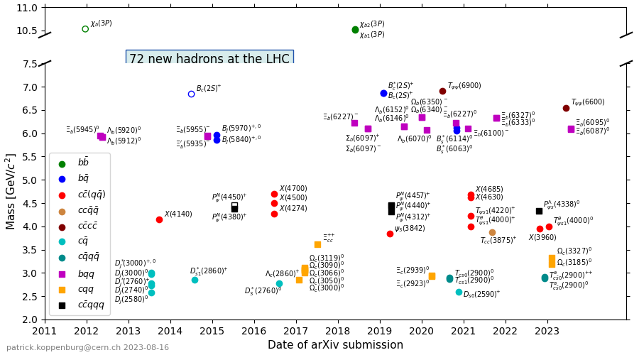
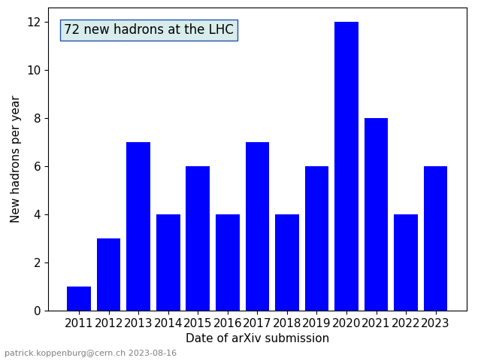
72 New Hadrons Discovered at the LHC
Most of them (64) were discovered by LHCb
Among them 23 exotic states made of 4 or 5 (anti-)quarks
Notes:
https://www.nikhef.nl/~pkoppenb/particles.html

Slide 6
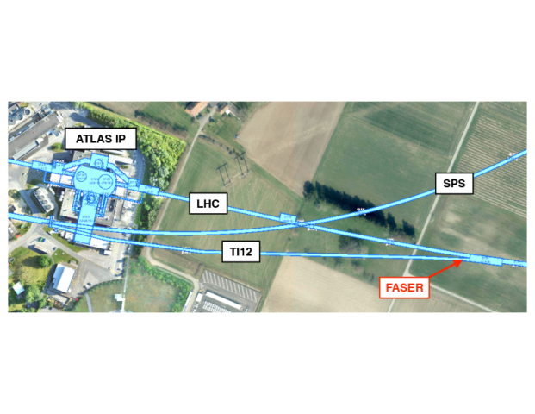
FASER
hep-ex > arXiv:2303.14185
First Direct Observation of Collider Neutrinos with FASER at the LHC
Expect 151 ± 40 events
Background estimate:
0.2 events
153 event observed (16 σ)
1 TeV
100 GeV

Slide 7
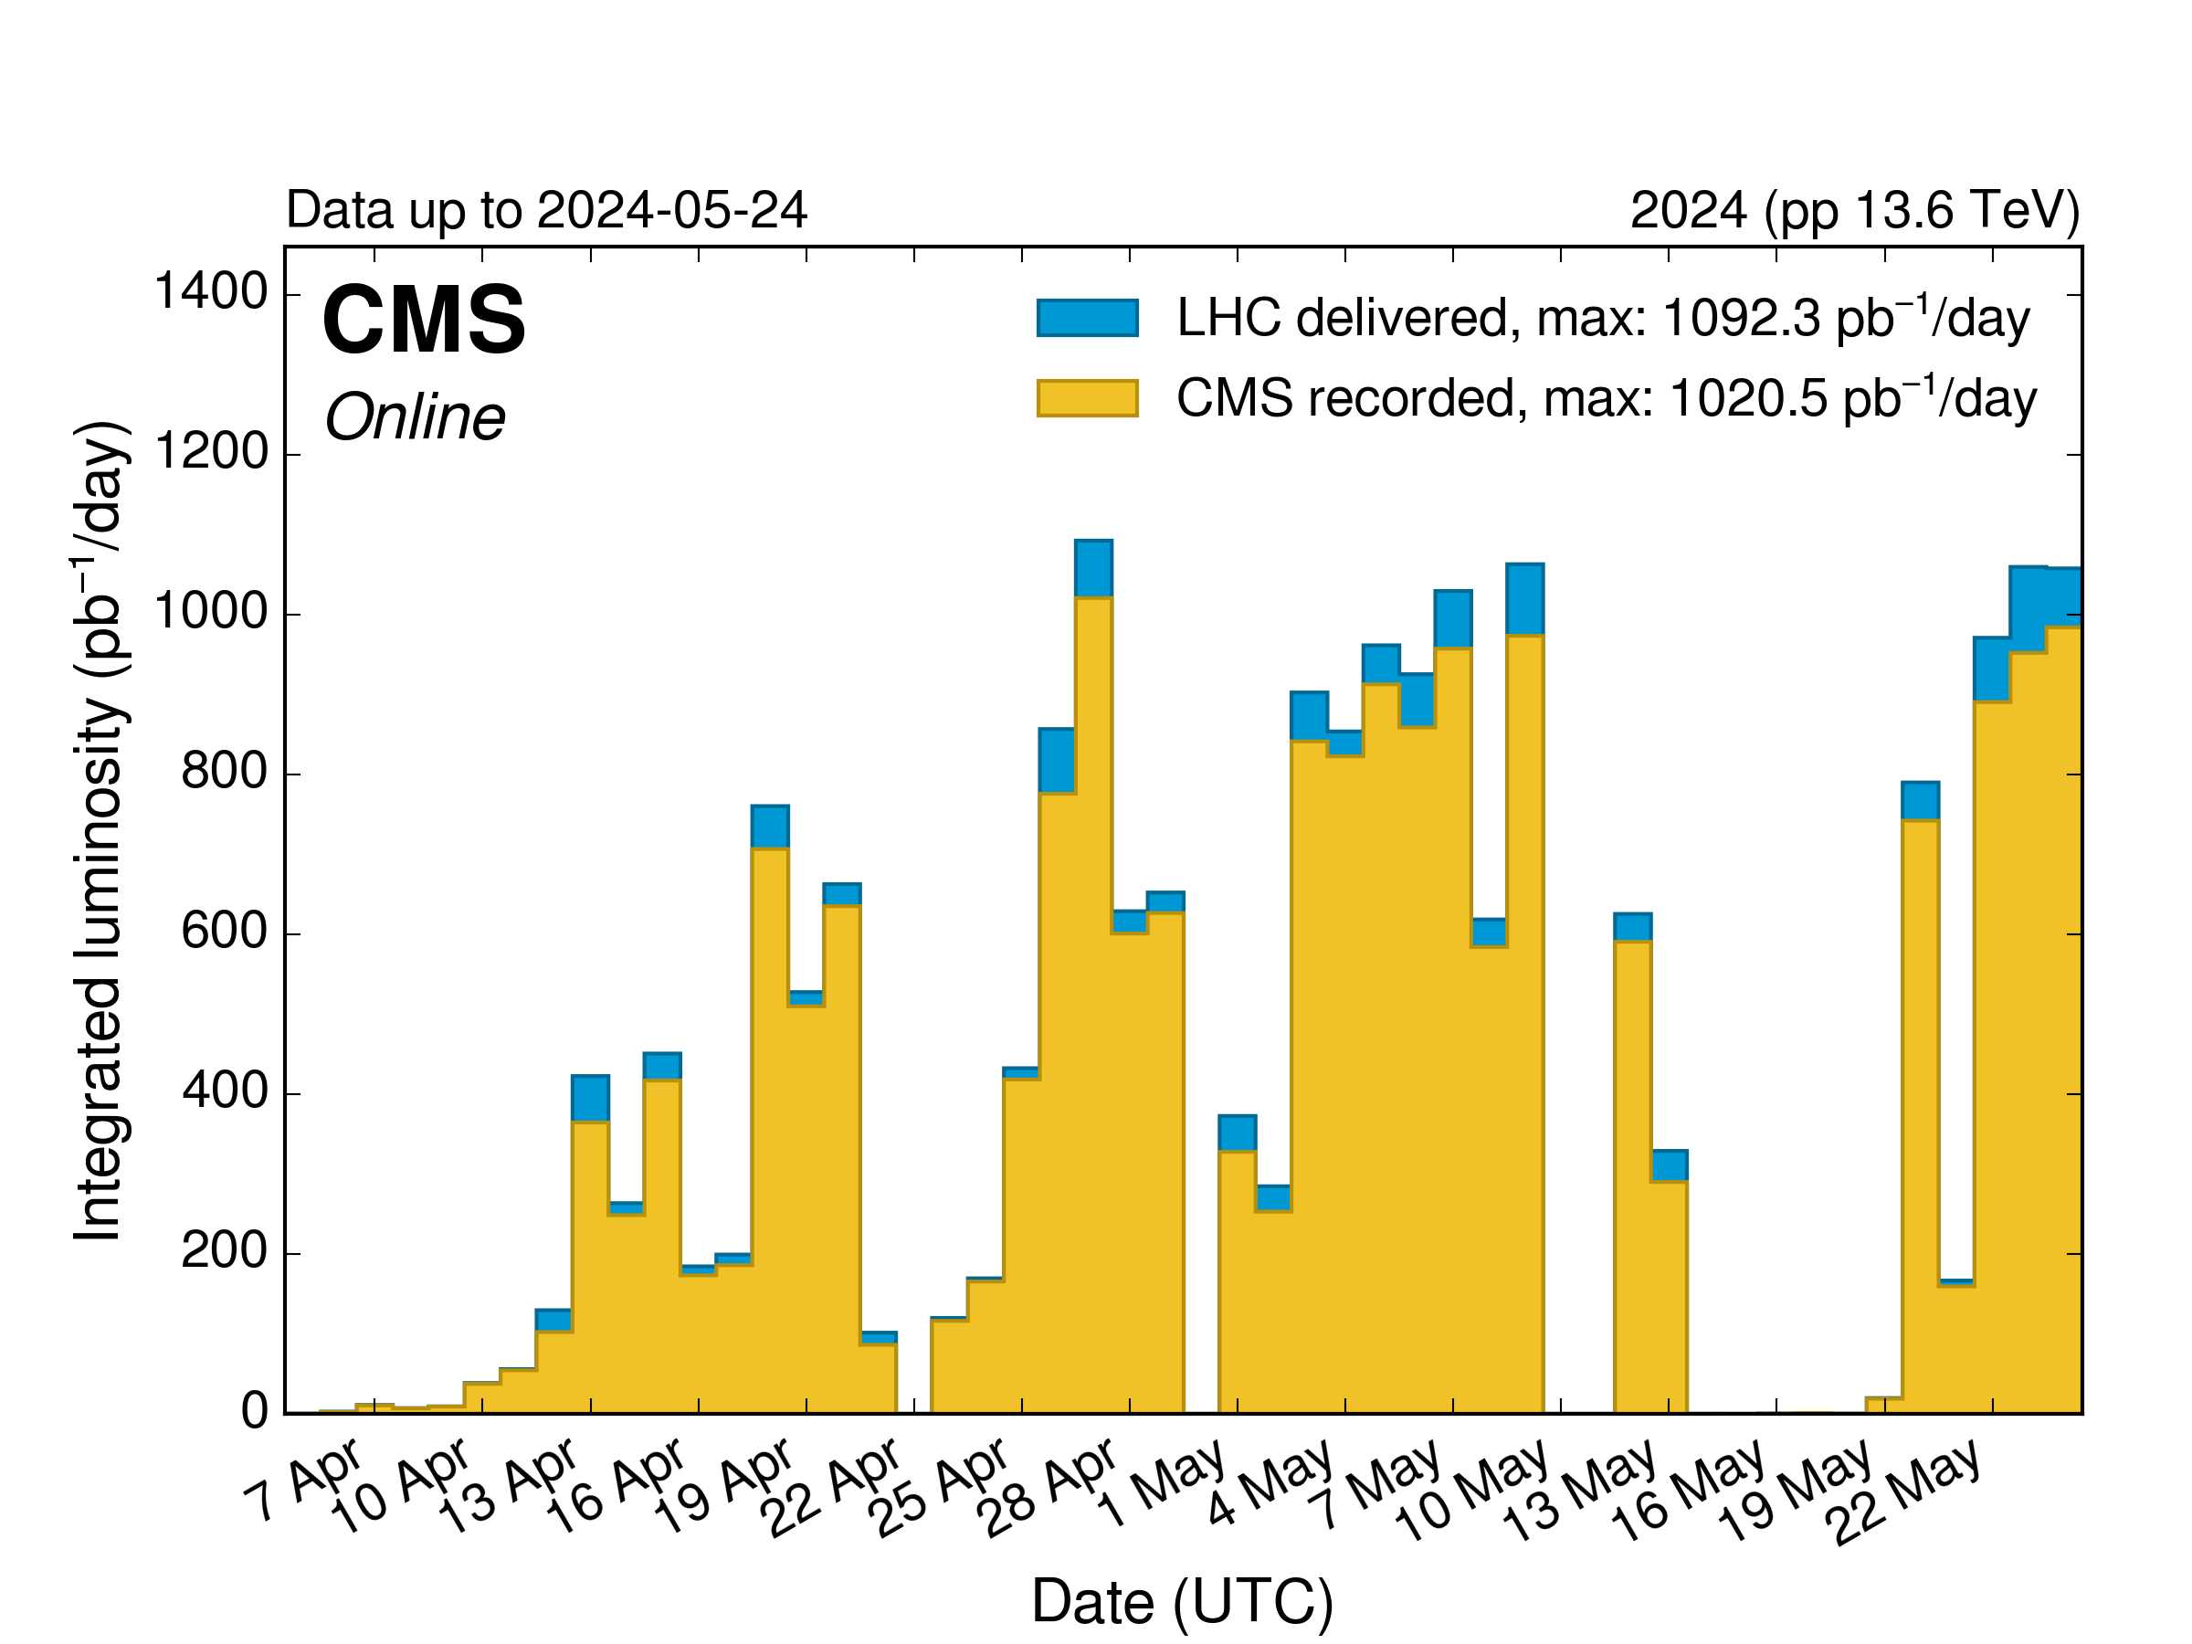
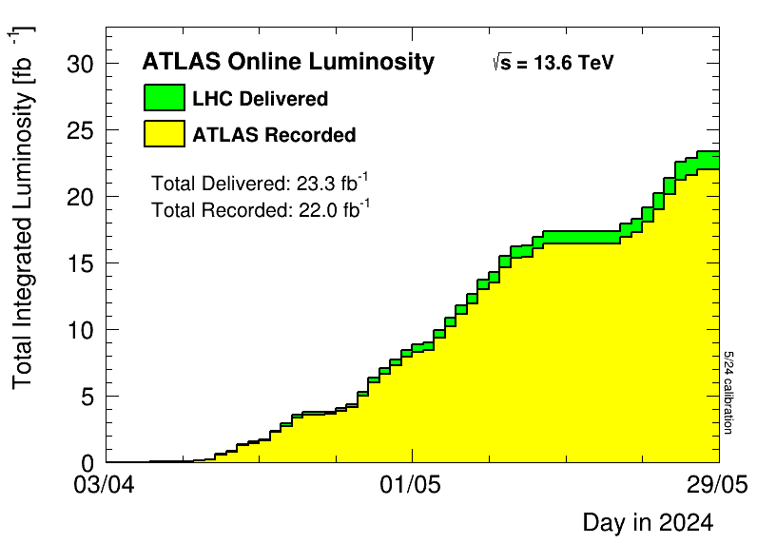
Brief Update 2024 LHC Run
All 4 experiments up and running
Good data taking efficiency
≈ 23 fb⁻¹ pp luminosity recorded so far in 2024 by ATLAS & CMS
Up to 1 fb⁻¹ per day

Slide 8
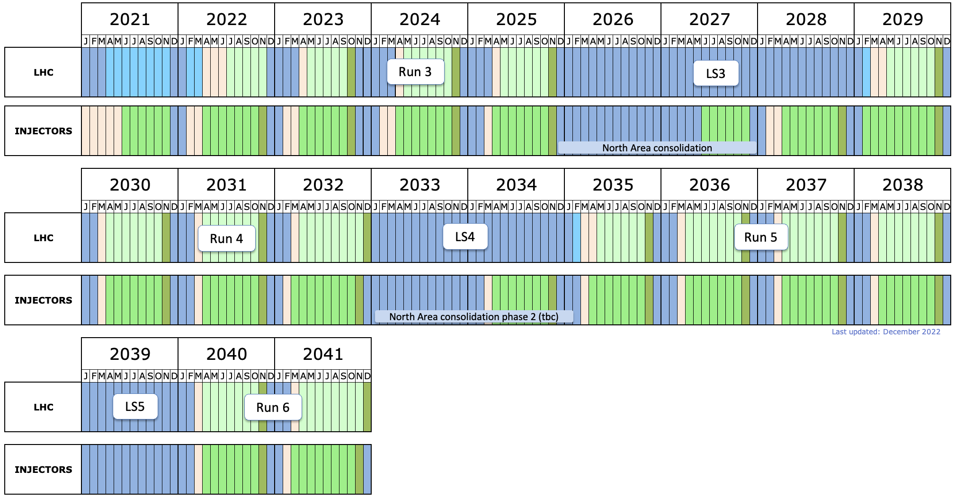
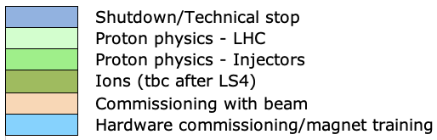
LHC Timeline
today
start HL-LHC
LS2: Upgrade of accelerator and detectors (Phase I)
LS3: Upgrade HL-LHC and Phase II ATLAS&CMS
North Area upgrade (SHiP)
LS4: Upgrade
Phase IIb ALICE&LHCb
  HL-LHC target:
  Deliver 3000 fb⁻¹ pp luminosity to both ATLAS and CMS

Slide 9
Phase II Upgrade ATLAS & CMS
Upgrades of ATLAS & CMS to prepare for HL-LHC:
  Replacement of inner detectors: higher granularity, more radiation hard
  Precision timing detectors

Slide 10
Challenges for the Detectors at the HL-LHC
Example: event pile-up
current detectors designed for 20 pp collisions per bunch crossing
2023: ATLAS&CMS coped with pile-up levelled to ≈ 60!
At the HL-LHC:
expect 140 - 200 pp collisions per bunch crossing
Need to identify the right vertex at which the Higgs was produced

Slide 11
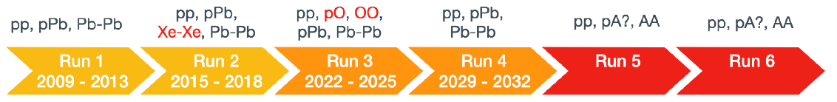
Phase IIb Upgrades
Fully exploit HL-LHC for Heavy Ion & Flavour physics
ALICE3:
Tracking precision x 3: 10 µm at p_{T} = 200 MeV
Acceptance x 4.5: |η| < 4 (with particle ID)
A-A rate x 5 (pp x 25)
Inner Tracker upgrade ITS3:
  Large-area curved sensors
  (stitched CMOS)
  Ultralight, air cooling, low power
  LHCb Upgrade II:
Precision timing few tenths of ps: Vertex Detector, RICH, ECAL,…
Tracker based on Scintillating Fibres with cryo-cooled SiPMs
& first rad-hard CMOS tracker
Innovative technologies relevant for future HEP experiments
Pathfinder towards future (accelerator) projects

Slide 12
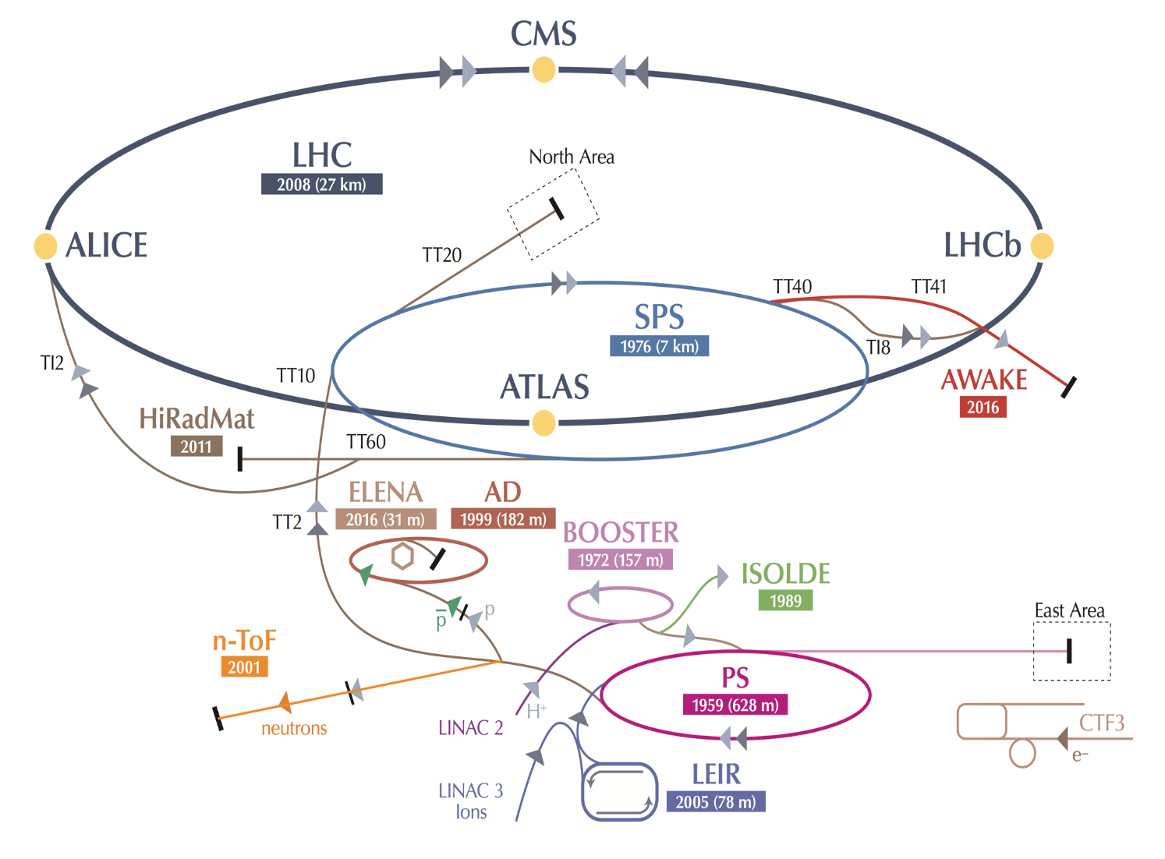

CERN Diversity Programme
AD Experiments: Antiproton Decelerator for antimatter studies
AWAKE: proton-induced plasma wakefield acceleration
CLOUD: impact of cosmic rays on aeorosols and clouds
COMPASS → AMBER: hadron structure and spectroscopy
ISOLDE: radioactive nuclei facility
NA61/SHINE: ions and neutrino targets
NA62: rare kaon decays
NA63: radiation processes in strong EM fields
NA64: search for dark photons
NA65: study of tau neutrino production
Neutrino Platform: ν detector R&D for experiments in the US, Japan
n-TOF: n-induced cross-sections
ECN3 upgrade → SHiP
Future of the diversity programme discussed in the
Physics Beyond Collider study /
Topics include:
LHC injectors
Low energy facilities
High energy fixed target
Opportunities gamma-factory
Precision measurement and rare decays
High energy beam dumps
Low energy hidden sector (axions, EDM)
QCD and Heavy Ion
~20 projects with > 1200 scientists

Slide 13
SHiP
Search for Hidden Particles (SHiP)
Beam dump experiment
Main scientific goal:
search for feebly interacting
GeV-scale particles
Details see:
https://cds.cern.ch/collection/SHiP%20Reports
Expected to start ≈ 2031

Slide 14

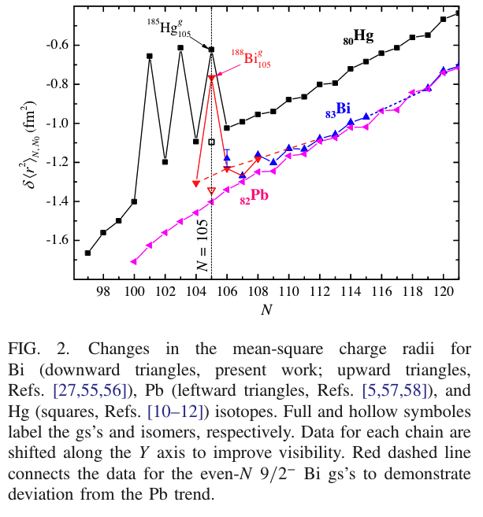
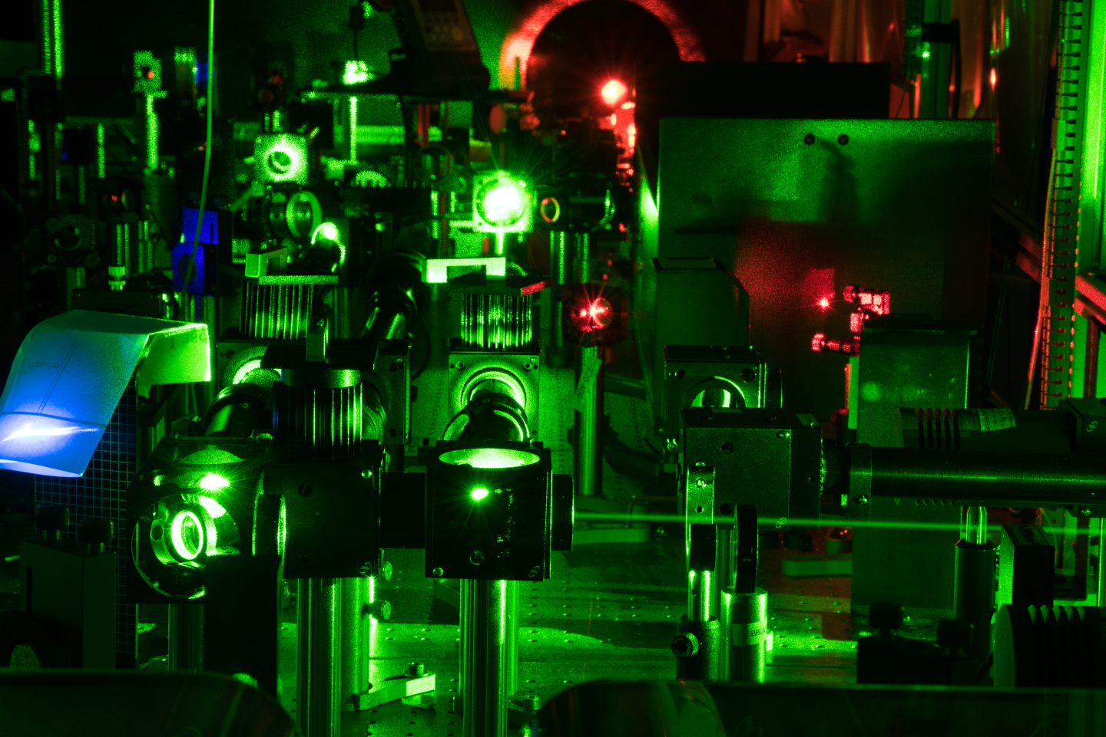


Physics highlight
Shape change of nuclei: from sphere to rugby ball and back
First observed 50 years ago at ISOLDE in neutron-deficient Hg isotopes
Now also observed in Bi:
Phys. Rev. Lett. 127, 192501 (2021)
N→ N+1
Adding 1 neutron changes the nucleus from a sphere to a pronounced rugby ball
Adding 1 neutron more the nucleus goes back to a sphere
Occurs at the same number of neutrons, 105, in Bi and Hg
N→ N+1
See also http://home.cern/news/news/physics/bismuth-isotopes-also-alternate-spheres-rugby-balls
Notes:
gs: ground state
m: isomer exited metastable nucleus

Slide 15
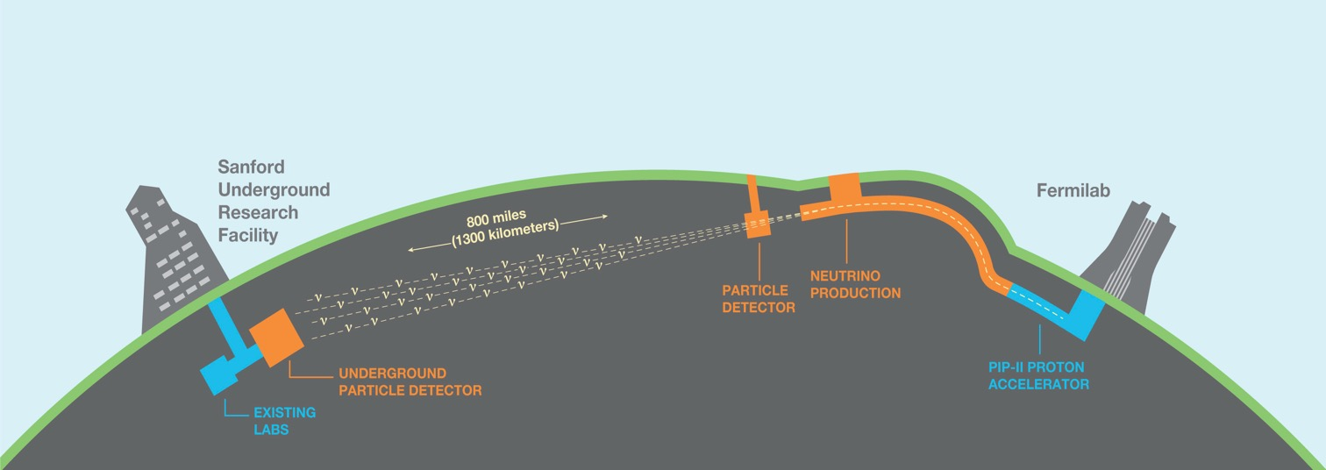
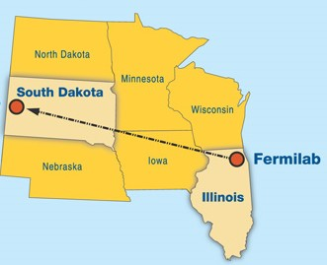

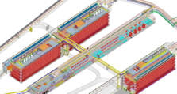
Long-Baseline Neutrino Facility (LBNF) and the Deep Underground Neutrino Experiment (DUNE)
1300 km
South
Dakota
ν_{μ}
Chicago
ν_{μ} & ν_{e}
FD
ND
Physics goals:
Study long baseline neutrino oscillations
Precision measurement of oscillation parameters (θ₁₃, θ₂₃) and determine the neutrino mass hierarchy
Search for CP violation in the neutrino sector and measure the CP-violation phase
In addition to the oscillation physics:
study atmospheric neutrinos, supernova bursts and nucleon decays

Slide 16
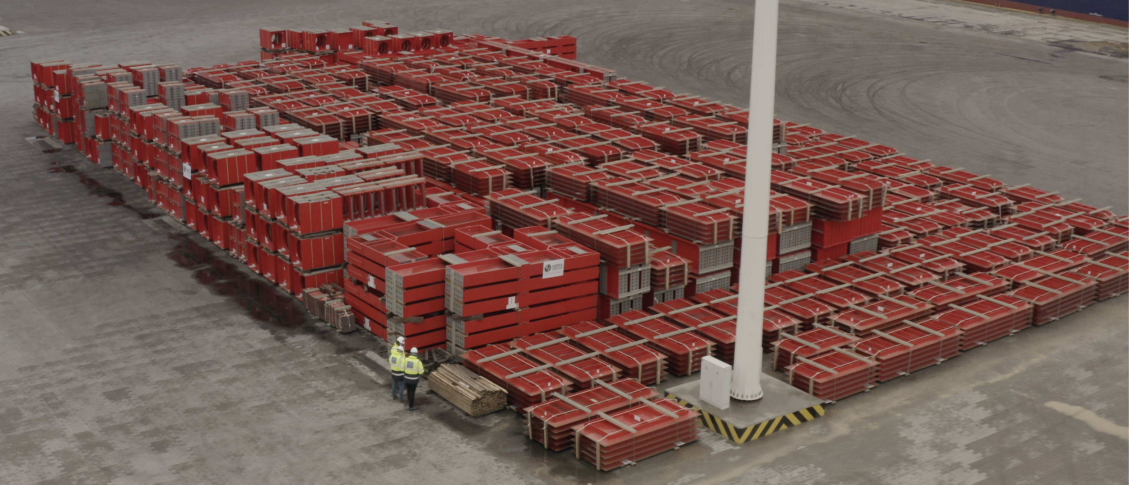
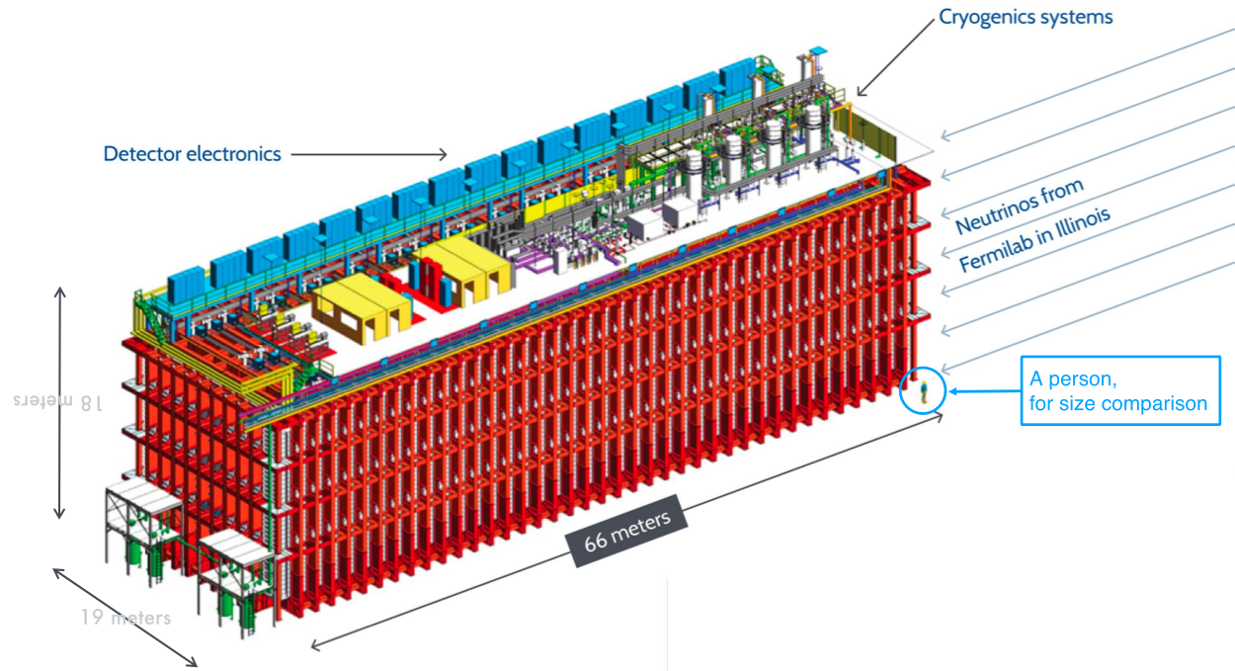
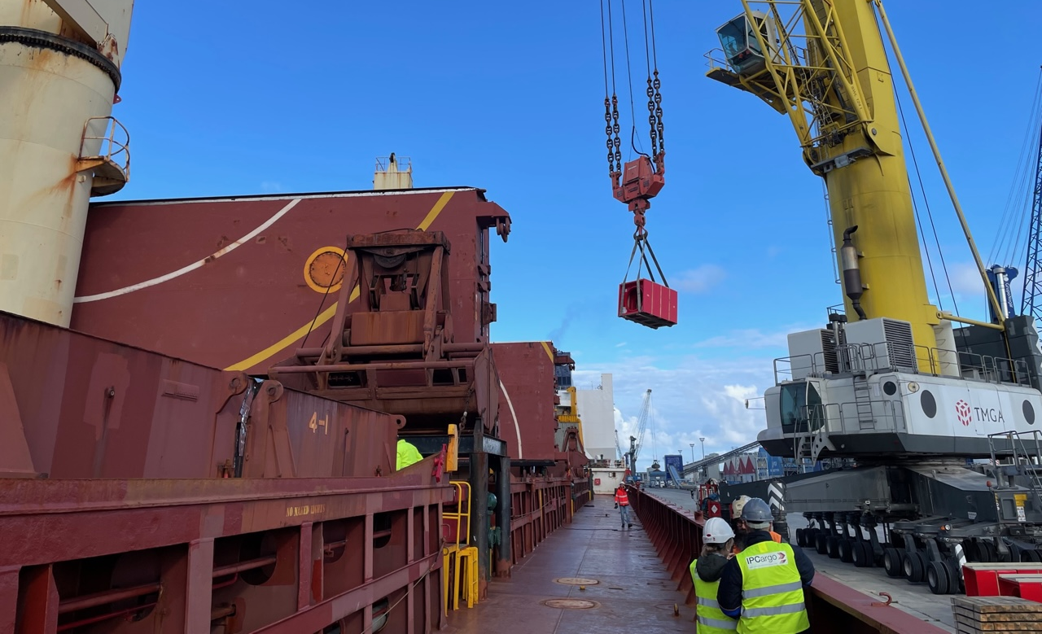
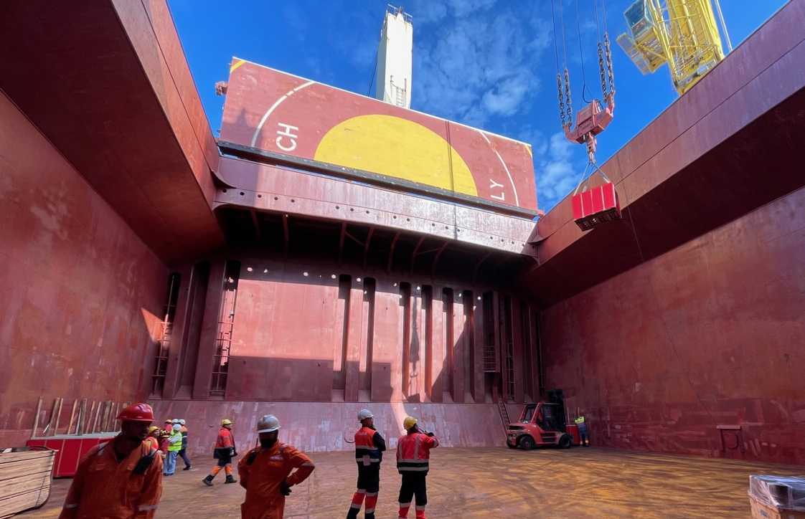
Neutrino Platform and LBNF/DUNE
At CERN two main activities for the LBNF/DUNE project in the US:
Construction of two large cryostats for the DUNE far detectors
Production of warm steel structure completed for cryostat #1
Now on board of a cargo ship on its way to the US
Cryostat #1 warm structure stocked @ A Coruna harbor
(3,000 tons approx.)
≈ 66×18×19 m³

Slide 17

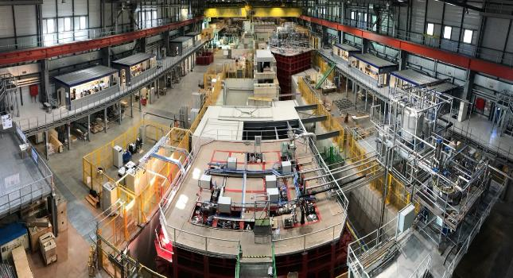
Neutrino Platform Activities
NP02:
Vertical Drift
2) ProtoDUNE at CERN: Validation of the final prototypes of the DUNE far detectors (horizontal and vertical rift concepts)
Update status NP04:
NP04 cryostat filled by end April
Purification completed
Inside NP04:
NP04:
Horizontal Drift
Filling NP04 with LAr:

Slide 18
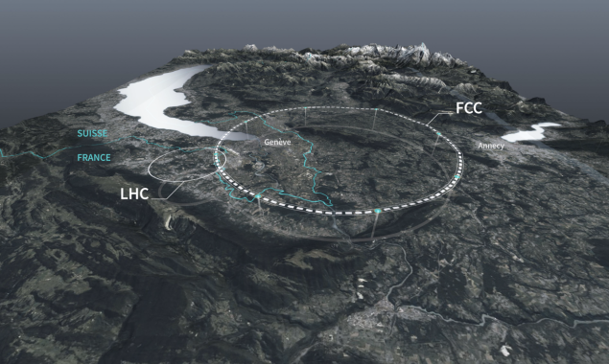
Future Circular Collider (FCC)

Slide 19
Future Circular Collider (FCC): Feasibility Study
European Strategy for Particle Physics:
An electron-positron Higgs factory is the highest-priority next collider. For the longer term, the European particle physics community has the ambition to operate a proton-proton collider at the highest achievable energy.
“Europe, together with its international partners, should investigate the technical and financial feasibility of a future hadron collider at CERN with a centre-of-mass energy of at least 100 TeV and with an electron-positron Higgs and electroweak factory as a possible first stage.
Such a feasibility study of the colliders and related infrastructure should be established as a global endeavour and be completed on the timescale of the next Strategy update.”
CERN has launched the FCC feasibility study to address these recommendations

Slide 20
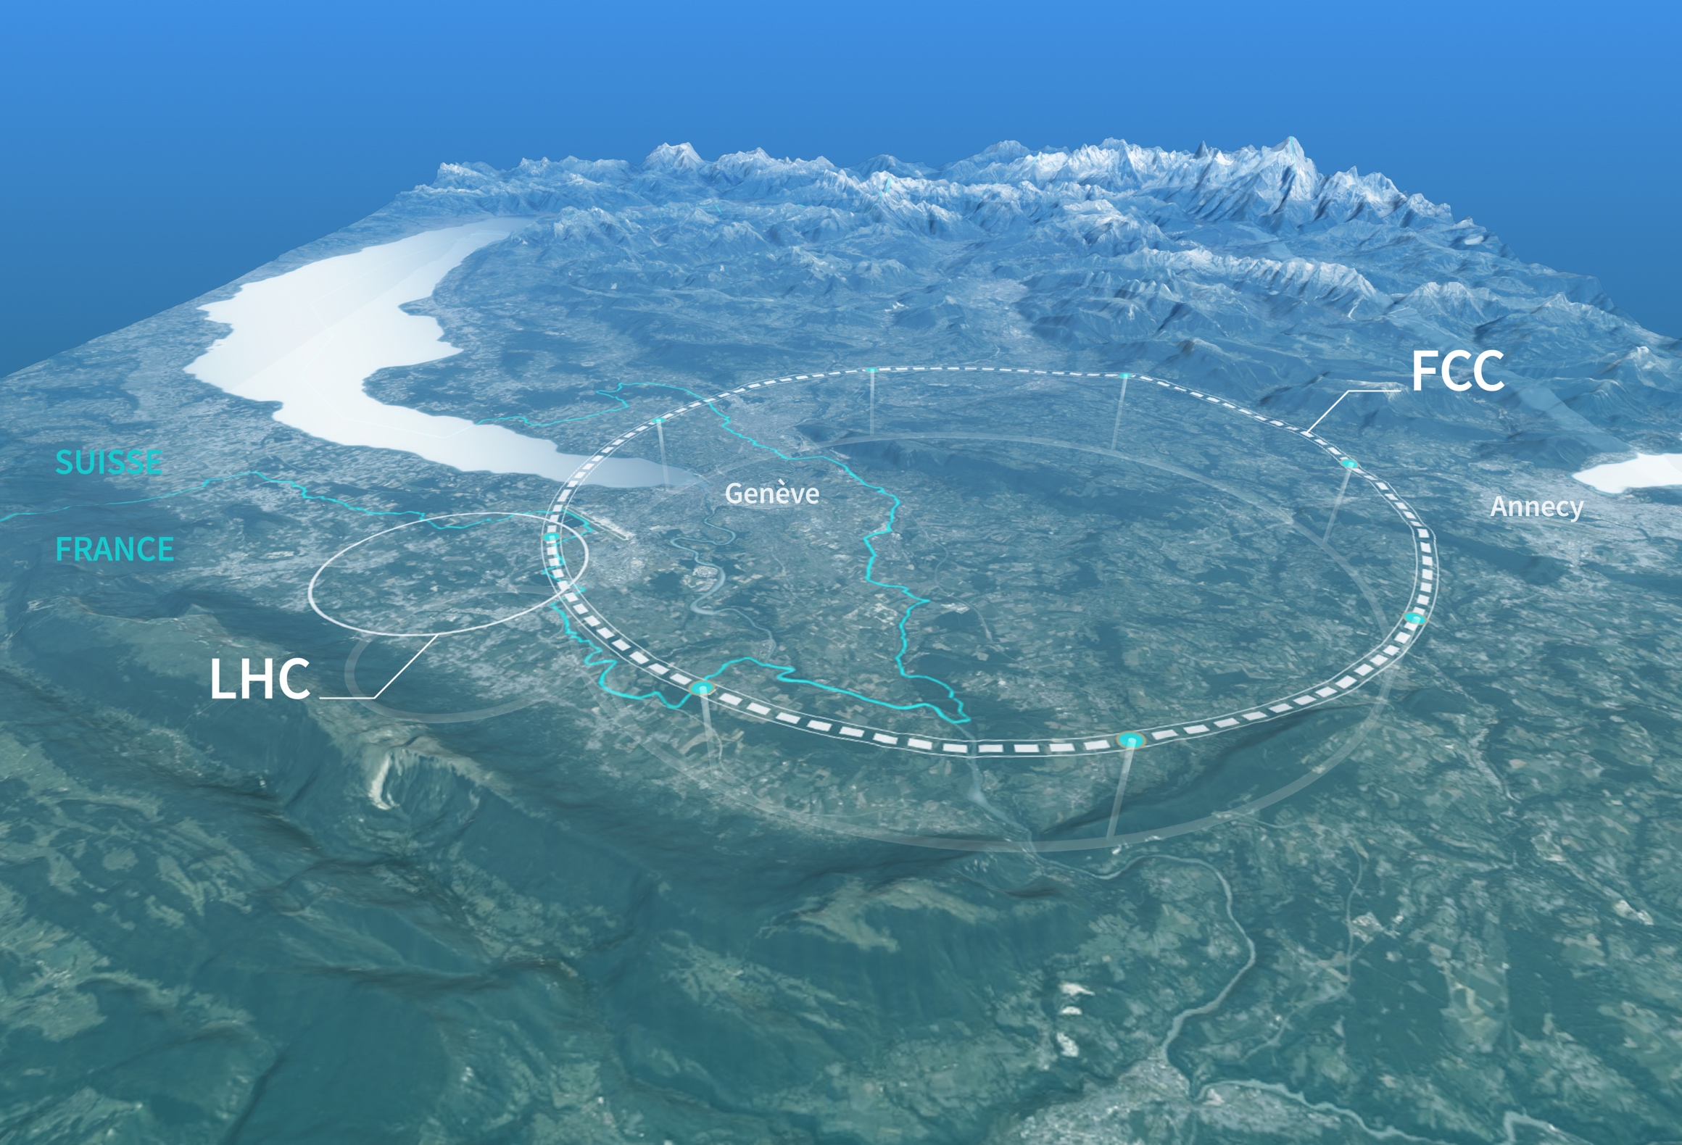
Preparing CERN’s future
Driven by the 2020 Update of the European Strategy for Particle Physics
Technical and financial feasibility study of a Future Circular Collider (report for end 2025)
Accelerator R&D to develop technologies for FCC and for alternative options
Detector and computing R&D
Maintain and expand a compelling scientific diversity programme
Continue to support other projects around
the world

Slide 21
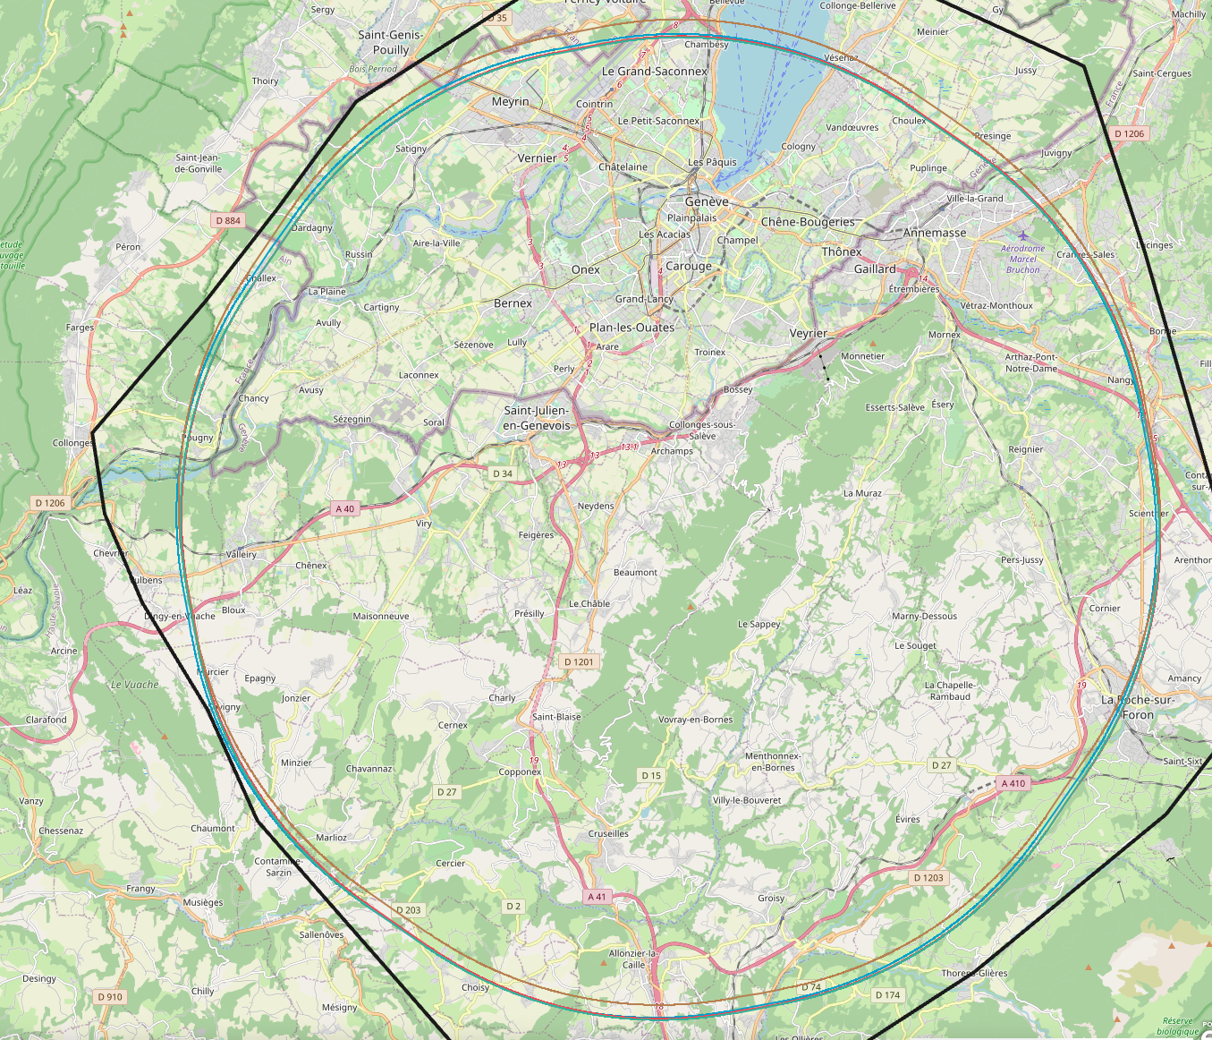
Preparing the Long-term (Post-LHC) Future
CERN Council unanimously approved the FCC Feasibility Study (2020-25)
FCC is a two-stage project:
e⁺e⁻ Higgs, EW and top factory
Hadron collider with O(100 TeV) pp cms energy
Mid-term review end 2023 regarded
as an important milestone
Deliverables include:
Infrastructure & placement
Technical Infrastructure
Accelerator design FCC-ee and FCC-hh
Physics, experiments, detectors
Organisation and financing
Environmental impact and sustainability studies
Socio-economic impact
PA: Experiment
PB: technical
PL: technical
PD: experiment
PJ: experiment
PF: technical
PH: technical
PG: experiment

Slide 22

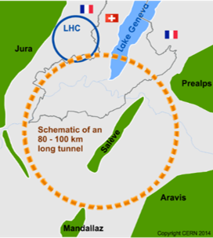
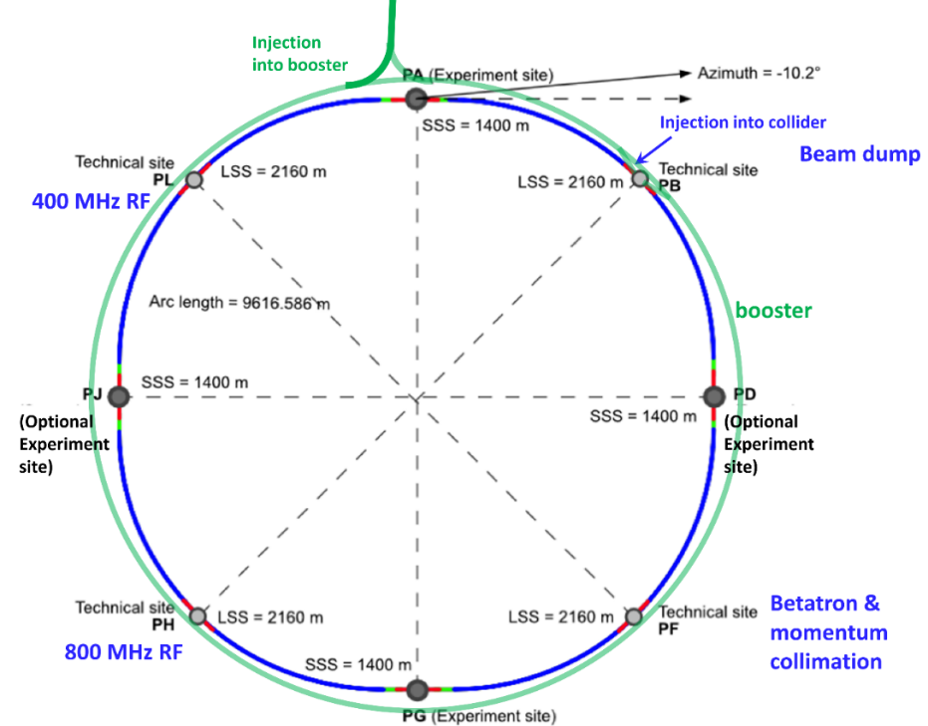
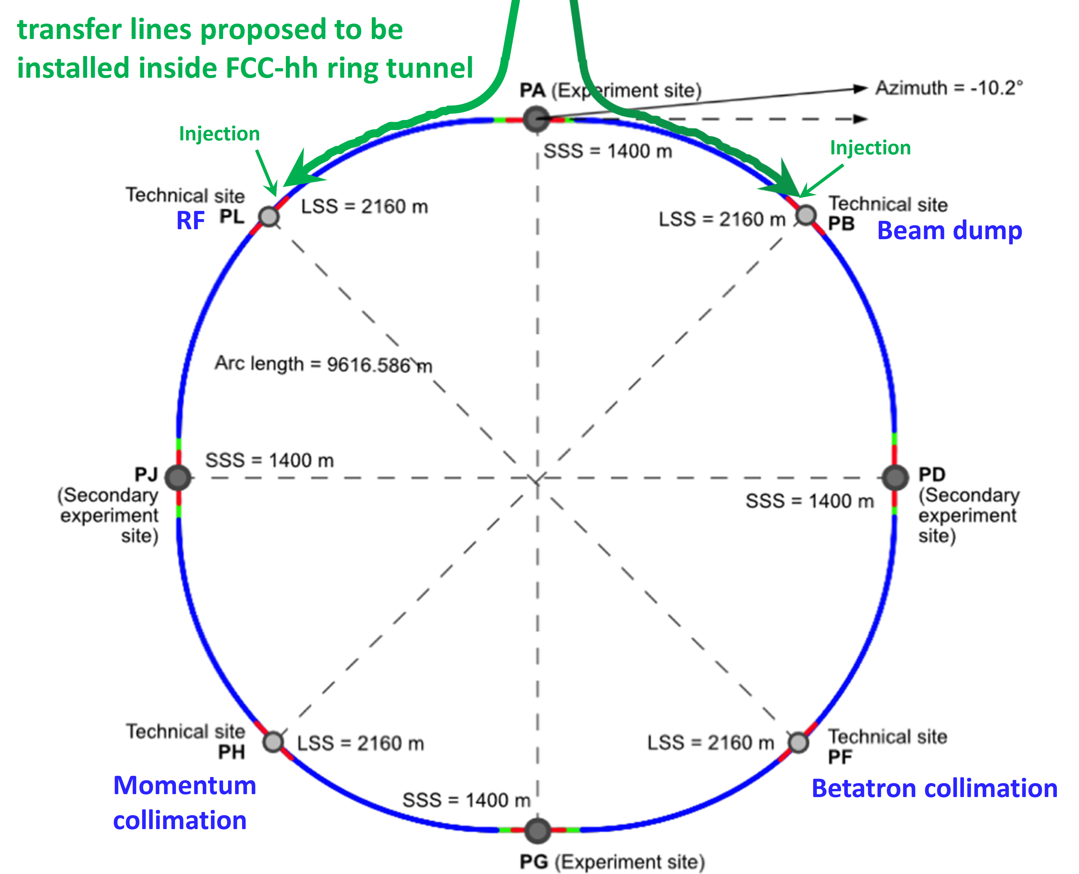
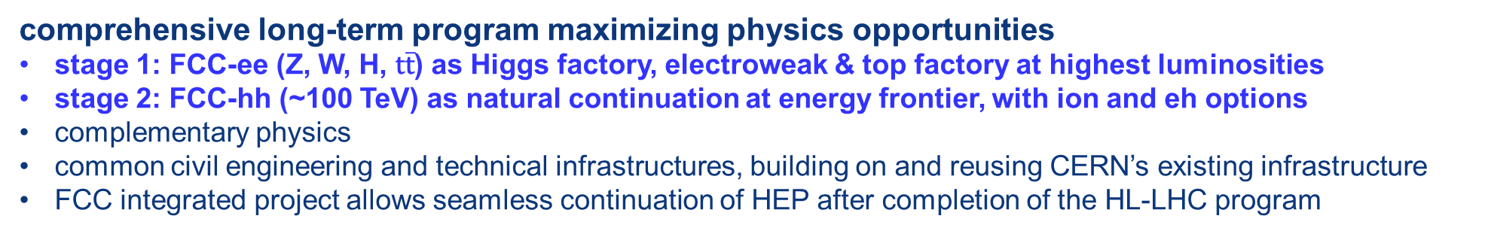
The FCC integrated program
inspired by successful LEP – LHC programs at CERN
comprehensive long-term program maximizing physics opportunities
stage 1: FCC-ee (Z, W, H, $\text{t}\overline{\text{t}}$) as Higgs factory, electroweak & top factory at highest luminosities
stage 2: FCC-hh (~100 TeV) as natural continuation at energy frontier, with ion and eh options
complementary physics
common civil engineering and technical infrastructures, building on and reusing CERN’s existing infrastructure
FCC integrated project allows seamless continuation of HEP after completion of the HL-LHC program
M. Benedikt
FCC-ee
FCC-hh
2020 - 2040
2045 - 2060
2065 - 2090

Slide 23
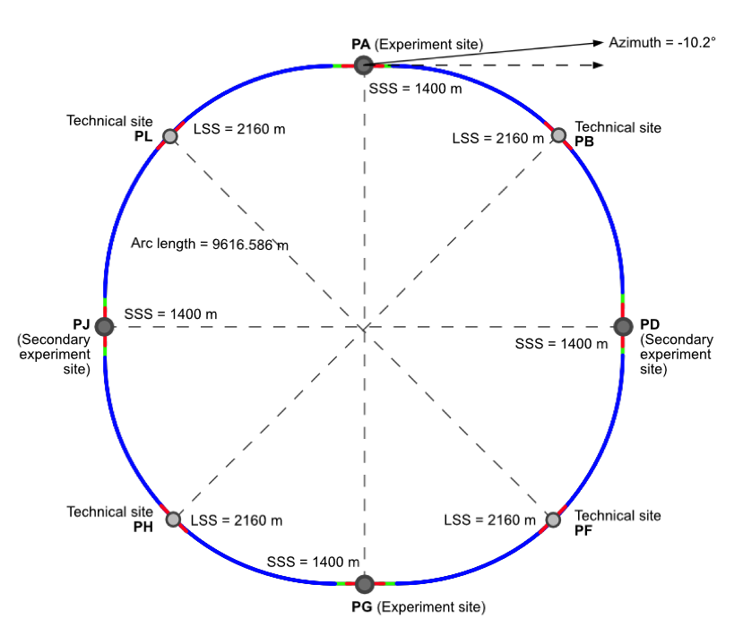
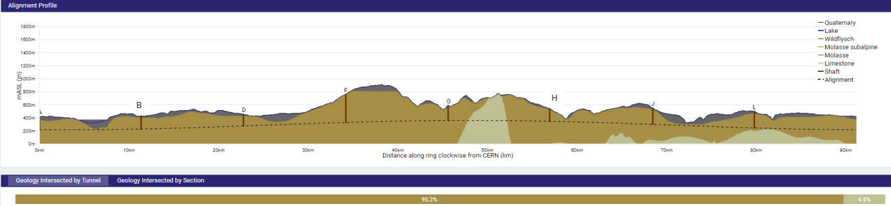
New: “lowest risk” placement
8 surface sites
C = 91.2 km
4-fold symmetry and 4-fold superperiodicity
FCC-ee 2 or 4 IPs
FCC-hh 4 IPs
Present implementation variant was established considering:
Geological 3D model and tunnelling risks
95% in molasse geology for minimising tunnel construction risks

Slide 24

FCC Roadmap Towards First e⁺e⁻ Collisions
>2045 first
ee collisions
Highest priority goals of the study:
Financial feasibility
Technical and administrative feasibility of tunnel:
no show-stopper for ~100 km tunnel
Technologies of machine and experiments:
magnets; minimize environmental impact;
energy efficiency & recovery
Gathering scientific, political, societal and other support
>2030
start tunnel
construction
>2038
machine
installation
2028 approval
2026/7
ESPPU
>2030 - 37
element production
2025/26
Feasibility proof
>2026 - 30 full
technical design
2014 FCC
study kickoff
2020
ESPPU
2020 FCCIS
kickoff
2025/26
Financing model
Operation concept
2013
ESPPU
2018 FCC CDR
2020-25
FCC Feasibility Study
FCCIS H2020 DS
today
2012 Higgs discovery announced
2011 circular Higgs factory proposal

Slide 25
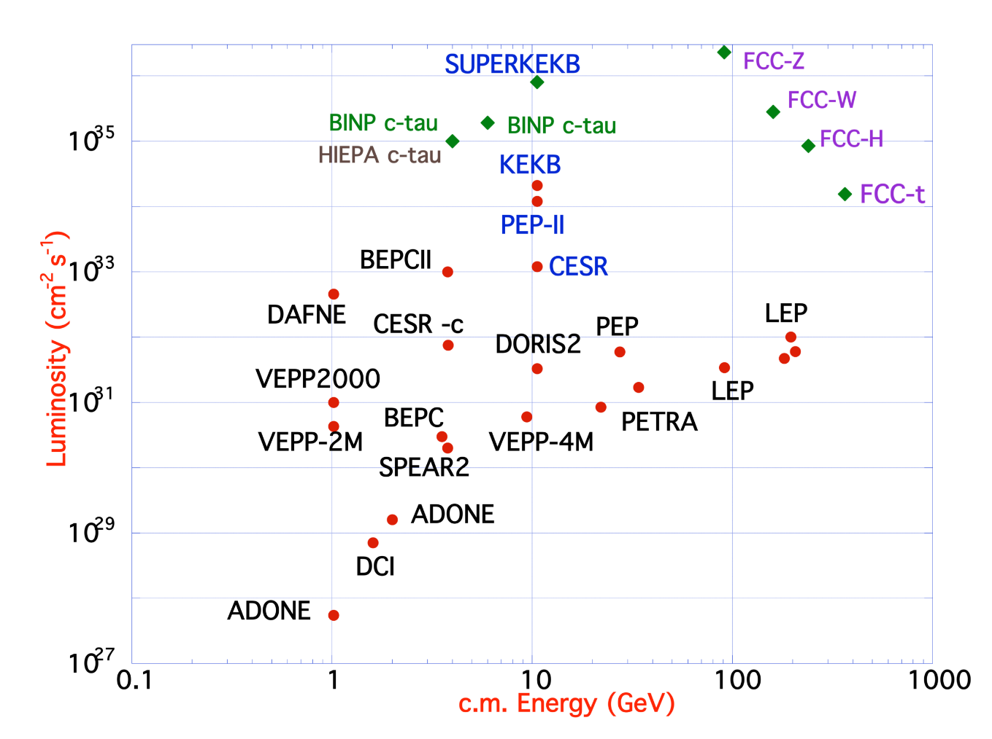
FCC-ee Design Concept
  Based on lessons and techniques from past colliders (last 40 years)
  B-factories: KEKB & PEP-II:
    double-ring lepton colliders,
    high beam currents,
    top-up injection
  DAFNE: crab waist, double ring
  S-KEKB: low by*, crab waist
  LEP: high energy, SR effects
  VEPP-4M, LEP: precision E calibration
  KEKB: e⁺ source
  HERA, LEP, RHIC: spin gymnastics
Marica Biagini
Marica Biagini
Combining successful ingredients of several recent colliders → highest luminosities & energies

Slide 26
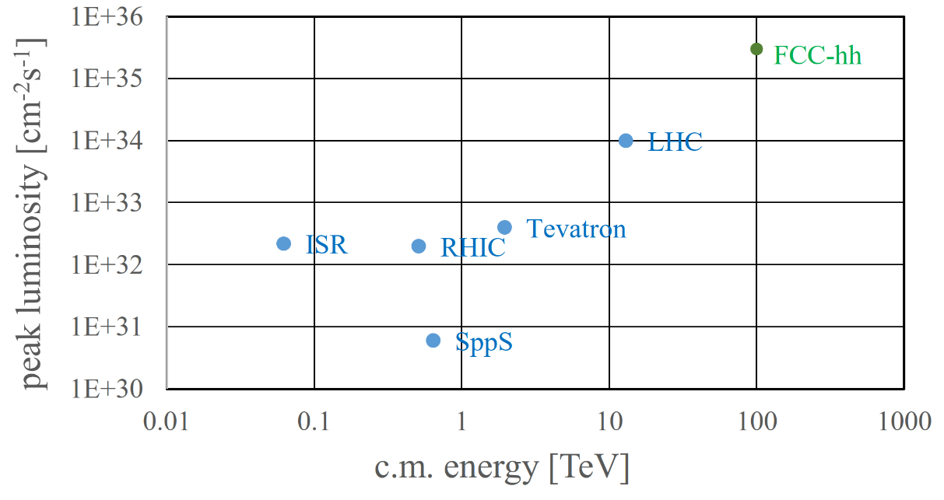
FCC-hh: Highest Collision Energies
Key challenges:
Order of magnitude performance increase in both energy & luminosity
100 TeV cm collision energy (vs 14 TeV for LHC)
20 ab⁻¹ per experiment collected over 25 years of operation (vs 3 ab⁻¹ for LHC)
Similar performance increase as from Tevatron to LHC
Key technology: high-field magnets

Slide 27
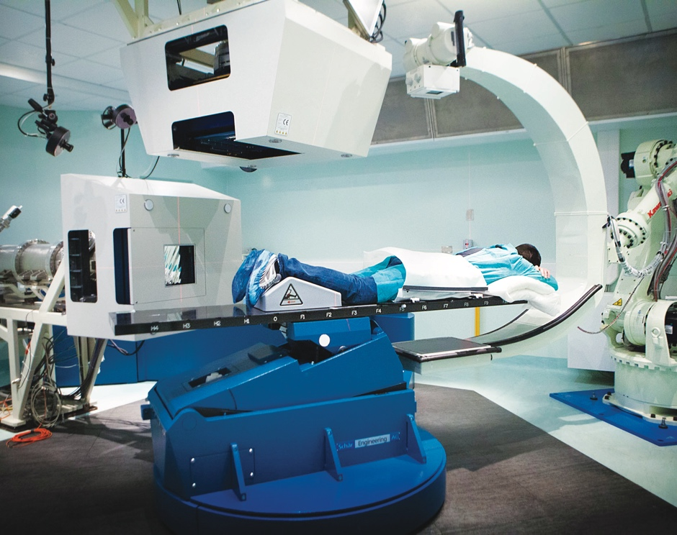
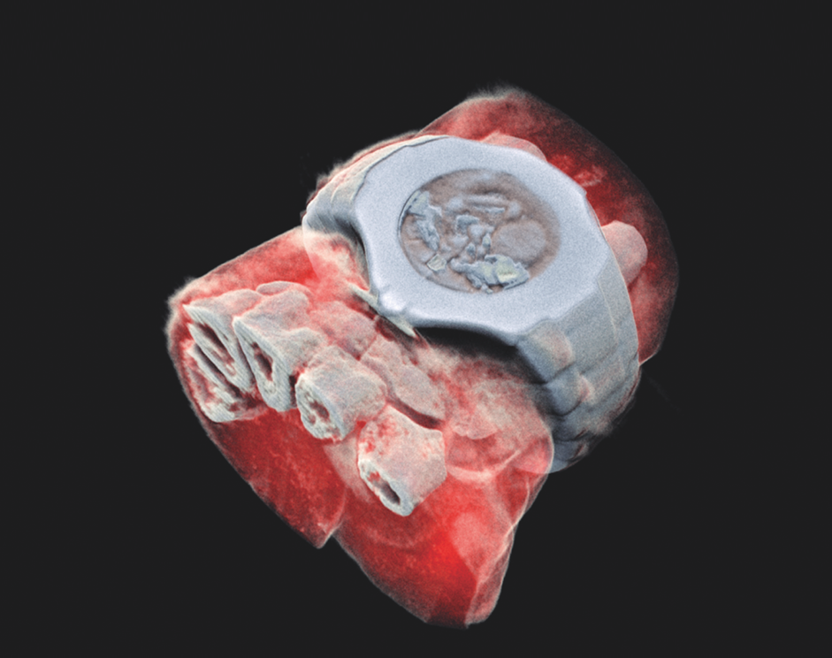
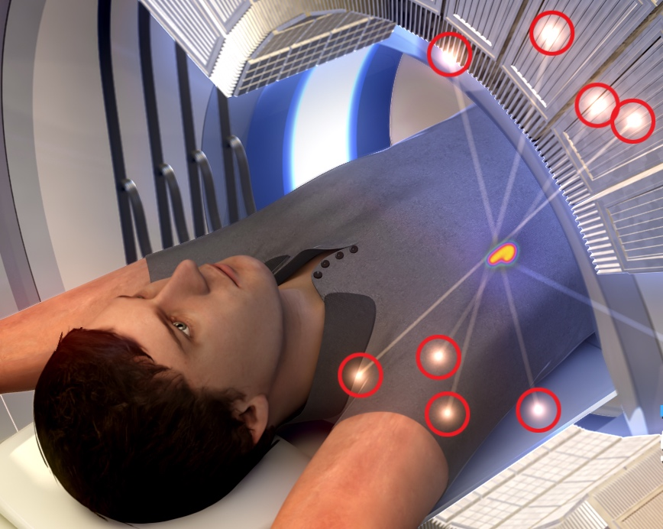
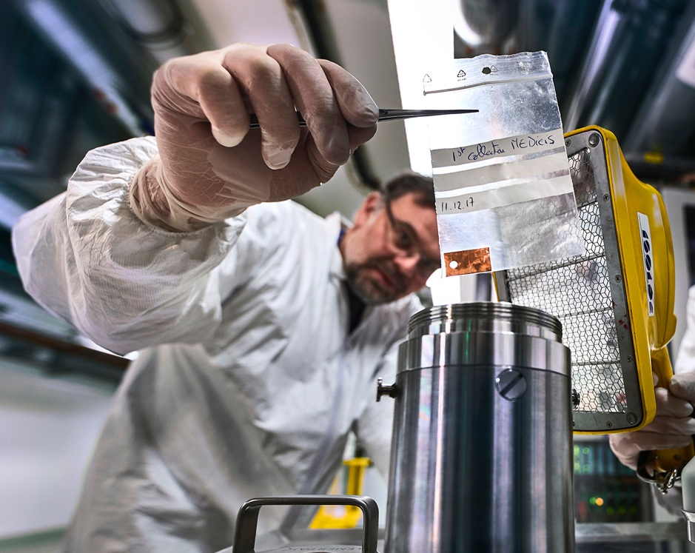
CERN’s technological innovations have important applications in medicine and healthcare
Technologies applied
at CERN are also used in PET, for medical imaging and diagnostics.
CERN produces innovative radioisotopes for nuclear medicine research.
© marsbioimaging
© CNAO
© ENVISION / ENLIGHT
Accelerator technologies are applied in cancer radiotherapy with protons, ions and electrons.
Pixel detector technologies are
used for high resolution
3D colour X-ray imaging.
Notes:
Background information (THE SPEAKER SHOULD NOT GO INTO THE DETAIL BELOW; THE INFORMATION IS PROVIDED AS SUPPORT FOR QUESTIONS AND, IF TIME PERMITS, TO ADD TO THE KEY INFROMATION ON THE SLIDE:
Cancer radiotherapy using protons and other ions instead of photons (used in conventional radiotherapy):
CERN has contributed to the birth of the proton- and carbon-ion treatment centres CNAO, in Italy, and MedAustron, in Austria, and continues to collaborate with them;
CERN also developed an RFQ technology now used by a company in an innovative linac for proton therapy (2021, system under test at STFC Daresbury);
CERN is now involved in the development of cutting-edge technologies for next-generation ion therapy facilities and of a facility for treating tumours with very high-energy electrons at ultra-high dose rates (FLASH therapy, with CHUV Lausanne)
Medical imaging:
CERN contributed to early developments in PET instrumentation (70s-80s);
Since 1995, the Crystal Clear collaboration has been engaged in the development of several organ-specific (breast, pancreas, prostate) and animal-dedicated PET scanner prototypes, and in pushing the limit of coincidence time resolution for time-of-flight (TOF) PET;
overall, the requirements of large-scale physics experiments often drive the mass production for specific equipment (e.g. the BGO crystals for the L3 detector at LEP), and make it possible for other applications to obtain the technology at a reasonable cost for e.g. building PET scanners.
New 3D colour X-rays of human extremities (2018) using CERN-developed Medipix 3 technology, by a start-up in New Zealand.
Nuclear medicine
CERN-MEDICIS (Medical Isotopes Collected from ISOLDE) is a one-of-a kind infrastructure designed to produce a new generation of non-conventional radioisotopes with potential applications in precision medicine and theranostics. Since December 2017, MEDICIS has been providing innovative radioisotopes to partner research institutes. MEDICIS aims to increase the range of radioisotopes available for biomedical research, thanks to its unique set-up that includes an irradiation station on a high energy proton beam and a radioisotope mass-separation beam-line.
THIS IS THE LAST SLIDE IN THE “TECHNOLOGY AND INNOVATION” SECTION

Slide 28
Thank you for your attention!

Slide 29
Backup

Slide 30
Overview CERN Scientific Programme
Following the 2020 Update of the European Strategy:
LHC and HL-LHC
  Detector operation in Run 3 (2022-2025)
  Phase II Upgrades ATLAS & CMS: installation in LS3 (2026-2028)
  R&D for Phase IIb Upgrade ALICE & LHCb: installation in LS4 (2033-2034)
Scientific diversity programme
  Operation of currently approved experiments
  High intensity Upgrade North Area (ECN3) during LS3
  Neutrino Platform: contribution to LBNF/DUNE infrastructure, DUNE R&D and construction
Preparation of next large project: FCC feasibility study
Detector R&D: following European Roadmap
Other activities: Computing, Quantum Technology Initiative

Slide 31
DUNE Far Detectors
  FD2 Vertical Drift
  80 Charge Readout Planes (CRPs) - 3 m x 3.4 m - on top and 80 on bottom
  Cathode in the middle, 6.5 m drift, -300 kV nominal
  CRP: perforated PCBs stuck with electrodes segmented
  Top CRPs readout with accessible electronics
  Bottom CRPs electronics in LAr including digitisation
  Field cage ensures uniform electric field
  PDs on the cryostat walls and on the cathode
FD1 Horizontal Drift
  25 rows of Anode Plane Assemblies (APAs): 6 m tall 2.3 m wide, 58 m long
  Two APAs on top of each other: 12 m tall
  APAs with three sets of wires winded around a SS frame
  Readout electronics in LAr including digitisation
  Drift of 3.5 m
  Cathode Plane Assembly (CPA) at -175 kV nominal voltage
  Photon Detector (PD) system embedded in the APA frames
Thanks to Wayne Salter

Slide 32
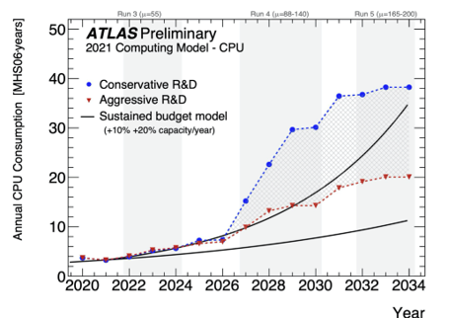
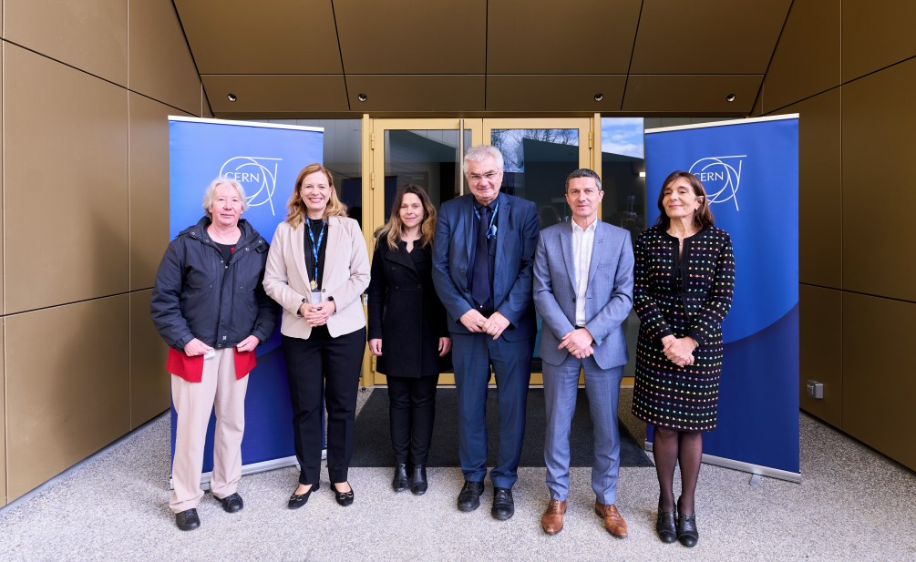
Computing for the HL-LHC
Example: ATLAS CPU estimates
Challenges for LHC computing:
Increased R&D on computing required to meet the HL-LHC computing needs at constant budget
  New Computer Centre at Prévessin:
  Phase I (4 MW) completed, expandable to 12 MW
  Very energy efficient (PUE = 1.1)
  Energy recovery to heat buildings on Prévessin site

