Slide 1
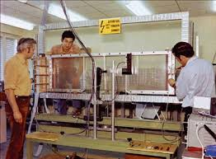
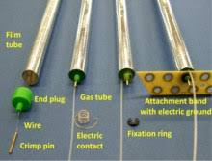
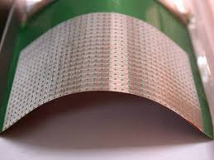
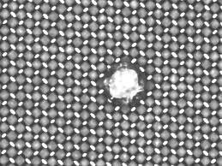
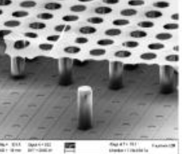
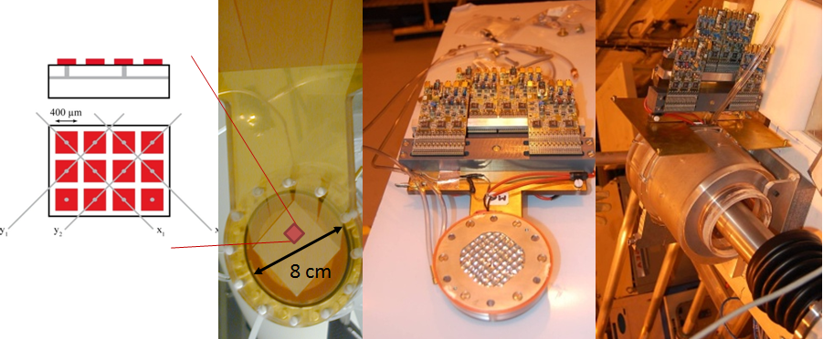
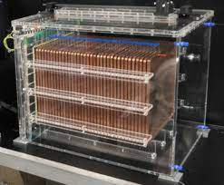
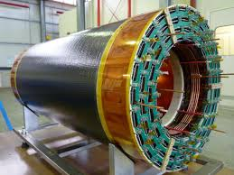
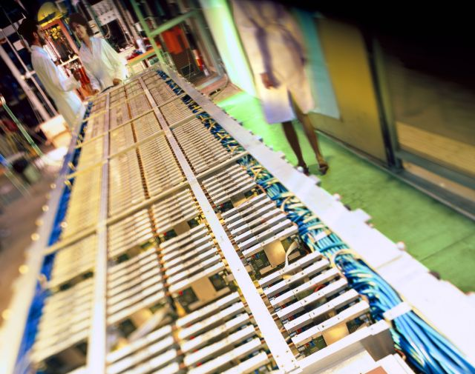
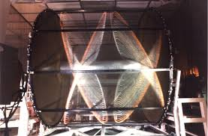
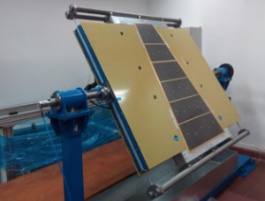
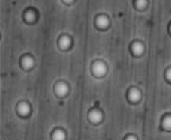
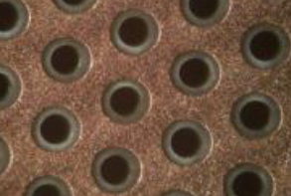
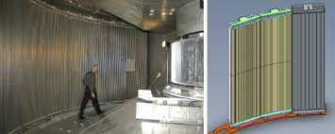
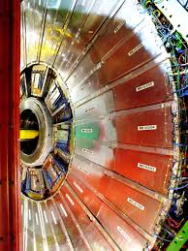
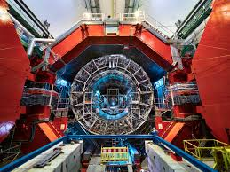
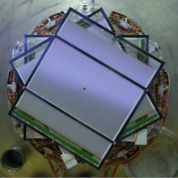
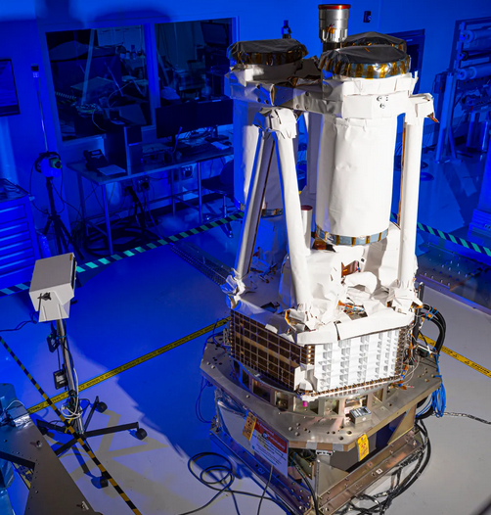
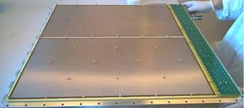
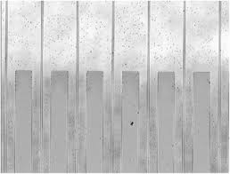
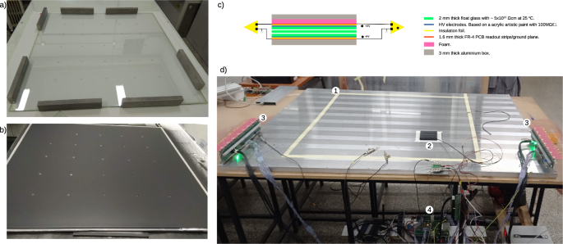
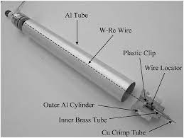
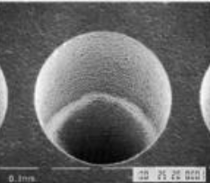
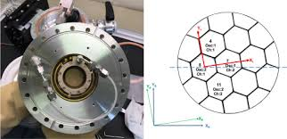
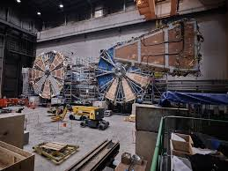
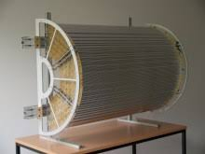
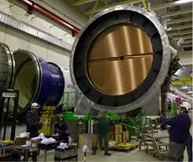
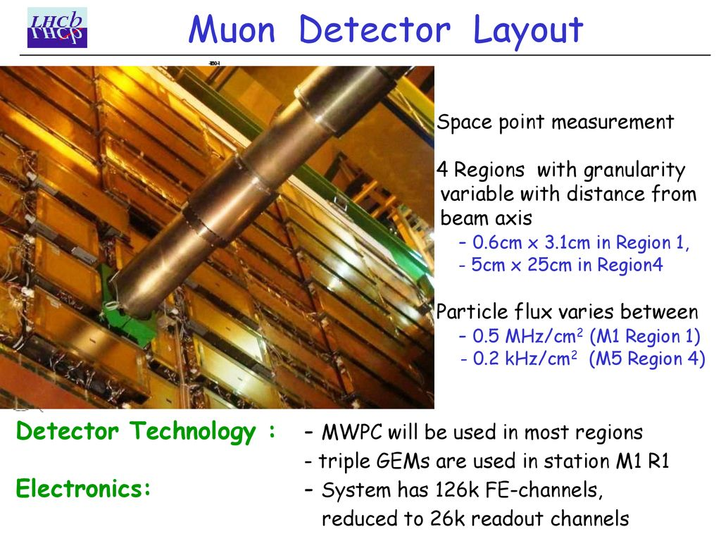
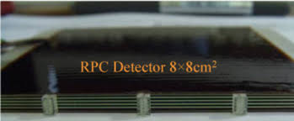
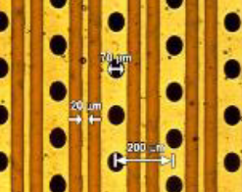
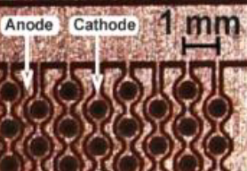
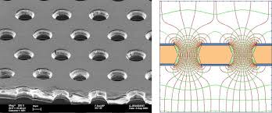
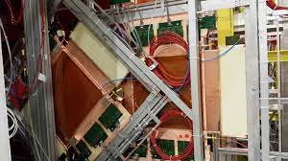
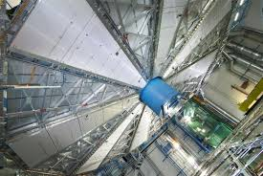
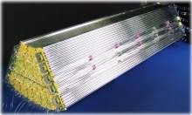
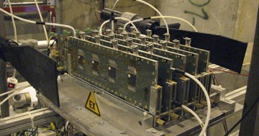
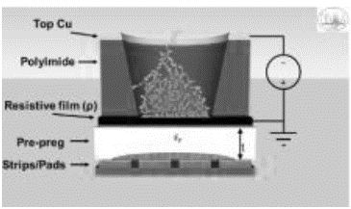
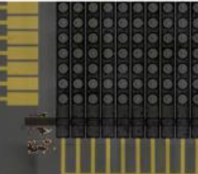
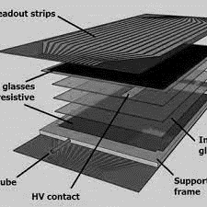
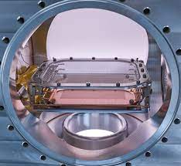
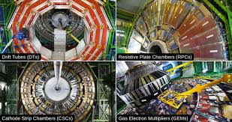
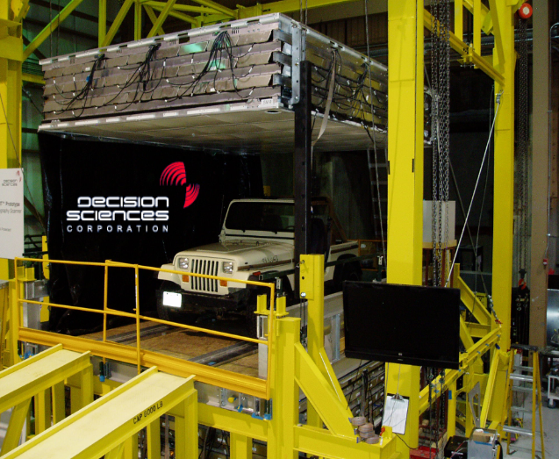
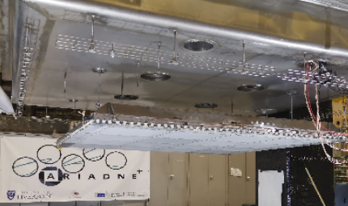
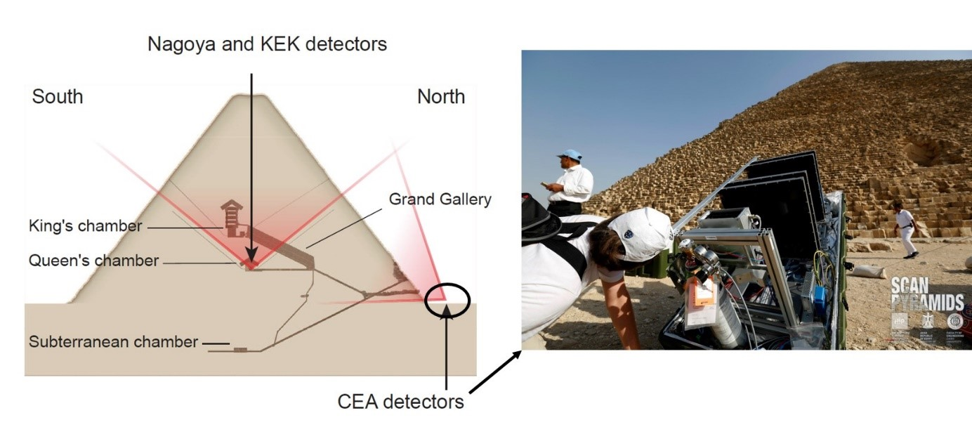
ECFA Detector R&D Roadmap
and CERN - DRD1 Collaboration
Maxim Titov, CEA Saclay, Irfu, France
CERN - Ukraine 2024: "Past - Present – Future" Conference,
Kyiv, Ukraine, May 28-29, 2024

Slide 2
P. Sphicas, ECFA Chair, CERN-UA Conference, May 28:
https://indico.cern.ch/event/1395415/contributions/5929907/attachments/2864969/5016019/2024-05-27-ECFA-Report-Ukraine.pdf

Slide 3
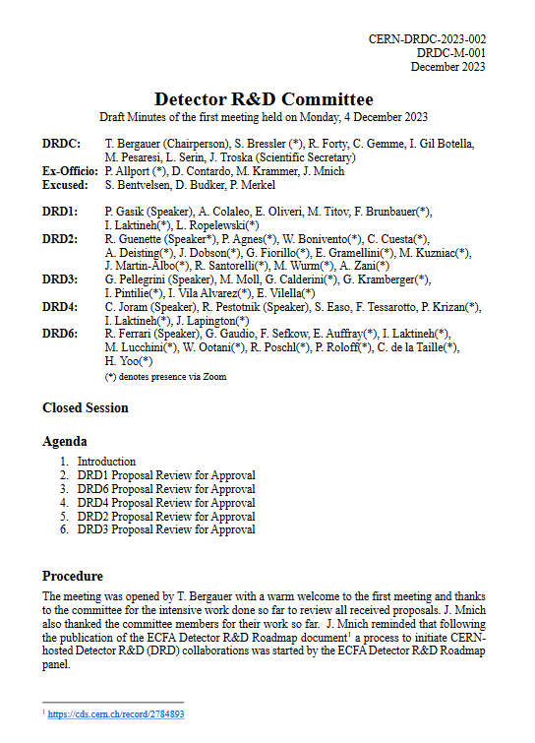
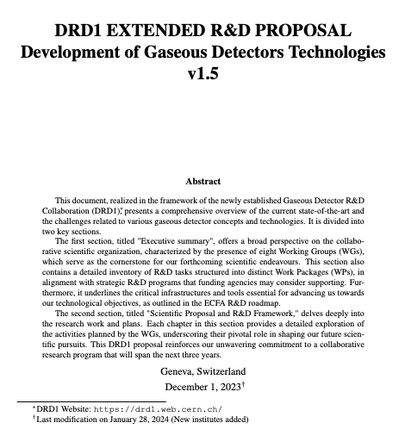
CERN RB approval & DRDC recommendation and guidelines in view of the first review and next steps
DRDC Meeting
(December 4, 20023)
CERN RB Approval (December 6, 2023)
DRD1 Proposal in CDS
(January 9, 2024)
Five proposals for new Detector R&D collaborations were recommended for approval by the DRDC: DRD1 (Gaseous detectors), DRD2 (Liquid detectors), DRD3 (Solid-state detectors), DRD4 (Photon detectors and particle identification), and DRD6 (Calorimetry). The Research Board approved DRD1, DRD2, DRD4 and DRD6 for an initial period of three years. The proposals for DRD4 and DRD6 can now be made public, while the final versions of those for DRD1 and DRD2 that had been provided very recently will be further reviewed by the DRDC in the coming weeks before being made public. The Research Board preliminarily approved DRD3 so that work towards establishing the collaboration can progress, on condition that the new collaboration structure be established in a timely fashion following the guidelines provided by the DRDC, and the new management appointed; approval of DRD3 will be reviewed at the next Research Board meeting in March 2024, on the basis of an updated proposal.
(116 pages)
DRDC Minutes: https://cds.cern.ch/record/2883179?ln=en
https://cds.cern.ch/record/2885937

Slide 4
Overview of DRD Collaborations in Europe
T. Bergauer, DRDC Chair, 2024 Elba Conference: https://agenda.infn.it/event/37033/contributions/229217/attachments/120206/174770/2024-05-27_PM2024_Bergauer_DRD-collaborations_v3.pdf

Slide 5
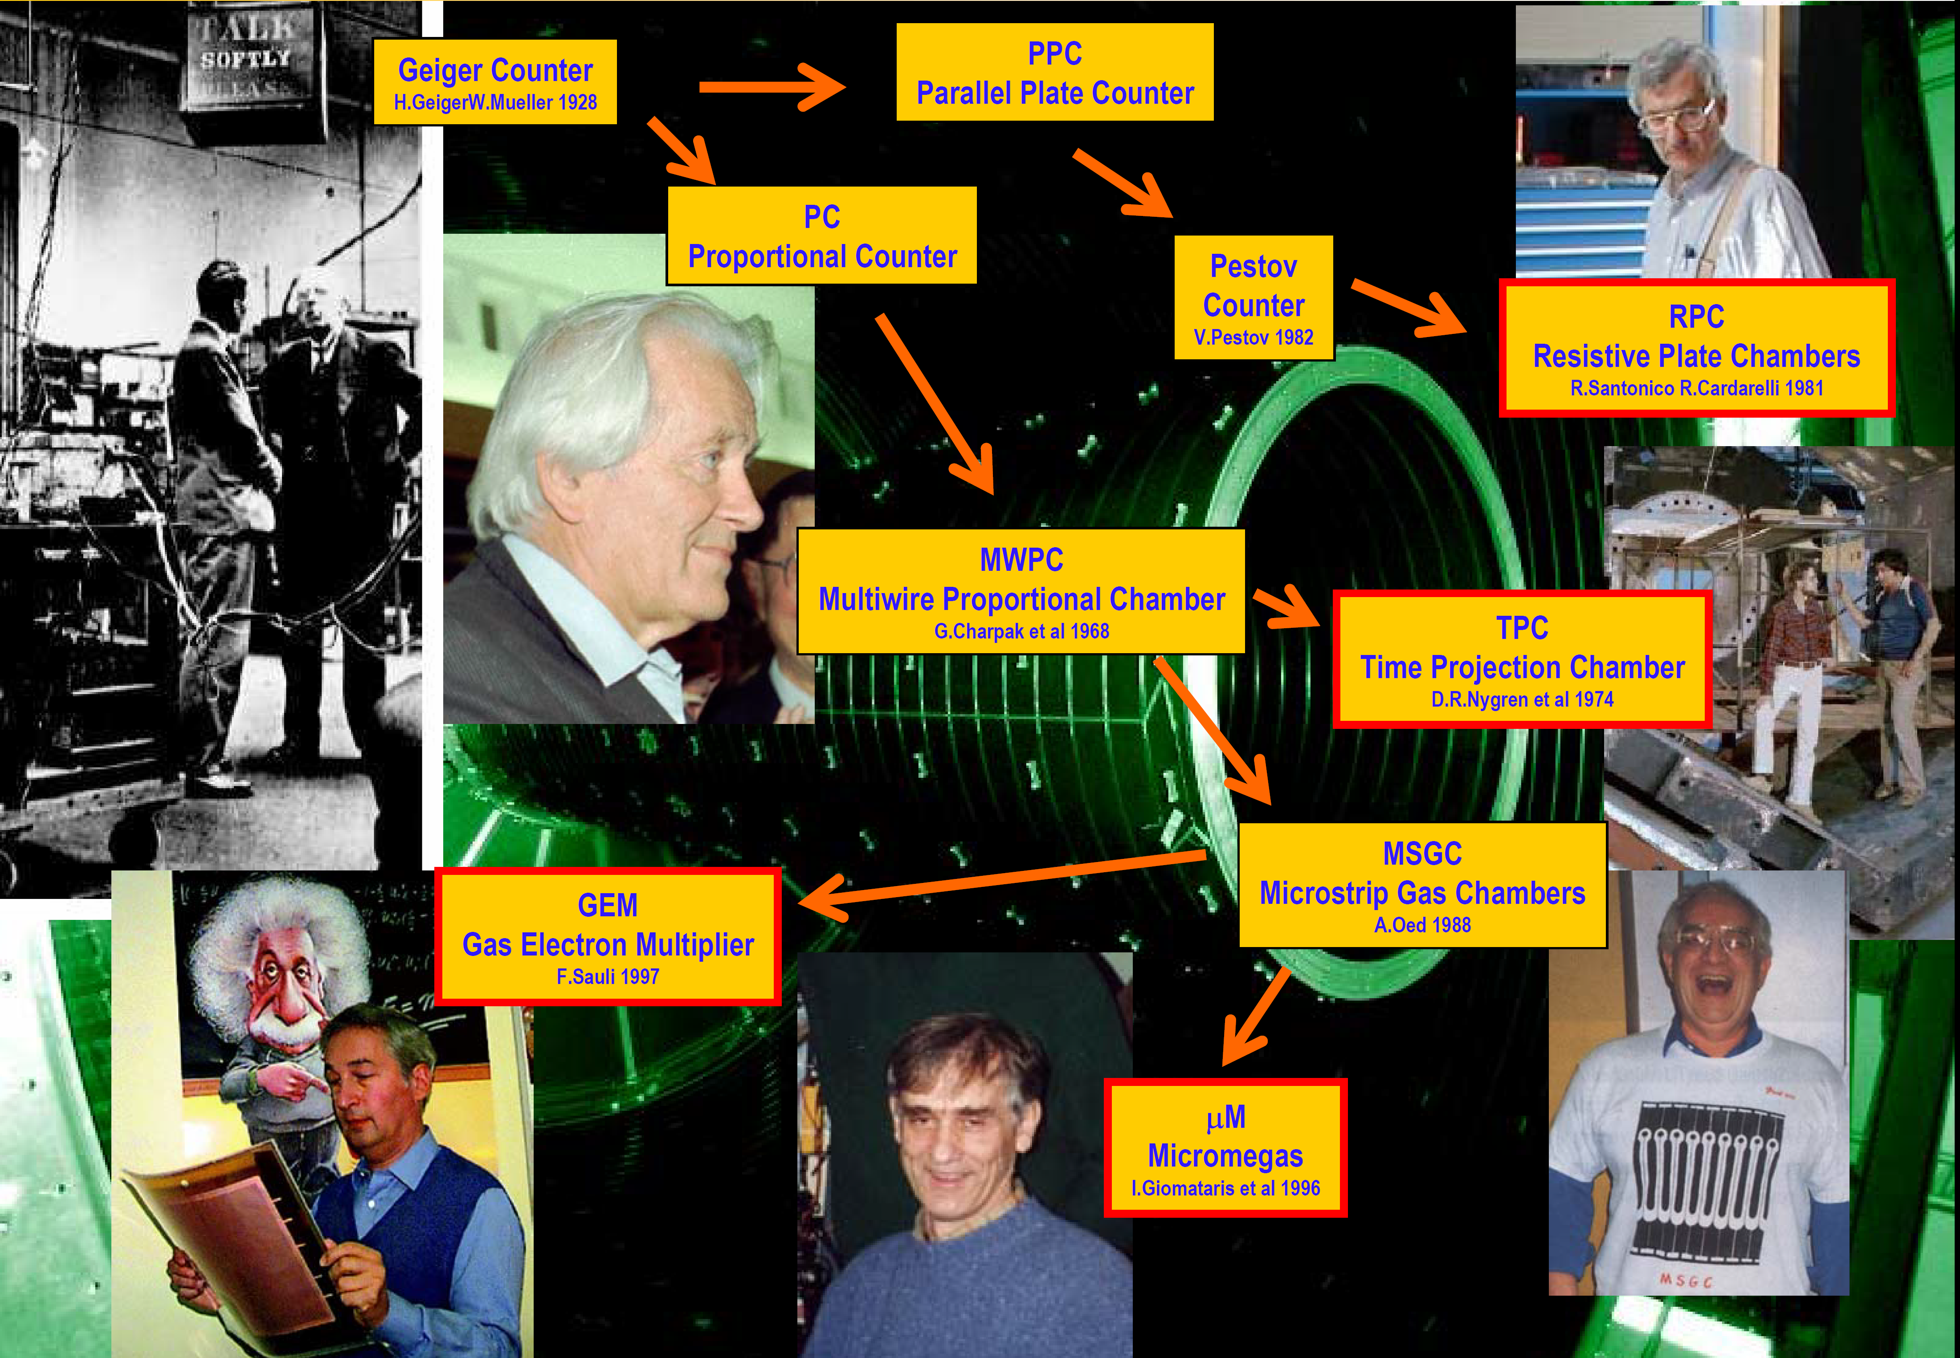
Gas-Based Detectors: A Brief History

Slide 6
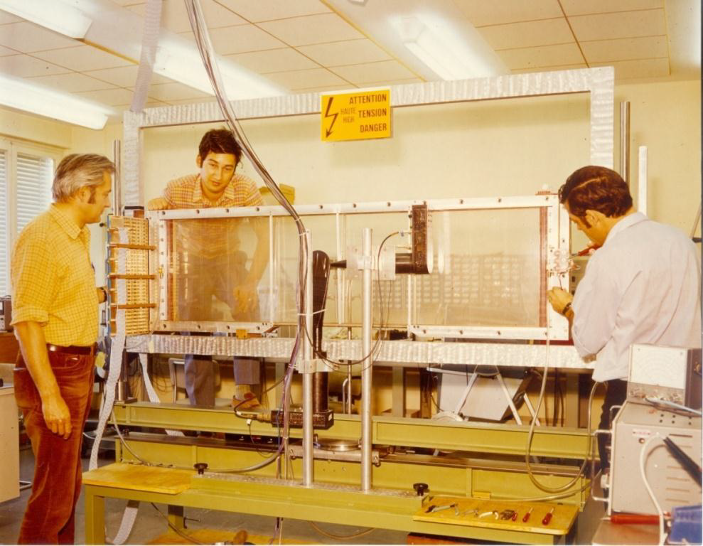
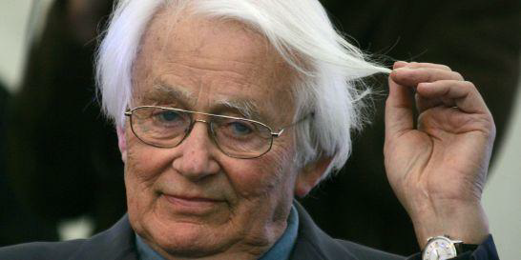

1968: MWPC – Revolutionising the Way Particle Physics is Done
Before MWPC: Detecting particles was a mainly a manual, tedious and labour intensive job – unsuited for rare particle decays
1968: George Charpak developed the MultiWire Proportional Chamber,
(MWPC), which revolutionized particle detection & HEP,
and marked transition
from Manual to Electronics era
G. Charpak, F. Sauli and J.C. Santiard
1992:
“Image” & “Logic (electronics)” tradition combined into the “Electronics Image” detectors during the 1970ies

Slide 7
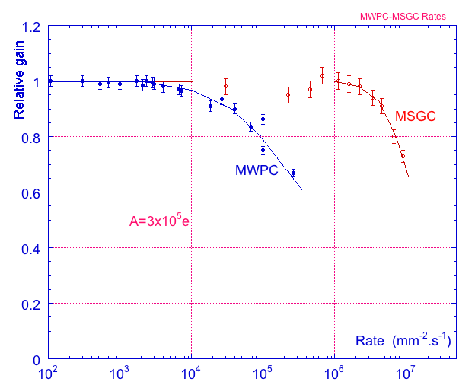
Gaseous Detectors: From Wire/Drift Chamber → Time Projection Chamber (TPC) → Micro-Pattern Gas Detectors
Primary choice for large-area coverage with low material-budget (+ dE/dx measurement)
1990’s: Industrial advances in photolithography has favoured the invention of novel micro-structured gas amplification devices (MSGC, GEM, Micromegas, …)
Rate Capability:
MWPC vs MSGC
Examples of Gaseous Detectors for Future Colliders:
HL-LHC Upgrades: Tracking (ALICE TPC/MPGD); Muon Systems: RPC, CSC, MDT, TGC, GEM, Micromegas;
Future Hadron Colliders: FCC-hh Muon System (MPGD - OK, rates are comparable with HL-LHC)
Future Lepton Colliders: Tracking (FCC-ee / CepC - Drift Chambers; ILC / CePC - TPC with MPGD readout)
Calorimetry (ILC, CepC – RPC or MPGD), Muon Systems (OK)
Future Election-Ion Collider: Tracking (GEM, μWELL; TPC/MPGD), RICH (THGEM), TRD (GEM)

Slide 8

Legacy of the CERN-RD51 Collaboration: 2008-2023
RD51 CERN-based “TECHNOLOGY - DRIVEN R&D COLLABORATION” was
established to advance MPGD concepts and associated electronics readout systems
RD51 community: ~ 90 institutes, 500 members
2018:
2008:
RD51 Spokespersons:
L. Ropelewski (2008-2022)
M. Titov (2008-2015, 2023)
S. Dalla Torre (2016-2022)
E. Oliveri (2023)
arXiv:1806.09955
Many of the MPGD Technologies were introduced before the RD51 was founded
With more techniques becoming available, new detection concepts were introduced and the existing ones were substantially improved during the RD51 period (2008-2023)
Beyond 2023, RD51 served as a nuclei for the new DRD1 (“all gas detectors”) collaboration, anchored at CERN, as part of the ECFA Detector R&D Roadmap

Slide 9




Legacy of the CERN-RD51 Collaboration:“RD51” Model
The success of the RD51 is related to the “RD51 model” inperforming R&D: combination of generic and focused R&D with bottom-up decision processes, full sharing of experience, “know-how”, and common infrastructure, which allows to build community with continuity and institutional memory and enhances the training of younger generation instrumentalists.
Community and Expertize
(RD51 Scientific Network)
RD51:
3 MAJOR
ASSETS
MPGD Technology Development
& Dissemination
CERN Courier (5 pages) Volume, October 2015
R&D Tools, Facilities and Infrastructure
https://rd51-public.web.cern.ch/

Slide 10



CERN Detector Seminars in 2022: LS2 Upgrades
Major MPGDs developments for ATLAS, CMS, ALICE upgrades, towards establishing technology goals and technical requirements, and addressing engineering and integration challenges … and first results from Run 3 !!!
"The New Small Wheel project of ATLAS"
by Theodoros Vafeiadis (17 Jun 2022)
https://indico.cern.ch/event/1168778/
"Continuous data taking with the upgraded ALICE
GEM-TPC"
by Robert Helmut Munzer (24 Jun 2022),
https://indico.cern.ch/event/1172978/
"The GEM detectors within the CMS Experiment"
Michele Bianco (08 Jul 2022)
https://indico.cern.ch/event/1175363/
All three major LHC upgrades, incorporating MPGDs,
started their R&D in close contact with RD51, using
dedicated setups at GDD-RD51 Laboratory

Slide 11

Gaseous Detectors: DRD1 Successor and Extension of RD51

Slide 12



DRD1 Collaboration: Large & Diversified Community
161 Institutes
5 Industrial, Semi-Industrial and Research Foundations
33 Countries
More than 700 members

Slide 13

Steps Towards Long-Term Detector R&D Program

Slide 14

Gaseous Detector R&D: Common Issues
Despite the different R&D requirements, there is potential for overlapping in many aspects, allowing for a larger community of gaseous detectors to benefit. The most straightforward example is the classic ageing issues, but many others can be mentioned:
MPGD- the main challenges remain large areas, high rates, precise timing capabilities, and stable discharge-free operation
RPC - focus stays on improving high-rate and precise timing capabilities, uniform detector response, and mechanical compactness.
Straw tubes- requirements include extended length and smaller diameter, low material budget, and operation in a highly challenging radiation environment.
Large-volume Drift chamber with a reduced material budget in a high-rate environment requires searching for new materials. Avalanche-induced Ion Back Flow (IBF) remains the primary challenge for TPC applications in future facilities.

Slide 15


DRD1 Scientific Organization
ECFA Detector R&D Roadmap and General Recommendations are addressed with a scientific organization based on:
  R&D Framework & Working Groups (RD51 Legacy) → Distributed R&D Activities with Centralized Facilities.
  Work Packages → Strategic R&D and Long -Term Funding (Funding Agency)

Slide 16

DRD1 Organization and Management
Approved during the Collaboration Board with Consensus
DRD1 spokespersons and CB chair candidates, CV, statements and open presentations: https://indico.cern.ch/event/1352912/
Wide consolations and nominations from whole community (about 160 institutes)
Election procedure discussed & approved by the DRD1 Implementation Team and DRD1 CB
About 110 instates casted votes:
COLLABORATION BOARD
RESOURCE BOARD
MANAGEMENT BOARD
Elections Results (2024 -2025)
2 Spokespersons: Eraldo Oliveri, Maxim Titov
CB Chair: Anna Colaleo
DRD1 implementation and organization: Community Driven with key role played by the Implementation Team (about 50 persons)
DRD1 Management Elections and Organization approved by CB. All roles will be approved by DRD1 Meting in June 2024
DRD1 Activities started
Prompt actions required to preserve and enhance the current momentum in the community
SPOKESPERSONS
SCIENTIFIC COORDINATION BOARD
(Working Groups, Work Packages, DRDs Liaisons, Common Projects
Simlar to the RD51 Structure + SCB

Slide 17

DRD1 Collaboration & Future Events: JOIN US !!!
1st DRD Collaboration Meeting Agenda (Jan. 29 – Feb. 2)
1st Collaboration Meeting
Jan. 29-Feb. 2 (CERN):
https://indico.cern.ch/event/1360282/
2nd Collaboration Meeting
June 17-21 (CERN):
https://indico.cern.ch/event/1413681/
3rd Collaboration Meeting
December 9-13 (CERN)
More information on DRD1- related issues:
- Symposium of Task Force 1: https://indico.cern.ch/event/999799/
- ECFA Detector R&D Roadmap (chapter 1): https://cds.cern.ch/record/2784893
- DRD1 Proposal: https://cds.cern.ch/record/2885937
- DRD1 Website: https://drd1.web.cern.ch/
- Working Groups: https://drd1.web.cern.ch/working-groups
- Work Packages: https://drd1.web.cern.ch/wp
2024 Gaseous Detector Conferences & Schools:
RPC2024 Conference, Santiago, 9-13 September: https://indico.cern.ch/event/1354736
MPGD2024 Conference, Hefei, 14-18 October: https://mpgd2024.aconf.org
DRD1 Gaseous Detector School, Nov. 27 – Dec. 6: https://indico.cern.ch/e/drd1school2024

