Slide 2

Ukraine:
A CERN associate member state since 2016
Prof. Dr. Christoph Schäfer
CERN International Relations

Slide 3
Solidarity with Ukraine
CERN management and CERN council are continuning to support Ukraine in these difficult times of Russian agression
  UA contributions payed by member states
  Special training and remote programme for UA students
  Task Force visit postponed to after the war

Slide 4
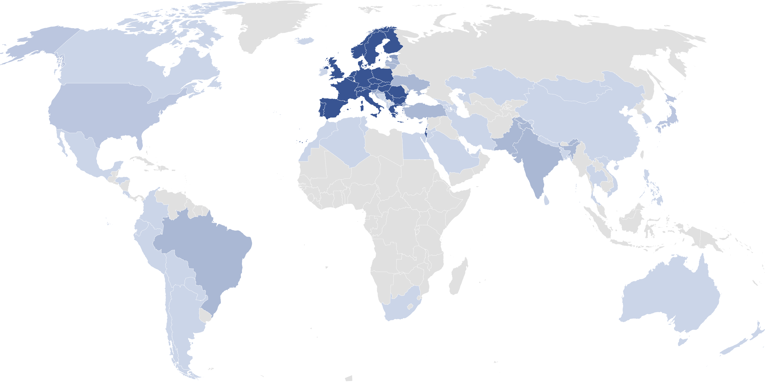
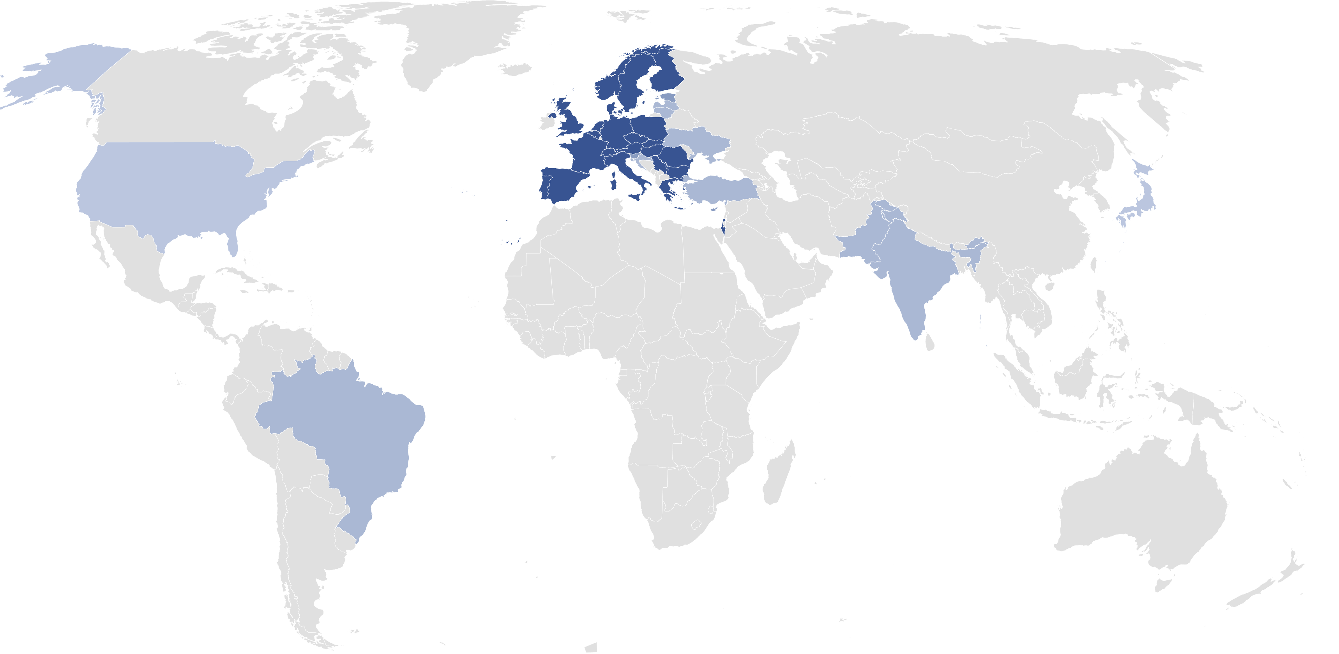
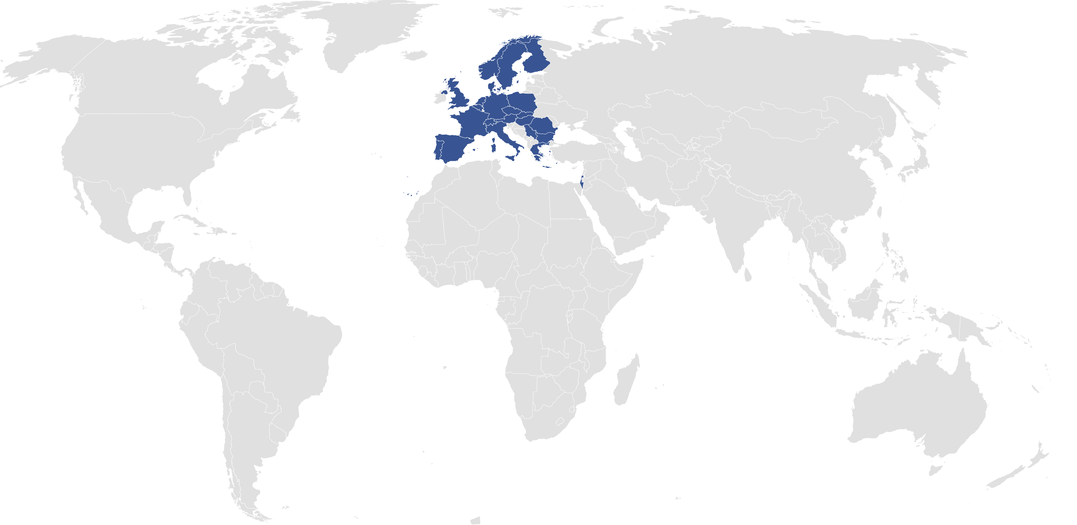

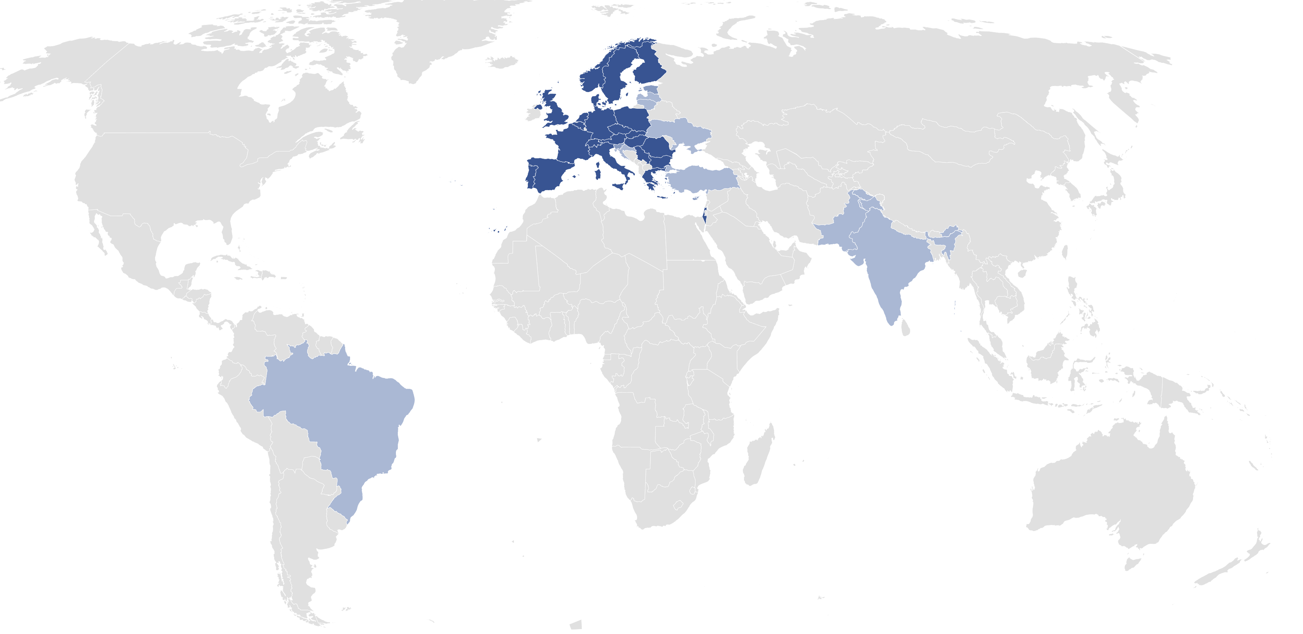
CERN: a world wide collaboration
23 member states
3 associate memberstates in
pre-stage to membership
8 associate member states
2 observer states
46 international co-operation
agreements
4

Slide 5
Associate Member State
For only 10% of the contribution compared to a full member you get:
Full access to all CERN infrastructure
Eligible for all CERN recruitment positions
Open to the full industrial procurement process
Participation in CERN council sessions

Slide 6
What you do not get:
No voting right in council and no attendance in closed CERN council sessions
No permanent CERN staff positions (max. 8 years)
Procurment and personnel return capped to the ammount of contributions as associate member

Slide 7
Ukrainian Contributions to CERN Budget
Current annual contributions are about 1 MCHF (payed by the member states since the war)
Contributions as a full member would be around 8.2 MCHF

Slide 8
Experience of Ukraine beeing associate member since 2016
Ukraine is doing very well - congratulations!
132 Ukrainians working at CERN
  4 Staff (x2 more than contributions)
  5 Fellows (x6 more than contributions)
HR return exceeds contributions
Industrial return is limited by contributions

Slide 9
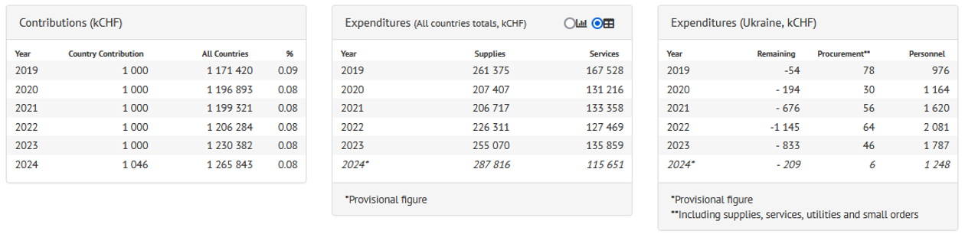
Procurement Numbers
Three Observations:
return exceeds contributions by far (up to a factor of two!)
return is dominated by personnel expenditures
procurement return severly limited by the cap

Slide 10
What next?
Capped industrial return is an issue
Constantly exceeding the return over contributions is an issue (For now CERN council is accepting this exception because of the war)
Issues arise because of overperformance of Ukraine!

Slide 11
What next?
Ukraine as a full member would solve these issues but:
  significant increase of contributions
  and the CERN contributions should ideally match the expenditures for particle physics in the country (that is CERN’s experience)

