Slide 1
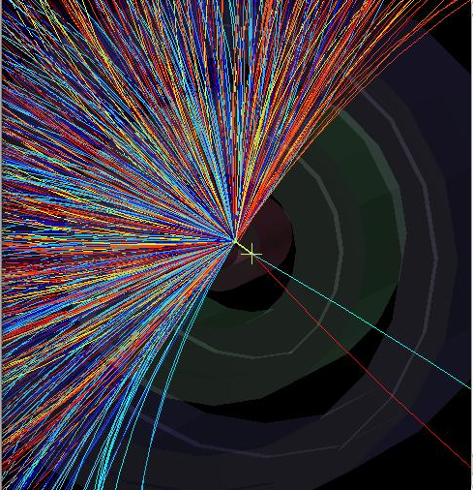
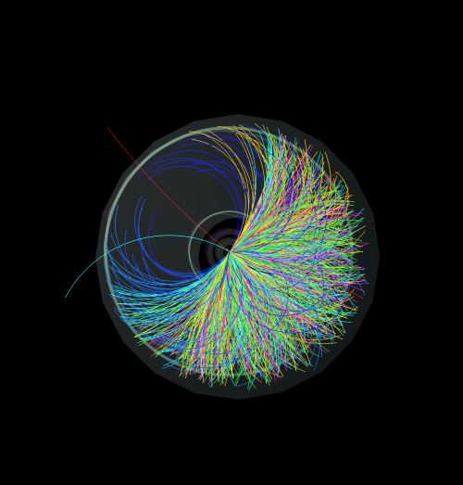
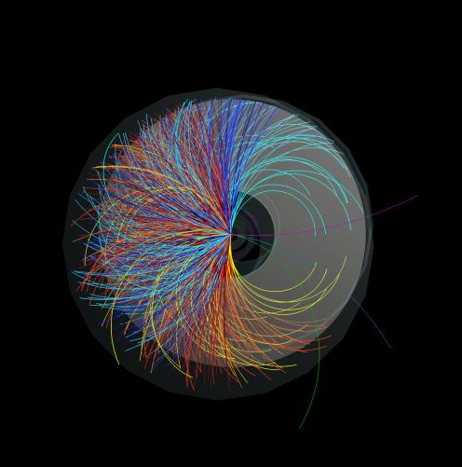
Looking for strange particles in ALICE
K⁰_{s}→ π⁺π⁻
Λ →π⁻p
Ξ⁻→π⁻Λ→ π⁻ p π⁻

Slide 2
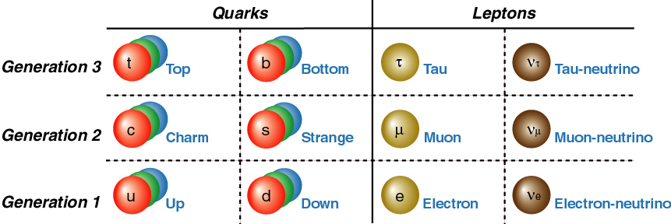
Today’s periodic system of the fundamental building blocks

Slide 3
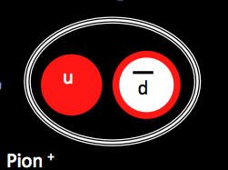
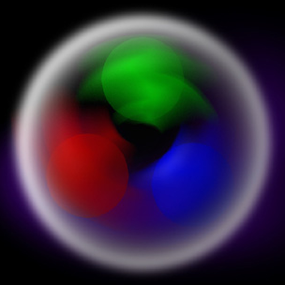
What are strange particles ?
meson baryon
s
K⁰_{s}
Λ
_ _
ds, ds
uds
hadrons (baryons or mesons) containing at least one strange (s) quark
Notes:
Strange particles are hadrons – composite particle smade of quarks

Slide 4
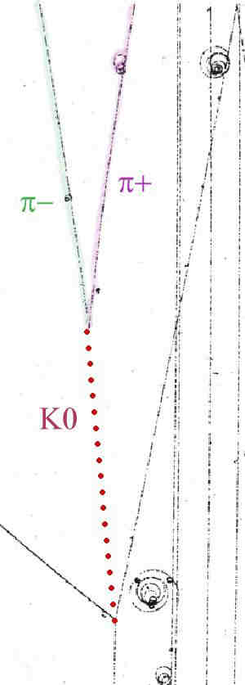
We will be looking for neutral strange particles, which travel some distance (mm or cm) from the point of production (collision point) before they decay into two oppositely charged particles
τ = 0.89 x10⁻¹⁰ s
cτ = 3x10¹⁰ cm s⁻¹ x8.9x10⁻¹¹ s
2.67 cm from the point of interaction
τ = 2.6 x10⁻¹⁰ s
cτ = 3x10¹⁰ cm s⁻¹ x2.6x10⁻¹⁰ s
7.2 cm distance from the point of interaction
K⁰_{s} → π⁺π⁻
→ π⁻p
_ _
Λ → π⁺p
Weak decays : strangeness is not conserved

Slide 5
How do we find V0s ?
K⁰_{s}→ π⁺π⁻
Λ →π⁻p
We look for two opposite tracks, having the same origin, which is not the interaction (collision) point

Slide 6
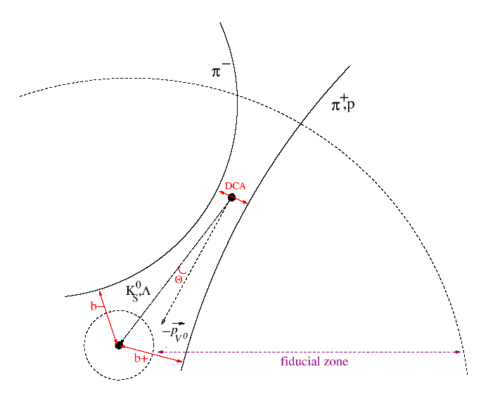
How do we find V0s ?
We look for two opposite tracks, having the same origin, which is not the interaction (collision) point

Slide 7
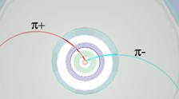
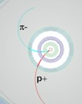
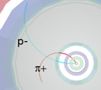

How do we identify each V0?
K⁰_{s} → π⁺π⁻
Λ → π⁻p⁺
anti Λ→ p⁻π⁺
P = Q.B.R
P momentum
Q electric charge
B magnetic field
R radius of curvature
V0 decay :
a neutral particle (no track) gives suddenly two tracks
Identify V0s from the decay topology

Slide 8
How do we identify each V0?
Calculate the (invariant) mass
Energy conservation E = E₁+E₂
Momentum conservation p = p₁+p₂
Total energy E² = p²c² + m²c⁴
c=1 E² = p² + m²
E = E₁+E₂ E₁² = p₁² + m₁² E₂² = p₂² + m₂²
E² = p² + m² m² = E² - p² =(E₁+E₂)² -(p₁+p₂)² = m₁² + m₂² +2E₁E₂ - 2 p₁ .p₂
Calculate the mass of the initial particle from the values of the mass and the momentum of the final particles
Particle Identification (done by a number of PID detectors) m₁ m₂
Radius of curvature of the particle tracks due to magnetic field p₁ p₂
P=Q.B.R (P momentum, Q electric charge, R radius of curvature, B magnetic field)

Slide 9
Strangeness enhancement in lead-lead collisions
Analysis of large event samples from lead collisions
Find number of K_{s}, Λ, anti-Λ
Calculate particle yields
Calculate strangeness enhancement taking into account particle yields in proton collisions

Slide 10
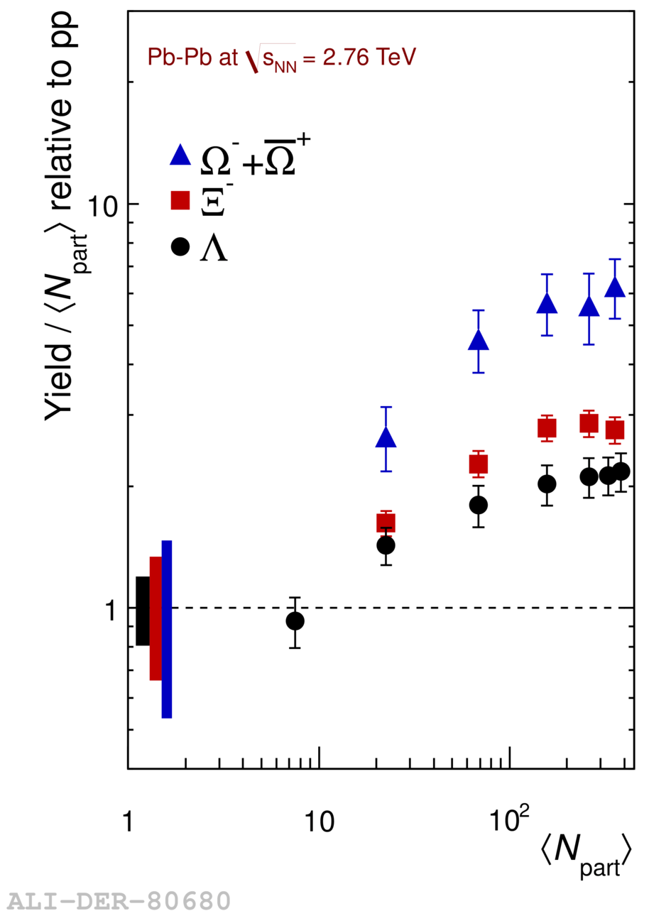
Strangeness enhancement : one of the first signals of QGP
Enhancement increases with number of strange quarks in the hadron (Ω has 3, Ξ has 2, Λ has 1)
Particle yield for Pb-Pb collisions/ the number of participants
-------------------------------------------------------------------------------------------------------Particle yield for proton-proton collisions / 2

Slide 11
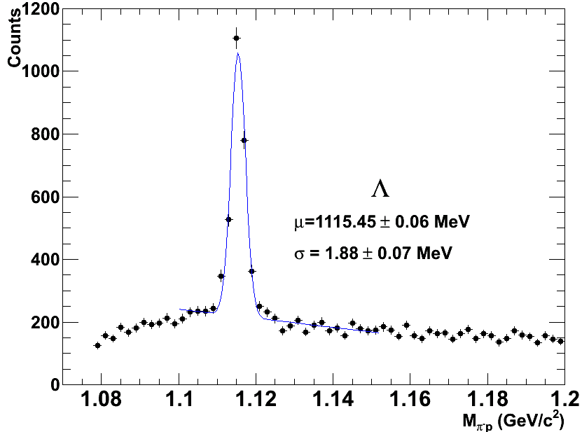
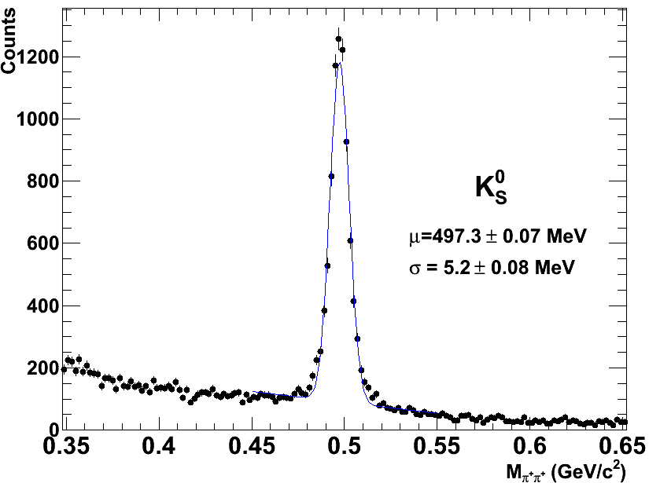
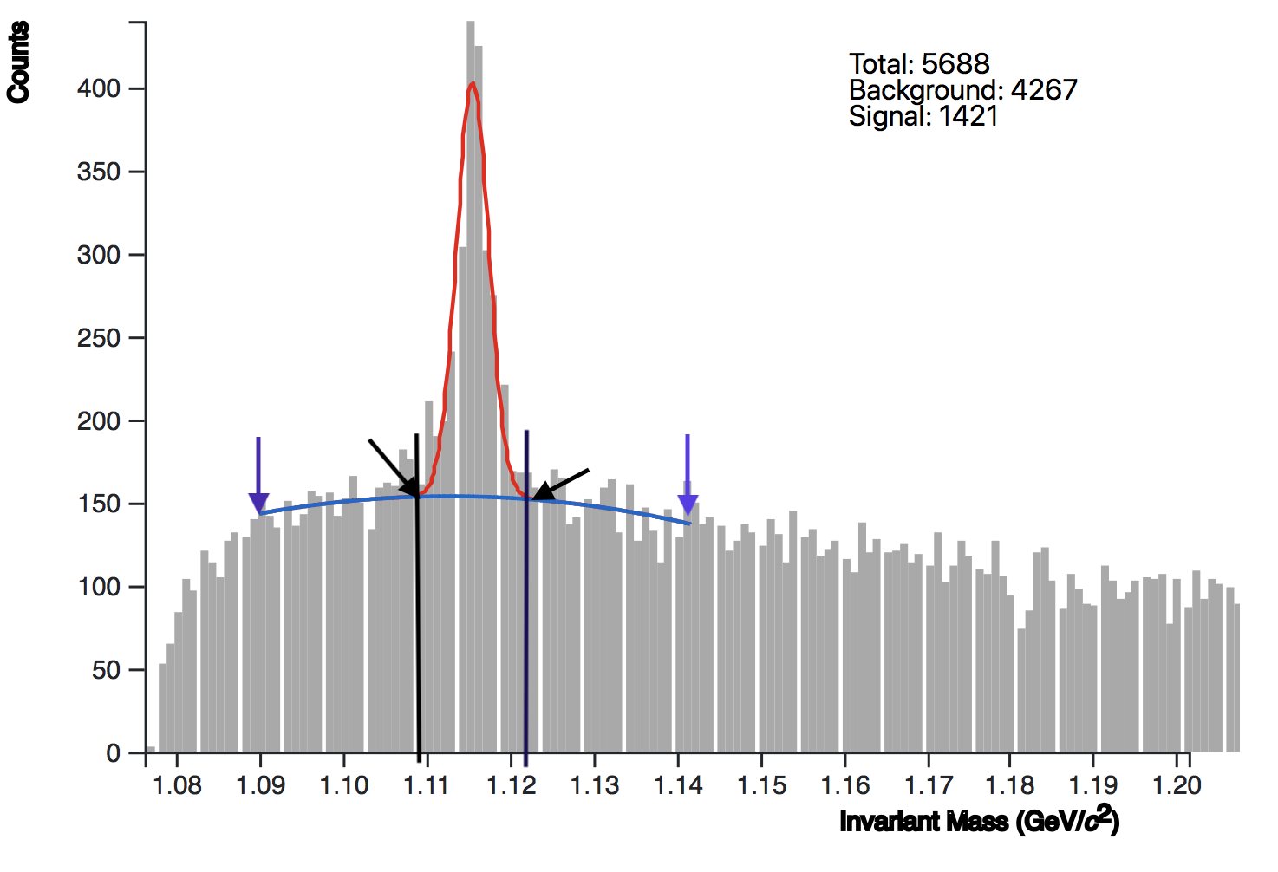
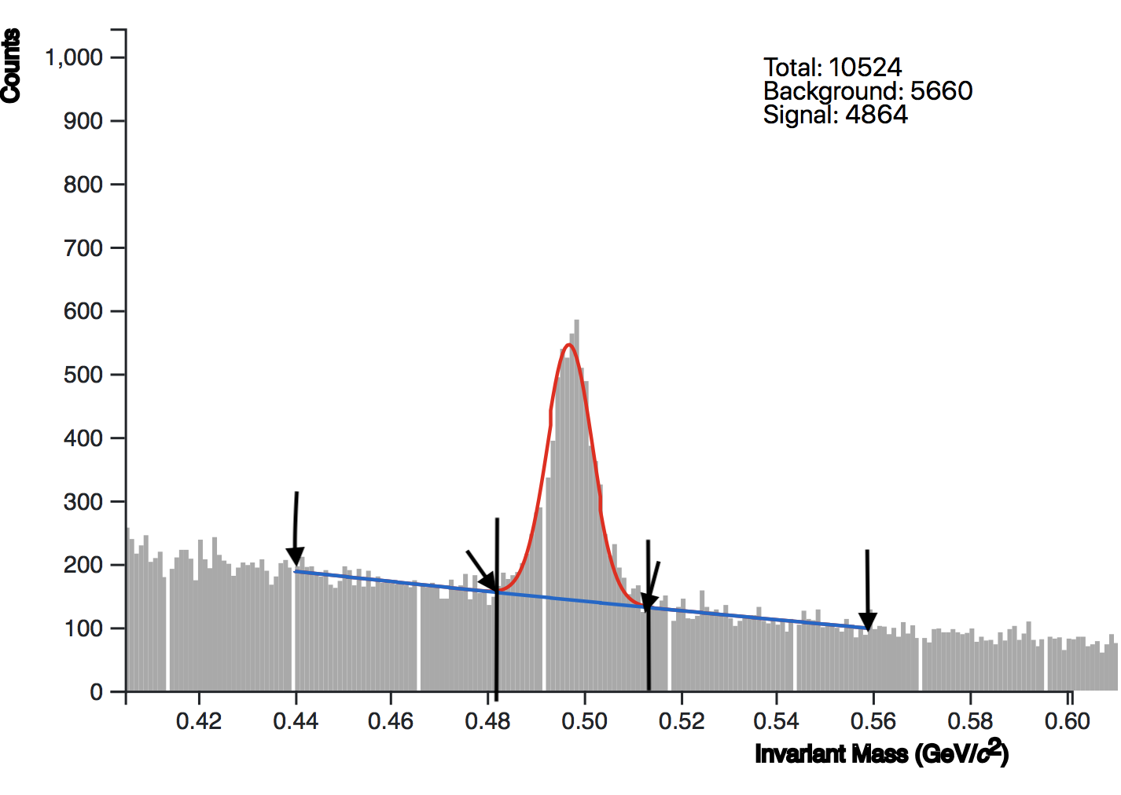
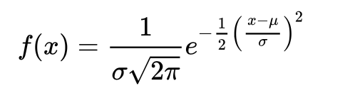
Fit functions describing the invariant mass distributions
Λ → πp
K⁰_{s} → ππ
PDG: 1115.7 MeV
PDG: 497.6 MeV
2nd degree polynomial for the background f(x) = ax²+bx+c
Gaussian for the peak
Find the number of K_{s}, Λ, anti-Λ after subtraction of the background

Slide 12
Geometry of a Pb-Pb collision
Peripheral collision
  Large distance between the centres of the nuclei
  Small number of participants
  Few charged particles produced (low multiplicity)
Central collision
  Small distance between the centres of the nuclei
  Large number of participants
  Many charged particles produced (high multiplicity)

Slide 13
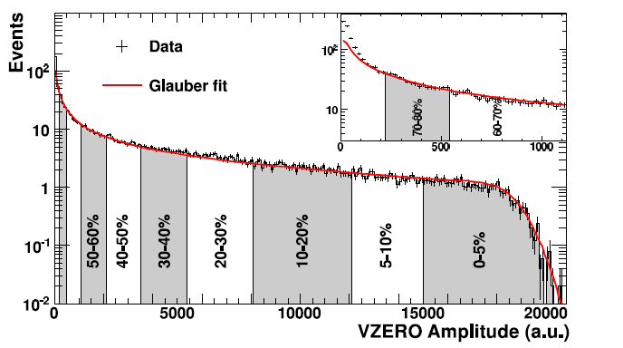
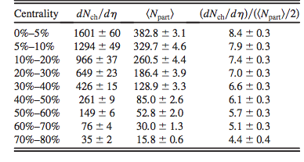
Centrality of Pb-Pb collisions
Distribution of the signal amplitude of V0 (plastic scintillators )
red line : described by model (Glauber)
peripheral
collisions
central
collisions

Slide 14
Strangeness enhancement calculation
Yield : number of particles produced per interaction = Nparticles(produced)/Nevents
Efficiency = Nparticles(measured)/Nparticles(produced)*
Yield = Nparticles(measured)/(efficiency x Nevents)
K_{s}-Yield (pp) = 0.25 /interaction ; Λ-Yield(pp) = 0.0617 /interaction ; <N_{part}> = 2 for pp
Strangeness enhancement: the particle yield normalised by the number of participating nucleons in the collision, and divided by the yield in proton-proton collisions**
*assumption on efficiency values : to match yields in Analysis Note
Measurement of Ks and Λ spectra and yields in Pb–Pb collisions at √sNN=2.76 TeV with the ALICE experiment
*pp yields at 2.76 TeV from interpolation between 900 GeV and 7 TeV
Analysis Note “Ks, Λ and antiΛ production in pp collisions at 7 TeV”

