Slide 1
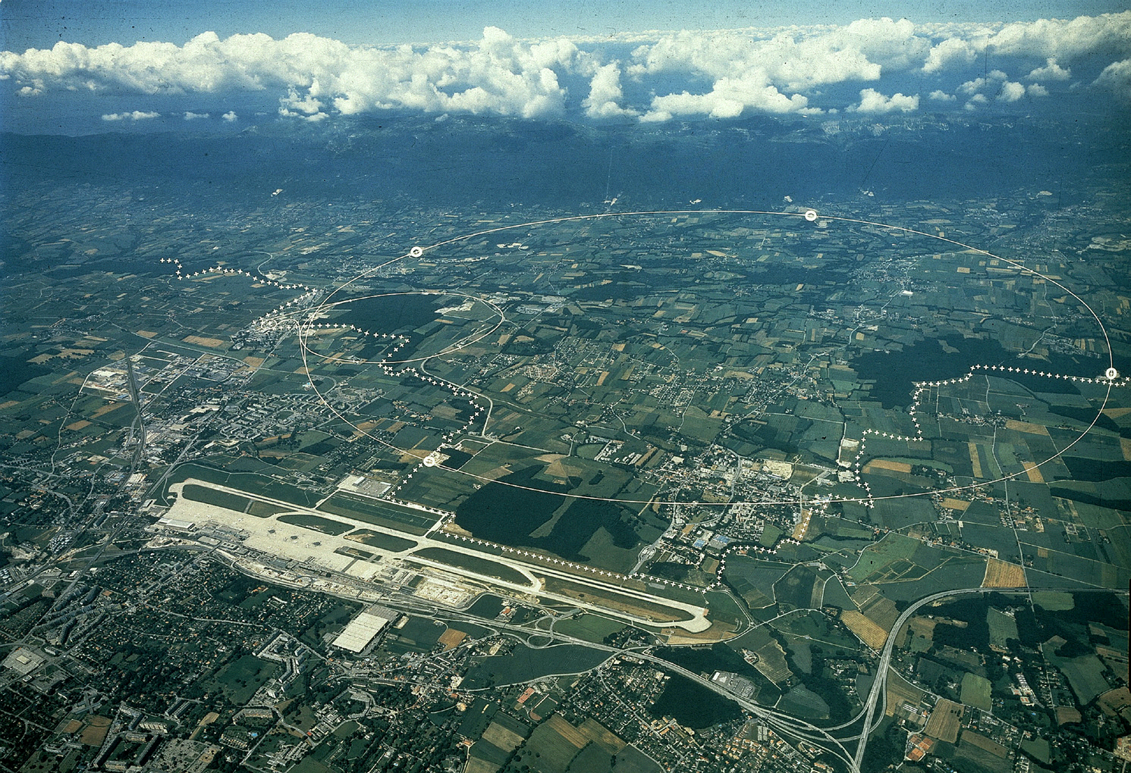
CERN accelerators
CERN 2nd site
SPS accelerator
CERN main site
Geneva Airport
LHC accelerator

Slide 2
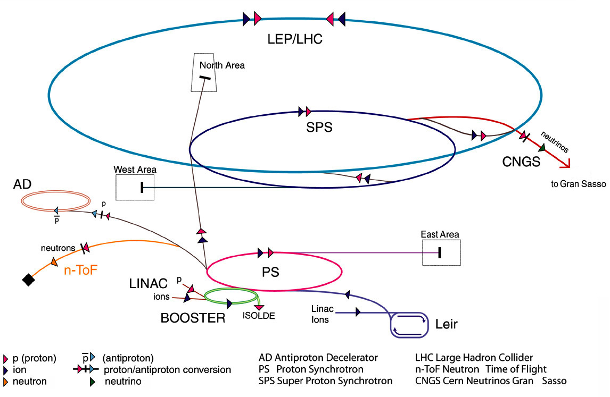
The CERN accelerators

Slide 3
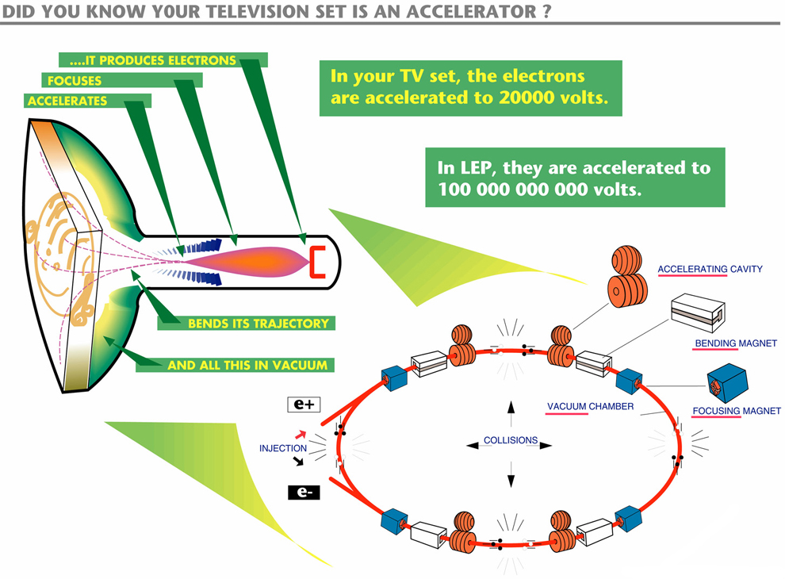

Slide 4
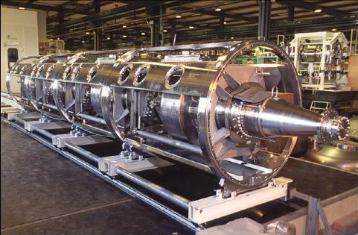
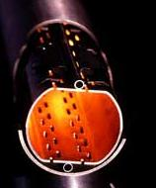
8 radiofrequency (RF) cavities for each beam, installed in groups of 4 in cryomodules, accelerate the beams
Each delivers 2 MV
Frequency : 400 MHz
The RF cavities are superconducting, cooled at 4.5 K
The beams circulate in specially designed beam pipes, with very high vacuum, 10⁻¹³ atm
https://videos.cern.ch/record/1709737

Slide 5
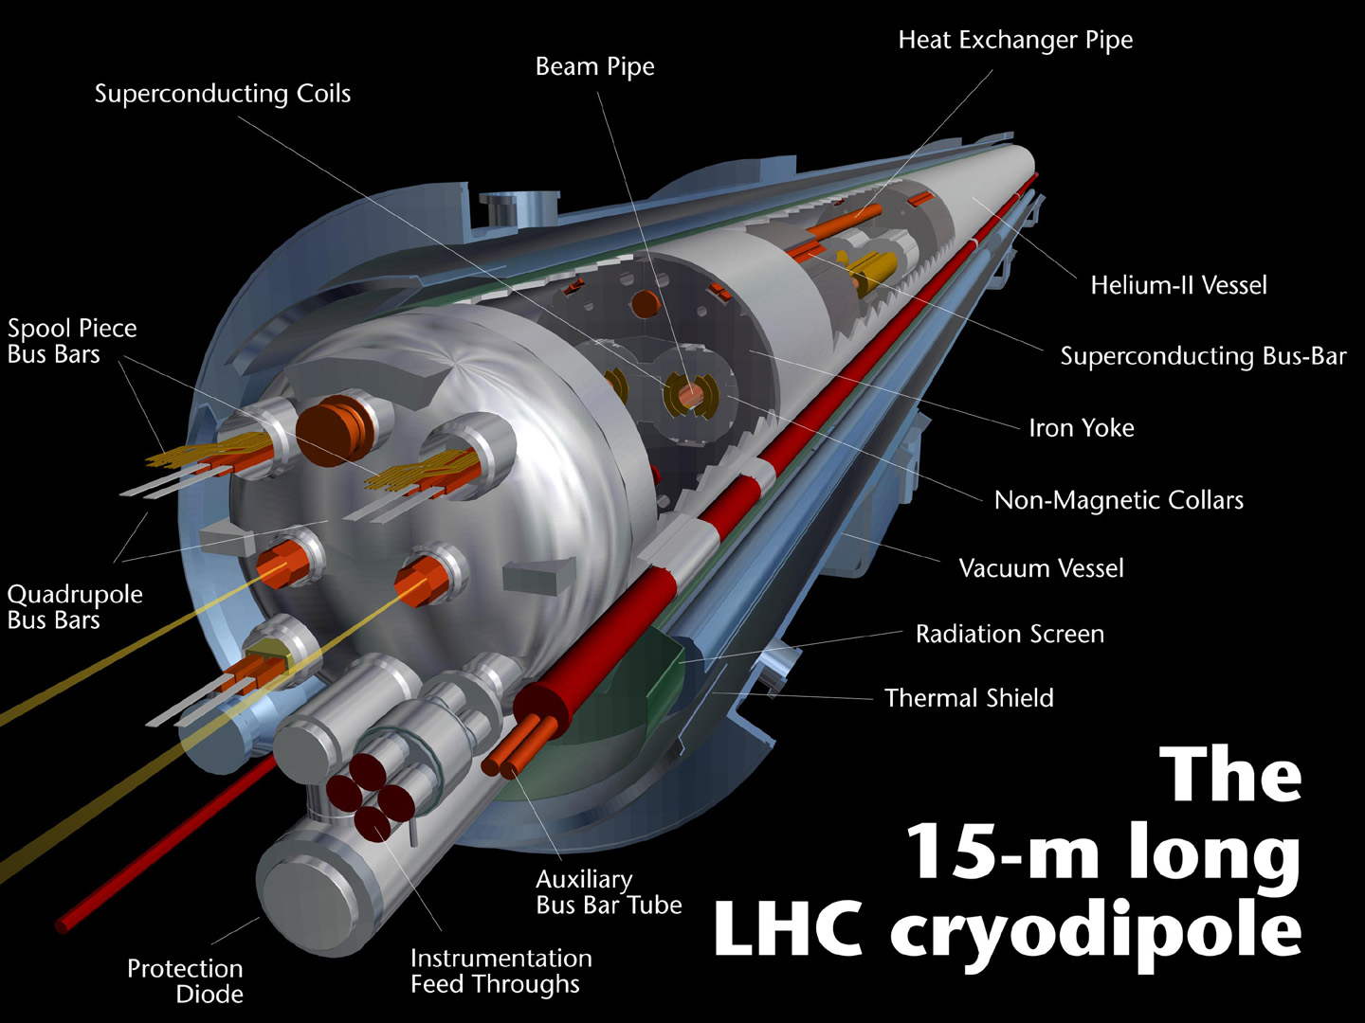
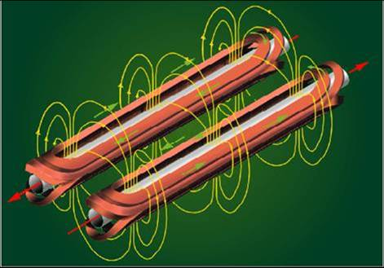
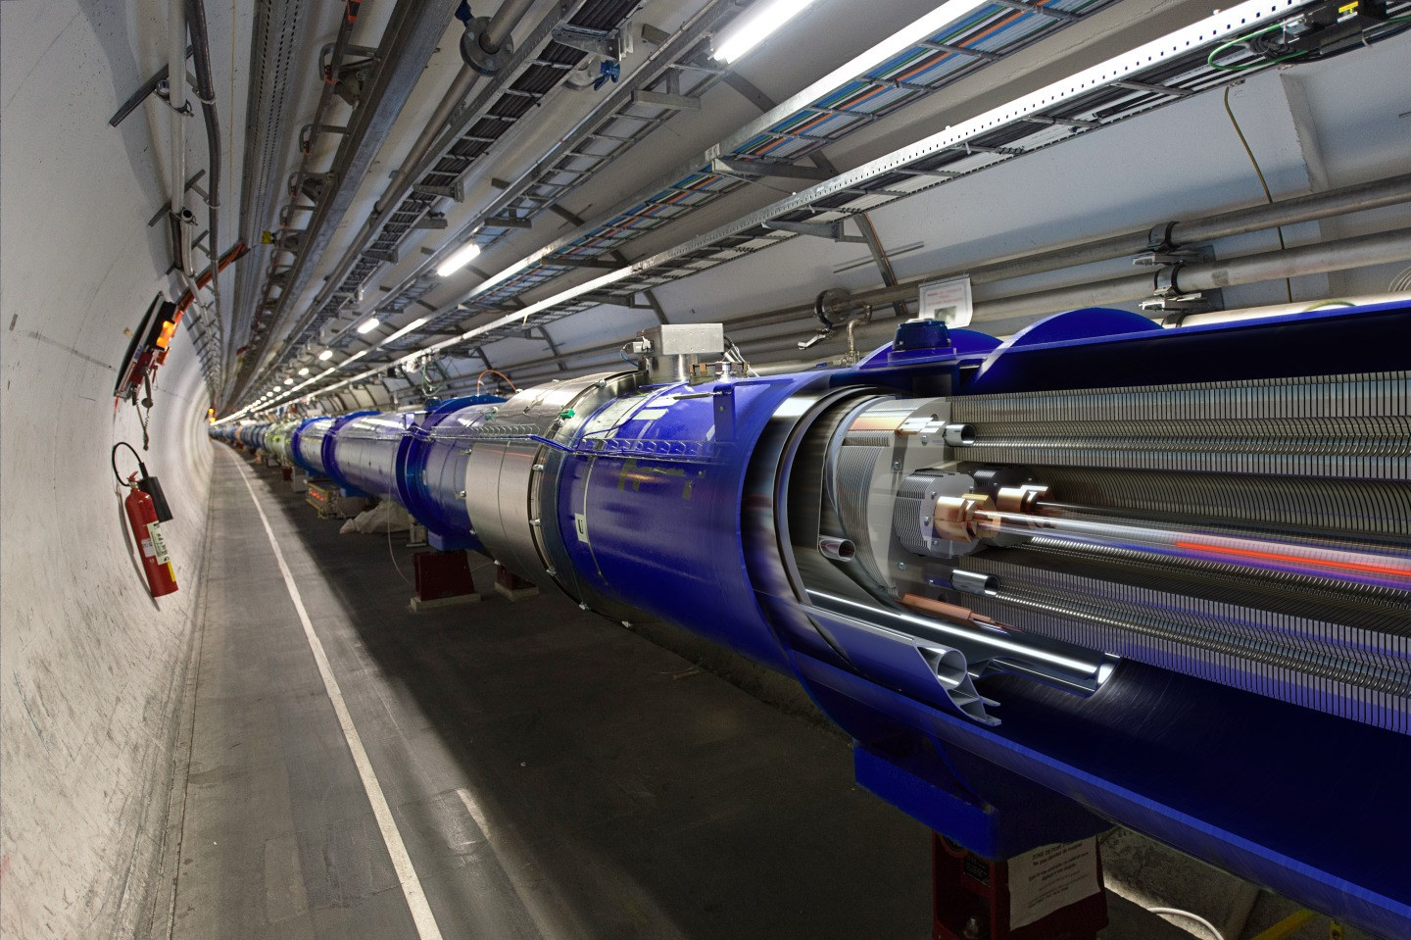
8.3 Tesla for 7 TeV beams; ~ 12 000 A needed
1232 magnetic dipoles bend the beams

Slide 6
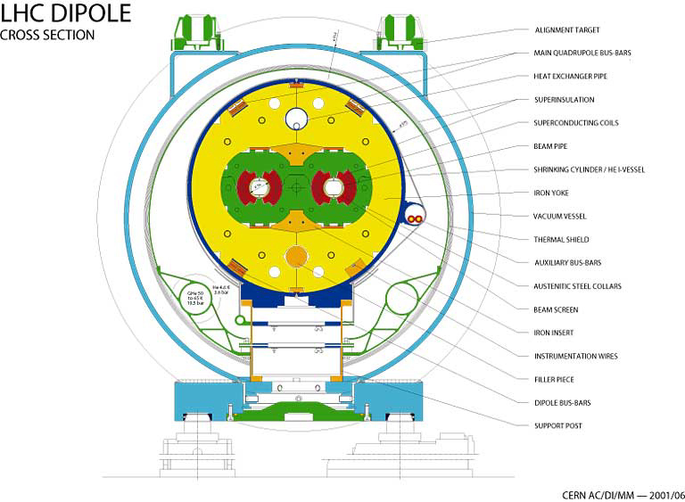

Slide 7
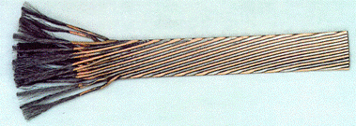
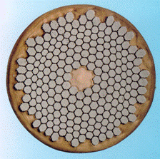
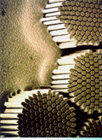
Superconducting cable : zero resistance; no losses (no heat)
1200 tons of superconducting cable
7600 km of cable
Total length of filaments : 10 times the distance earth - sun
Rutherford cable : 36 strands
Cryogenics
Cooled with 5000 tons of liquid Helium at 1.9 K
10000 tons of liquid Nitrogen cool the gaseous Helium to 80 K
Each strand (d = 0.825 mm) ~ 6500 filaments (d = 8 μm)
Niobium – Titanium supeconducting filament
(+ 0.5 μm layer of high-purity copper)

Slide 8
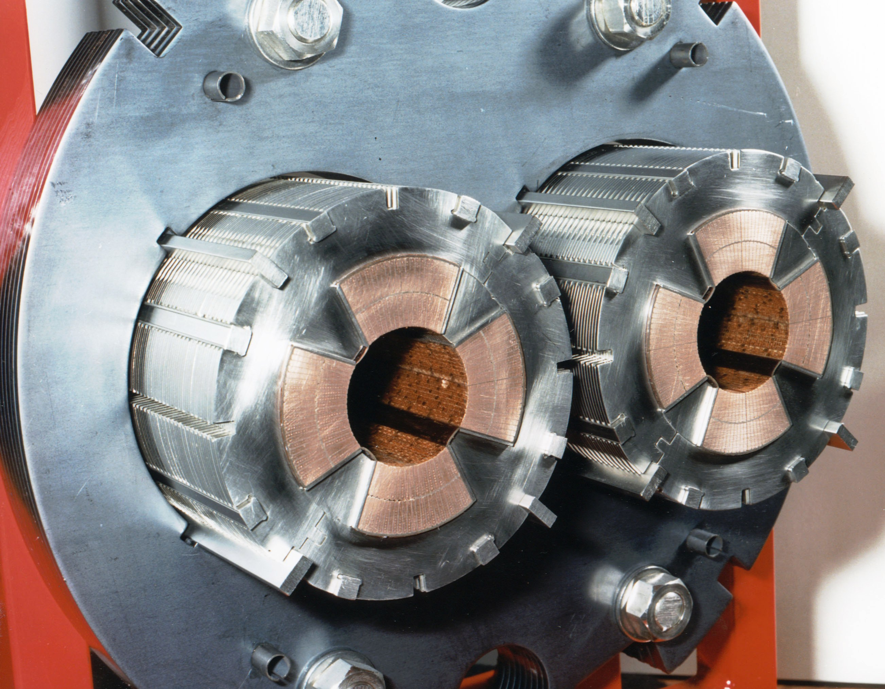
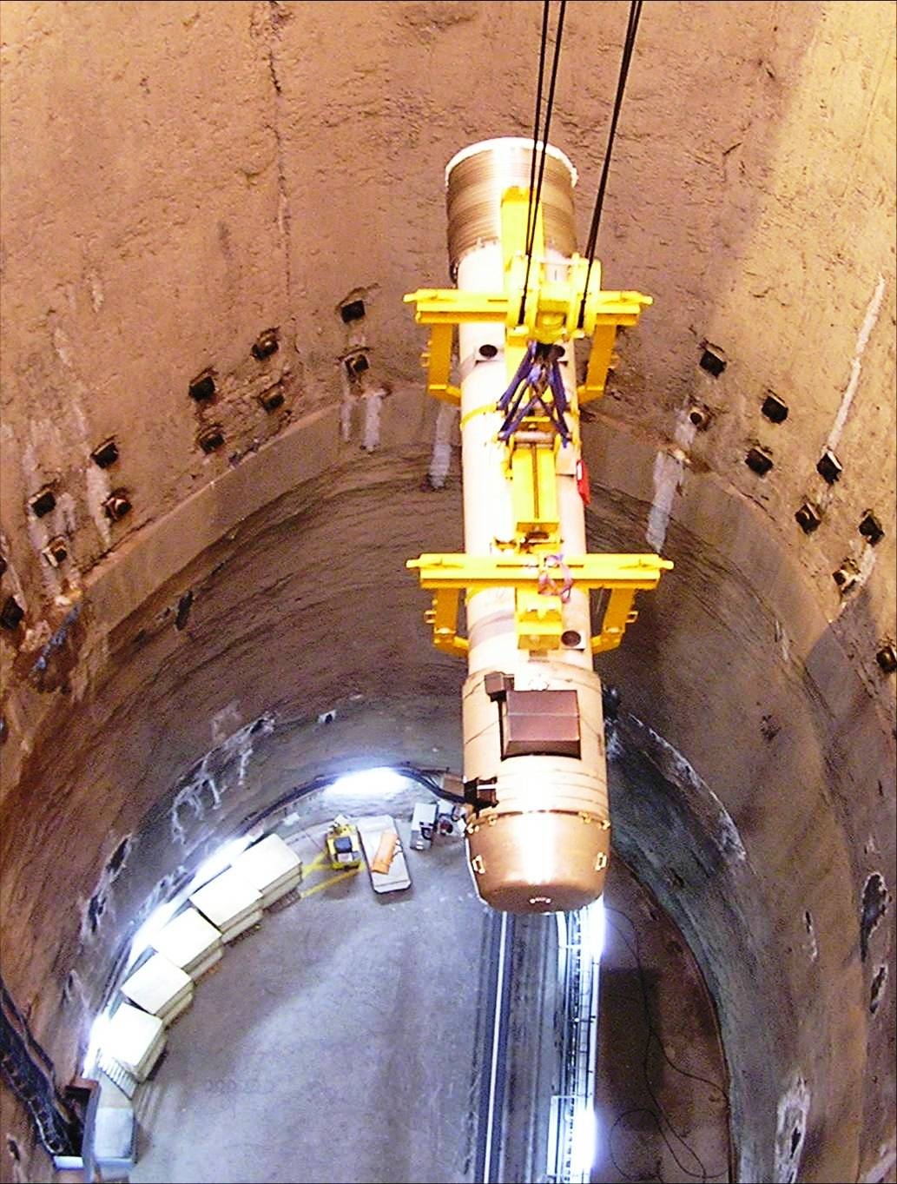
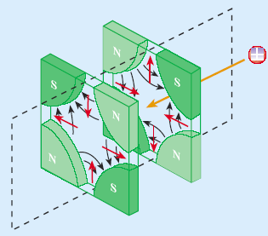
quadrupole magnets focus the beams

Slide 9
Proton Duoplasmatron source https://videos.cern.ch/record/1750714
Linac accelerating cavity https://videos.cern.ch/record/1750713
PS booster https://videos.cern.ch/record/1750712
Proton Synchrotron (PS) https://videos.cern.ch/record/1750711
Super Proton Synchrotron (SPS) https://videos.cern.ch/record/1750710
Large Hadron Collider (LHC) https://videos.cern.ch/record/1750708
Beam visualisation screens https://videos.cern.ch/record/1750709
Wire scanners for beam diagnostics https://videos.cern.ch/record/1750707
LHC dipole magnets https://videos.cern.ch/record/1750706
LHC quadrupole magnets https://videos.cern.ch/record/1750723
LHC accelerating cavities https://videos.cern.ch/record/1750705
Collimators https://videos.cern.ch/record/1750704
Current lead https://videos.cern.ch/record/1709734

