Slide 1
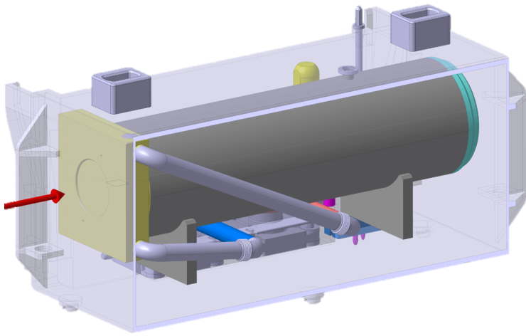
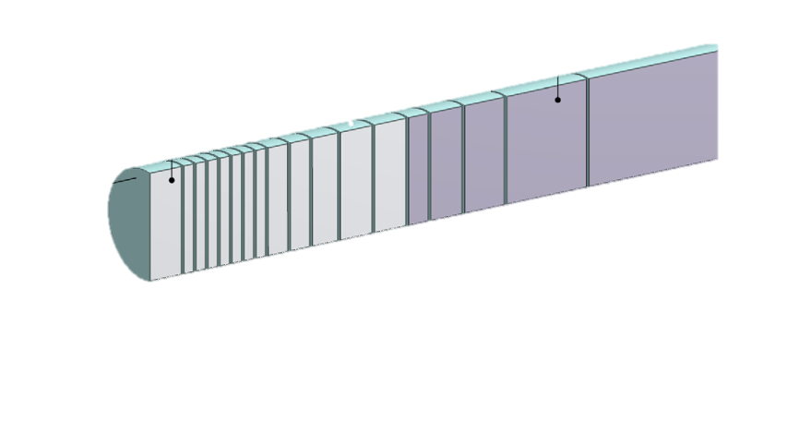
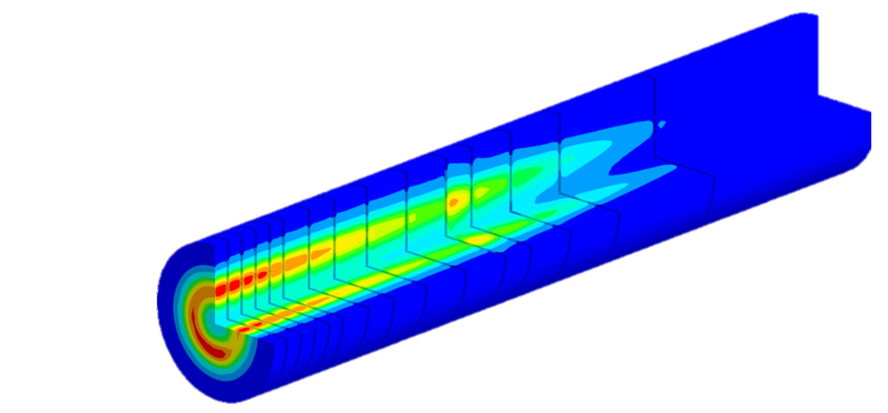
Target design baseline and challenges
WP3 BDF/HI-ECN3
Target & Target Complex Initial Concept Review (ICR)
Rui Franqueira Ximenes, M.Calviani, T.Griesemer, A.Francia, M.Parkin, Jean-Louis Grenard, D.Grenier, C.Mucher, L.Esposito, G.Mazzola (SY-STI), L. Gentini, S.Sgobba, A.Fontenla (EN-MME), M. di Castro, J.Lendaro (BE-CEM), R.Jacobsson (EP), M. Fraser (SY-ABT), C. Ahdida (HSE-RP), + HI-ECN3 team et al.
29/04/2024

Slide 2
Target presentations - Goal of today
Outline the current design, the studies and rational from CDR times until today
Highlight key challenges that need to be addressed
Set the plans for TDR
Show the recent developments/ideas
Identify missing threads

Slide 3
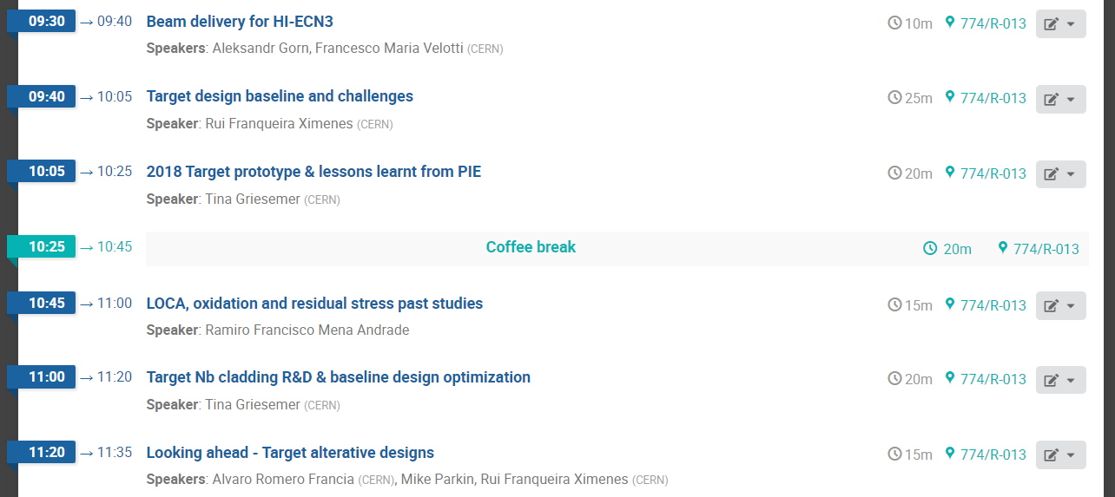

Target Agenda (morning):
From CDR to today
From the SPS to the Target
Looking in detail at the baseline design and CDR studies & some points left to be addressed
Lessons learnt from the 2018 Prototype post-irradiation examination
Quantifying critical items
Pre 2024 studies in view of addressing concerns
Looking ahead to an optimized and validated Target design
TDR Plans

Slide 4
Content
Intro Target talks & goal
Target function & requirements
Baseline design
Thermo-mechanical behaviour
Ta2.5W cladding
Target Radiation dose & damage
2018 Prototype
Conclusions
+ Missing threads

Slide 5
Target function & requirements

Slide 6
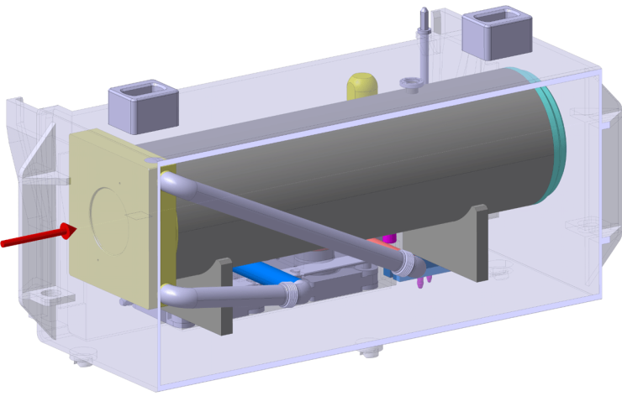
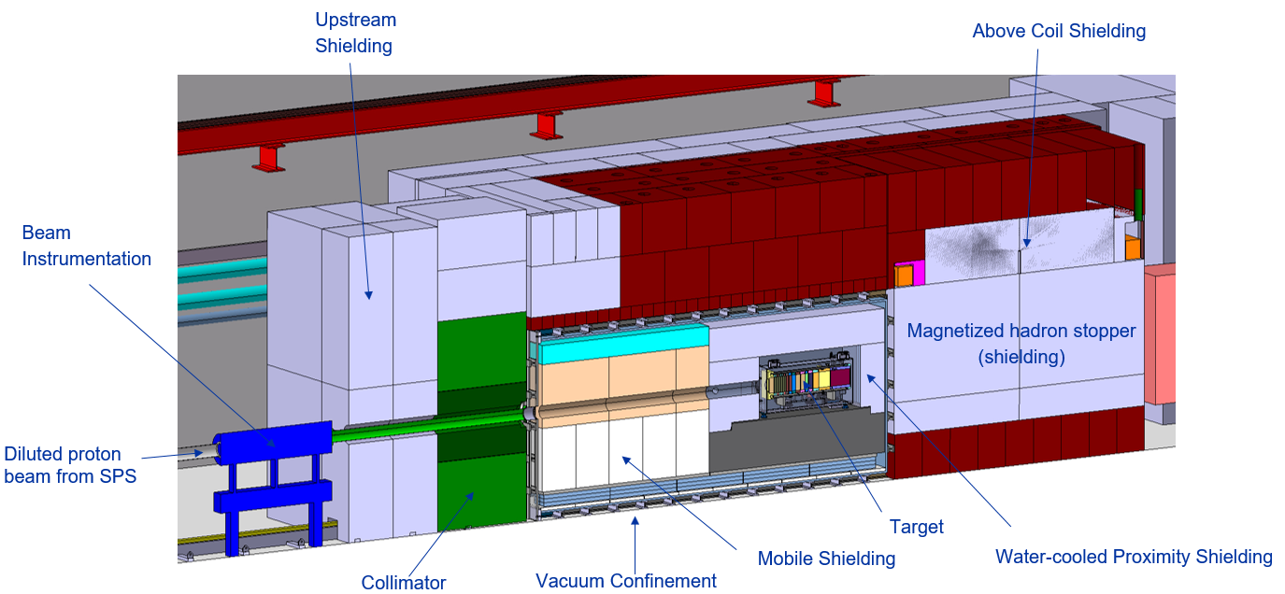
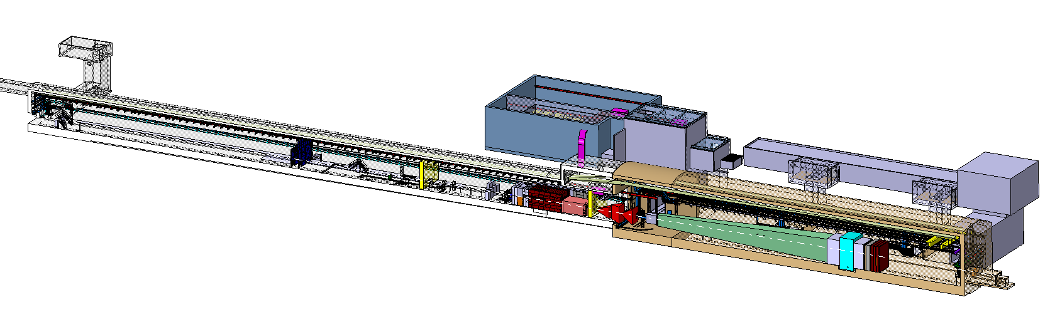
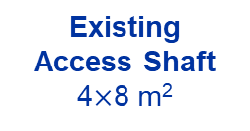
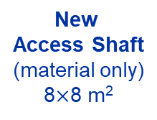
BDF/SHiP Target & Complex
Baseline Design → To be improved during TDR
WP4
350 kW-class Target
WP3
13 x TZM blocks (580 mm)
5x W blocks (780 mm)
New
Service Building
~ 500 – 700 m²
New
Access Shaft
(material only)
8$×$8 m²
Existing
Access Shaft
4$×$8 m²
B911
B918
Beam Dilution System
TCC8
WP2
WP4
ECN3
WP6,WP7 +al.
New Target Complex
containing the Beam Dump Target
WP5+SHiP

Slide 7
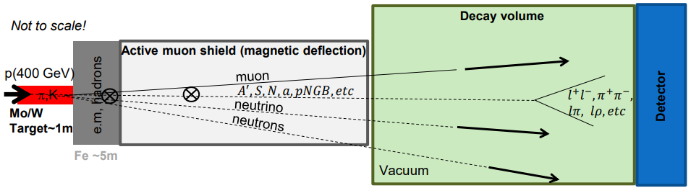
BDF/SHiP Target
Beam Dump Target / SHiP Target
  Fully absorbe all p+, maximize production of charm and beauty hadrons & re-absorption of pions, muons and kaons
High energy → production of charmed and beauty mesons
High ppp & POT → overcome small prod cross-section of extra rare events of hidden particles
High ρ, Z & A → Maximize p+ interaction
Shortest λ → Force absorption of K & π to reduce muon & neutrino background
SPS Beam Dump Facility: Comprehensive Design Study, https://doi.org/10.23731/CYRM-2020-002
SHiP Experiment - Comprehensive Design Study report, https://cds.cern.ch/record/2704147
R. Jacobsson

Slide 8
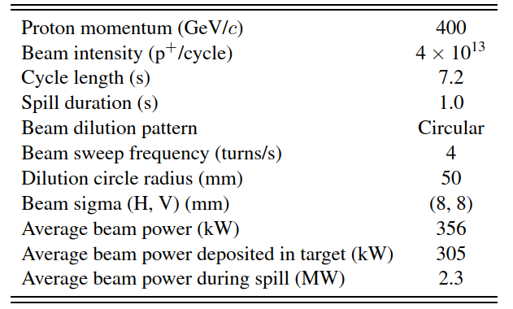
BDF Target
Target requirements
  Physics:
    high-Z material & with short interaction length
    Fully absorb SPS p+ beam
  Engineering:
    305kW power → cooling needs
    305kW power → temperature & thermal-induced stresses
  High nr of spills & POT → mechanical fatigue & radiation damage
Safety:
  High activation → Remote handling, waste disposal considerations, spallation/contamination products…
Baseline beam parameters of the BDF Target operation. https://doi.org/10.23731/CYRM-2020-002
~ 4.0×10¹⁹ p⁺/y
Very similar requirements to a neutron spallation target
Synergies with other labs are being pursued

Slide 9
Baseline Design

Slide 10
BDF Target baseline design
https://doi.org/10.1103/PhysRevAccelBeams.22.113001
Core geometry & materials
250 mm Diameter Target
580 mm of TZM (13 blocks)
  Reasonable high density & Z (Z=42, ρ=10.2g/cm³)
  Higher strength, better creep resistance, higher recrystallisation temp wrt Mo.
  Absorbs most of the beam power.
780 mm of W (5 blocks)
  High Z and density (Z=74, ρ=19.3g/cm³)
  Good radiation damage resistance
95 mm of water (5 mm * 19 channels)
  Required to cool the blocks
54 mm of Ta2.5W cladding (1.5 mm * 2 * 18 blocks)
  To avoid corrosion-erosion of the core materials
D250 mm
13 x TZM blocks
(580 mm)
5x W blocks
(780 mm)
Target Core with reasonable physics performance & that allows diluting (longitudinally) the energy deposition

Slide 11
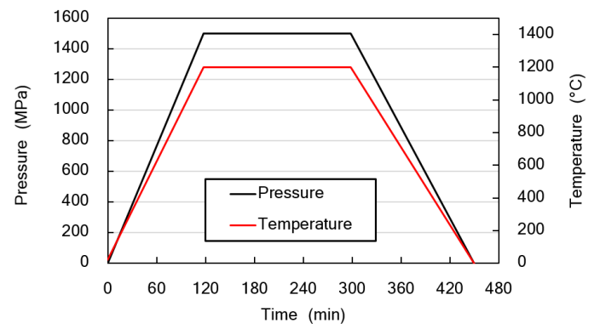
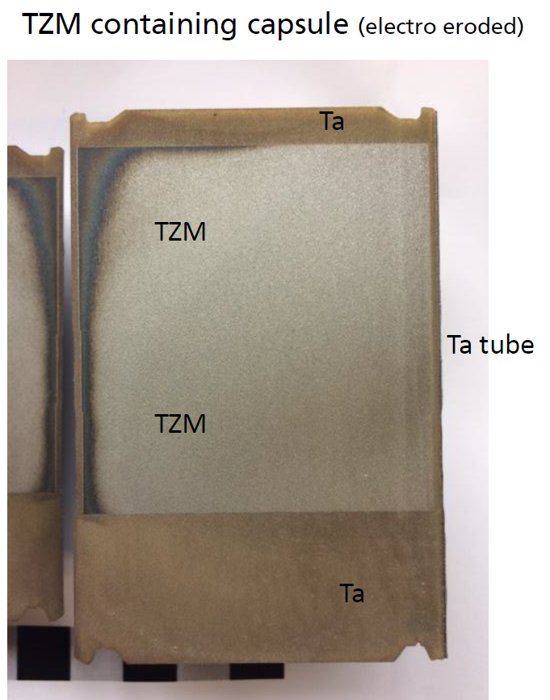
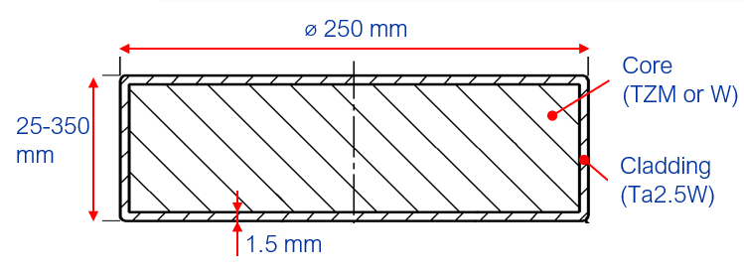
BDF Target baseline design
https://doi.org/10.1103/PhysRevAccelBeams.22.113001
Manufacturing technology
  Water-cooling circuit → Corrosion-erosion → Core cladded with Ta2.5W (1-1.5 mm thickness) by means of Hot Isostatic Pressing (HIP)
  HIP (Hot Isostatic Pressing)
  Diffusion bonded at High pressure and high temperature
  Key manufacturing feature. Essential for good heat transfer to the water circuit (cooling)
D250 mm
13 x TZM blocks
(580 mm)
5x W blocks
(780 mm)

Slide 12
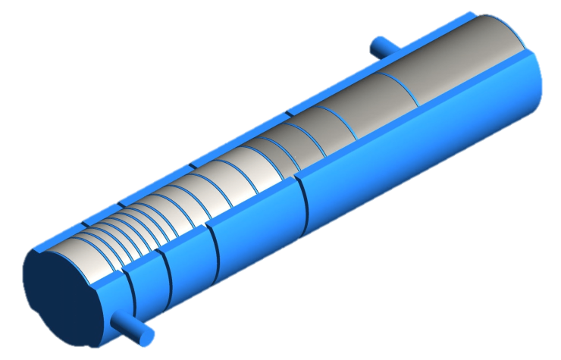
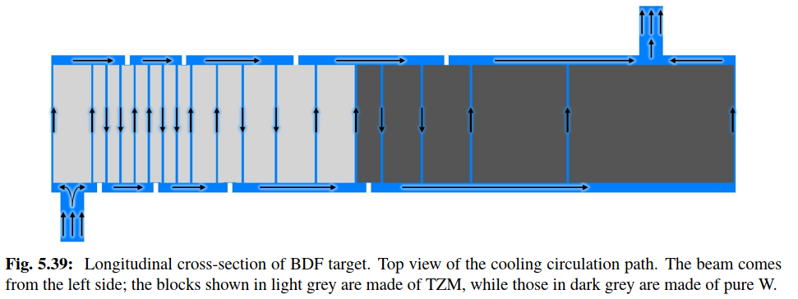
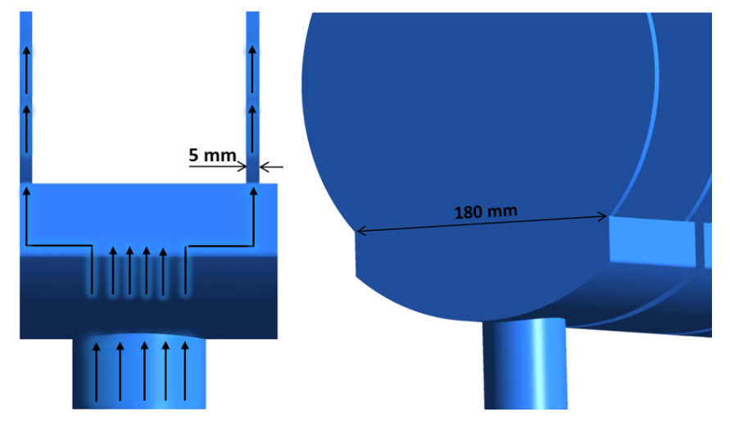
BDF Target baseline design
https://doi.org/10.1103/PhysRevAccelBeams.22.113001
Cooling
95 mm of water (5 mm * 19 channels)
  Water → better cooling for identical flow rate wrt He, Air.
  22 bar → higher boiling threshold
  5 m/s → high heat convection coefficient and limited erosion
  ~660l/min → To extract ~305kW of heat.
  Circuit Serpentine configuration with 2 parallel channels
    Serpentine → high speed at moderate flow rate
    2 parallel channels → pressure drop reduction & reduce failure in case 1 channel is blocked.
13 x TZM blocks (580 mm)
5x W blocks (780 mm)

Slide 13
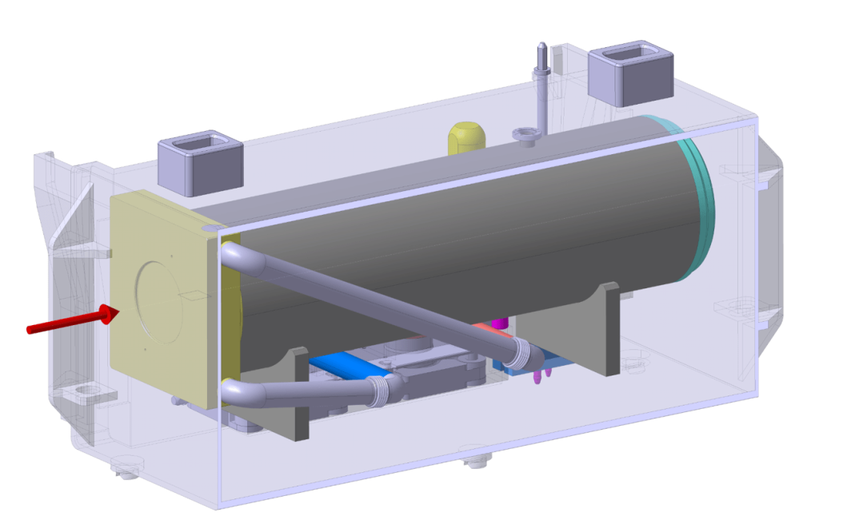
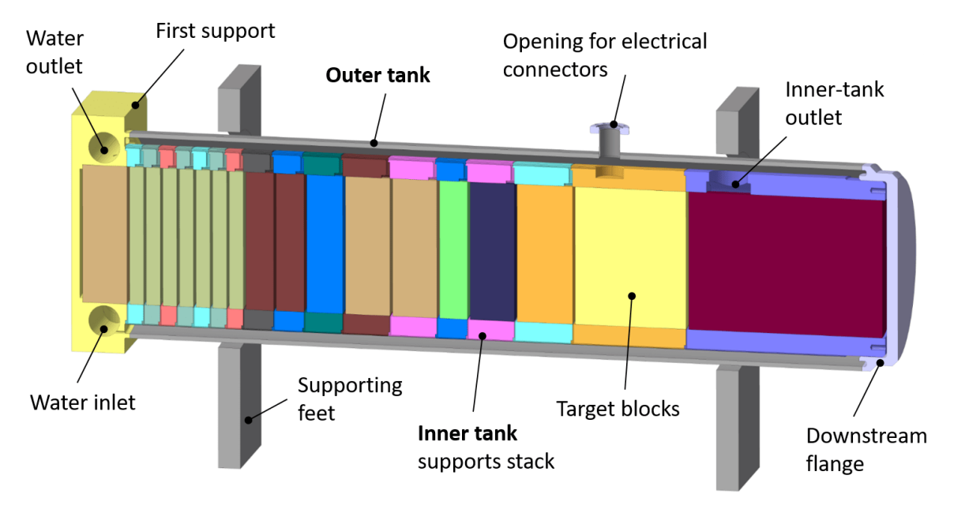
Key components
Remote handling & waste disposal features
Instrumentation & integration
Cooling
2nd outer Target (He) vessel
Target core
Target inner vessel
Beam windows
Services connections

Slide 14
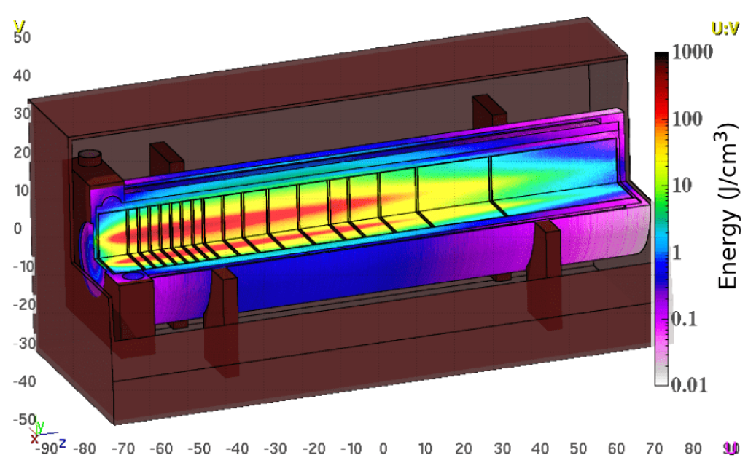
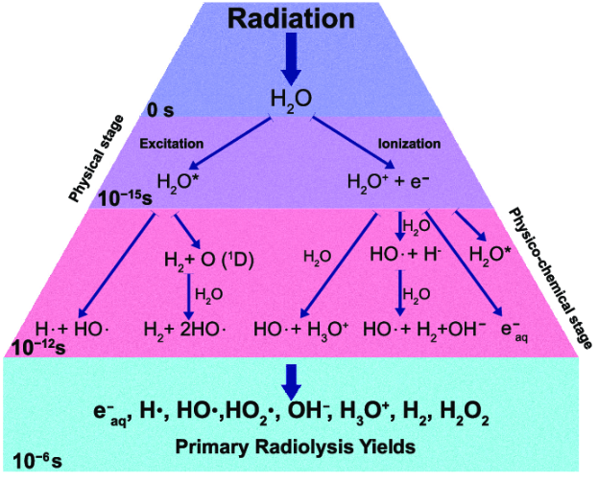
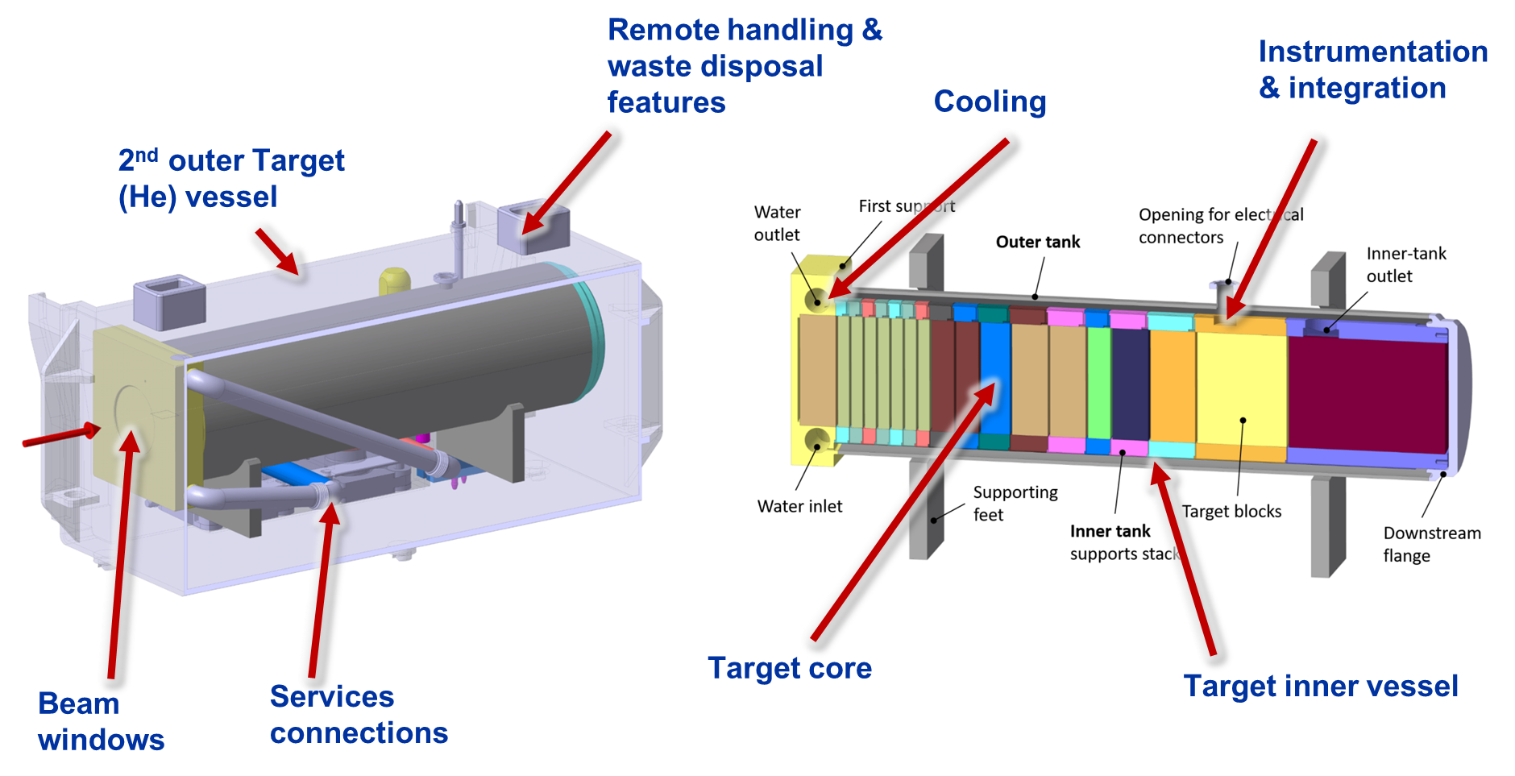
Missing threads → TDR studies (1/5)
Most of the shower develops on TZM and not on W → core could be further optimized for physics
Water in-beam promotes formation of radicals → safety concerns should be addressed
Target system missing full definition & design → detailed system design & engineering to be done
→ Mike, Alvaro & Tina’s presentations ←
13 x TZM blocks
(580 mm)
5x W blocks
(780 mm)
400GeV/c p+ beam4x10¹⁹ POT
BDF Target water cooling layout (20bar, 5m/s)

Slide 15
Themo-mechanical behavior
Baseline design

Slide 16
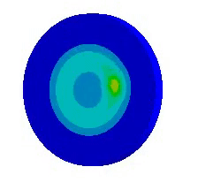
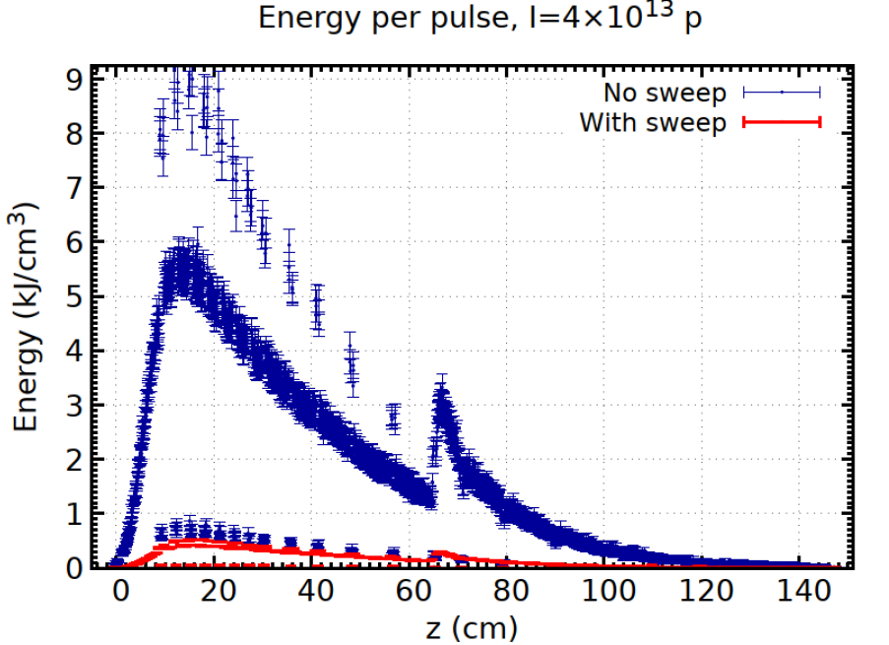
Thermo-mechanical behavior
Dilution system
2.3MW during the 1 s spill
→ Beam must be somehow diluted (blown-up and/or swept)
13 x TZM blocks (580 mm)
5x W blocks (780 mm)

Slide 17
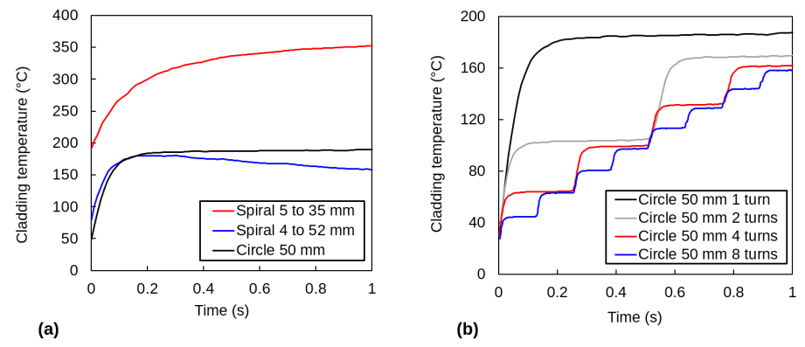
Thermo-mechanical behavior
Dilution system
Spiral, circular and elliptical sweep patterns explored.
Spiral discarded due to added complexity of the dilution magnets
Circular pattern using 4 dilution kickers
  Circular with 4 turns sweep
  π/2 scheme best in case of failure (33%p. target failure if 2 kickers fail)
  Beam size of 8mm 1σ. Limited by upstream magnets
13 x TZM blocks (580 mm)
5x W blocks (780 mm)

Slide 18
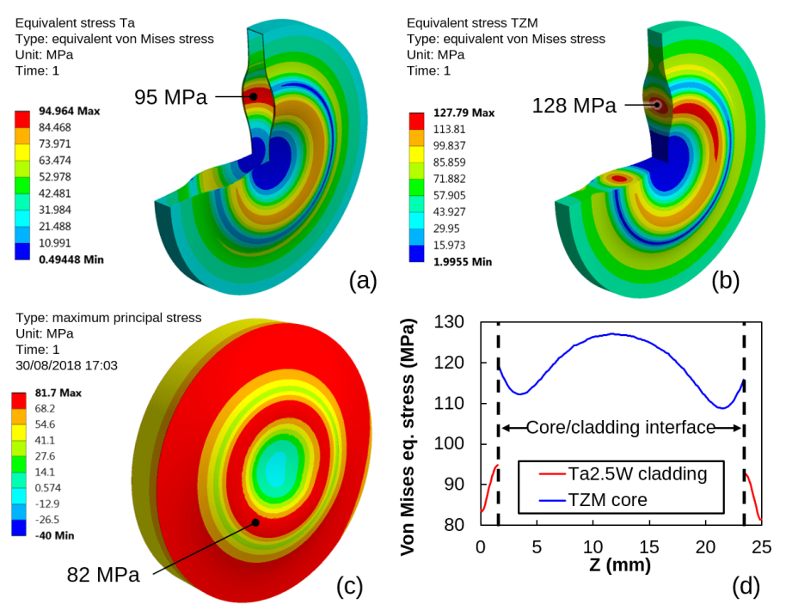
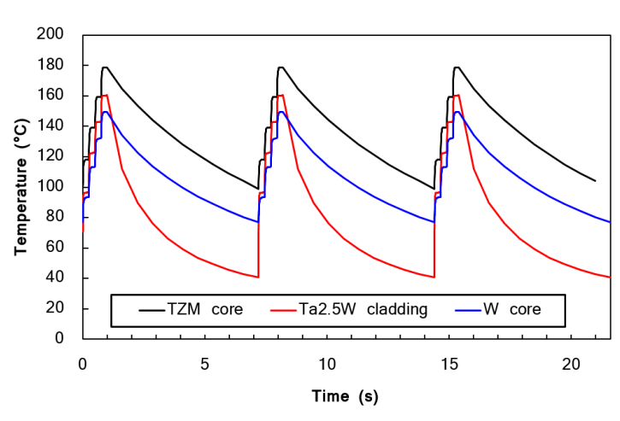
Thermo-mechanical behavior
Ta2.5W
TZM
Thermo-mechanical conditions of the core
High temperature (high average power)
Thermal-induced stresses (SS + pulse)
Residual stresses from manufacturing
Fatigue (10⁶ cycles / year)
Radiation damage / loss of mechanical properties
Erosion/corrosion
W
#4 TZM & #14 W

Slide 19
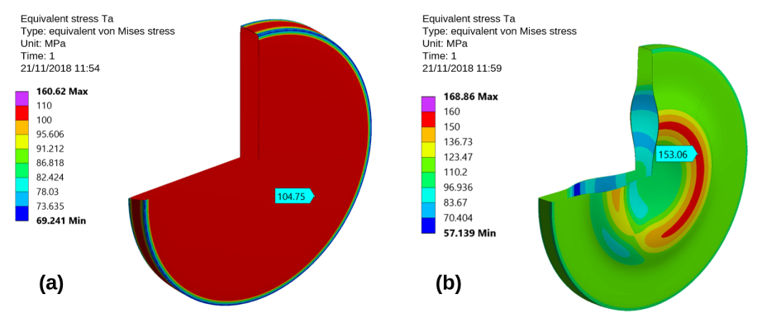
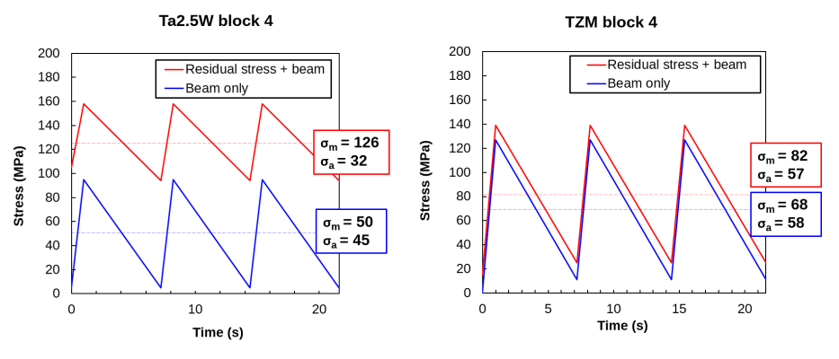
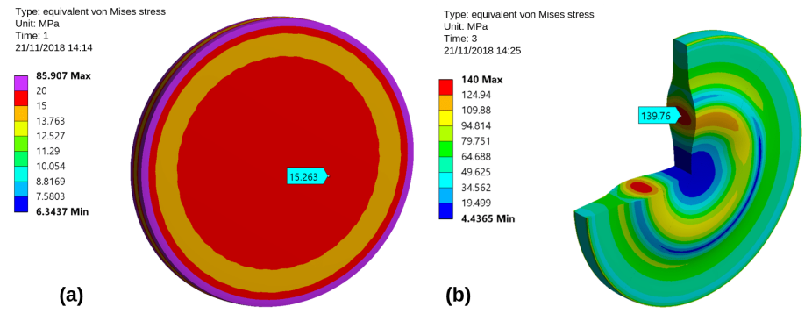
Thermo-mechanical behavior
Ta2.5W after HIP
HIPed Ta2.5W after spill
Residual stress (RS) TZM blocks
HIPing creates RS → driven by CTE difference between core material & cladding
RS is high in Ta2.5W cladding of TZM block (Purely tensile, radial direction).
  With beam, stresses are added.
  Stress amplitude is smaller, despite higher mean stress. No negative impact on fatigue.
RS is low in TZM itself (purely compressive).
  With beam, increases the circumferential radial stress by a small fraction.
  Slight impact on fatigue (increased mean stress)
TZM after HIP
HIPed TZM after spill

Slide 20
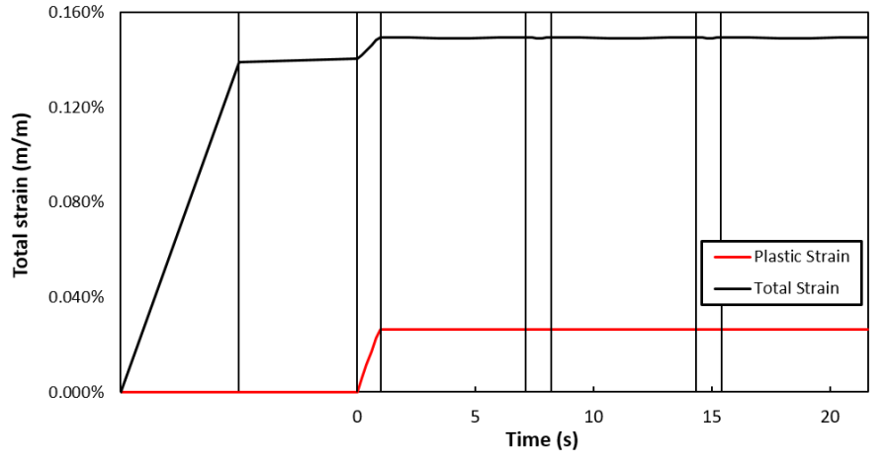
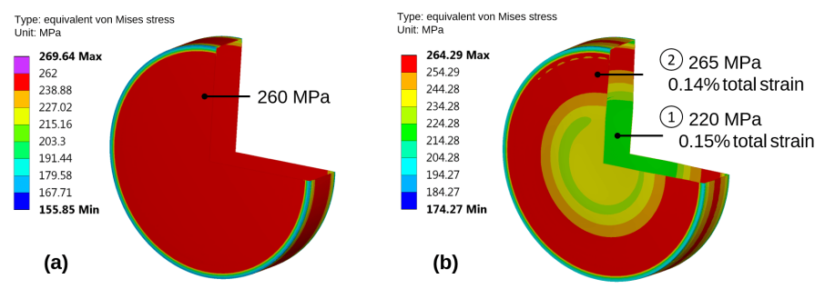
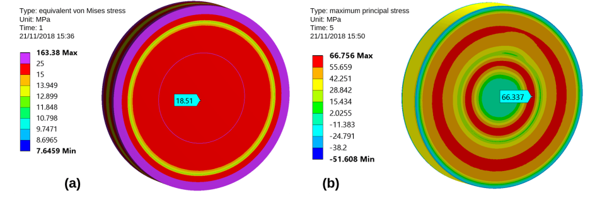
Thermo-mechanical behavior
Residual stress (RS) W blocks
With W, CTE difference is higher
RS is very high in Ta2.5W cladding of W block (Purely tensile, radial direction).
  With beam, circumferential compressive stresses from beam relieve the RS in the centre & tensile in the external part.
  Stress amplitude is smaller, despite higher mean stress. No negative impact on fatigue.
  → elastic shakedown
RS is low in W itself (purely compressive).
  Max principal stress decreases. Compressive increase by a small fraction.
  No impact on fatigue (increased mean stress)
Ta2.5W after HIP
HIPed Ta2.5W after spill
W after HIP
HIPed W after spill

Slide 21
Thermo-mechanical behavior conclusions &
Missing threads → TDR studies (2/5)
No cumulative yielding or failure expected with baseline during normal operation.
However, stress relaxation of the cladding is expected with first pulses. → Residual stress shall be fully understood & quantified
Large safety margin on W (even if operating at low temperature (brittle)) → Margin for Target core optimization
Critical element/material is Ta2.5W cladding. → Need for QA plan

Slide 22
Ta2.5W cladding
Manufacturing know-how

Slide 23
Ta2.5W cladding
Tantalum
Refractory with high melting point, conductivity, strength and ductility
High density
Low CTE
Full solubility with Molybdenum and Tungsten
Very good corrosion-erosion resistance in water medium
Sound experience in other Targetry applications (ISIS, LANSCE, KENS…)
Ta-2.5W: Solution strengthened Ta alloy with W
Higher strength yet still ductile
Enhanced hydrogen embrittlement resistance
Preliminary HIP and SPS Cladding trials w/ Ta2.5W & core materials
Prototype manufacturing
Extensive material & HIPed cladding characterization
Prototype beam tests
Post Irradiation Examination

Slide 24
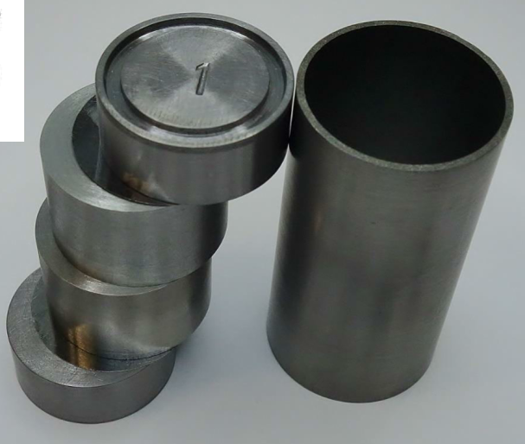
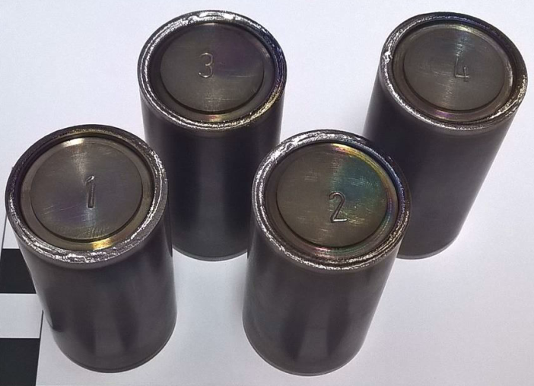
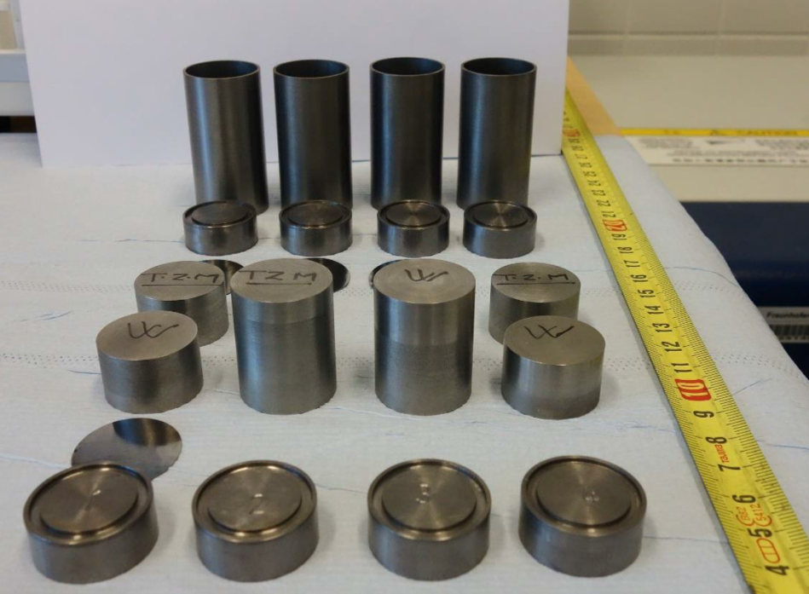
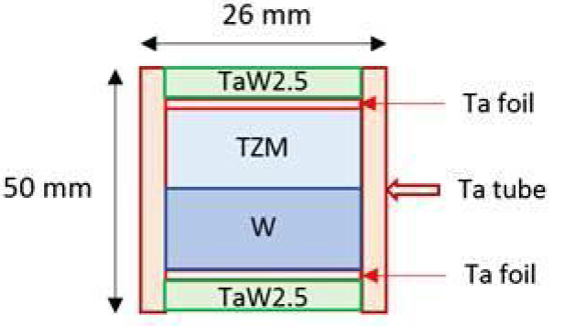
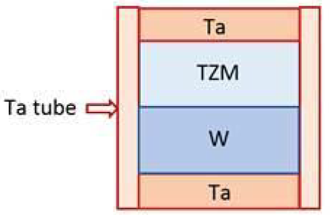
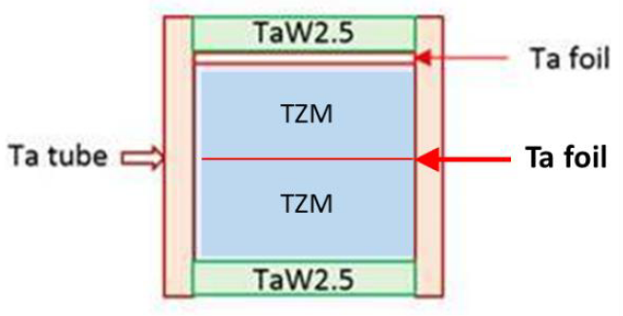
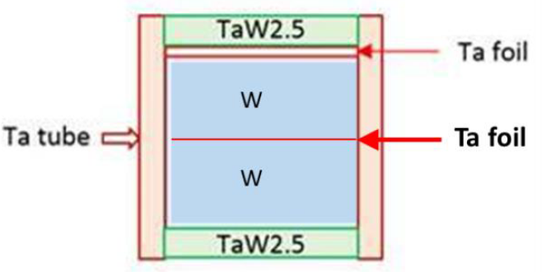
Ta2.5W cladding
Preliminary HIP and SPS Cladding trials w/ Ta2.5W
Assembly with EBW & joining via hot isostatic pressing (HIP)
Scope
Comparing two Heating cycles (1200°C/150MPa 1400°C/200MPa)
TZM//TZM & W//W via HIP w/wo interface Ta Foil
Ta2.5W vs Ta cladded on W and TZM, w/wo interface foil
Methodology
Microstructure w/ optical and electron microscopy
k (RT-300°C) and ρ measurements
Mechanical characterization of interfaces
Cold HIP cycle
Hot HIP cycle

Slide 25
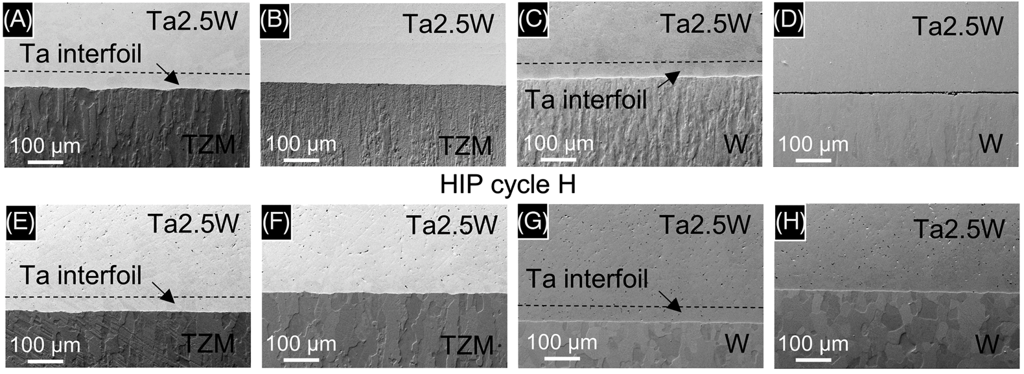
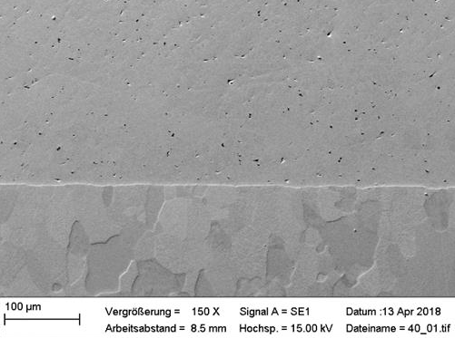
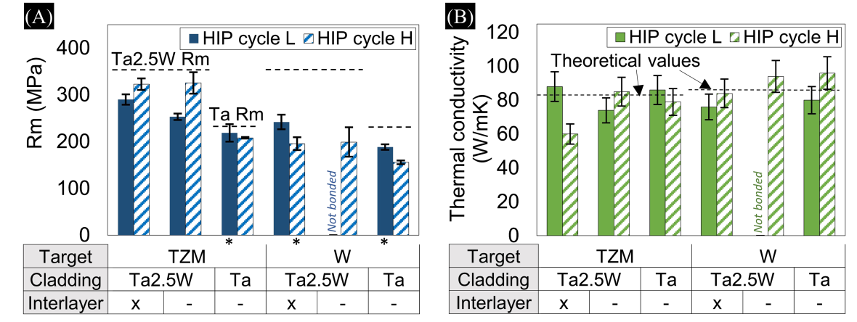
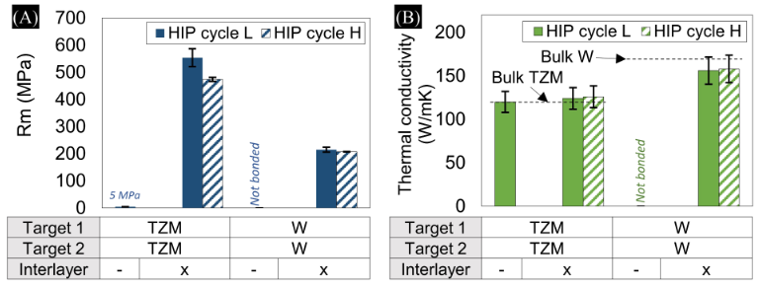
Ta2.5W cladding
Very difficult to see any diffusion layer !
Microstructural observations, tensile strength and conductivity measurements for some of the studied interfaces (https://doi.org/10.1002/mdp2.101 )
Notes:
Difficult to see diffusion layers
Yet no voids cracks are defects are seen in the microstructure analysis
Bonding quality assessed via k and tensile tests
Ta2.5 tendentially needs higher HIP T or interlayer
Higher difficult to bond w W could be higher strength (less plastic deformation) & lower diffusion rates due to small concentration of W
Lower strength of Ta/W and Ta/TZM at High T may be due to softening of the material. Verified with hardening tests (lower)

Slide 26
Ta2.5W cladding – the caveat

Slide 27
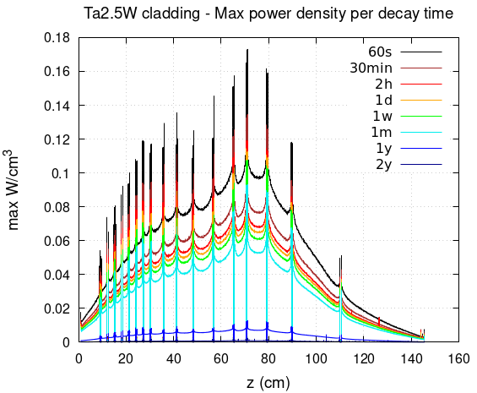
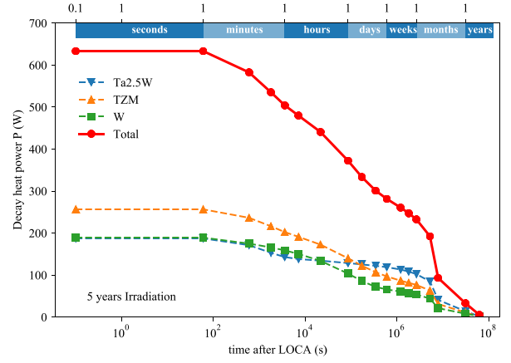
Ta2.5W cladding – LOCA
LOCA: Loss-of-Coolant Accident scenario
Hypothetical scenario used as a criterion for assessing the safety of a nuclear installation during its design phase.
Thermo-mechanical assessment in CDR
  Determine the temperature evolution of the target in a 2 years scenario after the accident.
  Depending on the assumptions, T > 300 C may be reached for prolonged periods ((O)weeks)
  & we already know the cladding is the most critical element of the target core on a thermo-mechanical point of view
Mena R., Ximenes R.F. and Calviani M. (2022), Loss-of-Coolant-Accident study for the Beam Dump Facility at CERN, NURETH-19 Conference

Slide 28
Cladding conclusions &
Missing threads → TDR studies (3/5)
Decay heat on baseline target is considerable & driven by cladding.
Possibility of LOCA poses a critical safety risk
  → Address LOCA in detail
  → look for alternative claddings
  → Ramiro & Tina’s presentations ←

Slide 29
Target radiation dose & damage

Slide 30
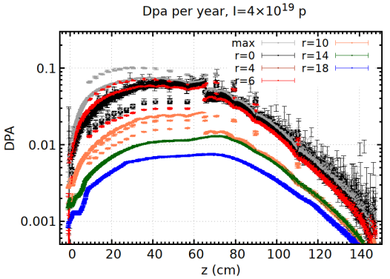
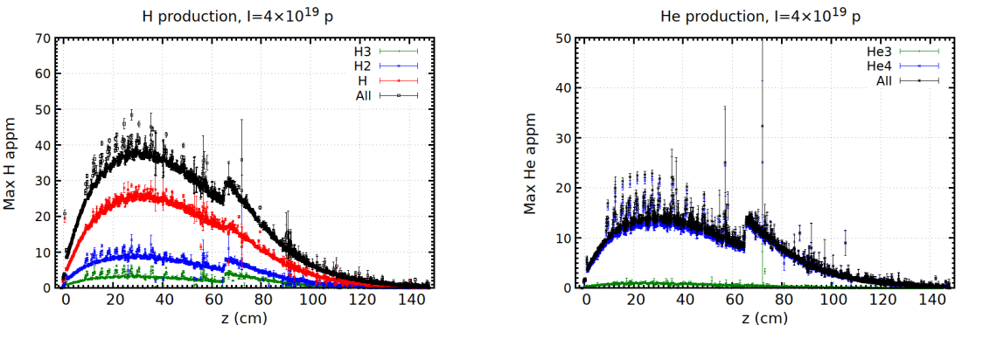
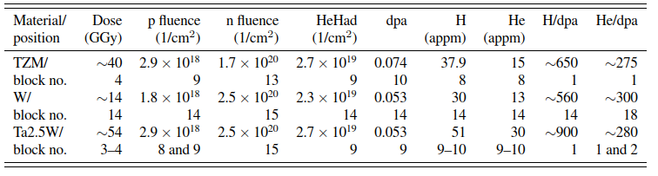
Target Radiation dose & damage
Radiation dose
  ~100 Sv/h after 4h cooldown
Radiation damage
  Radiation damage (dpa)
    Dpa up to 0.1 per year (1dpa without sweep)
  H & He gas production → swelling, grain boundary embrittlement
    40 ppm H & 15 ppm He per year

Slide 31
Target Radiation dose & damage & Missing threads → TDR studies (4/5)
Very high radiation doses → ALARA driven design and detailed waste disposal considerations to be analysed
Radiation damage & gas production → effect on target materials mechanical properties to be well understood and quantified

Slide 32
2018 Prototype

Slide 33
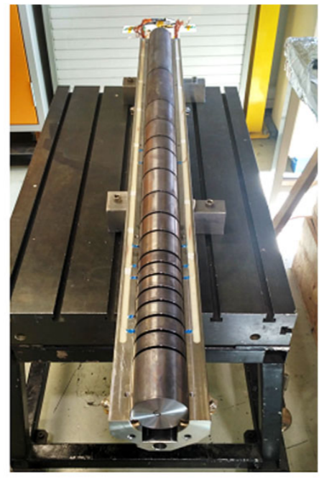


BDF Target Prototype
Purpose: to validate manufacturing and test operation at identical temperatures & mechanical stresses.
Reduced diameter (80 mm) prototype.
Tested in 2018 on a dedicated slow extraction (SX) testbench in the T6 primary beam line in TCC2 at CERN. Total of 2.4 × 10¹⁶ p⁺
https://doi.org/10.1103/PhysRevAccelBeams.22.123001
Notes:
Instrumentation (temperature and strain) of 4 most critical blocks
Total 14 hours of beam in 3 days → 2.4 × 10¹⁶ PoT

Slide 34



BDF Target Prototype
Design summary:
4 blocks instrumented with strain gauges and temperature sensors
Target blocks two half-shell parts which allow free expansion while guiding the 20-bar cooling water.
Shells inserted in a cylindrical SS tank. Water connections on the upstream side of the tank. Instrumentation on the downstream.
Collimator-like plug-in table, allowing fully remote handling. The prototype was designed to be the first complete remotely dismountable device of its type at CERN
Notes:
Staubli
Combiac connector
HTA16 water connector

Slide 35

BDF Target Prototype beam tests (2018)
Final target (at 4 × 10¹³ p+/cycle) :
Expected (FEM) Max von Mises stress of 95 MPa & max T of 160 °C on Ta2.5W. (180 & 150 °C on TZM & W respectively)
Prototype (at 3.75 × 10¹² p+/cycle) :
Expected (FEA) max stress amplitude(σ_{a}) of 50 Mpa (105 MPa von Mises equivalent) and max temperature of 250 °C on the Ta2.5W
σ_{a} @r=20mm: 37 MPa (FEA) vs 43 MPa (SG) on the Ta2.5W
T@r=20mm: 40 °C (FEA) vs 38.8 °C (Pt100) on the Ta2.5W
 | Final target | Target prototype
Proton momentum [GeV/c] | 400
Beam intensity [p+/cycle] | 4×10¹³ | 3-4×10¹²
Beam dilution | four circular sweeps | no
Beam extraction | 7.2 s cycle with 1s of beam extraction
Average beam power [kW] | 355 | 27-35
Average power on target [kW] | 300 | 18-23
Maximum¹ temperatures, strains measured (Transverse & Radial) and equivalent stress amplitudes vs calculated via FEA for 3.75 × 10¹² p+/cycle
Cladding Material (block) | T_{Pt100} [°C] |  | T_{FEA} [°C]
Ta2.5W (4) | 38.8±0.5 |  | 40
Ta (8) | 46±0.5 |  | 43.8
Cladding Material (block) | Δε_{SG} [μm/m] | σ_{a,SG} [MPa] | Δε_{FEA} [μm/m] | σ_{a,FEA} [MPa]
Ta2.5W (4) | 190 |-450 | 43 | 170 | 390 | 37
Ta (8) | 100 |-230 | 22 | 87 |-250 | 23
FEM calculation (with 3 × 10¹² p+/cycle on the prototype)
¹ Maximum within all the measured values by the instrumentation. The FEA values are at the same location of the PT100 and SG. The actual maximum temperatures in the blocks are higher but were not directly measured.
Notes:
The most critical measurements of the tests (with Pt100 and strain gauges (SG)) revealed good agreement with the FEA calculations [4]:

Slide 36






BDF Target Prototype removal (2020)
Unplug-in  Transport to the bunker  Unscrew downstream flange  Instrumentation wire cut & flange removal  Extraction half-shells core assembly  Unscrew half-shells  Removal top half-shell & first glimpse of the target blocks
BDF target assembly

Slide 37




BDF Target Prototype removal (2020)
Identification of the blocks and angular orientation with respect to the beam with a marker  Removal of the target blocks for the post irradiation examination (PIE) campaign  Storage of the extracted blocks in a shielded container

Slide 38


BDF Target Prototype Post Irradiation Examination
I. Reception
II. Film Dosimetry
III. Metrology and Microscopy
IV. Ultrasonic Tests
V. Specimen Extraction
VI. Microstructural Characterization
VI. Mechanical characterization
PIE in a step-wise approach
Purpose:
Identify any structural, chemical or geometrical changes
Understand survivability of the target materials
Assess if the cladding-core bonding is still reliable
Comparison of un-irradiated characterization studies with irradiated data
Ultimate Goal: Validate & Refine engineering design.

Slide 39
2018 Prototype conclusions &
Missing threads → TDR studies (5/5)
Gained manufacturing experience on a Ta2.5W-cladded baseline target.
Gained operational experience & validated engineering studies.
SX test-bench built & available in T6/TCC2 → Unique opportunity to test with beam (2025) alternative claddings & designs
PIE (2020-2022), final check of baseline target design. → identified design & material aspects to be improved, particularly W material
  → Tina’s presentations ←

Slide 40
Conclusions
Target Baseline design and challenges
Baseline is a well thought design solution.
Yet:
  Manny features in the design still need to be addressed (besides the core)
  There is potential for further target physics optimization
  Critical safety aspects such as LOCA & hydrogen production need to be addressed and mitigated, likely via alternative designs
  Materials QA and characterization is still required
  Radiation doses and effects to be further analysed
TDR, particularly 2025, will be the last (and only) chance to test anything else with beam at the SX testbench
Synergies with other targetry labs are being pursued

Slide 42




BDF Target design (baseline)
Baseline – safety limits

