Slide 1
[HI-ECN3 BDF Target & target complex initial review]:
Looking ahead – Target alternative designs
Alvaro Romero Francia, Tina Griesemer, Rui Franqueira Ximenes, Mike Parkin [SY-STI-TCD]

Slide 2
HI-ECN3 BDF target initial review
Baseline design.
Alternative designs:
    Removed water channels.
    The full W target.
    The full W target – exploring other options.
    In-beam tests
Conclusions.

Slide 3
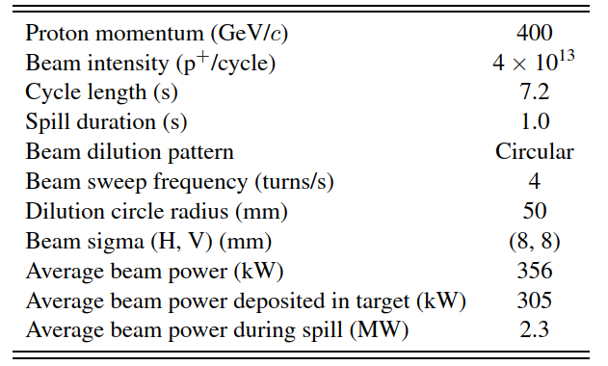
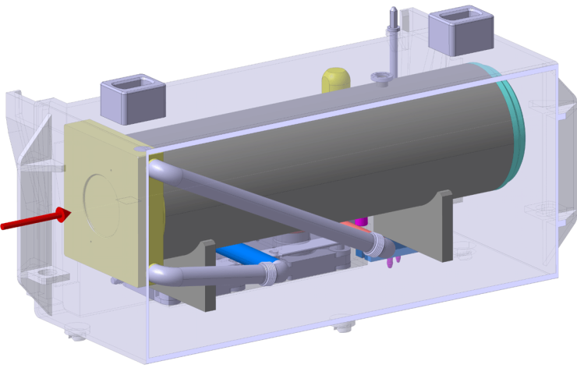
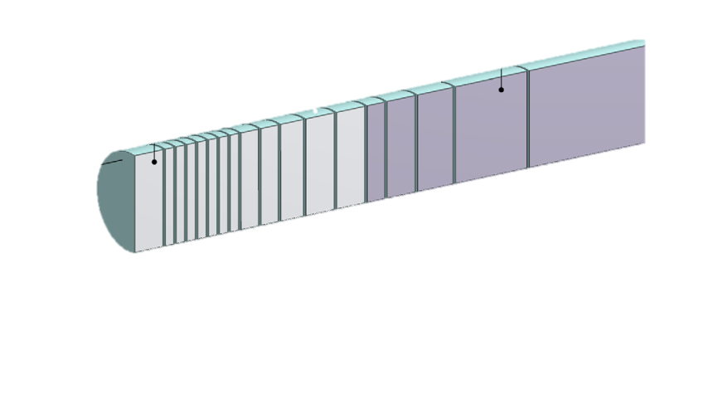
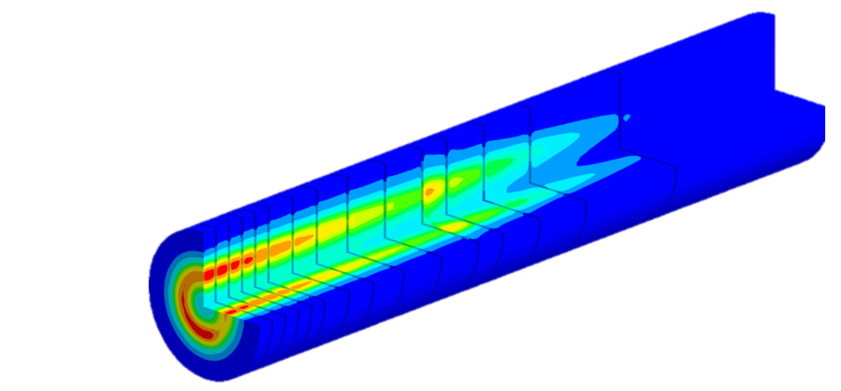
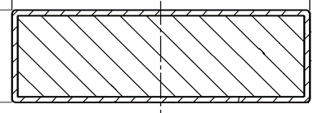
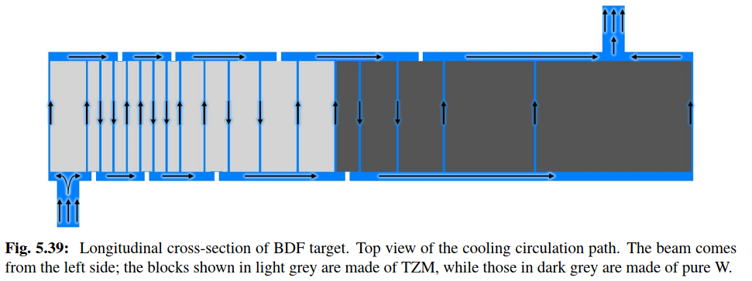
WP3 – BDF Target design
Baseline beam parameters of the BDF Target operation.
Baseline design
~ 4.0×10¹⁹ p⁺/y
Target will become an extremely radioactive device!
~100 Sv/h after few hours of cool-down
⌀250 mm
25-350 mm
13 x TZM blocks (580 mm)
5x W blocks (780 mm)
Baseline design is robust with thorough design report https://doi.org/10.23731/CYRM-2020-002, representative in-beam tests, PIE plus HIP & other testing.
1.5 mm
Ta2.5W cladding
BDF Target water cooling layout (20bar, 5m/s)

Slide 4
WP3 – BDF Alternative Target design requirements
Now is an opportunity to explore alternative designs.
Physics drivers
Particle production
    Want particle interactions with High Z materials, especially in the shower region –large effect. W > TZM > Cu
    -Replacing upstream TZM with W would be beneficial, even if this needs more cooling channels
      Overall density of target (including water channels) is not so important
  Background signal
    Capture all electromagnetic shower particles in the target – Need sufficient target ø and density
Operations drivers
Activation products of water
Production of Hydrogen
Thermal management & engineering drivers
Want lots of cooling channels in the shower region! (reduces overall ρ)
Want lots of high thermal conductivity materials in the shower region, eg copper (reduces ρ & Z)
Want to reduce target ø.
Want to reduce plate thicknesses (reduces overall ρ)
Want improved Tungsten grain structure
Reduce volume of water, especially in the beam & shower
4

Slide 5
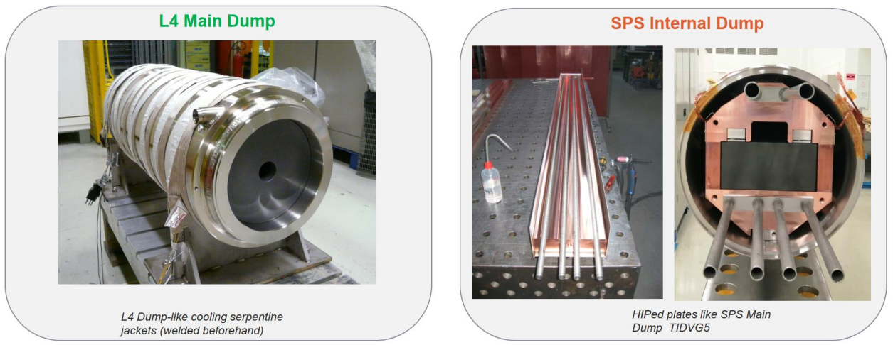
WP3 – BDF Target design
Alternative design – proven concepts

Slide 6
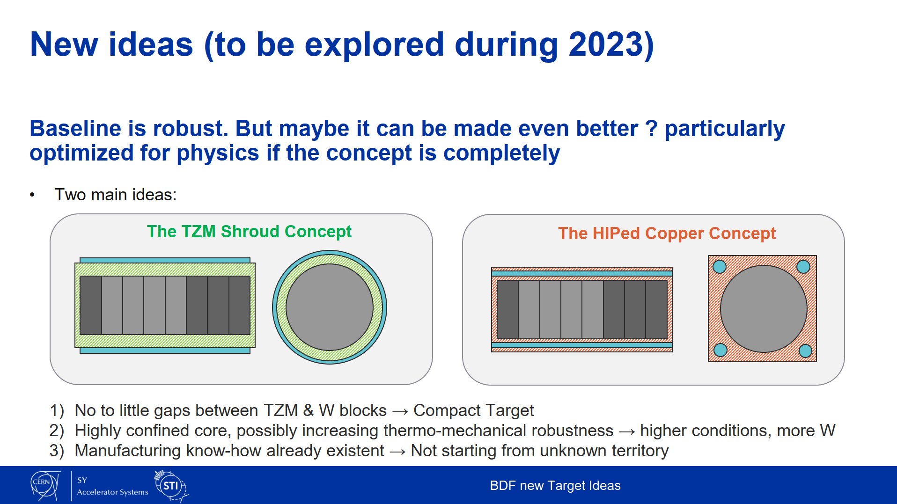
WP3 – BDF Target design
Alternative designs
→ Using what the section’s learnt experience
Based on L4 main dump
Based on SPS internal dump
Next slides
TZM
W
TZM
W
Drivers:
Reduce the amount radiolysis-produced free hydrogen gas (ATEX)
Reduce activation of the water (less water) and of the target (less Ta), and decay heat (less Ta)
Reduce contamination risk of water & W spallation products -(stronger and thicker external shroud instead of thin cladding)
Shorter target will simplify waste packaging and disposal.
Increase physics performance. (overall denser without water channels)

Slide 7
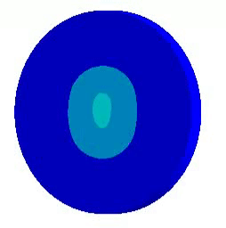
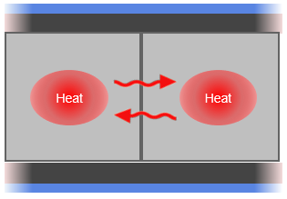
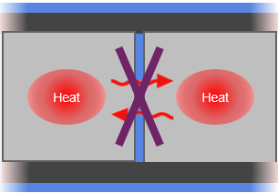
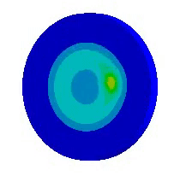
WP3 – BDF Target design
PREMATURE MODELS
with assumptions and simplifications
Alternative design – Initial approach
1. Is it beneficial to have the blocks in contact or not?
2. Diluted or sweep beam?
Contact (perfectly bonded)
Contact (not bonded)
Gap
(not bonded)
Diluted beam
OR
Sweep
…These options were explored in the 26th SHiP Collaboration Meeting, by T.Griesemer

Slide 8
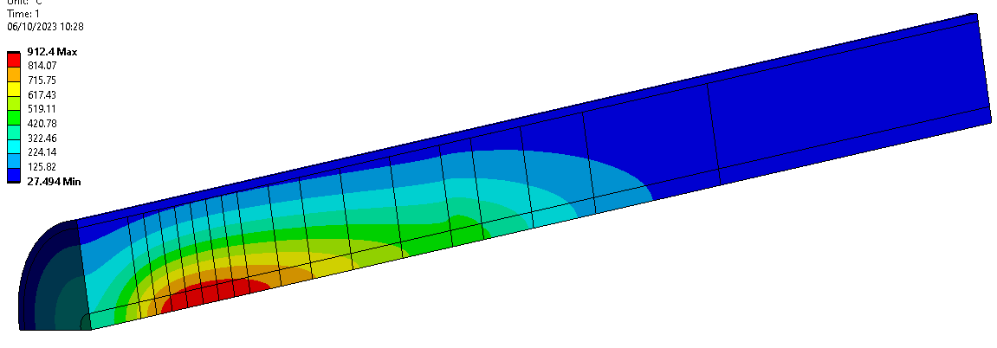
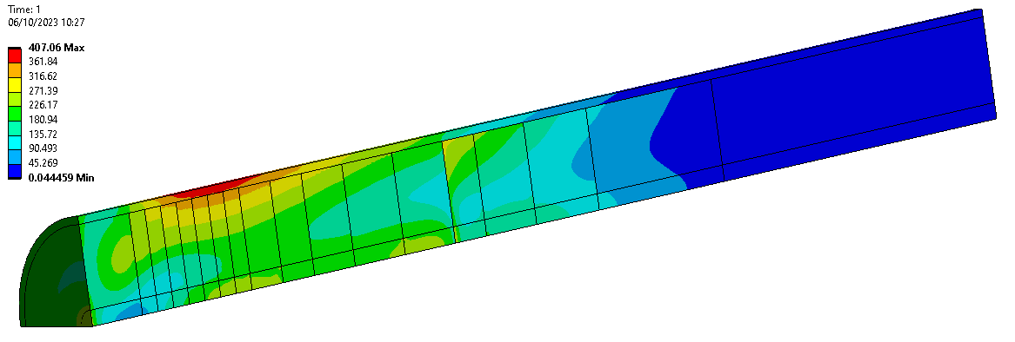
WP3 – BDF Target design
PREMATURE MODELS
with assumptions and simplifications
Steady State + One Pulse
35mm centre beam
Alternative design – TZM&W blocks, TZM shell
Temperature after 1 pulse [°C]
Contact (perfectly bonded)
Contact (not bonded)
Gap
(not bonded)
Contact (perfectly bonded): the stress distribution along the beam axis is homogeneous. On average, the equivalent stresses are lower.
Contact (not bonded): High stress gradients in single blocks.
Gap (not bonded): Higher temperatures, stress reduction is negligible compared to the perfectly bonded case.
Equivalent stresses after 1 pulse [MPa]
Blocks in Contact with perfect thermal bonding
Cooling water at circumference uses 10 000 W/m².K calculated using original water flow rate of baseline.
→ Having the blocks bonded is best option

Slide 9
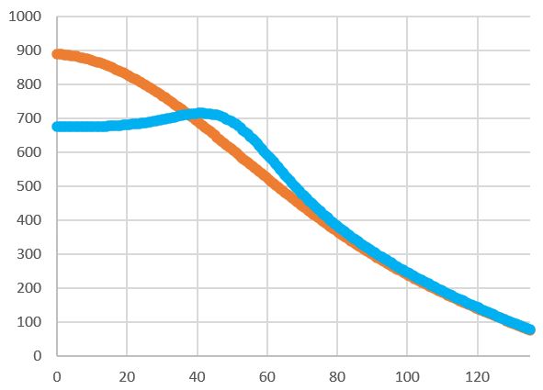
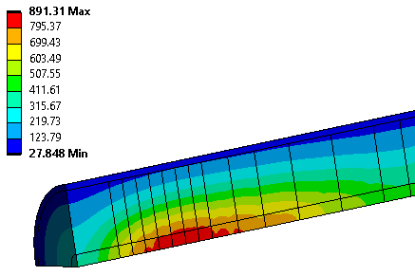
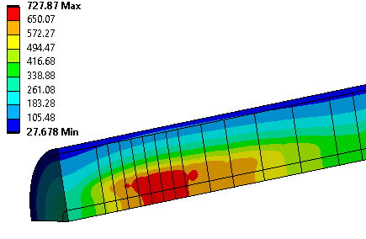
WP3 – BDF Target design
PREMATURE MODELS
with assumptions and simplifications
Alternative design – TZM&W blocks, TZM shell
Transient models
Diluted beam
Sweep
Maximum Temperature in Block 6
1000
Diluted beam
Sweep
Temperature [°C]
Max Temp: 700 °C
Max Temp: 900 °C
0
120
Position in radial axis [mm]
At plane of location of highest temperature

Slide 10
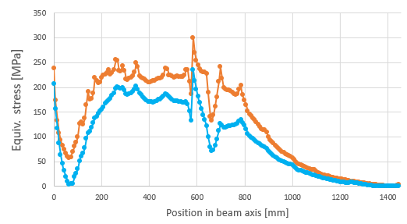
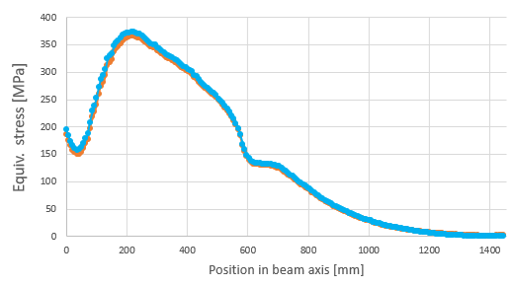
WP3 – BDF Target design
PREMATURE MODELS
with assumptions and simplifications
Equivalent stresses after 1 pulse
Alternative design – Initial approach
Center
350
The sweep significantly reduces the peak temperature compared to the diluted beam (Δ200⁰C)
The sweep reduces peak equivalent stresses by 70 MPa (down to 130 MPa) compared to diluted centrebeam
Diluted beam
Sweep
Equiv. Stress [MPa]
0
Position in beam axis [mm]
Shell
400
Diluted beam
Sweep
It is beneficial to have the blocks in contact.
The swept beam reduces the peak temperatures & stresses.
How would a full W target behave using this design?...
Equiv. Stress [MPa]
0
Position in beam axis [mm]

Slide 11
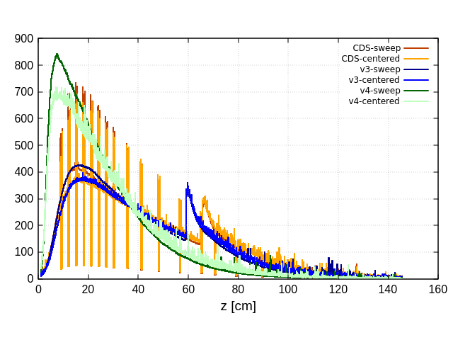
WP3 – BDF Target design
Alternative design – The full W target
Max energy deposition (J/cm^3)

Slide 12
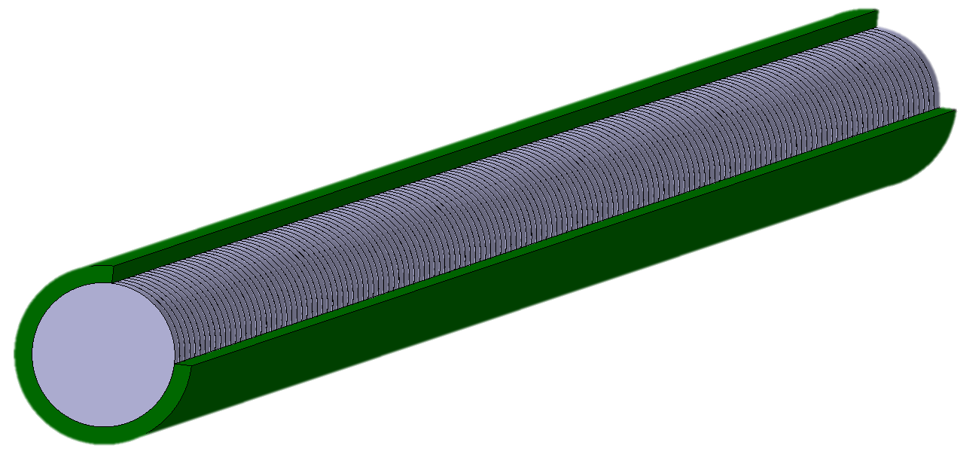
WP3 – BDF Target design
Alternative design – The full W target
Water cooling
TZM
All W! 10-mm slices
TZM shell
W
TZM
W
Water cooling
Beam direction
Full W compact target, encased in an actively cooled TZM shell.
The TZM discs in the baseline design are replaced with W. – Good for physics
The water-cooling channels in the baseline design are removed. – Good for operations
To achieve efficient heat evacuation, the W slices and the TZM shell are diffusion bonded by means of hot isostatic pressing (HIP). – better grain structure for mechanical properties
The thickness of the W slices is limited to the maximum capability through cold rolling.

Slide 13
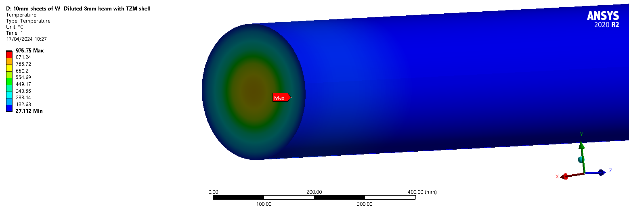
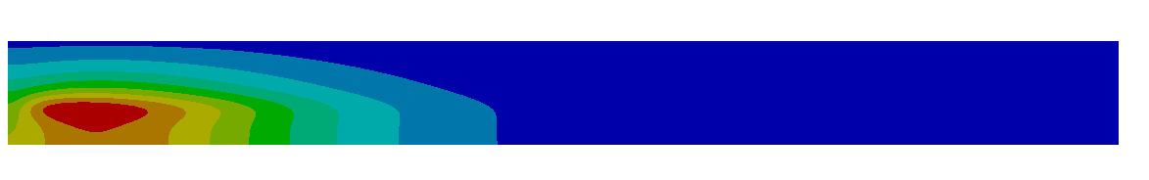
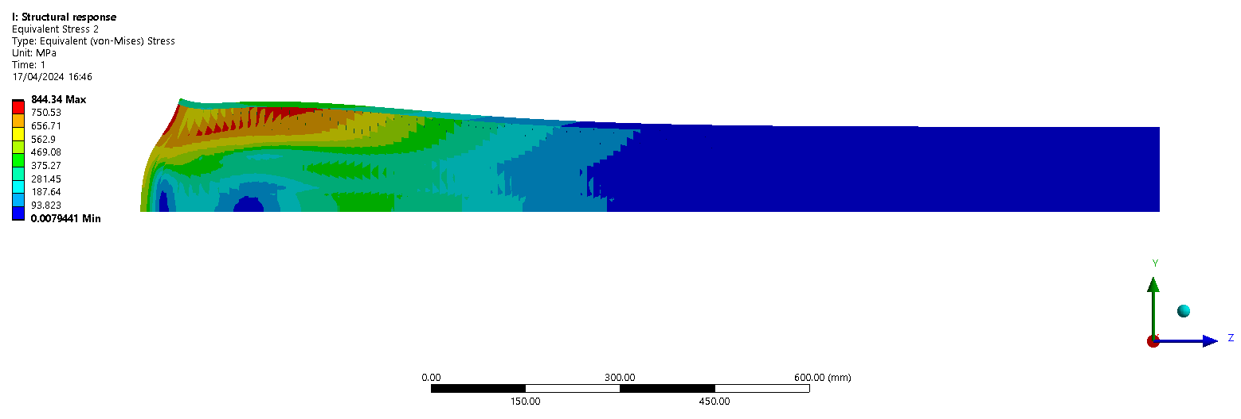
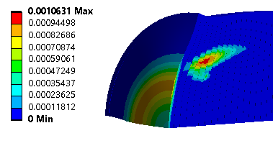
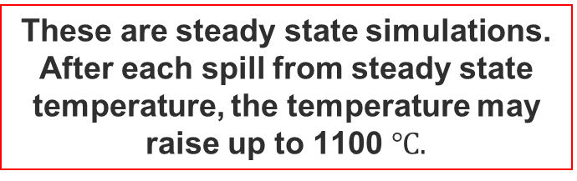
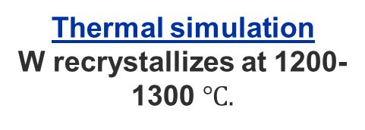
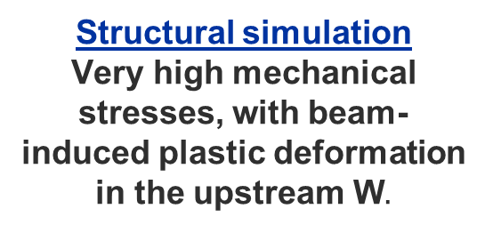
WP3 – BDF Target design
Steady state simulations!
Alternative design – The full W target
Temperature [Cº]
Thermal simulation
W recrystallizes at 1200-1300 $℃.$
Structural simulation
Very high mechanical stresses, with beam-induced plastic deformation in the upstream W$.$
Eq.Stress [MPa]
These are steady state simulations. After each spill from steady state temperature, the temperature may raise up to 1100 $℃.$
Plastic deformation
Eq.Plastic strain [mm/mm]

Slide 14
WP3 – BDF Target design
Alternative design – The full W target
A full W target core has improved physics performance…
..but the temperature in the W discs, and the beam-induced mechanical stresses must be reduced
- Currently, we are exploring alternatives to optimize the design of the full W target…

Slide 15
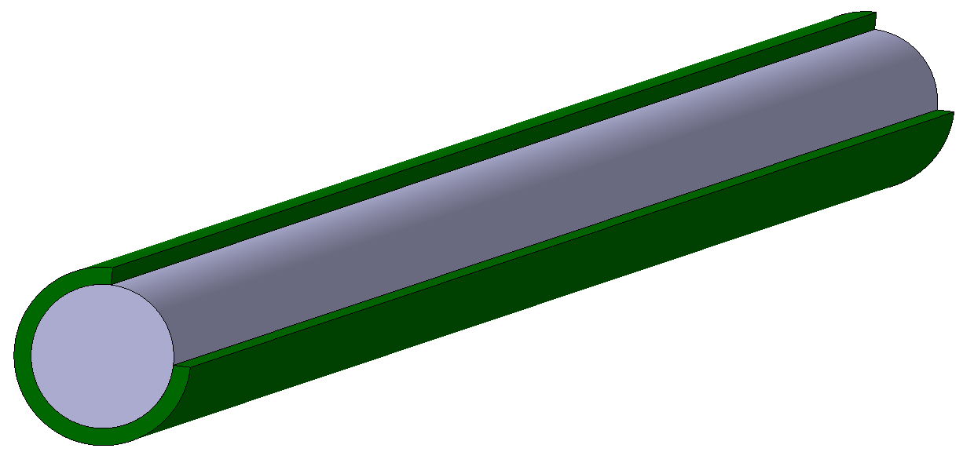
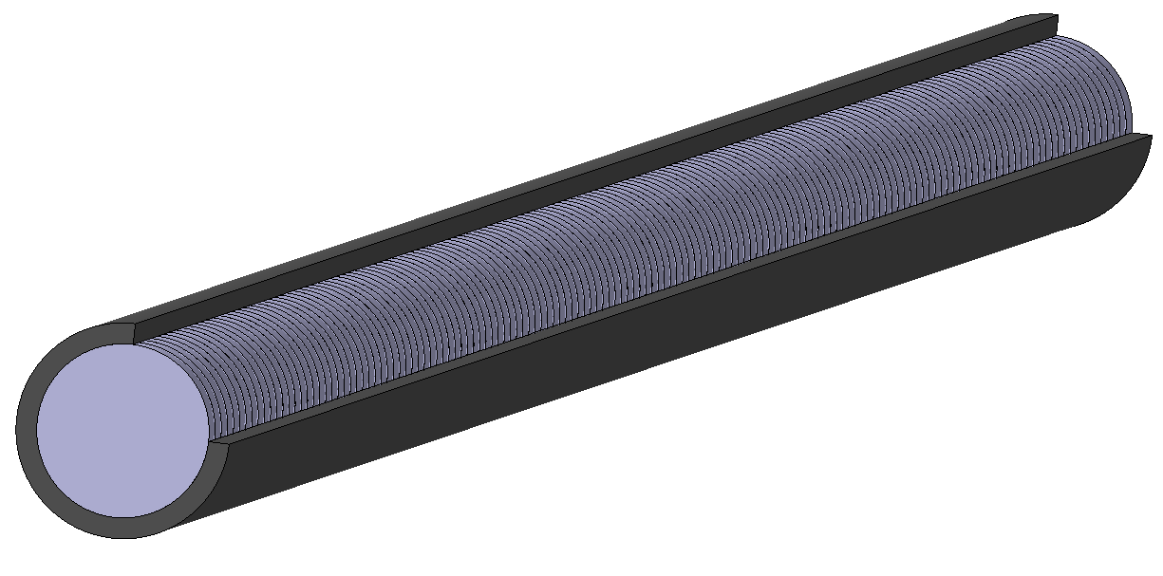
WP3 – BDF Target design
Alternative design – The full W target (exploring other options)
Single core W-target TZM shell
To improve the mechanical behavior in the W core.
H₂O
W-target – Ta shell
To improve the mechanical behavior in the shell.
Water cooling
H₂O
Beam direction
Water cooling
W-target – TZM shell
+ Upstream cooling
To reduce the upstream temperatures and therefore, beam-induced stresses.
H₂O
Alternative designs: Full W core
H₂O

Slide 16
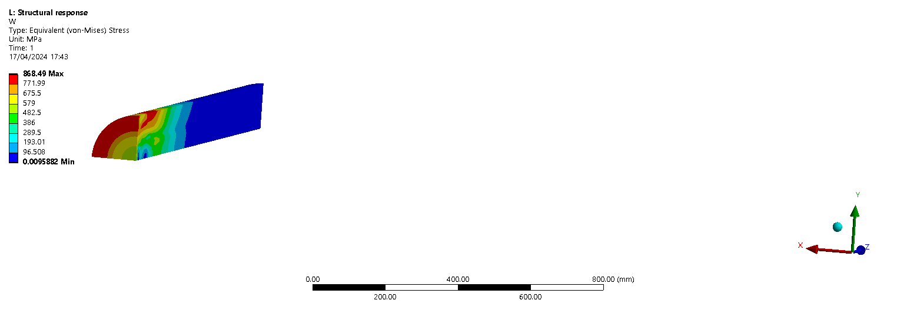
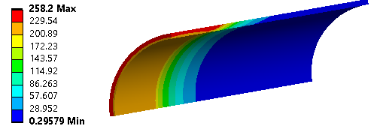
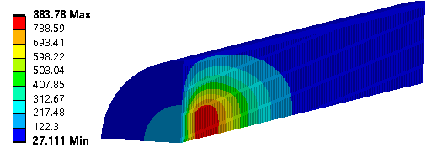
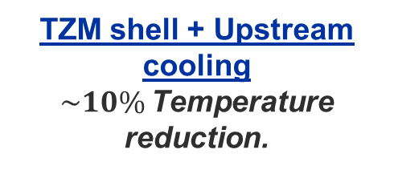
WP3 – BDF Target design
Alternative design – The full W target (exploring other options)
Single core W-target TZM shell
Similar stresses in core.
Water cooling
Eq.Stress [MPa]
Ta shell
Unacceptable mechanical stresses for Ta.
Beam direction
Water cooling
Eq.Stress [MPa]
TZM shell + Upstream cooling
$\sim 10\%$Temperature reduction.
Alternative designs: Full W core
Temperature [Cº]

Slide 17
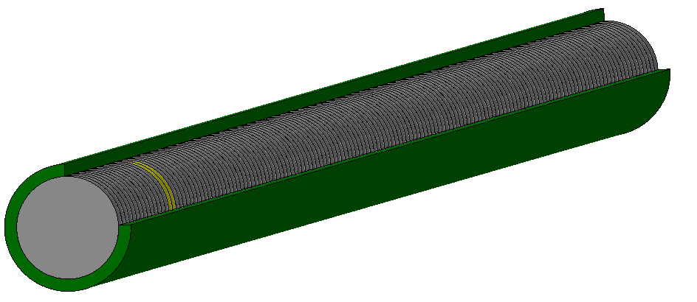
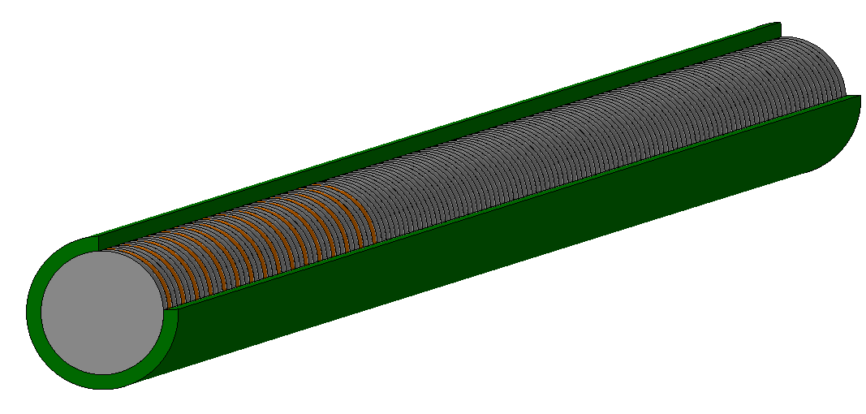
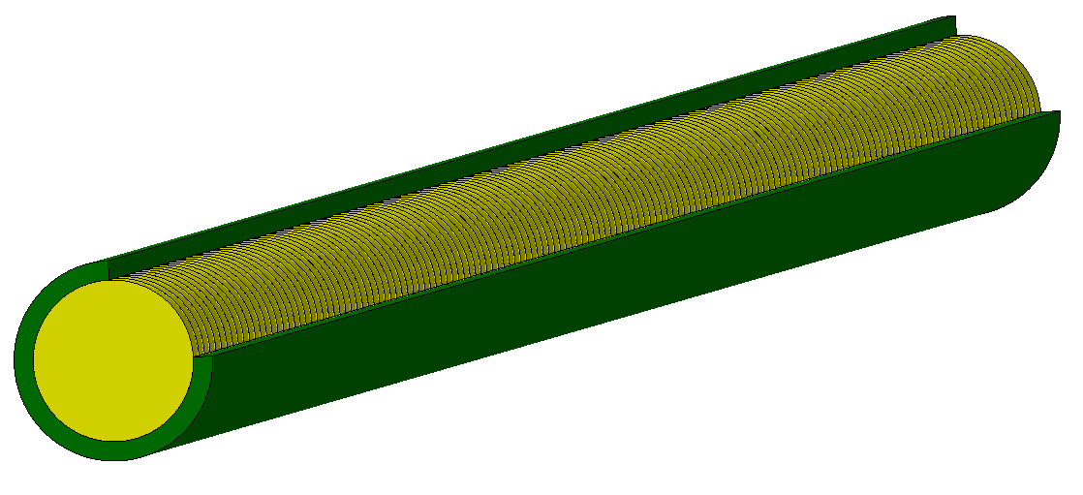
WP3 – BDF Target design
Alternative design – The full W target (exploring other options)
Gold sheets in peak energy density deposition
Enhance heat evacuation with two gold sheets in the location with the highest peak energy density deposition, while keeping the interaction length.
H₂O
Water cooling
H₂O
1-mm Copper slices between each W sheet
Enhance the heat evacuation in the upstream of the target
Beam direction
Water cooling
Alternative designs: Full W core with internal sheets
H₂O
The full Gold target
Enhance heat evacuation a full gold target while increasing the interaction length

Slide 18
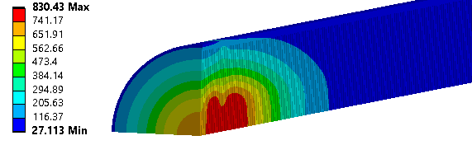
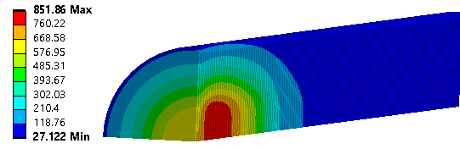
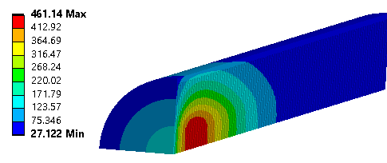
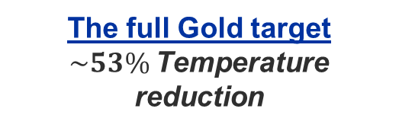
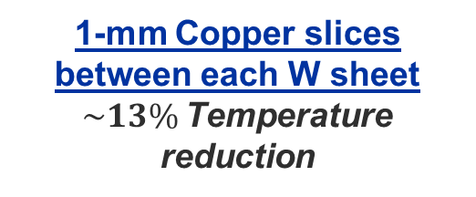
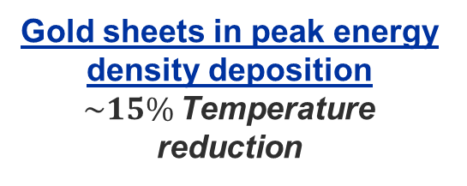
WP3 – BDF Target design
Alternative design – The full W target (exploring other options)
Gold sheets in peak energy density deposition
$\sim 15\%$Temperature reduction
Temperature [Cº]
Water cooling
1-mm Copper slices between each W sheet
$\sim 13\%$Temperature reduction
Beam direction
Water cooling
Temperature [Cº]
The full Gold target
$\sim 53\%$Temperature reduction
Alternative designs: Full W core with internal sheets
Temperature [Cº]

Slide 19
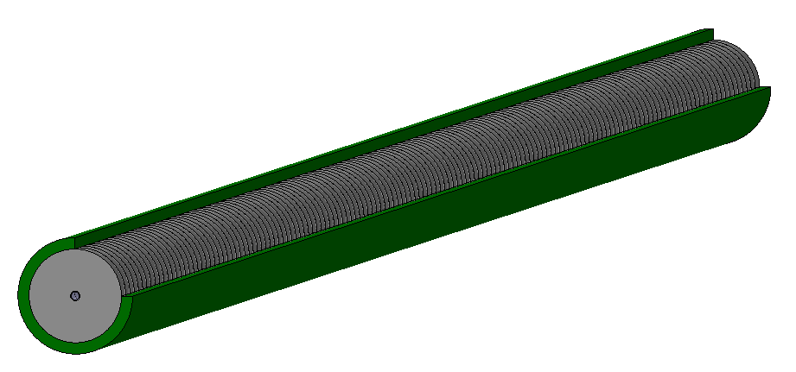
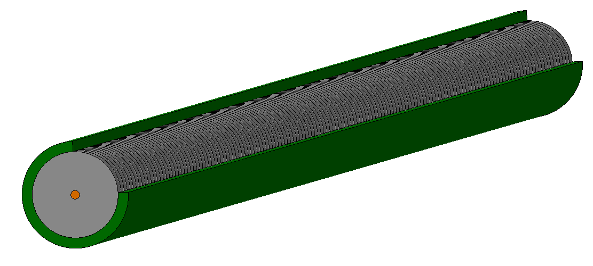
WP3 – BDF Target design
Alternative design – The full W target (exploring other options)
Ta pipe in the center with Water cooling
To enhance the heat evacuation by introducing a HIP Ta pipe in the center of the target.
H₂O
Water cooling
H₂O
Copper insert in the center
To conduct the heat towards the downstream of the target, where it could be evacuated by means of alternative cooling systems.
Beam direction
Water cooling
H₂O
Alternative designs: Full W core with inserts

Slide 20
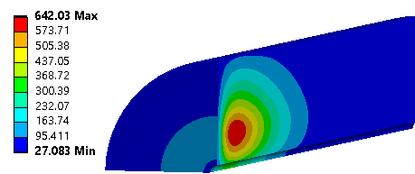
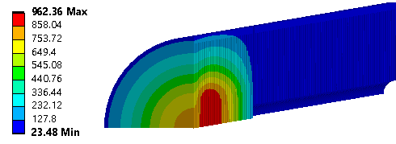
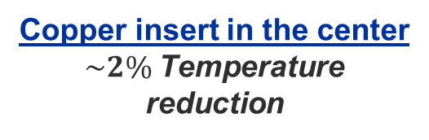
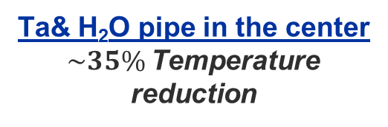
WP3 – BDF Target design
Alternative design – The full W target (exploring other options)
Ta& H₂O pipe in the center
$\sim 35\%$Temperature reduction
Water cooling
Temperature [Cº]
Beam direction
Water cooling
Copper insert in the center
$\sim 2\%$Temperature reduction
Alternative designs: Full W core with inserts
Temperature [Cº]

Slide 21
WP3 – BDF. More Alternative Target designs
-Helium cooling
W (non-clad) helium cooled, or mix of Helium and Water cooling
W
Ta cladding
Water cooling (with Ta cladding) at edges
W
beam
Helium cooling on faces
Helium
Water
Helium cooled blocks
Removes need for cladding
  In baseline design, Tantalum has high stress: residual from HIPing + thermal expansion in beam
  Tantalum bad for accident cases
Allows higher next-to surface local coolant temperatures (no risk of boiling)
-But HTC is lower than water
-Added cooling system complexity and cost
Studies are ongoing
21

Slide 22
Target Alternative Designs testing
Scaled representative target(s) will be tested in 400GeV beam in 2025.
Using the Test Stand base, and design of Test Stand top from the Baseline test in 2024
Option exists to test multiple alternative designs in beam.
Device movement
Test stand moved in/out of beam
Test stand movement
Test Target
Beam
Connections
Instruments
Water
Test Stand
Test stand setup in 2018.
Alternative options for test/stand in 2025
22

Slide 23
Conclusions
New alternative designs are being explored.
Target with increased W has improved physics
The elimination of the water cooling channels between the core discs:
  High stresses in cladding & issues of water in beam (with water channels) will have to be balanced against higher W temperatures and stresses in W (without water channels)
The introduction of high thermal conductivity materials such as Copper or Gold:
  Promising to reduce the temperature within the core.
  Issues of thermal expansion mismatch, gold has cost implication
We are also exploring “exotic” designs, such as cooling from the centre, or with helium. These studies are in a preliminary phase and may not be viable.
Variations on beam sigma & sweep radius, and target diameter will also be explored.

