Slide 1
Target complex introduction
HI-ECN3 BDF target & target complex initial review
Jean-Louis GRENARD – WP4
Acknowledgement: J. M. Martin Ruiz, C. Ahdida, M. Calviani, R. F. Ximenes , M. Fraser, R. Jacobsson, L. Krzempek, G. Mazzola, C. Mucher
29-04-2024

Slide 2
Target Complex presentations - goal
Set the scene with the current design
Highlight the key challenges
Detail ongoing and foreseen studies during the TDR phase
Identification of missing or unclear areas
Needs of technologies development

Slide 3
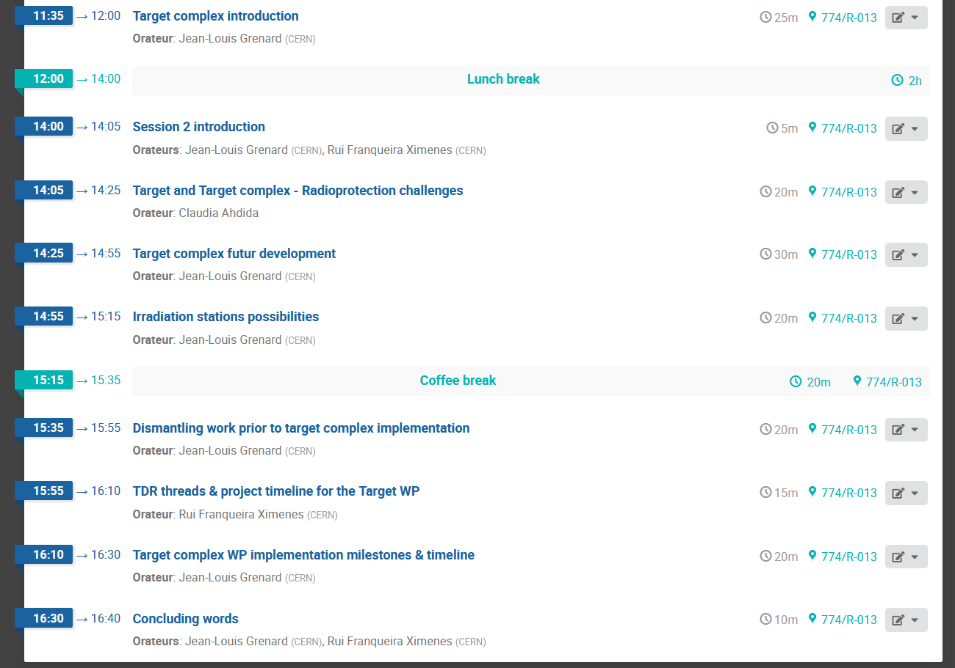
Target complex agenda

Slide 4
What do we call Target Complex?
The target area
  Target station which contain the target
  Associated shielding
  The space to perform target maintenance activities (inspections, replacement, repair…)
  Remote handling equipment (crane, spreaders, mobile robots)
  Confinement(s)
The target service building
  Air handling units
  Cooling stations
  Controls systems
  The space to perform post irradiation examination and preparation for target (and other activated components) final disposal

Slide 5
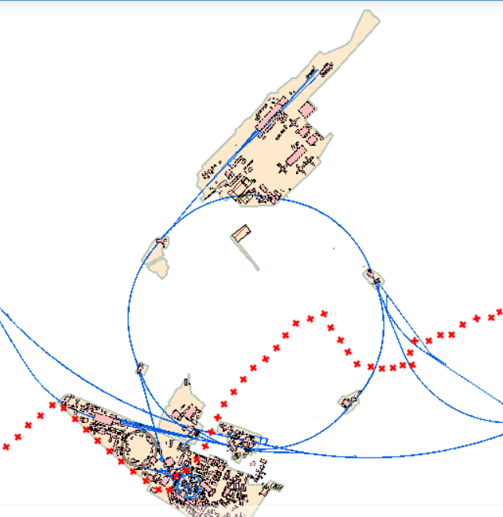
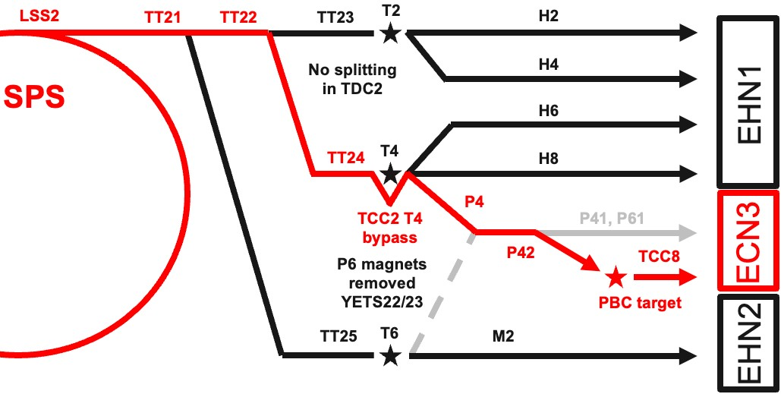
Target Complex in an existing facility
ECN3
Implementation in the SPS North Area ECN3 designed at construction in 70’s for a High Intensity (NAHIF)
Currently used by NA62 experiment
SPS North Area beam lines and associated infrastructure being currently consolidated
Would require the dismantling fraction of current beam line, target station, the experiment
Only one target station can be accommodated in the cavern
SPS extraction
towards North Area
CERN
Prevessin site
SPS
ring
CERN
Meyrin site

Slide 6
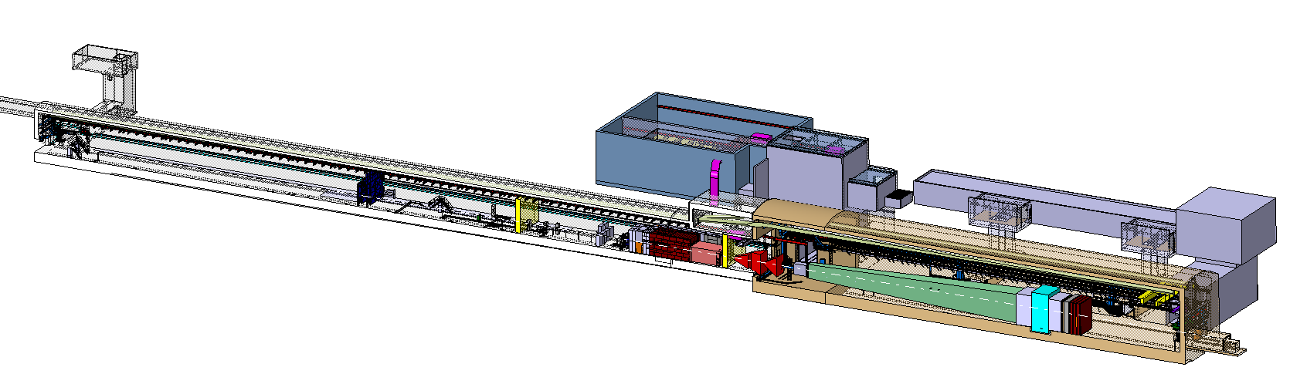
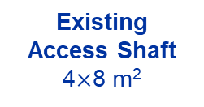
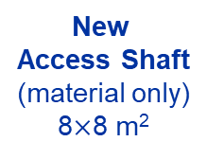
BDF/SHiP Target & Complex
New
Service Building
~ 500 – 700 m²
New
Access Shaft
(material only)
8$×$8 m²
Existing
Access Shaft
4$×$8 m²
B911
B918
Beam Dilution System
TCC8
New Target Complex
containing the Beam Dump Target
ECN3

Slide 7
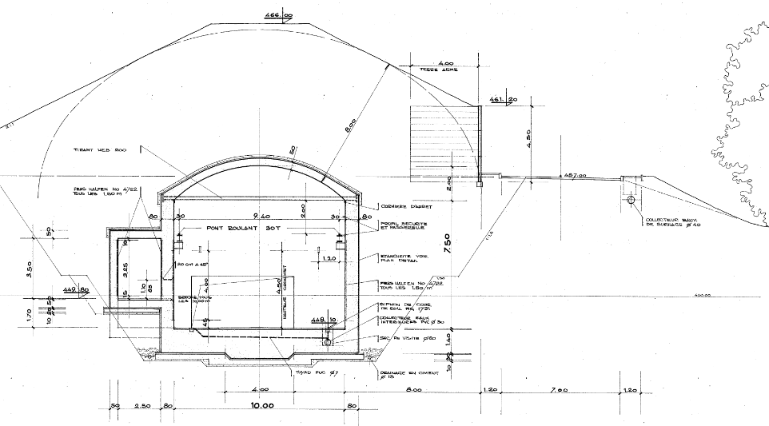
The TCC8 area
8m soil
~10m bellow ground
TCC8 cross section (length 170m)

Slide 8
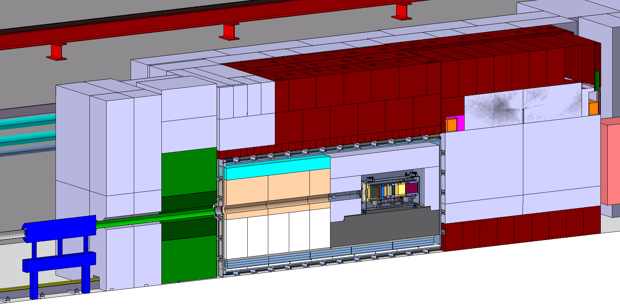
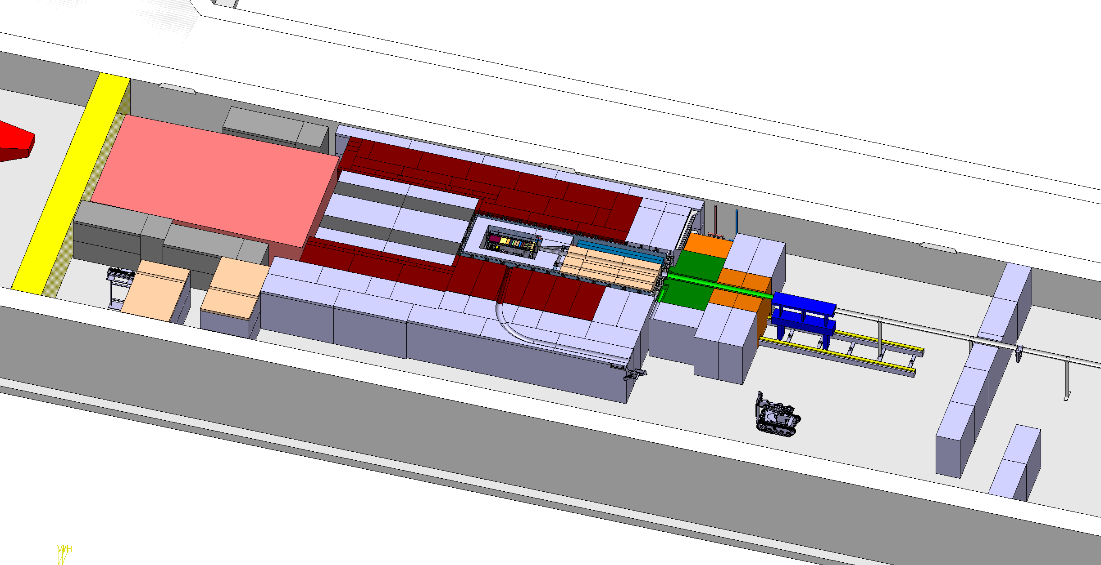
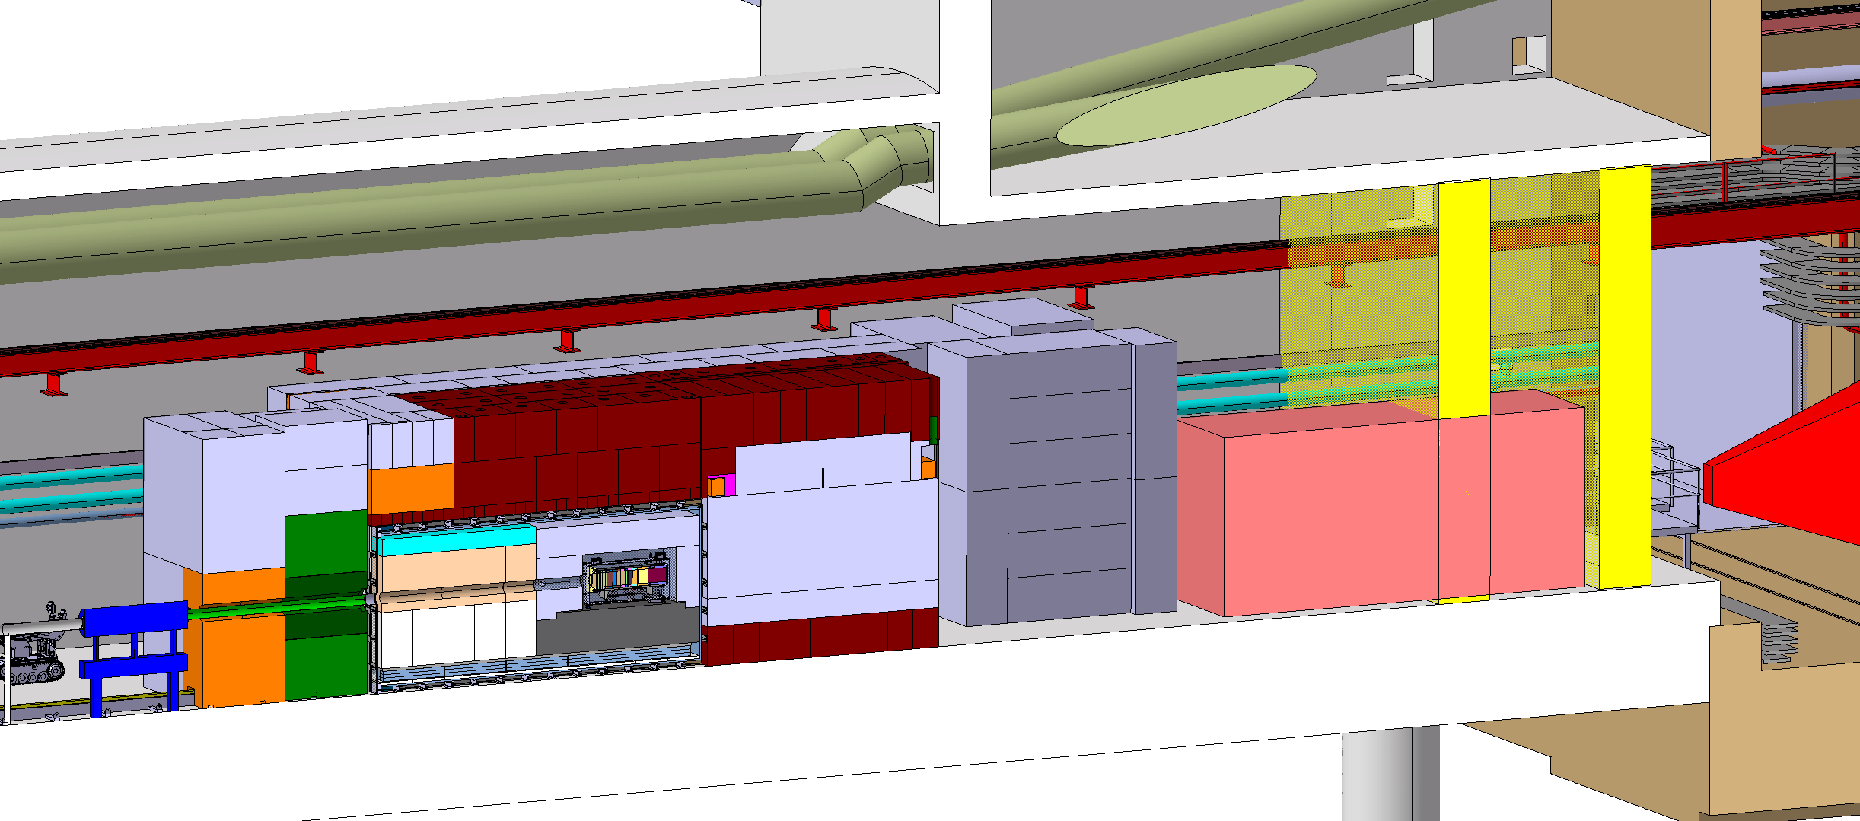
BDF Target complex integration
Upstream Shielding
Above Coil Shielding
Target area
Confinement wall
Magnetized
shielding
Beam instrumentation
Diluted Proton beam from SPS
Water cooled proximity shielding
Mobile Shielding
Vacuum confinement
Target
Collimator
Target station
SHIP experiment
Access chicane
Space for shielding temporary storage

Slide 9
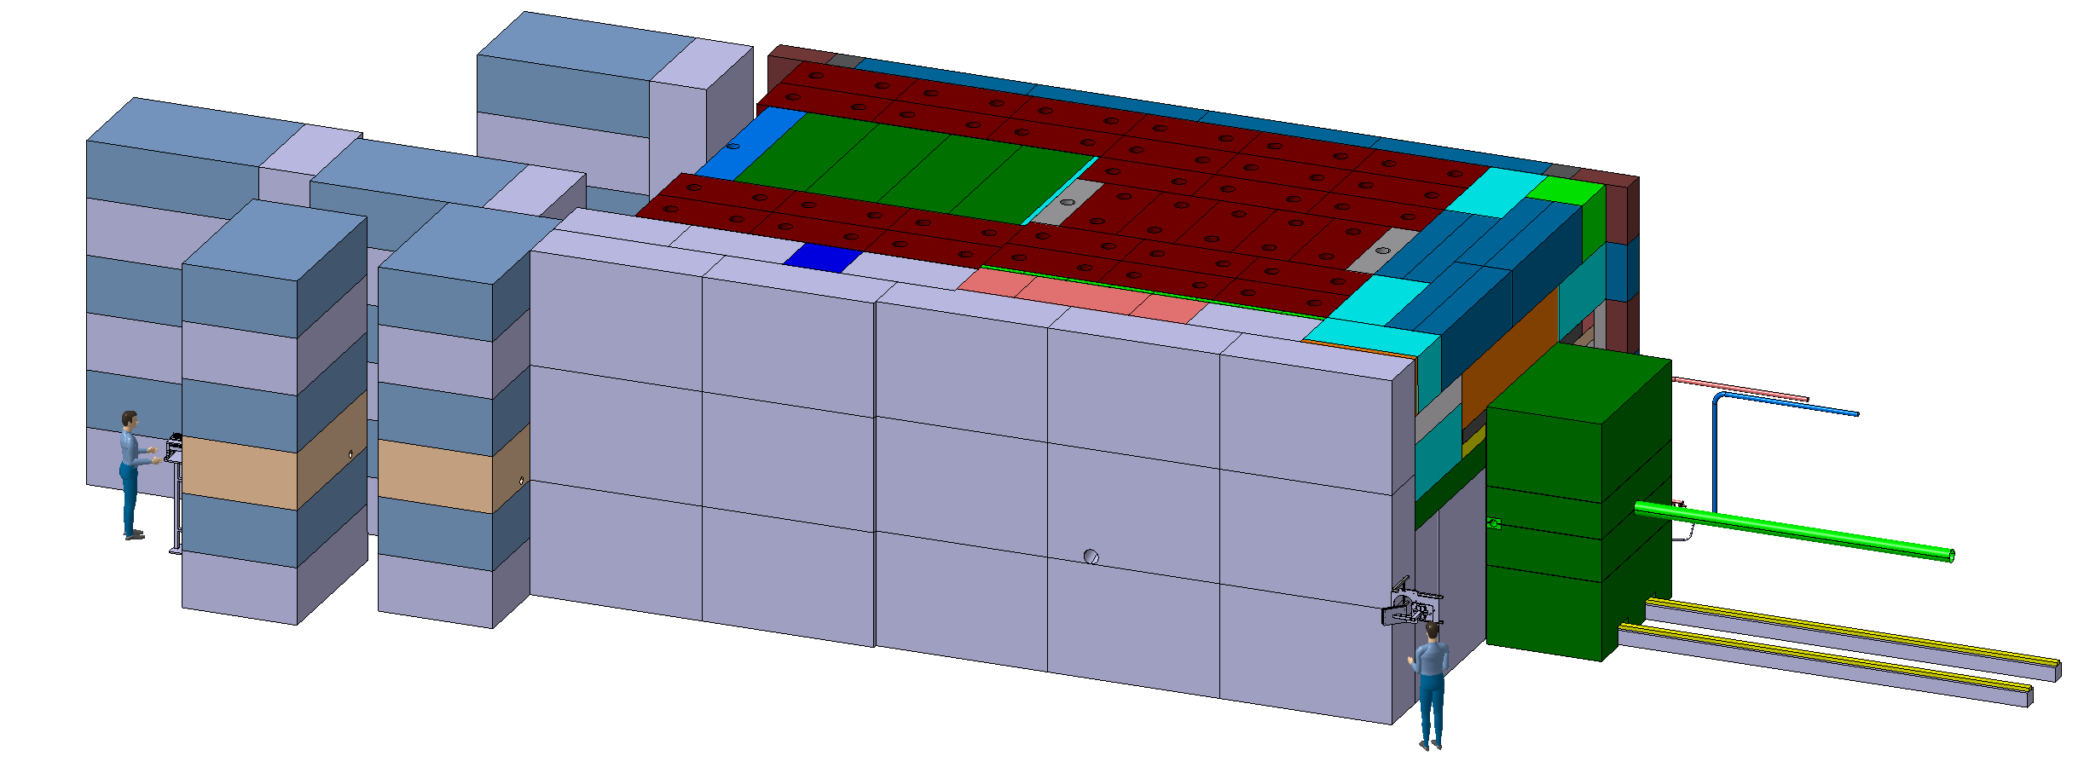
BDF Target complex integration - shielding
~4,8m
~8m
~ 180 m³ (~1400t) of cast iron + US1010
~ 360 m³ (~800t) of concrete / marble
~12m

Slide 10
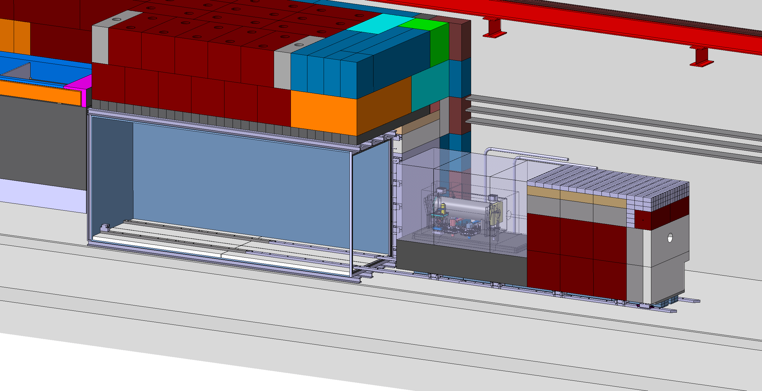
BDF Target complex integration extraction

Slide 11
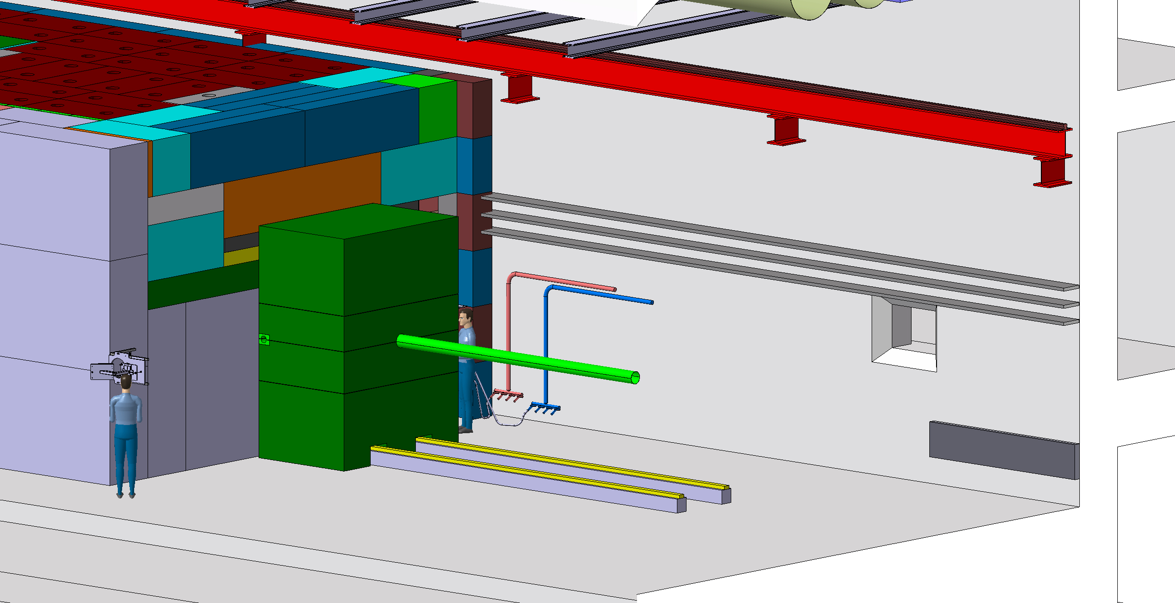

Slide 12
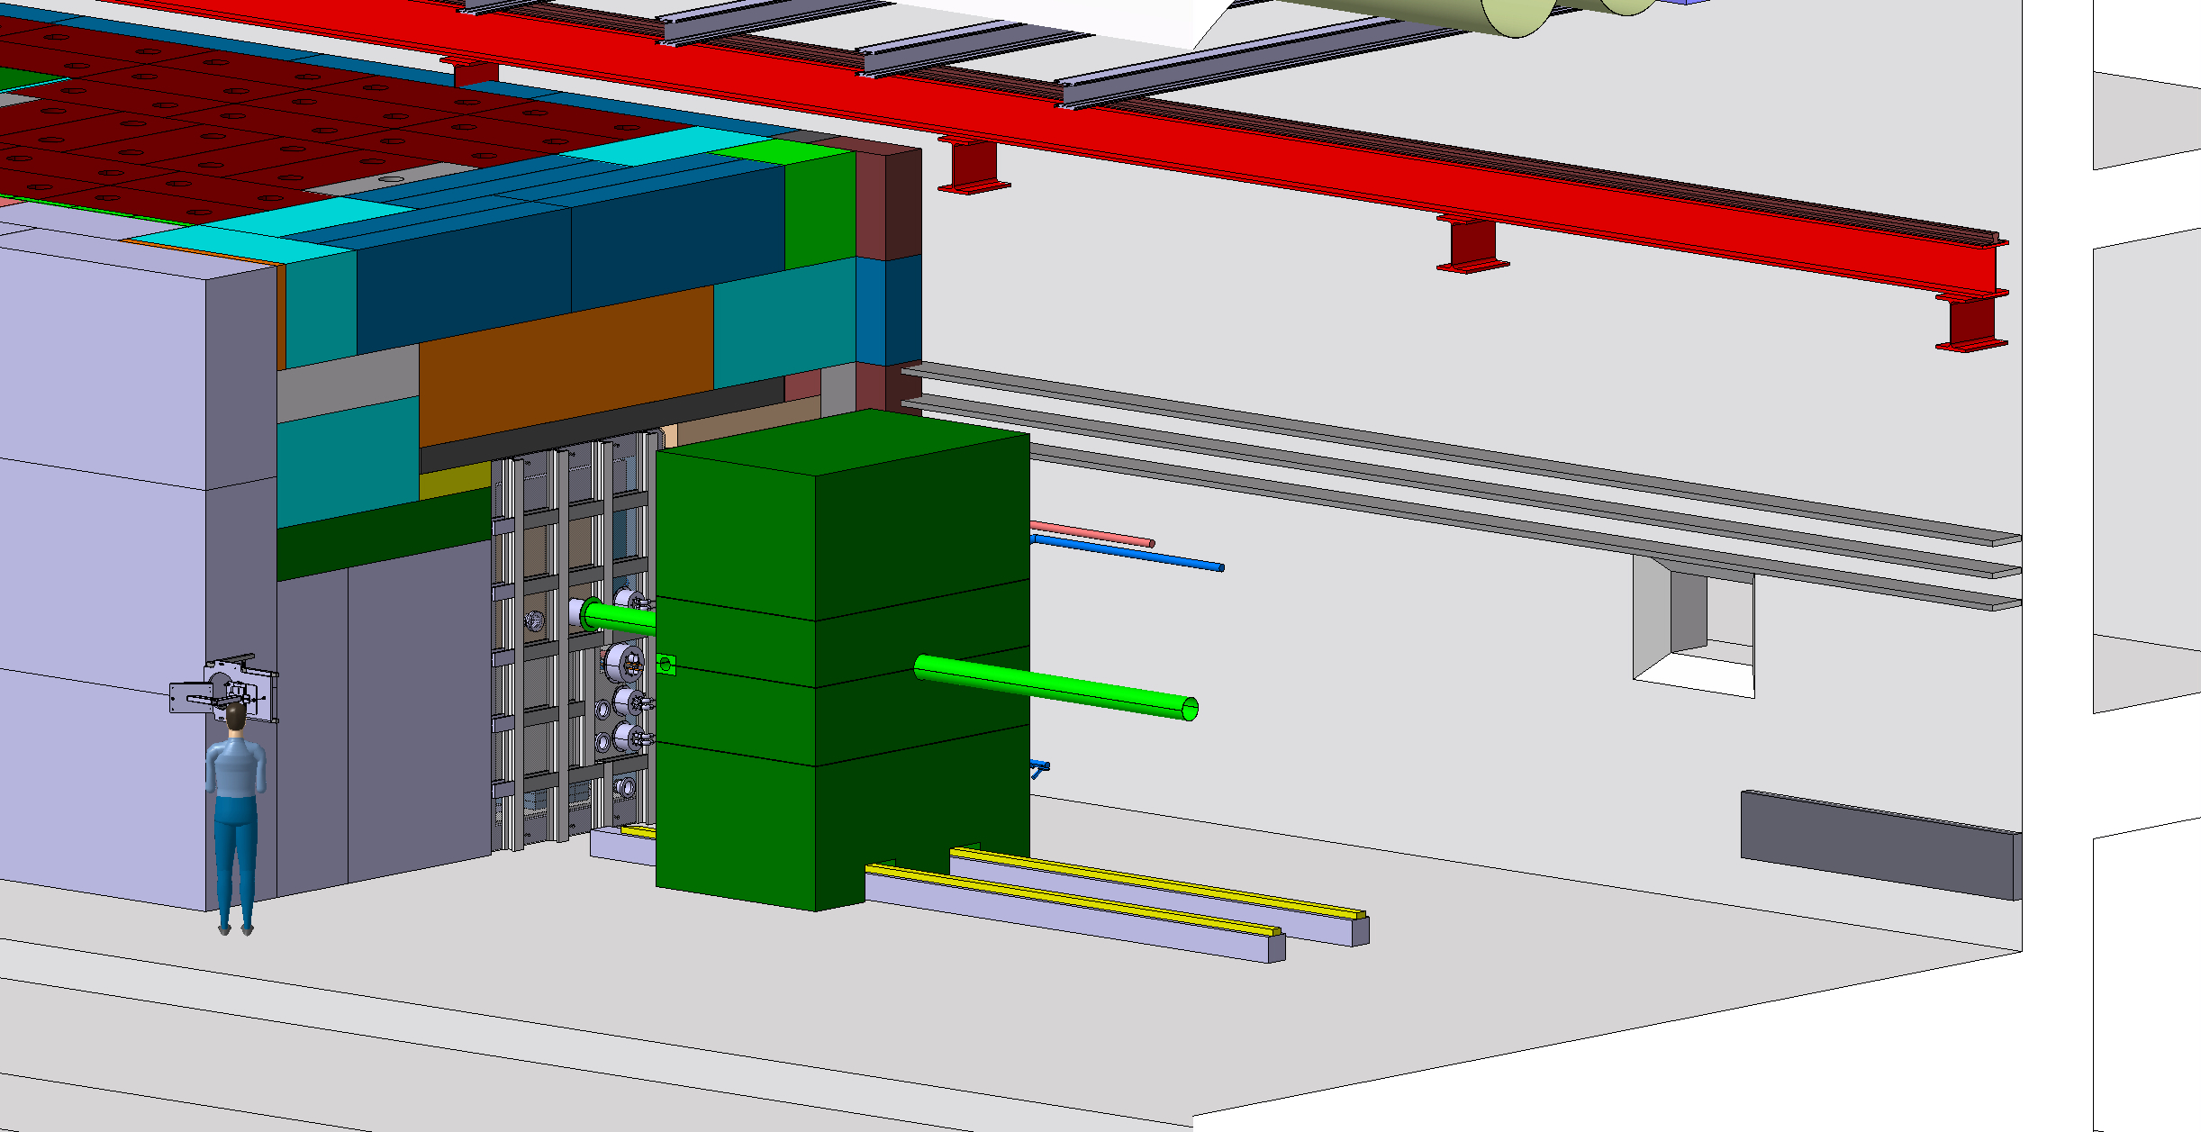

Slide 13
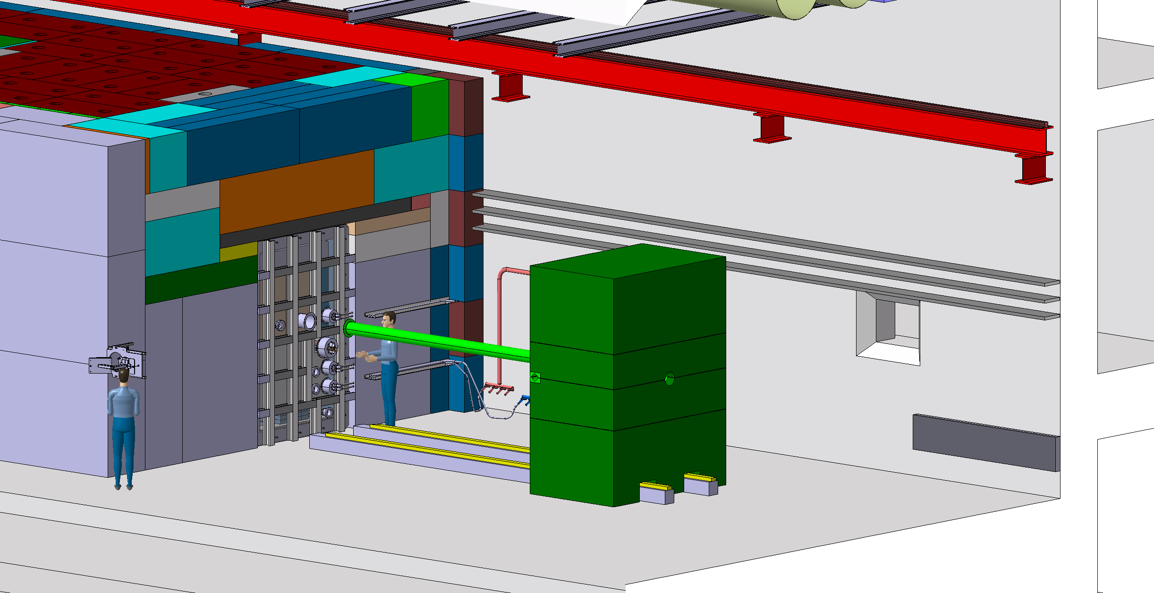

Slide 14
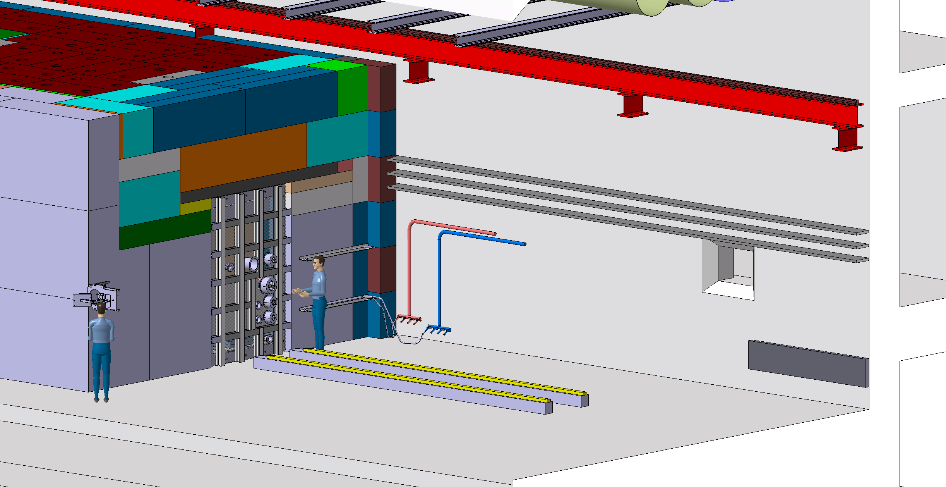

Slide 15
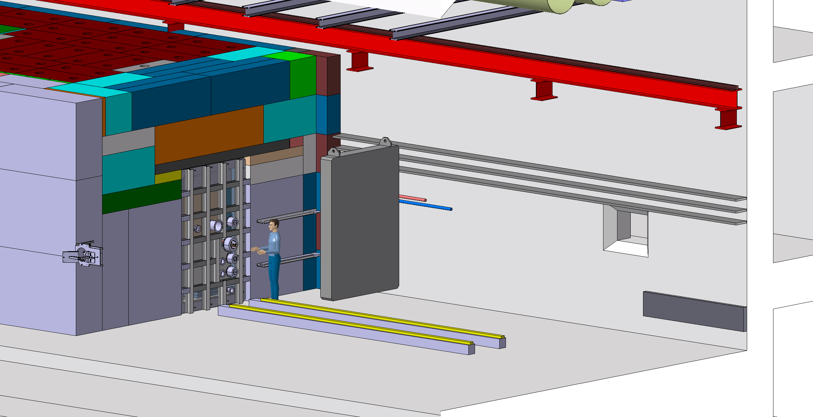
Installation of lifting tool
which include shielding

Slide 16
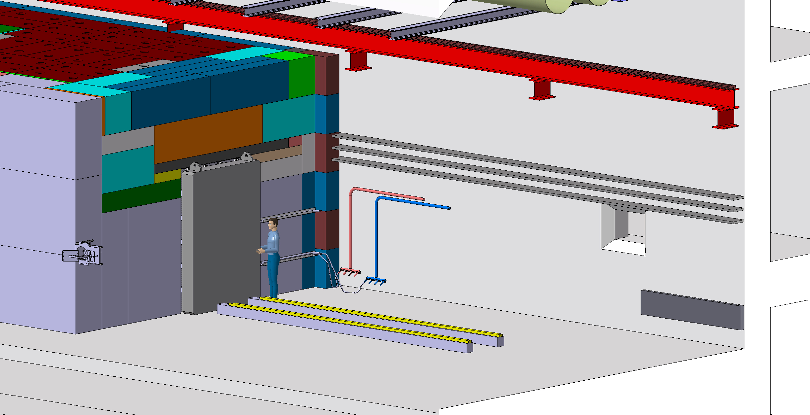

Slide 17


Slide 18
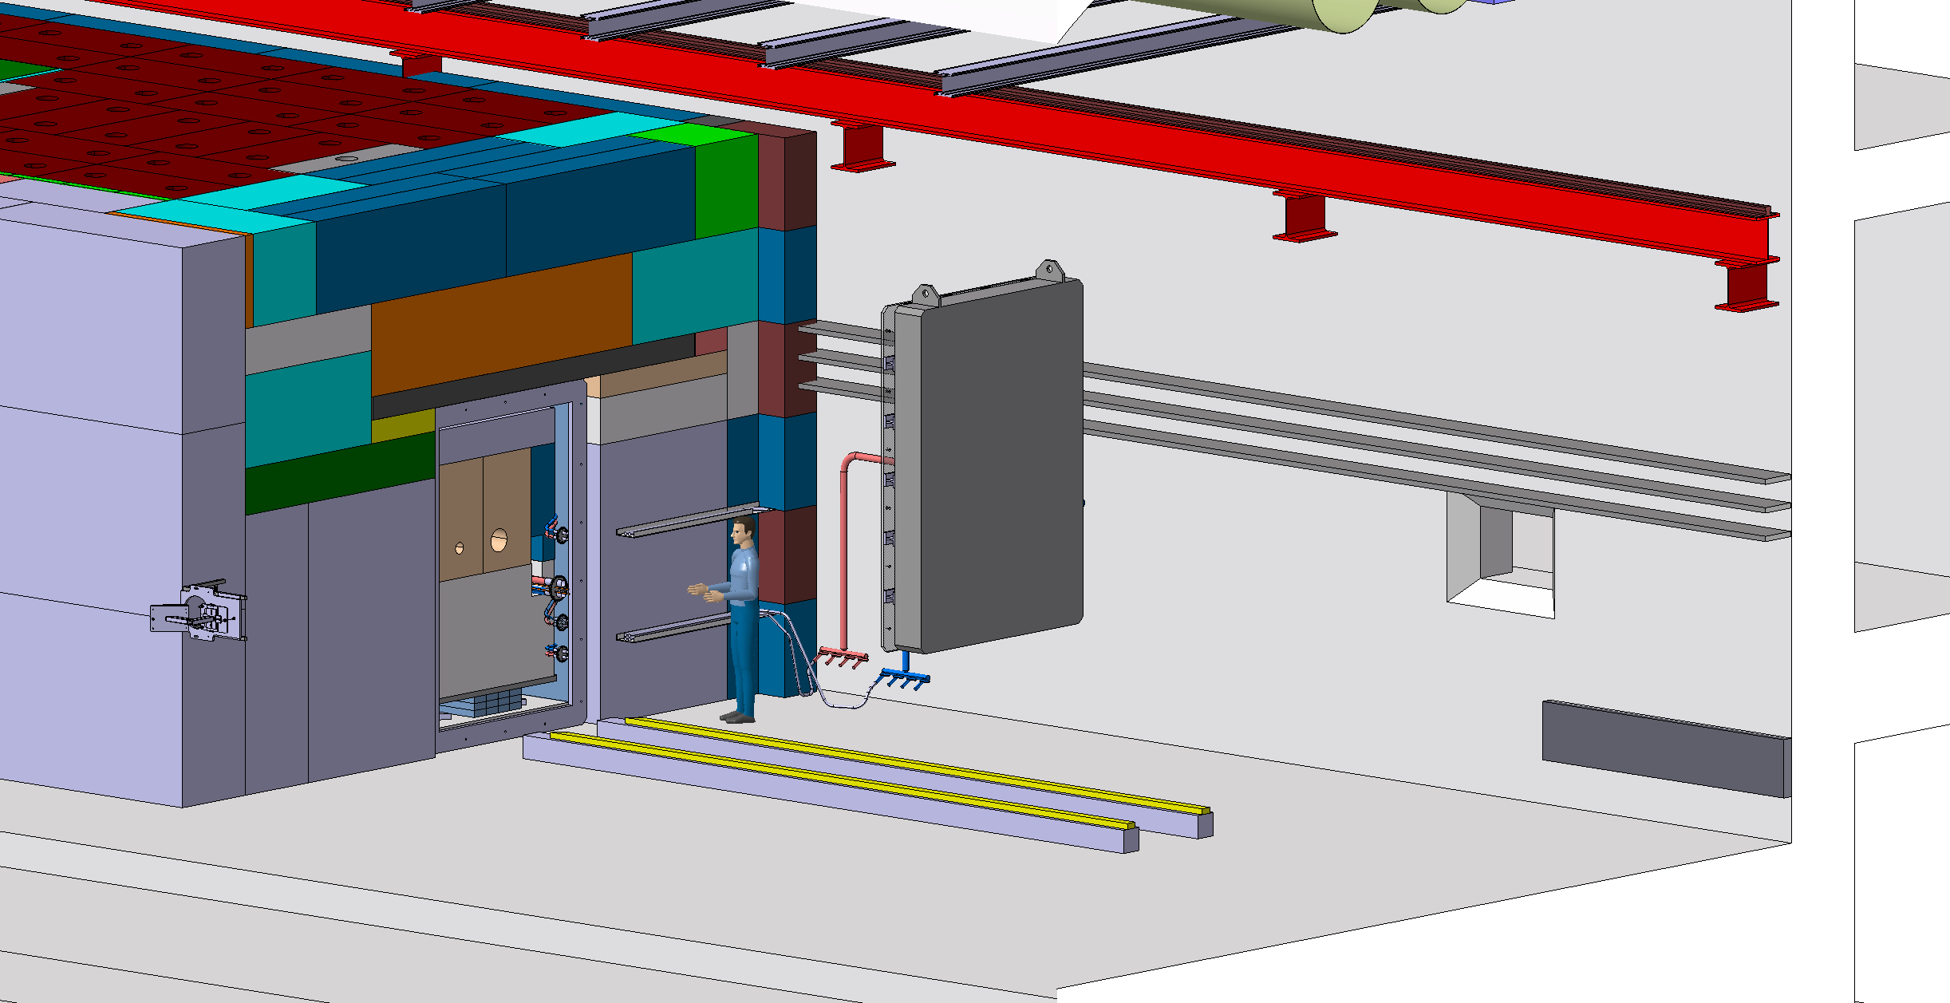

Slide 19
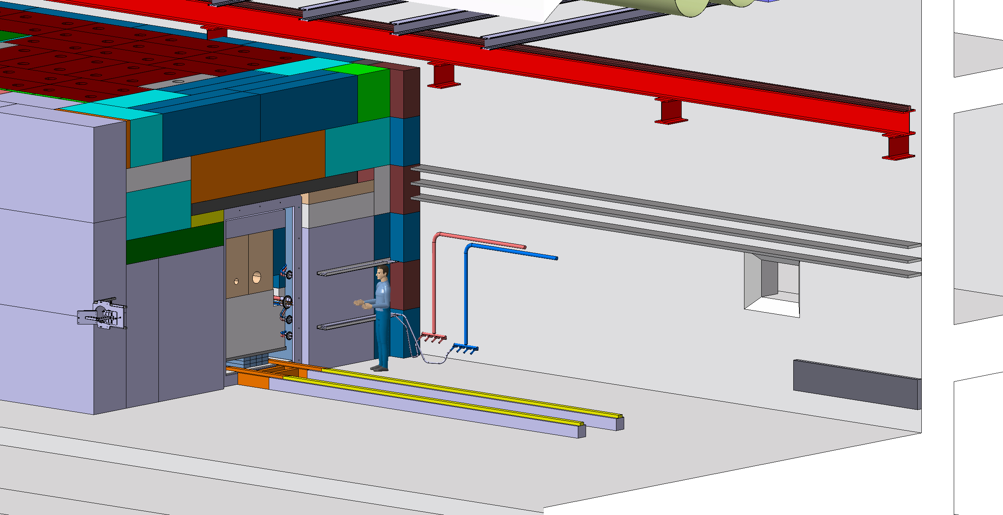

Slide 20
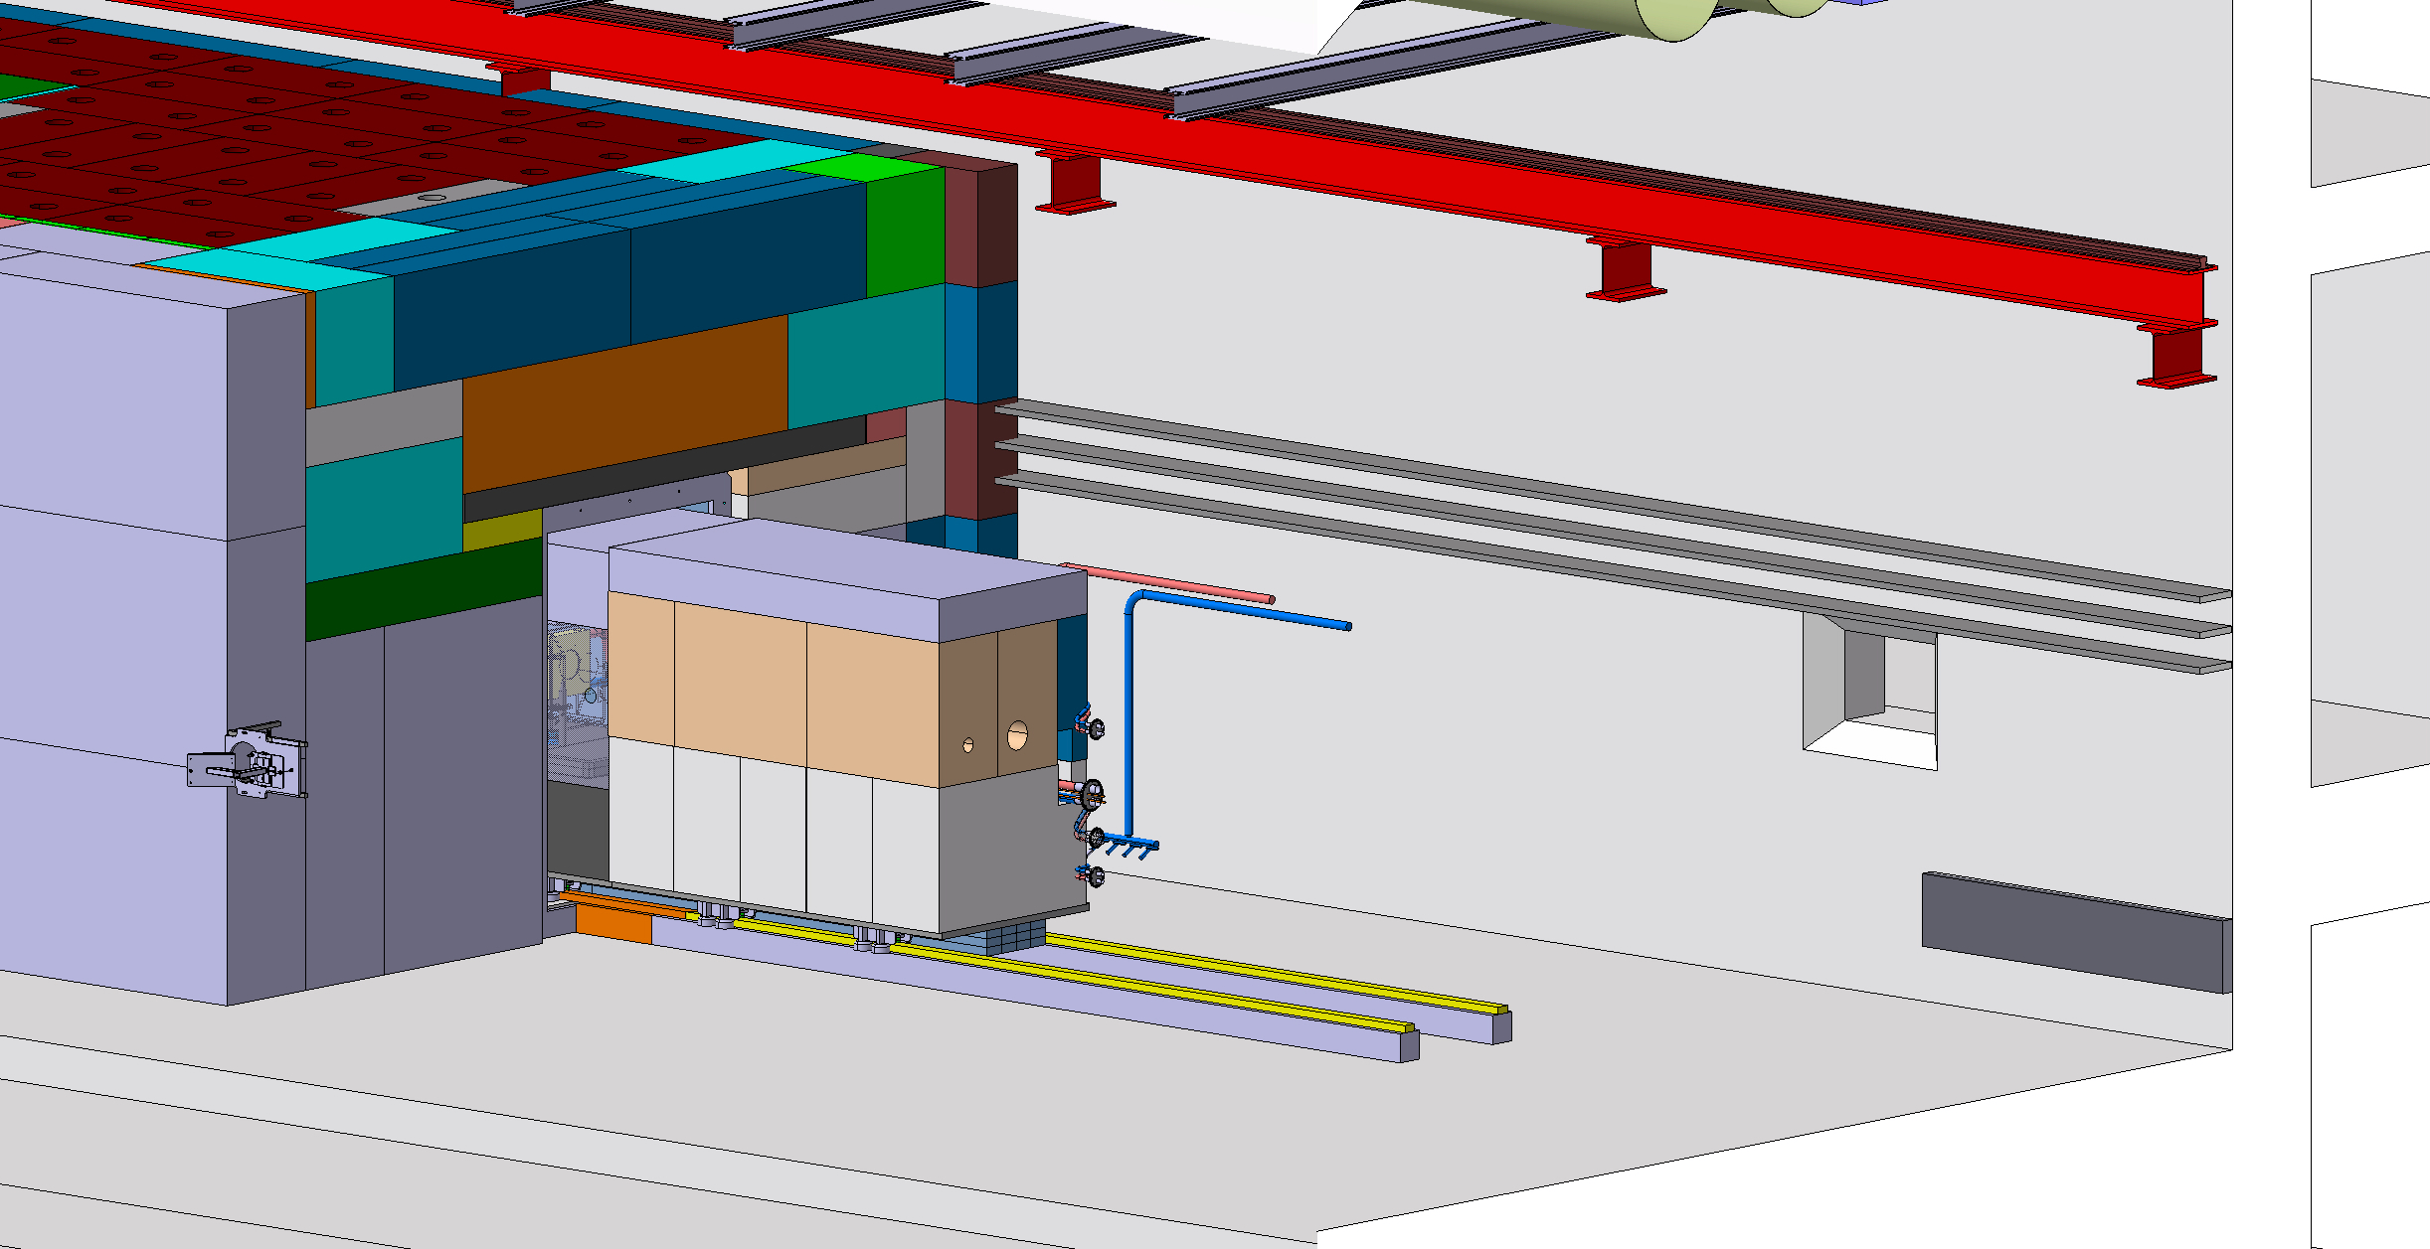

Slide 21
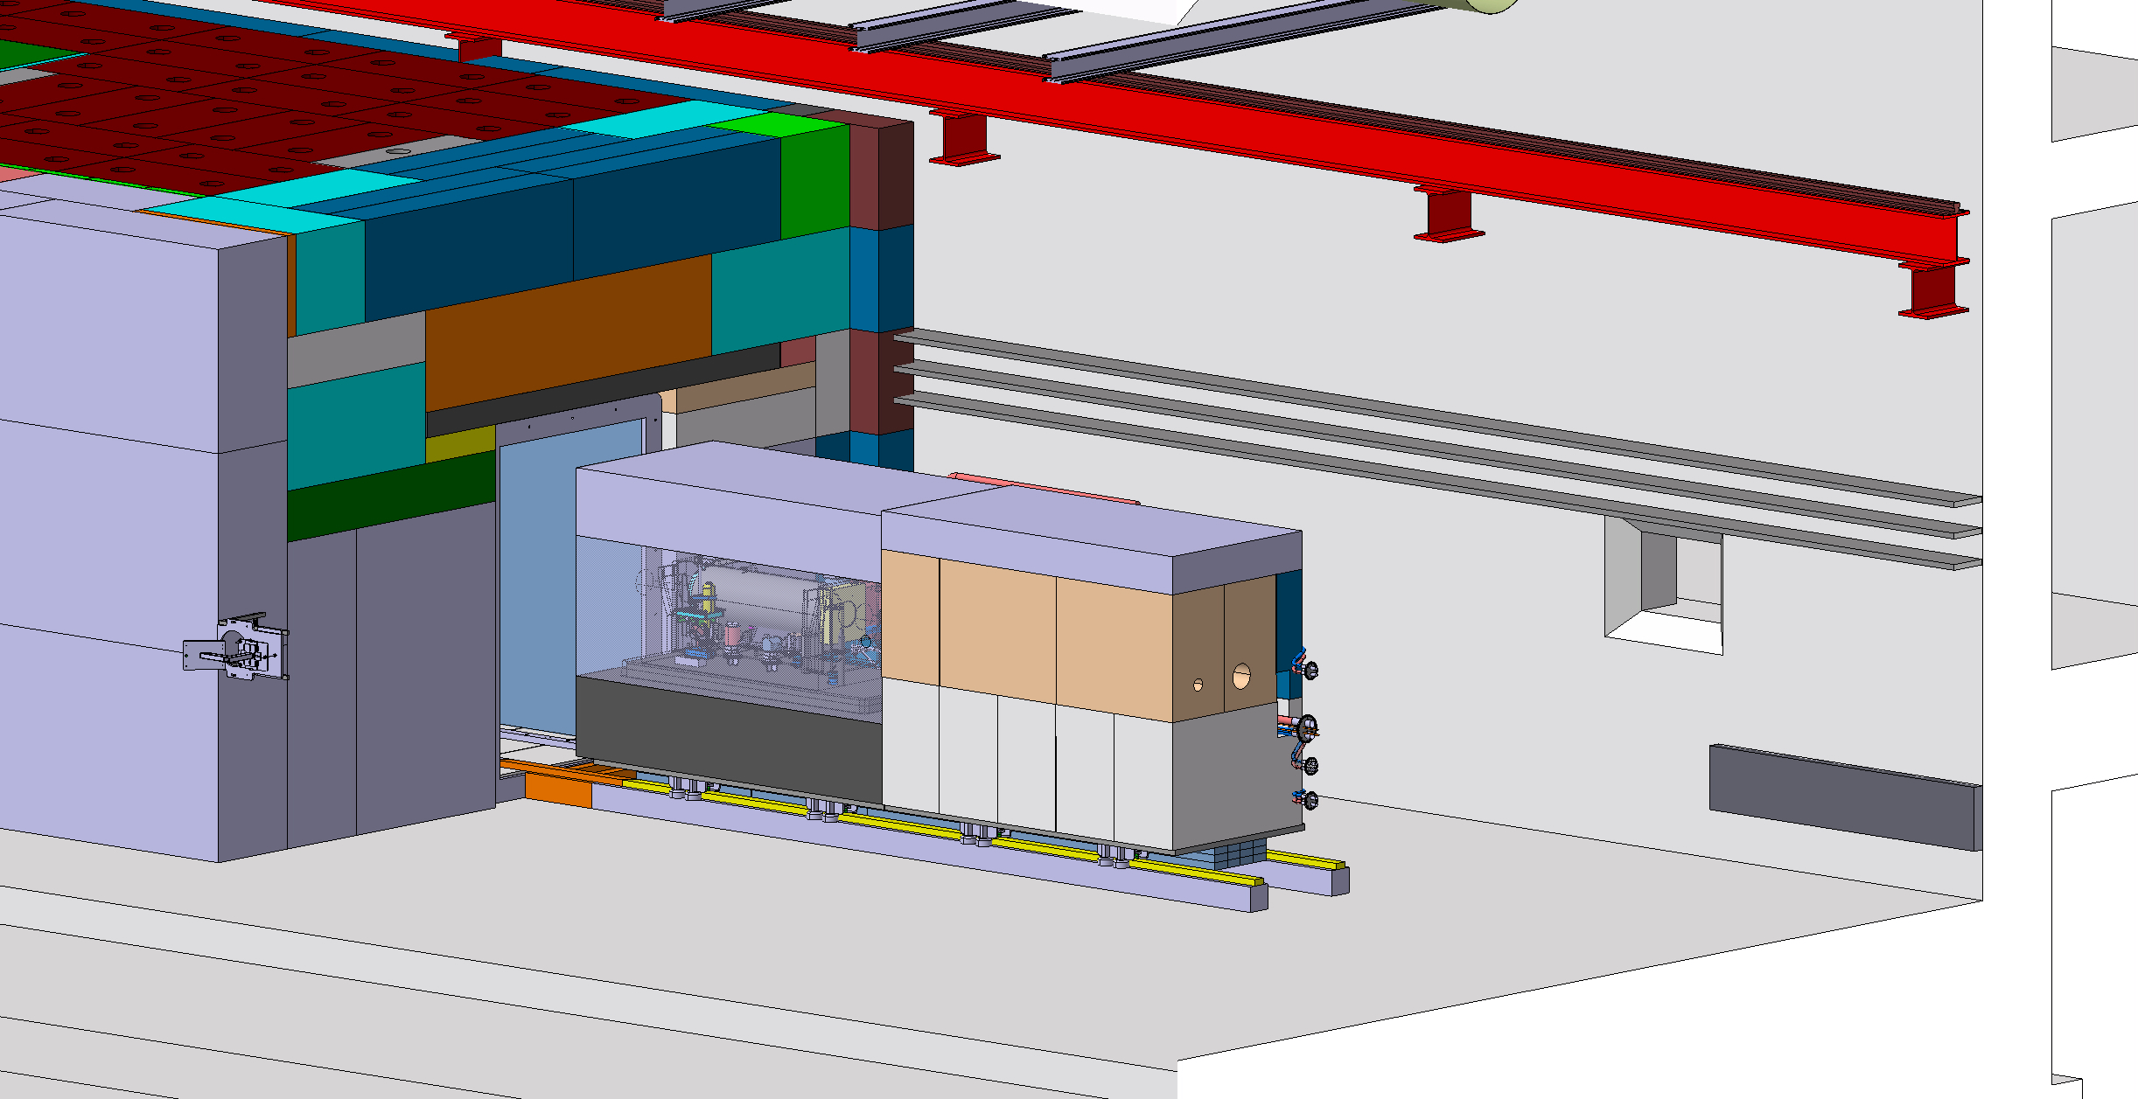

Slide 22


Slide 23
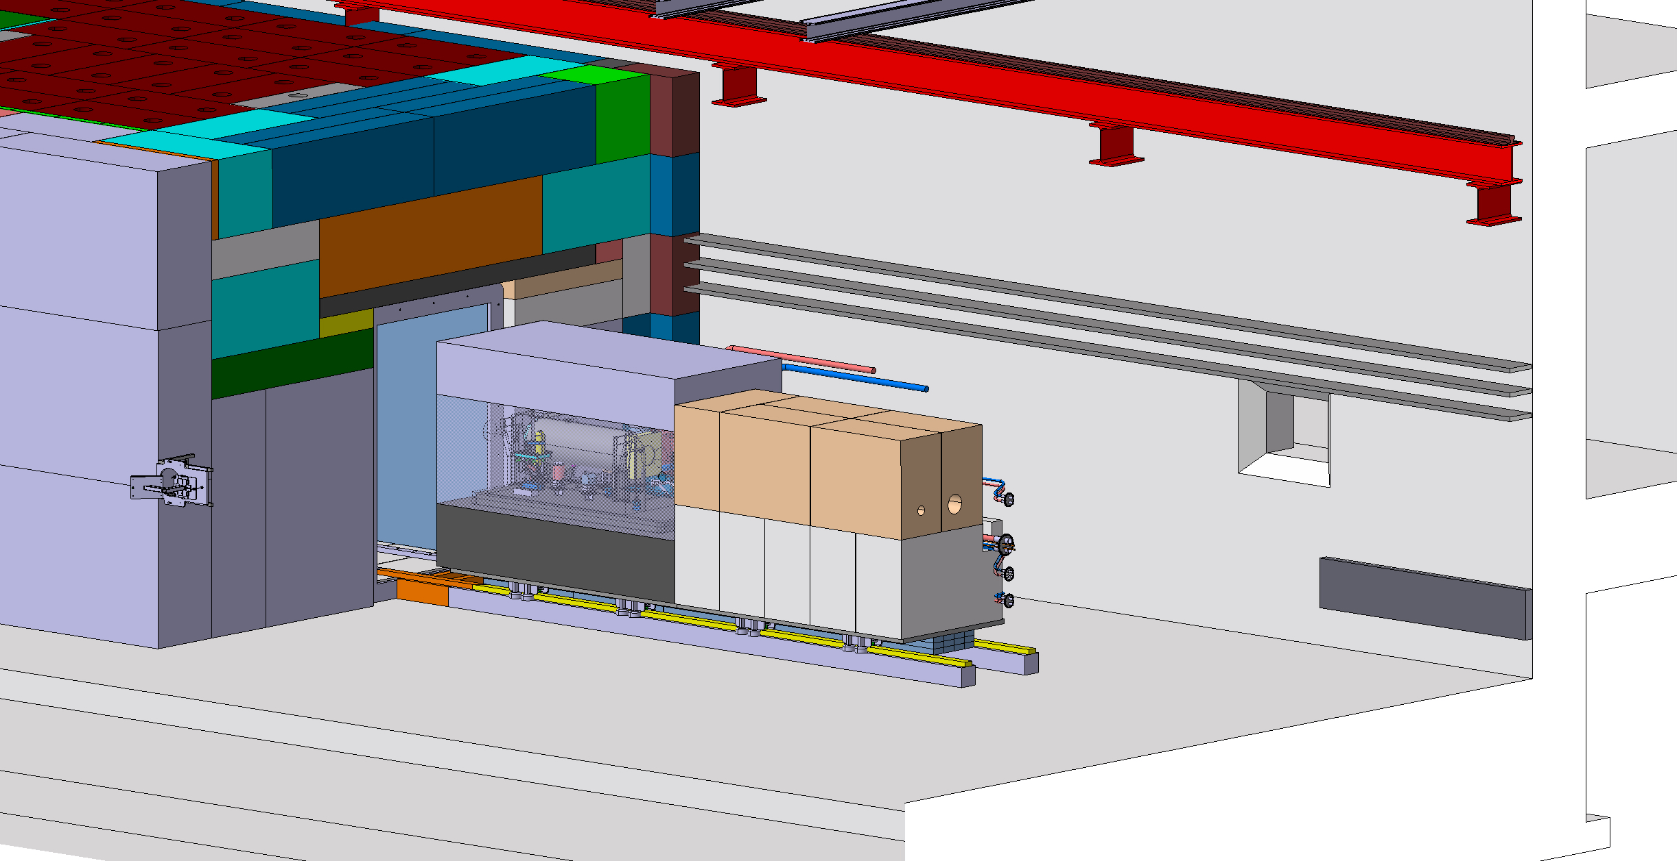

Slide 24
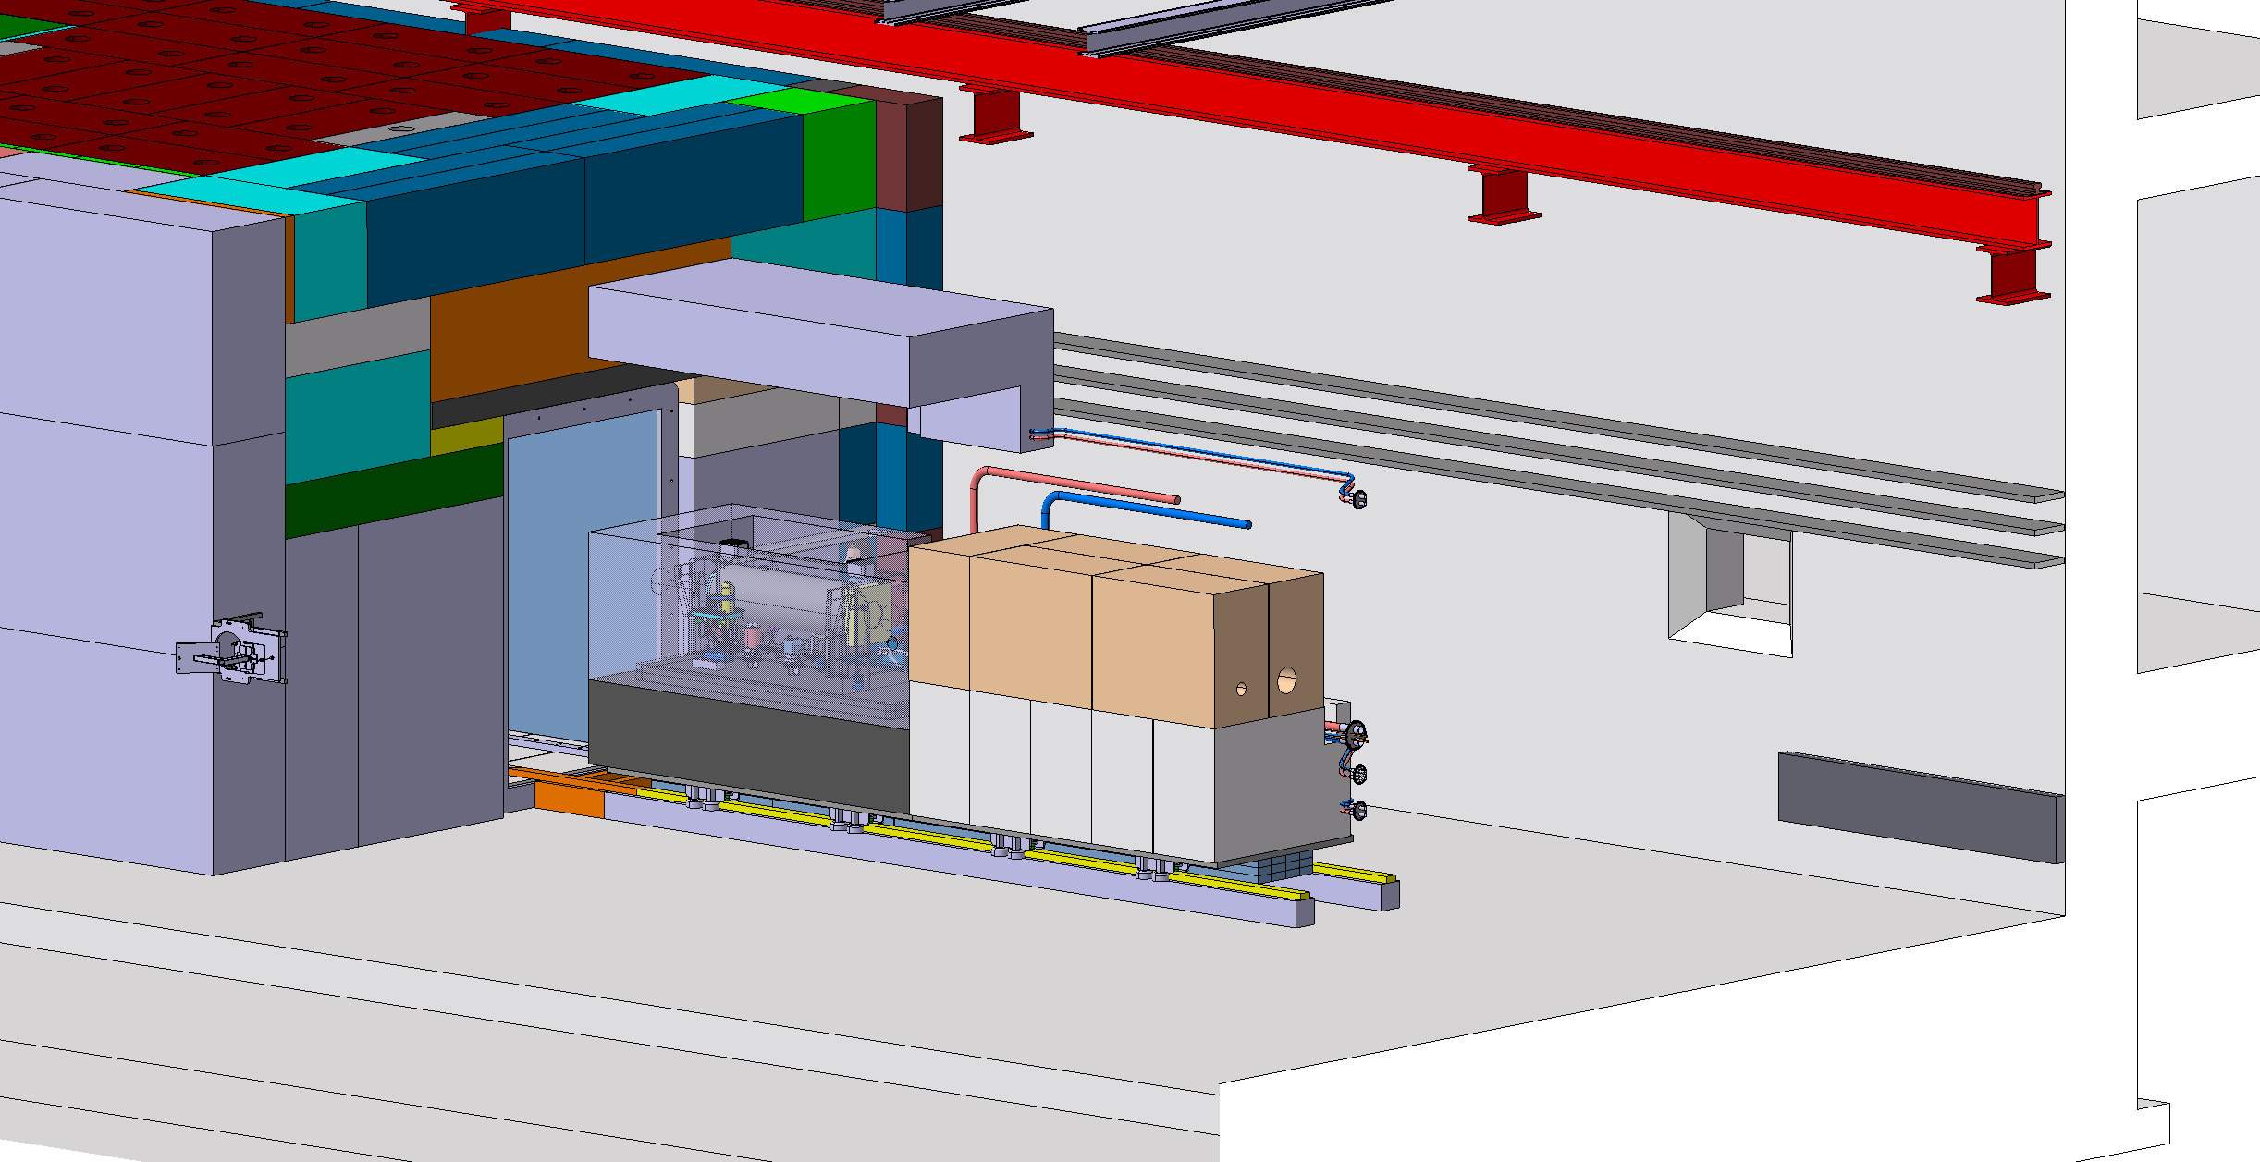

Slide 25
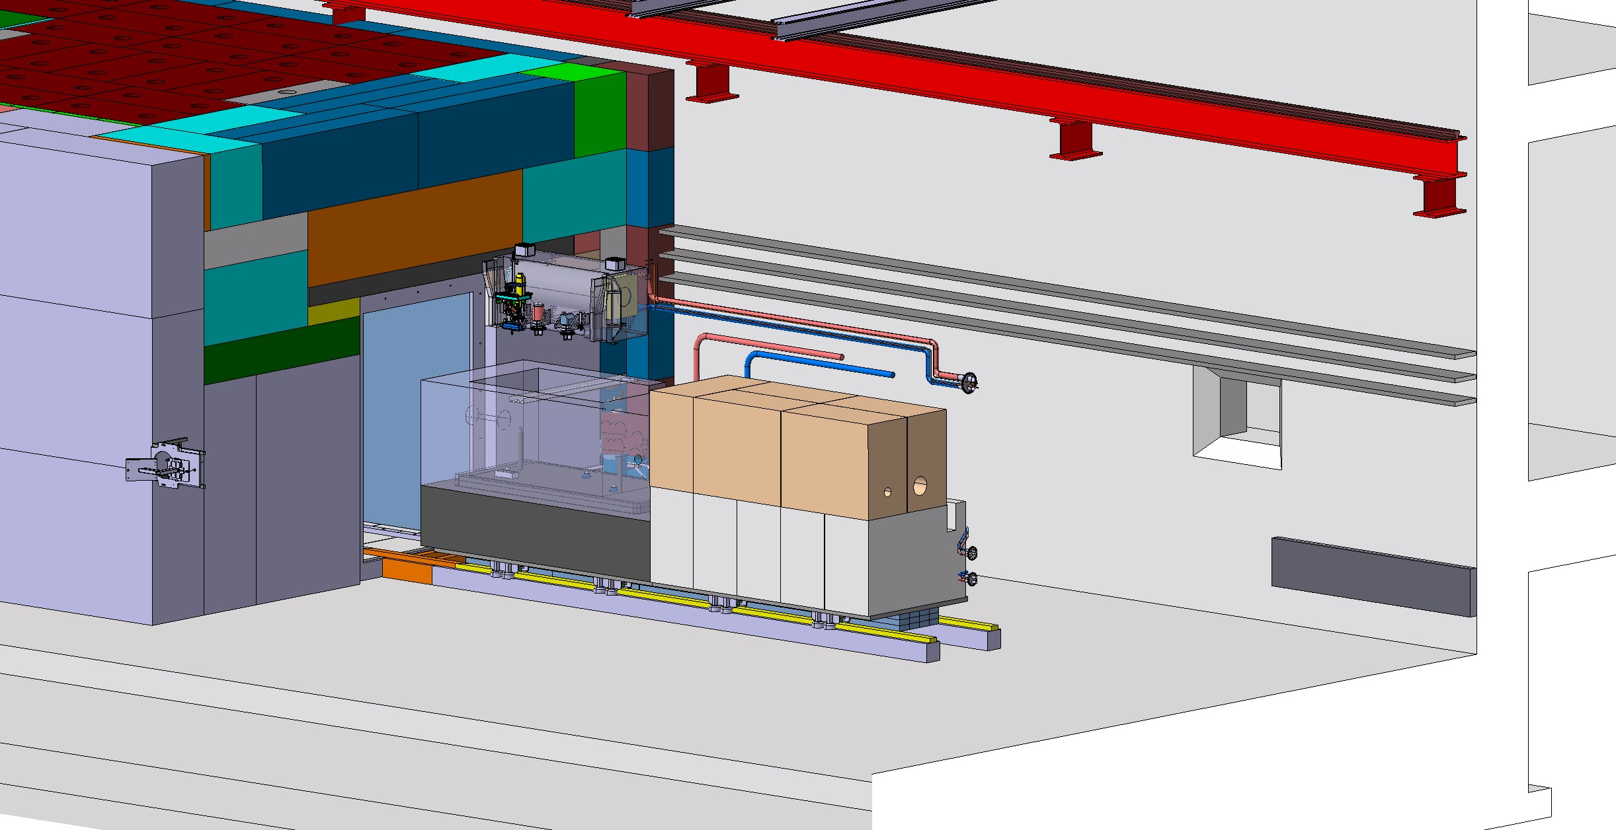

Slide 26
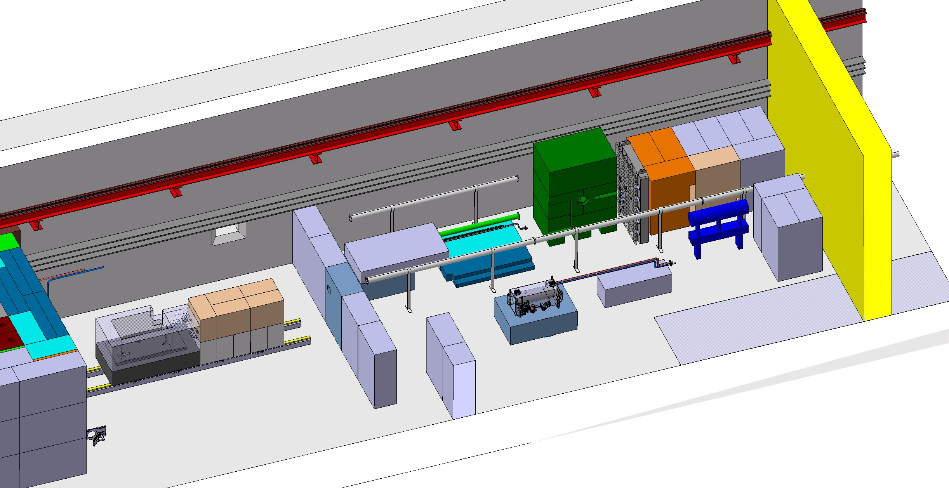
Space requirement for target exchange
~30m

Slide 27
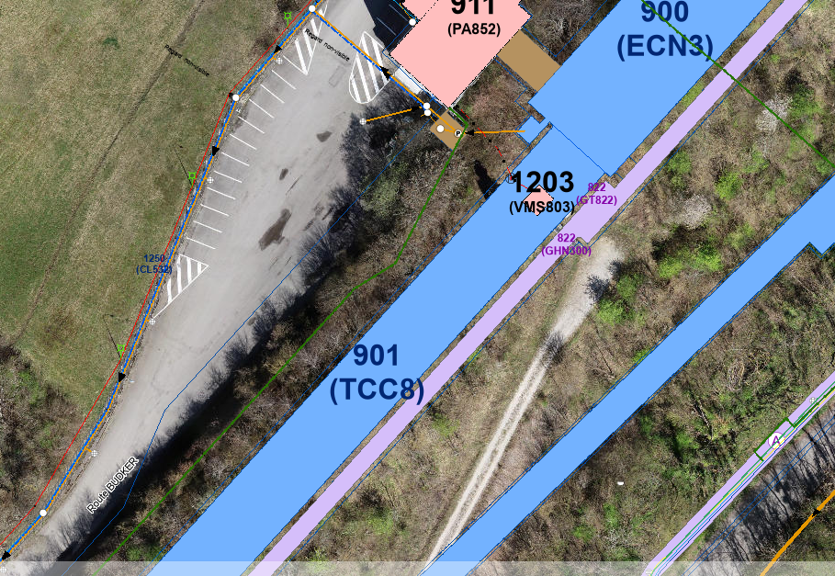
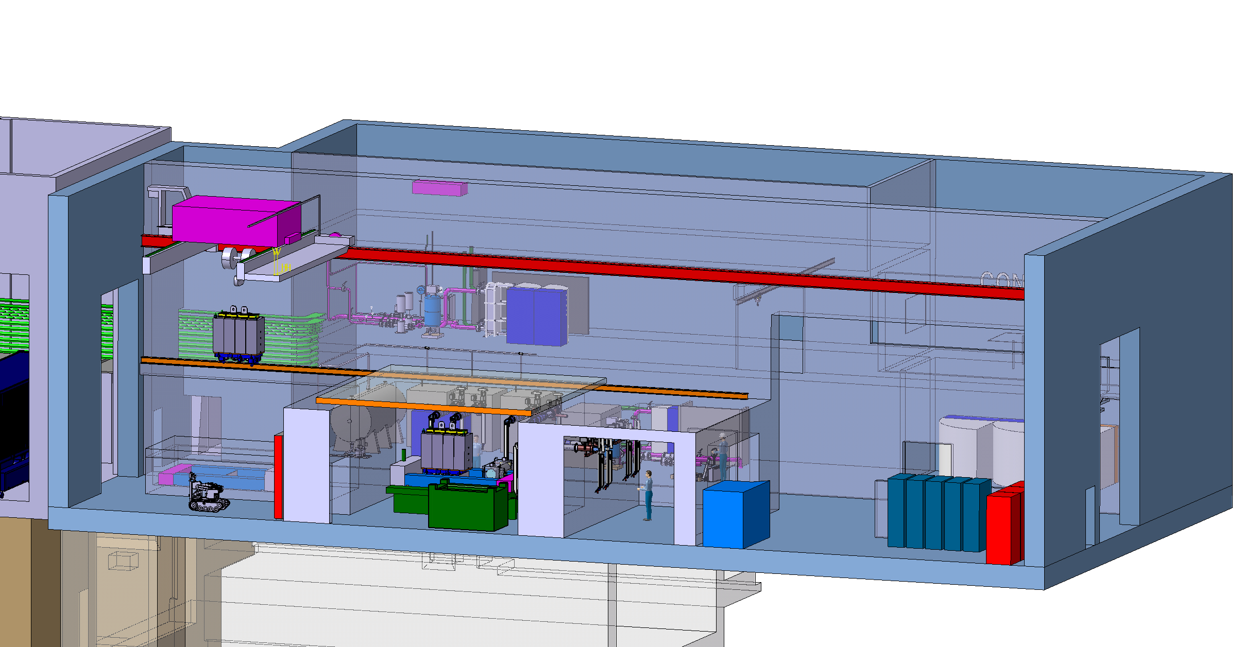
The target service building
Nuclear ventilation system of the target complex
  Air handling units, filters, dehumidifiers (outside)
Target cooling systems
  Pumps, Filters, Heat exchanger, Cooling instrumentation, He circulation system (target primary confinement)
Target controls systems
  Target monitoring (sensors), Target control valves, vacuum vessel confinement
  Service cell
Evaporator
Electrical distribution system
~700m²

Slide 28
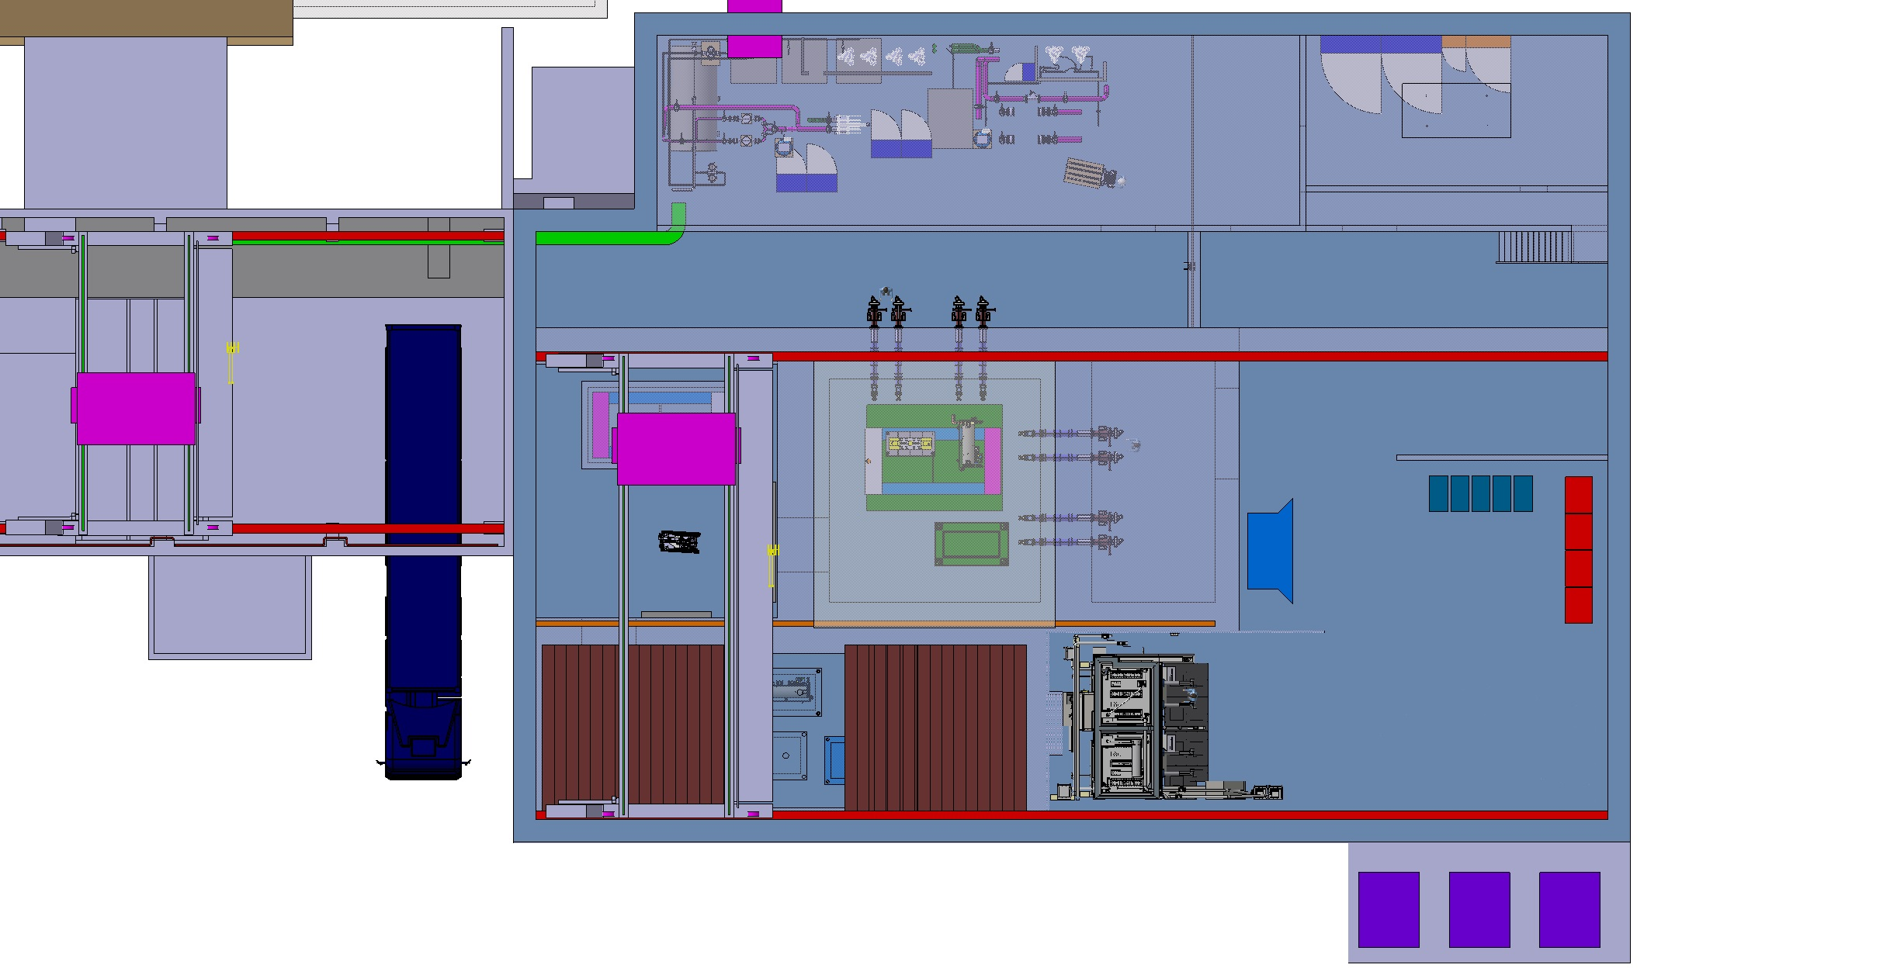
Service building
Cooling equipment
Material access
Control racks
New lorry access
Hotcell
Shielded buffer zone
Overhead travelling crane
Service cell
with a movable roof
*equipement shown based from ECN4 design

Slide 29
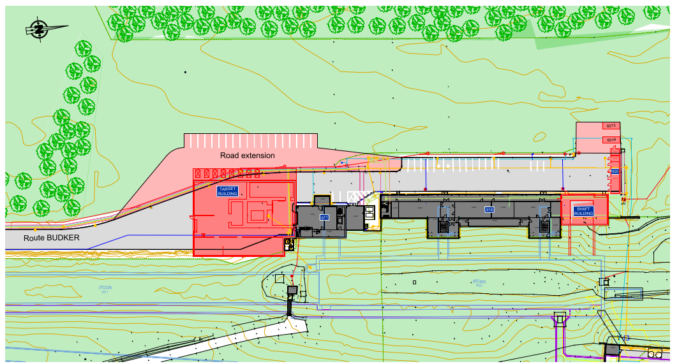
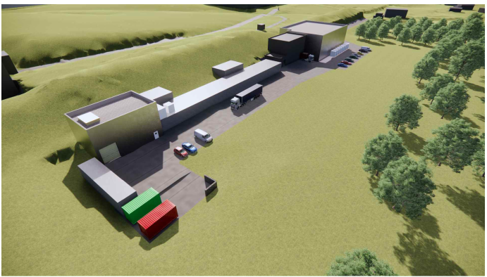
Service building within the BDF/SHiP complex

Slide 30
Description of subsystems described in the next talks

