Slide 1
Target complex futur development
HI-ECN3 BDF target & target complex initial review
Jean-Louis GRENARD – WP4
Acknowledgement: J. M. Martin Ruiz, C. Ahdida, M. Calviani, R. F. Ximenes , M. Fraser, R. Jacobsson, L. Krzempek, G. Mazzola, C. Mucher
29-04-2024

Slide 2
Agenda
Target station vacuum confinement
Target handling
Target shielding extraction
Target Complex handling
Target utilities – cooling
Target positioning,
Systems failure scenarios

Slide 3
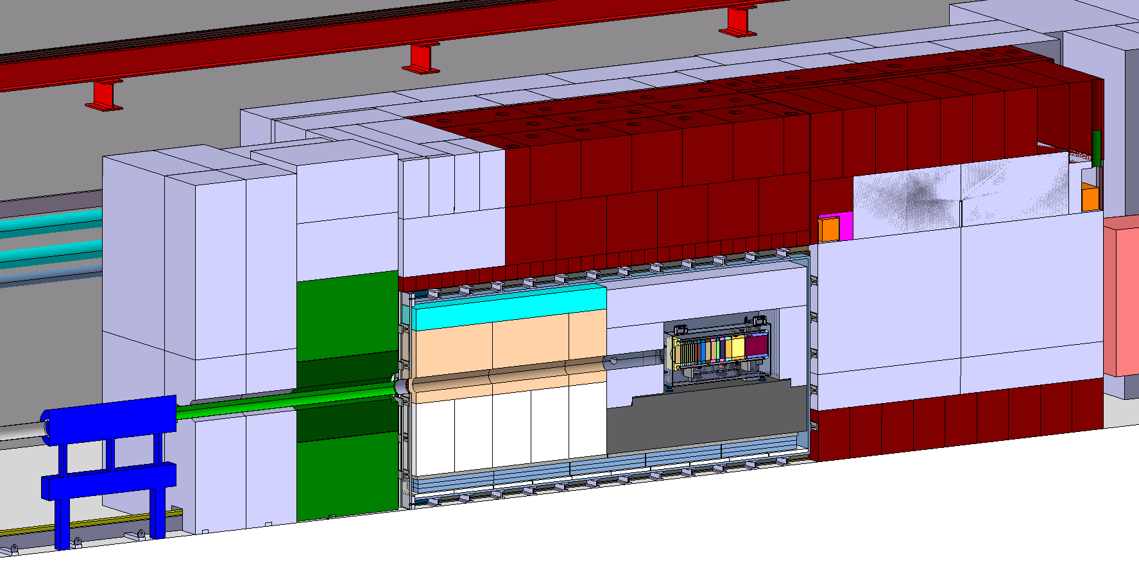
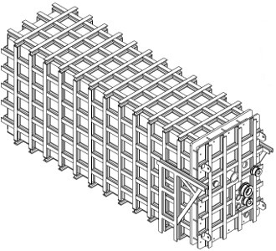
Target station vacuum confinement
Overall dimensions: ~6.36 x 2.05 x 2.95 m
Can be fully fabricated and tested at a contractor premisses
Primary vacuum to optimize air activation around target
Water containment (in case of water leak)

Slide 4
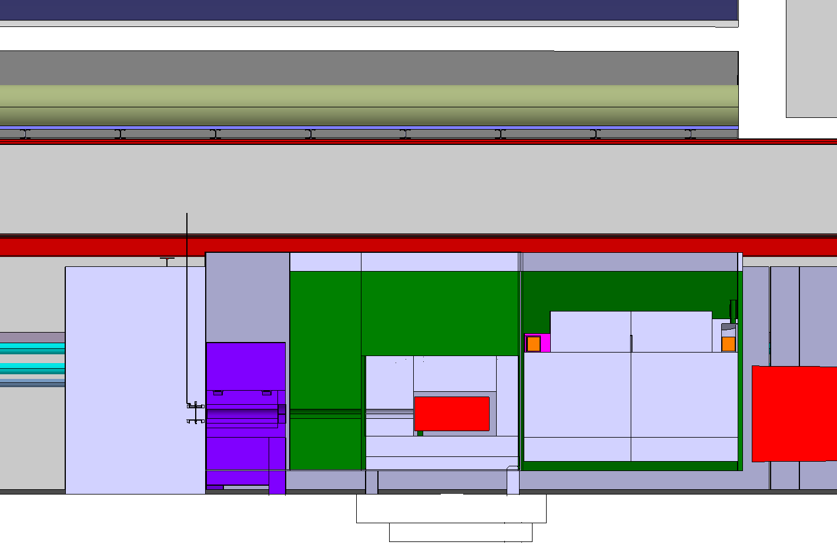
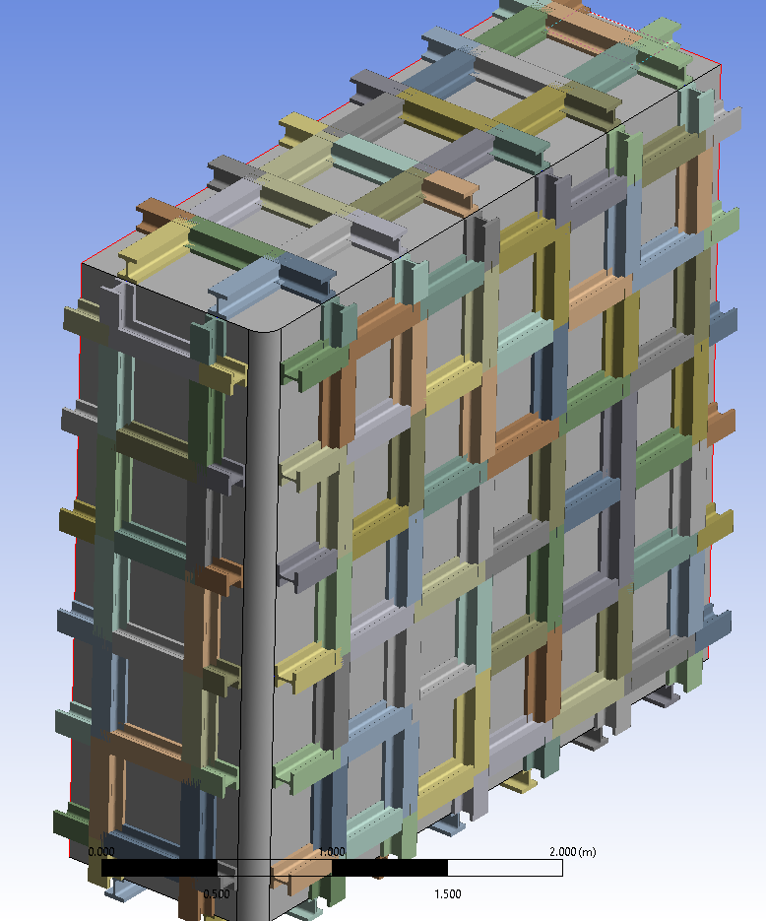
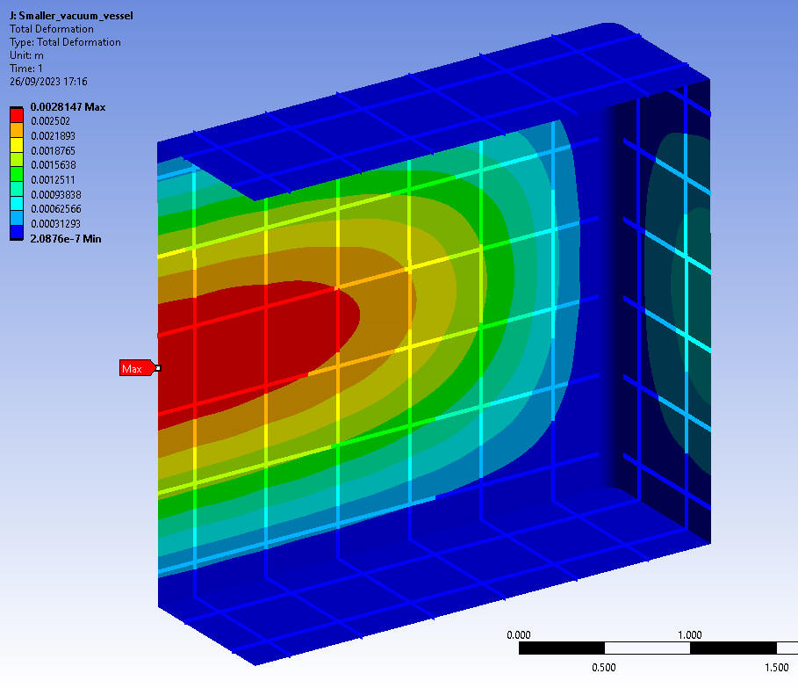
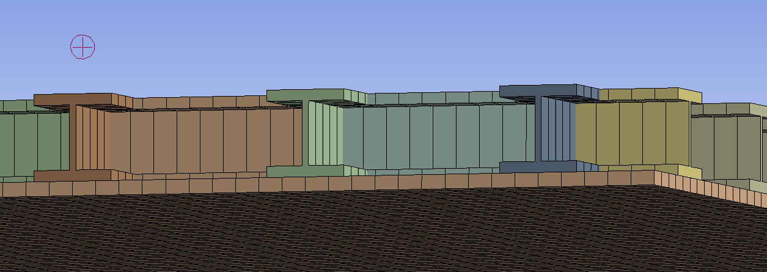
Target station vacuum confinement
Grid of HE 100 M beams (each 120 mm tall) crossing each other at 90º, 500 mm separation
Skin thickness: 30 mm
Boundary condition: floor beams fixed to the floor in the vertical direction.
Max displacement 3 mm
Max VM stress in the sheet: ~200 MPa local peak, lower elsewhere
Max utilization factor of the beams:0.49
Buckling factor: 0.82
Simplified analysis using 1-d beams and 2-d shell elements
More detail vessel design
500 mm
120 mm
Skin thickness: 30 mm

Slide 5
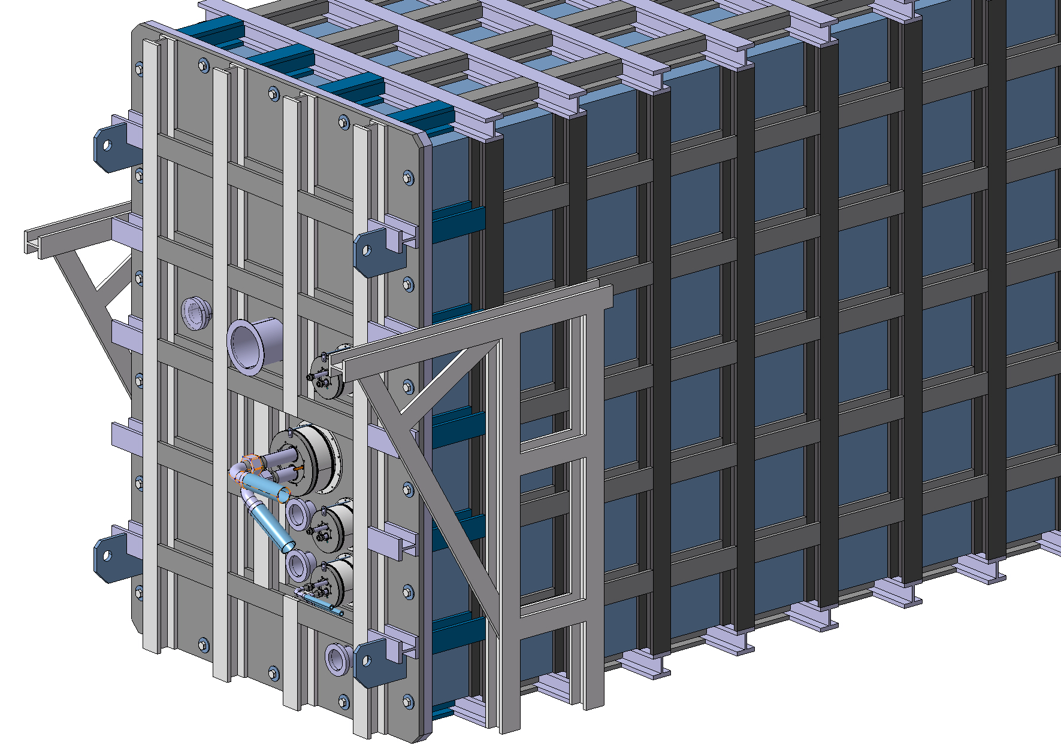
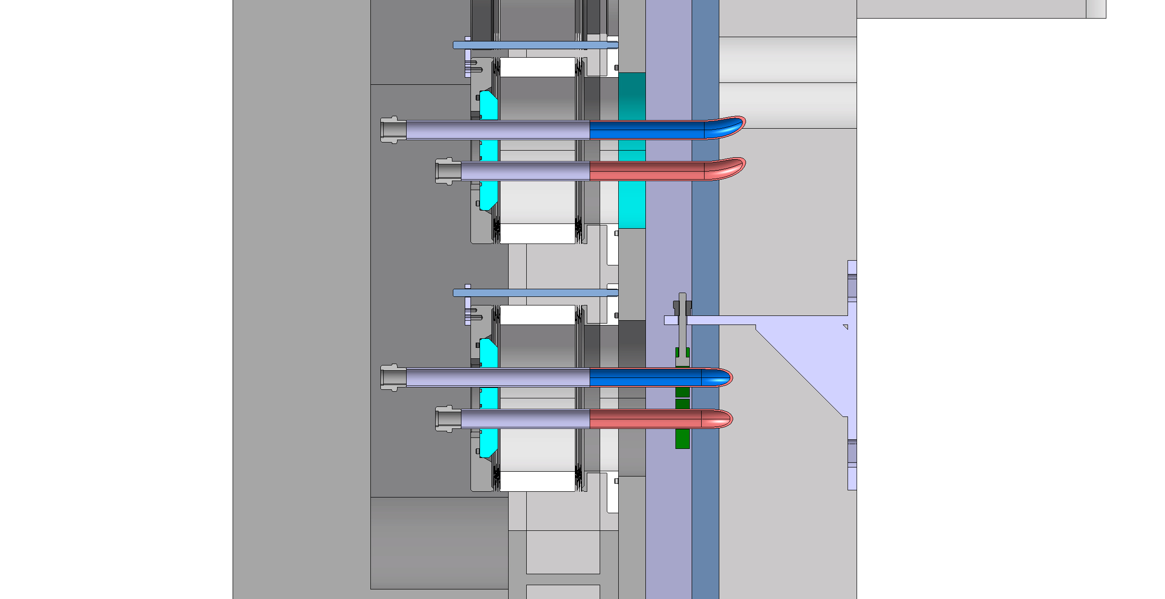
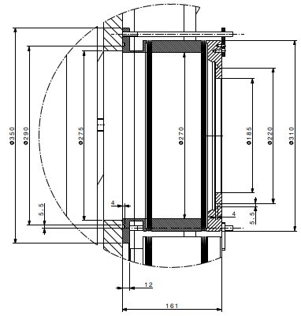
Target station vacuum confinement
Utilities feedthroughs
Mechanical design ready to build a prototype
Design of radiation tolerant gaskets
Decommissioning plan

Slide 6
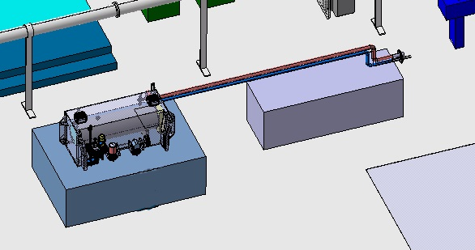
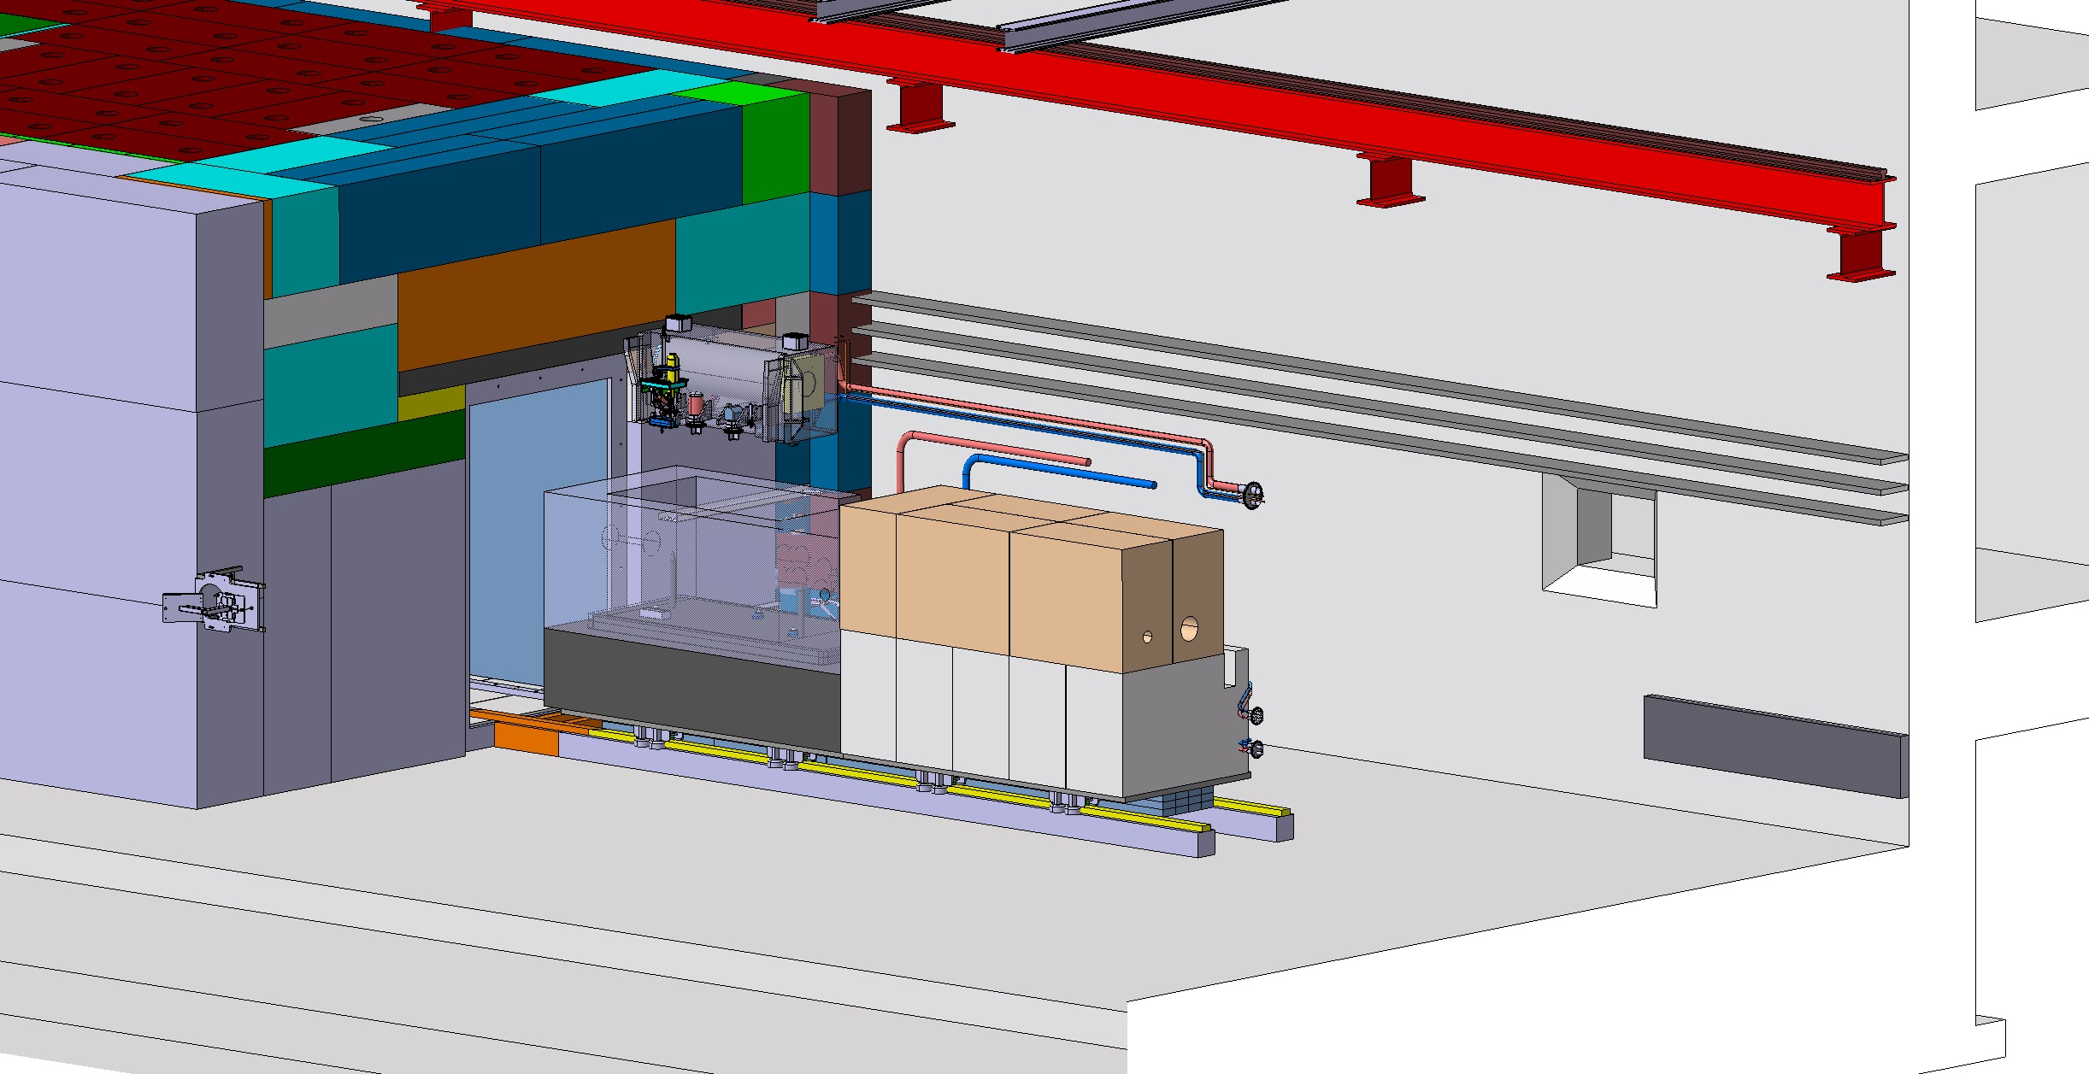
Target handling
Target utilities removed to fit cask

Slide 7
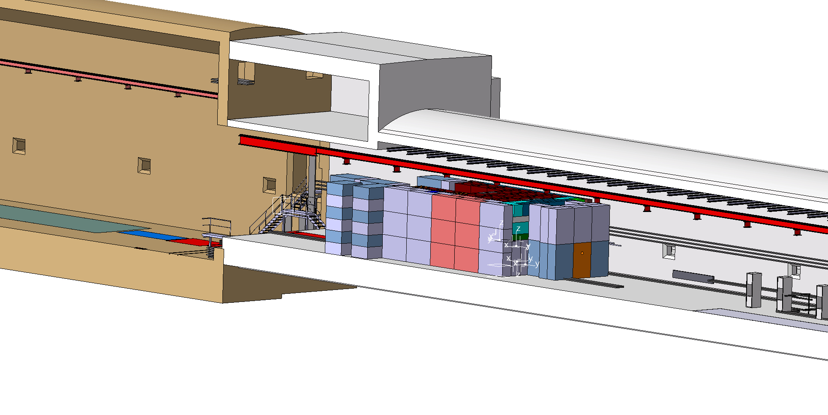
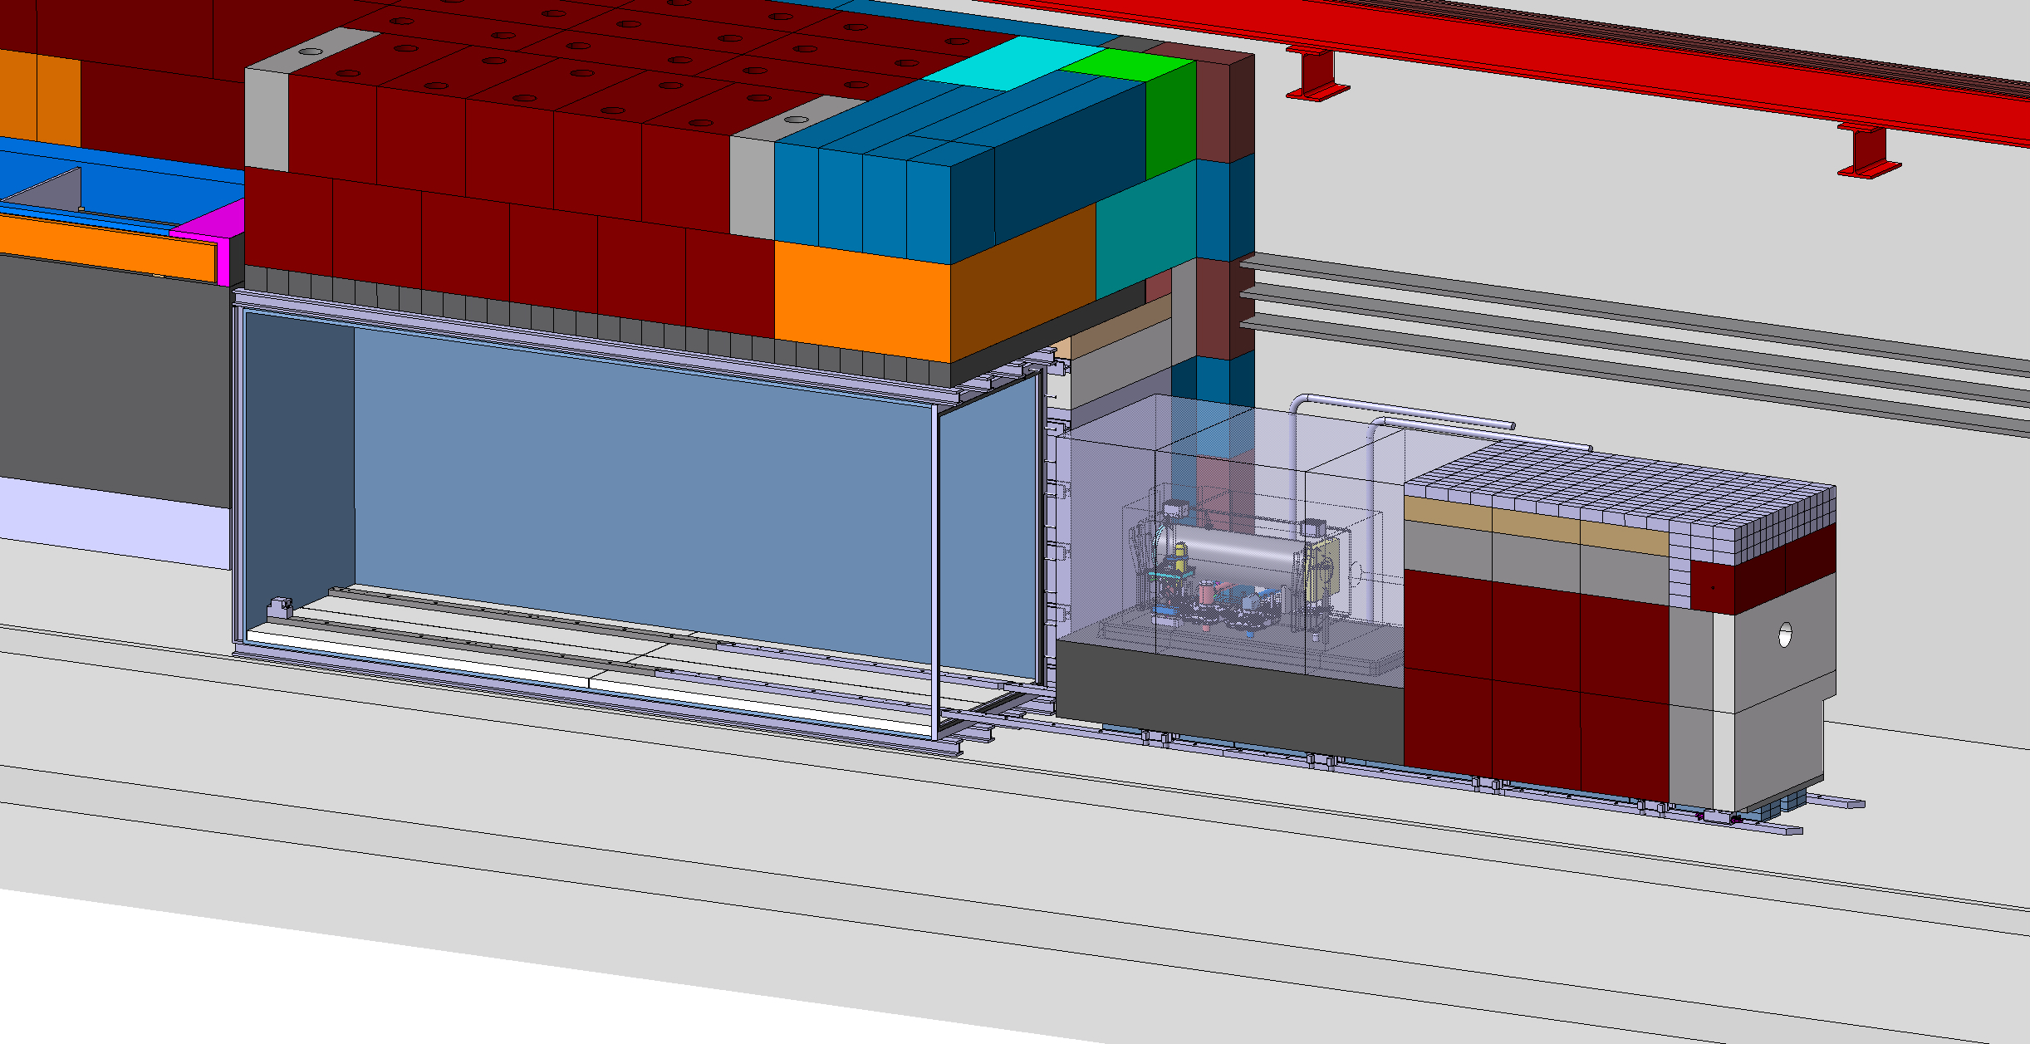
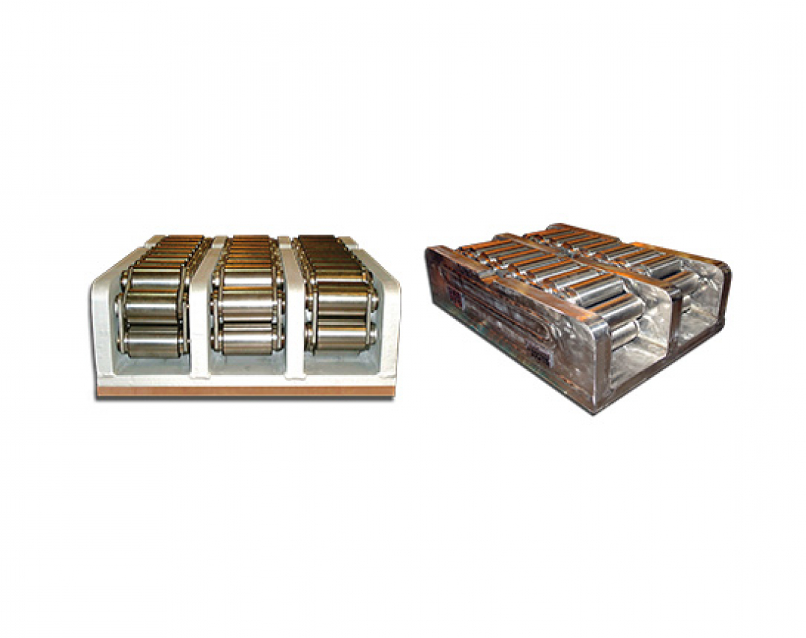
Target shielding extraction
Extraction on a trolley mounted on chain action rollers
~200t to move
Mainly developed around ‘’standard’’ cast iron blocks
In view of reuse of existing blocks from old facilities

Slide 8
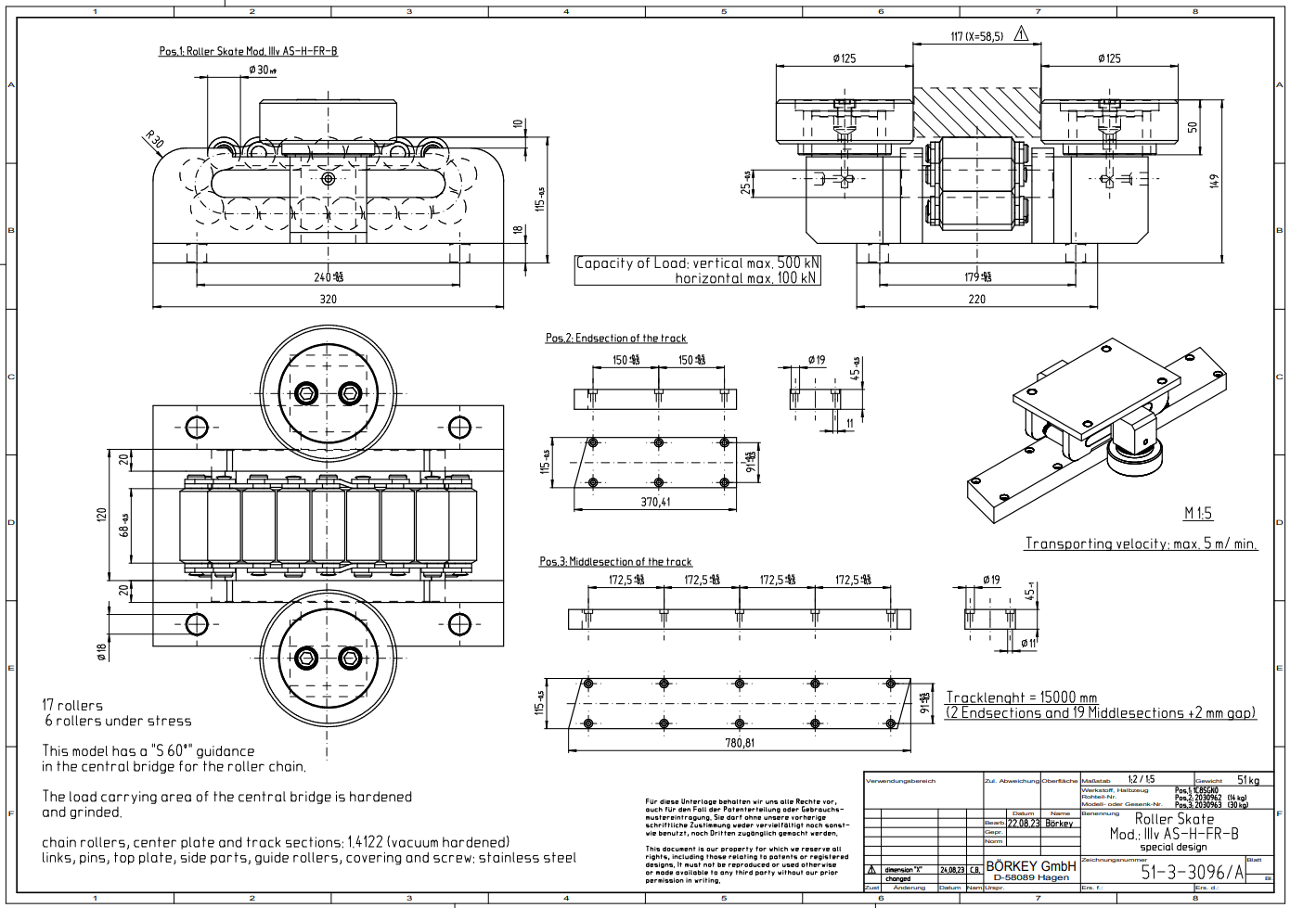
Target shielding wheels
Investigation for full stainless steel chain action rollers
Designed by specialized company:
  Type of stainless steel
  Number of rollers and configuration (8 rollers foreseen)
  Prototypes stainless steel rollers already at CERN ready for a test campaign (material selection assessment, test, ageing under harsh environment)

Slide 9
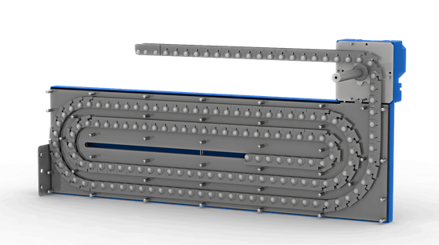
Target extraction mechanism
Installed on purpose prior to target trolley extraction
Possible mechanisms
  Serapid chain (push/pull rigid chain)
  Hydraulic jacks

Slide 10
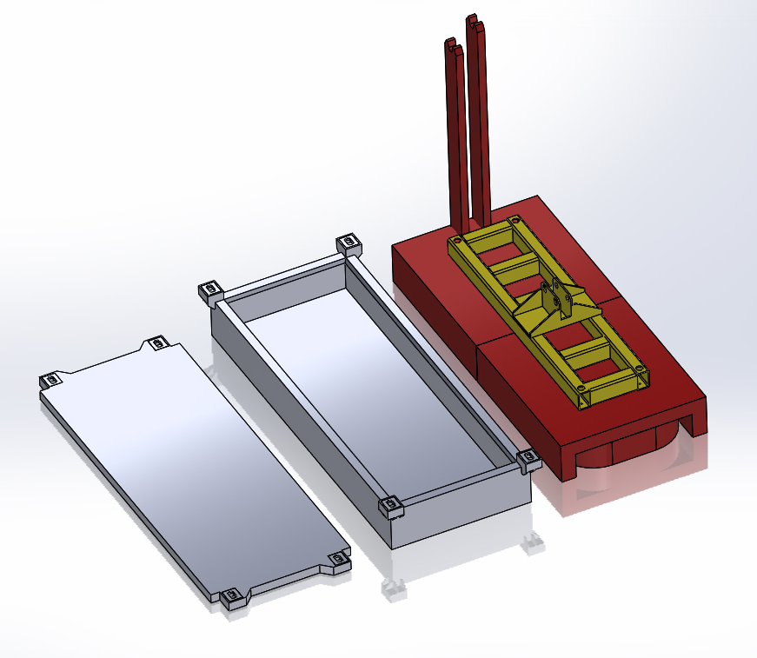
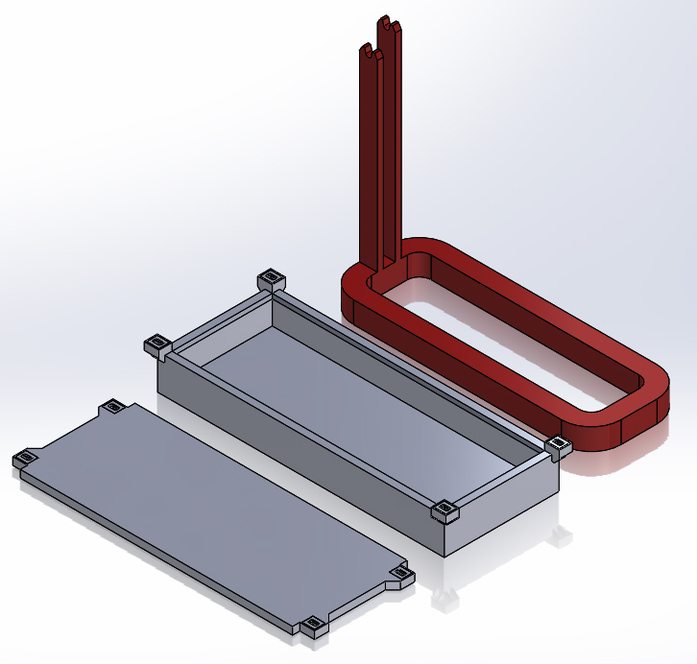
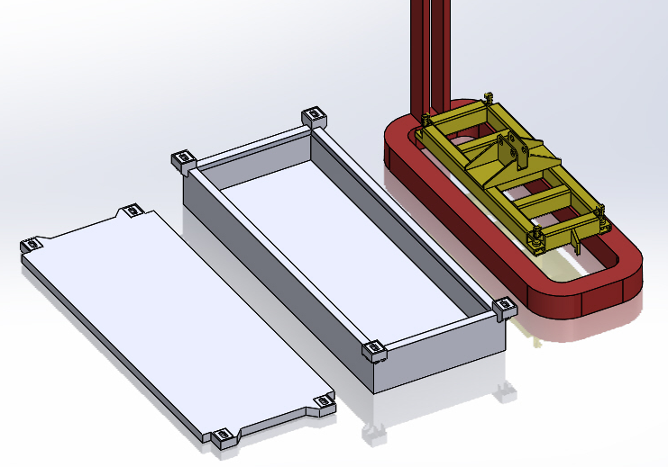
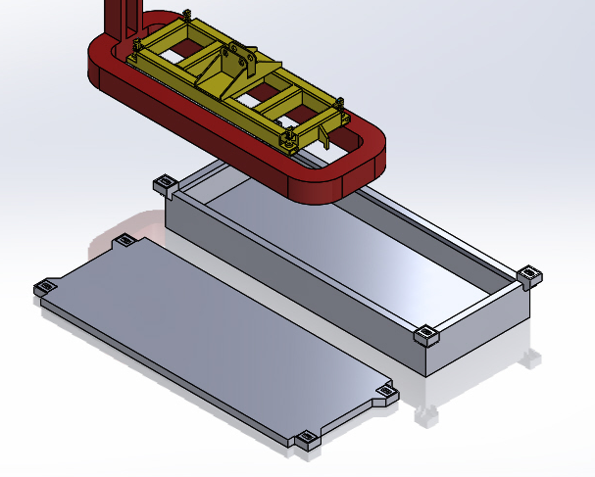
Target Complex handling - coil
Coil utilities:
Power feeding
Support plugin system
Remotely compatible Lifting
Active cooling?
Remove coil tails
Lower Coil into cask

Slide 11
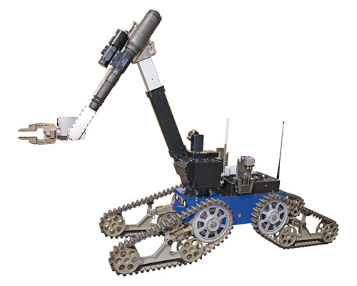
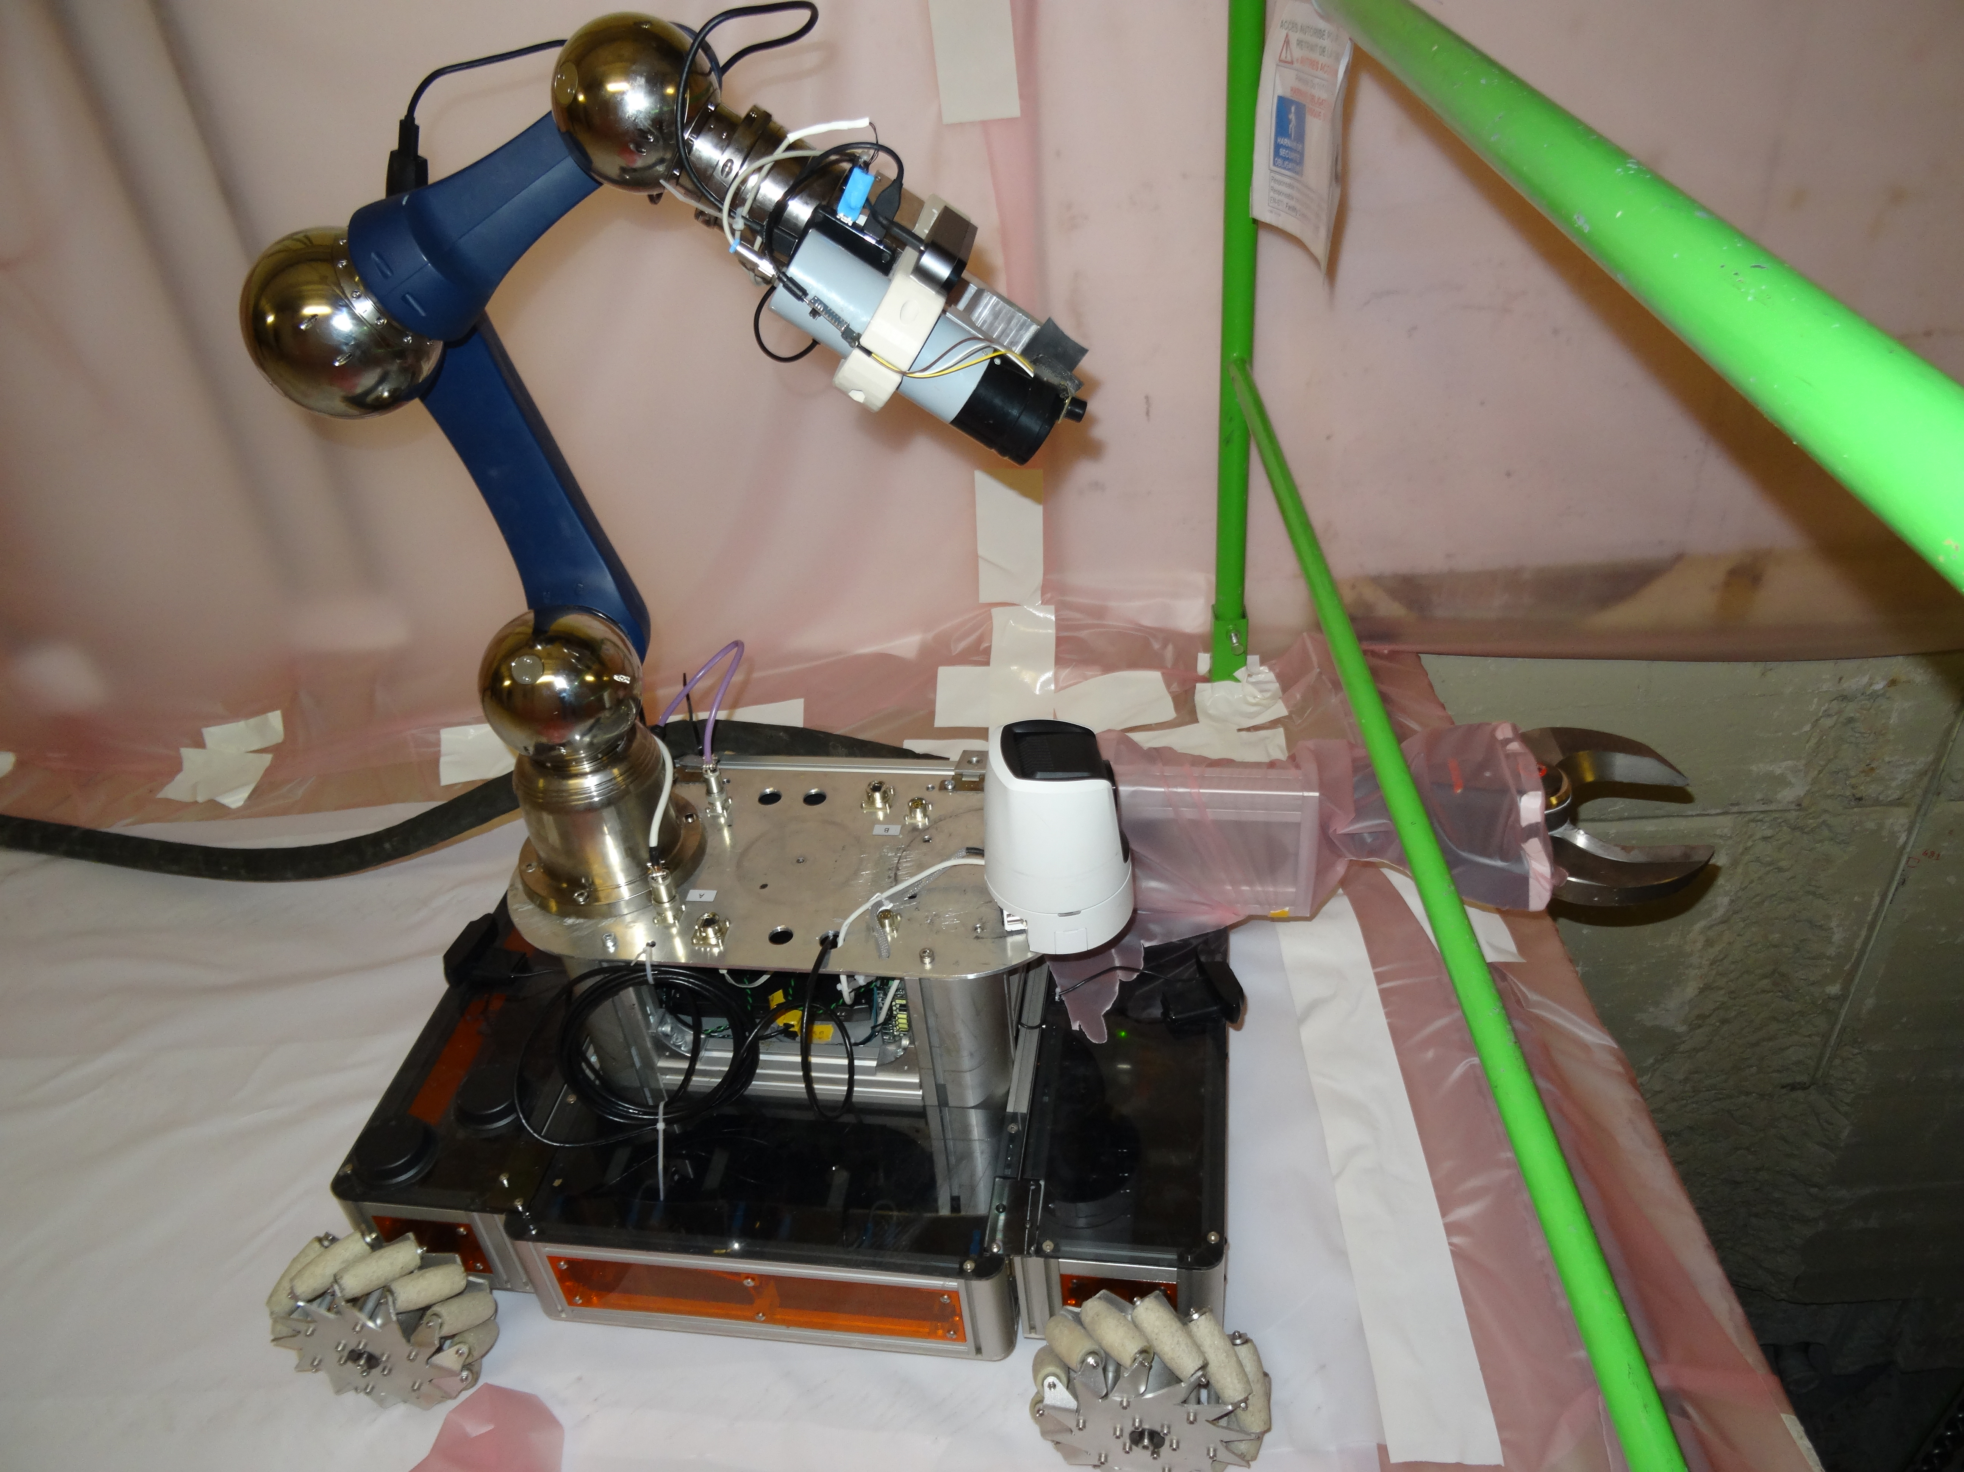
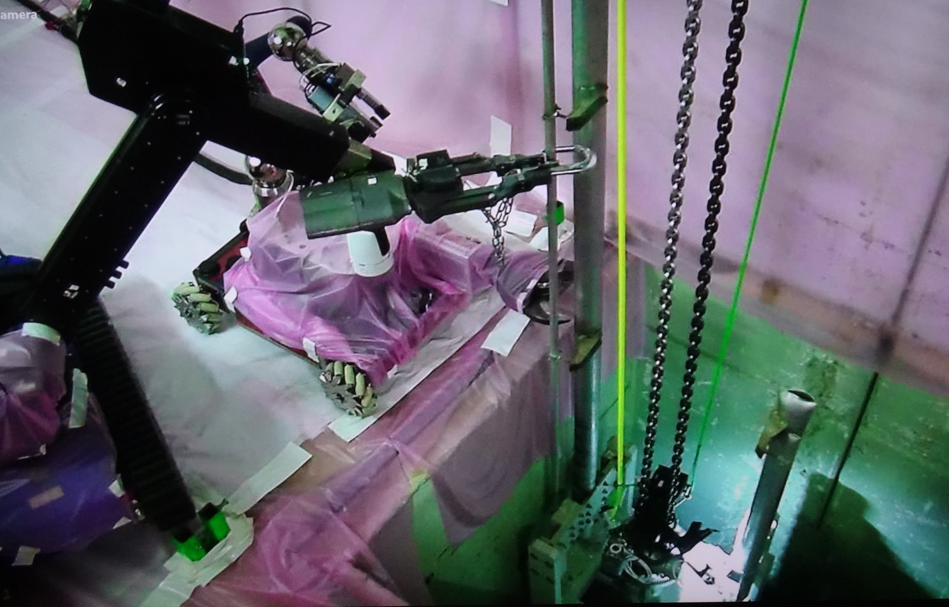
Maintenance of the target complex - few ideas
Target exchange
  Connections of utilities located in ‘’human’’ accessible environment
  Remote handling features for the connections
  Support of remotely controlled crane and ROVs
  Size reduction for final disposal by shearing
  Transfer from the underground to surface in shielded casks
n-TOF target#2 pipes reduction with ROVs

Slide 12
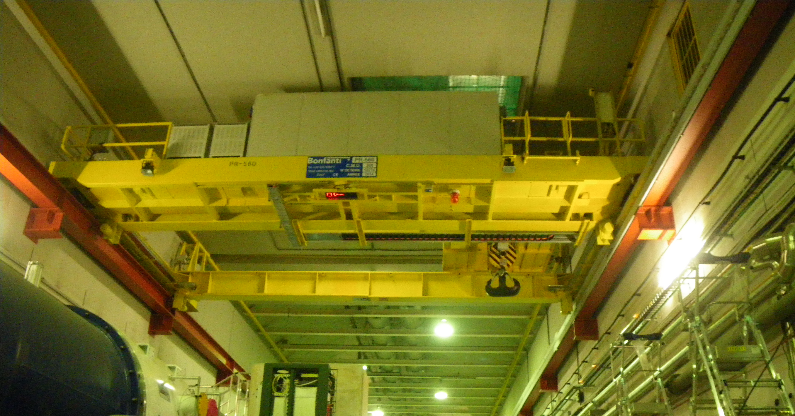
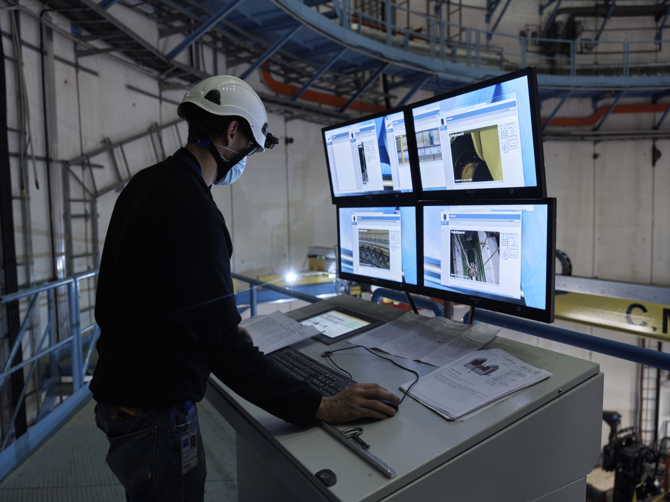
Target Complex handling
Existing overhead travelling crane 30t capacity replaced
  Redundancy on the 3 movements of the crane
  Integration of a video system
  Integration of a positioning system for the 3 movements
  Off-board control cubicles
  Cable festoon routing
  Remote tools connection on the hook
  Auxiliary hoist
  Investigation on possibility to optimize crane size
  Ongoing specification

Slide 13
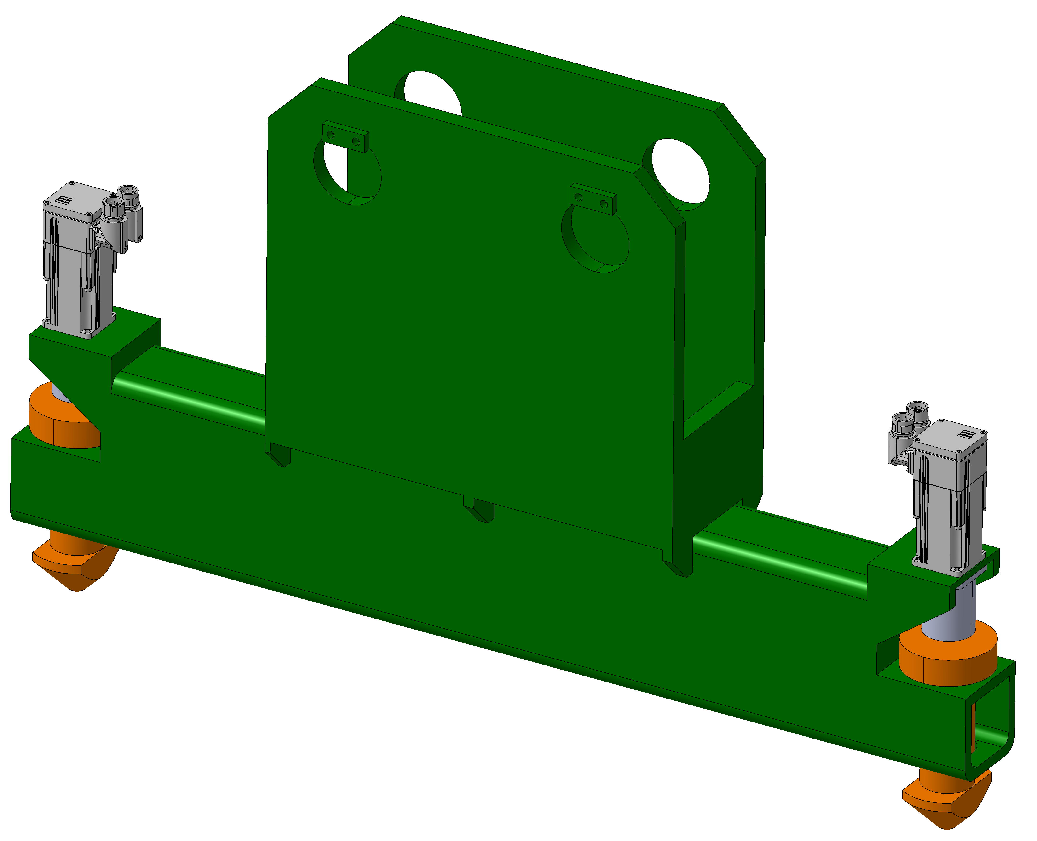
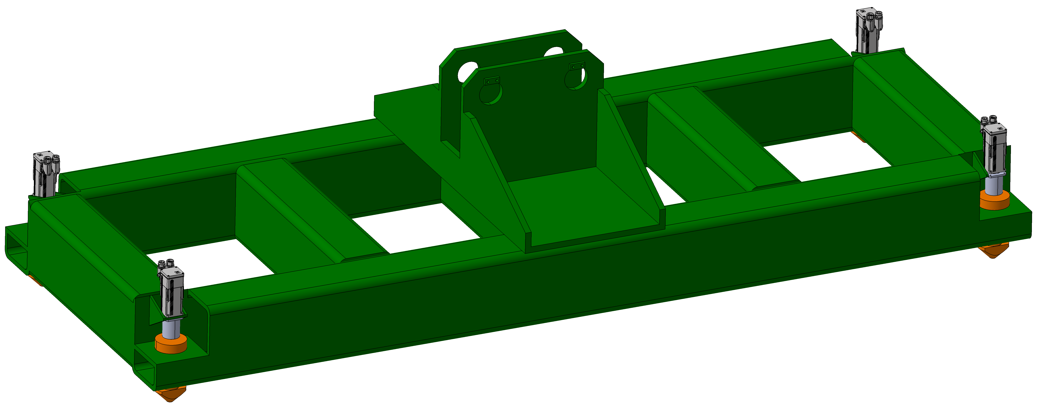
Target Complex handling
Lifting spreaders developments
  Target
  Shielding blocks
  Coil
  Casks

Slide 14
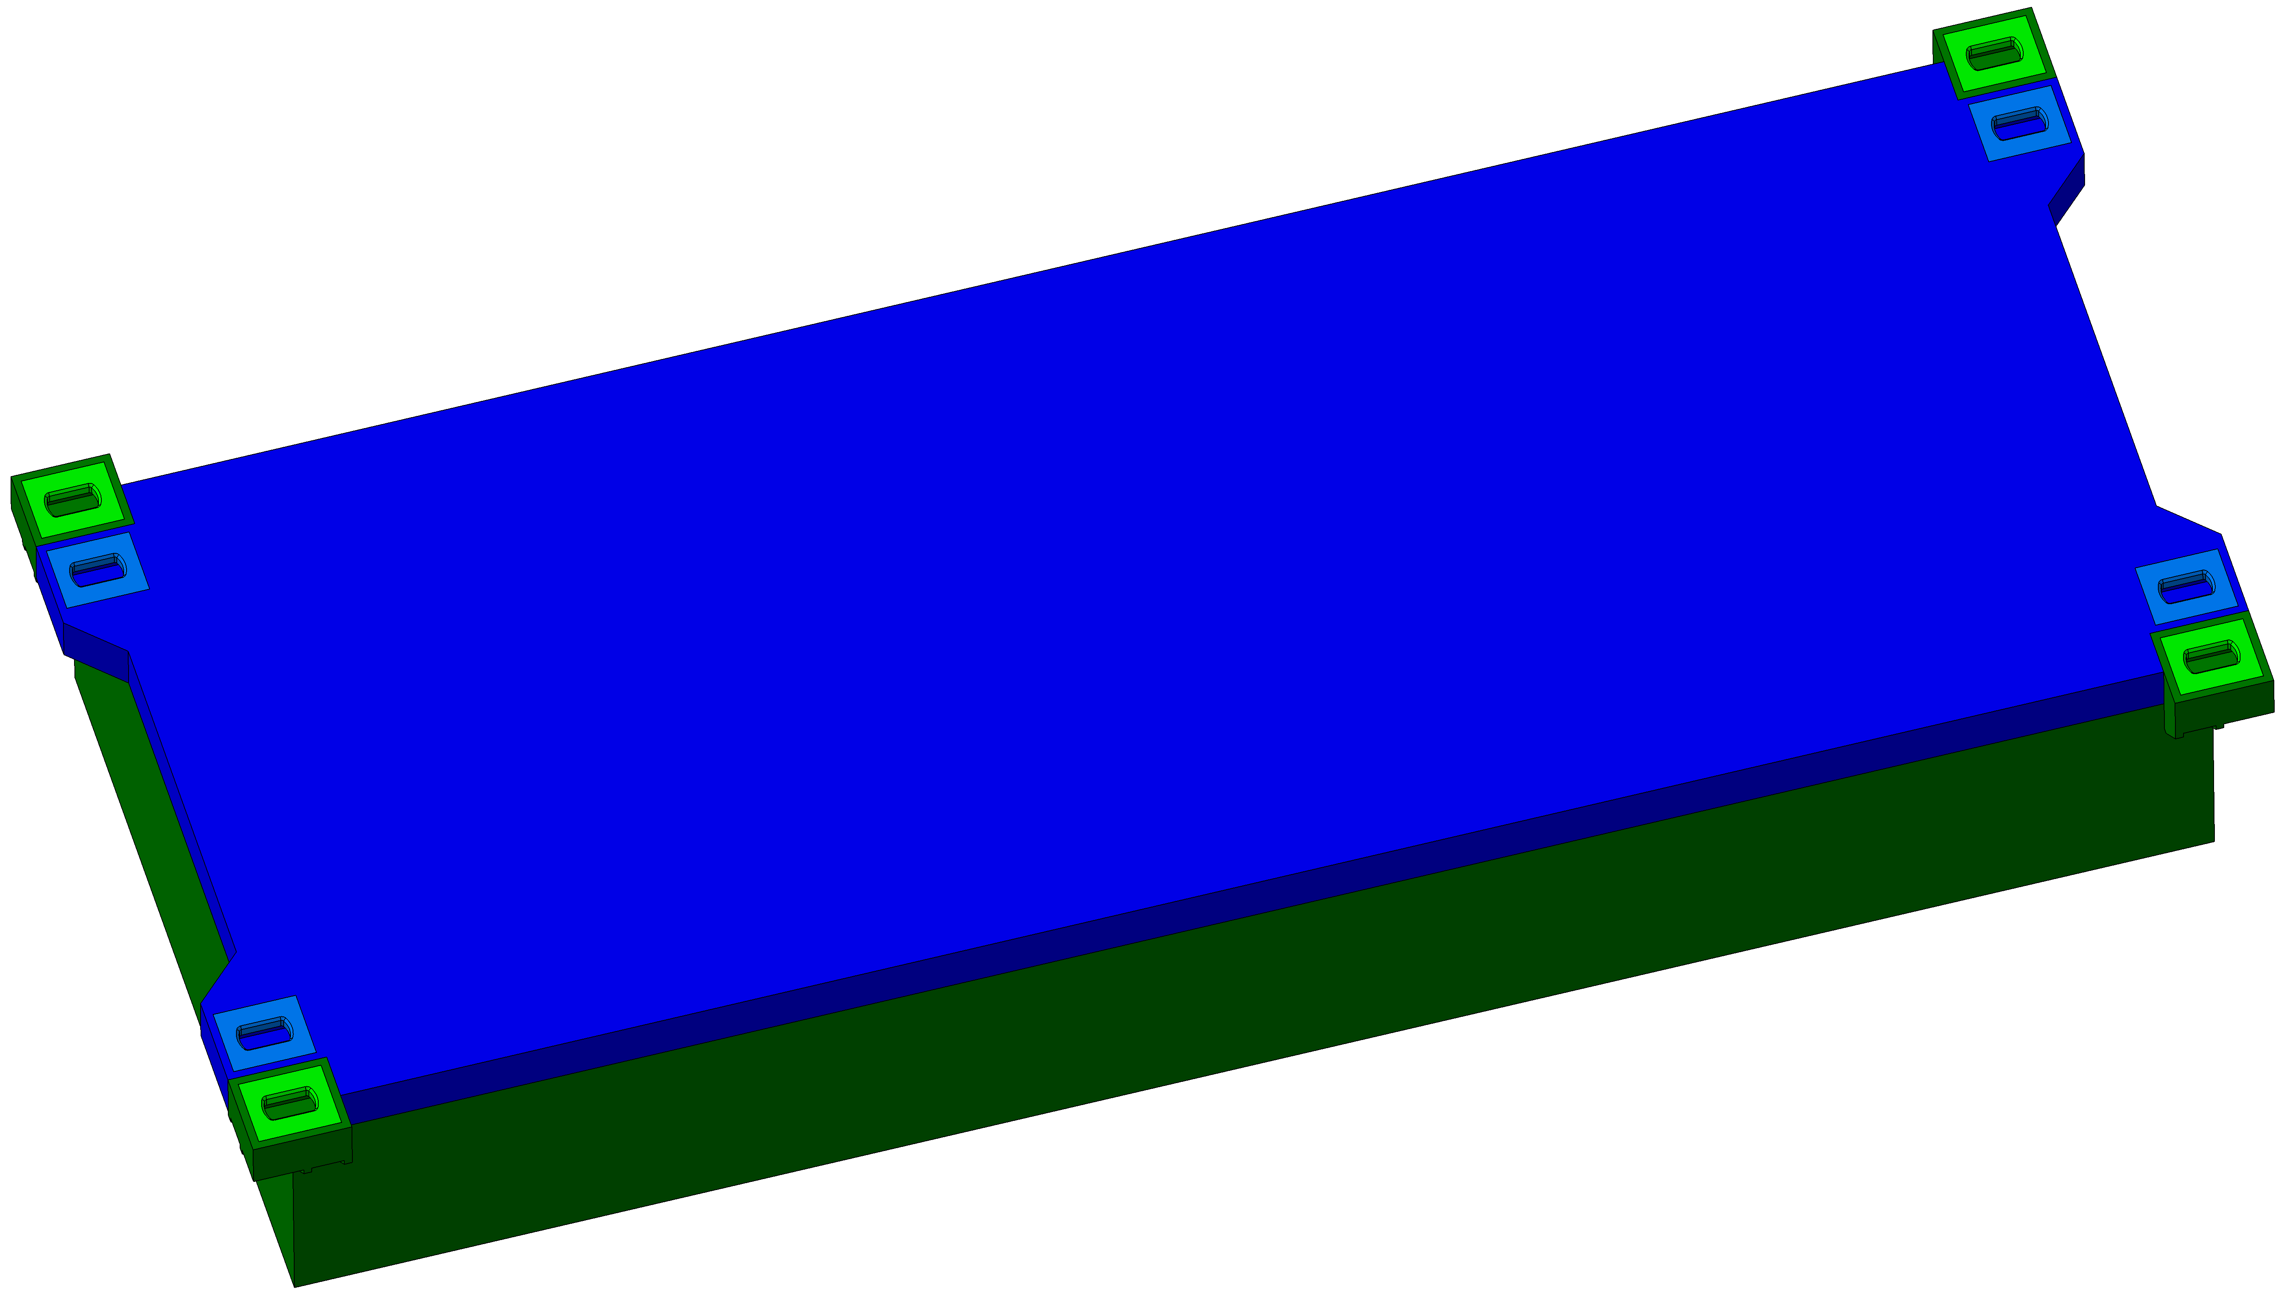
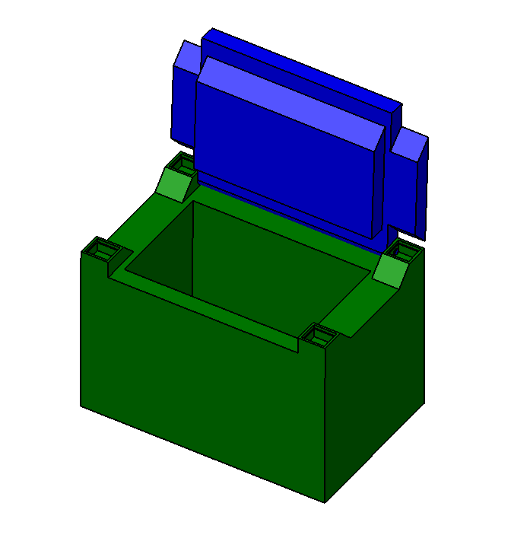
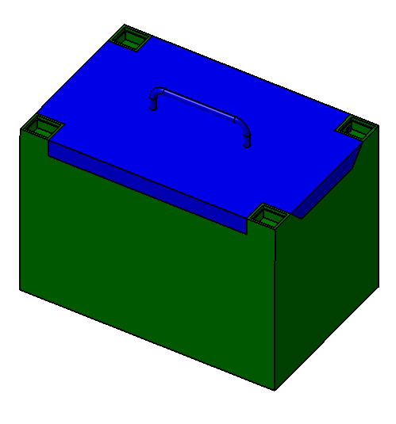
Target Complex handling
Casks
Target cask
Coil cask
One major limitation -> 30t object to handled + cask

Slide 15
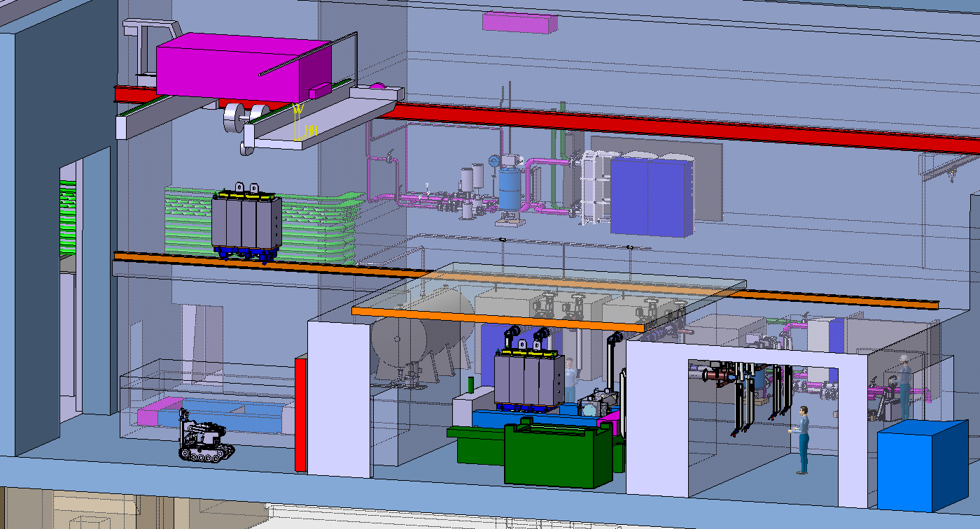
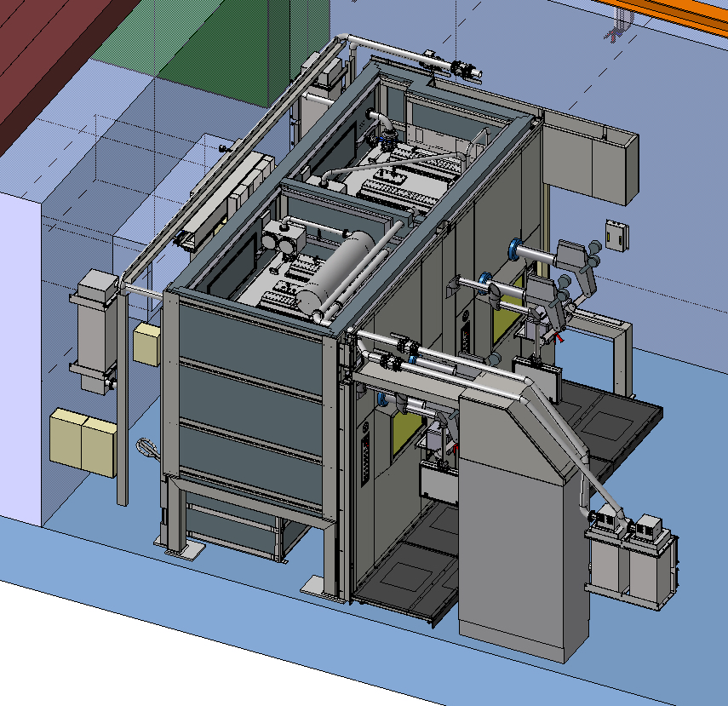
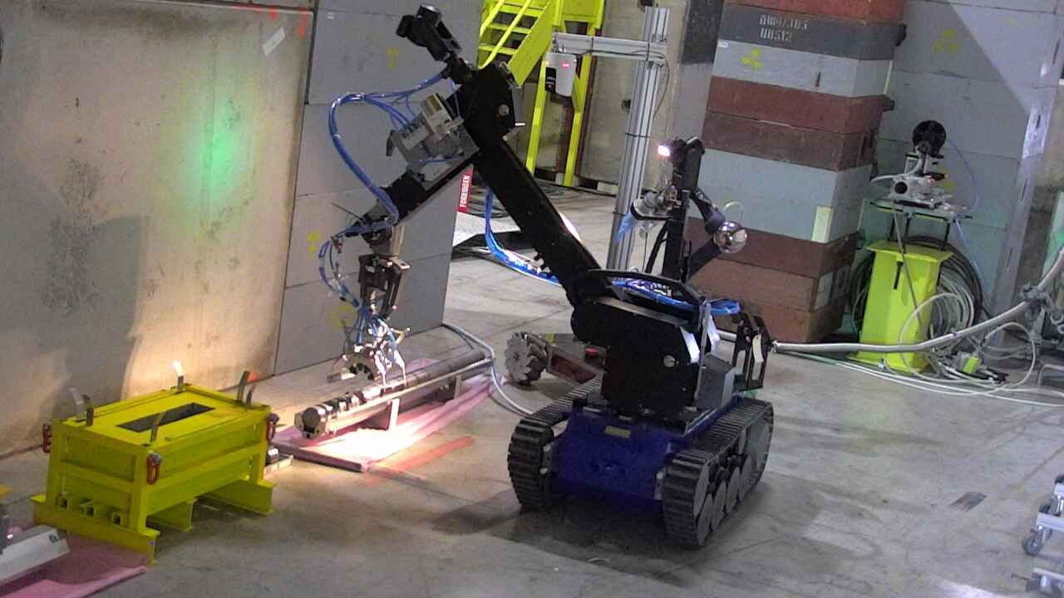
Service building – Service cell - Hotcell
Purpose
  Repair of activated components
  Size reduction and material separation for final disposal to optimize cost using different elimination path
  Post Irradiation Examination
Tools envisaged
  Master-slave manipulators
  Robots (fixed and mobile)
  Custom built machinery

Slide 16
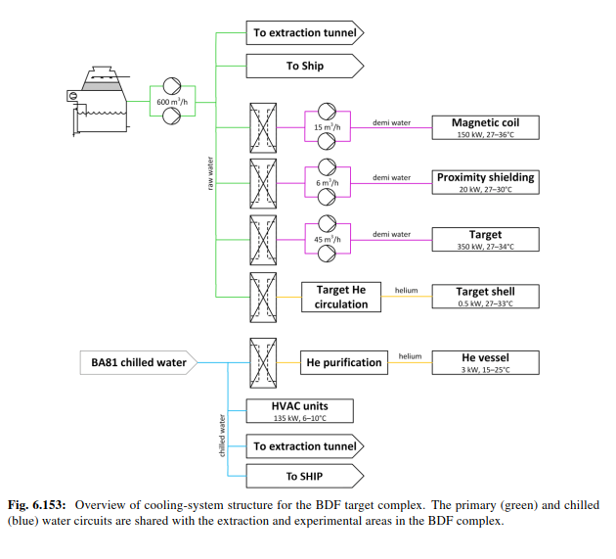
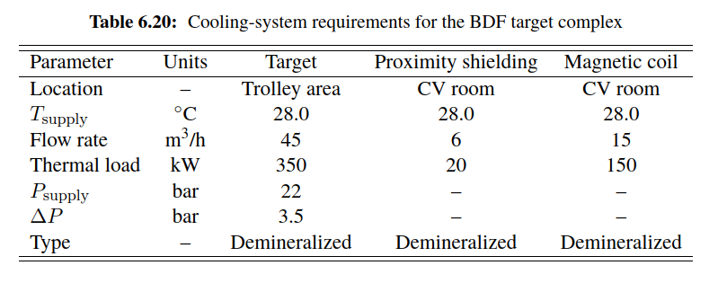
Traget complex cooling circuit
Number from CDS

Slide 17
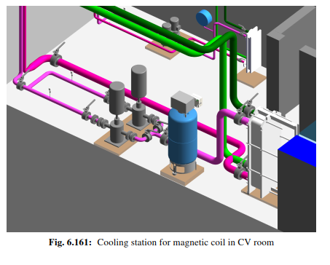
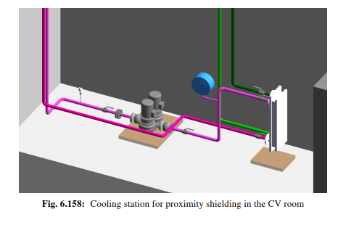
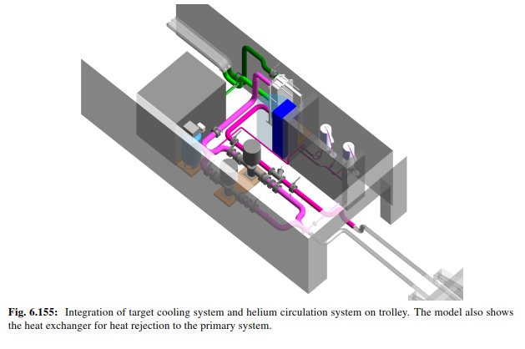
Target cooling systems
To be located in a shielded area (was located in the underground area in the CDS)
~5m²
~5m²
~20m²

Slide 18
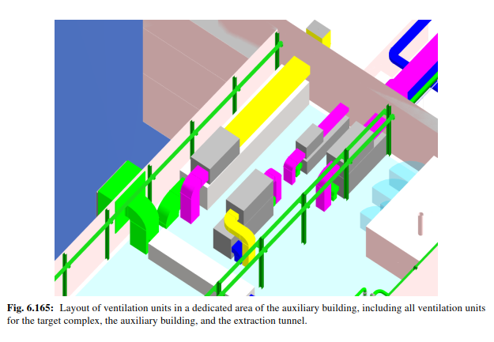
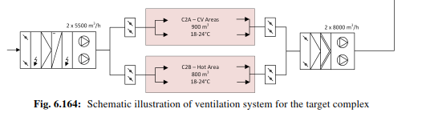
Ventilation systems
~150m²
Number from CDS

Slide 19
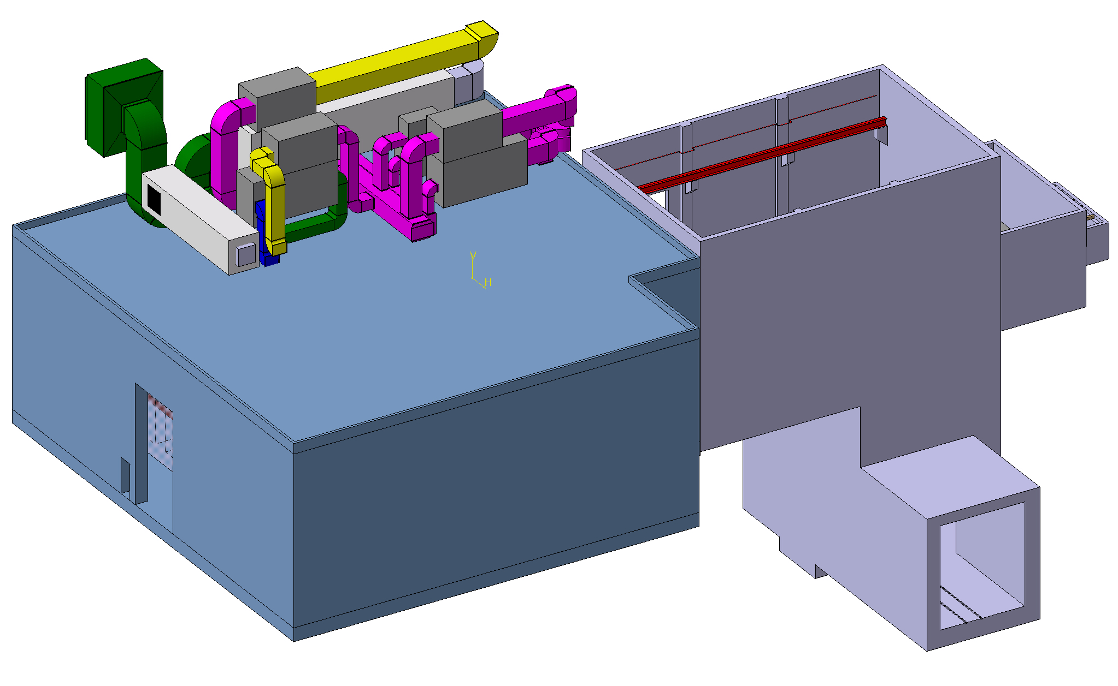
Ventilation systems
Target station and service building air handling units
*equipement shown based from ECN4 design

Slide 20
Target positioning
Target alignment precision with respect to beam line 1cm! But…
Everything inside the vessel can’t be realigned after 1rst start of operation
  Target need to have alignment features on its side
  Robust plug-in system (should survive several target exchange)
  Need measurement jigs to measure references every time we replace the target
  Need of remote technic measurements?
Floor and building deformation to take in consideration

Slide 21
Systems failure scenarios
Evaluation required for operation and maintenance scenarios
  Water leak
  Vacuum leak
  Fire
  Ventilation
  Cooling
  Extraction system
  Handling tools

