Slide 1
Target and Target complex –
Radiation Protection challenges
C. Ahdida, G. Mazzola
HI-ECN3 BDF target & target complex initial review
29/04/2024

Slide 2
Content
BDF Target
  BDF Baseline Target
  Alternative Claddings
  TDR studies
BDF Target Complex
  BDF @ ECN3
  TDR studies

Slide 3
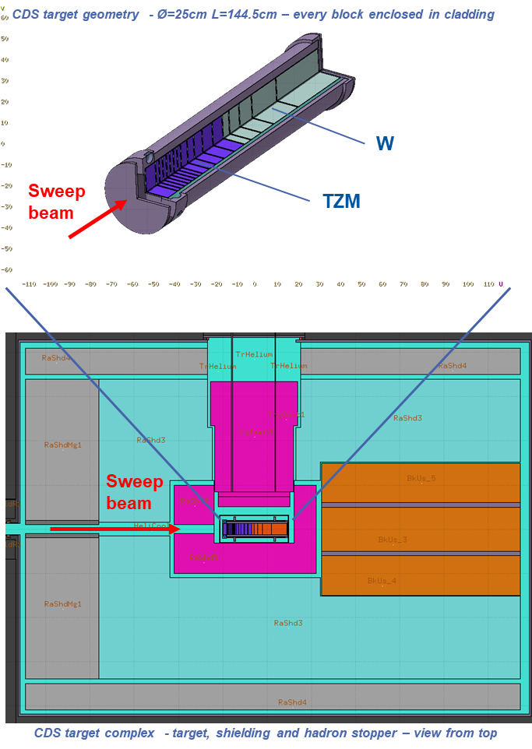
BDF Baseline Target
C. Ahdida et al., SPS Beam Dump Facility - Comprehensive Design Study, CERN-2020-002
M. Casolino et al., Radiological Assessment of the Beam Dump Facility at CERN, EDMS 2263868
CDS BDF FLUKA model
Main RP studies for the BDF Baseline Target were performed during the BDF CDS phase
Target:
  13 TZM blocks (Mo alloy)
  5 Tungsten blocks
  Tantalum* cladding
Target disks are water-cooled
Maximum of 5 years of irradiation with a total of 4×10¹⁹ PoT
RP studies:
  Residual radiation
  Radionuclide inventory
  Water activation
  Alternative claddings (after CDS)
  Prototype target tests
TZM: 0.08% titanium – 0.05% zirconium – molybdenum alloy
*Used pure Ta cladding not Ta2.5W for CDS RP studies

Slide 4
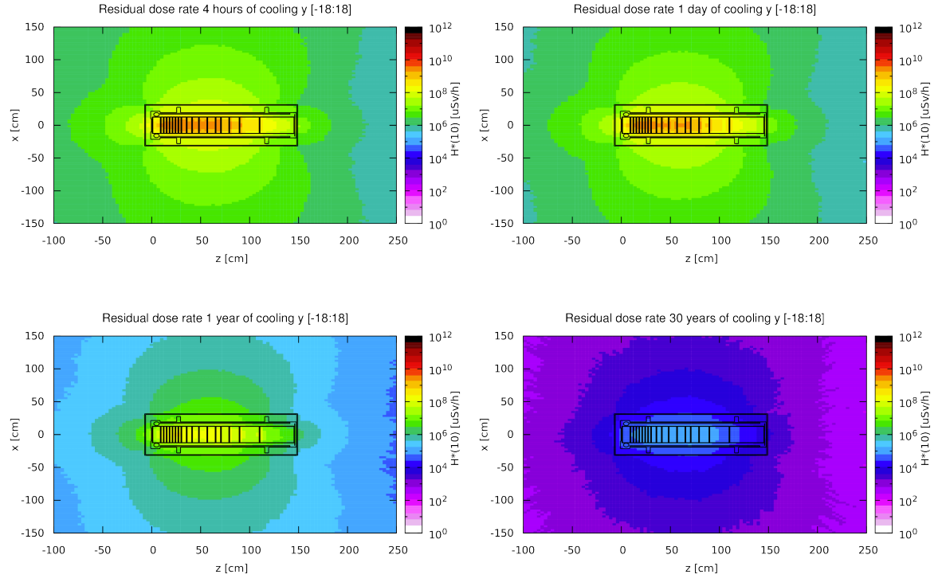
Residual Radiation
C. Ahdida et al., SPS Beam Dump Facility - Comprehensive Design Study, CERN-2020-002
M. Casolino et al., Radiological Assessment of the Beam Dump Facility at CERN, EDMS 2263868
Total PoT 2×10²⁰ (5 yrs)
Longitudinal cut along the target
The residual dose rates of the target were studied for 5 years of operation (now we have a max. of 15 years) and different cool-down times
The highest dose rates are in the order of 100 Sv/h after 4 hours of cooling and a few Sv/h after 1 year
Even after 30 years, dose rates at 40 cm still of the order of a few mSv/h → dedicated storage place in facility for irradiated target
For radioactive transport the max. dose rate level at any point on the external surface of a package shall not exceed 2 mSv/h
Thick iron cask (~30 cm thick) for transportation and storage as well as during handling
4 hours cool-down
1 day cool-down
1 year cool-down
30 years cool-down

Slide 5
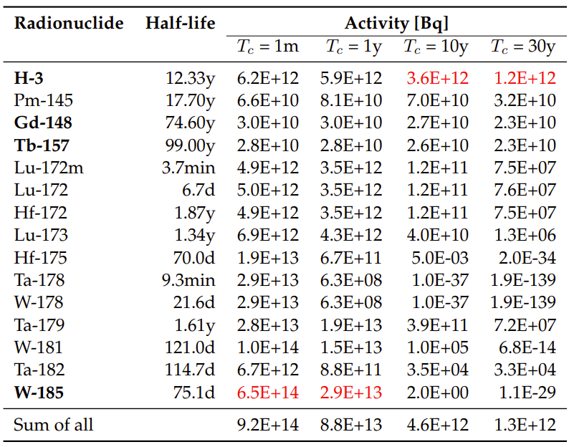
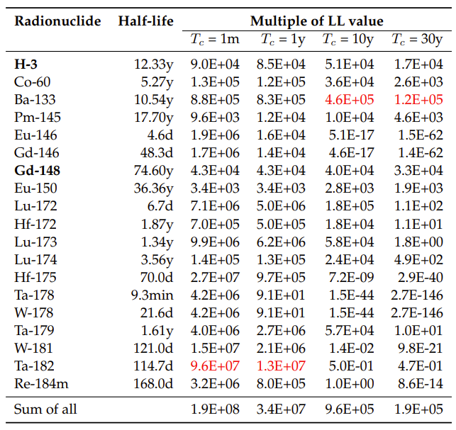
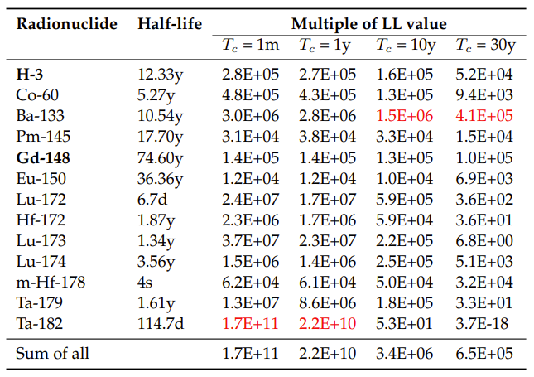
Radionuclide inventories
C. Ahdida et al., SPS Beam Dump Facility - Comprehensive Design Study, CERN-2020-002
M. Casolino et al., Radiological Assessment of the Beam Dump Facility at CERN, EDMS 2263868
Total PoT 2×10²⁰ (5 yrs)
Tungsten – Total Activity (Bq)
Tungsten – Multiple of LL
Tantalum – Multiple of LL
LL: CERN clearance limit (see backup slides)
Pure alpha/beta emitters are shown in bold
Dominant radionuclide is shown in red
Main contributors (>1%), sum for all radionuclides
Total of ~18 TBq of H-3 during 5 yrs operation

Slide 6
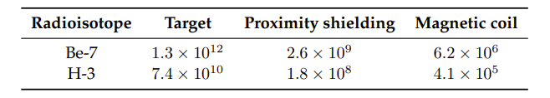
Water activation
C. Ahdida et al., SPS Beam Dump Facility - Comprehensive Design Study, CERN-2020-002
M. Casolino et al., Radiological Assessment of the Beam Dump Facility at CERN, EDMS 2263868
Activation of water from cooling circuits was estimated
Shielding estimate around demineralization cartridges was performed assuming Be-7 to be stopped, but no target debris
  → 50 cm cylindrical concrete shielding was foreseen and for the roof of the area 165 cm concrete
Remaining water in circuit mostly contains H-3 with a concentration of around 0.5 GBq/l per year of operation
Due to the high H-3 production in the target (~18 TBq during 5 yrs operation), a significant contribution to the H-3 concentration in the water can come from H-3 out-diffusion from the target disks and subsequent trapping in the cooling water
In case of 1% of out-diffusion every 2 months (best guess, no data available) and 100% trapping, the H-3 concentration from out-diffusion amounts to ~60 MBq/l every 2 months
The exchange of cooling water (1 m³) in one year would result in ~220 GBq of H-3 activity
PoT 1×10¹⁹ (1 yr)
Total Activity (Bq) for H-3 and Be-7
Results above do not take out-diffusion from target into account

Slide 7
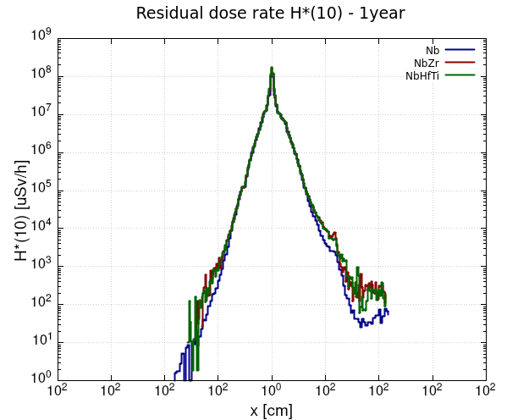
Alternative Claddings
G. Mazzola et al., BDF target – Nb cladding – LL study, EDMS 2838723
Cladding materials (EDMS 2838723):
  Tantalum – rho = 16.6 g/cm3
  Nb (ASTM R04210 – Type 2) – rho = 8.6 g/cm3
  Nb-1Zr (ASTM R04261 – Type 4) – rho = 8.6 g/cm3
  Nb-10Hf-1Ti (ASTM R04295) – rho = 8.86 g/cm3
Total PoT 2×10²⁰ (5 yrs), 1y cool-down
Residual dose rates (uSv/h)
Total PoT 2×10²⁰ (5 yrs)
Includes residual dose rates from surrounding material
Waste classification as FA-MA waste to be disposed of in Switzerland
No difference in the residual dose rates for the various Nb claddings
* LMA: Limite Maximale d’Admissibilité, no summation rule for the LMA

Slide 8
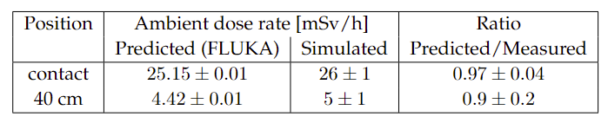
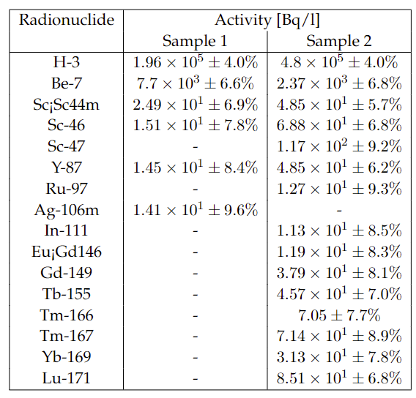
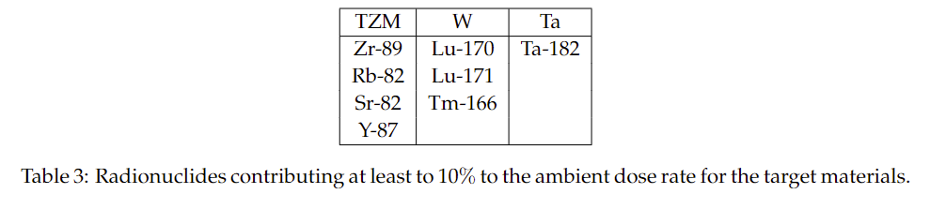
Prototype Target Tests
Benchmark of residual dose rates (mSv/h)
BDF target prototype w/ in total 14 h irradiation in TCC2, leading to 2.4E16 PoT
Target activation was measured and compared to FLUKA simulations showing excellent agreement (uncertainty mainly from measurement position)
Cooling water activation was estimated w/ FLUKA
Estimated residual dose rate after 1h of cooling at 40 cm from the cartridge is 18.7 mSv/h, while the PMI monitor measured 16.9 mSv/h
→ 10% discrepancy may be due to the fact that not all ions are captured by the cartridge
Both samples showed the presence of high-Z spallation products some of them could have been
produced in the target materials
Radionuclides in water samples
Water samples were analysed by liquid scintillation and gamma spectrometry
EDX of debris in water was inconclusive of material. No peaks were found for Ta, W, Mo or Ti. Metallic particle (Al, Ca, Fe, Cl, Fe, Cr) (EDMS 2364297)

Slide 9
TDR Studies for the Target
WP6.2 Radiation Protection
Execute the required RP studies for latest target design option(s) and full 15-years lifecycle of facility
  Residual dose rates
  Radionuclide inventories
  Shielding requirements
  Water activation
Execute the required RP studies for beam tests with prototype targets
WP6.3 Radioactive Transport and Waste Management
  Study the radioactive transport and waste aspects for the prototype target tests
  Provide guidance and support related to radioactive transport and waste for the BDF target design(s)

Slide 10
Content
BDF Target
  BDF Baseline Target
  Alternative Claddings
  TDR studies
BDF Target Complex
  BDF @ ECN3
  TDR studies

Slide 11


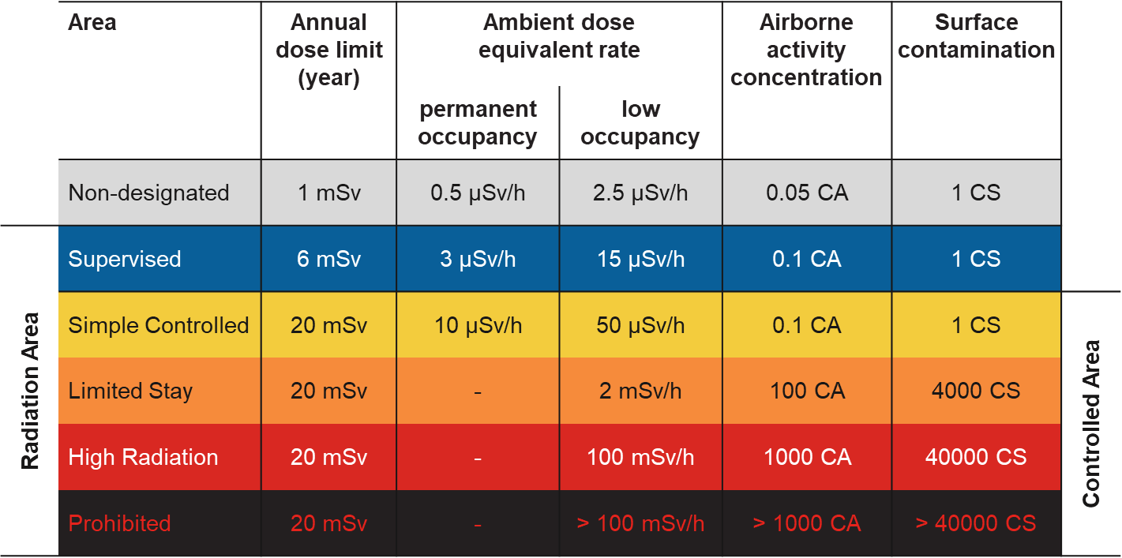
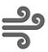

HI ECN3 facility design optimization
Giuseppe Mazzola et al., Radiological Assessment of the Beam Dump Facility at ECN3, EDMS 2911154
RP studies based on FLUKA MC simulations were performed for a design optimization of BDF/SHiP@ECN3
ALARA approach
Optimization required to ensure that exposure of personnel to radiation and radiological impact on environment are As Low As Reasonably Achievable
Prompt radiation
Reduce prompt radiation to comply with radiation area classification in the surrounding accessible areas as well as the 1 mSv limit at the CERN fence
Radiation area classification
residual radiation
Limit activation of target and experimental area to reduce residual dose rates to be compatible with an adequate area classification
Air and soil activation
Reduce activation of air and its releases into the environmental. Limit soil activation (³H<1000 Bq/kg, ²²Na<50 Bq/kg) and transfer to groundwater
Environmental impact
Reduce environmental impact from prompt radiation and releases of activated air to fulfill CERN’s dose objective for the public of <10 uSv/year

Slide 12
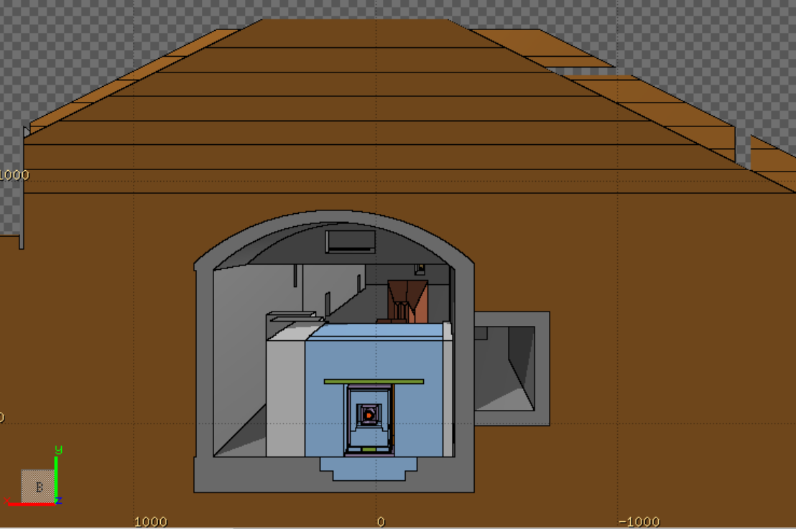
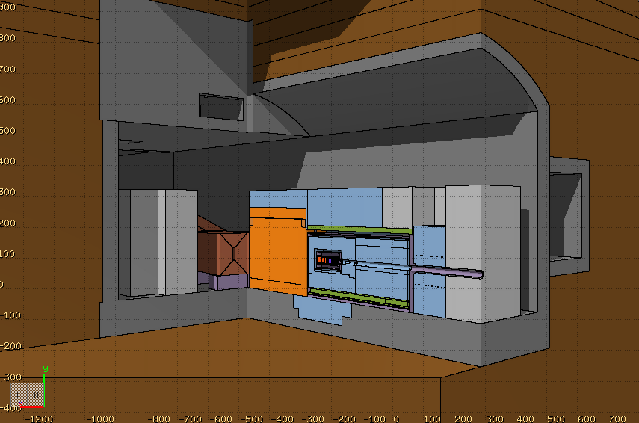
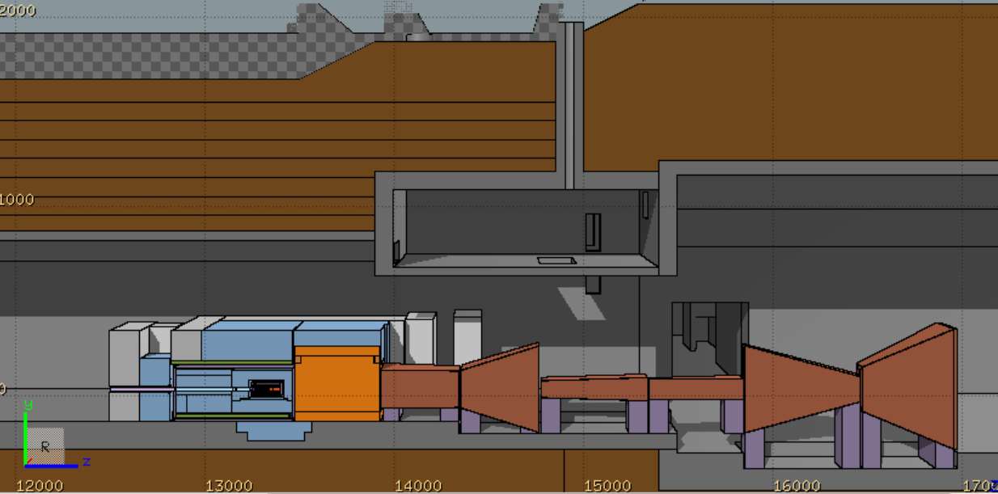
BDF/SHiP FLUKA model
Giuseppe Mazzola et al., Radiological Assessment of the Beam Dump Facility at ECN3, EDMS 2911154
FLUKA hosted by CERN (FLUKA v4-3.0) [1-3]
Target complex & muon shield, Created using FLAIR [4]
Moraine
8 m
A detailed BDF/SHiP target complex together with the muon shield was implemented in FLUKA
It was integrated in a FLUKA geometry including the full underground TCC8/ECN3 cavern and surrounding galleries, tunnels, rooms, etc.
Ground profile data from CERN’s Geographic Information System and technical drawings were used to model the surrounding ground
TCC8
Muon shield
1.6 m
11 m
1.6 m
W-TZM target
4.8 m
Magnetic part of hadron stopper
1 m
ECN3
Floor shielding (13.3 m³)
Stainless steel
US1010
Concrete
Moraine
Cast iron

Slide 13
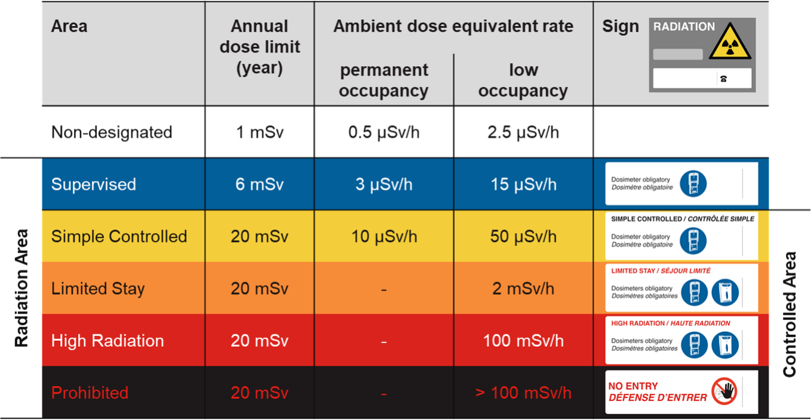
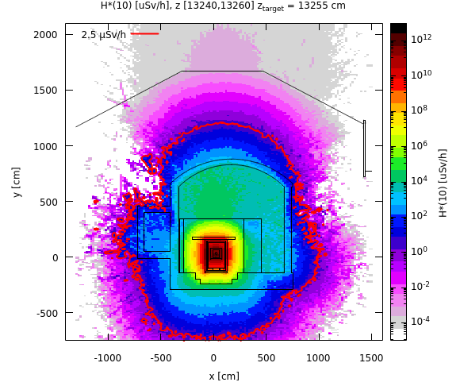
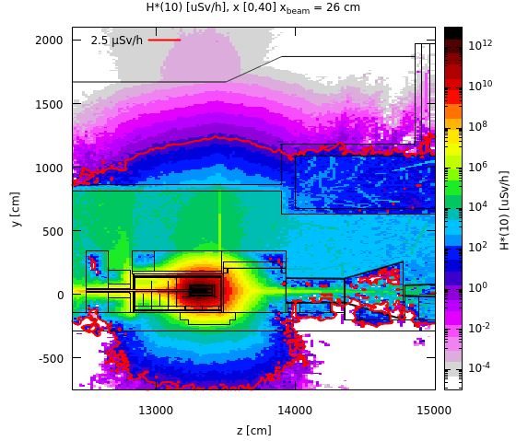
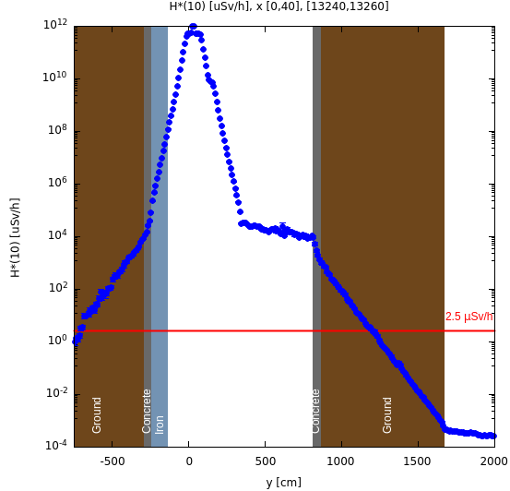
Prompt radiation in target area
Avg. intensity of 5.6×10¹² p/s
Cross-sectional view
Side view
Along y-axis
Shielding design is optimized for the prompt radiation
Thanks to shielding reinforcements towards the bottom, no increase of soil activation expected
100 rem = 1Sv

Slide 14
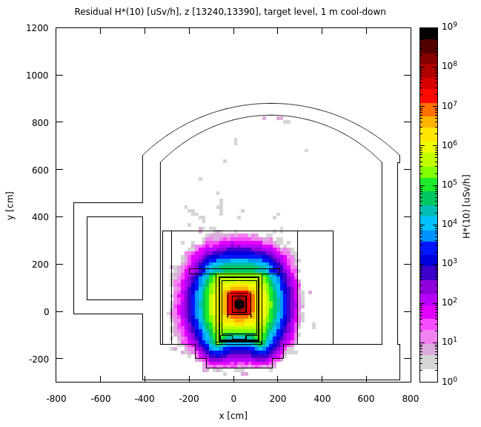
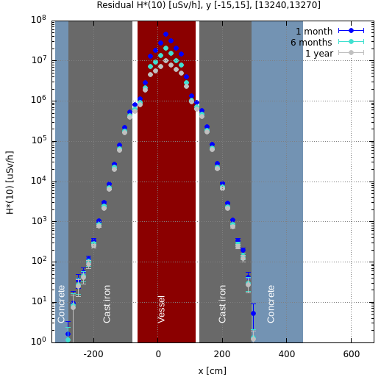
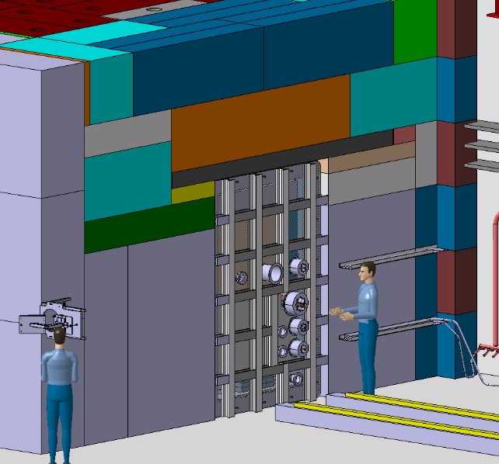
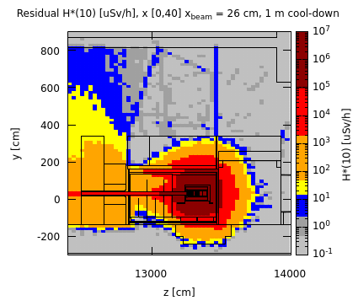
Residual radiation in target area
Total PoT 6×10²⁰
Cross-sectional view, target level
Along x-axis, working height
Upstream of vessel w/o upstream shielding
Preliminary worst case manual intervention scenario
1 month cool-down
No shielding
x [0,40]
x_beam = 26 cm
After removal of the shielding upstream of the vessel, residual dose rates are within a Limited Stay Controlled Radiation Area
Supervised Radiation Area on the sides
Further optimization by movable shielding
The shielding design contains well the high residual dose rates reaching in the central target region several 10 Sv/h after 1 month of cool-down
The residual dose rates outside the shielding are < 1 µSv/h
100 rem = 1Sv

Slide 15
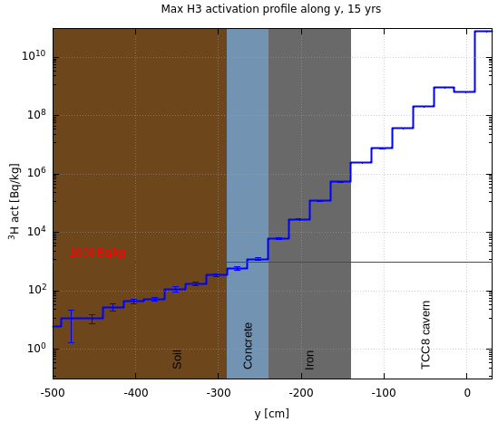
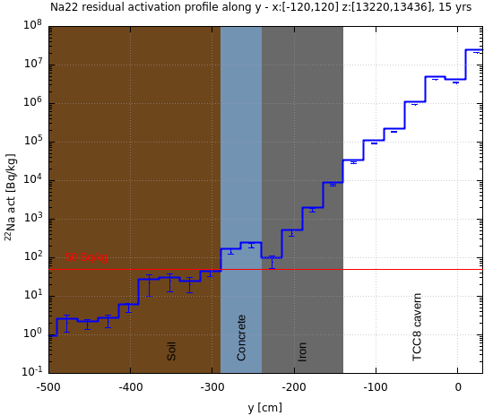
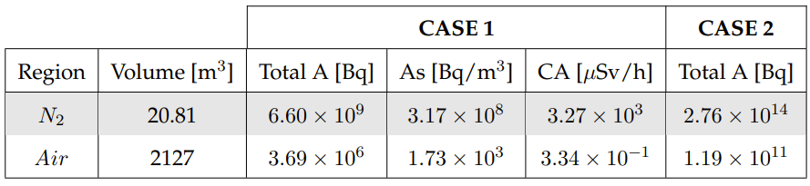
Air and soil activation
Total PoT 6×10²⁰
PoT 4×10¹⁹ per year
Specific activity of ³H and ²²Na in the soil below TCC8 (most critical area)
Air activation
Activation of air in target complex area were studied
Production of radionuclides evaluated with FLUKA in combination with ActiWiz [5]
³H
²²Na
¹
CASE 1: build-up of radionuclides during operation w/o air extraction and 30 min cooldown time before air release
CASE 2: constant immediate release of air (worst-case for upper limit of environmental impact)
Thanks to floor iron shielding, ³H and ²²Na activity concentrations in the soil are below respective design limits
A hydro-geological study is underway, which will allow to refine the design limits and possibly allow to reduce the required shielding
Flush of target complex with fresh air before any access to reduce specific airborne radioactivity to be compatible with 0.1 CA
¹ Person working 40h/w, 50w/y with standard breathing rate in activated air with CA = 1 receives 20 mSv

Slide 16
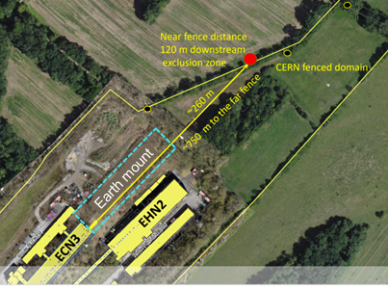
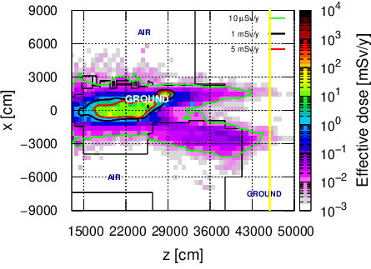
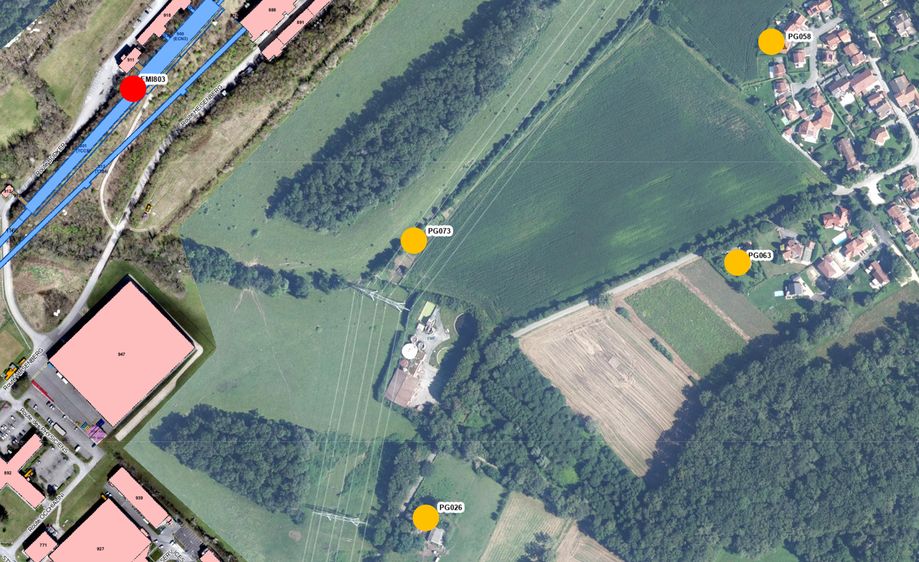
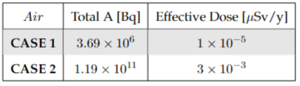
Environmental impact
Dose from air releases
Dose from stray radiation
Used max. dose coefficients from different age groups [6]
Positions of nearby population groups
Effective dose estimates
Muon prompt radiation aboveground downstream ECN3
Release point
CERN fence
H-3 release due to air activation of ~80 kBq
Worst-case immediate air release (CASE 2) yields 3 nSv/year and is thus well below the annual dose objective of CERN
Exposure of members of the public due to air releases is negligible
Annual limit of Non-designated Area on CERN domain (5 mSv/y) and at CERN fence (1 mSv/y) as well as dose objective for members of the public
(10 uSv/y) by far met
100 rem = 1Sv

Slide 17
TDR Studies for the Target Complex
WP6.2 Radiation Protection
Re-evaluate the target complex shielding requirements depending on the outcome of the hydrogeological study and possibly relaxed soil activation limits
Execute the required RP studies for the design optimization/integration of the target complex including handling considerations
Perform the residual dose rate studies for maintenance scenarios (e.g. target exchange) w/ different irradiation and cool-down scenarios
Perform the required RP studies (e.g. residual dose rates, radionuclide inventories, shielding requirements) for target sub-systems for transport, waste disposal and FIRIA
Evaluate RP requirements (e.g. shielding, ventilation, cooling station) for the service building
Evaluate RP requirements for irradiation stations at the Target Complex
WP6.3 Radioactive Transport and Waste Management
  Provide guidance and support related to radioactive transport and waste for the BDF complex design

Slide 18
Thank you for your attention!

Slide 19
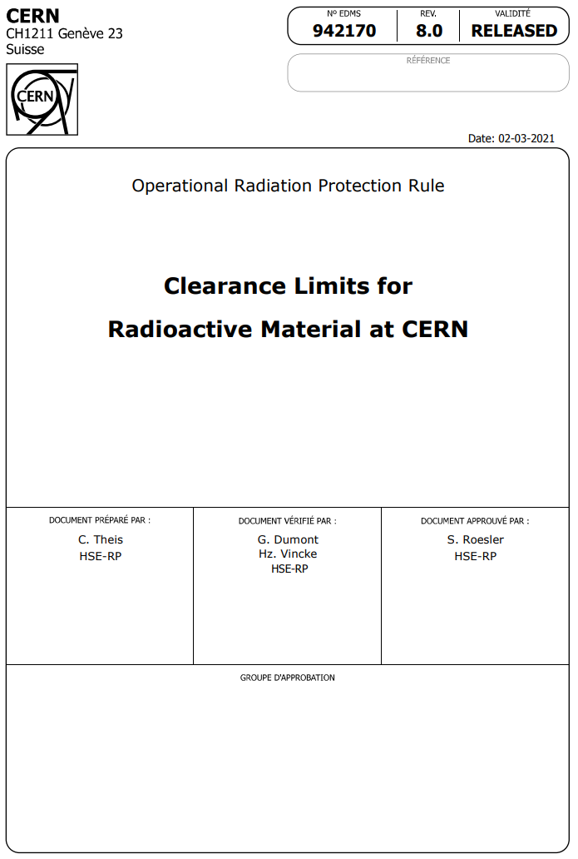


Radioactive Material
When is a material radioactive?
Specific and total activity exceed clearance limits (LL values)
as given in the Annex of EDMS 942170 (adopted from Swiss legislation)
OR
Net ambient dose equivalent rate > 0.1 µSv/h in 10 cm distance
OR
Surface contamination exceeds limits
as given in the Annex of EDMS 942170 (> 1 CS)
Examples: 0.1 Bq/g for ²²Na, ⁵⁴Mn, ⁶⁰Co
1000 Bq/g for ⁵⁵Fe
Sum rule for mixture
of radionuclides:
Sum rule for mixture
of radionuclides:

