Slide 1
Target complex WP implementation milestones & timeline
HI-ECN3 BDF target & target complex initial review
Jean-Louis GRENARD
29-04-2024

Slide 2
Priorities for the TDR
Target station design
Target complex utilities design
Target service building
Definition of interfaces
Definition of target and target ancillary lifecycle
Definition and assessment of failure scenarios

Slide 3
Target station design
Move toward a detail mechanical design
  Vacuum confinement → design supported by external partners
  Extraction system → design supported by external partners
  Shielding design → to update based on shielding recovery possibilities
  Target supporting interface → need to develop a model
  Utilities routing → need to built mock-ups to test handling and shearing
Design to be made compliant (and flexible) with target, beam line and experiment requirements

Slide 4
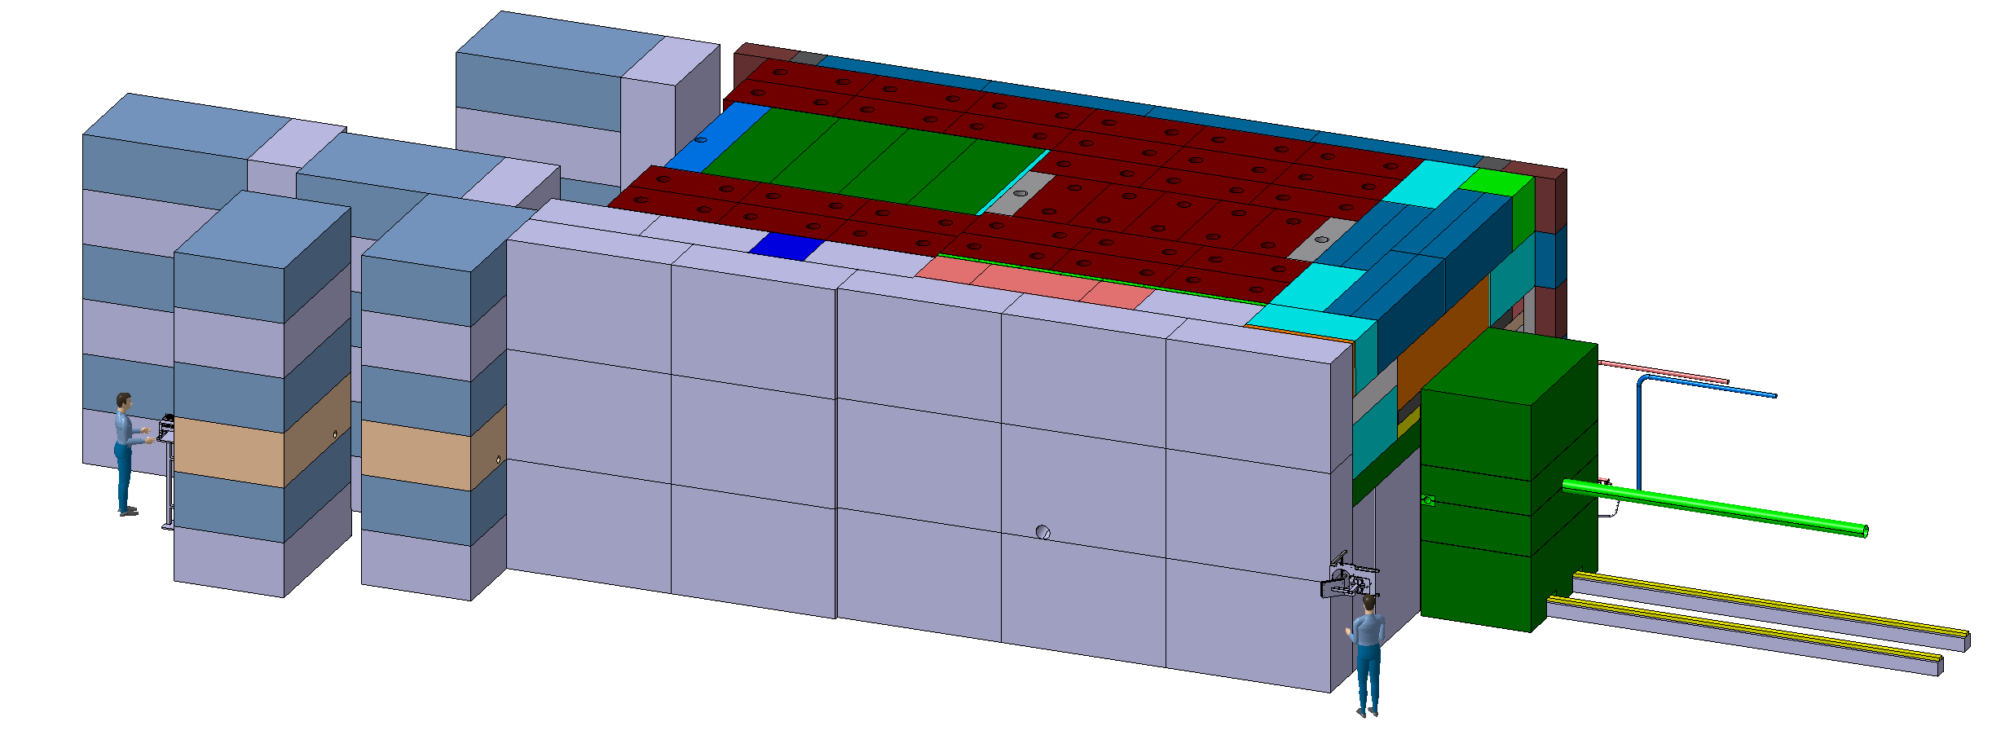
Target station pre-assembly
Full pre-assembly of the target station
Debugging for installation procedures
Rehearsal platform for exchange procedure and associated failure scenarios

Slide 5
Target service building
CE on the critical path
  Need the envelops defined by end of 2024
  Constrains with exiting CE structure (911 shaft and TCC8 soil retaining wall)
  Design of the building mainly driven by Cooling and Ventilation equipment
  Building confinement to be defined (fire assessment)
  Shielding assessment to define building superstructure
Equipment part of the building → staged implementation
  Service cell and associated tools
  Hot Cell
  → Utilities made available but installation system staged

Slide 6
Ventilation systems
Target area & Target service building
Need and definition of dynamic confinement(s)
Fire risk assessment to be handled via a FIRIA
REX of NA-CONS TCC2 FIRIA assessment to take in consideration

Slide 7
Cooling systems
Definition of preliminary need in term cooling power
Water leak handling → retention vessel(s), sump(s)
Possible hydrogen production in cooling circuit → ATEX room?
Tritiated water handling
  Built a new water release station vs using the existing one for RWTC

Slide 8
Safety systems
Access systems
Fire detection
Fire doors
Fire extinguishing means (including fire water collection)

Slide 9
Handling and robotic tasks and tools
Definition and design of remotely compatible interfaces
Lifting points
Supporting point and pre-guiding interfaces
Shearing interfaces
Casks
Definition and design of fixed remote handling infrastructure
Cranes
Definition of remote handling tasks
Target exchange
Target preparation for final disposal

Slide 10
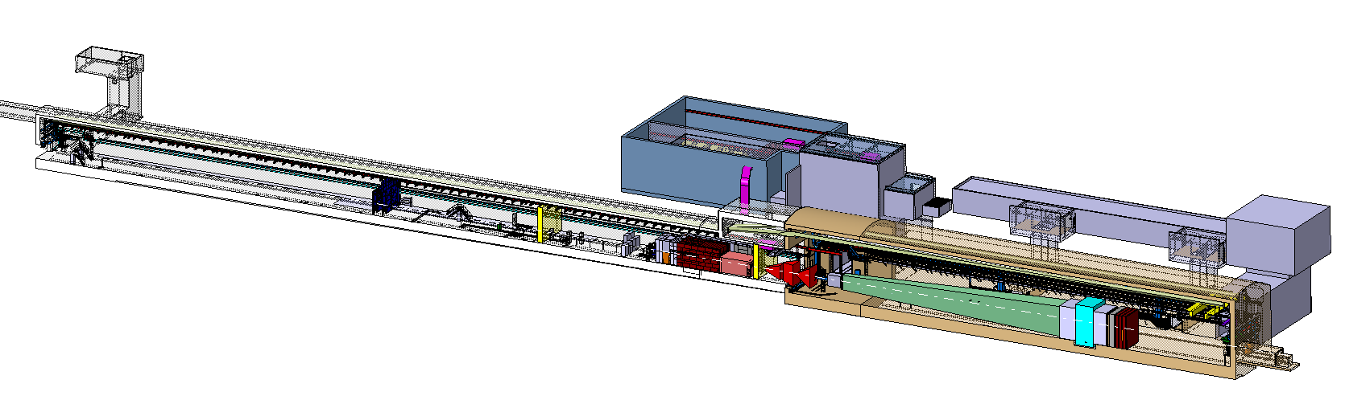
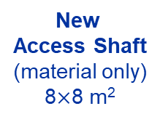
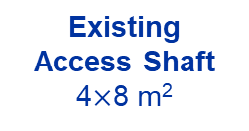
Interfaces
New
Service Building
~ 500 – 700 m²
New
Access Shaft
(material only)
8$×$8 m²
Existing
Access Shaft
4$×$8 m²
B911
B918
TCC8
New Target Complex
containing the Beam Dump Target
ECN3
Physical interface in between all the different systems

Slide 11
WP external key Interfaces
Beam delivery WP2
  Position and definition of beam instrumentation
  Beam pipe
  Dilution system definition and position
Target WP3
  Cooling circuit design
  Supporting scheme
  Utilities routing
  Handling
Experiment WP5 + SHiP
  Magnetized hadron stopper
  Utilities routing in TCC8 and ECN3
  Shielding to minimize background
  Installation and maintenance tasks
  Experiment position

Slide 12
WP internal key Interfaces
CE structure
Cooling systems
Ventilation systems
Confinements
Survey network
Safety systems
Remote handling tools
Shielding
Control systems (including protection systems)
Irradiation stations

Slide 13
Target and target ancillary lifecycle
How to replace a target?
What is the process to move from an operational broken target to final repository?
Target size reduction
Target material separation
Imposed final repository cask
Same apply for all target complex highly activated objects
  Probably more complex to handle
  Lot of destructive work to be performed

Slide 14
Definition and assessment of failure scenarios
Failure scenarios will trigger design choice and exclude certain technologies
  Defined redundancy level
  Back up plans
  Should contain all the different phases of the lifecycle of the complex
  Including unlikely events (ie earthquake)
  Preliminary risk of failure modes been established and need to work with stakeholders

Slide 15
Up to the TDR delivery
Many interfaces to handle
Inputs to design the target complex building which is on the critical path
Failure scenarios to take in consideration in the design
Certain choice on the target and experiment may have major consequence target station design
→ Some parameters have to be frozen by end of 2024
→ Once the target station will be built and installed some elements can’t be changed: ie vacuum vessel, target station position, target size (increase)
→ Adding extra features like irradiation stations at a later stage might be impossible

