Slide 1
Dismantling work prior to target complex implementation
HI-ECN3 BDF target & target complex initial review
Jean-Louis GRENARD
29-04-2024

Slide 2
Dismantling plan
Cooldown of about 6 months for the current target station (~70m at the beginning of TCC8) before start of dismantling activity
The rest of TCC8 dismantling can start at T0 of LS3 (to free the space for CE activities)
Detail inventory of the equipment being built to perform RP classification
Detail dismantling sequence to be built
Logistics for the equipment to take out to be organized
  Most beam line equipment to be recovered (to be used as operational spares)
Logistics for the shielding's to be reuse to be organised

Slide 3
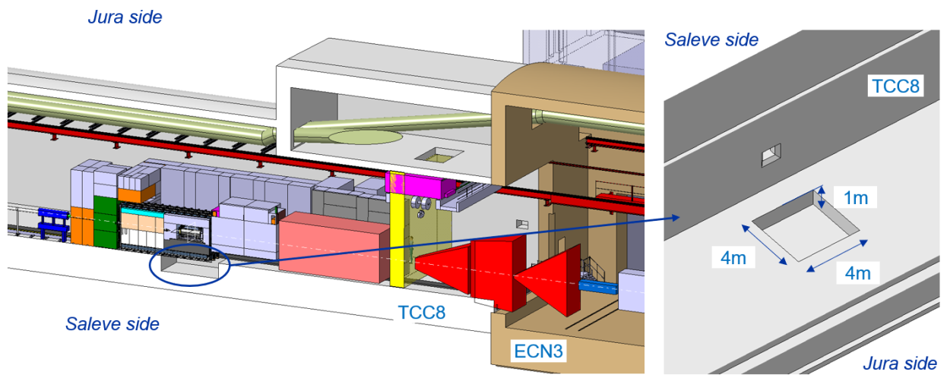
Target station CE work
Trench possibly needed bellow the target station to reinforce locally the shielding
To be confirmed following hydrogeological study outcomes

Slide 4
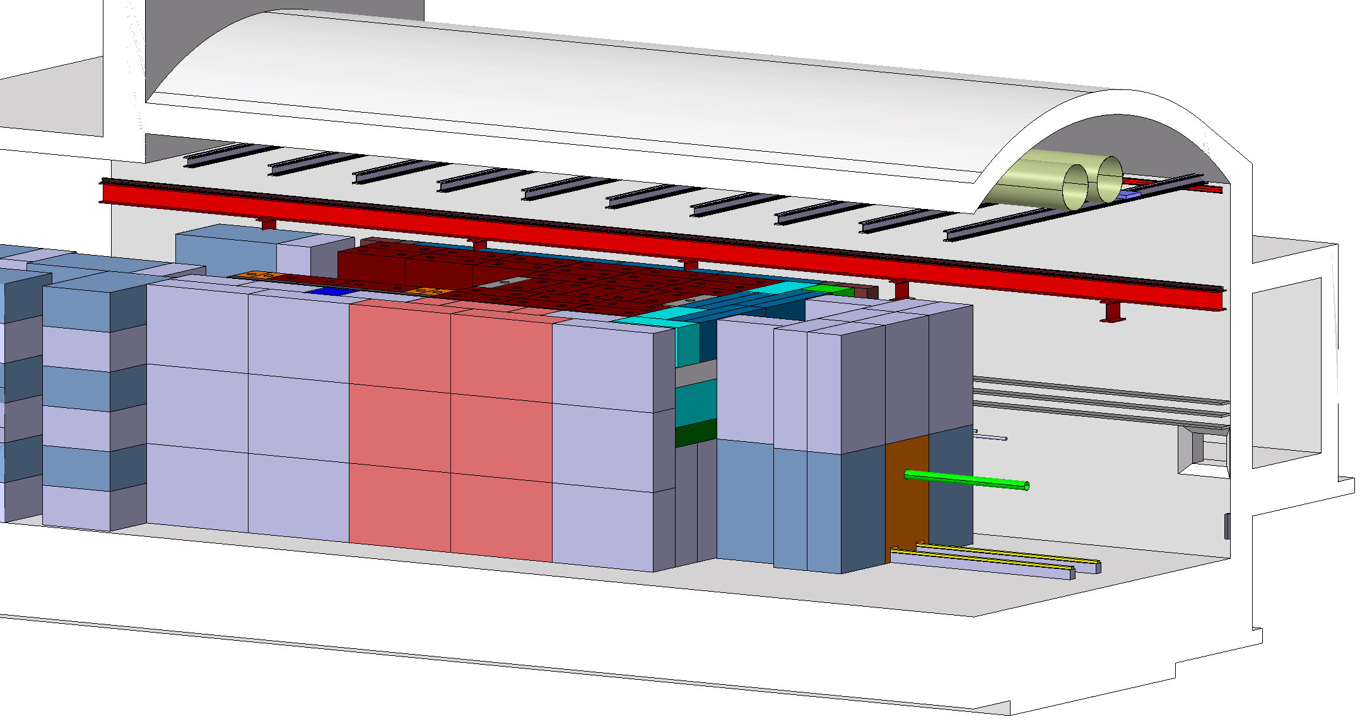
BDF/SHiP target station
~ 180 m³ of cast iron + US1010
~ 360 m³ of concrete / marble
Few special blocks (with active cooling, special shape) needed
3D model of target station currently being developed around ‘’standard’’ blocks

Slide 5
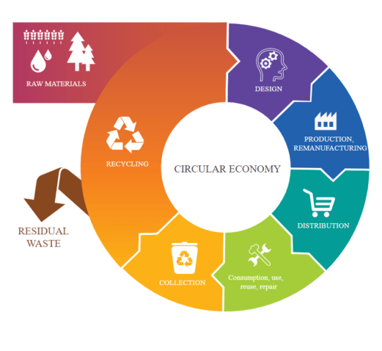
Cast iron and concrete blocks (current) costs
Scrap cast iron → ~1950 CHF/m³ (250 CHF/t)
Finished standard cast iron block → ~ 31200 CHF/m³ (4000 CHF/ton)
Finished standard concrete block → ~ 600 CHF/m³
Radioactive objects elimination paths
  TFA (<100µSv/h) → ~600 CHF/m³ (can go up to ~1200 CHF/m³ for large single blocks)
  FMA(>100µSv/h) → ~32000 CHF/m³
Large interest to reuse activated blocks (including those above 100µSv/h)

Slide 6
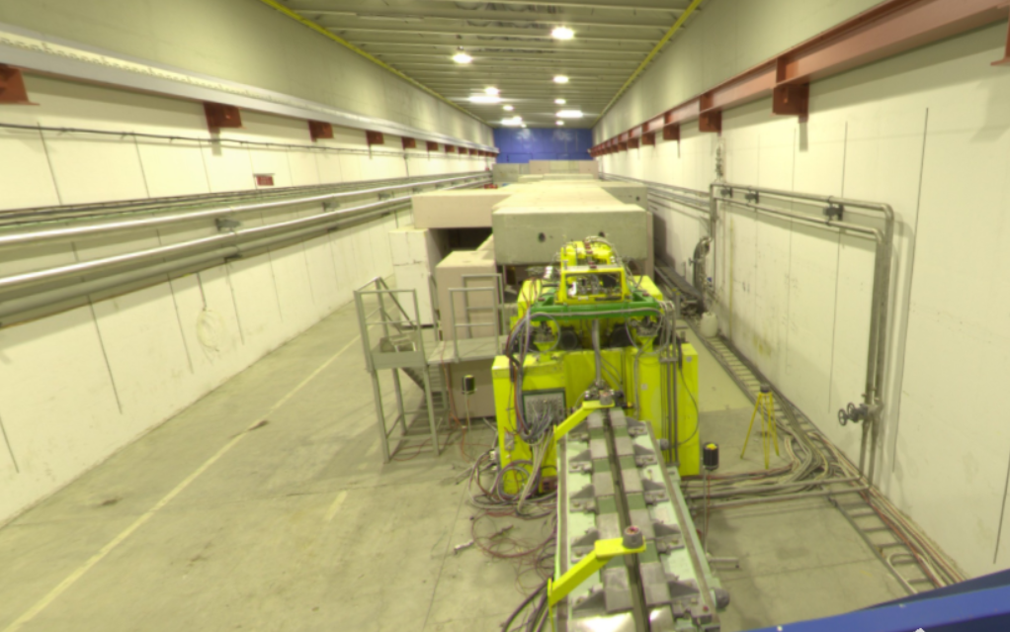
TCC8 tunnel (current T10 target station)
~15 m³ of standard radioactive cast iron blocks
~400 m³ of standard radioactive concrete blocks
Will be reused in situ for the target station

Slide 7
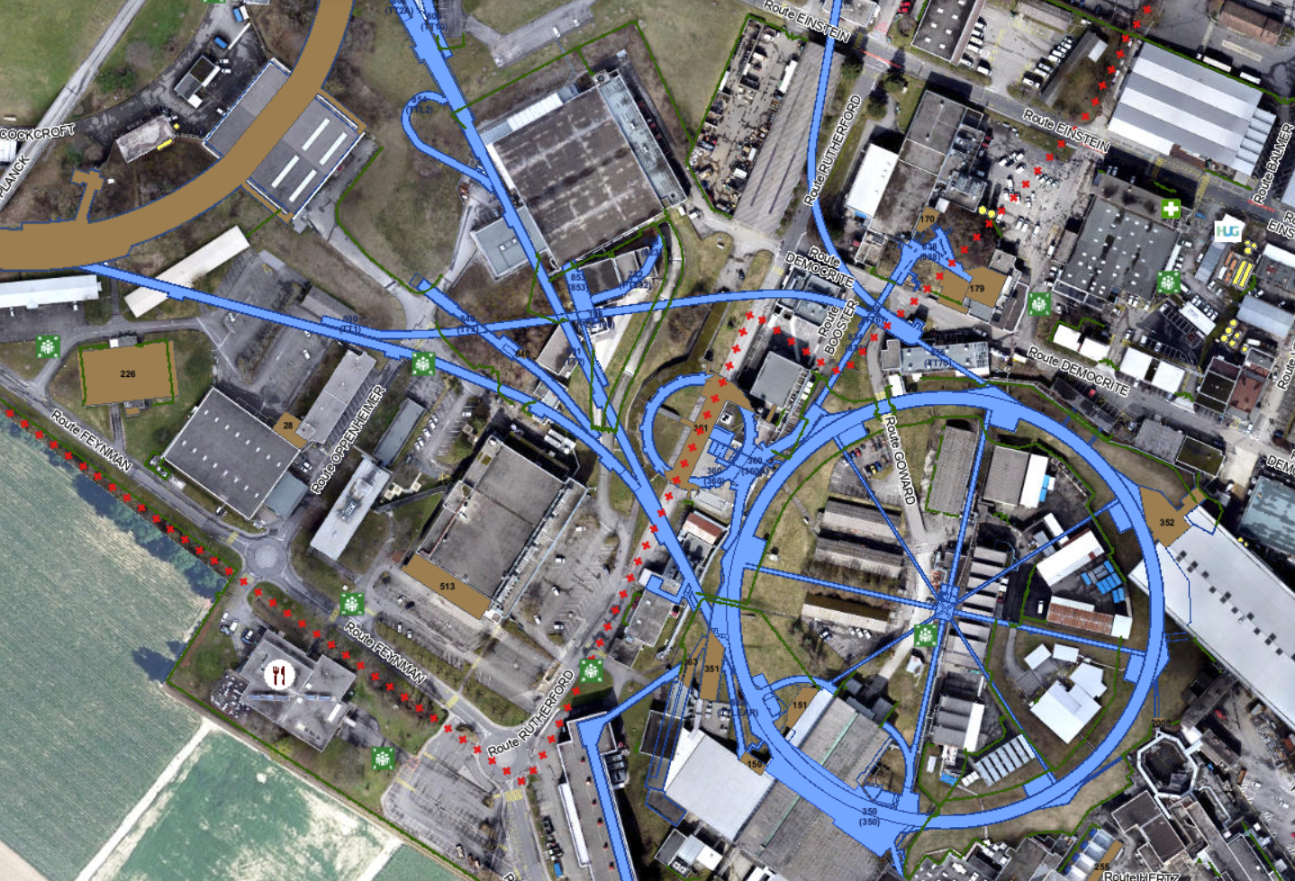
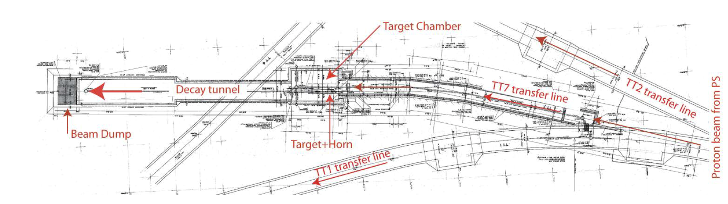
TT7 PS neutrino facility
TT7 Target chamber
PS ring
Operation in 1983-84

Slide 8
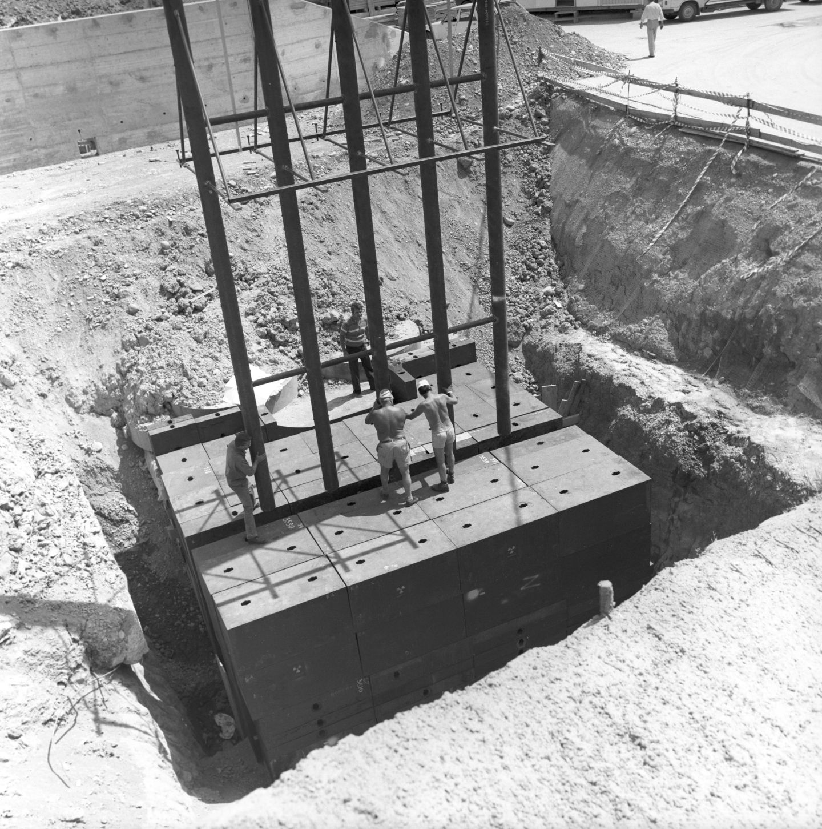
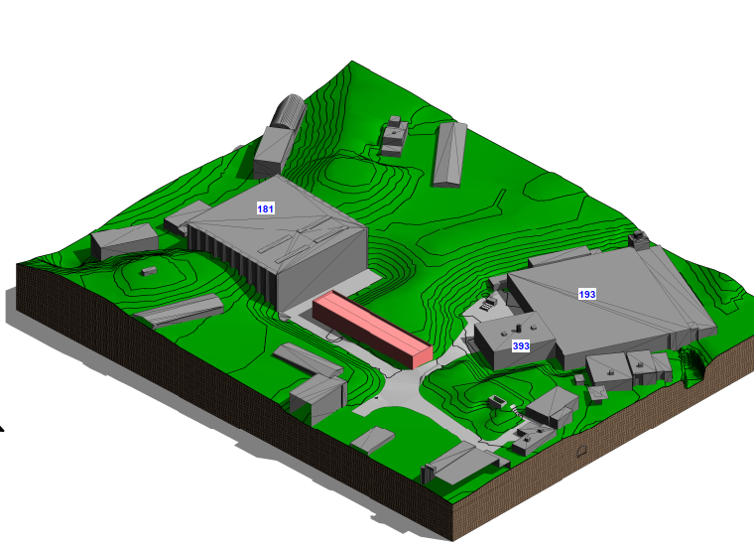
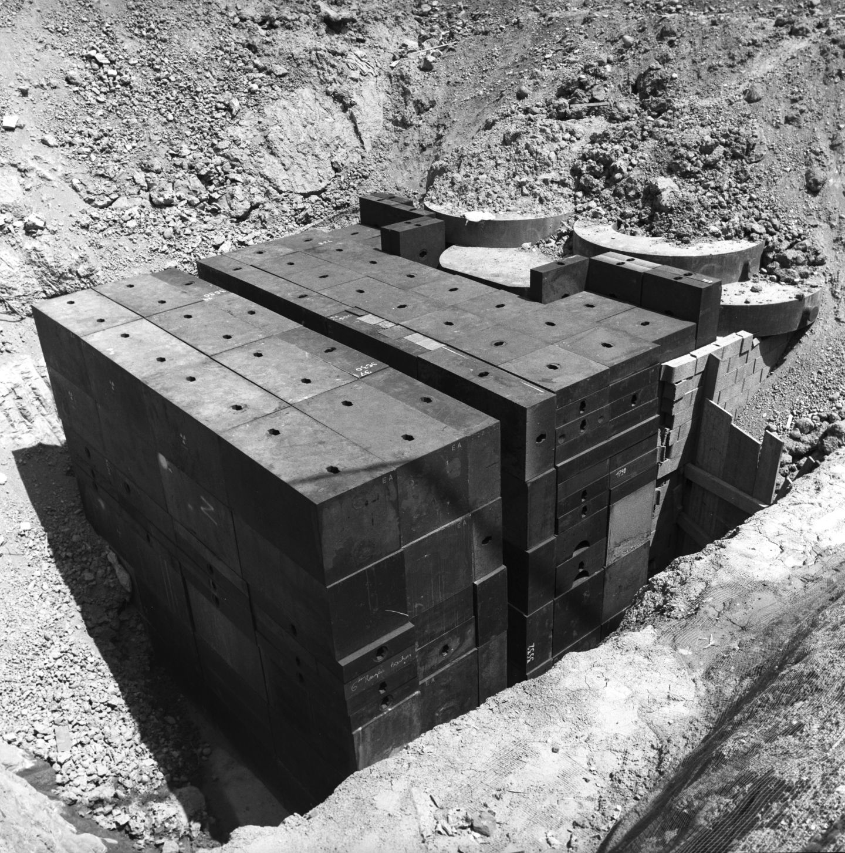
TT7 PS neutrino facility
100m³ of standard cast iron blocks + ~50m³ of non-standard cast iron blocks (~3MCHF)
Activated blocks (dose rate expected not to be high)
Need large excavation ~ 3000 m³
Fully independent of accelerator operation (and far enough)
Some disruption around the site to foresee during the execution
Some utilities dedicated to road located in the vicinity
Investment (~0.7 MCHF)

Slide 9
Conclusion
TCC8 target station dismantling need further development
Logistic will the key aspect to handle smoothly this dismantling
A good fraction of the shielding required for the construction of the new BDF target station being recovered (TT7 and TCC8)

