Slide 1
Beam pipe rope support from YE1
Mock-up
Ali Karaki - CMS Engineering and Integration Office
Josef Sestak - TE-VSC-BVO
18/03/2024

Slide 2
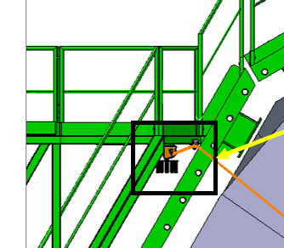
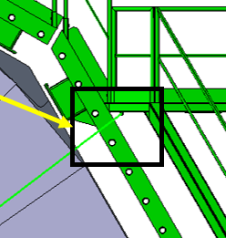
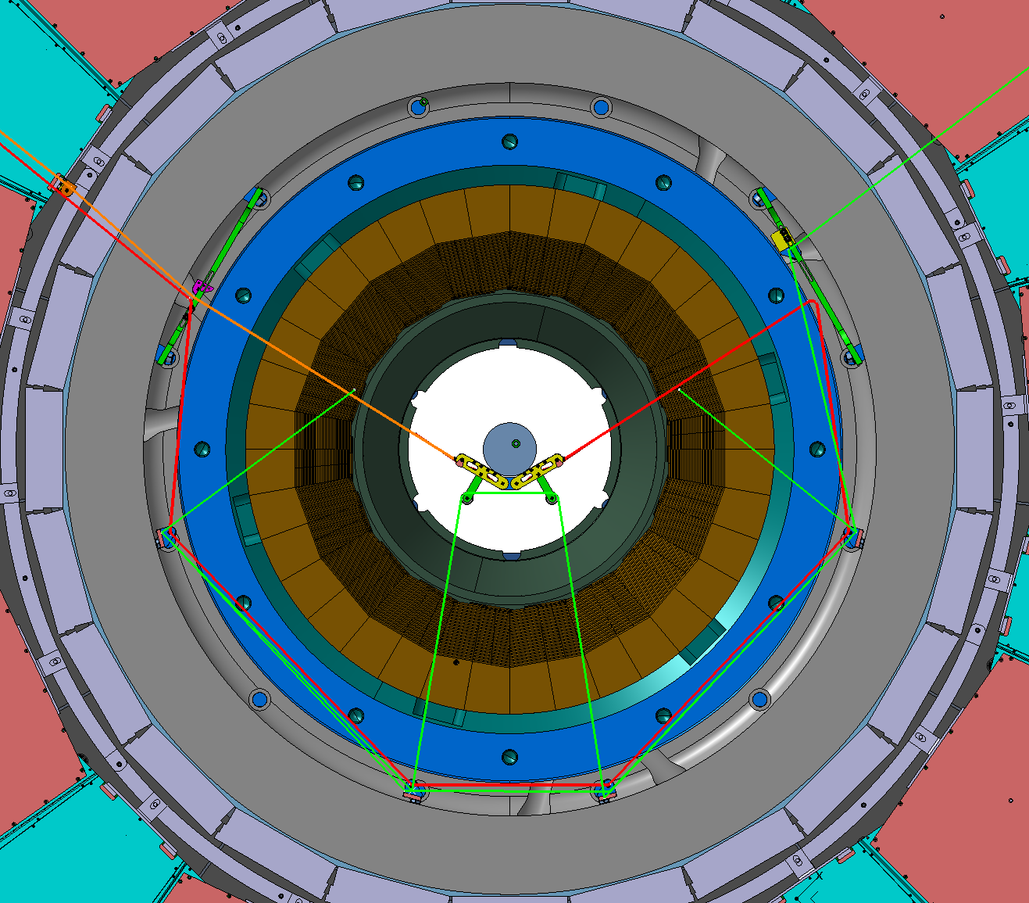
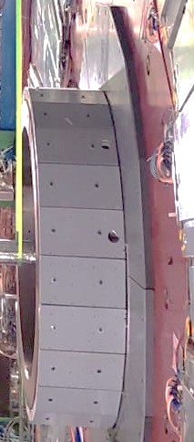
Support design overview
Wire ropes passing through the obsolete alignment holes of YE1 spacer ring.
Control the installation\removal of the support remotely from the tower by pulling the ropes.
Rope 1 is the main rope that takes the load, while rope 2 is used to retract rope 1 and keep it in the shadow of the spacer ring.
To be used when the endcaps are in closed configuration (no gap between YE1 and YE2), or in any position of YE1 at |z|<12.3m.
Manual winch
Manual winch
Rope 1
Rope 2
Beam pipe
YE1 spacer ring
YE1 Non-Ip side

Slide 3
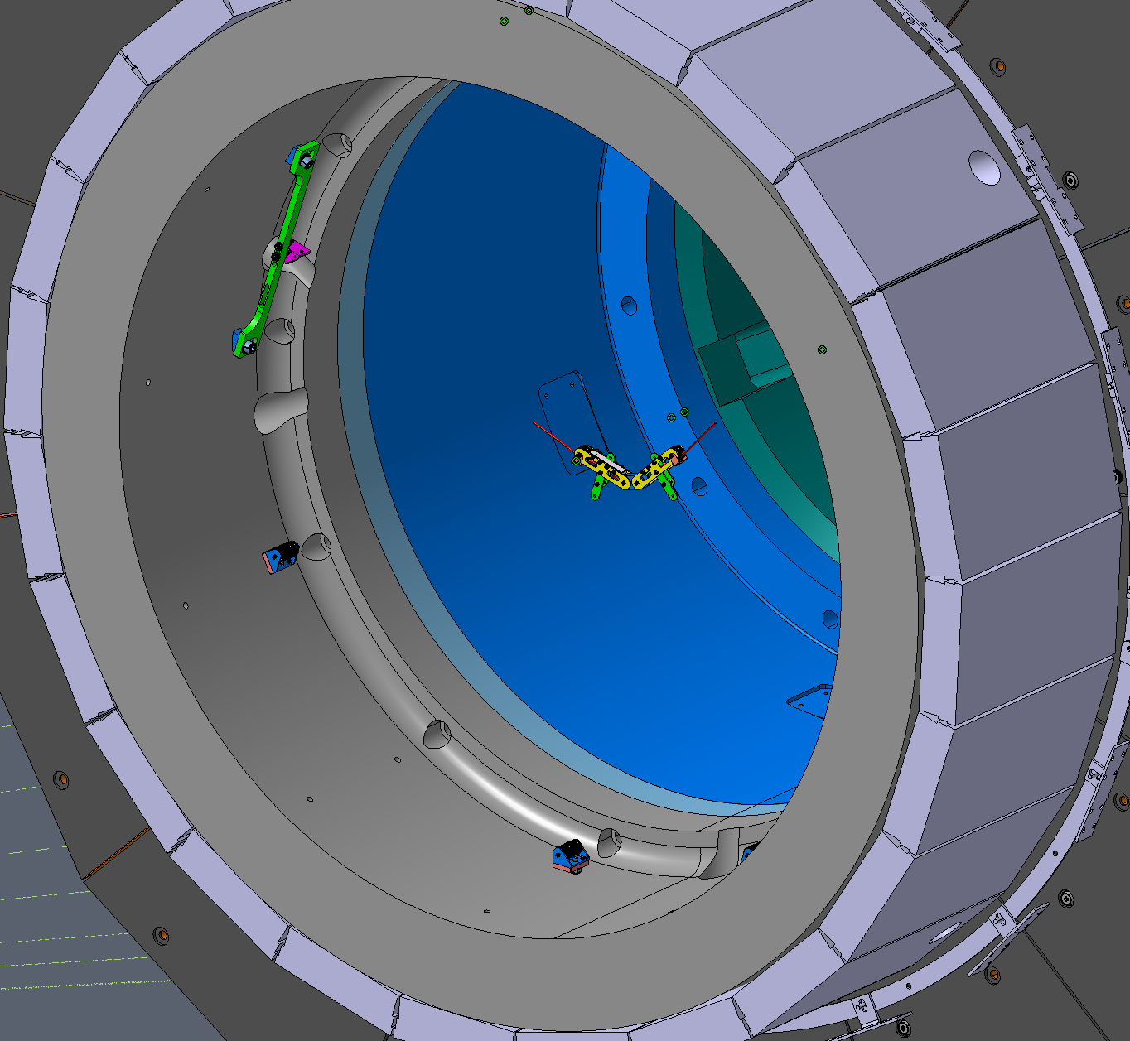
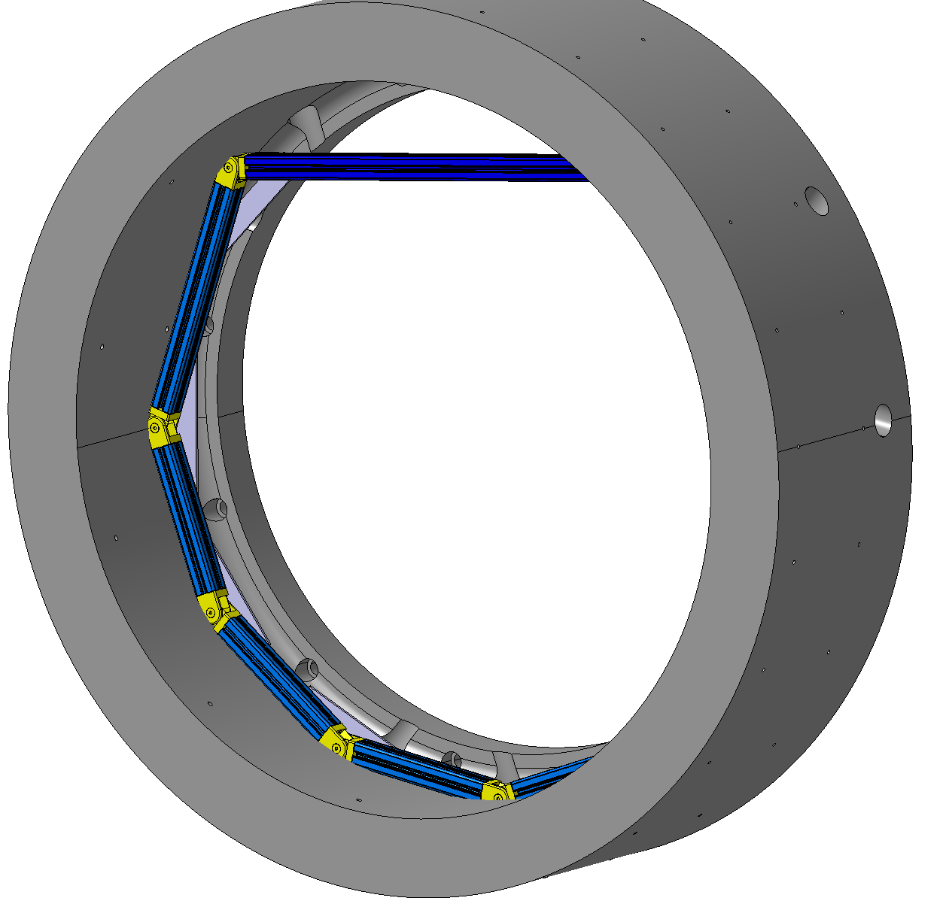
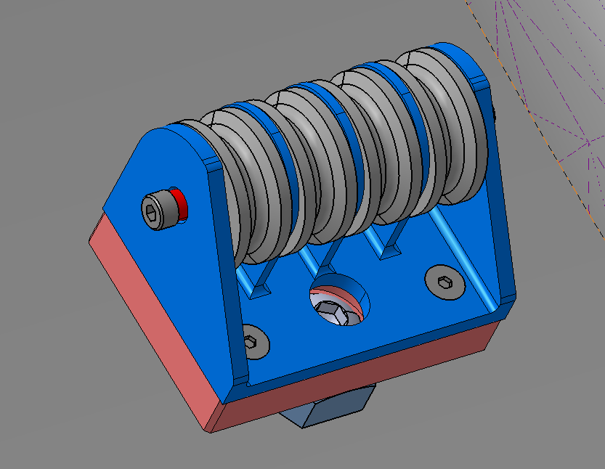
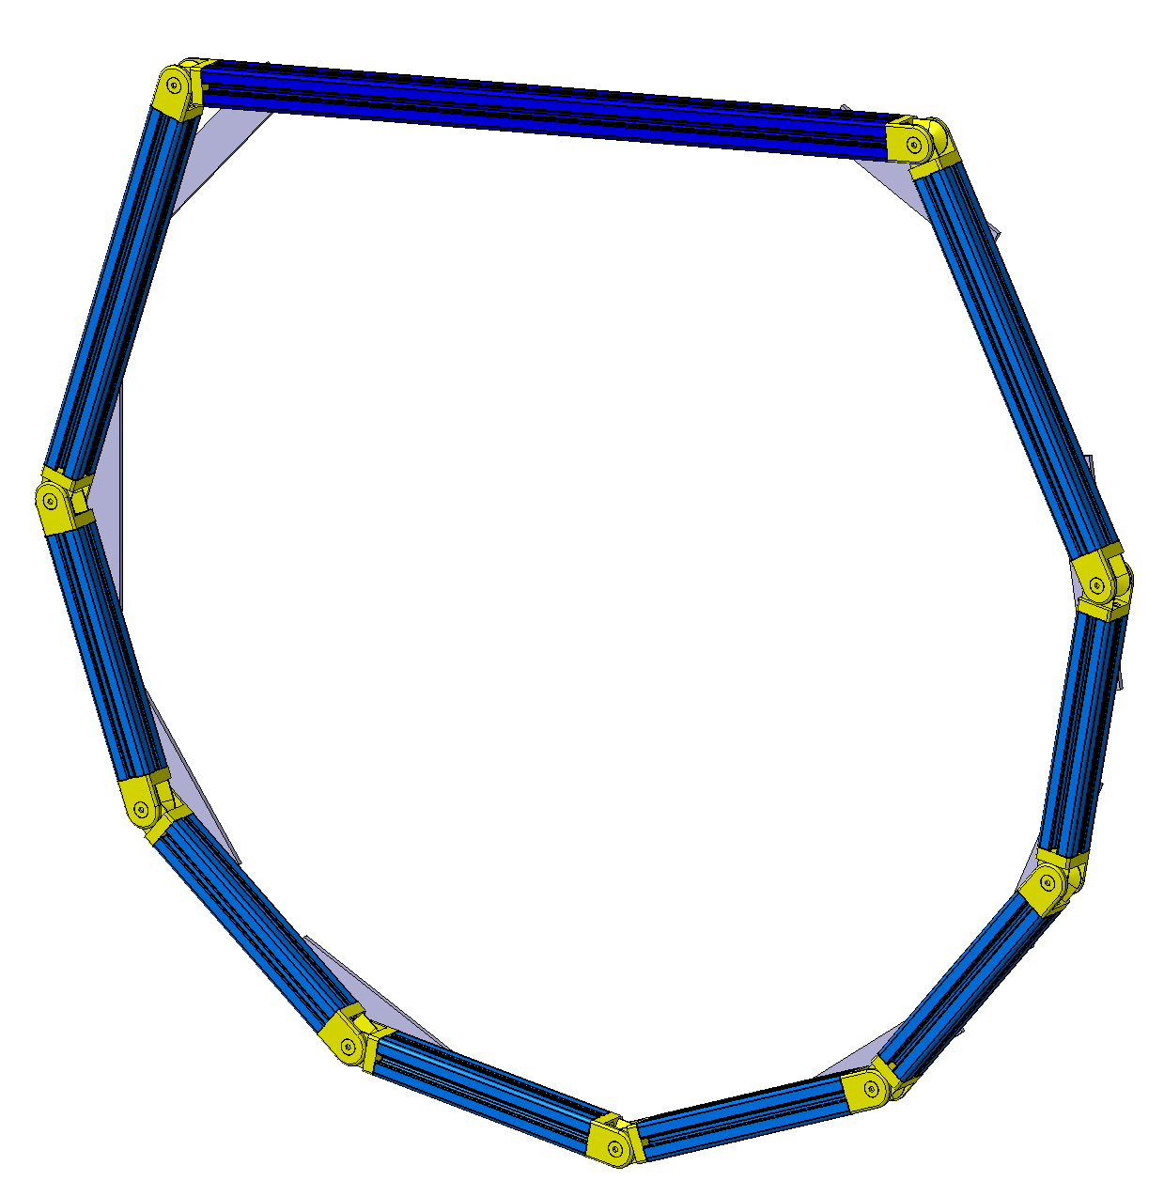
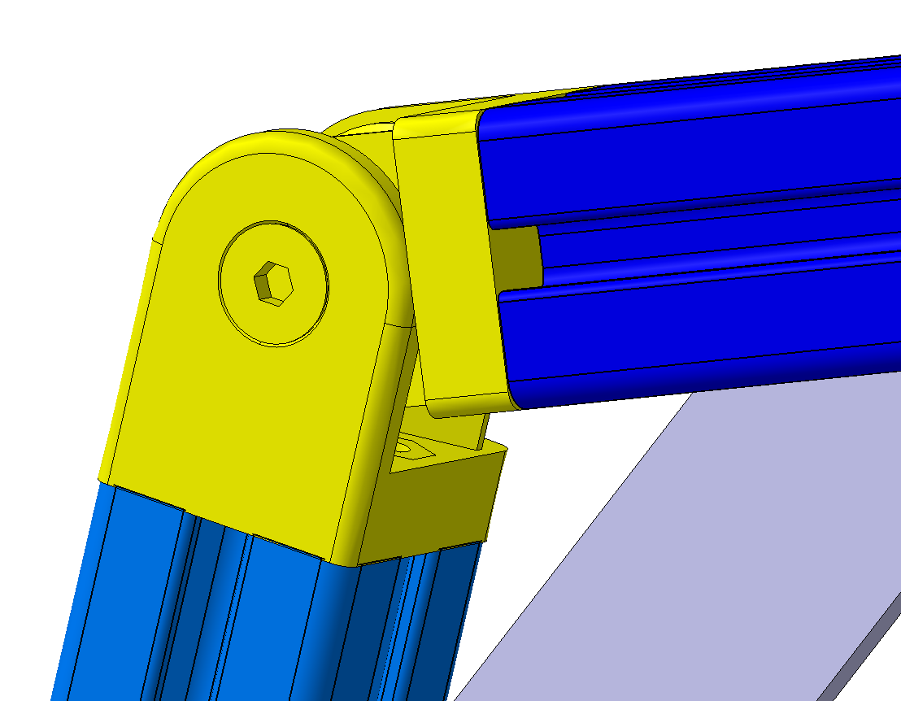
Mock-up
YE1 Inner Ring
YE1 Inner Ring and the mock-up superposed
Bosch Frame
M16 threaded holes
A mock-up was built to test the behavior of the support.
Bosch frame simulating the positions of the threaded holes in the YE1 ring where the pulleys will be attached.
Scale 1:2
Articulation
Reinforcement bar

Slide 4
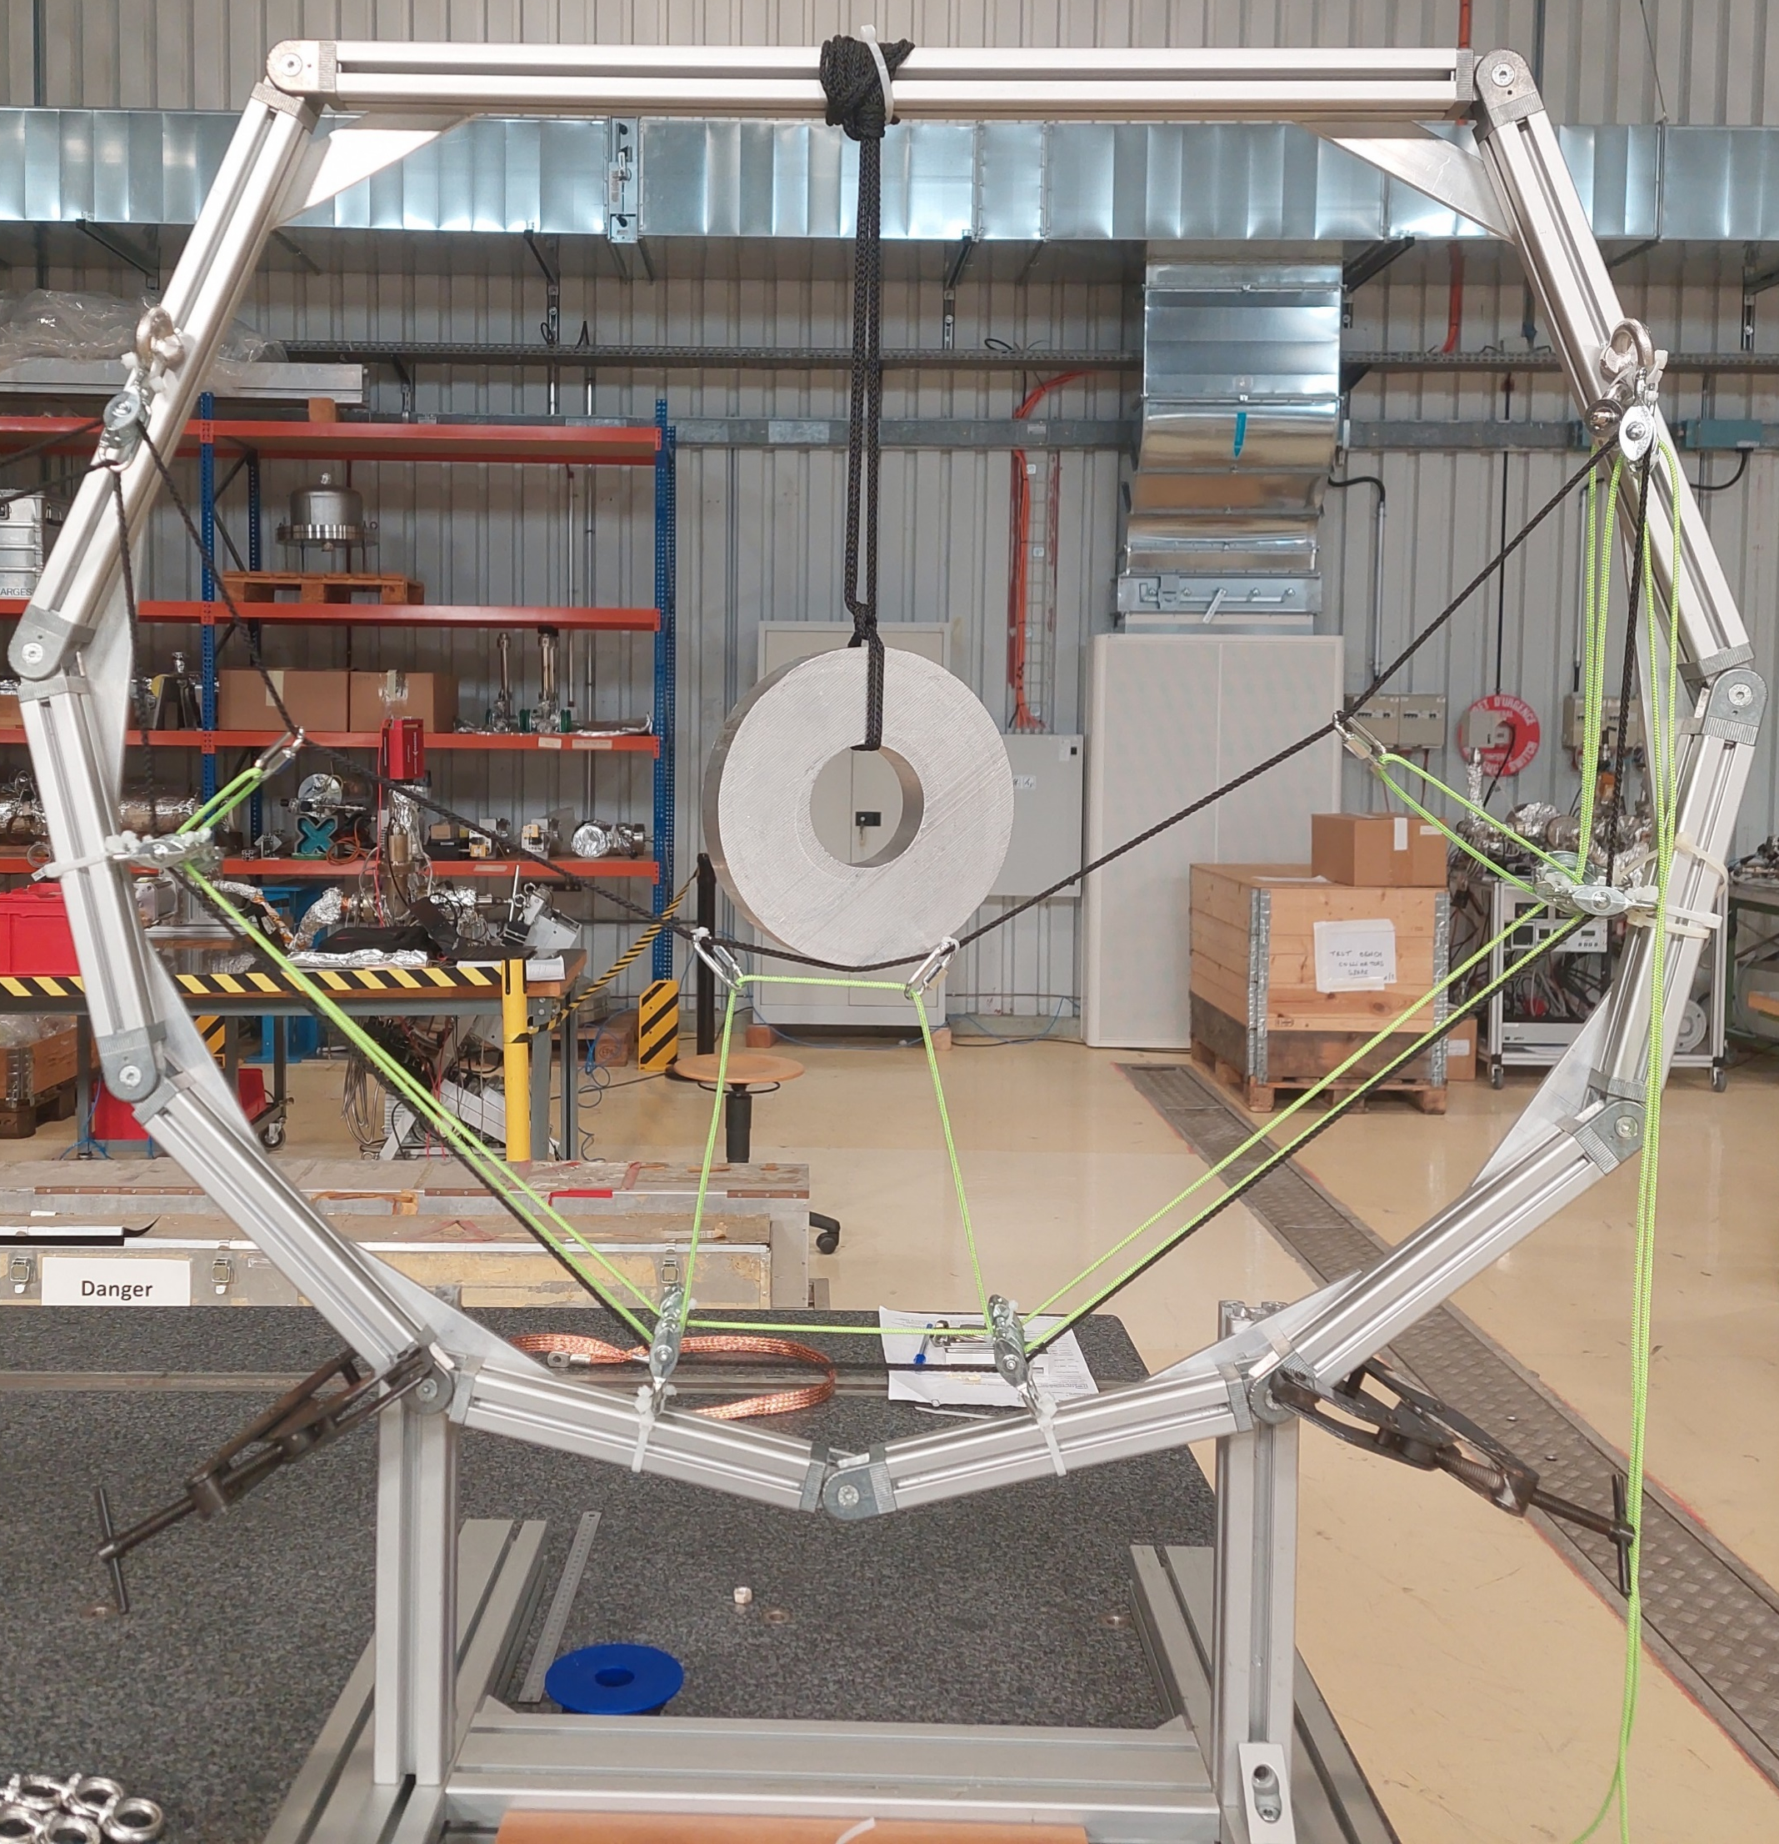
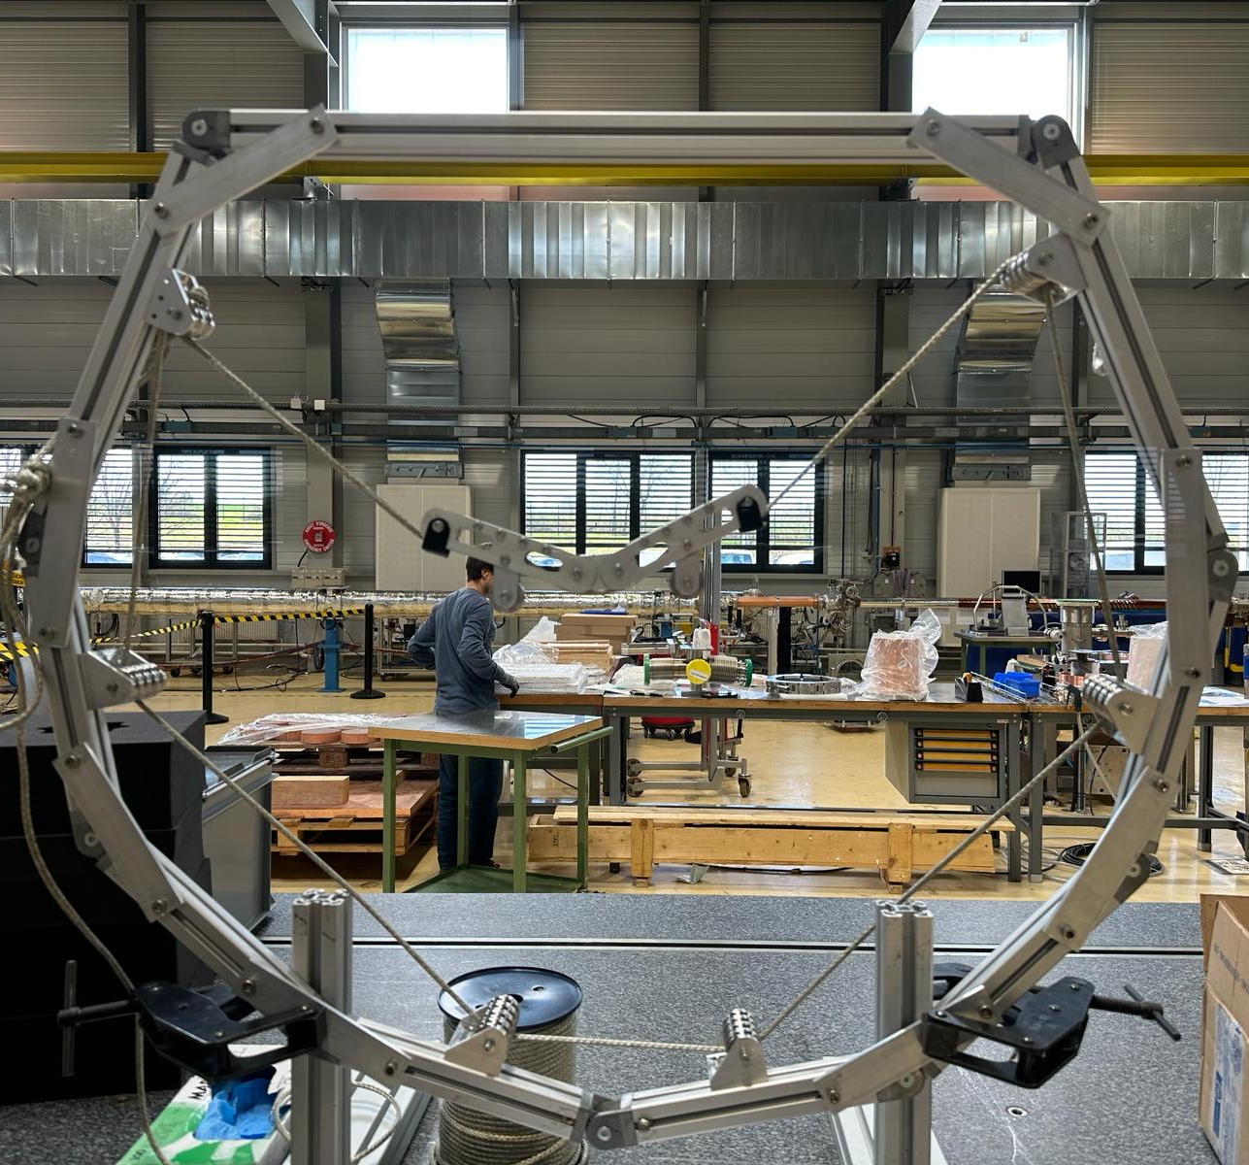
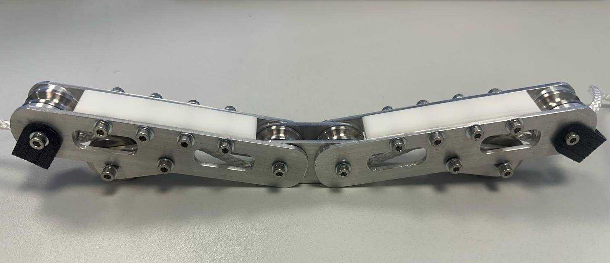
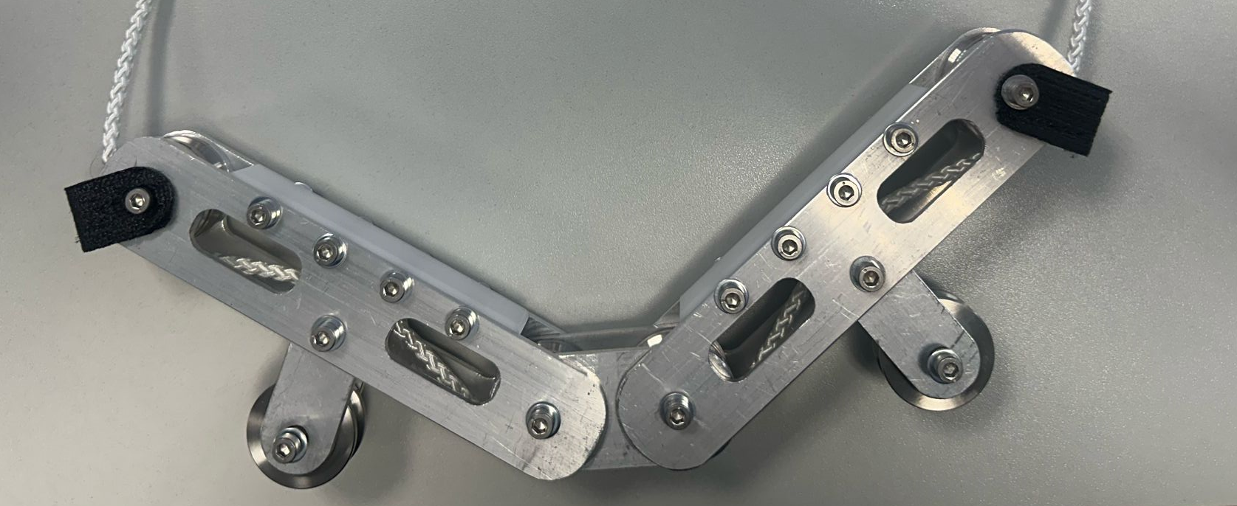
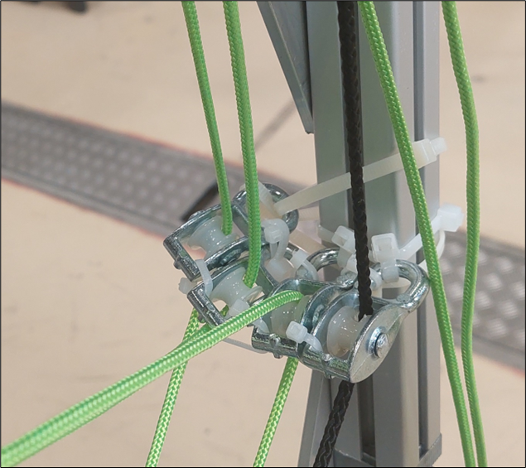
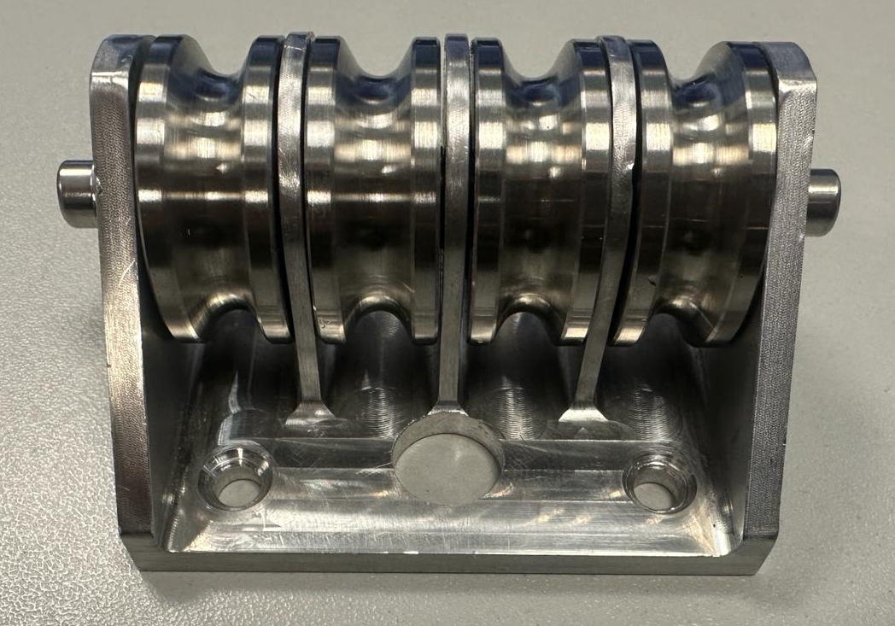
Mock-up
V1
V2
Interface with the BP
Pulley Block
Improvements: V1 vs V2
Better pulleys with bearings: less friction.
Dyneema rope.
The interface with the BP is implemented.
On the first mock-up, it was difficult to manipulate the rope due to the high friction at the pulleys, and the absence of the proper BP interface.

Slide 5
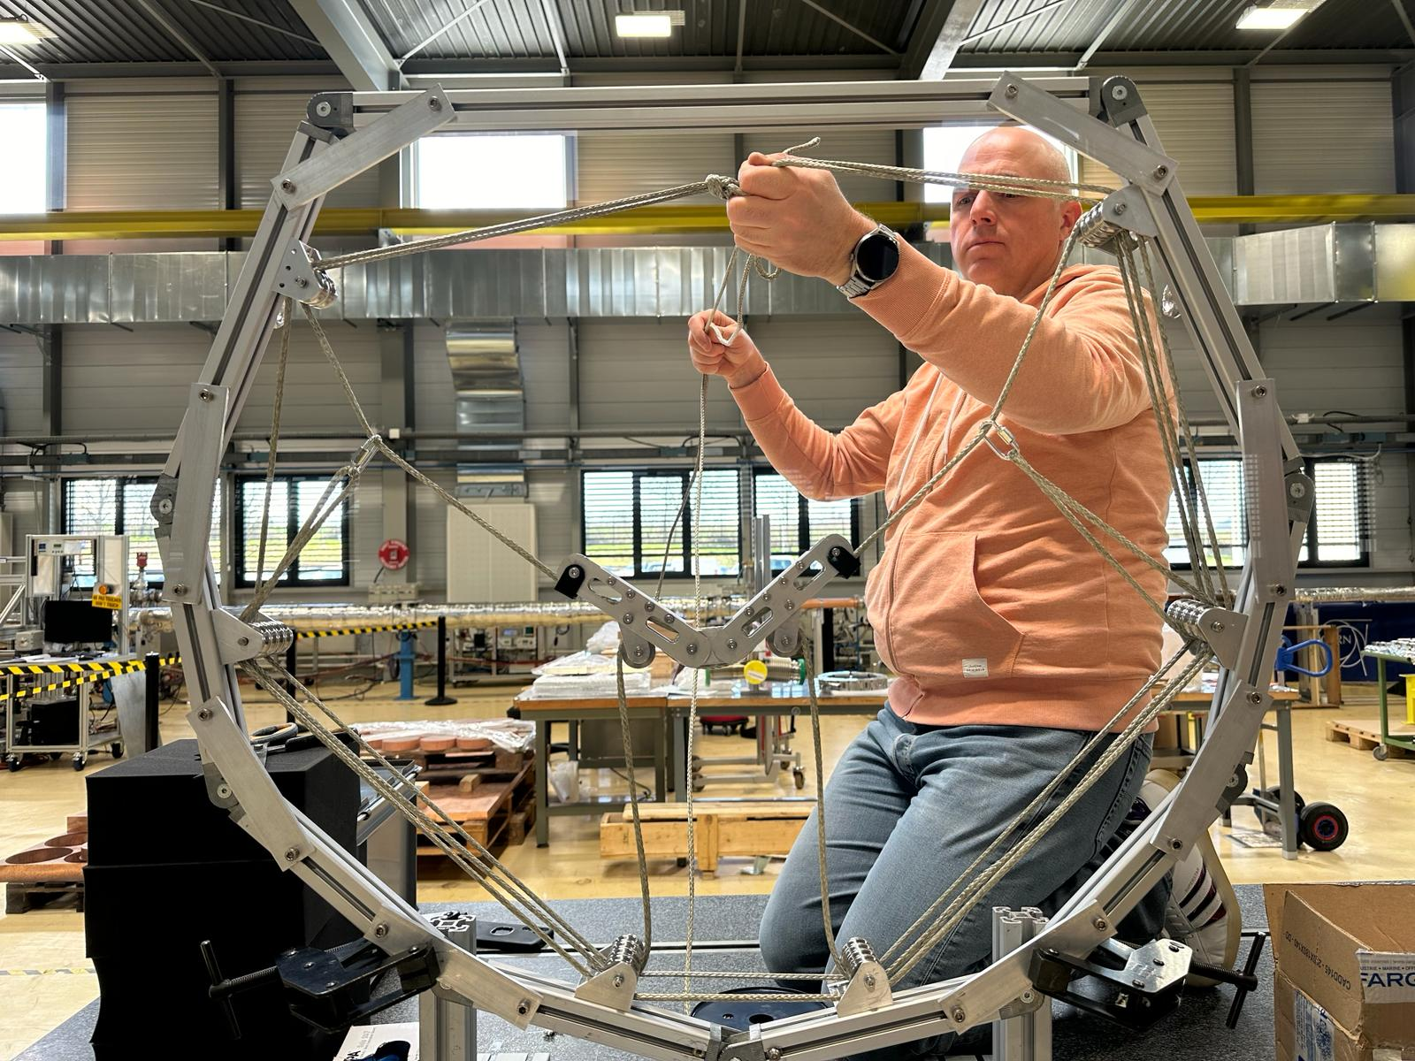
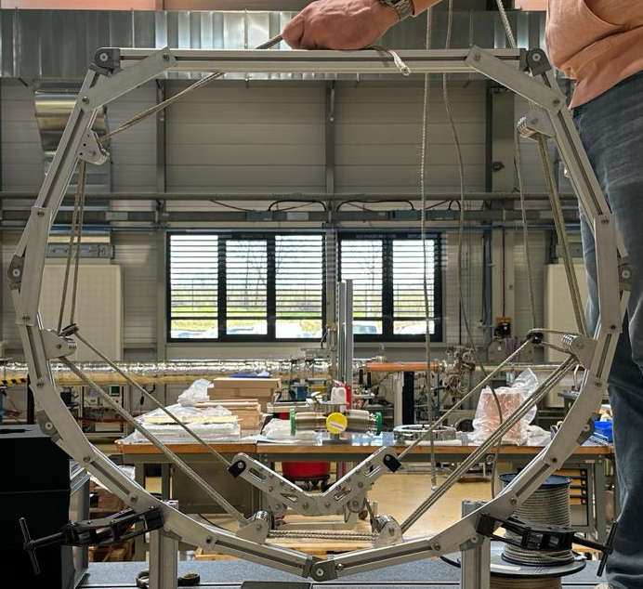
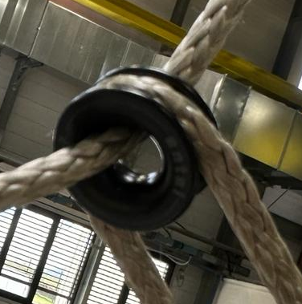
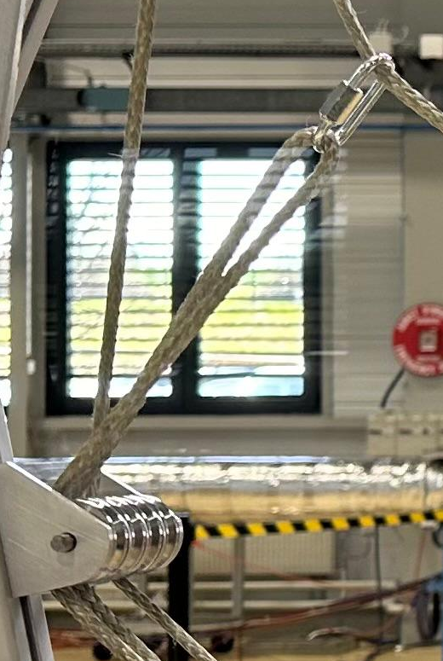
Mock-up: Ropes routing
Position 1: Support up
Position 2: Support retracted
2
1
1. High friction due to the small radius of the carabiner and the cables crossing.
It was replaced with a ceramic ring.
2. Couldn’t pass the cable between the swing pulleys without touching the support

Slide 6
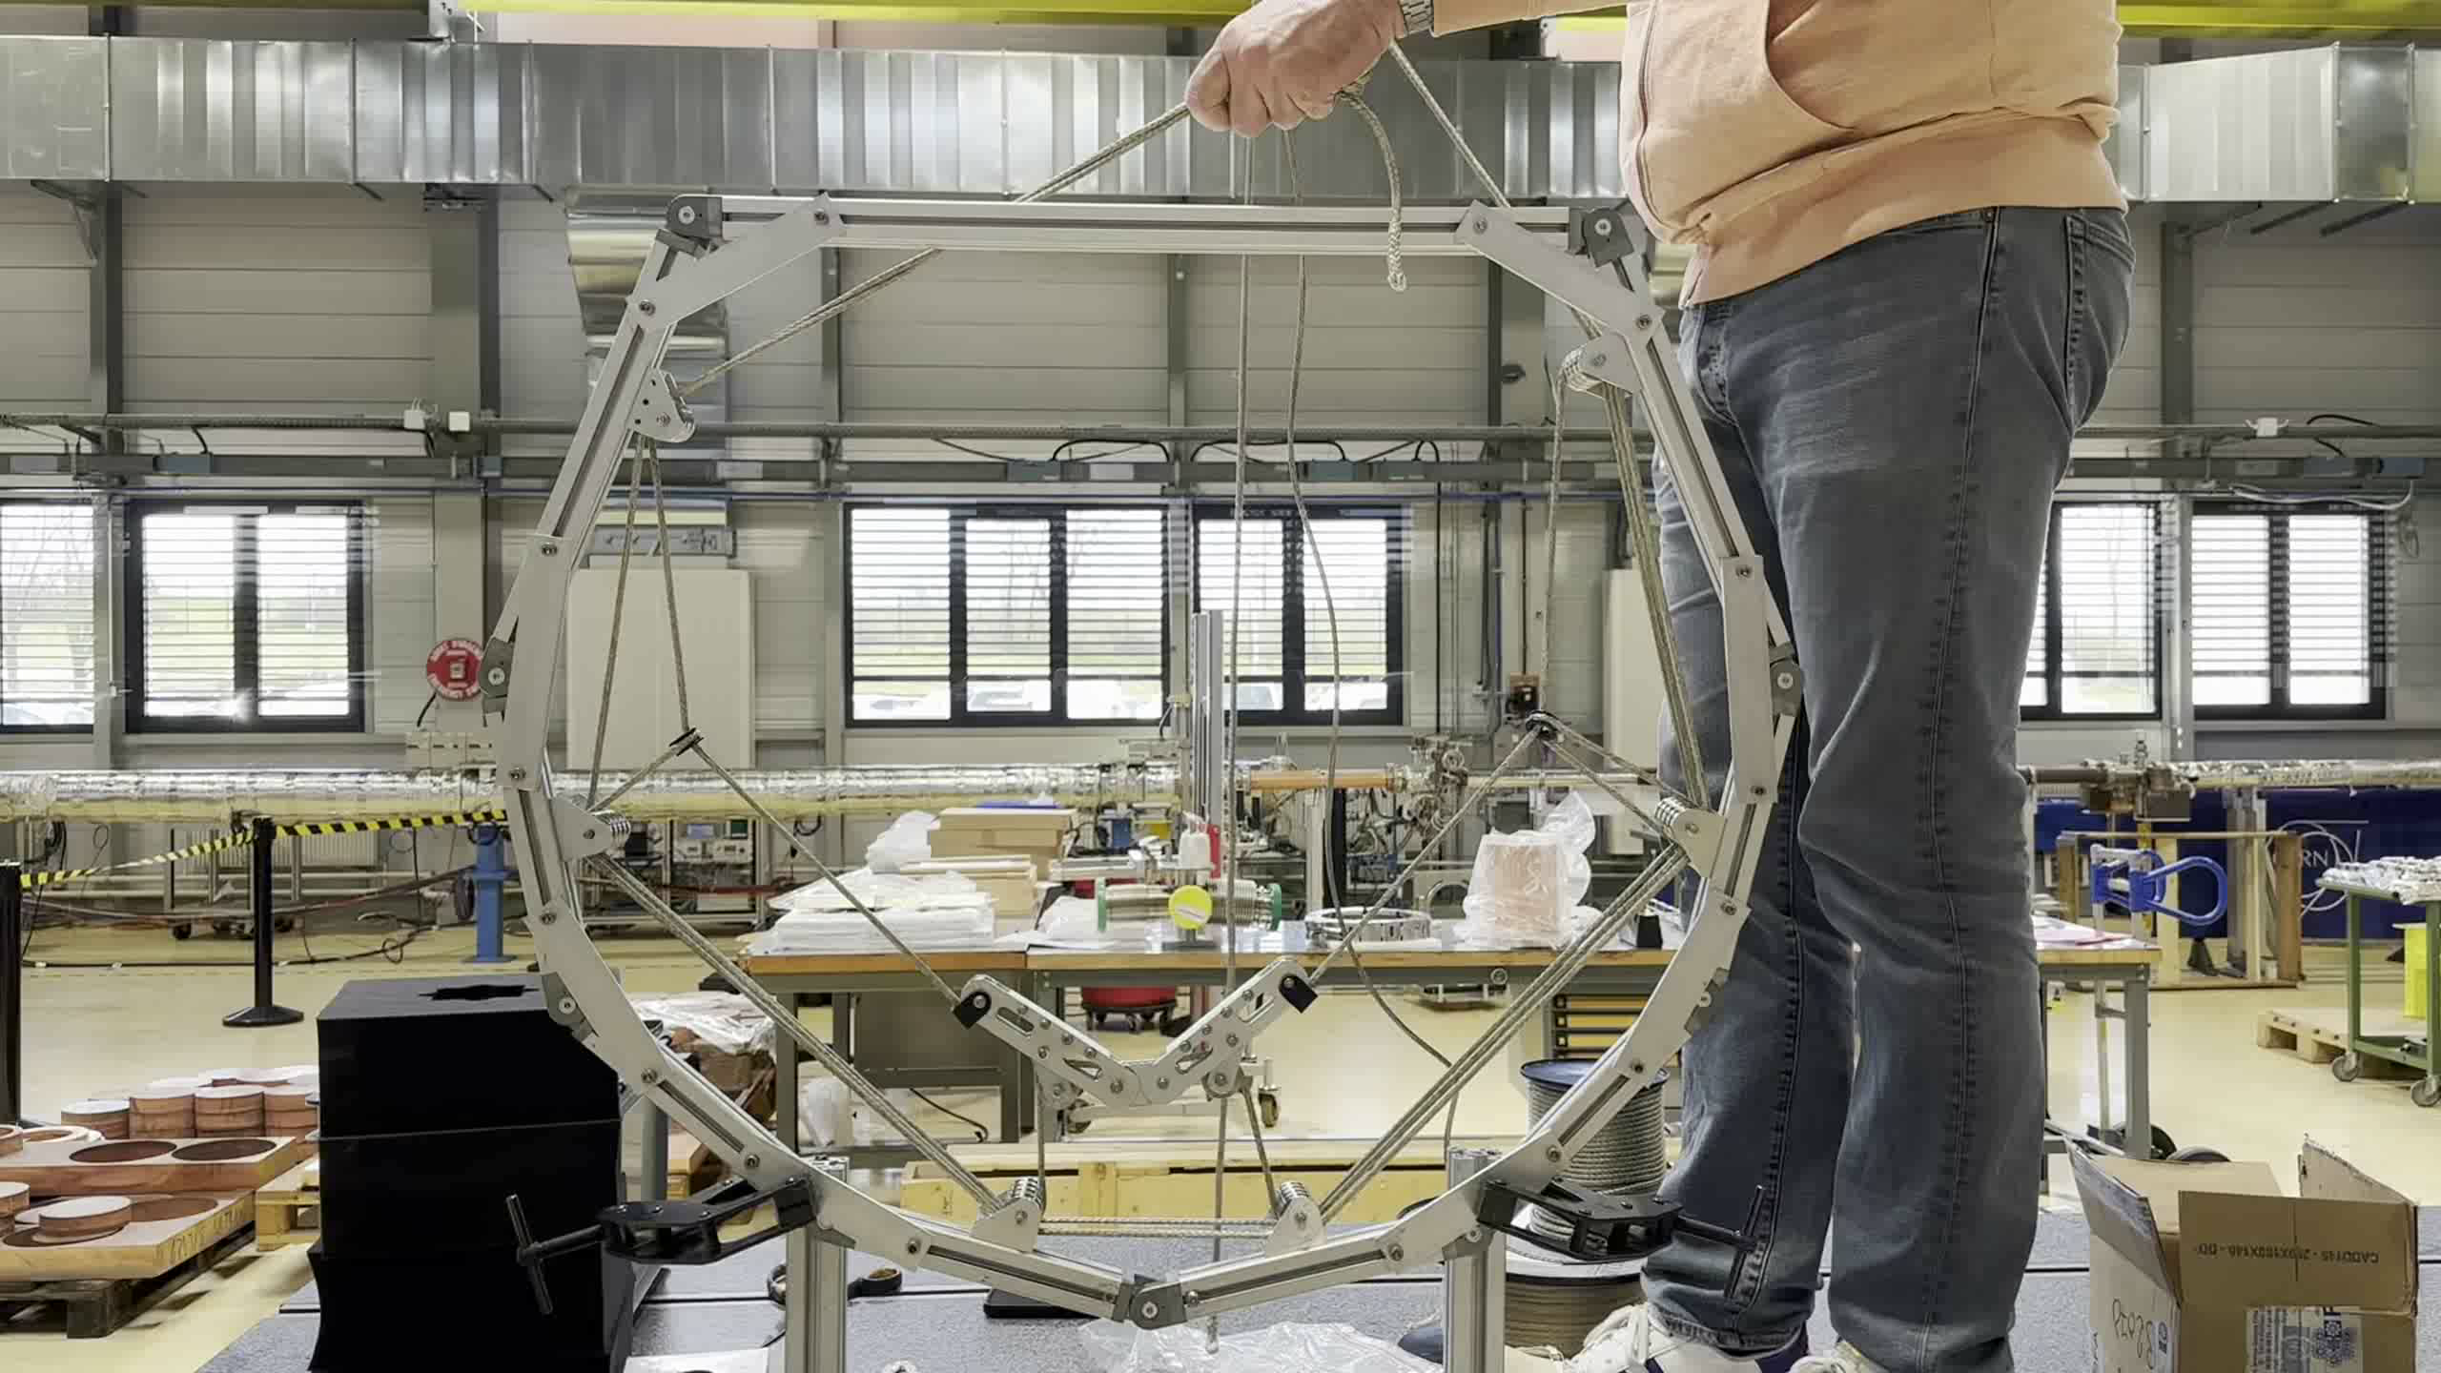
Mock-up: Movement test
Observations
Smooth movement
The support moves in the same plane – no lateral movements
Synchronization is important for a proper movement.
Three people will need to communicate during the installation . Two on the towers and one observing from a Scissor lift.

Slide 7
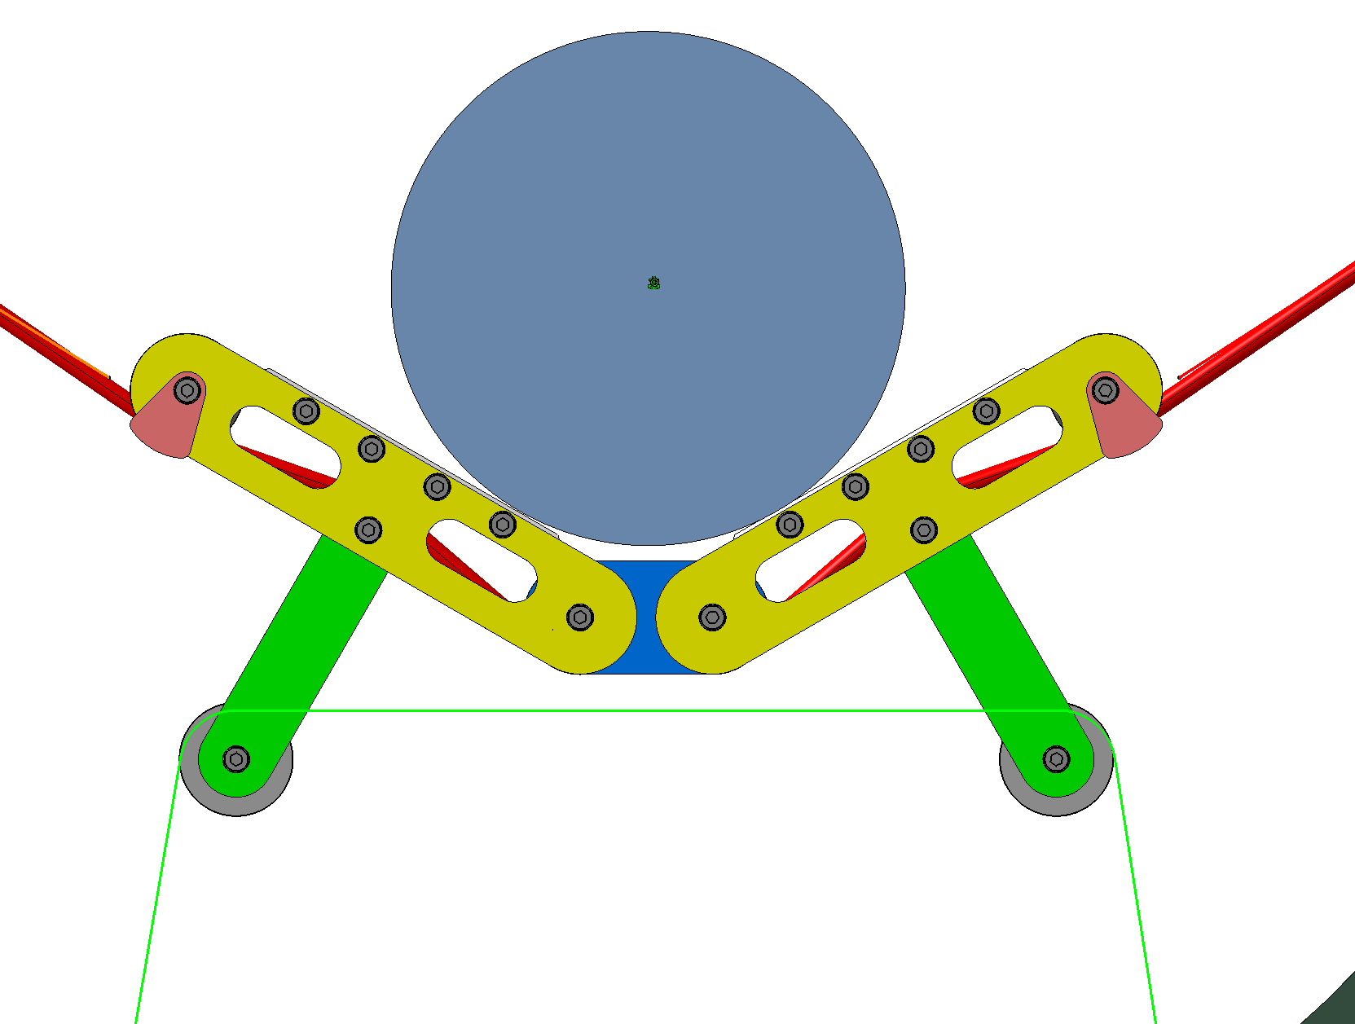
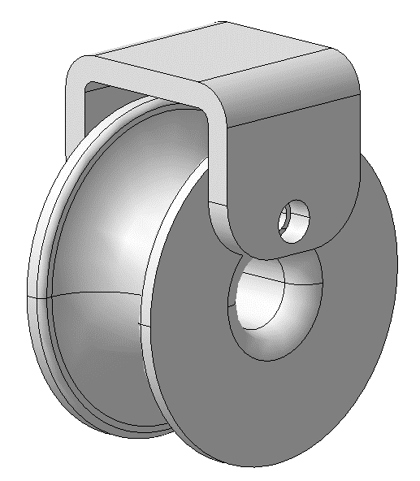
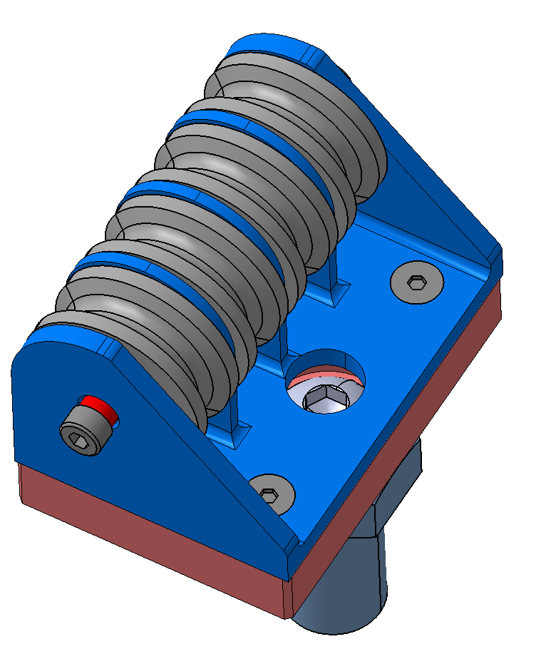
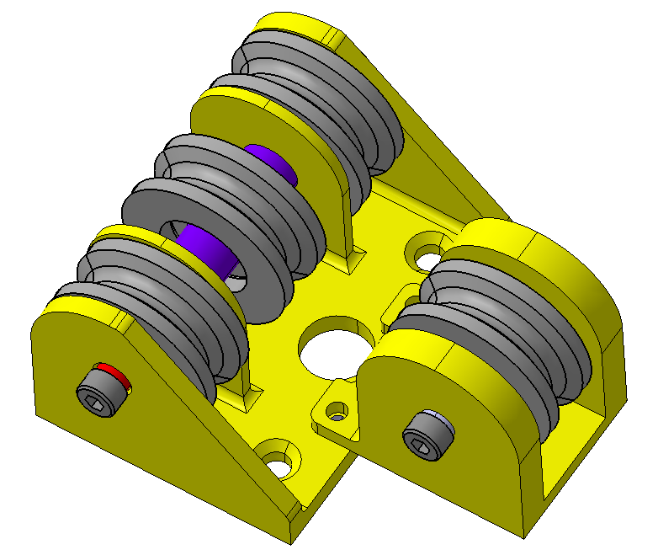
Mock-up: improvements
1. Extension of the swing plates, allowing the retraction rope to pass without touching the main support.
Extended Swing plates
Wire retainer
2. Machining of Teflon ring with a wire retainer.
3. Modification of 2 pulleys block to have two pulleys in the same plane avoiding the cables crossing.
4. Radiation test for the rope. Karlsruhe?

Slide 8
Back-up

Slide 9
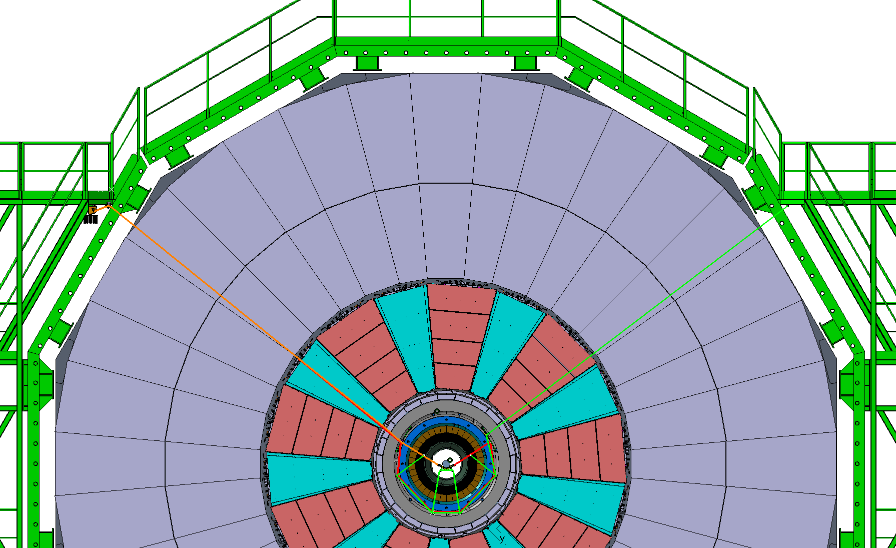
Support design overview
Control points (winches)
Guide point on RE2
Guide points on GE21
BP interface
Pulley system

Slide 10
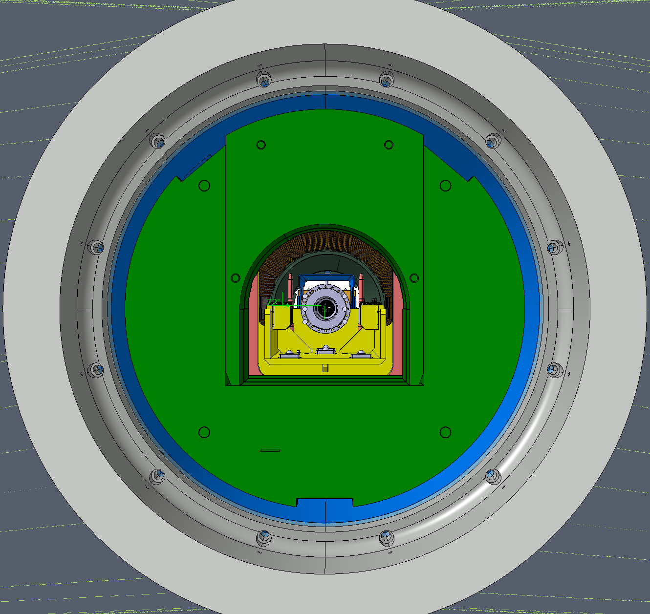
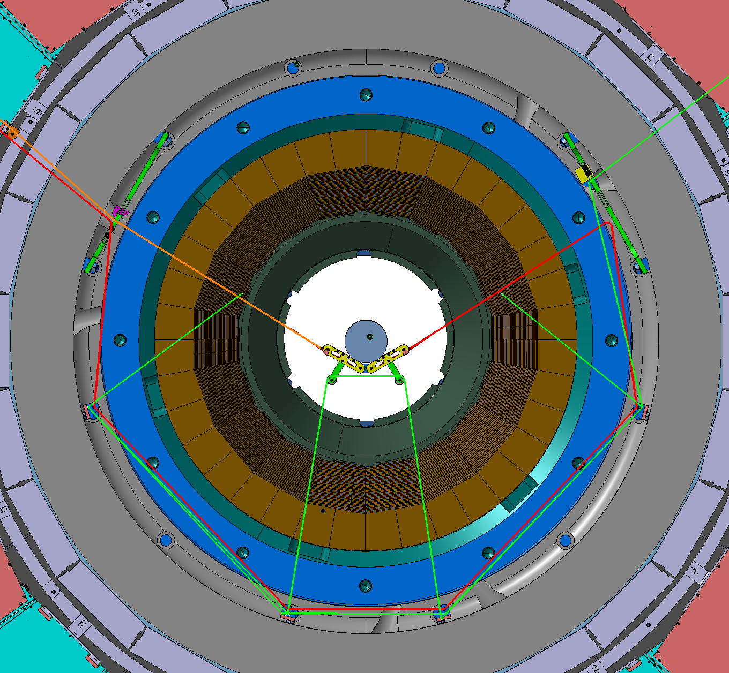
Support Envelope
When YE1 is fully open (10.4 m), the support must be retracted sufficiently to avoid any conflict with the FIN.
YE1 Inner ring
FIN
R705
R790

Slide 11
