Slide 1
CERN Baltic Group Conference CBC2024
October 15-17 Tallinn
Tallinn University of Technology
Fjodor Sergejev

Slide 2
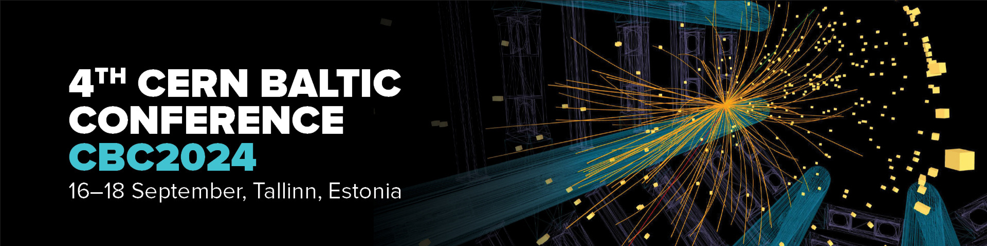
CBC2024, fourth in the row
https://indico.cern.ch/event/1416853/
15-17 October, Tallinn, Estonia
Abstract submissions until October 7:
CBC2024_submissions@taltech.ee

Slide 3
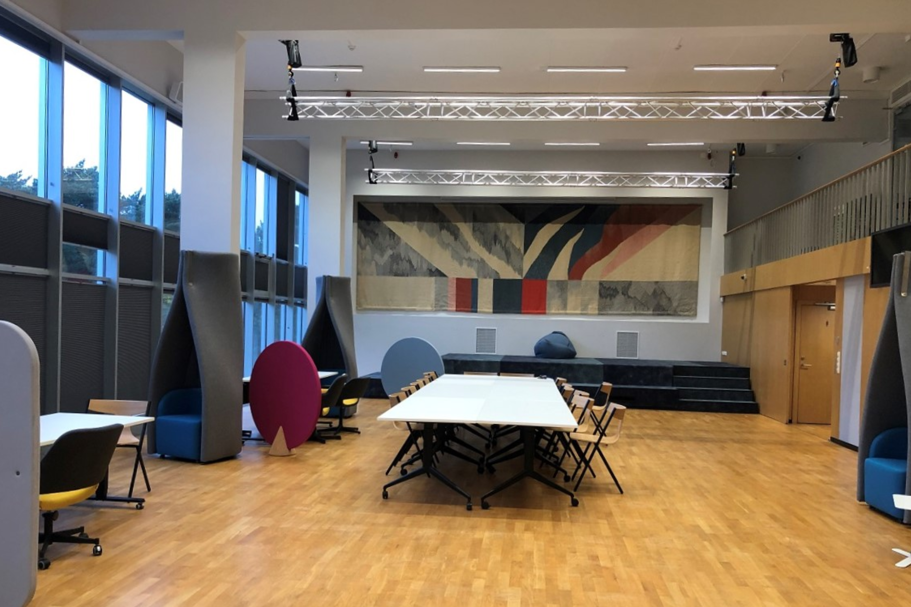
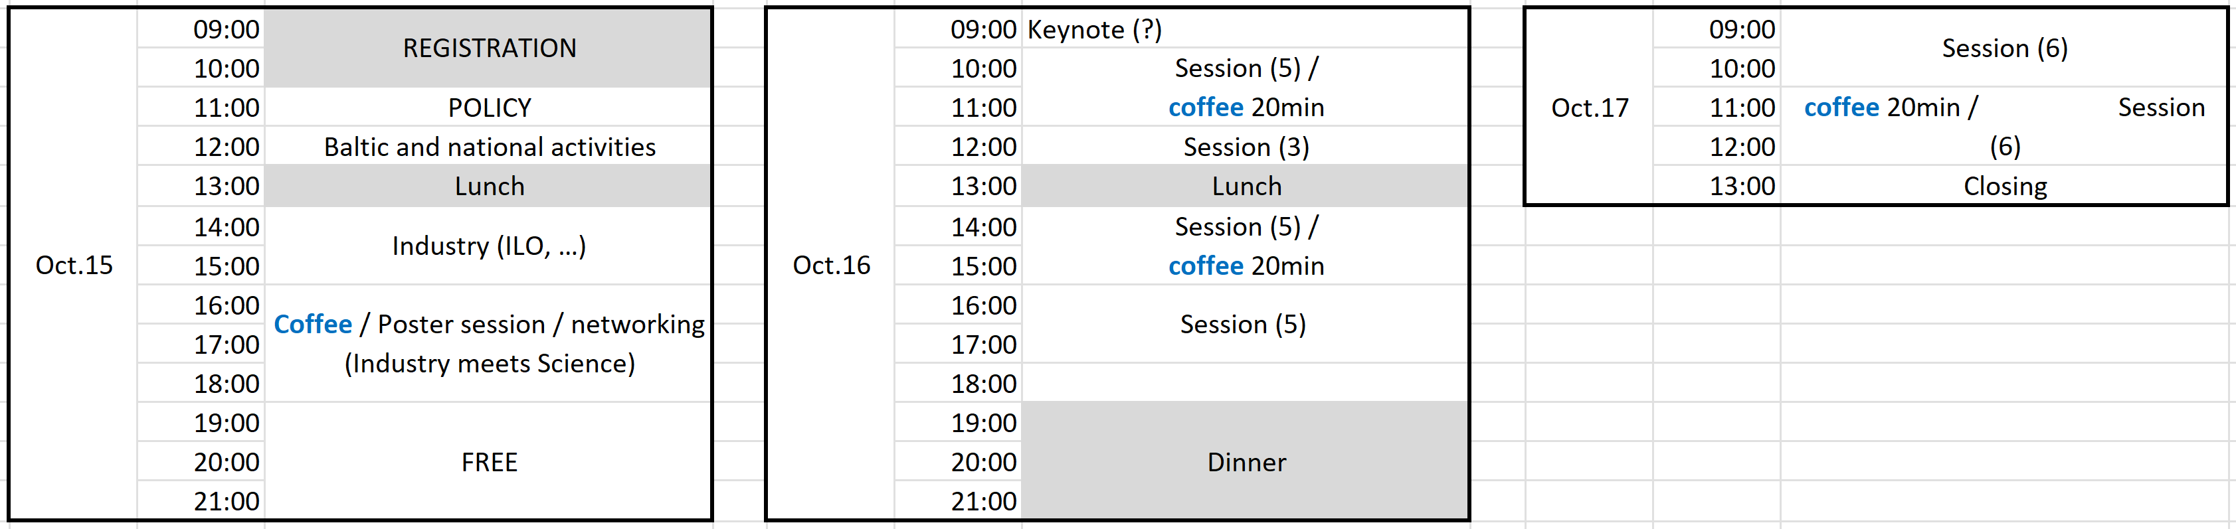
CBC2024
schedule
Tallinn University of Technology, Student House, Ehitajate tee 5, Tallinn

Slide 4

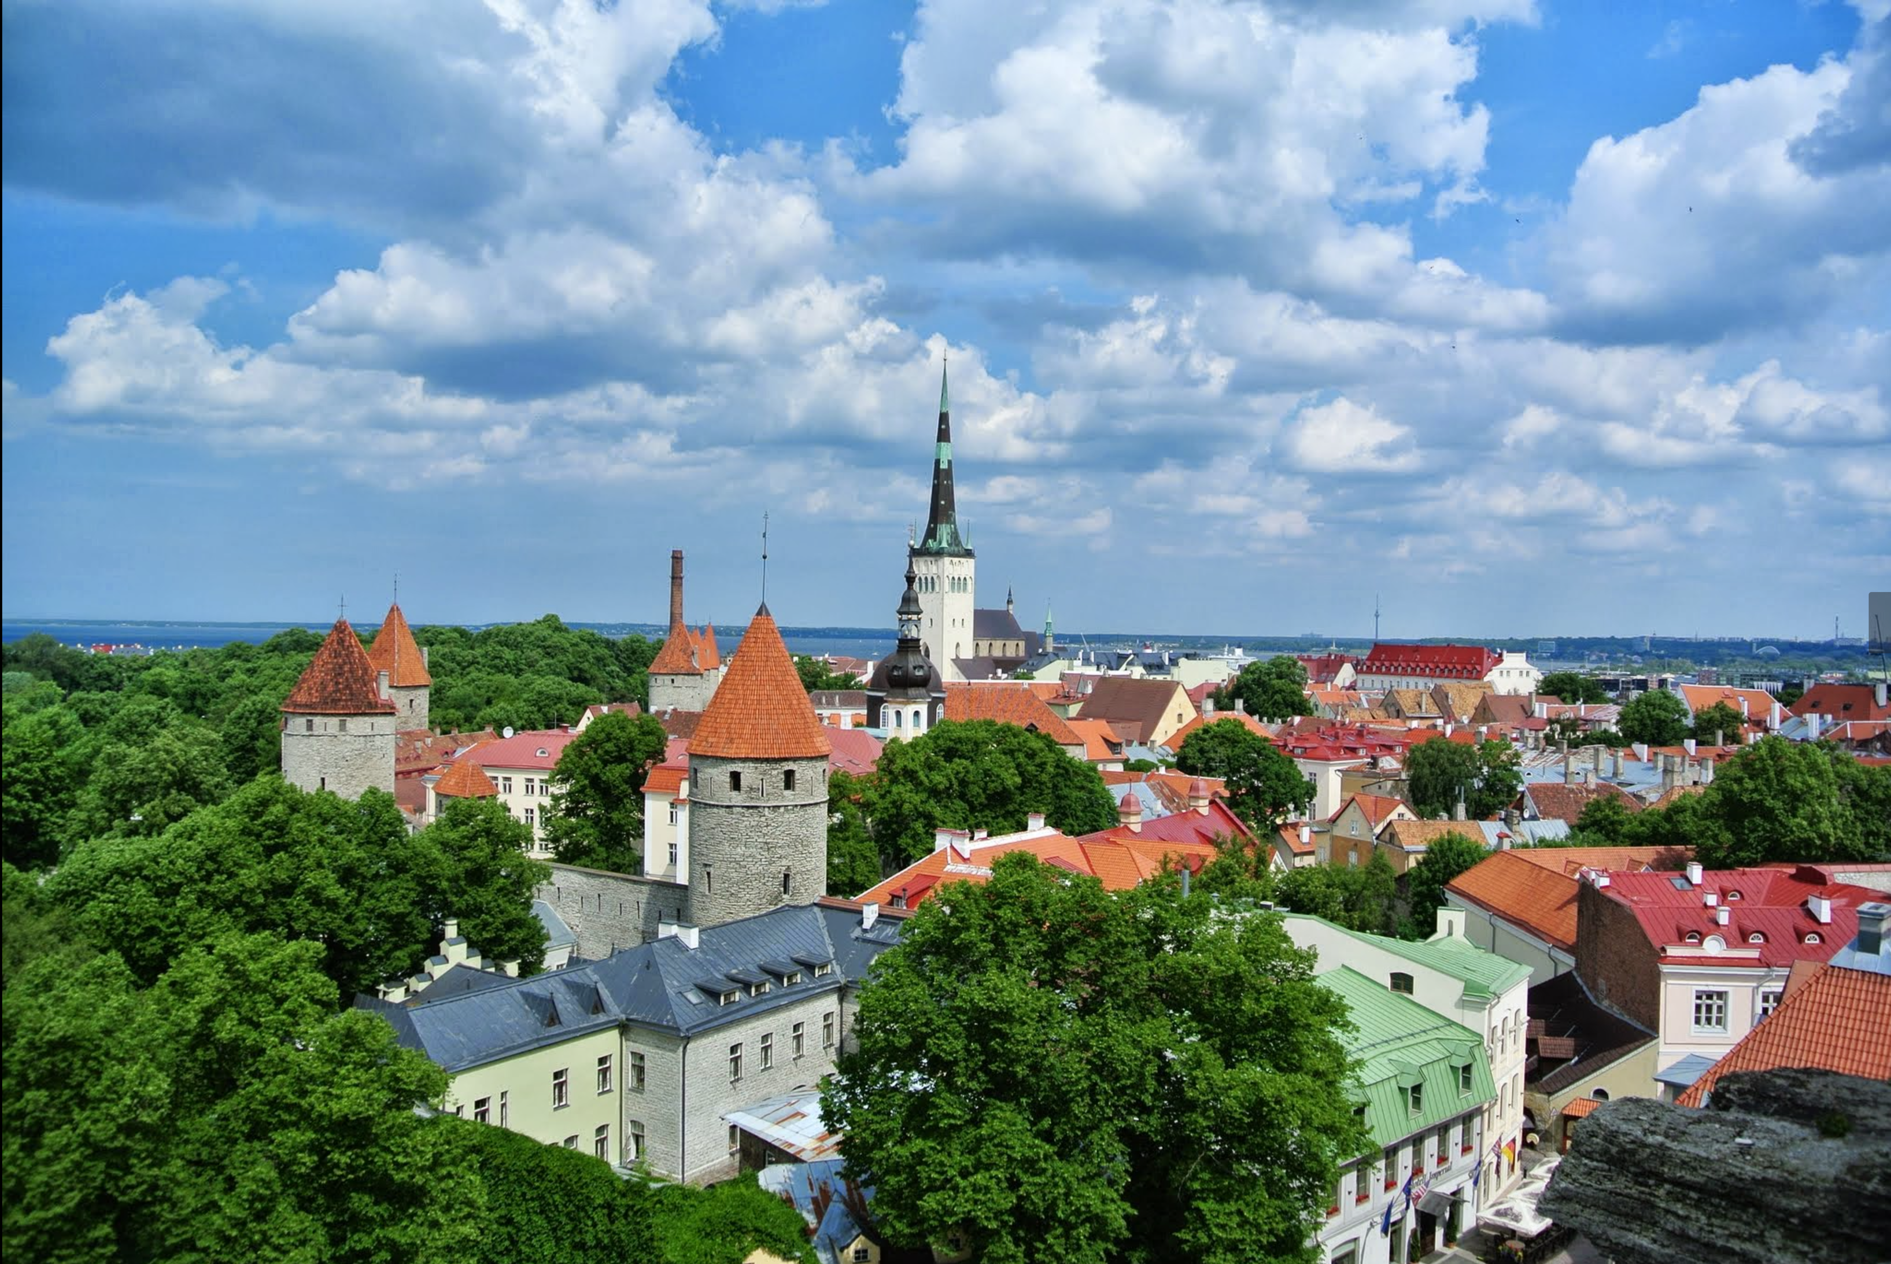

TALLINN UNIVERSITY OF TECHNOLOGY
taltech.ee/en

